Slide 1
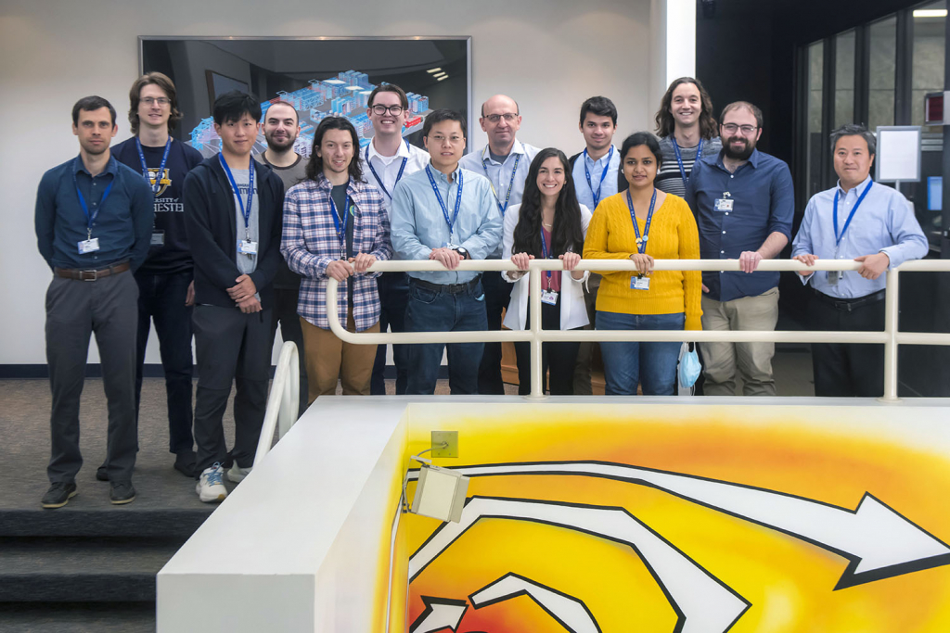
Annual Review of HEDP-Theory Group Performance in 2022
HED-t @ 2022 (we are still “growing”… )
S. X. Hu, Brennan Arnold,
John Cappelletti, Justin D’Souza, Dylan Durkee, Maitrayee Ghosh, Rati Goshadze, Josh Hinz,
Lianming Hu, Valentin Karasev, Deyan Mihaylov, Katarina Nichols, Aliza Panjwani, Adrien Pineau, Nathaniel Shaffer, Shuai Zhang
HED-t Members
(as of 12/2022)
6 Scientists
8 PhD Students
2 Undergrads
(missing Aliza & Dylan in this group photo)
HEDP-Theory Group Meeting on 12/16/2022

Slide 2
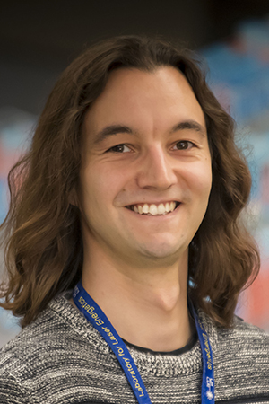
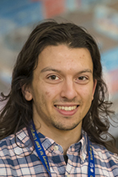
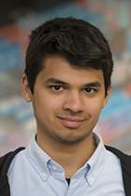
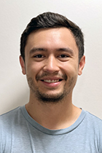

What’s new in 2022?
Thanks to the support from Theory Division Director & LLE’s senior management, five (5) new members have joined our group in 2022:
  Adrien Pineau (Assistant Scientist): from CELIA @ France (working on V. N. Goncharov’s ARPA-E project)
  Brennan Arnold (Horton Fellow): PhD student from UoR’s PAS (advised by S. X. Hu; working on HED/white-dwarf physics)
  Justin D’Souza (Horton Fellow): PhD student from UoR’s PAS (advised by S. Zhang; working on large-scale MD simulations)
  Dylan Durkee (CMAP Fellow): PhD student from UoR’s PAS (advised by S. X. Hu; working on CO2 properties under pressure)
  John Cappelletti (1st year): PhD student from UoR’s ME
  (advised by S. X. Hu; working on our real-space DFT code: MELIORA )

Slide 3
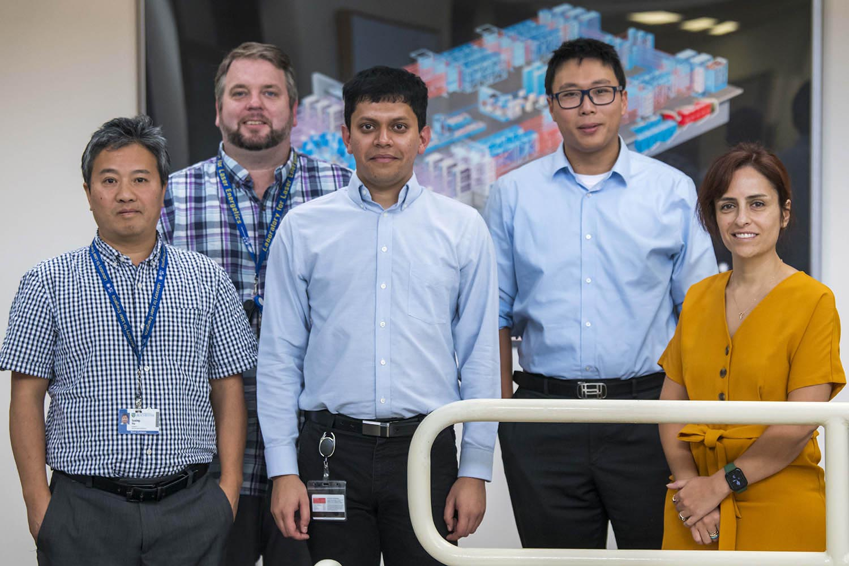
What’s new in 2022? (continued)
Deyan Mihaylov has been promoted to a staff member (Research Engineer) in the group; Congratulations to Deyan!
Our first PhD in Mechanical Engineering, Reetam Paul (advised by S. X. Hu), was officially graduated in September/2022. Dr. Paul is now a postdoc fellow @ Lawrence Livermore National Laboratory (LLNL).
(Reetam with his PhD defense committee; photo by Eugene Kowaluk )

Slide 4
We keep making progress in science and education, though we’re still in the pandemic-recovery mode
Published/Submitted 12 first-authored papers (including 1 Nat. Commun., 2 PRL, 7 PRB/PRE/PRM/PRR, 1 JPCM, 1 JAP), including 4 papers ar from PhD students!
Contributed to 20 co-authored papers in 2022 (including 2 Nat. Commun., 2 PRL, Sci. Rep., PRB/PRE, JPCM, PoP, etc.)
Collaborations with LLE Groups of HEDx/IM/LPI/Optical-Materials, as well as National Labs and other Universities have been continuously strengthened in 2022
Group Scientists gave Plenary/Invited Talks at conferences/workshops
A three-year NSF grant of $450,000 was secured to support advanced free-energy density functional development for HED applications (PI: Valentin Karasev; Co-PI: Suxing Hu).
Lianming Hu won the Discover Award for undergraduate research from UoR
DEI efforts: DEI seminar to the group occurred in the summer of 2022; Our PhD student Maitrayee Ghosh was encouraged to sit in LLE’s DEI Council; K. Nicols & S. X. Hu gave lectures to LLE’s BEST high-school program

Slide 5
Twelve (12) first-authored papers have been published (or submitted) by HED-t members* in 2022
N. R. Shaffer and C. E. Starrett, “Dense plasma opacity via the multiple-scattering method”, Phys. Rev. E 105, 015203 (2022).
V. V. Karasiev, D. I. Mihaylov, S. X. Hu, “Meta-GGA exchange-correlation free-energy density functional to achieve unprecedented accuracy for warm-dense-matter simulations”, Phys. Rev. B 105, L081109 (2022).
S. Zhang, M. A. Morales, R. Jeanloz, M. Millot, S. X. Hu, E Zurek, “Nature of the bonded-to-atomic transition in liquid silica to TPa pressures”, J. Appl. Phys. 131, 071101 (2022).
S. Zhang, D. E. Fratanduono, M. C. Marshall, J. R. Rygg, Amy E. Lazicki, A. Shvydky, D. Haberberger, V. N. Goncharov, T. R. Boehly, G. W. Collins, and S. X. Hu, “Species separation in polystyrene shock release evidenced by molecular-dynamics simulations and laser-drive experiments”, Phys. Rev. Res. 4, 013126 (2022).
S. Zhang, Valentin V. Karasiev, Nathaniel Shaffer, Deyan I. Mihaylov, Katarina Nichols, Reetam Paul, R.M.N. Goshadze, Maitrayee Ghosh, Joshua Hinz, Reuben Epstein, Stefan Goedecker, and S. X. Hu. “First-principles equation of state of CHON resin for inertial confinement fusion applications”. Phys. Rev. E 106, 045207 (2022).
A. Pineau, K. R. P. Kafka, S. G. Demos, T. Z. Kosc, V. N. Goncharov, S. X. Hu, G. Duchateau, “Benchmarking solid-to-plasma transition modeling for inertial confinement fusion laser-imprint with a pump-probe experiment”, Phys. Rev. Res. 4, 033178 (2022).
*underlined authors

Slide 6
Twelve (12) first-authored papers have been published (or submitted) by HED-t members* in 2022 [cont.]
S. X. Hu, David T Bishel, David A Chin, Philip M Nilson, Valentin V Karasiev, Igor E Golovkin, Ming Gu, Stephanie B Hansen, Deyan I Mihaylov, Nathaniel R Shaffer, Shuai Zhang, Timothy Walton, “Probing atomic physics at ultrahigh pressure using laser-driven implosions”, Nat. Commun. 13, 6780 (2022).
V. V. Karasiev, S. X. Hu, N. R. Shaffer, G. Miloshevsky, “A first-principles study of L-shell iron and chromium opacity at stellar interior temperatures”, Phys. Rev. E 105, xxxxxx (2022) [in press].
R. M. N. Goshadze, V. V. Karasiev, D. I. Mihaylov, S. X. Hu, “Shock-Induced Metallization of Polystyrene Along the Principal Hugoniot Investigated by Advanced Thermal Density Functionals”, Phys. Rev. Lett. (submitted).
R. Paul, K. Nichols, S. Zhang, V. V. Karasiev, S. X. Hu, “Thermally-Driven Charge State and Magnetic Transitions in FeO2 Under Geological Pressures”, Phys. Rev. Lett. (submitted).
M. Ghosh, S. Zhang, Lianming Hu, S. X. Hu, “Cooperative diffusion in body-centered cubic iron at Earth and super-Earths’ inner-core conditions”, J. Phys: Condens. Matter (submitted).
J. Hinz, V. V. Karasiev, D. Mihaylov, S. X. Hu, “Development of a machine-learning–based ionic-force correction model for quantum molecular dynamic simulations of warm dense matter”, Phys. Rev. Materials (under revision).

Slide 7
Ten more manuscripts are in the pipeline….
D. I. Mihaylov et al., “DRAGON: A GPU-accelerated Orbital-Free Density Functional Theory Molecular Dynamics Package for Fast First-Principles Simulations of Warm Dense Matter”, J. Comput. Phys. (in preparation).
K. Nichols et al., “Time-dependent density-functional theory calculations of nonlocal electron mean-free-path in conduction-zone plasmas for ICF applications”, Phys. Rev. E (in preparation).
N. R. Shaffer et al., “An extended Vlasov-Fokker-Planck approach for kinetic simulations of laser plasmas”, Phys. Plasmas (in preparation).
M. Ghosh et al., “Ab Initio study of alumina properties near melting at earth/super-earth core conditions”, Phys. Rev. B (in preparation).
V. V. Karasiev et al., “Framework for Laplacian-level noninteracting free-energy density functionals”, Phys. Rev. Lett. (in preparation).
V. V. Karasiev et al., “Exploring the H-He demixing dynamics under Jupiter interior conditions”, TBD (in preparation).
S. Zhang et al., “Toward an accurate equation of state and B1-B2 phase boundary for magnesium oxide to TPa pressures and eV temperatures”, Phys. Rev. B (in preparation).
A. Pineau et al., “Investigating the Dust Flux in the Meteoric Smoke Sampler (MESS) Instrument for Sampling Dust in the Mesosphere”, Atmos. Meas. Tech. (in preparation).
S. X. Hu et al., “Designing direct-drive gradient-density high-Z-pusher targets for moderate fusion energy gain”, Phys. Rev. E (in preparation).
S. X. Hu, (Book): “Computational Methods for High-Energy-Density Sciences”, (in preparation for Publisher Jenny Stanford)

Slide 8
HEDP-Theory Group members* contributed to twenty (20) co-authored papers published/submitted in 2022
L. He, D. Polsin, S. Zhang, G. W. Collins, N. Abdolrahim, Scientific Reports 12, 18954 (2022).
S. Burns, R. Rygg, …, S. Zhang, S. X. Hu, G. W. Collins. J. Appl. Phys., 131, 215904 (2022).
S. Singh, A. L. Coleman, S. Zhang, F. Coppari, …, D. E. Fratanduono, J. Synch. Rad. 29, 1033 (2022).
J. Lütgert, …, N. R. Shaffer, …, D. Kraus, Phys. Plasmas 29, 083301 (2022).
J. R. White, W. Johns, C. J. Fontes, N. M. Gill, N. R. Shaffer, and C. E. Starrett, Phys. Plasmas 29, 043301 (2022).
D. N. Polsin,…, R. Paul,…, J. R. Rygg, Nat. Commun. 13, 2534 (2022).
S. Malko,…, S. X. Hu, A. J. White, L. A. Collins, K. Nichols…, L. Volpe, Nat. Commun. 13, 2893 (2022).
H Abu-Shawareb,…, S. X. Hu, …, V. V. Karasiev,…, A.B. Zylstra, Phys. Rev. Lett. 129, 075001 (2022).
T. J. B. Collins,…, S. X. Hu, …, M. D. Wittman, Phys. Plasmas 29, 012702 (2022).
W Theobald, ,…, S. X. Hu, …, S. P. Regan, Phys. Plasmas 29, 012705 (2022).
A. J. White, L. A. Collins, K. Nichols, S. X. Hu, J. Phys: Condens. Matter 34, 174001 (2022).
R. C. Shah, …, S. X. Hu,…, S. P. Regan, Phys. Rev. E 106, L013201 (2022).
H. Poole, …, S. X. Hu,…, S. P. Regan, Phys. Plasmas 29, 072703 (2022).
Z. Chen, S. X. Hu, N. P. Bigelow, J. Low Temp. Phys. 208, 172 (2022).
R.W. Paddock, …, R.M.N. Goshadze, V.V.Karasiev, S. X. Hu, Phys. Rev. E (Accepted).
C. E. Starrett and N. R. Shaffer, Phys. Rev. E (submitted).
S. Jiang,.., S. X. Hu,…, Y. Ping, Commun. Phys. (submitted).
W Fox, …, S. X. Hu,…, S. P. Regan, Nat. Phys. (submitted).
B. Gifford, …, D. I. Mihaylov,…, S. Kilina, J. Phys. Chem. (submitted).
W. A. Angermeier, B. S. Scheiner, N. R. Shaffer, and T. G. White, Phys. Rev. Lett. (submitted).

Slide 9
HEDP-Theory Group members gave invited presentations to conferences/workshops in 2022
Shuai Zhang, “An equation of state model for exploring a cold dynamic compression path to metallic hydrogen”, [Invited Talk], High Energy Density Quantum Matter Zoom Meeting, Rochester, 2022.
Shuai Zhang, “Isentropes and Equations of State of Solid Hydrogen---Perspectives from Theory and Calculations”, [Invited Talk], Center for Matter at Atomic Pressures (CMAP) Friday Weekly Meeting (virtual), Rochester, 2022.
Deyan Mihaylov, “Improving the accuracy of density functional theory simulations of warm dense matter by including exchange-correlation thermal effects" [Invited Seminar], Center of Advanced Systems Understanding, Helmholtz-Zentrum Dresden-Rossendorf, Germany (9/2022?)
S. X. Hu, “Understanding Matter in Extreme Conditions with ab initio Calculations” [Invited Lecture], 4th International Winter School: Matter in Extreme Conditions from Material science to Planetary physics (MECMATPLA), Montgenevre, France. Mar. 12-19, 2022.
S. X. Hu, “Probing Atomic Physics at Extreme Conditions”, [Invited Talk], International Conference on High Energy Density Science (HEDS2022), Yokohama, Japan; April 18-22, 2022.
S. X. Hu, “Understanding High-Energy-Density Physics Through ab initio Calculations”, [Invited Colloquium], Department of Physics, University of Rochester (11/30/3022).
???

Slide 10
External collaborations with National Labs and other Universities are continuously strengthened
Collaborations with LANL are actively pursued in the following three fronts:
  With L. A. Collins & A. White on TD-mDFT development for stopping power and non-local electron thermal transport [K. Nichols (Horton Fellow), D. Mihaylov, N. R. Shaffer & S. X. Hu]
  With J. Daligaut and D. Saumon on white-dwarf physics (B. Arnold (Horton Fellow) & S. X. Hu)
  With C. Starrett on average-atom model and transport in WDM (N. R. Shaffer)
Collaborations with LLNL can be further strengthened:
  High-pressure physics of materials (S. Zhang, C. Wu, T. Ogitsu, et al.)
  VFP simulation of LPI (N. R. Shaffer, M. Sherlock)
Collaboration with SNL on dense plasma and atomic physics:
  Studies on dense plasmas (S. X. Hu, P. Nilson, S. Hansen, I. Golovkin, M. Gu, D. Bishel, A. Chin)
  Atomic physics in HED physics (N. R. Shaffer, K. Adler, S. Hansen, T. Gomez, C. Starrett)
Collaboration Prism & UNR:
  MERL project (V. V. Karasiev, S. X. Hu, S. P. Regan, R. Epstein, I. Golovkin, M. Gu, R. Mancini)
Collaborations with U. Florida (S. Trickey), U. Buffalo (E. Zurek), PPPL (S. Malko & W. Fox) UC Berkeley (R. Jeanloz, B. Militzer), Flatiron (M. Morales), UNR (T.G. White), Imperial College (G. Kagan), UNL (Y. Lu), Uni. of Basel (S. Goedecker), VCU (G. Miloshevsky), and RIT (Q. Yu) are actively initiated/maintained.

Slide 11
Financial and computational resources were actively acquired to support HEDP research in 2022
V. V. Karasev (PI) & S. X. Hu (Co-PI) secured an NSF Grant PHY-2205521 ($450,000 for FY: 2022-2025)
V. V. Karasev (PI) was awarded (35,000-CPU + 1100-GPU) node-hours on NERSC Supercomputers at Lawrence Berkeley National Laboratory
D. I. Mihaylov (PI) was awarded (100-CPU + 3750-GPU) node-hours on NERSC Supercomputers at Lawrence Berkeley National Laboratory, to support the development/modernization of our HED codes (DRAGON & MELIORA)
S. X. Hu and V. V. Karasiev maintained the collaboration with Prof. Q. Yu (RIT) with a sub-award of ~$50,000 from LLE’s CA to support Machine-Learning studies for HED physics

Slide 12
HEDP-Theory Group members have continued engaging and serving the broad physics community in 2022
M. Ghosh [Horton Fellow] chaired a session at 2022 APS-March Meeting
J. Hinz [Horton Fellow] reviewed and helped review papers from PRL and Frontiers in Physics
V. V. Karasev chaired a session at APS-DPP-2022 meeting
S. X. Hu chaired two sessions at APS-DPP-2022 meeting; He also co-organized the mini-conference on “transport properties of HED plasmas” at the meeting.
S. X. Hu has been co-organizing the 2nd Plasma Transport Workshop with national lab folks, which is to be held in June, 2023.
V. V. Karasev reviewed papers for Phys. Rev. X, Phys. Rev. Lett., Phys. Rev. B, Philosophical Transactions of the Royal Society A, Journal of Chemical Theory and Computation, Journal of Chemical Physics
S. Zhang reviewed proposal/papers for NSF, Nature, Nature Physics, PRL, PRB, PRE…
D. I. Mihaylov reviewed a paper for Nature Communications, Computer Physics Communications
N. R. Shaffer reviewed papers for PoP, PRE, Frontiers in Physics
In 2022, the HED-t Group hosted “virtual” visits/seminars of Prof. Frank Huo (UoR), Dr. Katie Hilleke (Uni. Buffalo), Ms. Tanja Kovacevic (UC-Berkeley)

Slide 13
Areas for future improvement & development……
A common project (like the CHON-FPEOS project we had in 2021) would help better connect HED-t members; This is important in particular in such a pandemic-recovery mode….
We need to identify some common project(s) to work together for 2023:
  Creating FPEOS tables for C and/or SiO₂??
  TD-DFT calculations of electron MFP for Be and C plasmas using SHRED code??
  ……
We need to continuously build our computational “tool-box” to advance HEDP research: QMC, real-space DFT code, tool(s) for free-energy calculations, methods beyond mean-field DFT, tools for extreme atomic physics (besides VERITAS)…..
……

Slide 14
Summary: Accomplishments & Highlights for 2022
Scientific Achievements:
  HED-t members authored/co-authored a total of 32 papers published in (submitted to) high-impact journals (including 3 Nat. Commun., 4 PRL,….).
  An DFT-based multi-band kinetic code, VERITAS, was developed and used for better understanding X-ray spectroscopy measurements of dense plasmas [Nat. Commun.]
Education Accomplishments:
  Graduated the first PhD (Reetam Paul), who joined LLNL and became one of NNSA’s next-generation workforce to research on energetic materials
  Four PhD students (Horton Fellows) submitted manuscripts for publications this year (comparing to none last year), which is an encouraging sign of “recovery”
Highlights for Programmatic Tasks (three are LLE’s L2-milestones):
  Created the CHON-FPEOS table for 3D-print target material for laser imprint mitigation and better ICF target designs [Phys. Rev. E]
  Finished the development of advanced T-SCAN-L xc-functional for accurate simulations of WDM and HED systems [Phys. Rev. B]
  Completed the DFT examination of iron opacity “mystery” [Phys. Rev. E]
  Completed the theory-experiment campaign on X-ray spectroscopy of dense plasmas, by using laser-driven implosions on OMEGA [Nat. Commun.]

Slide 15


Themes @ 2022: “fighting Covid” & “going back to normal”
Happy Holidays to everyone!!

