Slide 1
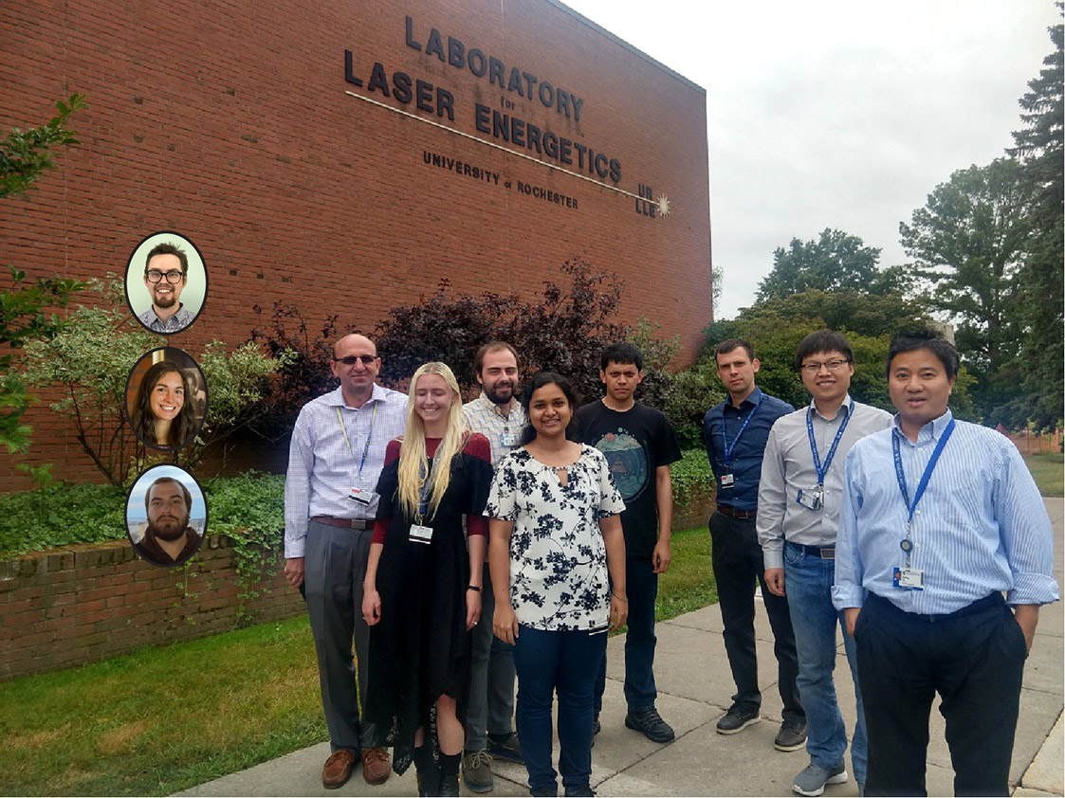
Progress Report on HEDP-Theory Group Performance in 2021
HED-t @ 2021
(still working on to get our undergrads’ pictures in)
S. X. Hu & All HED-t Members ➔
Laboratory for Laser Energetics
University of Rochester
HEDP-Theory Group Meeting on 12/16/2021

Slide 2

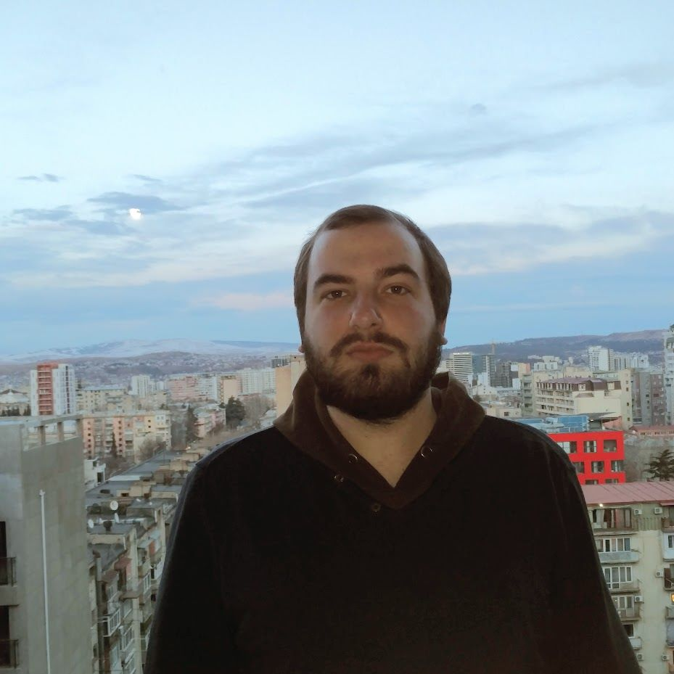
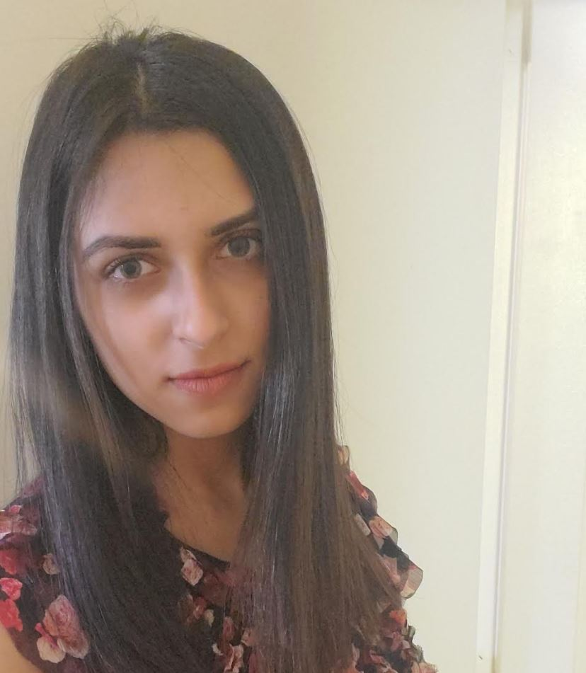
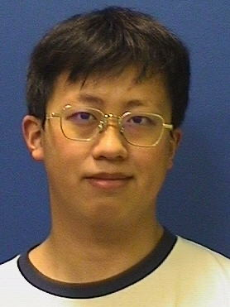
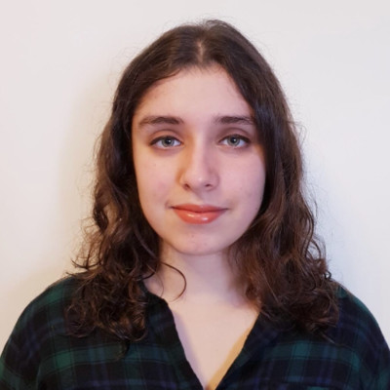
What’s new about LLE’s HEDP-Theory Group in 2021?
Thanks to the support from Theory Division Director & LLE’s senior management, six (6) new members have joined our group in 2021:
  Nathaniel Shaffer (Assistant Scientist): coming from XCP-div @ LANL
  Katarina Nichols (Strickland/Horton Fellow): PhD student from UoR’s P&A Department
  Rati Goshadze (NSF-supported): PhD student from UoR’s P&A Department
  Aliza Panjwani: Undergraduate student from UoR’s Chemistry Department
  Lianming Hu: Undergraduate student from UoR’s Mechanical Engineering Department
  Simran Chowdhry: Visiting undergraduate student from Imperil College London (UK)
Now our diverse HED-t Group grows to have 5-scientists + 6-grads + 3-undergrads (still building the “critical-mass”)!

Slide 3
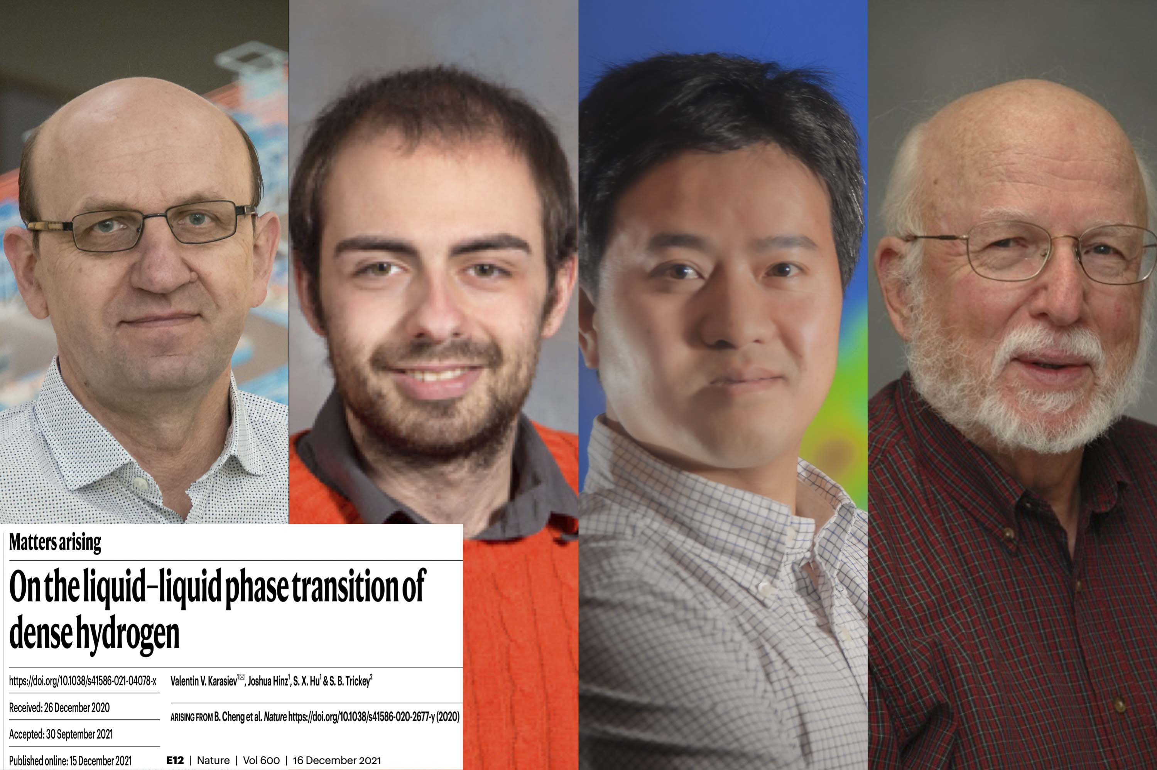
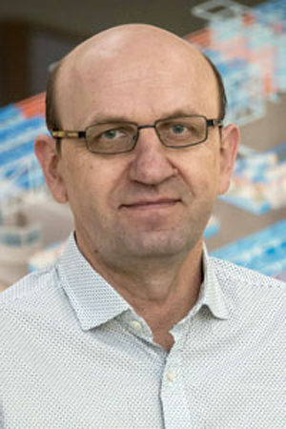
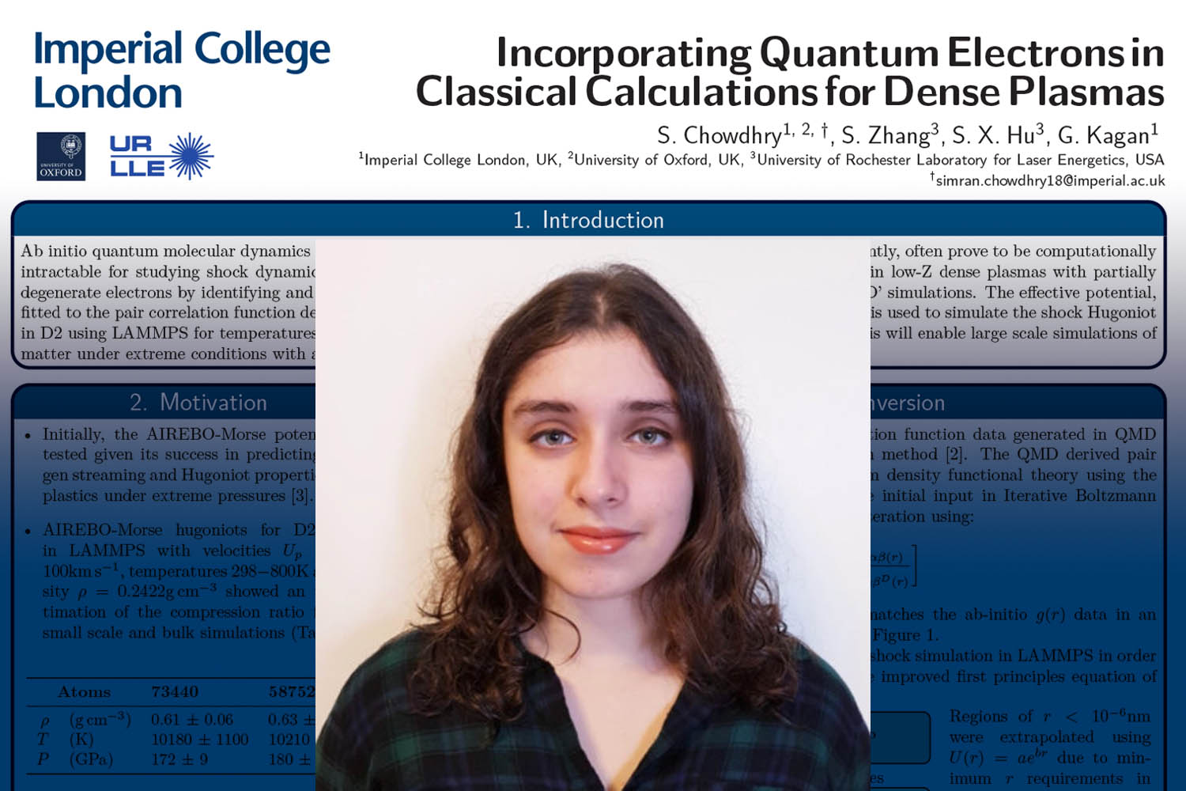
What’s new about LLE’s HEDP-Theory Group in 2021?
We have our FIRST first-authored article published in Nature today! (what a good timing!!) ➔ V. V. Karasiev, J. Hinz, S. X. Hu, S. B. Trickey, Nature 600, E12 (2021) ( https://rdcu.be/cDhKE )
Dr. Valentin Karasiev was promoted from Scientist to Staff Scientist; Congrats!!
Our visiting student, Simran Chowdhry advised by Dr. Shuai Zhang and Dr. Suxing Hu, has won the Outstanding Undergraduate Poster Award at the 63rd APS-DPP Meeting. Congrats to Simran!!

Slide 4
Overall our HEDP-Theory Group has made good progress in both science and education, even though the Covid pandemic continues taking a toll on all of us
Successfully completed three milestone tasks (including one L2), of which Dr. Deyan Mihaylov’s “iFPEOS table of D2/DT” was the unanimous choice of top accomplishment of FY21, selected by LLE’s senior management for reporting to NNSA/DOE
Published/Submitted 8 first-authored articles (including 1 Nature, 2 PRL, 1 PRB, 1 PRR, 2 PRE, 1 JAP), with 10 more first-authored manuscripts in the pipeline
Contributed to 11 co-authored papers in 2021 (including 1 PRL, 2 PRB, 2 PRE, 1 PoP…)
Collaborations with HEDx Group, National Labs, CELIA/CEA, and Other Universities have been continuously strengthened in 2021
Group Scientists gave Plenary/Invited Talks at conferences/workshops
Group Scientists actively served the broad physics community by organizing, chairing, and participating Workshops and Conferences, as well as serving as panelists or reviewers to papers/proposals for scientific journals and funding agencies

Slide 5
Three milestone tasks (including one L2) for DOE/NNSA have been completed by HEDP-Theory Group members in FY21
Top accomplishment unanimously picked by LLE’s senior management
L-2 milestone
Developing a temperature-dependent meta-GGA exchange-correlation functional (T-SCAN-L) to improve the accuracy of DFT calculations [PI: V. Karasev working with D. Mihaylov & S. X. Hu; LLE-10.8-9 milestone]

Slide 6
Eight (8) first-authored papers have been published/submitted by HEDP-Theory Group members (underlined authors) in 2021
V. V. Karasiev and S. X. Hu, “Unraveling the intrinsic atomic physics behind x-ray absorption line shifts in warm dense silicon plasmas”, Phys. Rev. E 103, 033202 (2021).
D. I. Mihaylov, V. V. Karasiev, S. X. Hu, J. R. Rygg, V. N. Goncharov, G. W. Collins, “Improved first-principles equation-of-state table of deuterium for high-energy-density applications”, Phys. Rev. B 104, 144104 (2021).
V. V. Karasiev, J. Hinz, S. X. Hu, S. B. Trickey, “On the liquid–liquid phase transition of dense hydrogen”, Nature 600, E12 (2021) [https://rdcu.be/cDhKE].
S. Zhang, D. E. Fratanduono, M. C. Marshall, J. R. Rygg, Amy E. Lazicki, A. Shvydky, D. Haberberger, V. N. Goncharov, T. R. Boehly, G. W. Collins, and S. X. Hu, “Species separation in polystyrene shock release evidenced by molecular-dynamics simulations and laser-drive experiments”, Phys. Rev. Research (submitted).
S. Zhang, Miguel A. Morales, Raymond Jeanloz, Marius Millot, S. X. Hu, and Eva Zurek. “Phase transformation path in Aluminum under ramp compression; simulation and experimental study”, J. Appl. Phys. [invited paper] (submitted).
N. R. Shaffer and C. E. Starrett, "Dense plasma opacity via the multiple-scattering method”, Phys. Rev. E (submitted).
V. V. Karasiev, D. I. Mihaylov, S. X. Hu, “Meta-GGA exchange-correlation free-energy density functional to achieve unprecedented accuracy for warm-dense-matter simulations”, Phys. Rev. Lett. (submitted).
S. X. Hu, R. Paul, V. V. Karasiev, R. P. Dias, “Revealing the Stoichiometry, Structure, and Isotope Effect of the Room-Temperature Superconductor of Carbonaceous-Sulfur-Hydride under High Pressure”, Phys. Rev. Lett. (submitted).

Slide 7
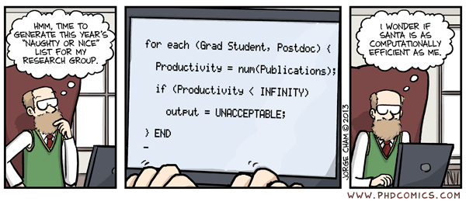
It looks like the Covid pandemic is truly taking a toll on our graduate students ➔ no publication/submission???
We are still DEBUGGING the “code”….
~1 ?
(Thanks to Deyan for finding out this interesting cartoon)

Slide 8
Ten (10) first-authored manuscripts are currently in preparation for submission (the “page” will get turned for our grads in 2022….)
M. Ghosh (Horton Fellow) et al., "Cooperative diffusion of Fe under earth and super-earth core conditions", Nature Chemistry (2022)
R. Paul (Horton Fellow) et al., “Thermally-driven Charge-state and Magnetic Transitions in FeO2 under high pressures”, Physical Review Letters (2022).
J. Hinz (Horton Fellow) et al., “Transferability of Machine-Learning Models for High-Energy-Density Physics”, Physical Review B (?) (2022).
B. McLellan (Horton Fellow) et al., “On the B1-B2 phase transition pathway of MgO under high pressures”, Physical Review B (2022).
R. Goshdaze et al., “Metallization of polystyrene under shock compression”, Physical Review B (2022).
V. V. Karasiev et al., “Derivation of meta-GGA non-interacting free-energy functional”, Physical Review B (?) (2022).
S. Zhang et al., “Study of B1-B2 phase transition of MgO with diffusion Monte-Carlo method”, Physical Review B (2022).
V. V. Karasiev et al., “Examining the iron opacity discrepancy with DFT”, Physical Review E(?) (2022).
S. X. Hu et al., “Probing Extreme Atomic Physics at Gbar Pressures”, Nature Physics (2022).
S. X. Hu et al., “VERITAS: A DFT-based multi-band kinetic code for x-ray spectroscopy of warm-/hot-dense plasmas”, Physical Review E (2022).
…… (more to come in 2022?)
By HED-t Grads

Slide 9
HEDP-Theory Group members (underlined) contributed to twelve (12) co-authored papers published in 2021
Katerina P. Hilleke, Tadashi Ogitsu, Shuai Zhang, Eva Zurek. “Structural motifs and bonding in two families of boron structures predicted at megabar pressures”, Phys. Rev. Mater. 5, 053605 (2021).
Heather D. Whitley, …, Philip A. Sterne, Damian C. Swift, Lin Yang, Shuai Zhang. “Comparison of ablators for the polar direct drive exploding pusher platform”, High Energ. Dens. Phys., 38, 100928 (2021).
Burkhard Militzer, Felipe González-Cataldo, Shuai Zhang, Kevin Driver, François Soubiran. “First-principles equation of state database for warm dense matter computation”, Phys. Rev. E 103, 013203 (2021).
R. C. Shah, S. X. Hu, I. V. Igumenshchev, …, W. Theobald, S. P. Regan, “Observations of anomalous x-ray emission at early stages of hot-spot formation in deuterium-tritium cryogenic implosions”, Phys. Rev. E 103, 023201 (2021).
A. Shvydky, A. V. Maximov, V. V. Karasiev, D. Haberberger, S. X. Hu, V. N. Goncharov, “Ionization state and dielectric constant in cold rarefied hydrocarbon plasmas of inertial confinement fusion”, Phys. Rev. E 104, 045207 (2021).
A. Lees, R. Betti, J. P. Knauer,…, S. X. Hu, …, “Experimentally Inferred Fusion Yield Dependencies of OMEGA Inertial Confinement Fusion Implosions”, Phys. Rev. Lett. 127, 105001 (2021).
A. Pineau, B. Chimier, S. X. Hu, G. Duchateau, “Improved modeling of the solid-to-plasma transition of polystyrene ablator for laser direct-drive inertial confinement fusion hydrocodes”, Phys. Rev. E 104, 015210 (2021).
L. E. Hansen, D. E. Fratanduono, S. Zhang, D. G. Hicks, T. Suer, Z. K. Sprowal, M. F. Huff, X. Gong, B. J. Henderson, D. N. Polsin, M. Zaghoo, S. X. Hu, G. W. Collins, J. R. Rygg, “Melting of magnesium oxide up to two terapascals using double-shock compression”, Phys. Rev. B 104, 014106 (2021).
B. J. Henderson, M. C. Marshall, T. R. Boehly, R. Paul, C. A. McCoy, S. X. Hu, D. N. Polsin, L. E. Crandall, M. F. Huff, D. A. Chin, J. J. Ruby, X. Gong, D. E. Fratanduono, J. H. Eggert, J. R. Rygg, G. W. Collins, “Shock-compressed silicon: Hugoniot and sound speed up to 2100 GPa”, Phys. Rev. B 103, 094115 (2021).
A. Shvydky, D. Haberberger, A. V. Maximov, …, S. X. Hu, …, V. V. Karasiev,…, “Density evolution after shock release from laser-driven polystyrene (CH) targets in inertial confinement fusion”, Phys. Plasmas 28, 092703 (2021).
A. Kryjevski, T. Luu, V. V. Karasiev, “Electronic structure of semiconductor nanoparticles from stochastic evaluation of imaginary-time path integral”, Phys. Rev. Research 3, 023173 (2021).
M. Laraia, C. Hansen, N. R. Shaffer, D. Saumon, D. P. Kilcrease, C.E. Starrett, “Real-space Green's functions for warm dense matter”, High Energy Density Phys. 40, 100940 (2021).

Slide 10
HEDP-Theory Group members gave plenary/invited presentations in conferences/workshops over the year of 2021
V. V. Karasiev, “Advancing the Accuracy of DFT Simulations for High-Energy-Density Plasmas by Developing Temperature-Dependent Exchange-Correlation Functional”, Invited Talk @ 63rd APS-DPP Meeting, Nov 8-12, 2021, Pittsburgh, PA
V. V. Karasiev, “Development of free-energy density functional methods for warm dense matter applications”, Invited Seminar @ European XFEL, September 30th, 2021.
S. Zhang, “Multi-megabar phase transitions from first principles—examples in MgO and Fe”, Invited Seminar @ CMAP, September of 2021.
S. Zhang, “Molecular to atomic transition in liquid silica at extreme conditions”, Institute of Physics (IOP)’s Invited Twitter/poster event: “Emerging Leaders Celebration”, 2021.
S. X. Hu, “Probing extreme atomic physics of warm and super-dense plasmas”, Topical Plenary Talk @ 5th Asia Pacific Conference on Plasma Physics (AAPPS-DPP-2021), Sept. 26 – Oct. 1st, 2021.
S. X. Hu, “Probing Extreme Atomic Physics in Super-dense Plasmas with Average-Atom Model and Ab-Initio Simulations”, Invited Talk @ Workshop: Average Atom Models for Warm Dense Matter, organized by UC-Berkeley, June 28-29, 2021.
S. X. Hu, “Understanding matter under warm and extremely dense conditions”, Invited Talk @ 2021 APS March Meeting, Mar. 8 – 12, 2021.

Slide 11
Internal collaborations with HEDx, IM, and other groups have been continuously strengthened in 2021
Many internal theory-experiment collaborative projects are on-going between HED-t and HED-x/IM/other Groups:
  MgO melting and other HED behaviors (S. Zhang, L. Crandall B. McLellan,…)
  Extreme atomic physics at Gbar pressures (S. X. Hu, P. Nilson, V.V. Karasev,….)
  Double shock in CH (M. Ghosh, Z. Sprowal, S. Zhang …)
  Super-hard materials with Boron (S. Zhang, D. Polsin,….)
  Cone-in-double-shell platform (S.X. Hu, D. Barnak, R. Rygg, …)
  Shock release at CH/DT interface (S. Zhang, M. Marshall,….)
  Understanding refractive index of release plasmas (V. Karasev, A. Shvydky, D. Haberberger…)
  Laser imprint understanding/mitigation (S.X. Hu, J. Peebles, W. Theobald, S. Regan,…)
  Intensity & broadband effects on absorption/electron transport (N. Shaffer, A. Maximov, V. Goncharov, ...)
Many jointed papers published/submitted with other internal groups in 2021:
  iFPEOS table of D2/DT (PRB - published)
  Hugoniot and sound-speed of Si (PRB - publishd)
  Species separation of CH shock release (PRR – submitted)
  Melting of MgO (PRB – published)
  X-ray diffraction of Na @ 400-GPa (Submitted to Nat. Commun.)
  Early x-ray emission in cryo-DT implosions (PRE – published)
  Material properties of CH-shock release plasmas (PRE & PoP – published)
  Inferring trends on cryo-DT implosions (PRL – published)
  ???

Slide 12
External collaborations with National Labs and other Universities are healthy/active and productive
Collaborations with LANL are actively going on the following three fronts:
  With L. A. Collins & A. White on TD-mDFT development for stopping power and non-local electron thermal transport [K. Nichols (PhD student) & S. Hu]
  With M. Schmitt & B. Scheiner on double-shell (S. Hu & D. Barnak)
  With C. Starrett on transport and WDM (N. Shaffer, S. Zhang, S. Hu)
Collaborations with LLNL can be further strengthened:
  QMC simulation of materials (S. Zhang, M. Morelas)
  Melting of Sn (S. Zhang, C. Wu, H. Whitley,…)
  VFP simulation of LPI (N. Shaffer, M. Sherlock)
  Meta-dynamics and HED-material phases (R. Paul [student], S. Hu, S. Bonev)
Collaboration with SNL and Prism on extreme atomic physics has fruited:
  Students involvement (D. Bishel, A. Chin, P. Nilson, S. Hansen, I. Golovkin, M. Gu, S. Hu)
  X-ray line shapes (N. Shaffer, K. Adler, S. Hansen, T. Gomez, C. Starrett)
Collaboration with CELIA/CEA had resulted in one paper & one LMJ proposal
  WDM (V. Karasev, V. Recoules, G. Ducheatau, A. Pineau, F. Dorchies, S. Hu)
Collaborations with U. Florida (S. Trickey), UC-Berkeley (B. Militzer), U. Buffalo (E. Zurek), PPPL (S. Malko & W. Fox), Princeton (T. Duffy), Imperial College (G. Kagan), UNL (Y. Lu), Uni. of Basel (S. Goedecker), and RIT (Q. Yu) are actively initiated/maintained.

Slide 13
HEDP-Theory Group members have continued participating and serving the broad physics community in 2021
Several members (K. Nichols, B. McLellan, D. Mihaylov, N. Shaffer, S. Zhang, V. Karasiev, S. Hu) gave talks at APS-DPP-2021
R. Paul, S. Zhang, D. Mihaylov, S. Hu presented talks at 2021 APS-March Meeting
M. Ghosh & R. Paul presented poster/talk to AGU meeting 2021
S. Zhang, D. Mihaylov, V. Karasev, N. Shaffer have participated in the Average-Atom Workshop
V. Karasev refereed papers for PRL/PRB/PRE… and reviewed proposals for DOE/NSF
S. Zhang refereed papers for Nature/PRL/PRB/PRE/….
S. Hu served as panelist to NSF’s plasma-physics program & DOE/NNSA’s SAAP program
S. Hu served as panelist for LANL’s Double-Shell Milestone Review Panel
S. Hu is co-organizing the 2nd Plasma Transport Workshop with national lab folks
Our HED-t Group hosted “virtual” visits/seminars of Dr. Alex White (LANL), Dr. Sang-Kil Son (CFEL/Hamburg), Dr. Anour Benali (ANL), and Dr. Adrien Pineau (CELIA)

Slide 14
External grants and computational resources acquired/worked in 2021
V. Karasev (PI), D. Mihaylov, & S. Hu (Co-PI) continued working on our NSF Grant PHY-1802964 (extended to 2022)
V. Karasev (PI) & S. Hu (Co-PI) have submitted a renewal proposal (~$675,000 for 2022-2025) to NSF’s plasma physics program
V. Karasev (PI) were awarded ~10 millions of HPC core-hours on NERSC Supercomputers at LBNL
S. Hu & Q. Yu (RIT) received a seed fund of $25,000 from CMAP to initiate Machine-Learning (ML) method for HEDP
S. Hu initiated the collaboration with Prof. Q. Yu (RIT) with a sub-award of ~$50,000 from LLE’s CA to support ML studies for HEDP

Slide 15
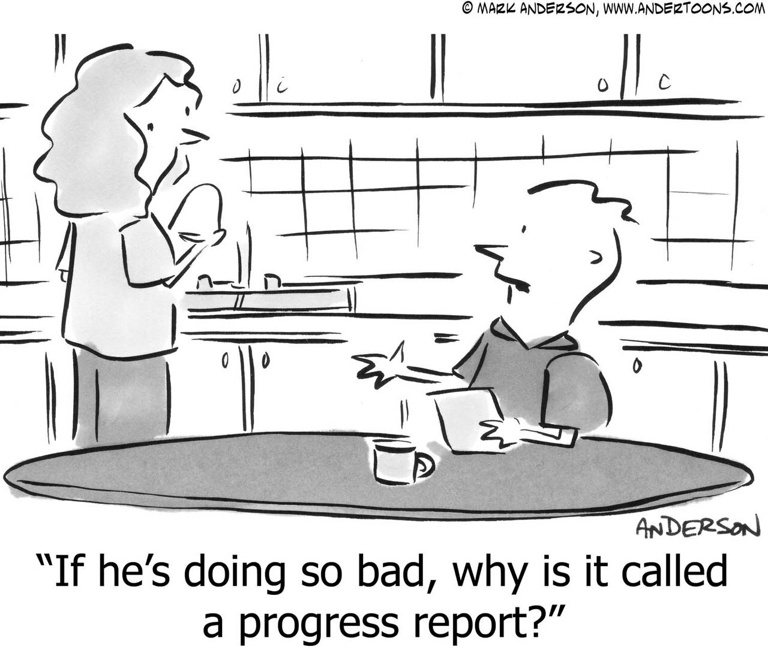

Summary
“Theme” of the year @ 2021
“If they’re doing too bad, why is it called a progress report?”

