Slide 1
Recent Foams and Aerogels Development at Los Alamos National Laboratory
23rd Target Fabrication Specialists’ Meeting
April 23-26 2019, Annapolis MD
Chris Hamilton, Christina Hanson, Stephanie Edwards, and John Oertel
LA-UR-19-23279

Slide 2
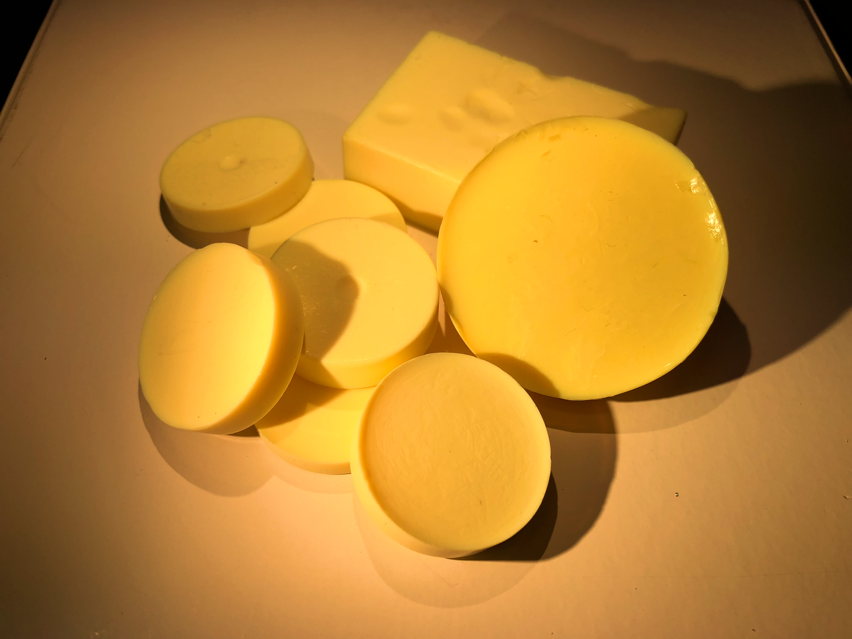
Outline
DVB aerogel, tantalum oxide
lower d, Doped DVB, Ta₂O₅
Polyimide aerogels, for targets
possible candidate for DS, MShock
PI aerogel: AM R&D, non target fab
additive manufacturing
stockpile materials replacement
air-buoyant solids
energetic materials
Silica aerogels for Cherenkov detectors
attaining high densities, low densities
critical parameters: clarity, light collection

Slide 3
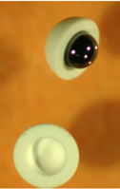
DVB Aerogel
polyHIPE still problematic
voids, shrinkage at low densities
Reduced density DVB aerogel
for Double Shell, MARBLE?
reduced d from 30 mg/cm³ to 16 mg/cm³
Doped full-d plastics
halogens, silicon
Doped DVB aerogel
~100 mg/cm³ Si doped, Cl doped (LDRD)
3% Cl, 3% I doped less robust (MShock)
DVB in MARBLE VC target
Checked out Stephanie Edwards’ poster?
Double Shell parts

Slide 4
Tantalum Oxide Aerogel, Ti doped SiO2
1:5 TiO₂:SiO₂
Chunky/ smooth
Ta₂O₅ aerogel: high z, low d
for DS, other applications
200 mg/cm³, 400 mg/cm³
Machined tantalum oxide aerogel sphere
tantalum oxide aerogel. ~250 mg/cm³
Checked out Stephanie Edwards’ poster?

Slide 5
Polyimide Aerogel
Dianhydride + diamine
Polyamic acid oligomers imidized
thermally or chemically
Crosslinking to form gels
triamines, acid chlorides, etc
Wide variety of monomers:
tailored properties
M.A.B. Meador et al., ACS Appl. Mater. Interfaces 2015, 7, 1240.
2 mm
2 mm

Slide 6
Polyimide Aerogel for Targets
Broad density range
17-120 mg/cm³ (GA has done lower, we have done higher)
Machinable
DVB replacement for Double Shells?
replacement for doped DVB for Mshock
Tunable stoichiometry?
Machined PI aerogel, 100 mg/cm³ for MShock target
2 mm
2 mm

Slide 7
Polyimide Aerogel AM: can we print it?
Introduce acrylate functionality
Allows photopolymerization
At the cost of lost thermal stability
Thermal imidization
2 mm
from M. Hegde et al., Adv. Mater. 2017, 29, 1701240.

Slide 8
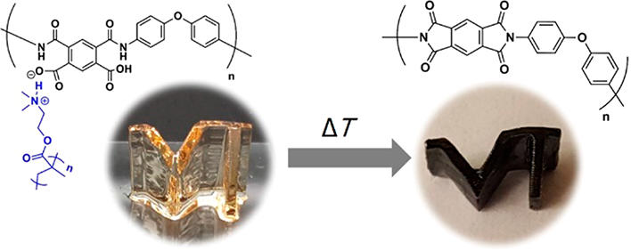
Polyimide Aerogel AM: can we print it?
Introduce acrylate salts
Allows photopolymerization
At the cost of lost thermal stability
Unless…
M. Herzberger et al., ACS Macro Lett. 2018, 7, 493.
2 mm
D. A. Rau et al., ACS Appl. Mater. Interfaces 2018, 10, 34828.

Slide 9
Polyimide Aerogel AM: can we print it?
Acrylate functionalized monomers
photopolymerized
supercritical drying
thermal imidization, shrinkage
Direct ink write?
3D printed polyamic acid gel
Thermally treated PI aerogel
Checked out Christina Hanson’s poster?!

Slide 10
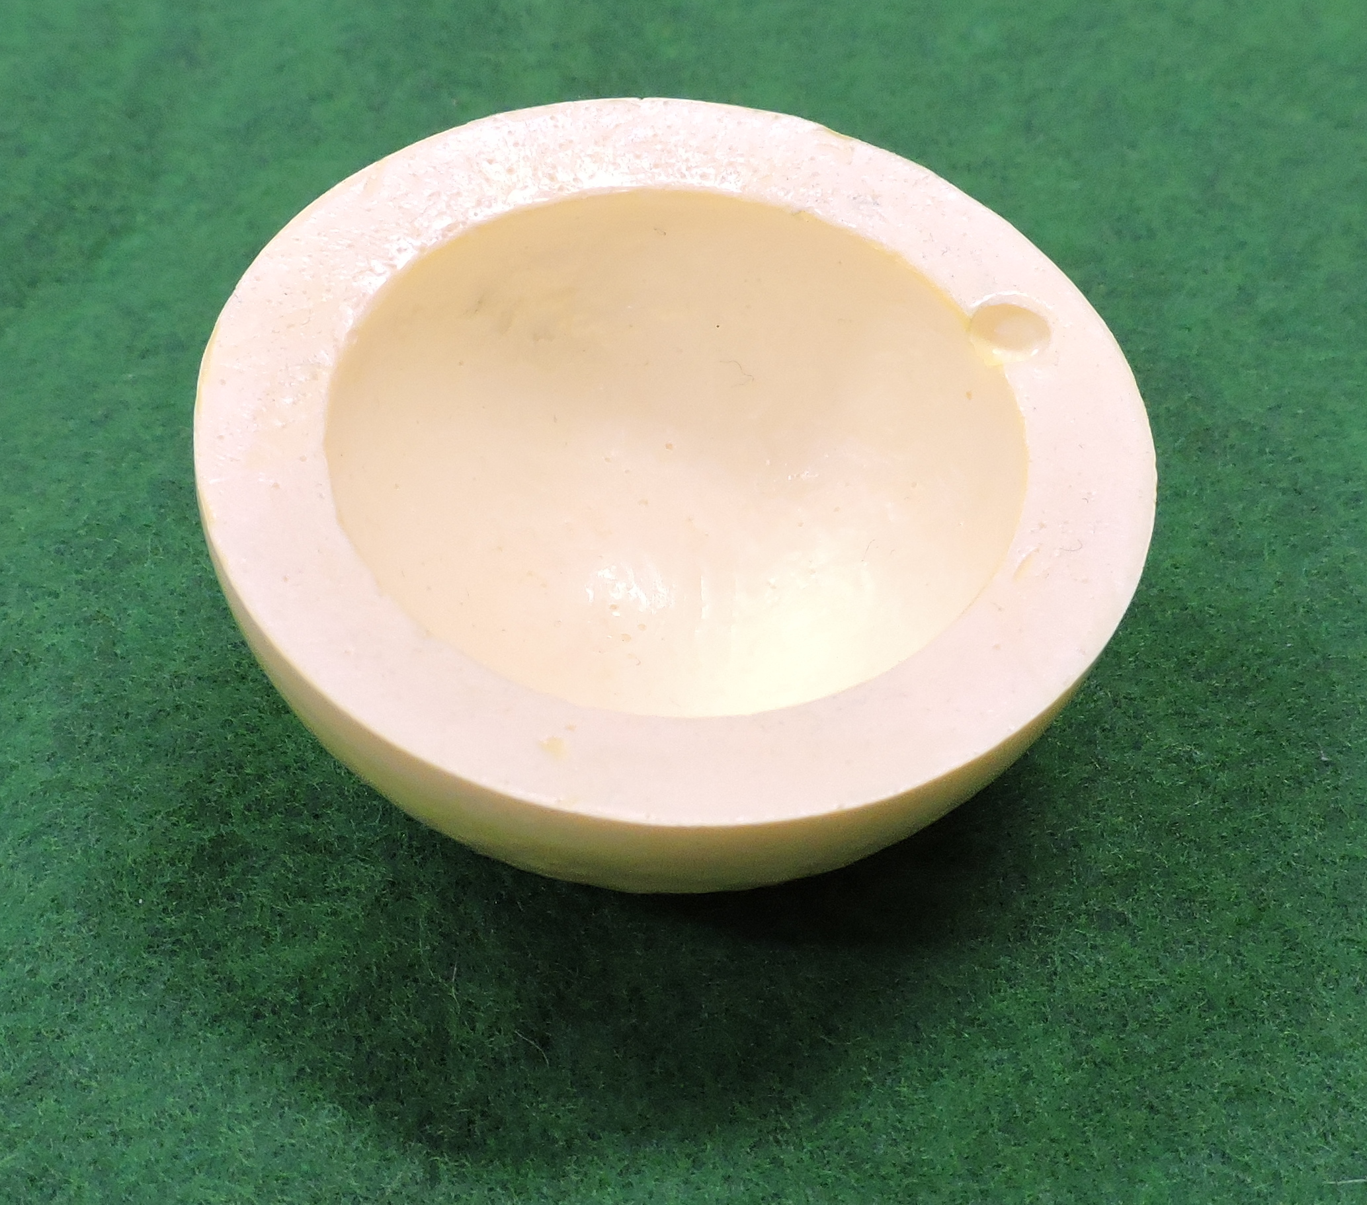
Polyimide Aerogels for Other Applications
Stockpile materials replacement
APO-BMI, alternate drying methods
LDRD- buoyant solids
SiO₂ not viable
alternate drying strategies, composites
Energetics: switchable safing
eventually: sensitized, MIC, other composites
GS
aerogel detonation? L: before, R: after
10 cm
PI aerogel hemi, 120 mg/cm³
http://asd.gsfc.nasa.gov/

Slide 11
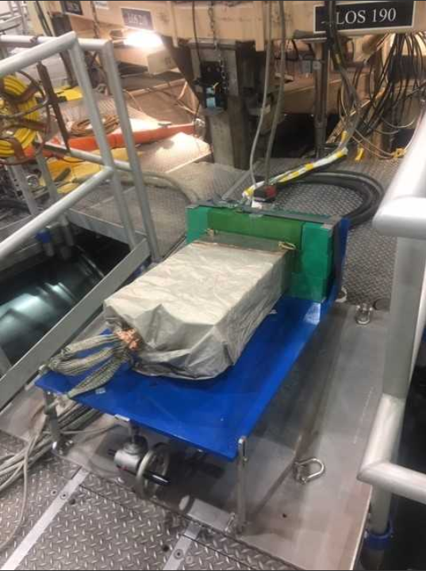
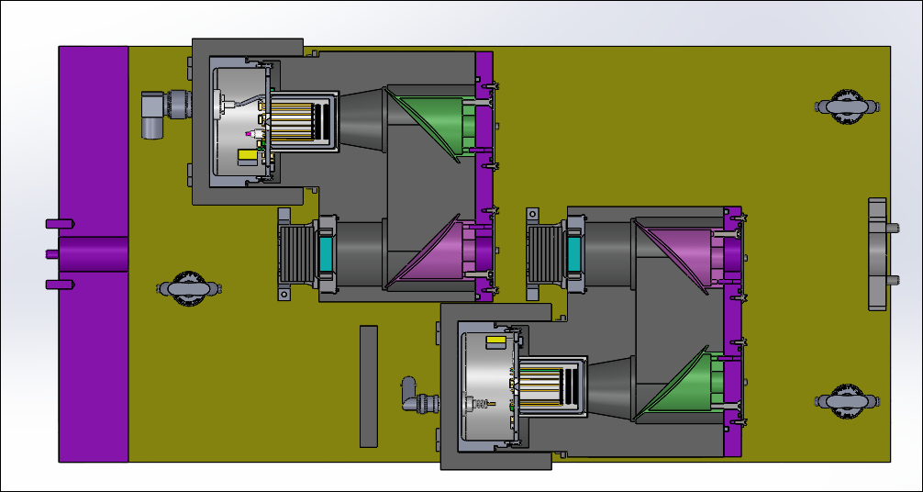
SiO₂ Aerogel Cherenkov detectors
Cherenkov radiation
gas, liquid, aerogels in between
refr. index (density) determines energy threshold
ACD fielded on Cygnus at NNSS, now Z
PMT
OAP
Cherenkov radiator 2
X-rays
OAP
4” Tungsten
Collimator
Cherenkov radiator 1
Y. Kim et al., Rev. Sci. Instrum. 2016, 87, 11E723.

Slide 12
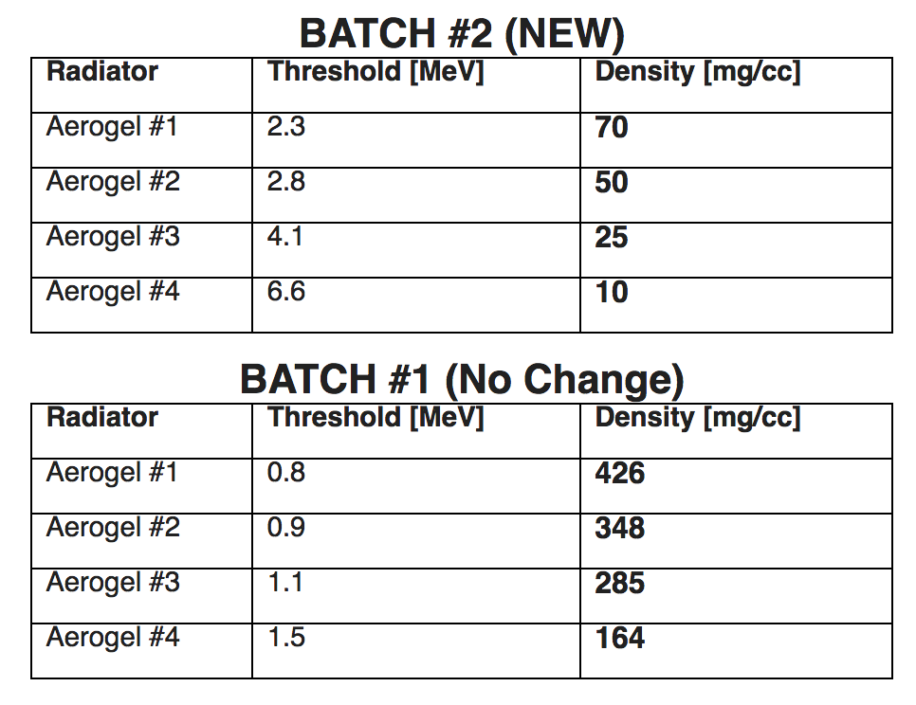
SiO₂ Aerogel Cherenkov detectors
Density range 10 to 425 mg/cm³
thermal sintering required for high d
chemistry: TMOS, MeSi51, CS
critical parameter: optical clarity
Machining, solvents
Aerogel Cherenkov radiators, L to R: density 70, 164, 285, 348, 426 mg/cm³
I.L. Rasmussen, J. Physique Colloq. 1989, C4, C4-221 (2nd Int. Symp. Aerogels 1988).
M. Tabata et al., Nucl. Instrum. Meth. A 2012, 668, 64.

Slide 13
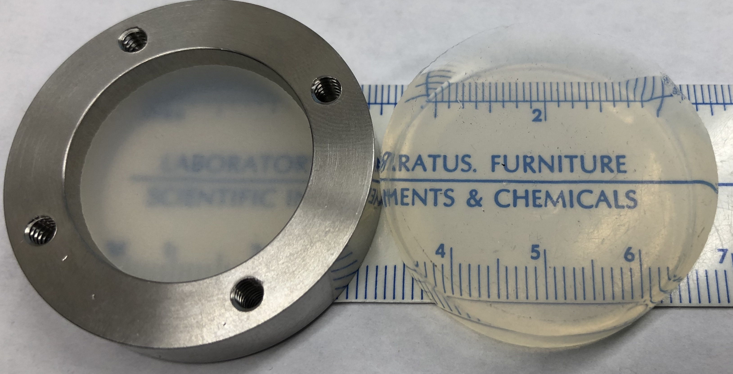
SiO₂ Aerogel Cherenkov detectors
More info
thermal sintering
Machining, solvent?
From I.L. Rasmussen, J. Physique Colloq. 1989, C4, C4-221 (2nd Int. Symp. Aerogels 1988).
348 mg/cm3 aerogels, L: machined; R: as cast.

Slide 14
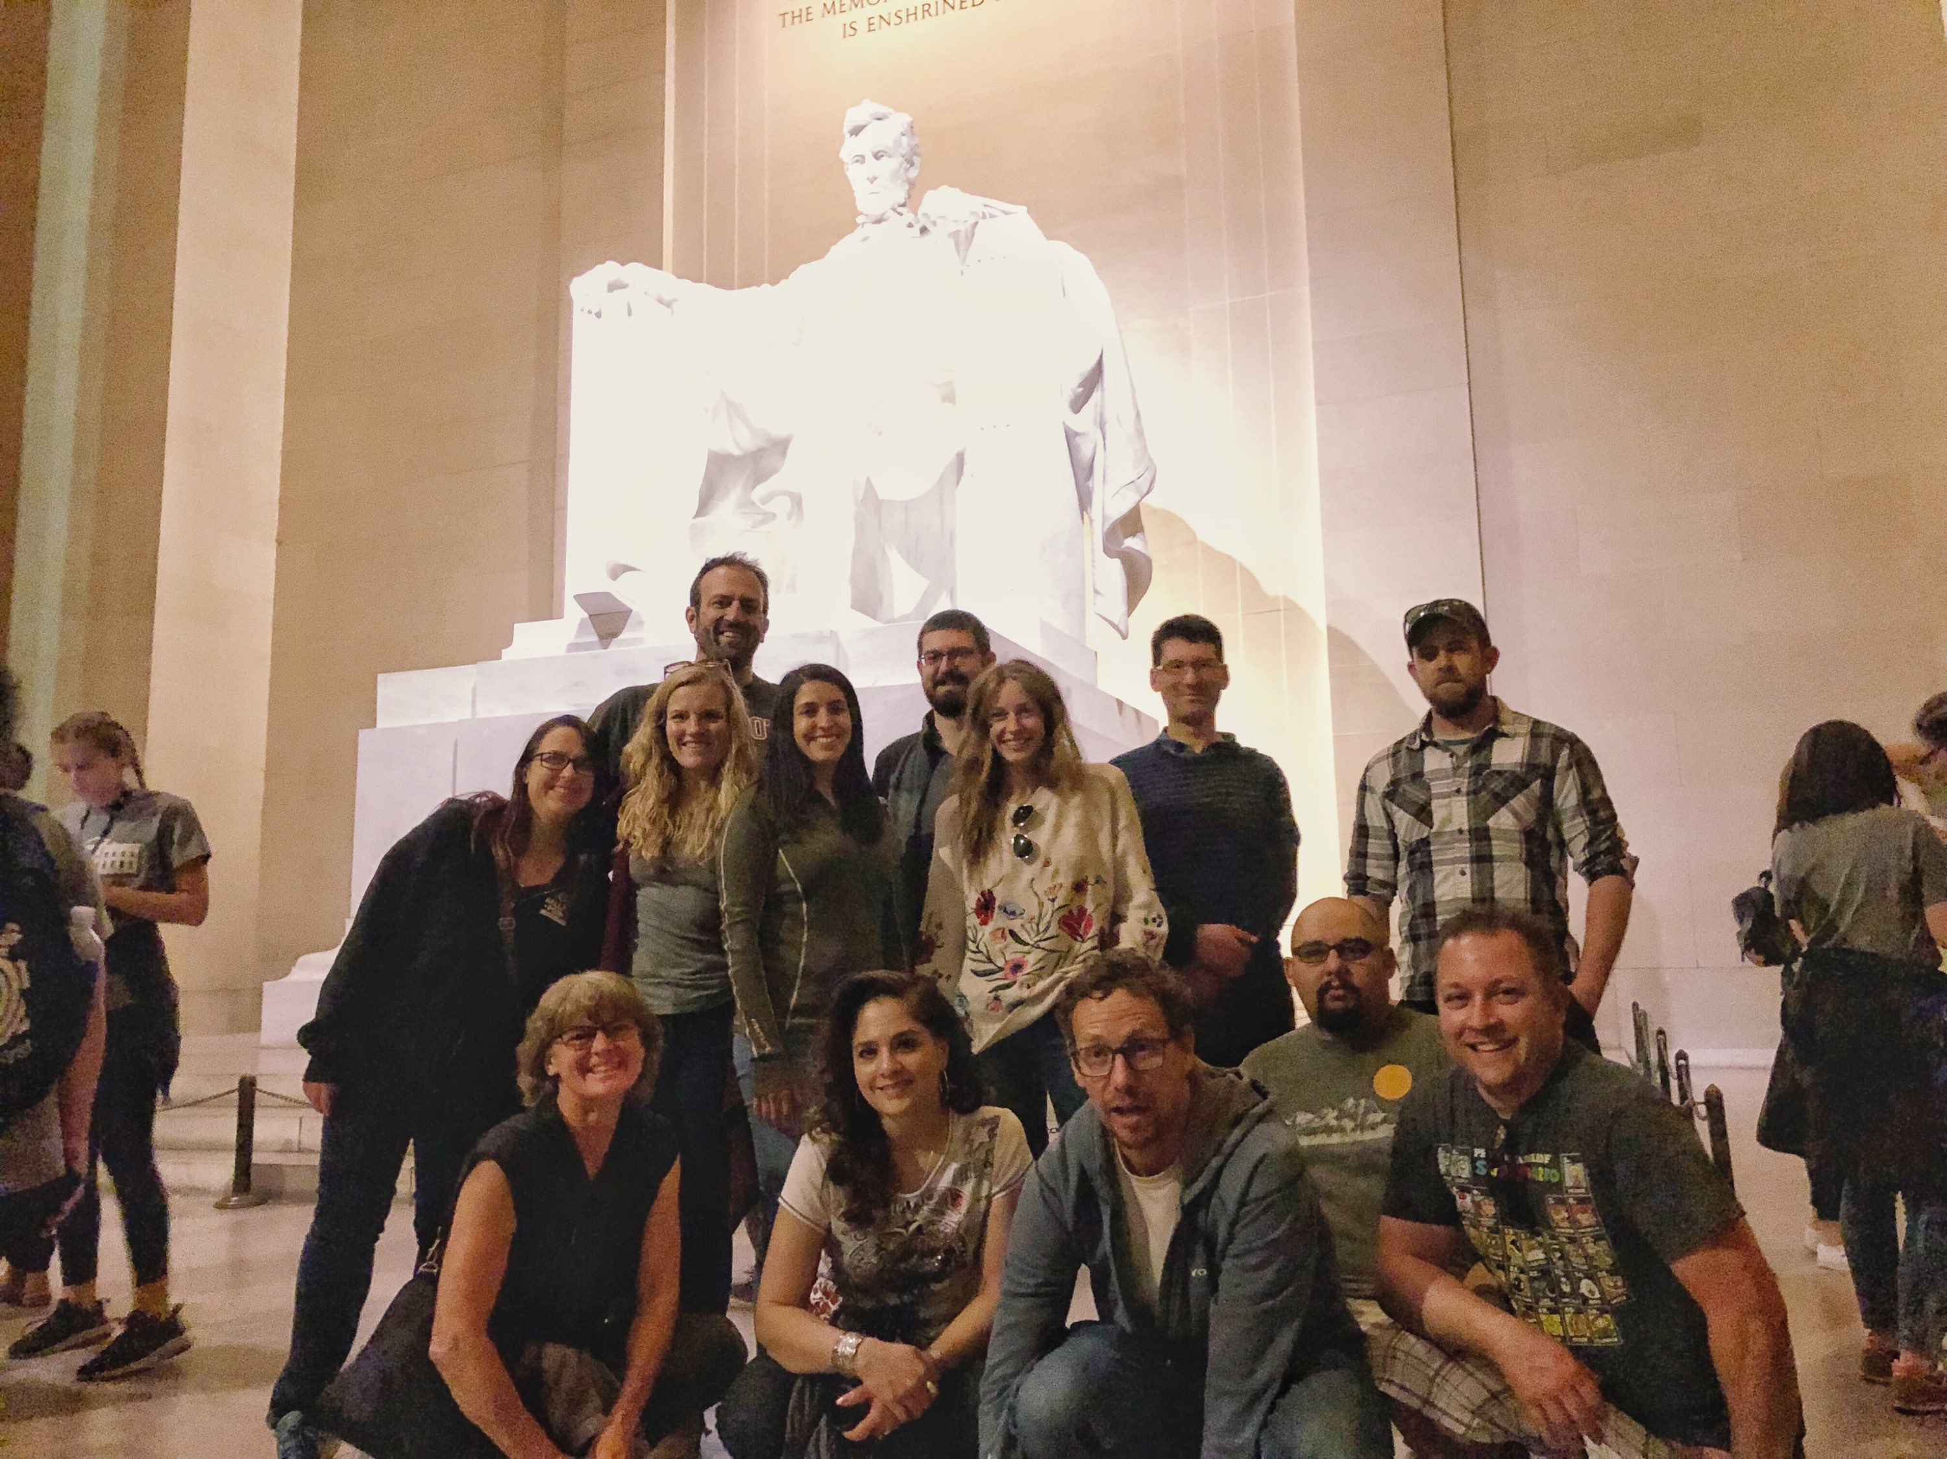
Summary
Plethora of foams:
DVB, Ta₂O₅, PI, SiO₂
Acknowledgments
LANL MST-7 Target Fab team
Miles Beaux, Bryce Tappan
Matt Lee, Kyle Cluff
Hans Herrmann, Yongho Kim
target fab colleagues at LLNL, GA
References:
M.A.B. Meador et al., ACS Appl. Mater. Interfaces 2015, 7, 1240.
M. Hegde et al., Adv. Mater. 2017, 29, 1701240.
M. Herzberger et al., ACS Macro Lett. 2018, 7, 493.
D. A. Rau et al., ACS Appl. Mater. Interfaces 2018, 10, 34828.
Y. Kim et al., Rev. Sci. Instrum. 2016, 87, 11E723.
I.L. Rasmussen, J. Physique Colloq. 1989, C4, C4-221.

Slide 15
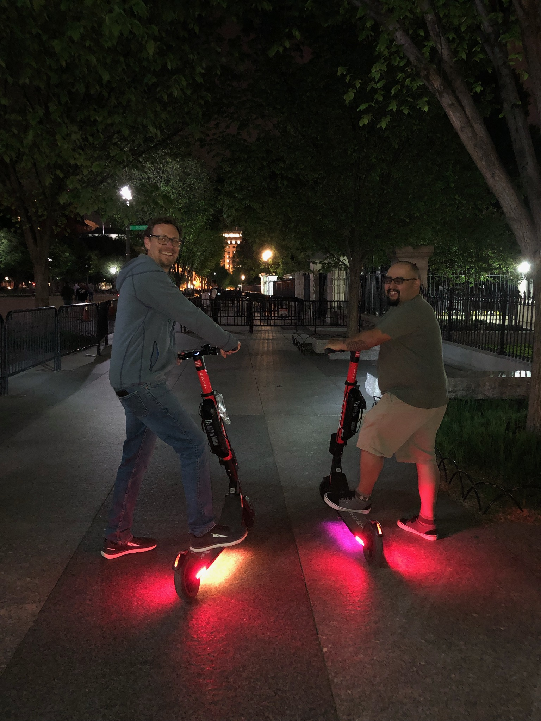
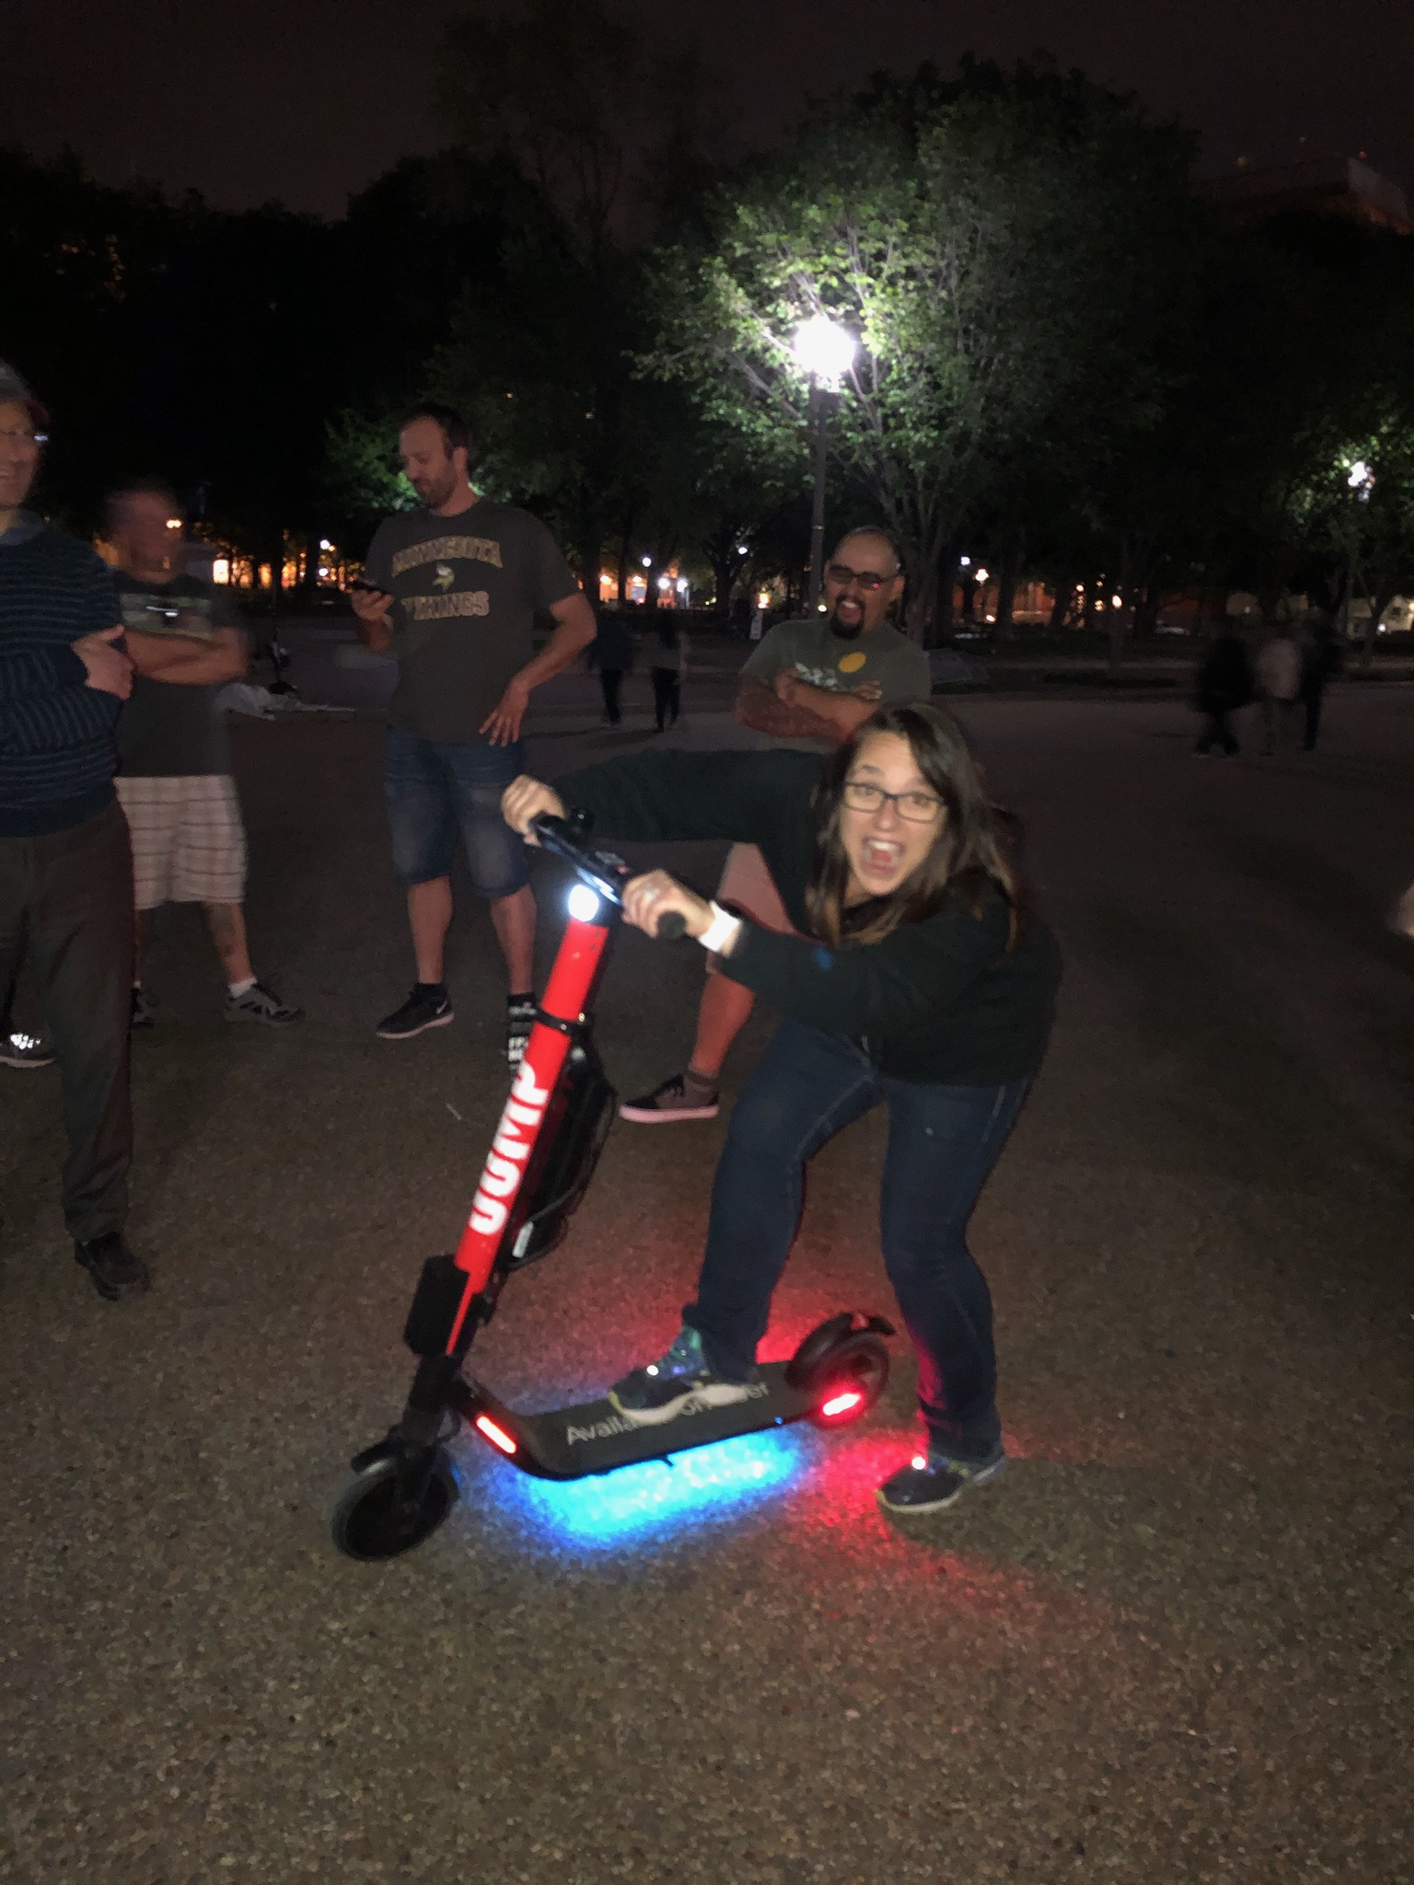
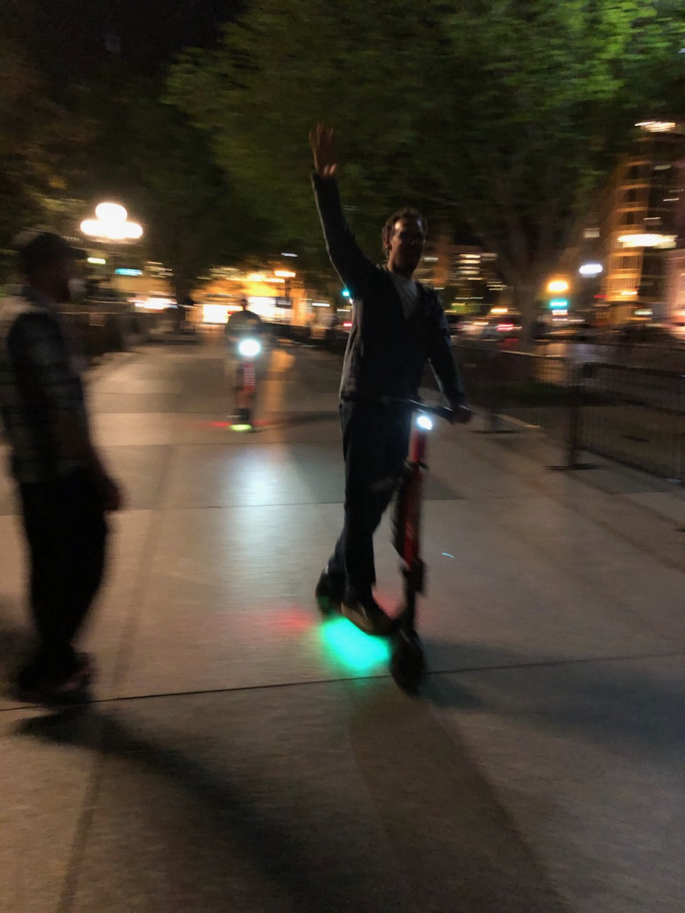

Slide 16
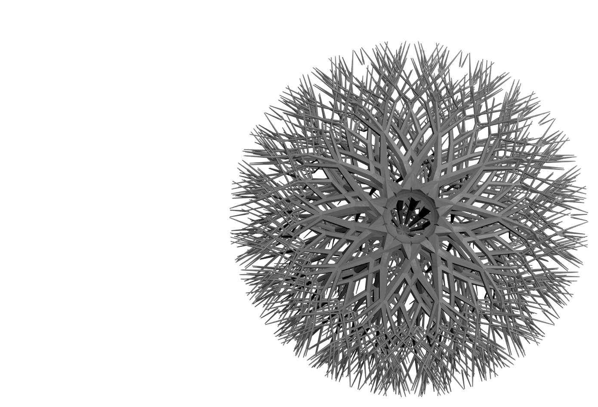
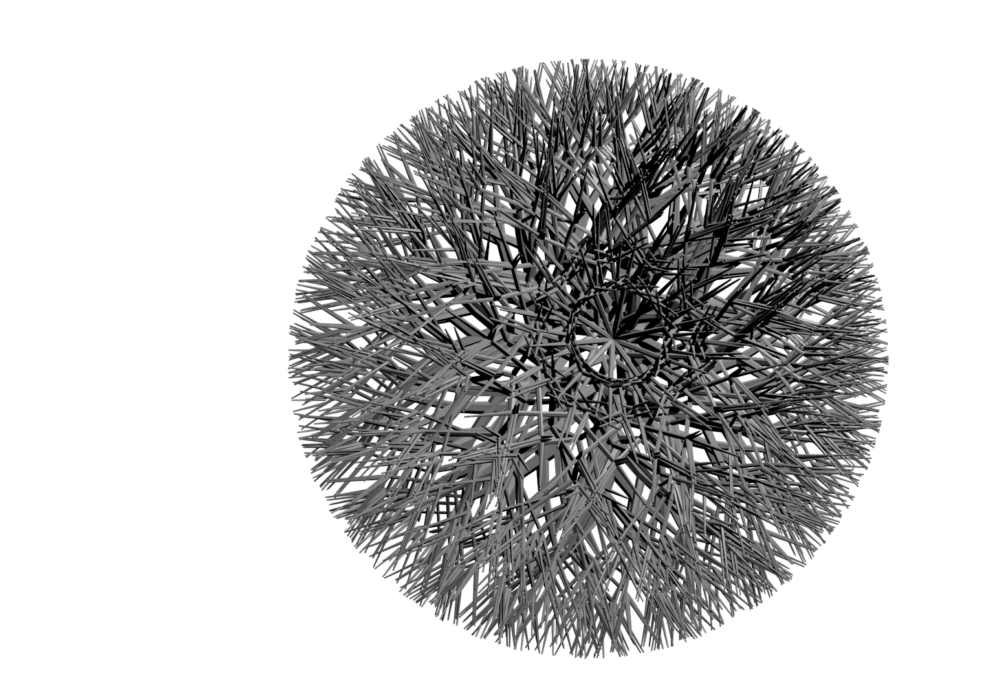
Future Directions and Materials
Double Shells, Revolver, other future platform requirements
Precisely controlled density- density gradients
Pure metals, mixed metals, compositional gradients
Spherical geometries- radial density gradients
Structural foams require strength
Bijels: past and present
Tunability, flexibility
Bijel templated, polymer cast metal foams
True metal particle stabilized bijels
Bijel templated ultralow density carbon
Recent AM advances for metals
Printed metal foams: density gradients

