Slide 1
Ion Beam Analysis of Laser Targets
Target Fabrication Meeting 2019
Swanee J. Shin, L. Bimo Bayu Aji, Sergei O. Kucheyev
April 25, 2019

Slide 2
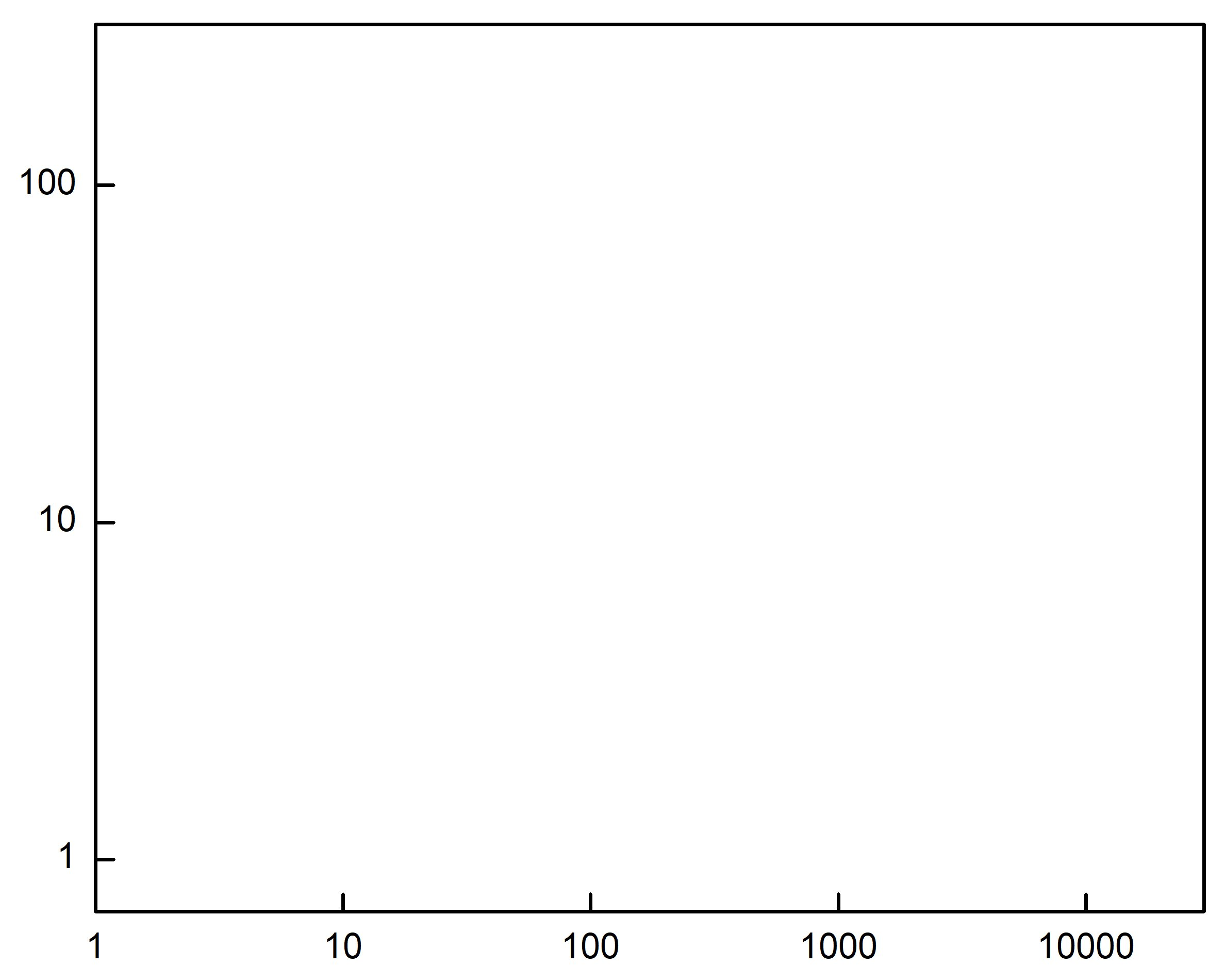
Ion beam analysis (IBA) is an important tool to measure elemental composition
Low Energy
Medium Energy
High Energy
Ion beam analysis is widely used for targets metrology
Ar
SIMS
ERDA
W in HDC
Mid Z in opacity samples
Depth profiling of gradient density samples
Low Z contamination
Hydrogen content
Deuterium content
Ion Mass (amu)
He
MEIS
RBS
LEIS
NRA, PIXE, PIGE
H
Ion Energy (keV)
RBS : Rutherford Backscattering Spectrometry
ERDA : Elastic Recoil Detection Analysis
NRA : Nuclear Reaction Analysis
PIXE : Particle Induced X-ray Emission
Combined with other complementary tools IBA provides critical pre-shot data

Slide 3
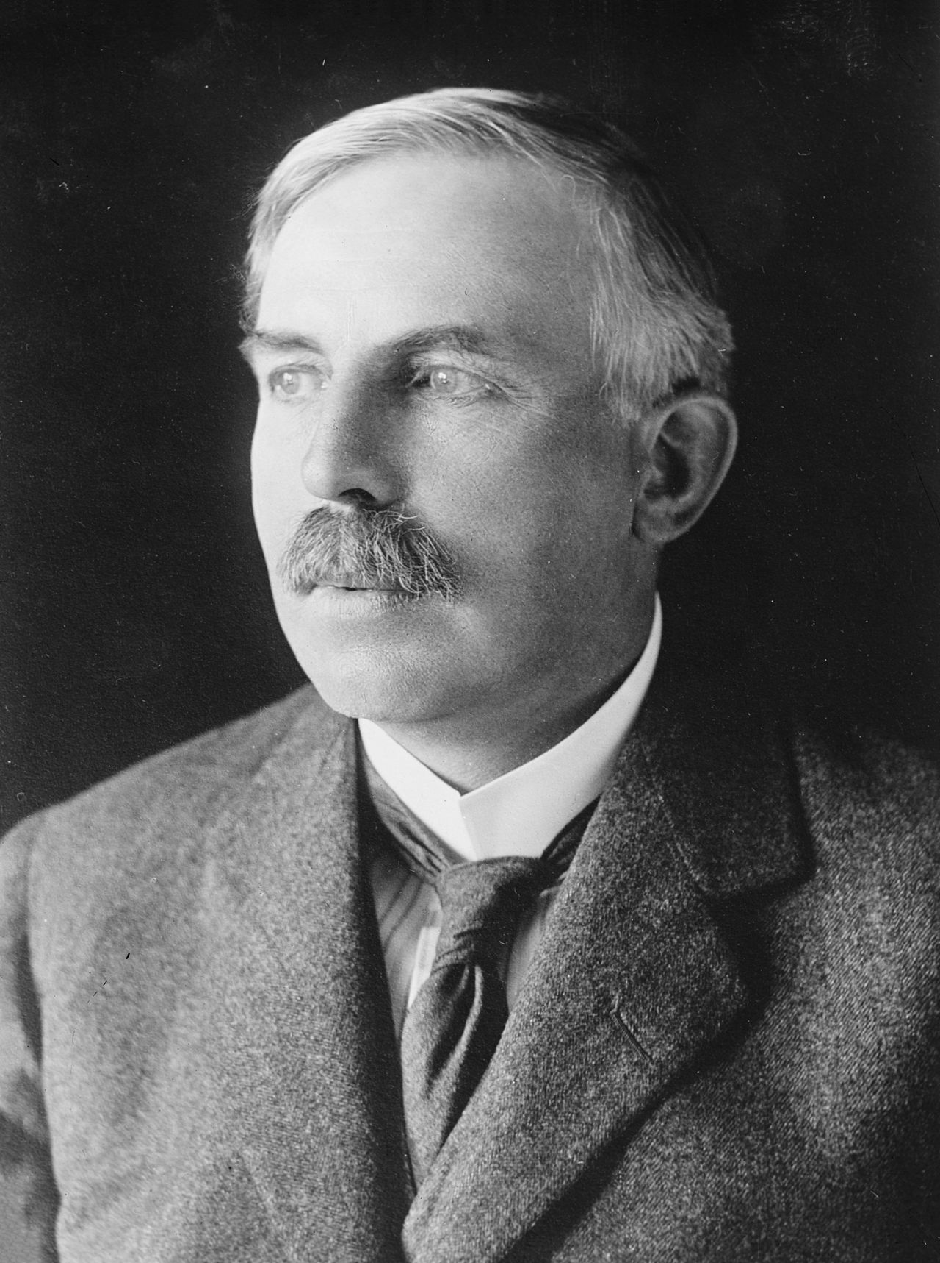

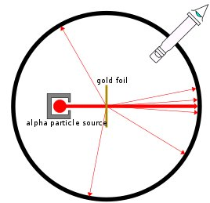
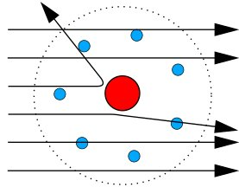
Ion beam analysis is based on physical interaction between incident ions and target atoms
Ernest Rutherford (1871-1937)
Known as “the father of nuclear physics”
Discovered alpha, beta radioactivity
Discovered atomic nucleus
Discovered proton
Form the basis of
- Ion beam analysis
- Atomic model
- Nuclear reactions
- Manhattan project
- LLNL
Au foil experiment
Rutherford model

Slide 4
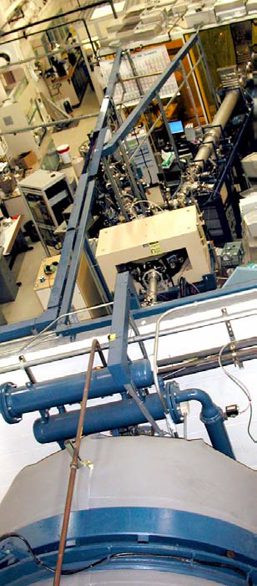
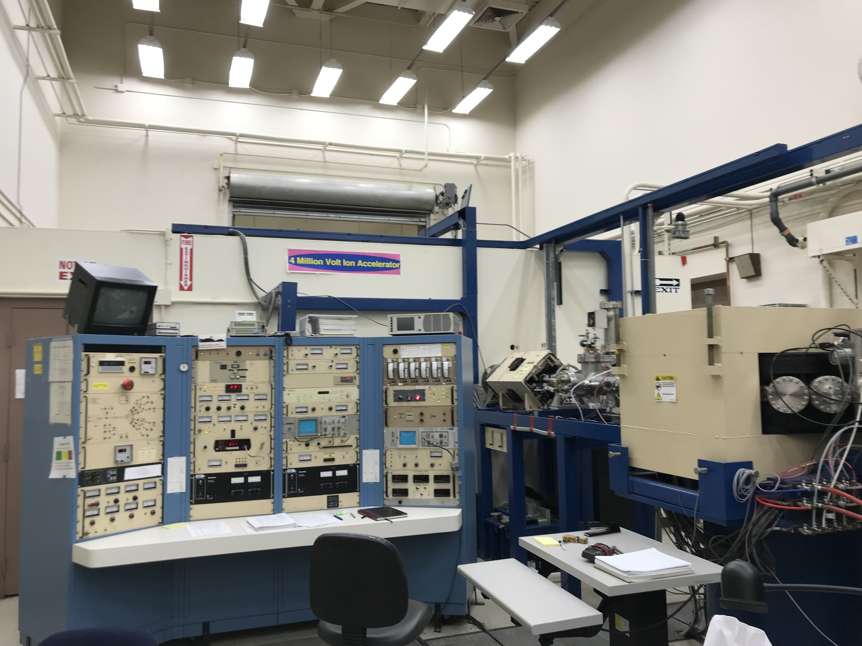
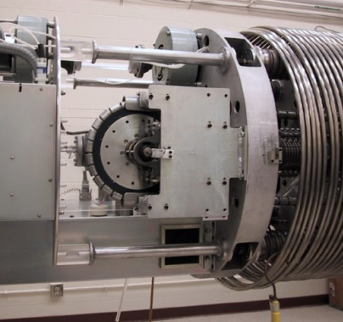
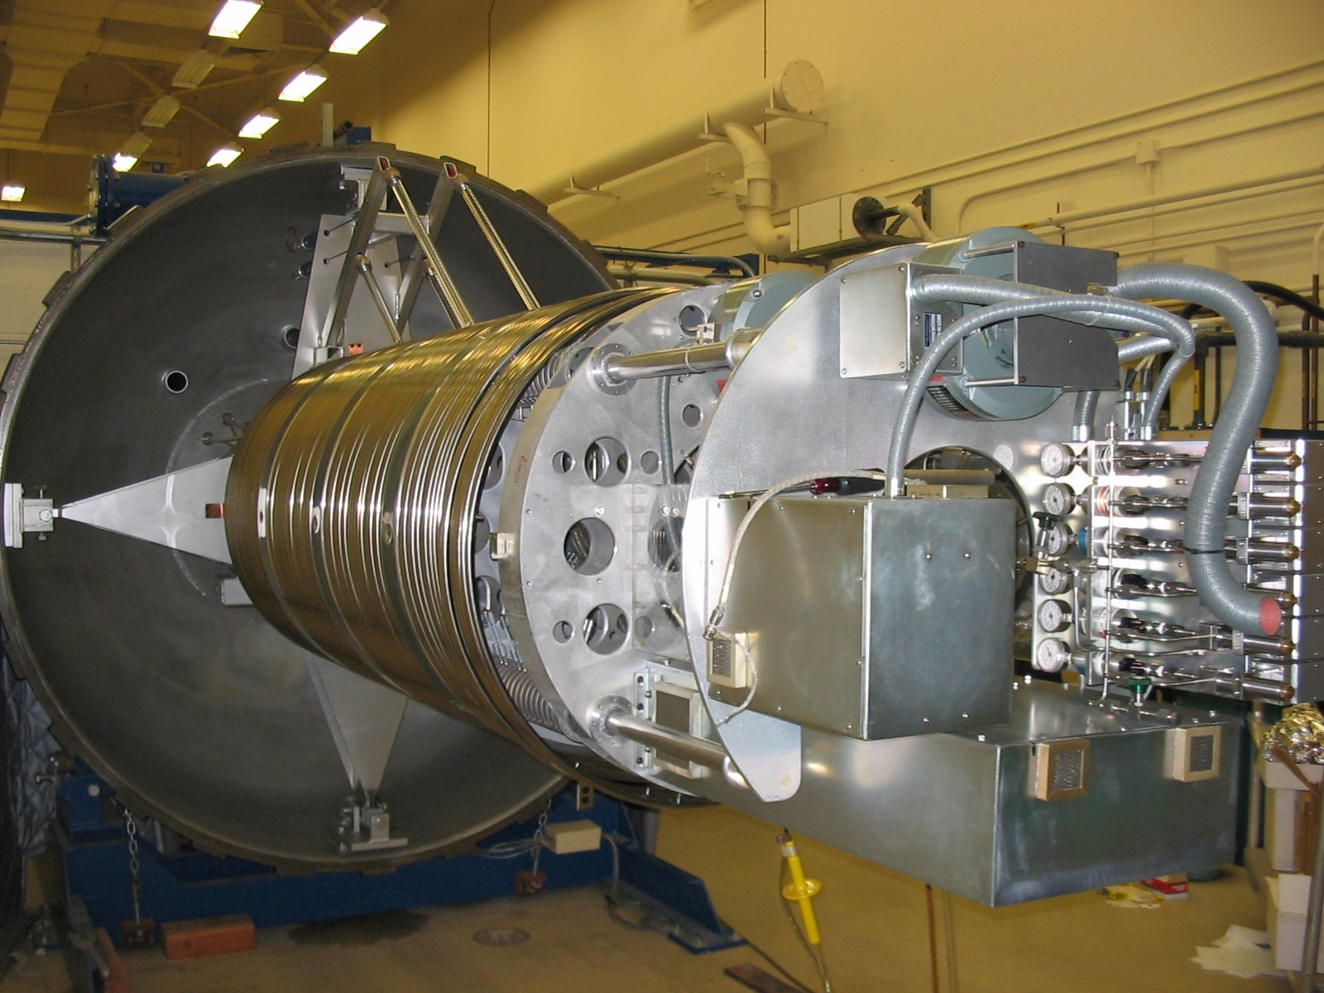
Ion beam facility at LLNL allows probing materials with up to 4 MeV/charge ions
Charging system
Analysis beam line
Control console
Bending magnet
Charging chain
Pressure vessel
Gas bottles
Acceleration Tube
Pressure vessel &
beam lines
Acceleration tube and gas bottles

Slide 5
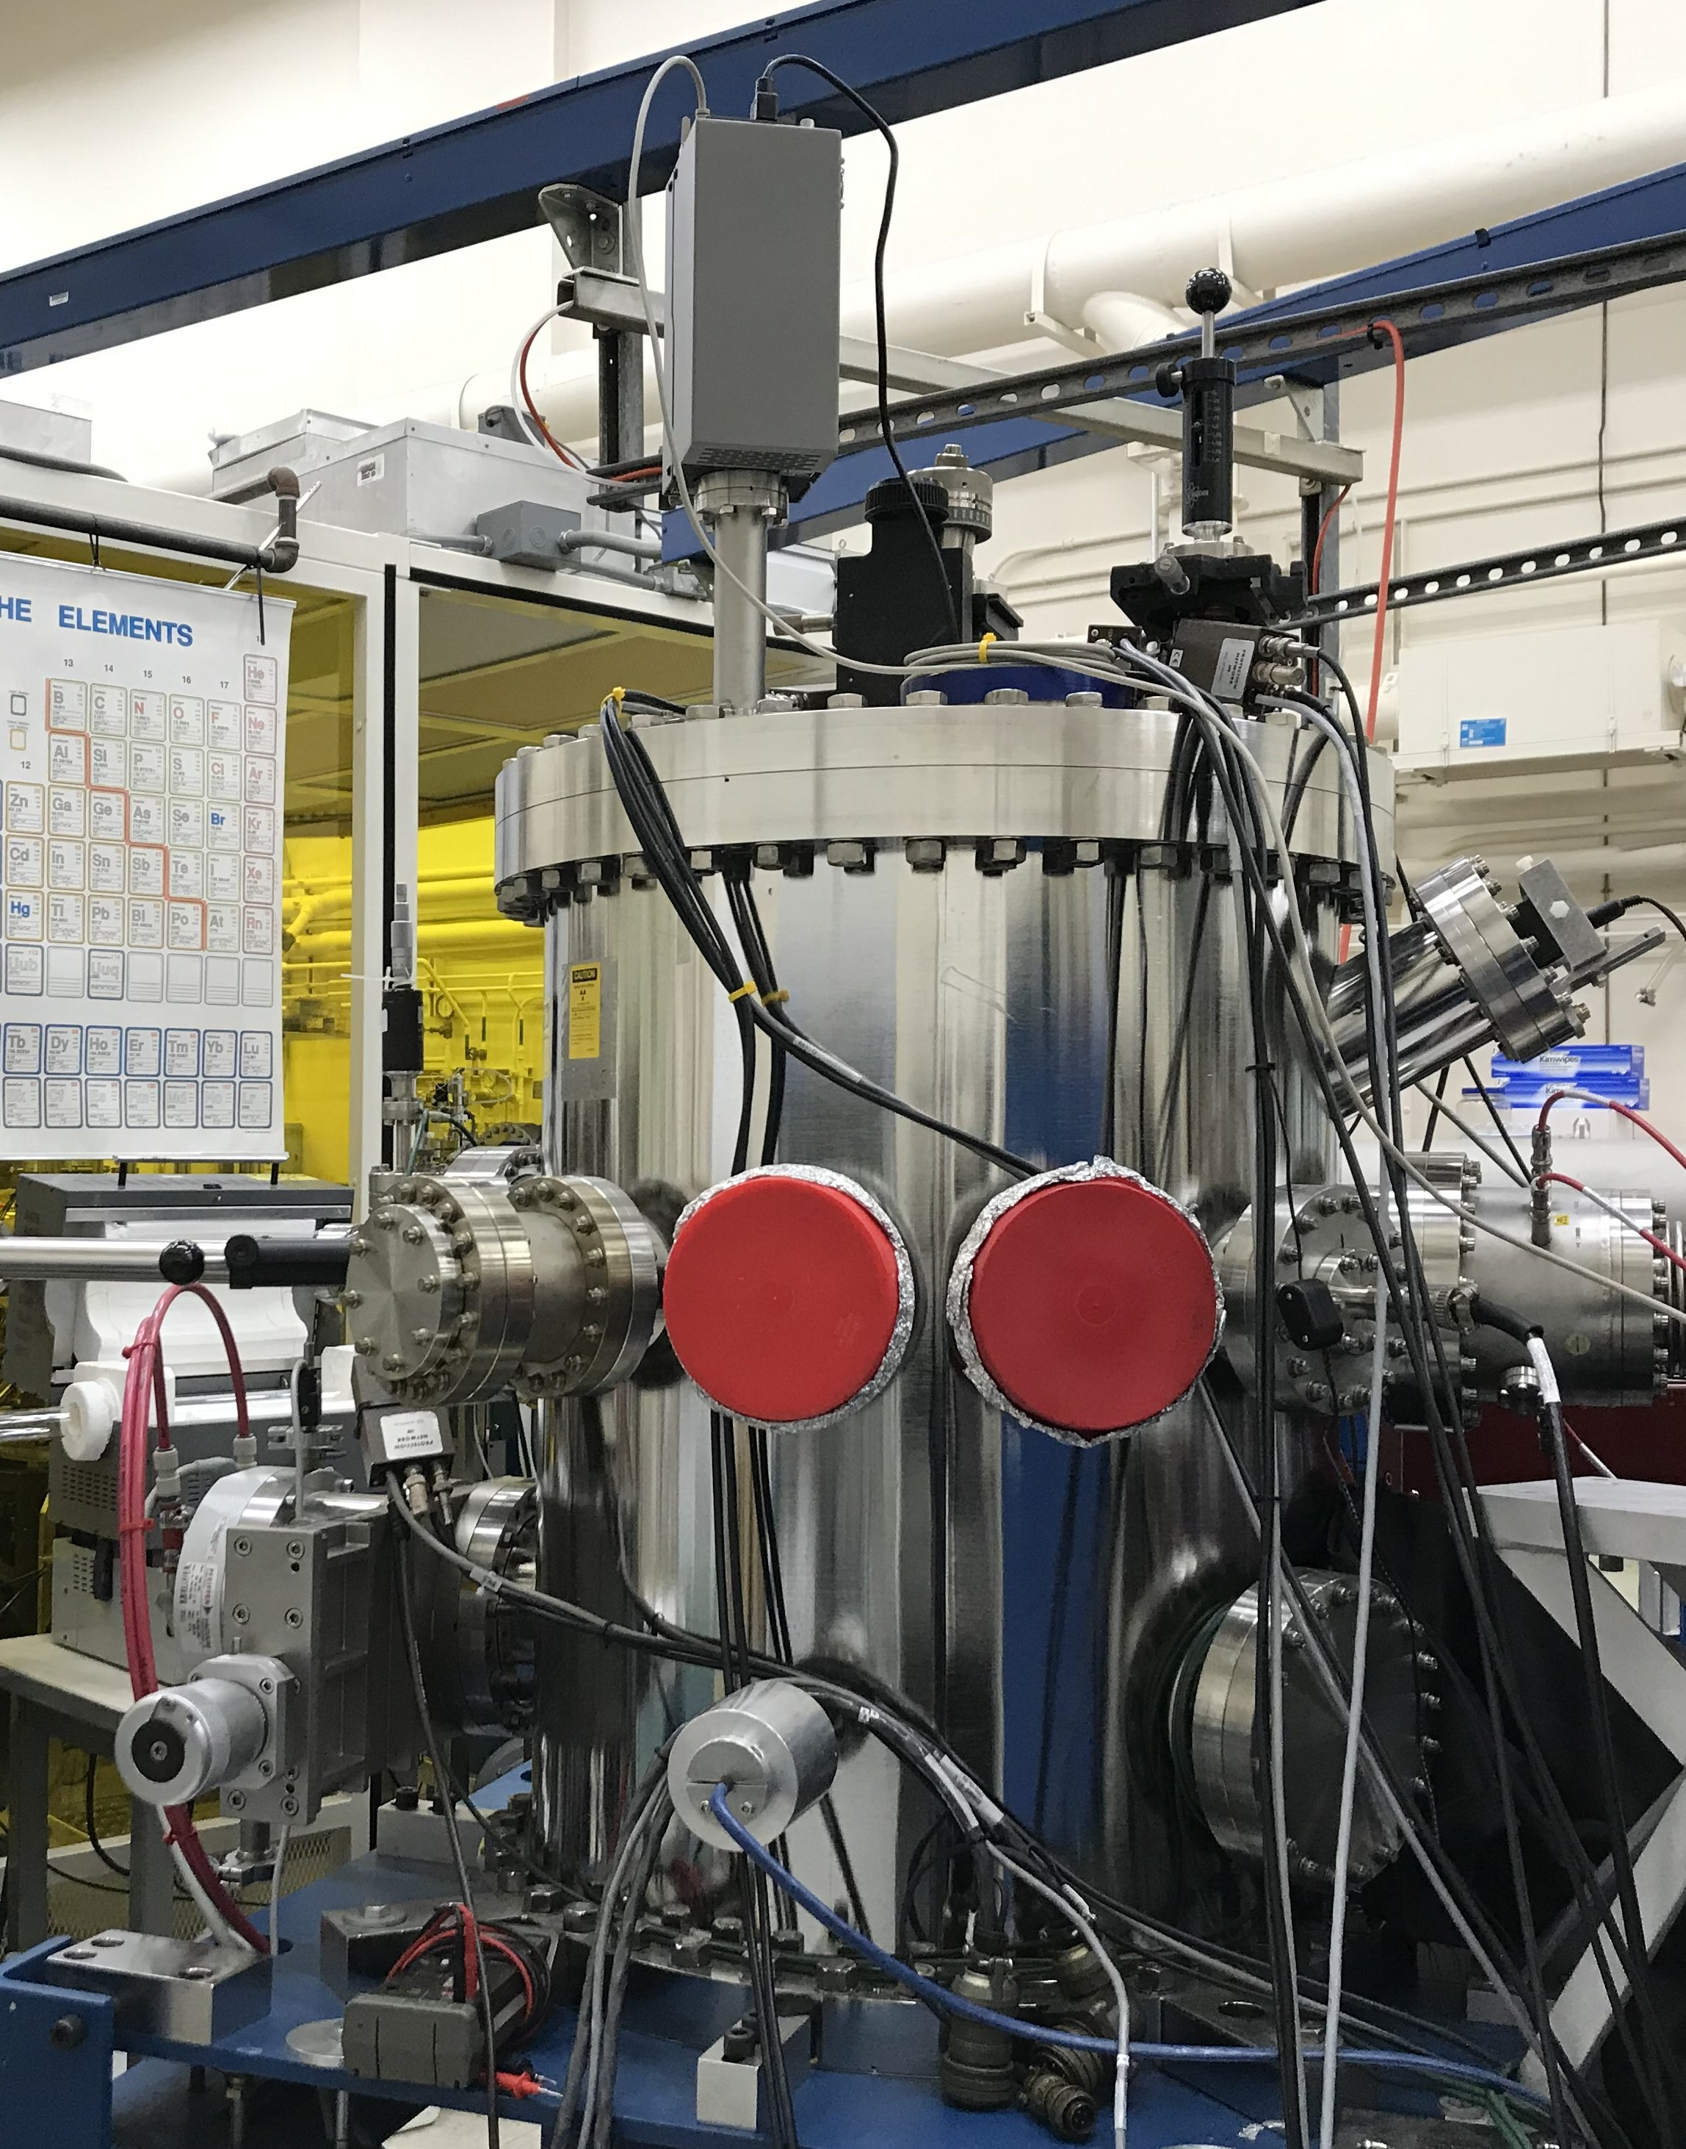
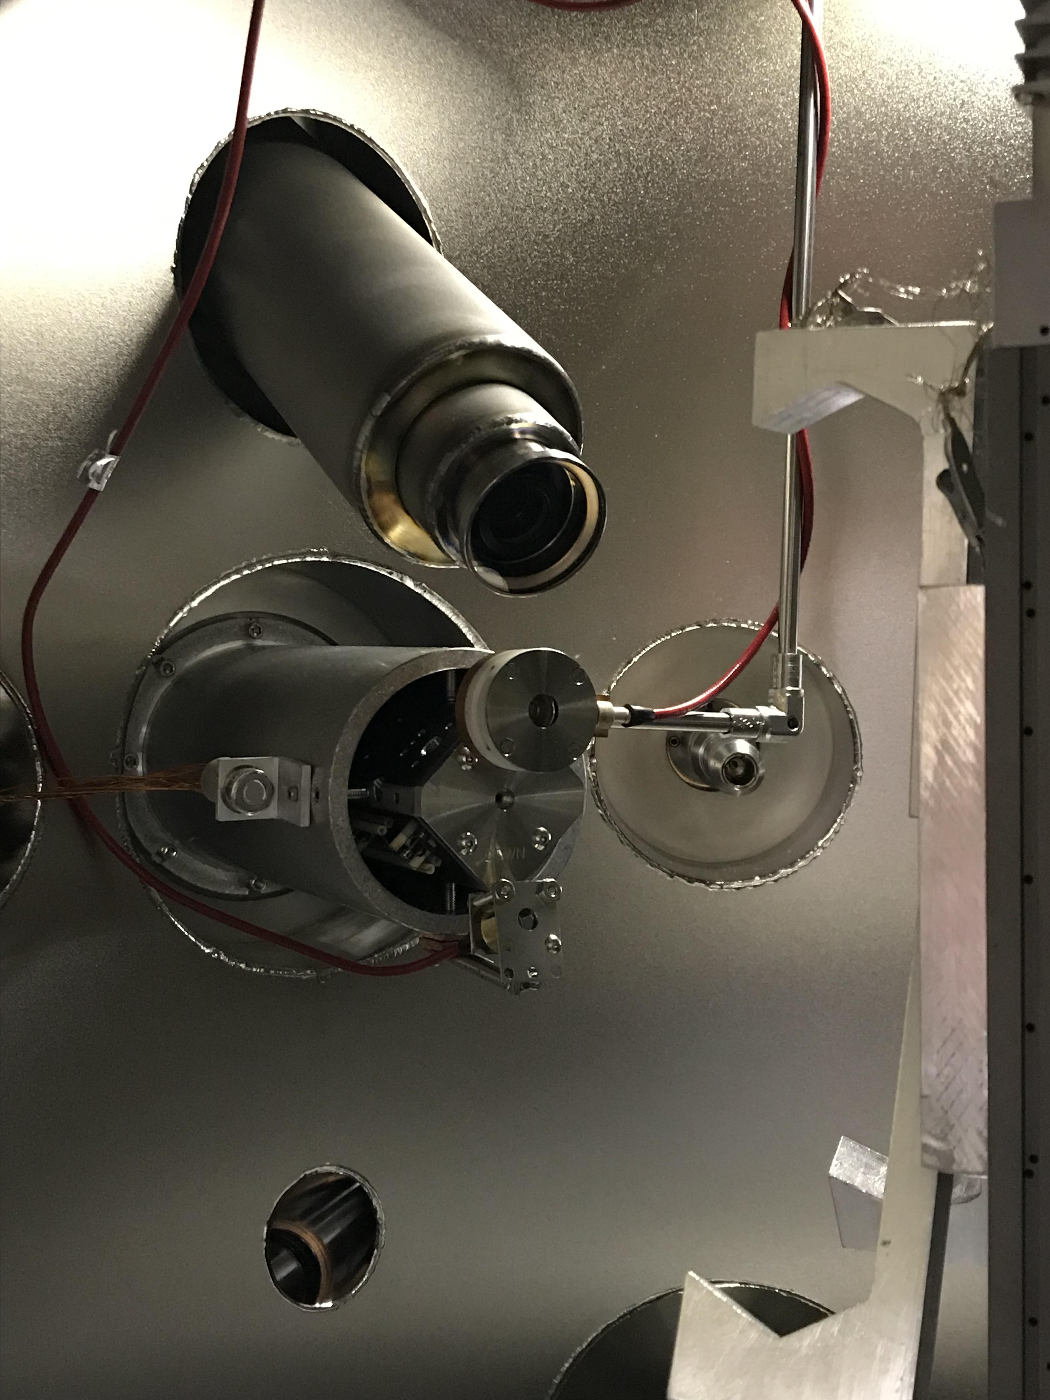
The ion beam facility is equipped with various diagnostics for state-of-the-art ion beam analysis
RGA
Microscope
Annular
detector
Microbeam
lens
ERDA
detector
PIGE port
Electron
gun
Sputter gun
port
X-ray detector
Analysis chamber
164◦ detector
RGA: Residual Gas Analyzer for detecting gaseous species
X-ray detector: Used for PIXE
Annular, 164◦, and glancing angle detectors: Used for RBS, NRA

Slide 6
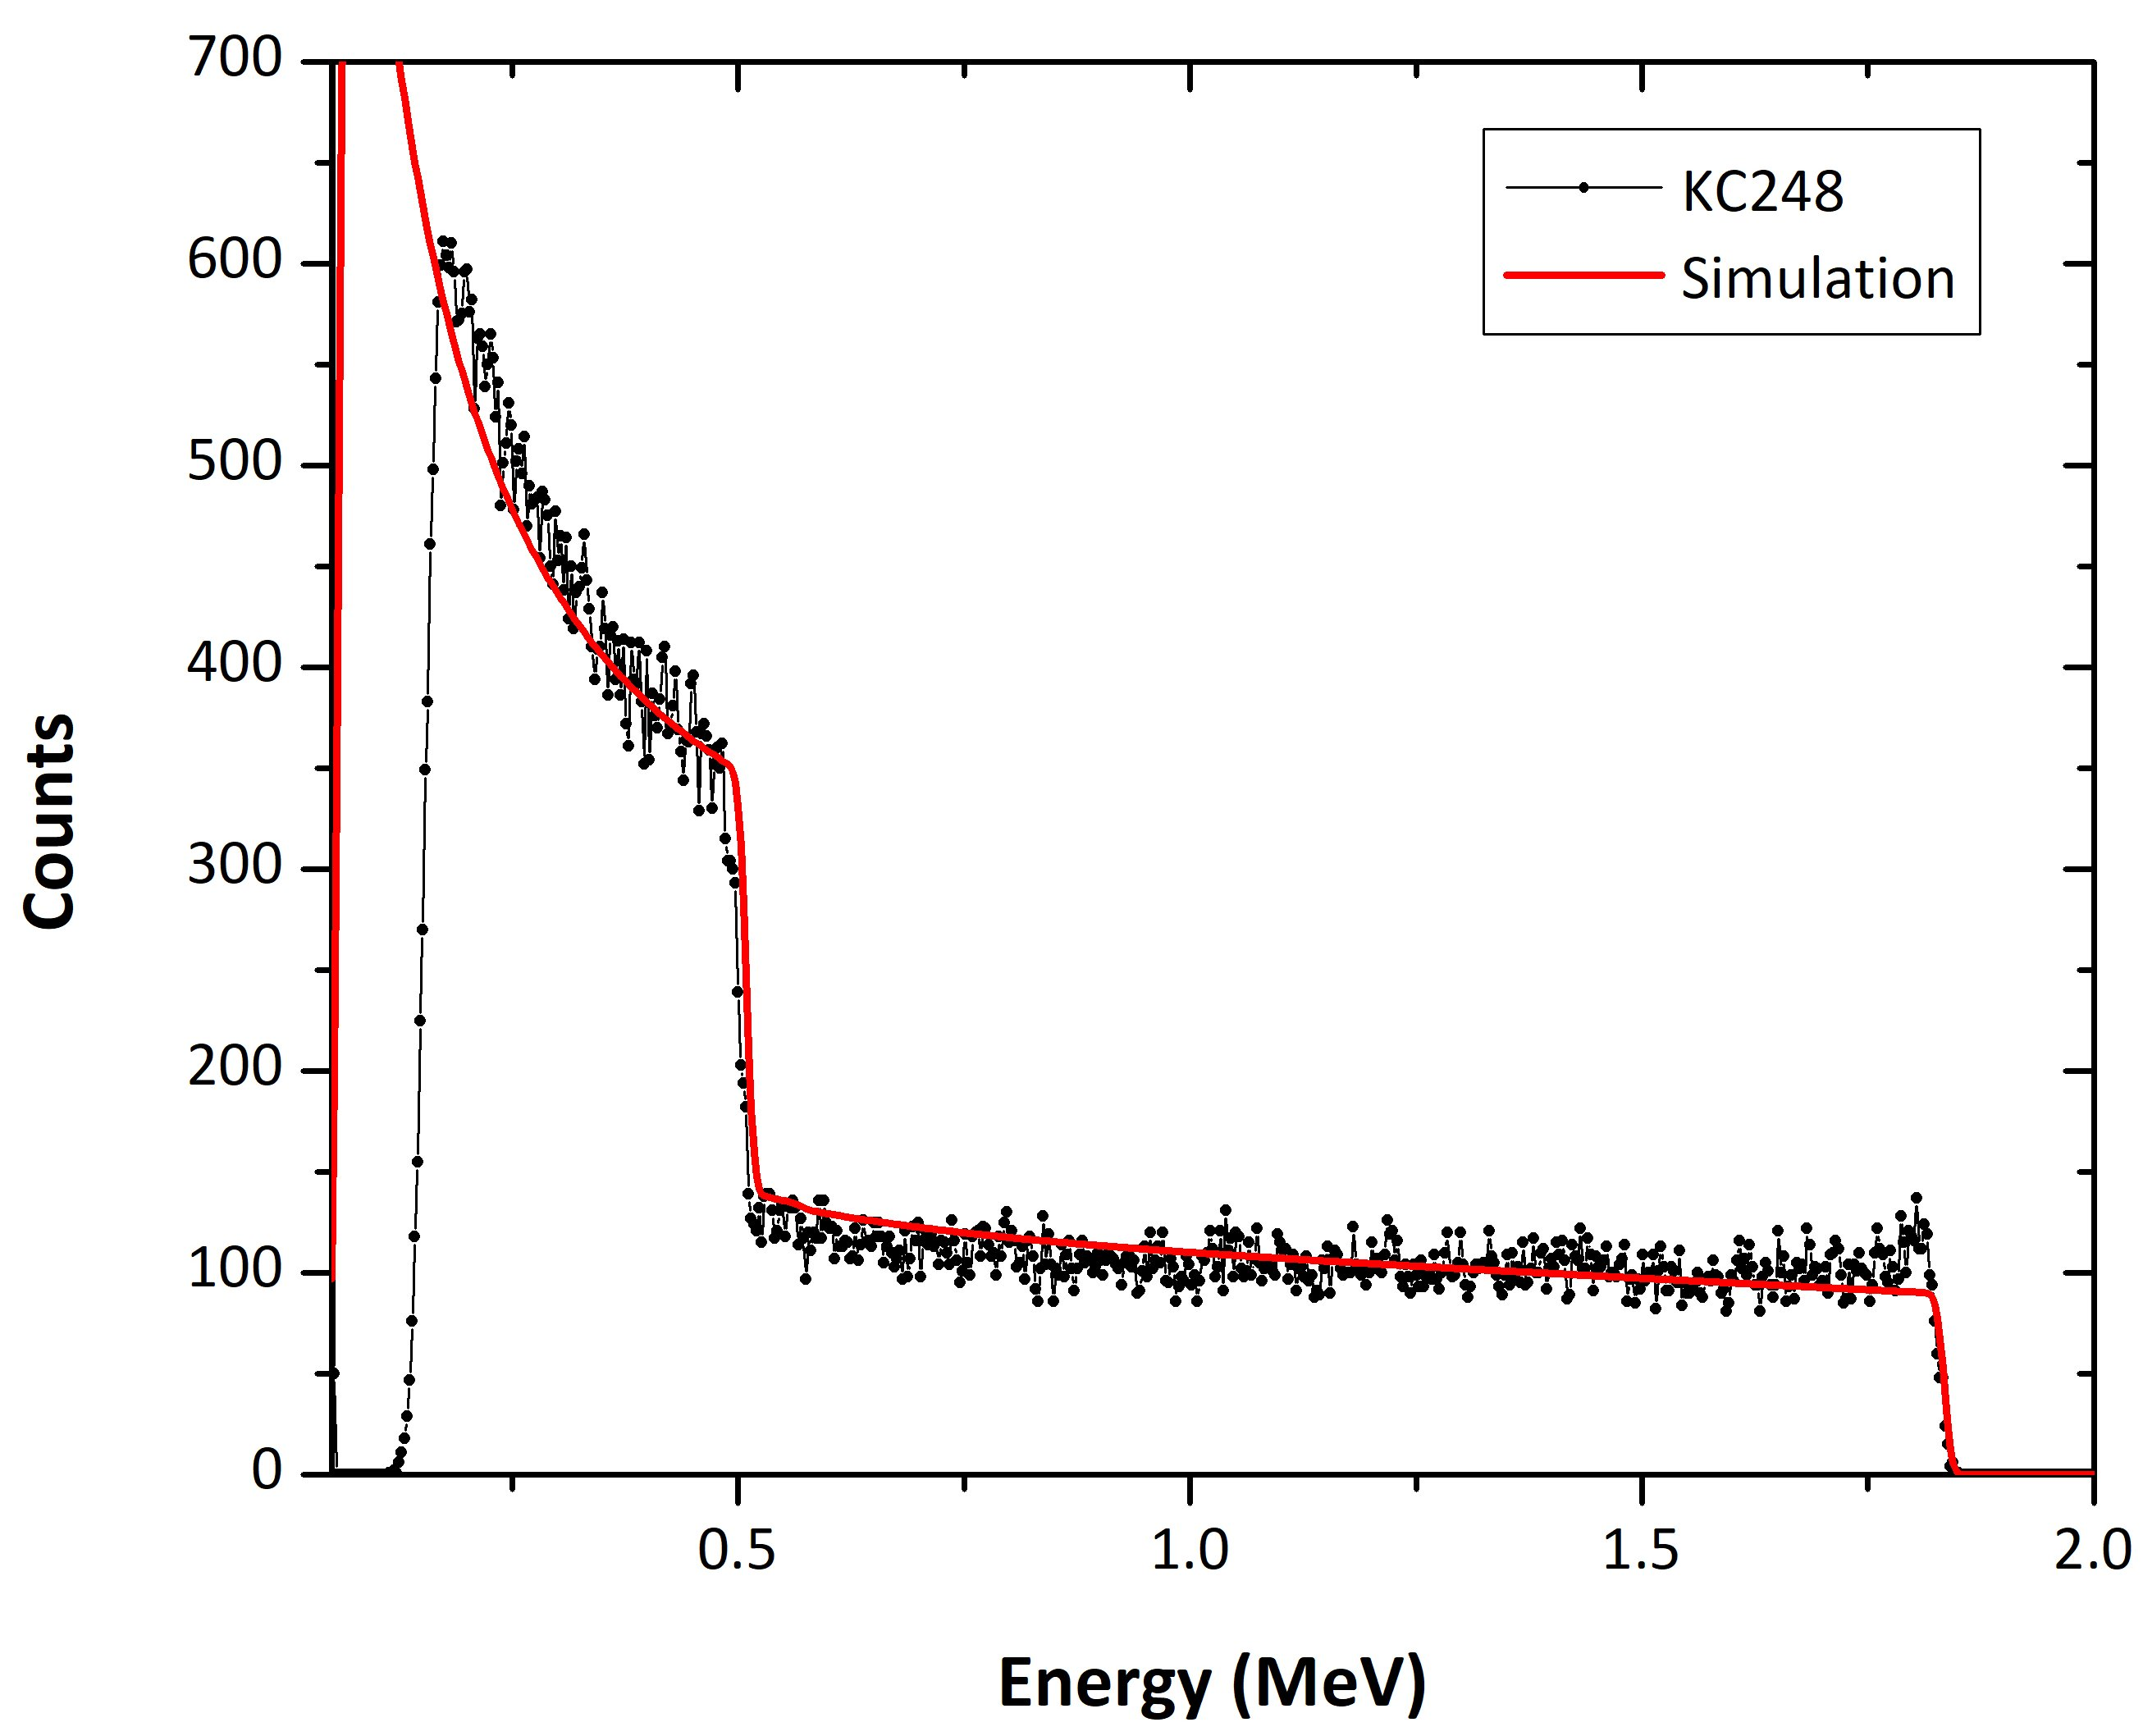
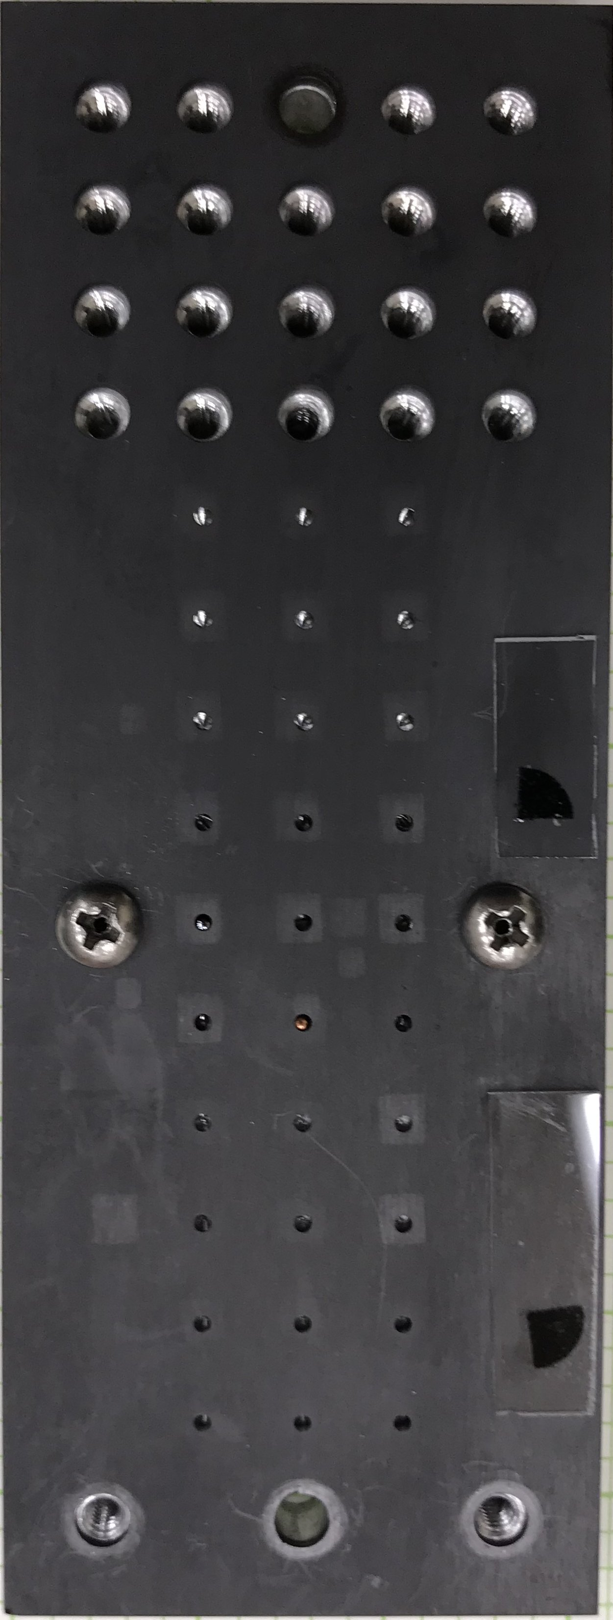
RBS is used to measure W concentration in HDC capsule
2 MeV He⁺
ions
[W] = 0.27 at.%
capsule
Depth
(stopping power)
Detector
Composition
(scattering cross section)
Sample holder for
broad-beam capsule
measurements
Atomic mass: ¹²C
Atomic mass: ¹⁸⁴W
Target atomic mass
(kinematic factors)
Very large scattering cross section of W allows:
- Easy detection of low W concentration
- Capable of resolving ~0.02 at.% difference

Slide 7
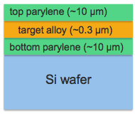
RBS is used to measure Fe and Mg atomic areal densities in FeMg opacity targets
Related presentation: H. Huang, Thu 11:00 AM
Opacity target geometry
Depth
3 MeV He⁺
ions
~ 300 nm
Detector
Mg
Fe
Beam energy and current were optimized
Advanced simulation method with accurate stopping powers was used
- Areal densities of Fe and Mg were independently measured
Deviation of 3% or less for 3 independent measurements
Results are consistent with 2 independent RBS measurements off-site

Slide 8
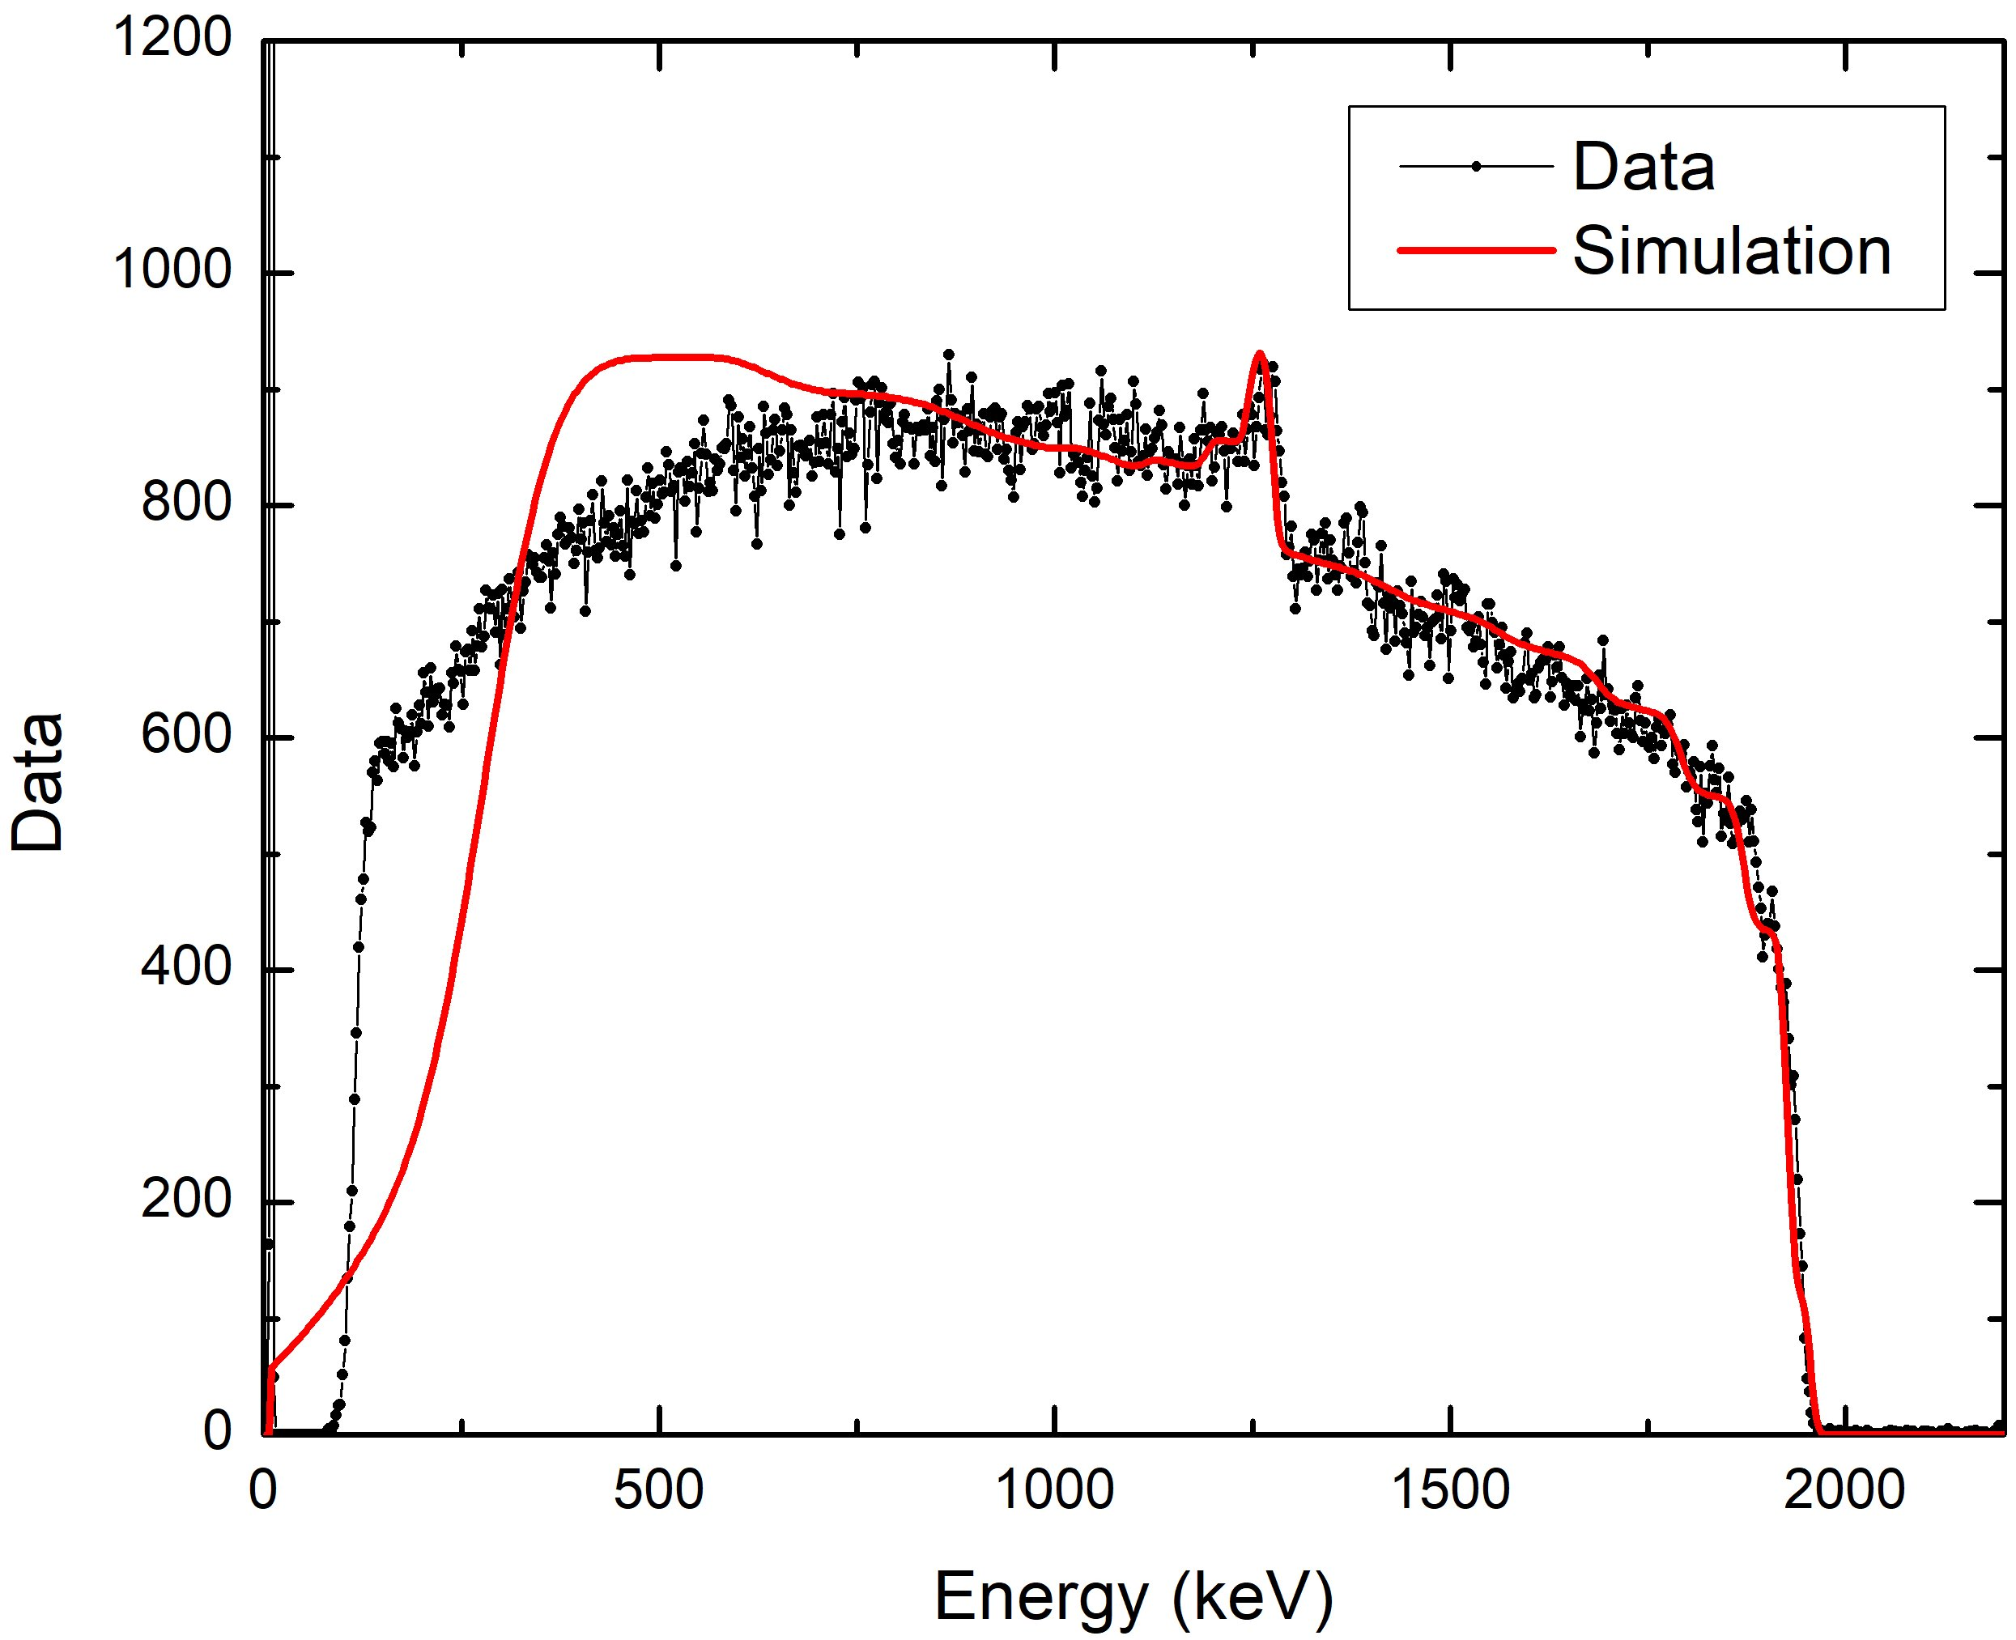
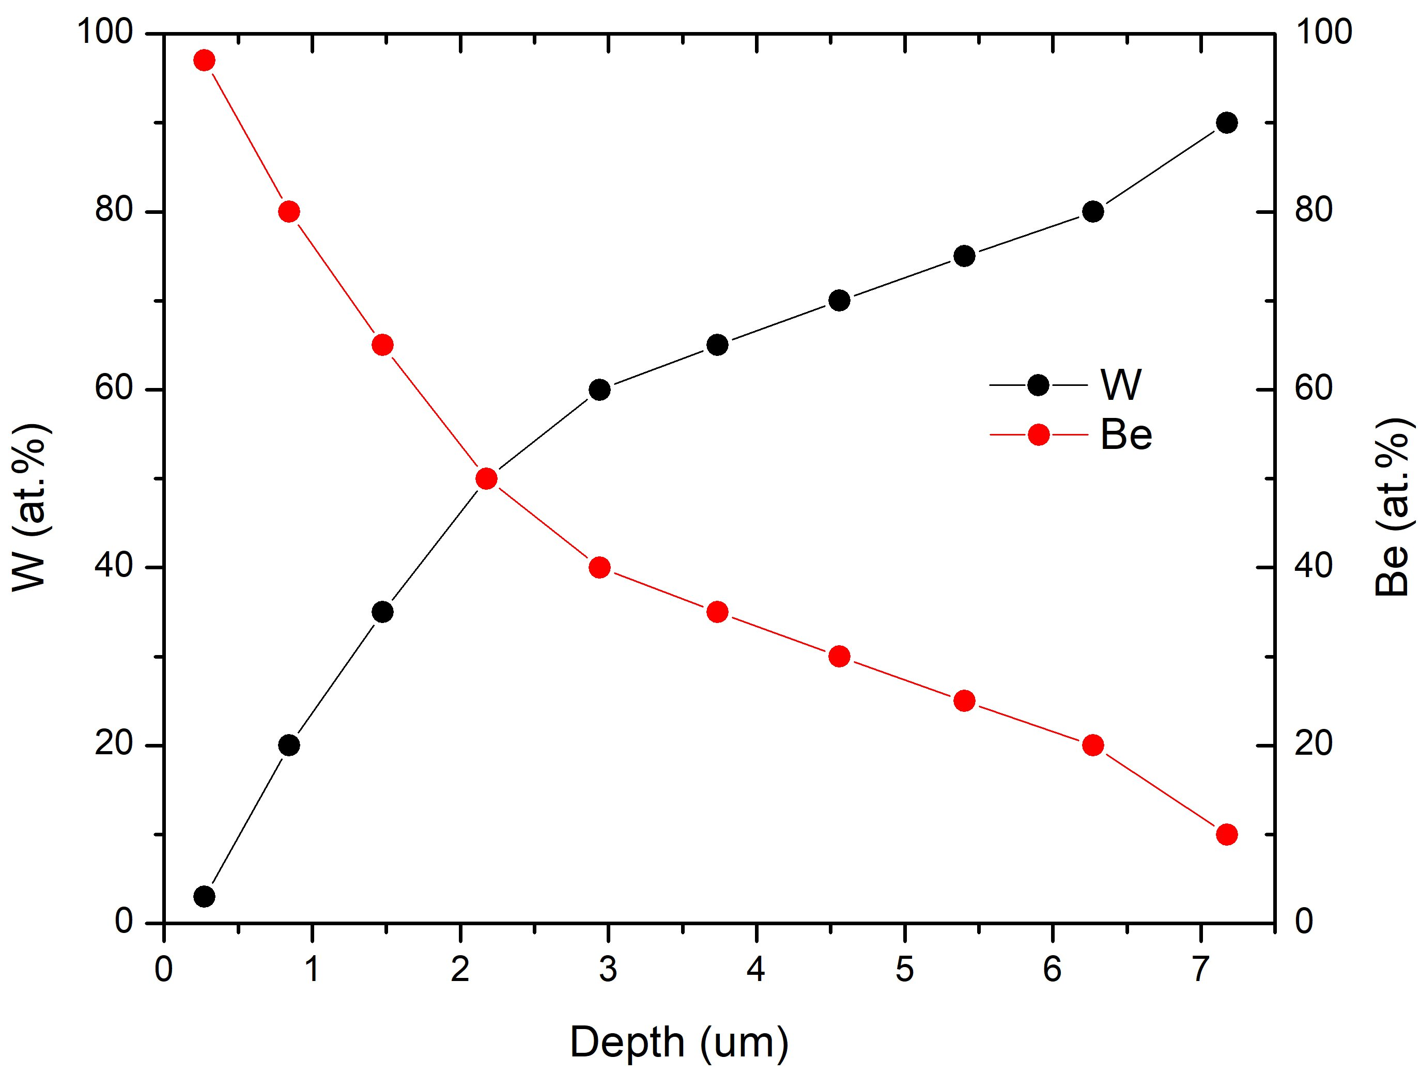
Proton beam RBS can measure composition profiles over large depths
Multiple scattering from are all taken into account
(Total film thickness, SEM image : ~8.5 um)
Depth Profile
~5 um
W spectrum
Be
Thickness calculation assumes that the density changes linearly as a function of the W:Be ratio of the alloy
~7.6 um
BeW alloy
W

Slide 9
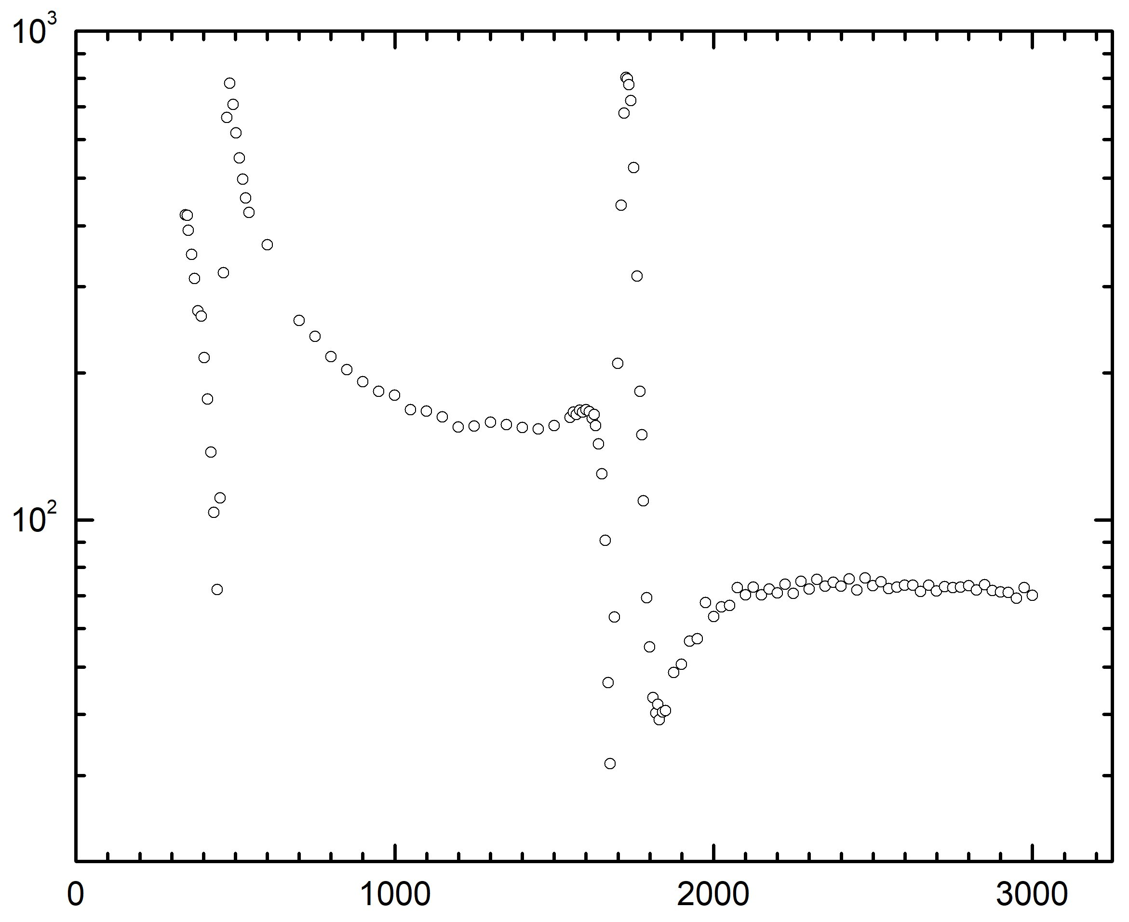
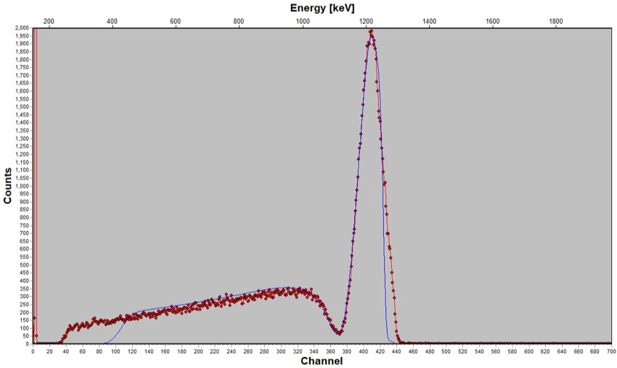
Non-Rutherford (resonant) backscattering could be used
to detect C contamination on a machined Fe surface
Related presentation: C. Castro, Wed 9:50 AM
Light (low Z) element in heavy (high Z) matrix is typically considered non-ideal case for RBS
Resonance scattering (enhanced cross section) could be used to probe low Z elements
¹²C(p,p)¹²C ion scattering cross section
RBS spectrum of carbon substrate
using 1.75 MeV proton ion beam
1.75 MeV
1.75 MeV
Cross section (mb/sr)
Incident energy (KeV)
- Without resonant peak, even 10 at.% C in Fe matrix is difficult to detect
- With resonance peak, 2-3 at.% C on Fe matrix is readily detected

Slide 10
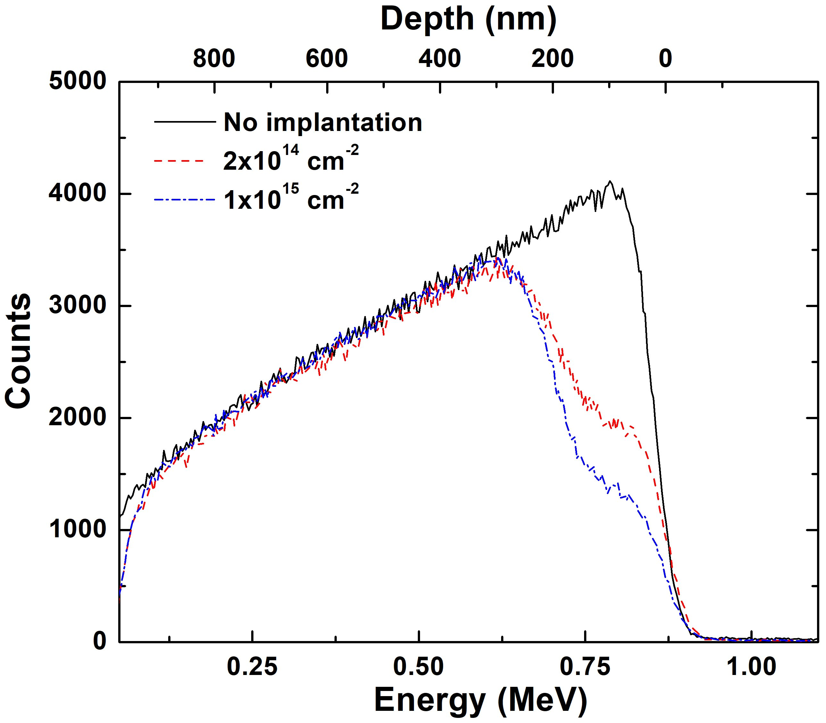
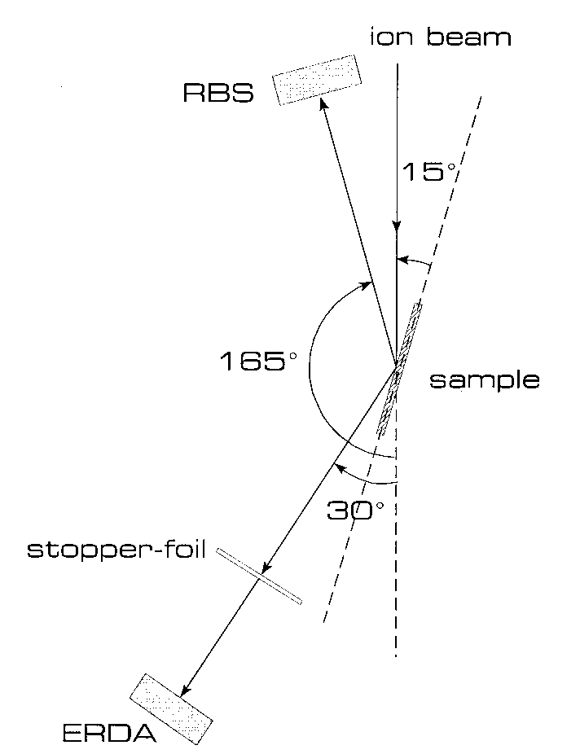
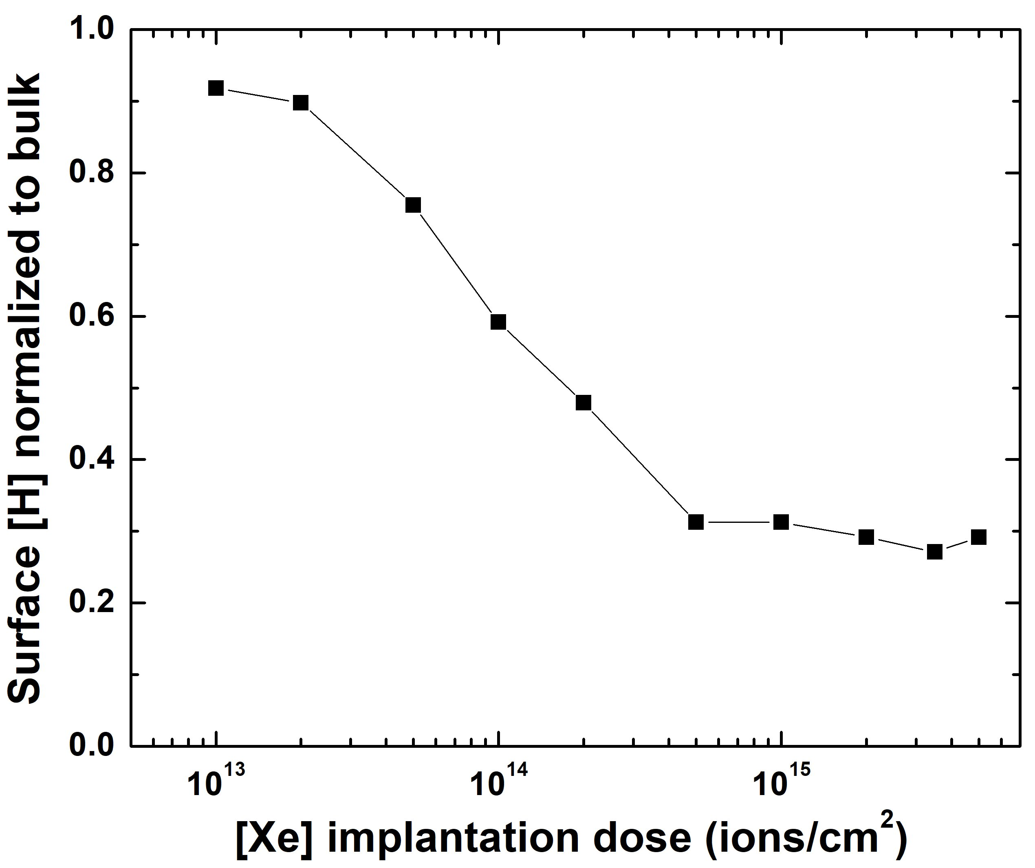
ERDA (Elastic Recoil Detection Analysis) could measure depth profiles of hydrogen in targets
Evolution of hydrogen concentration in Xe implanted GDP for RadChem experiments
- Hydrogen concentration was measured as a function of ion dose
- Combined with RBS, we were able to measure C, O, H concentration in GDP

Slide 11
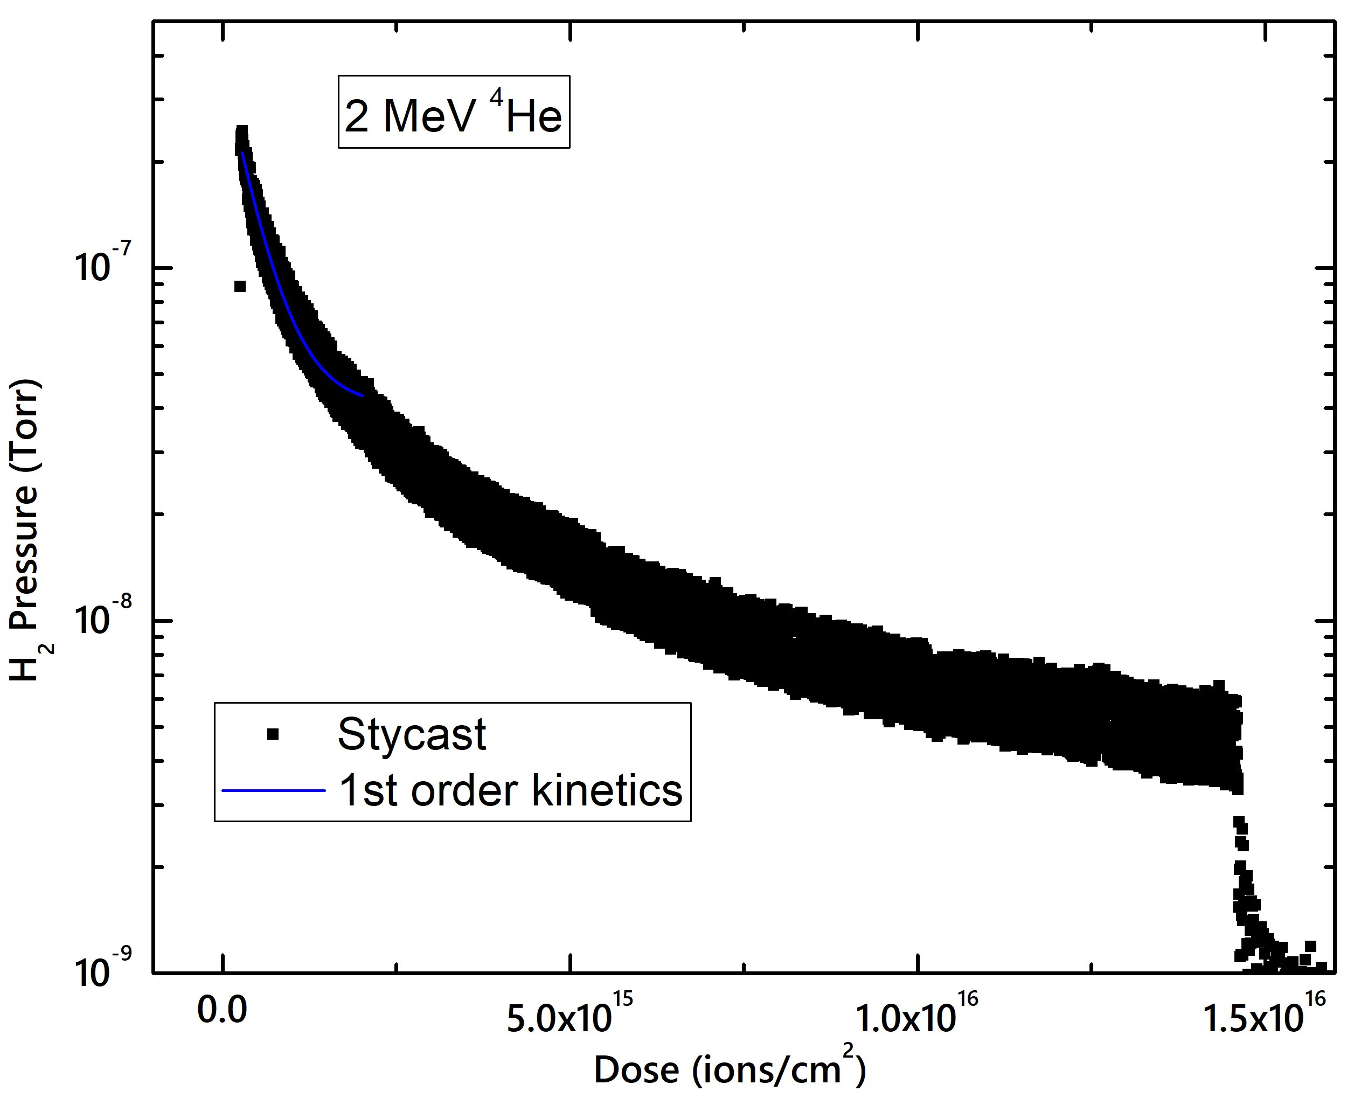
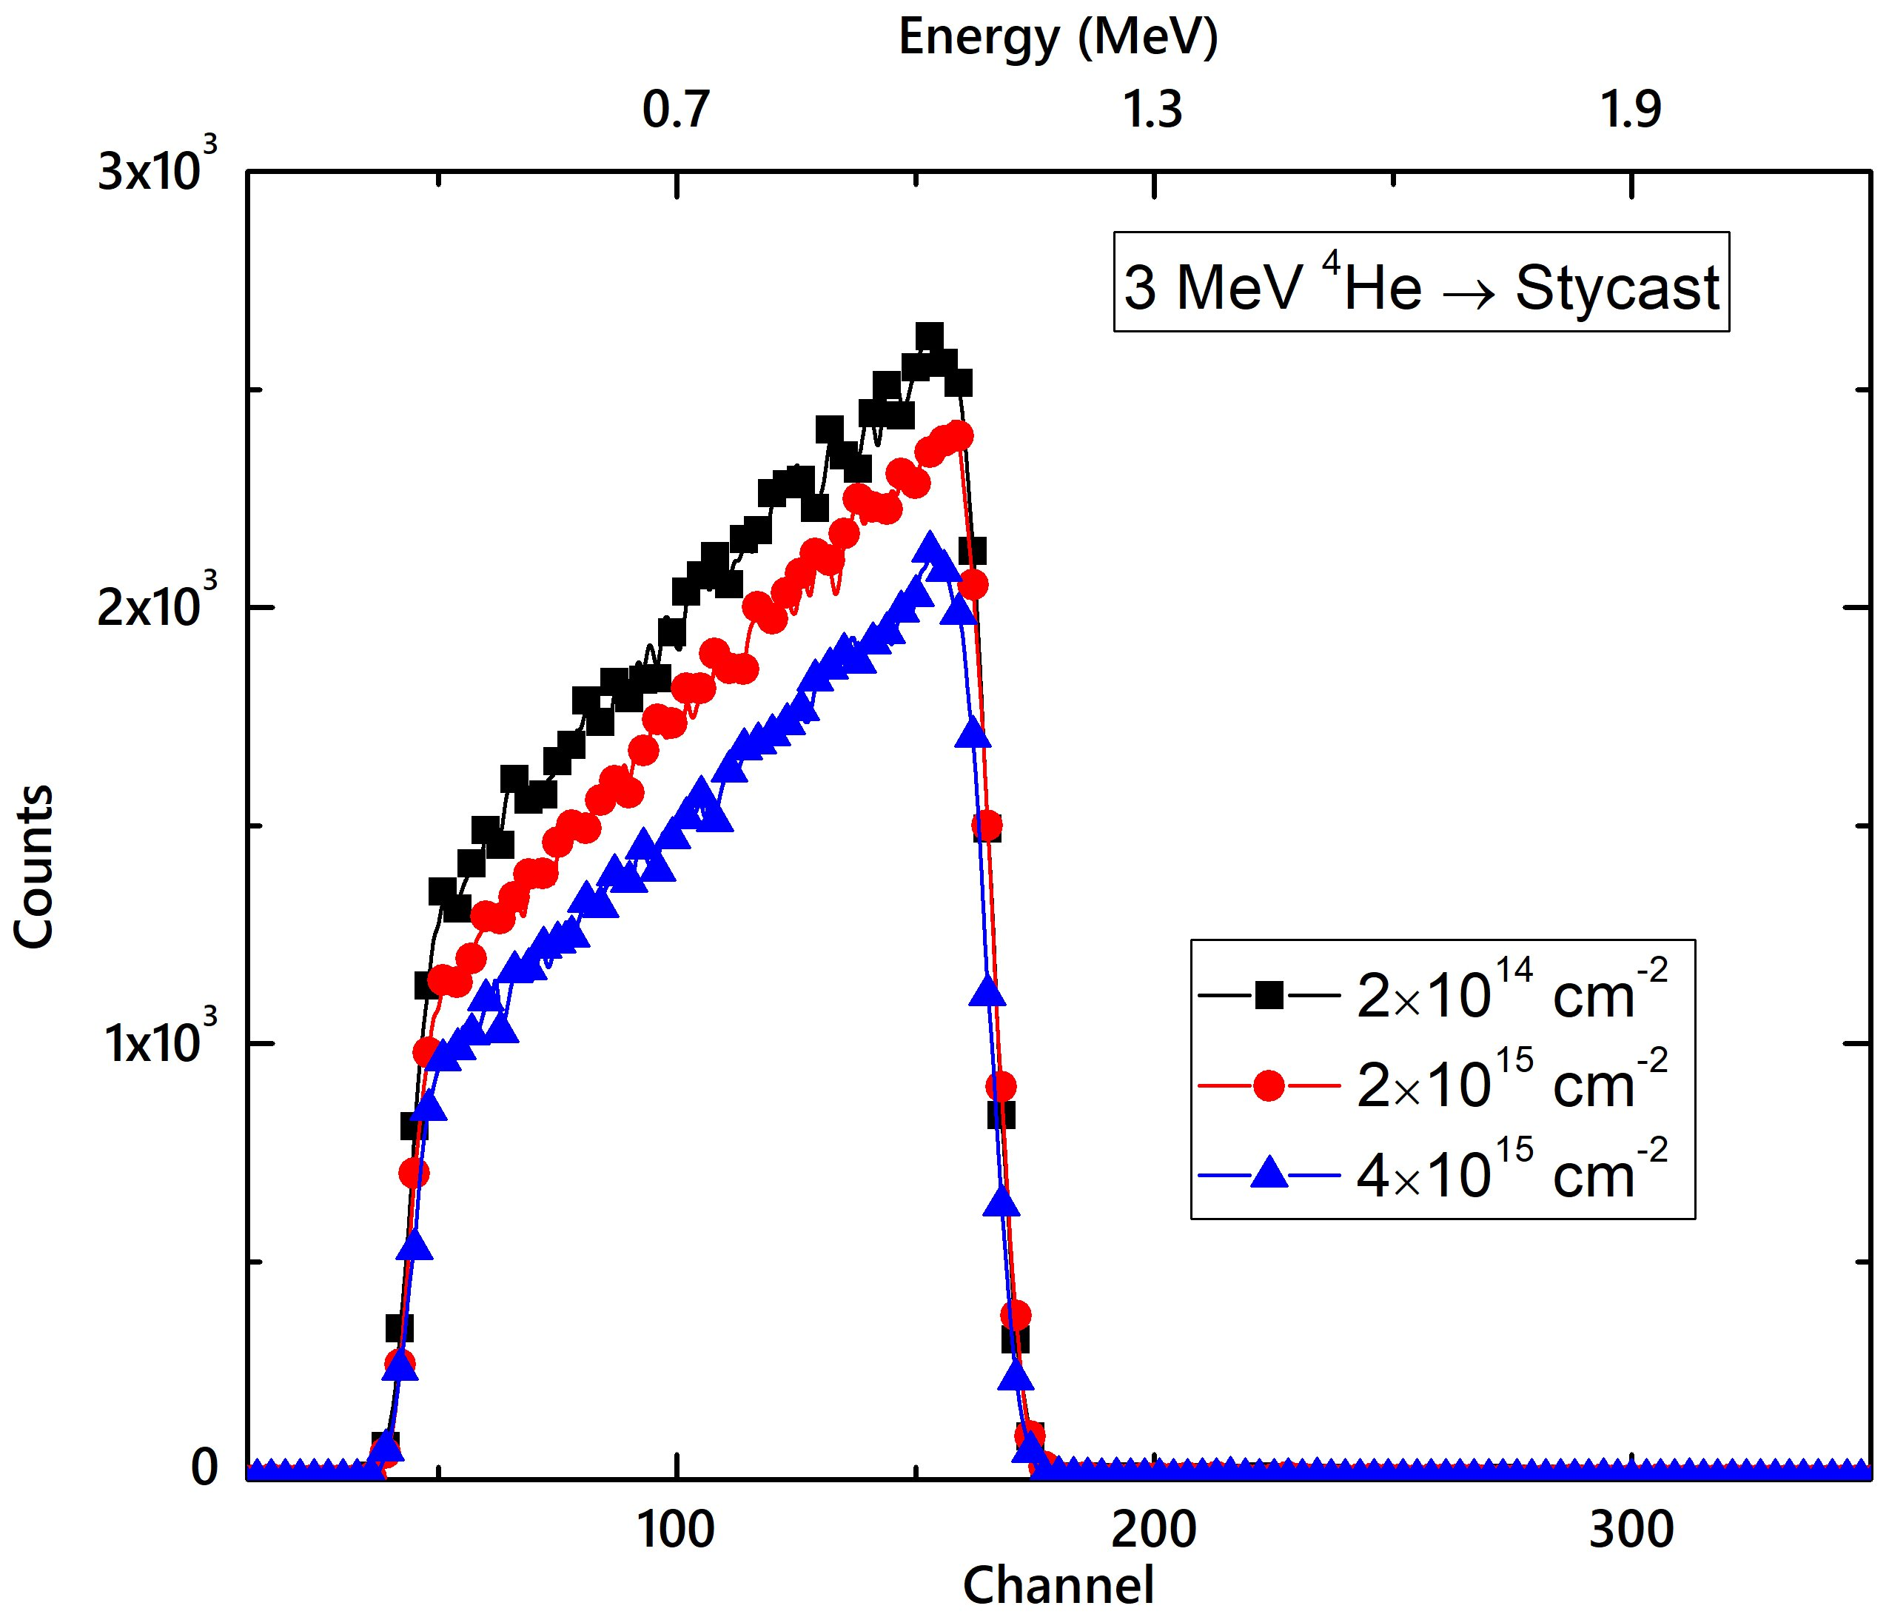
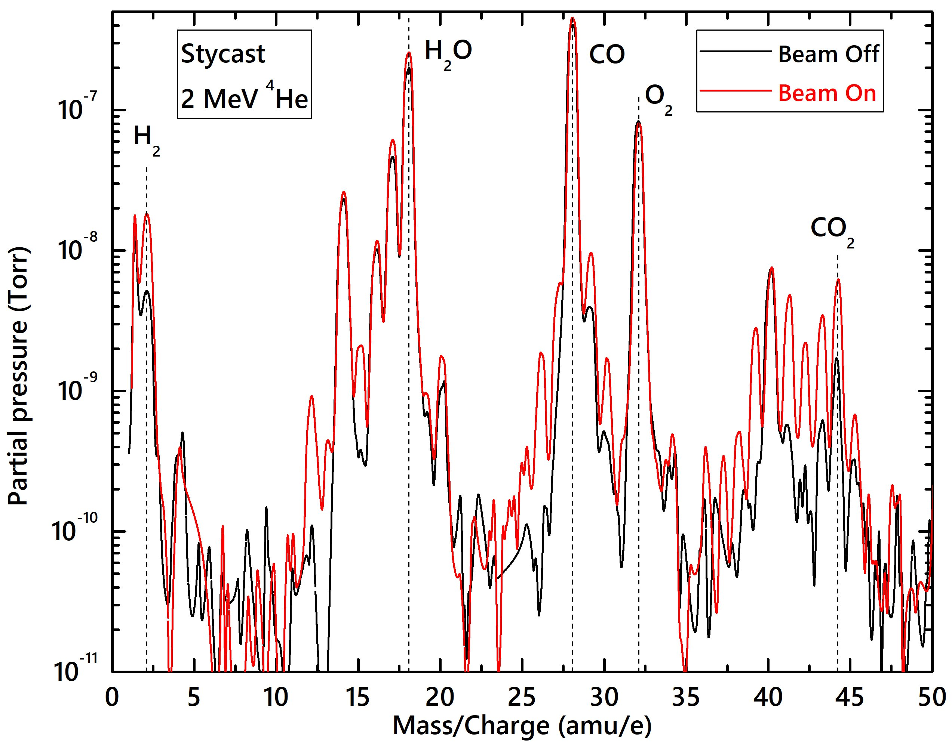
RBS, ERDA, and RGA are used to measure decomposition kinetics of alpha-irradiated Stycast
Related presentation: M. Wilson, Wed 1:50 PM
ERDA
RBS
RGA
Complete compositional analysis from RBS+ERDA:
C 1.00 H 0.96 N 0.06 O 0.10

Slide 12
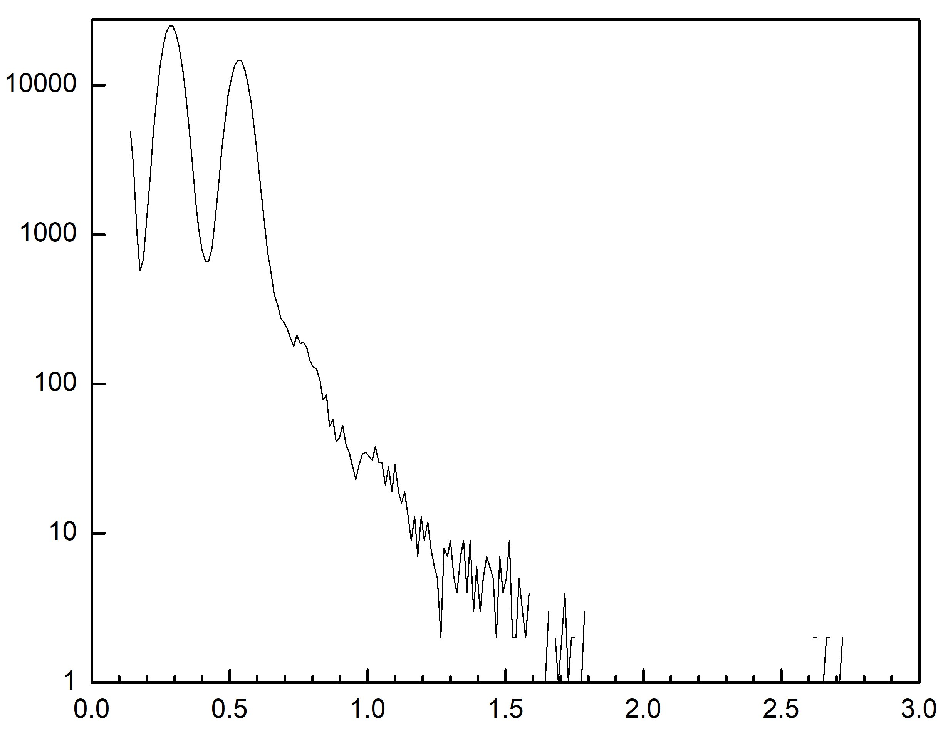
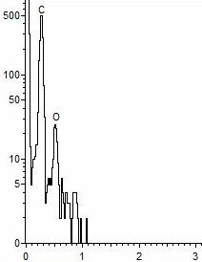




PIXE (Particle Induced X-ray Emission) provides excellent low- & mid-Z detection sensitivity
PIXE
EDS
GDP
GDP
Yield
Yield
C K$α$
O K$α$
Energy (keV)
C K$α$
Energy (keV)
O K$α$
The principle is similar to EDS, but PIXE has better sensitivity

Slide 13
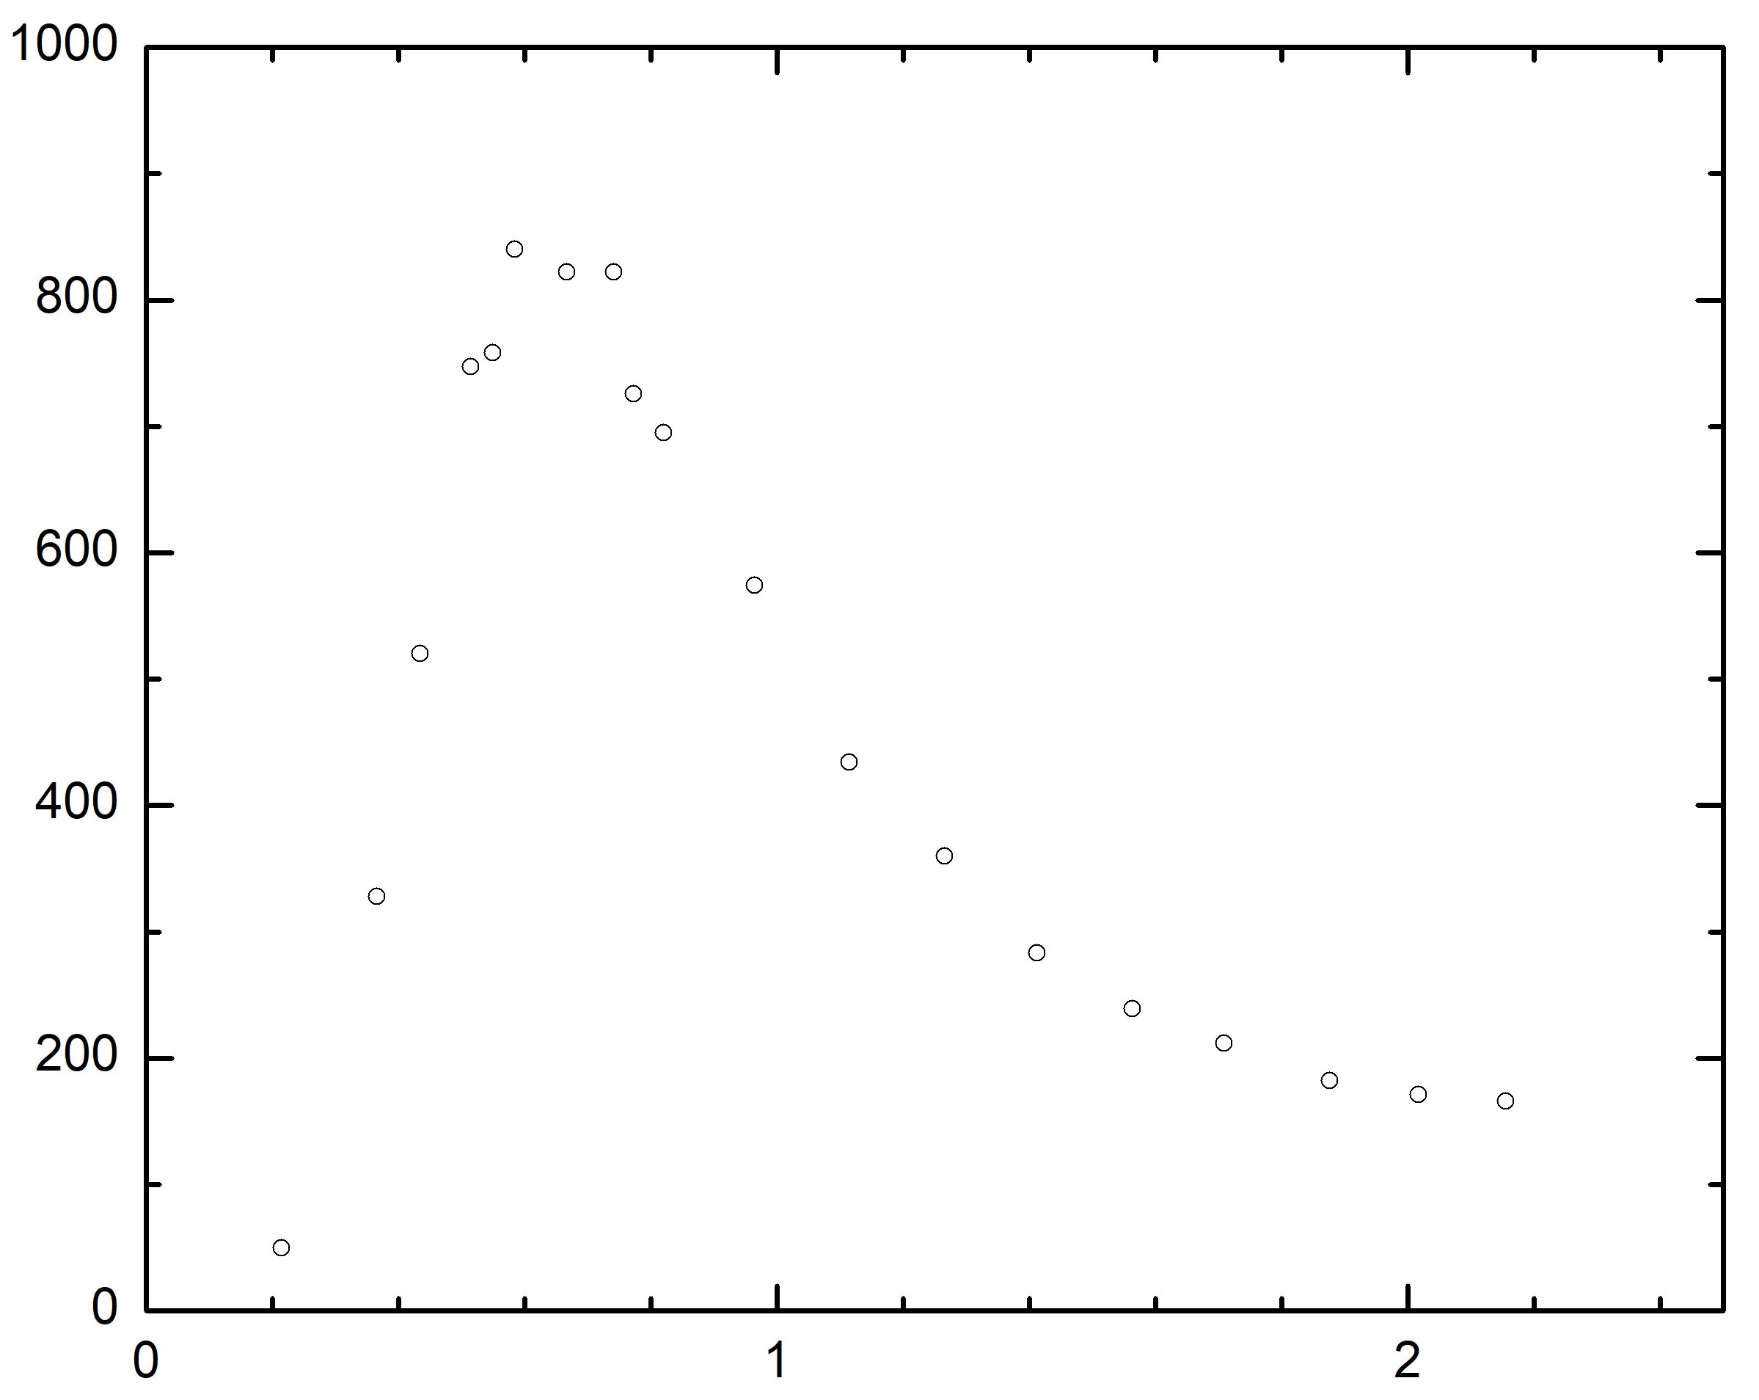
NRA could be used for isotope profiling (D in HDC capsule)
³He NRA for deuterium profiling
²D + ³He = ¹H + ⁴He, Q = 18.4 MeV
Increase in ion energy (inverse kinematics), most energy taken by ¹H
Integrate ¹H peak to calculate D concentration
diagnostics
pulse
D(³He,p)⁴He
scattering cross section
Cross section (mb)
C(³He,³He)C
(RBS)
D(³He,⁴He)H
0.8 MeV
D(³He,¹H)⁴He
Incident energy (MeV)
0.8 MeV ³He NRA of CD

Slide 14
Ion Beam Analysis is flexible and can provide crucial elemental information regarding target components
RBS Strength - Quantitative without standards - Depth-profiling - Non-destructive - Simple, fast, and direct | Weakness - No phase or microstructure information - Moderate sensitivity for light impurities - Expensive and rare facility
ERDA Depth profile of H, D
nRBS Selectively enhanced detection sensitivity (isotope specific)
PIXE Similar to EDS but with better sensitivity. Good for low- & mid-Z atom detection in heavy matrix
NRA Detect products of nuclear reactions (isotope specific)

