Slide 1
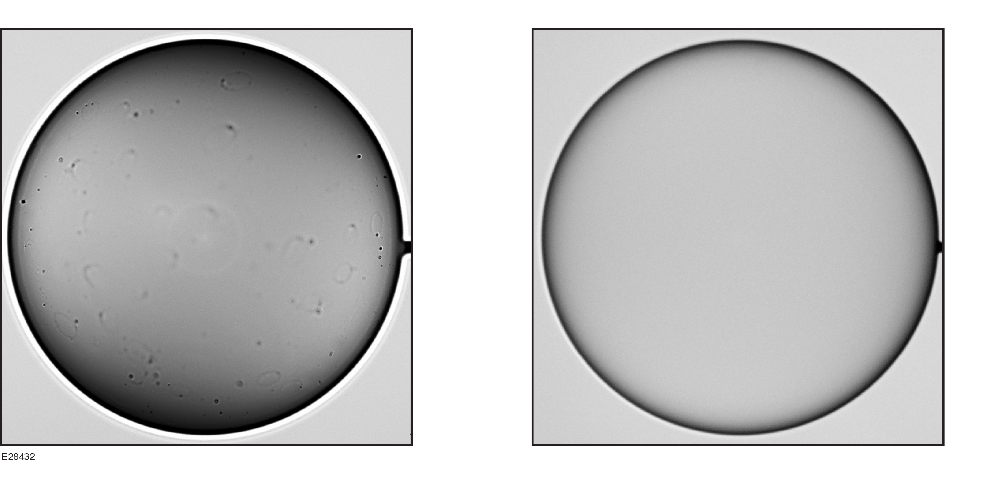
Properties of Vapor-Deposited and Solution-Processed Targets for Laser-Driven Inertial Confinement Fusion Experiments
M. J. Bonino
University of Rochester
Laboratory for Laser Energetics
23rd Target Fabrication Meeting
Annapolis, MD
23–26 April 2019

Slide 2
D. R. Harding
University of Rochester, Laboratory for Laser Energetics Department of Chemical Engineering
W. Sweet, M. Schoff, and A. Greenwood,
General Atomics
N. Satoh
Industrial Development Center, Central Research Laboratory
M. Takagi
Institute of Laser Engineering Osaka University
A. Nikroo
Lawrence Livermore National Laboratory

Slide 3
Characterization of GDP and polystyrene capsules shows that polystyrene targets are close to meeting the required surface specification, while GDP targets require further development
The GDP process produces targets with many domes that affect low-adiabat, high-yield implosions
Polystyrene targets need improvement to reduce the number of voids in the wall
Polystyrene yields must improve to be cost effective for routine production
Complete characterization of targets is very time consuming; automation is desirable

Slide 4
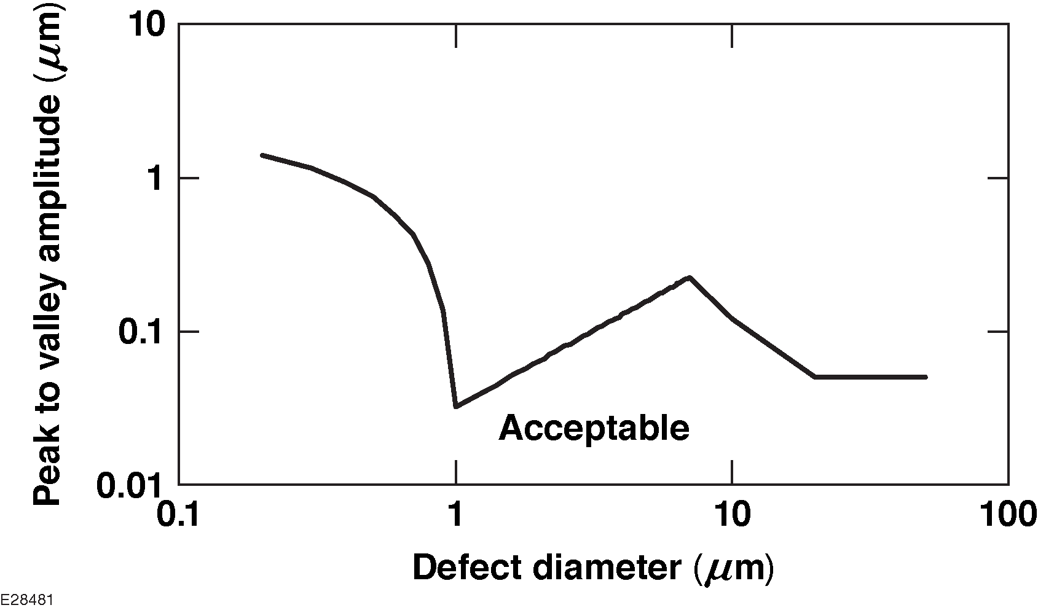
Defects on GDP and polystyrene targets have to meet demanding acceptance criteria; each target type has virtues and limitations
GDP
advantage: deterministic diameter and wall-thickness uniformity
disadvantage: dome count = 1000’s per capsule
yield: 10% (16 of 160 capsules sent to LLE, five weeks lead time with existing mandrels)
Polystyrene
advantage: reduced number of surface defects
disadvantage: voids throughout the wall = 100’s per capsule
yield affected by processing issues (cracks and scratches): $<$10% (four months lead time)
Acceptable if:
$$\sum_{i=0}^{n}{ 0.001 × D_{i}^{2} <1}$$

Slide 5
Characterization of targets with different techniques is used to streamline the process and provide complimentary analysis
Qualitative evaluation of surface features – ~3-$μ$m spatial resolution
5 $×$, 50 $×$, 100 $×$ objective (Mitutoyo)
Quantitative analysis of the height/dimension of features 1 to 5 $μ$m
confocal microscope (Leica, DCM 3D)
(0.8-$μ$m lateral resolution, 10-nm height)
Interferometry (Filmetrics, model FZO)
wall thickness, delta wall, nm resolution
Detailed analysis of isolated features using higher resolution ($<$ 0.5 $μ$m)
atomic force microscopy (NanoSurf Lens AFM)
SEM (Zeiss Sigma HD VP, Auriga FE SEM)

Slide 6
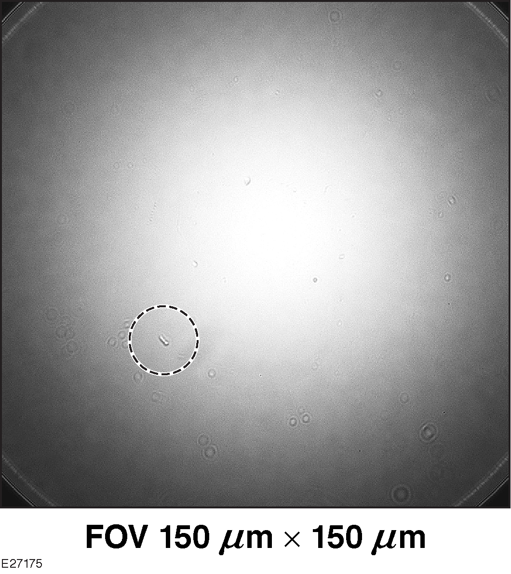
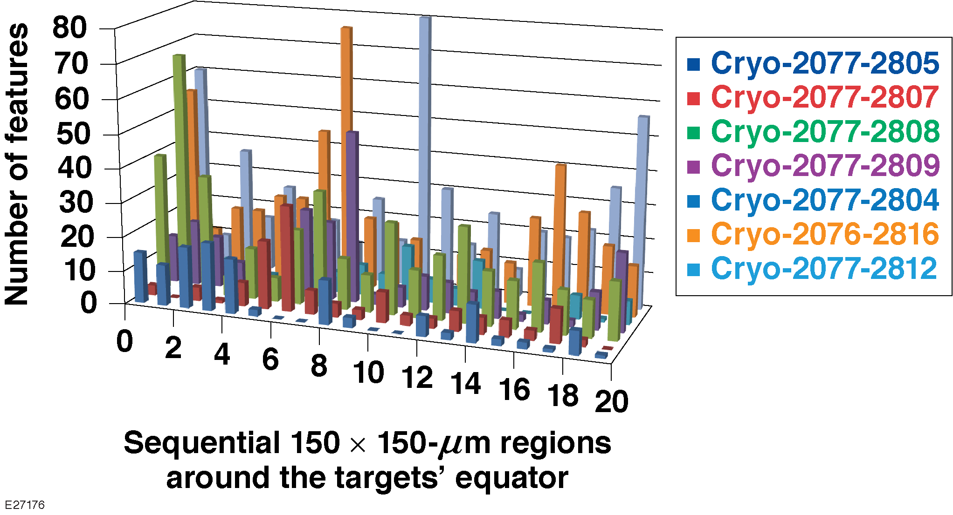
Dome defects on GDP capsule surfaces exceed what is acceptable
GDP – Qualitative evaluation
Each capsule was observed on a great circle, with a quantified number of defects (1- to 10-𝜇m range)
There were 131 to 538 per great circle which translates to 800 to 3500 per capsule

Slide 7
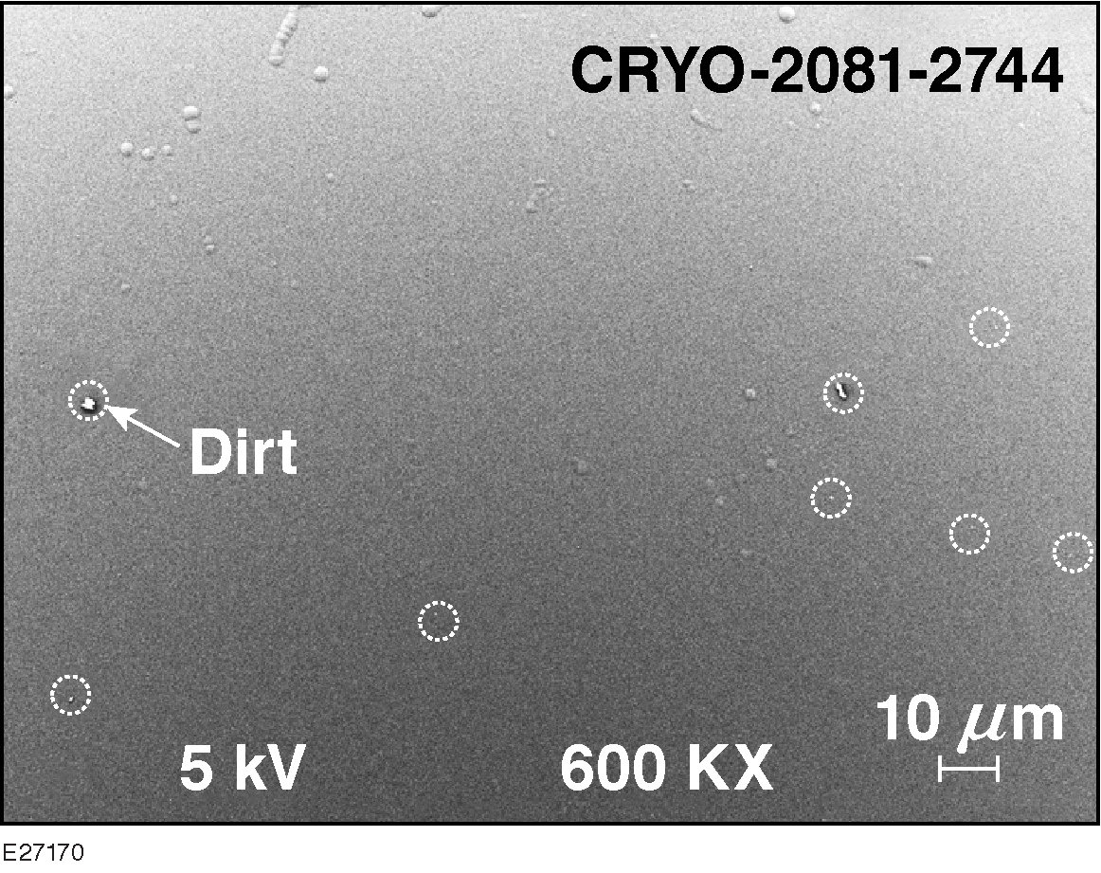
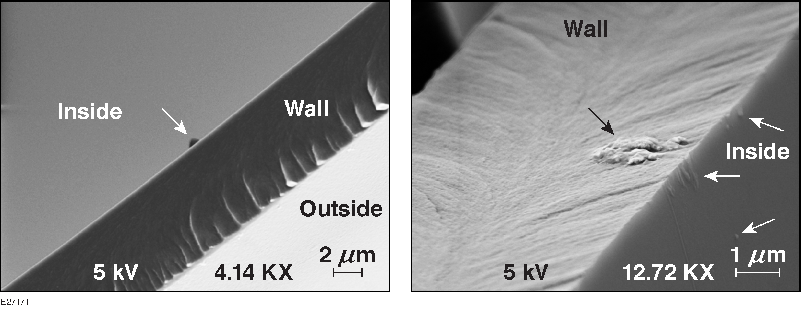
Domes are present on the inner and outer surfaces, as well as inside the capsule wall
GDP
120 domes in a region 400 $μ$m $×$ 200 $μ$m, $<$ 5-$μ$m diam
Scales to 3000 per capsule (good agreement with qualitative)

Slide 8
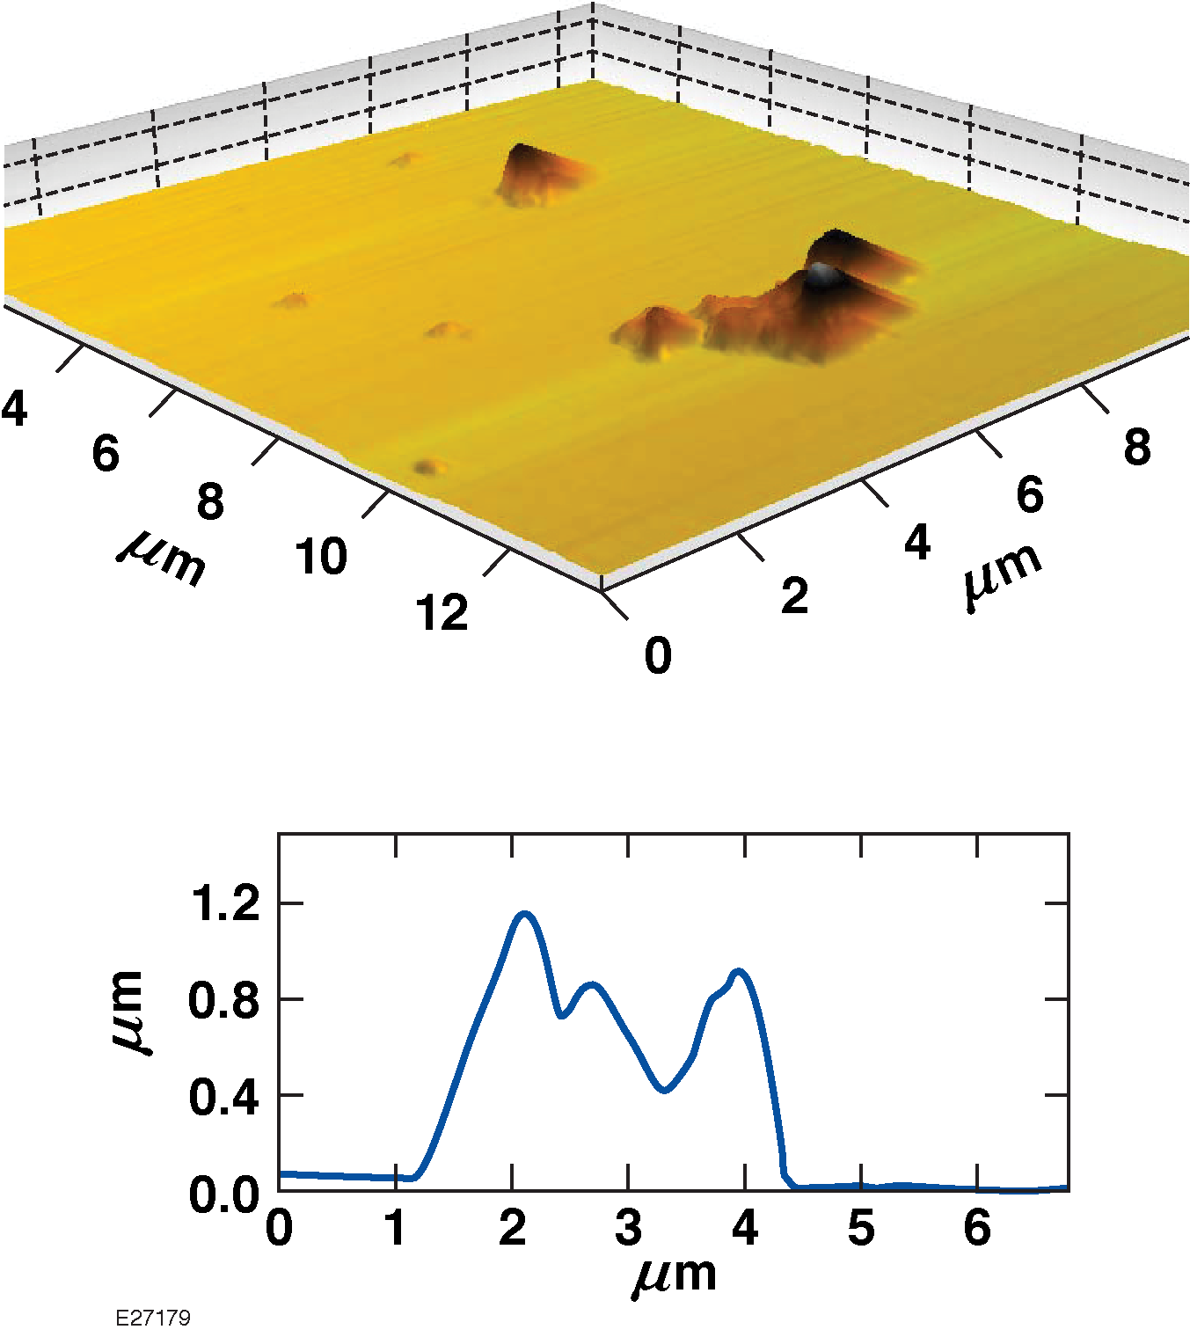
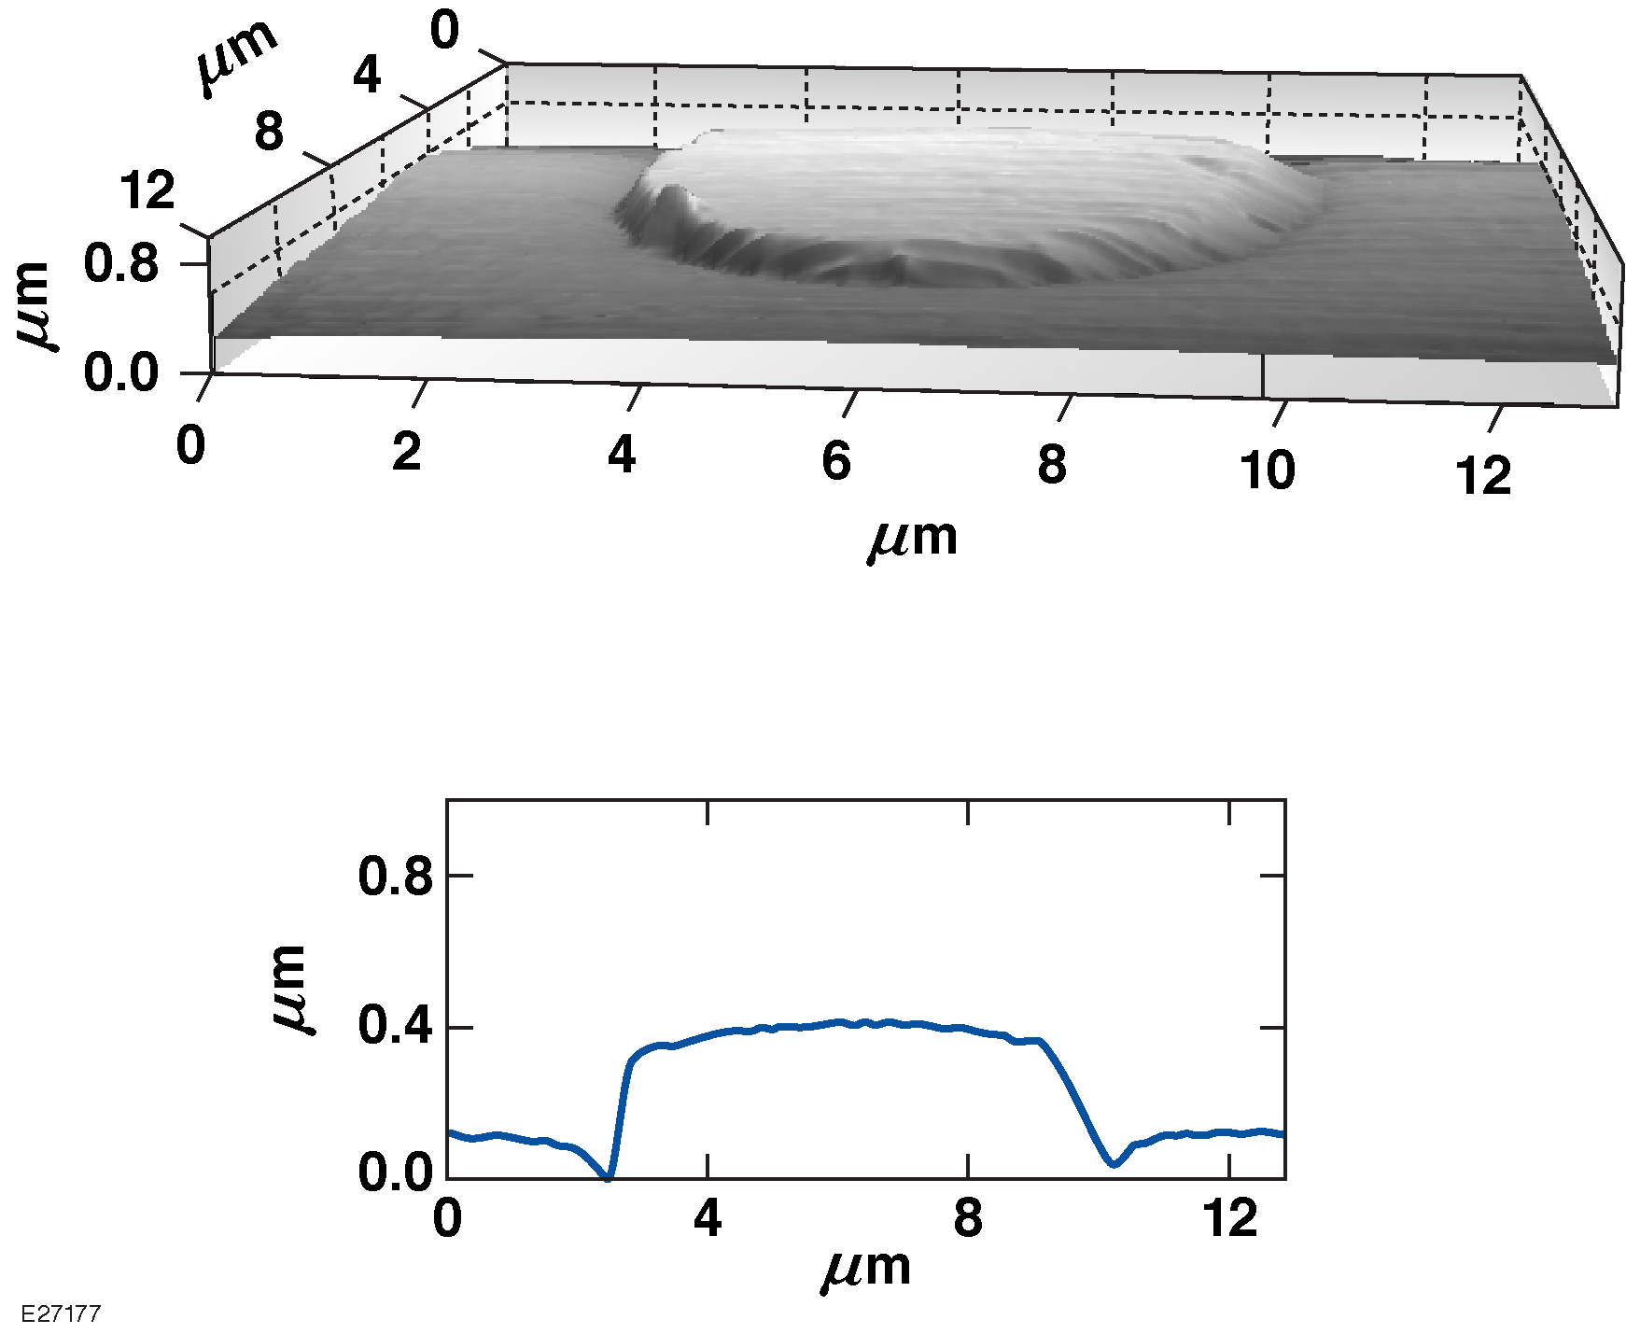
Polishing domes on GDP capsules reduces the defect height, but does not remove all features
Polished GDP

Slide 9
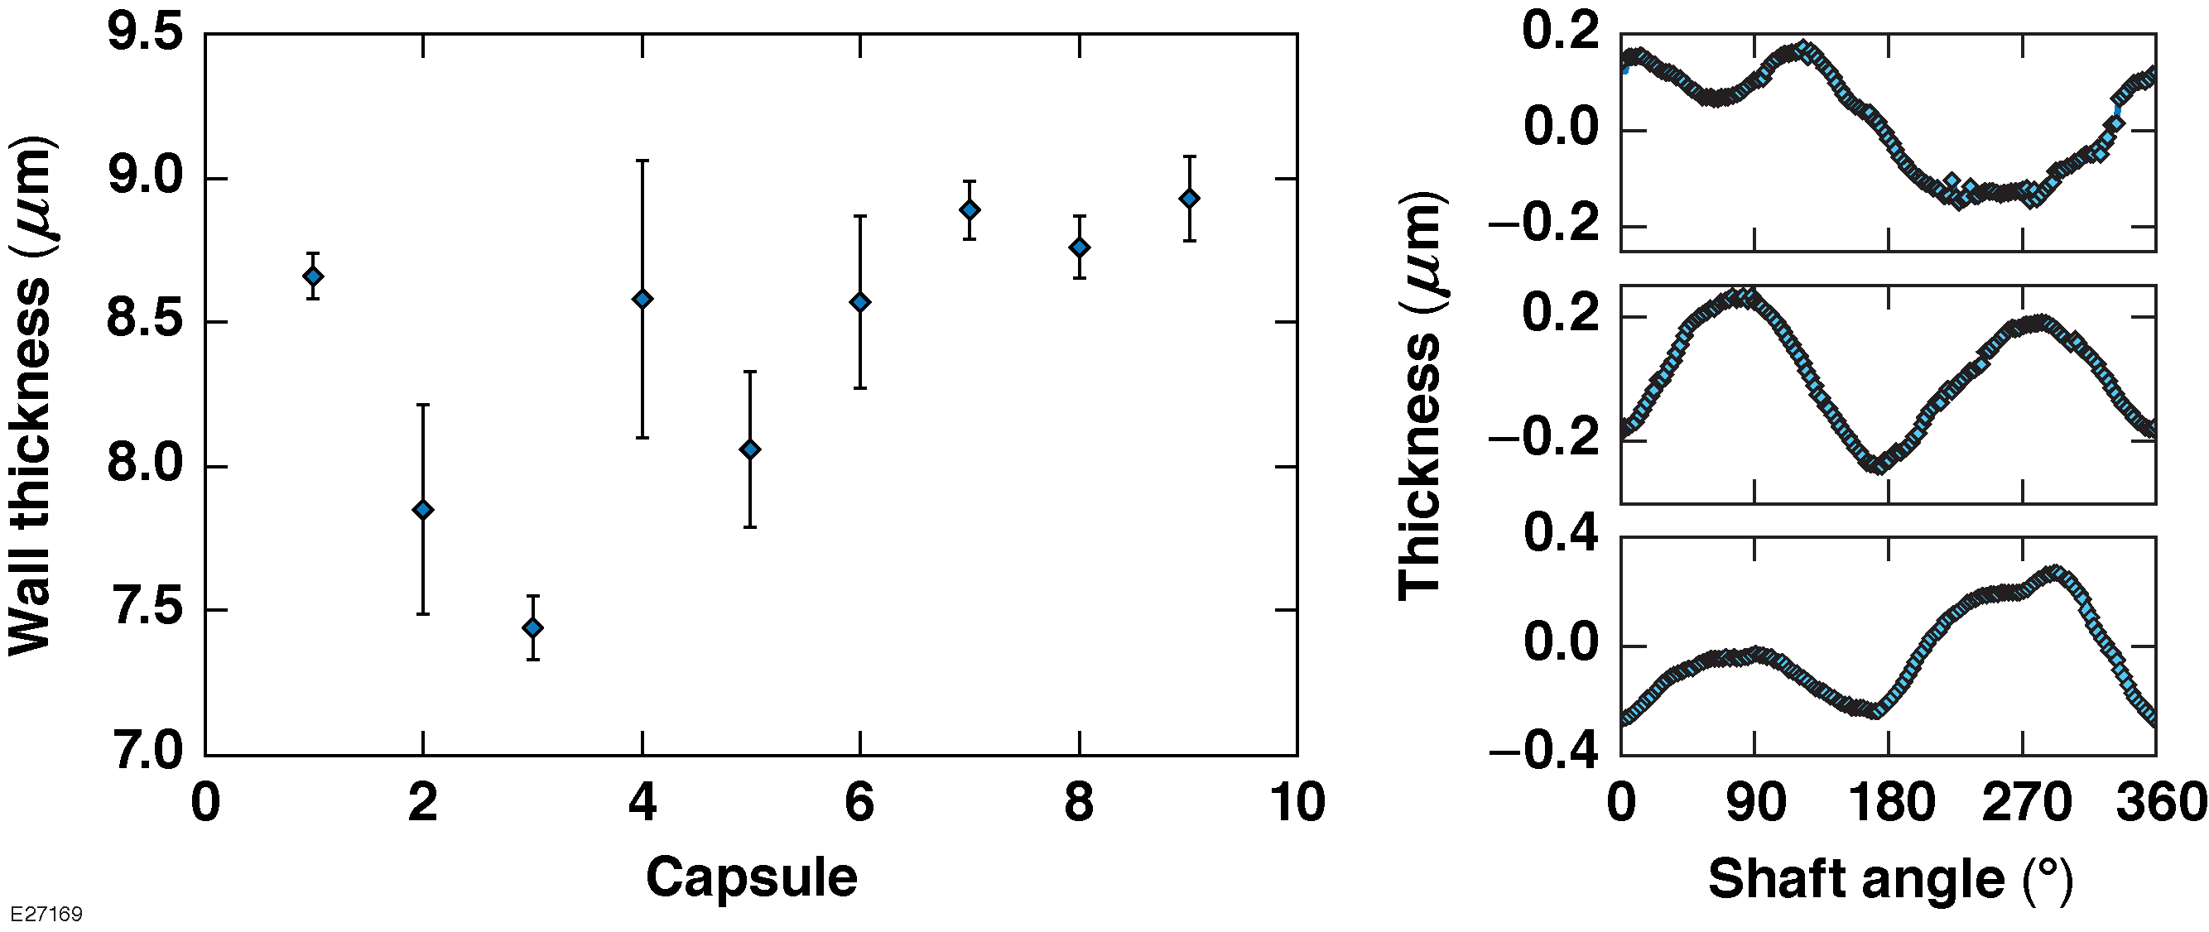
Hamamatsu shells have few defects but the variability of the wall thickness is too large
Hamamatsu polystyrene
The wall thickness of nine polystyrene targets was measured at 90° increments along one great circle of the shell using confocal microscopy
The variation in the thickness of the wall of one polystyrene target (9-mm thick; 0.54 mm peak-to-valley) was measured along three orthogonal great circles using interferometry (GDP 0.01 $δ$ wall)
Reported uniformity of GA-produced polystyrene shells is superior.

Slide 10
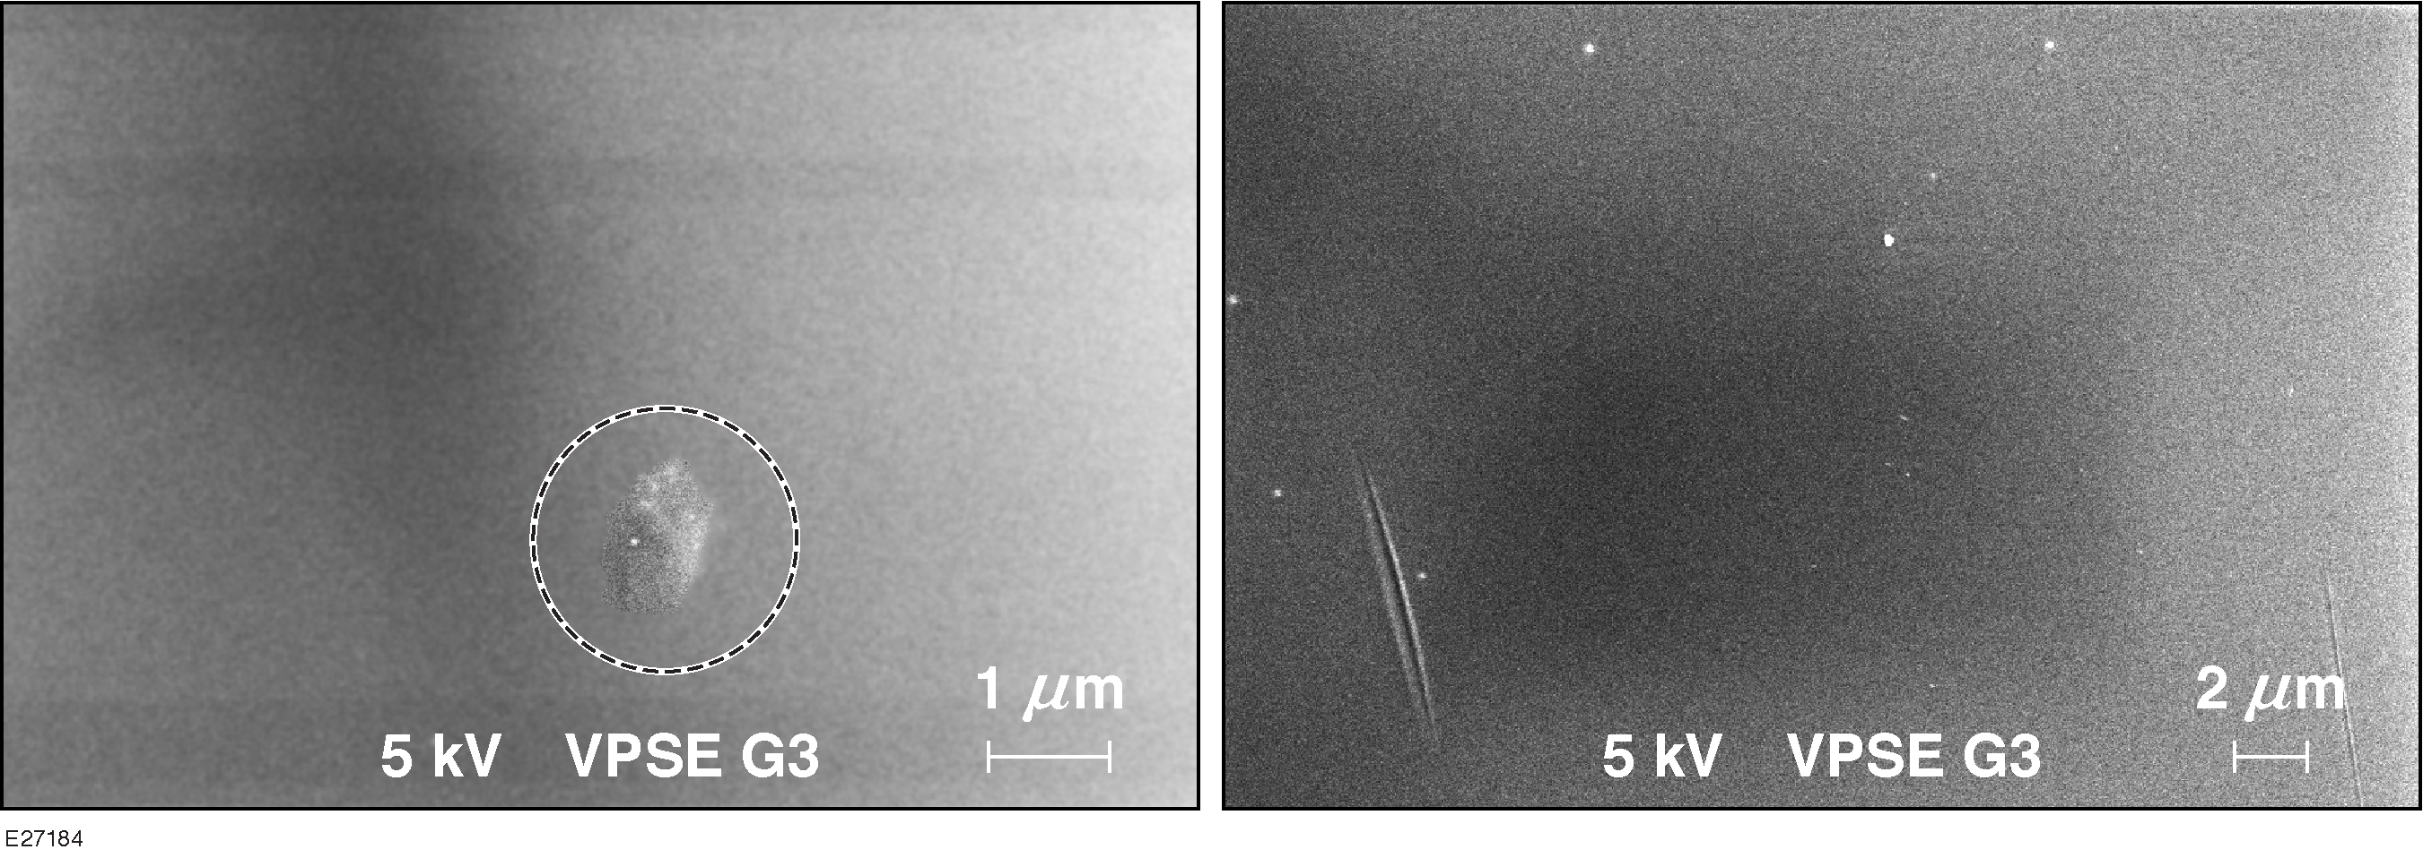
Few surface defects are visible in General Atomic’s polystyrene targets
Near surface vacuole
Scratch caused by tumbling conditions
The SEM operating in variable pressure mode allows surface inspection without needing a conductive layer

Slide 11
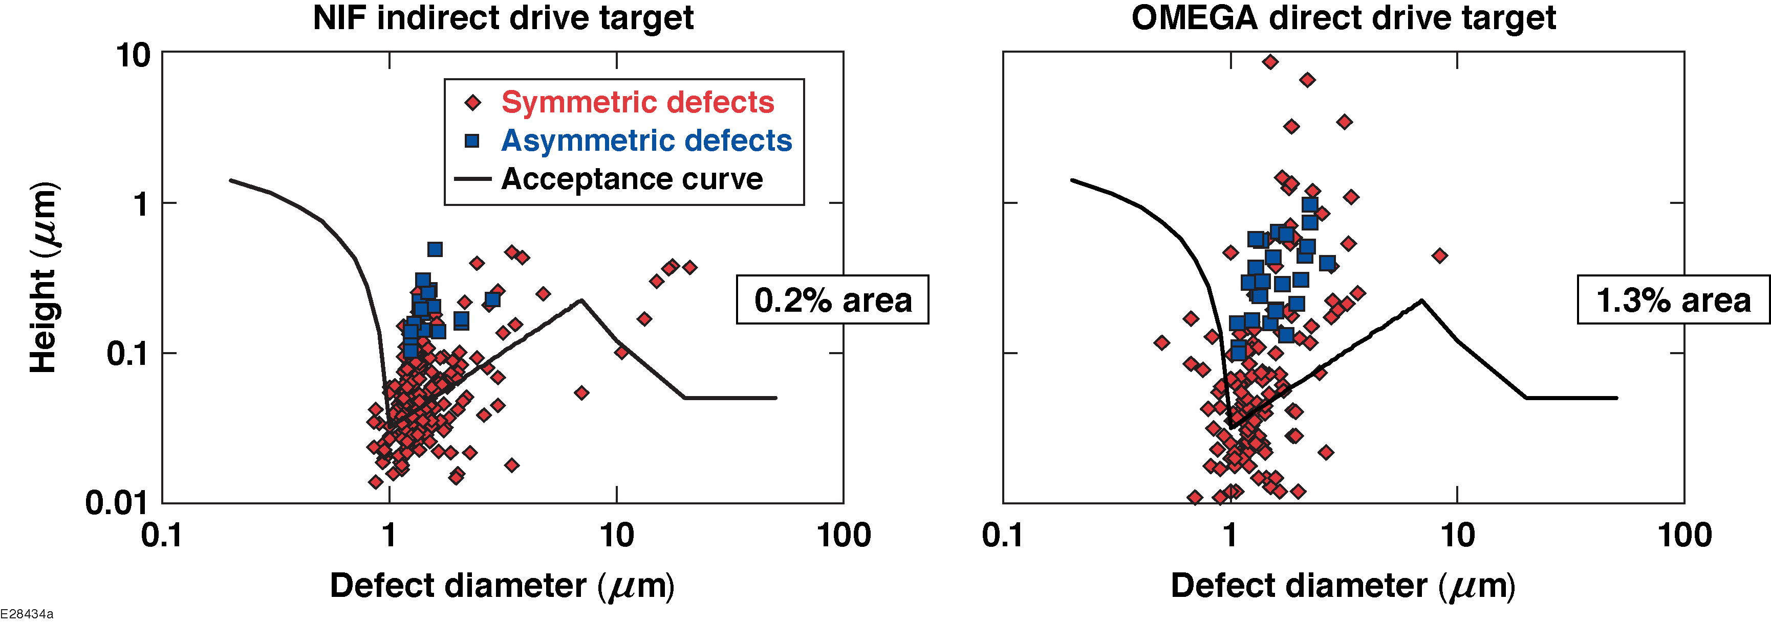
Defects on polished GDP capsules were quantified using atomic force microscopy

Slide 12
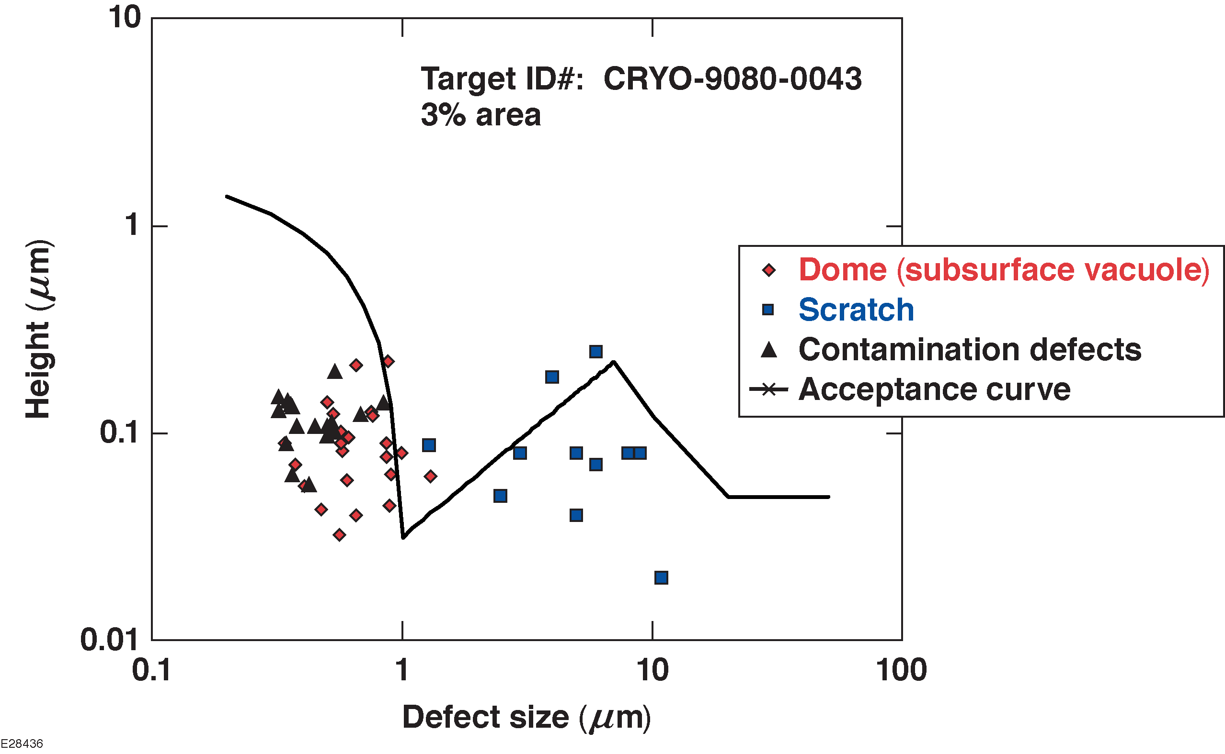
Defects on a polystyrene capsule were quantified using atomic force microscopy

Slide 13
Polystyrene has the best prospects of meeting the goal
 | Polished NIF | Polished OMEGA GDP | OMEGA polystyrene
Scanned area (𝜇m²) / % of total surface area | 26,500 (0.2%) | 31,300 (1.3%) | 64,530 (2.7%)
Out of spec area (𝜇m²) | 1,449 | 305 | 24
Estimated defect area over the capsule (𝜇m²) | 687,200 | 21,170 | 900

Slide 14
Characterization of GDP and PS capsules shows that PS targets are close to meeting the required surface specification, while GDP targets require further development
The GDP process produces targets with many domes that affect low-adiabat, high-yield implosions
Polystyrene targets need improvement to reduce the number of voids in the wall
Polystyrene yields must improve to be cost effective for routine production
Complete characterization of targets is very time consuming; automation is desirable

Slide 15
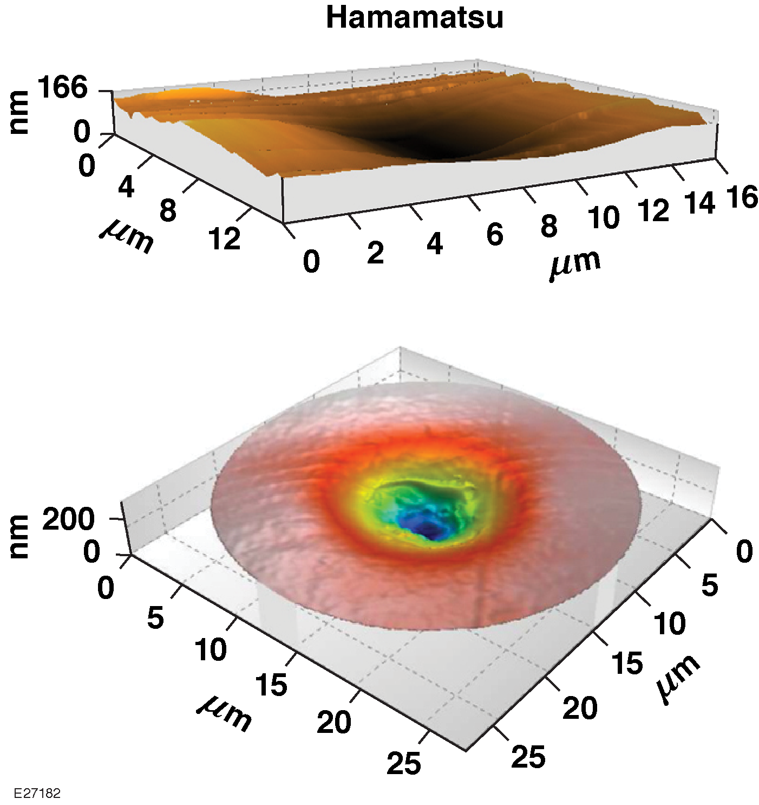
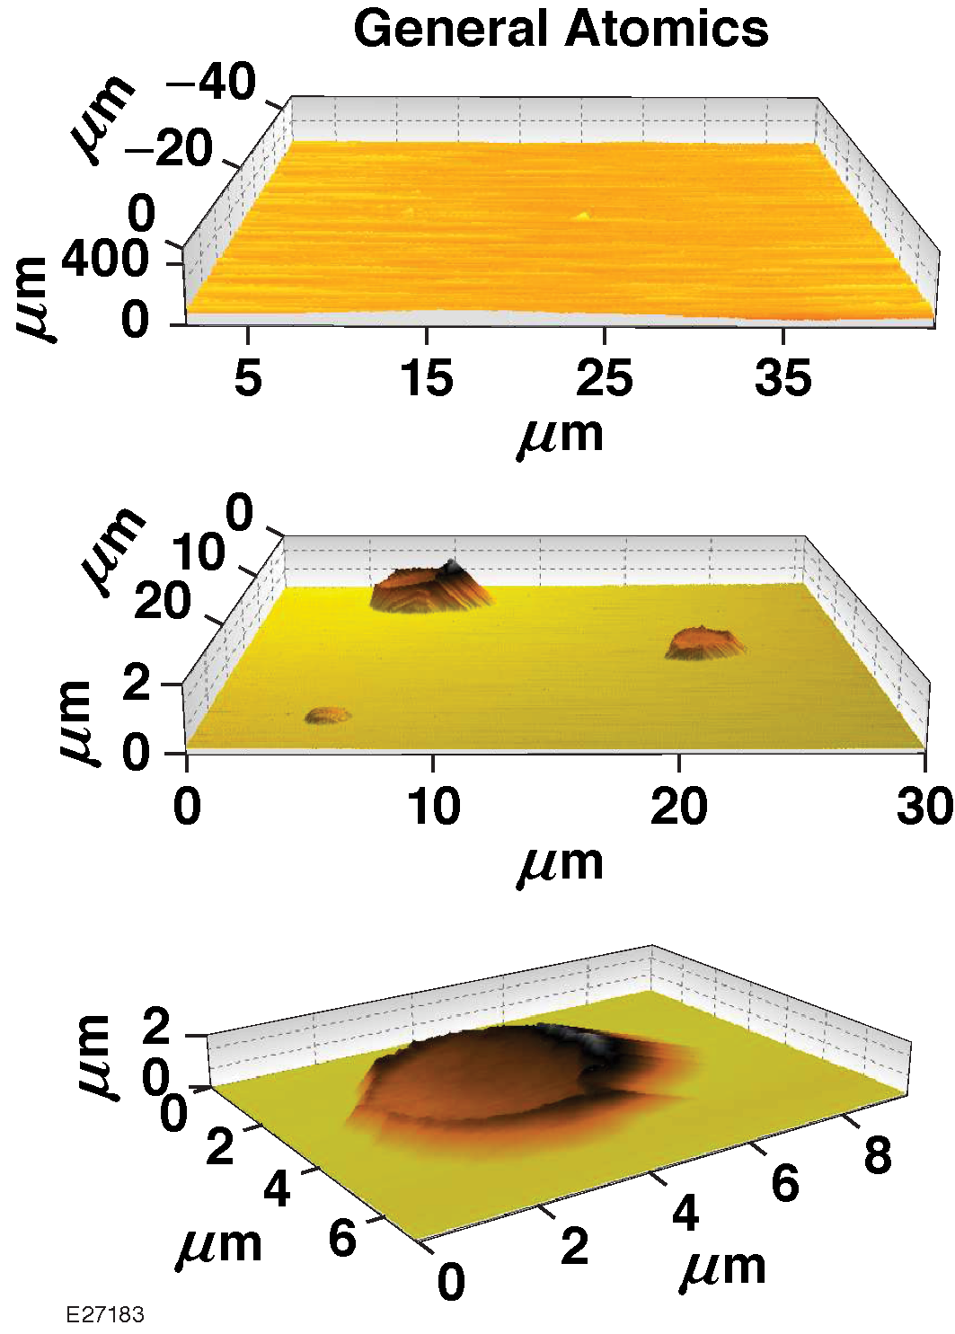
Polystyrene capsules exhibit vacuoles
Confocal and AFM images

