Slide 1
Supporting Stockpile Stewardship with High-Energy-Density Physics Experiments
To: Target Fabrication Conference
April 25, 2019
Alan Wan
Acting Program Director
Weapons Physics and Design Program
Lawrence Livermore National Laboratory

Slide 2
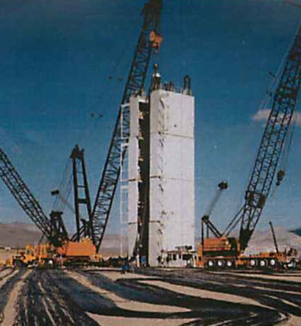

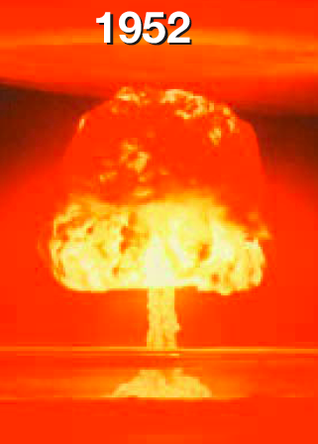
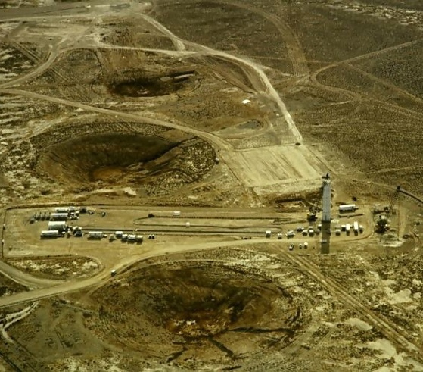
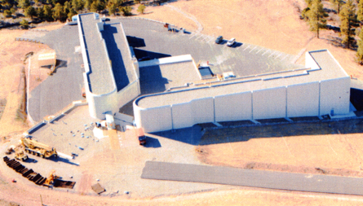
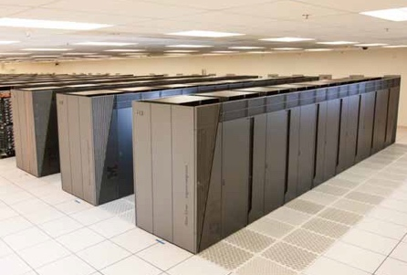
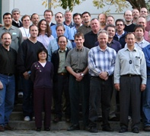
Stockpile Stewardship Program: Maintain confidence in the US nuclear deterrent without further underground nuclear testing
Confidence in stewards and capabilities grounded by experimental reality
1945
1992
Present
2032
Increasing role of Science & Technology as we move further away from the Underground Test (UGT) era

Slide 3
Take Away Message: In the absence of further UGT’s and facing changes due to aging and threats, we need better science underpinning of future stockpile and therefore requiring better experimental capabilities and tools
Experimental science is critical to underpin the design, assessment, and certification of the enduring stockpile
  It takes decades to build the capabilities and tools to train the stewards
  We need improved capabilities for a full range of weapon areas
We need to maintain preeminent weapon science capabilities
  Science is part of deterrence
  Communicate the importance of science to stakeholders
We need experiments to certify the future certifiers
  Grounded by experimental realities, meeting mother nature head on
  External community – academics, DOE Science, …
We must be prepared to be able to effectively deliver the science underpinning for future stockpile needs in a much shorter time scale in response to anticipated changes and threats

Slide 4


Majority of the yield of our nuclear weapons occurs in the high energy density state. HED facilities are the only way to access this regime without nuclear weapons testing
Primary phase
Super-critical assembly
Primary energy production
Energy transfer
X-rays transfer energy from primary to secondary
HE phase
High explosive creates supercritical assembly
Nuclear Phase
(UGTs, NIF, Z, Omega)
Secondary phase
Secondary produces energy, explosion and radiation
Pre-nuclear phase
(UGTs, sub-crits, DARHT, JASPER, etc)
HED is one key area that we have demonstrated scientific and technical superiority

Slide 5
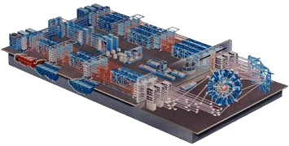
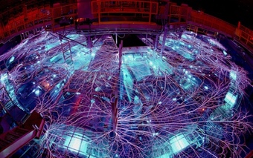
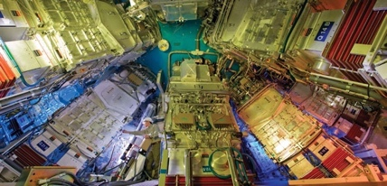







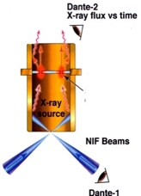
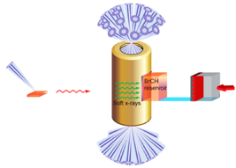
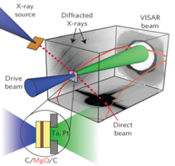
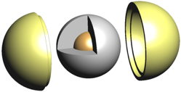
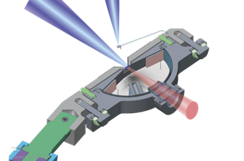
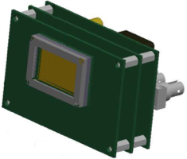
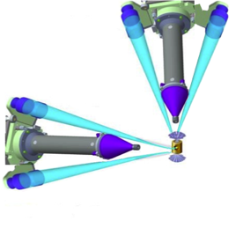
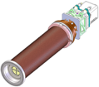
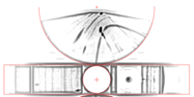
NNSA HED’s Stockpile Stewardship effort requires long-term investments to deliver the data, stewards, platforms, and diagnostics
Data
Stewards
(5+ years)
Dayne Fratanduono
Dan Casey
Maria Barrios
Ryan Nora
Channing Huntington
Alex Zylstra
Hans Rinderknecht
Platforms
(5-10 years)
Searchlight
RT Strength
Diffraction
Double Shell
EXAFS
Mach EOS
compact
proton
Spectrometers (MIT)
Diagnostics
(5-10 years)
Multi-frame CMOS
SLOS
TARDIS
Target Fabrication enables us to carry out the experiments with precision in order to impact SSP’s models, material & plasma properties, in regimes previously inaccessible

Slide 6

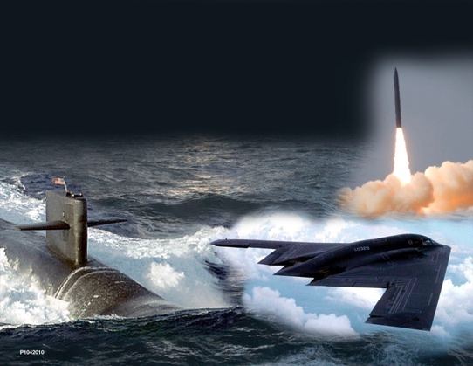

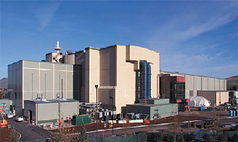
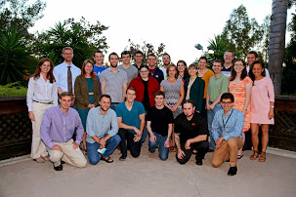

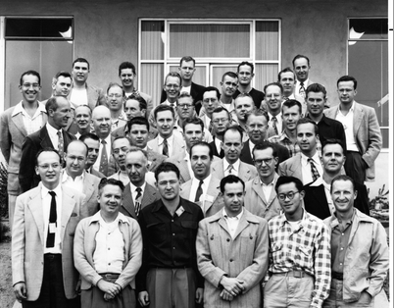
Attracting and training the next-generation stewards and developing new capabilities are critical for long-term stockpile sustainment
People Matters
Confidence in stewards and capabilities grounded by experimental reality
Recruit, train, retain the next-gen stewards
1945
1992
Present
2032
In the absence of further UGTs, HED and other experimental platforms are essential in recruiting, training, and retaining the next-generation stockpile stewards

Slide 7
NNSA has a 5-year HED Plan to deliver for Stockpile Stewardship
HED Topics | Due Date | Major Technical Goals
Thermonuclear Burn | 2020 | Determine the efficacy of NIF for ignition and credible physics-scaling to multi-megajoule yields for all ignition approaches
 | 2021 | Reduce uncertainties in yield scaling based on the 2020 ICF assessment
 | 2022 | Establish modern mission requirements for a high yield capability
 | 2023 | Increase energy coupling from the driver to the fusion fuel
 | 2023 | Execute thermonuclear burn experiments that inform primary boost
 | 2023 | Conduct major program review to assess the investments needed to meet modern mission requirements
Material & Plasma Properties | 2018 | Deliver data to assess material replacement options for W80-4 LEP
 | 2024 | Support national Pu aging and manufacturing assessment effort through cross platform HED experiments
 | 2024 | Resolve discrepancies between opacity experiments and models through cross-platform measurements
Rad Hydro & Transport | 2019 | Complete radiation transport campaign relevant to W80-4 LEP
 | 2022 | Experimentally constrain complex hydro models used for stockpile assessments
Output and Survivability | 2020 | Develop platforms for measuring thermomechanical shock to inform LEP options
 | 2023 | Enable SGEMP model validation using new warm x-ray capabilities
 | 2024 | Measure the response of weapon components under high-neutron fluence irradiation

Slide 8
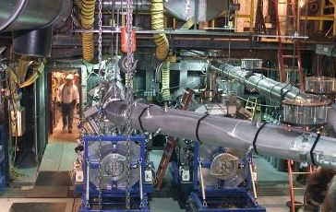
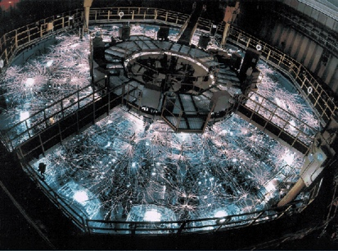
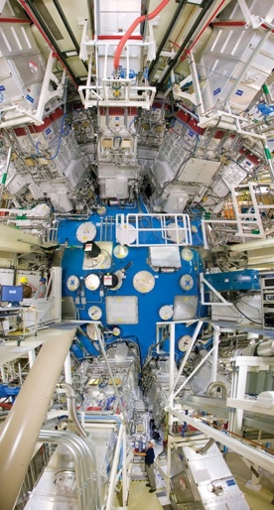
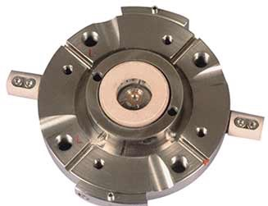
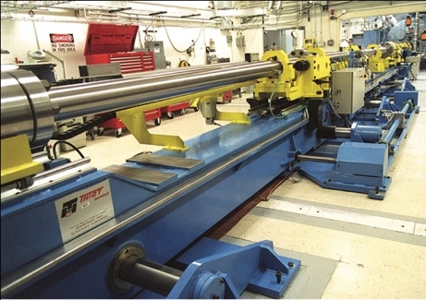
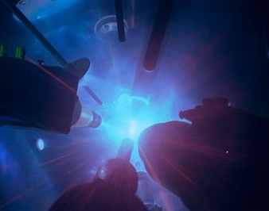
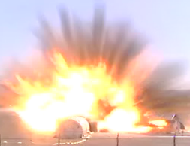

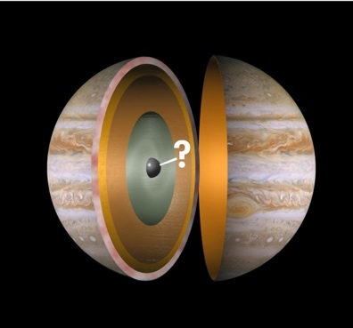
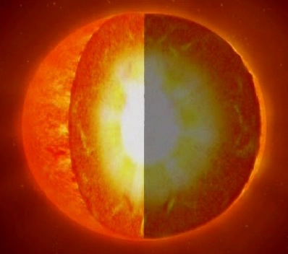
Validated materials and plasma data is critical to improve the predictive capability of system performance
Material & Plasma Properties
Low Pressures Moderate Pressures High Pressures
Low Temperatures High Temperatures
Providing Data Today
Maturing Experiments
Diamond Anvil
U1A
Z
Gas Guns (JASPER)
HEPP
Omega
NIF
Ordinary Matter
Center of giant planets
Center of stars

Slide 9
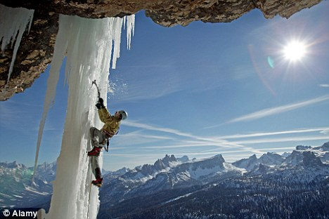
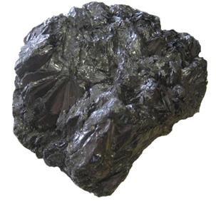
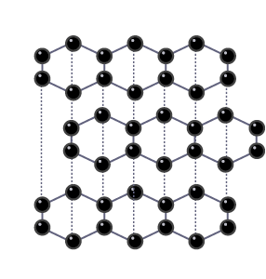


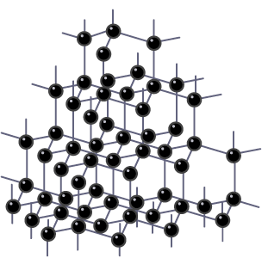
Modeling primary implosion at extreme conditions needs accurate next-generation material property models
Material Properties
Phase of the material matters
Strength of the material matters
Graphite
Atomic Structure
H₂O With Strength
Diamond
Atomic Structure
H₂O Without Strength
HED delivers validation data in regimes previously only accessed through theory and simulations

Slide 10
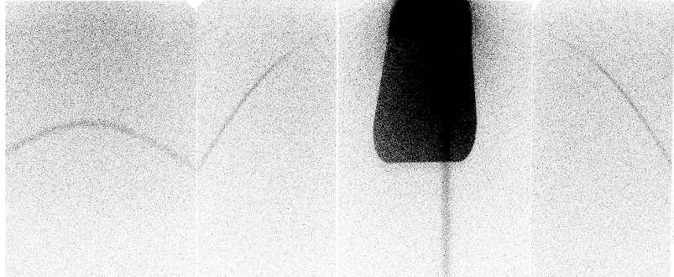

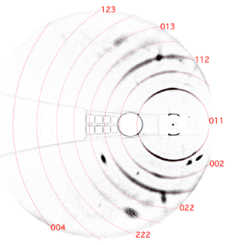
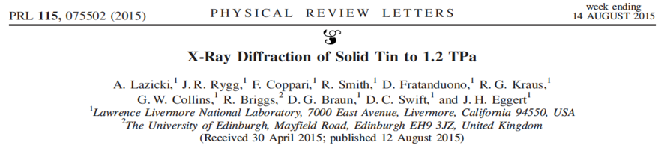

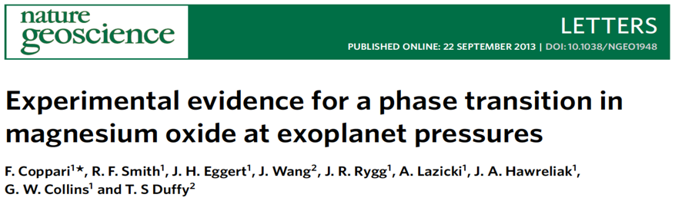
Ramp-compressed solid diffraction platform was developed over a decade leading to todays NIF Hi-Z experiments
Phase Matters
Fe diffraction at Janus, 10/02/2008
Diffraction at Omega, 2008-2018
> 600 shots
Diffraction at NIF, 2013-2018
103 shots including Classified and fundamental-science shots.
Pb
(2014)
X-ray source
Drive:

Slide 11
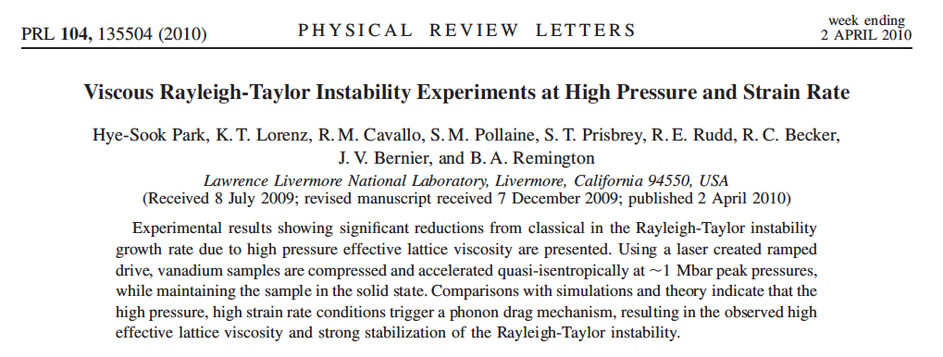
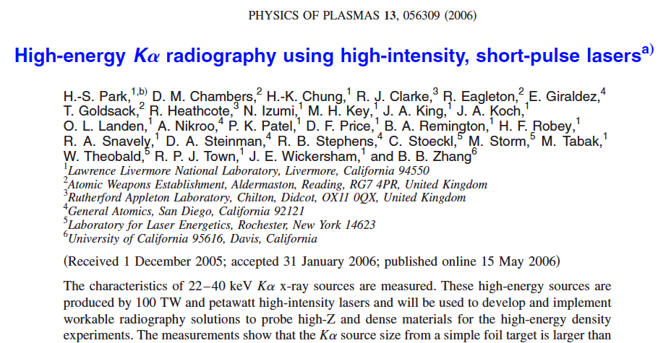
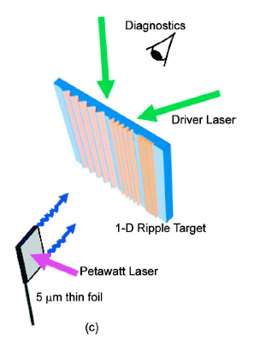
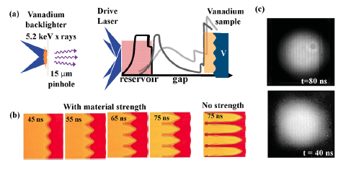
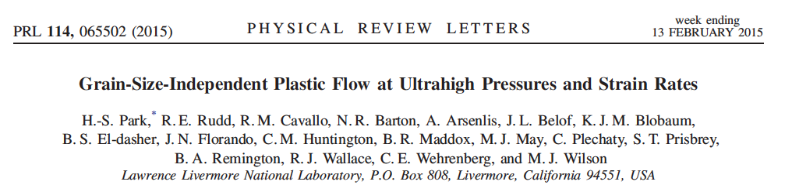
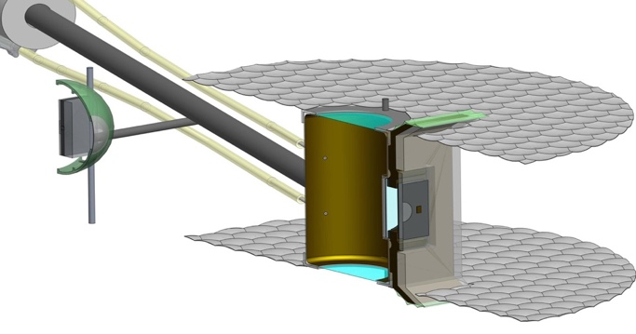
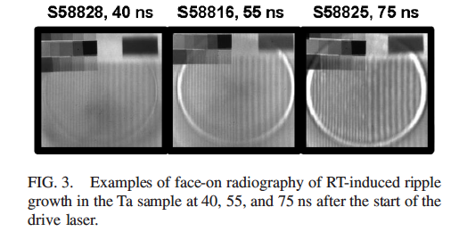
We developed a Rayleigh-Taylor platform to determine material strength
Strength Matters
Vanadium RT experiments at 1 Mbar on Omega-60 (2006-2010)
Developing high-energy backlighter on Omega-EP (2009-2011)
Tantalum RT and Laue strength experiments at 1 Mbar on Omega-60 (2011-2015)
High-Z RT experiments at 3, 5, 8 Mbars on NIF (2017+)
backlighter
sample under investigation
layered reservoir

Slide 12
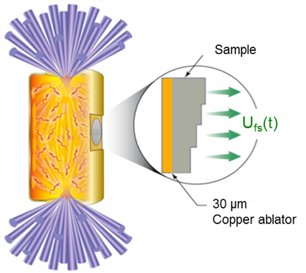
The ramp compression EOS platform on NIF is maturing as demonstrated by recent results on Platinum
EOS Matters
NIF platform design and data return
Stress-Density measured for ramp compressed Platinum
Excellent agreement is observed between NIF and Z
Improved target construction and hydrocode simulations have improved design reduced experimental uncertainties

Slide 13
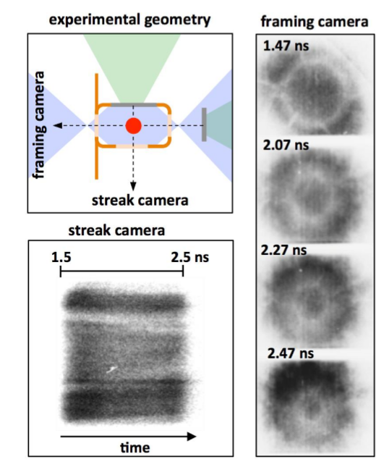
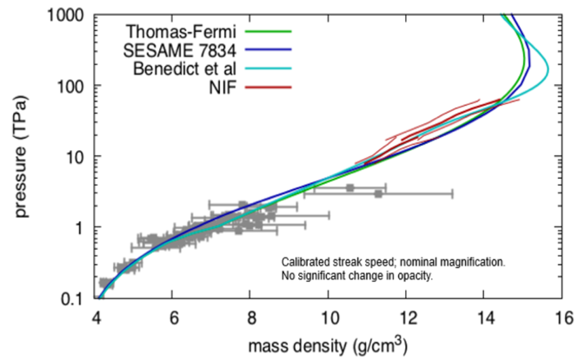
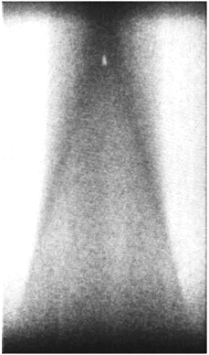



WE have developed and utilized a range of high pressure plasma EOS platforms
Plasma EOS
Omega Gbar platform:
since 2011 (Hawreliak)
NIF Gbar platform: since
2013 (Kritcher, Swift, Doeppner)
Yielding data in the 50-800
Mbar pressure regime
backlighter
Diamond Hugoniot
laser
drive
Preliminary,
Swift
Streak camera
time
Omega relative EOS platform
2005 to today (Celliers, Hicks)
NIF relative EOS platform
2013 (Fratanduono)
Yielding data in the 20-150
Mbar pressure regime
VISAR
Preliminary, Lazicki, Gregor

Slide 14

LLNL continues to develop new HED platforms in materials and plasma properties
New HED Platforms
Insensitive High Explosives
Spall and Damage
Ejecta
Drive
Target catcher
Michelle Gregor, Jon Eggert, Fernandez Panella, Lara Leininger
Drive
4w, proton radiography
time length
Void collapse ~100 ps ~1000 nm
Chemical reactions ~10 ns
Carbon condensation ~100 ns ~10 nm
Carticle agglomeration ~1 μs ~100 nm
Hans Rinderknecht, Yuan Ping, Suzanne Ali, H.S. Park, J. Eggert
Ray Smith
High-pressure Hugoniot and phases of shocked IHE. First high explosives experiments at Omega successfully performed 4/19/18
First 2-D VISAR data to explore fracture of Al. Omega shot earlier this year
Metal ejecta transport: surface/particle & particle/particle interactions

Slide 15


LLNL continues to develop new HED platforms in materials and plasma properties
New HED Platforms
Foam/Porous EOS
EXAFS
High Pressure Plasma EOS
Foam sample
To Dante
Jon Eggert, Dayne Fratanduono, H.S. Park, Rick Kraus
F. Coppari, Y. Ping, A. Krygier, J. McNaney
cone
Amy Jenei, Michelle Gregor, Damien Swift
EOS and properties of porous, foam, additive manufactured materials
Develop EXAFS platform to infer bulk material temperatures
  Develop an EOS platform to reach 100’s of Mbar in a planar physics package

Slide 16

Recent Fe opacity experiments at Z show discrepancies between measurement and theory
Opacity
• Opacity experiments on Fe at 156 eV show reasonably good agreement with theory. (Anchor 1)
• Experiments on Fe disagree at 182 (Anchor 2) - 195 eV.
• There are systematic deviations from theory in both the overall level of the opacities and in the detailed shapes of the lines.
195 eV
182 eV
170 eV
A higher-than-predicted measurement of iron opacity at solar interior temperatures
J.E. Bailey, T. Nagayama, G.P. Loisel, G.A. Rochau, C. Blancard, J. Colgan, Ph. Cosse, G. Faussurier, C.J. Fontes, F. Gilleron, I. Golovkin, S.B. Hansen, C.A. Iglesias, D.P. Kilcrease, J.J. MacFarlane, R.C. Mancini, S.N. Nahar, C. Orban, J.-C. Pain, A.K. Pradhan, M. Sherrill, and B.G. Wilson
164 eV
A national strategy has been developed to replicate the iron opacity experiments
on NIF and deliver cross-platform validation of opacity data at ”anchor” conditions

Slide 17


We are conducting a wide range of HED experiments to study radiation transport and radiative properties
Radiation Transport
Omega
Z
NIF
Calorimetry
Radiography
2000
Drive
Drive
Radiography
Drive, burn-thru
Drive – calorimetry
Backlighter
1st Calorimetry
1st Radiography
Streak emission
Calorimetry
Radiography
Calorimetry
Burn-thru
Calorimetry
Qualify NIF materials
Drive
Calorimetry
Radiography
Polar DIM
2005
2010
2011
Searchlight: Steve MacLaren, PI
HED delivers data in complex configurations to validate radiation transport models

Slide 18





The re-shock campaign gave us a controlled platform to obtain quantitative data for comparison with models and simulations
Hydrodynamics
Planar Hydro
Main drive
NIF’s large energy enables large features to be driven and radiographed enabling detailed comparisons with simulation
Reshock
drive
Simulation
Experiment

Slide 19


Targets with split tracer strip & foam allow simultaneous “traditional” and “inverse” measurements
CRF foam
unshocked Ni foam
Ni-doped Carbon foam
shock front in Ni foam
CRF foam
CHI spikes
λ = 120 μm, a = 6 μm
CHI tracer
plastic spikes
PAI layer
CHI ablator
drive direction
30 ns data (N160105-002)
Pre-shot target radiograph

Slide 20













The 2-Shock platform¹ uses a large Case-to-Capsule (CCR) and a ~140 eV foot to obtain a round, reproducible implosion
Convergent Hydro
3.10 mm
Ablation Front Stability
Graded Si dopant
2-Shock
Low Foot
HED 2-shock
CCR = 4.25
Hi-Foot
CCR=2.54
Uniform 1%Si-doped CH
175 µm
1130 µm
2-Shock
HDC
8.5
mg/cc
0.3/0.03 mg/cc ⁴He fill
675 µm
1.60 mg/cc ⁴He fill
5.75 mm
5.75 mm
N150301
N150503
N151223
N160501
N170416
¹S.F. Khan et al, Phys. Plasmas 23, 042708 (2016)

Slide 21

The HED 2-Shock Campaign uses the CD MixCap¹ technique to measure sensitivities to ablator-fuel mix
Nuclear Diagnostics for Mix
CH
175 µm
1% Si-doped
CD
D+D
D+T
3.2 µm
CD layer
Warm unmixed CD
T+T
675 µm
HT
D mix
with T
Hot spot
D+T → n (14.1 Mev) + ⁴He
T+T → 2n ( 0-9.4 MeV) + ⁴He
D+D → n (2.5 MeV) + ³He
Across experiments, the DT/TT ratio is an excellent indicator of the relative amount of atomic mixing
¹V.A. Smalyuk et al., PRL 122, 025002 (2014)

Slide 22








We are conducting a range of vulnerability and hardening experiments to assess survivability under hostile environments
Output & Survivability
Weapons systems must survive a range of hostile environments
NIF sources
Radiation effects on
materials and electronics
X-ray effects
on seeker systems
NIF x-ray
source
NIF provides x-ray & neutron environments
Ensures the performance
of space assets
National Security Applications
X-ray source
Test objects
The System Generated Electromagnetic Pulse (SGEMP) experiments study the physics of x-ray interactions in user-provided test objects

Slide 23




Inertial Confinement Fusion (ICF) is about making a hot, dense plasma and holding it together long enough to create significant fusion yields
Thermonuclear Burn
~ 35X
convergence
~2 mm diameter
Notes:
23

Slide 24












The US Inertial Confinement Fusion program is studying three main approaches.
ICF approaches
Laser Indirect Drive
Laser Direct Drive
Magnetic Direct Drive

Slide 25



A multi-lab Double Shell campaign is focused on delivering a platform to study burning plasma with metal pusher and impact of mix on burn
New Platform: Double Shell
fill-tube
jetting
collision &
momentum transfer
inner shell
shape
hard x-ray
preheat
pusher/fuel
4π mix
outer shell
joint issues
high-Z
pusher/foam
stability
ablator/foam
stability
Near-term focus on improving hohlraum coupling efficiency and inner-shell symmetry
Hohlraum coupling efficiency w/ outer shell
A national Double Shell effort: working together to solve a technically challenging problem

Slide 26






Increasing fusion yields widens application space and reduces extrapolation uncertainties for SSP studies
Material & plasma properties at actual weapon conditions
Innovative design and physics concept assessments
Full weapon Physics:
primary boost, secondary physics
At threat level full system tests
1 GJ
100 MJ
1 MJ
A high yield capabilities requirement drive highly diagnosed and highly flexible platforms for rapid assessments of the stockpile, adversary capabilities, and potential new technologies, thus greatly enhancing nation’s nuclear agility

Slide 27











HED weapon physics efforts are focused on supporting the current and future stockpile needs and develop the stewards and capabilities for long-term stockpile sustainment
Summary
Sustaining the Current Stockpile
Enabling the Future Stockpile
Capability for Long-term Stockpile Sustainment
Recruit, train, retain the next-gen stewards
Experiments are critical in developing and maintaining the design and innovation culture for the weapon program in the absence of further underground nuclear testing

