Slide 1
Exploring Ionic Liquids as Designer Solvents for Metal Electrodeposition
23rd Target Fabrication Meeting
Annapolis, Maryland
Corie Horwood
Anh Pham, Zach Gavin, Amitesh Maiti,
Vanessa Peters, Michael Stadermann
April 25, 2019

Slide 2
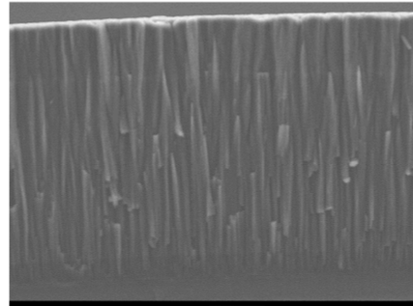
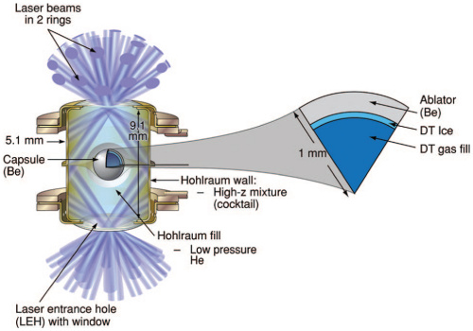
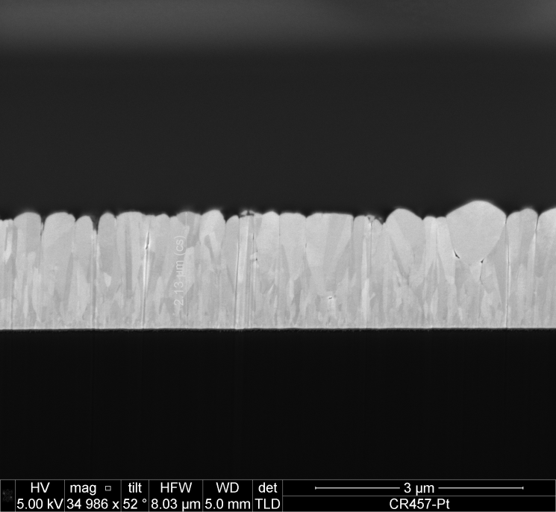
NIF ignition designs require low-Z ablators and high-Z hohlraums
10 µm
Be
Pt
3 µm
Physical vapor deposition (PVD) is currently used for making beryllium shells and DU hohlraums
PVD issues: columnar growth, voids, “stickiness”
Beryllium – Low-Z ablator material
DU hohlraums – increase X-rays generated by laser beams
Electroplating these materials offers a robust pathway for producing small grain, dense materials
SEM images: John Bae

Slide 3
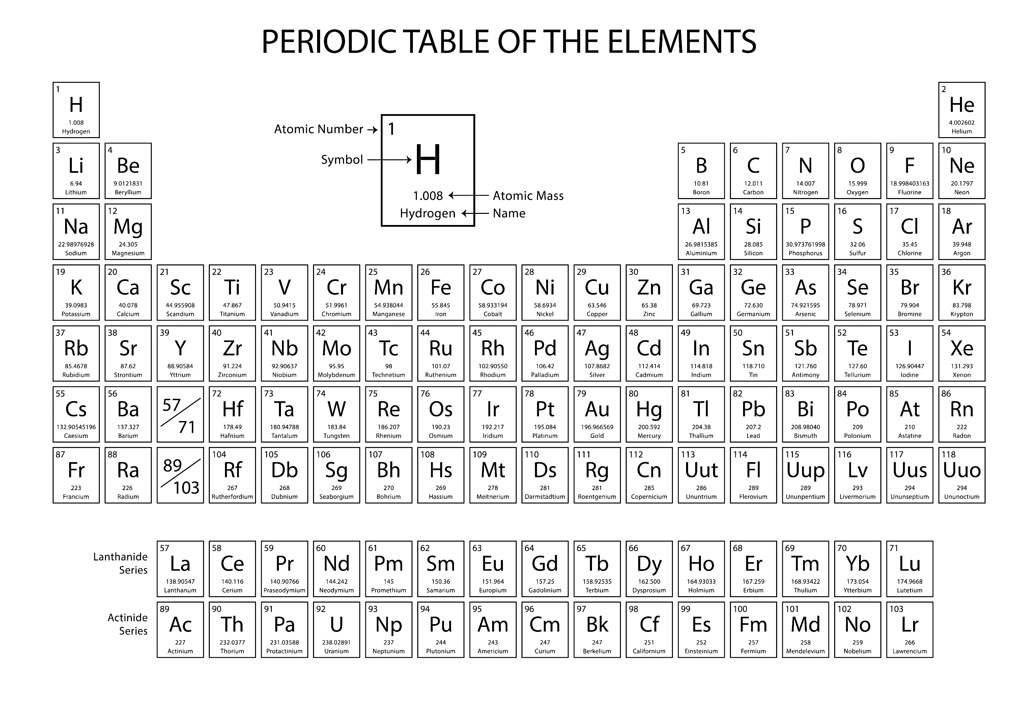
Wide electrochemical window of ionic liquids allow electroplating of several metals of interest for ICF
Electrochemical window of water limited by hydrolysis
No water present ionic liquids
Ionic liquids are difficult to oxidize/reduce, giving large stability window
-2.4 V
Potential
0 V
Beryllium
Platinum
Gold
Uranium
Plutonium
Aluminum
Copper
IL Cation
Silver
Reduction potentials for metals
M^{n+} + ne⁻ → M
Electrochemical window of water
Electrochemical window of ionic liquids
Standard reduction potentials of metals indicated

Slide 4


Ionic Liquids (ILs) are salts that are liquid at room temperature
1-Ethyl-3-methylimidazolium trifluoromethanesulfonate
(EMIM OTf)
Organic cation
Inorganic anion
Possible IL candidates
Requirements
Cations
Air/moisture stable
Good conductivity
Electrochemical window to -3 V
Low viscosity
Available to purchase
(no custom synthesis)
Imidazolium
based
Pyridinium
based
Ammonium based
Anions

Slide 5
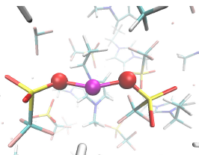
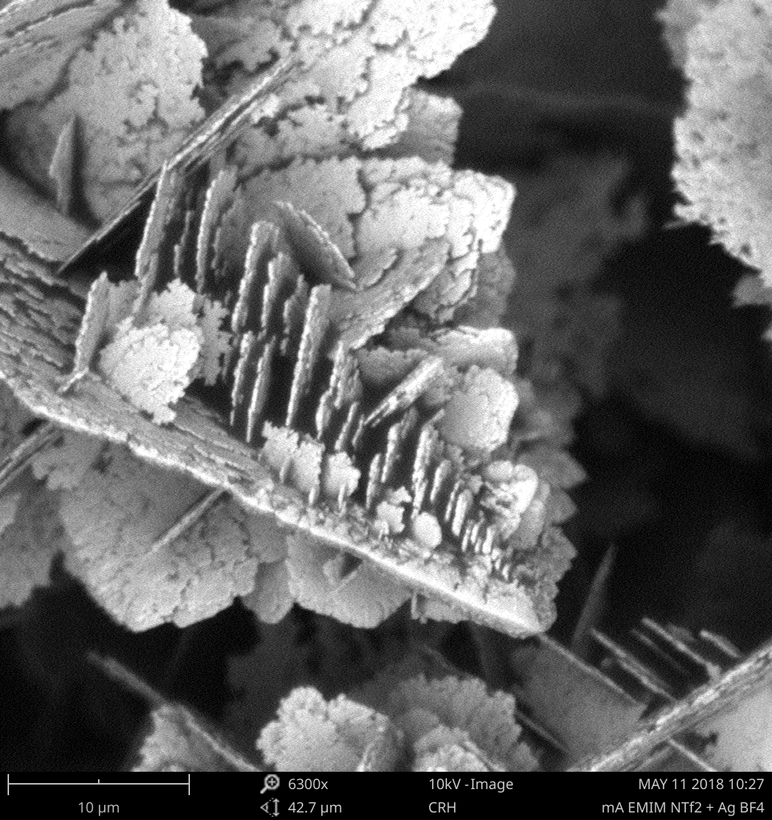
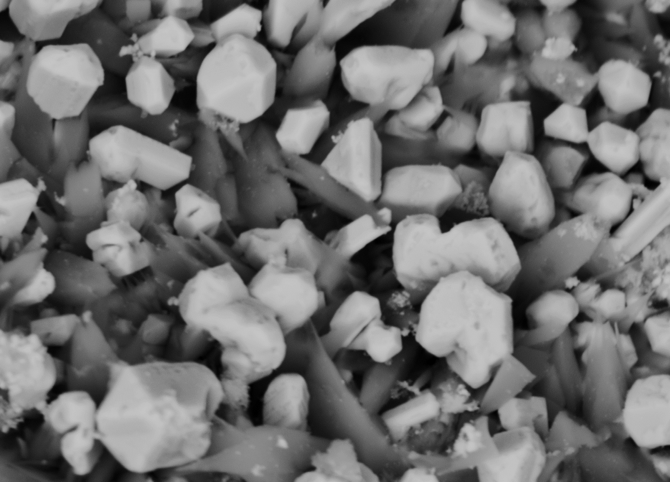
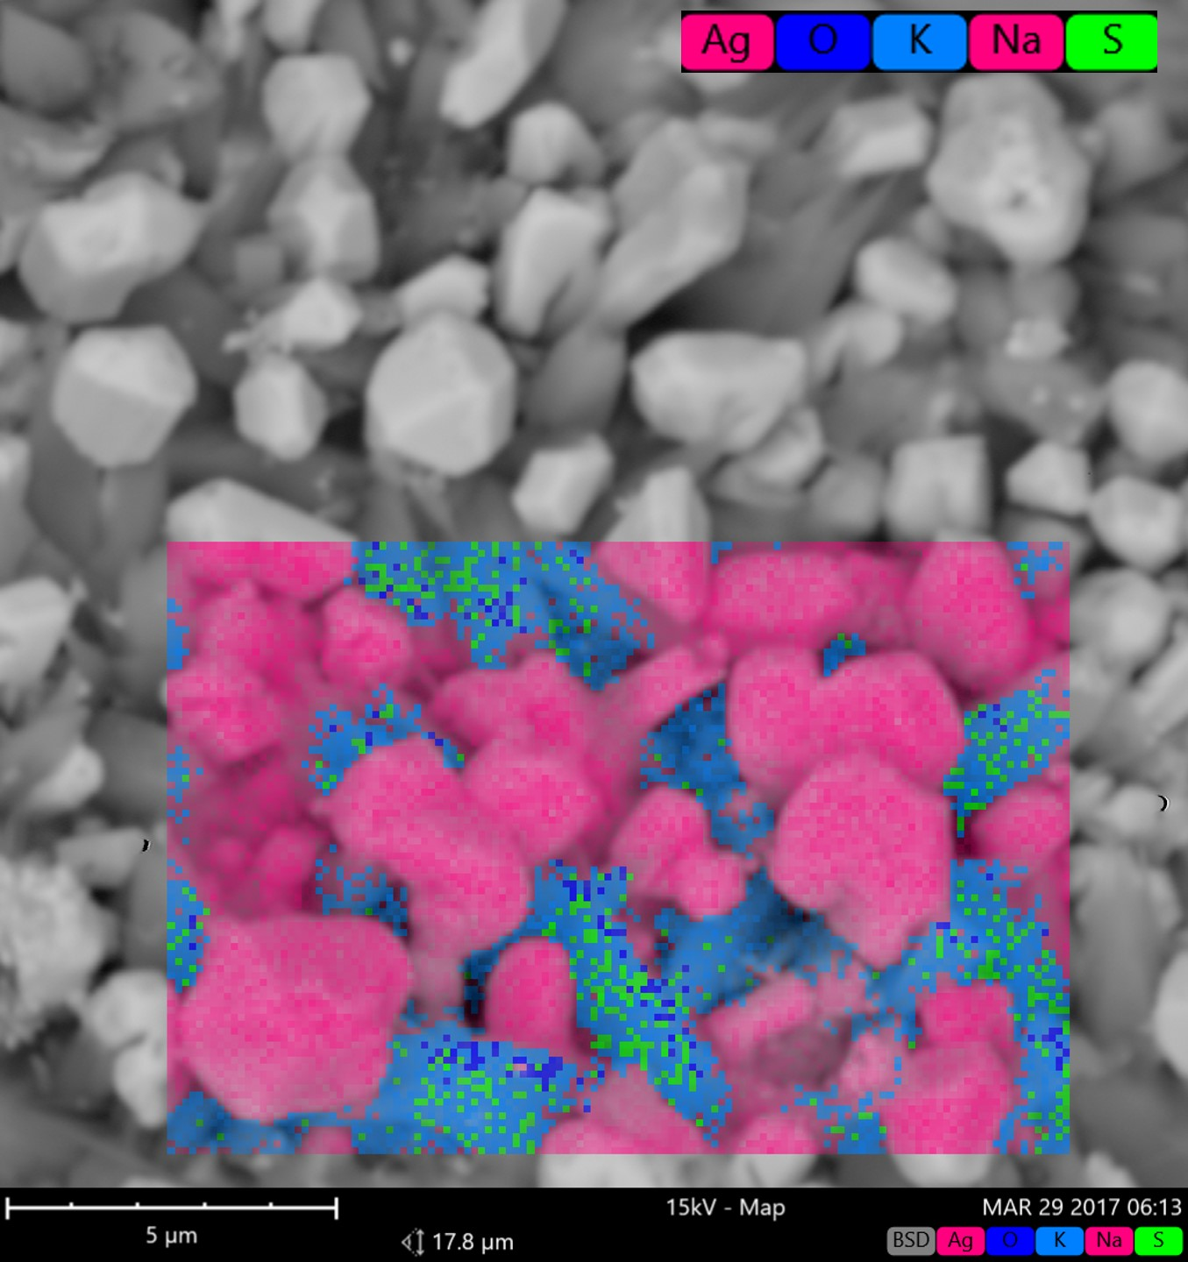
Determining the best solvents for electrodeposition requires good understanding of how solvents affect deposition.
Effect of IL cation
Effect of IL anion
Stability of cation determines negative limit of electrochemical window
Cation affinity for different crystal faces determines preferred growth orientation
Binding strength of IL anion determines potential that metal ions are reduced
metal
Initial problems
No well-established, reliable reference electrode
Literature on electroplating shows only thin layers
Metals deposited from ILs are often dendritic or contaminated
anion
anion
Columnar growth
Na
5µm
5µm
Planar growth
Dendritic silver deposit
Silver deposit contaminated with cation breakdown products
Cation defines electrochemical window

Slide 6
Challenge #1: Developing a reference electrode for controlling potential in electrochemistry experiments
oxidizing
Na
reducing
5µm
Silver deposit contaminated with cation breakdown products
Typical reference electrode found to drift by 100+ mV during short experiment

Slide 7
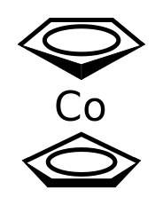
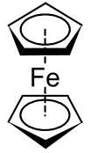

Precise control of potential is critical and requires developing a reference electrode for use in ionic liquids
Cobaltocene
Ferrocene
Ferrocene drift
Reference electrode drift
A stable reference electrode is required for plating alloys and gradients.
A silver wire quasi-reference electrode (QRE), commonly used for IL electrochemistry, shows drift in potential throughout experiment.

Slide 8

Ag₂S coated Ag wire found to be most stable and reproducible reference electrode for ionic liquids
Reference electrode (RE) stability is increased by isolating RE in tube with porous frit.
~ 1 mV drift per day over 2-3 month lifetime
Ag₂S coated Ag Wire
Glass tube
Ionic liquid
RE reproducibility is increased by incorporating a well-defined surface coating.
Variation of 57 mV between REs with Ag₂S coating (vs. 225 mV variation without Ag₂S coating)
PTFE shrink tube
  Paper: Horwood, Electrochem. Comm. 88, 105 (2018).
  Patent: Solvent Independent Reference Electrodes for Use with Non-aqueous Electrolytes, 16336–00083–US, 2018.
Porous glass frit

Slide 9
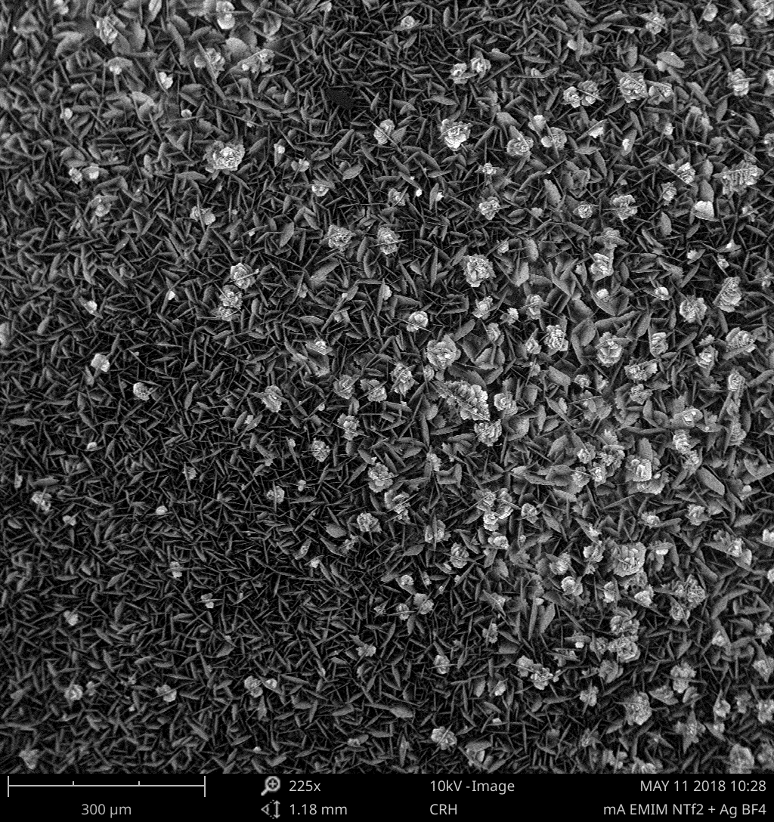
Challenge #2: Measuring diffusion coefficients for metal ions in ionic liquids
10µm
300µm

Slide 10
Metal ions seem plagued by unusually poor diffusion in IL while redox standards show normal diffusion
Cu²⁺
+
Diffusion of redox standard is slower
in IL vs. water
Diffusion of Cu²⁺ is orders of magnitude
slower than redox standard
Diffusion of Ag⁺ and Cu²⁺ ions in ionic liquids is ~1000x slower than in water.
BMP NTf2 + 5 mM Fc + 20 mM CcPF6
EMIM BF4 + 0.2 M Cu OTf

Slide 11
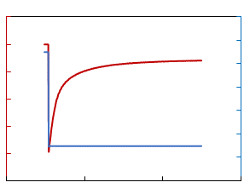
Current decay can be used to measure the diffusion coefficient
Q (charge)
Measure current
Current
Potential
Q
Slope = 2nFAπ^{-1/2}D^{1/2}C
Apply potential
Time
t^{1/2}
Cottrell equation
Q = 2nπ ^{-1/2}FAC_{o}D^{1/2}t^{1/2}
Q(measured)=(constant)(unknown) time

Slide 12
Diffusion coefficient varies with ionic liquid anion
Metal ions diffuse 300-6000x slower in ILs vs. water
Copper ions diffusion slower than silver ions

Slide 13
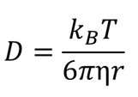
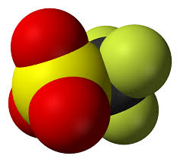
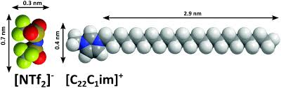
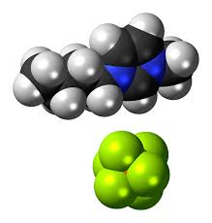
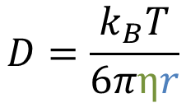
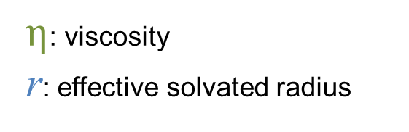
Solvated radius may be more influential than viscosity in determining metal ion diffusion in ILs
$$D=\frac{k_{B}T}{6πηr}$$
$η$: viscosity
r: effective solvated radius
+
Cu²⁺
Cu²⁺
Cu²⁺
anion
anion
anion
How do we measure/estimate r? How many anions are in solvation shell?

Slide 14
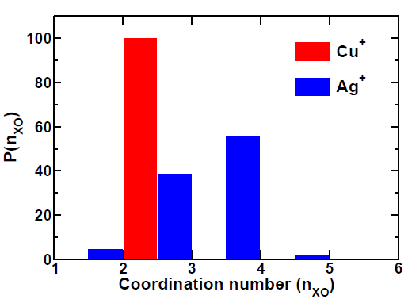
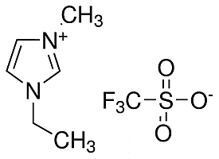
Solvation of ions in ionic liquids is important for metal ion diffusion and reduction potential
Copper
anion
anion
Molecular dynamics simulation of Cu⁺ in EMIM OTf
Cu⁺ has a static solvation shell of two anions
Ag⁺ has a fluid solvation shell of 2-5 anions
Pham et al. J. Phys. Chem. B 2018, 122, 50, 12139-12146.

Slide 15
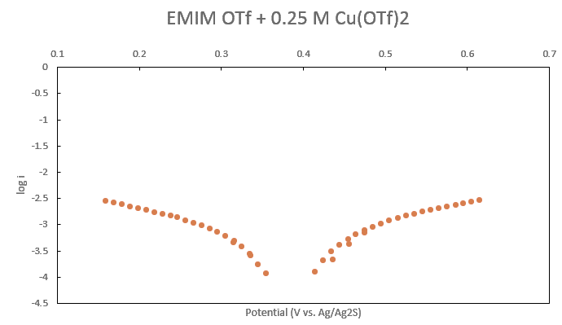
New pulsed potential approach was developed to measure reduction potentials in ionic liquids
Potential
Measure current
Current
Potential
Reduction potential
Apply potential
Anion has significant effect on reduction potential of metals in ILs
Log(current)
Time
Cu reduction
Cu oxidation
Intersection → reduction potential
Slope → info on mechanism

Slide 16
Strength of metal/anion interaction is a key factor in both reduction potential and diffusion coefficient
Metal ions are harder to reduce in ILs compared to water

Slide 17
Strength of metal/anion interaction is a key factor in both reduction potential and diffusion coefficient
Metal ions are harder to reduce in ILs compared to water
Metal ions diffuse 300-6000x slower in ILs vs. water
Metal ions are more easily reduced in ILs with better diffusion, indicating weaker binding of anions.
Ideal ILs for deposition have low overpotentials and fast diffusion

Slide 18
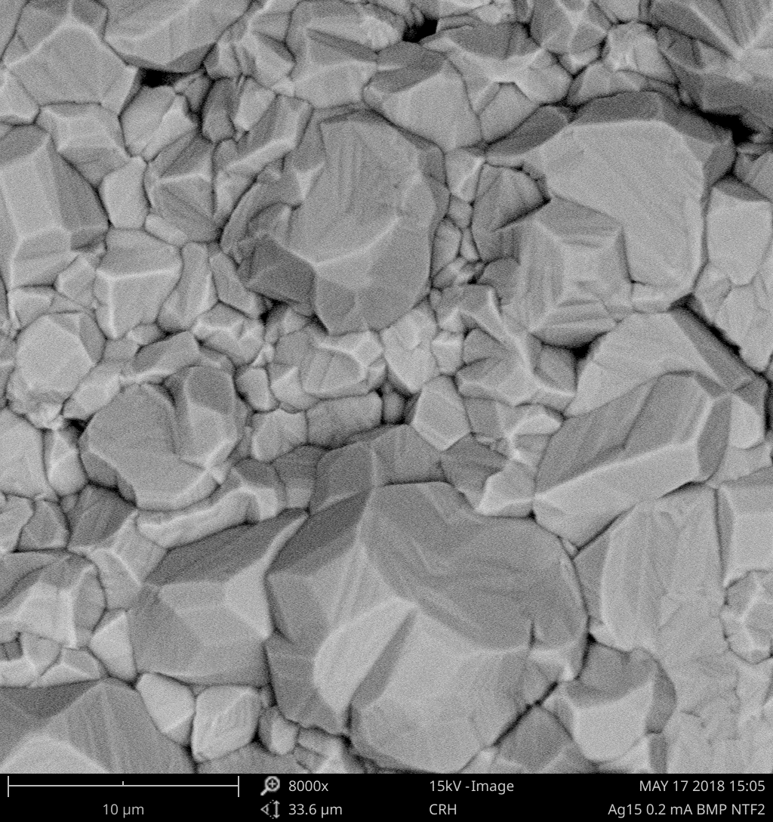
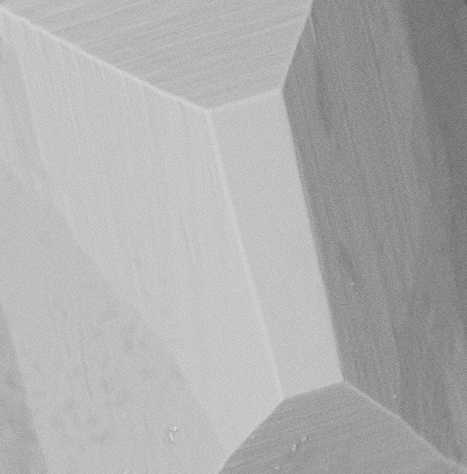
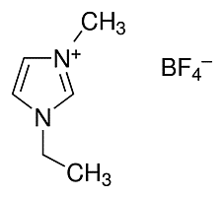

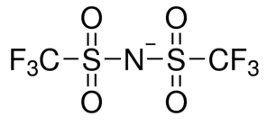
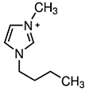
Study of copper and silver deposition has allowed us to better understand electrodeposition in ionic liquids, and move towards choosing appropriate ILs for deposition
Silver deposited from ionic liquids
5µm
Change anion for faster diffusion
Change cation for larger crystals
5 µm
5 µm

Slide 19
We are using this knowledge to select candidate ILs for electroplating beryllium
5µm
Silver
Change anion for faster diffusion
Change cation for larger crystals
5 µm
5 µm
Future work:
Beryllium electrodeposition
Need soluble, but weakly bonded, Be precursor
Need IL anion strong enough to solvate Be, but not too strong to inhibit diffusion and reduction
Need cation that promotes planar Be deposits

