Slide 1
Design and Development of Low Density Tantalum Oxide Hohlraum Liners via Templating of Additive Manufactured Lattices
Target Fabrication Meeting 2019
Presenter James Oakdale
April 23-26, 2019
LLNL-PRES-772622

Slide 2
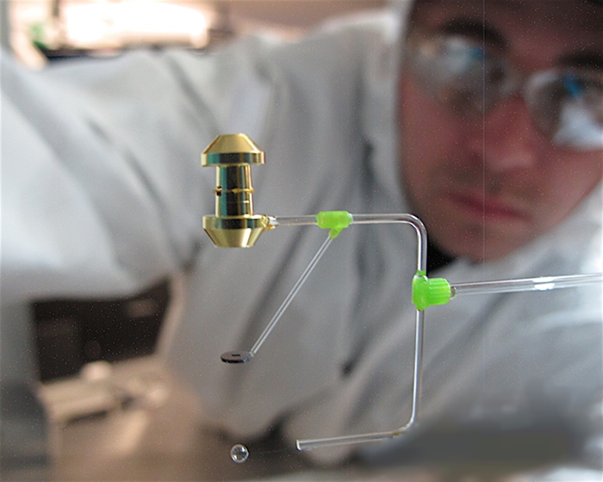
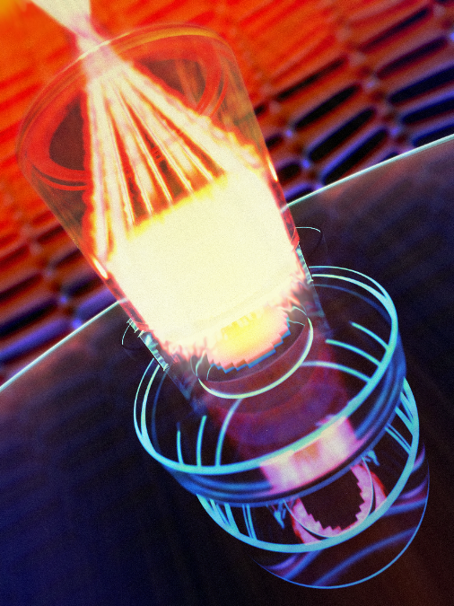
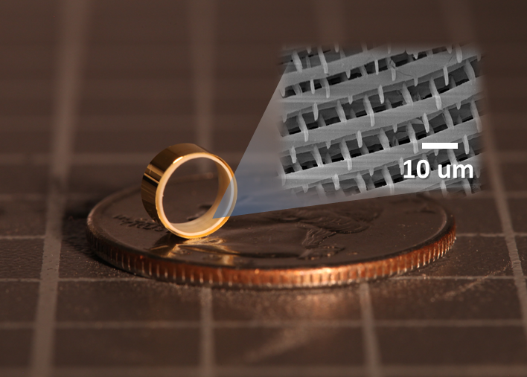
Target fabrication presents a myriad of material science challenges, we are advancing additive manufacturing solutions
Additive manufacturing (AM), i.e. 3D printing, is already an indispensable target fabrication tool
AM opens the door to bespoke designer foam materials that would otherwise be inaccessible using traditional manufacturing techniques
https://lasers.llnl.gov/news/experimental-highlights/2017/september
Material Strength Tests
Foam-lined Hohlraums
Other Applications
Diagnostics:
-neutral density filter
-zone plate mask
External Collaborations:
-Ion Accelerator
Developed under 15-ERD-019
Under Development 18-ERD-004
Notes:
Additive manufacturing – trial and error

Slide 3
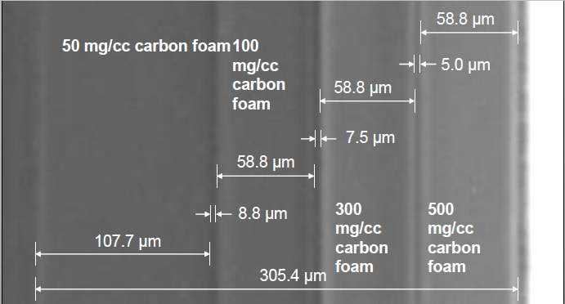
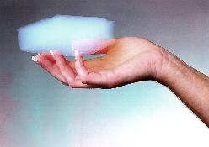
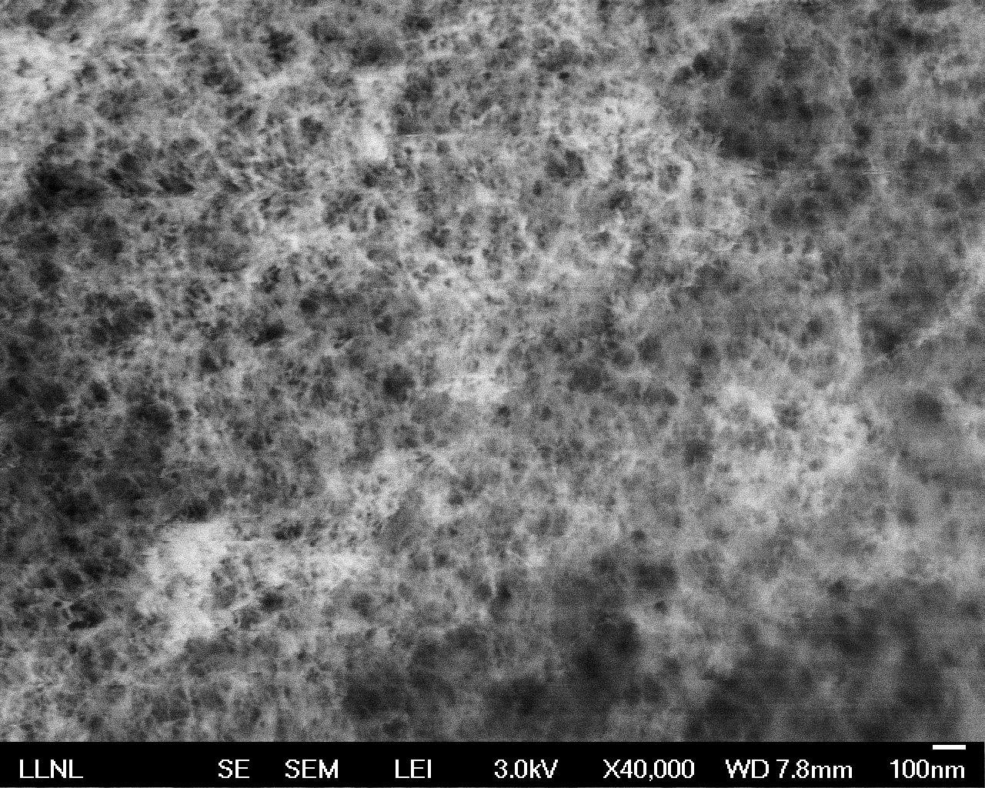
A variety low density porous materials are utilized for laser targets, processing these materials can be challenging
Aerogels are often the low-density material of choice due to the wide range of available compositions and the ability to prepare ultra-low densities with extremely fine pore structure
Image from General Atomics
500 nm
Additive manufacturing holds promise as a tooling-free fabrication method with increased reproducibility and the ability to make tailored density profiles in any form factor.
Notes:
Additive manufacturing – trial and error

Slide 4
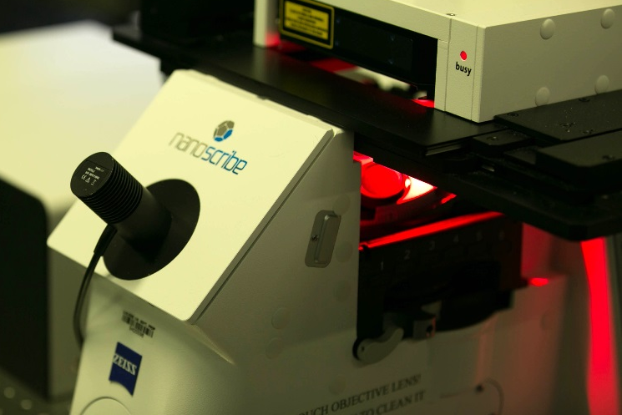
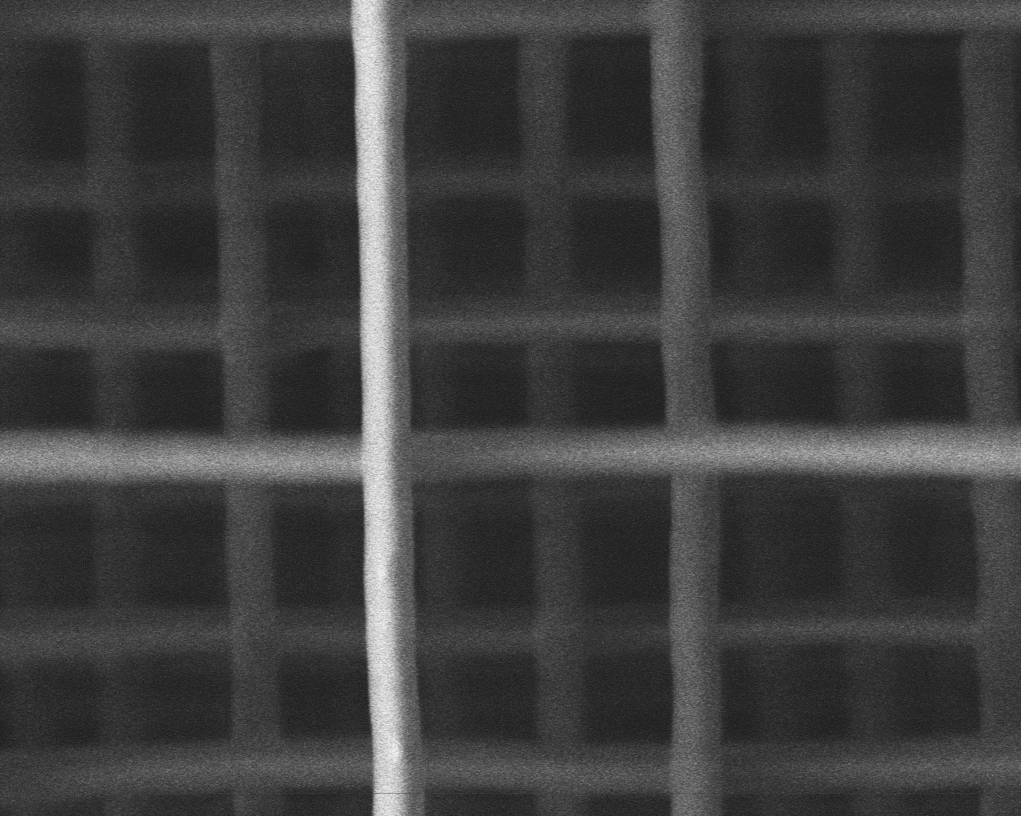
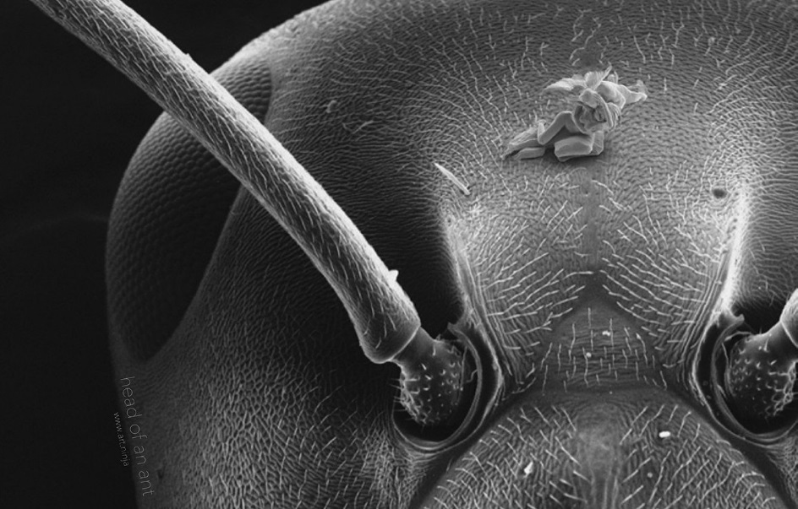
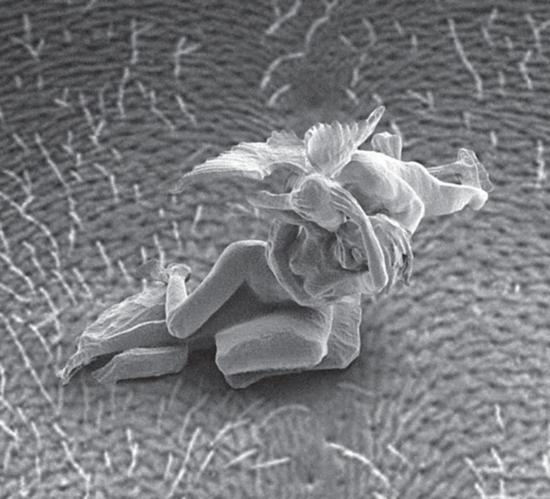
DLW-TPP offers the resolution and throughput needed to 3D-print low density porous materials
DLW-TPP = Direct Laser Writing via Two Photon Polymerization
Here, a femtosecond pulsed 780 nm laser delivers enough flux (TW/cm²) to drive non-linear multi-photon absorption.
1 µm
(top-down view of a single voxel line)
“Cupid and Psyche” on the head of an ant – Jonty Hurwitz
https://3dprintingindustry.com/news/artist-3d-prints-and-loses-the-worlds-smallest-sculptures-36561/
Notes:
Additive manufacturing – trial and error

Slide 5
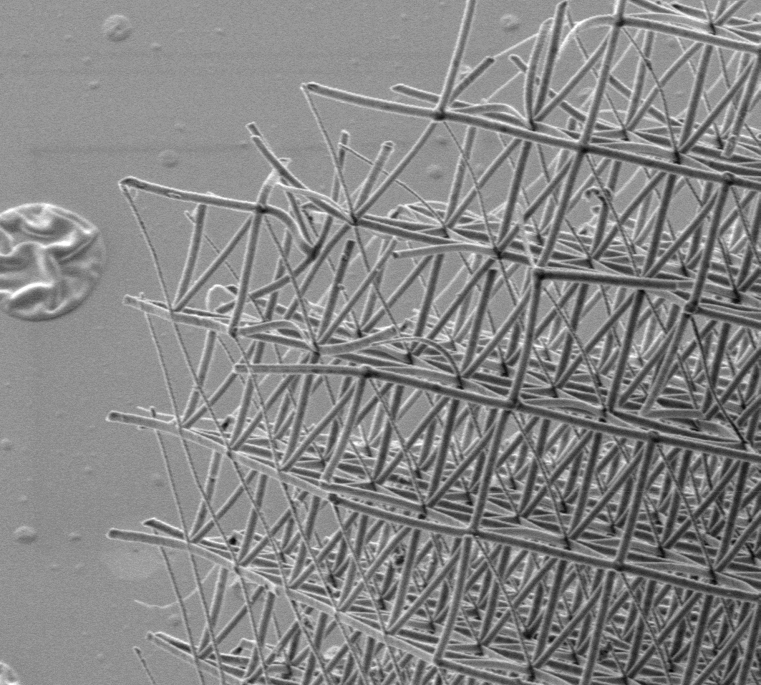
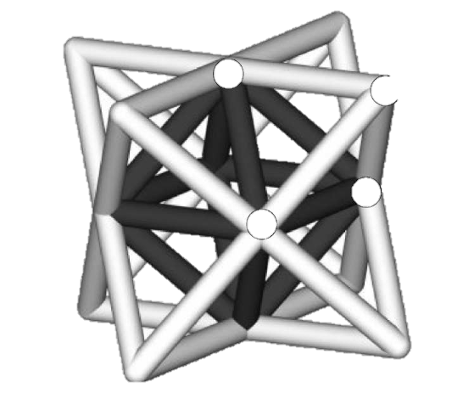
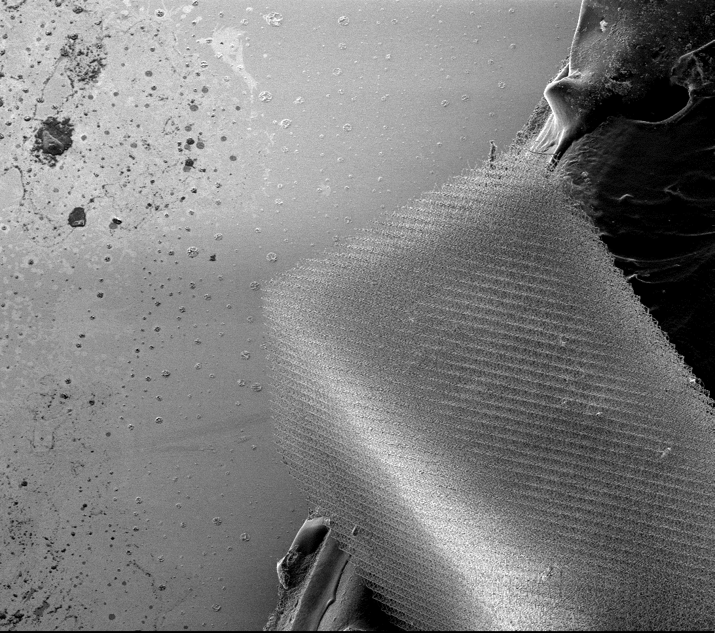
Target material tolerances are strict and there are guide lines for 3D printed materials, for instance foam pore size
The density of spacing-filling lattice structures is a function of cell size and feature size (i.e. beam diameters or strut size)
25 um unit cell octet-truss lattice
10 um
Strut Size
2 um
Cell Size
0.5 um
1 um
0.2 um
Density = 12 mg/cc
100 um
Material requirements for HED targets are strict and push the limits of what is currently possible even with sophisticated printing techniques such as DLW-TPP.

Slide 6
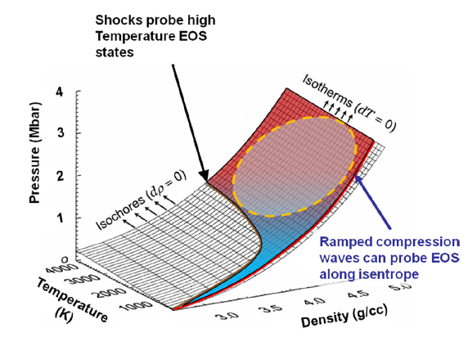
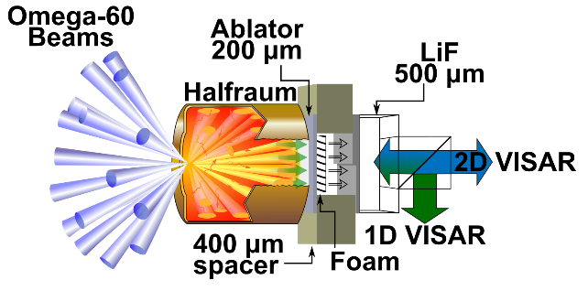
AM-Foam Application: Ramp-compression material strength tests on the Omega Laser Facility
Ramp-compression material strength tests explore the behavior of materials in off-Hugoniot states (high pressure, low temperature region of phase space)
Candidate component for 3D-printing
Physics of Plasma 2012, 19, 056311
The density and thickness of the foam component helps control the temporal shape of the pressure wave applied to the material target of interest.
VISAR = velocity interferometer for any reflector
Notes:
Additive manufacturing – trial and error

Slide 7
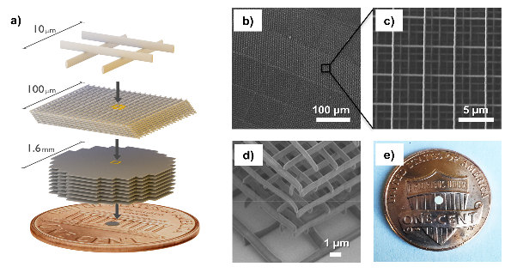
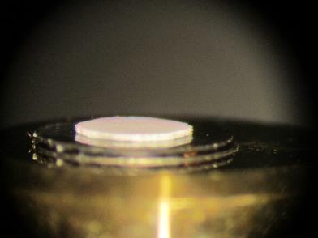
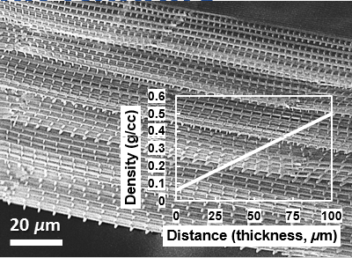
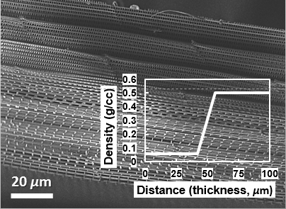
3D printing enabled on-demand fabrication of graded density foam materials for material strength tests
DLW-TPP was carried out using a commercial Nanoscribe Photonic GT printer. Low density foam structures were composed of ‘log-pile’ lattices.
Predicted Densities
300 nm (line Width)
400 nm
Measured Densities
Adv. Funct. Mater. 2017, 27, 1702425
0.5 mm
Notes:
Additive manufacturing – trial and error

Slide 8
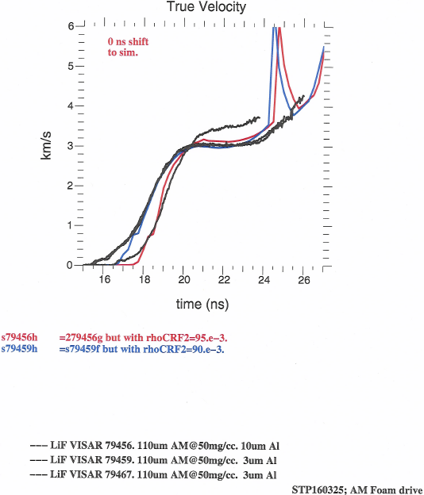
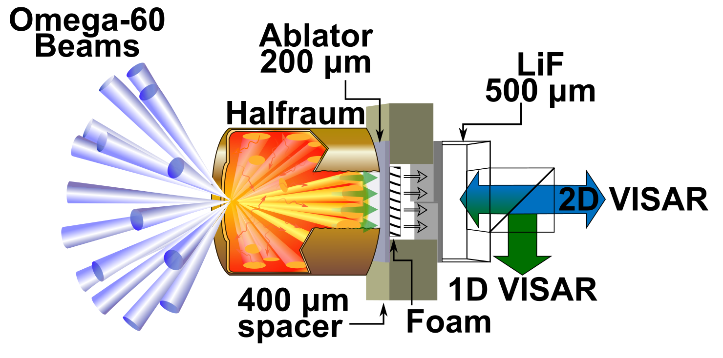
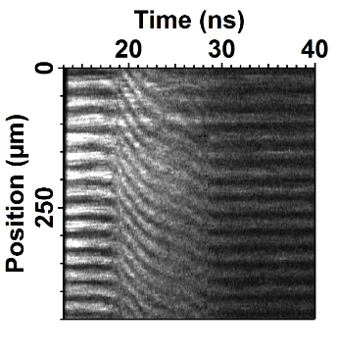
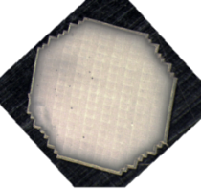
Preliminary HED experiments with AM-foams were promising but an undesired pattern was detected
1D VISAR Diagnostic
0.5 mm
AM-Foam
~70 mg/cm³
2D VISAR Diagnostic
0.5 mm
AM-foam left an apparent foam structure related shock pattern on the Al-sample target. This result necessitated further refinement of the printing process.
VISAR = velocity interferometer for any reflector
Notes:
Additive manufacturing – trial and error

Slide 9
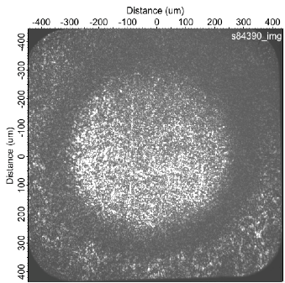
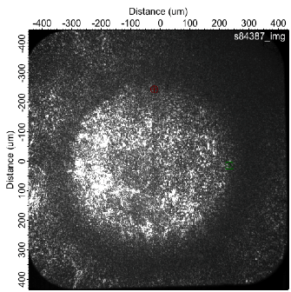
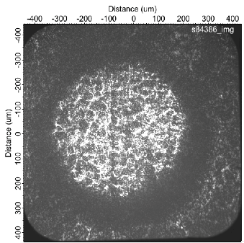
Ramp-compression of second generation samples showed high drive uniformity and left behind no discernable pattern
No Foam
AM Foam
Standard
Interdigitated
Chemical Foam
2D VISAR Snapshots
No Foam
Aerogel
In addition to good drive uniformity, AM-foams yielded a potentially useful pressure hold period that is not observed in chemical foams samples. Testing is on-going.
VISAR = velocity interferometer for any reflector
Notes:
Additive manufacturing – trial and error

Slide 10
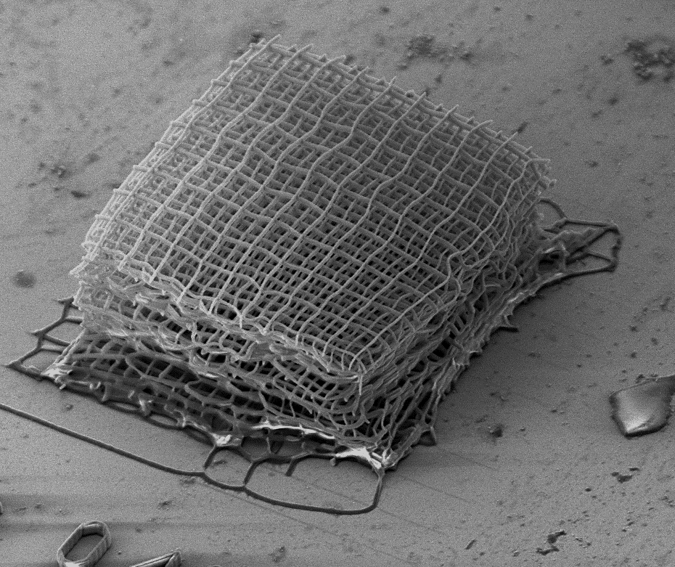
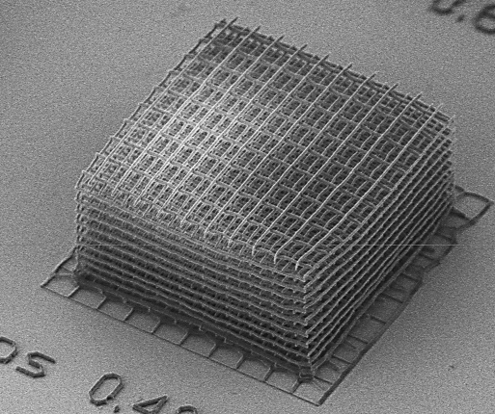
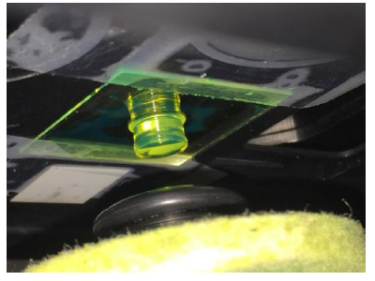
We continue to supply AM-Foams for further HED experiments and we are now working to expand the materials accessible via AM processes
A variety of designer AM-foams have been shot including stepped and graded density
Demonstrated densities* range from 50 mg/cm³ to 1.2 g/cm³ for polymeric AM-Foams.
  *Pore size was restricted to <10 um.
  *Self-supporting structures required >350 nm wide voxels.
<300 nm Features
>300 nm Features
vs.
10 µm
10 µm
DLW-TPP derived materials are generally polymeric
  Composition is approx. C_{0.40}H_{0.45}O_{0.15}
Notes:
Additive manufacturing – trial and error

Slide 11
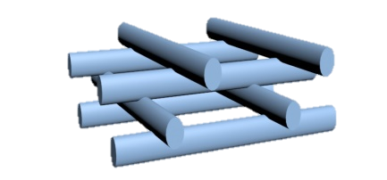
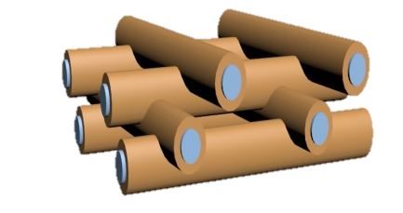
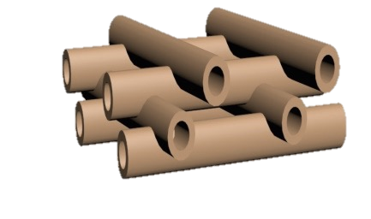
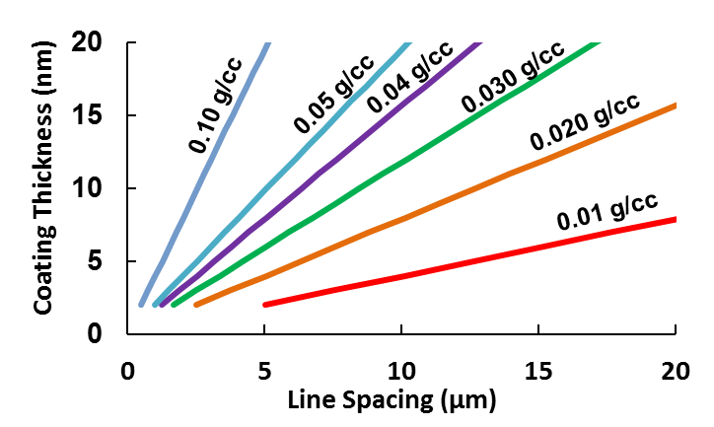
We are now working towards a universal templating strategy using atomic layer deposition followed by selective polymer removal
Template Removal
Template
Lattice Density after Template Removal*
Advantages of Templating
Retains AM Features
Enables Mid-High Z Materials
Significant Density Reduction
Dust mitigation (ideally)
*Density calculations for a DLW-TPP log pile lattice with an tantalum oxide ALD coating
ALD = Atomic Layer Deposition
Notes:
Additive manufacturing – trial and error

Slide 12
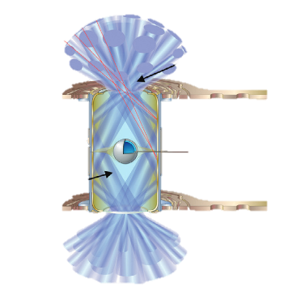
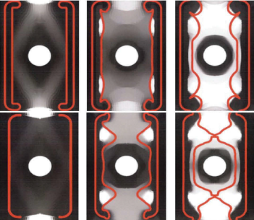
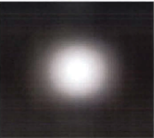
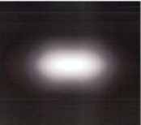
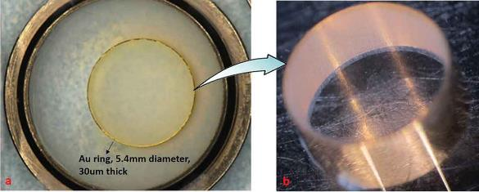
Templated AM-Foam Application: Foam lined Hohlraums liners for improved energy efficiency during ICF
Interaction of laser beams with the hohlraum wall (typical Au with or without U) creates an inward moving plume of plasma, which may cause undesirable backscatter and refraction resulting in energy loss and unsymmetrical drives.
Beginning
Middle
End
With Foam Liner
Without Foam Liner
Fusion Science and Technology, 73:2, 194-209, 2018
Current fabrication entails laser-cutting cast-liners from highly-uniform, low-density, tantalum oxide (Ta₂O₅) aerogels.
Notes:
Additive manufacturing – trial and error

Slide 13
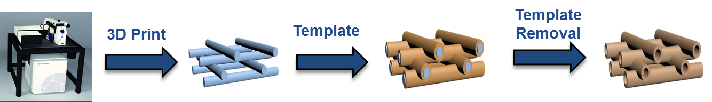
AM-foam materials undergo a series of shrinkages and one expansion throughout the templating process
Design:
Programmed
Printed
ALD Ta₂O₅
Etched Sample
Reality:
~9% volume shrinkage
Solution Etching ~0.5% expansion
1% Shrinkage
Plasma Etching ~1-2% shrinkage
Thermal burnout ~5-15% shrinkage
Programmed
Printed
Thermal Cycle
ALD Ta₂O₅
Etched Sample
AM Liners are printed, inserted into hohlraums, ALD coated to various thicknesses (5-20 nm) of tantalum oxide, and then the polymer is etched away.

Slide 14
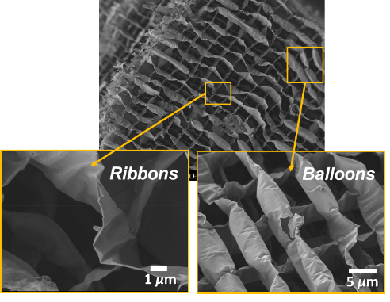
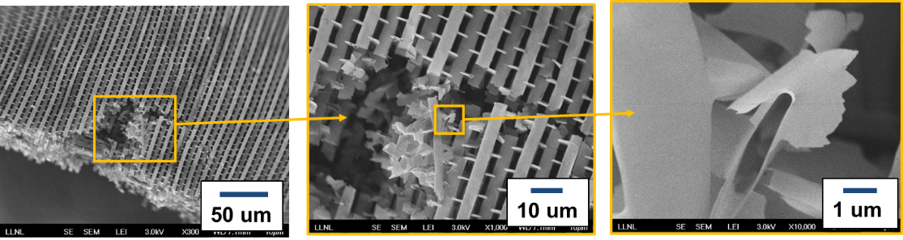
We developed a solution etch process to remove the polymeric template without distorting the liner structure
Initial attempts to ‘burn-out’ >400 ºC or plasma etch away the polymeric template caused significant shrinkage
Selective solution etching of the template results in no volumetric shrinkage. *The volume of the part actually increases by ~0.5% after solution etching.
Cross-linked (insoluble) photoresist
Soluble Monomers

Slide 15
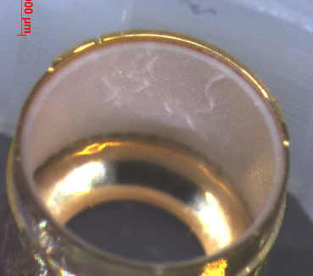
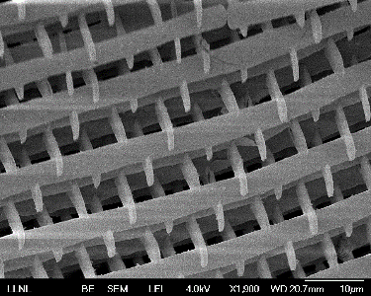
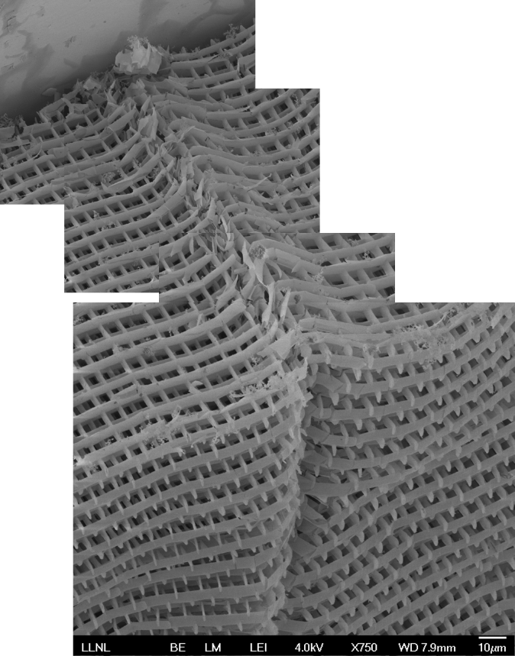
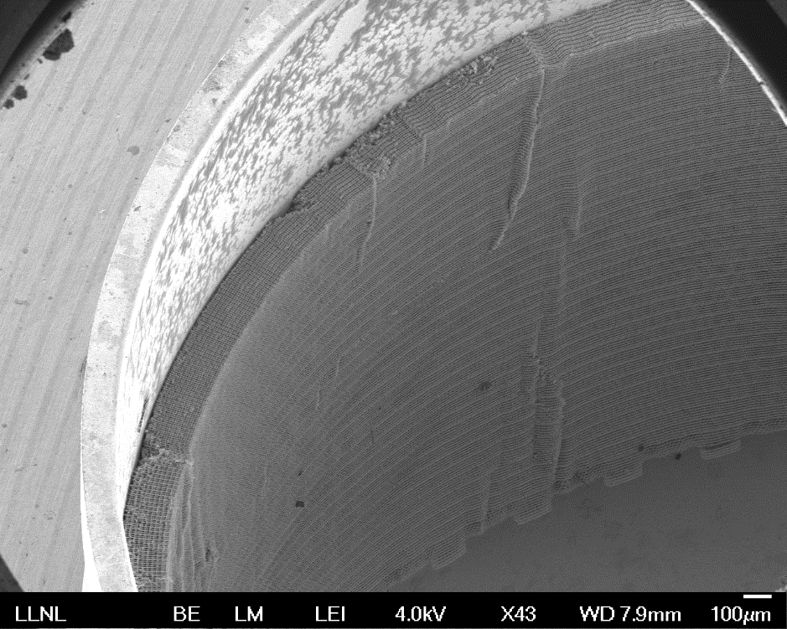
We have successfully demonstrated the templating process on a full scale hohlraum liner
Full scale, 5.769 mm diameter 20 mg/cc Ta₂O₅ (10 nm) liner with 200 um thick walls inserted into a Au hohlraum.
Au Hohlraum
Buckling defects due to lattice swelling during etching
AM-Foam
Density ~ 20 mg/cc
We are currently working on improving the reproducibility of this process, which will entail development of more advanced lattice designs that can better accommodate swelling.

Slide 16
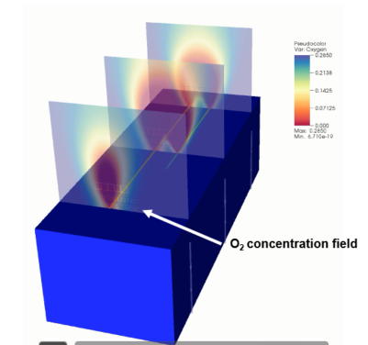
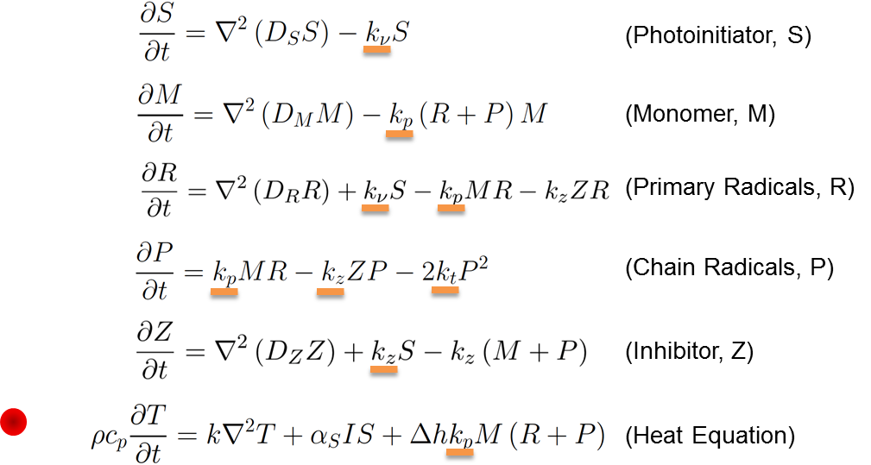
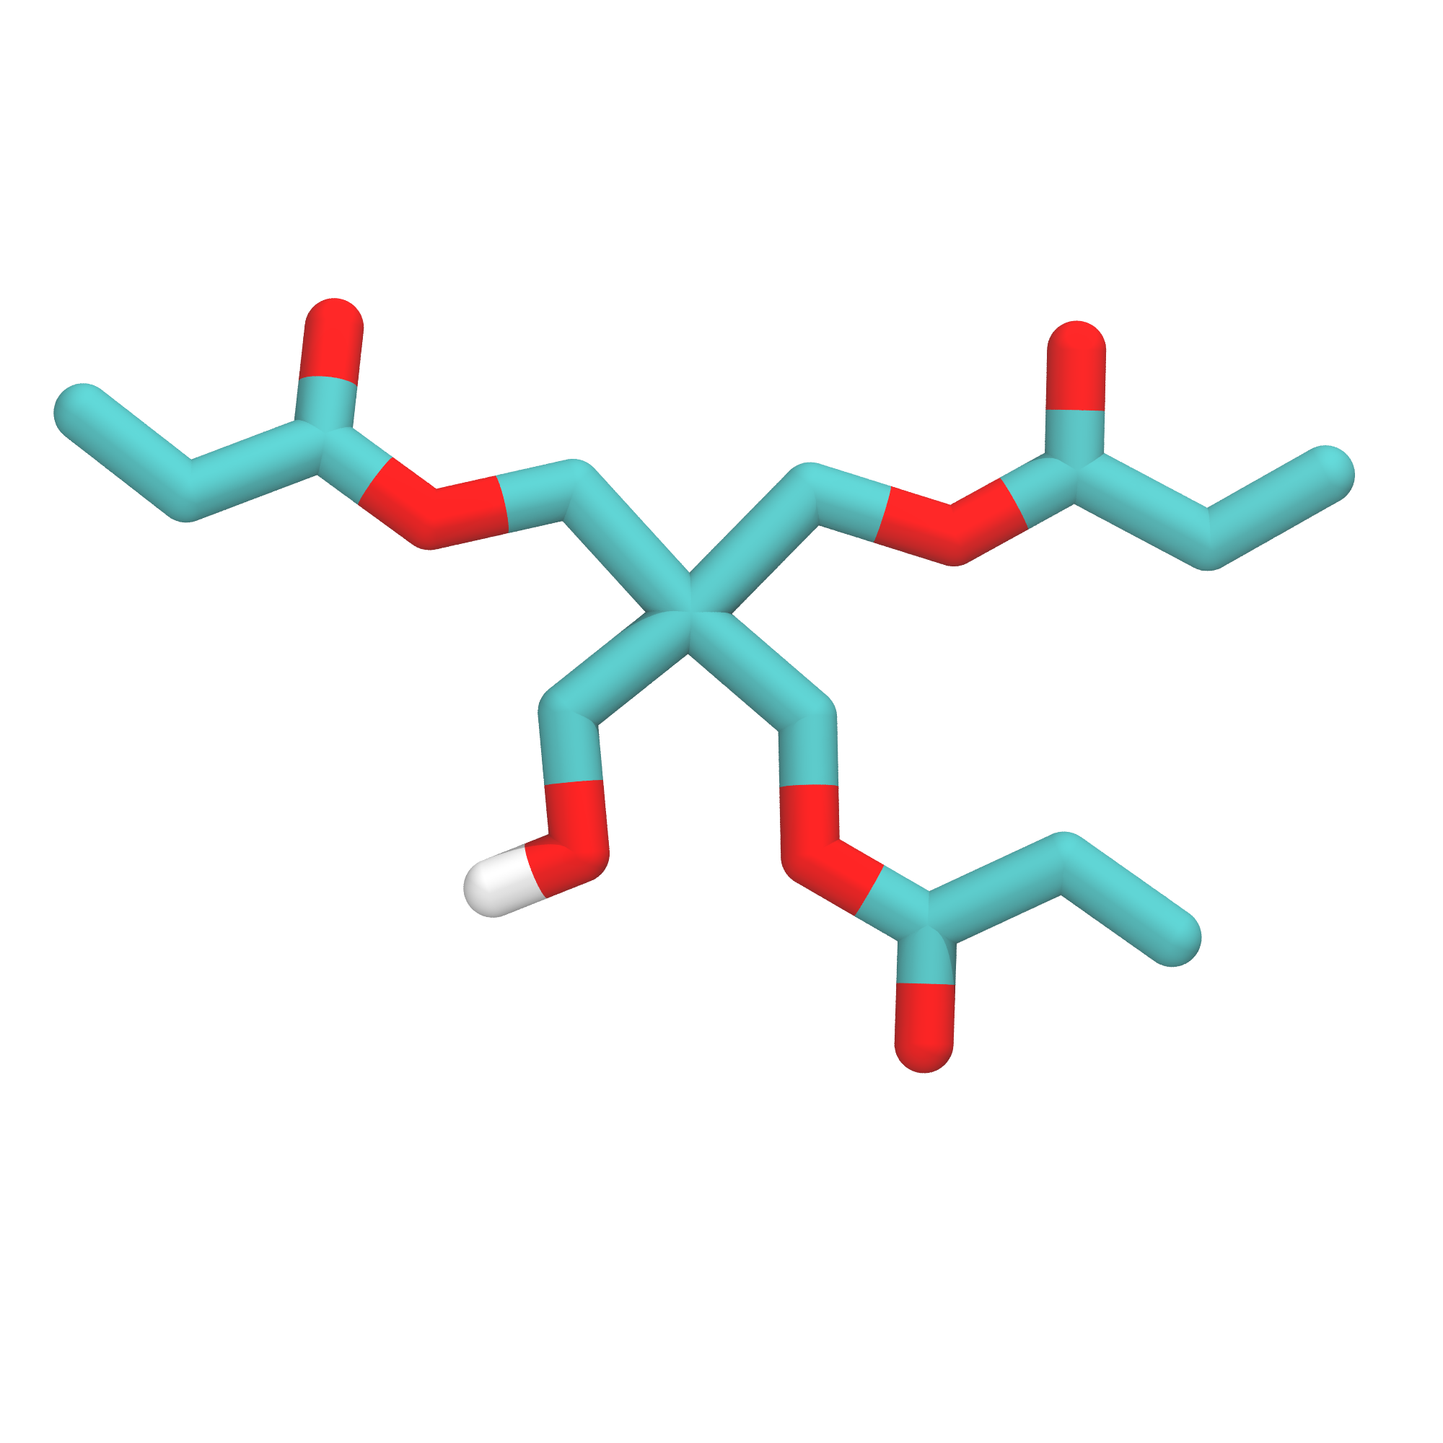
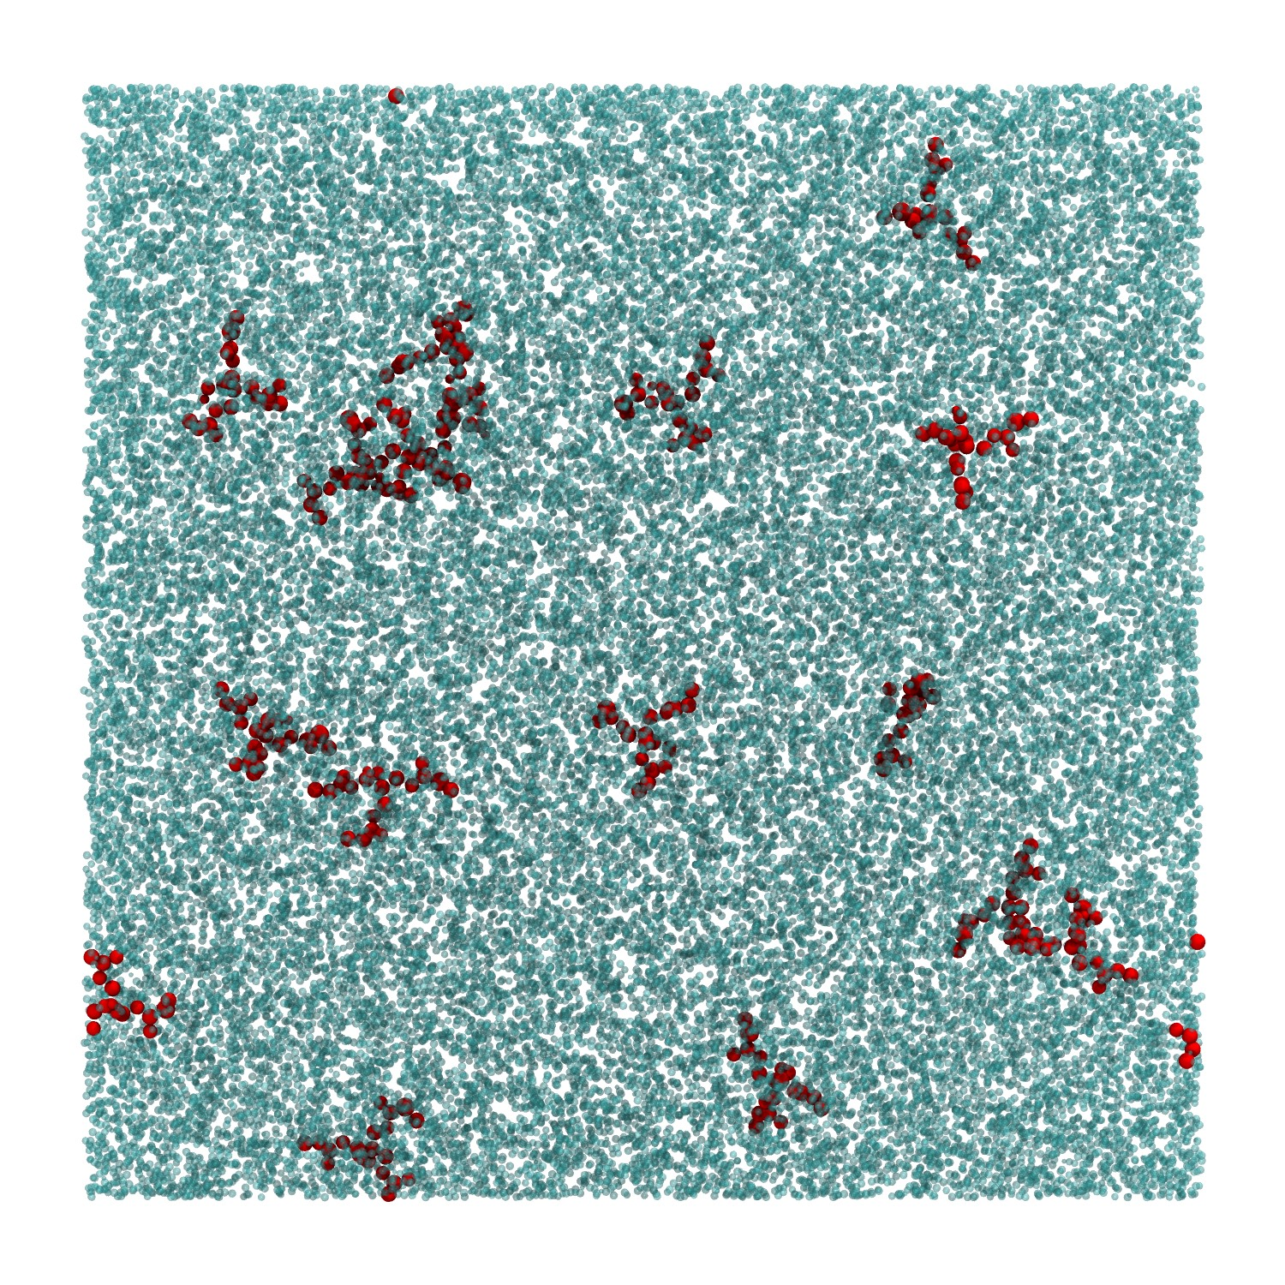
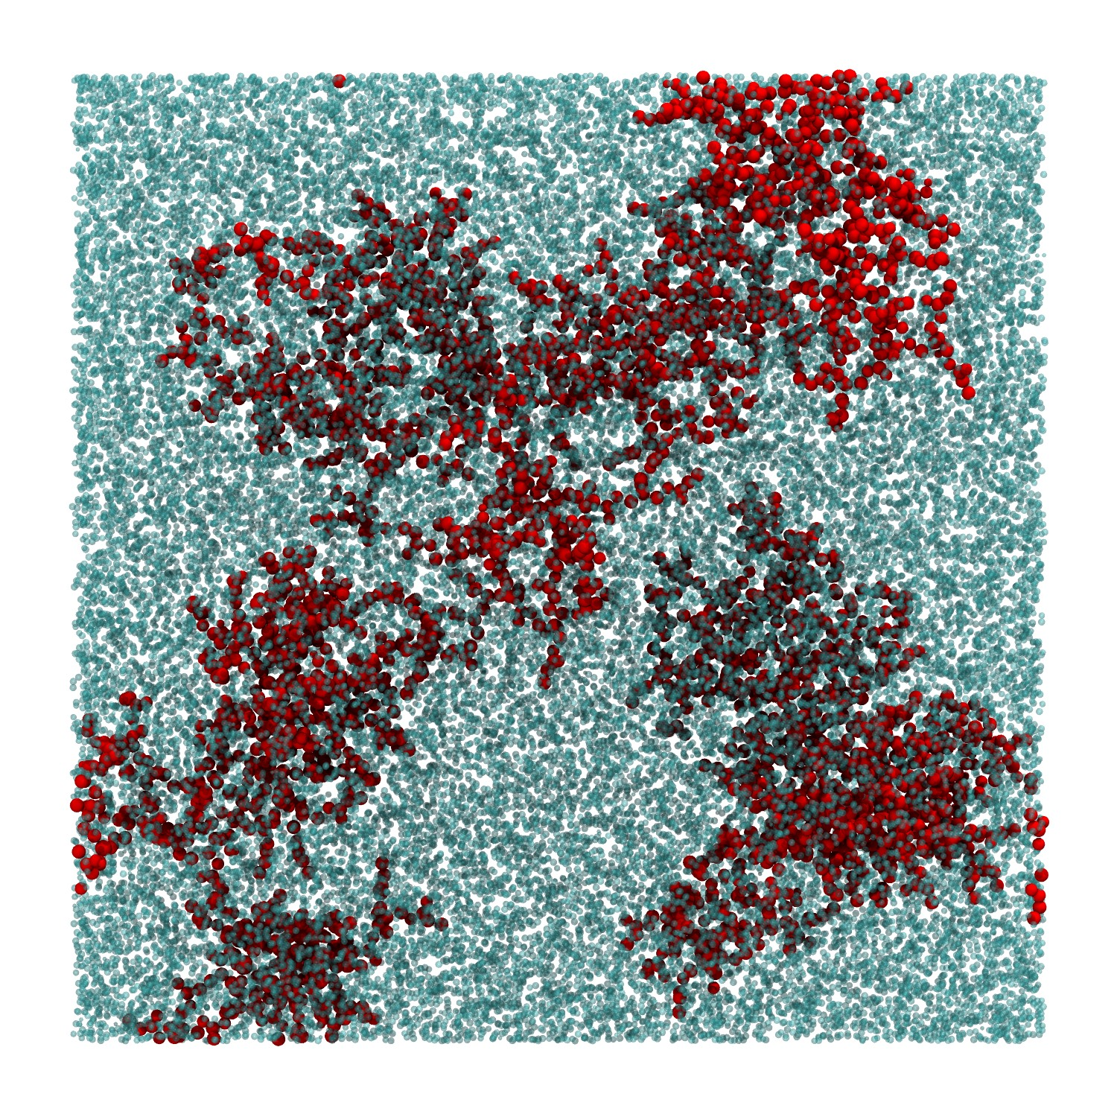


Finally, we are working to develop atomistic and continuum scale models to improve DLW-TPP process optimization and to guide photoresist design
O₂ concentration field
Degree of conversion
Atomistic = Network Morphologies
…new bond, bend, and torsion topology is mapped onto the affected region

Slide 17
Additive manufacturing of low density porous materials via DLW-TPP has the potential to provide designer materials.
AM-Foams for Material Strength Tests
Supported by LDRD: 15-ERD-019
Project Team
Juergen Biener
Matthew Worthington
Jianchao Ye
James Oakdale
Jean-Baptiste Forien
William Smith
Ray Smith
Suzanne Ali
Hye-Sook Park
Shon Prisbrey
Peter Amend
Trevor Willey
L.B. Bayu Aji
Tony van Buuren
Carol Davis
Target Fabrication
Ted Baumann
Advanced Templating
Supported by LDRD: 18-ERD-004
Project Team
Juergen Biener
Michael Stadermann
Monika M. Biener
Matthew Worthington
Salmaan H. Baxamusa
Jianchao Ye
James Oakdale
Jean-Baptiste Forien
Daniel Malone
Chantel Aracne-Ruddle
Todd H. Weisgraber
William Smith

Slide 19











An advanced interdigitated stitching strategy was developed to over come standard stitching induced artifacts.
Galvo-scanning the write laser enables >10 mm/sec print speeds but also restricts the overall writable area (field of view) due to various optical aberrations and vignetting.
Larger target fab. sized structures are made by stitching together smaller individually printed blocks (~100 x 100 µm).
Vignetting - wikipedia
Standard Stitching
Interdigitated Stitching
50 µm
etc.
Adv. Funct. Mater. 2017, 27, 1702425
5 µm
Notes:
Additive manufacturing – trial and error

Slide 20





Interdigitated stitched samples show higher density uniformity compared to standard stitched samples.
Differently stitched samples of identical density and unit-cell lattice structure were imaged via x-ray computed tomography at ALS beamline 8.3.2.
Standard Stitching
Interdigitated Stitching
The improved homogeneity of the interdigitated sample is confirmed through the observation of largely featureless CT images.
Notes:
Additive manufacturing – trial and error

