Slide 1
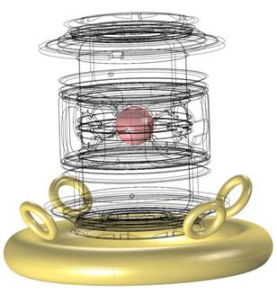
Toward quantum levitation of thermonuclear fusion fuel capsules
TFM 2019
Annapolis, MD
Sergei Kucheyev
April 24, 2019

Slide 2
The team
LLNL
Bimo Bayu Aji
Alex Baker
Elis Stavrou
Anna Hiszpanski
Alyssa Maich
Scott McCall
David Steich
Sergei Kucheyev
LLNL summer students
Robert Jacob
Jacob Beckham
Dante O’hara
GA
John Bae
Jason Rodriguez

Slide 3
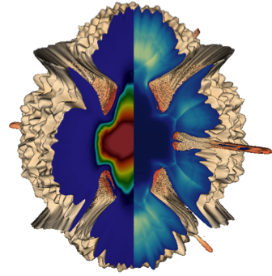
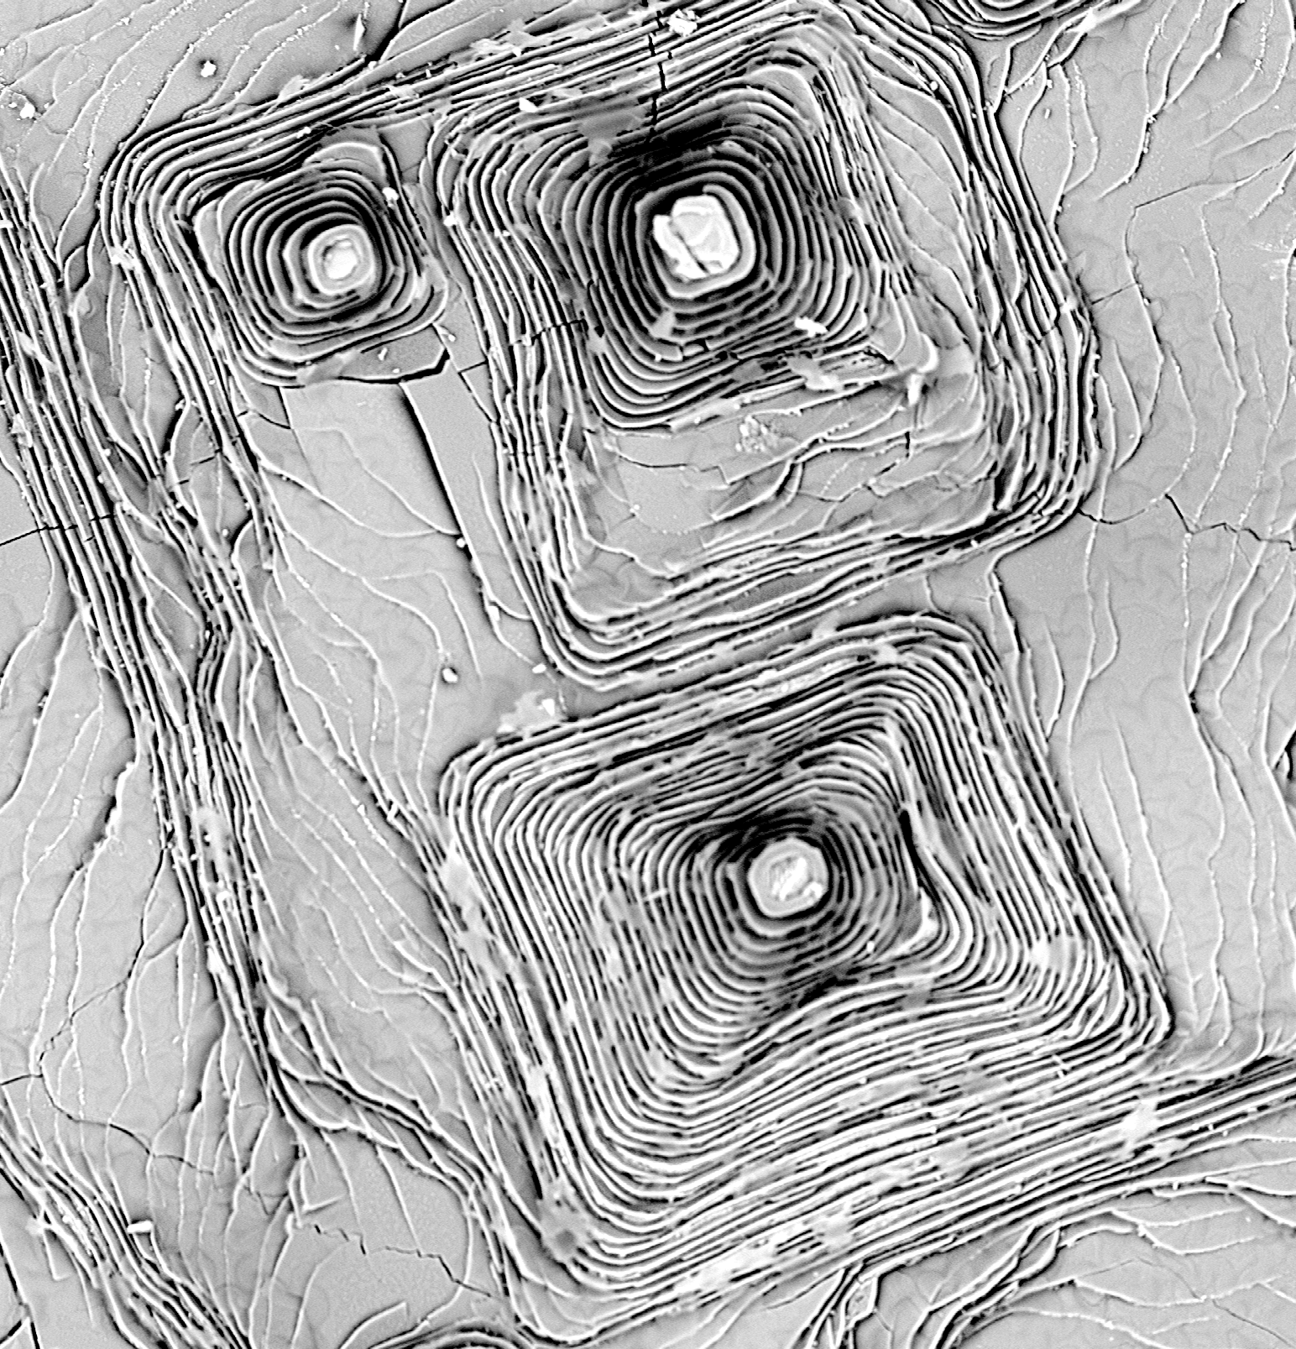
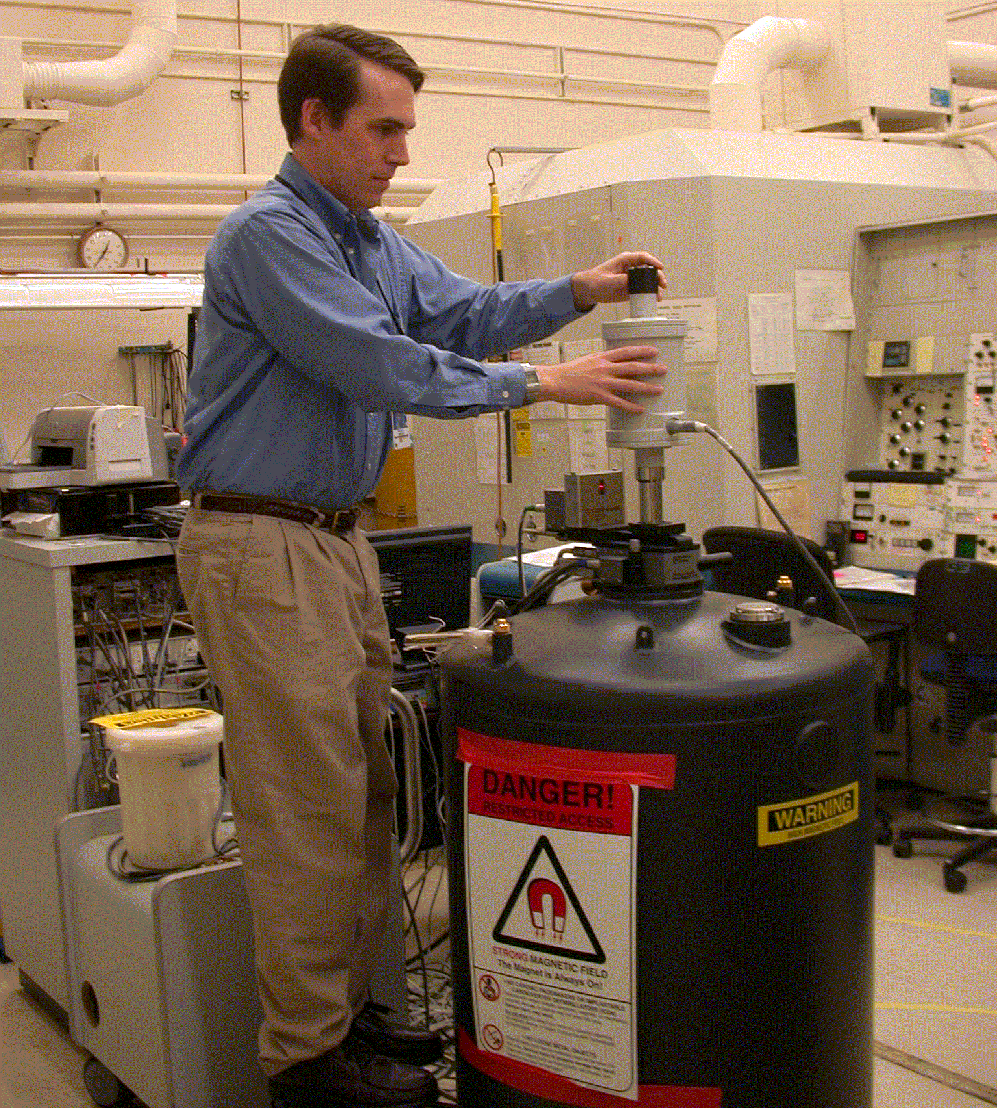
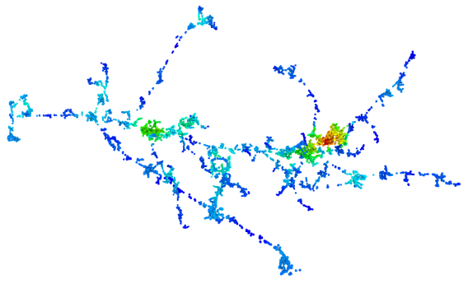
Outline
Why levitate?
Levitation scheme
MgB2 film growth
  Mg vapor annealing
  Solid state diffusion in multilayers
Levitation force measurements
Flux pinning by radiation damage

Slide 4
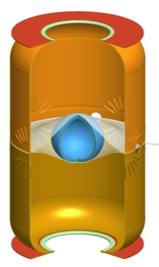
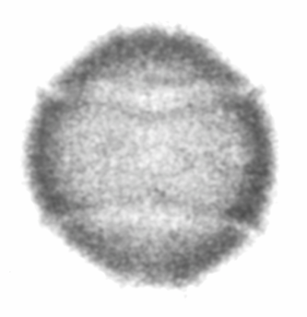
Tents can cause significant perturbation to the implosion
Simulated DT fuel at stagnation
Radiograph
Tent
Tent
Phys. Plasmas 23, 056302 (2016); ibid 25, 072705 (2018)
Tent
capsule
The ideal capsule support is via levitation

Slide 5
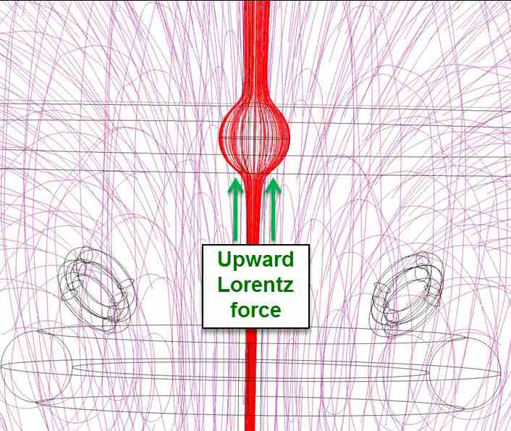
The ideal capsule support is via levitation
Capsule is coated with thin (~100 nm) superconducting layer, with magnetic coils outside the hohlraum
The 1st step is the development of superconducting coatings

Slide 6
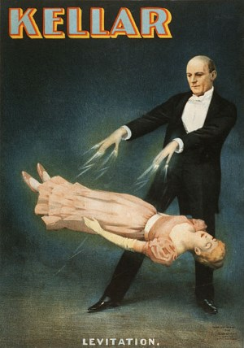
Levitation is not a new concept
R. Kleiner and W. Buckel, Superconductivity (Wiley, 2016)

Slide 7
Levitation has been considered for capsule support for decades but remained elusive

Slide 8
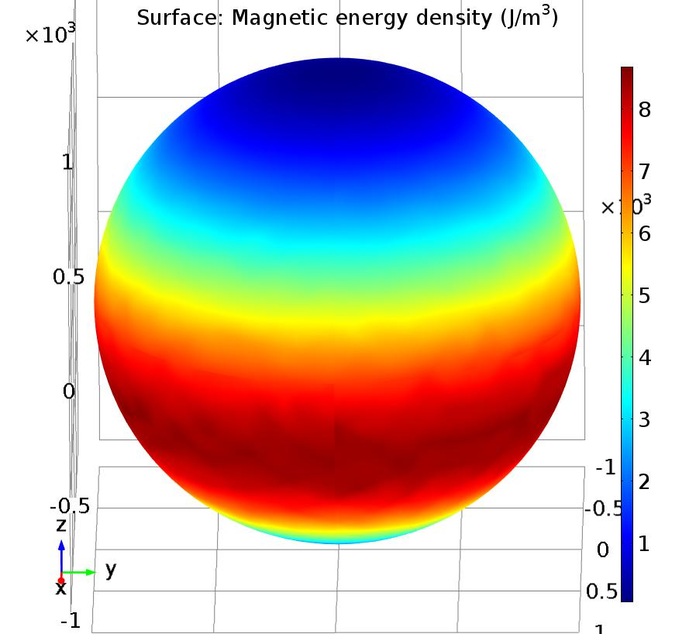
Simulations predict levitation in a low-field magnetic trap
Combined (i) electromagnetic, (ii) mechanical, and (iii) thermal simulations of Lorentz forces, magnetic pressures, current densities, and thermal loading.
Lower magnetic pressure
Higher magnetic pressure
Film thickness: 40-400 nm
B = 100-300 G
J = 10-1000 A/cm²
Lorentz force = 50-150 µN
Levitation height = 5-6 mm
Upward Lorentz Force
Supercond. Sci. Technol. 31 (2018) 055006

Slide 9
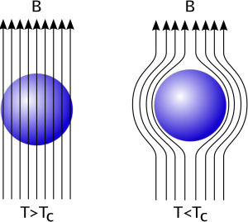
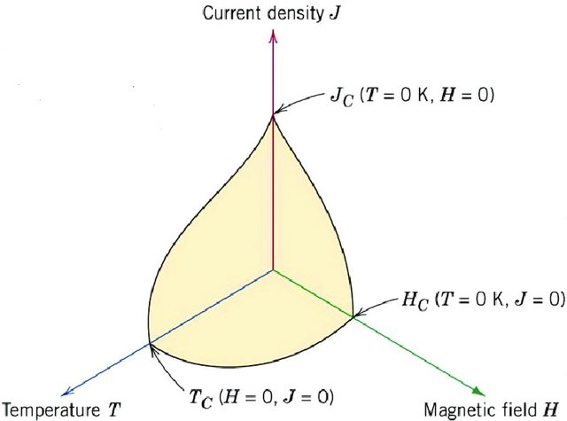
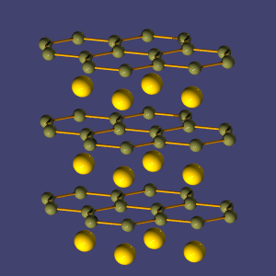
MgB₂ is a promising material for superconducting levitation of ICF fuel capsules
MgB₂ lattice
Excellent superconducting properties
Low Z
“Simple” binary compound
Synthesis compatible with current ablator platforms
Material | T_{c} (K) | J_{c} (A/cm²) | H_{c2} (T)
YBCO | 95 | <8e6 | >100
MgB₂ | 39 | <1e9 | >50
Nb₃Ge | 23 | <1e5 | <40

Slide 10
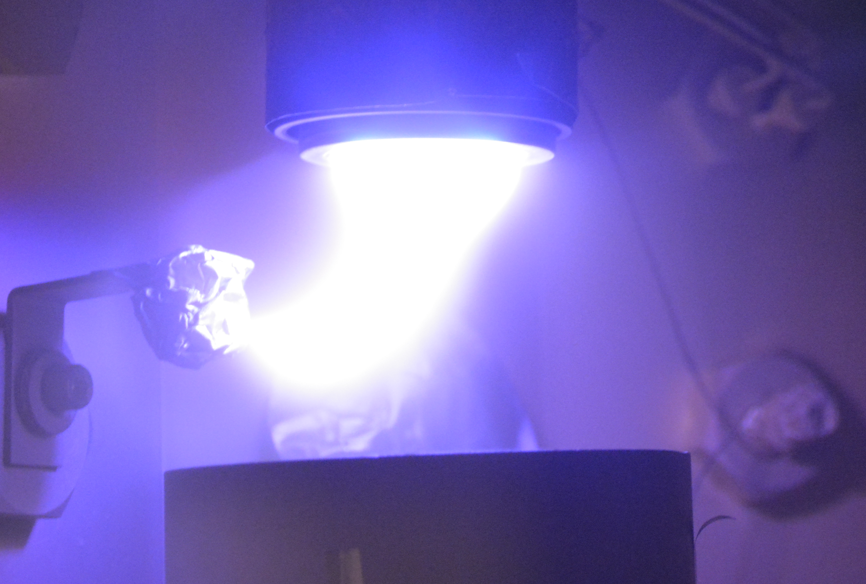
We have studied two film growth methods scalable to non-planar substrates in a non-epitaxial regime
Mg vapor annealing of B films @ >650 ºC
Solid-state diffusion of B/Mg multilayers @<650 ºC
35 nm B
1
25 nm Mg
2
35 nm B
3
C
Challenges:
High reactivity of both B and Mg
High vapor pressure and low sticking coefficient of Mg
Multi-phase stability of MgB_{x}
Complexity of B chemistry
Precursor B and Mg films were sputter deposited on carbon
Most previous research on MgB₂ films involved epitaxial growth (on SiC and Al₂O₃), not applicable to the coating of ICF capsules

Slide 11
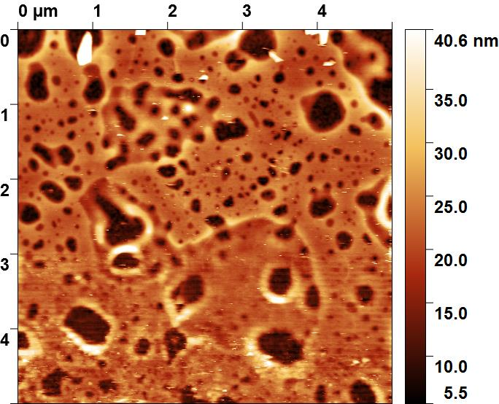
Boron films thinner than ~50 nm rapidly age
137 days @ RT in vacuum
Post-deposition anneal at 1000 ºC stabilizes B films

Slide 12
With vapor annealing, best results are for short anneals at 850 ºC with RTA-like profiles
We studied simplest T(t) profile
Results non-trivially depend on annealing conditions
Supercond. Sci. Technol. 30 (2017) 095001
Typical T(t) profile for YBCO
Supercond. Sci. Technol. 31 (2018) 055006; Appl. Surf. Sci. 448 (2018) 498.

Slide 13
Oxygen impurity is inimical to superconductivity of MgB₂
Films with [O] >13 at.% are not superconducting
T_{c} scales linearly with [O] with a slope of ~3K/at.%
Films thinner than 55 nm do not follow this trend

Slide 14
Vapor annealed MgB₂ films with thicknesses <55 nm are smooth
160 nm MgB₂
~40 nm RMS
Limitations of Mg vapor annealing:
High-temperature process (850 ºC).
Limited to ~55 nm films; thicker films exhibit multiple nucleation, with ~10 nm wide crystallites and stress-related effects.
Role of surfactant-mediated epitaxy (Fe, Ni, and Cu)?
55 nm MgB₂
~1 nm RMS
540 C/min, 12 min@850 ºC

Slide 15
MgB₂ films can be made via low-T solid state-diffusion approach
35 nm B
1
25 nm Mg
2
35 nm B
3
C
The SSD approach requires much lower thermal budgets than Mg vapor annealing

Slide 16
Nucleation and grain growth are rate limiting steps in MgB₂ formation
Inter-diffusion kinetics suggests that nucleation and grain growth (rather than diffusion) are rate limiting steps.
The same activation energy in the entire temperature range studied (400-650 ºC).
J. Appl. Phys. 125 (2019) 075306.

Slide 17
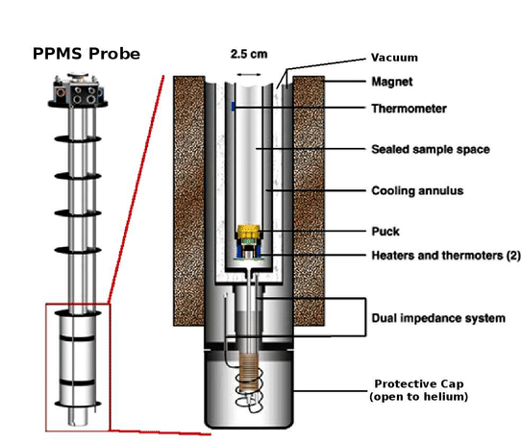
We have developed a new method of levitation force measurements
Load cell at RT above the probe
Sample hangs on string above coils in B gradient
Commercial superconducting magnet/cryostat provides fine control of temperature and magnetic field
B-field gradient generates levitation force in superconductor

Slide 18
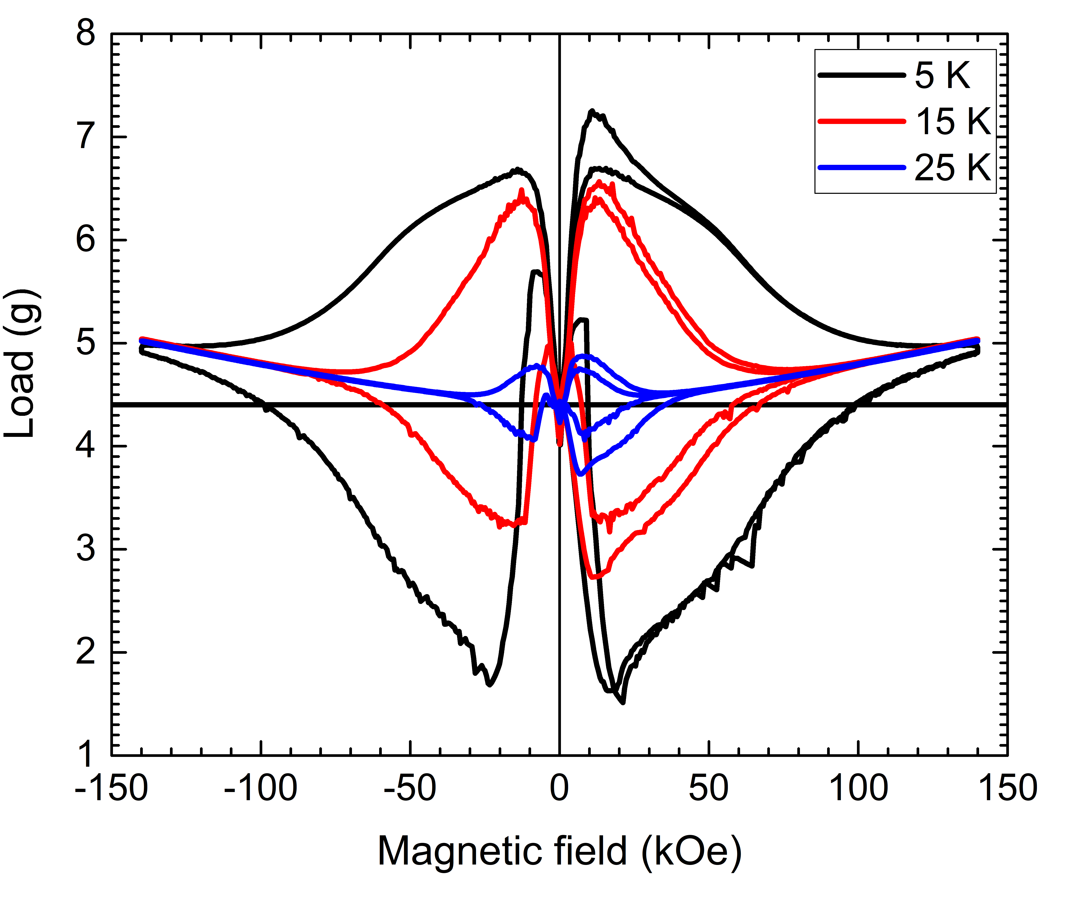
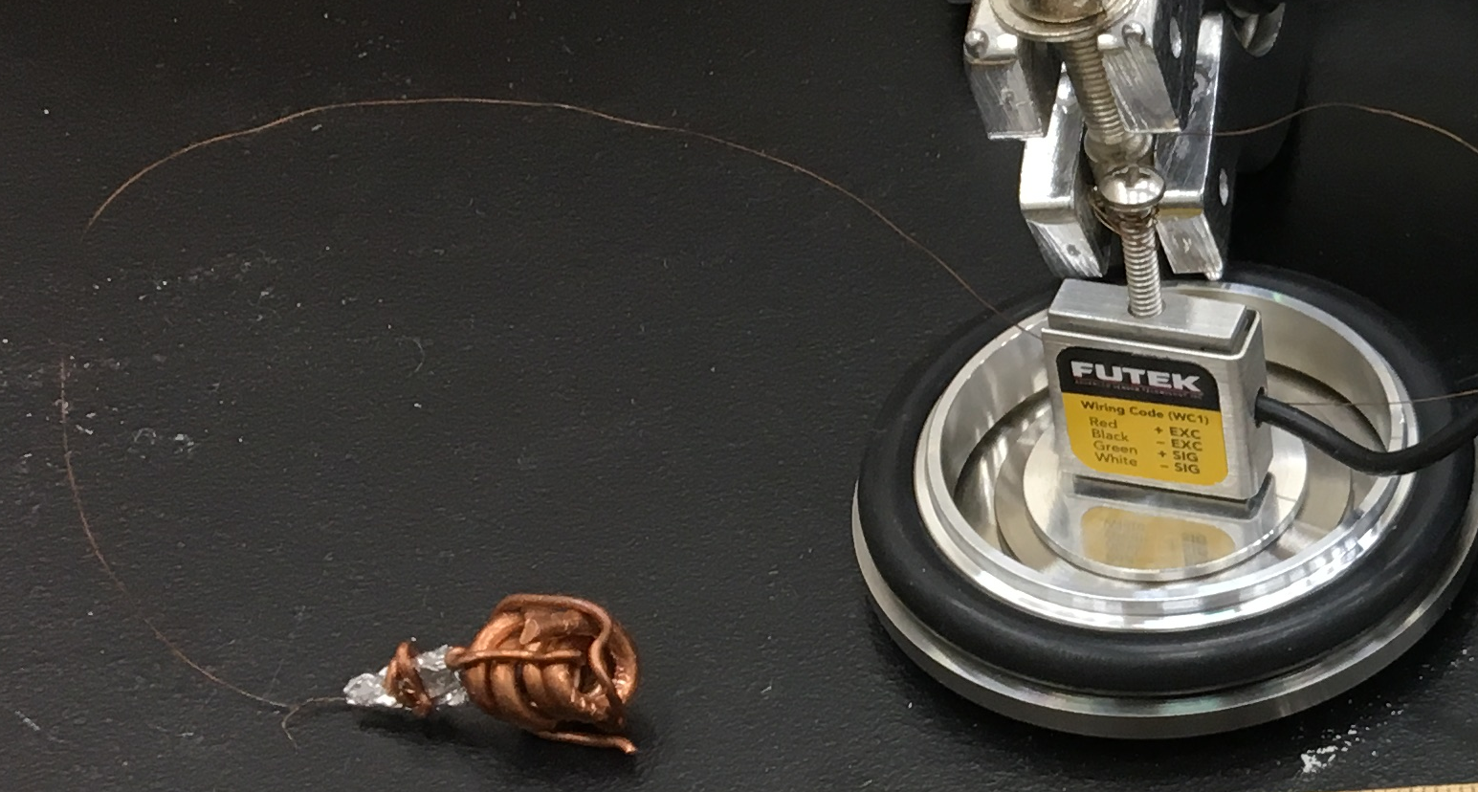
Superconductor lifts many times its own weight!
Levitation force experiments are in progress

Slide 19
Defect-related superconducting properties of MgB₂ can be tuned by irradiation
Lattice defects are needed for efficient flux pinning

Slide 20
Summary
Superconducting levitation is attractive for capsule support.
MgB₂ is currently the material of choice for levitation.
Non-epitaxial superconducting MgB₂ films have been made by
  Mg vapor annealing @850 ºC,
  Solid-state diffusion annealing @450-650 ºC.
Oxygen impurity is inimical to superconductivity of MgB₂.
Quantum levitators can be tuned by defect-induced flux pinning.
Levitation force measurements are in progress.

