Slide 1
Identification of Particles On Targets Using
Parallax X-ray Images and ImageJ
4/24/2019
Curtis Walters, Travis Briggs, Daniel Casey,
Sebastien Le Pape, Louisa Pickworth, Swanee Shin
Notes:
Thanks all the collaborators.

Slide 2
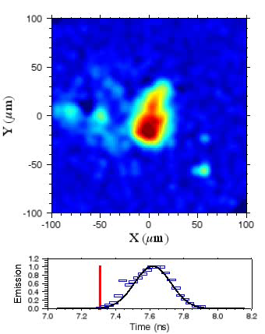
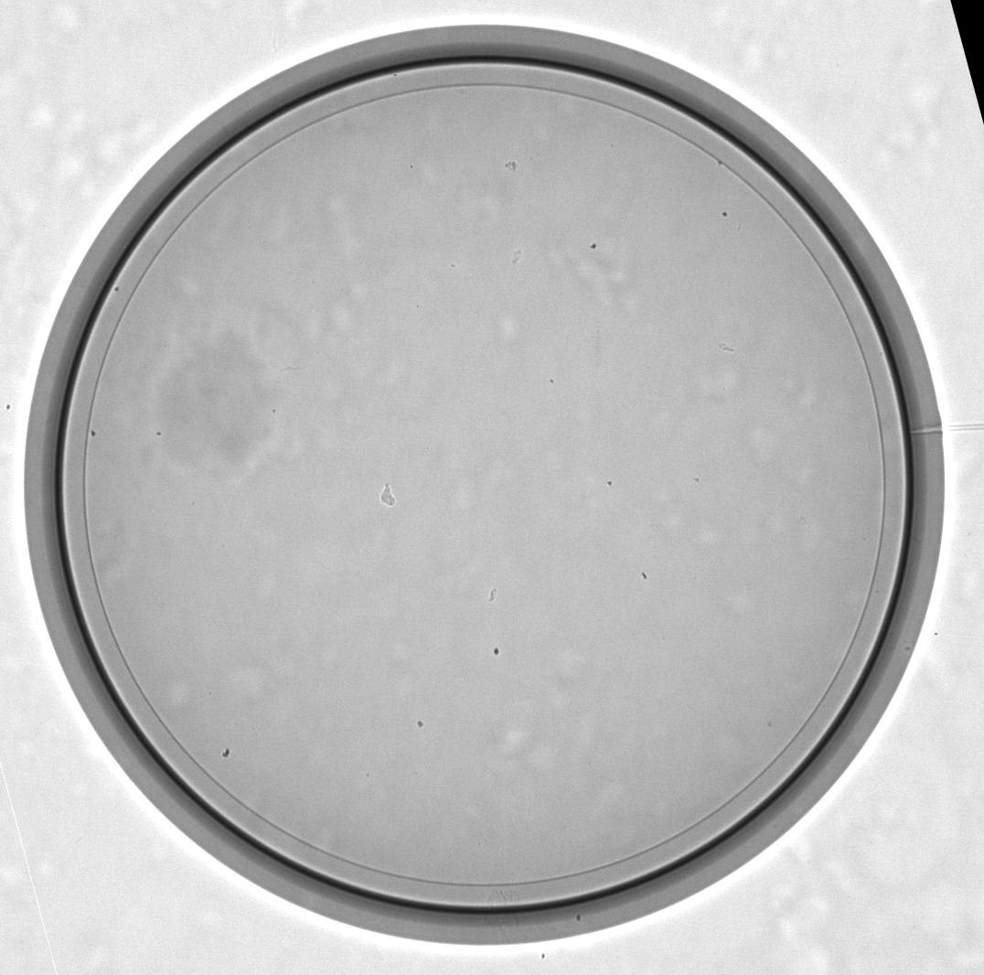
Particles on Target Capsules Can Negatively Affect the Implosion
N160313_TC_0-0
N160313
X-ray Image of Layered Target Taken Just
Prior to Insertion into Target Chamber
NIF Target Capsules Need to be Free From Particles That Can Cause
Ablation-front Instabilities and Degrade Performance.
Notes:
So why do we care about particles? Particles are a concern because they add a very localized mass to an otherwise very uniform capsule that is going to be highly compressed during the shot. This high compression means that small mass defects can seed perturbations in the ablation front that grow during the implosion. If the perturbation is large enough it can result in capsule material becoming mixed into the hot spot where it will radiate x-ray energy, which causes a cooling of the hot spot and degraded performance.
On the left is a series of self-emission x-ray images from an imploding capsule as observed from the north pole of the target chamber.
The very large bright spot is associated with the fill tube defect that has caused capsule material to be injected into the hot spot.
The moving bright spot coming in from the left we call a meteor, and is hypothesized to be associated with a particle on the capsule which seeded an implosion front perturbation that was severe enough to cause capsule material to be carried into the hot spot.
On the right is an x-ray image of the capsule used for this shot that was taken after the DT ice layer was formed and prior to insertion into the target chamber. In this image we can see the diamond capsule, an inner dark region of the capsule where it has been doped with tungsten, the inner circle is the edge of the DT ice layer, and on the right we can see the capsule fill tube. The large, splotchy features in the image are defects on the beryllium window of the the x-ray source, and if we look very closely we can see a number of small, dark features which are our usual suspects for particles.
Our targets are assembled in a clean area are monitored for cleanliness so we know the state of the target before it is delivered to NIF, and on Friday Tom Braun will talk about the work being done to monitor and improve cleanliness during the target assembly process.
After the targets are assembled they are transported to, and installed at NIF. At several points during the shot cycle x-ray images are collected to determine if any additional particles have appeared. Because the capsule is fully enclosed inside the hohlraum, any additional particles that are observed on it are deemed to have come from the hohlraum walls.
While somewhat larger, darker particles in the x-ray image are easily observed by eye, but smaller particles are also of concern, so image processing is used to find and mark them.

Slide 3
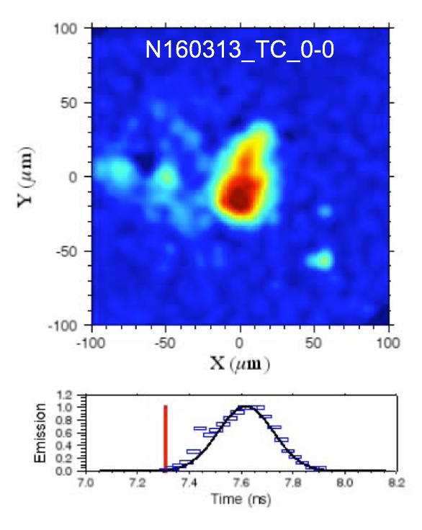
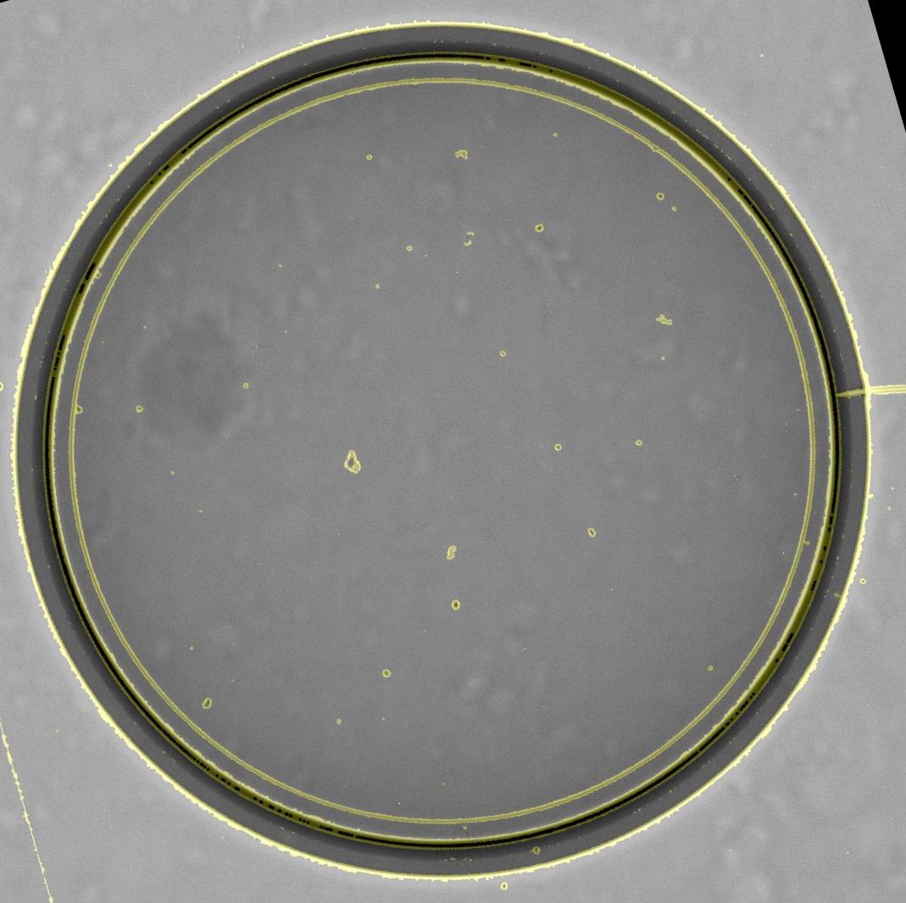
Particles on Target Capsules Can Negatively Affect the Implosion
N160313_TC000-000
N160313
X-ray Image of Target Taken Just
Prior to Insertion into Target Chamber
NIF Target Capsules Need to be Free From Particles That Can Cause
Ablation-front Instabilities and Degrade Performance.
Notes:
The first step in the image processing is to use the ImageJ edge finding algorithm to to find all object boundaries.
In the image on the right the results of the edge finding have been changed to yellow and overlaid on the original x-ray image.
As can be seen here, the processing has identified numerous small particles that are not easily observed by eye.
However, finding all the possible particles in the x-ray image is only the first step in determining if they are on the capsule or not. This is due to the facts there there are seven other surfaces associated with the target system where particles may be found, and although we can locate a particle's position in X and Y, a single x-ray images give us no depth information and cannot be used to find the z positions of the particles.

Slide 4
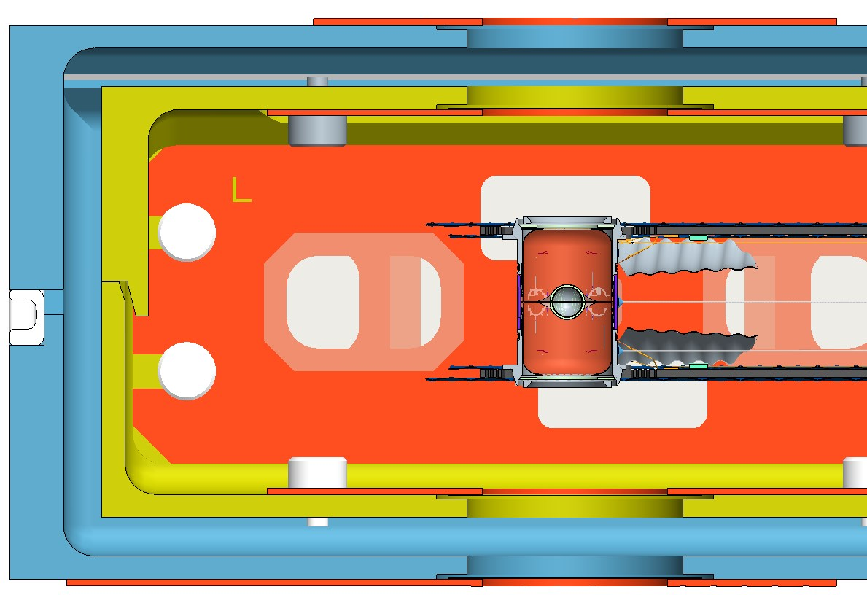
Eight Different Surfaces Contribute to the Particles Seen in X-ray Images
X-ray Source
Outer shroud window
Inner shroud window
Capsule / Tents
LEH window
X-ray Camera Window
We Need to Determine if the Observed Particles are on the Capsule
Notes:
This is a schematic of the target system at NIF where we have indicated the different surfaces where particles can be found. Here we see the capsule which is supported by tents, and here we seethe hohlraum that surrounds it. Surrounding the cryogenic target are shrouds that protect it from condensation of the background gas.
The shrouds have windows in them that permit x-rays to pass through so that the capsule can be imaged, and four of the surfaces where particles may be found are associated with the windows on the upper and lower, and inner and outer shrouds.
Particles located on the shroud windows are of absolutely no concern due to the fact that the shrouds are retracted prior to the shot.
Particles may also reside on the upper and lower laser entrance hole windows, but are only of concern if they are unusually large, which does not usually happen.
Finally, particles may also be found on the X-ray camera window, but these are of no concern with respect to the shot performance.
In general, an x-ray image of the capsule will show particles that are resting on several of these surfaces, so the problem becomes one of determining which, if any, are on the capsule.

Slide 5
Parallax Image Analysis Gives the Height of Observed Objects
Source Aligned
with Capsule
Source Deviated
Capsule Shift
X-ray Camera
Red Particle Shift
Blue Particle Shift
Notes:
While a single x-ray image has no depth information and cannot be used to determine where in Z a particle is located, pairs of images that are obtained with a parallax offset may be used to make such a determination.
This is a cartoon of how a parallax measurement works.
On the left we have a source aligned with a capsule, a red particle above the capsule, and a blue particle below it, and images of all three objects are projected onto the x-ray camera.
On the right we can see the effect of shifting the source position.
The dotted outlines show the original position of the objects, and we see that when the source is deviated the images of the objects projected onto the camera are shifted.
For objects closer to the source, such as the red particle, the shift is larger than that seen for objects closer to the camera, such as the blue particle.
By knowing the geometry of the system, that is, the distance between the x-ray source and the x-ray camera, along with the z-position of the capsule, the magnitude of the shift in position in the image of the different objects may be used to determine their z position.

Slide 6

Thresholding Images Identifies the Particles to be Analyzed
Greyscale Image
Thresholded Image
¹ Li, CH & Tam, PKS (1998), "An Iterative Algorithm for Minimum Cross Entropy Thresholding"
Pattern Recognition Letters 18(8): 771-776
The Optimal ImageJ Thresholding Algorithm, Li's The Minimum Cross Entropy
Thresholding Method ¹, was Determined by Trial and Error
Notes:
The first step in the parallax image processing is to analyze the aligned image and locate the particles in it.
On the left is the aligned, greyscale image, and on the right we see the result of thresholding this image to separate the particles from the background. The broken circle comes from image processing artifacts associated with the edge of the tungsten dopant region in the middle of the capsule's shell.
The image processing was performed using ImageJ, which has 17 different thresholding algorithms that produce a wide range of results depending on the input image.
By a process of trial and error it was determined that using Li's minimum cross entropy thresholding produced the best results in that it was able to distinguish grey particles on a lighter grey background.
The one downside of using such a sensitive threshold is that some of the noise in the image also gets identified as particles.

Slide 7

Automated Processing is Needed to Handle the The Large
Number of Particles Generally Observed
Aligned Image
Deviated Image
Determining a Particle's Location Requires Every Particle in the Aligned Image
to be Correlated with a Unique Particle in the Deviated Image
Notes:
The second step in the parallax image processing is to analyze the deviated image and locate the particles in it.
As a reminder, what we are doing in creating the deviated image is we are shifting the x-ray source, and the source shift changes where in the image the particles will be found. In this example the source shift resulted in all the particles being shifted towards the upper left hand corner of the image, but the magnitude of the shifts for the different particles is dependent upon where in Z they are located. Using the information in the two images allows us to determine the Z locations of the particles, and once we have that we can determine if any of them are on the capsule.
The difficulty is that, in order to be able to do the calculation, for every particle we see in the aligned image we have to find where that particular particle ended up in the deviated image.
For larger particles with distinctive shapes, such as these two, the association of the pairs in the two images is relatively straightforward, but given the number of small particles generally observed, making a complete set of unique pairs from the two images is not something that can be done by hand!
In addition to the complexity of just handling the large number of particles generally observed, there is also the problem of unique identification of the correct pairs when there is a region with several near neighbors that can be paired in different ways, for example these regions here.
Finally, each of images contains noise that can potentially lead to false positives, complicating the process of making the full list of unique pairs.

Slide 8
The Distance a Particle Will be Displaced in the Parallax Shifted Image Can be Calculated for Each of the Target Components
Outer Shroud Window
Inner Shroud Window
7.6 mm
17.9 mm
12.6 mm
LEH Window
Capsule centerline
Target Fielded Inside Cryo Shroud at NIF
Notes:
In looking closely at the schematic of a target fielded at NIF one thing that becomes clear is that the relative positions of all the components where particles may be found is fixed and well known. For example the distance between the capsule centerline and the outer shroud window is always 17.9 mm.
As the amount of displacement a particle will undergo in the deviated parallax image is based upon where it is located in Z, the fixed positions of the target components imply different, well-defined displacements for particles on each of the different surfaces.
For example, as seen in the chart on the right, for a nominal shift of the x-ray source the displacement of the capsule in the deviated image would be 317 pixels, while any particles found on the upper or lower LEH windows would be deviated by 338 and 298 pixels, respectively.
We can exploit the fact that there are only a small number of known displacements in the deviated image to create a process that makes the identifications of the particles easier. Instead of calculating displacement vectors for all possible pairs of particles in the two parallax images and then sorting that list to determine which ones give the actual set of matched pairs, we can use an image processing approach based on translating the deviated image in its entirety. The amount of translation to be used will be defined by the particular component we are looking at. For example if we wanted to identify the particles on the Top Outer Shroud we would back translate the deviated image by 405 pixels, that will put particles that were on the shroud back where they came from.
We can then take the original aligned image and compare it to the deviated image that has been back translated. If we find any coincidences in particle positions we will have found the particles on that particular component. The following series of images will give a visual representation of the calculations that are performed.

Slide 9
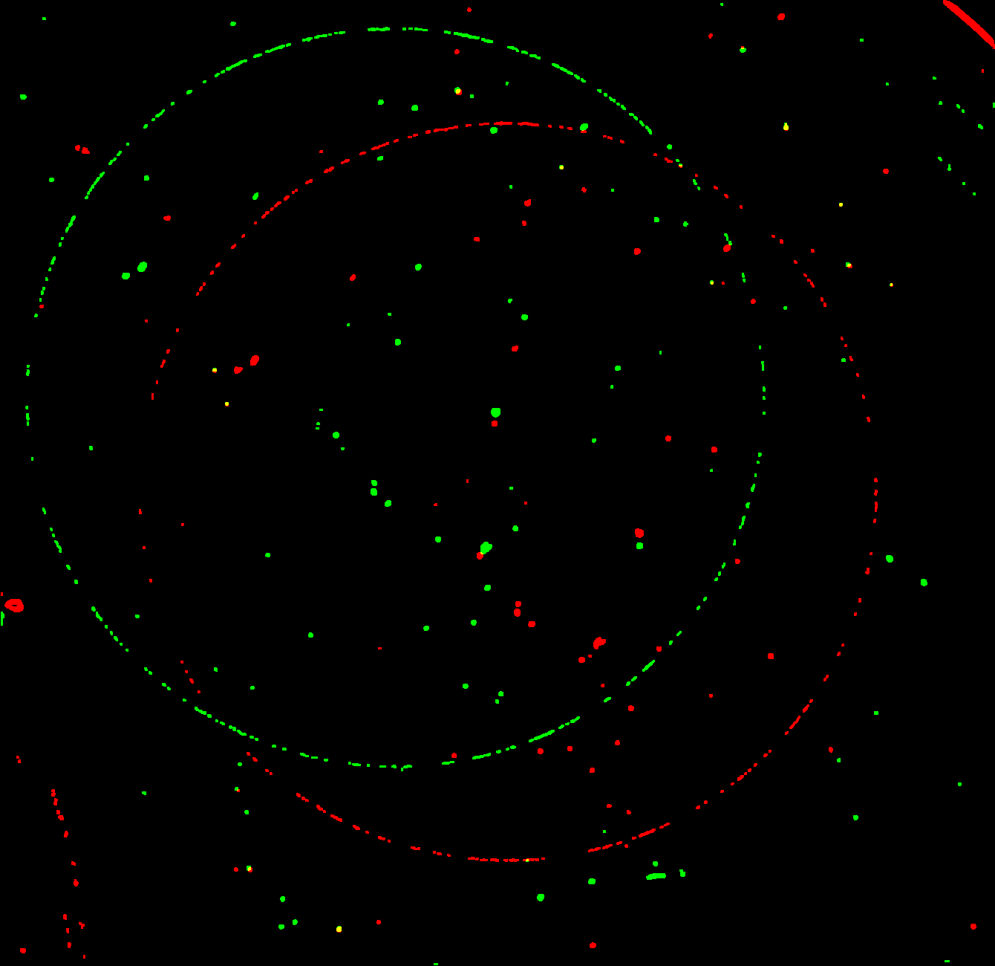
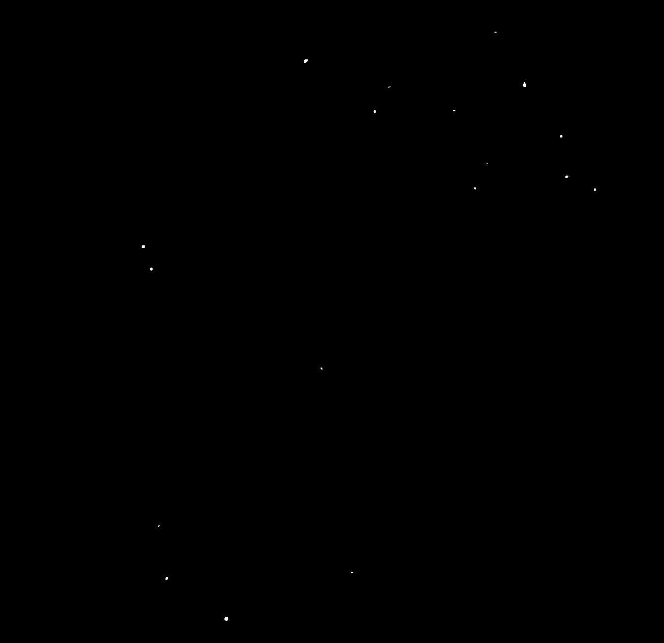
Coincidence Images Created Using Aligned and Translated Deviated Images Identify Particle Candidates for a Given Component
Red = Aligned Image
Green = Back Translated Deviated Image
Coincidence Image
Back Translation = X-ray Camera Window
Notes:
On the left is a composite image of the aligned image and back-translated deviated image that was made to help visualize the image processing approach that is being used to identify the particle locations. It was created by having the particles in the thresholded aligned image changed to red, the particles in the deviated image that has been back translated changed to green, and adding the two images together.
The amount of back translation used in this example is actually zero so as to search for particles that are on the X-ray camera window. This is because these particles being so close to the image plane means they remain fixed in position even when the source is deviated.
On the right we have a coincidence image which was created by multiplying the thresholded aligned image with the back translated deviated image. As we can see here, it is only at locations where a particle exists in both images that we get a particle in the coincidence image, and in this particular case what we see here are the particles on the x-ray camera window.
This creation of a coincidence image is performed for each of the eight surfaces in the target system where particles may be found, ....

Slide 10
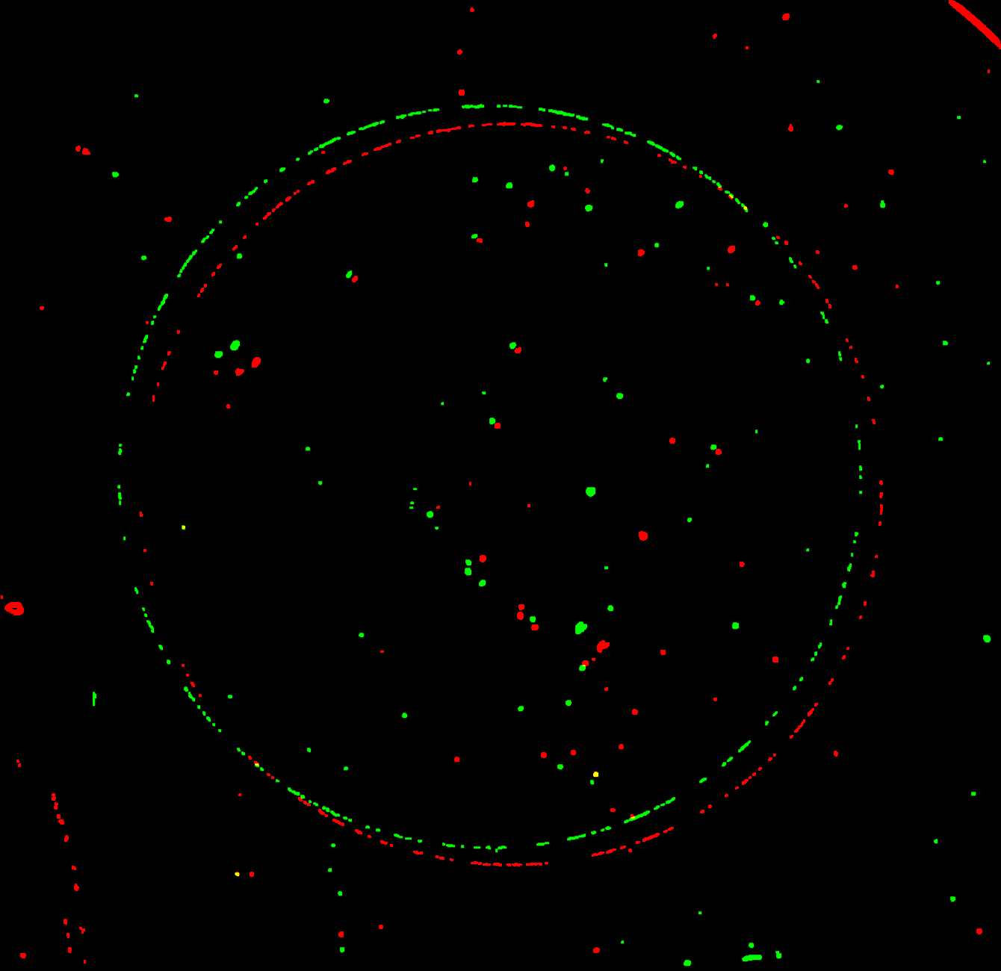

Coincidence Images Created Using Aligned and Translated Deviated Images Identify Particle Candidates for a Given Component
Red = Aligned Image
Green = Back Translated Deviated Image
Coincidence Image
Back Translation = Bottom Outer Shroud
Notes:
...., and in stepping through the target system from the bottom to the top, the next surface after the x-ray camera window is the bottom outer shroud.
Here we see a pair of images that were created using a back translation of the deviated image that puts particles that are on the bottom outer shroud back to where they were in the aligned image, and the coincidence image made by multiplying those two images together shows the particles that are located on this surface.

Slide 11
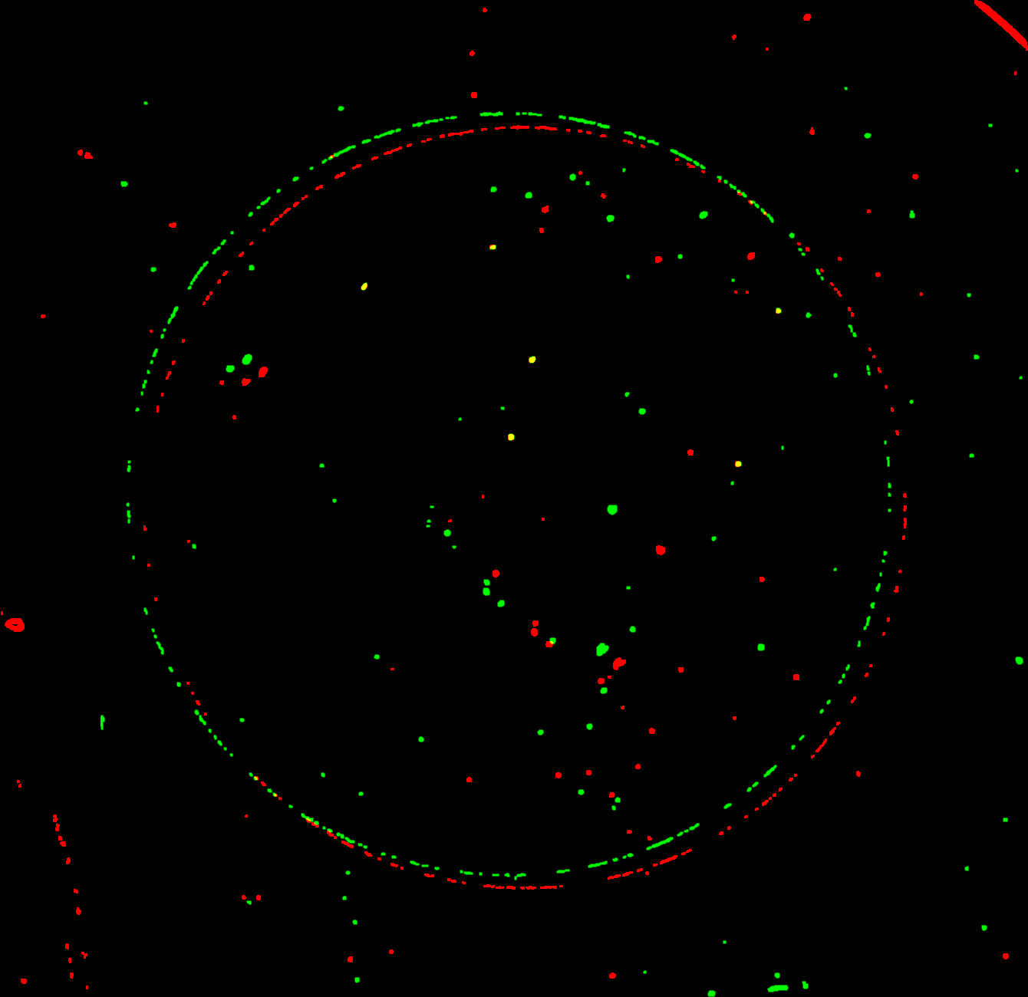
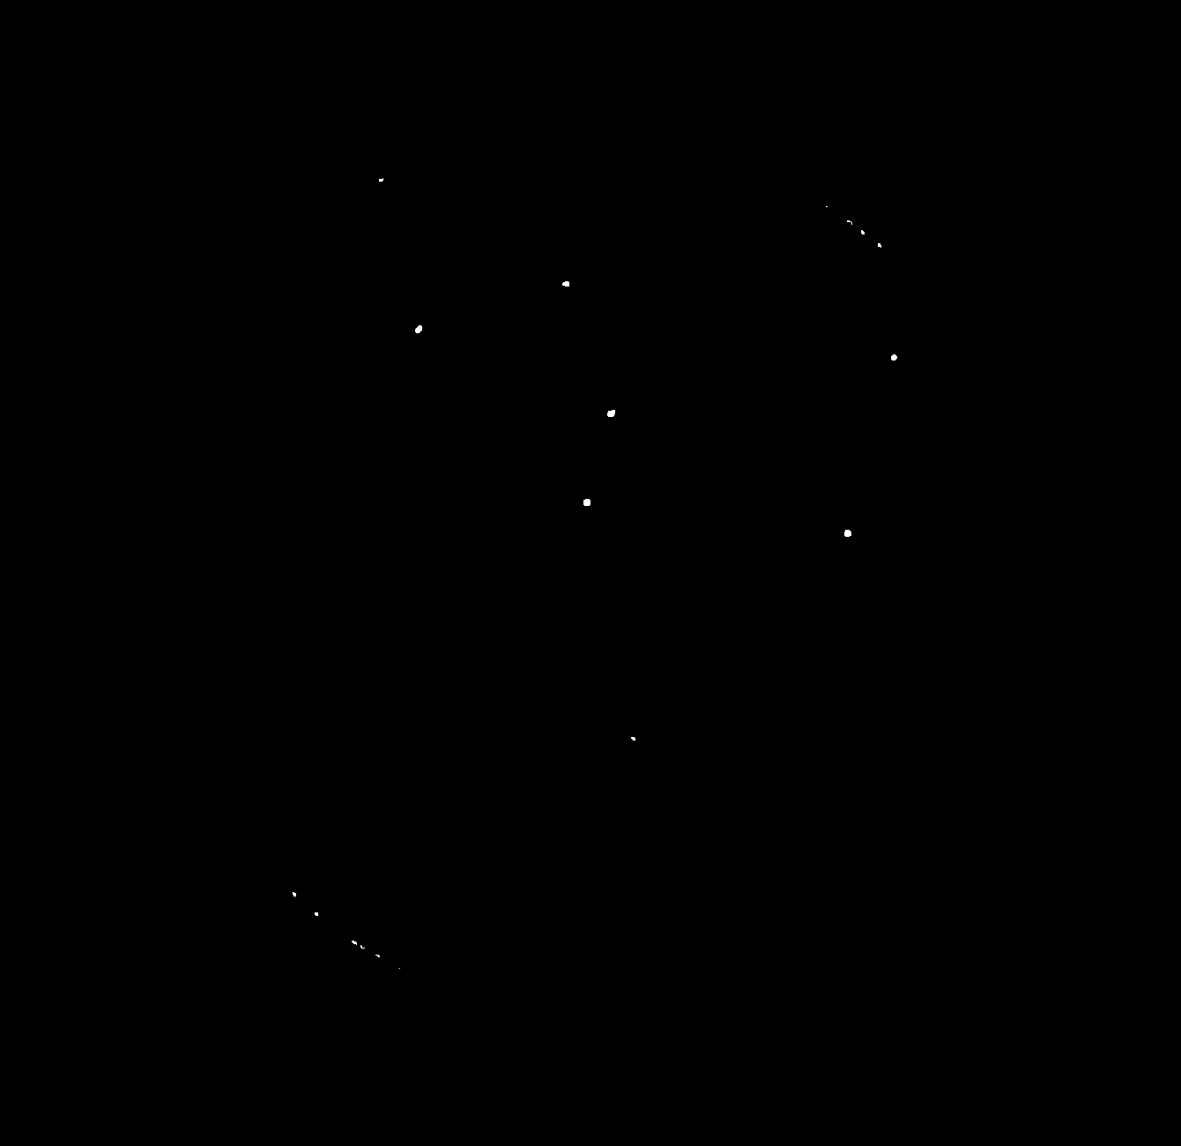
Coincidence Images Created Using Aligned and Translated Deviated Images Identify Particle Candidates for a Given Component
Red = Aligned Image
Green = Back Translated Deviated Image
Coincidence Image
Back Translation = Bottom Inner Shroud
Notes:
Continuing to step through the target system we next go to the Bottom Inner shroud, ....

Slide 12
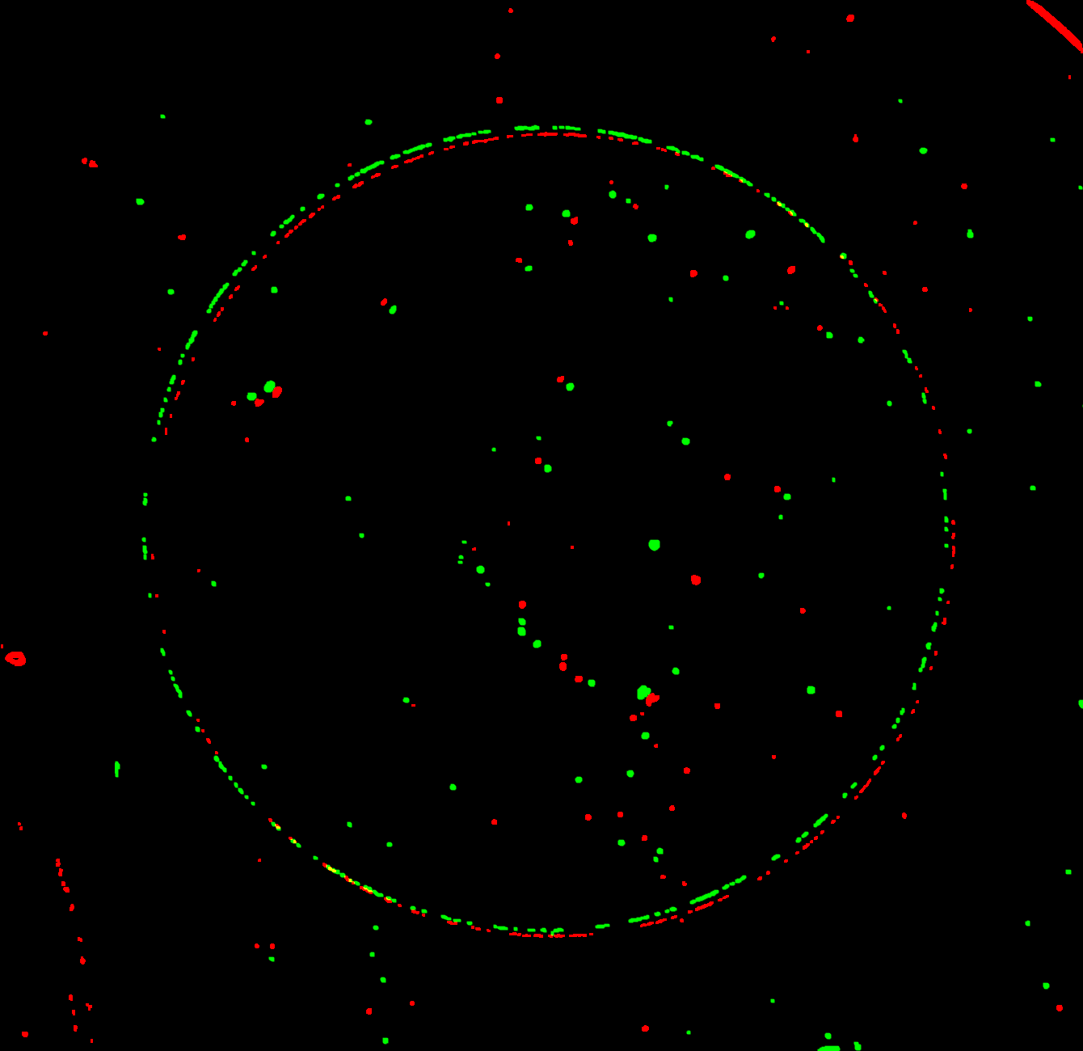

Coincidence Images Created Using Aligned and Translated Deviated Images Identify Particle Candidates for a Given Component
Red = Aligned Image
Green = Back Translated Deviated Image
Coincidence Image
Back Translation = Bottom LEH
Notes:
... the bottom LEH window, and .......

Slide 13
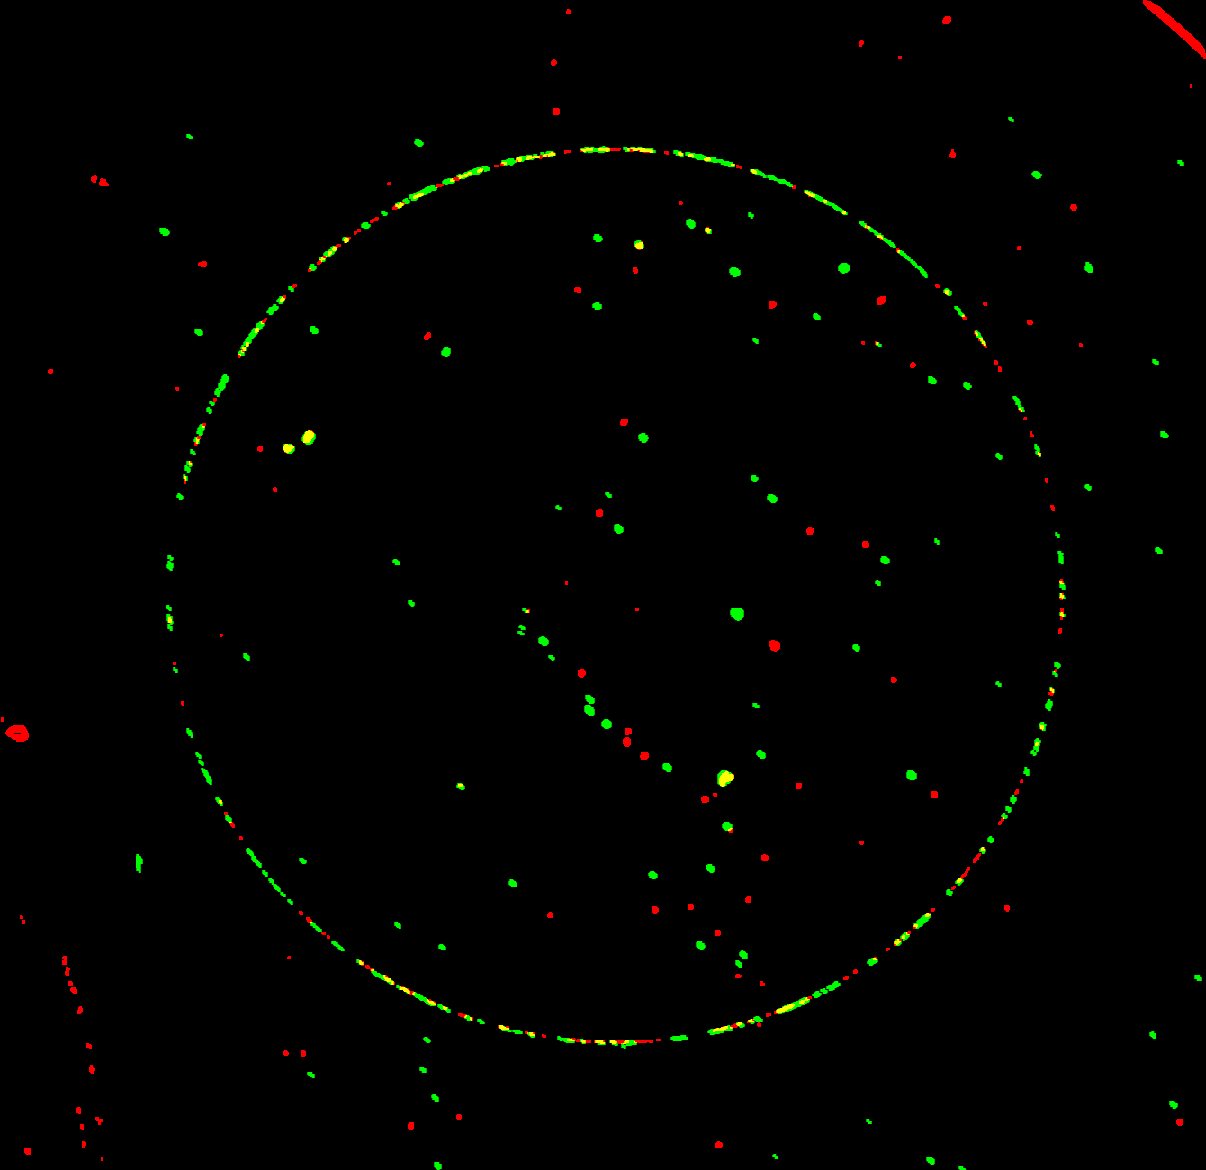

Coincidence Images Created Using Aligned and Translated Deviated Images Identify Particle Candidates for a Given Component
Red = Aligned Image
Green = Back Translated Deviated Image
Coincidence Image
Back Translation = Capsule
Notes:
... the capsule.
As a reminder, the broken circle is due to image processing artifacts located at the edge of the dopant region in the capsule wall. Because this is such a common occurrence, finding particles that lie within the capsule shell region is not something that can be easily automated and we still rely on the operator to visually scan the image to determine if any real particles are located there.
As we continue to step through the target system, we next come to, ....

Slide 14
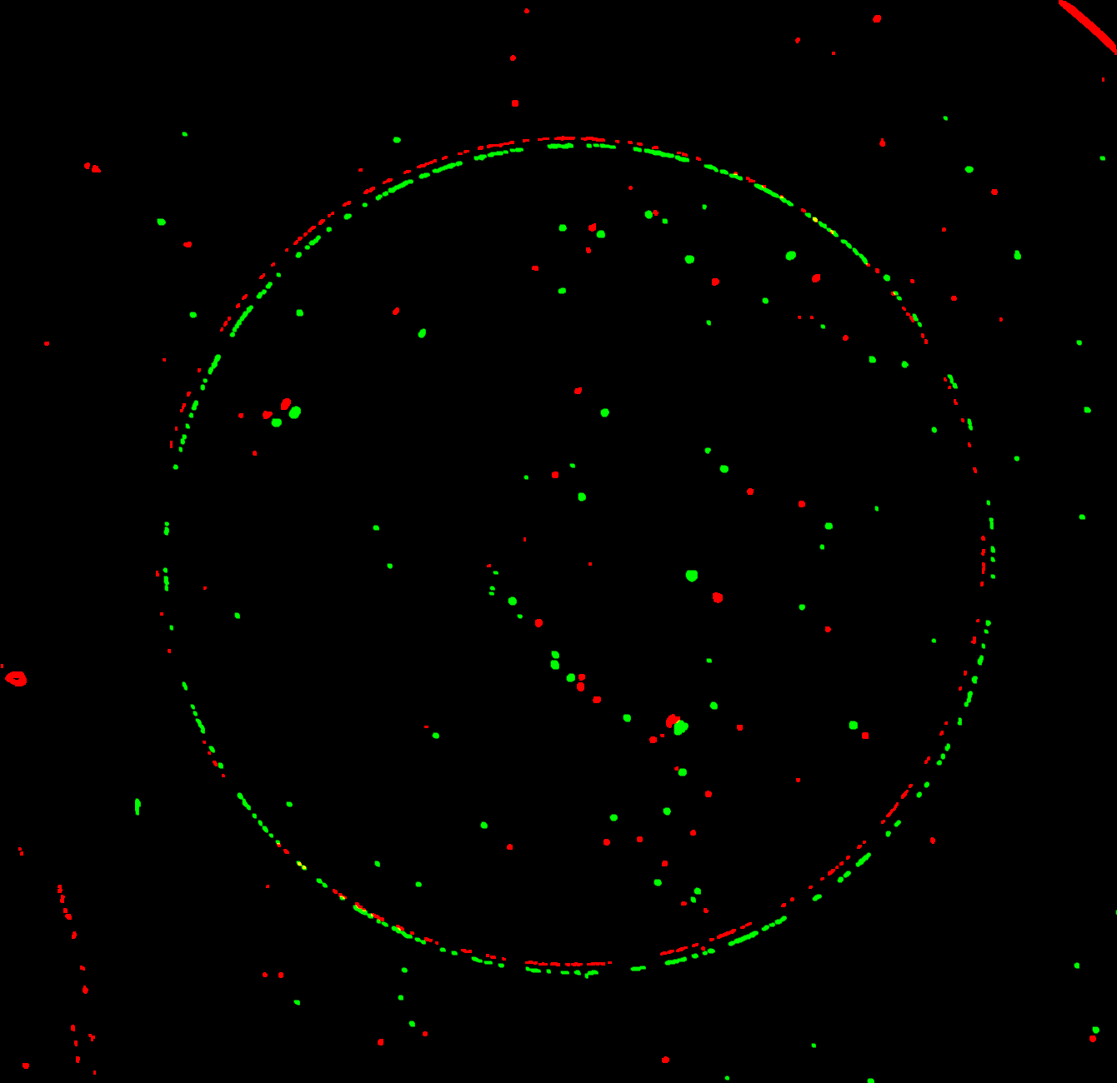

Coincidence Images Created Using Aligned and Translated Deviated Images Identify Particle Candidates for a Given Component
Red = Aligned Image
Green = Back Translated Deviated Image
Coincidence Image
Back Translation = Top LEH
Notes:
...., the Top LEH window, ....

Slide 15
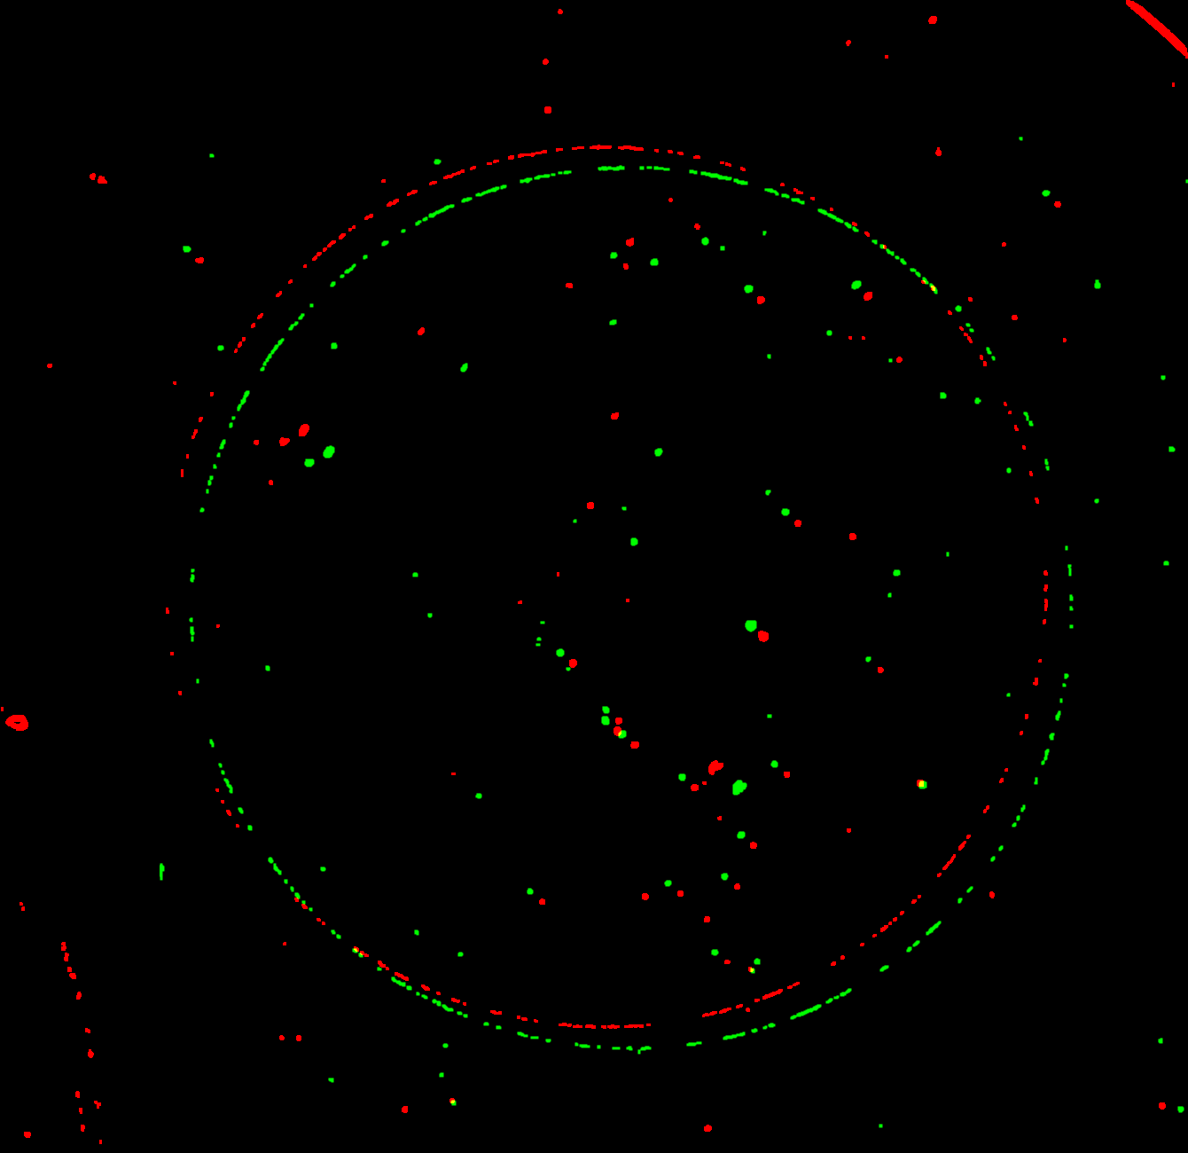
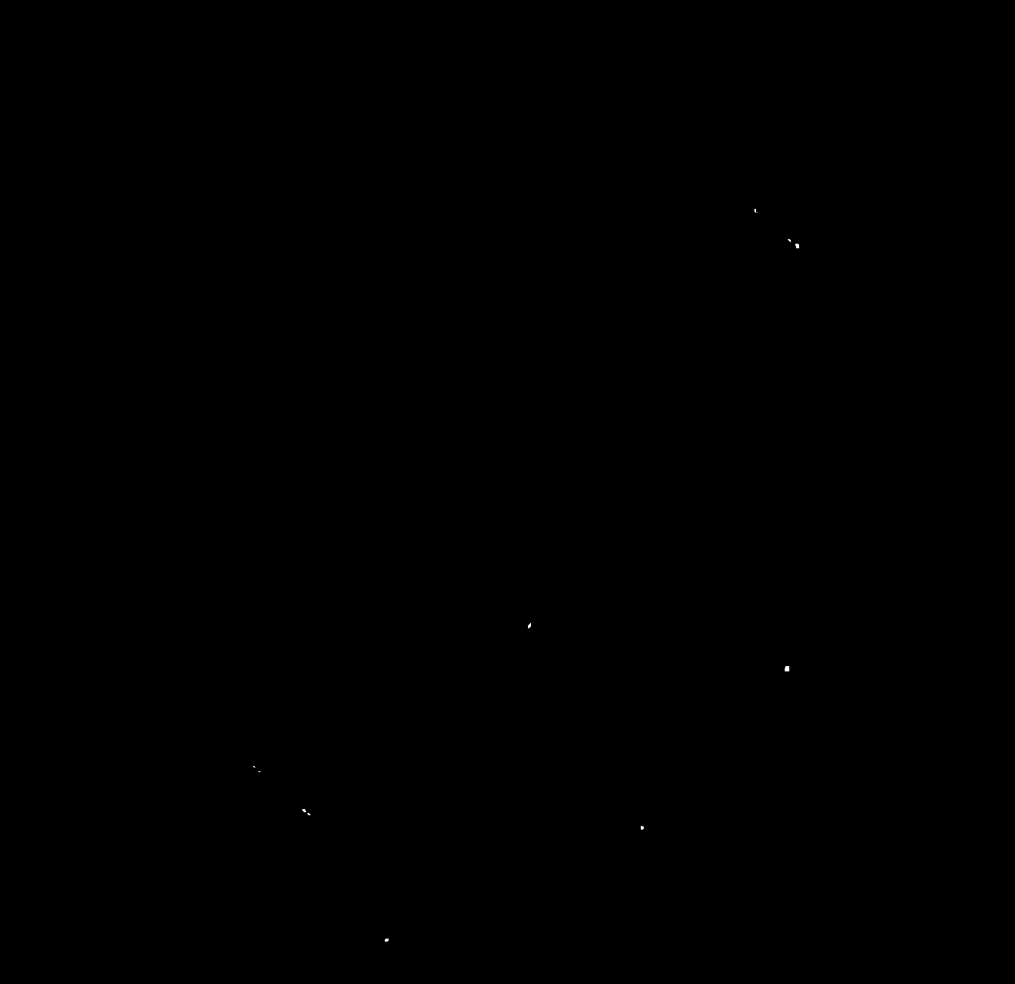
Coincidence Images Created Using Aligned and Translated Deviated Images Identify Particle Candidates for a Given Component
Red = Aligned Image
Green = Back Translated Deviated Image
Coincidence Image
Back Translation = Top Inner Shroud
Notes:
..., the Top Inner shroud, ....

Slide 16
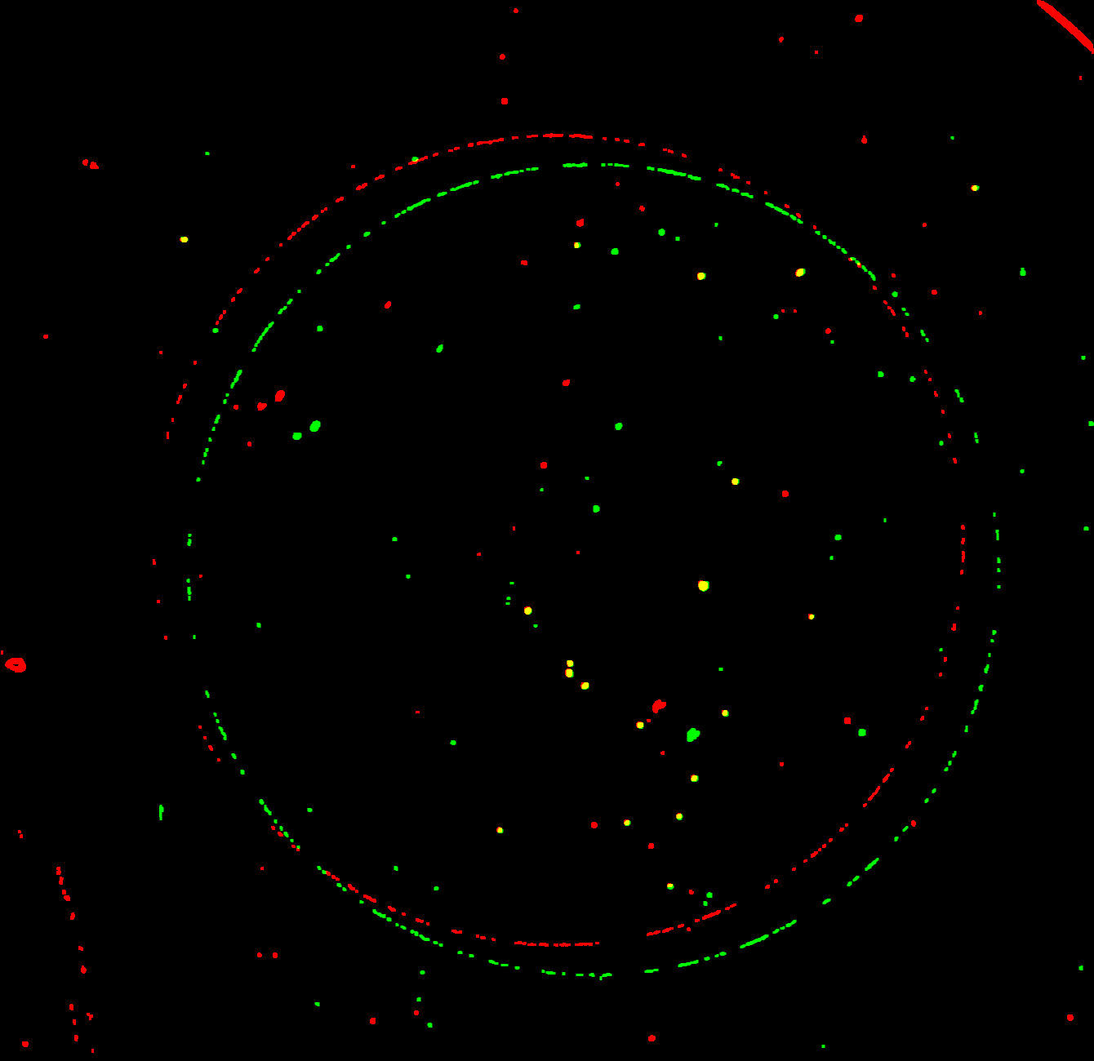

Coincidence Images Created Using Aligned and Translated Deviated Images Identify Particle Candidates for a Given Component
Red = Aligned Image
Green = Back Translated Deviated Image
Coincidence Image
Back Translation = Top Outer Shroud
Notes:
..., and finally the top outer shroud.

Slide 17
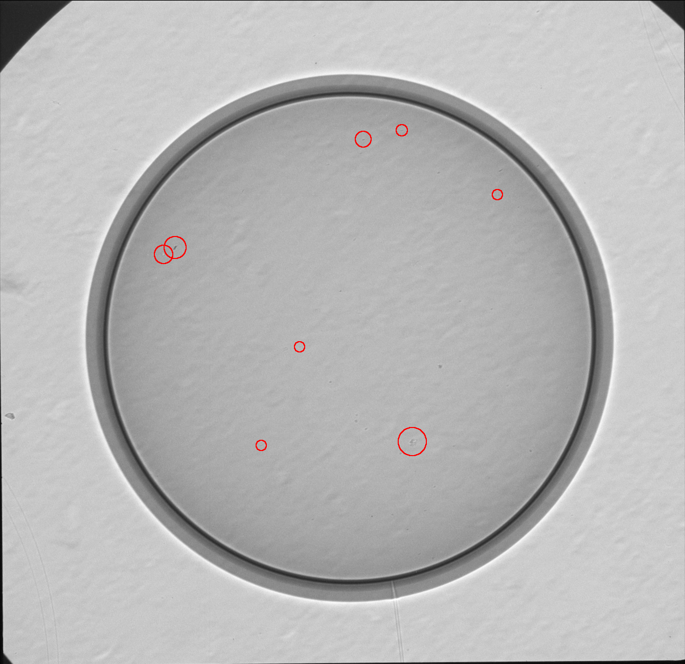
Particle Identification Using Parallax Images is an 8 Step Process that Outputs a Highlighted Image and a Data Table
Particle information is forwarded to the shot RI's who use it when analyzing shot results
Automation of the particle identification is crucial for producing high-quality results
Notes:
Once the calculations are completed for the eight different surfaces where particles may be found, all of the results are collated and sorted and the final location assignments made.
The operator is then presented a series of images to confirm the correctness of the automatically identified particle pairs, this step is used to eliminate mis-identifications due to noise or image artifacts.
The centered image is then displayed and the particles identified to be on the capsule or tents are circled in red, such as we see here. If any particles would have been found on the lower LEH they would have been circled in cyan, and any found on the upper LEH circled would have been circled in yellow.
Finally, a table with the image (X, Y) coordinates and the areas of the particles is generated. This data is passed on to the shot RI's who use it to determine if the target is acceptable for a shot, and if it is shot they will use it in the cases where unusual features such as meteors appear in the shot data.
Particle Identification Sequence of Operations
1) Image acquisition
2) Image Processing
3) Measure capsule translation
4) Create overlap images for each component
5) Identify particles in the overlap images
6) Collect and sort the results
7) Operator review of results
8) Generate highlighted image and data table

Slide 18
A Data Set Composed of 15 Target Shots was Used to Look for Correlations Between Particles and Meteors
Notes:
Having a nearly fully automated process for finding particles on targets has given us the ability to collect and review data from a large number of shots.
The first review of data attempted to determine if there was in fact a correlation between the existence of particles on the capsule and the observation of meteors in the shot data.
A first set of 15 shots has been analyzed and for 8 of those shots the target was free of particles. Six of these particle free targets showed no meteors; however, two of them did have a meteor, indicating that there may be other mechanisms associated with meteor production.
For the remaining 7 shots a total of 18 particles were observed on the capsules. Eleven of these particles, 61% of the total, were correlated with meteors in the shot data, however, no meteor was observed for the remaining seven particles.

Slide 19
A Data Set Composed of 15 Target Shots was Used to Look for Correlations Between Particles and Meteors
On average, particles associated with meteors were 158µm² .
An approximate threshold for seeding a meteor is ~ 30µm³
Notes:
Looking more closely at the details associated with the particles that were observed on the capsules showed that the ones that were associated with meteors were, as a class, larger than the ones that were not correlated with meteors.
The average size of a particle that produces a meteor was 158 um cubed, vs 27 um cubed for the particles that did not produce meteors.
In total, the data strongly suggest that particles on the capsule induce meteors, but that there is a size threshold to do so.

Slide 20
Measurements Show a Direct Correlation Between the use of DU in the Hohlraum and and Increase in the Number of Particles
Gold hohlraums show very few particles. DU hohlraums show significantly more particles and the use of a gold liner only partially reduces the effect.
Notes:
Because NIF targets are built using any of three different types of hohlraum materials the second review of the shot data that was performed was to look to see if there was a correlation between the hohlraum material and the number of particles observed.
The hohlraums are manufactured with either depleted uranium (DU), gold (Au), or depleted uranium that has been coated with a thin gold liner and a review of twenty-seven targets used for shots was performed.
The chart on the left shows the percentages of each target type that were found to be particle free. As the data clearly show, gold hohlraums give the best results with respect to target cleanliness, 63% of the gold hohlraum targets were found to be particle free. This is in stark contrast to DU hohlraums, where only 8% were particle free, and the use of a gold liner over the DU only partially mitigated particle generation.
The chart on the right shows the number of particles typically found on targets that were not perfectly clean. Again the data show that gold hohlraums give the best performance, if particles are found typically there is only one. Again the performance of DU hohlraums is markedly worst with 10 particles being generally found, and the again the use of the gold liner on the DU only partly mitigates the problem.
The shot RI's and shot campaigns have been informed of these findings and make use of them to select a hohlraum material that balances the physics needs with the shot risks.

Slide 21
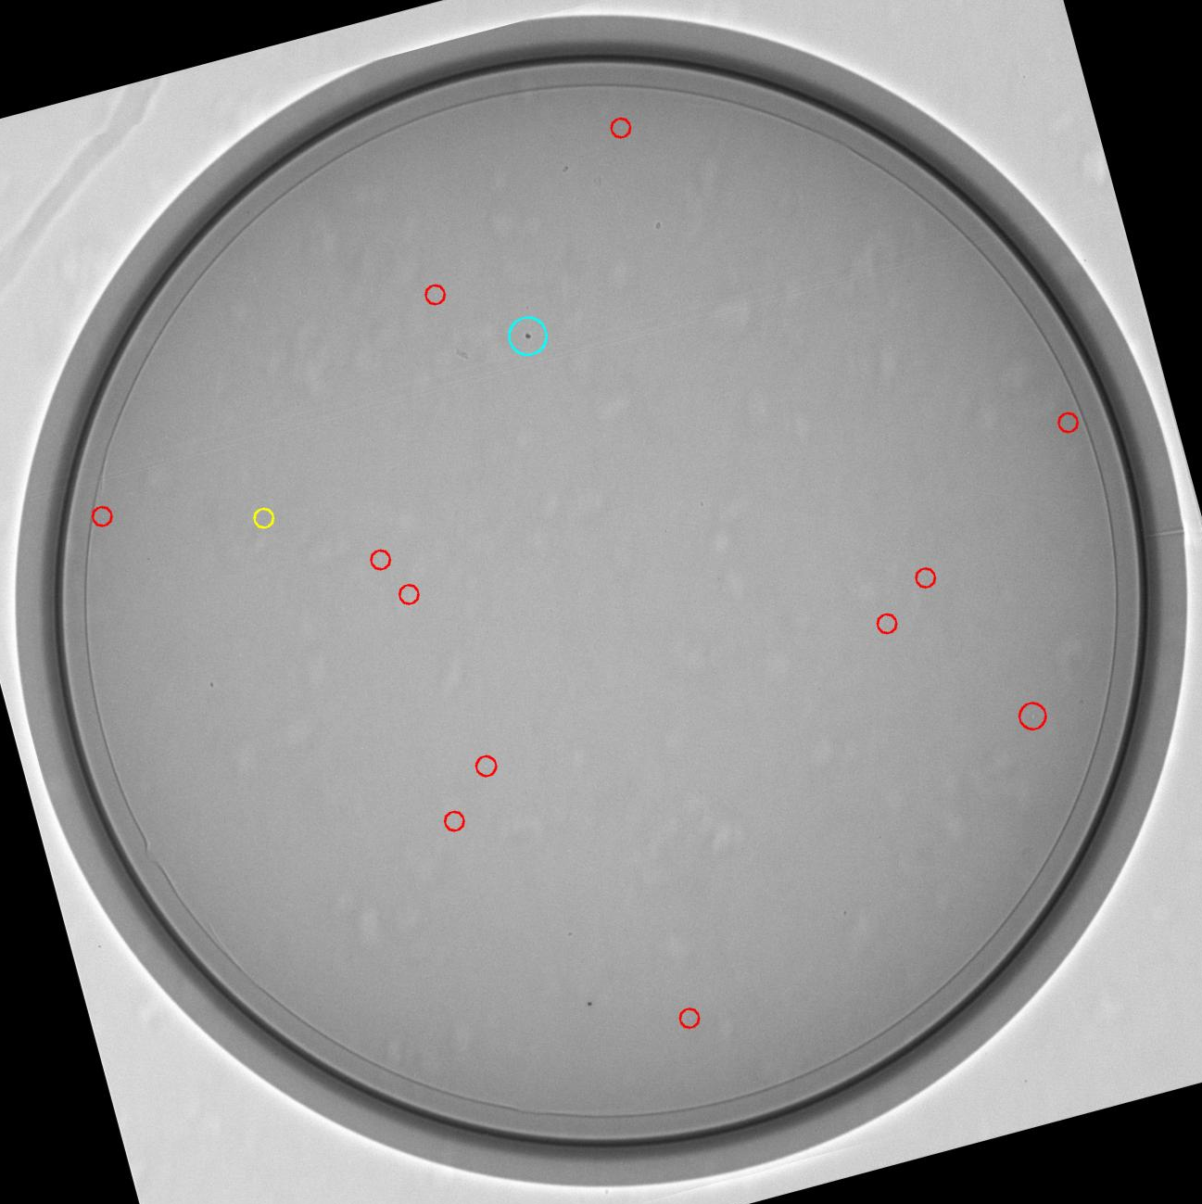
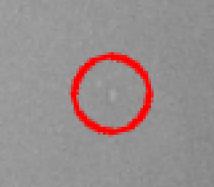
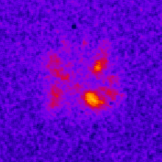
All Ignition Targets Continue to be Inspected to Identify Particles and Other Defects Located on the Capsule.
N181203
Red = Capsule Cyan = Lower LEH Yellow = Upper LEH
Experiments have begun where well characterized high Z (Au) and low Z (CH) particles
have been intentionally placed on the capsule at well characterized locations.
Notes:
All ignition targets fielded at NIF continue to be inspected to identify any particles that might exist on the capsule, and shot data, as always, is analyzed and any unusual features are noted.
Recently we've seen a new type of feature in the shot data where numerous regions of high emission appear early in the shot and converge towards the center of the capsules.
The image in the lower right corner is a self emission x-ray image of a imploding capsule which shows such an event with approximately seven separate, bright features.
Looking closely at the particle analysis of the capsule used for this shot we saw that it had numerous white spots on them.
The upper right image is a magnified portion of the capsule image showing one of the white spots, and as can be seen here, the spot has an edge to it and so it is just as easily found by the particle detection macro as a dark particle is.
The exact nature of the defect that is generating these lighter regions in the x-ray image is presently unknown and being investigated.
Finally, in order to systematically explore the connection between particles on the capsule and bright features in the shot data, experiments have begun where high Z and low Z materials have been intentionally placed on the capsule in well characterized positions, and high resolution simulations of the effect of particles on the implosion are in progress.

Slide 23
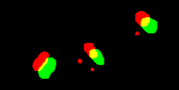

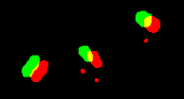



Metrics Used to Identify the Location of Observed Particles
Composite Image:
Capsule
Composite Image:
Bottom LEH
Composite Image:
Bottom Inner Shroud
shiftOverlap Image:
Capsule
shiftOverlap Image:
Bottom LEH
shiftOverlap Image:
Bottom Inner Shroud

Slide 24
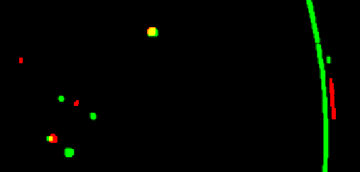
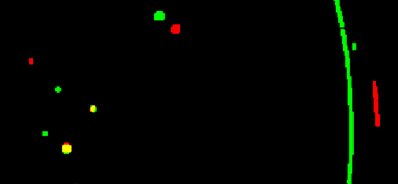
Metrics Used to Identify the Location of Observed Particles
Composite Image
Location = Bottom LEH
Composite Image
Location = Bottom Outer Shroud

Slide 25
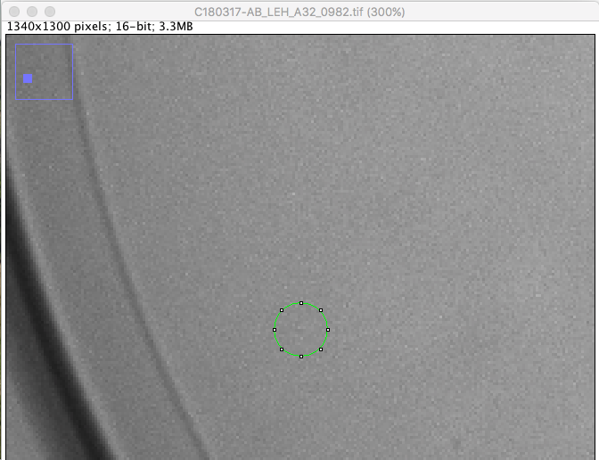
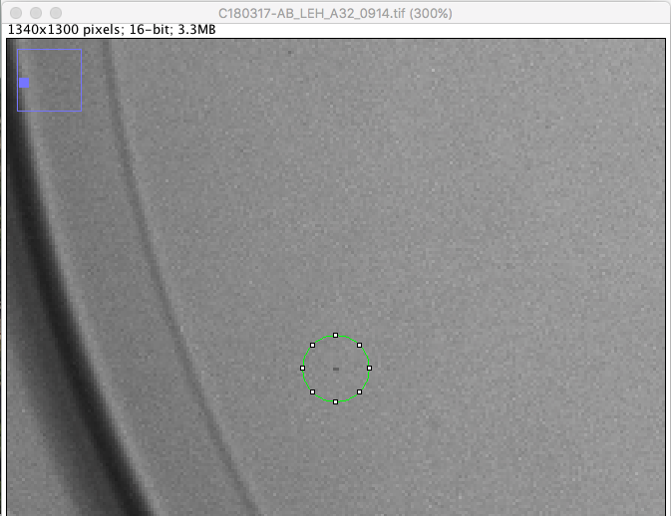
Human review of the data is needed to remove false positives
Image processing artifact - Aligned
Particle on X-ray camera window - Deviated.

Slide 26
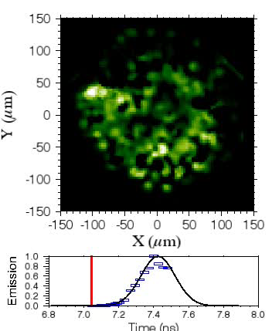
‘Imaging symcaps’ are a sensitive platform to furthering our understanding
N180305-002-999 pole view
Tilted Fill tube &
Particles
Fill tube
32 particles located on the capsule
This experiment shows large particulates observed in metrology can impact the HDC implosion
Notes:
FIX Movie

Slide 27
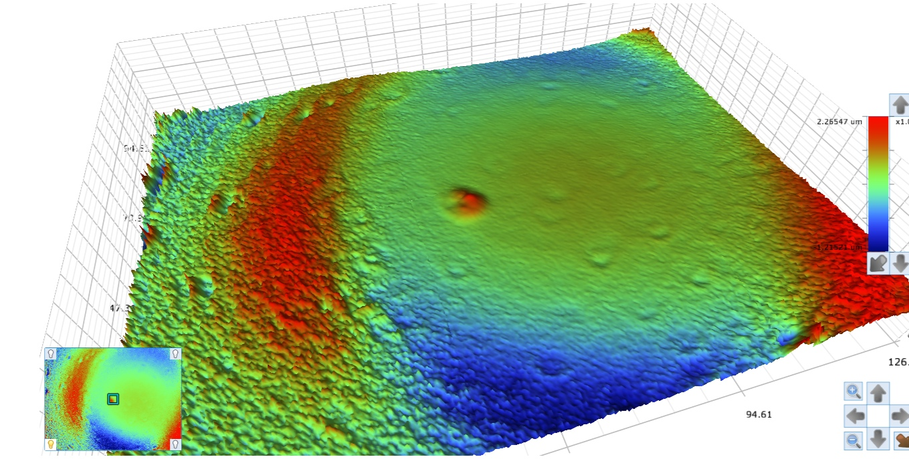
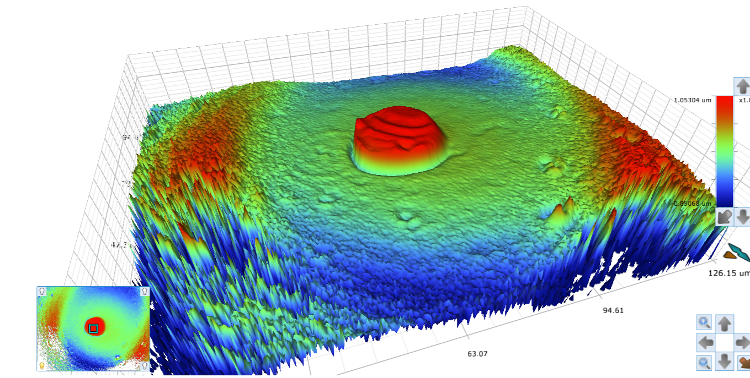
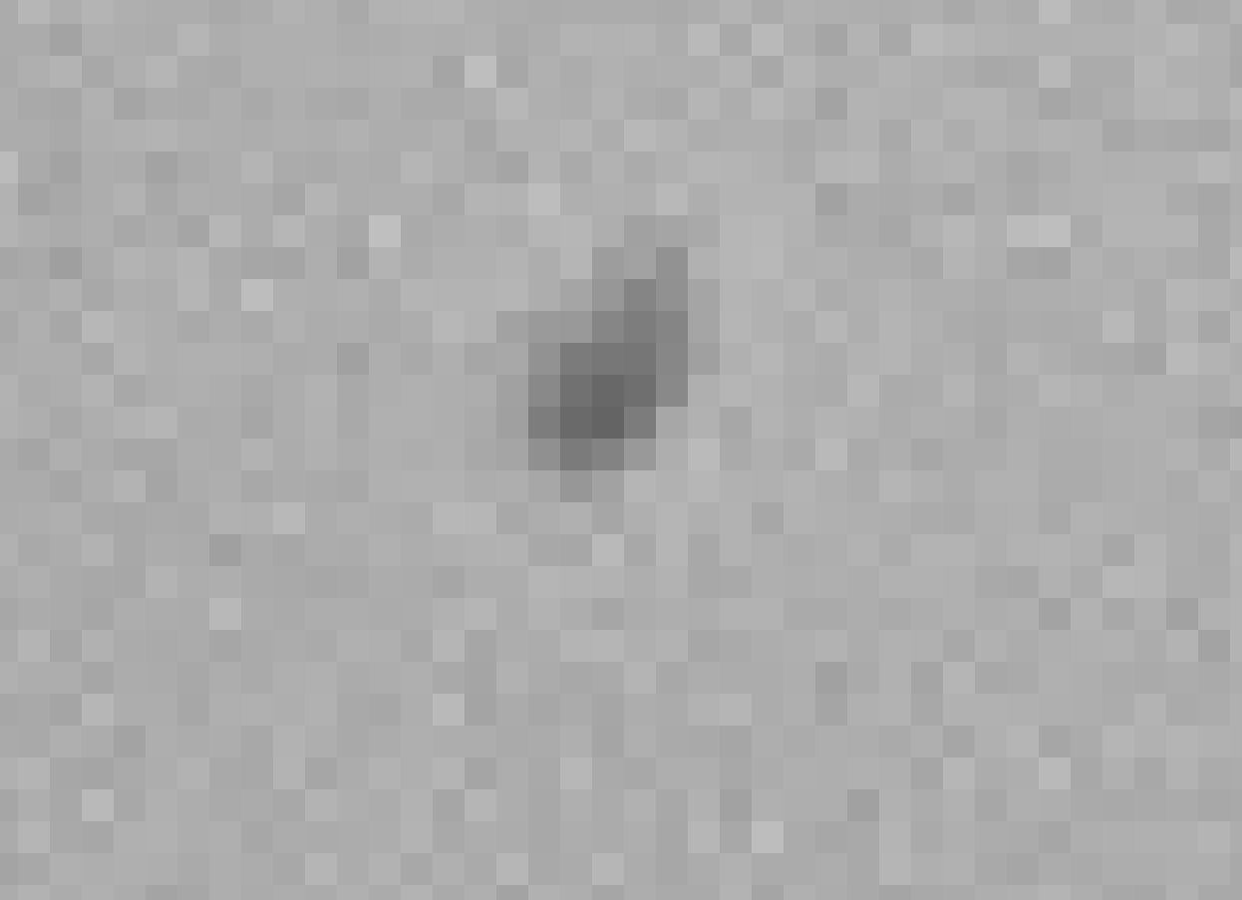
General Atomics were able to produce small Au ‘dots’ of 5, 9 and 20 µm diameter and 0.5 µm thick deposited directly on to the HDC capsule
White Light Interferometry measurement from GA of Au Dots (0.5 µm thick)
The differences between this experiment and the HDC shots that correlated ‘meteors’ to particles:
Au hohlraum
‘Big Foot’ laser pulse shape
The dot is uniform and deposited onto the capsule, the polar dot is under the tent
Equatorial dot
Diam.= 5 µm
X-ray metrology images of polar 20 µm diameter dot vs. particle
Polar Dot
Diam.= 20 µm
Polar “dot”
557um²
This shot
N171106
“dust” 165um²

Slide 28
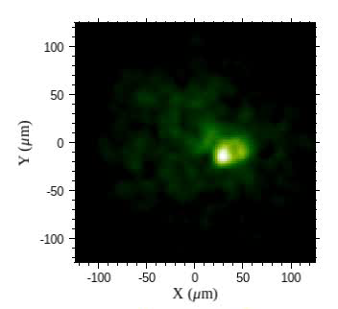
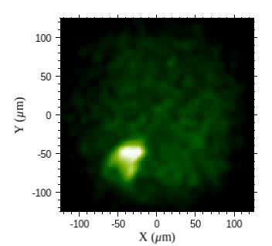
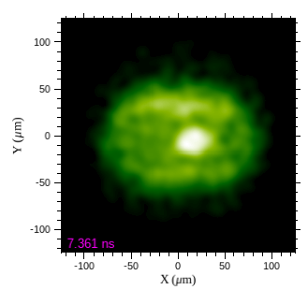
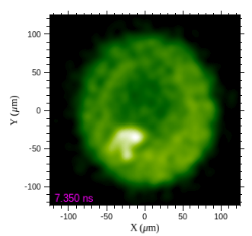
X-ray imaging data shows a strong fill tube feature, and some evidence of a tent feature, but no “meteors” from the pre-imposed dots.
Equator (movie)
BT-400ps to +100 ps
Pole (movie)
BT-280ps to -70 ps
90-78
0-0
BT= 7.5 ns
Y_{DD}= 6.76E12
T_{ion} = 2.77 keV
The absence of decel. perturbations from the dots might indicate:
Dot not thick enough
Role of the tent
Other unidentified seeds
Differences in BF/HCD AF stability
Differences in DU/Au AF stability
BT-140ps
BT-150ps
Notes:
FIX Movies

Slide 29
First experiment with pre-imposed high Z dots show lack of
instability growth from the imposed features
Shot summary:
  Good imaging data but neither the 5 µm or 20 µm diameter dot seeded a visible deceleration perturbation
  Imaging data shows clear fill tube and possible tent perturbations in the ‘BigFoot’ subscale platform
Next step:
Test if the Big-Foot pulse shape is more stable than an equivalent HDC pulse shape in a Au-hohlraum
Perform a dot experiment with a HDC pulse shape in a DU Hohlraum
Notes:
DIVOT shots????

Slide 30
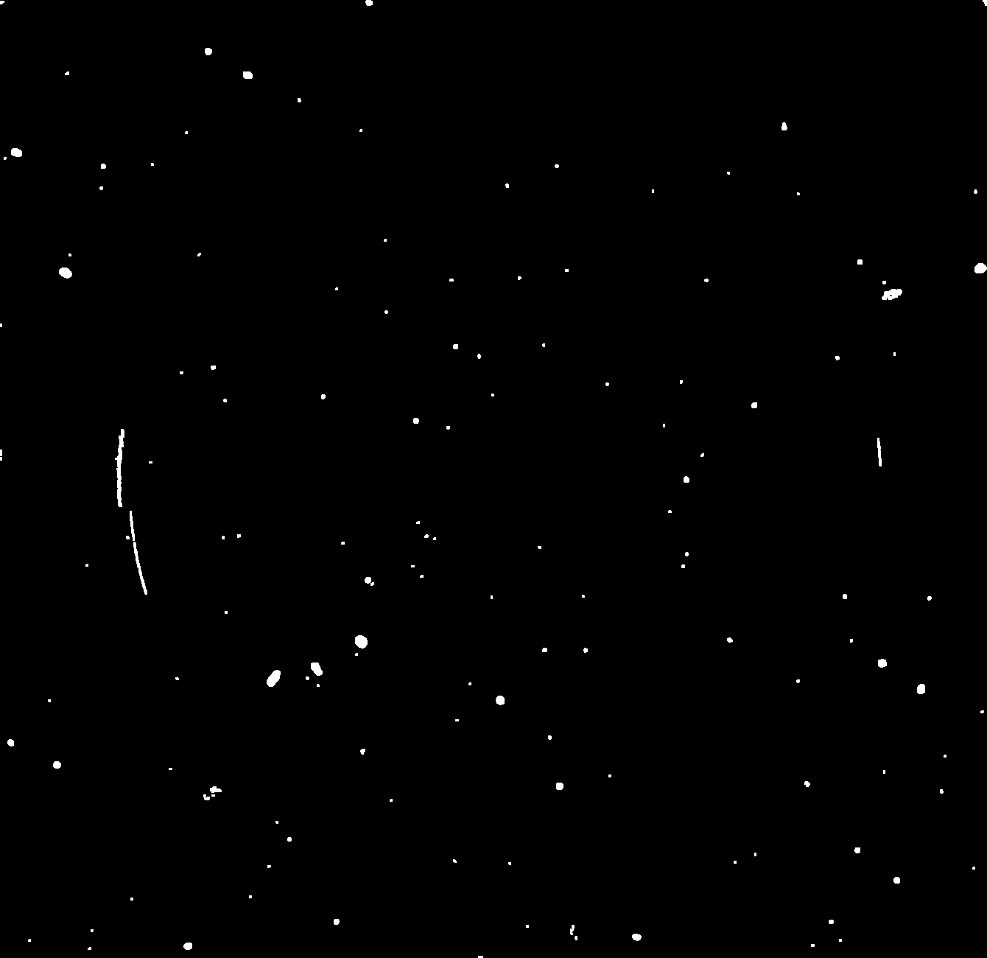
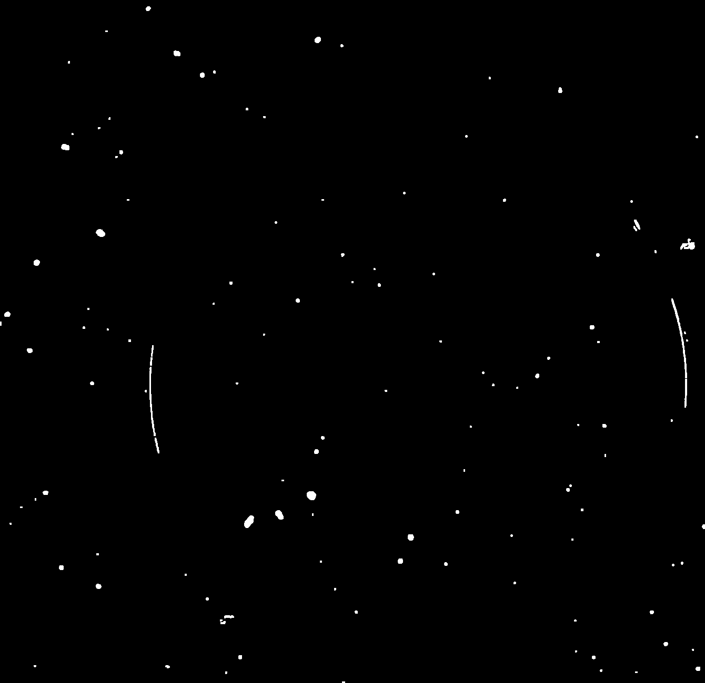
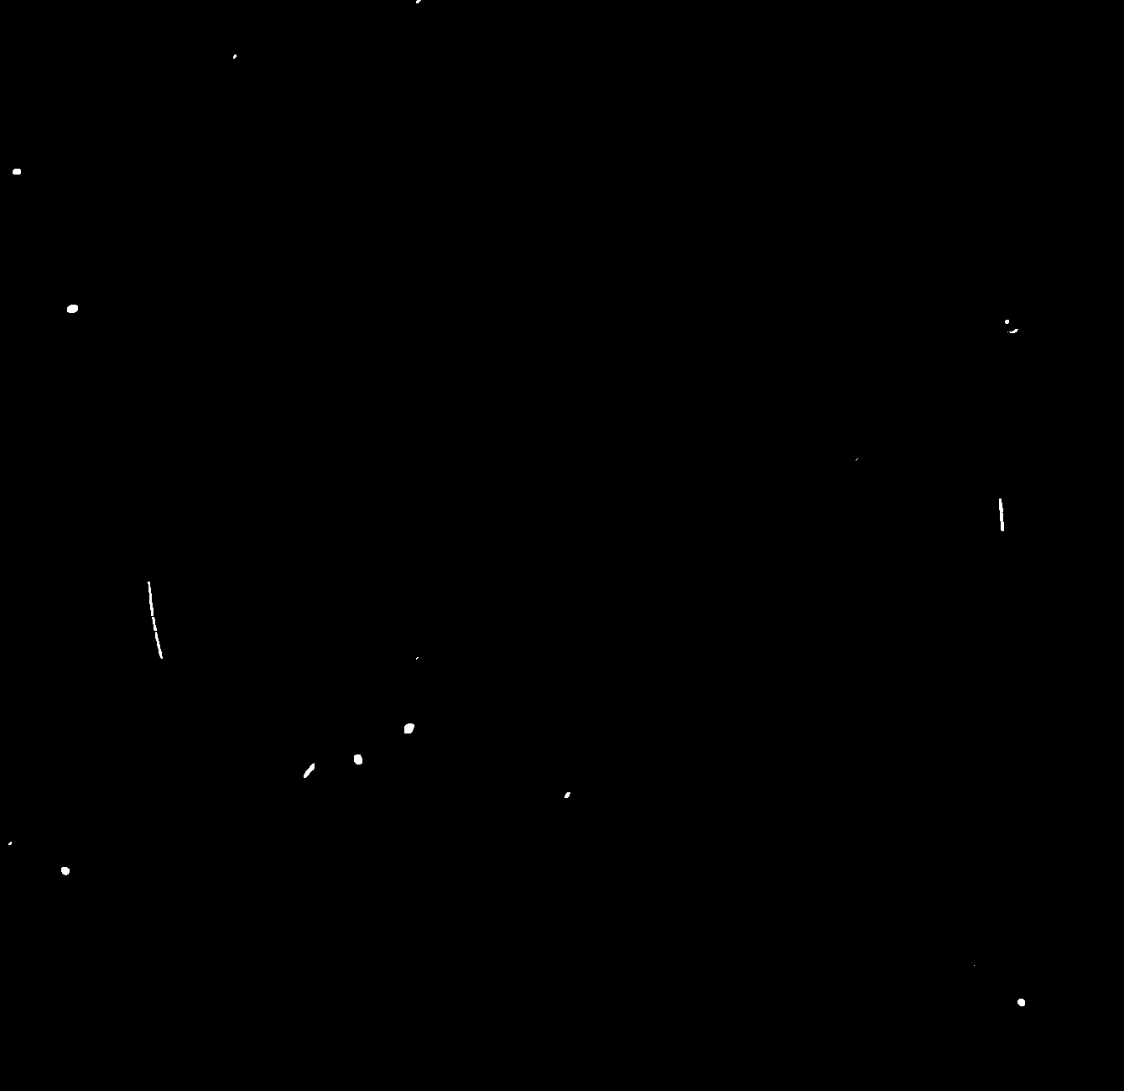
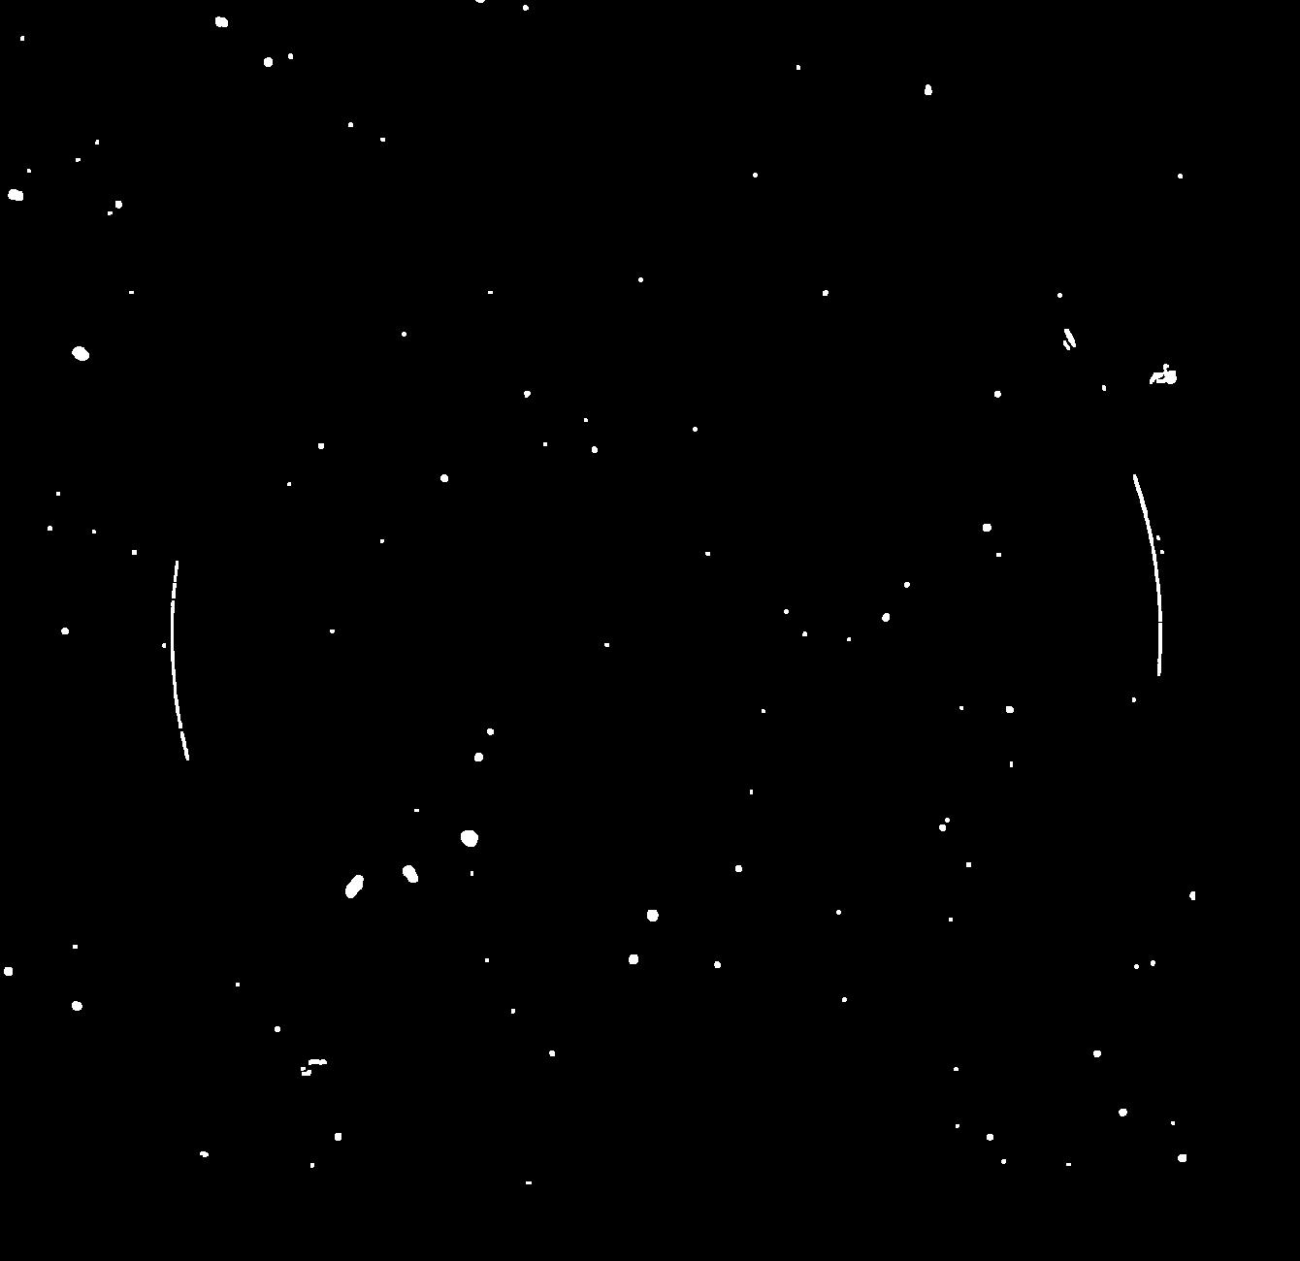
Coincidence Images Created Using Aligned and Translated Deviated Images Identify Particle Candidates for a Given Component
Aligned Image
Deviated Image
Coincidence Image
Translated Deviated Image
Example of a deviated image translated by a distance equal and opposite to what a particle on the capsule would have undergone
Multiplying the aligned image by the deviated image translated by a capsule displacement gives candidates for the capsule location
Particle on the component
Creating Coincidence Images Associated with Each Target Component
Reduces the Complexity of the Particle Identification Calculation
Notes:
Instead of performing mathematical calculations that attempt to determine the correct pairing of particles in the two images we can use an image coincidence approach.
This is accomplished by taking the calculated displacement that a particle on a particular target component would experience, and using it to translate the deviated image by an amount that is equal and opposite to that distance.
This results in a return of the particles to their starting point as defined by the aligned image, if and only if they are on the surface for which the calculation is being performed.
In the example above the deviated image has been translated by an amount that undoes the displacement a particle on the capsule would have undergone, and as we can see, the red circle that marks the capsule position has been re-centered.
In this example, to identify particles that are candidates for being on the capsule we simply multiply the aligned image by the translated deviated image to create a coincidence image where all particles other than those that have a high probability of being on the capsule have been eliminated.
This sequence of operations is performed for each of the eight surfaces in the target system to identify the candidates for each of the possible locations.

Slide 31
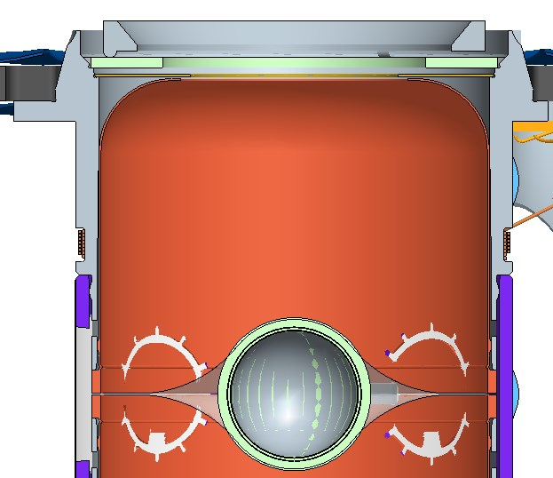
The Distance a Particle Will be Displaced in the Parallax Shifted Image Can be Calculated for Each of the Target Components
Storm Window
LEH Window
5.6 mm
5.0 mm
Capsule centerline
The Distance a Particle Will be Displaced in the Parallax Shifted Image
Can be Calculated for Each of the Target Components
Notes:
The one place on the target where it is not possible to distinguish between different surfaces is at the top of the target, at the LEH and Storm windows.
The separation between these two components is only 0.6mm, which results in a difference in displacement in the deviated image of only two pixels.
This is not of a concern as particles determined to be on either of these two surfaces would be treated in the same way when determining if a target was acceptable for a shot.

