Slide 1
Diamond turning of High Tool Wear Materials for Equation of State Targets
Target Fabrication Conference 2019
Carlos Castro, L. Ahrendes, T. Matz, N. Le, D. Fratanduono, R. Seugling, A. Nikroo
April 2019

Slide 2
Presentation Outline
Equation of State (EOS) Targets
Machining of EOS components
Why Diamond Tools for Machining
List of Diamond Turnable Materials
High tool wear materials Diamond Turned at LLNL
Other materials
Summary

Slide 3
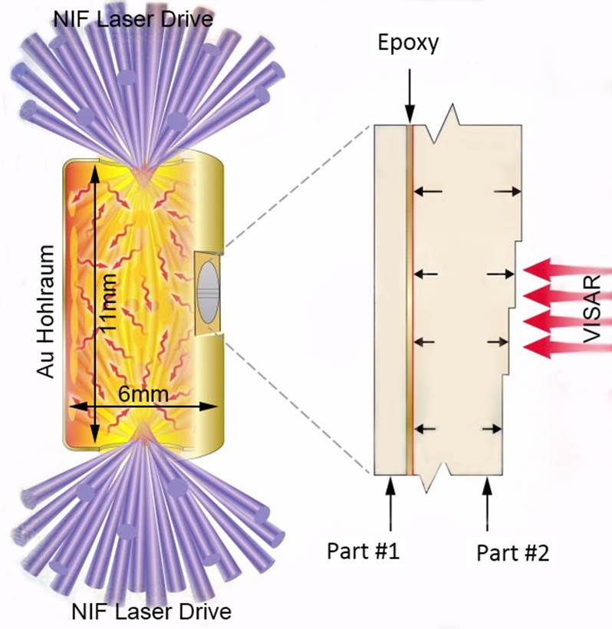
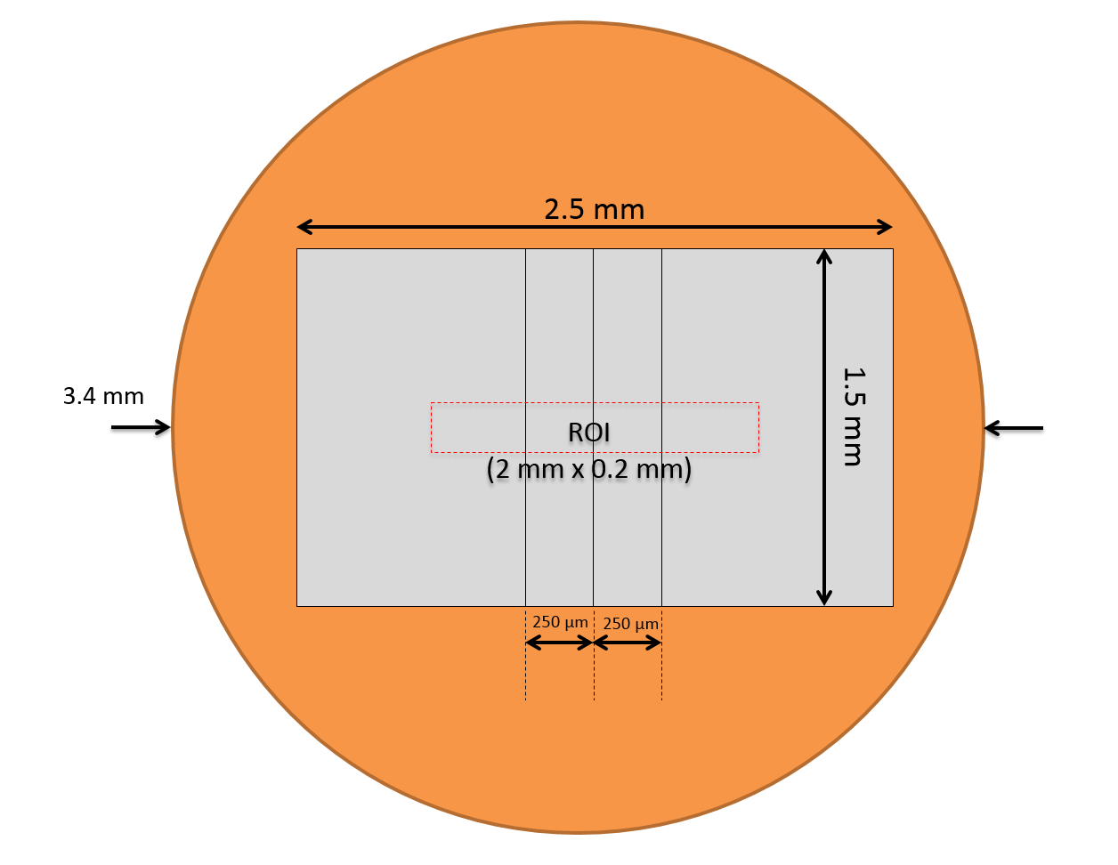
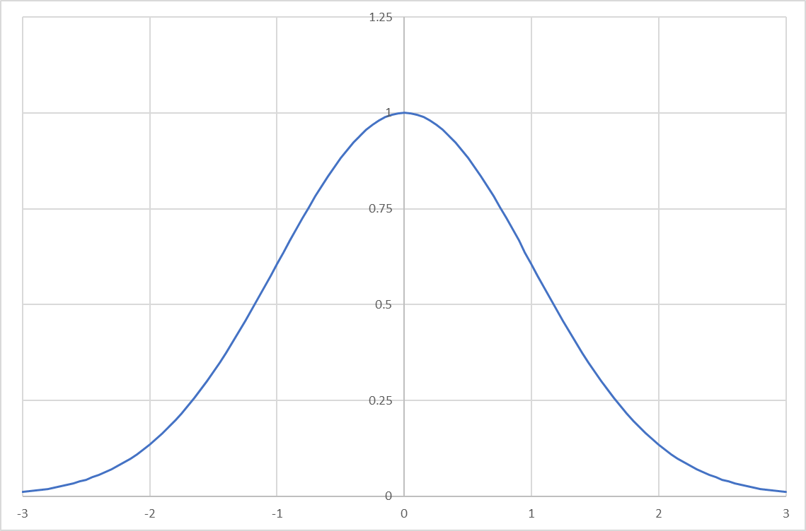
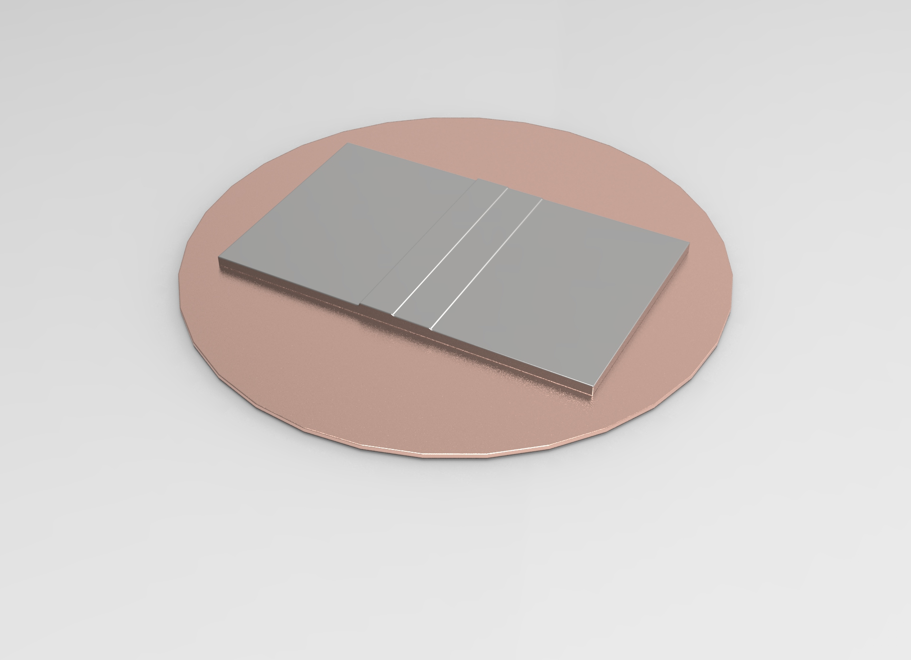

Equation of State (EOS) Targets
The gold hohlraum is driven top and bottom using the NIF laser to create an x-ray drive on the sample shown on the right. Part #1 is ablated causing a pressure wave through the stepped sample, part #2. The velocity of the stepped profile is measured using a velocity interferometric diagnostic (VISAR1). Variation in thickness and form correlate to a velocity error.
Target Specifications:
The specification for the acceptable thickness variation for Equation of State (EOS) targets is defined using the Half Width Half Maximum (HWHM) of a Gaussian Distribution fitted to the histogram of the thickness data from a Region of Interest (ROI) on each component and the final assembled the physics package.
For the EOS targets the HWHM specification is 50nm.
The figure shows a schematic of a planar target assembly where the sample is a combination of two thin foils machined independently and assembled using an adhesive.
HWHM
The ROI for defining the HWHM
is shown by the red dashed rectangle
The blue arrow shows how the HWHM is defined

Slide 4
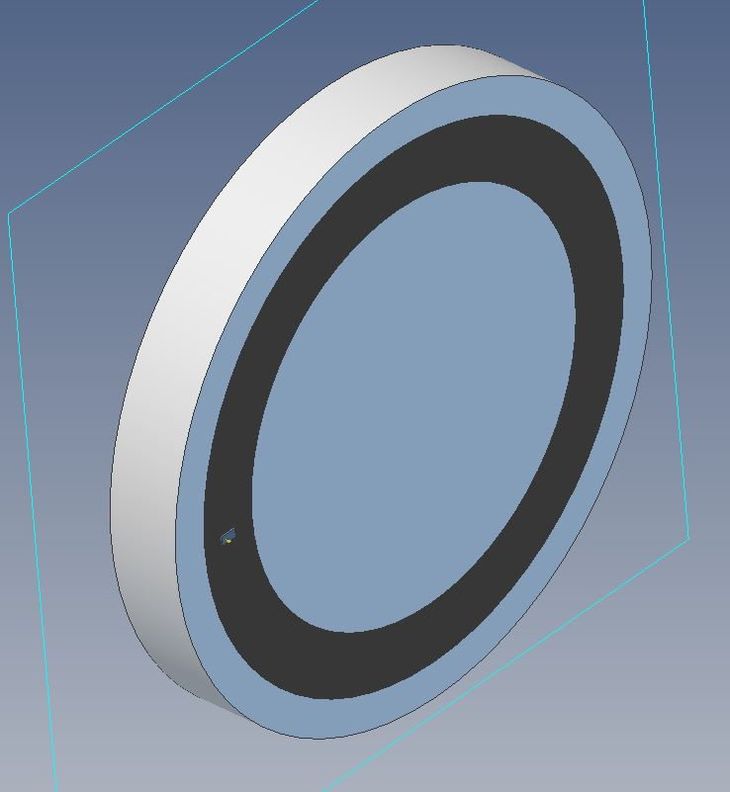
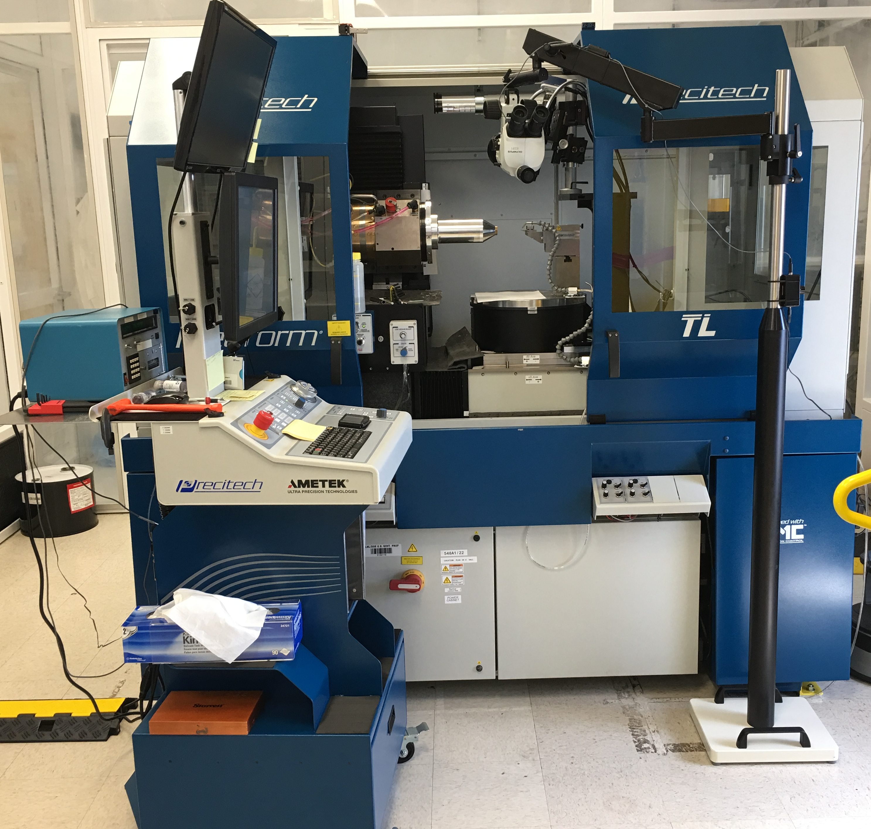
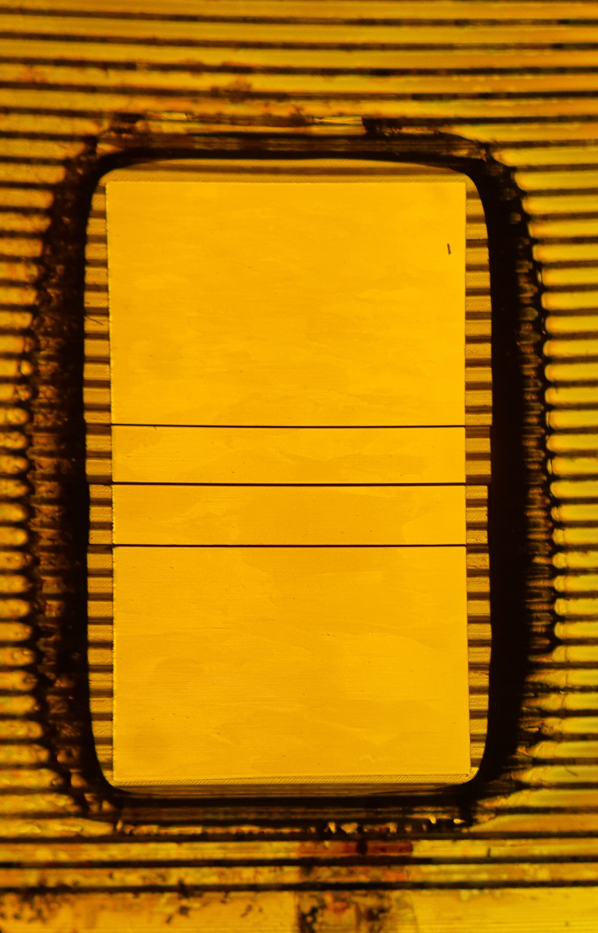
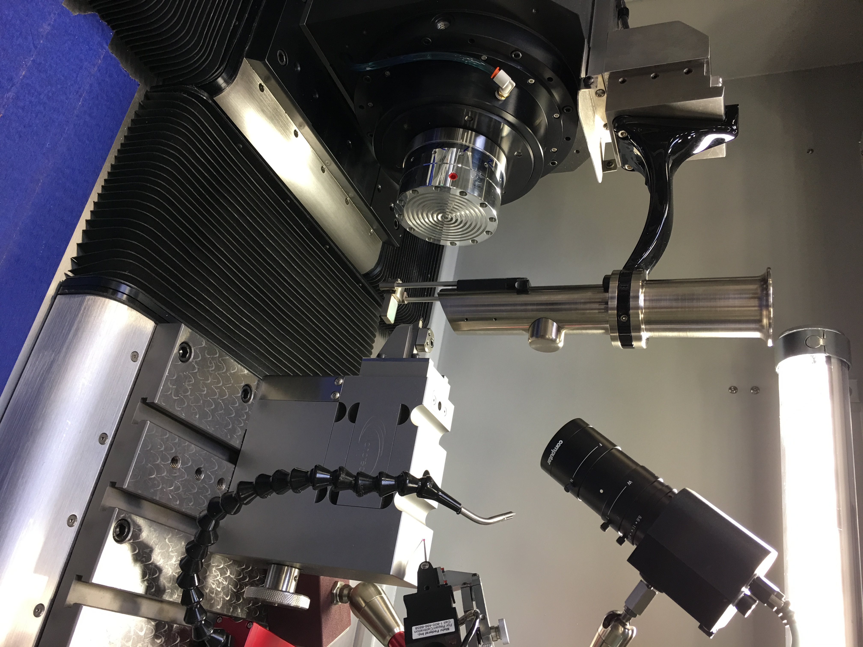
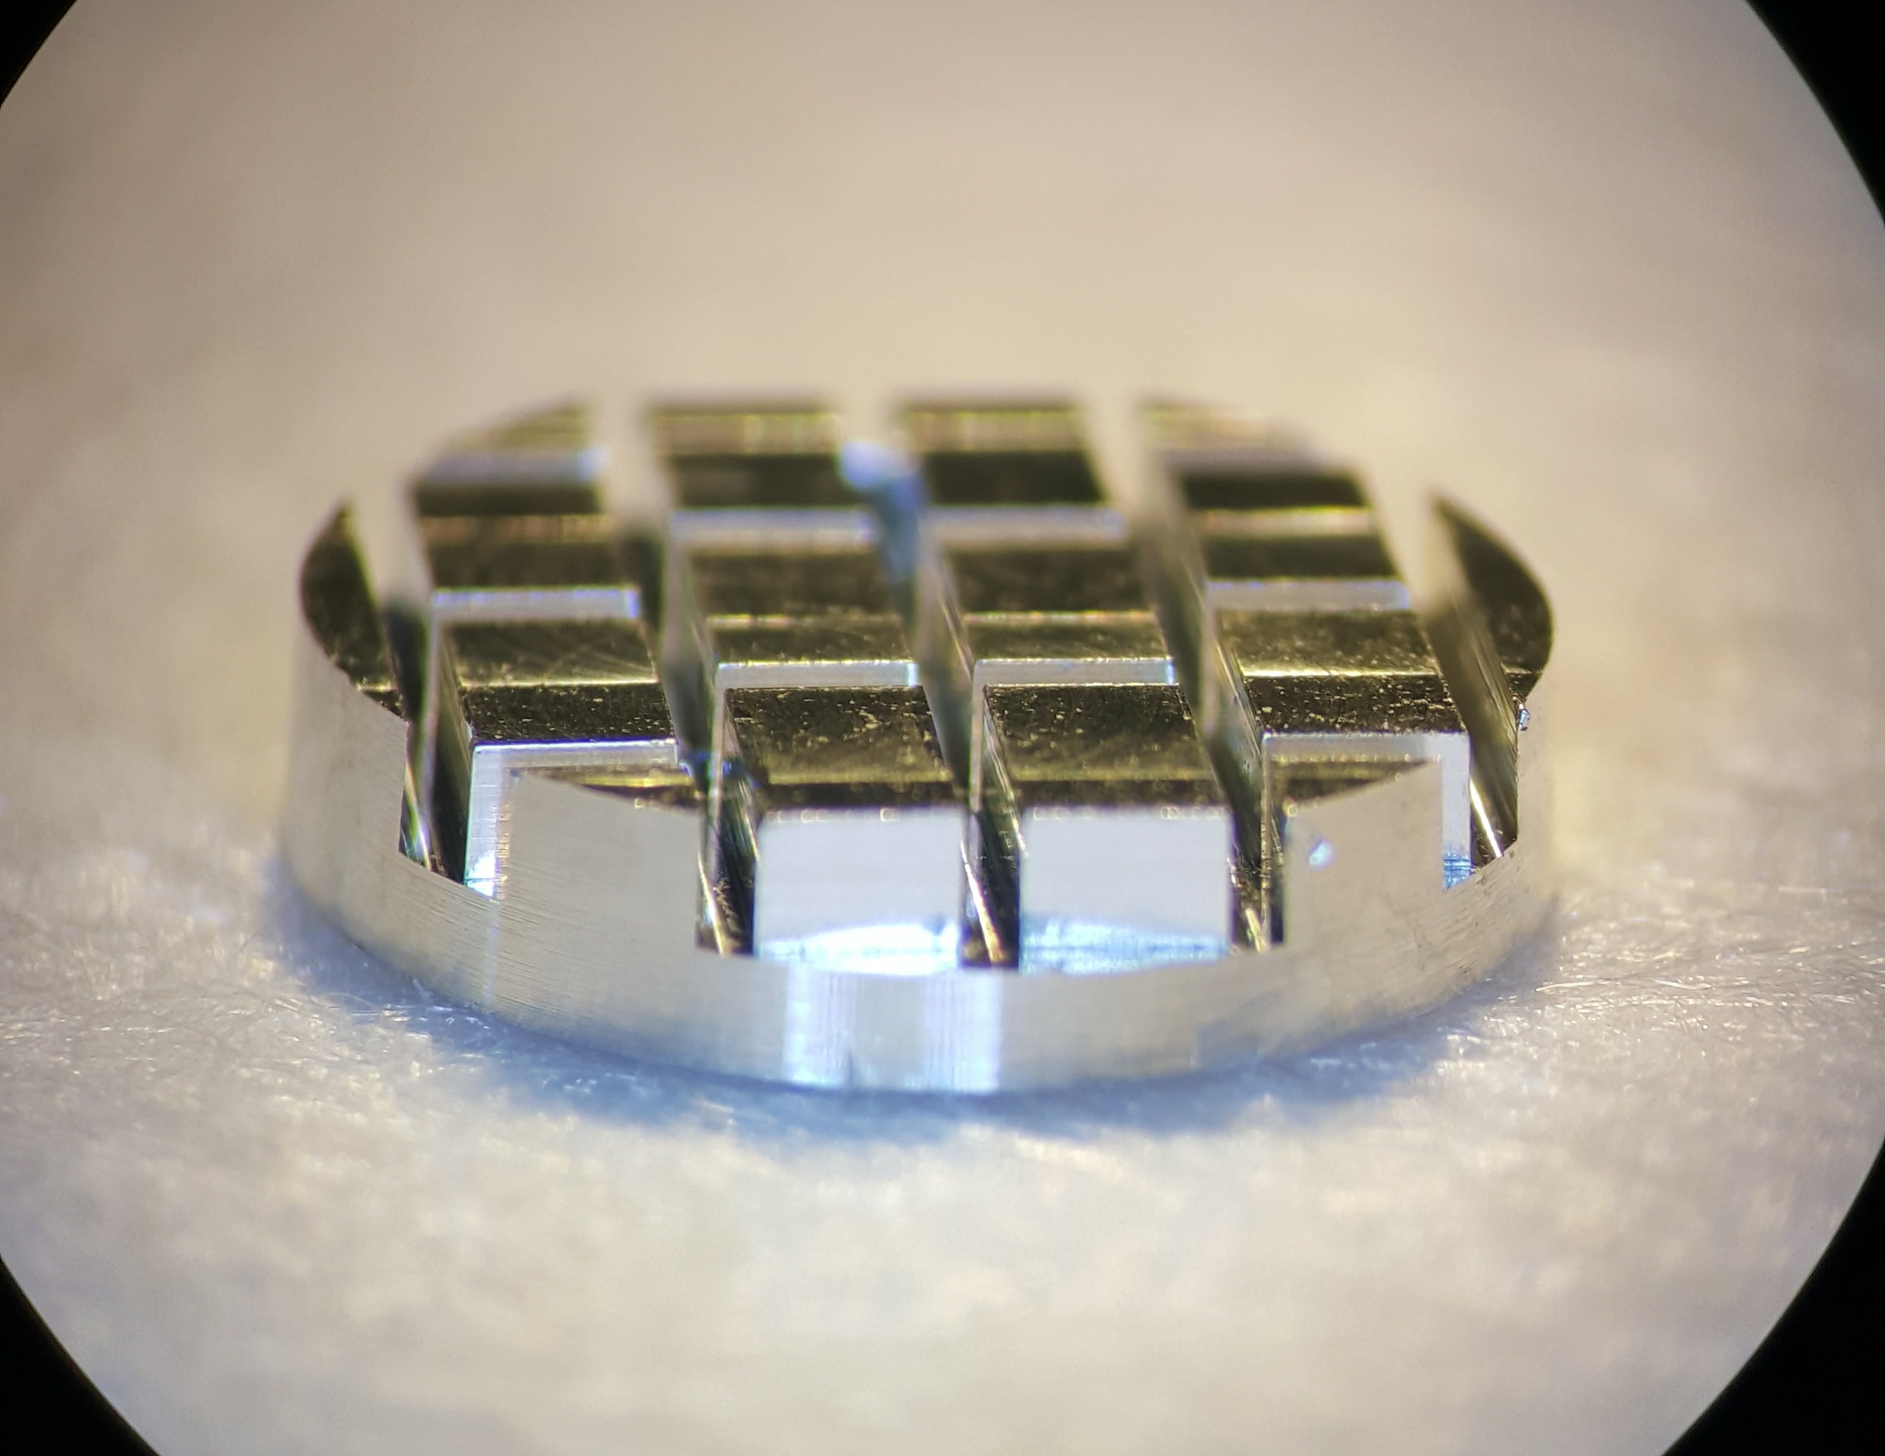
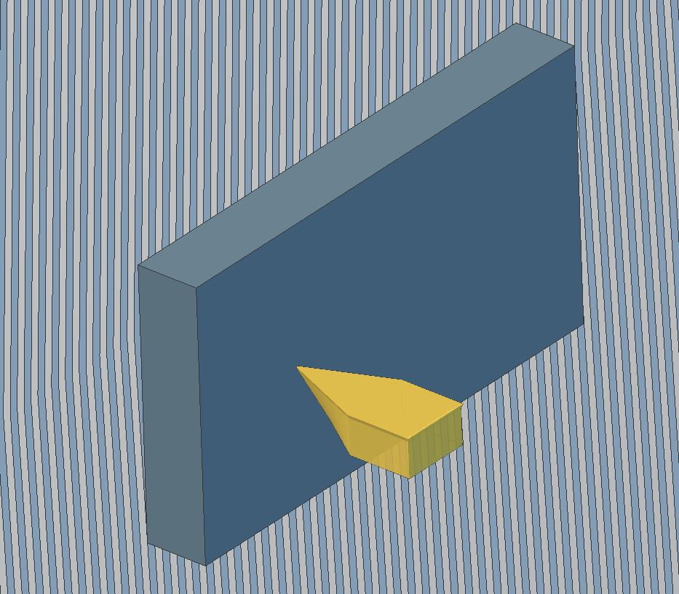
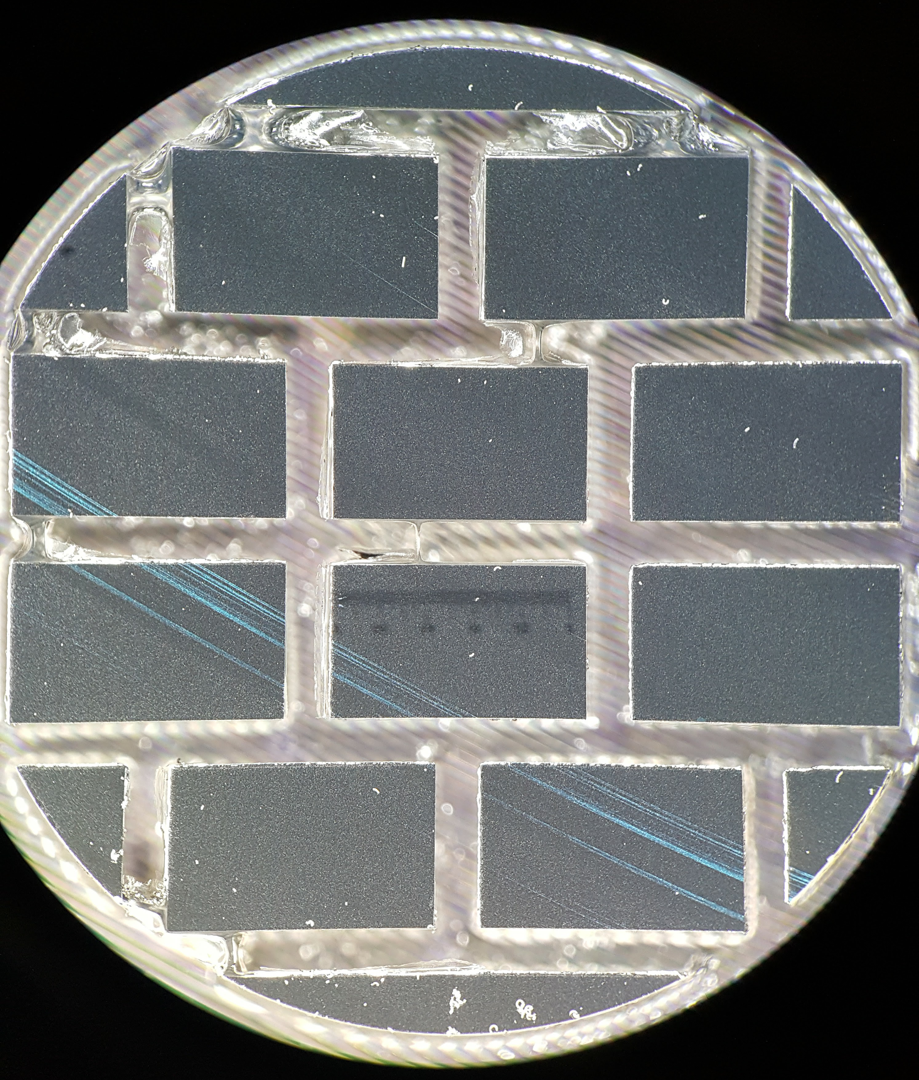
Machining process of a stepped EOS sample
EOS samples are turned (machined ) off-axis
Samples are mounted on a Ø100 mm Disk using a soluble adhesive (multiple parts)
The work holding disk is held by vacuum on the lathe spindle
Samples are machined on both sides and have in-process WLI checks
Parts are then Machined to the specified thickness and profile

Slide 5
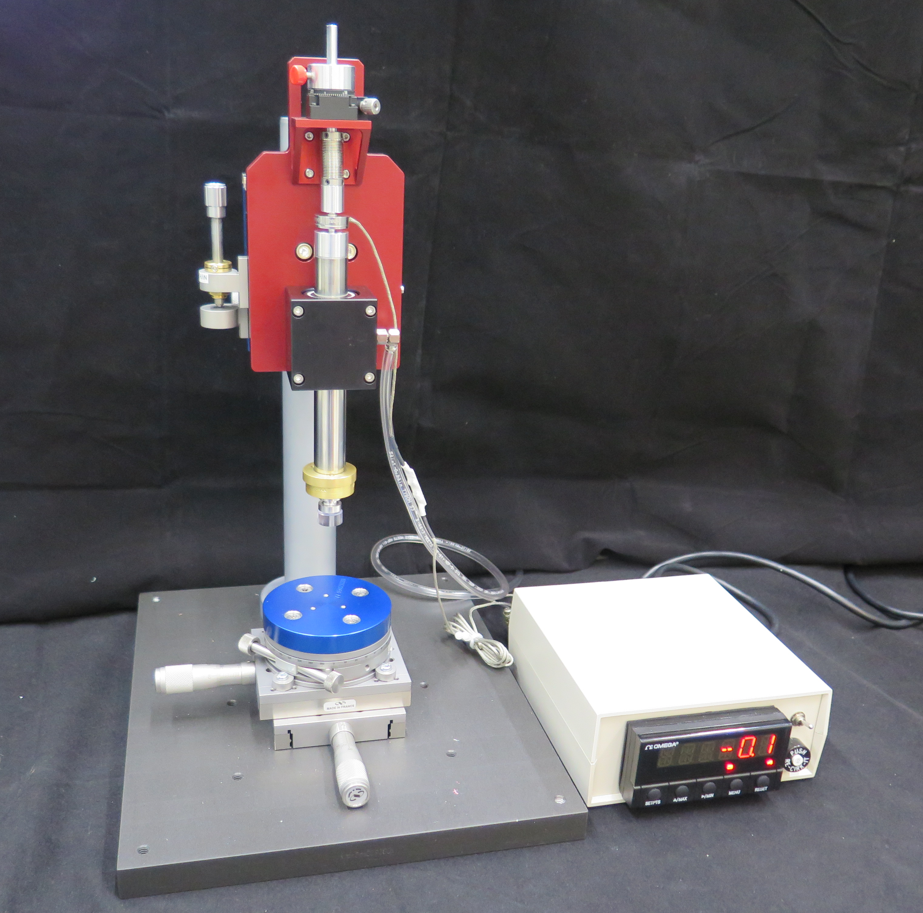
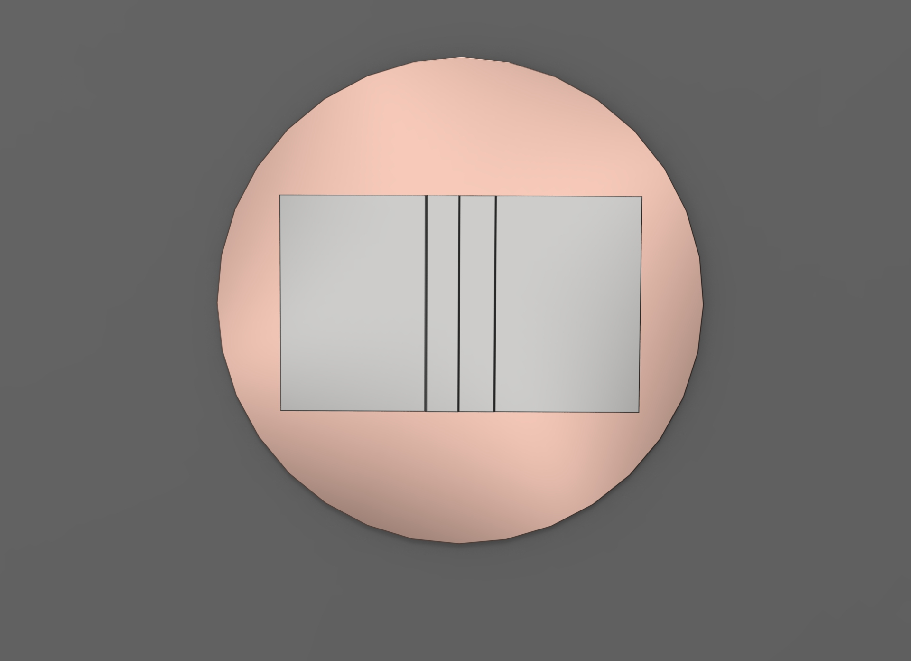
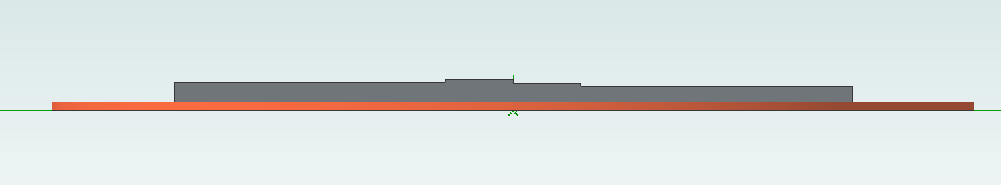
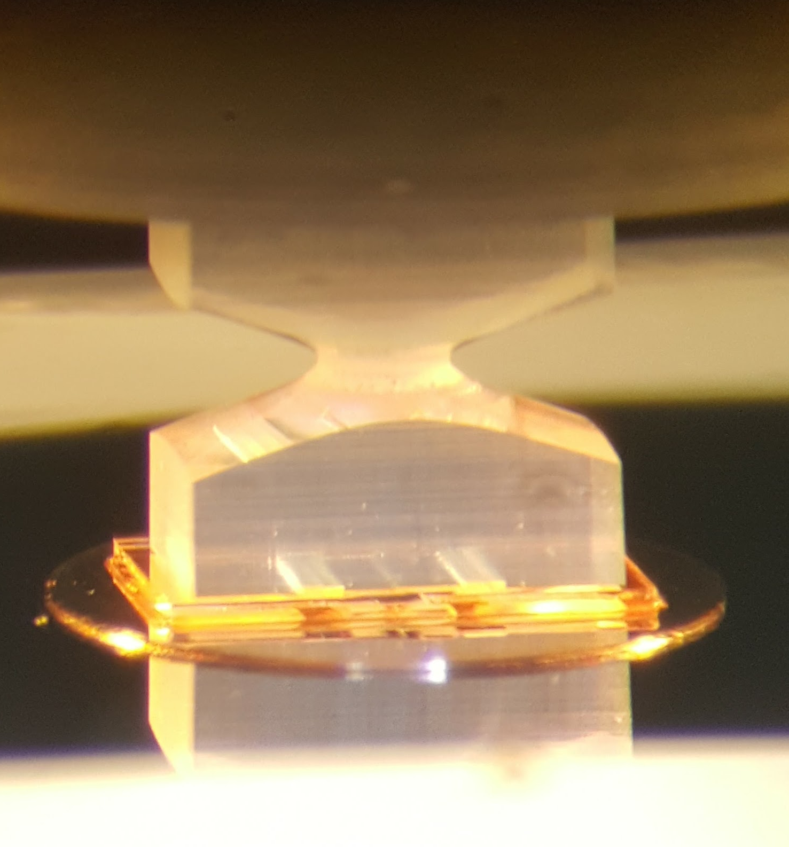
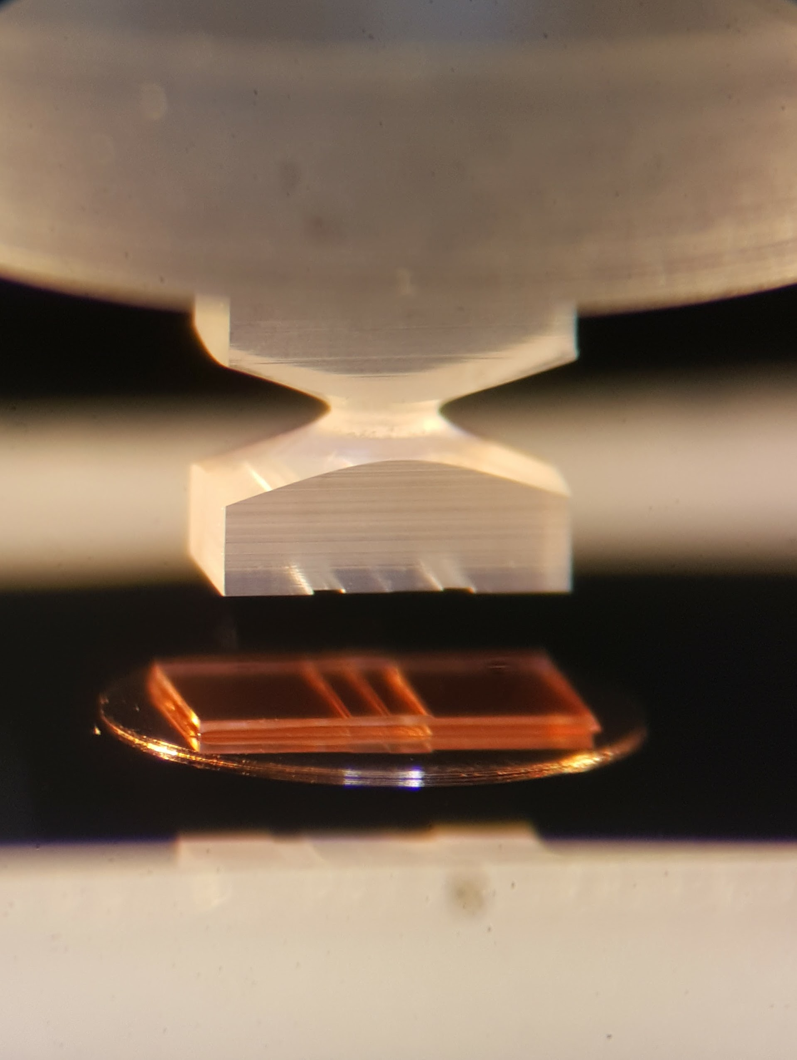
EOS Target assembly specifications
EOS assembly station with force sensor
Parts must be within 50nm of profile and parallelism
Assembly must be within 50nm parallelism
Parts must be measured independently using the Double-sided white light interferometry (DSWLI) before assembly
For the EOS targets the physics team asked Target Fabrication if we could reduce the HWHM from 100nm to 50nm. This would reduce the uncertainty of the data they get for each target shot on NIF by a factor of 2. Reducing the uncertainty by a factor of 2 reduces the number of targets that need to be shot by a factor of 4, saving 3 shots for each data point.

Slide 6
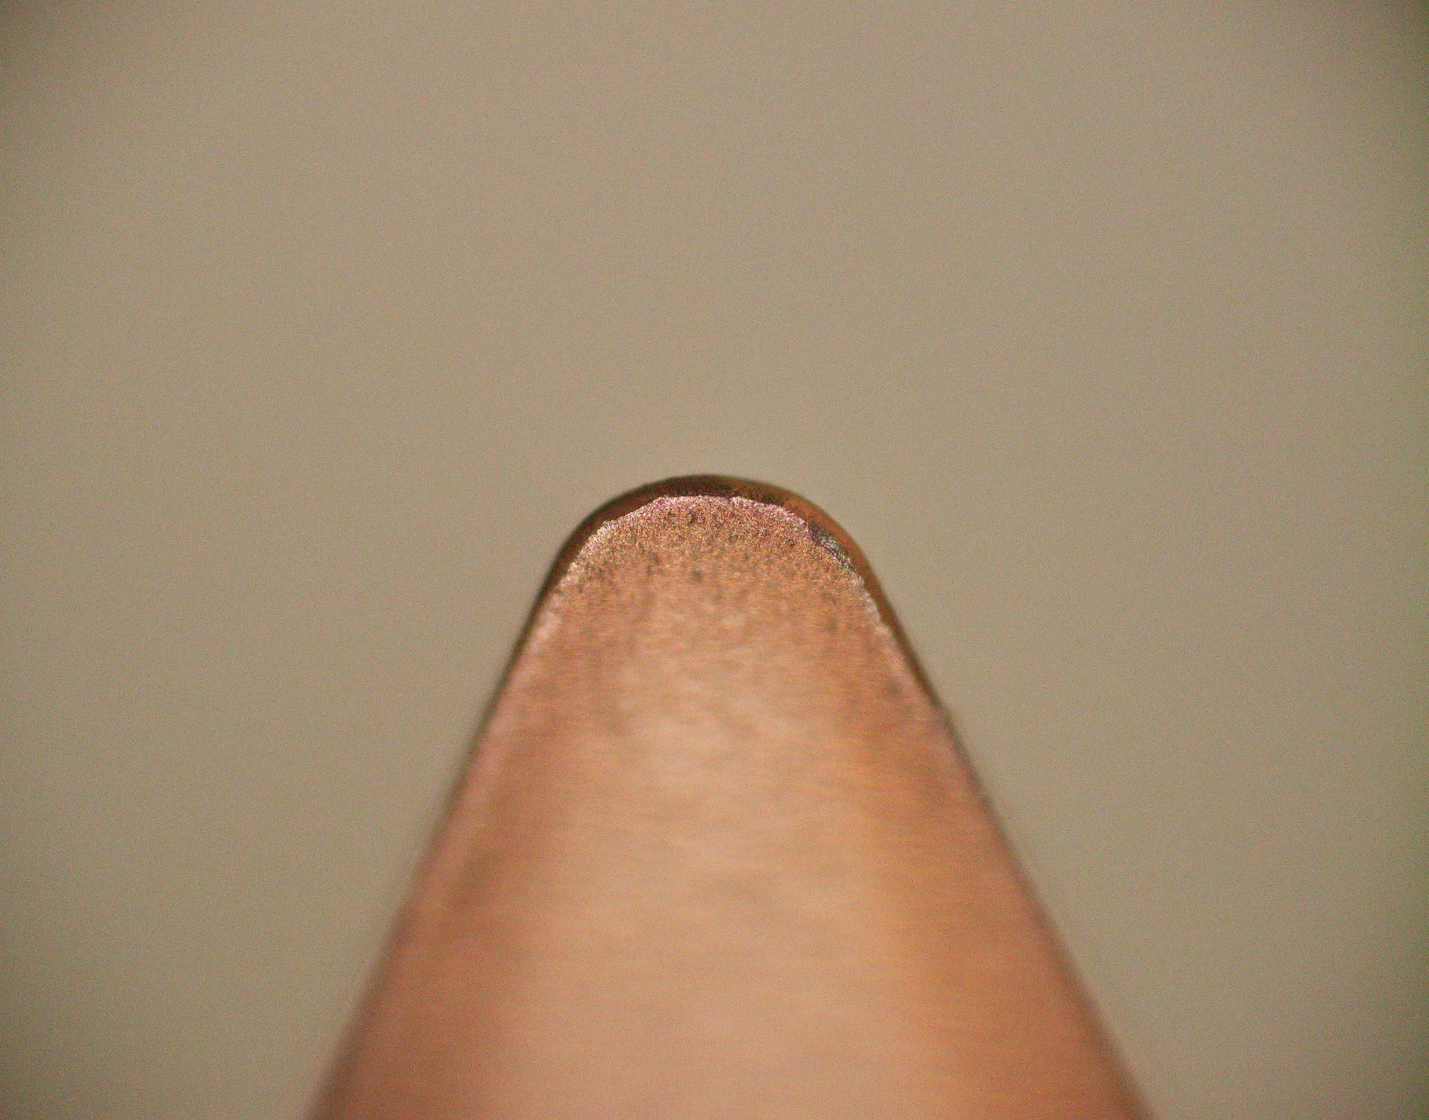
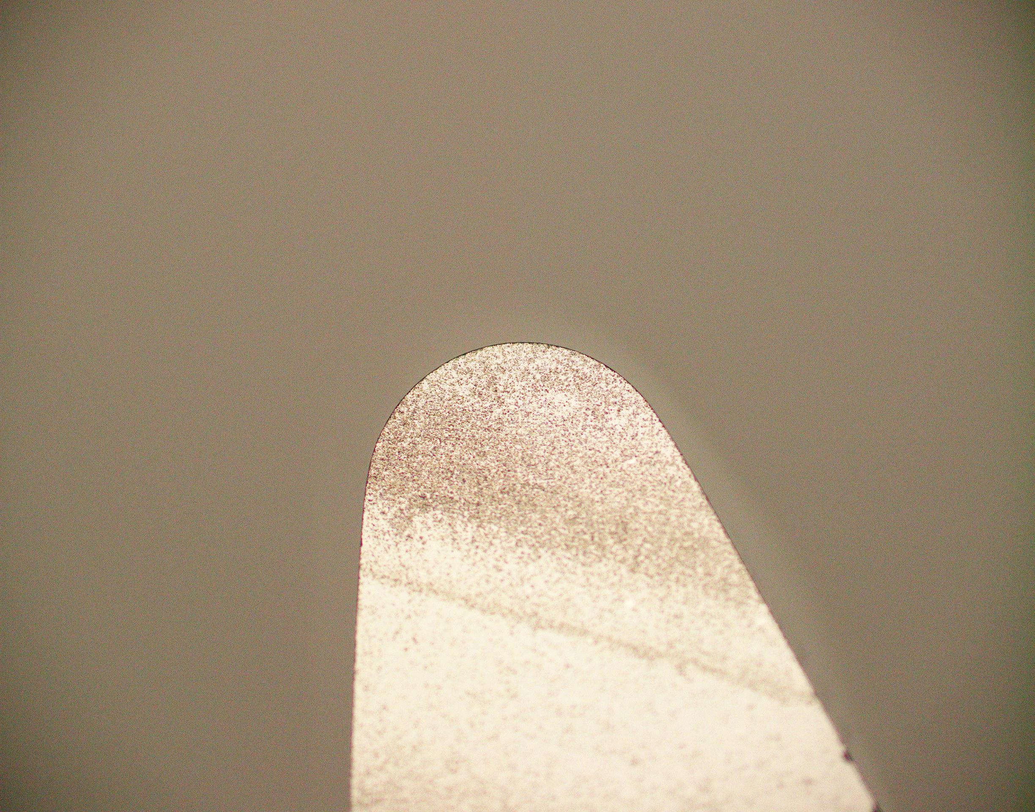
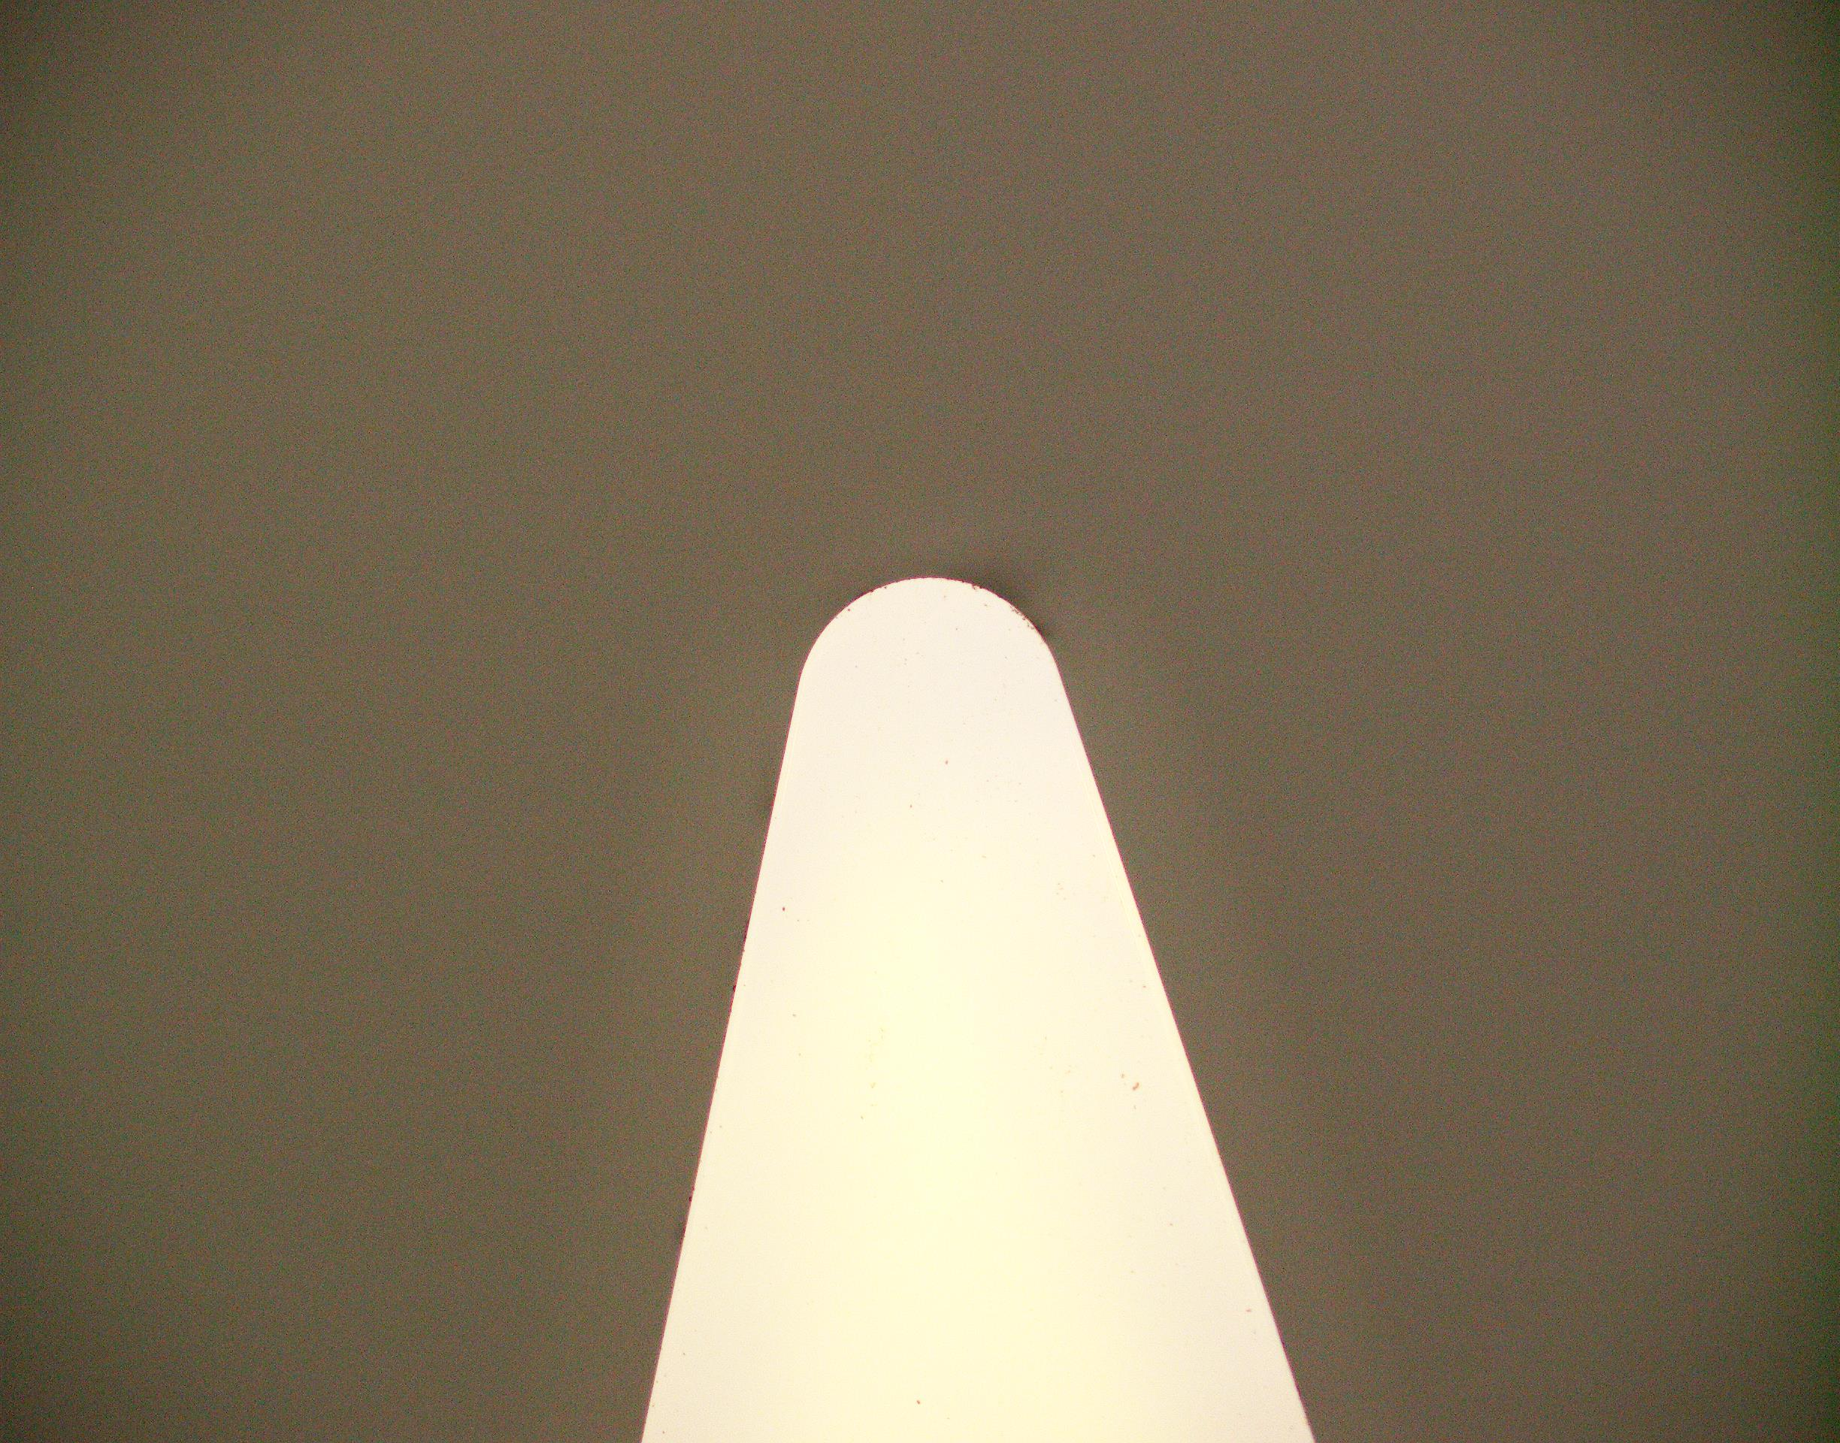

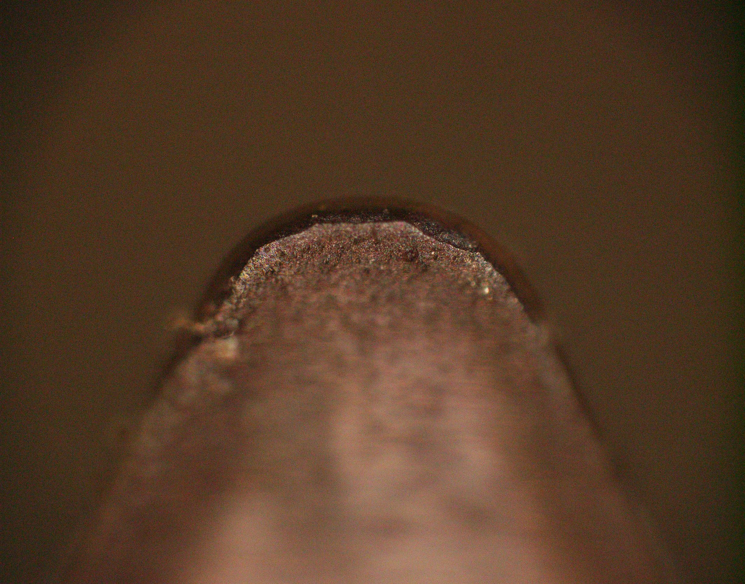
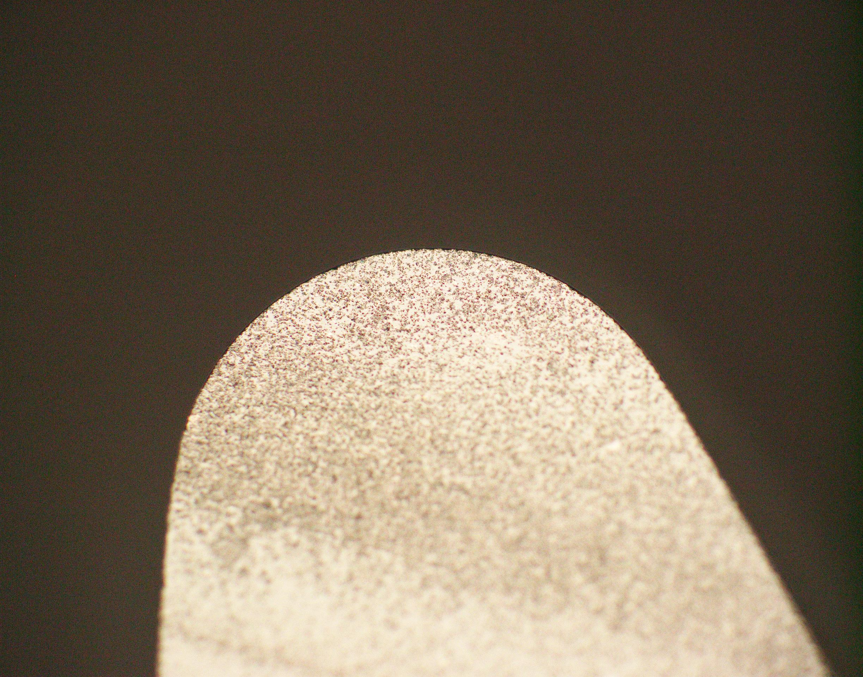

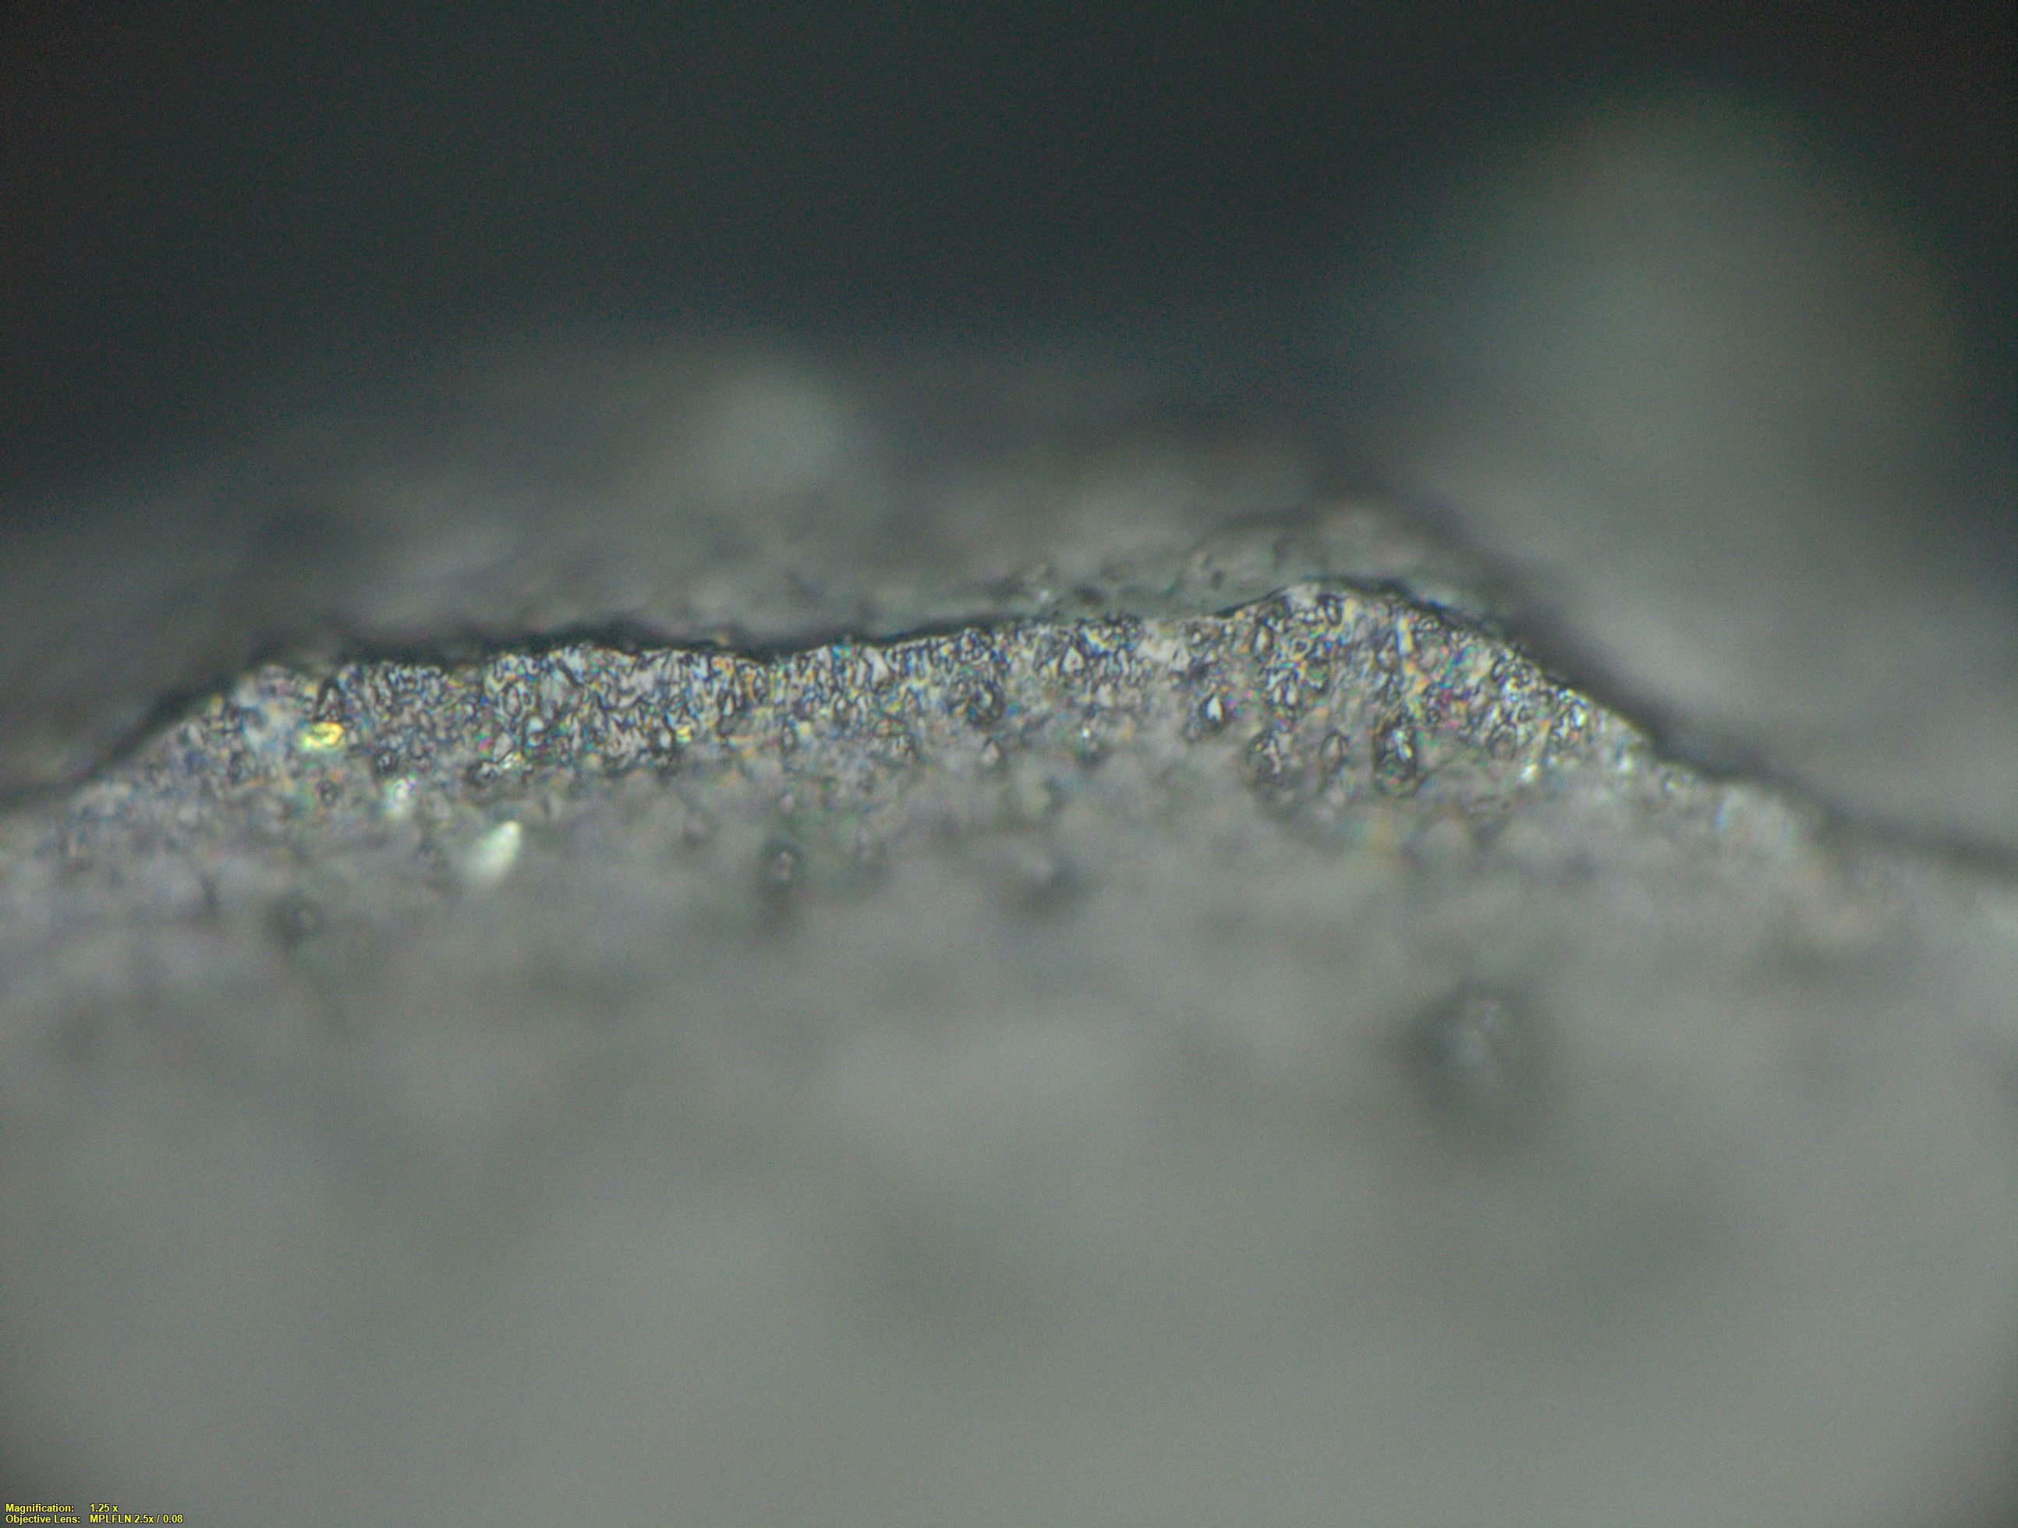
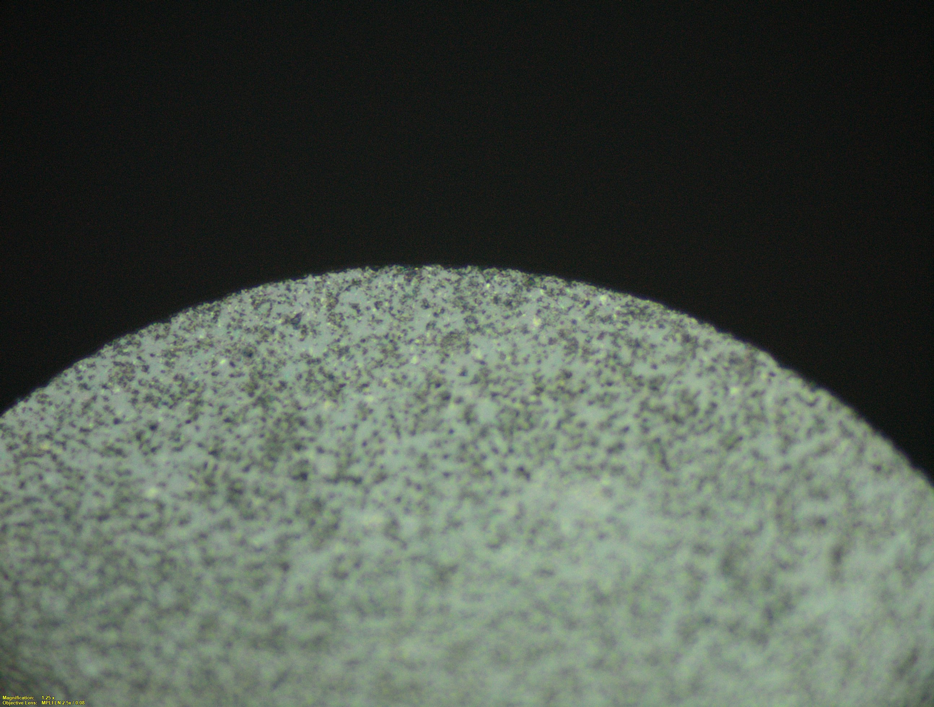
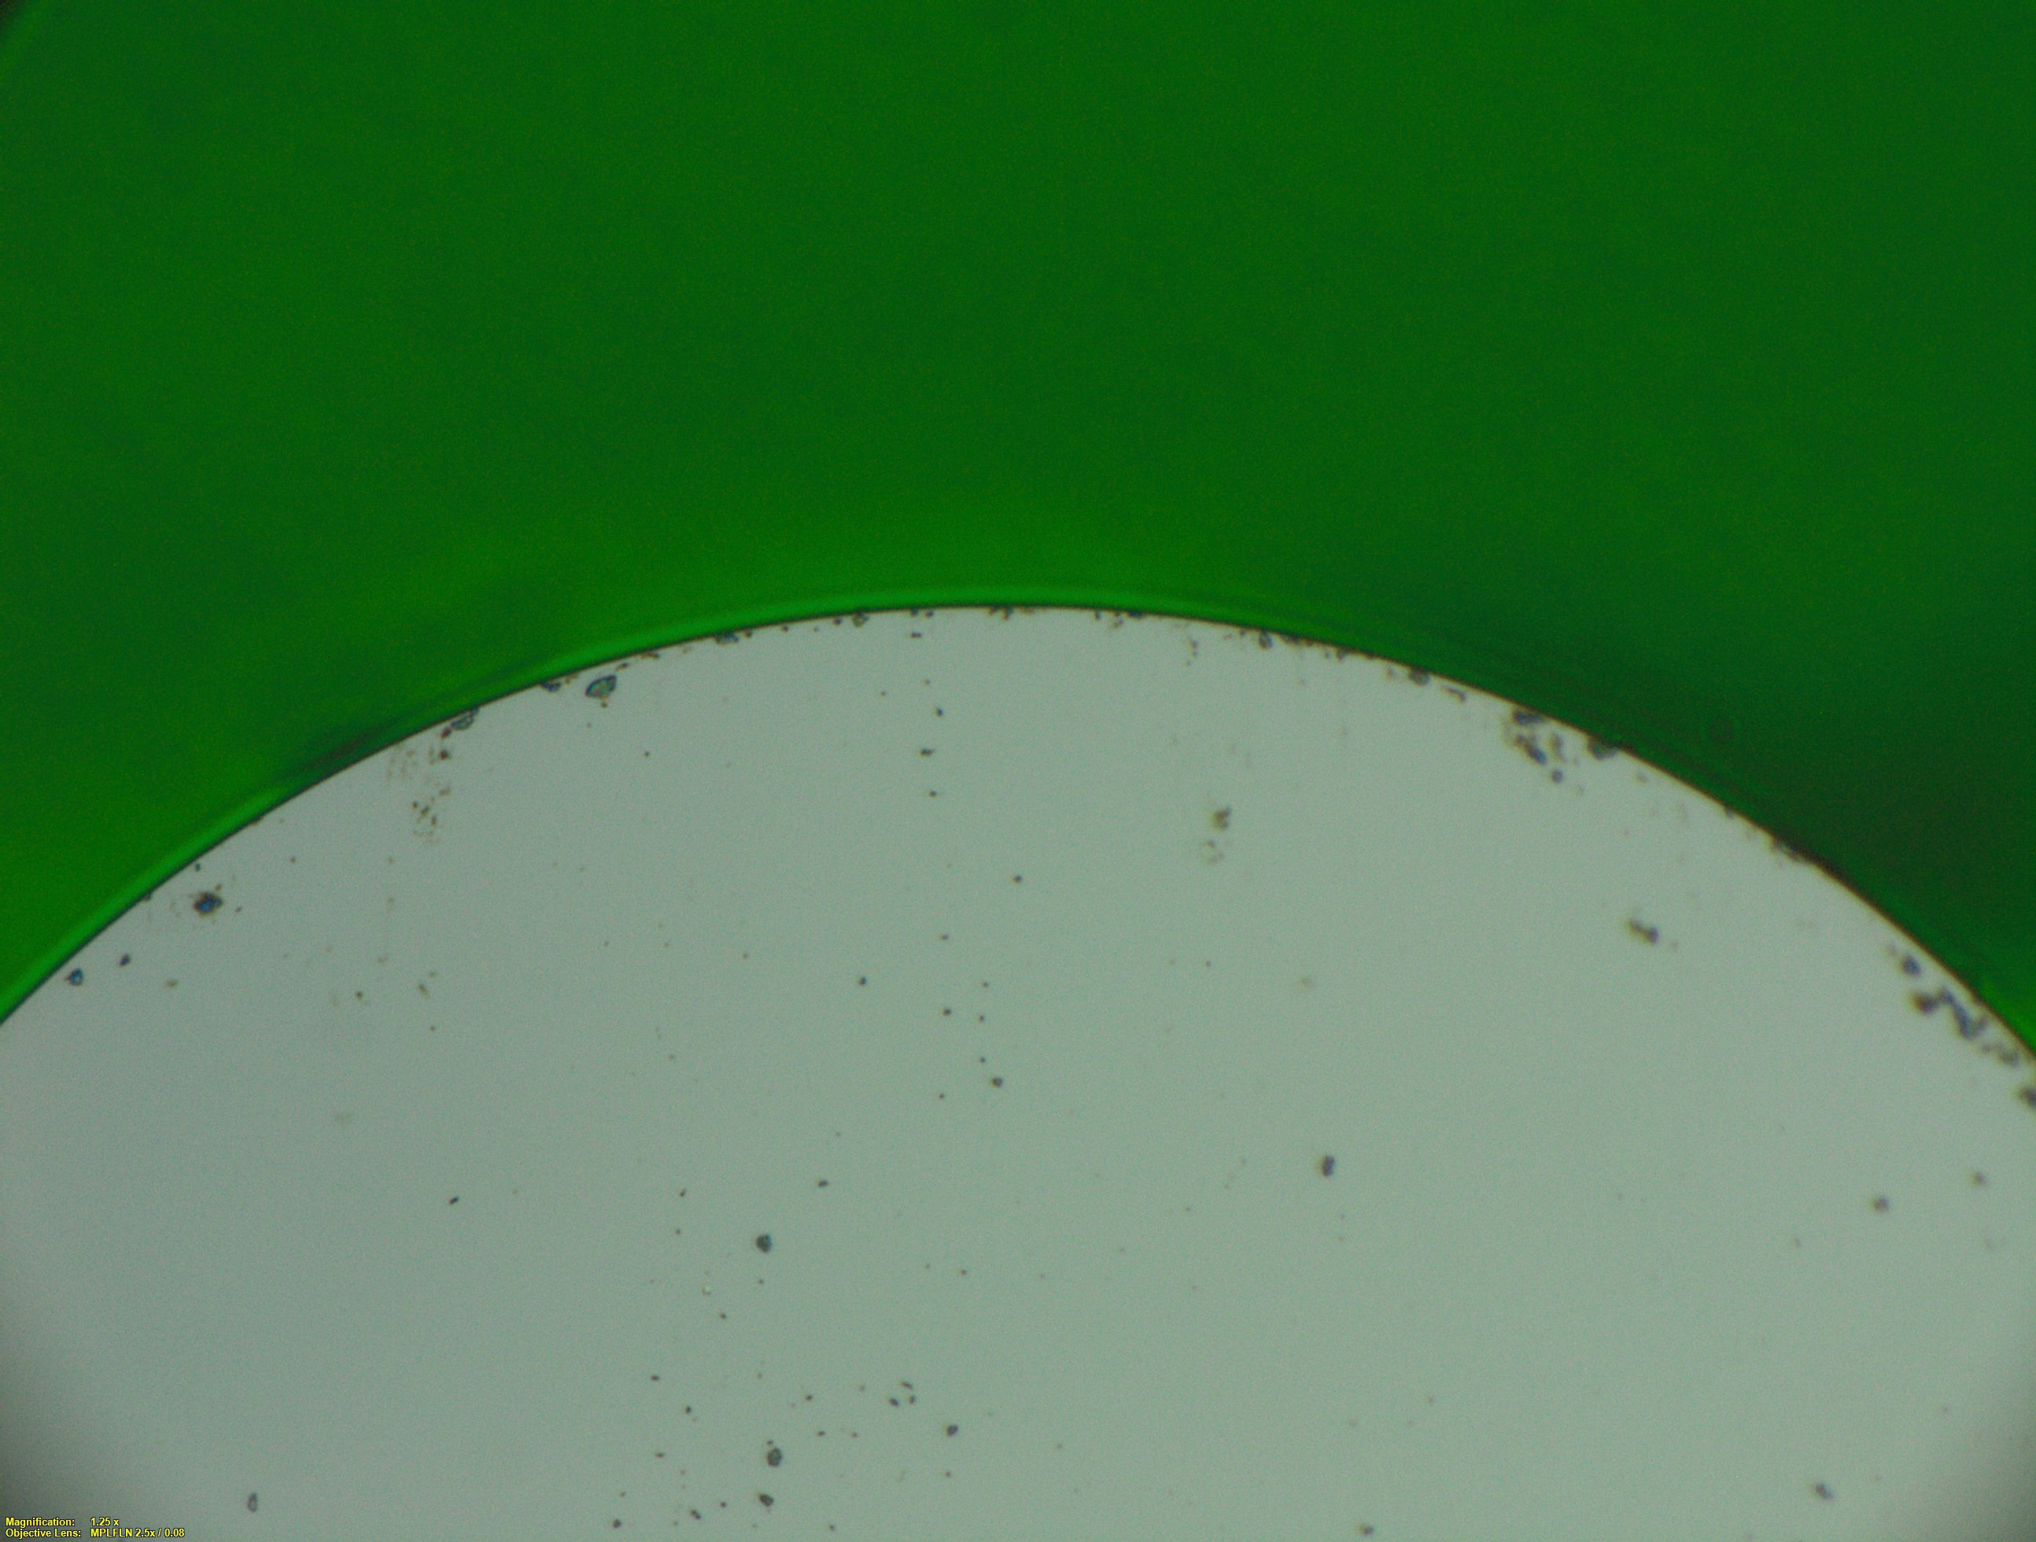
Why do we use Single Crystal Diamond Tools for Target Fab
We use diamond tools to manufacture high precision components – Typical machine tool (Diamond Turning Lathe) has submicron positioning and contouring <.010um precision
We use diamond tools to machine small features on Target components – Zero tool tip radius used in gratings
We use diamond tools to achieve specified surface roughness – < 5nm Ra typical
Carbide 100umR
CBN 250umR
Diamond single crystal 25umR
Diamond Endmills
10X
20X
100X

Slide 7
List of diamond turnable materials:
“Chemical Aspects of tool wear in single point diamond turning”
Data for elements with know diamond turning properties |  |  |  |  | Diamond Turnable?
Element |  | Melting Point c° | Microhardness kg/mm² | No. of unpaired d-shell electrons | Yes | No
In | Indium | 157 | 10 | 0 | Yes
Sn | Tin | 232 | 9 | 0 | Yes
Pb | Lead | 373 | 5 | 0 | Yes
Zn | Zinc | 420 | 51 | 0 | Yes
Pu | Plutonium | 640 |  | 0 | Yes
Mg | Magnesium | 649 | 48 | 0 | Yes
Al | Aluminum | 660 | 25 | 0 | Yes
Ge | Germanium | 937 | 721 | 0 | Yes
Ag | Silver | 962 | 96 | 0 | Yes
Au | Gold | 1064 | 96 | 0 | Yes
Cu | Copper | 1083 | 76 | 0 | Yes
U | Uranium | 1132 |  | 1 |  | No
Mn | Manganese | 1244 | 384 | 5 |  | No
Be | Beryllium | 1277 |  | 0 | Yes
Si | Silicon | 1410 | 1211 | 0 | Yes
Ni | Nickel | 1453 | 189 | 2 |  | No
Co | Cobalt | 1495 | 247 | 3 |  | No
Fe | Iron | 1535 |  | 4 |  | No
Ti | Titanium | 1660 | 142 | 2 |  | No
Cr | Chromium | 1857 | 250 | 5 |  | No
V | Vanadium | 1890 | 248 | 3 |  | No
Rh | Rhodium | 1966 |  | 2 |  | No
Ru | Ruthenium | 2310 |  | 3 |  | No
Nb | Niobium | 2468 | 128 | 4 |  | No
Mg | Molybdenum | 2617 | 192 | 5 |  | No
Ta | Tantalum | 2996 |  | 3 |  | No
Re | Rhenium | 3180 | 319 | 6 |  | No
W | Tungston | 3410 | 348 | 4 |  | No
Data for selected elements with unkown diamond turning properties
Sb | Antimony | 631 |  | 0
Y | Yttrium | 1522 |  | 1
Pt | Platinum | 1772 |  | 1
Ir | Iridium | 2443 |  | 3
Several mechanisms can contribute to tool wear and they can work simultaneously
Adhesion and formation of a built-up edge
Abrasion, microchipping, fracture
Tribochemical wear
Chemical tool wear is when carbon atoms are pulled from the tightly bonded diamond lattice. Once an atom leaves the diamond, it may diffuse into the work piece, graphitize, or react with the oxygen or the work piece to form a carbide.
Mr. C.J. Evans
Precision Engineering Division
National Inst. Of Standards and Technology
Metrology A 107 Blg 220, Quince Blvd
Gaithersburg MD 20899, USA
January 1996

Slide 8
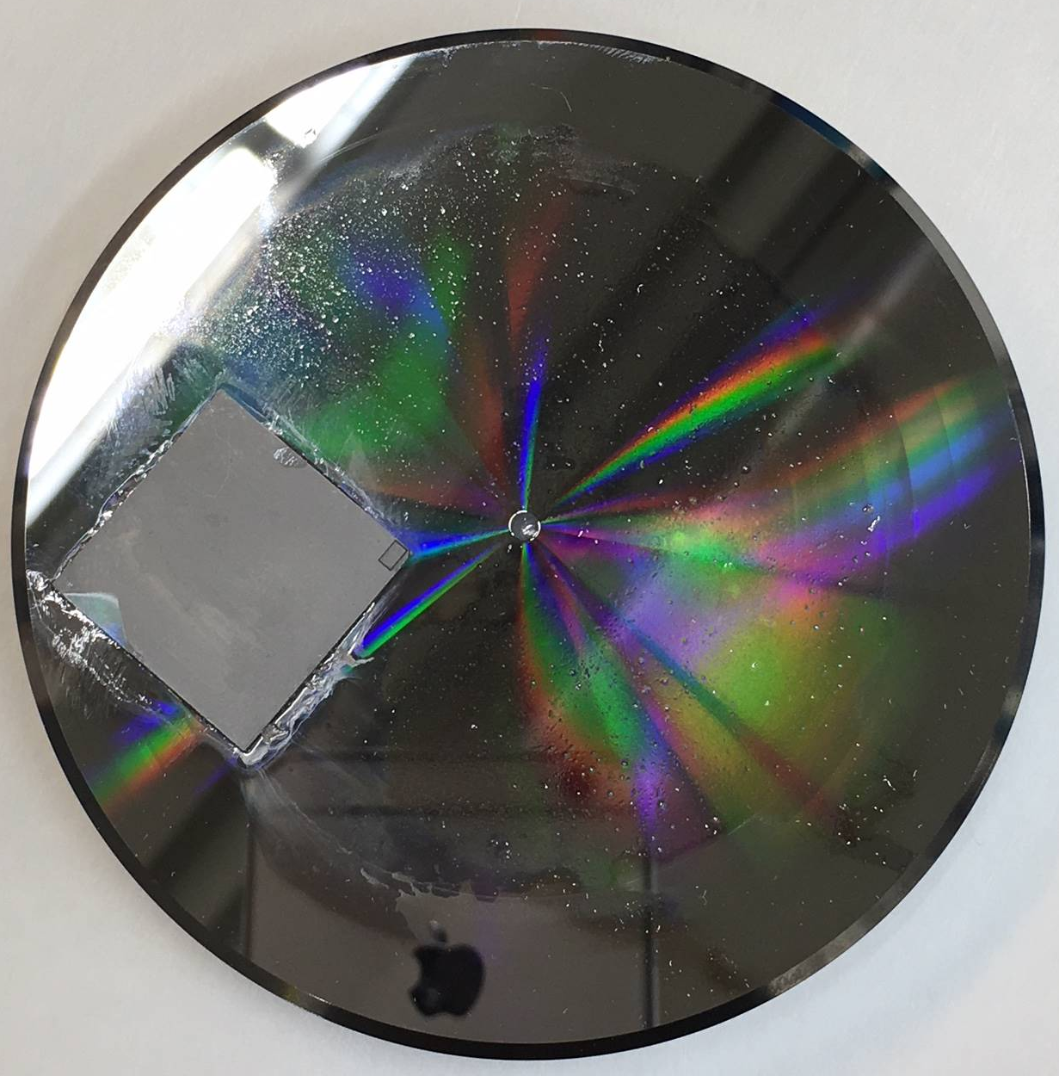
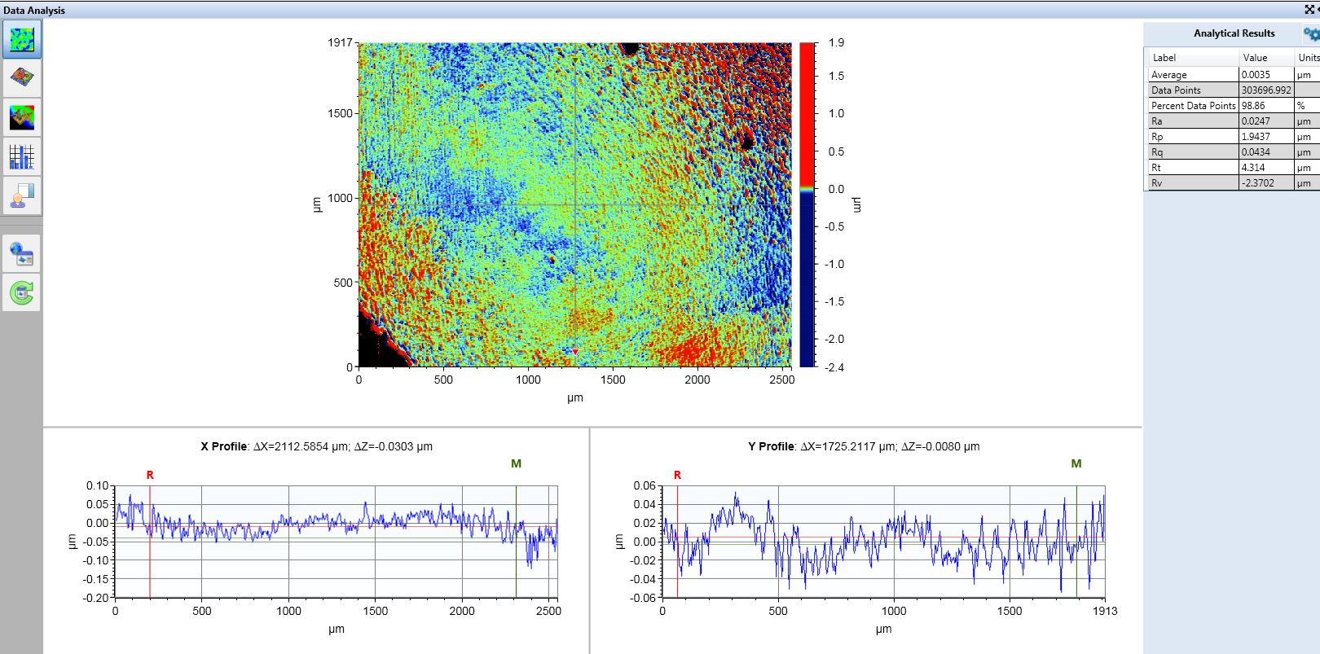
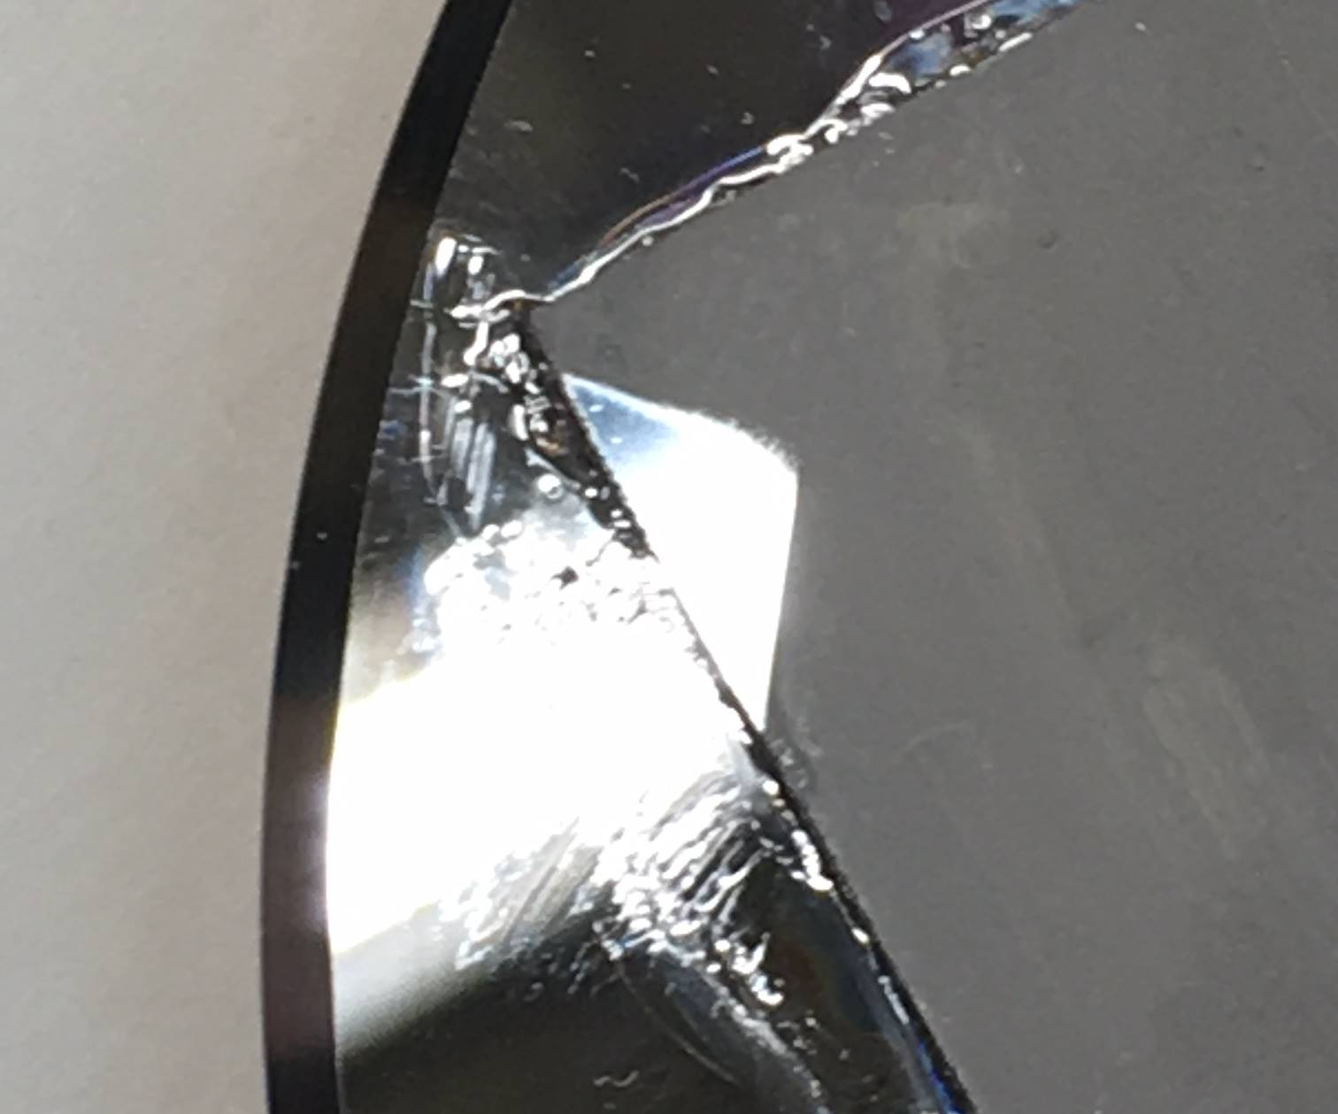
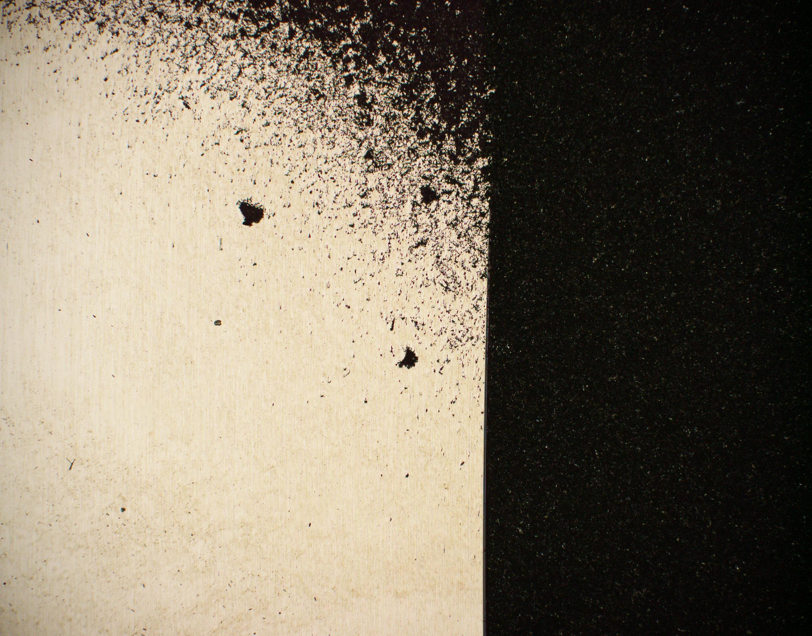
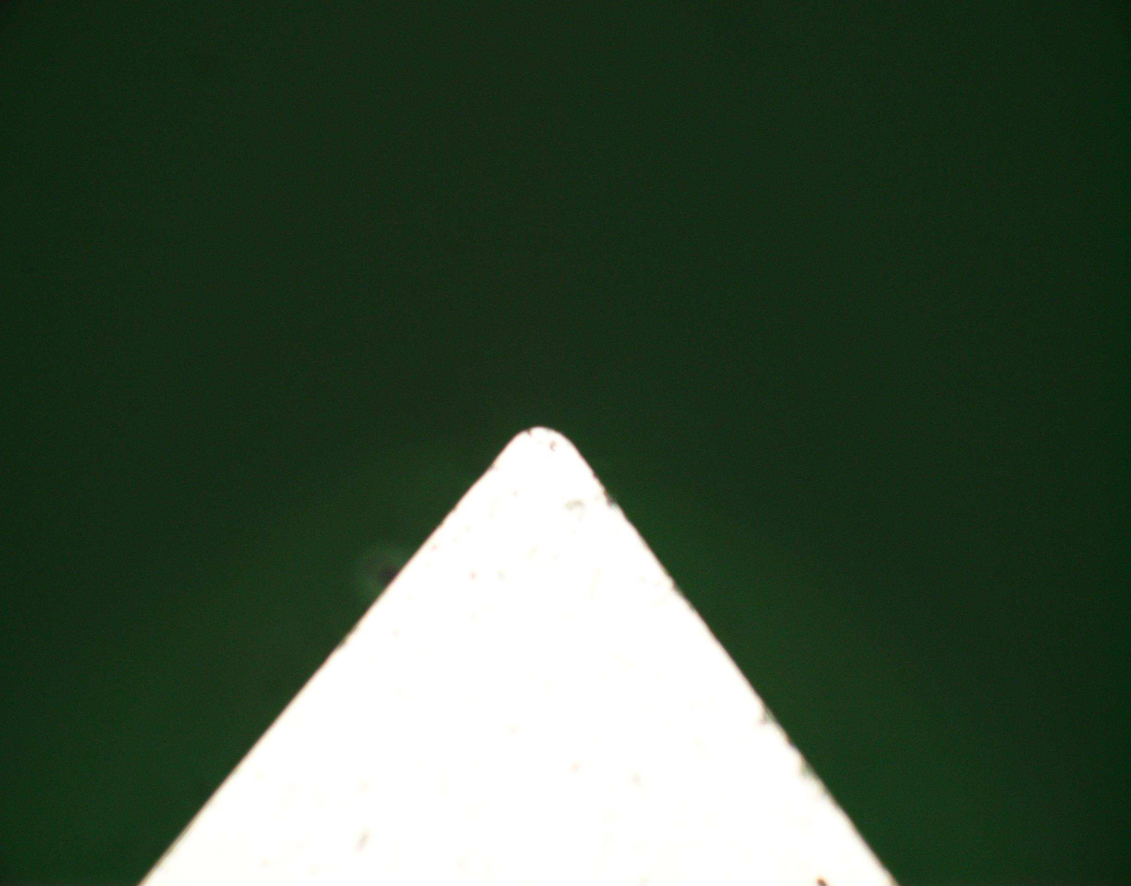
Machining of Iridium for EOS targets
Initial test cuts on Ir 99.7 % purity 25mm x 25mm foil from American Elements – (Dayne Fratanduono)
Cutting parameters
.025mm tool radius 80º included angle
1.0mm/min tool federate
.002mm depth of cut (DOC)
1000 rpm
Cut area 21mm² (20um total depth)
Cutting Fluid-Odorless Mineral Spirits
Ø100mm Disk
Surface roughness 25nm Ra in turned area
80°
Diamond Turned surface
Stock Surface
Legacy tools from LODTM 1970’s

Slide 9
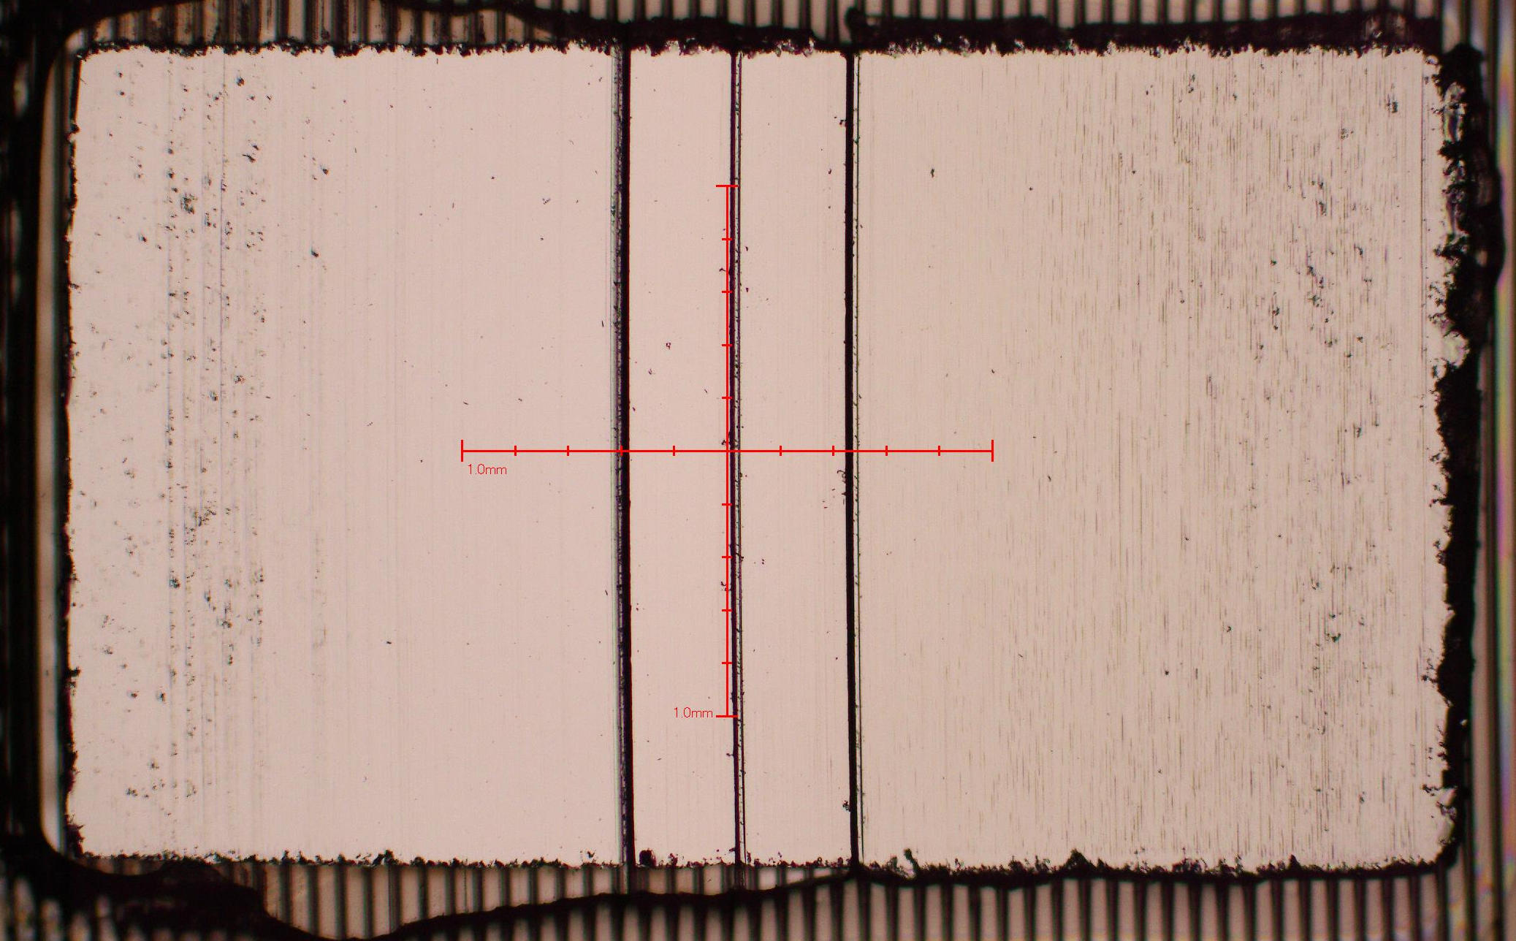
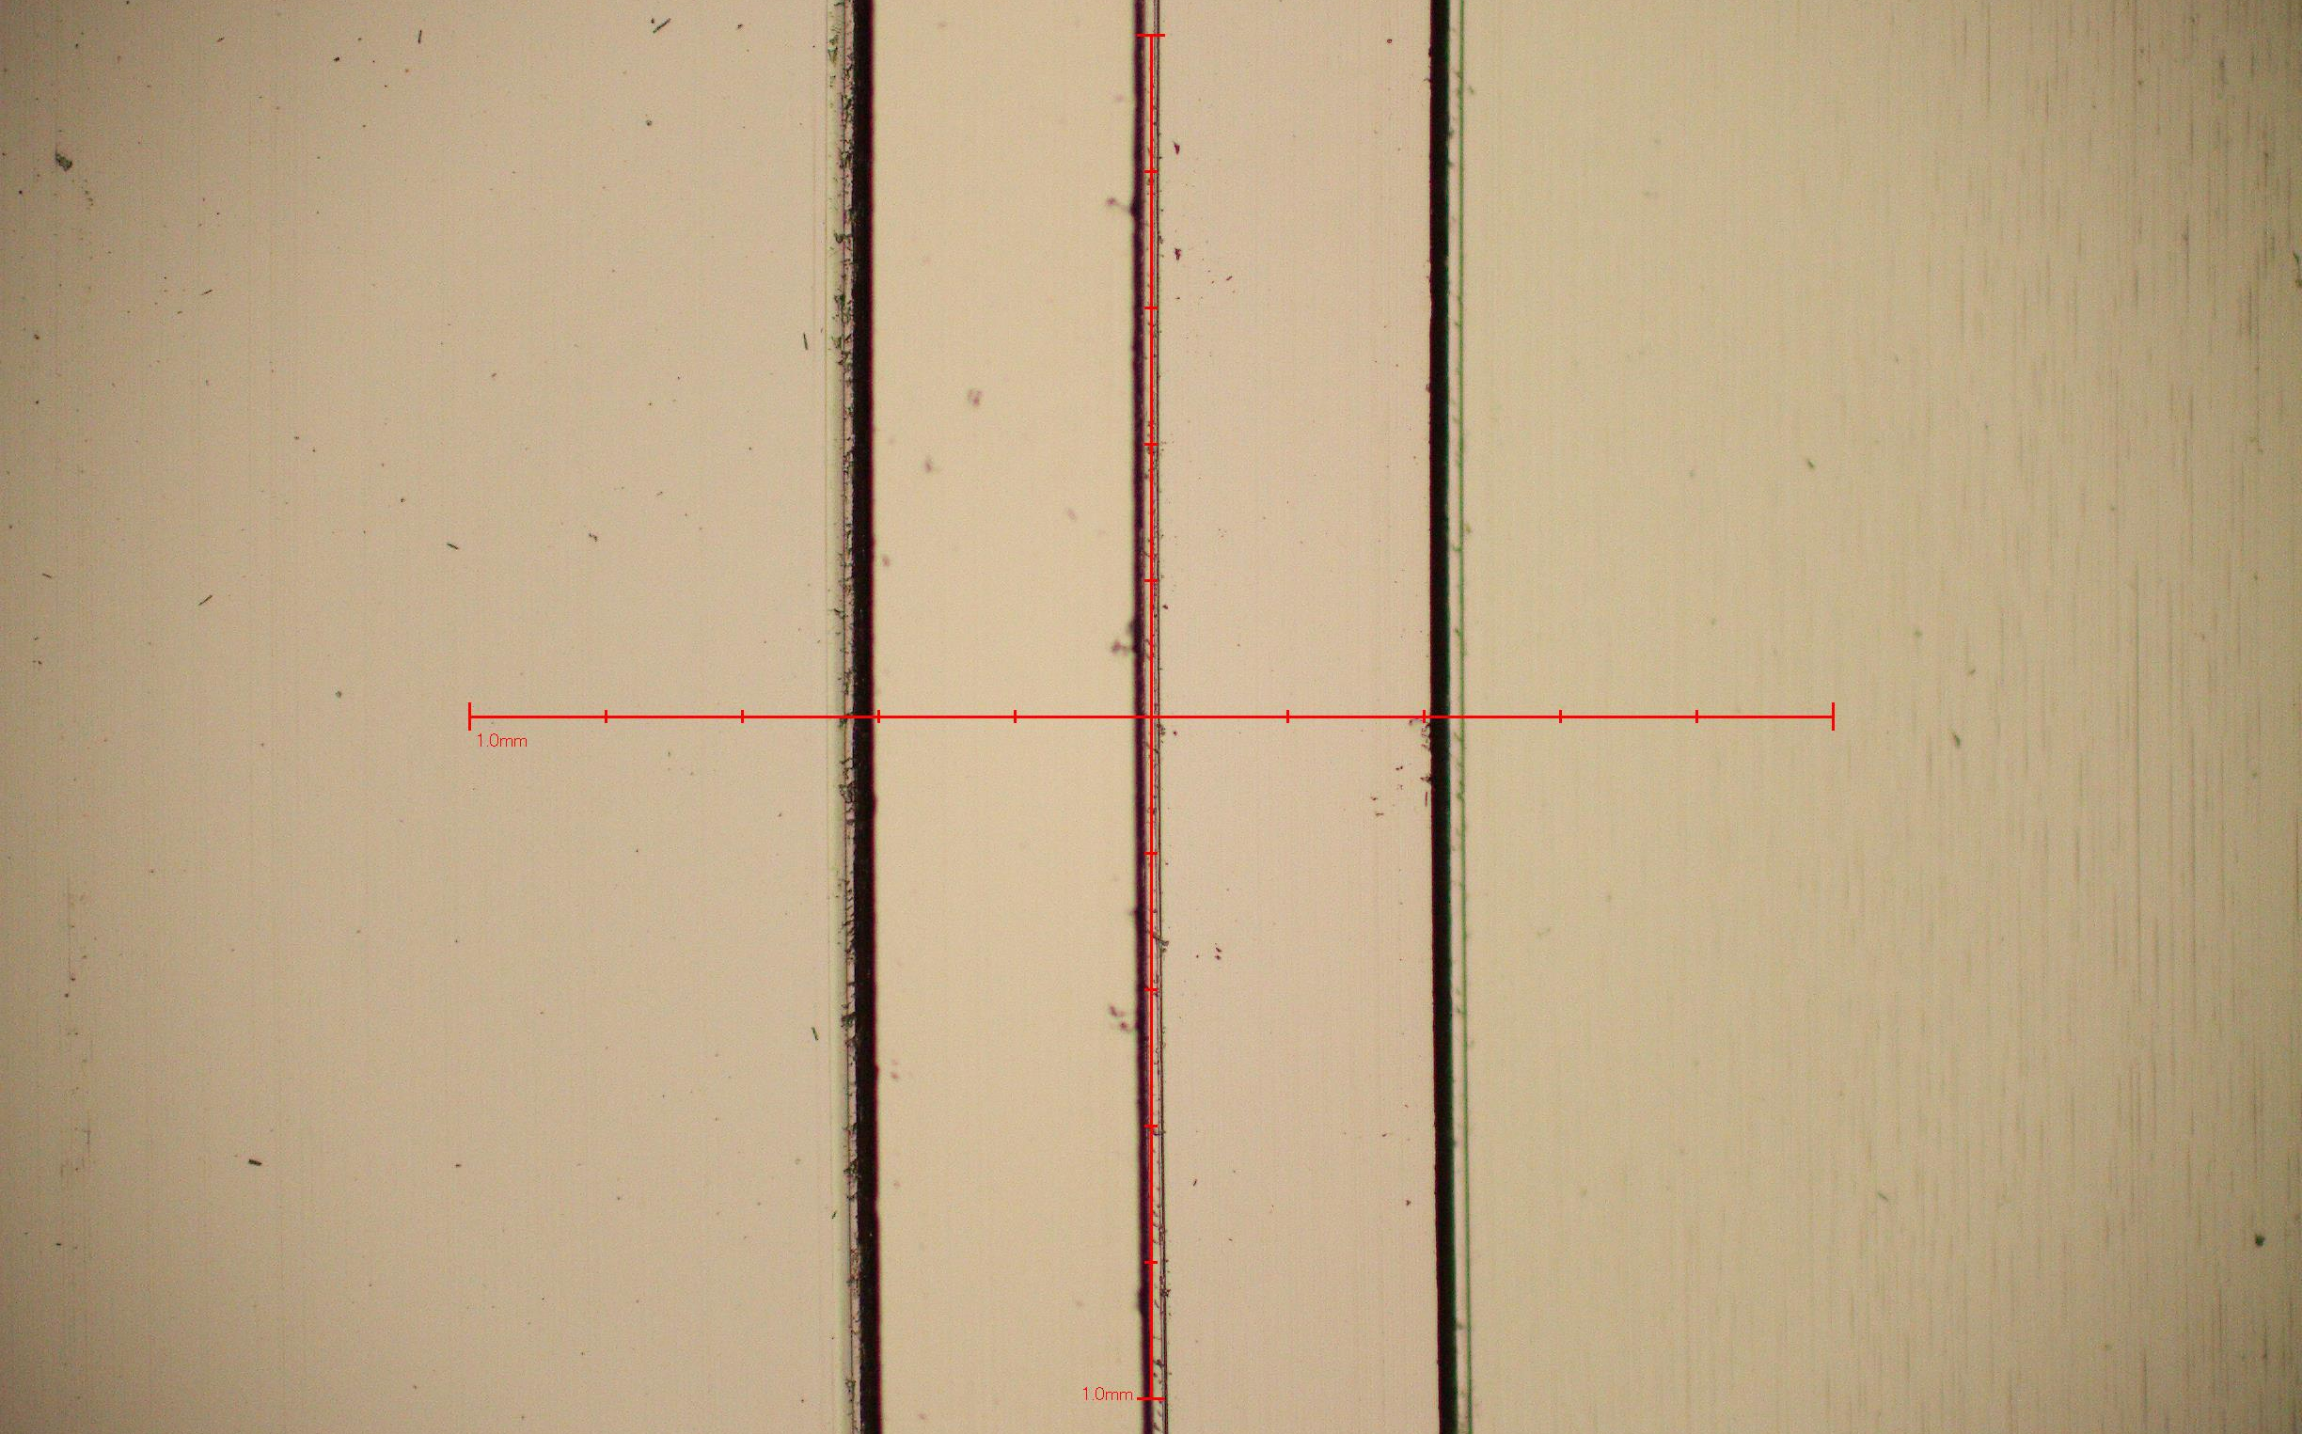
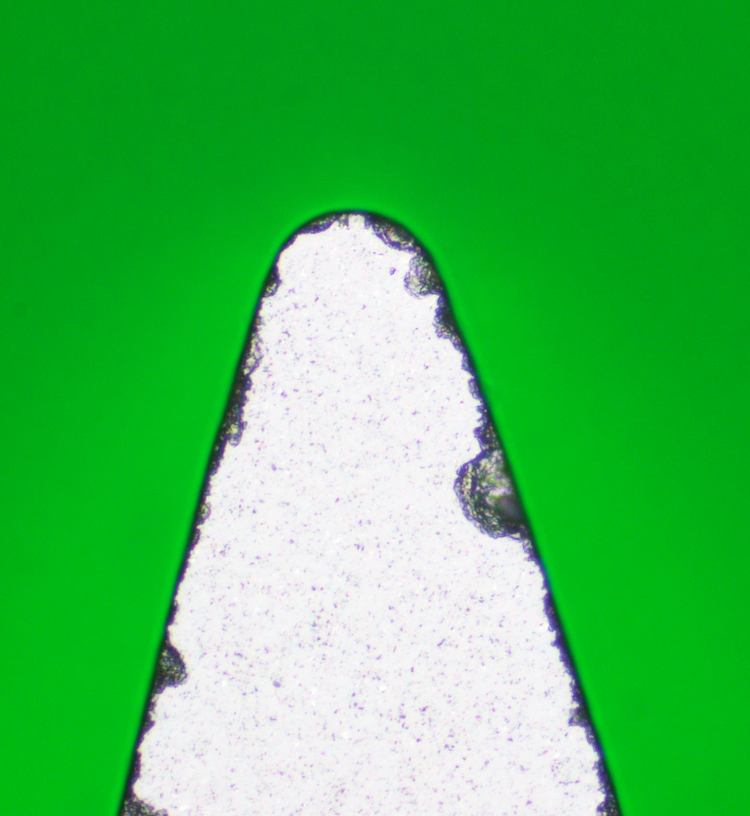
Process improvements reduced the number of tools per target
First Sample
Very high tool wear was observed during the machining of the stepped samples
14 natural diamond tools were used to machine the first stepped sample
Polycrystalline Diamond (PCD) tools were introduced to rough material
5x Photo of finished sample 1mm reticle scale
.047um Ra
9.0um Step
.017um Ra
.019um Ra
.077um Ra
0.0um Step
PCD tools were used to rough cut most of the material leaving only 4 um of material for the Diamond tool to finish cut the profile.
PCD tools exhibited much higher wear resistance than single crystal diamond tools.
10x Photo of finished sample 1mm reticle scale

Slide 10
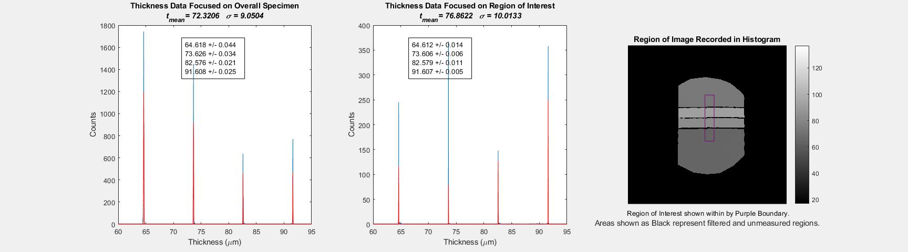
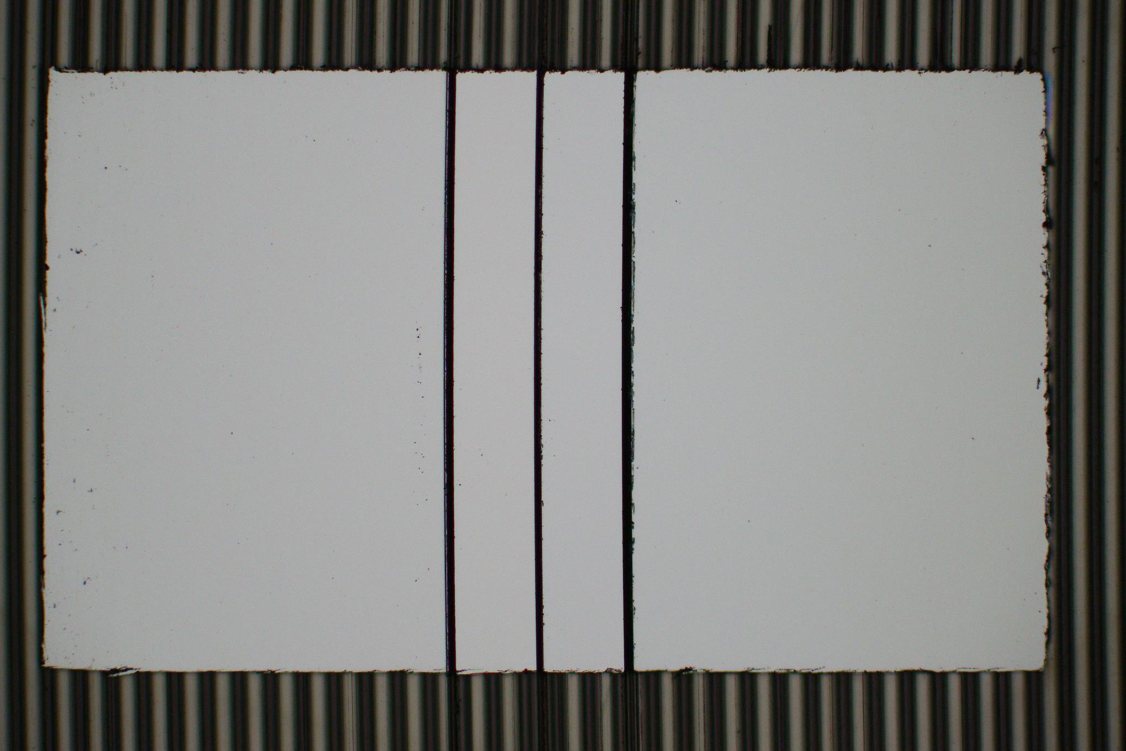
IrEOS Stepped sample and Region of Interest Results
IrEOS specimen;
< 50nm parallelism overall
< 15nm parallelism in ROI
2 PCD tools
2 Natural Diamond tools

Slide 11
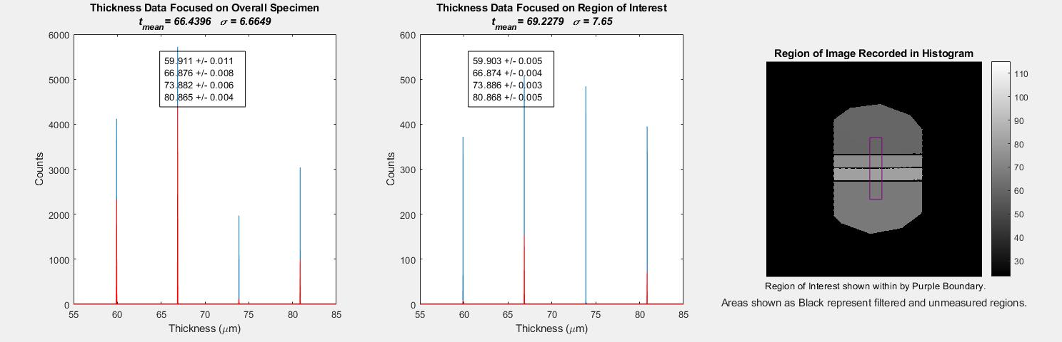
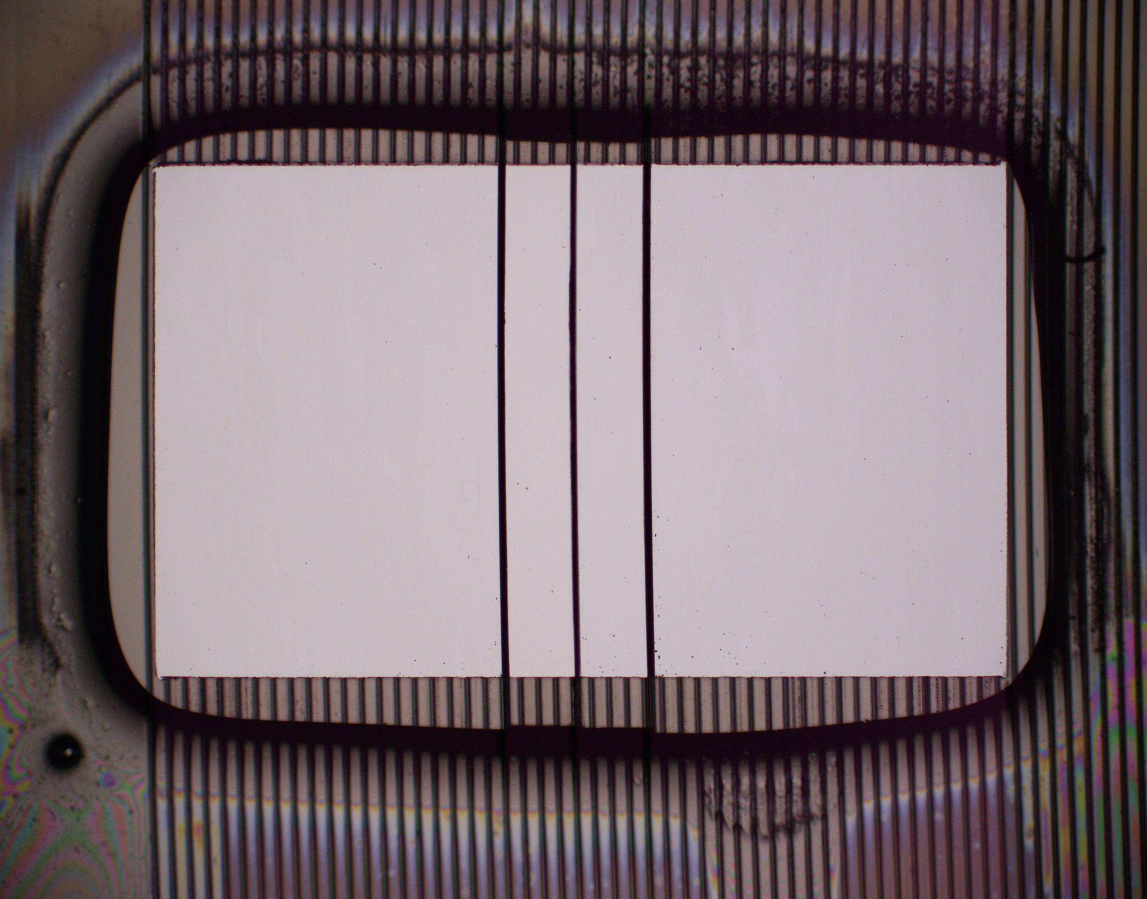
Platinum Stepped sample and Region of Interest Results
PtEOS specimen;
< 12nm parallelism overall
< 7nm parallelism in ROI

Slide 12
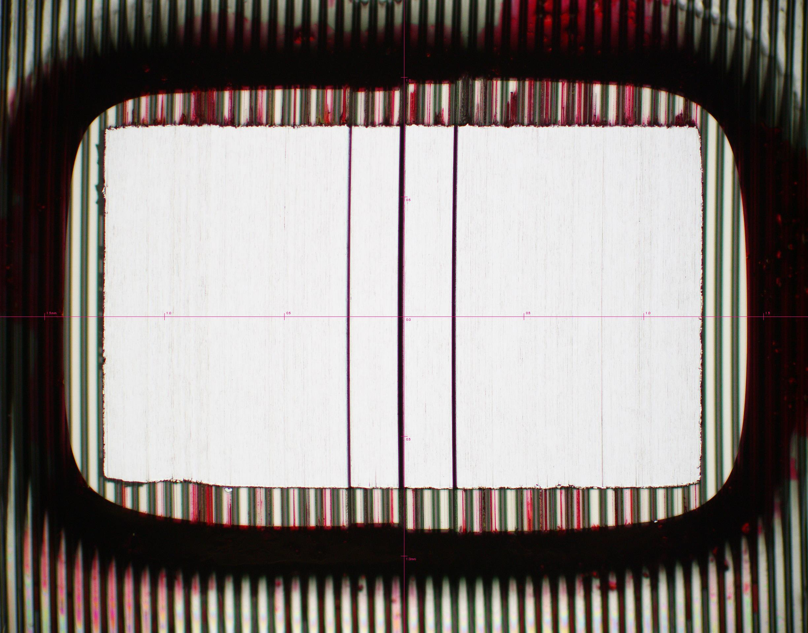
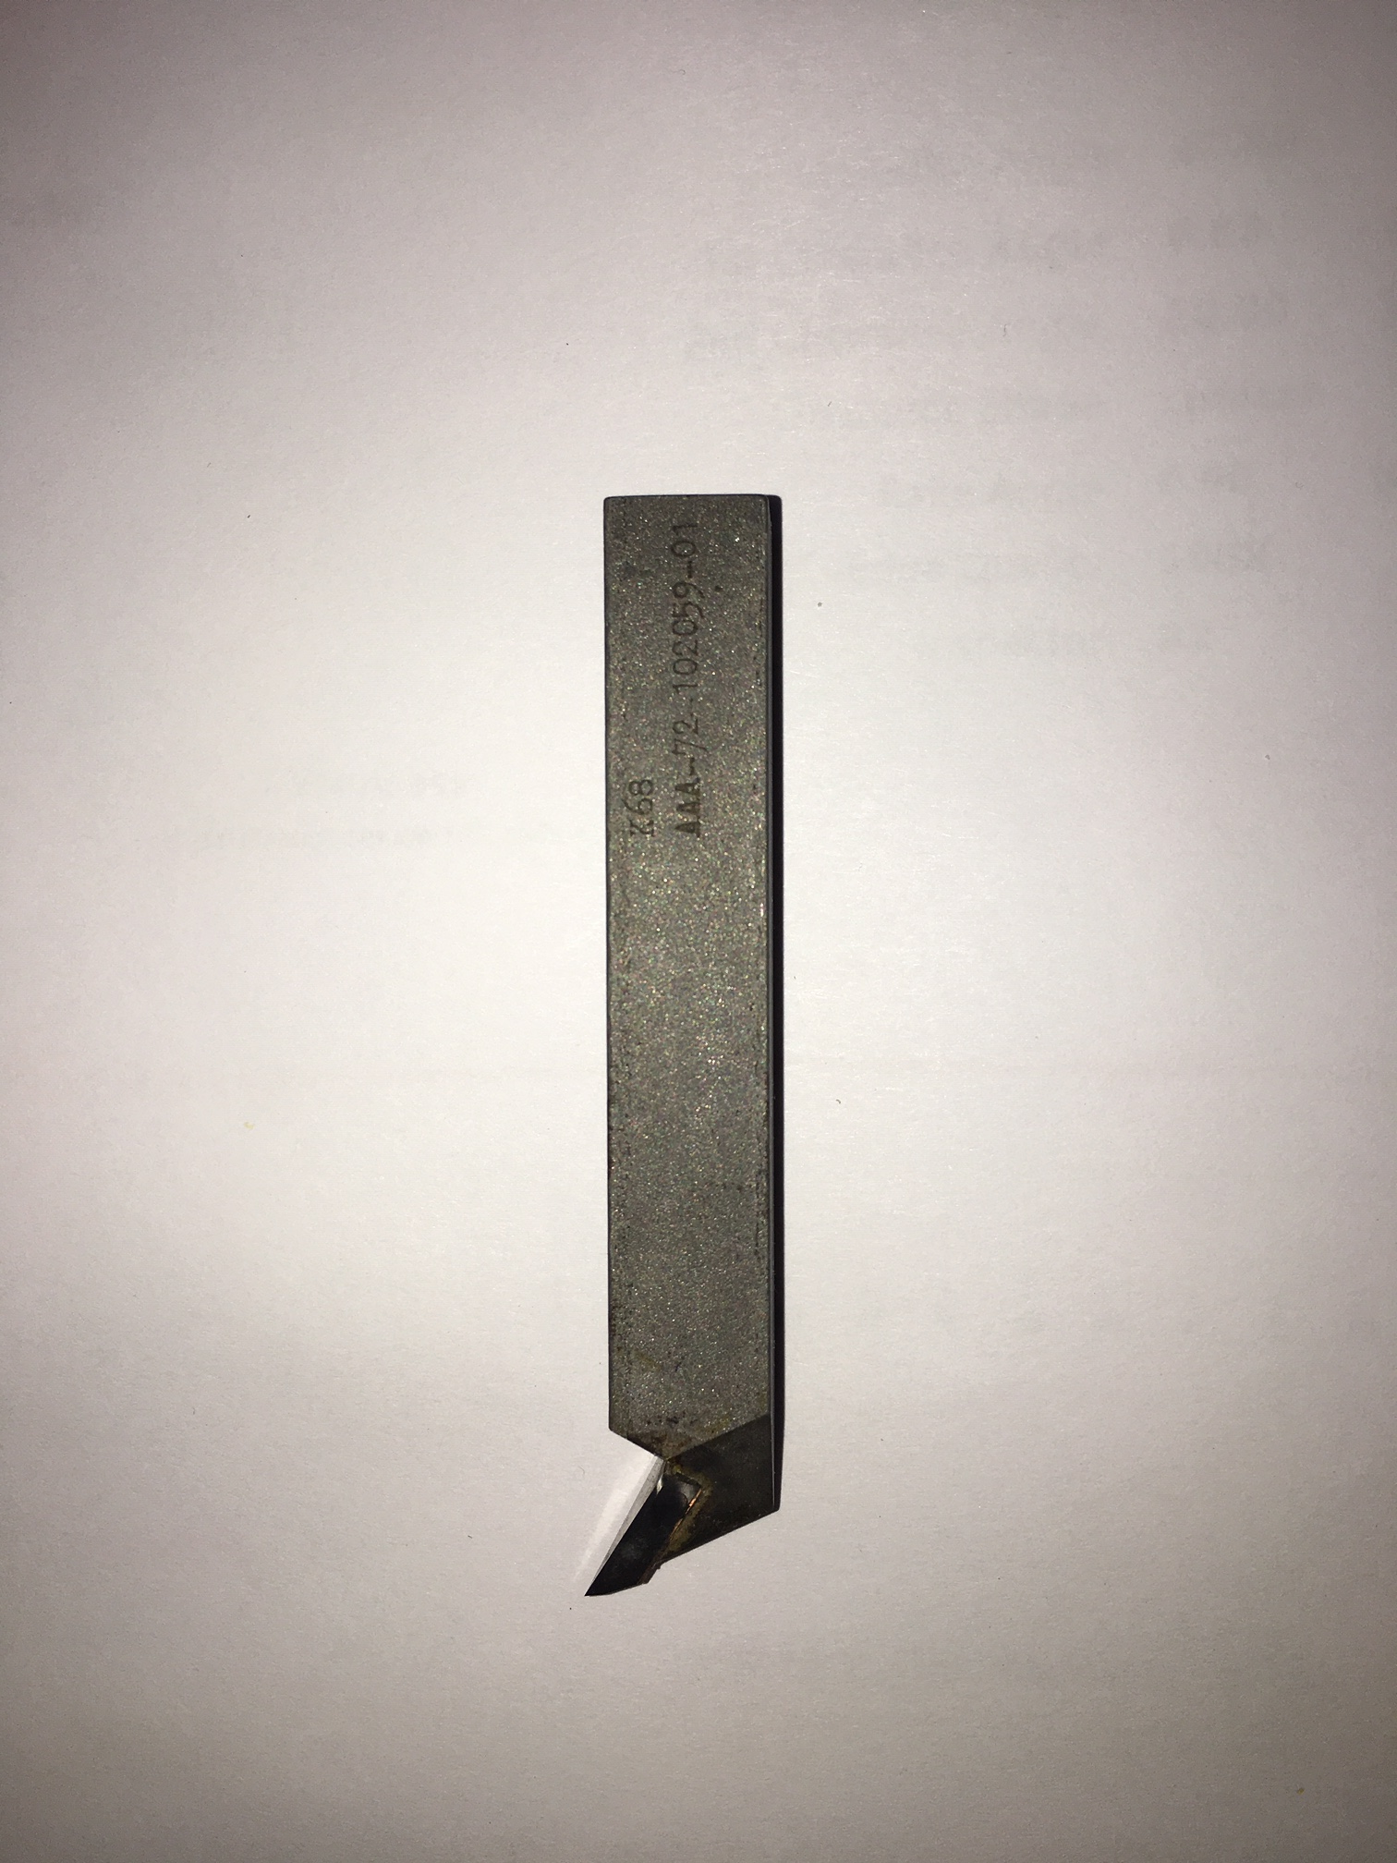
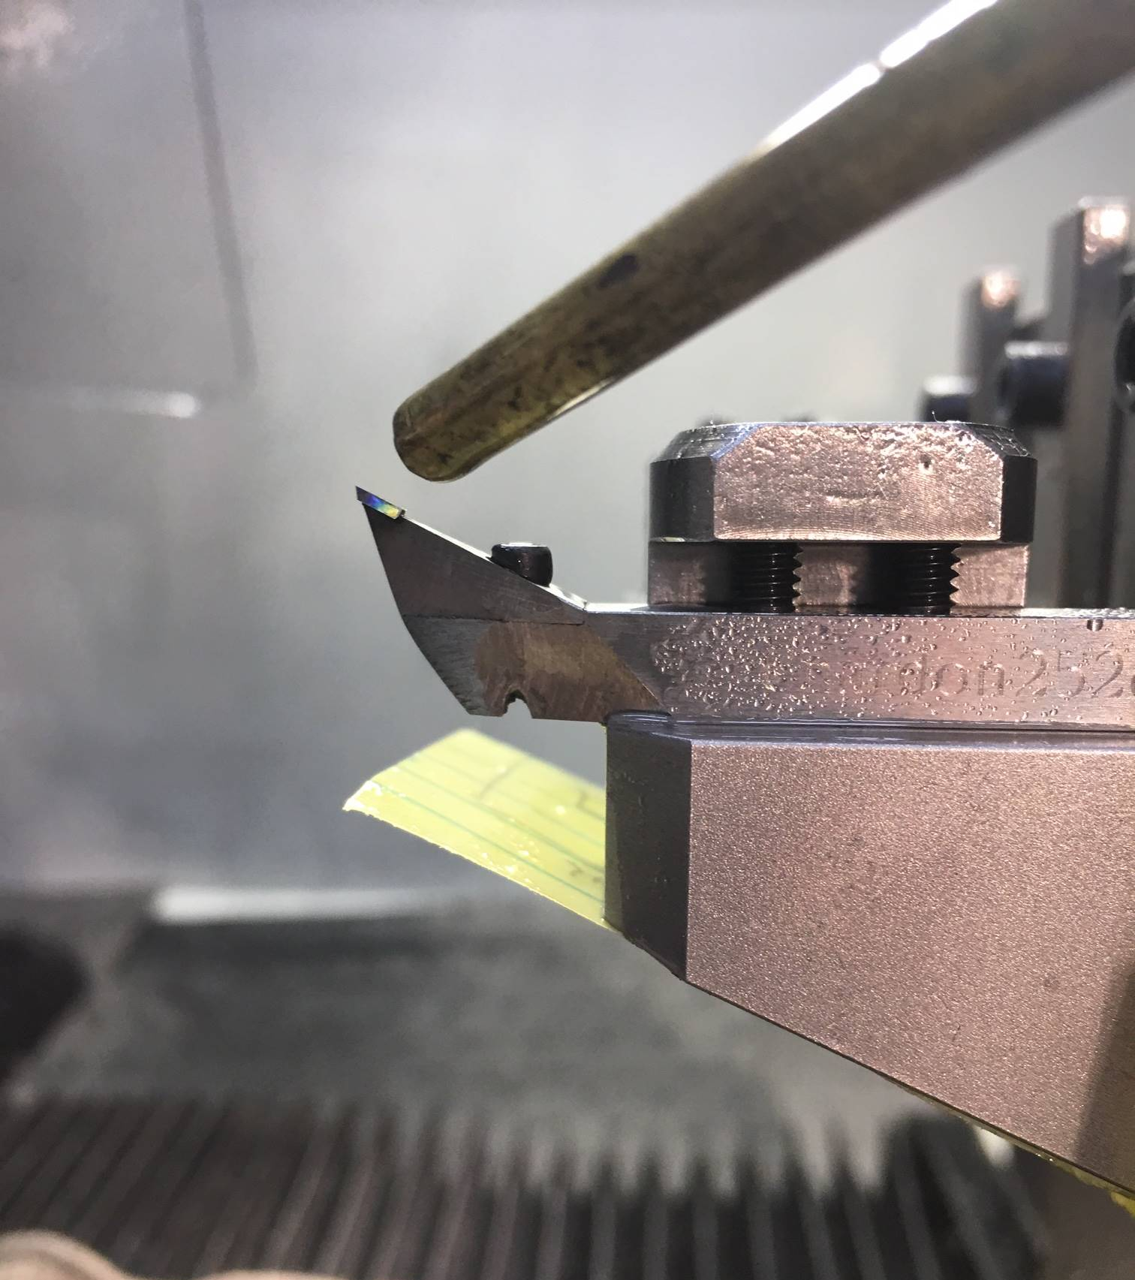
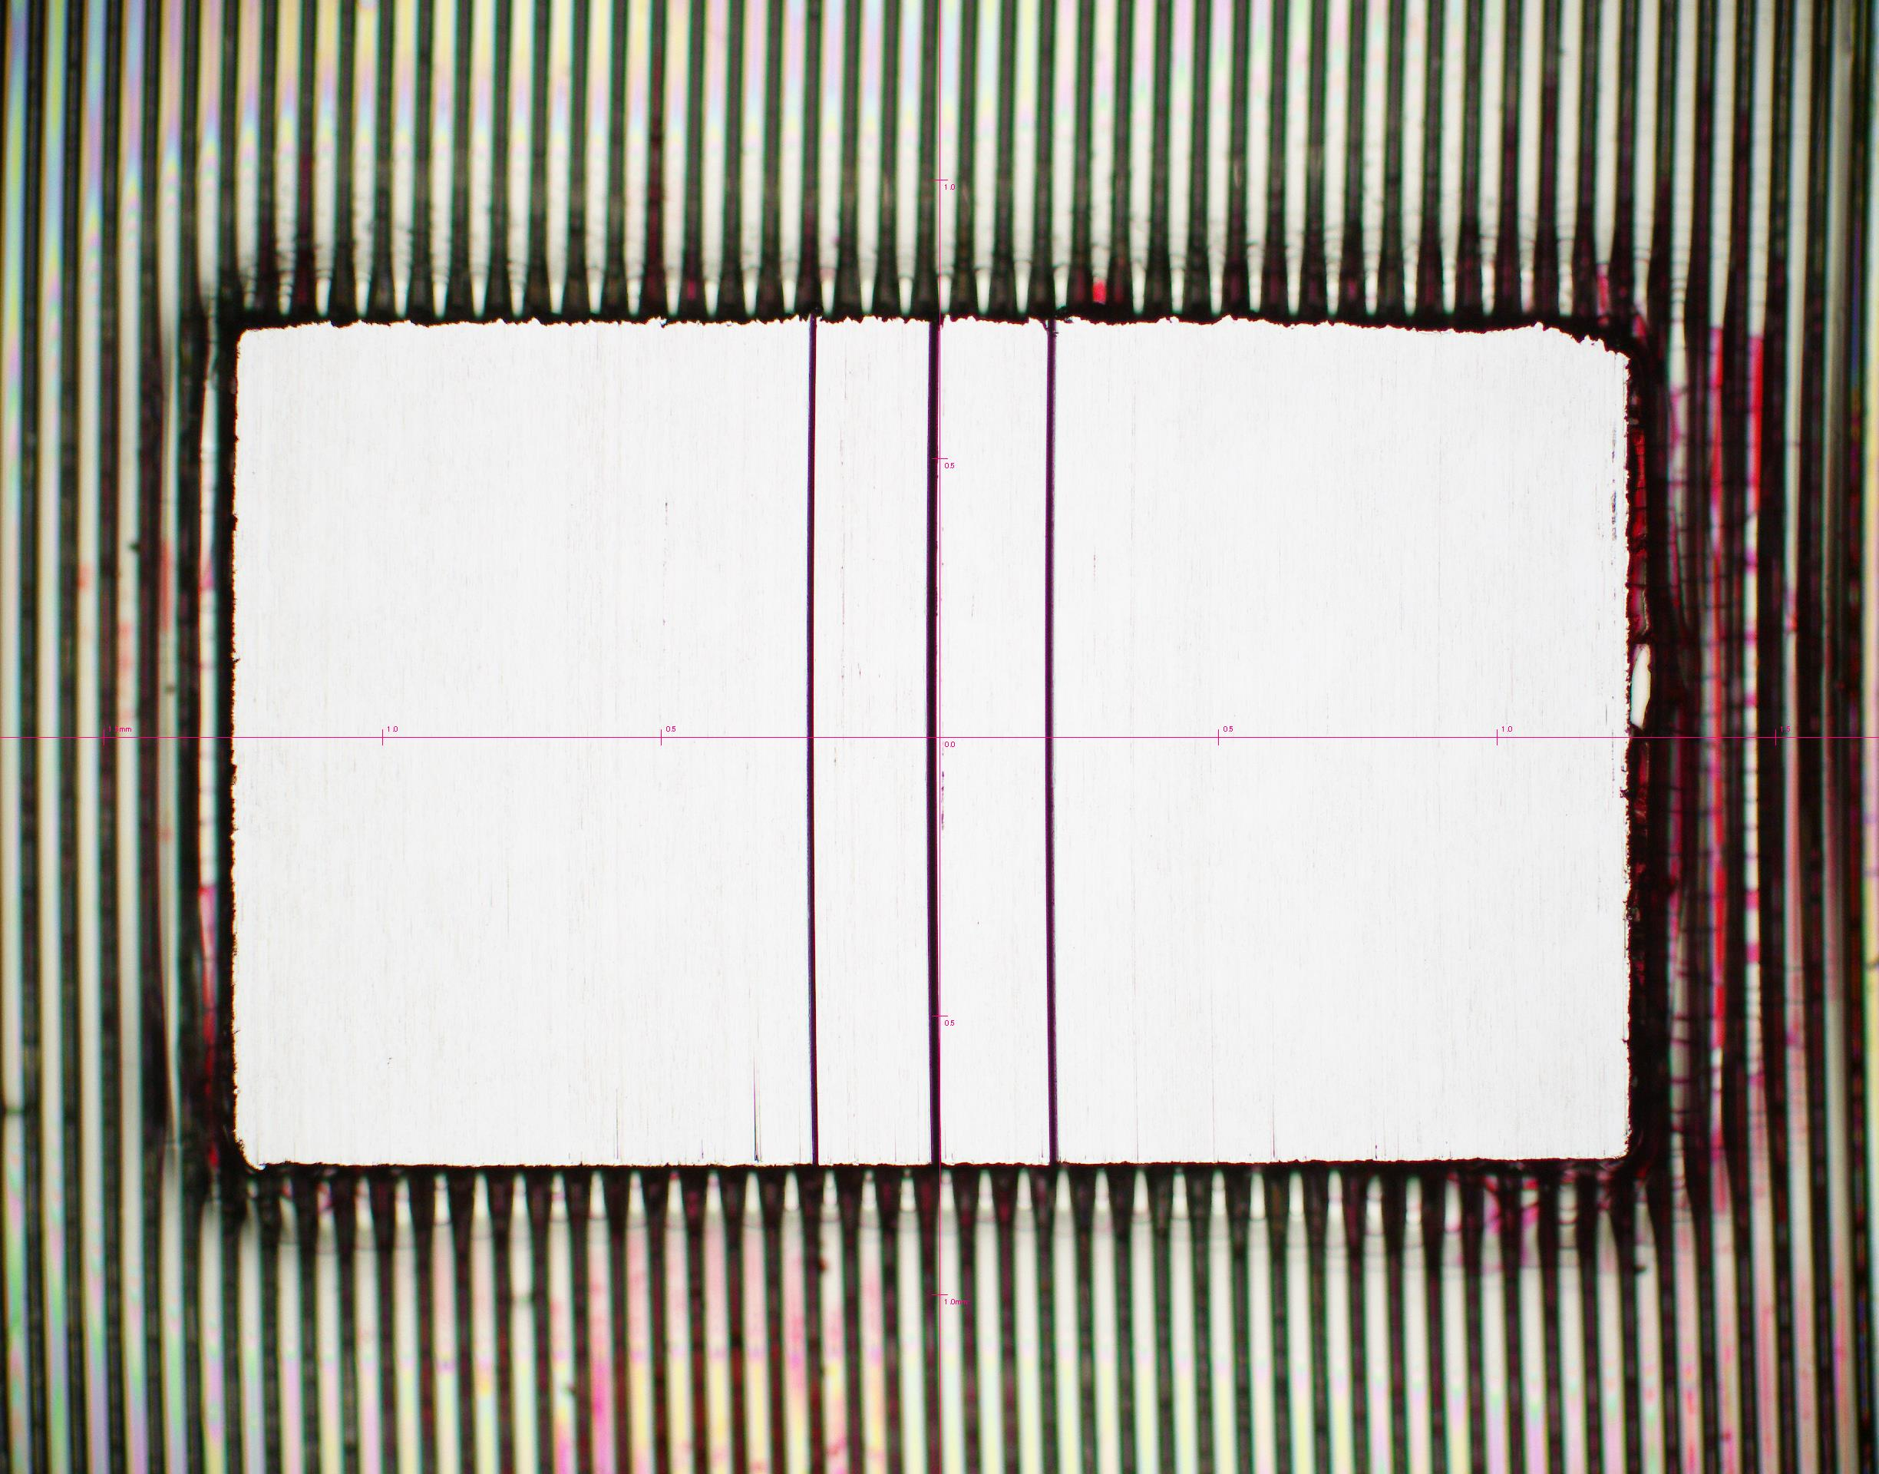
Machining of Tantalum (manhole cover) for EOS targets
25º
1972 Legacy carbide tool designed by LLNL for turning Ta
Process development
Initial tests 0° rake tools
Cutting fluid- EcoCut
Limited to 100nm depth of cut
Note: Legacy Ta tools +25° rake angle
We then partnered with tool vender to manufacture SPDT replaceable insert tools at +25° rake angle
Results
< 15nm Ra
300nm depth of cut
20nm HWHM in ROI
19.5 nm HWHF parallelism base on DSWLI

Slide 13
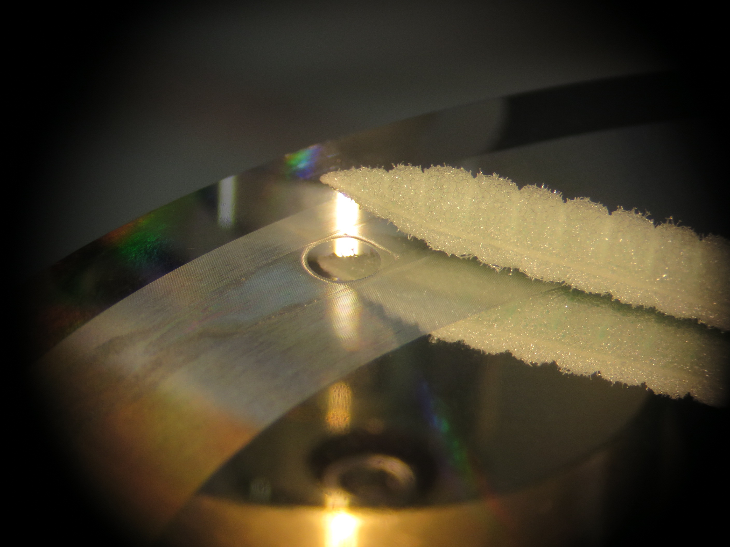
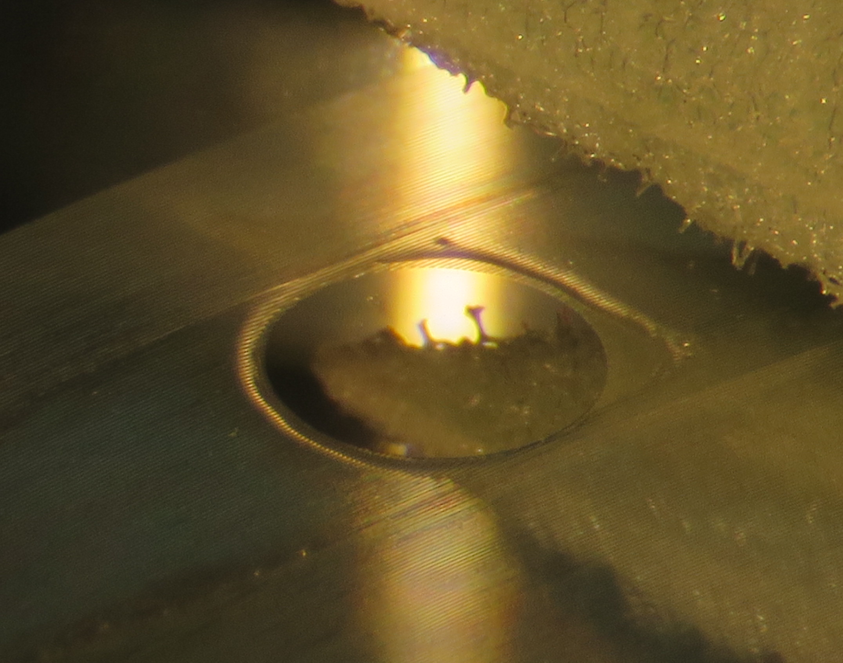
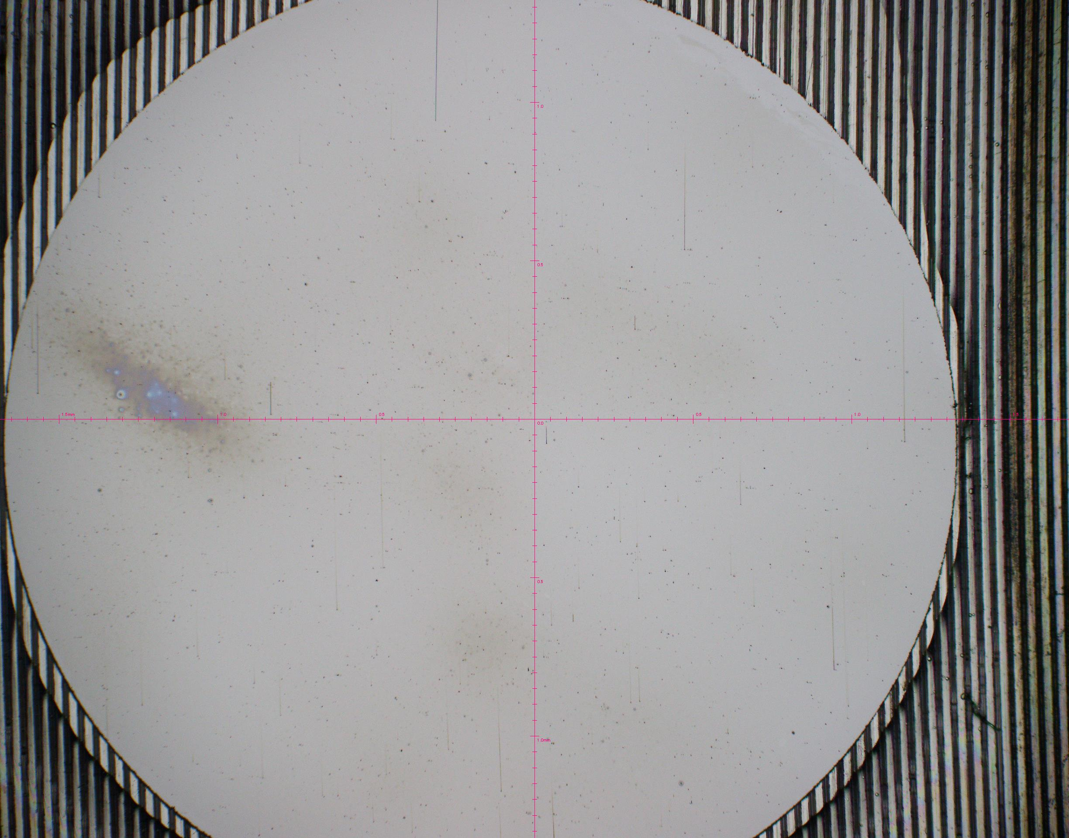
Machining of an Iron (99.99%) disk for diffraction targets TARDIS
Lapping and polishing has resulted in very low yields.
DT was a last resort but offered a quick turnaround
16nm Ra Surface roughness measured on the white light interferometer (WLI)
100% yield (4 Disks)

Slide 14
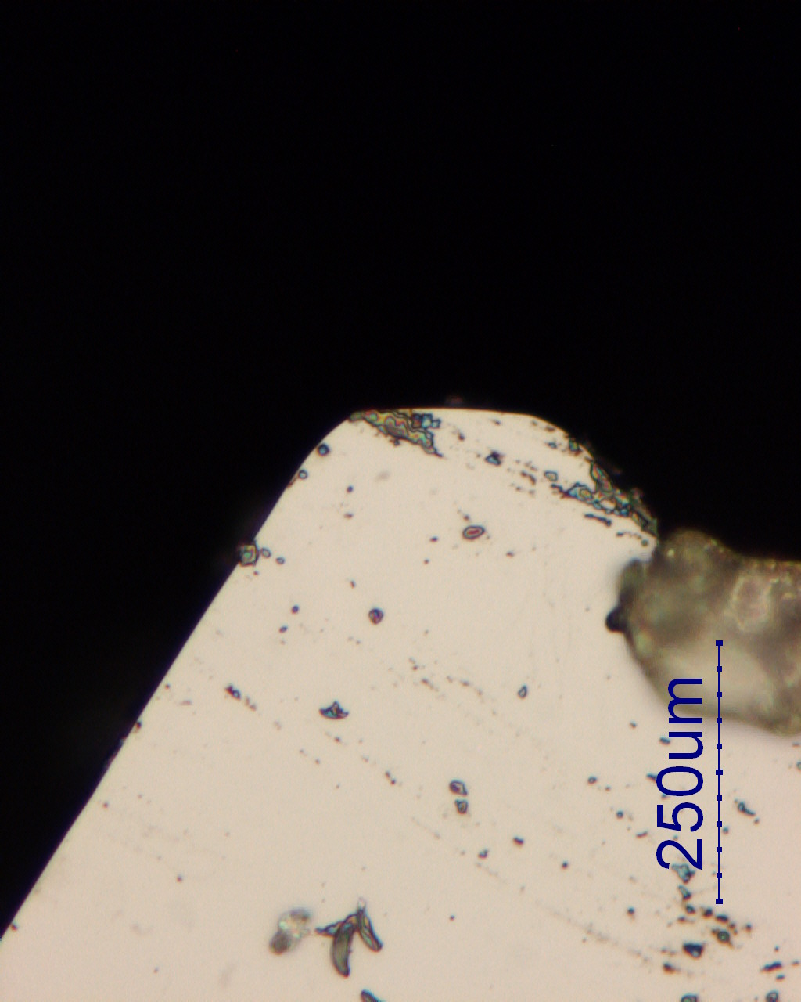
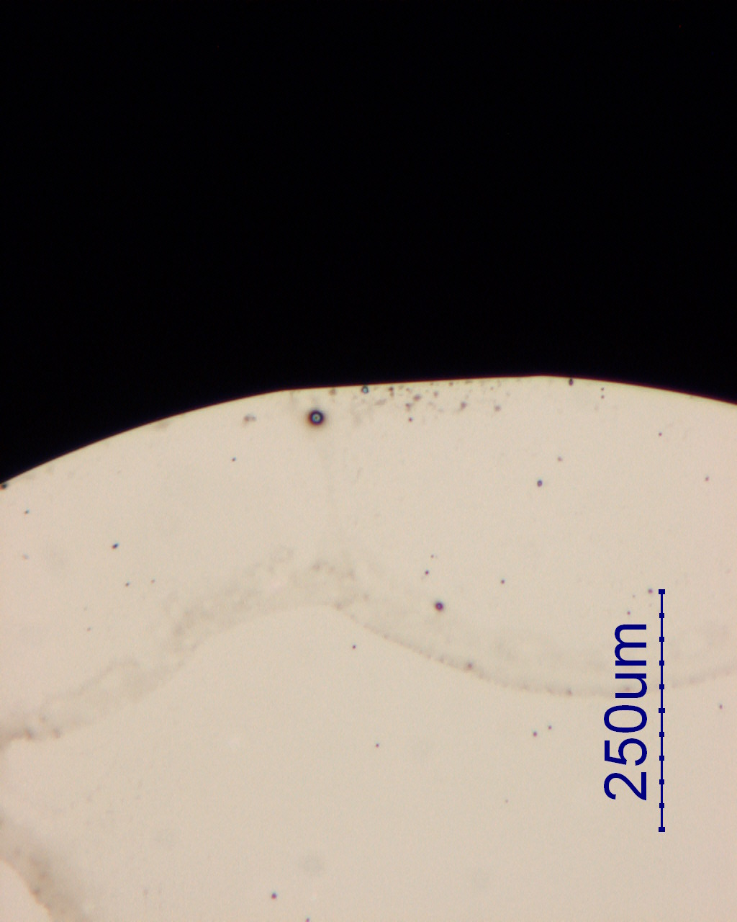
Machining of MgO for EOS targets
Schafer Corp
3 Day Cut Study June 2016: 3 Test Cuts
Tool Specification | Tool Radius | Tool Rake Angle | Depth of Cut (DOC) | Feed Rate (FR) | Total infeed | Surface Finish
Test Cut 1 | .025mm | 0° | .002mm | 5mm/min | .026mm | Part Shattered
Test Cut 2 | .150mm | 0° | .0005mm | 3mm/min | .010mm | .752um Ra
Test Cut 3 | .250mm | -30° | .0005mm | 3mm/min | .004mm | .242um Ra

Slide 15
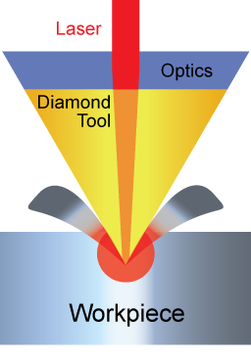
Micro-LAM (Laser Assisted Machining) MgO Test Cuts- July 2016
Micro-LAM’s Summary
Note:
1. Surface roughness readings were obtained using a Taylor Hobson CCI 6000
2. 4 readings were taken to cover multiple areas across the machined sample
3. Avg. Sa represents the average of the 4 roughness measurements (Sa 1…Sa 4)
4. The fact that Pass 3 yielded better surface finish then Pass 2 indicates that the tool was preserved and the additional laser power enhanced the ductility of MgO.
5. Sample machined uniformly across entire area
Customer: Schafer Corp
Test Date: 19-21st July, 2016
Test Location: Micro-LAM
Tool Pass | Tool Radius | Tool Rake Angle | Depth of Cut (DOC) | Feed Rate (FR) | Laser Power | Surface Finish
1 | .250mm | -35° | .008mm | 4.25 mm/min | 25% | 128nm Sa
2 | .250mm | -35° | .006mm | 2.55 mm/min | 25% | 99nm Sa
3 | .250mm | -35° | .006mm | 2.55 mm/min | 35% | 79nm Sa
Note:
Test cuts were duplicated without LAM. We were able to get similar surface finishes without LAM
Micro-LAM claims that their tool was preserved and the laser power enhanced the ductility of MgO

Slide 16
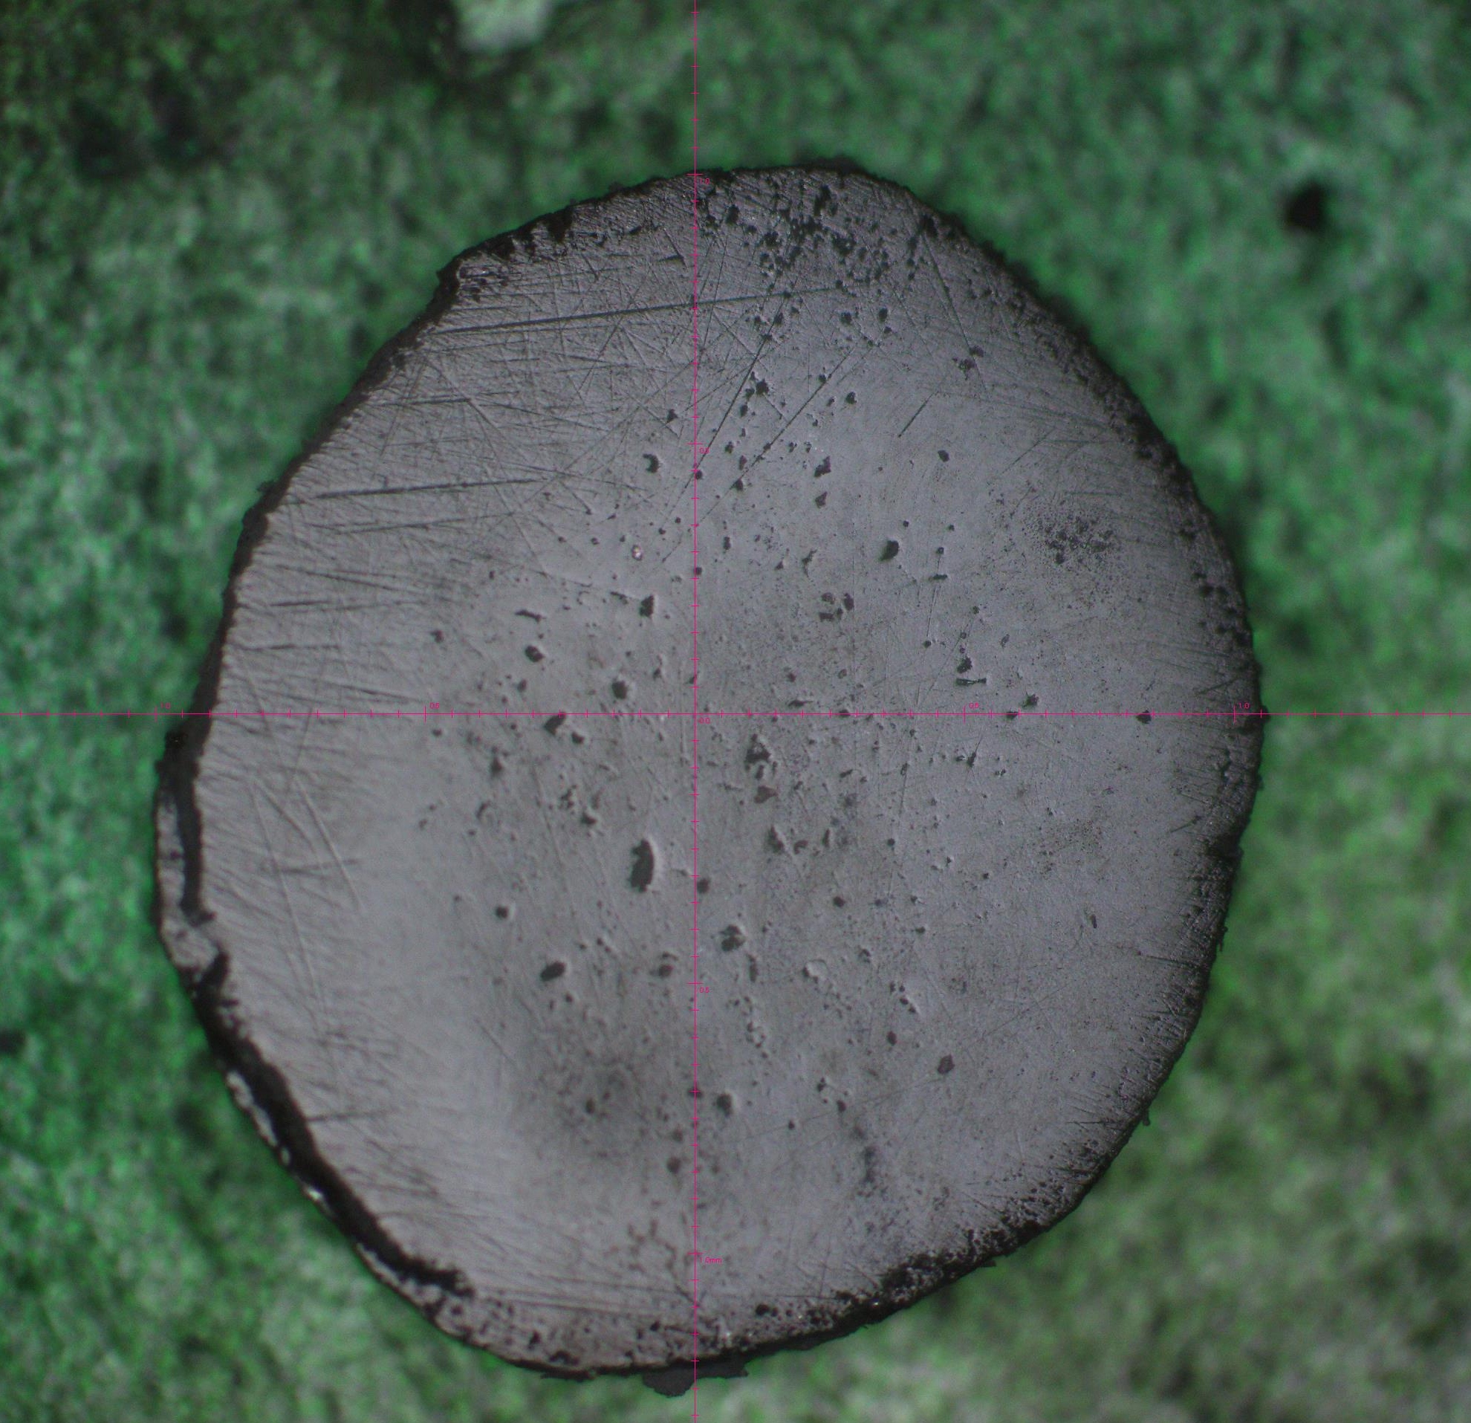
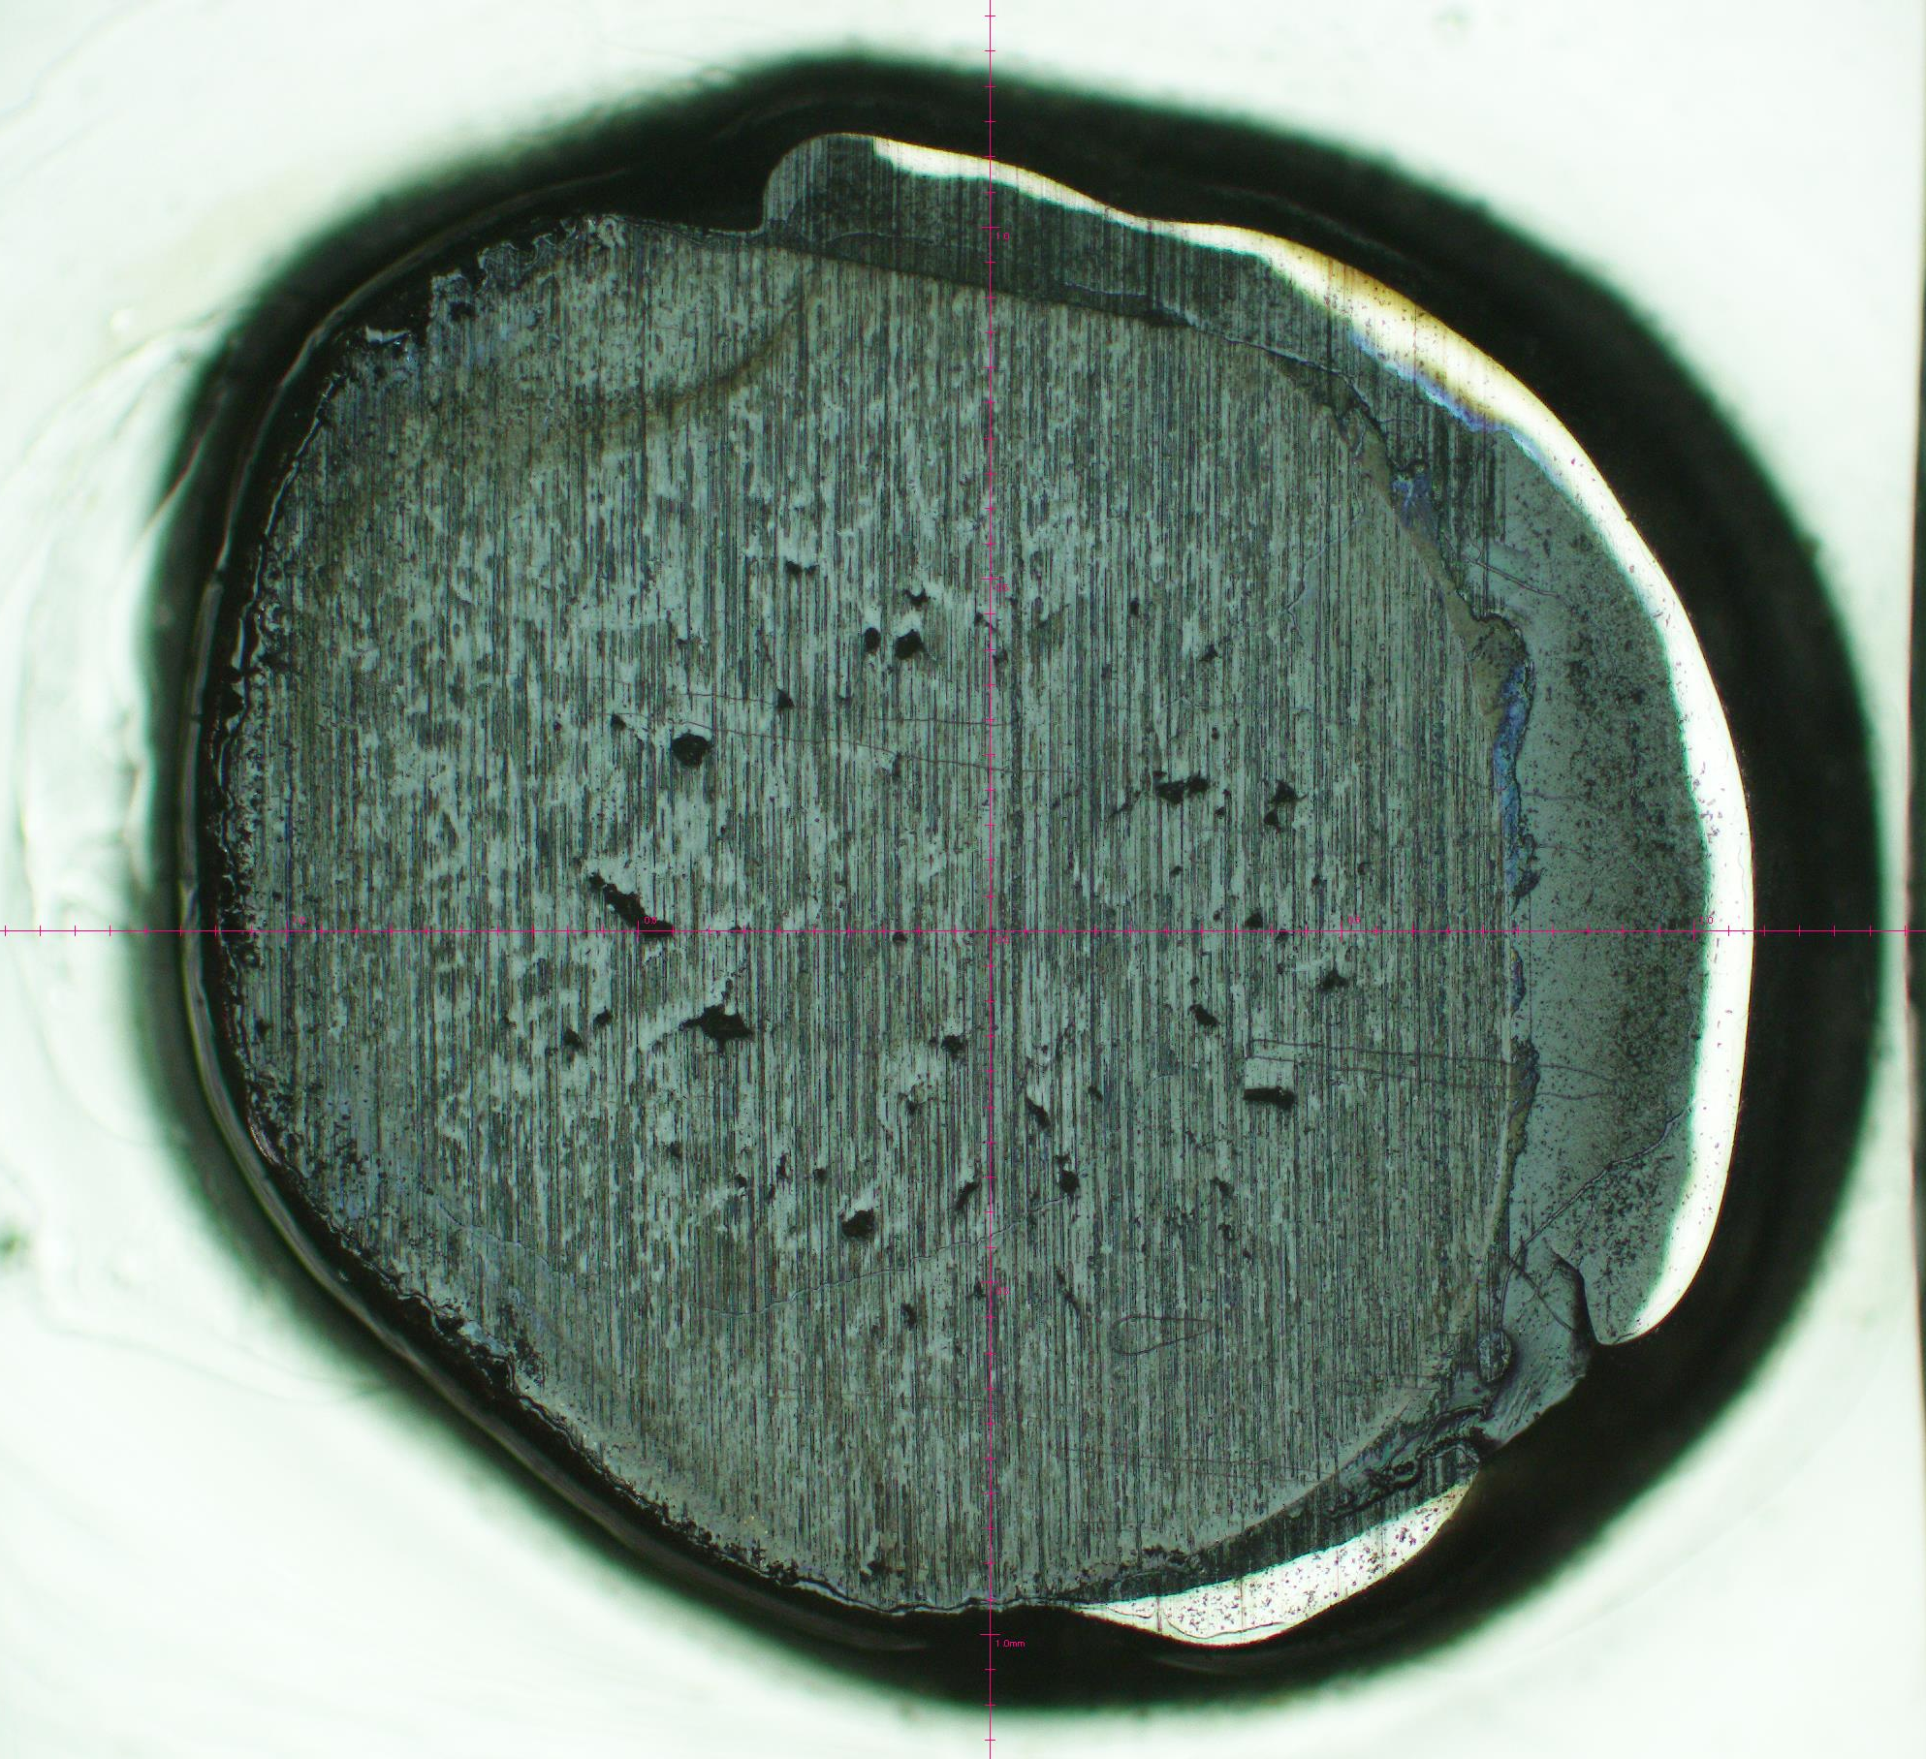
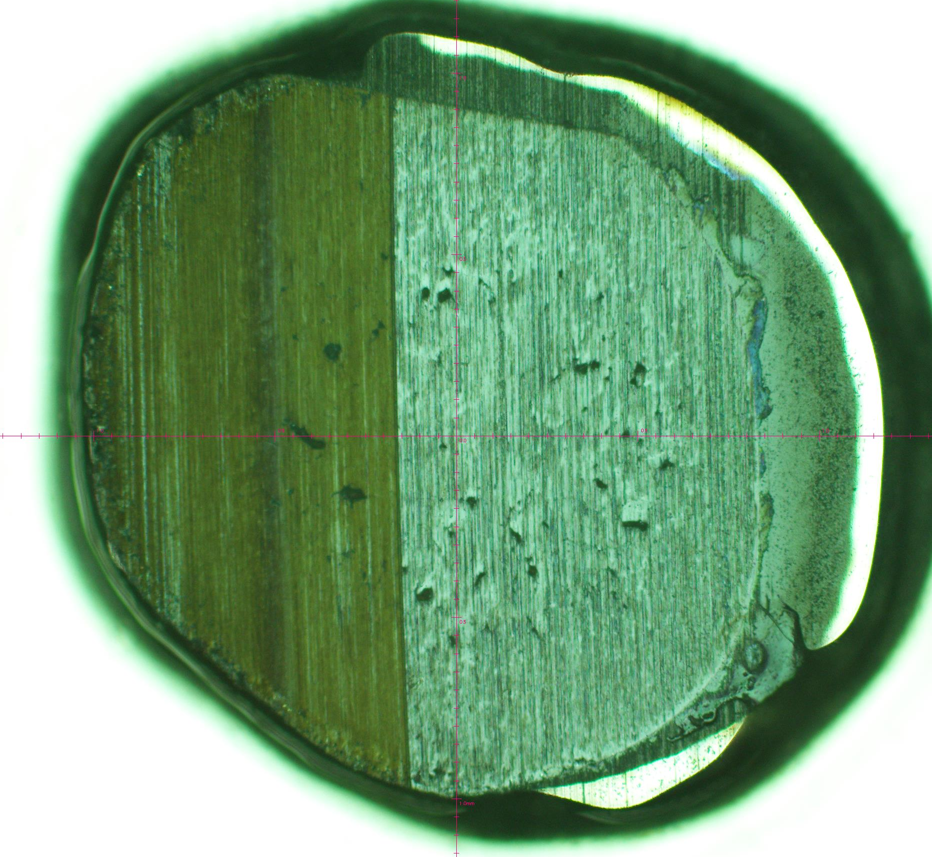
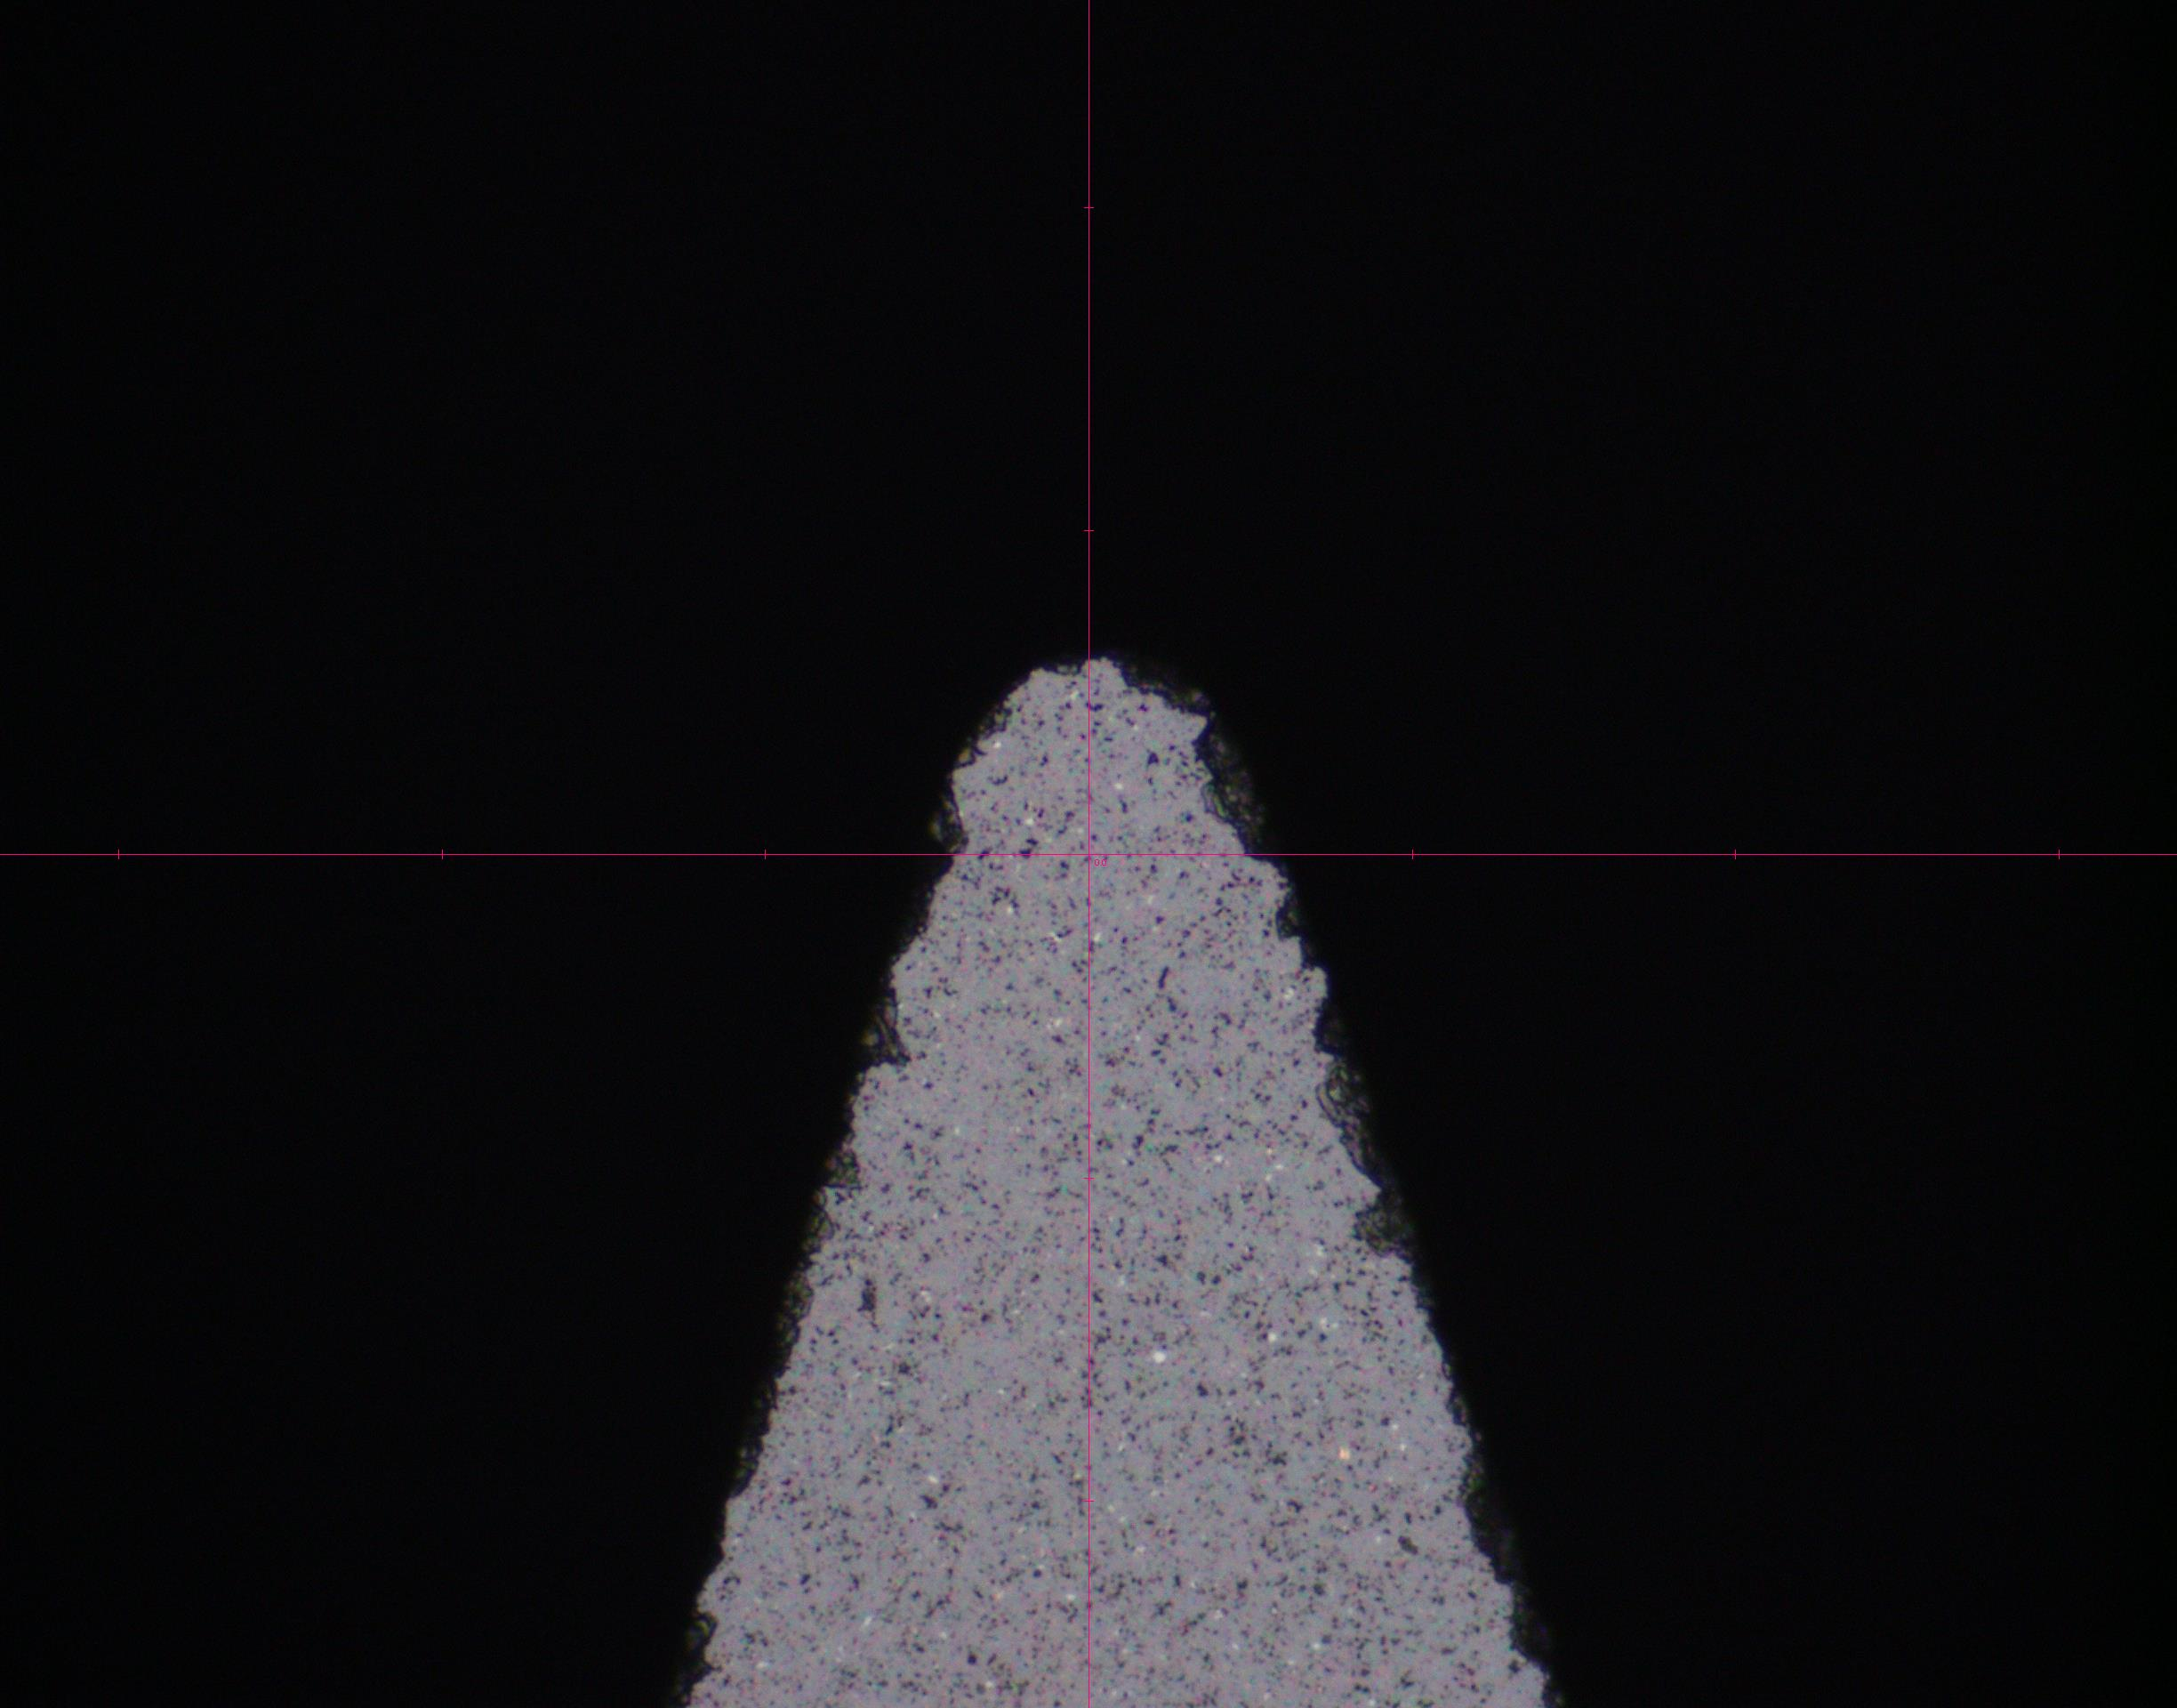

Machining of MgSiO3 for EOS target
Surface roughness
40nm Ra measured on WLI
Surface roughness
70nm Ra measured on WLI
Photograph of as received sample (5x)
Sample has voids and possible inclusions
PCD Test cut 10um material removed
Single crystal diamond Tests
The finish cuts followed the PCD tool
The first finish cut was across the entire sample. A 70nm Ra surface roughness was recorded using the white light interferometer (WLI). 4 microns of roughed material was removed
The second finish cut was only on half of the sample. An additional 4um of material was removed from one half of the sample, resulting in 40nm Ra surface roughness.
Photo of new PCD tool
Photo of used diamond tool
Wear on PCD tool-not catastrophic
Significant wear on diamond

Slide 17
Summary
We have successfully diamond turned previously thought of as “Not diamond turnable” material
We are developing machining processes for high tool wear compounds
The technology offers experimenters new materials for target components (Hohlraum, liners, back-lighters)

