Slide 1
Improvements in CH Ablators Fabricated by Microencapsulation
W. Sweet, R. Jimenez, R.I. Mohammed, F.H. Elsner,
K.J. Boehm, J.C. Williams, A. Garcia, R.R. Paguio,
M. Ratledge, H. Huang, N.M. Ravelo, N.G. Rice,
E. Mathison, H. Xu, P. Fitzsimmons, and M.P. Farrell
General Atomics, P.O. Box 85608, San Diego, California 92186-5608
23rd Target Fabrication Meeting
Annapolis, Maryland
April 23-26, 2019
Work supported by General Atomics IR&D

Slide 2
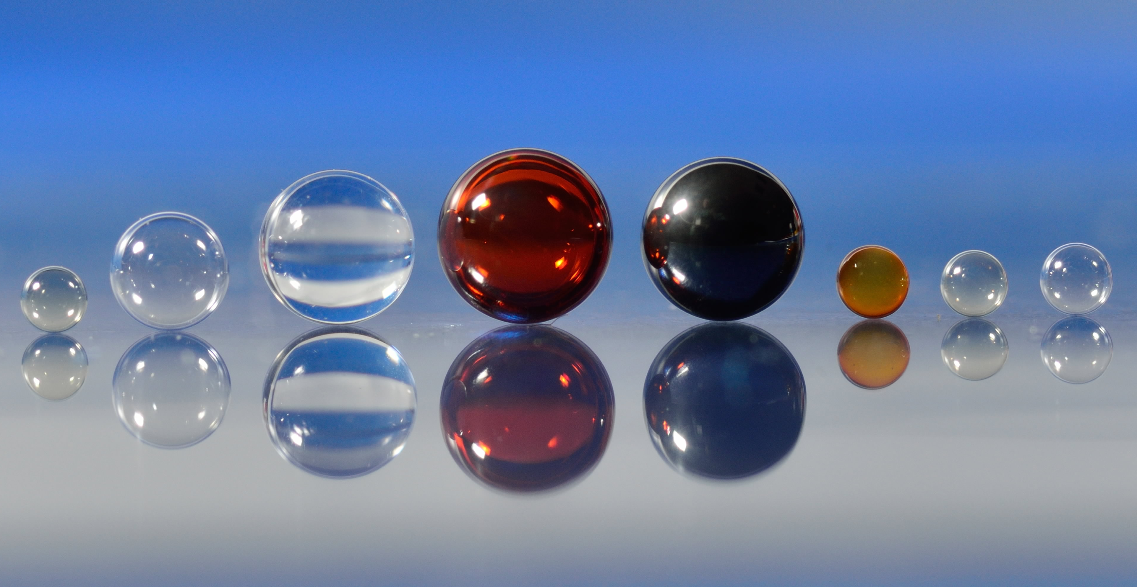
GA uses microencapsulation to fabricate many types of shells and beads
Microencapsulation overview
PAMS mandrels
Polystyrene capsules
Wetted foam fabrication

Slide 3
Microencapsulation is a high volume technique for fabrication of polymeric shells
Steps
Droplet generation
Curing
Inner water removal & drying
Characterization
Outer Water (W2)
Droplet
generation
Inner Water (W1)
Polymer
Solution (O1)
Osmotic inner water removal
Shells cured & agitated in heated bath
Drying in a vacuum oven
Hundreds to thousands of shells can be fabricated in a single batch

Slide 4
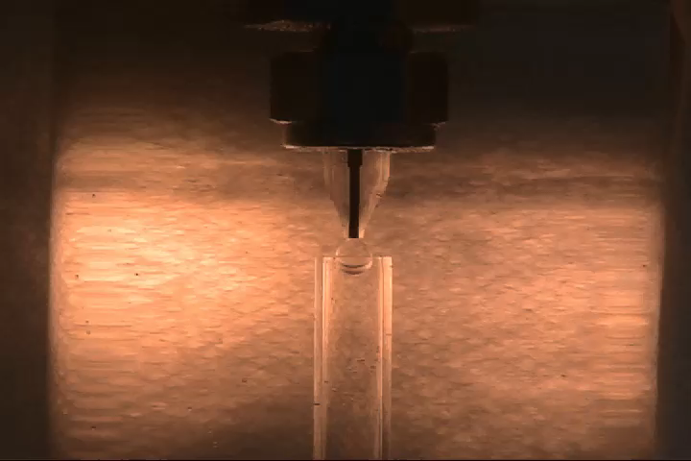
Microencapsulation in the Droplet Generator

Slide 5
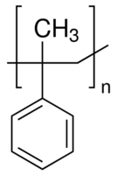
Poly(α-methylstyrene) Shell Fabrication Status

Slide 6
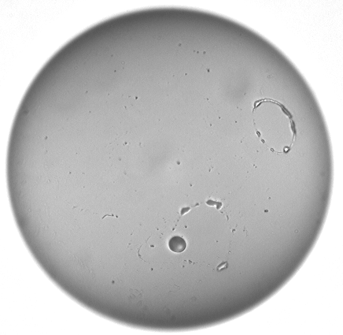
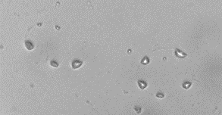
Last year, efforts have focused on ensuring the quality of the PAMS feed material
Examples of 2017 Pyro Residue
Unusually poor PAMS pyrolysis residue linked to one PAMS lot in 2017
Ensuring long term supply of residue-free PAMS is essential
Additional lots of PAMS from the existing supplier have been
pre-qualified as residue-free—multi-year inventory of qualified material
Shells were fabricated from material from alternate vendors
Worked with the existing supplier to improve the quality of the material
Synthesis of small lots of PAMS at GA to ensure supply of high quality,
residue-free PAMS

Slide 7
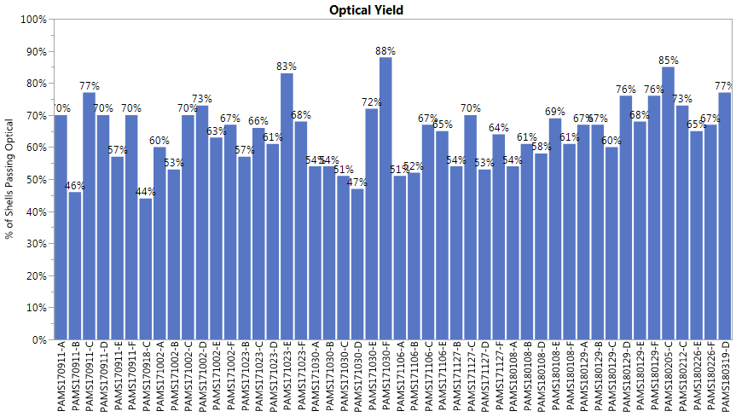
Optical yield for GA-synthesized PAMS is already comparable to vendor-supplied material
GA-PAMS has typical optical passing rate
Lower pass rate for PAMS from an alternate supplier
2017
2018

Slide 8
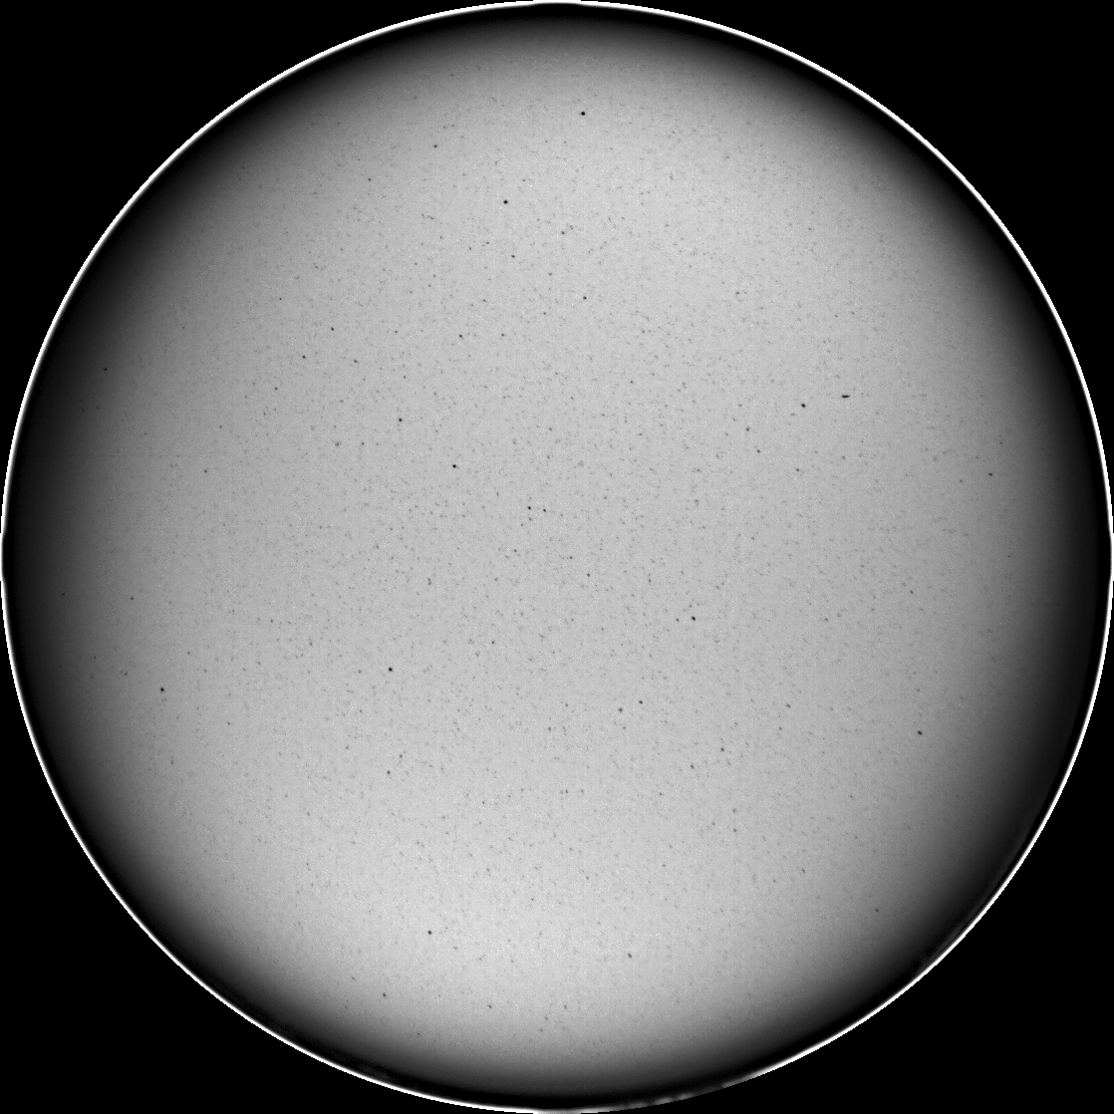
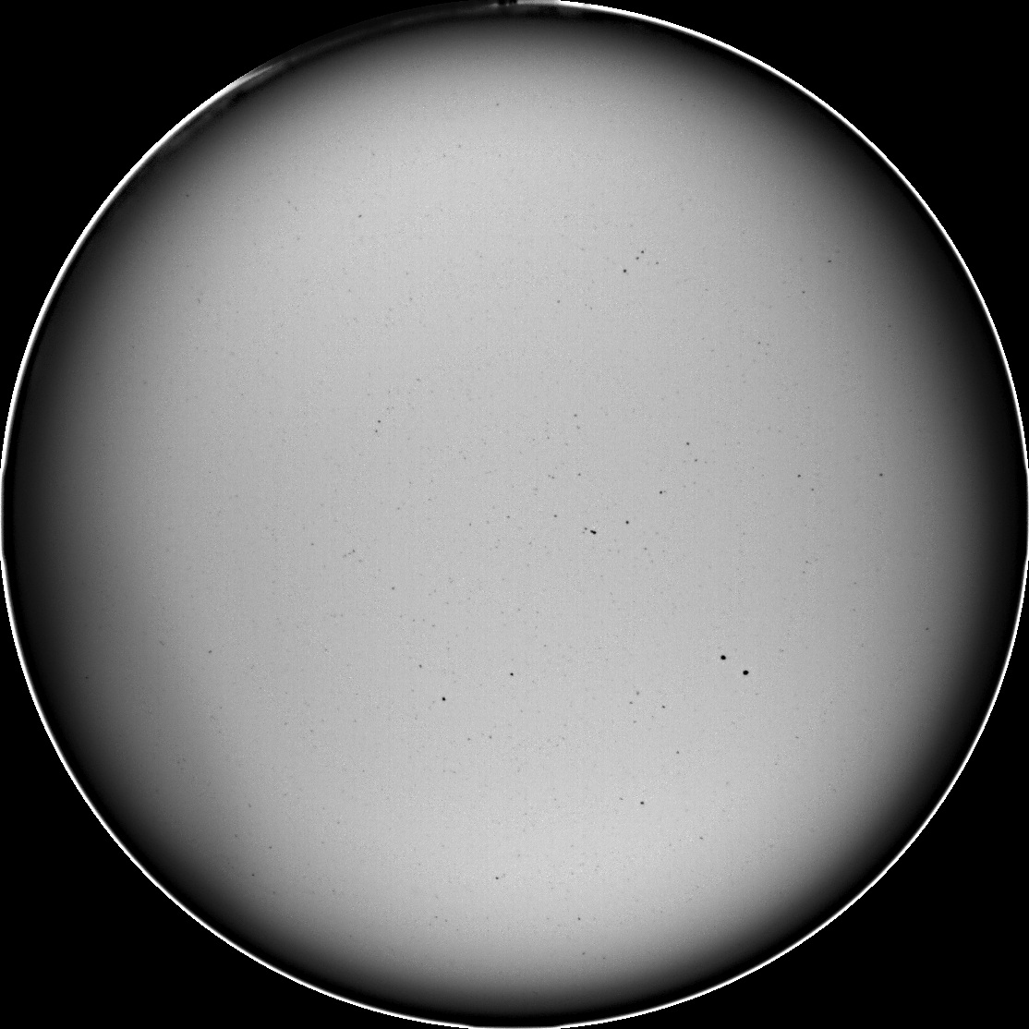
GA-fabricated PAMS material matches optical quality of supplier-provided PAMS
200 μm
200 μm
PAMS180226-A,
Typical Vendor-Supplied PAMS
PAMS180226-E,
GA-Fabricated PAMS

Slide 9
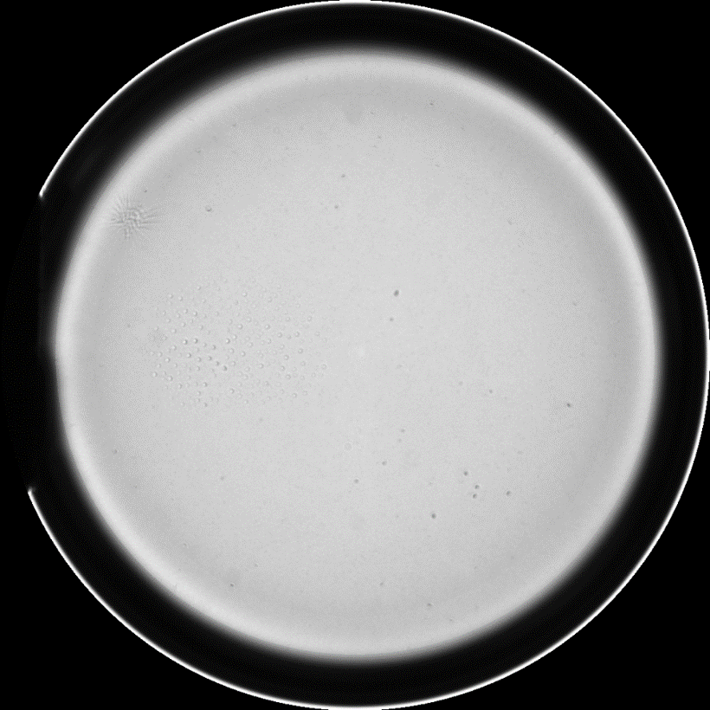
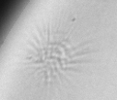
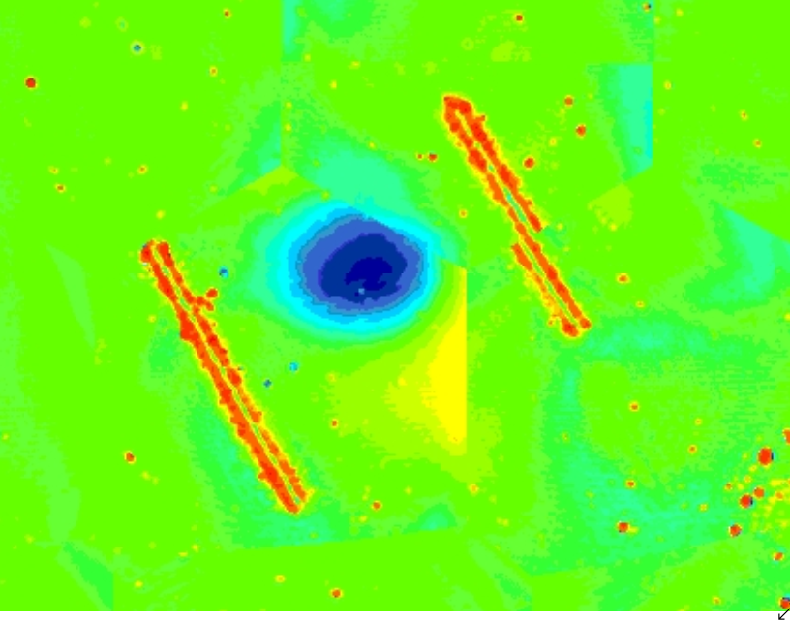
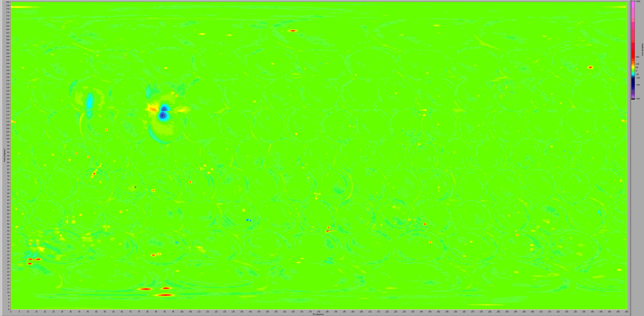
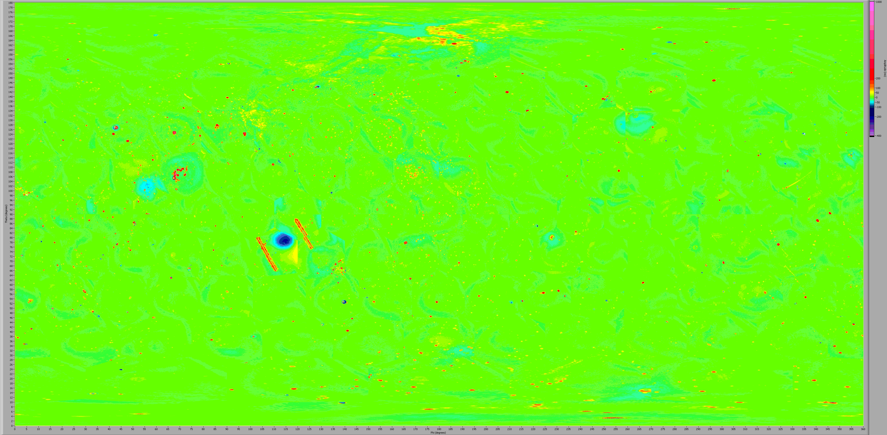
“Star crack” reduction is another objective—will improve PAMS optical yield & quality of NIF GDP capsules
~150 µm diameter
100 nm deep
Robotic culling image
(Visible star crack)
AZ100 image
(No visible star cracks)
“Star/spider cracks” & depressions often form as a bubble nucleates during the removal of the inner water
PSDI data for GDP often has a single depression with dimensions characteristic of star cracks
Production PAMS shells rejected for star cracks:
  10-40% of PAMS shells with standard AZ100 culling
  ~30-60% of PAMS shells on new robotic
  culling station
NIF PSDI:
Fiducials added to star crack before coating

Slide 10
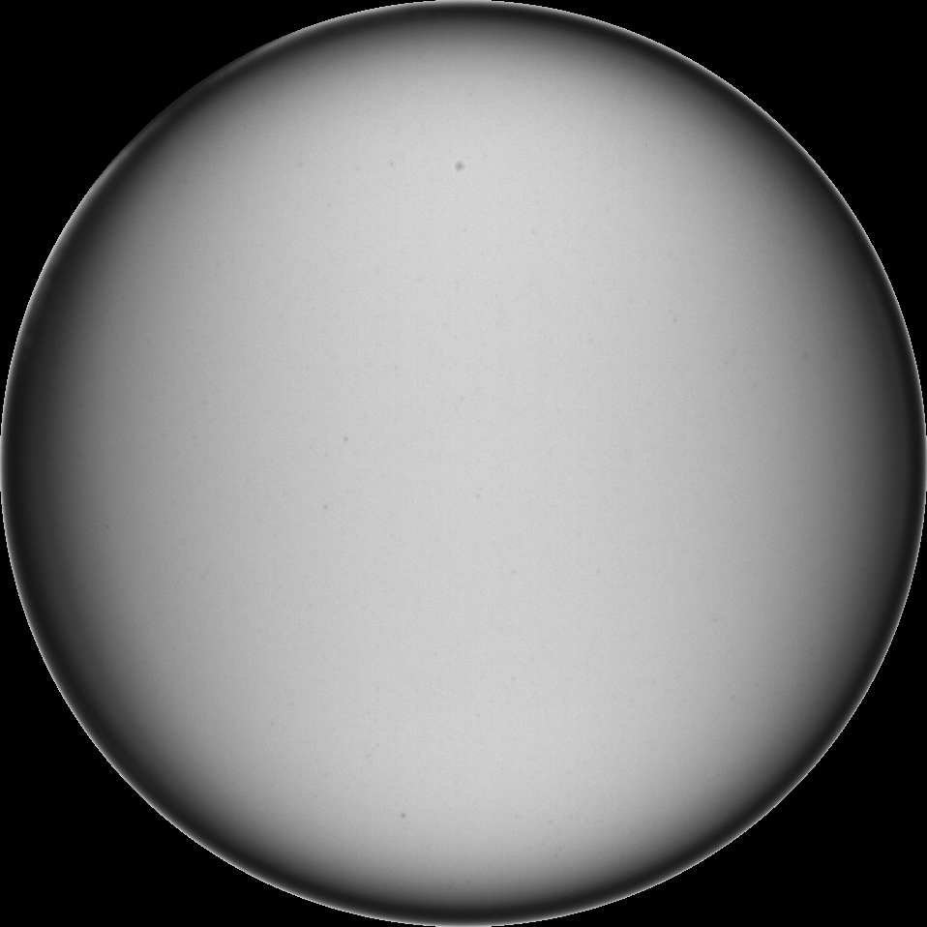
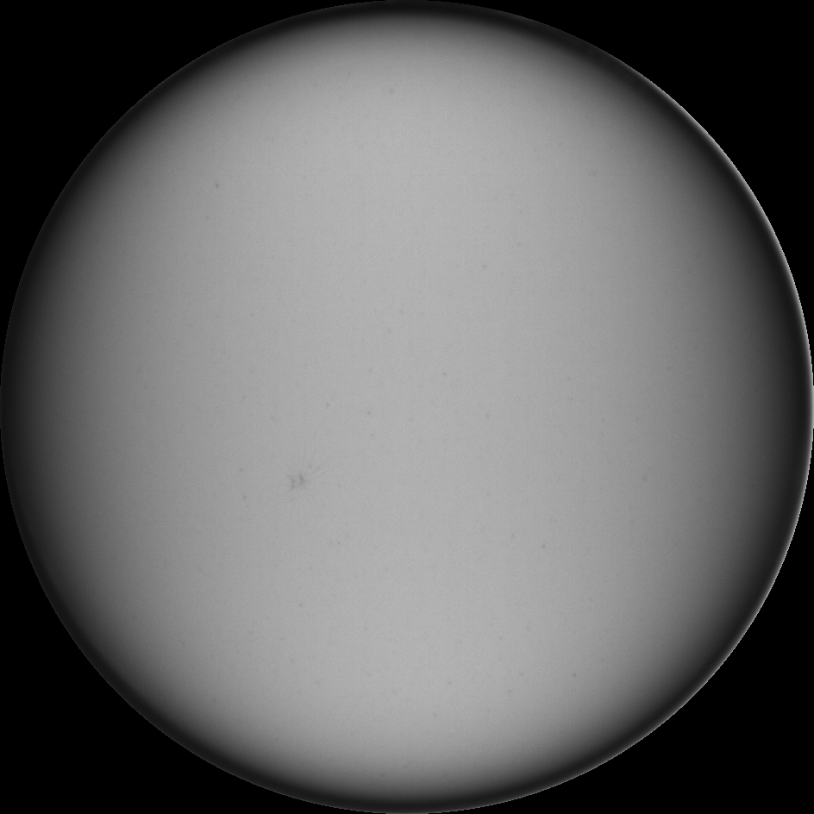
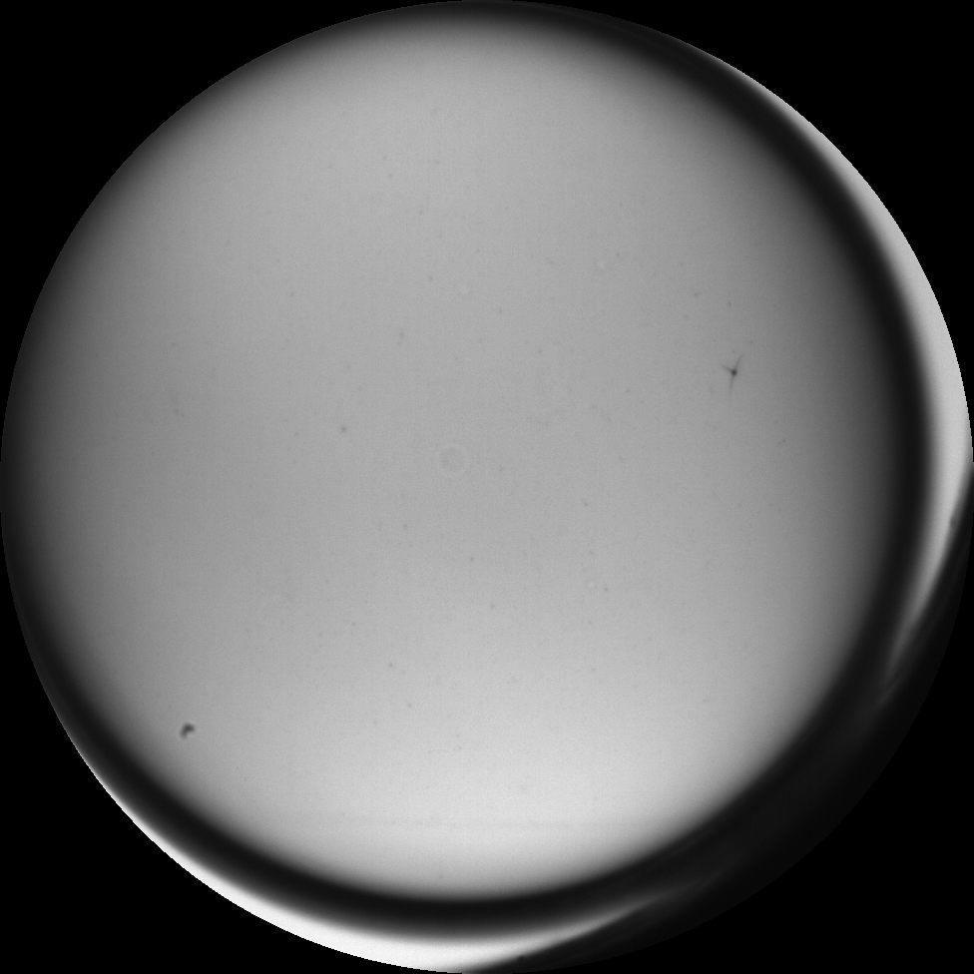
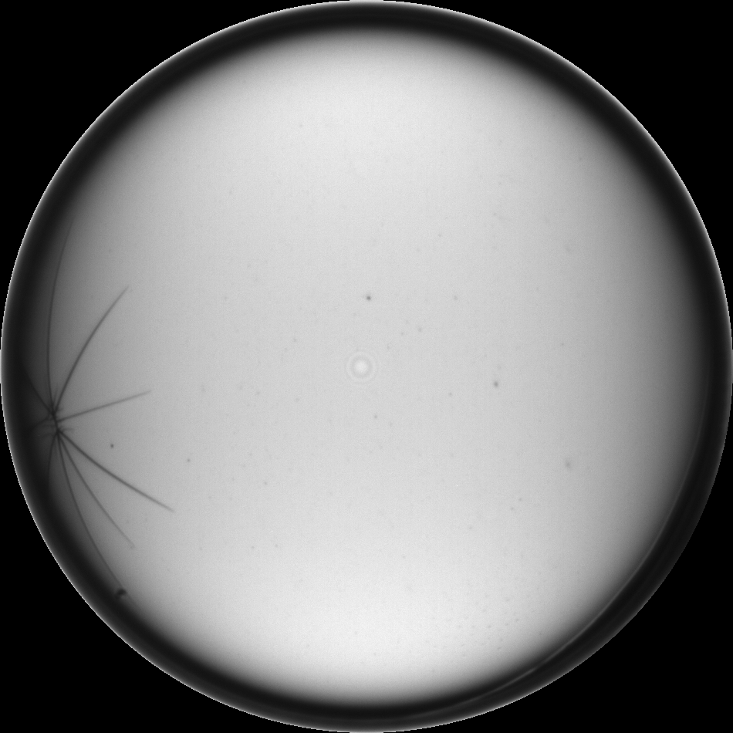
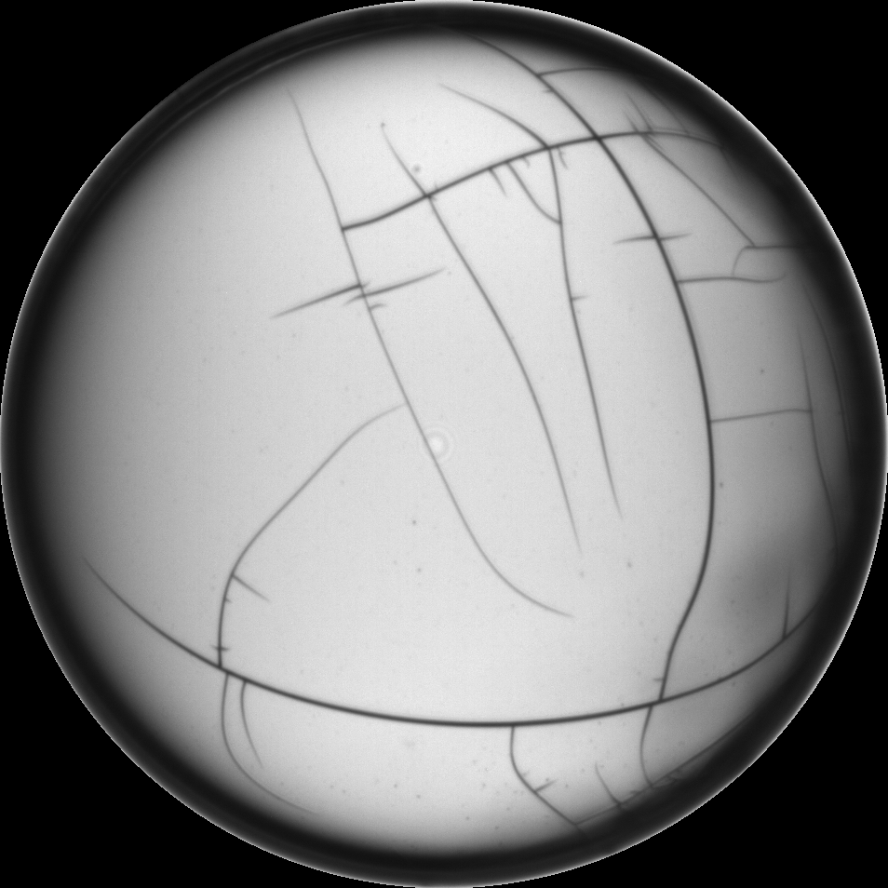
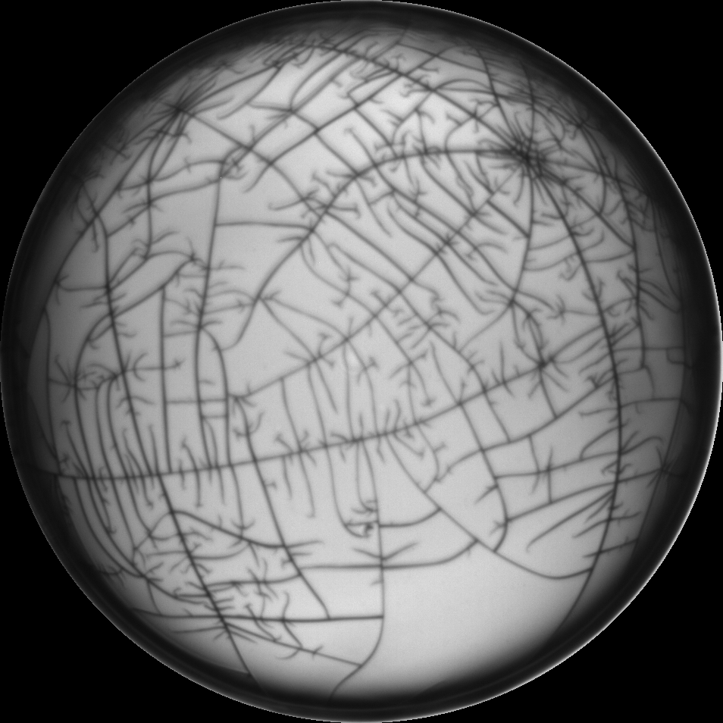
Star cracks were assessed manually and with automated defect statistics from the AZ100
0
1
2
3
4
5

Slide 11
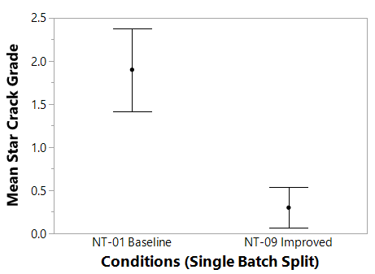
Promising conditions for star crack reduction were identified
Influence of Nucleation Conditions on Star Cracks
*A batch prone to cracking was used to make it easier to see trends.
The batch was split and placed either in standard or R&D conditions.
Replication & evaluation of AFM data is required before implementing as a production step

Slide 12
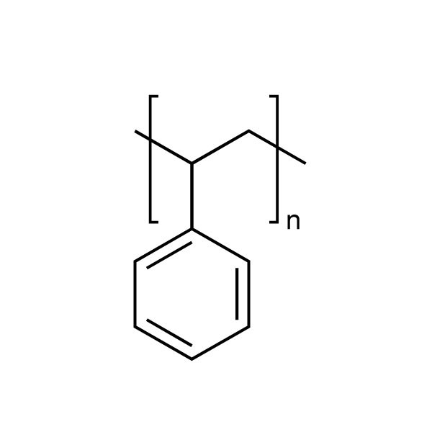
Polystyrene Shell Fabrication Status

Slide 13
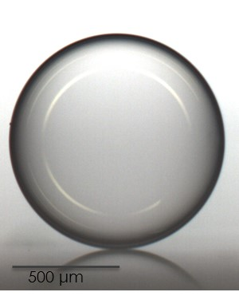
Recent microencapsulation R&D efforts have focused on reducing vacuoles in PS shells
Polystyrene is of interest to LLE for the 100GBar Initiative as an inherently dome-free alternative to GDP
Process development has resulted in shells equivalent to or better than GDP for the following:
  Wall uniformity
  AFM
  Optical defects
Polystyrene Shell

Slide 14
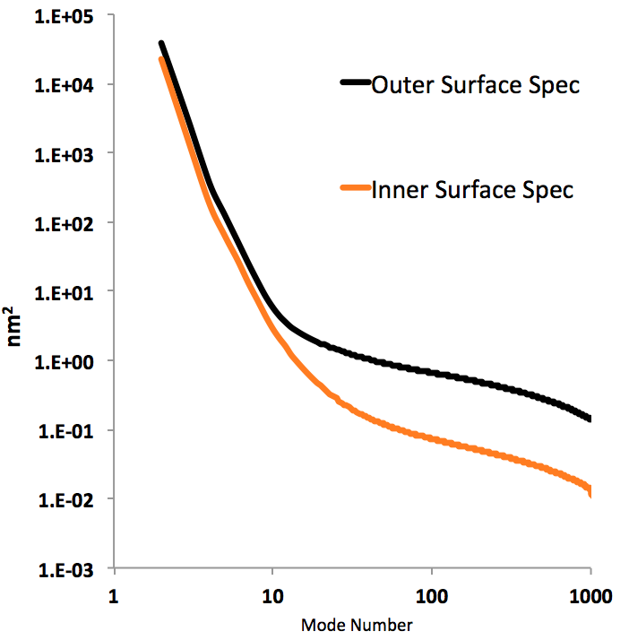
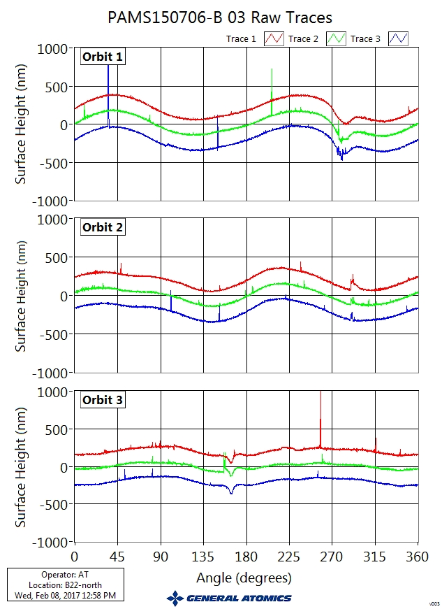
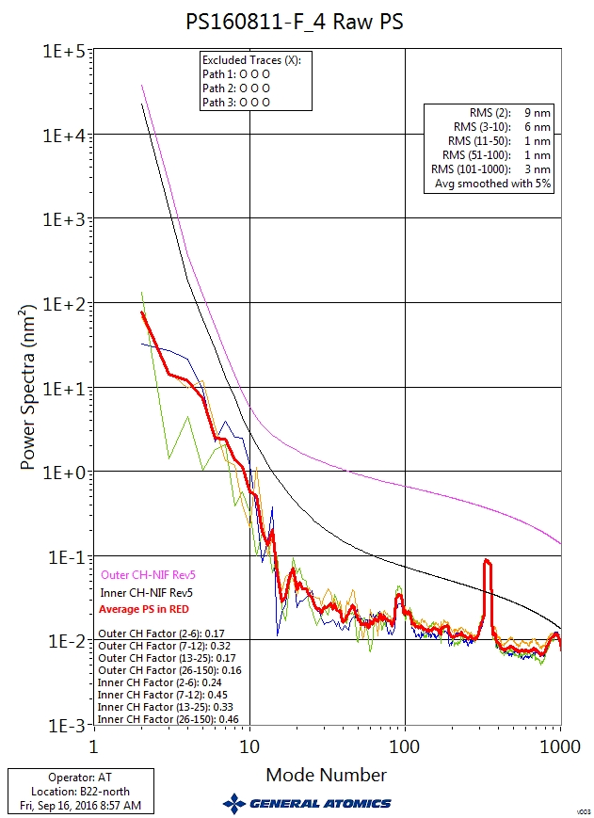
AFM is used to assess shell quality
Raw Traces (Defect Examples)
Power Spectrum
Low modes
High modes
Mid modes
Low Modes 2-6
Mid Modes 7-25
High Modes 26-150
Low Modes
Sphericity
Mid Modes
Wrinkling
Isolated Defects
High Modes
Small features
Roughness
Scratches

Slide 15
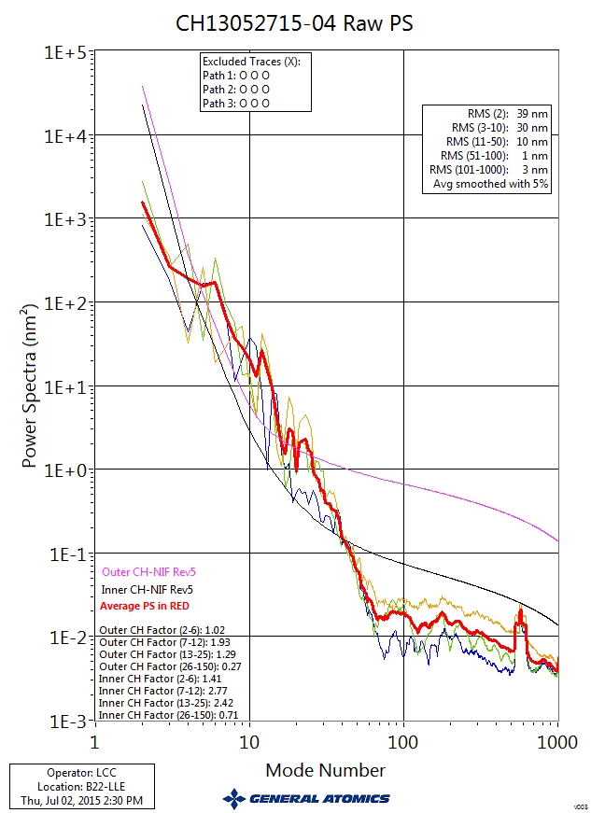
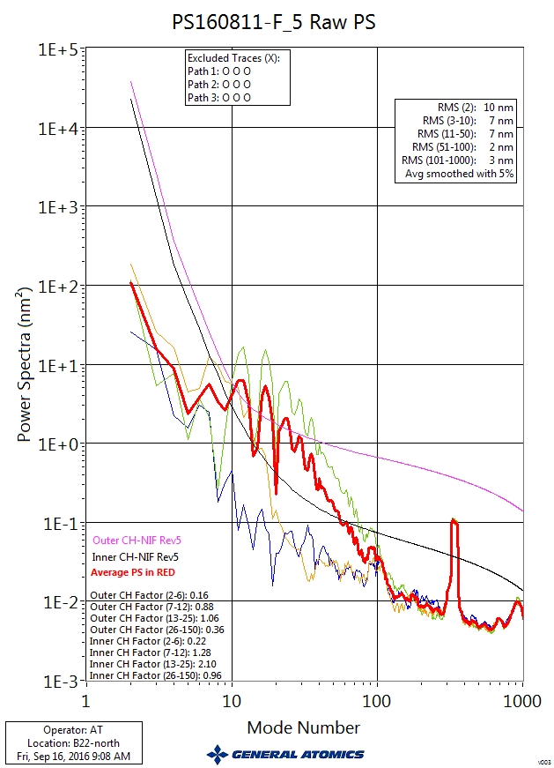
PS shells have better low modes than typical GDP
Best PS vs. GDP
Typical PS vs. GDP
GDP
GDP
NIF Spec
NIF Spec
Best PS
Typical PS

Slide 16
Low modes are consistently low for batches fabricated over a range of conditions
Comparison of AFM for Delivered GDP and Representative PS batches
GDP
Low Modes
Polystyrene Batches

Slide 17
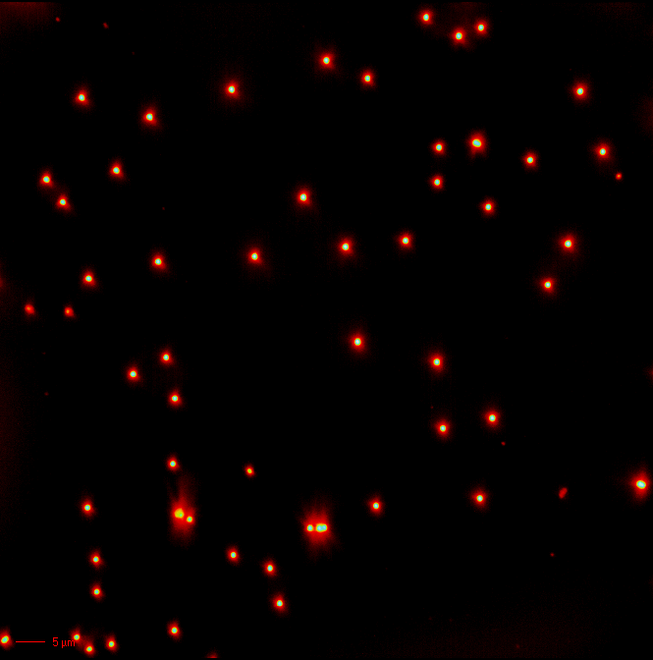
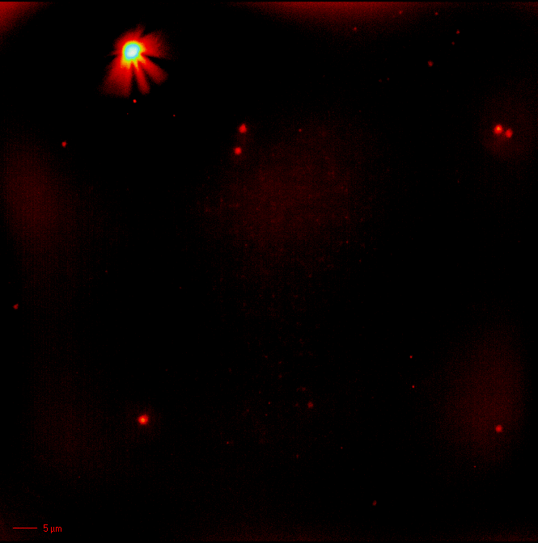
Dark field microscopy can be used to characterize submicron defects
0.49 µm Calibration Standard
GDP Shell
GDP Defects
H. Huang, J. Walker,
K. Sequoia
In dark field microscopy of submicron defects, light intensity is a surrogate for size

Slide 18
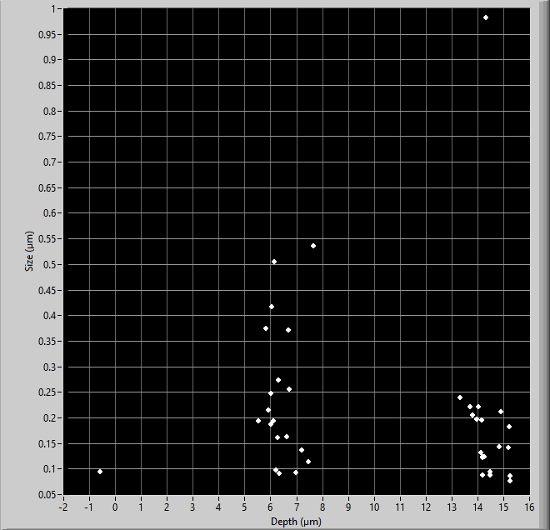

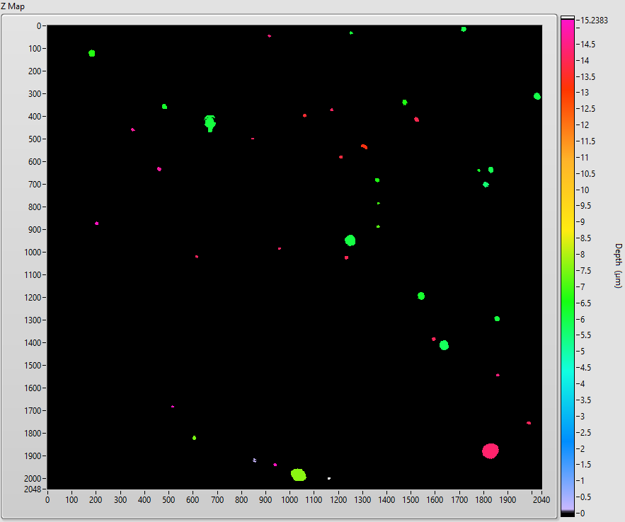
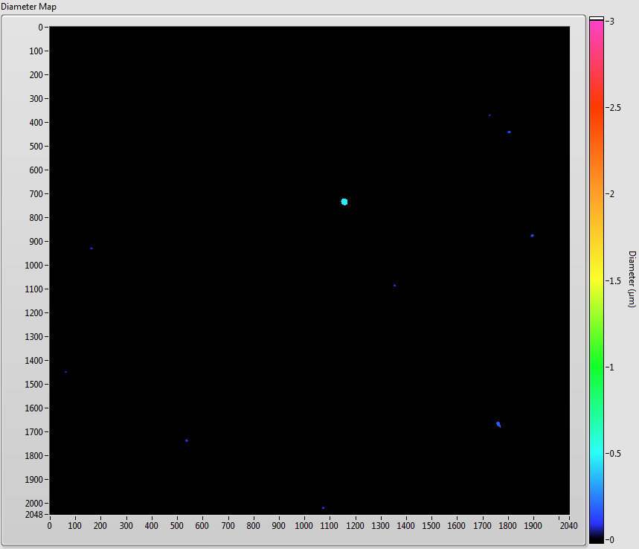
Quantitative dark field analysis is now being used for process feedback
GDP (SCD52-V)
PS shell (PS180213-B)
Inner wall defect
Inner surface
Outer surface
Defect position within wall
Artifact
Inner surface
Defect Diameter (µm)
Defect Diameter (µm)
Outer surface
Wall
Depth (µm)
Depth (µm)
Map color indicates defect depth
in wall
Defect Diameter (µm)
Defect Diameter (µm)
Position
Position
With the improved dark field method, we can now determine that
most defects cluster near the surface of the walls for both SCD and PS.

Slide 19
Dark field defect counts of candidate batches are much lower than typical GDP
SCD (GDP)
PS
Record Low Defect Count
*Bars represent the batch average of the dark field defect count using one image per shell (~0.5% of surface area)

Slide 20
Maximum dark field defect size in candidate batches has also been reduced
Median defect size
Max defect size
SCD (GDP)
Old PS
New PS
*Bars represent the batch average of the maximum defect size for one image per shell (~0.5% of surface area)

Slide 21
Dark field analysis suggests some PS shells are close to meeting the current LLE defect specification
See also M. Bonino’s Talk
Unacceptable for 100GBar spec
-C
-C
Measured defects*
Unacceptable for current cryo spec
Acceptable for 100GBar spec

Slide 22
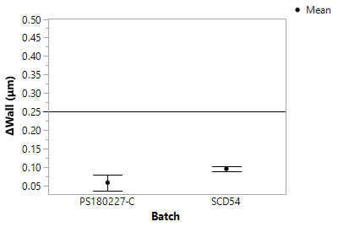
Wall uniformity comparable to that of GDP was maintained for recent process conditions
0.25 µm specification
GDP
PS
Notes:
Include more data here

Slide 23
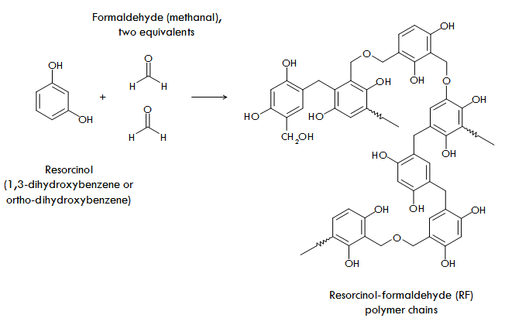
Foam Shells
From http://www.aerogel.org/?p=71

Slide 24
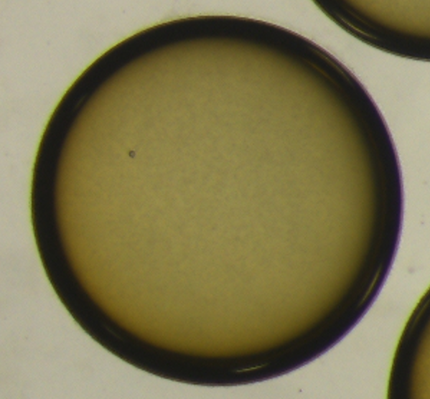
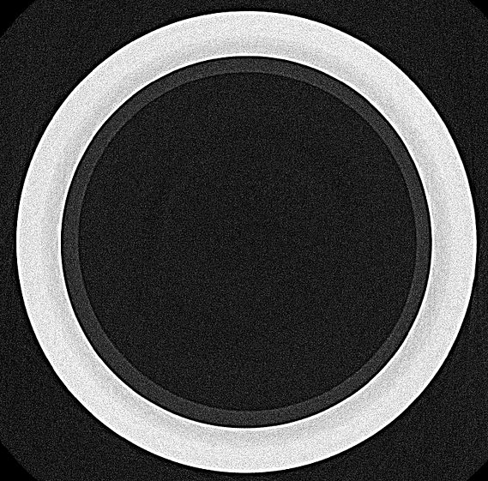
GA Fabricated RF-lined GDP shells in support of LANL wetted foam project
RF shell
GDP
RF
5 Day Polish
LANL
RF-lined GDP design
1 mm
Ref: B. Haines, Phys. Plasmas 26, 012707 (2019)
The “inside-out” fabrication route for foam-lined shells has many challenges:
  Low modes: GDP coating is conformal—low RF shell out-of-round is essential
  Non-concentricity: RF shells are thicker and typically less uniform than PAMS
  Domes: RF has more surface roughness than PAMS.
  Anhydrous polishing process developed

Slide 25
Conclusions
Microencapsulation is a versatile technique used to mass-produce capsules from many materials
Current PAMS effort is focused on securing
residue-free PAMS & on star crack reduction
Best ever PS shells were fabricated last year as a result of process improvements
Some strategies from PS shell development
might be applicable to PAMS

