Slide 1
Overview of Materials Developments In the Target Fabrication Group at LLNL
23rd Target Fabrication Specialist Meeting
Annapolis, Maryland
April 23rd, 2019
Suhas Bhandarkar
for LLNL Target Fabrication S&T Group

Slide 2
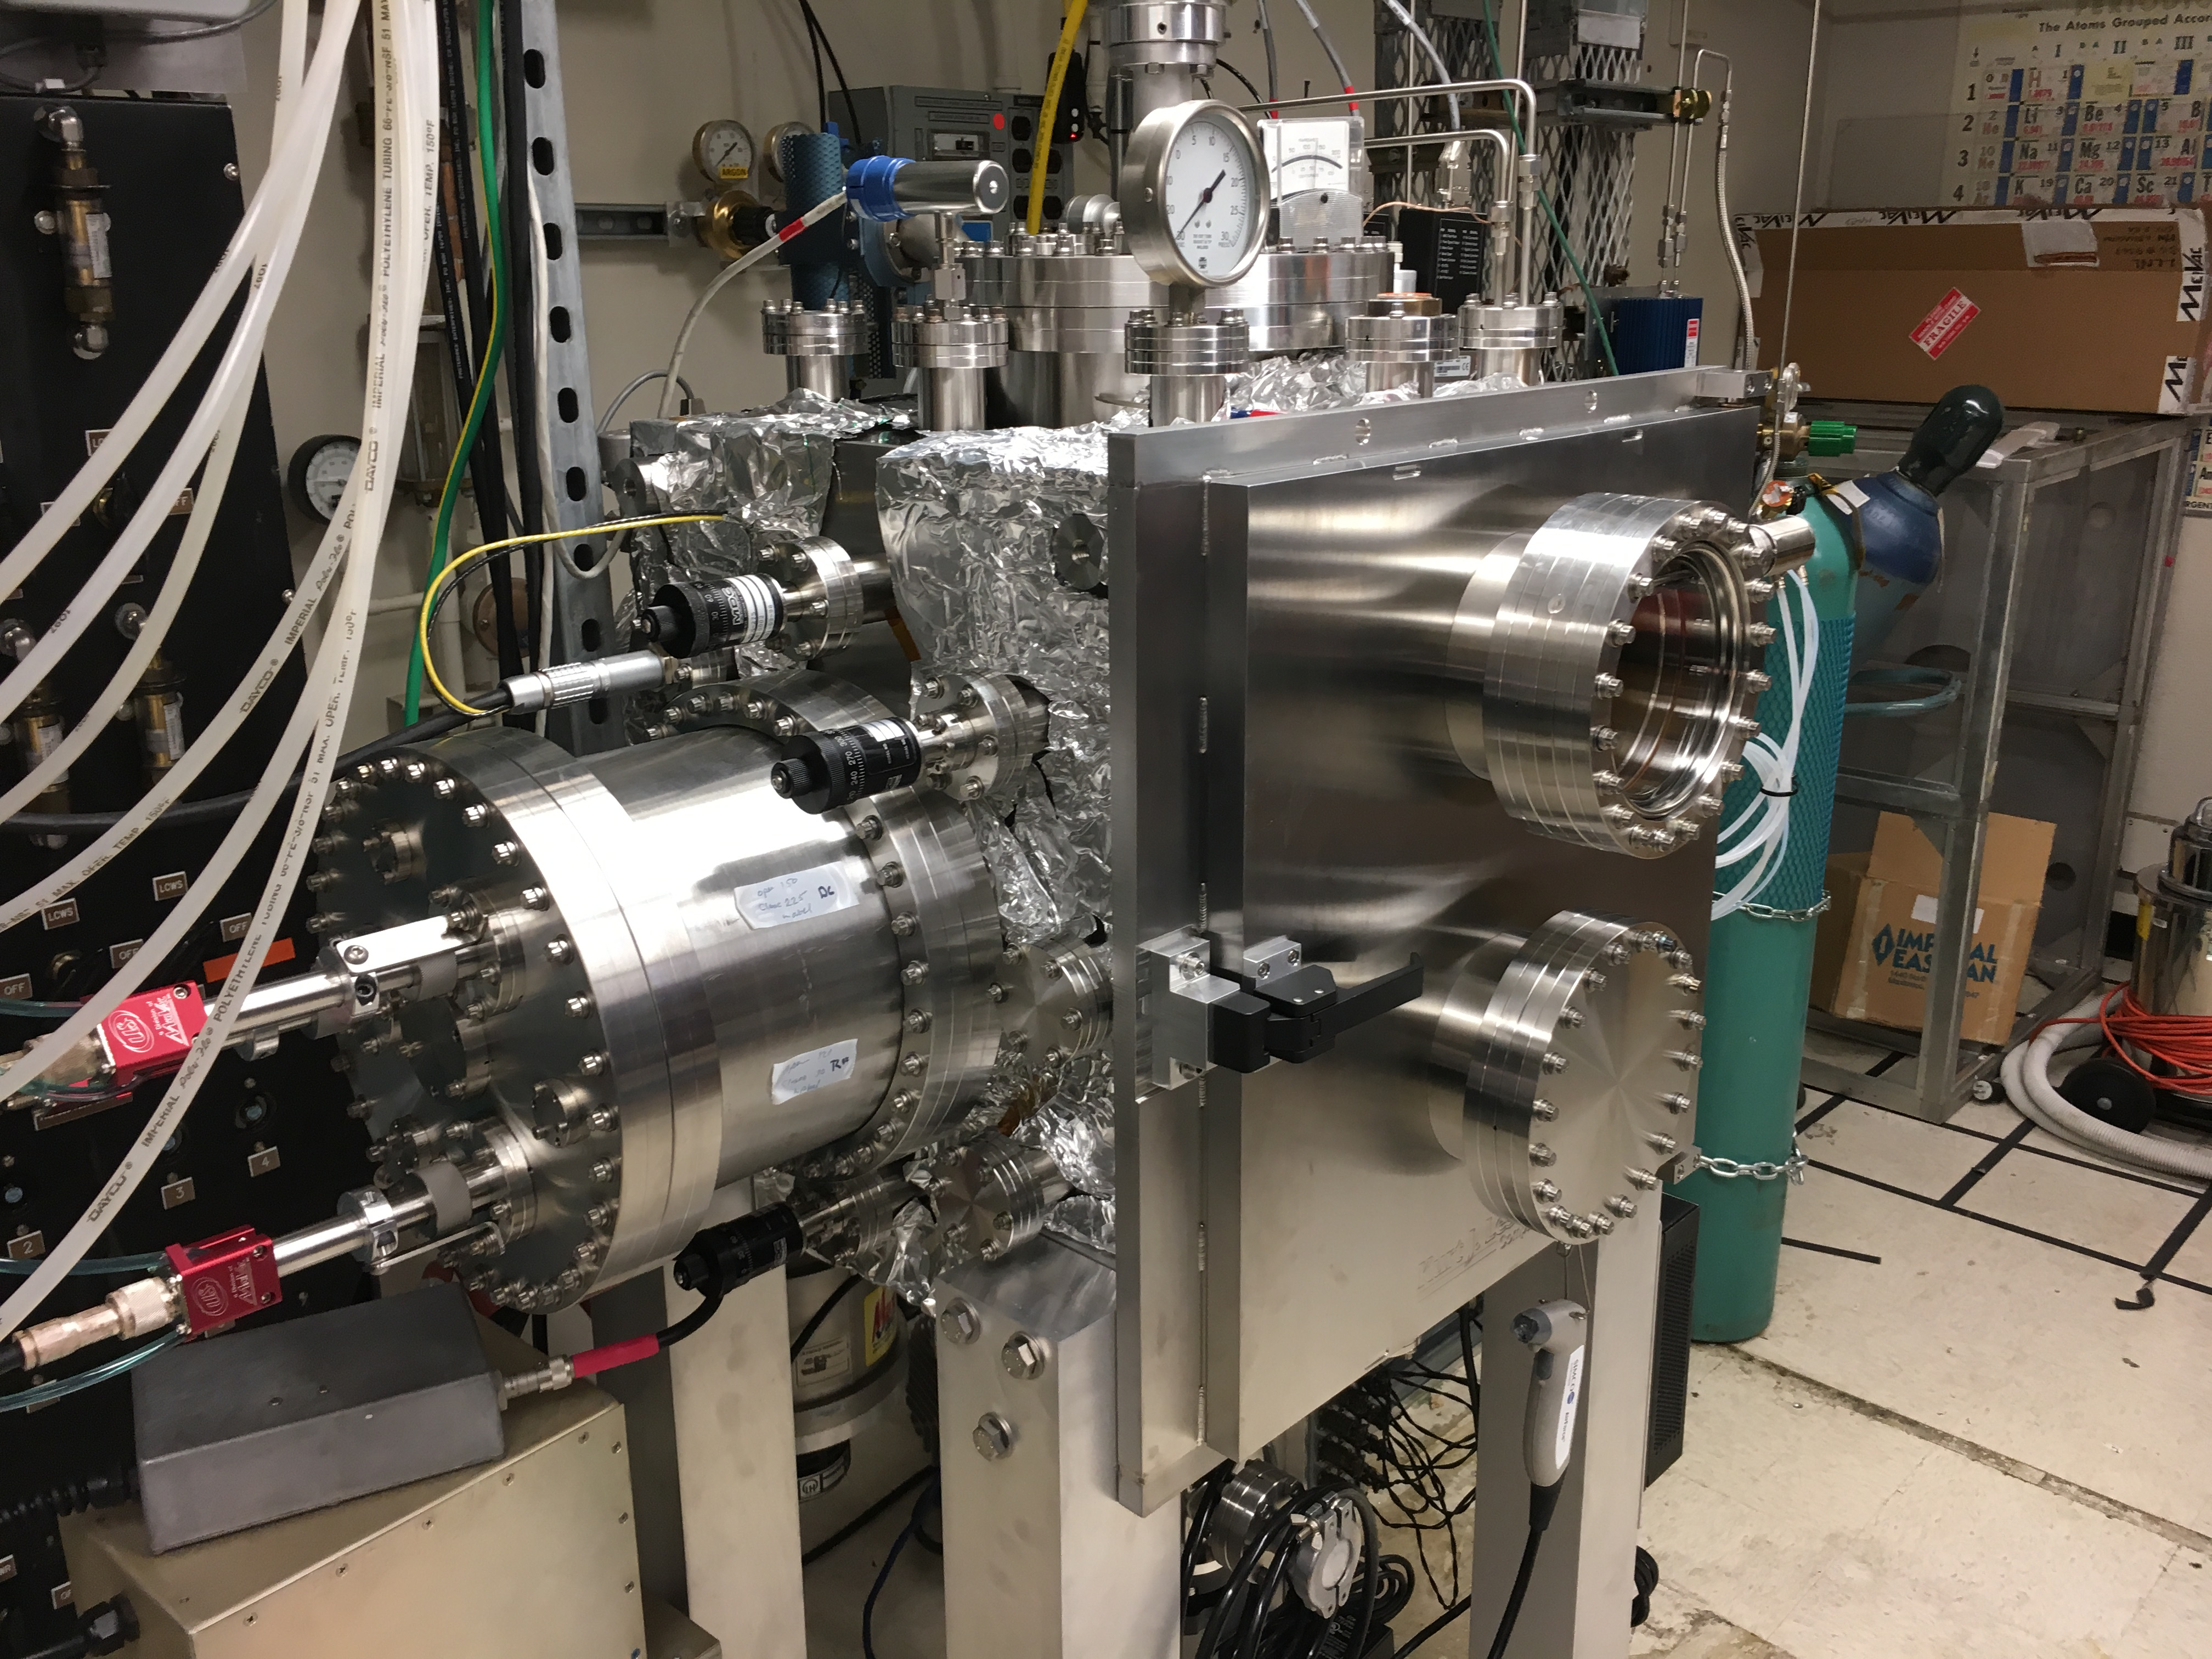
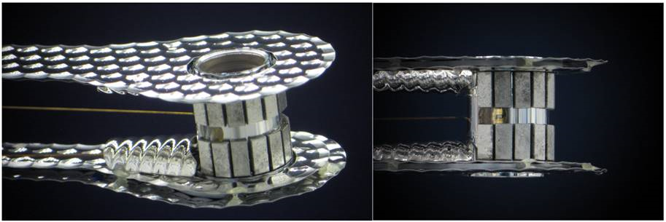
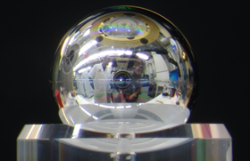
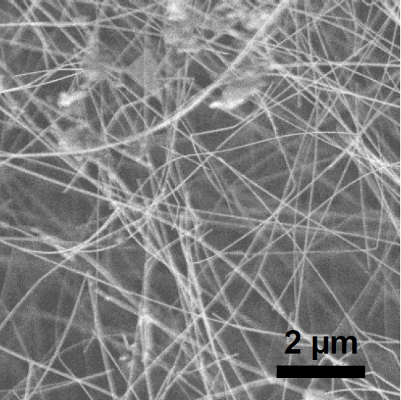
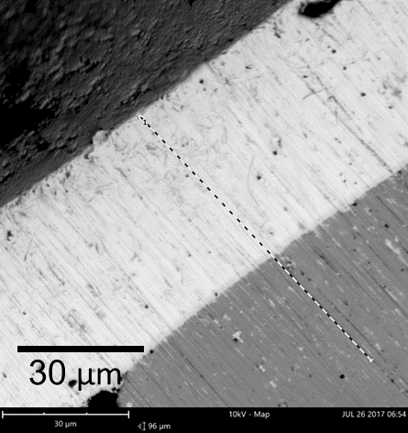
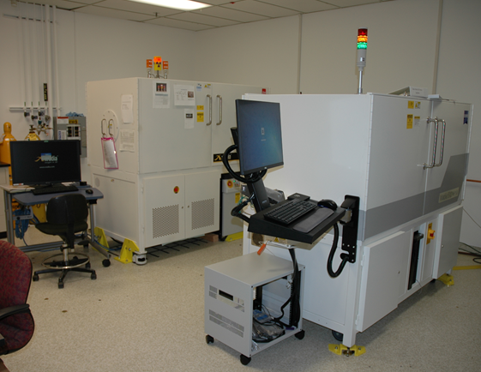
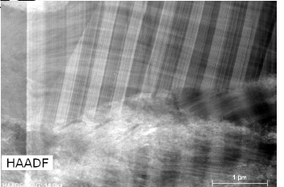
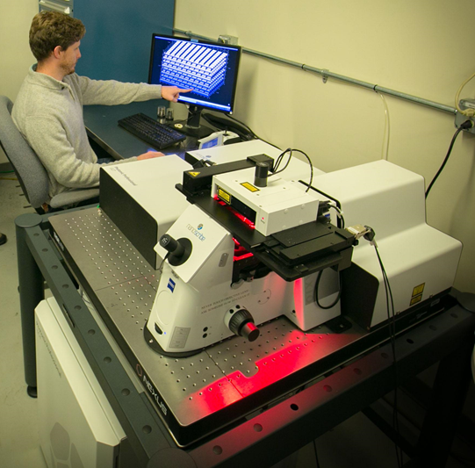
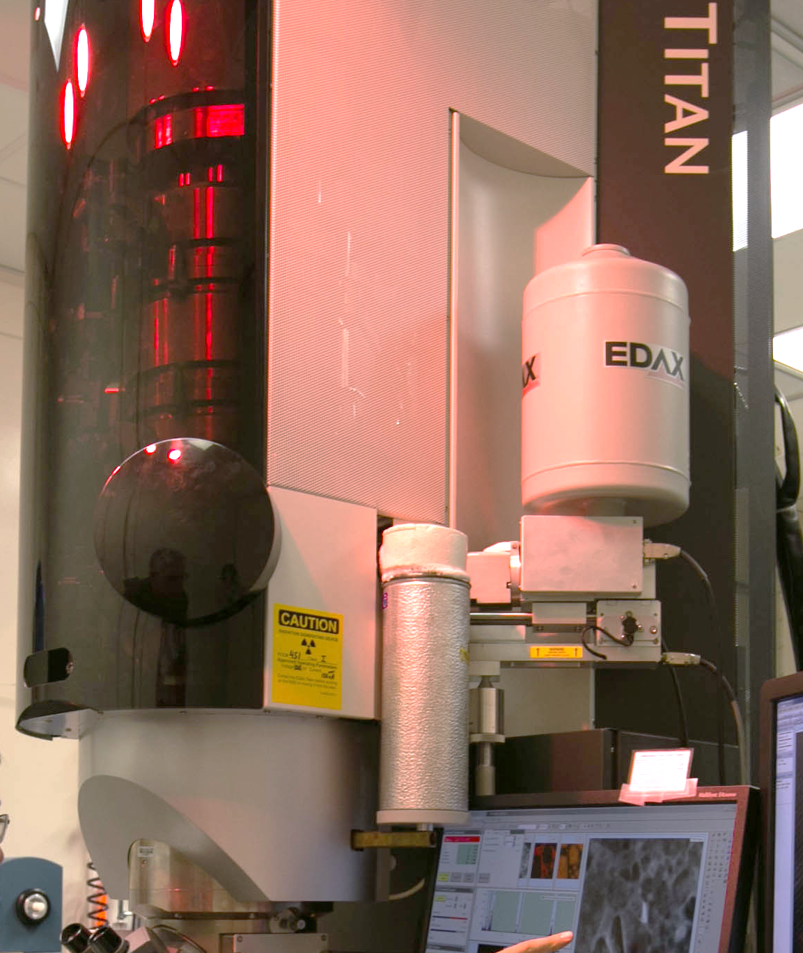
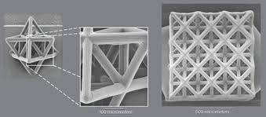


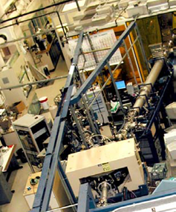




LLNL Target Fab S&T retains a dedicated pool of experts. It leverages capabilities in other directorates as well as maintains close collaborations with external partner institutions
Target Fab
Precision Machining
Vapor Processing Lab
Coatings
Soft Matter/ Nanomaterials
Foams
Tomography
Additive Manufacturing
Advanced Materials & Processes
TEM/FIB
Metrology & Spectroscopy
Beamline measurements

Slide 3
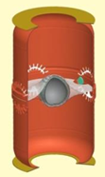
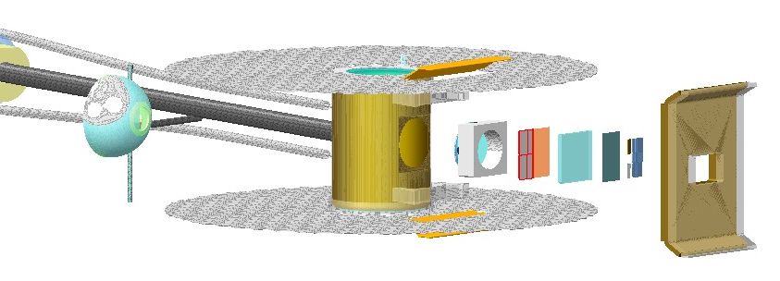
Our mission is to pursue both long-term and short-term R&D based on Physics priorities
Inertial confinement fusion
High energy density physics
Better ablator materials
Mitigate capsule support perturbations
Mitigate the fill tube perturbations
Improve drive symmetry thru hohlraum modifications
Develop new materials and characterization capabilities
Precision machining & coining
Glueless bonding
Pu processing, machining & bonding
Foam development, shaping and machining
X-ray sources development
New materials and processes
Though these overall categories require long term attention and don’t change frequently, we work with HED/ICF Physics to fine-tune the priorities of new ideas and directions within each

Slide 4
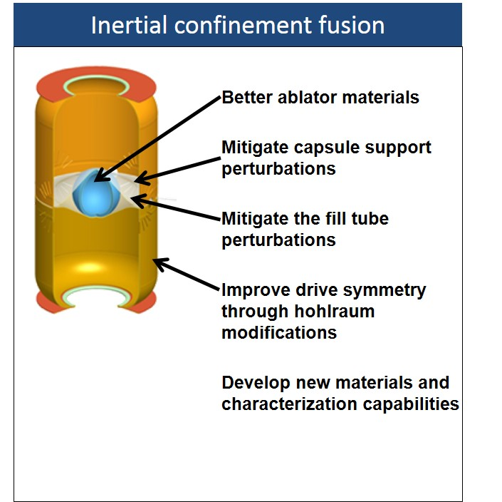
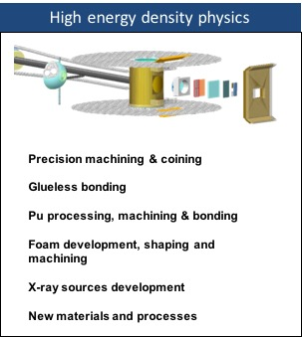
We have embarked on a number of key initiatives to develop necessary materials and technologies for upcoming and future targets
Nano crystalline diamond (NCD)
Smoother Be shells
Nano-joining materials using iCVD
Glueless bonds for metals
Tetracage with C-nanotube yarns
‘Fishing pole’
Superconducting coatings
2um FT
Pu machining
Sub-micron Pu bonds
Use of foams in hohlraums
New hohlraum designs (Iraum, Rugby, Frustraum)
High Z Metal shells by eplating
Fine grained metal alloy shells (HiPIMS)
Eplating unique metals using ionic liquids
AM templated & Nano-porous Au foams
Nanowire synthesis & foams
Cryogenic hydrogen R&D
Particle detection & location from X-ray images
Ion-beam analysis
X-ray reflectometry & phase cont. comp. tomography
Here, I will complement the technical highlights that Abbas presented previously with a S&T overview

Slide 5
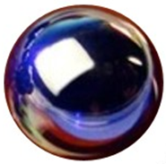
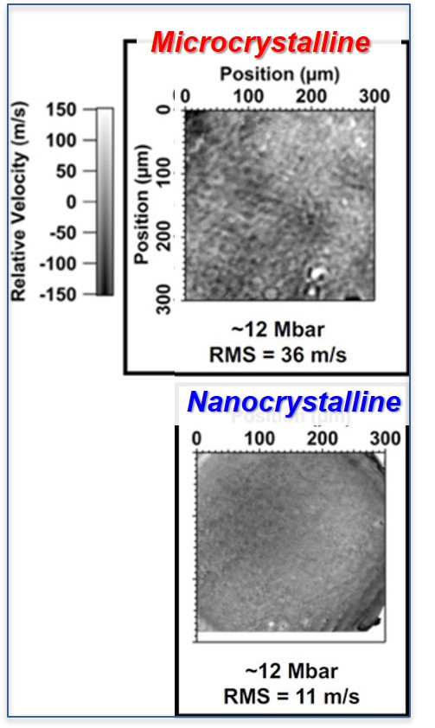
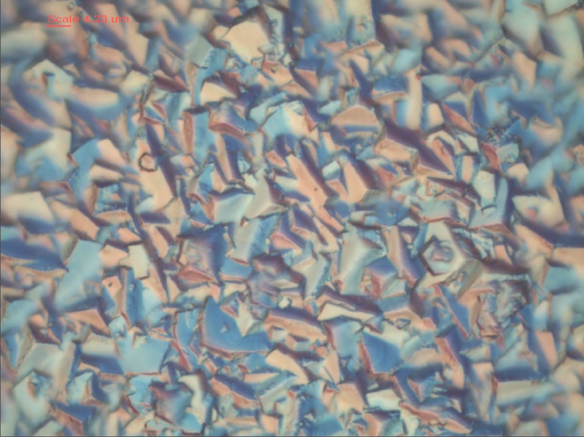
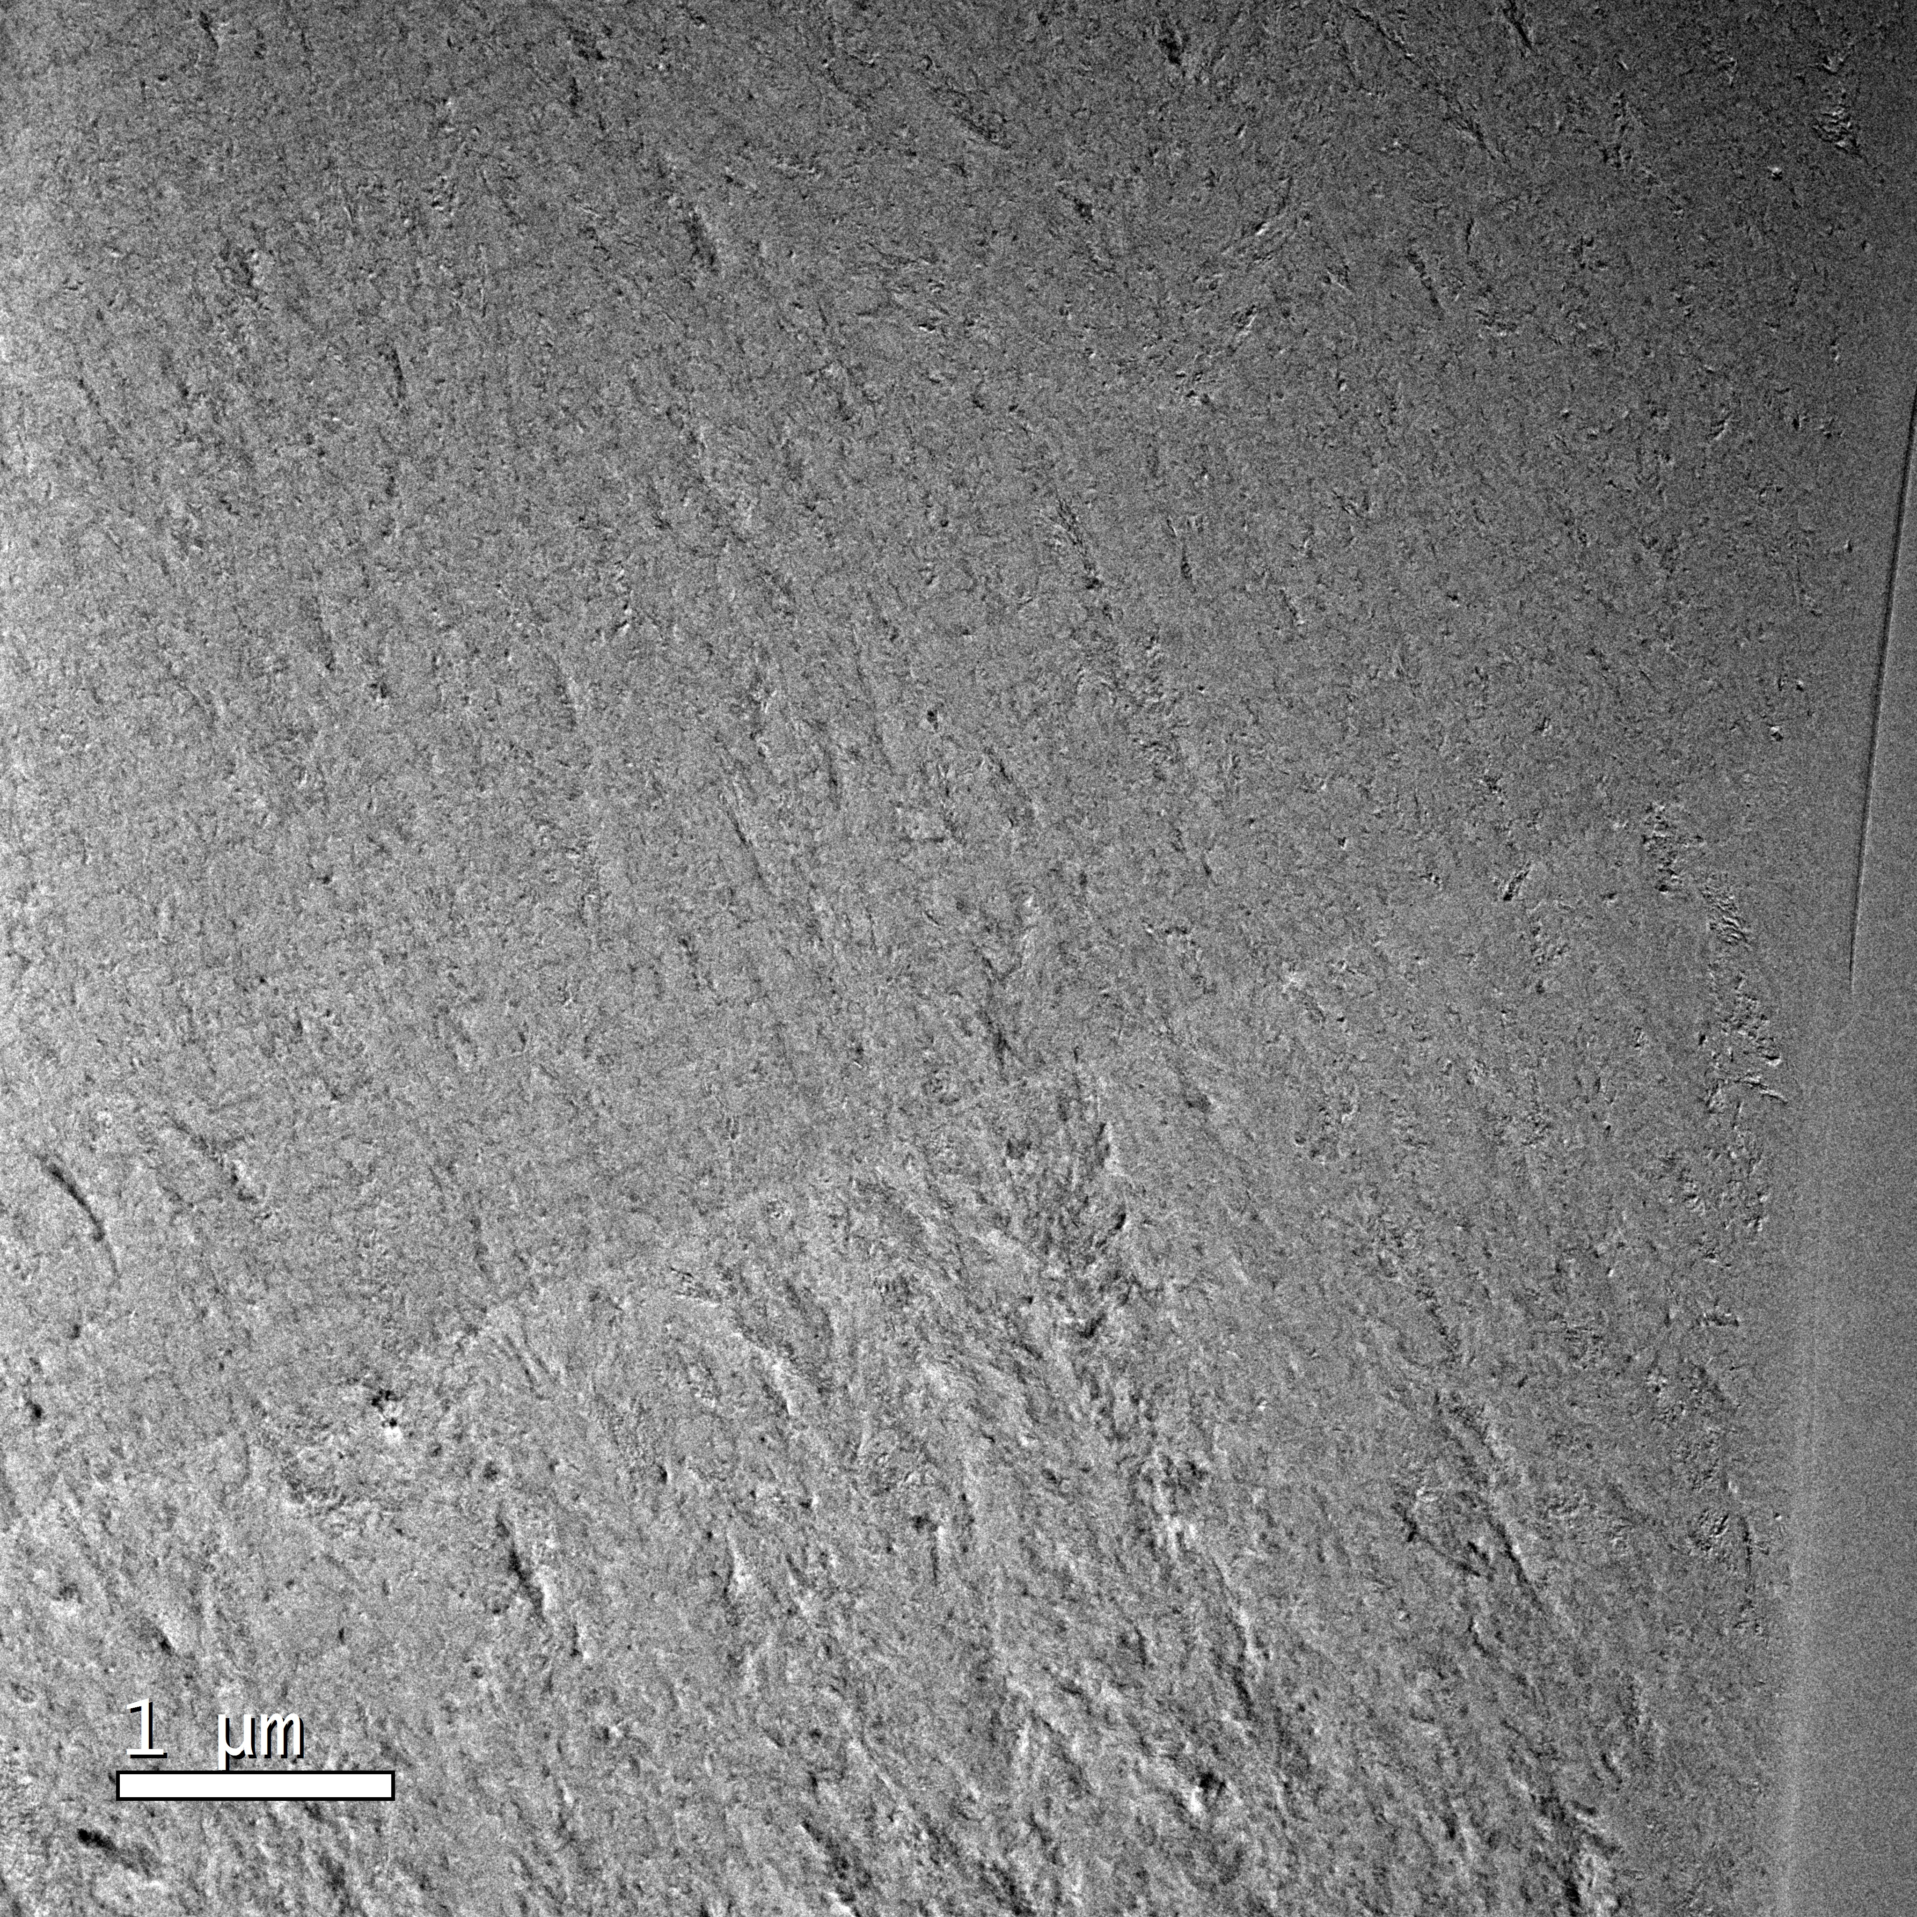
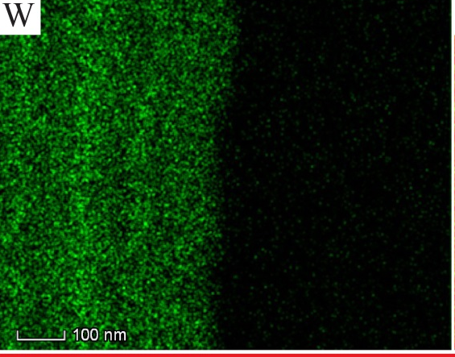
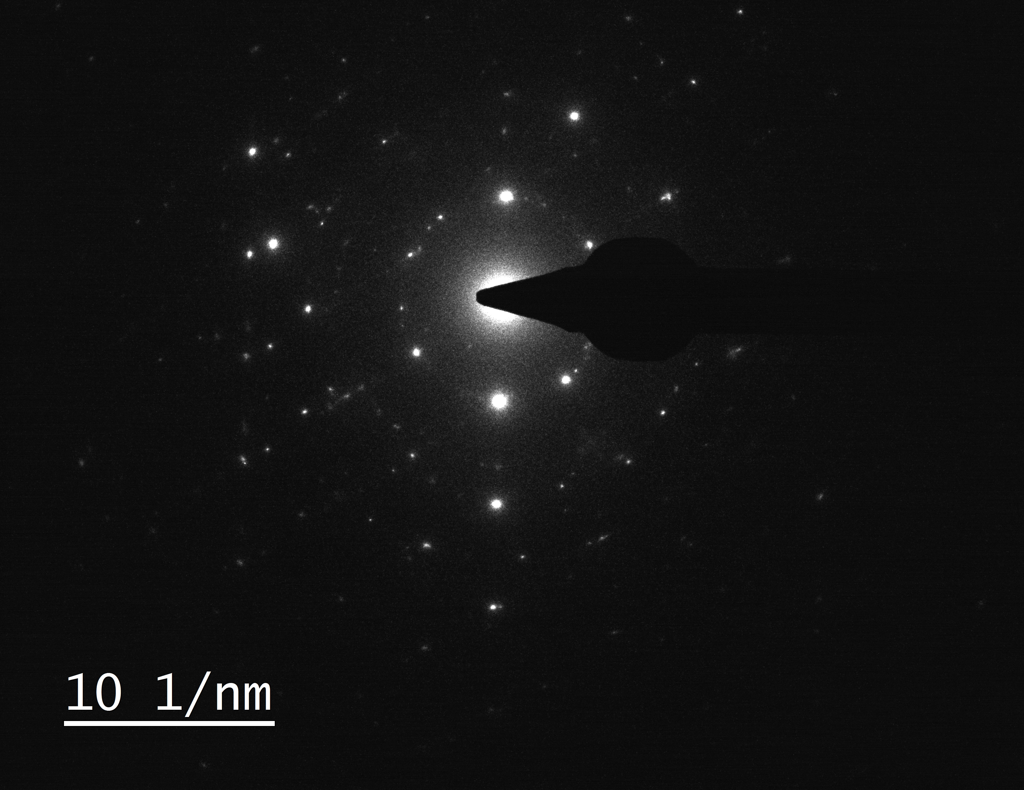
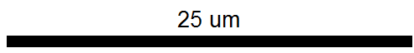
HDC capsules with nanocrystalline (NCD) structure were produced recently and shot on NIF for the first time
Despite being in production, HDC shells still require substantial R&D to reach maturity
Flats
Shells
Velocity from planar HDC with different grain sizes
Previous shells were micro-crystalline with columnar morphology
New void-free NCD shells: reproducible growth & dopant levels
As grown surface
Further refinement of grain size
KC463
W-doped NCD
10um
Lateral grain size 2-5 µm
Undoped NCD
interface
EBSD grain orientation map
SAD
150 nm aperture
Growth direction
Work by J. Biener & M. Stadermann in collaboration with Diamond Materials & GA
KC247

Slide 6
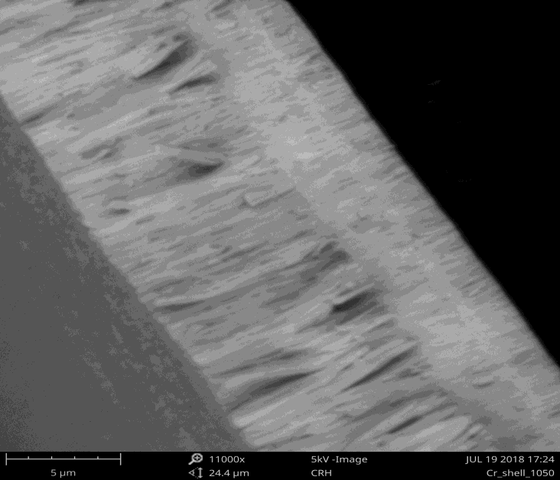
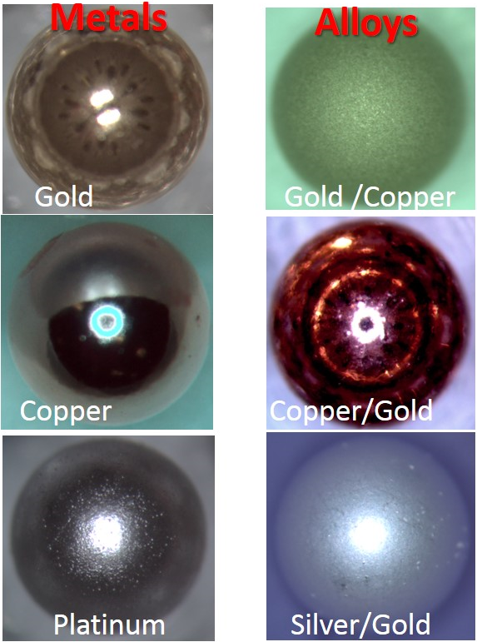
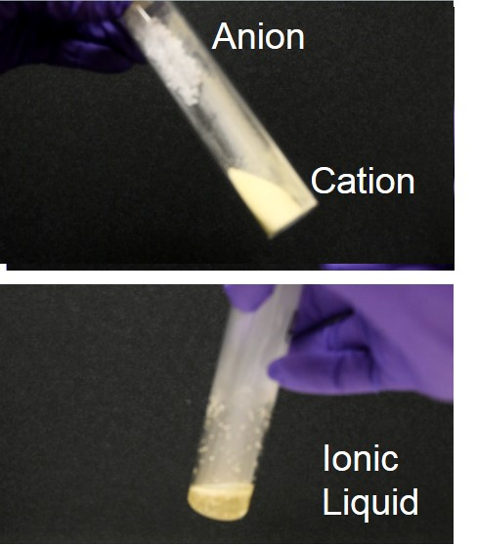
We are developing new methods for making hollow spheres through deposition of thick, dense, leak-tight metal coatings with low stress
Electrochemistry
Sputtering
Interesting possibilities of making new pure & alloyed metal shells through both aqueous & ionic liquid electroplating
Cr shell made with HiPIMS, an emerging technique for controlled microstructure
E’plated metal & metal alloy shells
Ionic liquids expand possibilities
DCMS
HiPIMS
Engwall, Tues 1:50pm
Peters, Thurs 9:10pm
Horwood, Thurs 9:30pm
Also Kucheyev, Wed 2:30pm on superconducting coatings
Developing reliable fabrication of target-quality shells generally takes many years of sustained effort

Slide 7
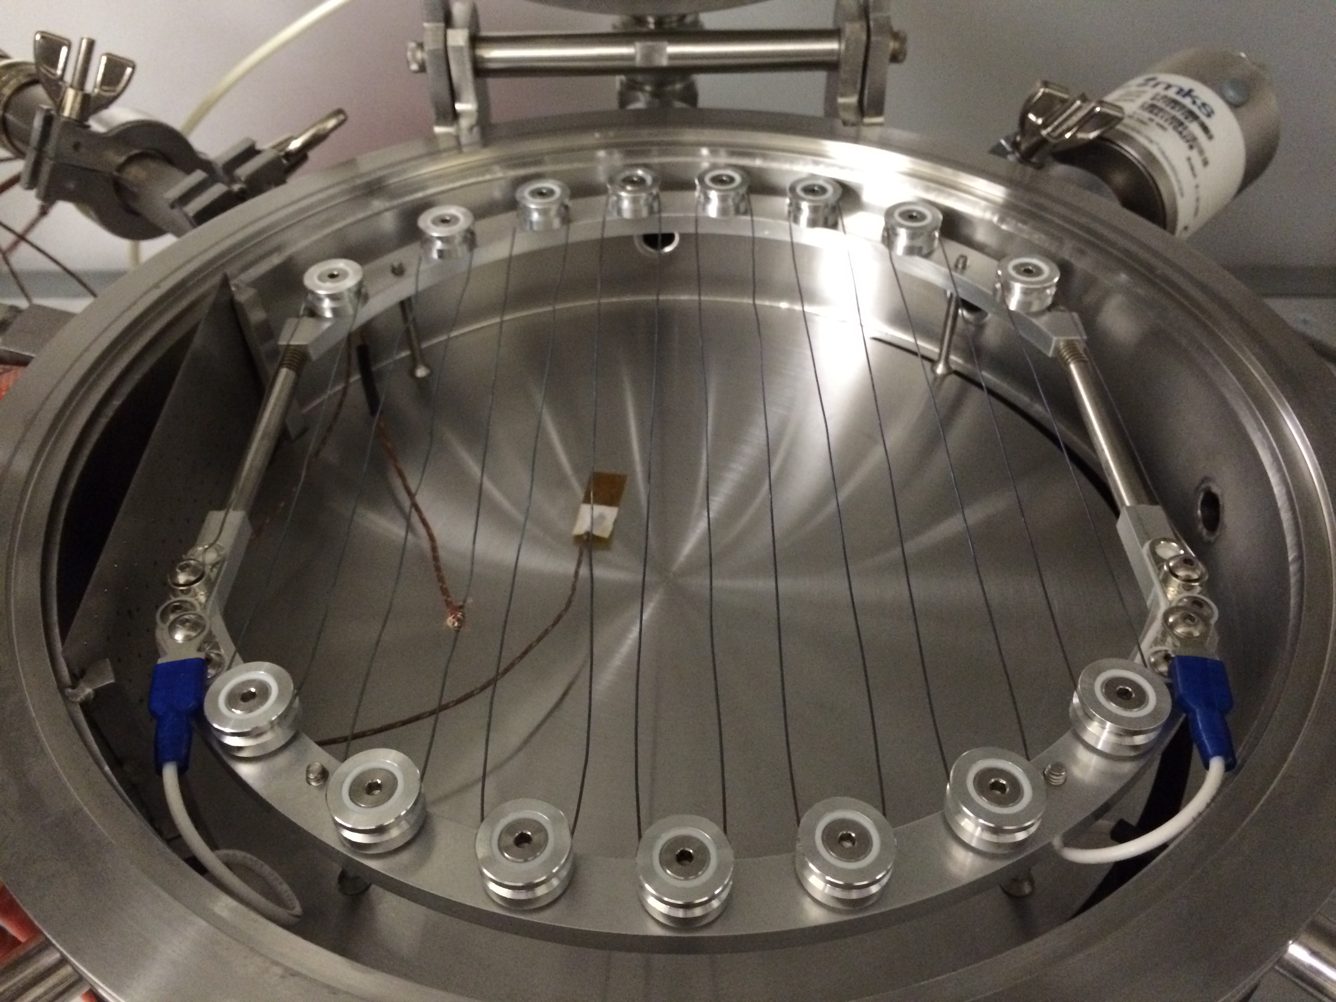
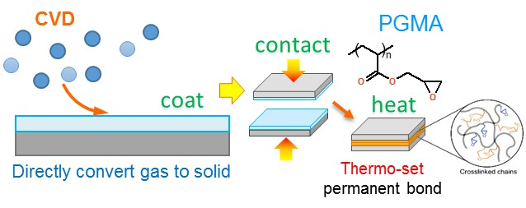
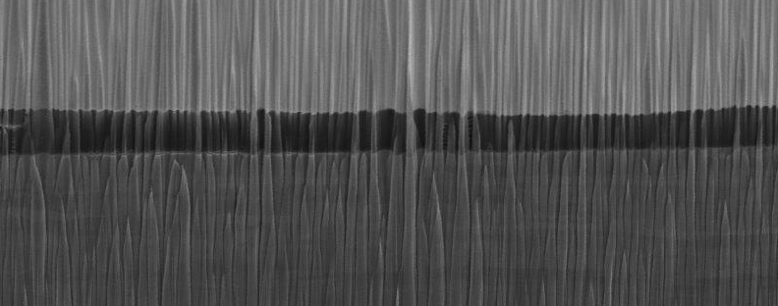
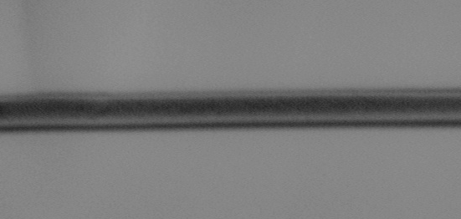
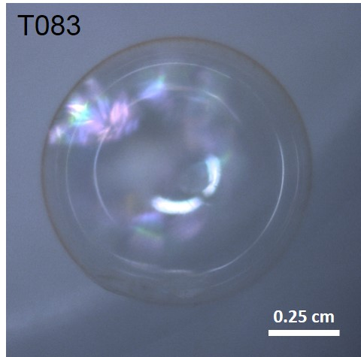
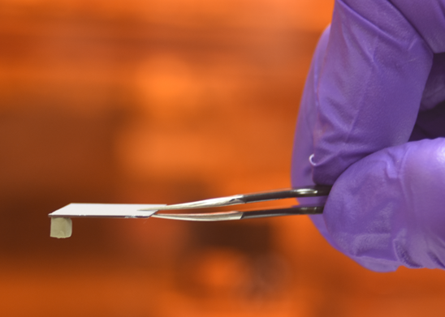
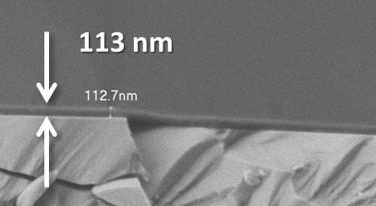
Beyond the demonstration of transparent capsules, iCVD is being used for exploring nano-bonding
Transparent plastic shell 1 mm dia made using iCVD
Epoxy type polymers with low Tg deposited via iCVD for thin bondlines
Pb
Ultrathin solid adhesive
V
Foil or foam
5 μm
SiC
384 nm
SiC
Thin Solid Films 635, 2017, 37-41
Work by X. Lepro-Chavez, S. Baxamusa et al

Slide 8
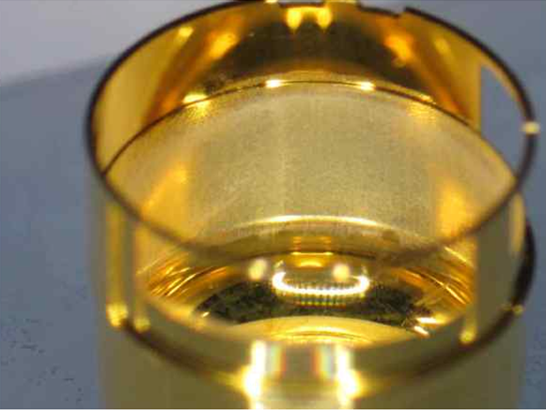
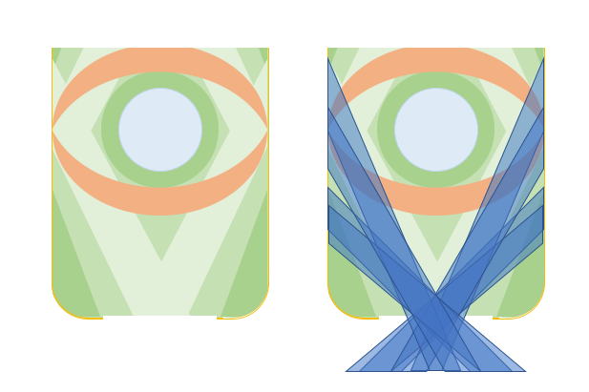
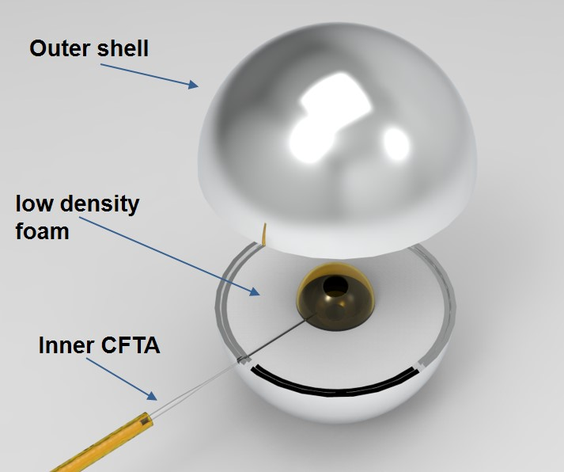
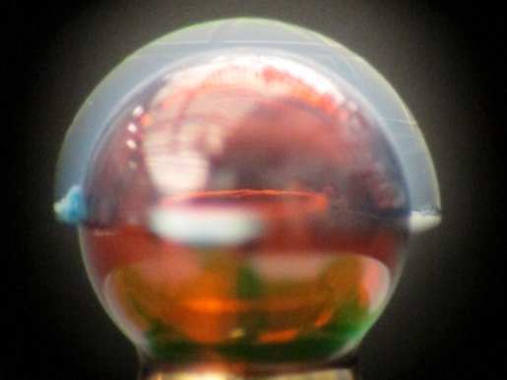
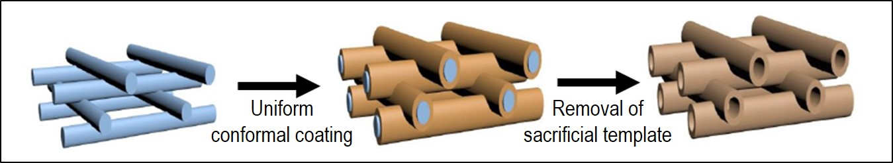
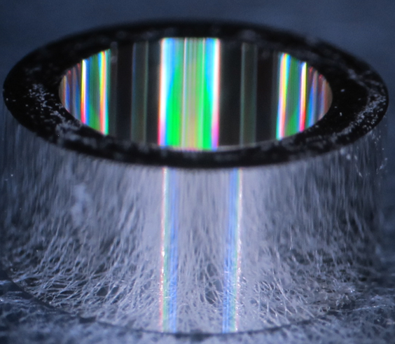
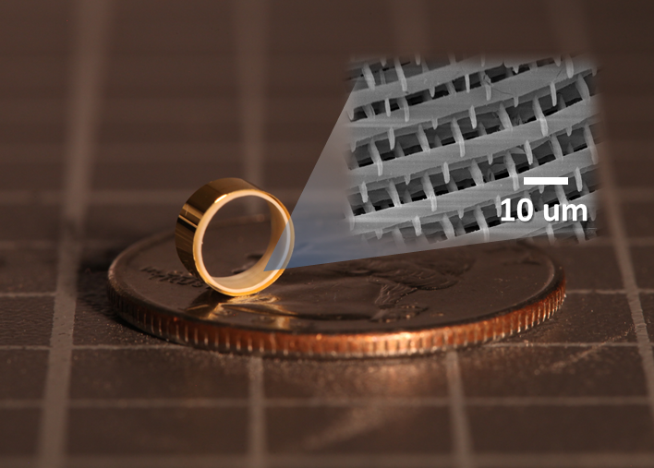
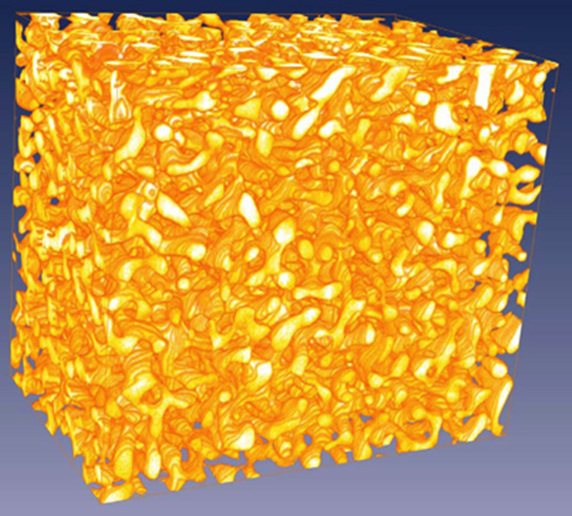
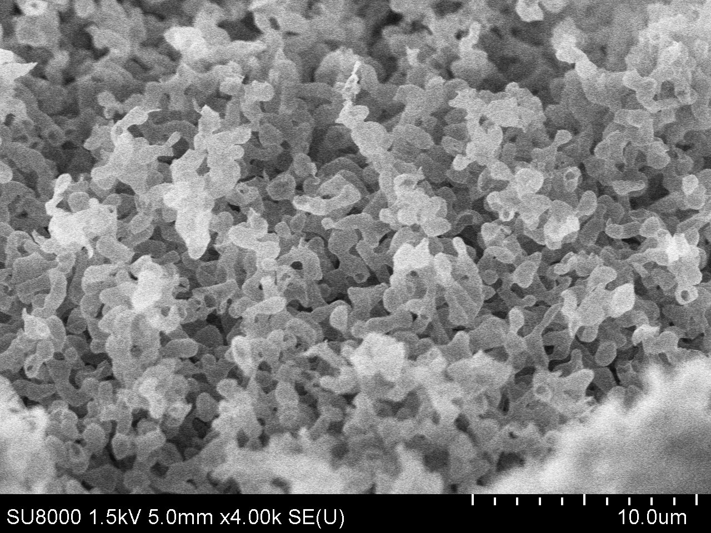
There are wide-ranging applications of ultra-low density foams in targets and we have a broad portfolio of new templating (& nanowire freeze-extract) methods to make a variety of shapes
Specialized foam-lined hohlraums
Advanced
hohlraum design
Foam shells for interfacing with capsules
hohlraum
capsule
foams of different density
Low density foams using 2PP writing yield unique microstructures and designer shapes
Foams fabricated using nano-porous Au as a template
Work by M. Biener
Oakdale, Wed 1:30pm
27mg/cc tantala
Also Fears, Thurs 3:10pm on nanowire foams

Slide 9
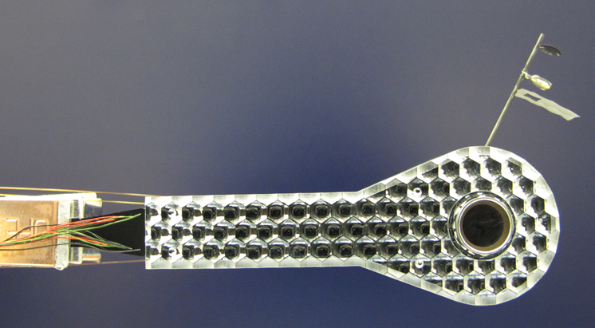
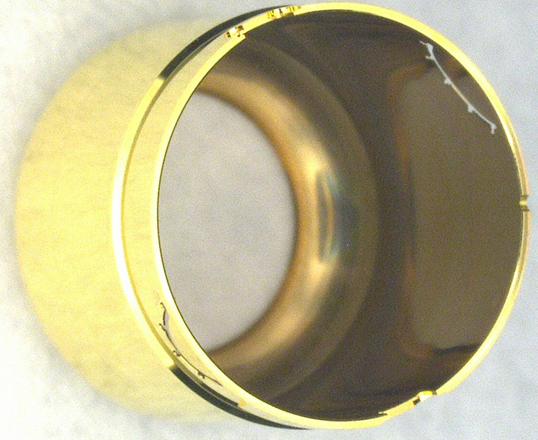
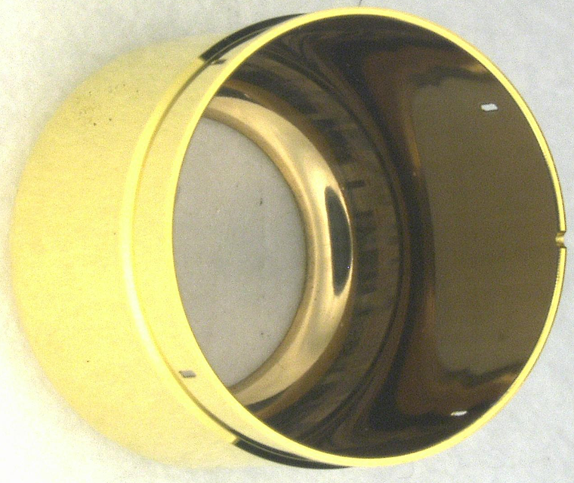
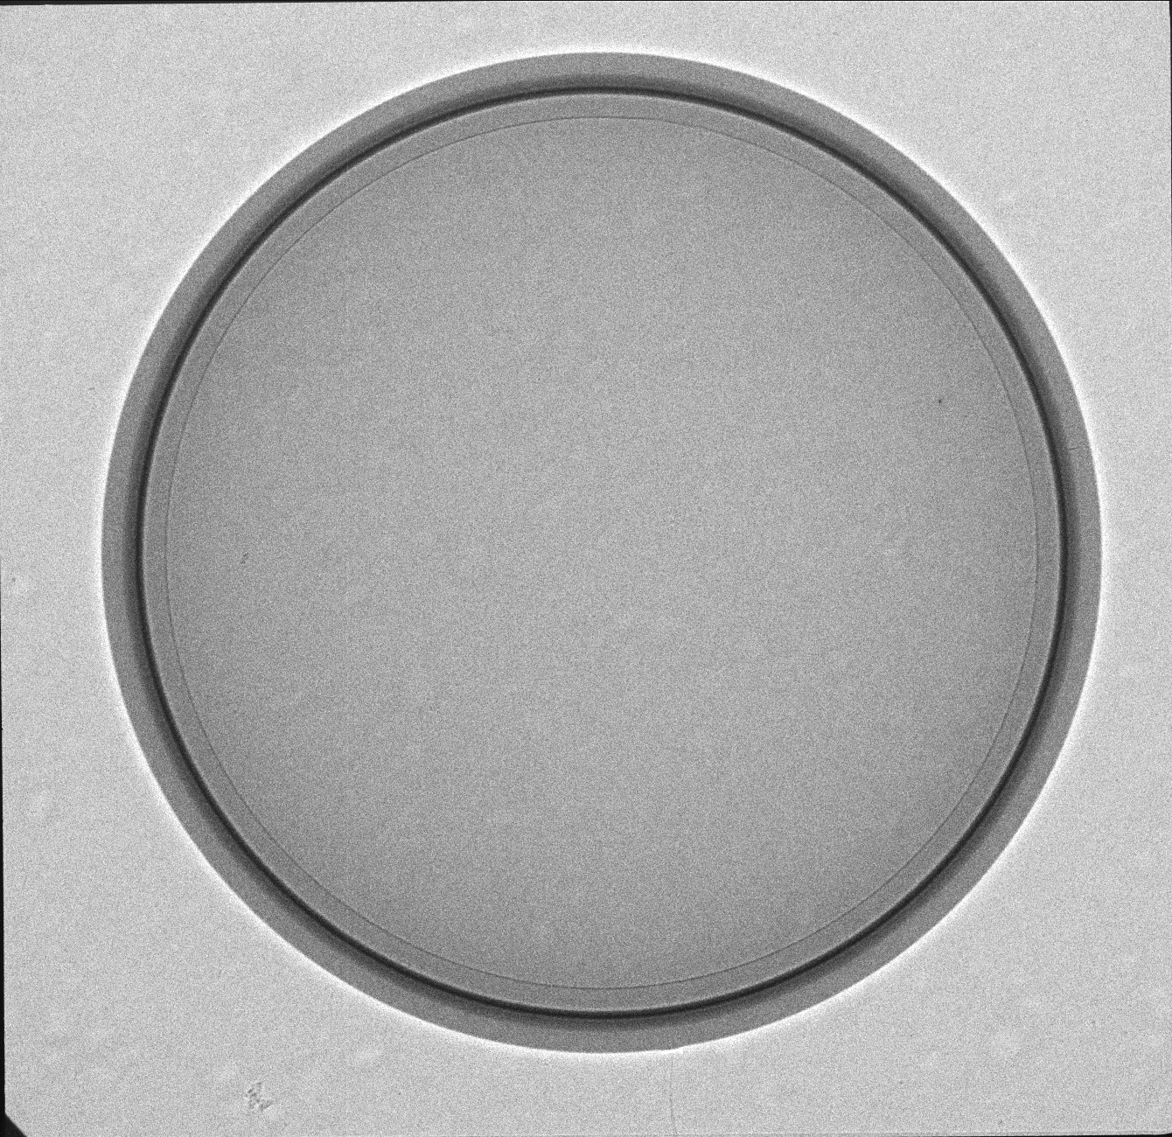
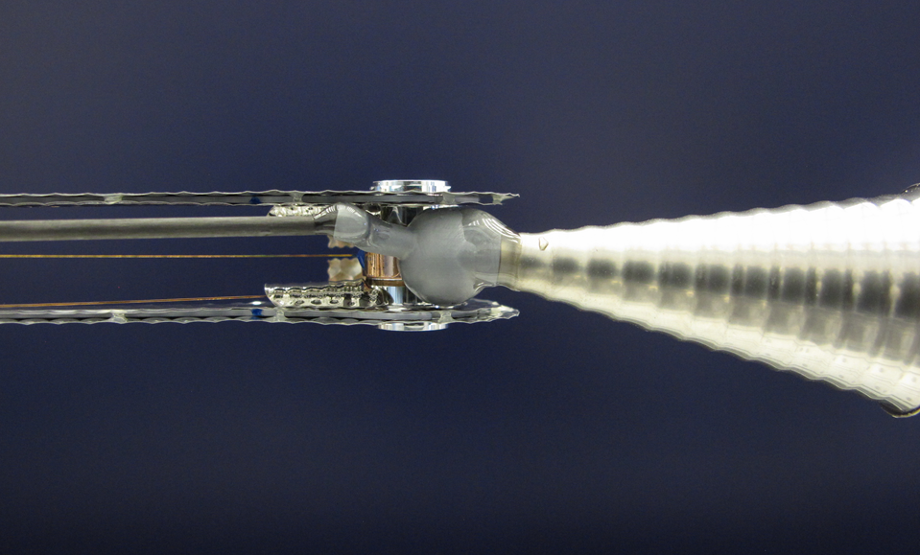
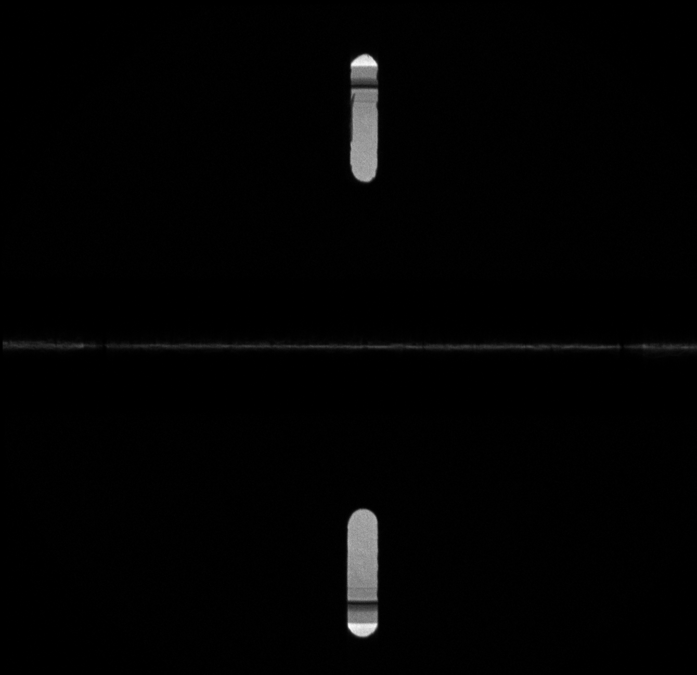
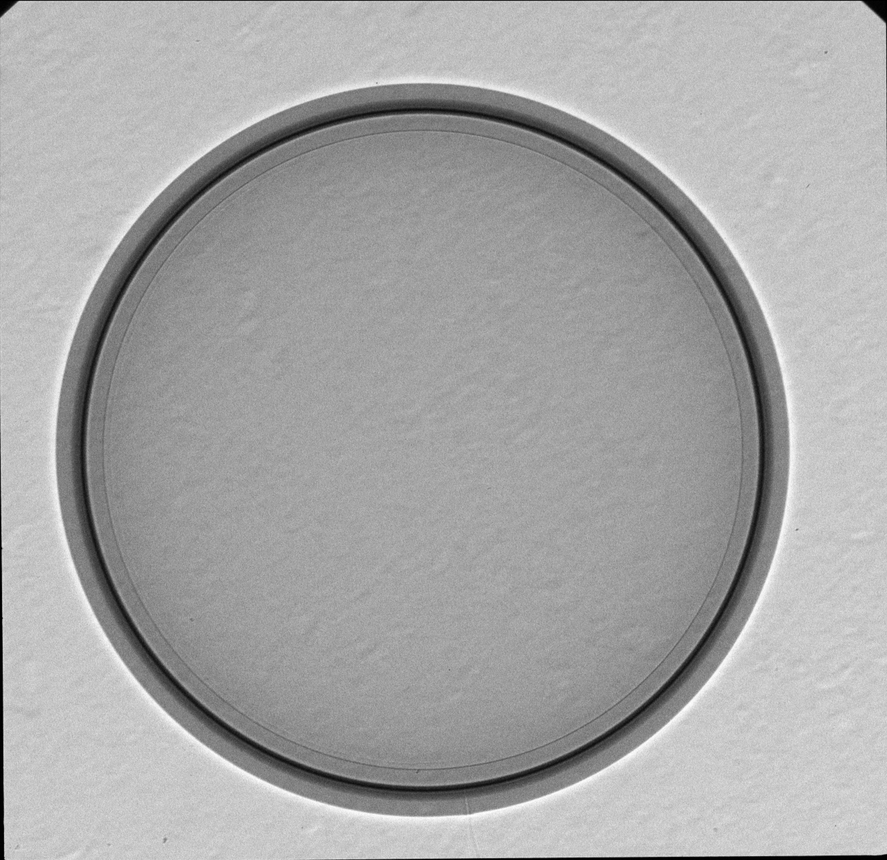
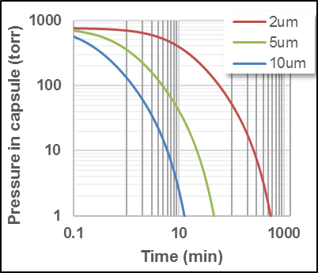
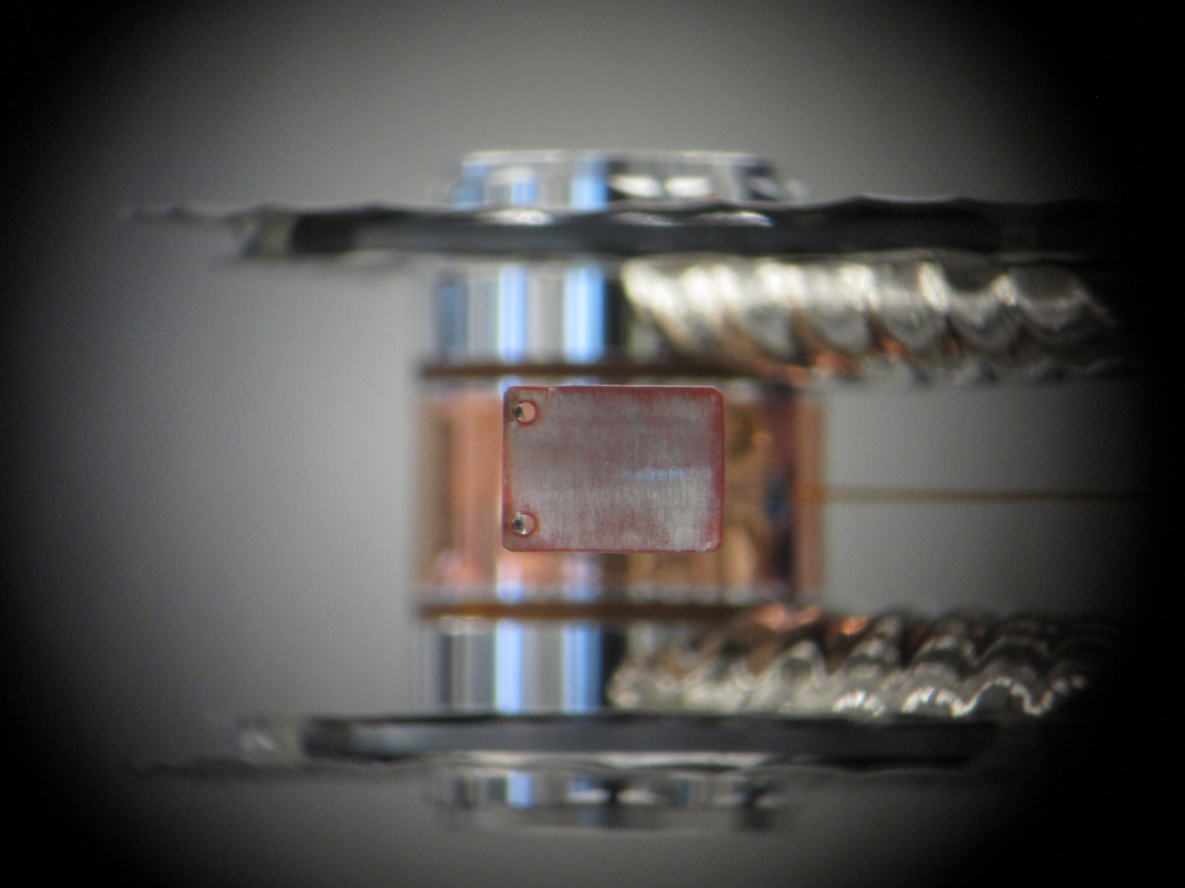
Cryogenic ice team has been instrumental in enabling and sustaining a layered shot per week
Layered shot rate has been near double over the past 2 years despite more non-standard targets
HT layers in targets for new imaging approaches
‘Fang’ target with a minimal side-view (no starburst arc)
Fielding a target with 2um required careful gas handling procedures (pump-purge, etc)
RRI (refraction enhanced imaging)
Compton Radiography
Kroll, Thurs 2:30pm
2um FT
CBI (crystal backlit imaging)

Slide 10





S&T team has been expanding our capabilities for making high quality layers at a range of ice thicknesses with good modal control
Cryogenic thermal conductivity
Thin DT ice layers
Measurement of cryogenic thermal impedance of the Al TMP-Si bond is key for better low modes
DT layer thickness has been recently pushed to its lower limit (<20um)
Filltube
Thinner
Thicker
Test sample for thermal impedance measurement for improving the bond performance
<20um
Work by J. Sater et al
Wray, poster

Slide 11


We continue to work on the high degree of cleanliness required for targets, both on characterization and mitigation of flaws that can potentially affect capsule implosion
We have developed an automated routine to detect and identify the spatial location of debris seen in X-ray images
We have embarked upon a systematic study of offending particles of target components
# | Location | X | Y | Area (um^2)
1 | Bottom LEH | 466.1 | 980.2 | 89.8
2 | Capsule | 250 | 929.8 | 31.4
3 | Capsule | 489.1 | 522.1 | 37.4
4 | Capsule | 746.1 | 993.1 | 41.9
5 | Capsule | 795 | 580.7 | 18.0
6 | Capsule | 274.4 | 786.4 | 19.5
Braun, Fri 9:30am
Walters, Wed 11:00 am

Slide 12



When needed, we leverage LLNL site-wide capabilities as well as advocate for their continued upgrade & expansion
Ion beam analysis is critical for specific characterization
New Plasma-FIB will greatly increase capability & throughput for microsculpting of capsules & foams
Helios G4 P-FIB CXe
µm-scale holes in TATB
Multiple ion source
4-8x faster milling
Low damage
High resolution
10 nm FIB
1 nm SEM
Shin, Thurs 11:40am

Slide 13

Targets S&T project portfolio seeks to have relevant impact on HED/ICF program while seeking to explore underlying science
Significant contributions to drive new target types for important shots
  Smaller (2um) filltubes
  Capsule microstructure improvement
  Tentless capsule suspension techniques
  New hohlraum designs
  Design-specific fuel-ice, both composition and thickness
  New HED physics packages
Long-term efforts on metal shells, unique foams, growing options for ablator & hohlraum materials lay the groundwork for continued progress of the missions we support
(Kong, Thurs 9:50am ; Crippen, Thurs 1:30pm)
(Lepro Wed 2:10pm, Schiaffino Wed 2:50pm, Aracne-Ruddle, poster)

