Slide 1
Overview of Target Production Planning Efforts for the National Ignition Facility (NIF)
April, 2019
B. Butlin ¹, A. Nikroo ¹, C. Choate ¹, P. Di Nicola ¹, K. Bigelow ³, J. Jensen ², K. Youngblood ²
¹Lawrence Livermore National Laboratory, ²General Atomics, ³Gryphon Schafer
Notes:
It takes a great Production Management team to run NIF target production and the names listed here are all key contributors to this effort

Slide 2
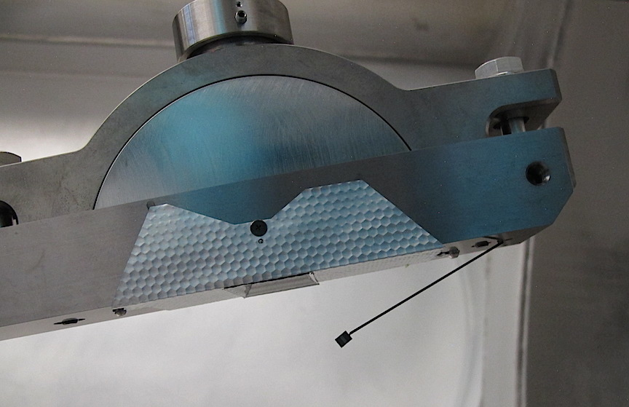
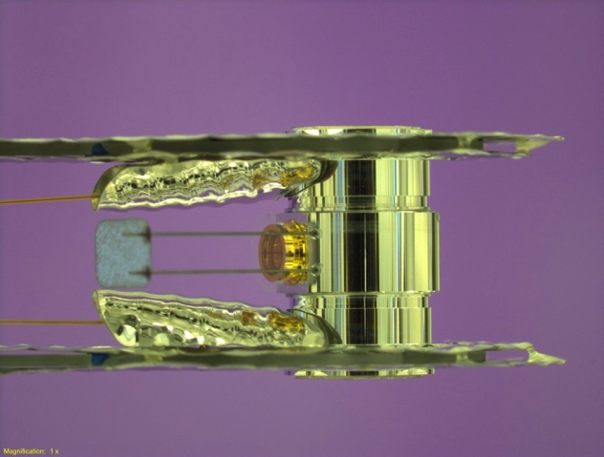
Target Fab team at LLNL designs and builds nearly 500 NIF targets per year, in addition to Omega targets
Warm simple targets (B298)
Omega ~ 900
NIF ~ 460
Z ~ 20-30
Warm complex targets (B381W/B321)
Cryo targets (B381)
NIF targets are broken up into 3 categories
This presentation will focus on the production planning efforts for the NIF targets.
Notes:
Recognize from Abbas’s presentation…but it was important for me to include, because while I’ll be focusing on the NIF target planning efforts, it is important to notes that this is in addition to the planning efforts for Omega targets and in some cases resources are shared and resource bottlenecks occur. The technique required to build the targets is different as well as the requirements, ie Cleanroom – assy line.
Not shown: LANL (35) and AWE (3) – do work to support these
Omega: 858, NIF Warm: 255 NIF Cryo:195
90% of our effort – NIF targets

Slide 3
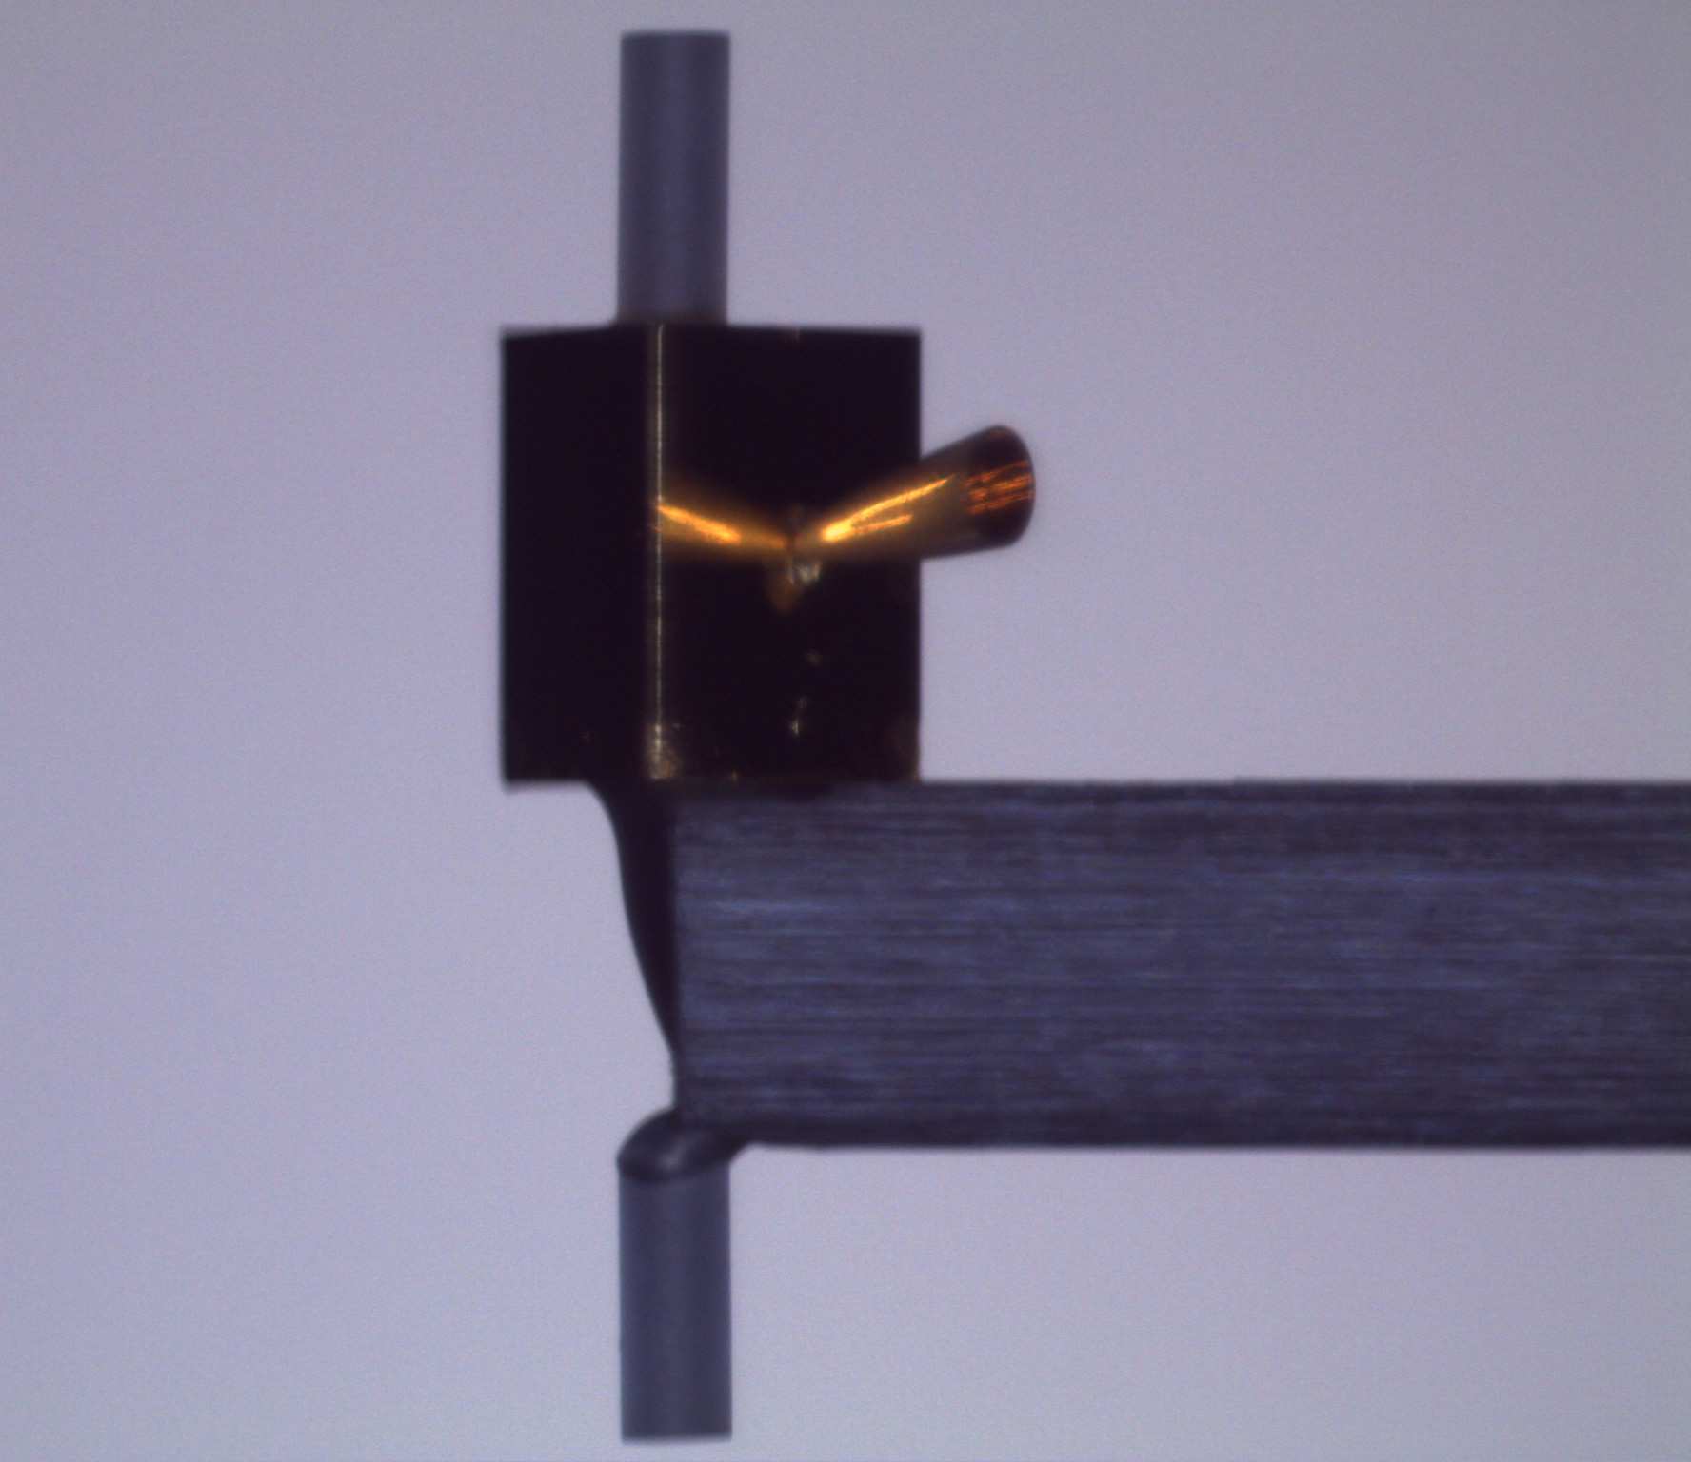
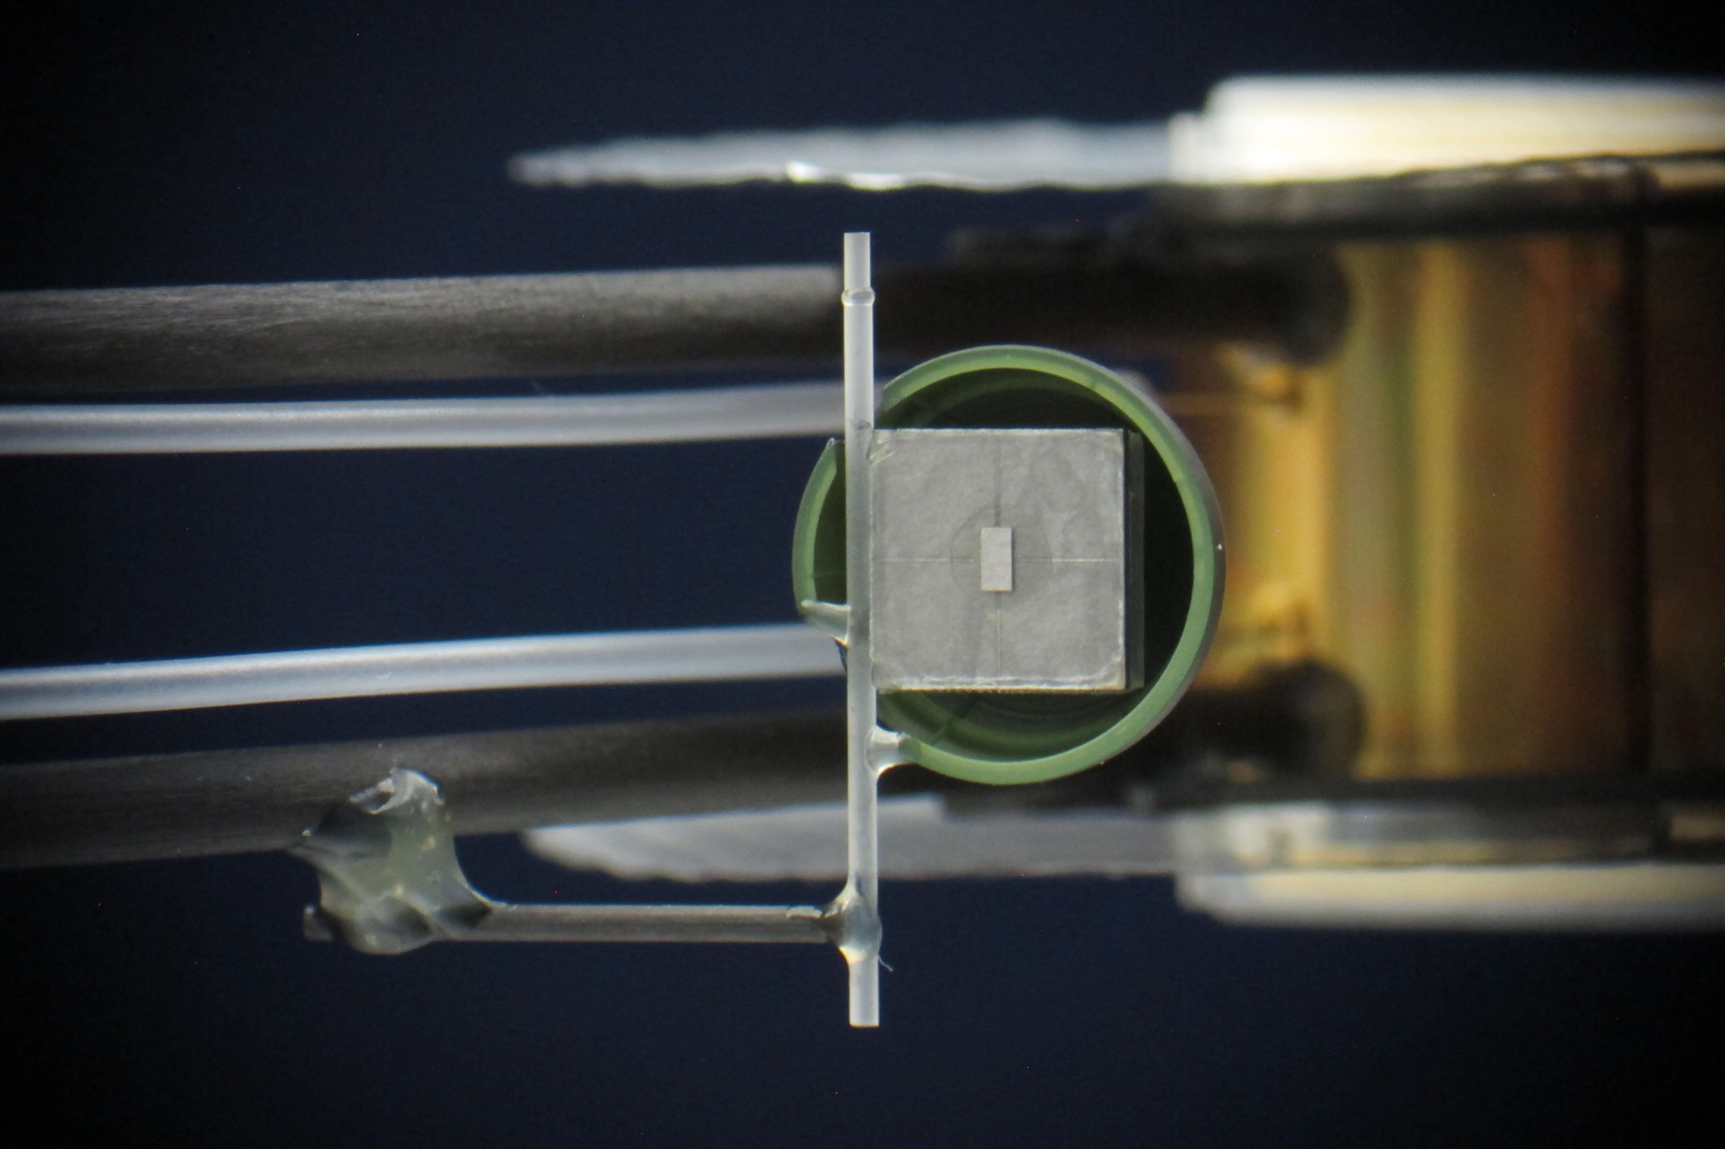
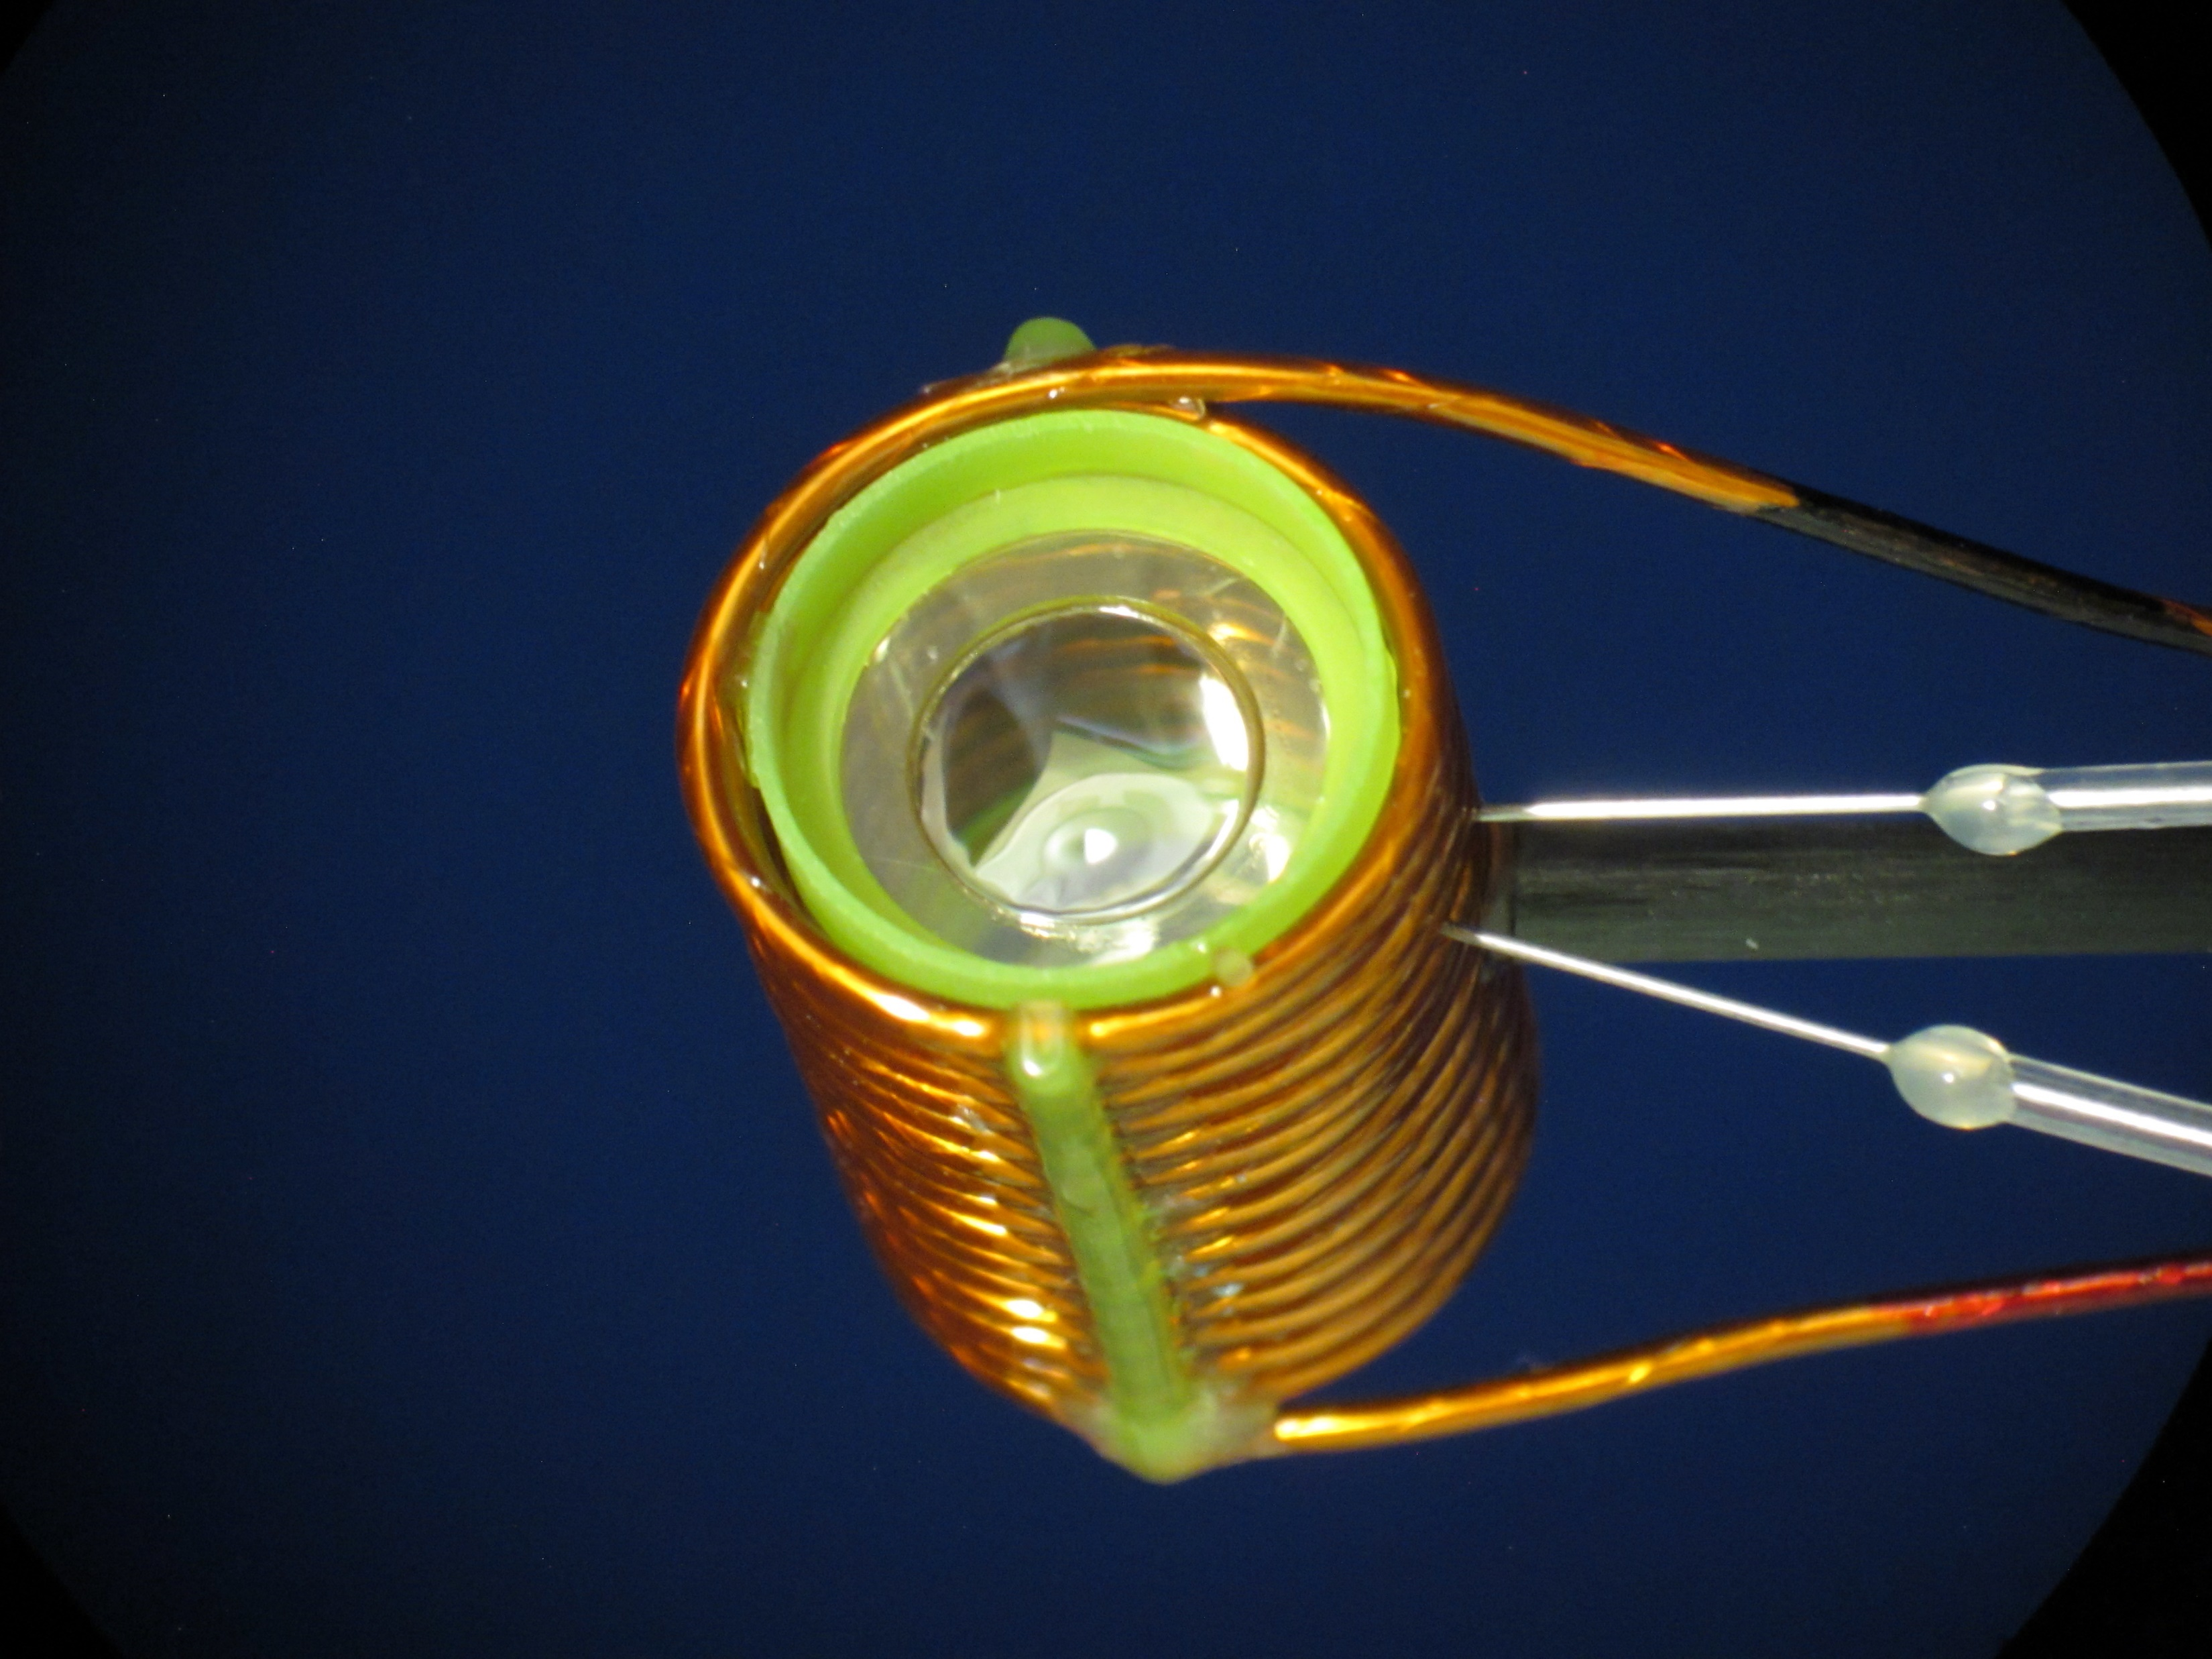
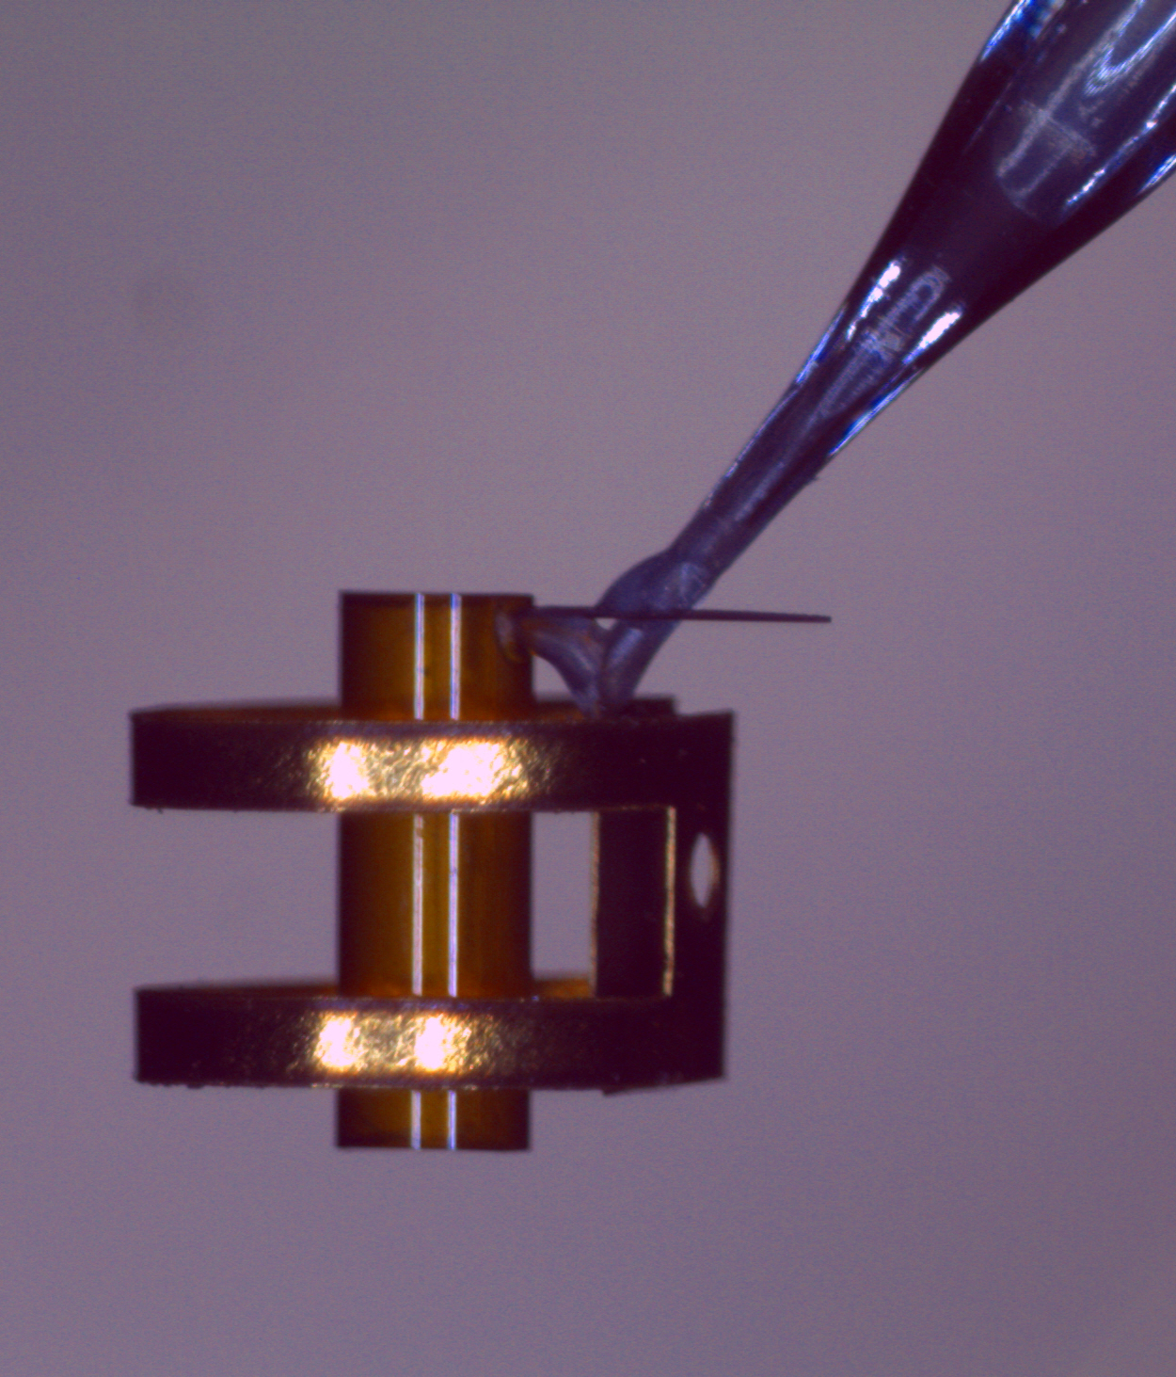
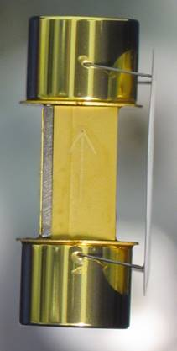
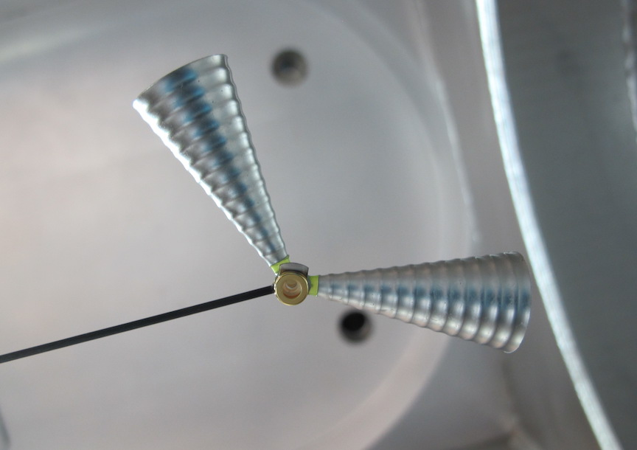
We build a large variety of target platforms each year and the complexity continues to increase
Each target platform requires different assembly steps, tooling, training, and procedures.
Notes:
2:20

Slide 4
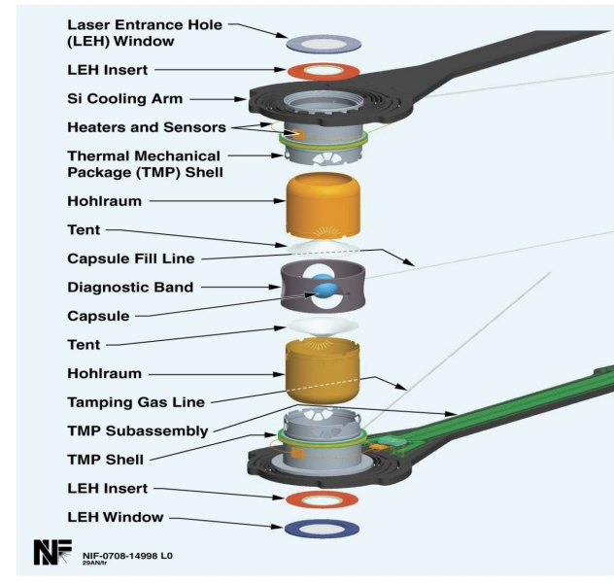
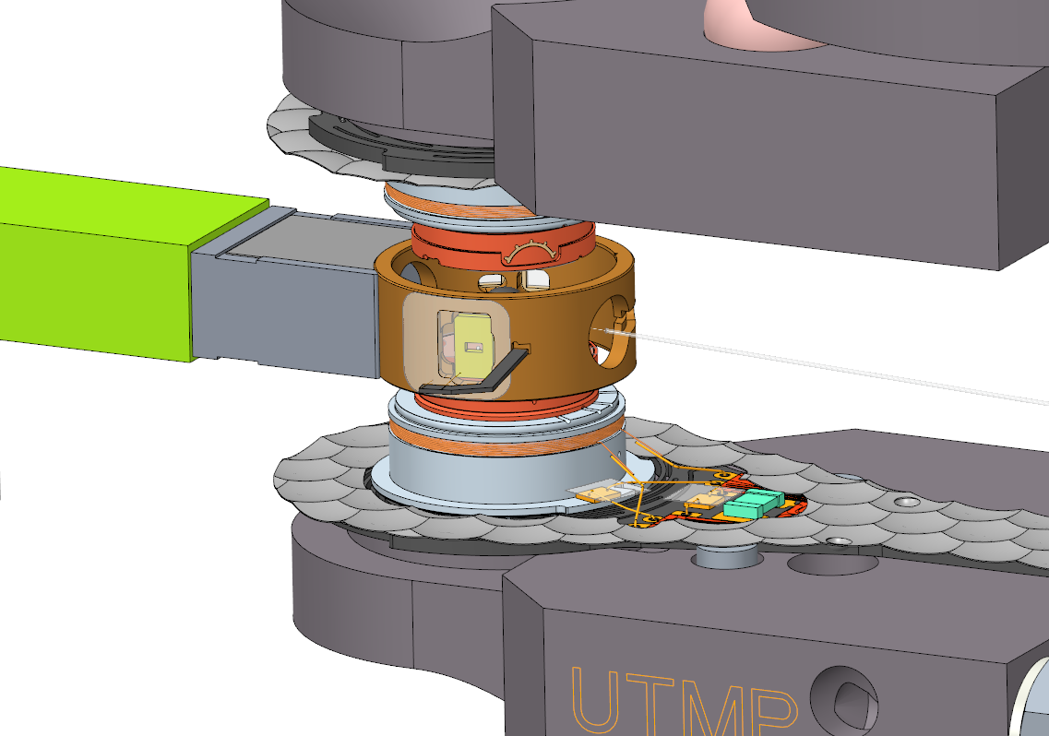
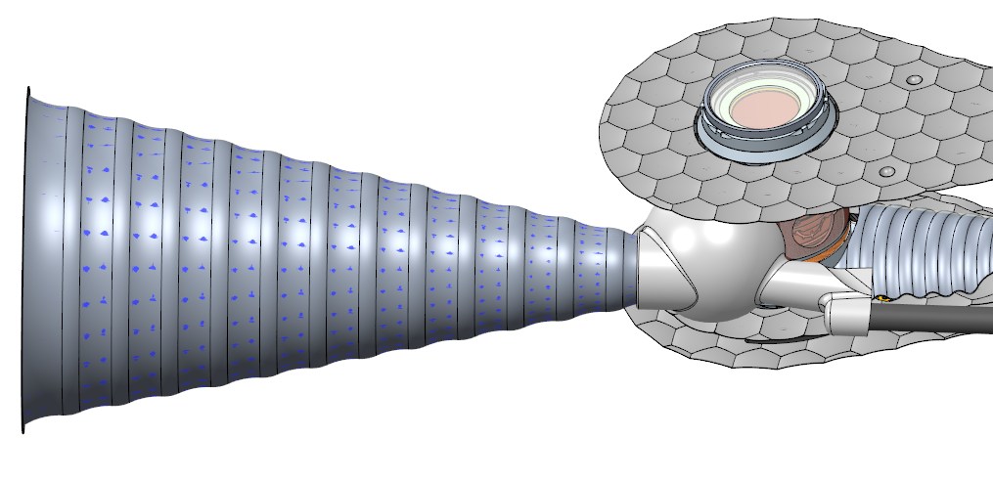
NIF targets are complex and have to be assembled and metrologized with extreme precision
Basic Cryogenic Target platform
Most targets require additional components
Luxel/GA
GA
LLNL
GA
GA
GA
LLNL
GA
GA
GA
GA
GA
GA
GA
Luxel/GA
NIF targets often consist of 50 – 100 components
Notes:
Multiple positioners, but only one used per shot -> everything on one target and alignment and metrology becomes even more import at the target level
Components from GA and Luxel

Slide 5
With the variety and complexity of targets coming through the production line in parallel, target assembly could easily look like this.
Without proper planning and evaluation, target assembly would be slow and frustrating.
Notes:
Our traffic jam is a bunch of porches, fararis, land rovers… each unique
Over 10,000 parts / year – standardize where we can, but many unique – good component management is important
R&D efforts also merge into our production line
Frustration! See this enough during our commute, certainly don’t want to see this on the production floor.

Slide 6
Ideally, an assembly line is streamlined and product flows quickly through the line
This is not realistic for target production.
Notes:
How many of you have taken a target design through assembly?
4:20

Slide 7
Target assembly looks more like this, with many different paths a target can take, and twists and turns along the way
Strategic planning and continual monitoring is required to keep production running smoothly.
Notes:
Each target platform requires a different path – 10-20 targets being assembled in parallel.
Twists and turns come from last minute changes from the physicists.
Free flowing
Targets of varying type are assembled in parallel. In series would be much easier, but we would not be able to keep up with the NIF demand.

Slide 8
Assembly planning efforts start at a high level, over 6 months before target assembly begins by looking at the target demand data
Capacity calculations and past build metrics help us determine if we can make the planned targets
Tooling and equipment needs are evaluated
As the demand between factories changes, assembler training is evaluated and training plans are put in place
Cryo Warm-Complex Warm-Simple
Tracking assembler qualifications and creating new training plans is important at this planning phase.
Notes:
Cross training between factories became very important at the end of FY18 – we would not have met the FY19Q1Q2 demand, without cross training.
20 assemblers between multiple factories, ~55 target types or independent process steps. On average, each person is trained in ~4-5 of these targets/steps
In addition to the demand shown: another 10% for R&D, other additional requests, and the LANL and AWE targets that we support
FASC: Facility Advisory Steering Committee

Slide 9
About a month before the target assembly start date, we begin detailed assembly plans and reviews based on a graded approach
EXACT Duplicate?
No review
Processes Defined
Hash
Friday, 9:10
Target Request
Yes
~55%
Verification list
Drawings
Metrology plans
Data/Specs
Assembly guides for deviations from standard procedures
Components available
No
Similar
Review deltas
Adjust as needed
Yes
~40%
~5%
No
Approval to begin assembly
Full Review
Verify all info available for build
Full review -> Assembly Review (ARC):
Formalization of assembly plan
Layout of assembly steps in the order they must be performed
Identification of new tooling and/or procedures
Includes any special instructions
Lessons Learned are collected and fed back into the planning process
Notes:
Have to go through this for each target. If we din’t, we would easily end up in the traffic jam I showed earlier.
~1/2 targets are new articles. Have to be methodical, yet efficient through this process.
LL: Don’t repeat mistakes. In affect, we are doing an ISO 9001
8:00

Slide 10
In addition to proper planning, continual monitoring of production is critical to keep target assembly thriving
We do this through the collection and evaluation of metrics and through feedback from the assembly team
We collect metrics that help us plan, evaluate our progress, and calculate our build capacity
Number of Targets assembled each month
Failed targets
Target float (shot date – target build completion date)
Assembly effort hours
We also collect metrics that help us understand issues and help us prioritize our resources
Production problems
Cross training
Cleanliness data
Safety, Security, Quality, and Efficiency (SSQ&E) observations are also performed biweekly to give us feedback (from production personnel) on areas that can be improved
Braun
Friday, 9:30
We closely track our work to maintain efficiency and quality while performing the work safely and securely.
Notes:
SSQ&E: NIF facility wide program to ensure we maintain the right balance
~10:00

Slide 11
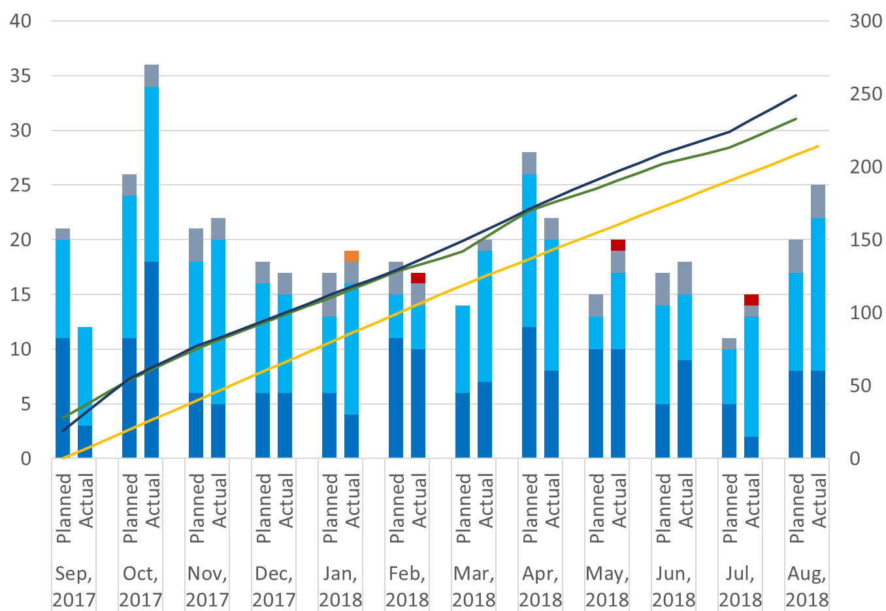
Target assemblies completed each month are tracked compared against the plan
Warm Targets Assembled for FY18 NIF Shots
Warm
NIF Warm Target Builds
Similar metrics are tracked for cryo NIF targets.
Notes:
Let me go through this plot for you.
Cum line helps us ensure we never get too close to the Demand line. If we do, we need to shift resources. 30 day offset
FY18: ended the year above plan because we pulled in FY19 shot targets. Have similar metrics for FY19, but wanted to show you a complete plot.
Prod and post prod failures are included – look at this closer on the next slide

Slide 12
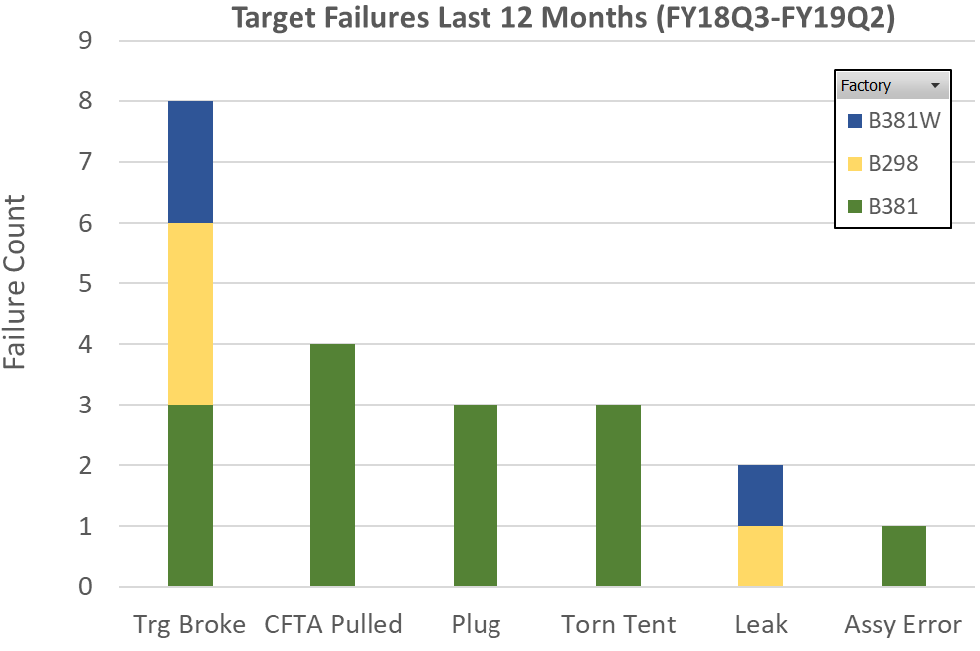
Target assembly failures are also evaluated so we know how many “contingency” targets we should put in the plan
4.5% failure rate, lowest ever at highest complexity!
These metrics also tell us where to focus our efforts to improve target yield.
Notes:
Often pushed to the limits in some of our target designs
12:00

Slide 13
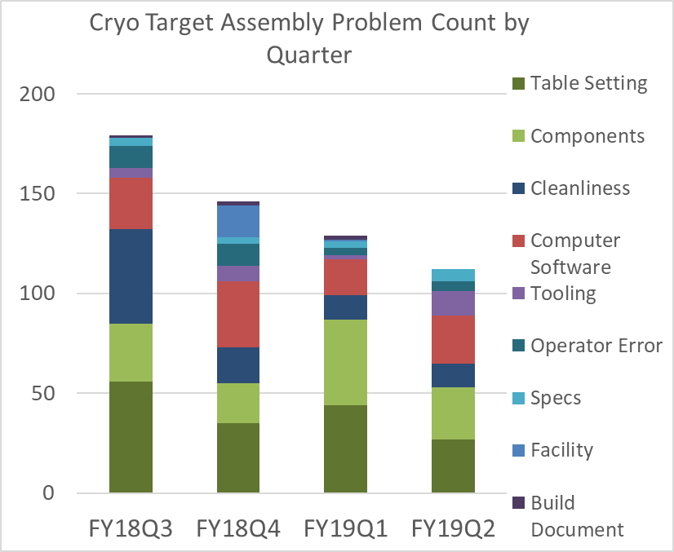
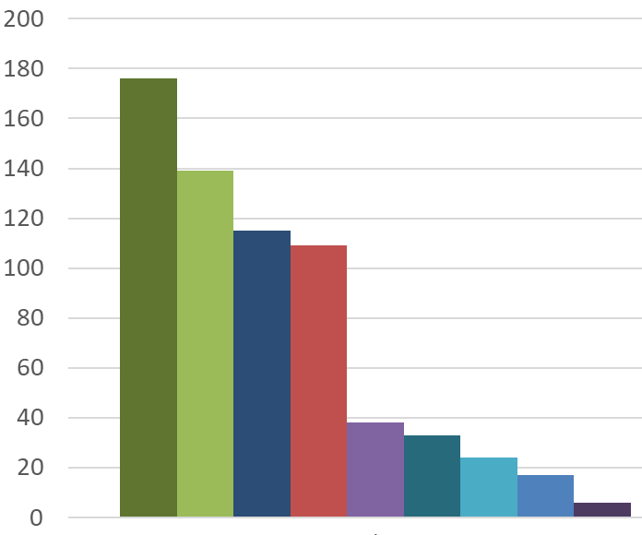
Target assembly problems are tallied so we know where to focus improvement efforts
Tally of all issues over the last 12 months
Issues encountered by quarter
Table Setting
Components
Cleanliness
Computer / Software
The number of recorded issues steadily declined and throughput increased as more focus was placed on problem reduction.
Notes:
Causes delays
Cleanliness – specifications tighter with increased DT shots
Table setting: Flow chart completed late or detail missed – most often caused when physics changes or gives us requirements late.

Slide 14
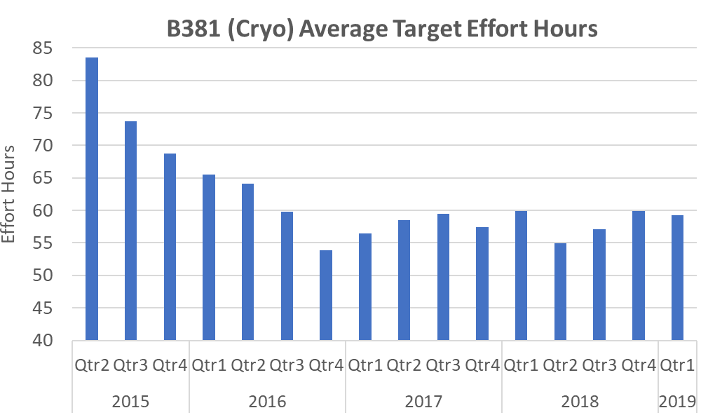
Target assembly effort hours are monitored and help us evaluate production and understand capacity
This is down from averaging ~100 hours in 2013
More DT shots
2015
2016
2017
2018
2019
Constant balancing act to maintain or increase throughput:
Process improvements, simplifications and optimized scheduling vs. increased target complexity, additional metrology requirements, and training new personnel.
Notes:
Reached an all time low at the end of 2016. Did this my removing activities with low ROI (return on Investment) and adding automation where we could. Have fluctuated sense.
Bottom line. Competes
14:30

Slide 15
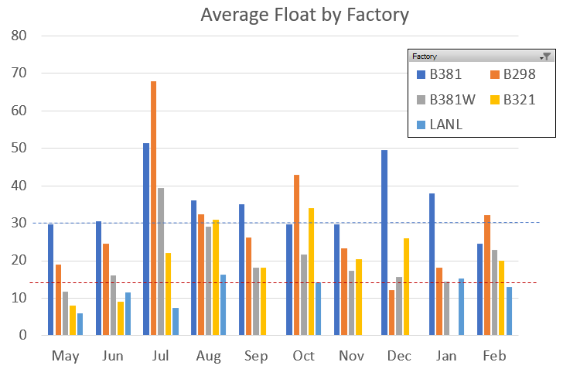
Number of days the target is completed before the shot date (Float) is also closely monitored
NIF goal is 14 days of float, but our internal Target Fab goal is 30 days
A large float gives us time to recover if a target has a problem in assembly or parts arrive late.
Notes:
Strive to have targets available as early as we can before the shot.
Few years ago ~40% of our targets were below the 14days.
If our float is consistently low or is trending down we look at what changes need to be made to get it back up to where we want it to be. Low float often driven by late parts or late Requirements, often dependent on results from a previous shot
LANL – also working to meet this. Will monitor AWE in the future

Slide 16
Strategic planning and continual monitoring of production is essential for successful target production
Our production planning and evaluation tools enable us to:
Successfully deliver high quality targets to meet the NIF target demand
Reduce assembly frustrations
Launch new target platforms quickly and smoothly
Notes:
Convoluted production, but keep it running smoothly.
Driving in free flowing traffic is much more fun and enjoyable
A/R Skip summary and open to answering any questions.
16:30

