Slide 1
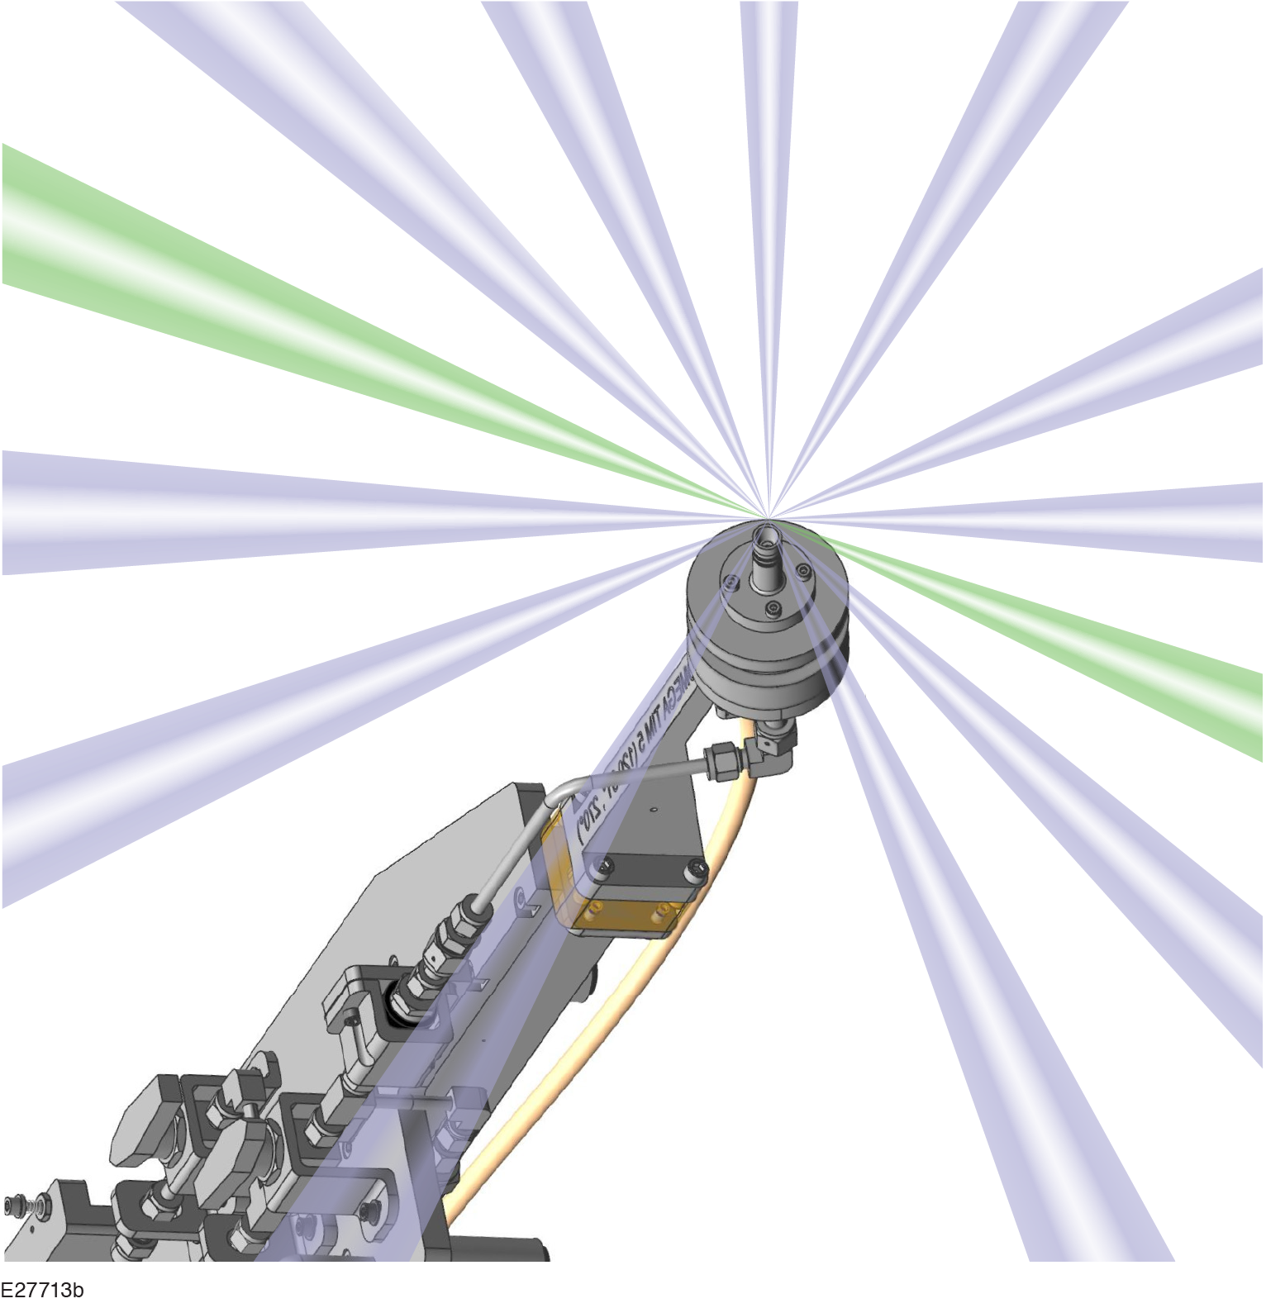
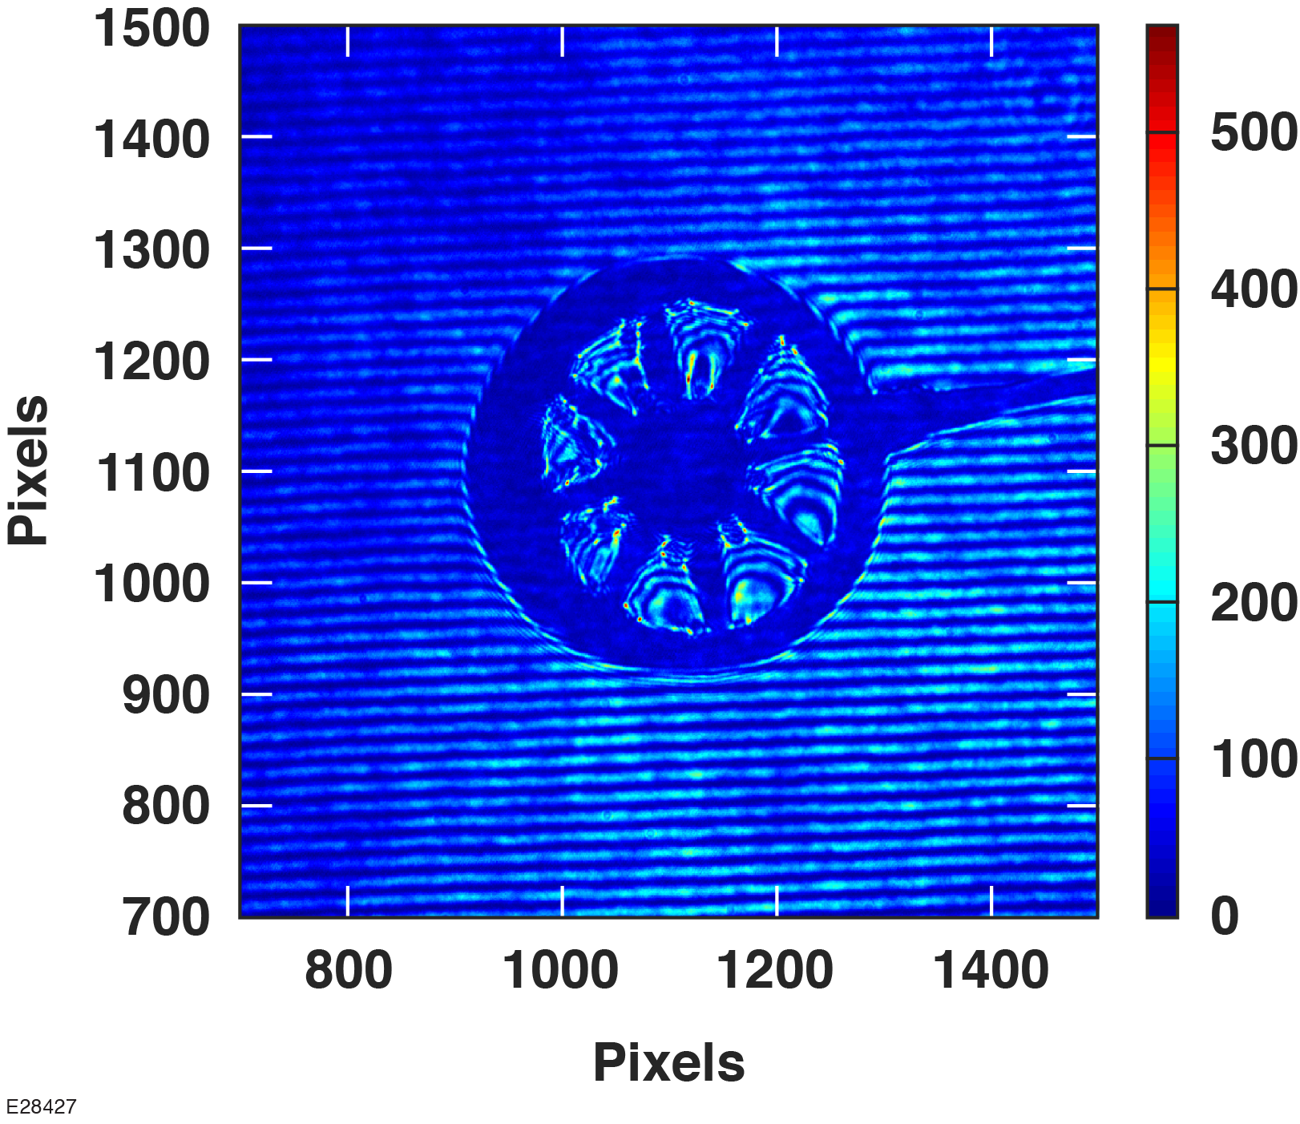
Targets for Underdense Plasma Studies at the Laboratory for Laser Energetics
J. L. Shaw
University of Rochester
Laboratory for Laser Energetics
Target Fabrication Meeting
Annapolis, MD
23–26 April 2019

Slide 2
Underdense plasma targets open new experimental capabilities on OMEGA and OMEGA EP
Laser wakefield acceleration (LWFA) is a path to develop advanced electron diffraction and x-ray radiography sources that can be coupled with large-scale inertial confinement fusion/high-energy-density laser drivers such as OMEGA or the NIF
LWFA experiments require millimeter-to-centimeter long underdense plasma targets; LLE has activated a gas-jet platform to support these and other laser–plasma interaction experiments
LWFA requires long-focal-length laser configurations; a path to do this with plasma lenses is being developed

Slide 3
D. Wasilewski, D. R. Harding, Z. Barfield, D. Haberberger, A. M. Hansen, J. Katz, D. Mastrosimone, and D. H. Froula
University of Rochester Laboratory for Laser Energetics
P. Fan and Y. Lu
University of Nebraska Lincoln
J. Campbell
Material Science Solutions
J. P. Sauppe and K. A. Flippo
Los Alamos National Laboratories

Slide 4
Why plasma accelerators?

Slide 5
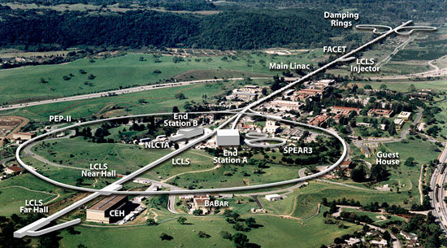
Conventional, radio-frequency accelerators are key scientific tools
SLAC

Slide 6
Conventional, radio-frequency accelerators are key scientific tools
SLAC
3 km

Slide 7
Advanced x-ray sources also rely on kilometer-scale electron accelerators
SLAC
1 km
Notes:
Talking Points:
-Recent breakthroughs: undulators in synchrotron light sources and x-FEL
-These relativistic-electron-beam-based x-ray sources boast impressive performance
-Require dedicated, kilometer-scale, permanent accelerators
-Size makes it nearly impossible to incorporate them into OMEGA, NIF, and other large-scale laser facilities that are being used for ICF/HEDS research
-Real need to demonstrate the fundamental science of new methods of x-ray generation that might lead to intense, directional x-rays beams in the 20-80 keV range in the near term and in the > 1 MeV range in the long term.

Slide 8
Can we develop a high-performing, compact electron and x-ray source?
SLAC
SLAC
Gradient: 10 to 20 MV/m

Slide 9
Can we put SLAC in your hand?
SLAC
SLAC
Gradient: 10 to 20 MV/m
Plasma
Gradient: 40+ GV/m

Slide 10
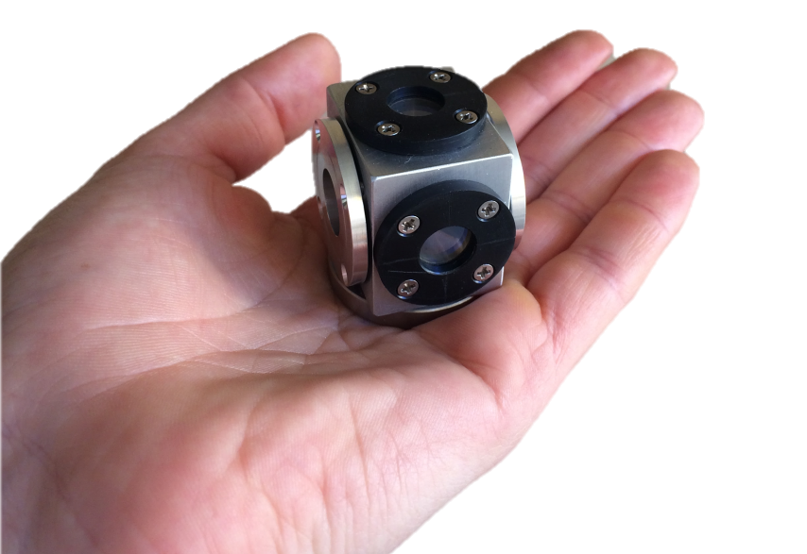
Can we put SLAC in your hand?
SLAC
Swap 10 to 20 m of rf cavities for < 1 mm of plasma
SLAC
Gradient: 10 to 20 MV/m
Plasma
Gradient: 40+ GV/m

Slide 11
General Principle: Laser Wakefield Acceleration (LWFA)
Wake in water
meter scale
Wake in plasma
micron scale
Wakefield
Height versus Density
modulations
https://www.youtube.com/watch?v=PHGiexy10ew
Wake driver
Boat versus Laser

Slide 12
Two types of underdense plasma targets are needed to develop LWFA on OMEGA EP
Gas-jet target
Plasma-lens targets

Slide 13
Gas-Jet Targets at LLE

Slide 14
An ultrafast gas-jet system was developed for use on OMEGA EP
The gas-jet-system was specifically designed to limit gas release in case of failure to protect sensitive electronics in the OMEGA EP compressor
maximum gas release in event of total failure: 30 cm³
The gas-jet valve is fast opening; the gas jet opens and closes in ~100 μs with a 0.5-Hz repetition rate
Built by Alameda Applied Sciences Corporation

Slide 15
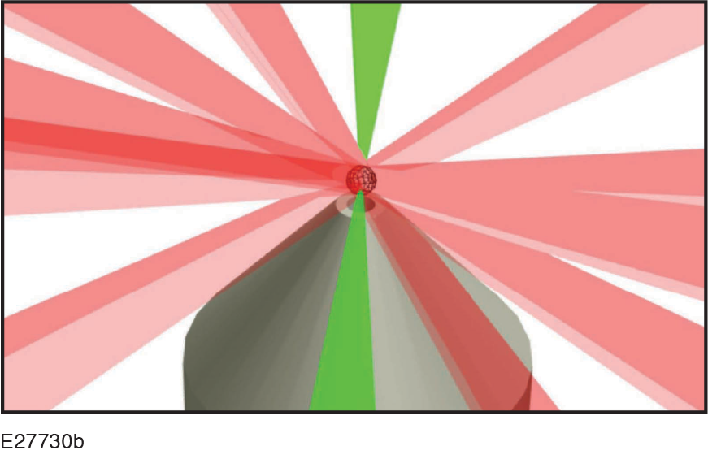
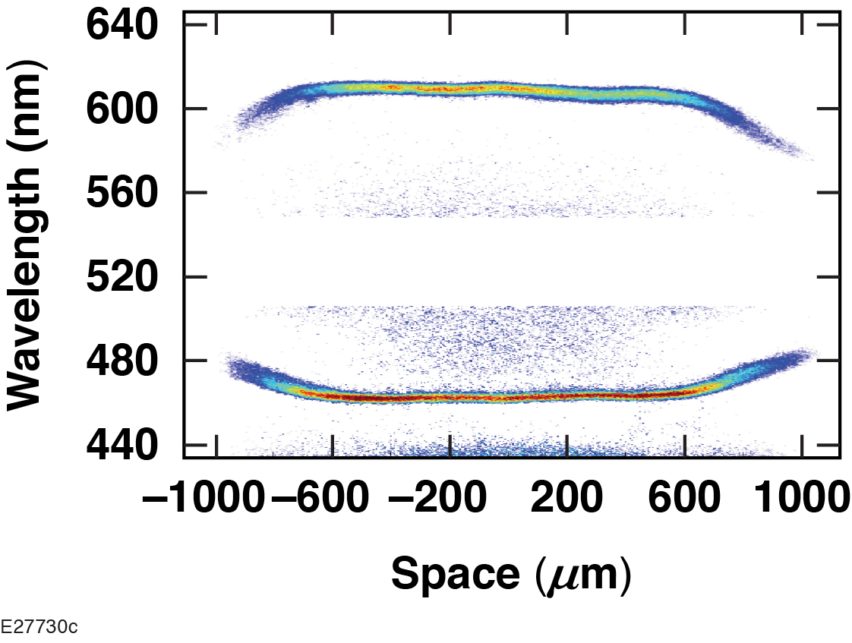
The gas jet has been activated for use on OMEGA and OMEGA EP
Thomson probe
Parameter | Value
Systems | OMEGA EP (long* and short** pulse) OMEGA (Long† Pulse)
Mach numbers | 3 to 6
Nozzle diameters | 500 μm to 10 mm
Gas fills | H₂, He, N₂, Ar, Ne, Kr, Xe, CO₂
Fill pressures | Up to 720 psi (Demonstrated densities up to 4 ✕ 10²⁰ cm^{–3})
Nozzle: 2-mm M3

Slide 16
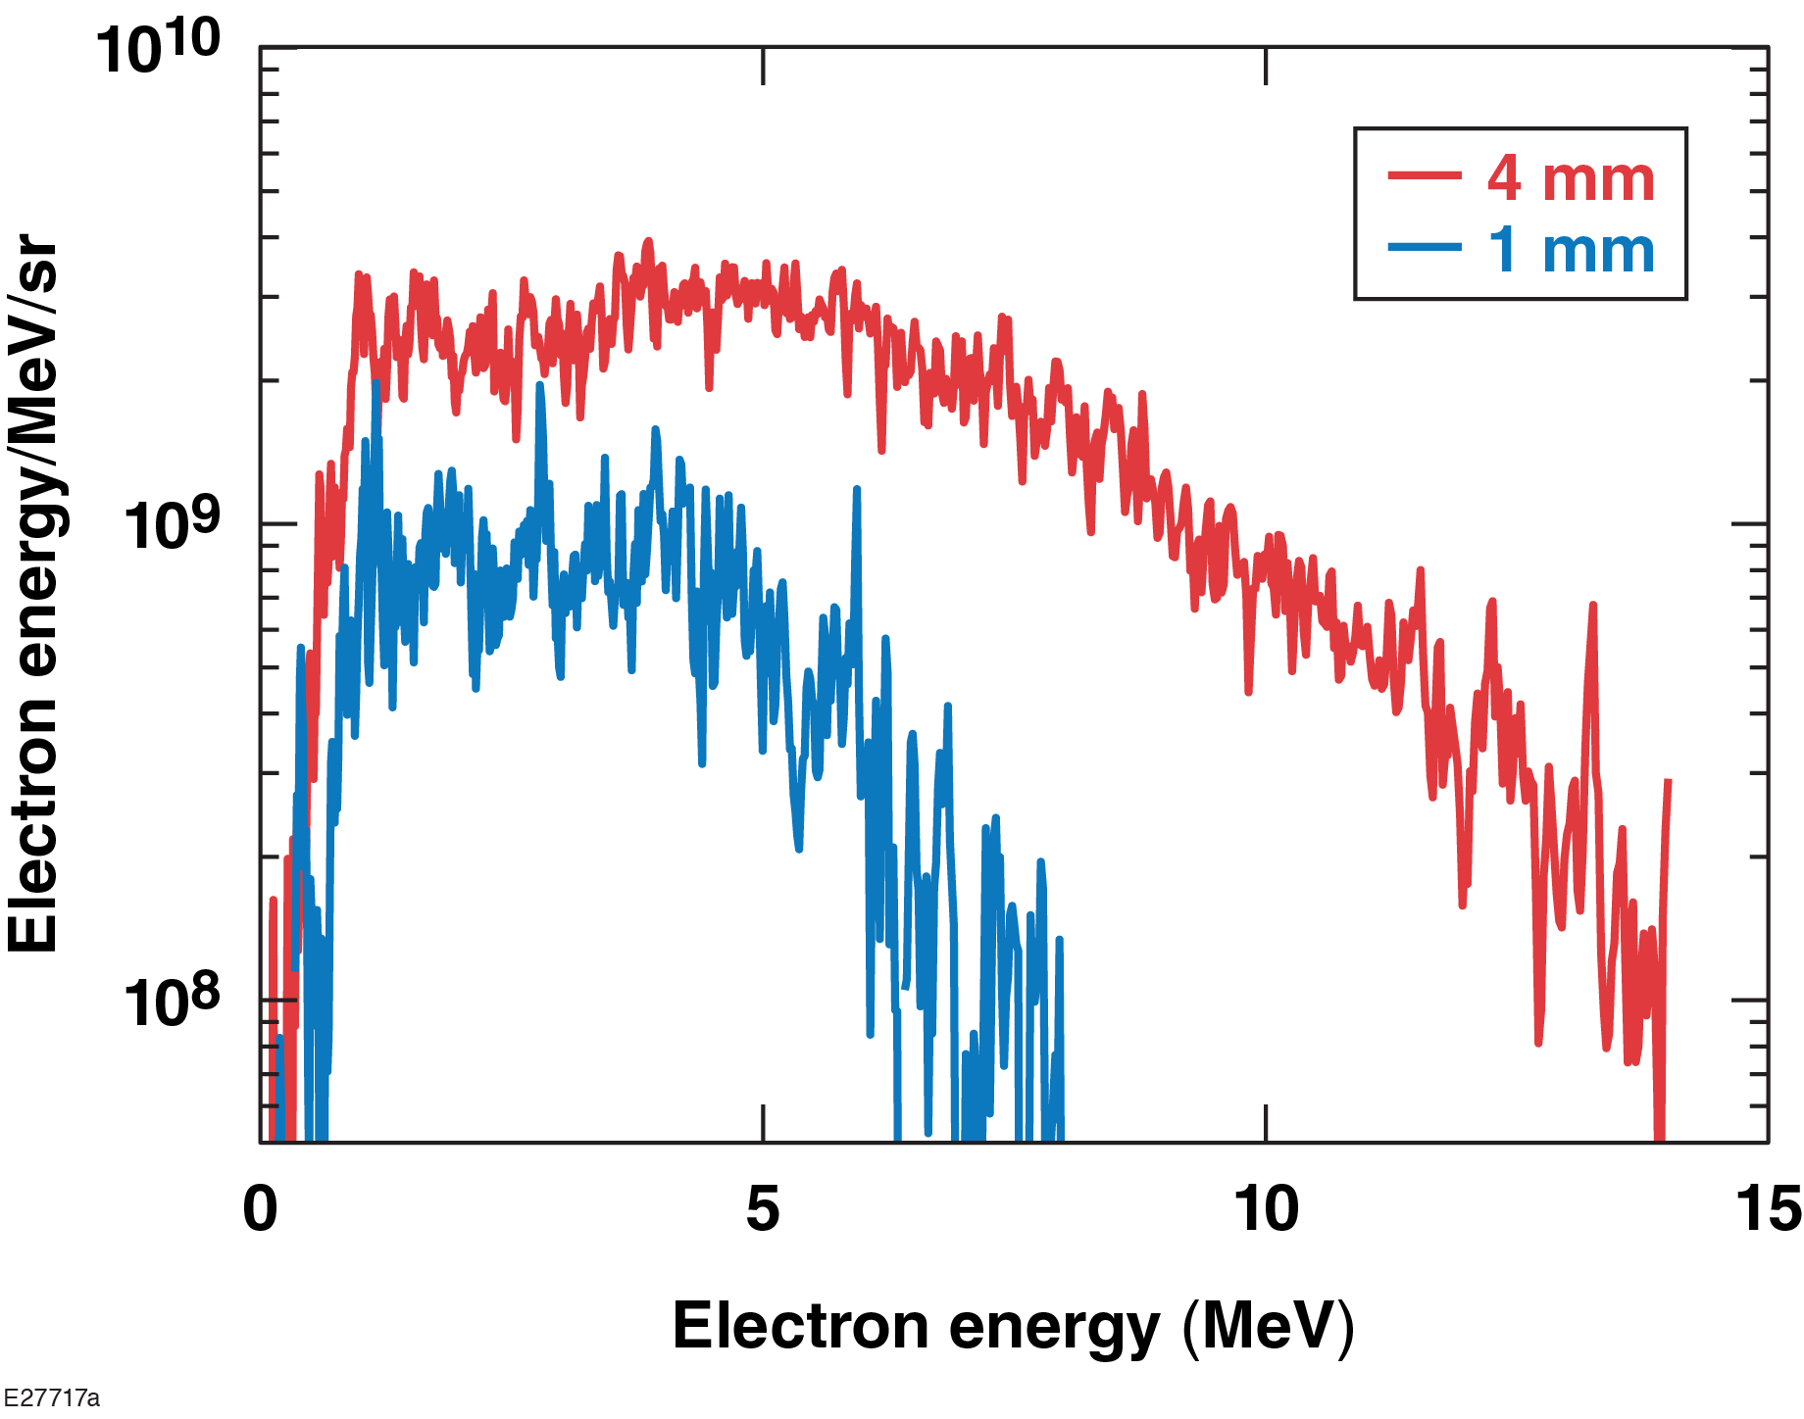
Initial LWFA experiments on the gas-jet platform produced low-energy electron beams
Electron spectra for 300 J
For shot energies of 60 J, no electrons with energies above 1 MeV were produced
For shot energies of 300 J, electrons were observed
cutoff energies of ~8 MeV for 1-mm-diam nozzles
cutoff energies of ~14 MeV for 4-mm-diam nozzles

Slide 17
Long focal lengths are required for successful LWFA campaigns
Titan Laser System at LLNL
nominal f/3 geometry → low charge, max electron energy < 100 MeV
f/10 geometry → 10 nC of charge, electron beam, max electron energy > 300 MeV
OMEGA EP at LLE
nominal f/2 geometry → low charge, max electron energy of 14 MeV
Diameter
Focal length
f/$\text{\# =}\frac{\text{Focal} \text{length}}{\text{Diameter}}$

Slide 18
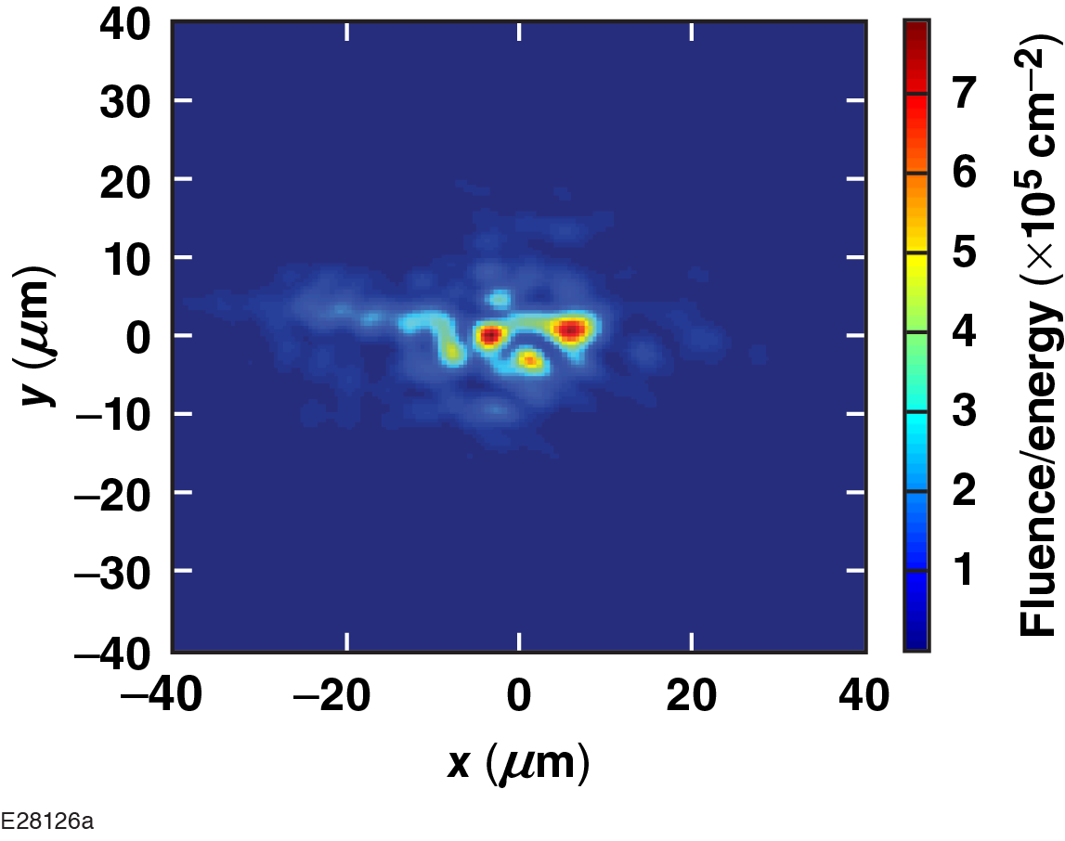
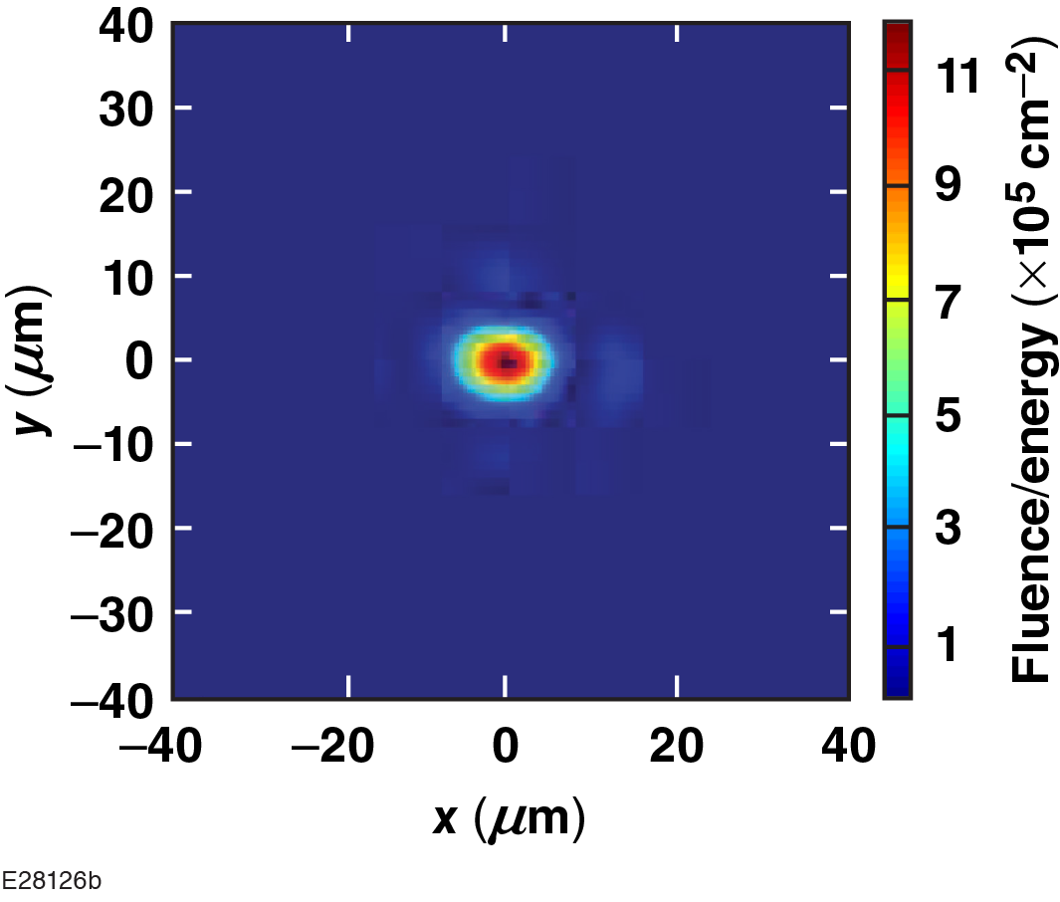
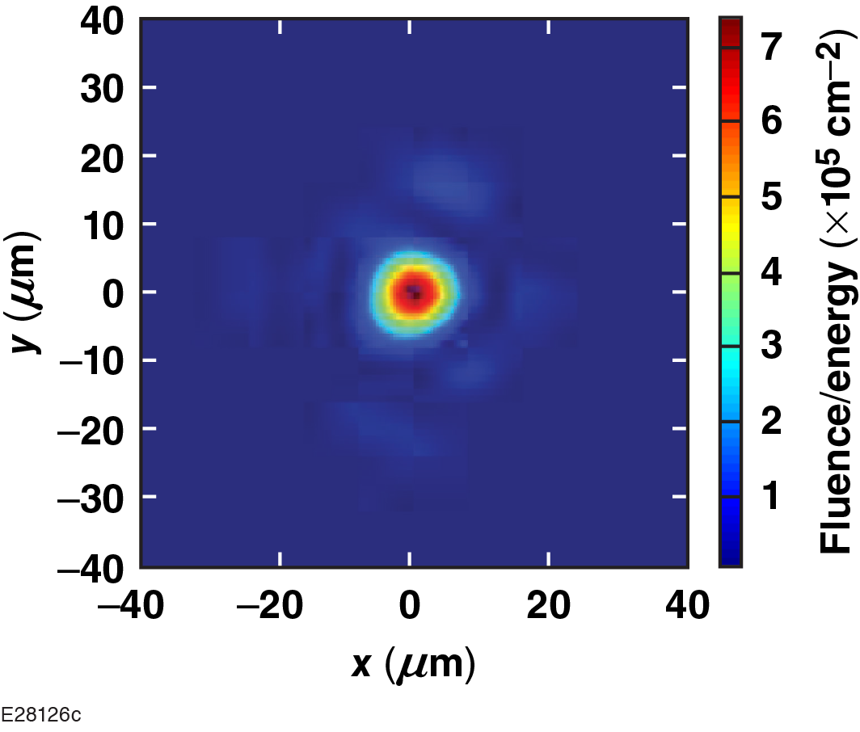
LLE developed an apodizer capability to convert OMEGA EP from f/2 to longer focal lengths
Standard OMEGA EP f/2 focus
f/6 apodizer
f/8 apodizer
Nominal target spot at focal plane
Nominal target spot at focal plane
Nominal target spot at focal plane
>0.97
>0.97
Max energy: 500 J
Max energy: 95 J
Max energy: 55 J

Slide 19
OMEGA EP LWFA experiments with apodized beams yielded 200 MeV+ electron beams
Particles/sr/MeV
Electron Energy [MeV]
Correcting f/# of laser yielded a high-energy electron beam

Slide 20
Long focal lengths are required for successful LWFA campaigns
Titan Laser System at LLNL
nominal f/3 geometry → low charge, max electron energy < 100 MeV
f/10 geometry → 10 nC of charge, electron beam, max electron energy > 300 MeV
OMEGA EP at LLE
nominal f/2 geometry → low charge, max electron energy of 14 MeV
f/6+ geometry → >> 10 nC of charge, electron beam, max electron energy > 200 MeV
Diameter
Focal length
f/$\text{\# =}\frac{\text{Focal} \text{length}}{\text{Diameter}}$

Slide 21
LLE developed an apodizer capability to convert OMEGA EP from f/2 to longer focal lengths
Standard OMEGA EP f/2 focus
f/6 apodizer
f/8 apodizer
Nominal target spot at focal plane
Nominal target spot at focal plane
Nominal target spot at focal plane
>0.97
>0.97
Max energy: 500 J
Max energy: 95 J
Max energy: 55 J

Slide 22
LLE developed an apodizer capability to convert OMEGA EP from f/2 to longer focal lengths
Standard OMEGA EP f/2 focus
f/6 apodizer
f/8 apodizer
Nominal target spot at focal plane
Nominal target spot at focal plane
Nominal target spot at focal plane
>0.97
>0.97
Max energy: 500 J
Max energy: 95 J
Max energy: 55 J
Can we find a way to refocus the laser without losing ~90% of energy?

Slide 23
Plasma-Lens Targets

Slide 24
The objective is to produce a plasma lens that can defocus the OMEGA EP short-pulse laser from its current f/2 to an f/# ~6+ for LWFA and other experiments
x
OMEGA EP short pulse
y
z

Slide 25
A longer, low-energy laser pulse creates a plasma lens, which can then refocus the short-pulse beam for LWFA
Plasma lens
Let the plasma expand and density drop to produce a plasma a lens
After the profile relaxes, use the plasma lens to refocus OMEGA EP short-pulse beam
Plasma lens
OMEGA EP
100+ ps
Plasma
lens
target
Plasma lens
OMEGA EP short pulse

Slide 26
Plasma lens targets need to produce a plasma with specific properties
Plasma lens
The radial plasma density profile (r² = x² + y²) needs to have a parabolic form
peak density on axis
Maximum plasma density should not exceed ~10²⁰ cm^{–3}
this roughly corresponds to a uniform density of 1 mg/cm³*
if the target density is larger, we must pre-heat the target and then let plasma expand to drop the density below the threshold
x
y
z
Parabolic radial profile and max plasma density drive target concepts.

Slide 27
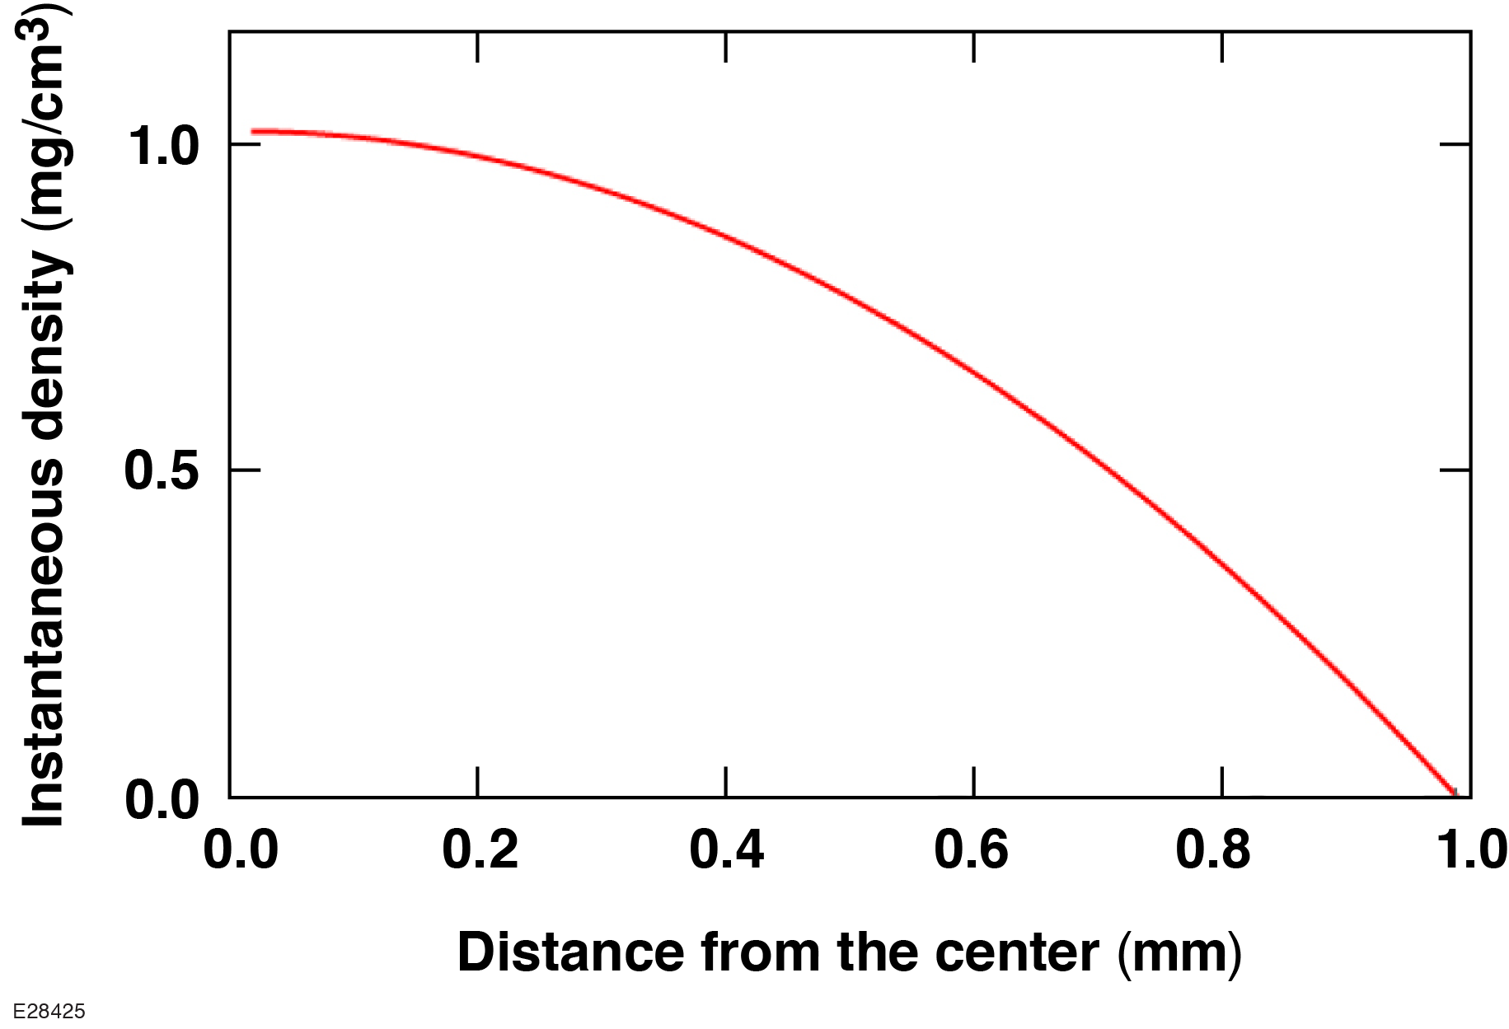
Graded foam targets would provide the most-uniform plasma lens, but the fabrication of a low density is a limiting factor

Slide 28
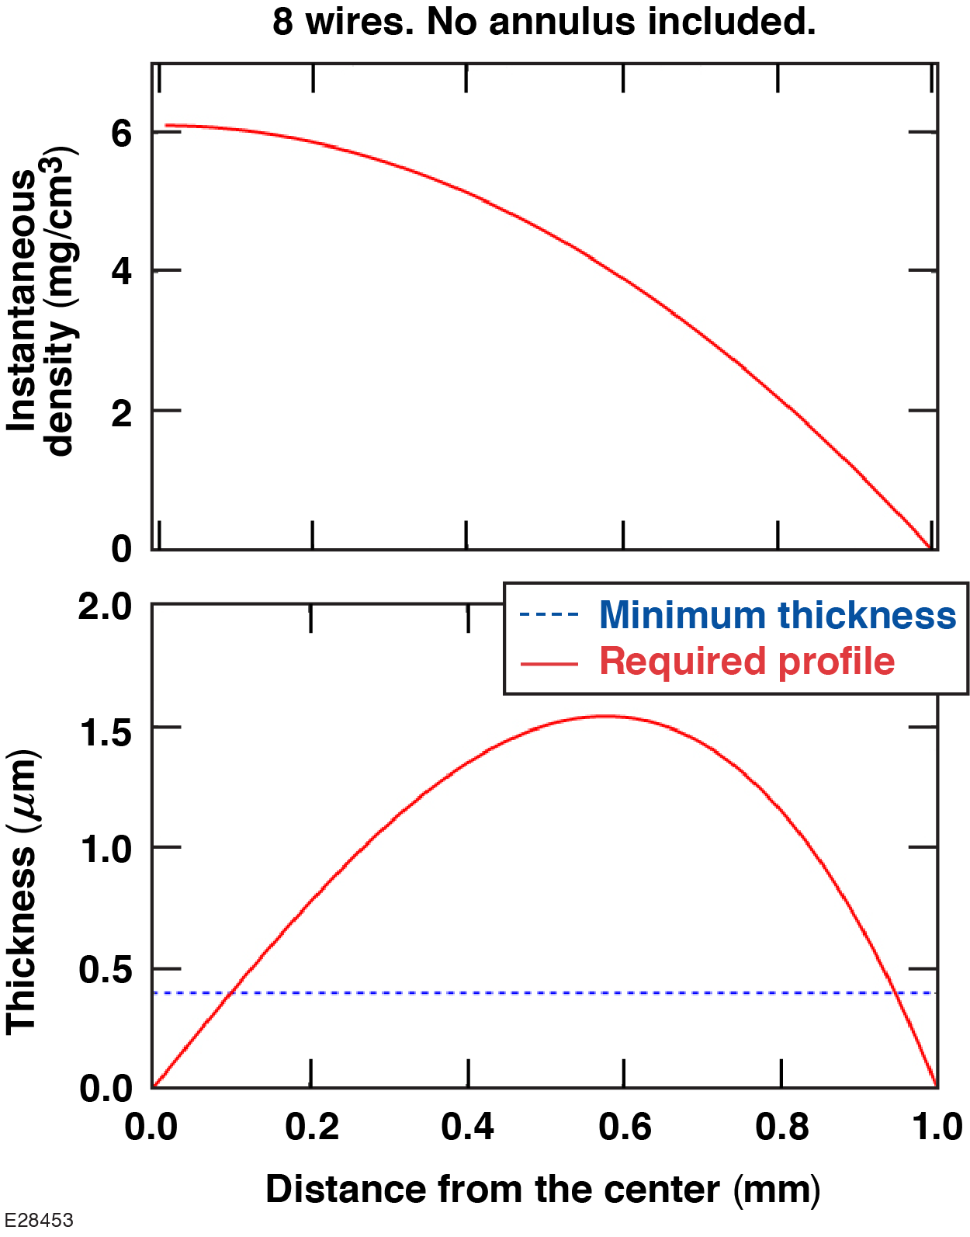
Two-photon polymerization presented a path toward shaped, low-density plasmas
Poster by D. Wasilewski (LLE)
Talk by Y. Lu (UNL)
ρ = 1.2 g/cm³
R = 1.0 mm
W = 1.5 µm
W = 0.4 µm

Slide 29
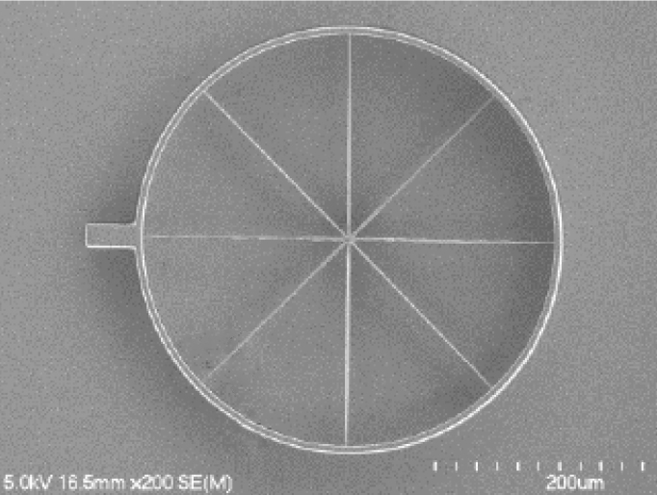
Plasma-lens targets up to 500 µm in diameter have been fabricated
50.0 µm
50.0 µm
SEM image
Courtesy P. Fan, UNL
Image of mounted target
Courtesy D. Wasilewski, LLE
Image of mounted target
Courtesy D. Wasilewski, LLE

Slide 30
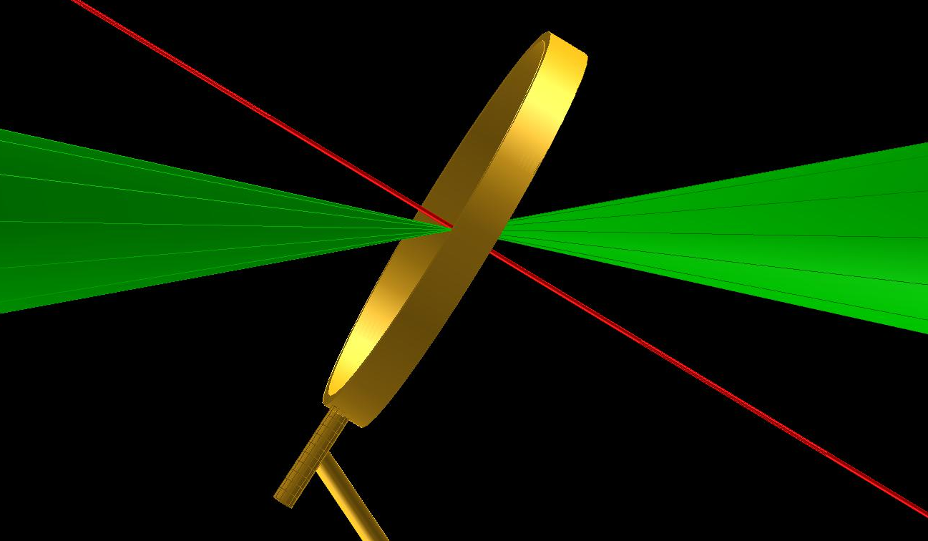
Goal of initial experiments with plasma lens targets is to measure the temporal evolution of the plasma density profile
Diagnostic axis
Beam propagation

Slide 31
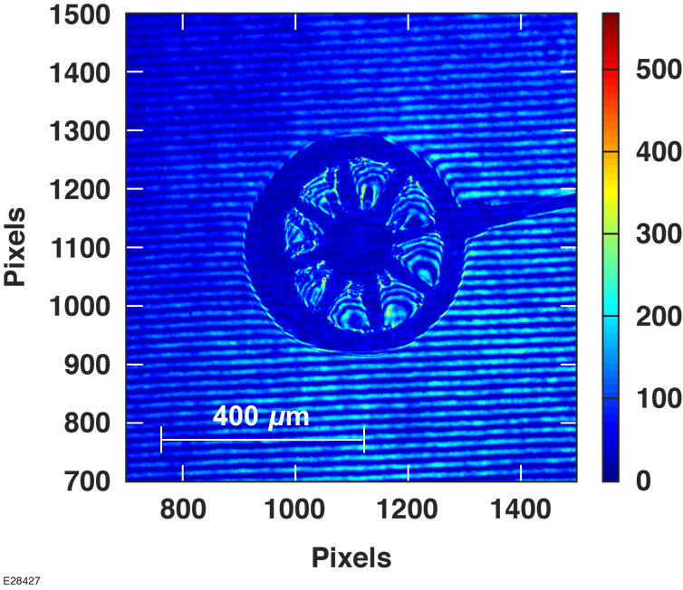
Goal of initial experiments with plasma lens targets is to measure the temporal evolution of the plasma density profile
Diagnostic axis
Beam propagation

Slide 32
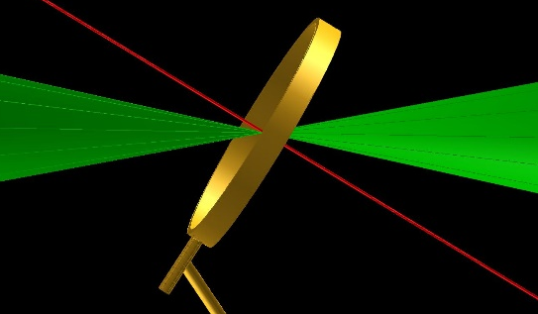
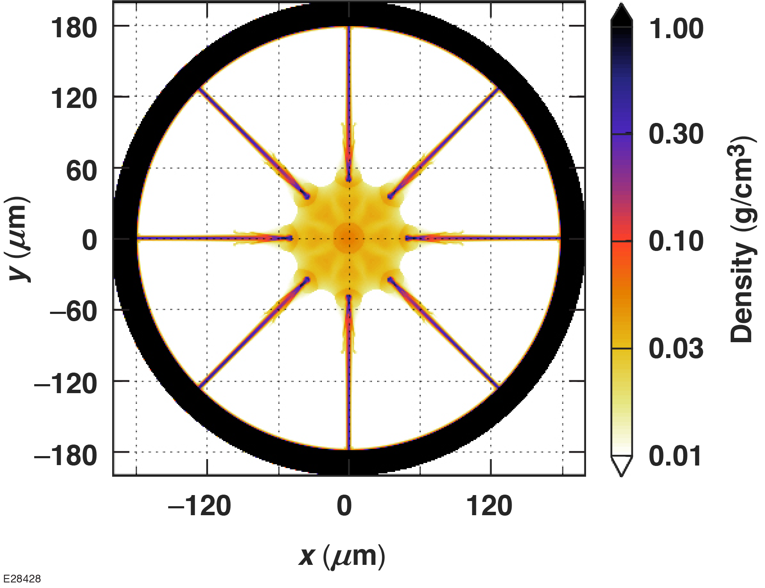
Preliminary characterization of 400-µm-diam plasma-lens targets indicates targets need to be further heated to produce the desired plasma-lens profile
Diagnostic axis
Beam
190212 135 ps
400 μm

Slide 33
Preliminary characterization of 400-µm-diam plasma-lens targets indicates targets need to be further heated to produce the desired plasma-lens profile
Diagnostic axis
Beam
190212 135 ps
400 μm
Are there additional innovative target fabrication techniques to aid in developing plasma lenses for kilojoule-class lasers?

Slide 34
Conclusion

Slide 35
Underdense plasma targets open new experimental capabilities on OMEGA and OMEGA EP
LWFA is a path to develop advanced electron diffraction and x-ray radiography sources that can be coupled with large-scale inertial confinement fusion/high-energy-density laser drivers such as OMEGA or the NIF
LWFA experiments require millimeter-to-centimeter long underdense plasma targets; LLE has activated a gas-jet platform to support these and other laser–plasma interaction experiments
LWFA requires long-focal-length laser configurations; a path to do this with plasma lenses is being developed

Slide 36
Acknowledgements
This material is based upon work supported by the U.S. Department of Energy under Award # DE-SC0017950, the National Science Foundation under Award # PHY-1705224, and by the Department of Energy National Nuclear Security Administration under Award Number # DE-NA0003856.

Slide 37
Backup

Slide 38
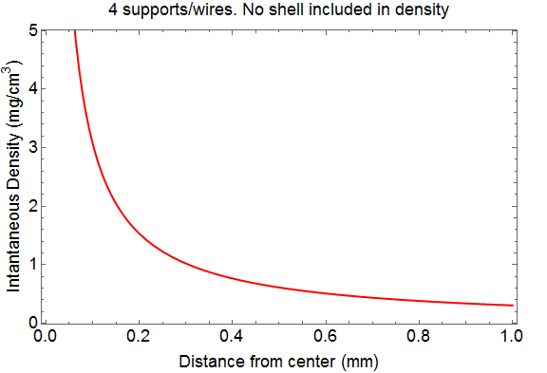
The current concept is to use two-photon polymerization to build the structured density needed
ρ = 1.2 g/cm³
R = 1.0 mm
W = 0.4 µm
Assume 1-µm depth
Average density over circle: 0.611 mg/cm³
Initial four-wire concept produces a low average density but does not produce a parabolic density profile.

Slide 39
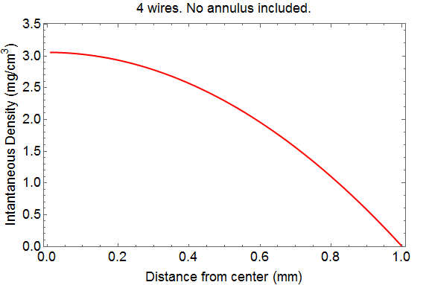
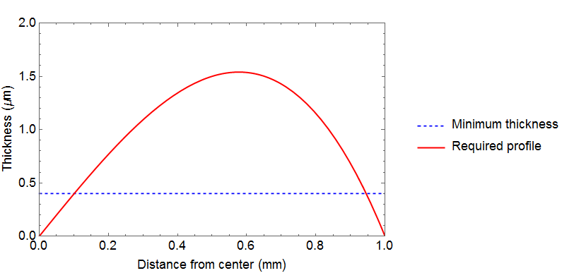
The current concept is to use two-photon polymerization (2PP) to build the structured density needed
ρ = 1.2 g/cm³
R = 1.0mm
W = 1.5 µm
W = 0.4 µm

Slide 40
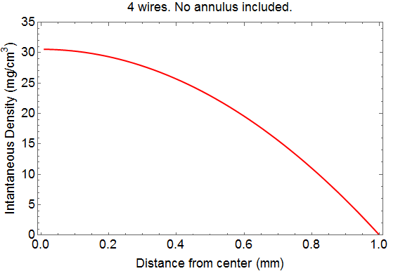
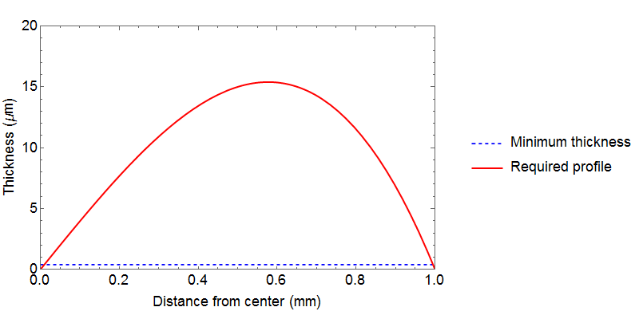
Further increase in wire thickness yields higher densities but no change in profile
ρ = 1.2 g/cm³
W = 1.5 µm
R = 1.0mm
W = 0.4 µm

Slide 41
In reality, 2PP will require layered spokes, but the produced profile is still the desired shape
ρ = 1.2 g/cm³
W = 1.5 µm
R = 1.0mm
W = 0.4 µm
This is very much NOT to scale. If we want 1.5 µm max thickness, and the minimum thickness is 0.4 µm, we can only stack four wires and then we have at 1.6 µm thickness.

Slide 42
Layering the pinwheel design in a rotating fashion could improve radial uniformity

