Slide 1
Overview of the LLNL Target Fabrication Engineering and Design Process
Target Fabrication Conference - 2019
Nick Hash
TFab Mechanical Design Lead
April 22-26, 2019

Slide 2
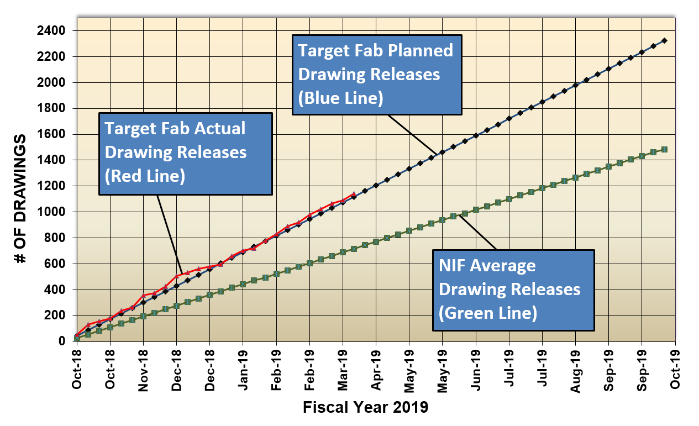
Target Mechanical Design is an essential part of target fabrication for NIF
TFab Engineering and Design support 500 shots a year on NIF
An average of 40 drawings/documents/Filmstrips a week are released
The design group releases over 2000 drawings a year

Slide 3
Target schedule goal is to provide target one month before the shot
Finalizing TR and Physics Design (CDP, etc.)
~ T-6months
If major R&D required then extended time must be allotted
Iteration with physics
T-17 weeks
Mechanical Design
Assembly Plan
Metrology Plan
Eng Review Facility Reviews
Drawings Released
TFE checks
Iteration w/physics
Mechanical Design and Specs
T-13 weeks
Component procurement or manufacture
Component Manufacturing
T-9 weeks
Final assembly
Final Assembly
Final metrology roll up, final NCRs
Document and Deliver
Delivered target
1 month before shot
T-4 weeks
Follow on shot date??
Production and Engineering work nearly seamlessly through this process

Slide 4
Target mechanical design based on requirements kicks off the process
Finalizing TR and Physics Design (CDP, etc.)
~ T-6months
If major R&D required then extended time must be allotted
Iteration with physics
T-17 weeks
Mechanical Design
Assembly Plan
Metrology Plan
Eng Review Facility Reviews
Drawings Released
TFE checks
Iteration w/physics
Mechanical Design and Specs
T-13 weeks
Component procurement or manufacture
Component Manufacturing
T-9 weeks
Final assembly
Final Assembly
Final metrology roll up, final NCRs
Document and Deliver
Delivered target
1 month before shot
T-4 weeks
Follow on shot date??
Production and Engineering work nearly seamlessly through this process

Slide 5
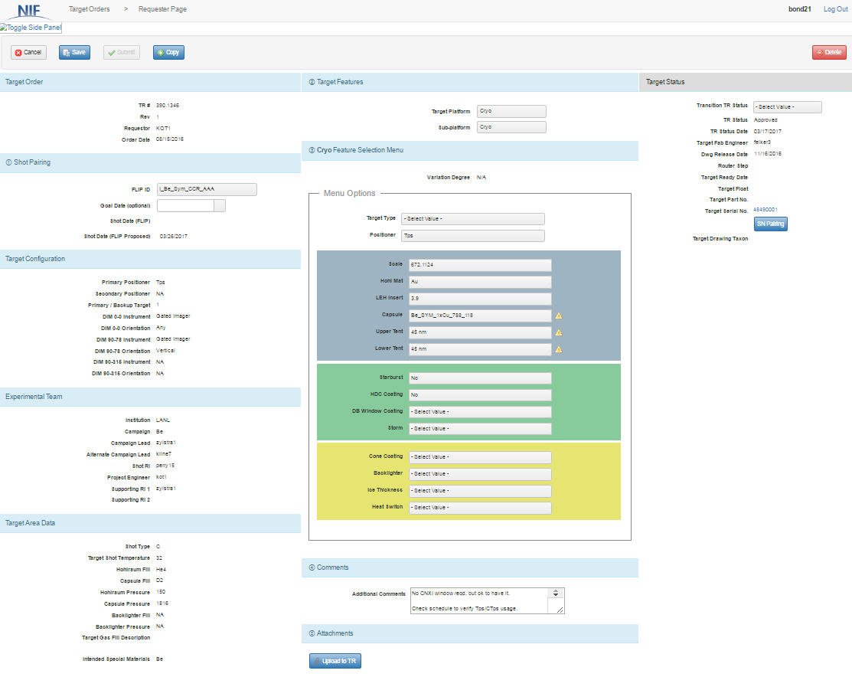
Physics Requirements are formally gathered in a target request form which feeds into target design
Requirements (2)
Shot Info (1)
Target request is organized in three columns to allow clear communication and multiple sources of data
Status(3)
RI or PE
(request date)
RI or PE
(Target info)
Shot Planner Data (auto filled)
Target Fab
(approval, status)
NIF Shot planner
(shot related info)
Cryogenic style targets utilize “menu” items
Warm style targets use a Conceptual Design Package (CDP)

Slide 6
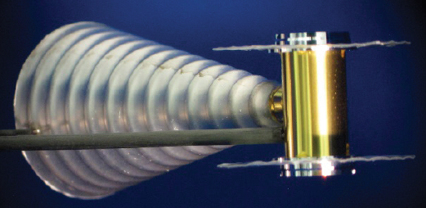
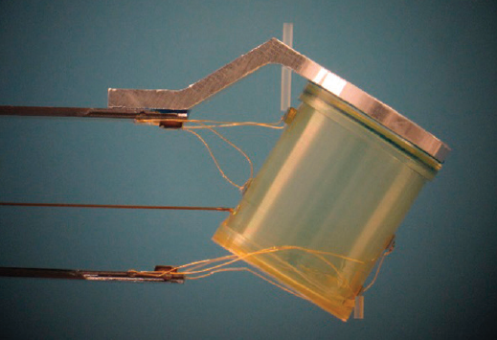
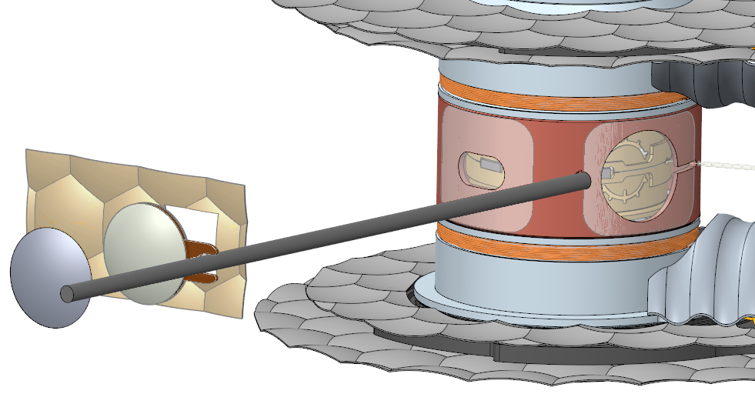
Once requirements are solidified, existing target platforms are assessed as a starting point for the new design
Existing platforms with simple changes
New platforms require significantly more effort
Capsule/hohlraum change
Physics package change (EOS)
MagLIF Cryogenic gas pipe
Refraction Enhanced Imaging Platform

Slide 7
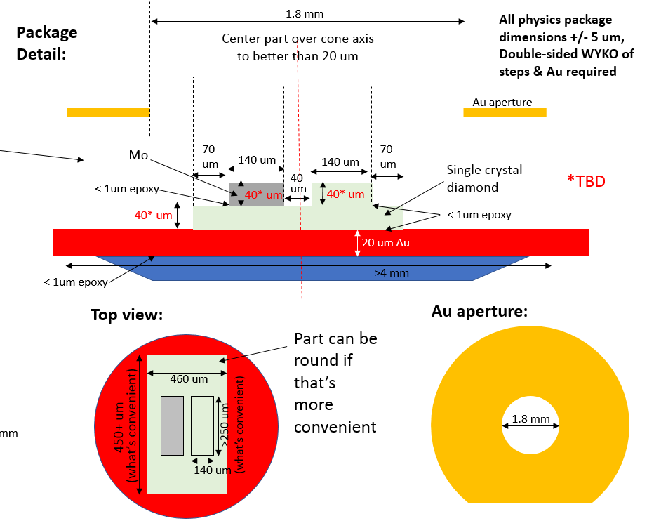
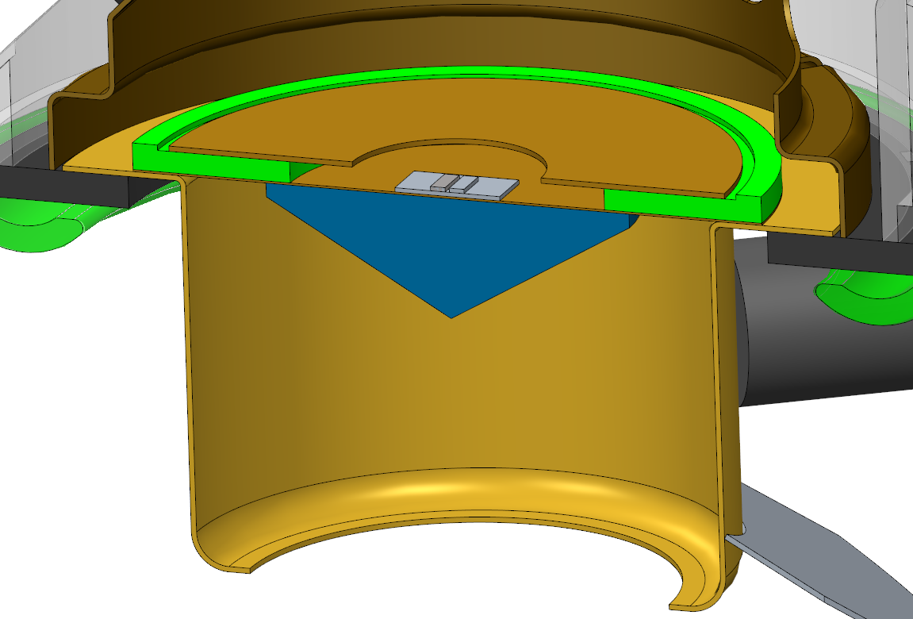
Creo 3D modeling software is utilized to create a representation of the target
Target Requirement CDP
3D Creo Assembly Model
Models allow for a better visualization in 3D space
Allows for geometry checks
Helps identify possible interferences or assembly issues

Slide 8
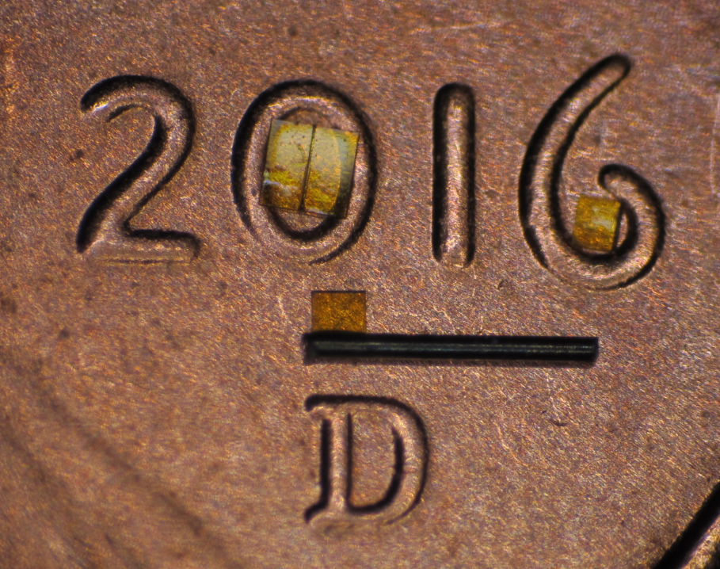
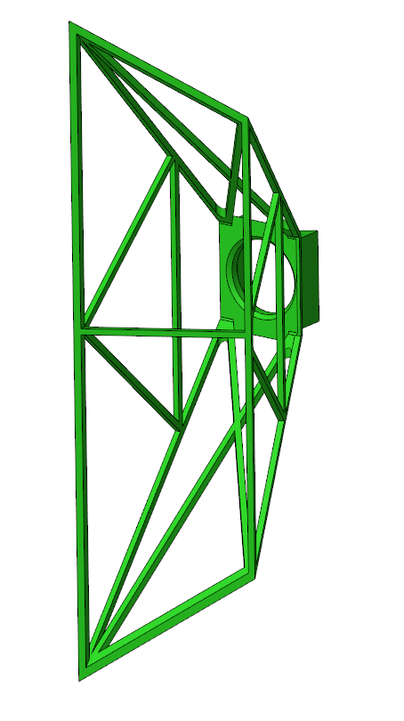
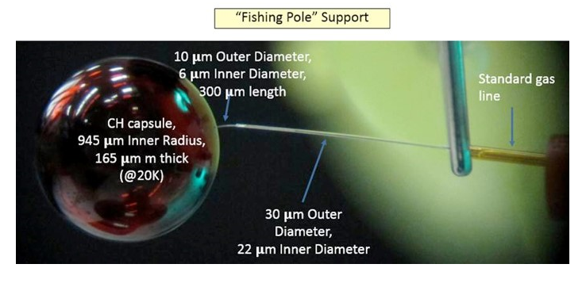
Engineering design must take many factors into account when designing a viable target platform
Small components can be difficult to manufacture and handle during assembly
R&D efforts can take considerable amounts of time with no guarantee of success.
Complex parts may require alternate manufacturing methods
Can the parts for the desired requirements be manufactured
Are the components too small?
Are they too complex (Additive manufacturing may be a possibility)
Have we done something like it before (proven method vs. R&D)

Slide 9
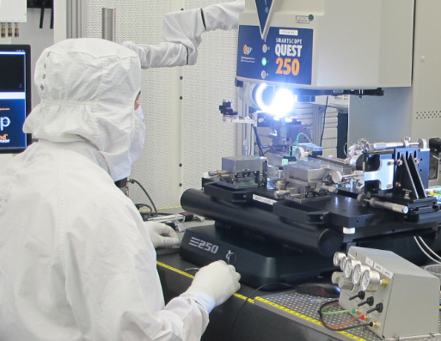
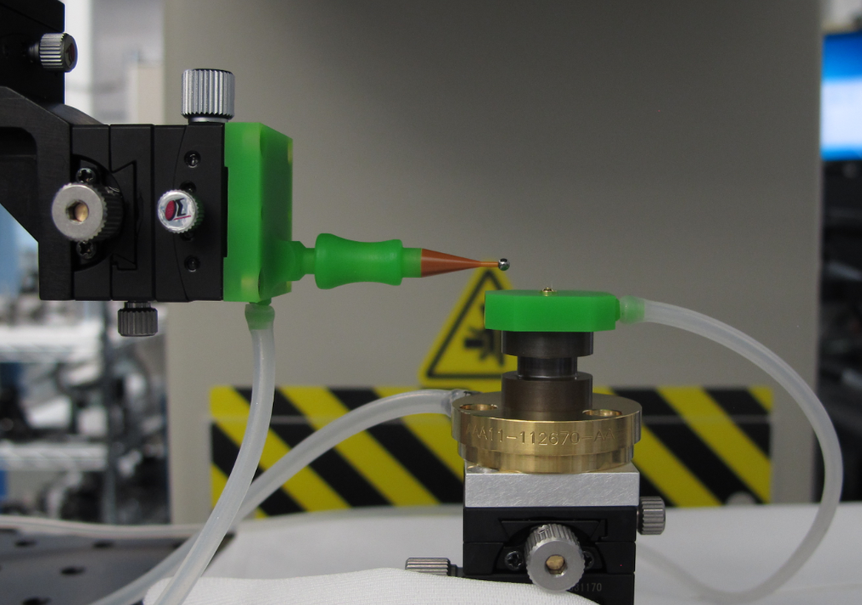
Assembly concerns and required precision is considered during the design phase
New Tooling?
New Metrology?
New Assembly Processes?
“Filmstrips” are created to highlight the above items to Production.
“Filmstrip” example

Slide 10
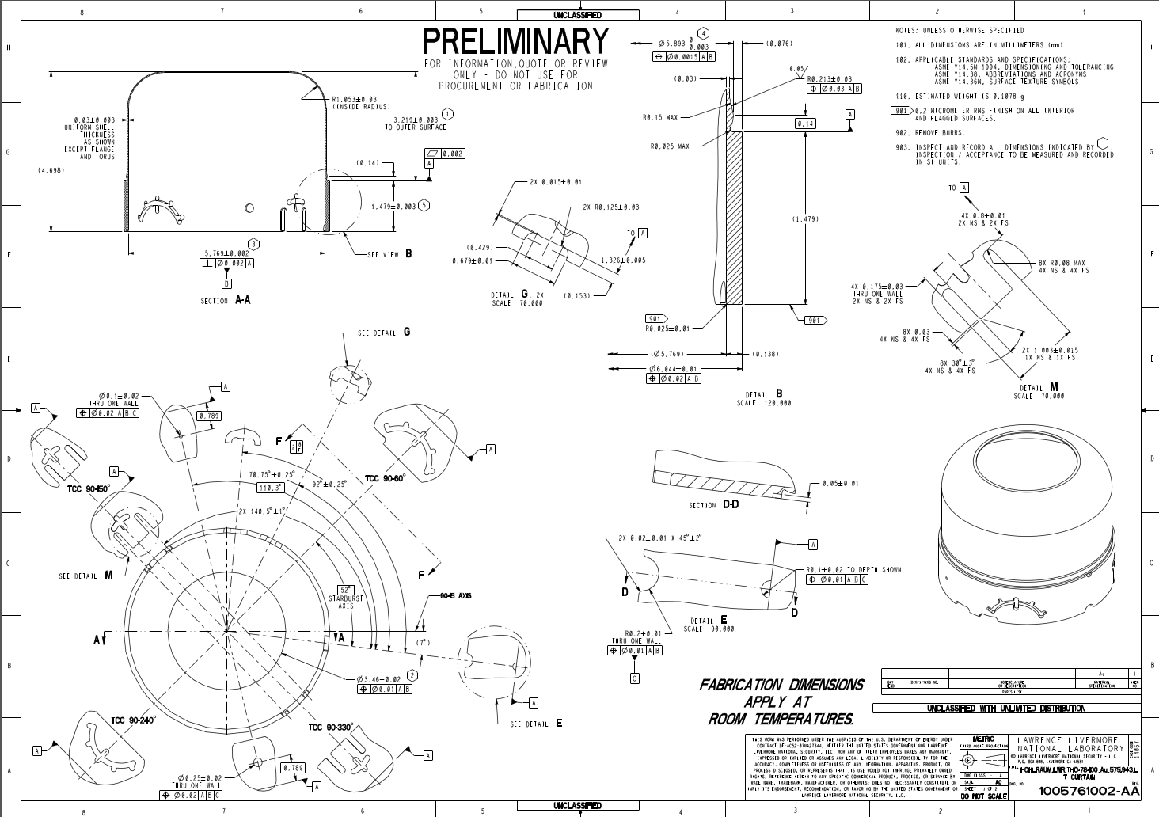
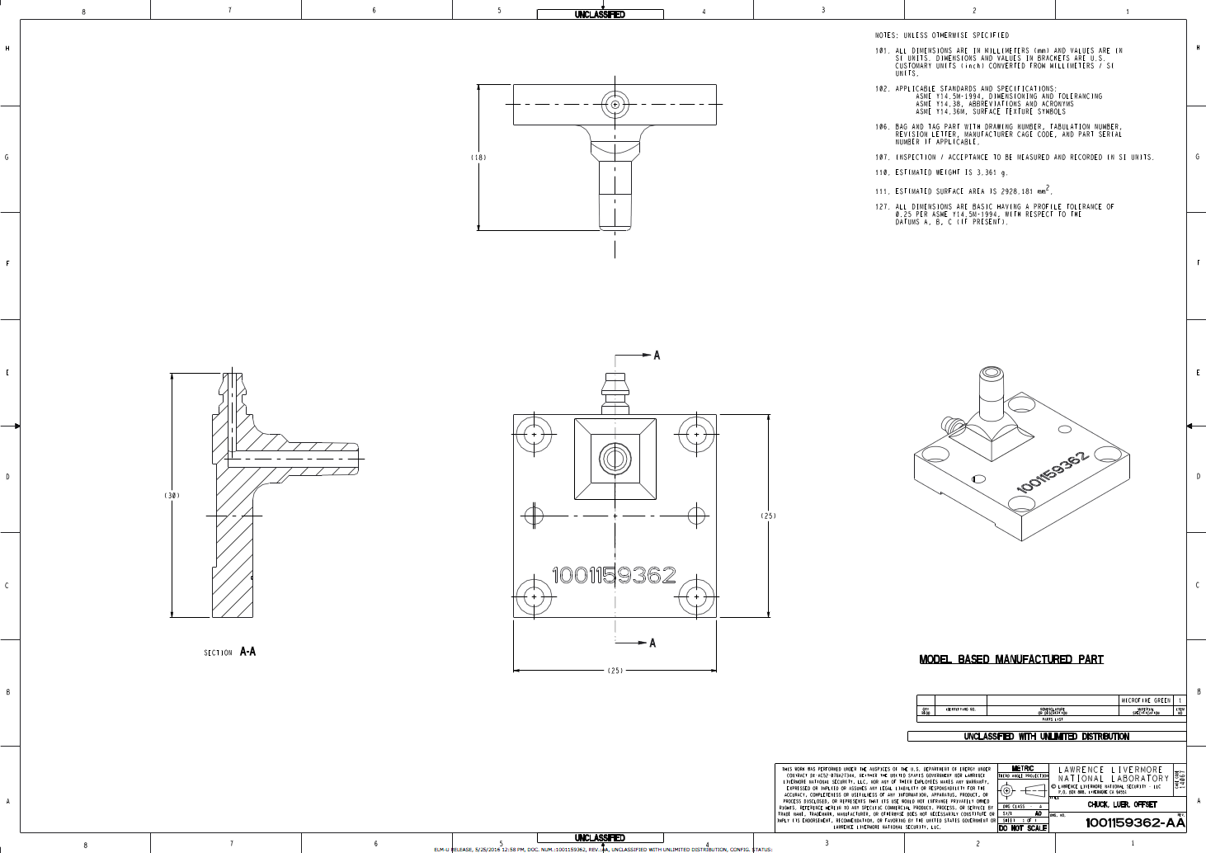
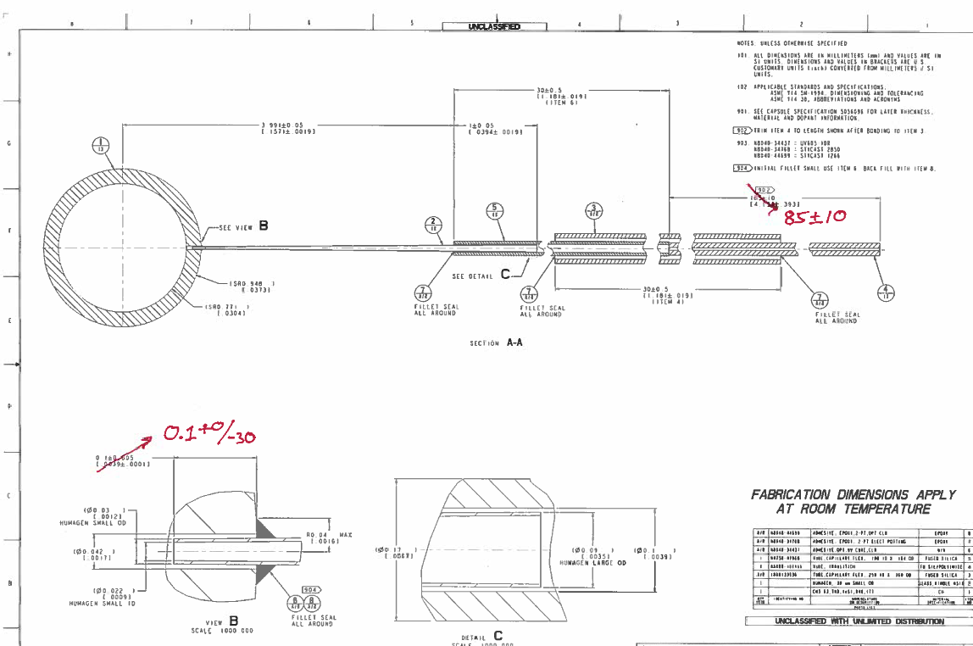
Preliminary drawings are produced once 3D models are created
Preliminary drawings can be sent to vendors and expert groups for fab and facility safety considerations
At this point part drawings can still be modified to take relevant suggestions into account
“Redlined” drawings convey suggested changes

Slide 11
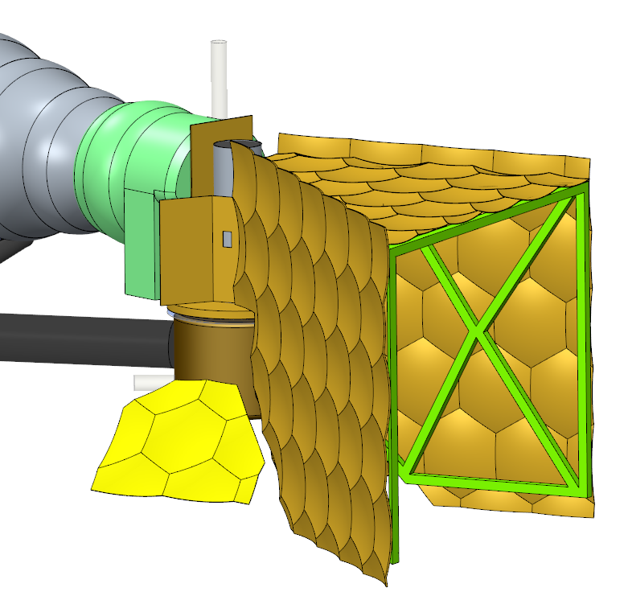
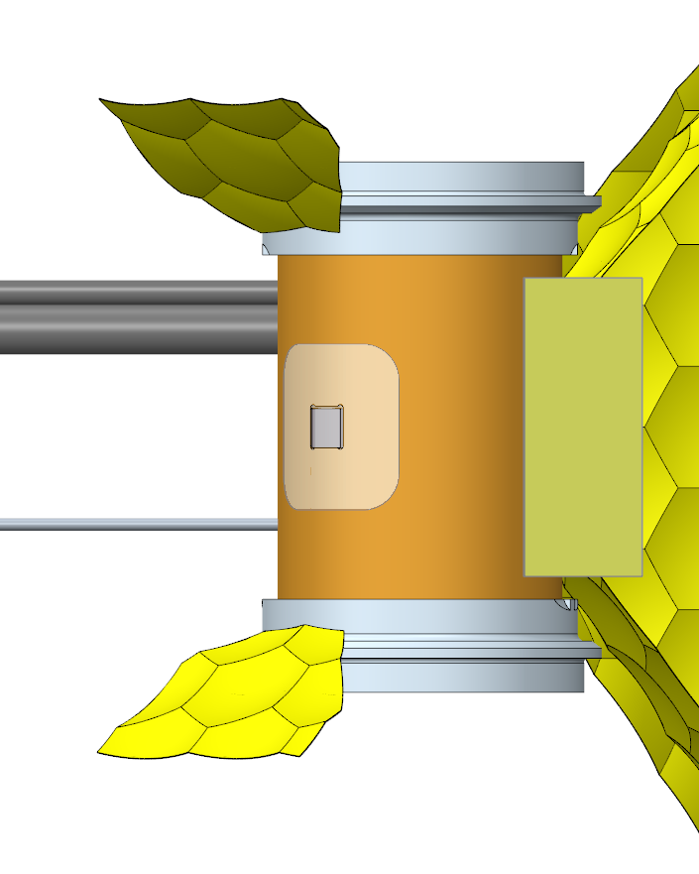
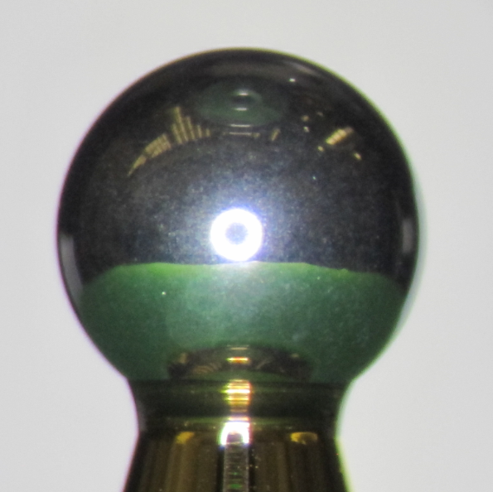
Facility safety is a key consideration which can involve significant effort in collaboration with expert groups
The amount of Beryllium allowed into the target chamber is closely monitored
Shields that reside in Unconverted Light must be dimpled for machine safety
Target alignment fiducials must be visible
Unconverted Light Mitigation
Debris and shrapnel
Can the target be aligned in the chamber
Are approved materials being used (new materials must go through testing. The mass of materials must also be considered)
Engineering Design Reviews are held to verify design with expert groups, the NIF Facility and Target Production

Slide 12
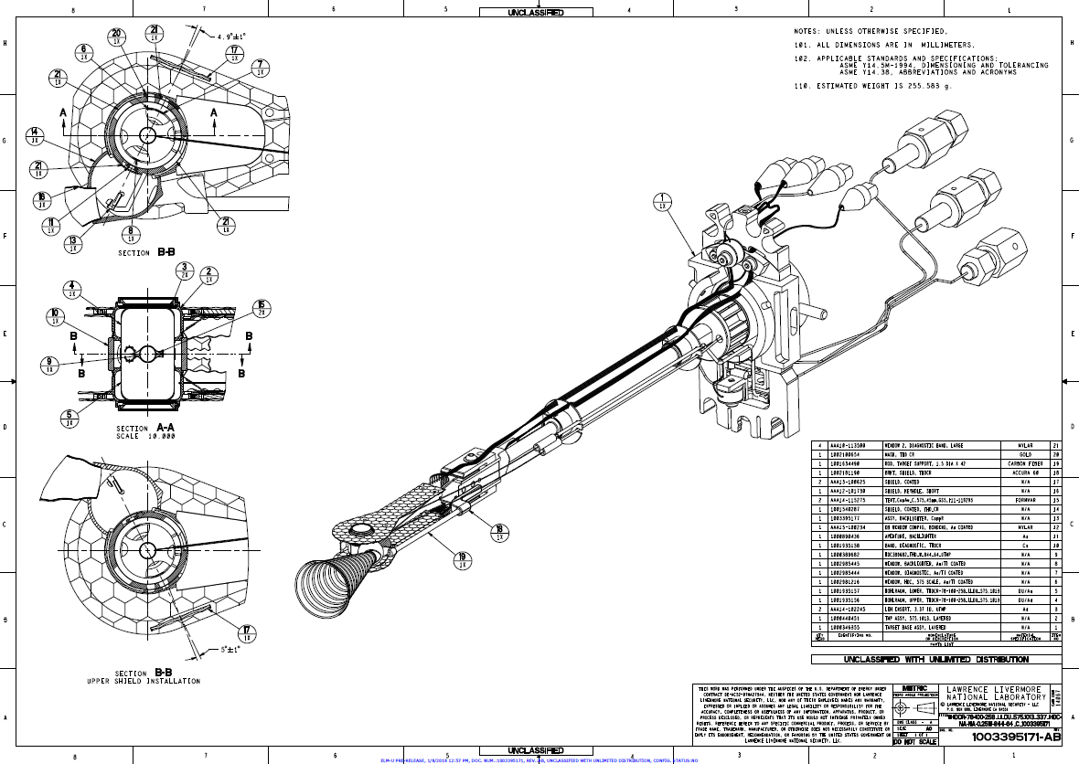
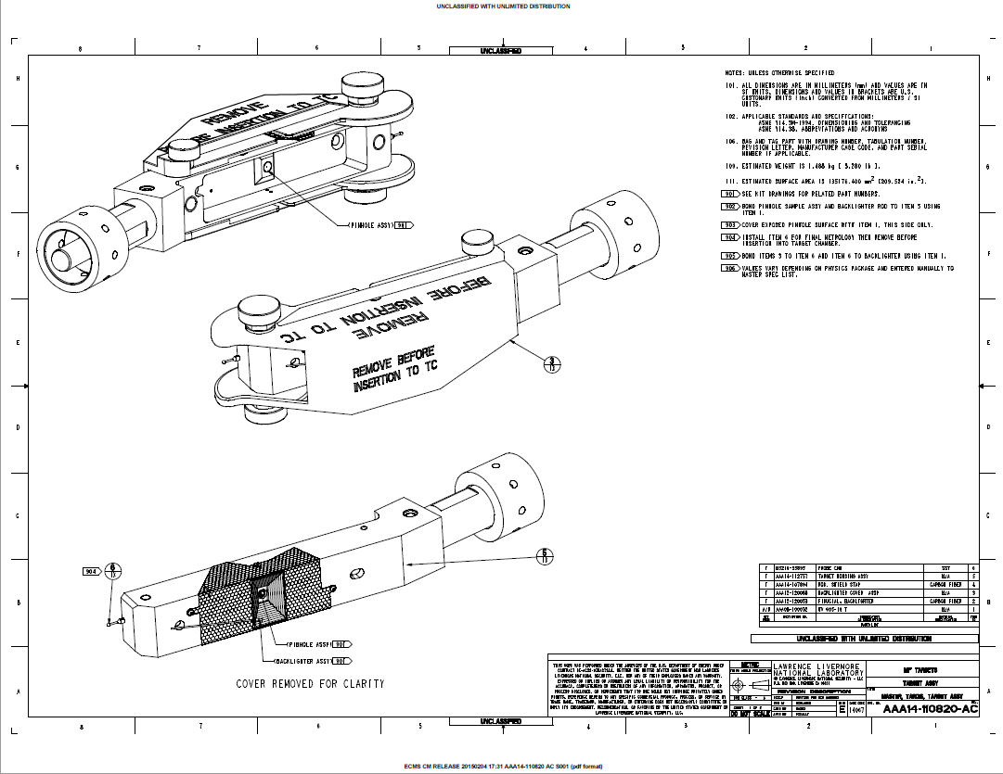
Finalized drawings/models are released and components can then be ordered
Released drawings act as the final contract
Ready to order parts!
Simple existing platform targets can require as little as one new drawing for documentation
More complex designs can have over 40 drawings for a single target
Final released drawings MUST match the assembled target that will be shot on NIF

Slide 13
Once the design phase is complete, the next phase of the target fabrication process begins
Finalizing TR and Physics Design (CDP, etc.)
~ T-6months
If major R&D required then extended time must be allotted
Iteration with physics
Mechanical Design
Assembly Plan
Metrology Plan
Eng Review Facility Reviews
Drawings Released
Design and Engineering phase complete!
T-17 weeks
TFE checks
Iteration w/physics
Mechanical Design and Specs
T-13 weeks
Component procurement or manufacture
Component Manufacturing
T-9 weeks
Final assembly
Final Assembly
Refer to B. Butlin’s talk: Overview of Target Production Planning Efforts for the National Ignition Facility (NIF)
Final metrology roll up, final NCRs
Document and Deliver
Delivered target
1 month before shot
T-4 weeks
Follow on shot date??
Production and Engineering work nearly seamlessly through this process

Slide 14
Special Thanks to the Design Team!
J. Diaz, C. Heinbockel, C. Henning, C. Santos & S. Vonhof

