Slide 1

Three-dimensional Characterization of the Third Line-of-Site Neutron Imaging Pinhole at NIF
LA-UR-19-23442
Lynne A. Goodwin
April 23, 2019
Managed by Triad National Security, LLC for the U.S. Department of Energy’s NNSA
Notes:
FROM SLIDE 1 to SLIDE 11, the first 10 slides should only take 5 minutes to get through.

Slide 2
Summary
1. Pinhole arrays are evolving to be more complex.
  More lines of site
  More precise shapes
  More apertures
2. Plausible neutron, gamma and x-ray image reconstruction requires
accurate pinhole array metrology.
3. We developed a new metrology protocol by using 4
different instruments to characterize the pinhole array.
4. “ACCURATE METROLOGY IS OF PARAMOUNT IMPORTANCE
TO RELIABLY RECONSTRUCT THE DATA IMAGES”.
Petr Volegov
Notes:
Our target fab team was asked to machine and characterize a series of Neutron Imaging pinholes for neutron imaging which is a very important system at NIF.
Talks and posters at previous conferences have described how we developed the machining.
Today, I’ll describe how we do evermore detailed characterization of the pinhole that drastically affects interpretation of the data.

Slide 3
The neutron imaging team is large and spans both LANL and LLNL.
LLNL
David Fittinghoff
Robin Hibbard
Cory Waltz
LANL
Valerie Fatherley
Verena Geppert-Kleinrath
Justin Jorgenson
John Martinez
Derek Schmidt
Michael Springstead
Petr Volegov
Carl Wilde
Notes:
Neutron imaging is a big effort at LANL and LLNL.
At LANL, there are 4 different engineering and physics groups involved.

Slide 4
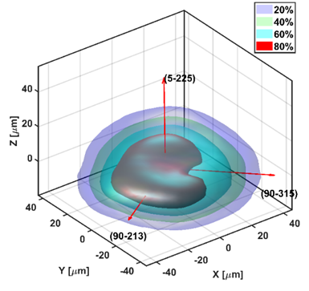
3D neutron imaging gives many measurements
that help us understand ICF implosions.
The size of the fuel tells us the
  internal energy of the fuel.
The shape of the fuel is efficiency.
  Rounder is more efficient, less wasted energy.
The gamma image is the state of the ablator.
The x-ray image is more of a temperature image.
Notes:
The science we are getting out of this and the quality of measurements gives us more information on ICF implosions.

Slide 5
The goal of the neutron imaging pinhole
metrology project is to:
Deliver a precisely machined pinhole
Provide accurate knowledge of the
as-built dimensions
Notes:
Basically the goal is to deliver a 3D mathematical description of the as-built pinhole.

Slide 6
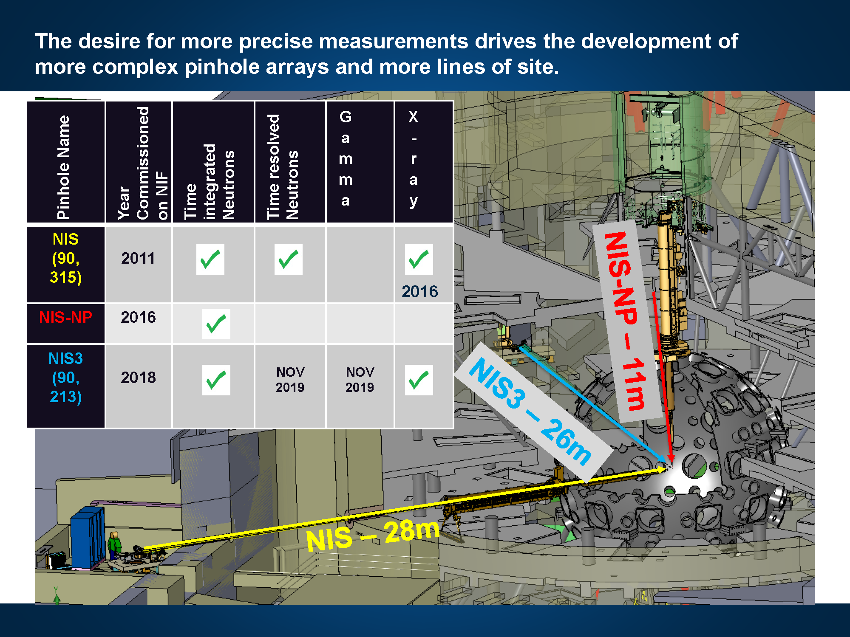
Fatherley, et al, (2018) Proc. SPIE 10763.
Notes:
This is a NIF chamber slide.
A. Basically the neutron imaging system is comprised of three pieces,
(1) an aperture array (a pinhole) to form the neutron images,
(2) a detector to measure the neutron flux passing through the pinhole array, and a
(3) recording system where the neutron source distributions are captured.
B. Having 3 lines of site perpendicular to each other would provide information for reconstructing a 3D image of the source.

Slide 7
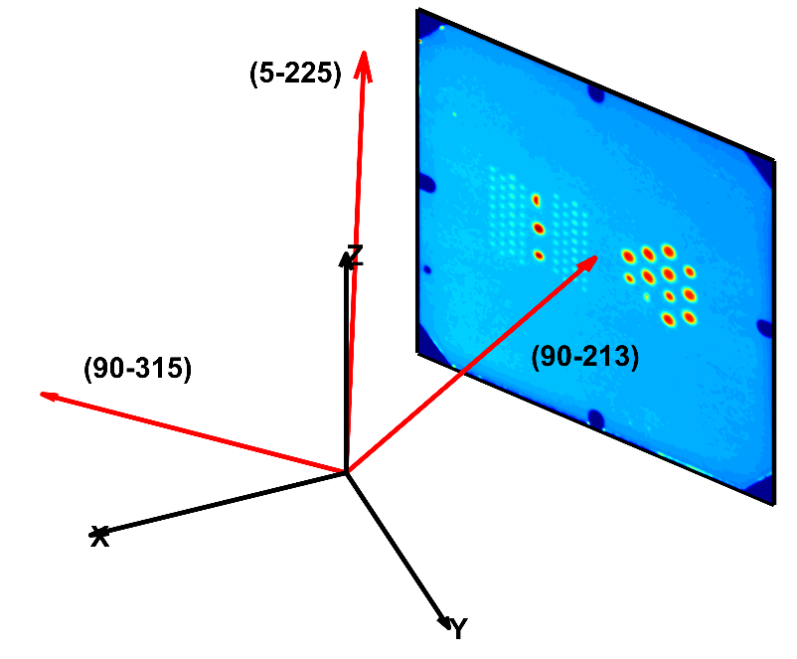
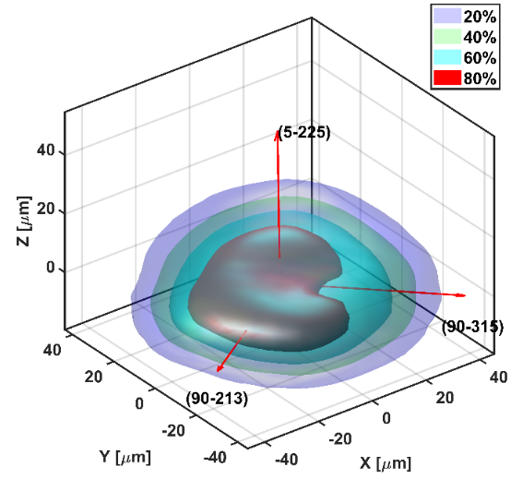
Data analysis requires accurate metrology.
Lots of complicated math is used
to deconvolve the affect of the pinhole
on image reconstruction.
RAW DATA
In a journal near you…..
Petr Volegov, Journal of Applied Physics
118, 205903 (2015).
N160717
FINAL DATA
Notes:
Data analysis requires detailed knowledge of the imaging system, especially the geometry of the pinhole.
Furthermore, if you want to believe the data you need to understand the geometry of the pinhole.
The complicated math step (arrow) requires knowledge of the aperture used to make the image.
Knowing the shape and how the fuel comes together is important.

Slide 8
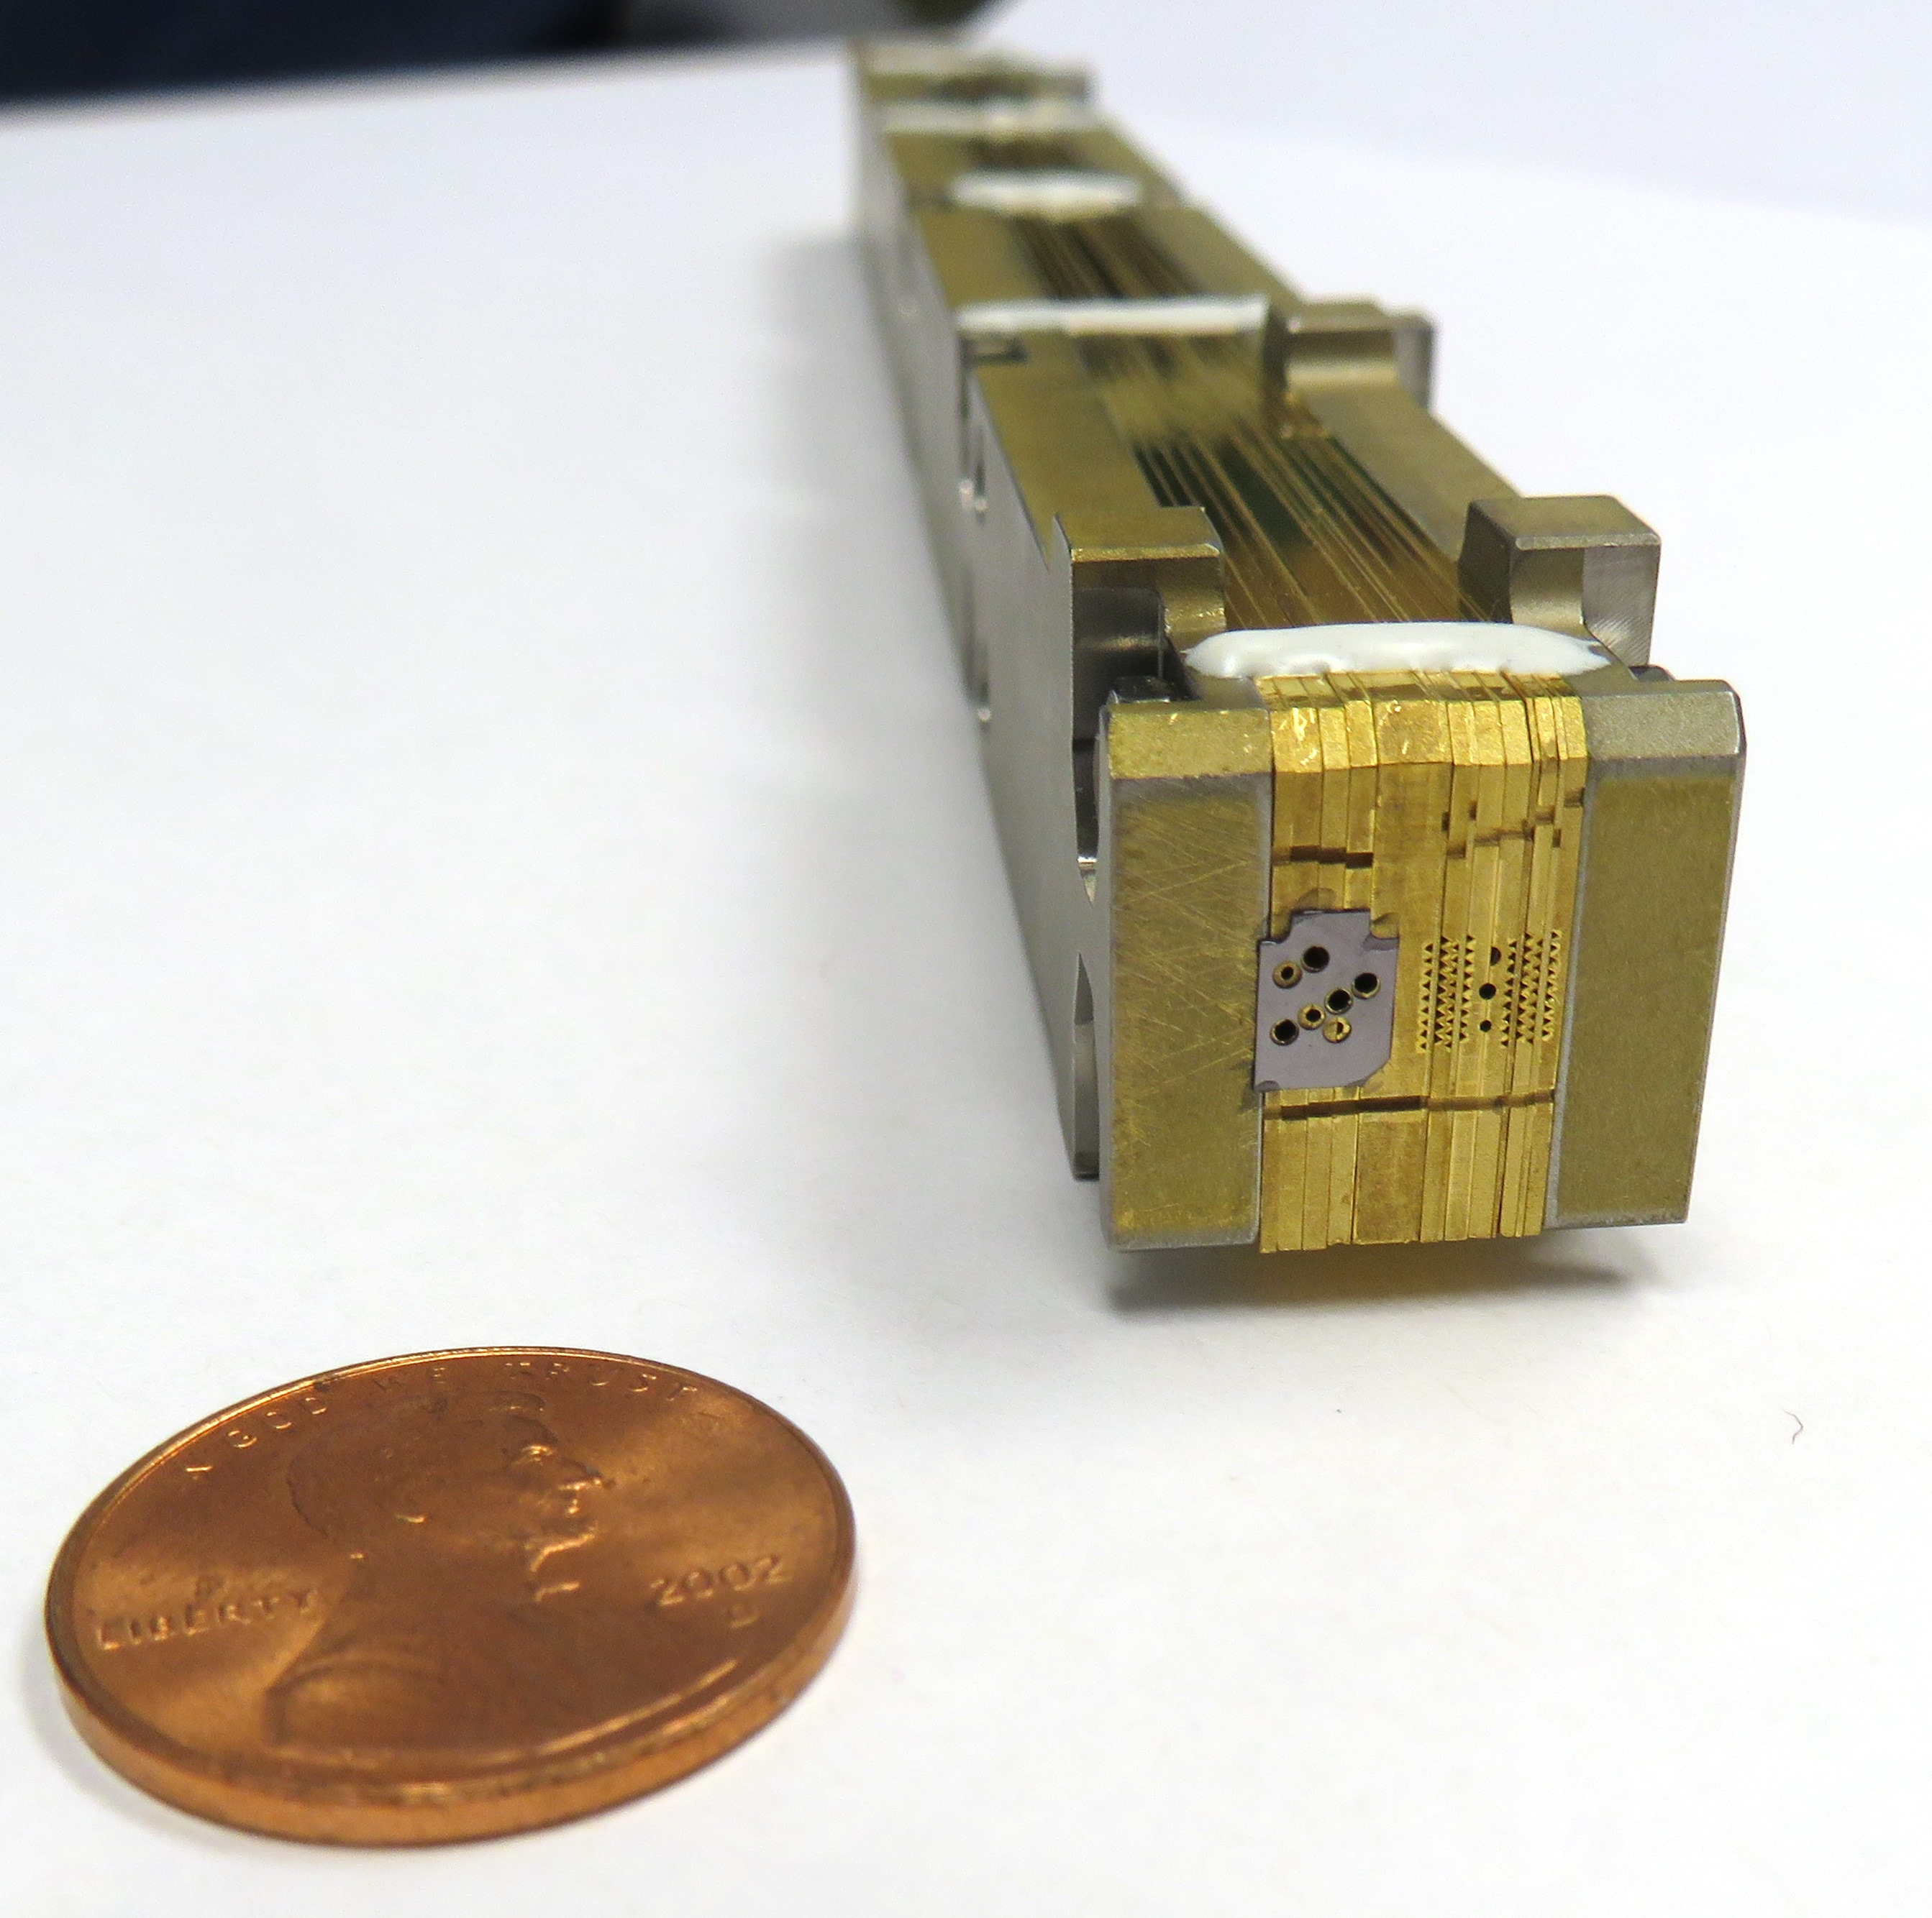
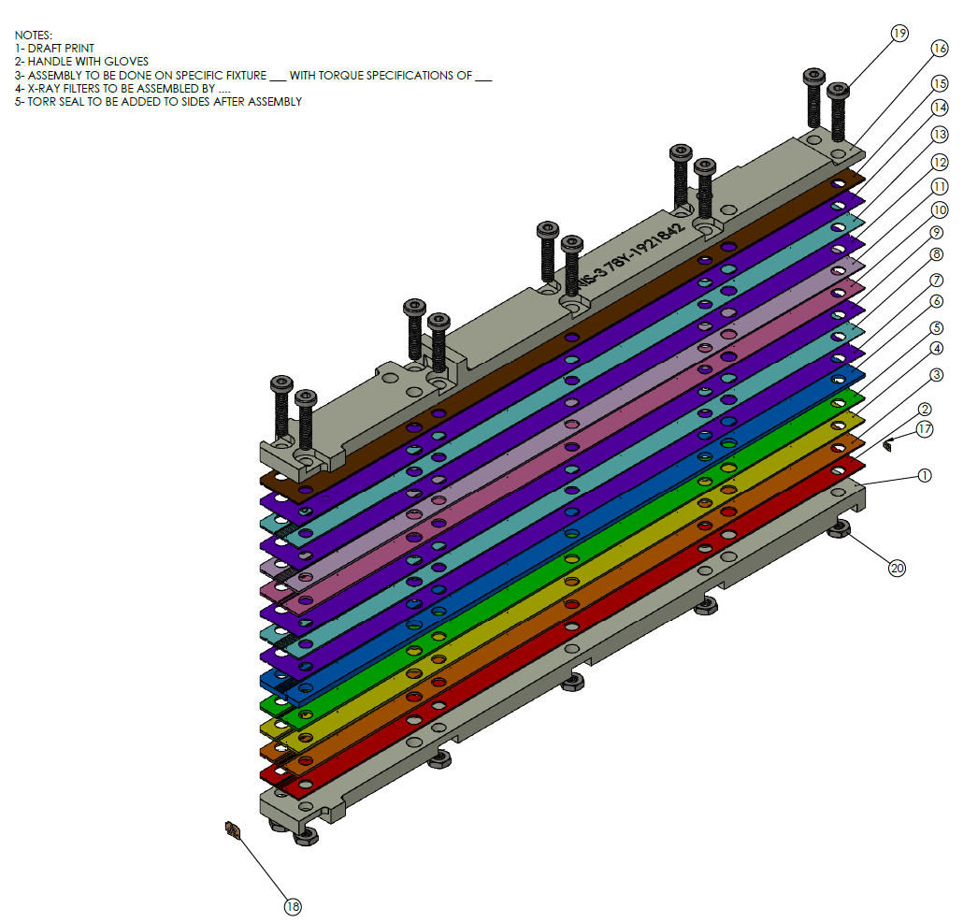
The third generation pinhole array (PHA) is extremely complex.
Target
Chamber Center
(TCC)
16 LAYERS
2 outer Tungsten
14 inner Gold foils
Back end view of Pinhole Array
15-mm x 16.6-mm x 200-mm
87 openings
15 circular
72 triangular
Notes:
The pinhole is an array of apertures made of pinholes and penumbras that need to be pointed to the source.
The pinhole array has to be within 250um of the source.
The purpose of the pinholes is for alignment to the source.
The purpose of the penumbras are to show which pinholes are best aligned.
The back end view of the pinhole array is where the Tantalum x-ray foil is installed. It is also where the largest openings of the aperture are located.
We want the highest Z material possible because we want the highest neutron stopping power. Neutrons are penetrating radiation.

Slide 9
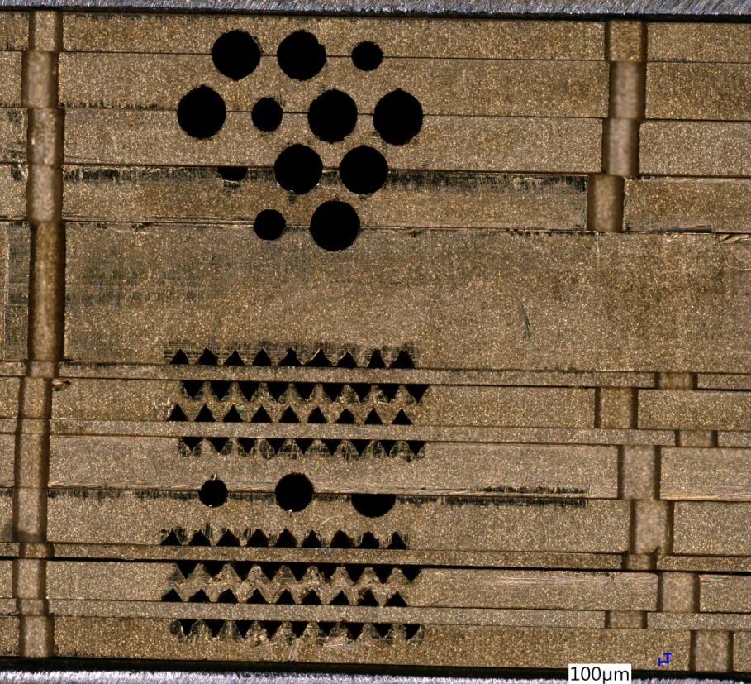
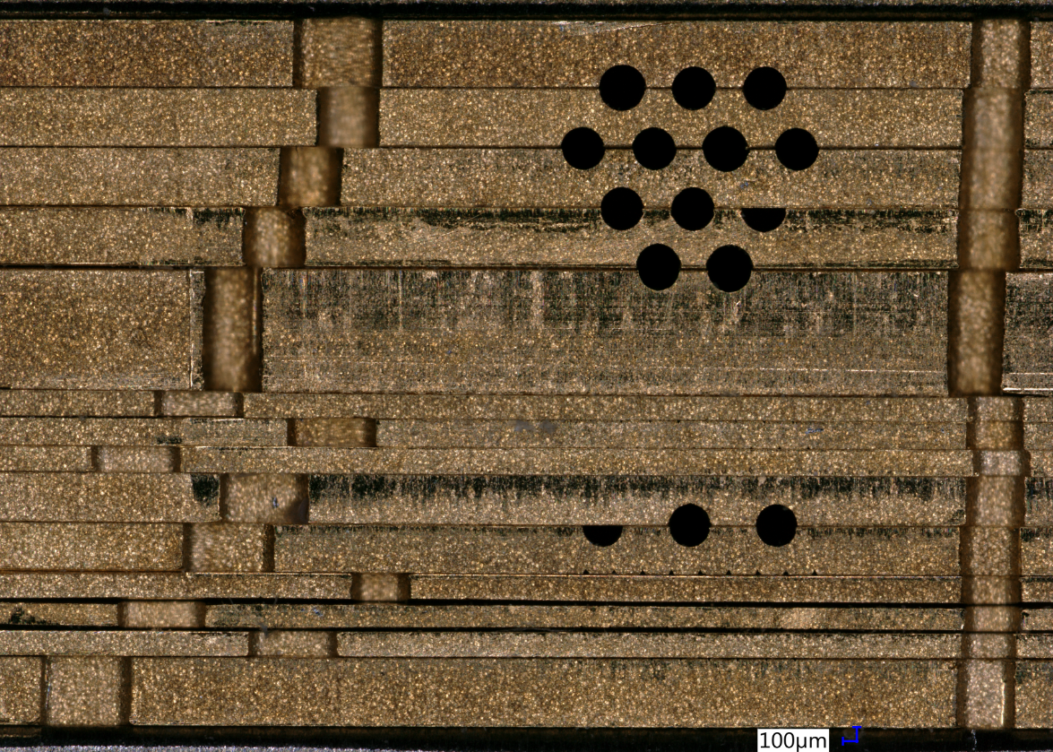
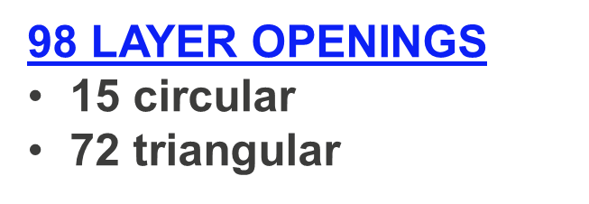
Within the 16 stacked layers of the PHA are the 15 circular and 72 triangular openings.
Ø334 µm
Ø609 µm
Front View
Back View
15 µm
230 µm
Keyence VHX-5000 image of the pinhole array
Notes:
Neutron imaging uses a pinhole camera and it’s probably the funkiest pinhole you’ve ever seen!
The closeup view shows the view of where the pinhole is located close to target chamber center.
The front view is tapered.
The back end faces the detector.
The VHX WAS USED FOR A HIGH ACCURACY STITCHED IMAGE OF THE FRONT AND BACK WITH A CALIBRATED REFERENCE.

Slide 10
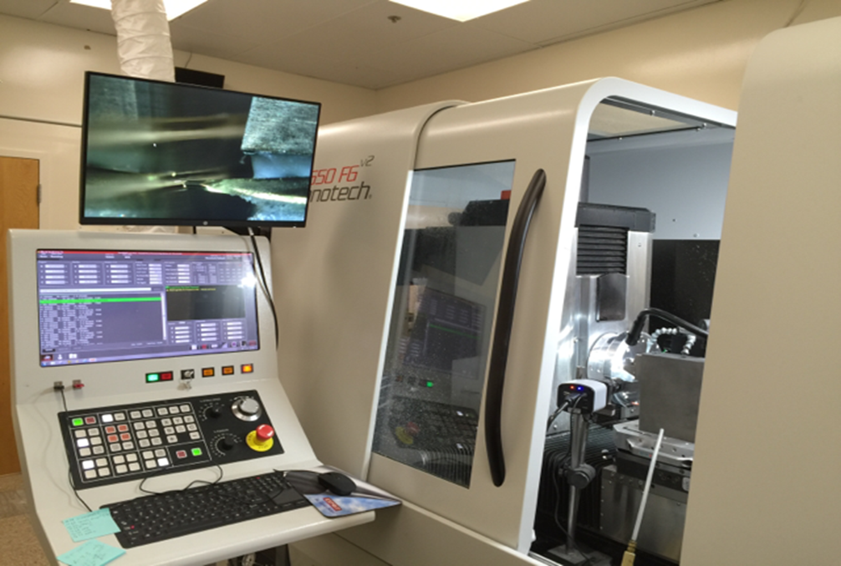
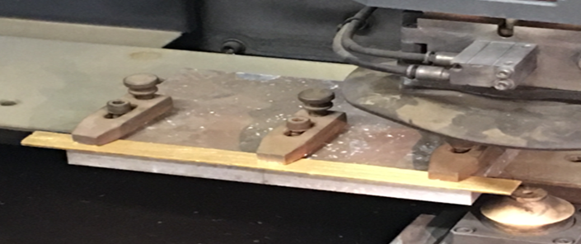
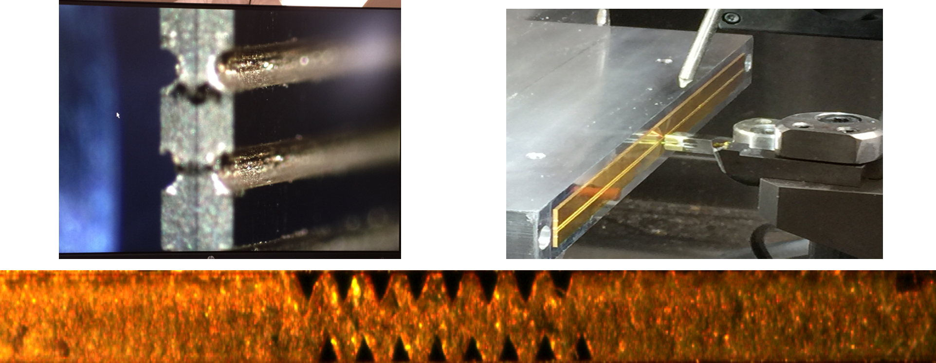
Machining a single gold layer takes on average 2.5 weeks per layer side, with 24 hours of continuous machining for the triangles and 4 days machining for the half-circles.
Fabrication on 4-axis diamond turning lathe
Roughing on a wire EDM
Total machining time was 7 months.
Machining of circular and triangular openings
John I. Martinez, et al. (2018), Fusion Science and Technology, 73:3, 453-457
Notes:
Tungsten layers were fabricated at LLNL.

Slide 11
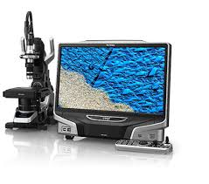
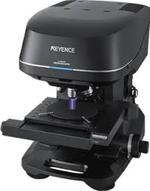
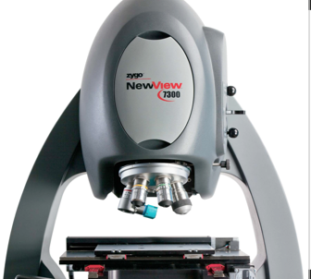
We need four separate instruments to fully
characterize the pinhole array.
KEYENCE
VHX-5000
MEET
THE
METROLOGY
DREAM
TEAM!
Digital microscope
Smartscope
Quest 300
Optical coordinate measuring
system, single point interferometer
KEYENCE
VK-X1000
3D laser scanning confocal
microscope
ZYGO
New View 7300
2 people worked 6 weeks in parallel to characterize the pinhole array.
Non-contact, 3D, scanning
white light interferometer
Notes:
STARTING AT THIS SLIDE IS THE MEAT OF THE TALK!!! The next slides should only take 7 minutes for the 15 minute talk.
We need four instruments because not one instrument will do everything.
Each one only measures a part of the shape of each aperture and we need various things to tie the measurements together to tie them into one model. One establishes references from each machine to tie them all together in a model at the end.
ZYGO -> Non-contact, three-dimensional, scanning white light interferometry (depth profiles)
SMARTSCOPE- optical coordinate measuring system (Edge profiles and datum tracking)
KEYENCE- 3D laser scanning confocal microscope- (shape of triangular and circular grooves)

Slide 12


Each member of the dream team has its own unique qualities and challenges.
KEYENCE
VHX-5000
Large Field of View
Register pixel size beyond
inherent software
Accuracy - 1.1 um
Smartscope
Quest 300
Register datums
Need more space for
complete characterization
Accuracy - 1.3 um
High accuracy
stitched half-circle &
triangle profiles
KEYENCE
VK-X1000
Reflection from
mirror surfaces
Accuracy - 10 nm
ZYGO New
View 7300
Accurate validation
of half-circle profiles
Measures bottom
features only, not sides
Accuracy - 0.1 nm
Notes:
Keyence VK-X1000- Strong raw data!
Optimized for characterizing any material, transparent, mirrored, and complex surfaces and challenging shapes.
Customizable for example staging- we built a vacuum chuck specifically designed to hold the thin, springy gold layer flat for imaging
Measurement accuracy is 0.5nm without vibration
ZYGO
Good for flat surfaces, better Z resolution for evenly reflected surfaces.

Slide 13
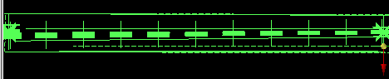
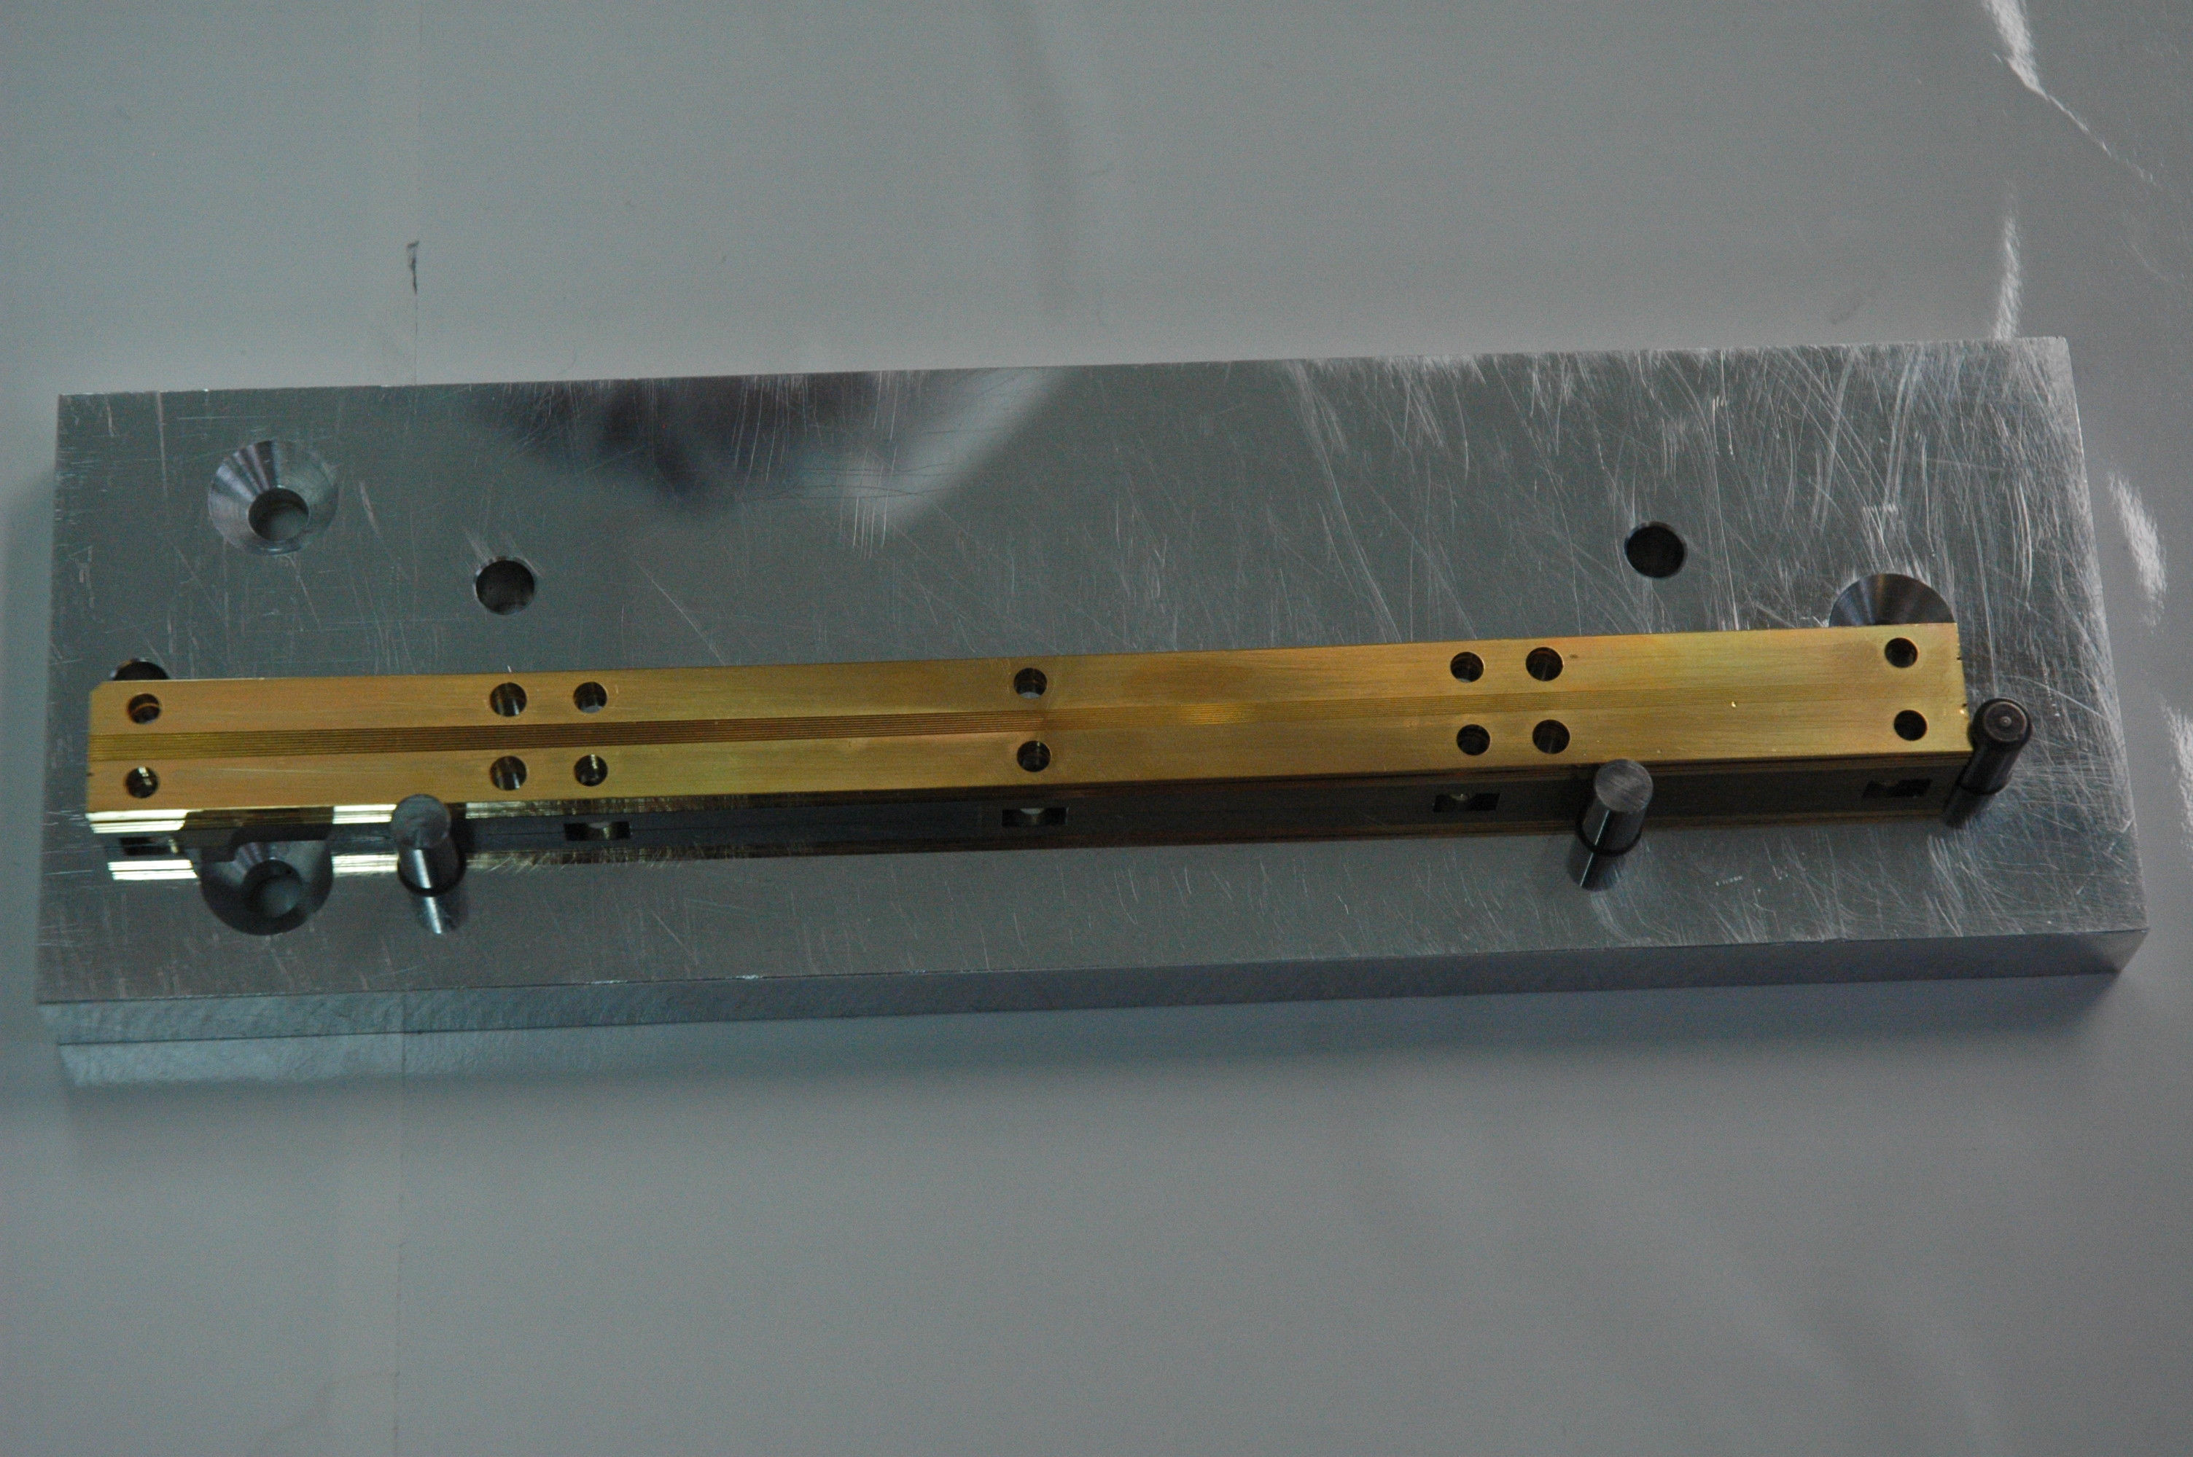
OCMM imaging defines specific locations along the length of the groove.
Q
P
N
E F G H J K L M N P Q
M
L
K
Back
Front (closest to TCC)
J
H
G
Skeleton of the 60⁰ gold, triangular grooves of layer 7.
Notes:
DEREK
1. OCMM face inspections.
2. Add VK scans on top.
3. Match these to the 3D model from the OGP.
The OCMM ties all of the data together from all of dream team!

Slide 14
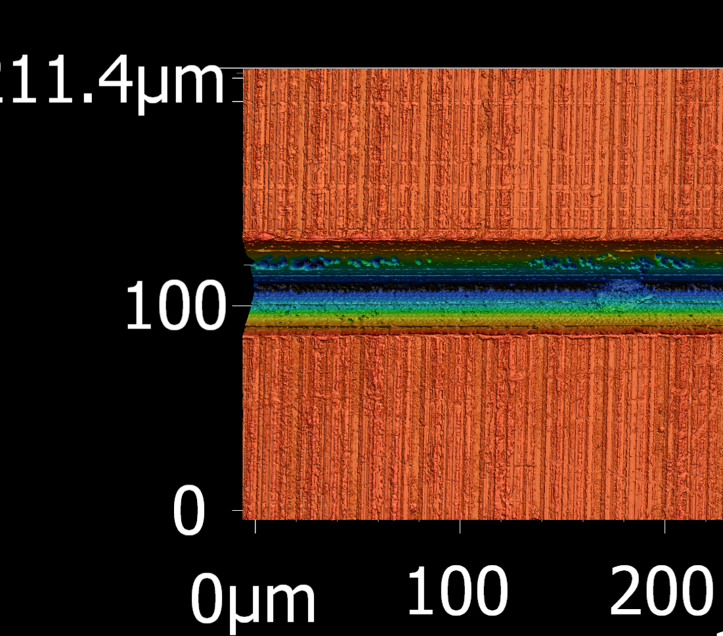
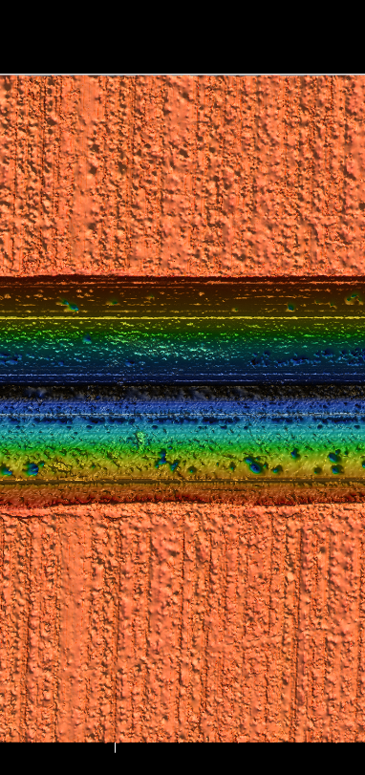
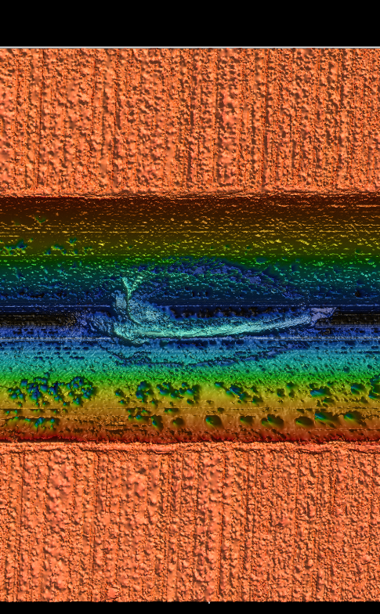
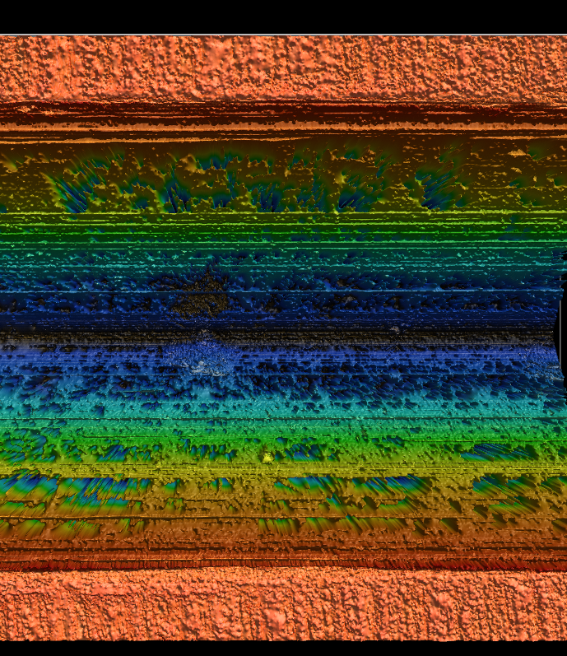
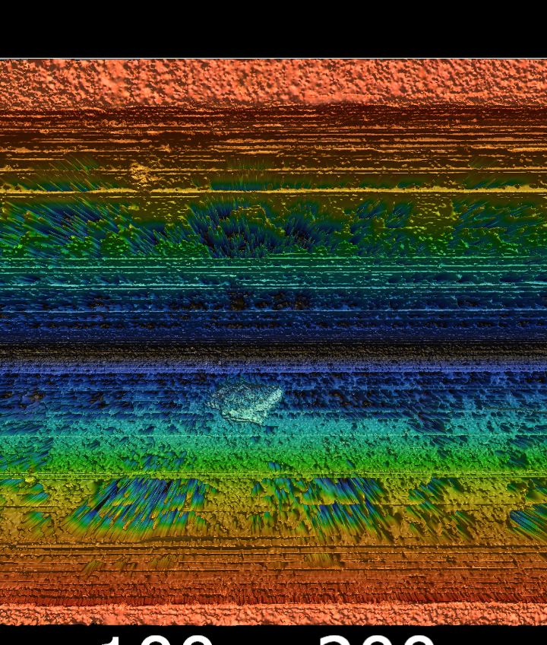
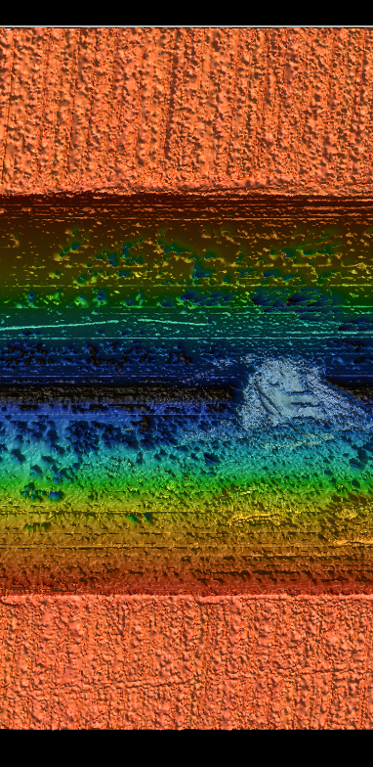
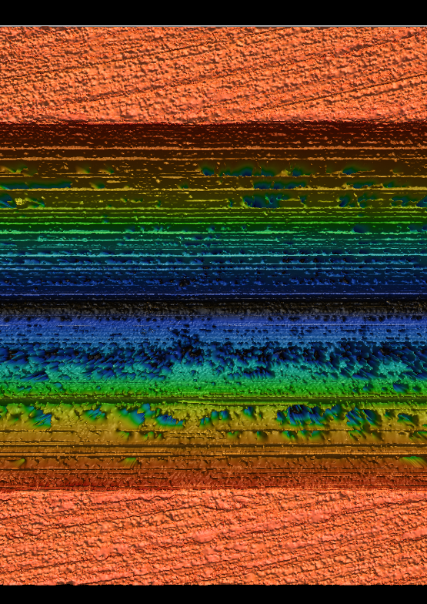
Keyence images of layer 7
(Scans all taken with same magnification)
We need to measure the triangle shape because it changes along the length of the groove.
Front (closest to TCC)
Back
Q P N M L K J H G F E
211
L
P N M L K J H
J
G
Notes:
We need to measure the triangular shape along the length because it changes. (tie this back to requirements)
Physical Scribe marks were added to mark specific locations along the layer.

Slide 15
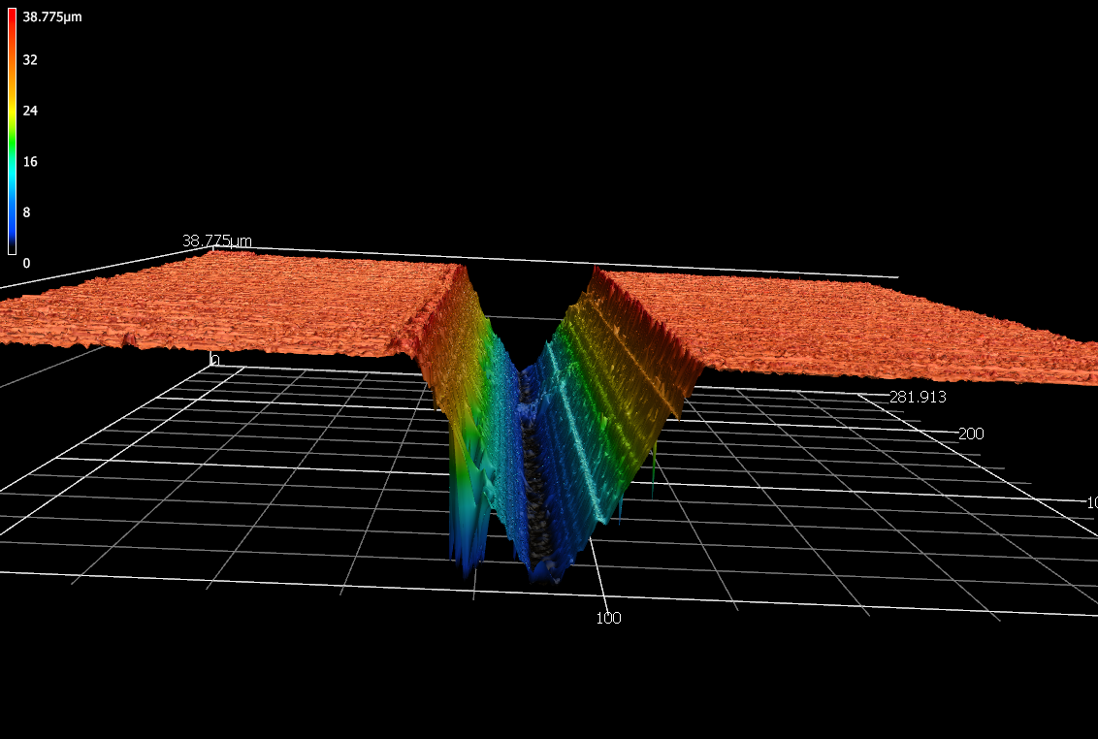
The Keyence images show compromised areas in the gold foil layer.
Upraised berm
Particle
contamination
Q
P
N
Reflection
M
L
K
Bottomed out
J
H
G
Triangular, Layer 7, Aperture 31, Location P
Notes:
Challenges with surfaces- shape of tool or dropping out of plane.
Berm deburred but when see a berm, and the layers are stacked on top of each other, can we torque it down flush?
Due to the mean free path of the neutrons, the neutrons do not see the particle contamination.
Reflective surfaces give extraneous data.
NEXT SLIDE: Bottomed out due to light trap but able to discern the depth based on the data from the sides.

Slide 16
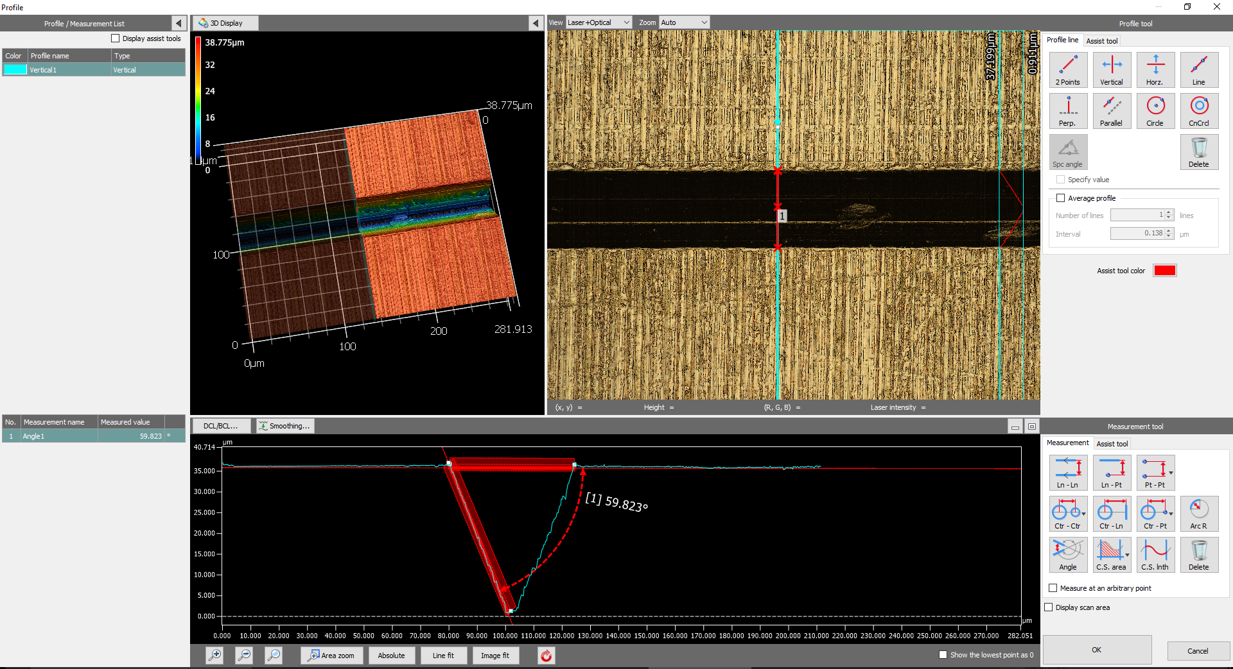
Even though we lose bottom depth, it can be interpolated from the sides.
Q
P
N
M
L
K
J
H
G
Triangular, Layer 7, Aperture 31, Location P

Slide 17
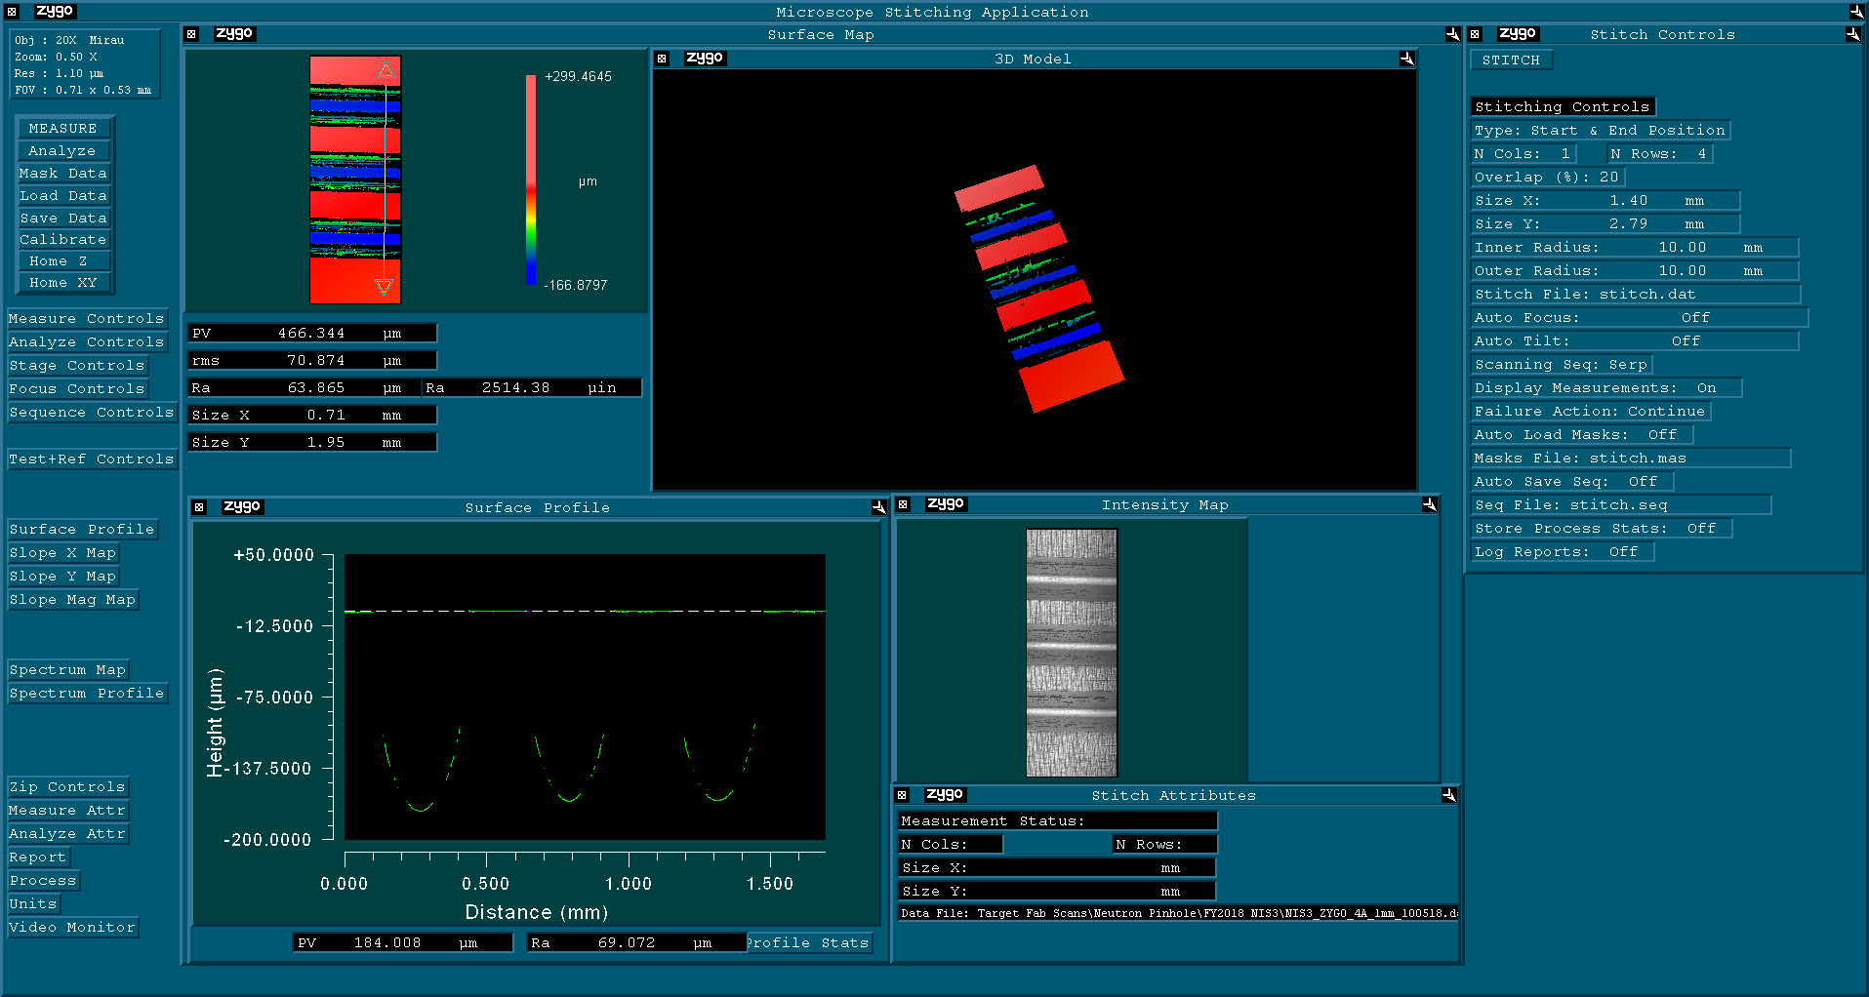
Half-circles, Layer 4, Aperture 8, 1mm in.
ZYGO imaging verifies shape and depth of each half-circle profile.
Q
P
N
M
L
K
J
H
G
Notes:
ZYGO shows where the grooves start and stop and accurate depth of penumbra profiles.

Slide 18
The data from the four images is synthesized into one model.
X,Y,Z data in the form of a .csv file is output from each measurement technique.
Data is sent to the analyst who:
1. Builds a forward model based on the aperture
function of the shape of the aperture.
2. Post-processes the data from the analysis
routine to determine what the actual image is.

Slide 19
Summary
1. Pinhole arrays are evolving to be more complex.
  More lines of site
  More precise shapes
  More apertures
2. Plausible neutron, gamma and x-ray image reconstruction requires
accurate pinhole array metrology.
3. We developed a new metrology protocol by using 4
different instruments to characterize the pinhole array.
4. “ACCURATE METROLOGY IS OF PARAMOUNT IMPORTANCE
TO RELIABLY RECONSTRUCT THE DATA IMAGES”.
Petr Volegov
Notes:
Deconvolution requires a precise understanding of the actual aperture and not just the designed aperture.
With the new PHA and the metrology we’ve done, we now have a picture that shows either end of the PHA and the metrology on the top of it.
The addition of characterization information improves the quality of image reconstruction.

