Slide 1
Contamination Control in the Target Fabrication Cleanroom at the National Ignition Facility
23rd Target Fabrication Specialist Meeting
Annapolis, Maryland
T. Braun¹, B. Butlin¹, E. Piceno¹, K. Clark², E. Giraldez², S. Baxamusa¹, M. Schoff², A. Nikroo¹, M. Stadermann¹ ¹: LLNL, ²: General Atomics
April 26th 2019

Slide 2
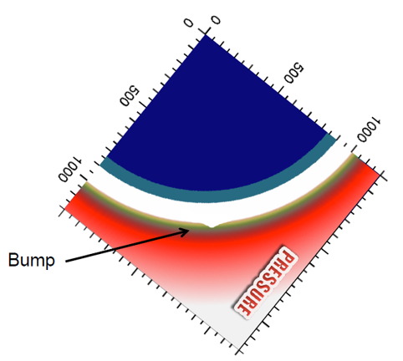
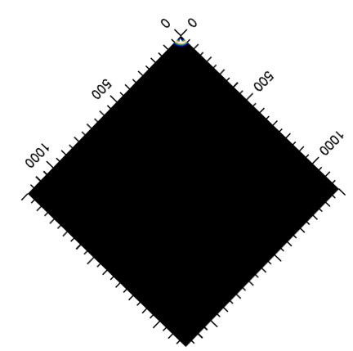
Particles on NIF target capsules can cause instabilities that degrade performance
Images: Steve Haan, LLNL
Video: Louisa Pickworth, LLNL

Slide 3
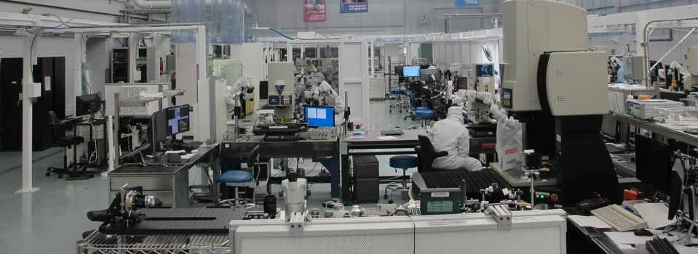
NIF Target assembly is performed in a class 100 cleanroom to produce targets for ICF platform
Class 100 cleanroom
It is crucial that cleanliness levels are measured & tracked and sources of contamination (internal or external) are identified and mitigated

Slide 4
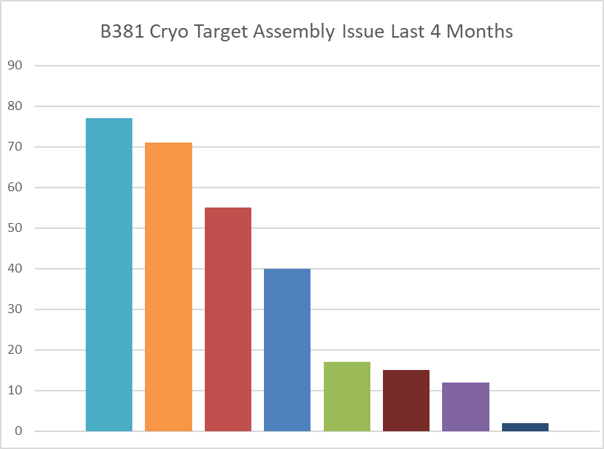
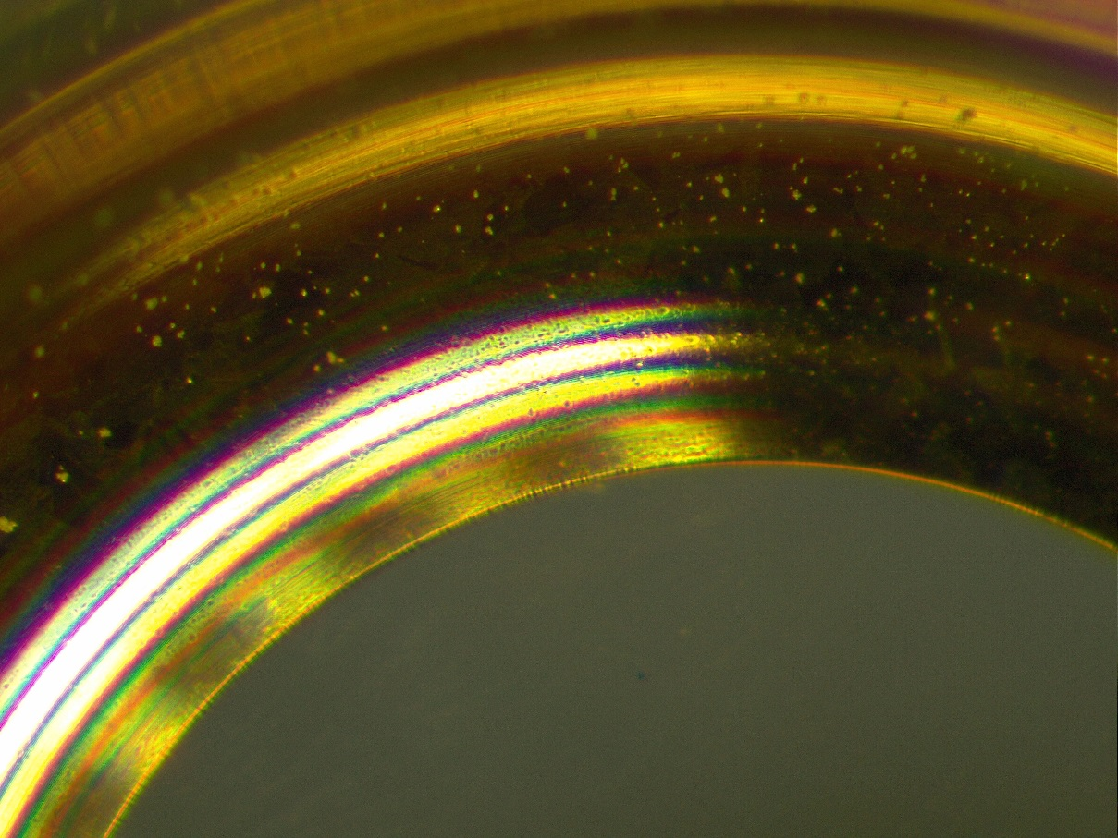
We experienced increased frequency in cleanliness issues which became the primary driver of assembly process issues
Debris exceeded specifications and resulted in lost targets in a few cases and re-work in many cases.
Issues also observed on targets fielded on NIF
We began a systematic effort to identify and mitigate the sources
Internal sources
External sources (components)
We collect metrics that help us understand issues and help us prioritize our resources
Tilted Fill tube &
Particles
Tally of all issues over 4 months in FY2018
Fill tube
cleanliness
32 particles located on the capsule
Debris on hohlraum (external source)
B. Butlin
Overview of Target Production Planning Efforts for the National Ignition Facility (NIF)
C. Walters
Determination of the Location of Particles on Targets Fielded on NIF via Parallax X-ray Imaging

Slide 5
We began systematic data collection and analysis of air borne particles in various parts of assembly floor
Class 10000/ ISO 7
Class 100/ISO 5
Hohlraum line
Capsule line
Final Ass.
Tent line
Live data can be accessed through internal wiki
A comprehensive particle counting system has been set up that measures airborne particles throughout the clean room and at various work stations.

Slide 6
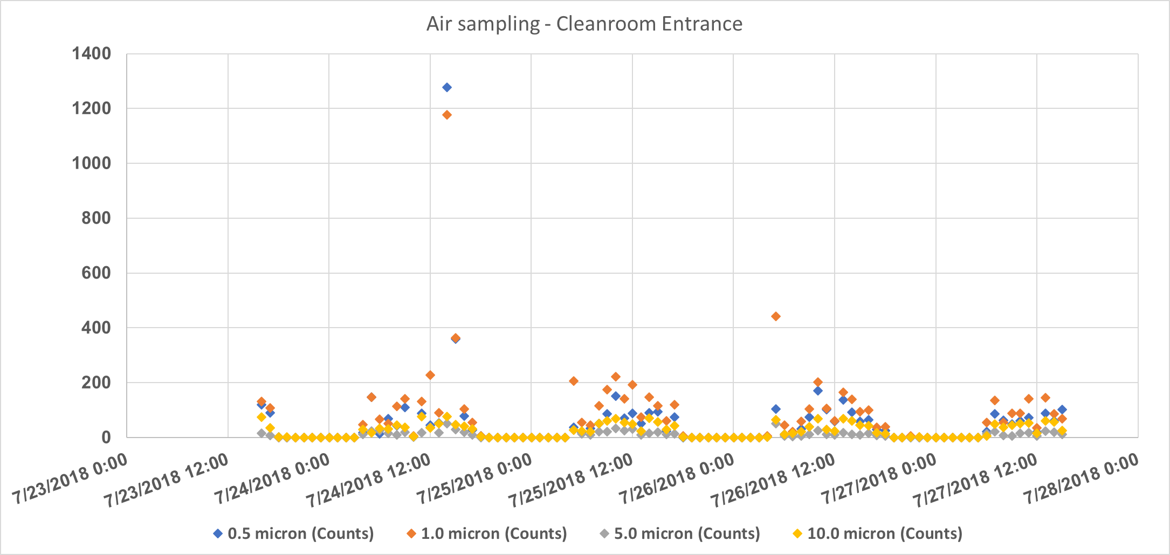
We are able to correlate particle creation to time of day and personnel
Work hours
Work hours
Work hours
Work hours
Airborne particle count increases with personnel entering and exiting the clean room

Slide 7
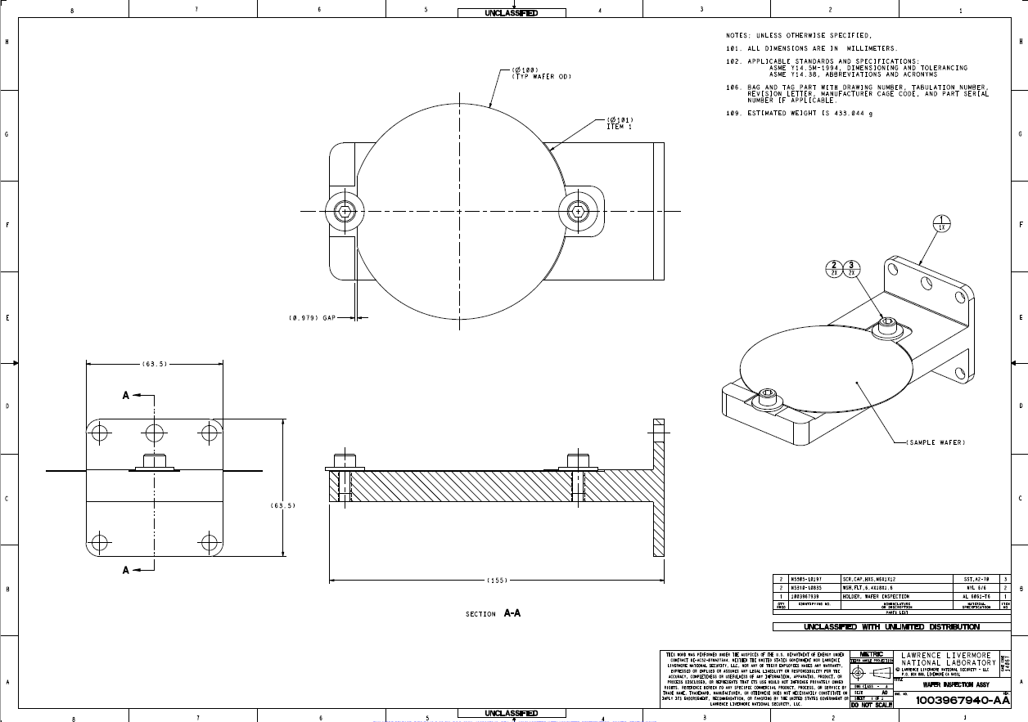
In addition to airborne particle measurement we set up an automated wafer particle analysis
Wafer holder was designed to fit the existing tent metrology system which minimized required modifications to the setup.

Slide 8
In addition to airborne particle measurement we set up an automated wafer particle analysis
Realtime run of particle analysis on wafer

Slide 9
Weekly bright light inspection of each station allows tracking cleanliness process over time
One calendar week
Bright light inspections at each station allow us to quickly:
Track cleanliness progress
Make corrections as needed by prioritizing resources towards that station.

Slide 10
A significant external source of particles entering the cleanroom appeared to be on target components
Debris was found on many parts in proximity to the capsule!
LEHs
TMPs
Hohlraums
Diagnostic Bands
Debris on Hohlraums as received
Debris on Hohlraum packaging

Slide 11
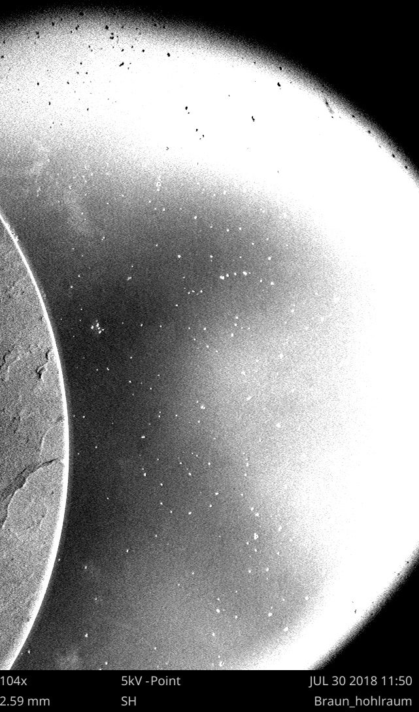
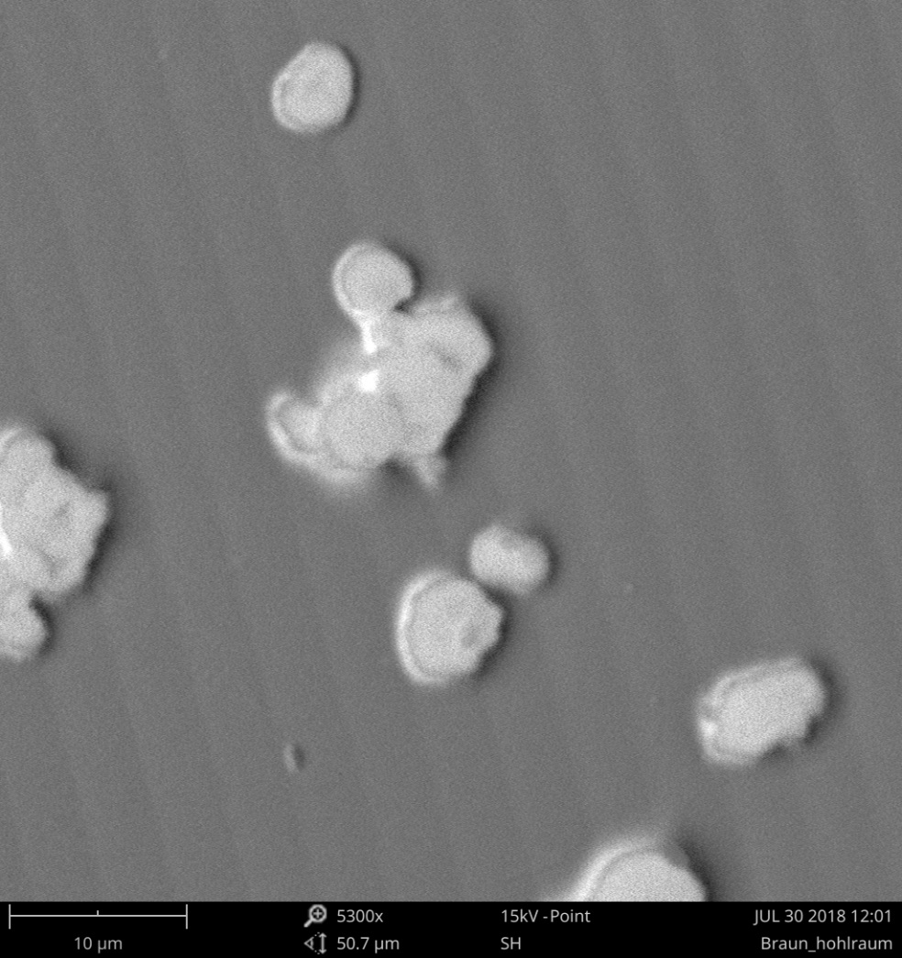
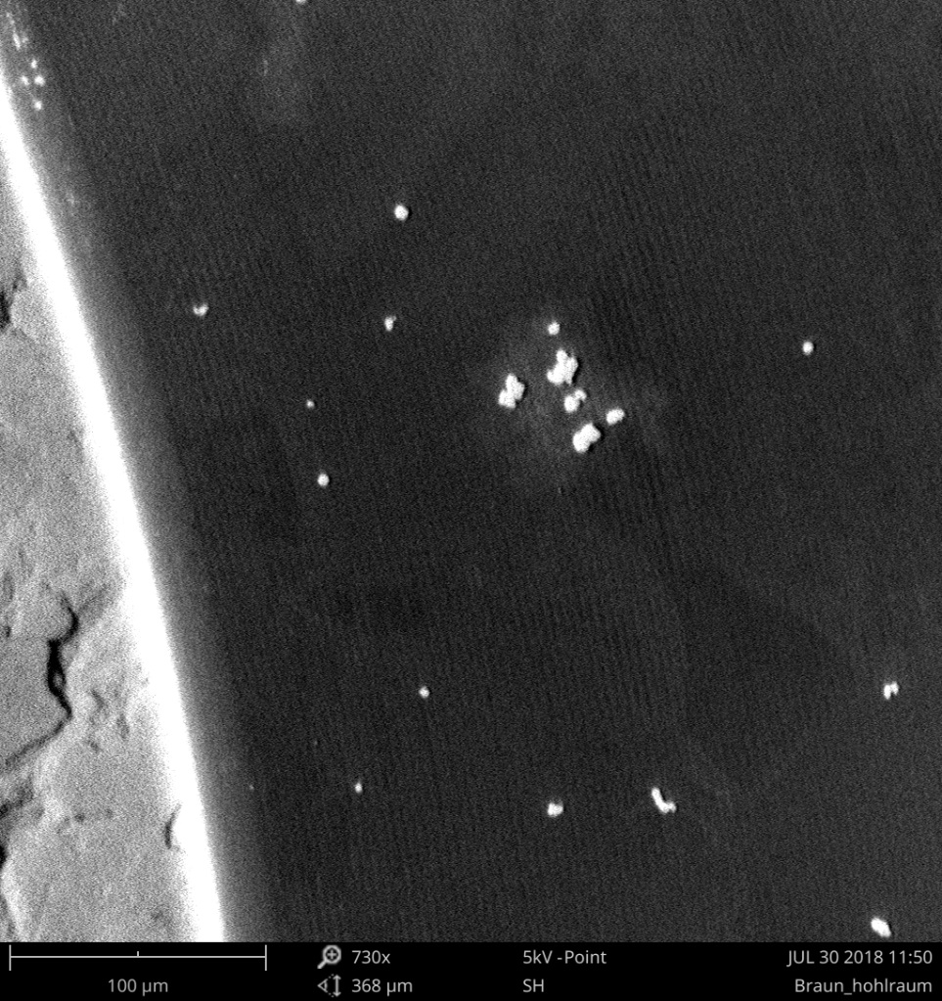
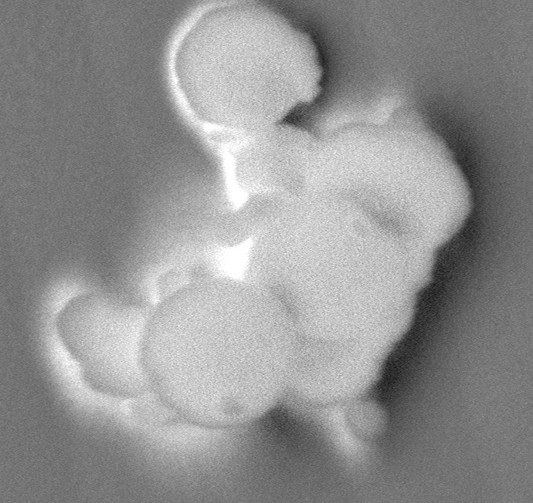
We examined debris observed on as received components to identify the source and a mitigation
hohlraum
particles
Edge of LEH

Slide 12
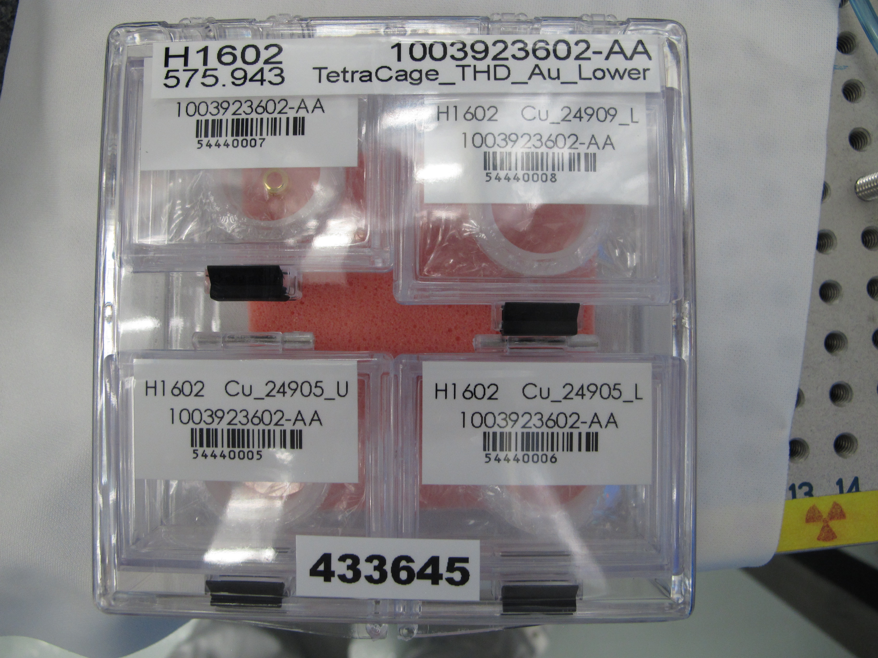
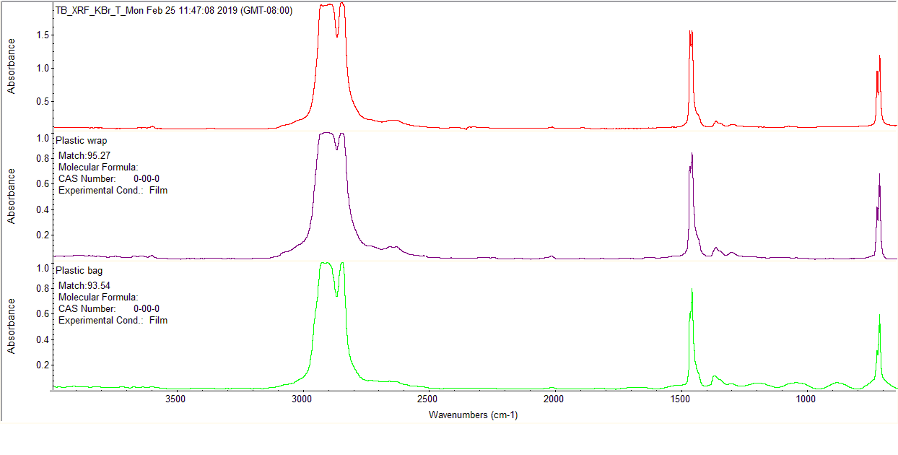
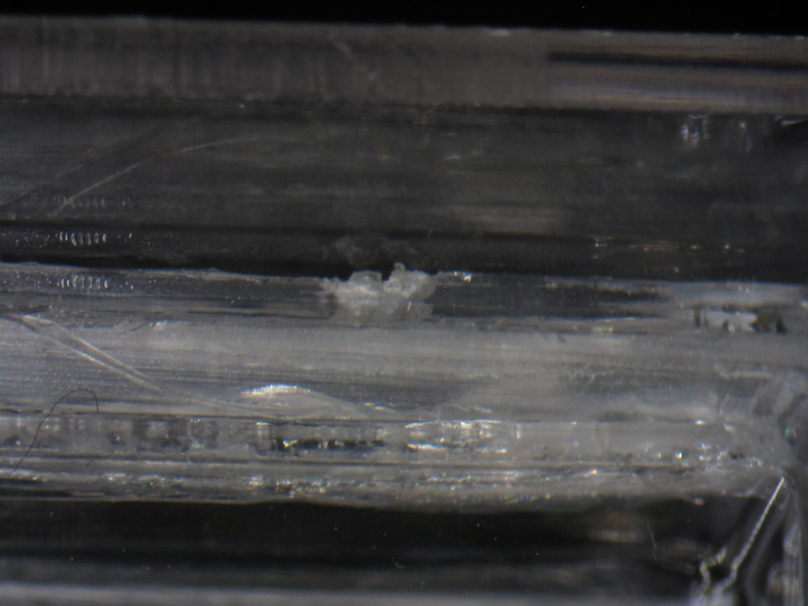
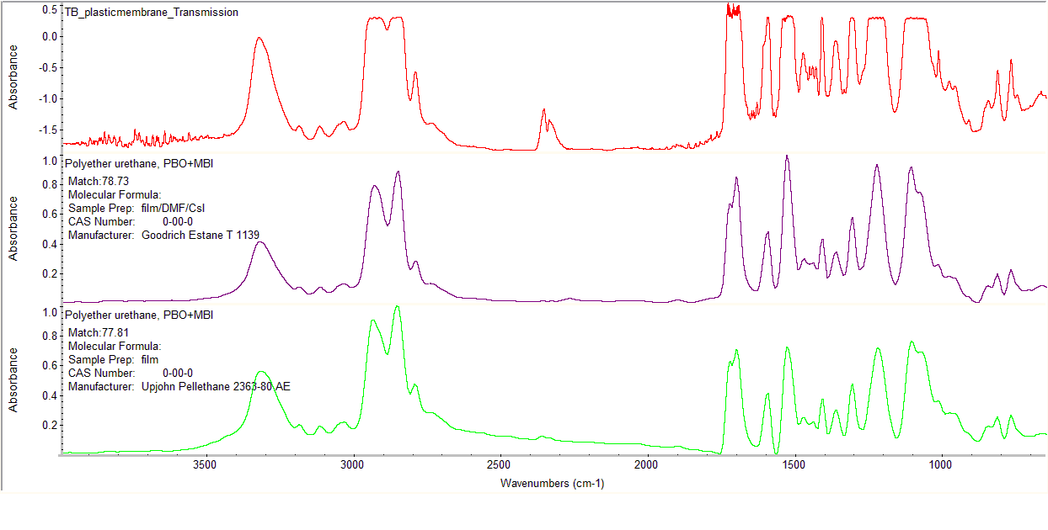
Analysis of particles and holders indicates that contamination might come from packaging
Hohlraum packaging
FTIR analysis of particles and packaging
Si peak

Slide 13
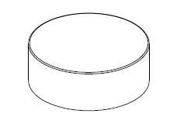
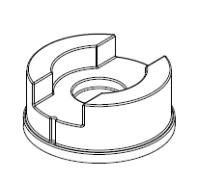
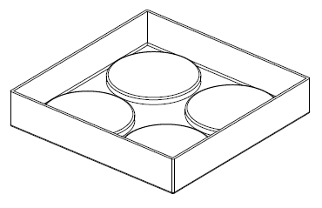
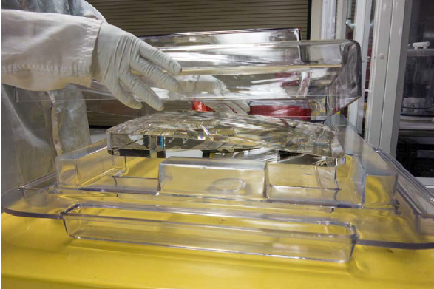
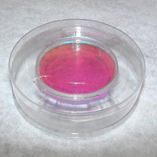
In cooperation with General Atomics, we have designed a cleanable universal packaging container
New universal packaging container is cleanable and can be used for different parts, saving money and effort hours
The design was inspired from the current containers used in the NIF Optics Assembly Building
Container can be used for different parts

Slide 14
We have extended our cleanliness tracking to work with GA components
Closely working with General Atomics allow both groups to track and improve cleanliness
GA is constantly improving their component cleaning process for parts. Overall parts are coming in cleaner.
LEH parts are now packaged differently, visual results looked excellent!

Slide 15
Prioritizing our resources towards cleanliness has led to a significant decrease in cleanliness issues
Tally of all cleanliness issues over the last four quarters in FY2018 / FY2019

Slide 16
We have implemented a number of changes and best practices to track and avoid drift in the cleanliness process both at LLNL and GA
Identified external and internal issues
Packaging and PetG containers are being optimized
Shipping
Component inspection
Gowning
Air Outlets
Facility testing
We are continuously monitoring cleanliness
We are now able to monitor each workstation separately
We have many things that are done correctly
Cleanliness issues are decreasing
Personnel comes forward if they see something

Slide 18
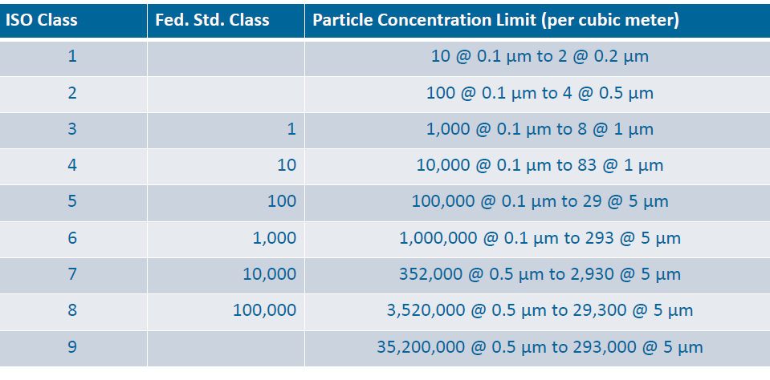
Comparisons of Classifications
Target Fabrication R1600 Cleanroom

