Slide 1
Ionization Waves of Arbitrary Velocity

Slide 2
Ionization waves of arbitrary velocity (IWAV’s) were created using a “flying focus”
A flying focus combines a chirped laser beam and a chromatic lens to make the location of best focus—and therefore peak intensity—move at any arbitrary velocity*
Simulations** and experiments† have demonstrated that a flying focus can create ionization waves that track the velocity of the focus
  superluminal and/or backward IWAV’s mitigate ionization-induced refraction
Applications exploiting the ionization front dynamics include plasma-based laser amplifiers ‡, photon accelerators, and many others

Slide 3

Collaborators and acknowledgments*
P. Franke, S.-W Bahk, I. A. Begishev, R. Boni, J. Bromage,
S. Bucht, A. Davies, D. Haberberger, J. Katz, T. J. Kessler,
A. L. Milder, J. P. Palastro, J. L. Shaw, and D. H. Froula
University of Rochester Laboratory for Laser Energetics
M. Edwards, Q. Jia, K. Qu, and N. Fisch
Princeton University
N. Vafaei-Najafabadi
Stony Brook University
J. Vieira
Instituto Superior Técnico
F. Quéré
CEA Saclay

Slide 4




“Flying focus” is a dynamic focal spot with velocity determined by pulse length, direction of chirp, and amount of chromatic aberration*
$$τ=$$
$$+2l/c$$
$$l$$
Forward subluminal
Time
$$v_{g}$$
$$v_{f}=v_{g}/3$$

Slide 5




“Flying focus” is a dynamic focal spot with velocity determined by pulse length, direction of chirp, and amount of chromatic aberration*
$$τ=$$
$$+2l/c$$
$$l$$
$$τ=$$
$$−2l/c$$
$$l$$
Time
Forward subluminal
Backward, speed of light
Time
$$v_{g}$$
$$v_{g}$$
$$v_{f}=−v_{g}$$
$$v_{f}=v_{g}/3$$

Slide 6



“Flying focus” is a dynamic focal spot with velocity determined by pulse length, direction of chirp, and amount of chromatic aberration*
$$τ=$$
$$+2l/c$$
$$l$$
$$τ=$$
$$−2l/c$$
$$l$$
$$τ=$$
$$−l/c$$
$$l$$
Time
Time
Forward subluminal
Backward, speed of light
Line focus (“infinite”)
Time
$$v_{g}$$
$$v_{g}$$
$$v_{f}=∞$$
$$v_{f}=−v_{g}$$
$$v_{f}=v_{g}/3$$

Slide 7
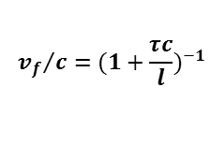
Any velocity is achievable, both forward and backward relative to the laser
$${v_{f}}/c={(1+\frac{τc}{l})}^{−1}$$
ex. 3

Slide 8
Any velocity is achievable, both forward and backward relative to the laser
$${v_{f}}/c={(1+\frac{τc}{l})}^{−1}$$
ex. 3
Forward superluminal

Slide 9
Any velocity is achievable, both forward and backward relative to the laser
$${v_{f}}/c={(1+\frac{τc}{l})}^{−1}$$
ex. 3
ex. 1
Forward subluminal

Slide 10
Any velocity is achievable, both forward and backward relative to the laser
$${v_{f}}/c={(1+\frac{τc}{l})}^{−1}$$
ex. 3
Backward superluminal
ex. 1

Slide 11
Any velocity is achievable, both forward and backward relative to the laser
$${v_{f}}/c={(1+\frac{τc}{l})}^{−1}$$
ex. 3
Backward subluminal
ex. 1
ex. 2

Slide 12





An experiment was performed using the flying focus to produce ionization waves of arbitrary velocity (IWAV’s) in ambient air
Multi-Terawatt laser
SHG
A 25.5-mJ pump gave intensities in the low- to mid-10¹⁴ W/cm² (sufficient to form a spark in air)
It was diagnosed with spectrally resolved schlieren (1-D spatial, 1-D spectral)
The linearly chirped probe equated spectral resolution with temporal resolution
Chirped probe (2$ω$)
z
Chirped pump (1$ω$)
$$z$$
Schlieren stop
$$dz/dt$$
Imaging spectrometer
$λ$ = time

Slide 13
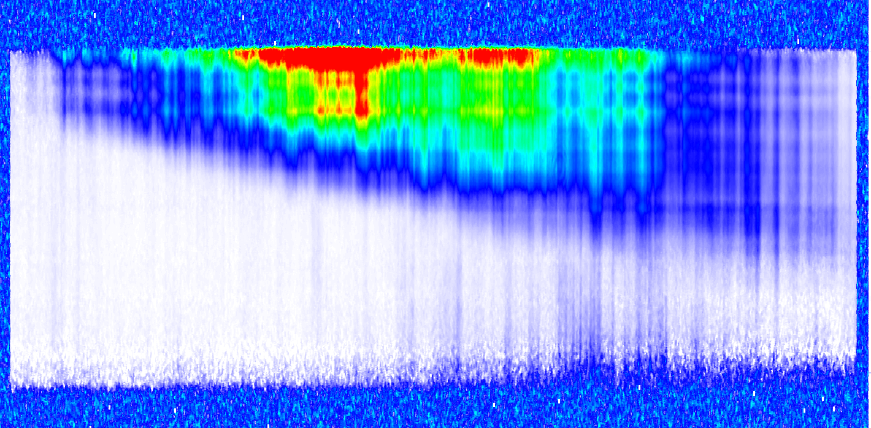
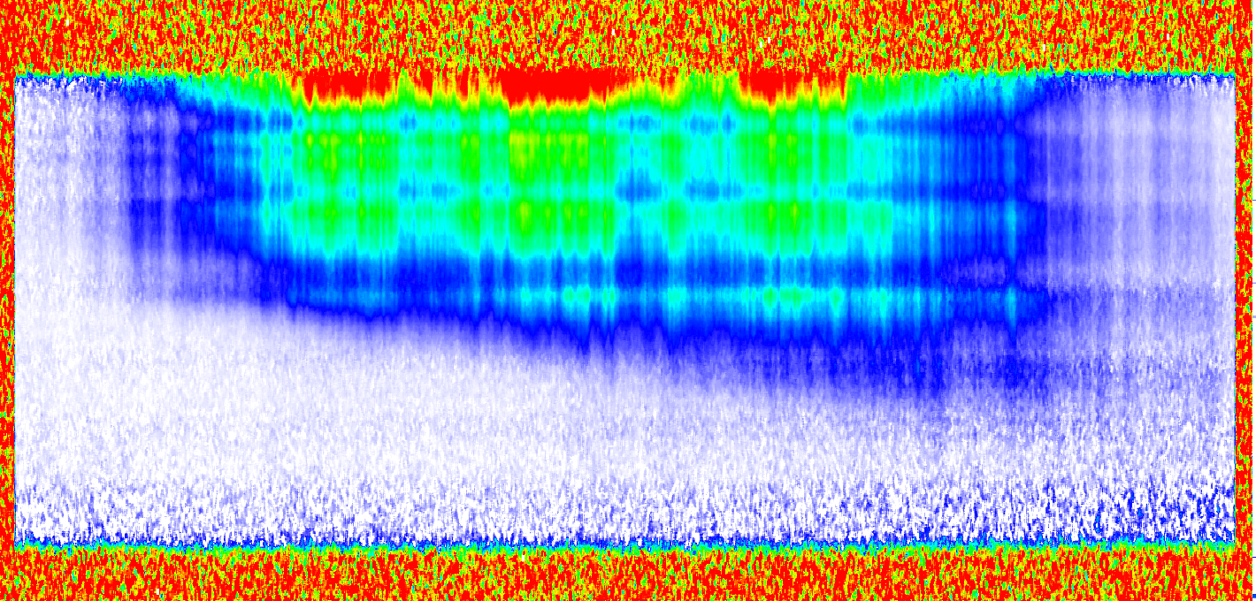
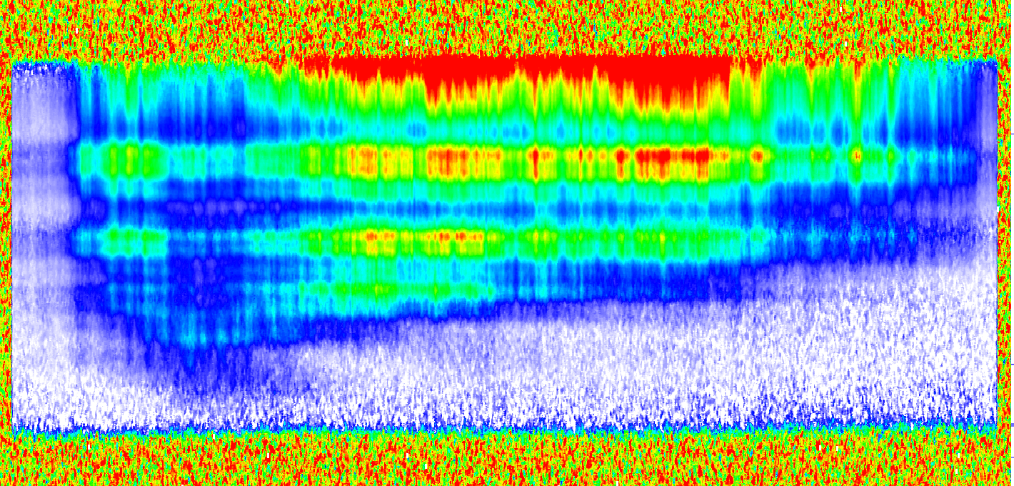
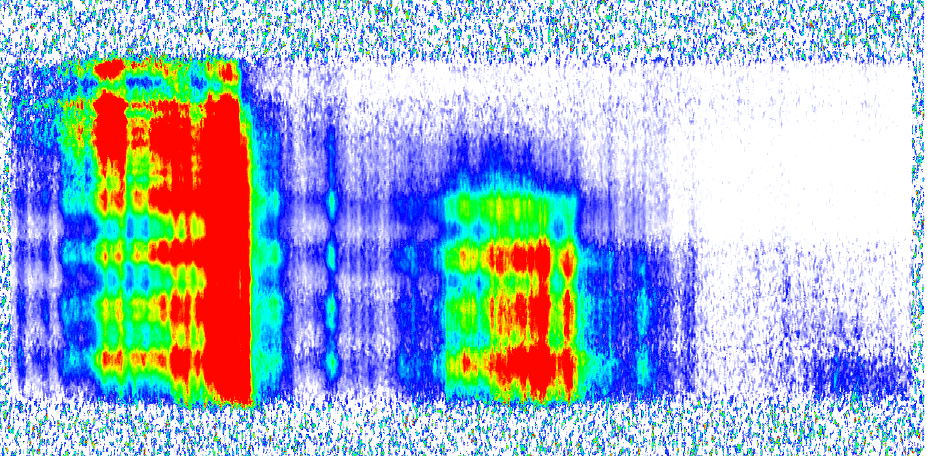









Subluminal to superluminal IWAV’s were demonstrated, both forward and backward relative to the laser
$τ≈−31$ps
$τ≈−22$ps
-5
-5
0
$$v/c = −0.92±0.13$$
$$v/c = −1.78±0.13$$
0
5
Time (ps)
Time (ps)
10
5
15
10
20
15
$τ≈−10$ps
$τ≈+20$ps
0
10
$$v/c = +3.8±0.6$$
15
$$v/c = +0.44±0.1$$
20
Time (ps)
Time (ps)
5
25
10
30
-2
-1
0
1
2
-2
-1
0
1
2
$z$(mm)
$z$(mm)

Slide 14
Subluminal to superluminal IWAV’s were demonstrated, both forward and backward relative to the laser
$τ≈−31$ps
$τ≈−22$ps
-5
-5
0
$$v/c = −0.92±0.13$$
$$v/c = −1.78±0.13$$
0
5
Time (ps)
Time (ps)
10
5
15
10
20
15
$τ≈−10$ps
$τ≈+20$ps
Ionization-induced refraction
0
10
$$v/c = +3.8±0.6$$
15
$$v/c = +0.44±0.1$$
20
Time (ps)
Time (ps)
5
25
10
30
-2
-1
0
1
2
-2
-1
0
1
2
$z$(mm)
$z$(mm)

Slide 15







Superluminal and/or backward IWAV propagation mitigates ionization-induced refraction, facilitating the creation of long, uniform, laser-produced plasmas
2-D schlieren
2-D shadowgraphs
200
(a) $τ ≈ −17$ ps, (~line focus)
$y$(μm)
0
-200
200
(b) $τ ≈ +20$ ps (subluminal forward)
$y$(μm)
0
-200
200
(c) $τ =$ best compression
$y$(μm)
0
-200
-2
-1
0
1
2
-2
-1
0
1
2
$z$(mm)
$z$(mm)

Slide 16
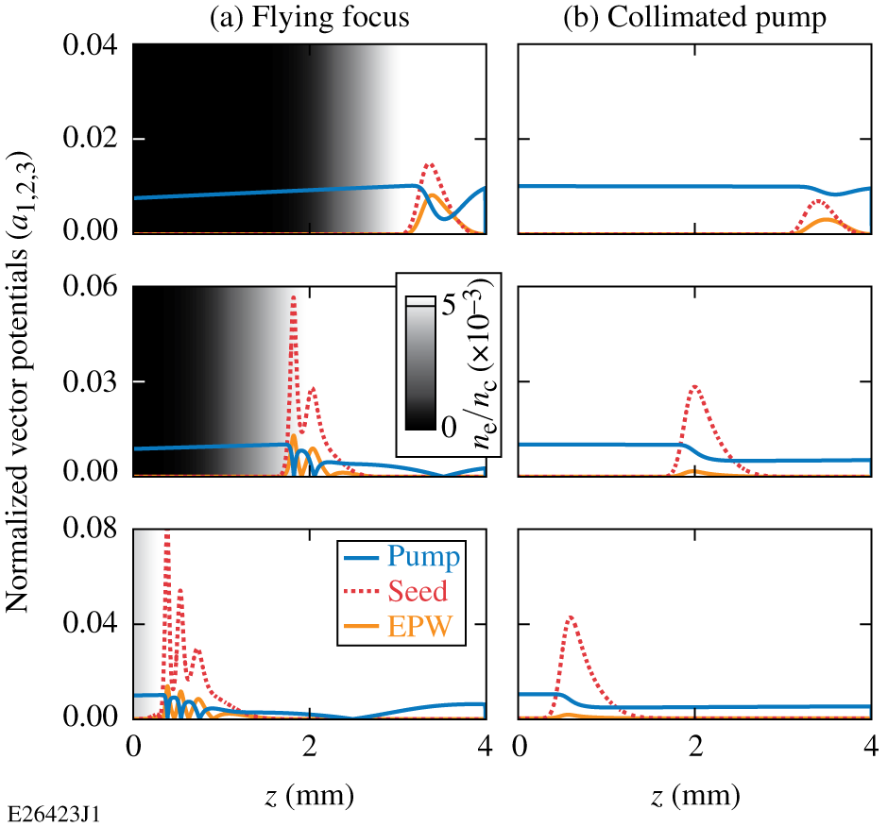
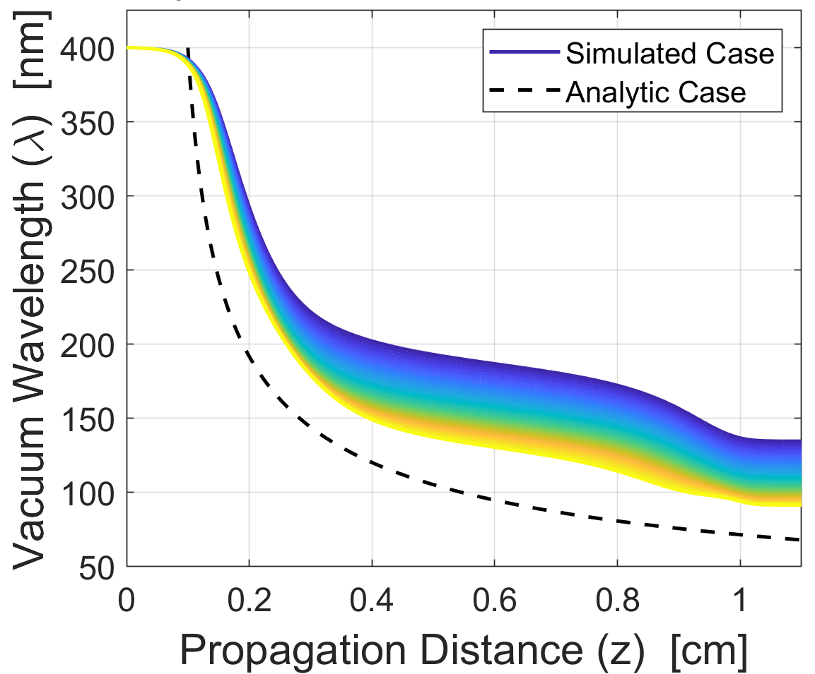





Applications of IWAV’s include plasma-based laser amplifiers and photon acceleration
Raman amplification*
Photon acceleration**
$n_{e,max}$ ($ηmin$)
$$v_{φ}$$
$$n_{e}$$
$n_{e}=0$($η=1$)
$$ξ=ct−z$$

Slide 17
Ionization waves of arbitrary velocity (IWAV’s) were created using a “flying focus”
A flying focus combines a chirped laser beam and a chromatic lens to make the location of best focus—and therefore peak intensity—move at any arbitrary velocity*
Simulations** and experiments† have demonstrated that a flying focus can create ionization waves that track the velocity of the focus
  superluminal and/or backward IWAV’s mitigate ionization-induced refraction
Applications exploiting the ionization front dynamics include plasma-based laser amplifiers ‡, photon accelerators, and many others

Slide 18












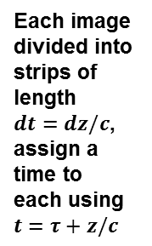
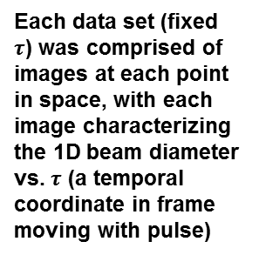






An experiment was performed using a low intensity beam to confirm the expected focal spot dynamics
Lens translated to image different positions
$$l$$
IR ultrafast streak camera
$z_{1}$…
$$z_{5}$$
Object plane
Image plane
Each data set (fixed $τ$) was comprised of images at each point in space, with each image characterizing the 1D beam diameter vs. $τ$ (a temporal coordinate in frame moving with pulse)
$$z_{2}$$
Each image divided into strips of length $dt=dz/c$, assign a time to each using $t=τ+z/c$
Regroup such that each frame represents a single point in time but every point in space
$$z_{2}$$
$$t_{1}$$
$$t_{5}$$
$$z_{3}$$
$t_{0}$…
$$z_{3}$$
$$t_{2}$$
$$r$$
$$z_{4}$$
$$t_{6}$$
$z_{1}$…
$$z_{5}$$
$t_{1}$…
$$τ$$

Slide 19
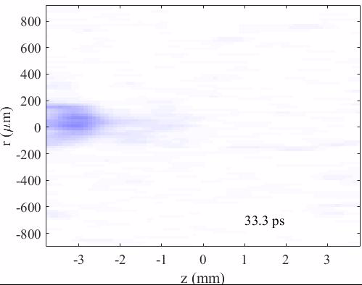
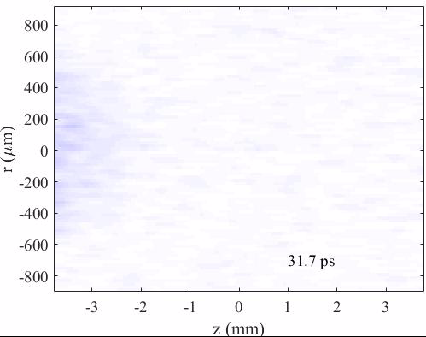


The resulting movies show the effect of the flying focus
$τ=+61.5 ps$, $v/c=+0.2$
$τ=−52.2 ps$, $v/c=−.51$

Slide 20

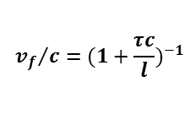



The measured velocities agreed with the expected analytic formula
Normalized pulse length $τc/l$
-4
-3
-2
-1
1
2
3
4
5
40
Subluminal backward
Subluminal forward
Superluminal forward
Superluminal backward
30
Any velocity is achievable, from $−∞$ to $+∞$
$$v_{f}/c$$
10
$${v_{f}}/c={(1+\frac{τc}{l})}^{−1}$$
0
-10
-60
-40
-20
20
40
60
Pulse length $τ$ (ps)

