Slide 1
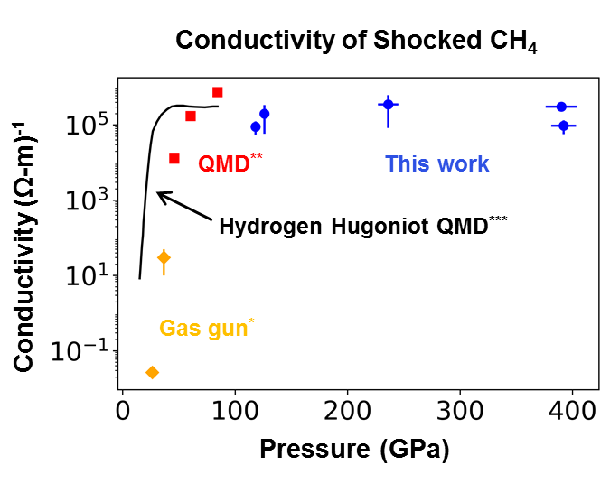
Equation of State and Metallization of Methane Shock-Compressed to 400 GPa
60th Annual Meeting of the American Physical Society Division of Plasma Physics
Portland, OR
5-9 November, 2018
G. Tabak
University of Rochester
Laboratory for Laser Energetics

Slide 2
We present Hugoniot EOS and conductivity data on methane to 400 GPa
Methane is a major constituent of icy giant planets; its high-pressure behavior is important to evolutionary models
Methane samples were precompressed in diamond-anvil cells and shocked using the OMEGA 60* and GEKKO XII** lasers
The compressibility of shocked methane changes at ~50-100 Gpa
We observed an insulator-conductor transition at the same conditions

Slide 3
Coauthors
G. TABAK,¹ M. A. MILLOT,² S. HAMEL,² T. OGAWA,⁴ P. M. CELLIERS,² D. E. FRATANDUONO,² A. LAZICKI,²
D. SWIFT,² S. BRYGOO,³ P. LOUBEYRE,³ T. R. BOEHLY,¹ L. CRANDALL,¹ B. HENDERSON,¹ M. ZAGHOO,¹ S. ALI,²
R. KODAMA,⁴ K. MIYANISHI,⁴ N. OZAKI,⁴ T. SANO,⁴ R. JEANLOZ,⁵ D. G. HICKS,⁶ G. W. COLLINS,¹ J. H. EGGERT,² and J. R. RYGG¹
¹University of Rochester, Laboratory for Laser Energetics
²Lawrence Livermore National Laboratory
³Commissariat a l’energie atomique et aux énergies alternatives (CEA)
⁴University of Osaka
⁵University of California, Berkeley
⁶Swinburne University of Technology

Slide 4
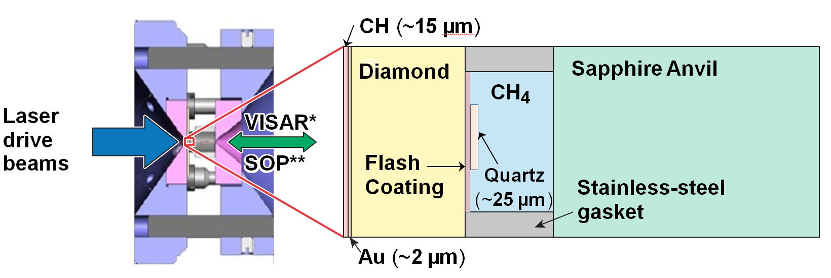
Methane samples were precompressed in diamond-anvil cells (DAC’s) and shocked using the OMEGA 60 and GEKKO XII lasers
Shock velocity, reflectance, and self-emission were measured using the velocity interferometer system for any reflector (VISAR) and streak optical pyrometry (SOP)
Quartz was used as a material standard for the Hugoniot and temperature measurements

Slide 5
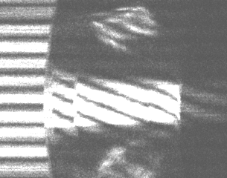
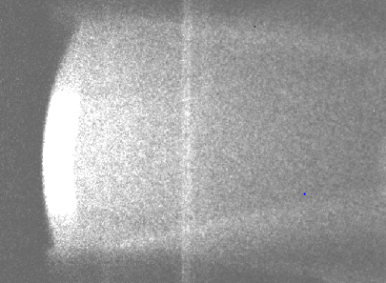
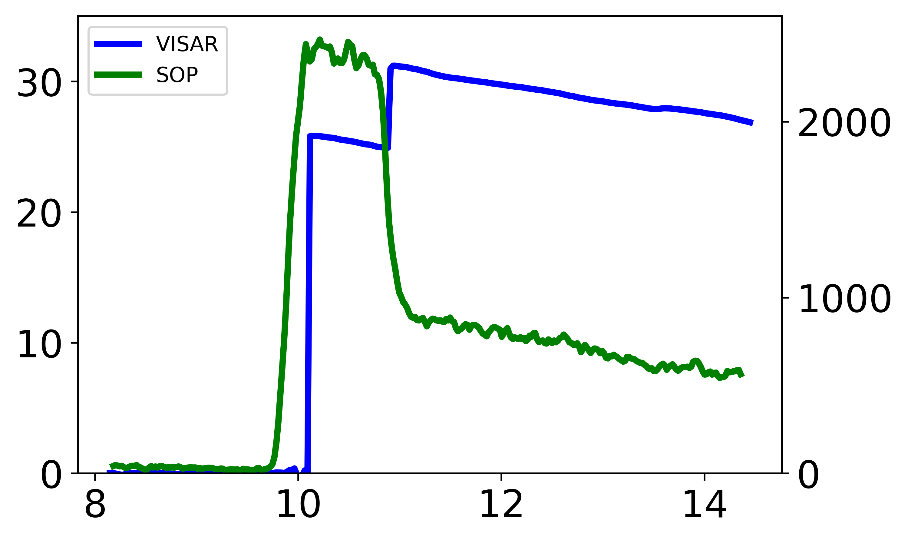
VISAR and SOP simultaneously measured the shock velocity and self-emission of the target, respectively
VISAR Streak Record
SOP Streak Record
Combined VISAR and SOP plots
CH₄ → Sapphire
C→Quartz
Quartz→CH₄
x
Velocity (km/s)
SOP Counts
Quartz→CH₄
C→Quartz
t
Time (ns)
EOS is derived from shock velocities in quartz and methane via impedance matching
Methane self-emission is referenced to quartz for temperature measurements
VISAR fringe amplitude provides the reflectance (referenced to quartz) and this is used to model both quartz and methane as a gray-body

Slide 6
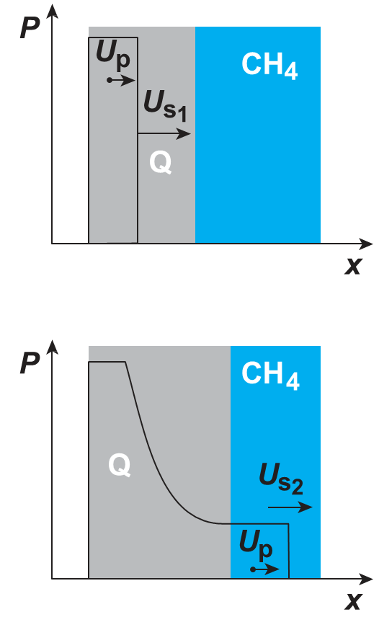
The impedance-matching method relies on the shock and release behaviors of a known standard
Rankine–Hugoniot equations
$$\frac{ρ}{ρ_{0}}=\frac{U_{s}}{U_{s}−U_{p}}$$
$$P−P_{0}=ρ_{0}U_{s}U_{p}$$
$$E−E_{0}=\frac{1}{2}(P+P_{0}) \left(1/{ρ_{0}}−1/ρ\right)$$

Slide 7
The impedance-matching method relies on the shock and release behaviors of a known standard
Rankine–Hugoniot equations
$$\frac{ρ}{ρ_{0}}=\frac{U_{s}}{U_{s}−U_{p}}$$
$$P−P_{0}=ρ_{0}U_{s}U_{p}$$
$$E−E_{0}=\frac{1}{2}(P+P_{0}) \left(1/{ρ_{0}}−1/ρ\right)$$

Slide 8
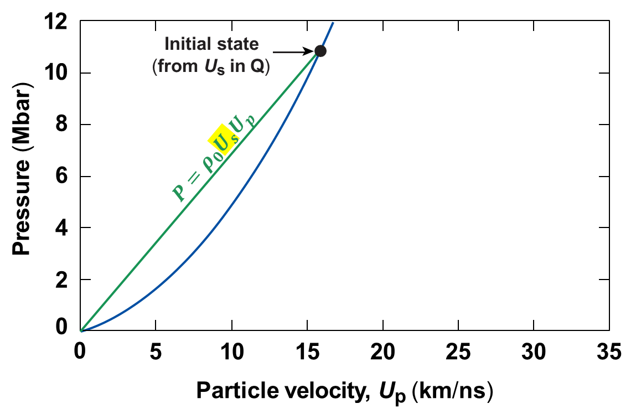
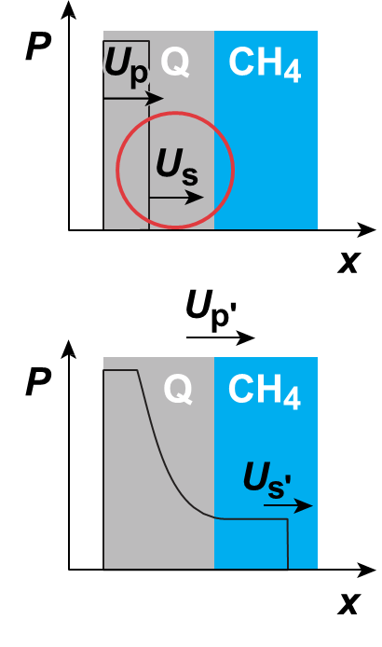
Equation-of-state data are obtained from the impedance-matching technique

Slide 9
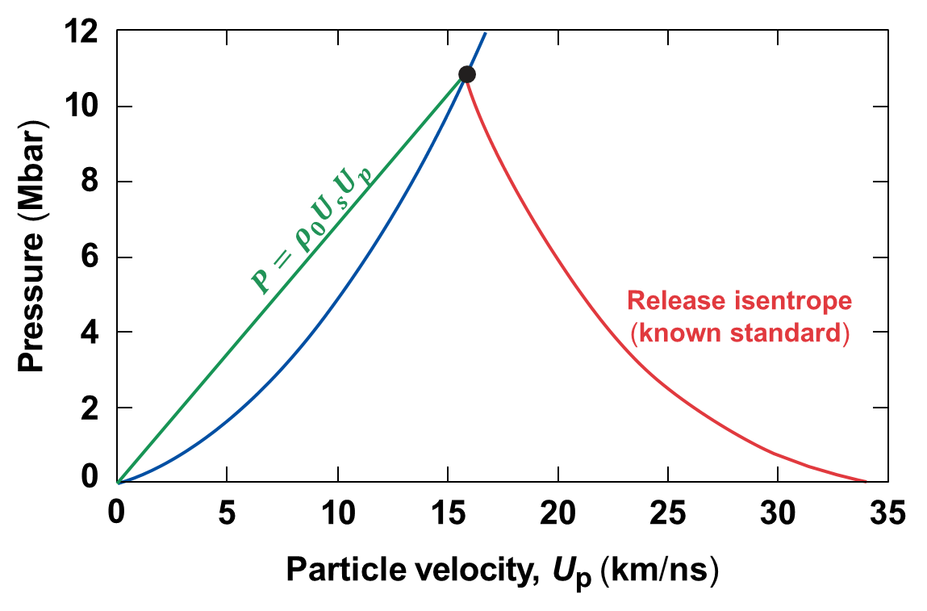
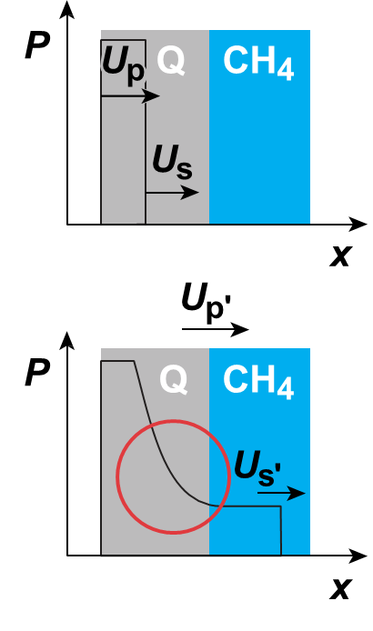
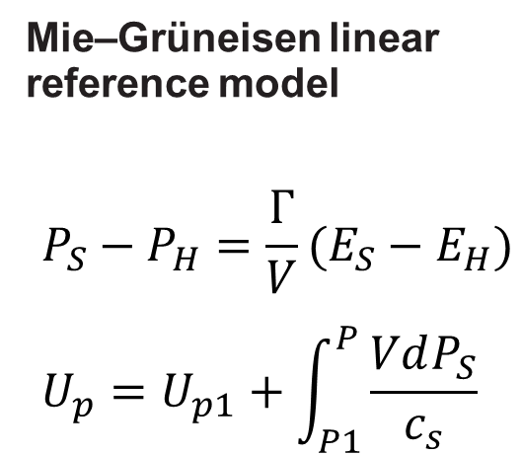
Equation-of-state data are obtained from the impedance-matching technique

Slide 10
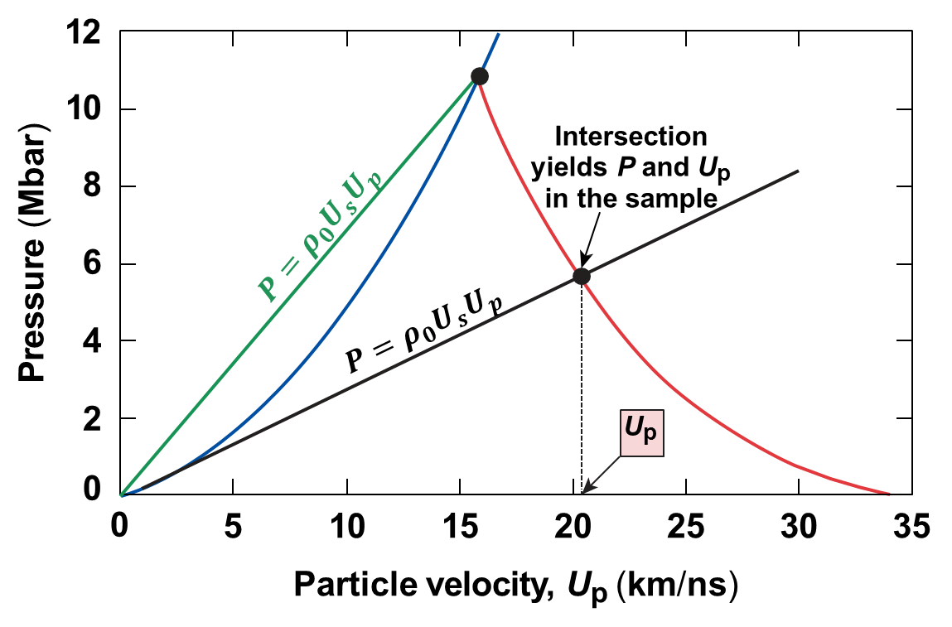
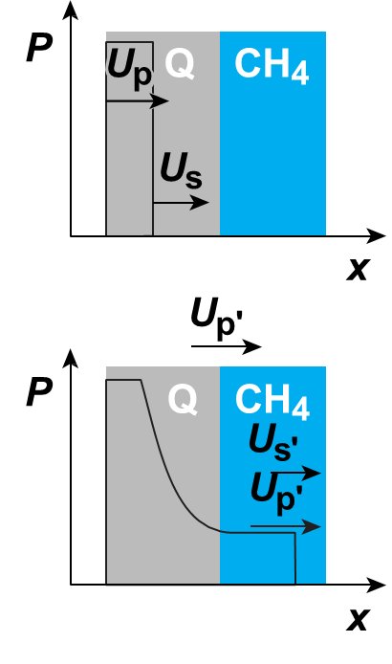
Equation-of-state data are obtained from the impedance-matching technique

Slide 11
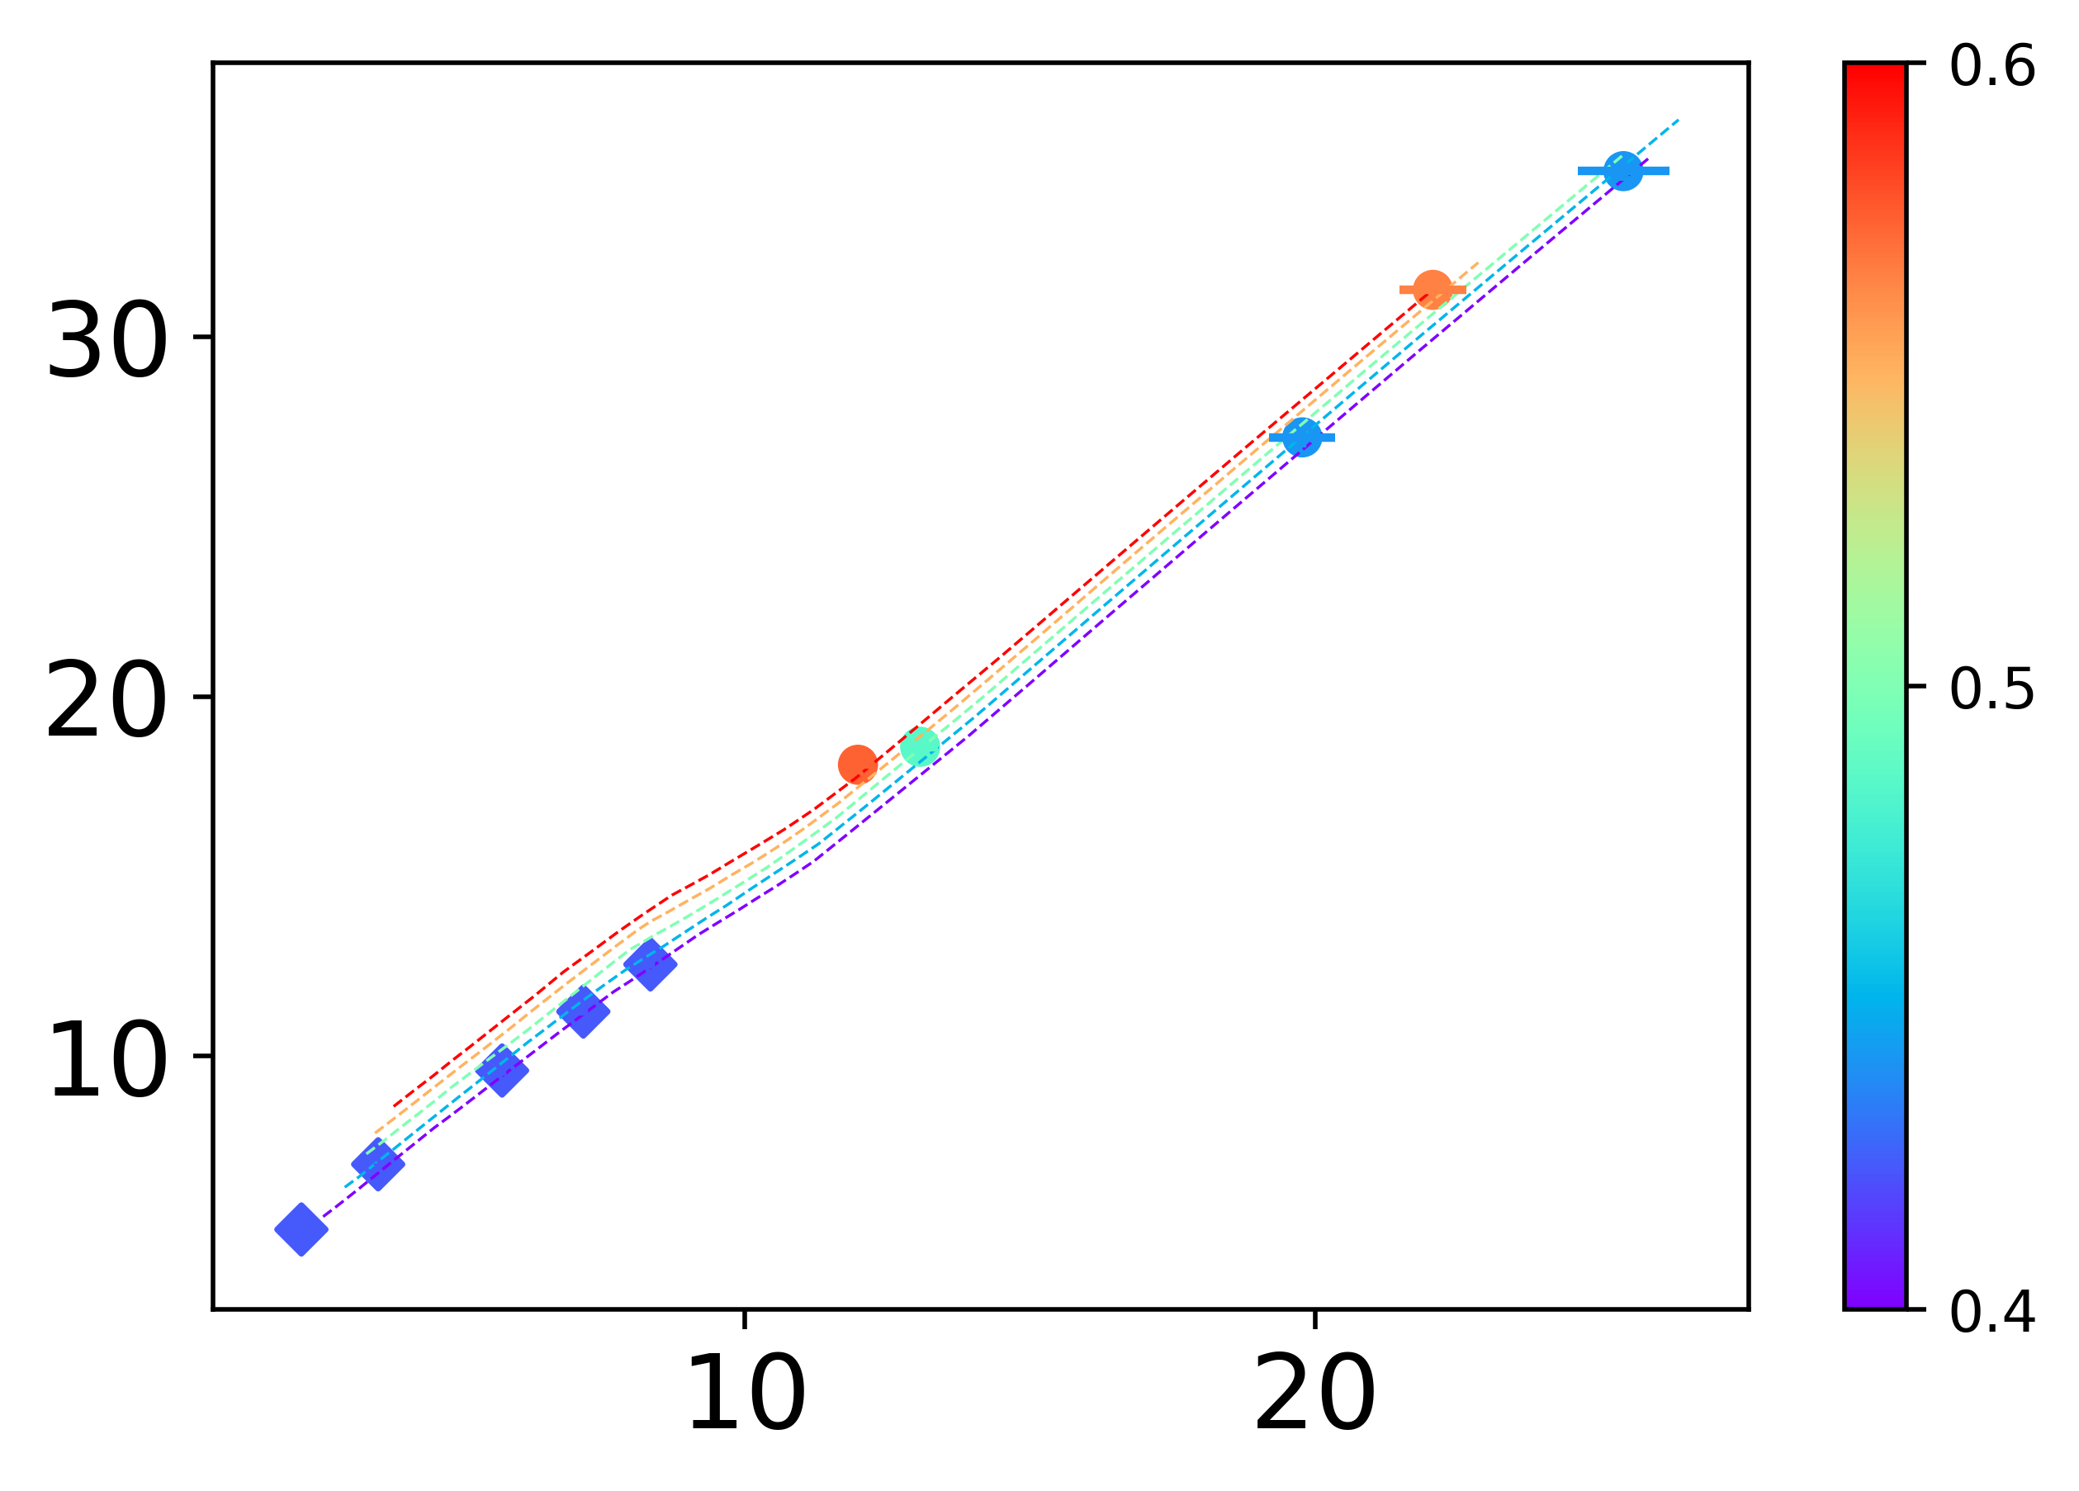
The shock and particle velocities follow a linear trend at higher pressures
Shock versus Particle velocity in CH₄
⁞ DFT Hugoniot curves*
●This work
U_{s} (shock velocity, km/s)
Initial Density (g/cm³)
♦Gas gun**
u_{p} (particle velocity, km/s)
Change in slope at U_{s}~15 km/s suggests a change in compressibility

Slide 12
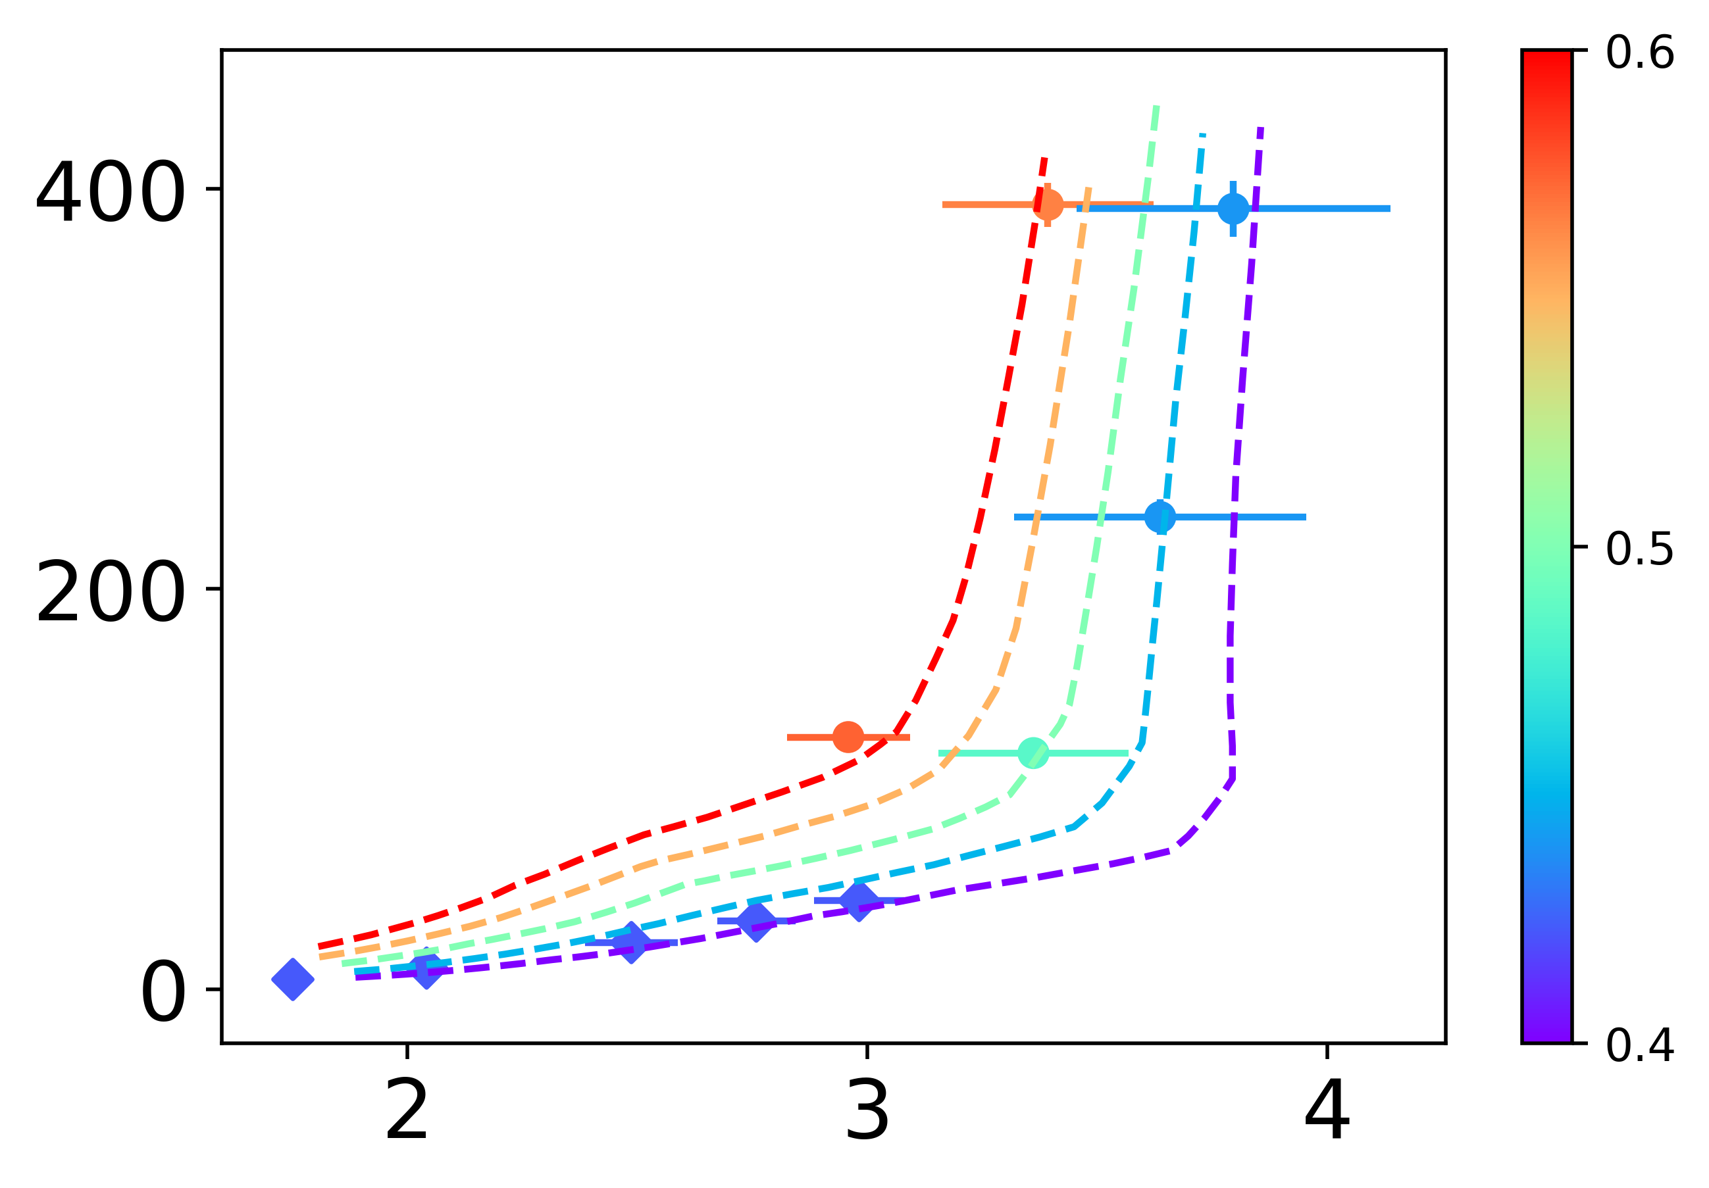
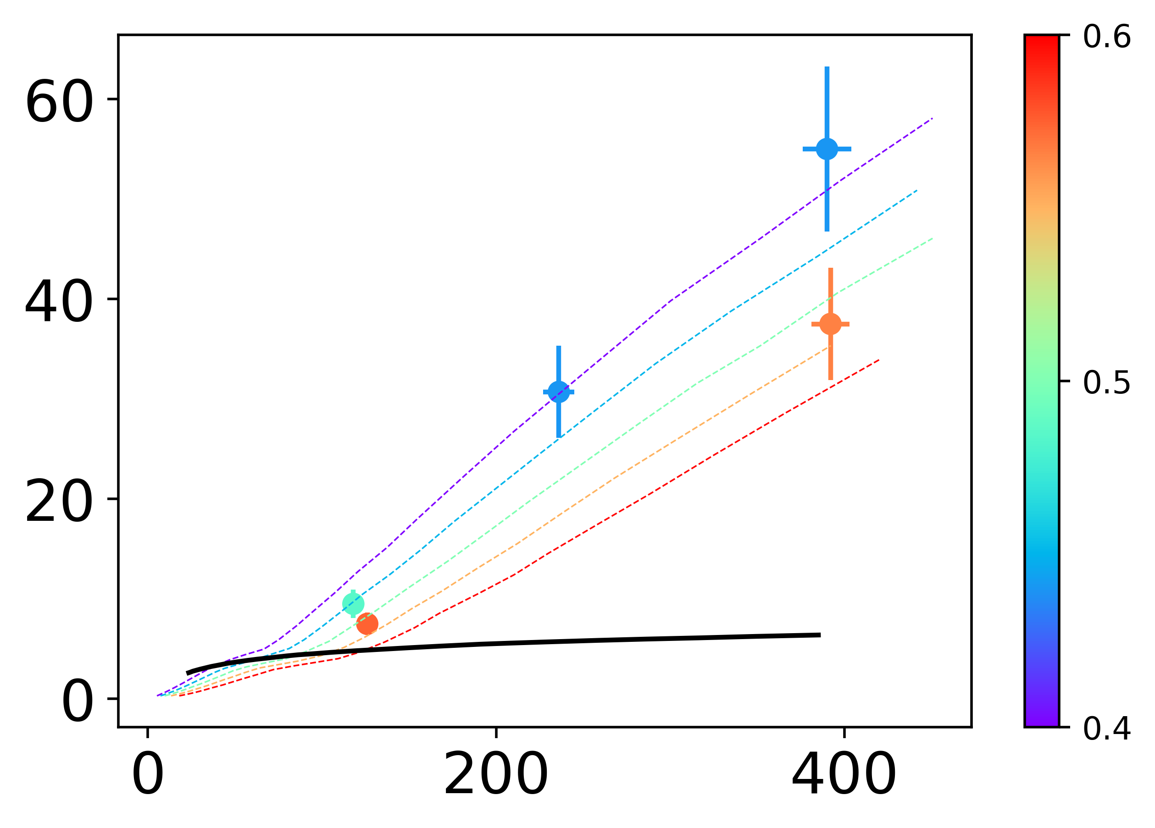
Pressure and temperature data reveal changes in the compressibility and thermal response of compressed methane
Pressure versus Compression Ratio
Temperature versus Pressure
●This work
●This work
⁞ DFT Hugoniot curves*
⁞ DFT Hugoniot curves*
Pressure (GPa)
Initial Density (g/cm³)
Temperature (kK)
Initial Density (g/cm³)
♦Gas gun**
Uranus ice layer†
ρ/ρ₀
Pressure (GPa)
Methane compression saturates at roughly ~100 GPa

Slide 13
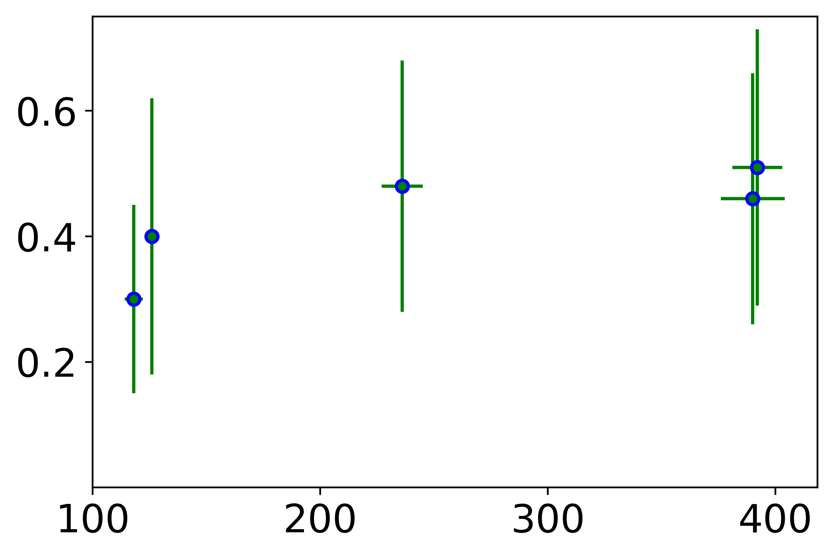
At the pressures where the compressibility changed we also observe a saturation in reflectance
Reflectance versus Pressure in Shocked CH₄
Reflectance
Pressure (GPa)

Slide 14
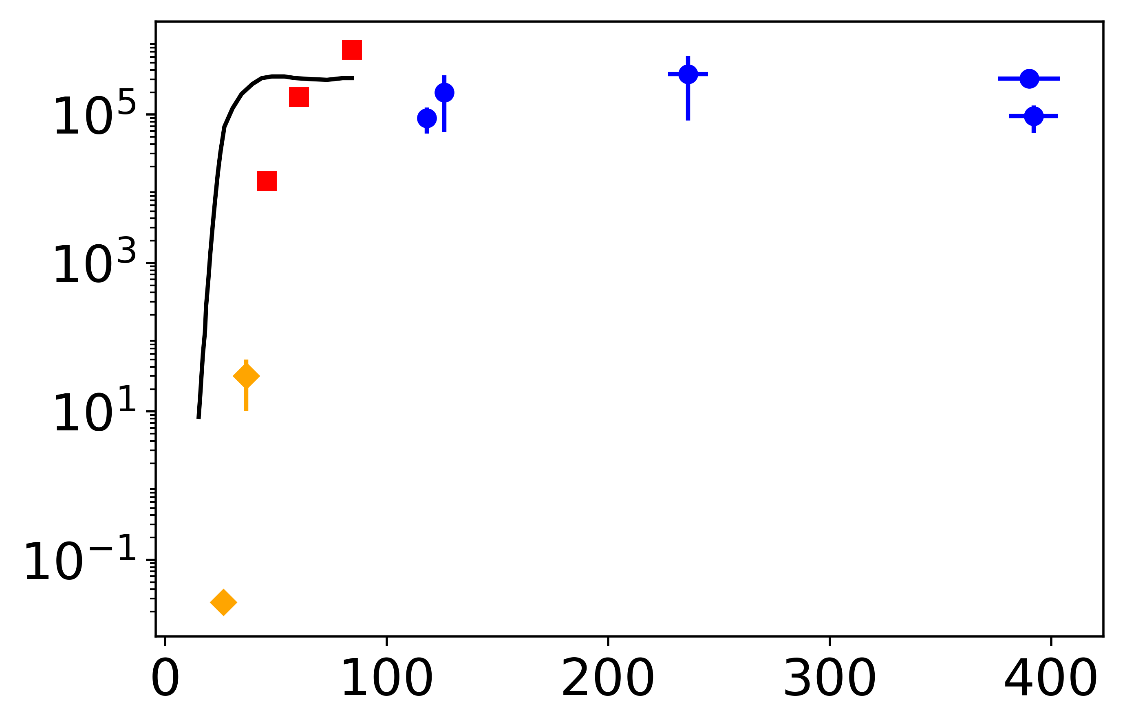
At the pressures where the compressibility changed we also observe a saturation in reflectance
Reflectance versus Pressure in Shocked CH₄
Conductivity of Shocked CH₄
■CH₄ QMD**
●This work
Reflectance
$↕$ Hydrogen Hugoniot QMD***
Conductivity (Ω-m)⁻¹
♦Gas gun*
Pressure (GPa)
Pressure (GPa)
There is an insulator-conductor transition at ~50-100 GPa

Slide 15
High-pressure methane is produced in the laboratory up to 400 GPa
Methane is a major constituent of icy giant planets; its high-pressure behavior is important to evolutionary models
Methane samples were precompressed in diamond-anvil cells and shocked using the OMEGA 60* and GEKKO XII** lasers
The compressibility of shocked methane changes at ~50-100 Gpa
We observed an insulator-conductor transition at the same conditions

