Slide 1
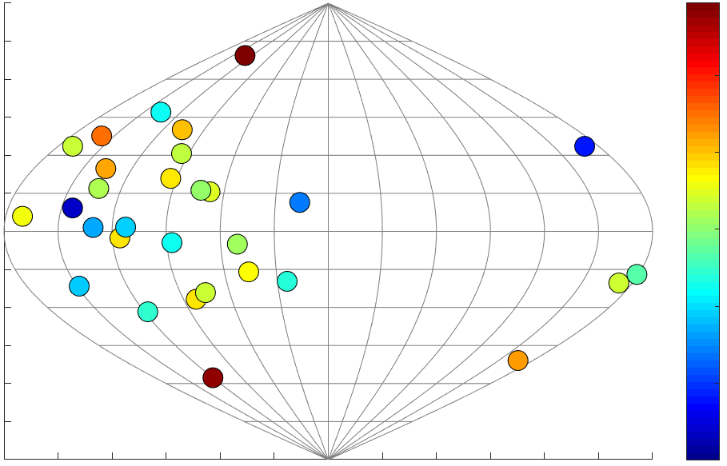
Signatures of Systematic Azimuthal Asymmetry in Nuclear Diagnosis of ICF Implosions on the NIF
Hotspot velocity (km/s)
0
120
30
100
60
80
NIF polar angle θ
60
90
120
40
150
20
180
HDC + BF campaigns
0
0
60
120
180
240
300
360
NIF azimuthal angle φ
H. G. Rinderknecht

Slide 2
Signatures of Systematic Azimuthal Asymmetry in Nuclear Diagnosis of ICF Implosions on the NIF
Hotspot velocity (km/s)
Velocity-corrected FNAD ~ −ρR
0
120
0
1.1
91 km/s
P₁/P₀ = 6%
30
100
30
1.05
60
80
60
NIF polar angle θ
60
1.0
90
NIF polar angle θ
90
120
40
120
0.95
150
20
150
180
HDC + BF campaigns
0
180
BF N180226
0.9
0
60
120
180
240
300
360
0
60
120
180
240
300
360
NIF azimuthal angle φ
NIF azimuthal angle φ
H. G. Rinderknecht

Slide 3
Combining nTOF hotspot velocities and FNAD ρR maps improves understanding of stagnation asymmetry in NIF experiments
Summary
Fill tube
(7˚)
Hotspot velocity is systematically toward ɸ ~ 90˚ on recent DT cryogenic implosions
Areal-density (ρR) asymmetry amplitude and direction are correlated with hotspot velocity
Mode-1 implosion asymmetry can explain both the velocity and ρR signatures
Mode-1 drive asymmetry?
V_{HS}
ρR
minimum
nTOF: neutron time-of-flight
FNAD: flange neutron activation diagnostics

Slide 4
Many thanks to my collaborators:
D.T. Casey, R. Bionta, R. Hatarik, A. Moore, E. Hartouni, D. Schlossberg,
G. Grim, O. Landen, P. Patel
Lawrence Livermore National Laboratory
This work was performed under the auspices of the U.S. Department of Energy by Lawrence Livermore National Laboratory under Contract DE-AC52-07NA27344.

Slide 5
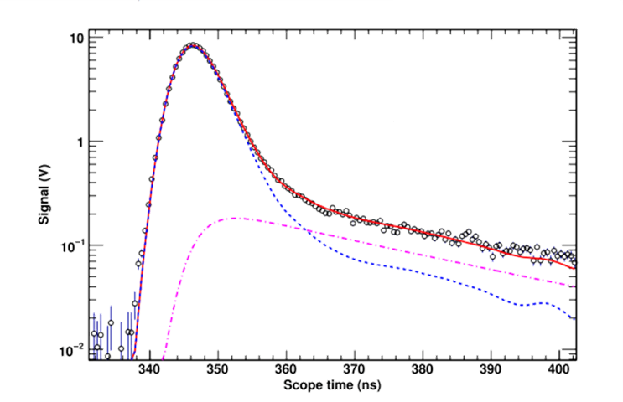
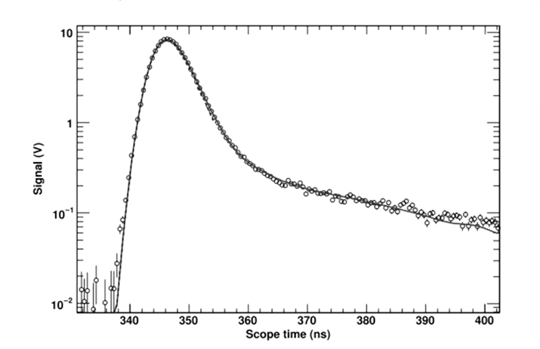
Method: Velocity
DT- and DD-neutron spectra are sensitive to hotspot velocity: net velocity produces a Doppler shift in neutron energy
DT-neutron time-of-flight (nTOF) signal*
Each detector measures the hotspot velocity projected along its line of sight
*R. Hatarik et al., J. Appl. Phys. 118, 184502 (2015).

Slide 6
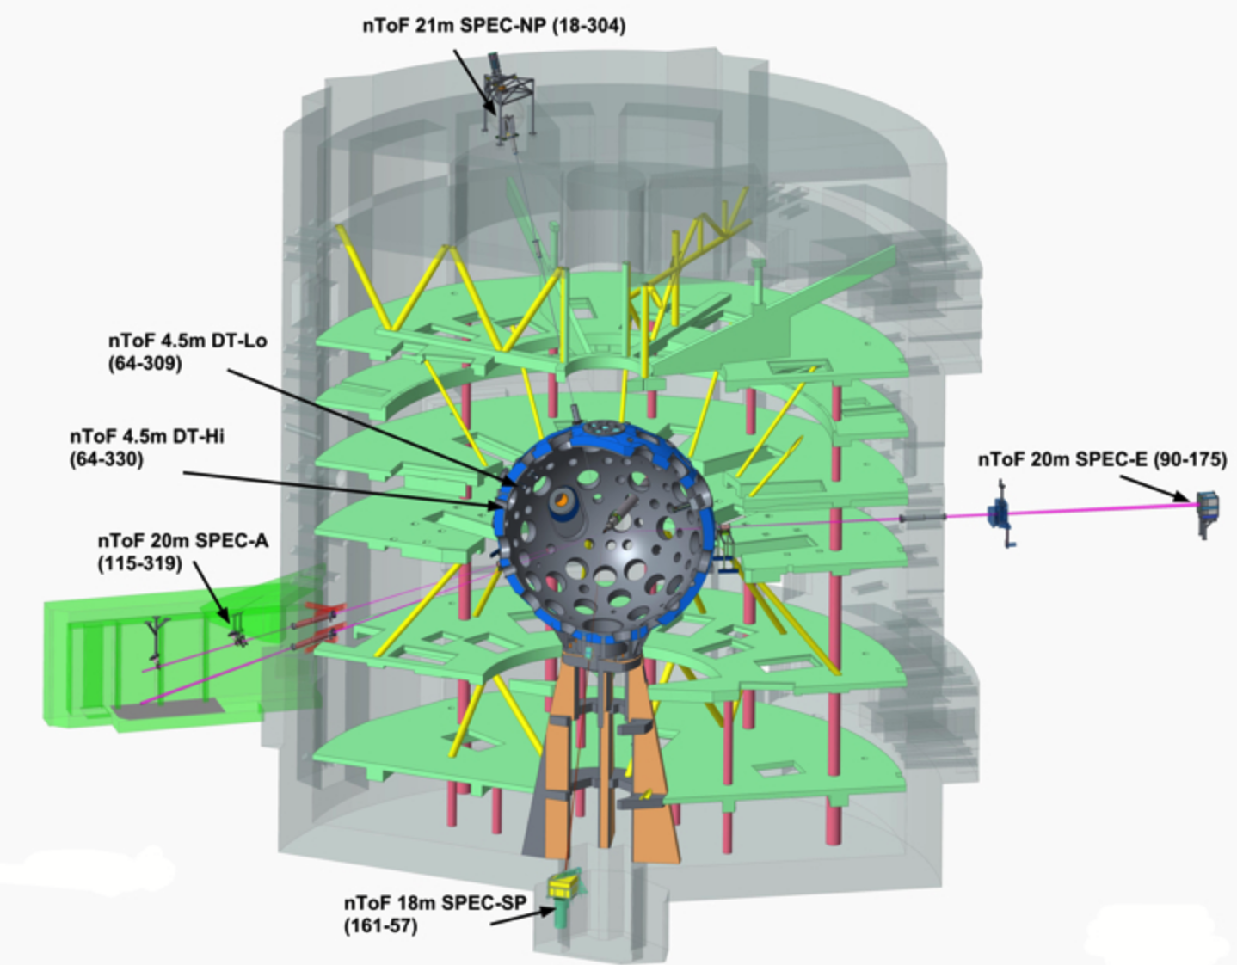
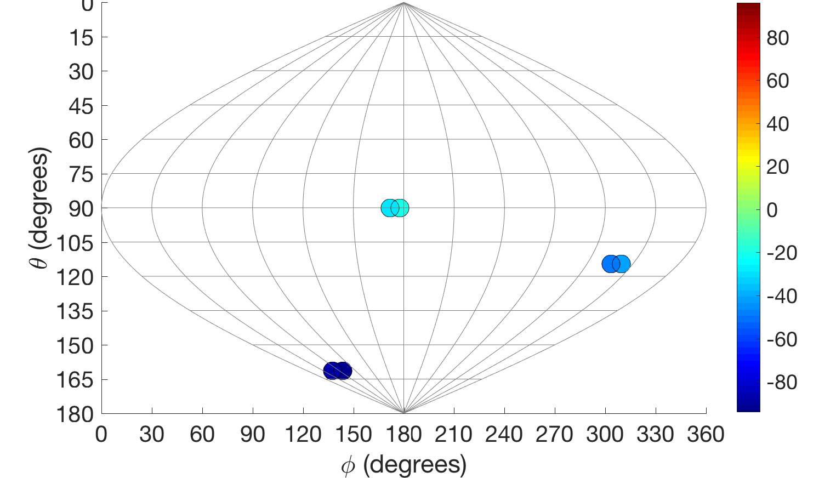
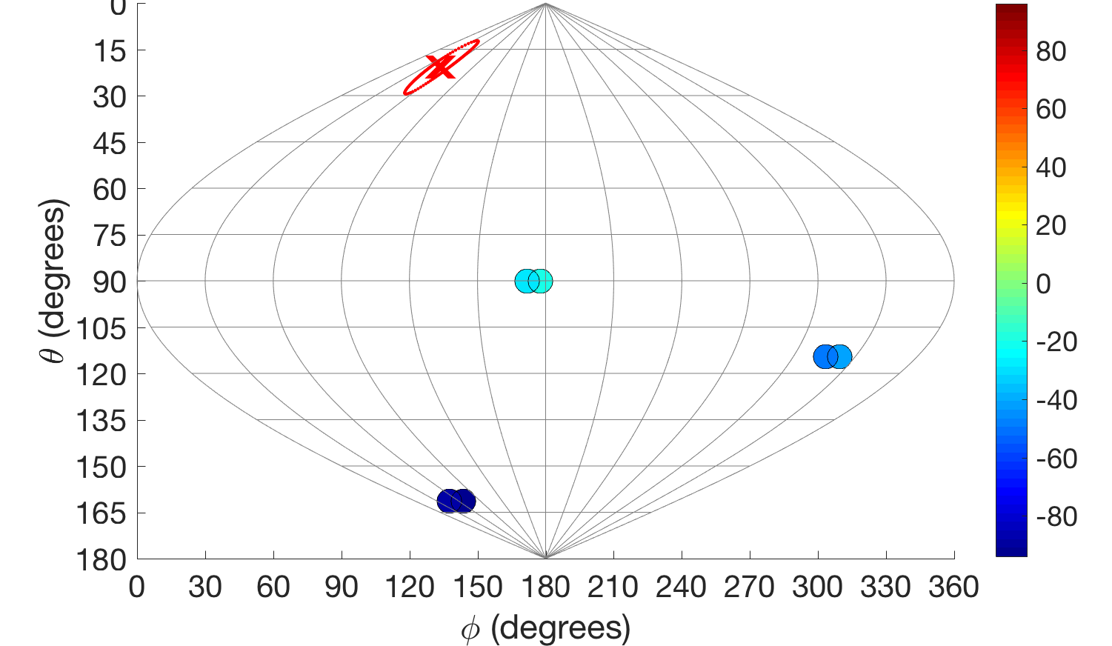
Method: Velocity
On the NIF, DT- and DD-neutron spectra are used to measure the mean hotspot velocity on up to four nTOF lines of sight
nTOF 21m SPEC-NP (18-304)
NTOF velocities: N160207
nTOF velocities: N160207
0
0
Best Fit:
119 km/s @ (21˚,49˚)
−23 km/s
nTOF 20m
SPEC-E (90-175)
SPEC-E
− 45 km/s
nTOF 20m
SPEC-A (115-319)
SPEC-A
SPEC-SP
− 91 km/s
A best-fit hotspot velocity (x) and uncertainty boundary is found, using:
𝛘² ≤ min(𝛘²) + 𝛘²_{limit}
nTOF 18m SPEC-SP (161-57)
R. Hatarik et al., Rev. Sci. Instrum. 89, 10I138 (2018).
Notes:
This analysis takes into account neutron upshift due to ion temperature (“Ballabio shift”).
See R. Hatarik, HTPD
[R. Hatarik, RSI 2018 (forthcoming)]

Slide 7
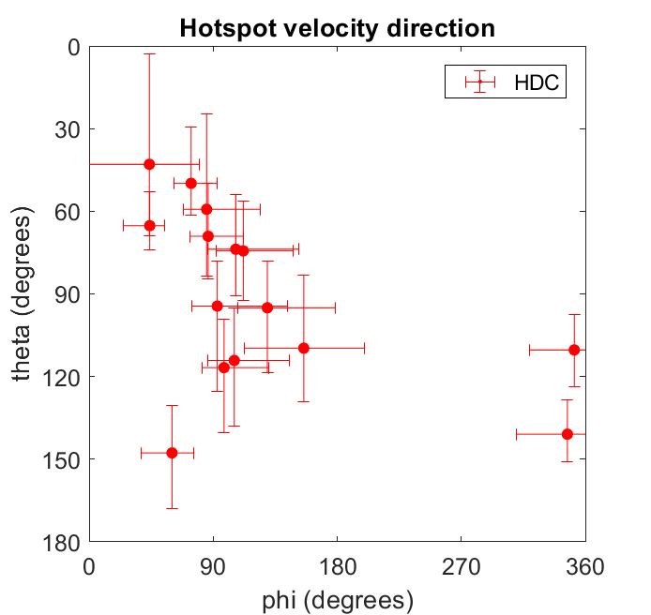
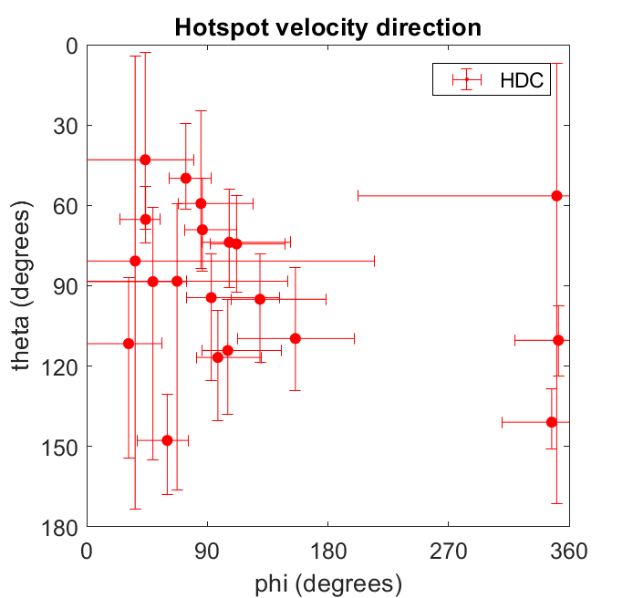
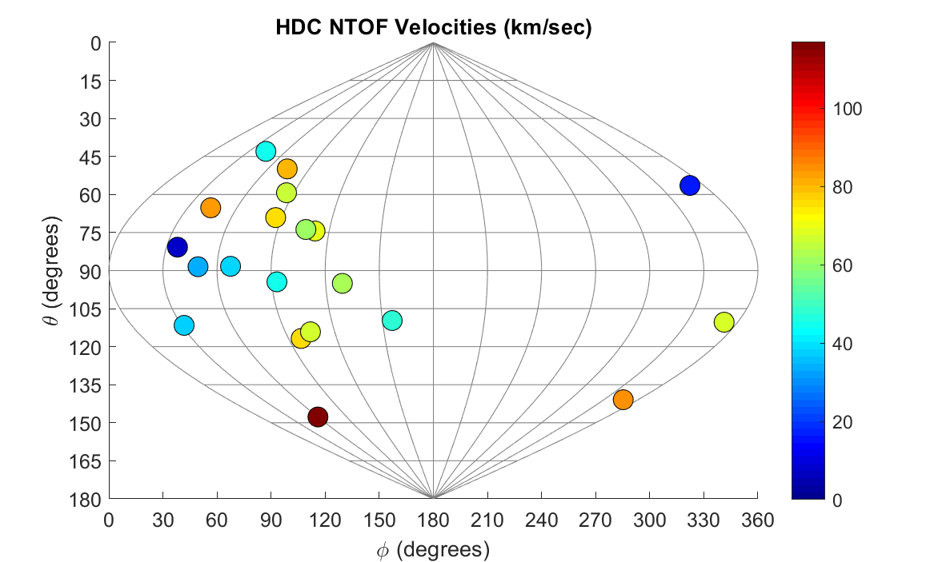
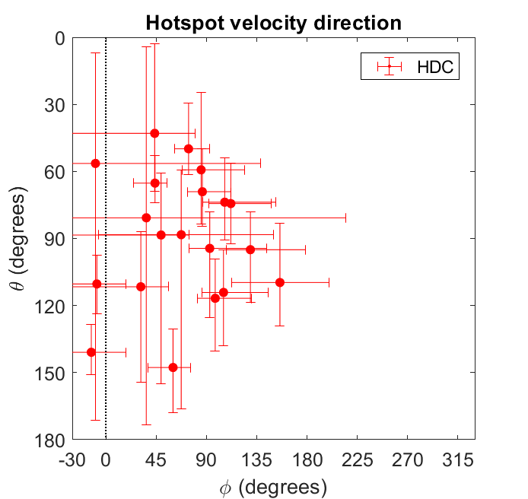
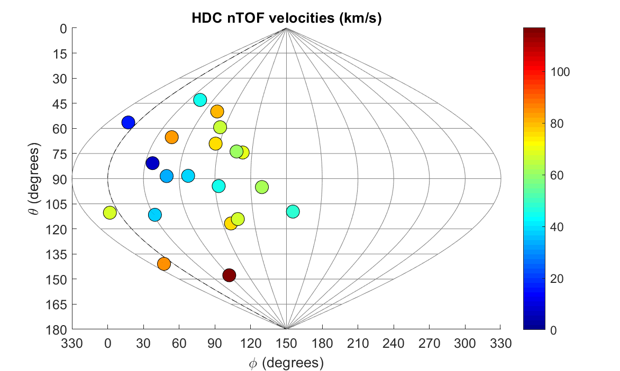
Looking at a group of cryogenic DT implosions, a pattern emerges: hotspot velocity tends toward ɸ ~ 90˚ on the equator
Result #1: Velocity
HDC: 20 shots
Showing analyzed shots, FY16—18

Slide 8
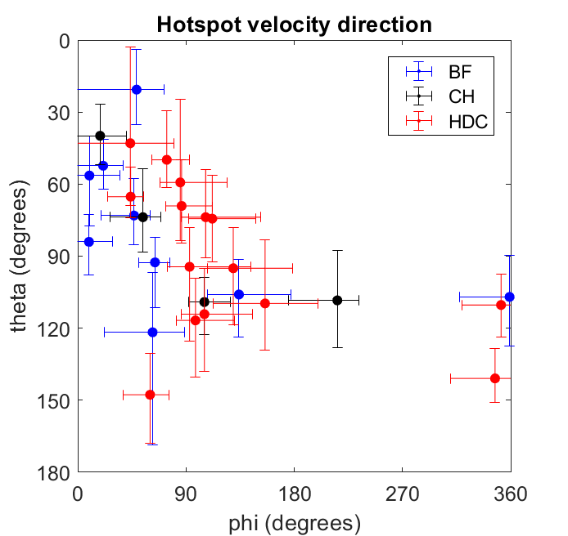
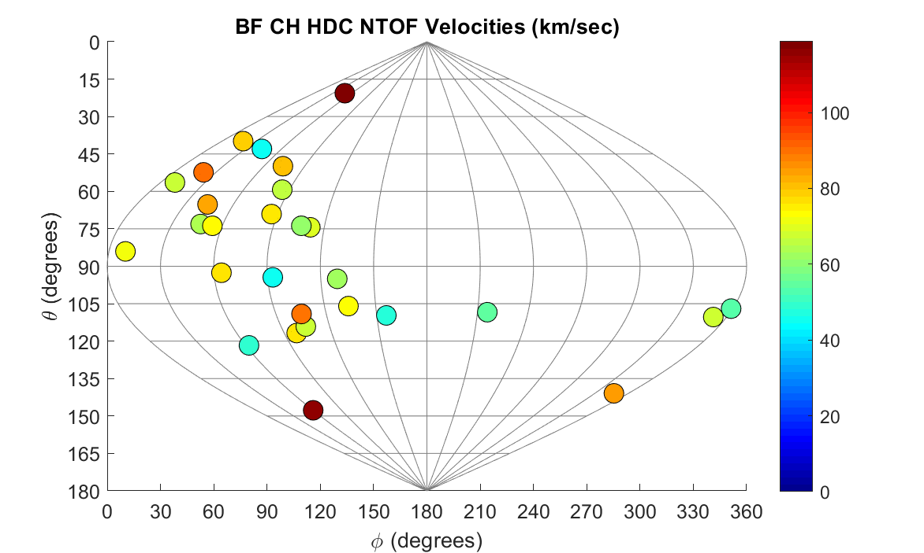
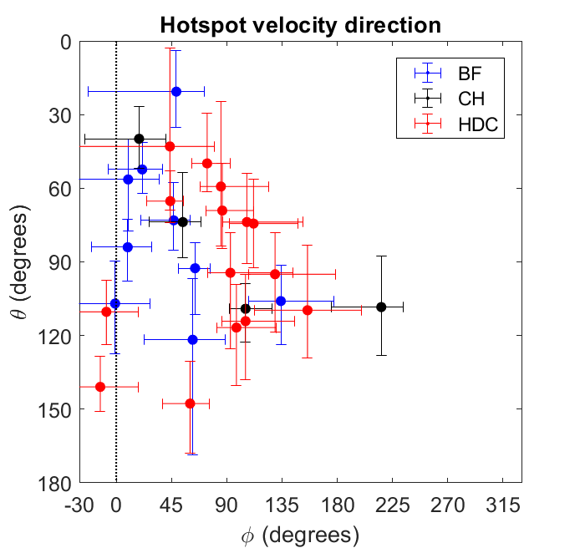
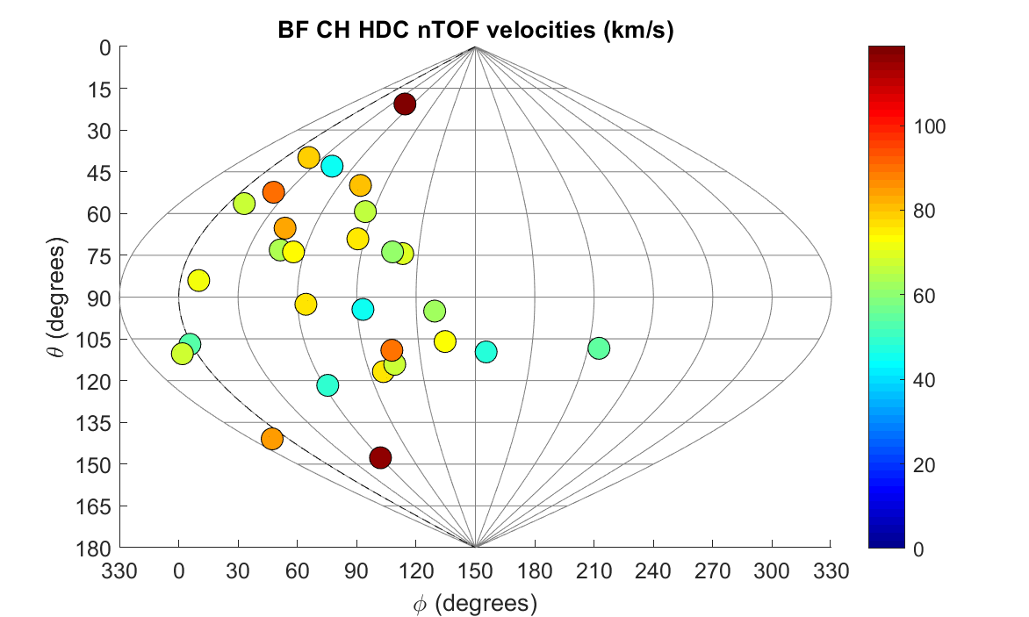
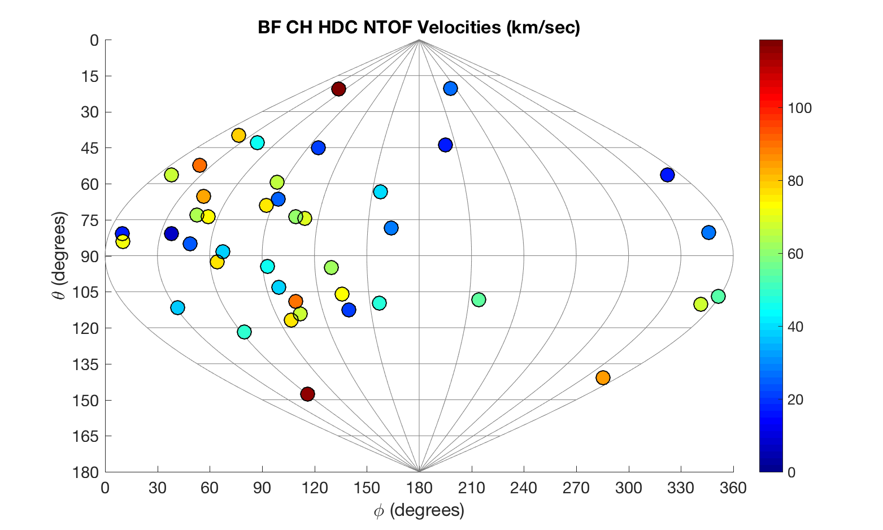
Looking at a group of cryogenic DT implosions, a pattern emerges: hotspot velocity tends toward ɸ ~ 90˚ on the equator
Result #1: Velocity
Only V > 40 km/sec
HDC: 15/20 shots
BF: 9/10 shots
CH: 4/15 shots
Showing analyzed shots, FY16—18 with V > 40 km/s

Slide 9
Nuclear activation detectors (NADs) diagnose variations in neutron fluence due to scattering in fuel
Method: ρR
⁹⁰Zr(n,2n)⁸⁹Zr cross-section
F = 1 – dsr
∝ –ρR
Normalized flange NAD activation:
Detectors
Spherical harmonic
fit to the data (modes 1, 2)
C. Yeamans and D. Bleuel, Fusion Sci. Technol. 72, 120 (2017).
Notes:
Asymmetric areal density (ρR) causes different neutron scattering, and thus different spectra and activation, along different lines of sight.

Slide 10
However, a neutron energy shift from hotspot flow velocity can cause an “offset” (mode 1) in activation patterns
Method: ρR
F = 1 – dsr
∝ –ρR
ΔE ∝
V_{HS}·r̂_{det}
Mode-1 asymmetry in activation:
is this due to velocity or areal density?
∝ –ρR
∝ V_{HS} cos θ_{det}

Slide 11
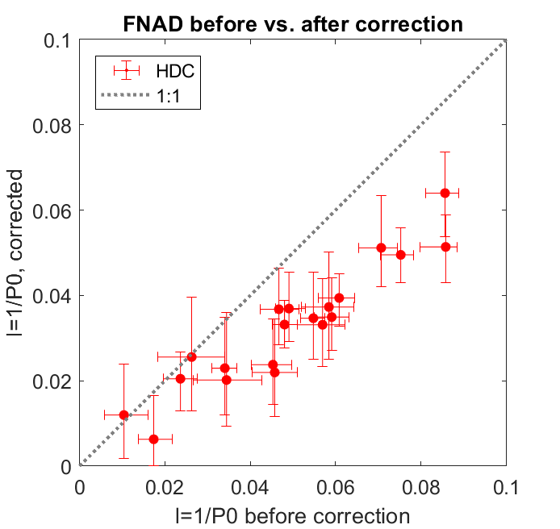
Using the mean hotspot velocity, we can correct FNAD data to infer areal-density variation (ρR)
Method: ρR
Mode-1 amplitude, corrected
Corrected:
V = 119 km/s
*
Mode-1 amplitude, uncorrected
The mean hotspot velocity accounts for ~30% of FNAD mode-1 amplitude.
*see H.G. Rinderknecht et al., Rev. Sci. Instrum. 89, 10I125 (2018).
Notes:
0.07735, 0.0407
Horiz: 8.77 – 12.03 → 32.6 inch / unit → 8.77 + 0.07735*32.6 = 11.29”
Vert: 1.98 – 5.23 → 32.5 / unit → 5.23 – 0.0407*32.5 = 3.91”

Slide 12
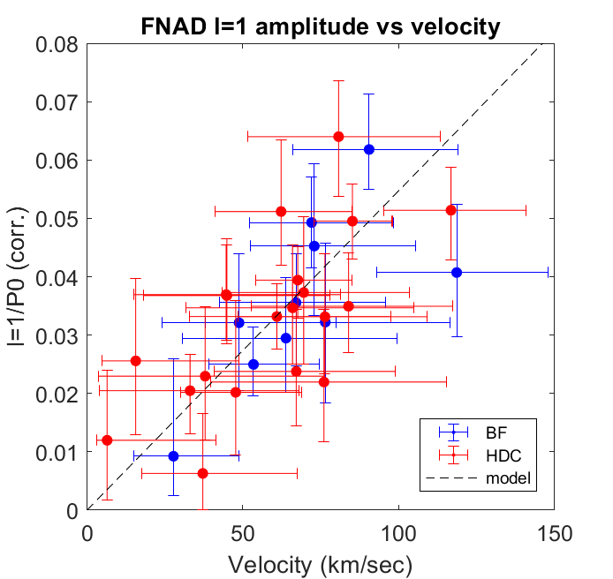
In cryogenic implosions, the corrected FNAD mode-1 amplitude (∝ ρR asymmetry) increases linearly with hotspot velocity
Result #2: ρR
FNAD amplitude vs velocity
Mode-1 amplitude, corrected
Velocity (km/s)

Slide 13
The residual FNAD mode-1 is in the same direction as the hotspot velocity on most shots
Result #3: direction
Bigfoot
series:
160207
170524
171119
119 km/s
64 km/s
53 km/s
161030
171015
180226
73 km/s
49 km/s
91 km/s
170109
171029
180311
77 km/s
67 km/s
72 km/s
180128
28 km/sec

Slide 14
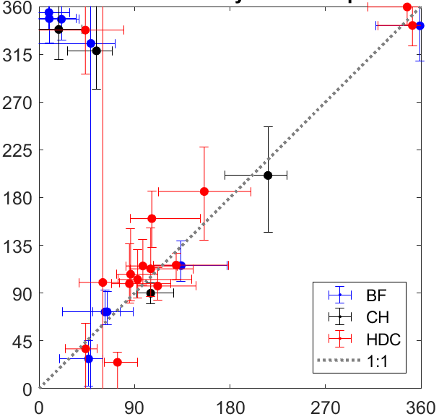
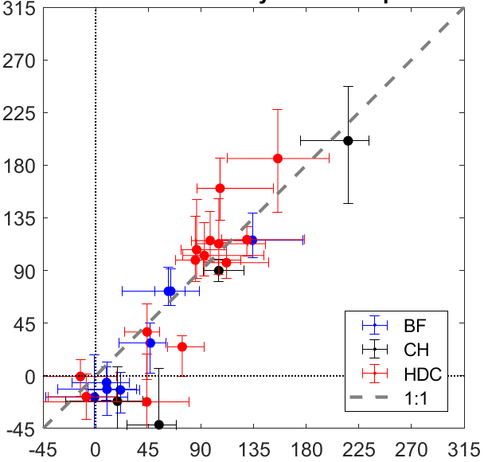
The residual FNAD mode-1 is in the same direction as the hotspot velocity: mean velocity and low ρR are toward ɸ = 90˚
Result #3: direction
Mode-1 ɸ (degrees)
Velocity ɸ (degrees)
HDC: 15/20 shots
BF: 9/10 shots
CH: 4/15 shots
Showing analyzed shots, FY16—18 with V > 40 km/s

Slide 15
The following picture emerges from the data: low ρR and velocity in one direction can be caused by reduced compression on that side
Interpretation
V
min ρR

Slide 16
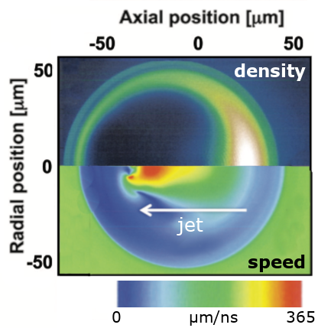
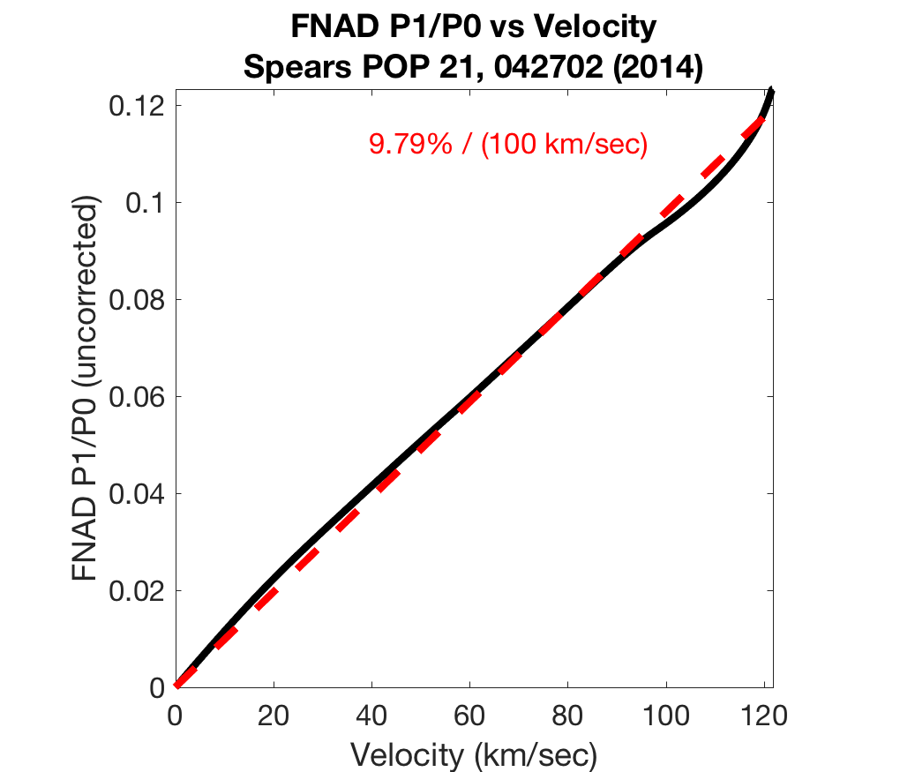
The following picture emerges from the data: low ρR and velocity in one direction can be caused by reduced compression on that side
Interpretation
Brian Spears P1 drive shows the same trend:
Axial position (μm)
FNAD P1/P0 vs velocity
V
min ρR
Radial position (μm)
Sim: 9.8% / (100 km/s)
B. Spears et al., Phys. Plasmas 21, 042702 (2014).
Notes:
Paul Springer dynamic 1D model

Slide 17
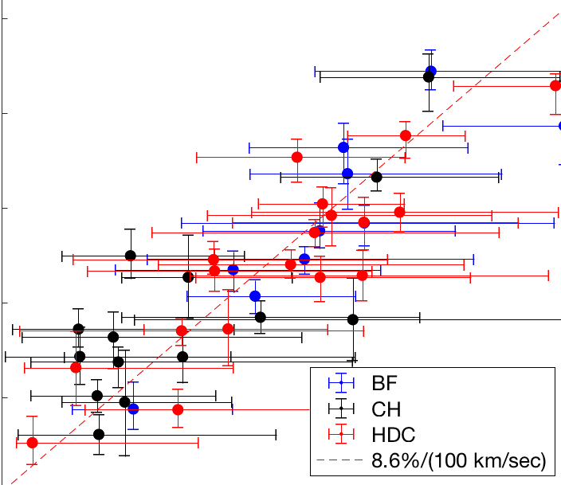
The following picture emerges from the data: low ρR and velocity in one direction can be caused by reduced compression on that side
Interpretation
Brian Spears P1 drive shows the same trend:
Axial position (μm)
FNAD P1/P0 vs velocity
V
min ρR
Radial position (μm)
Sim: 9.8% / (100 km/s)
Data: 8.6% / (100 km/s)
B. Spears et al., Phys. Plasmas 21, 042702 (2014).

Slide 18
Combining nTOF hotspot velocities and FNAD ρR maps improves understanding of stagnation asymmetry in NIF experiments
Summary
Fill tube
(7˚)
Hotspot velocity is systematically toward ɸ ~ 90˚ on recent DT cryogenic implosions
Areal-density (ρR) asymmetry amplitude and direction are correlated with hotspot velocity
Mode-1 implosion asymmetry can explain both the velocity and ρR signatures
Mode-1 drive asymmetry?
V_{HS}
ρR
minimum
Related talks on causes of the observed asymmetry:
A. Pak, Impact of fill tube perturbation on HDC implosions this session (BO6:2)
K. McGlinchey, Simulating radiation asymmetries and fill tubes this session (BO6:3)
R. Nora, 3D Hydra capsule studies on effect of hohlraum windows this session (BO6:4)
D. Schlossberg, Experiments with laser-driven mode-1 asymmetry this session (BO6:7)
T. Ma, Experimental investigation of mode-1 asymmetries this session (BO6:11)
C. Young, 3D radiation asymmetries using dynamic view factor model Monday pm (CO6:2)
O. Landen, Sensitivity of yield and compression to asymmetry Tuesday (GO6:5)

Slide 19
Appendix – backup slides

Slide 20
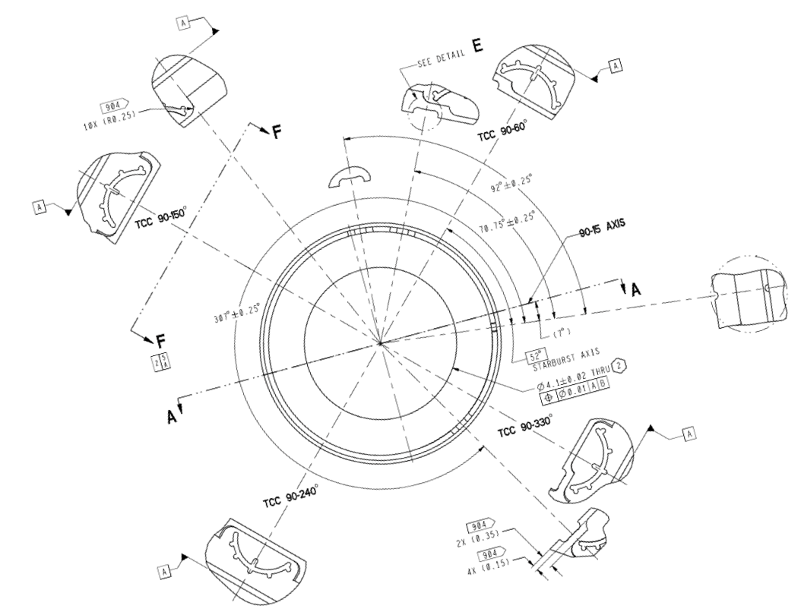
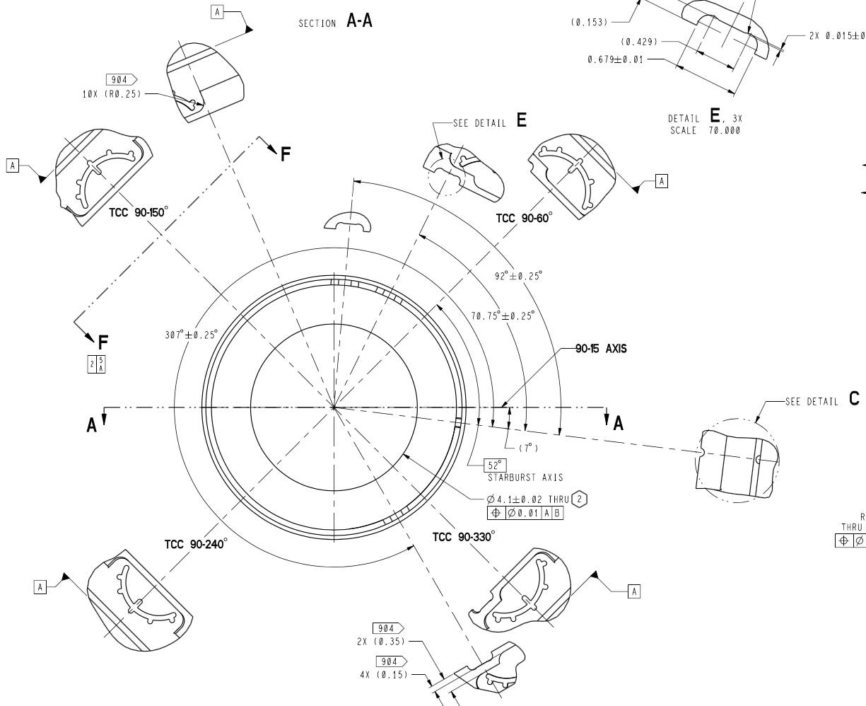
The source of the ɸ = 90˚ asymmetry is currently under investigation
Interpretation
<V>, FNADs
Drive asymmetries:
Hohlraum positioning offset (X)
2ω unconverted light asymmetry
…
Target asymmetries:
Fill tube (7˚): see A. Pak, this session
Diagnostic patches: see T. Ma, this session
…
See also O. Landen, Tuesday (GO6:5):
“Sensitivity of yield and compression to velocity, shock timing, coast time and asymmetry in indirect-drive NIF implosions,”

Slide 21
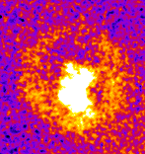
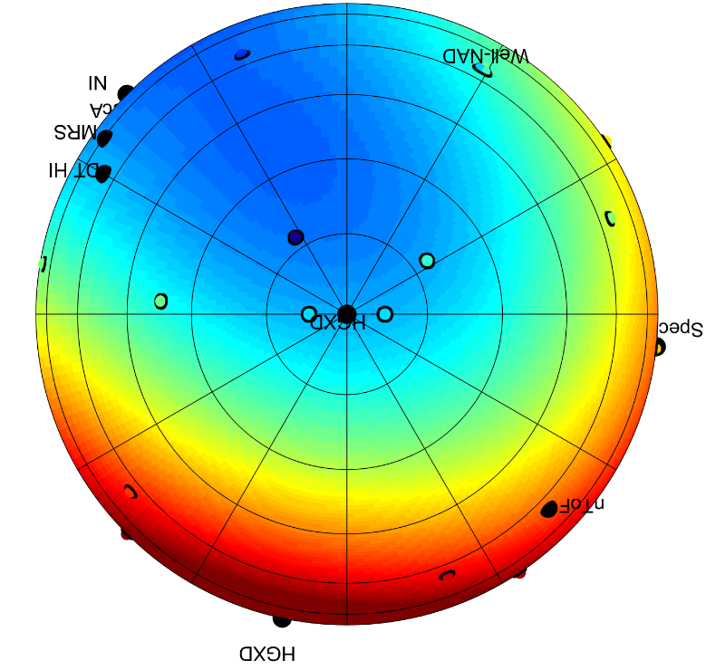
Azimuthal asymmetry is suggested by many diagnostics: we are now beginning to put together the pieces of this mode-1 puzzle
Interpretation
Flange NADs
Down-scattered neutron ratio
(MRS, nTOF, NIS)
X-ray late-time images
BT -150ps
315
315
NITOF
315
MRS
SpecNP
0
0
0
7 (FT)
7 (FT)
SpecE
7 (FT)
90
90
90
C. Yeamans & D. Bleuel,
Fusion Sci. Technol. 72, 120 (2017)
NTOF: R. Hatarak, et al., J. Appl. Phys. 118, 184502 (2015)
MRS: J.A. Frenje, et al., Phys. Plasmas 17, 056311 (2010)
NITOF: F. E. Merrill, et al., Rev. Sci. Instrum. 83, 10D317 (2012)
A. Pak, et al.,
Phys. Plasmas 20, 056315 (2013)

Slide 22
Method: Velocity
On the NIF, DT- and DD-neutron spectra are used to measure mean hotspot velocity on up to four NTOFs line of sight
NTOF 21m SPEC-NP (18-304)
NTOF velocities: N160207
0
SPEC-E
NTOF 20m
SPEC-E (90-175)
SPEC-A
NTOF 20m
SPEC-A (115-319)
SPEC-SP
R. Hatarik, RSI 2018 (in press)
NTOF 18m SPEC-SP (161-57)
Notes:
This analysis takes into account neutron upshift due to ion temperature (“Ballabio shift”).
See R. Hatarik, HTPD
[R. Hatarik, RSI 2018 (forthcoming)]

Slide 23
Method: Velocity
On the NIF, DT- and DD-neutron spectra are used to measure mean hotspot velocity on up to four nTOF lines of sight
nTOF velocities: N160207
0
Best Fit:
V_{SPEC-SP} =
V: 119 ± 24 km/s
θ : 21˚ ± 13˚
ɸ : 49˚
+19˚
- 42˚
SPEC-E
SPEC-E
V_{SPEC-E}
SPEC-A
SPEC-SP
SPEC-SP
A single best-fit velocity (x) and uncertainty boundary is found, using:
𝛘² ≤ min(𝛘²) + 𝛘²_{limit}
Notes:
This analysis takes into account neutron upshift due to ion temperature (“Ballabio shift”).
See R. Hatarik, HTPD
[R. Hatarik, RSI 2018 (forthcoming)]

Slide 24
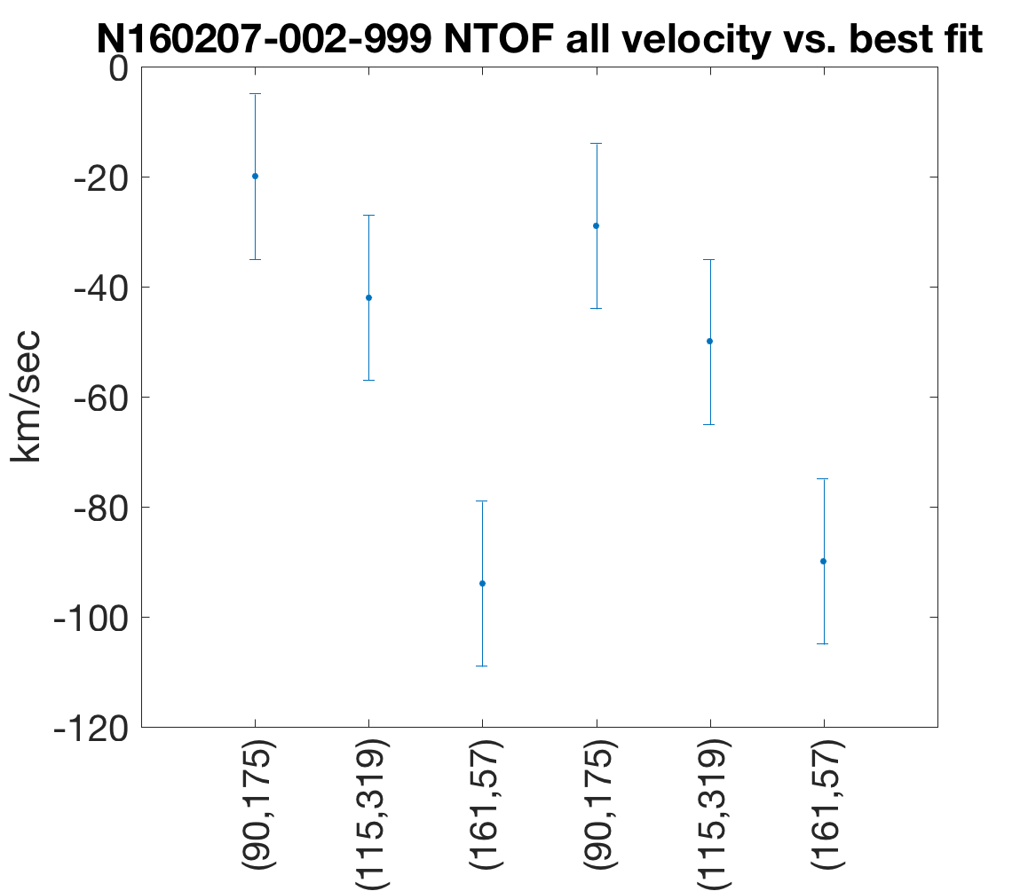
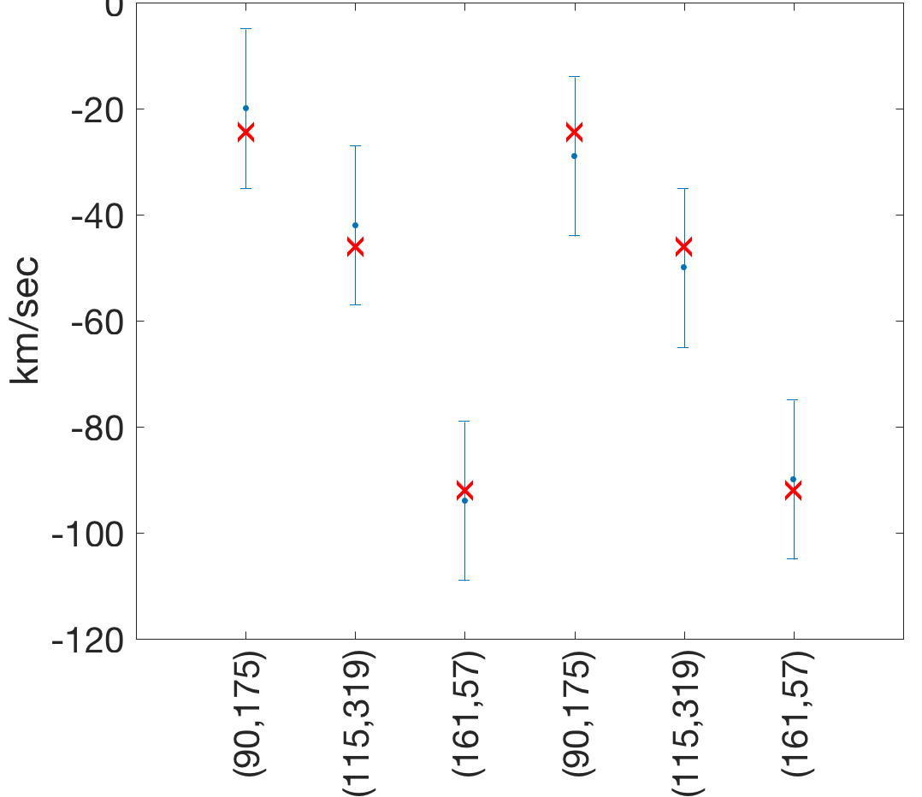
Uncertainties in the measurements allow a range of solutions: an envelope of “acceptable” mean velocity is calculated using a reduced 𝛘² method
Method
nTOF velocities: N160207
nTOF velocities: N160207
DT
DD
Best Fit:
V: 119 ± 24 km/s
θ : 21˚ ± 13˚
ɸ : 49˚
+19˚
- 42˚
SPEC-E
SPEC-A
SPEC-SP
“Acceptable” velocity vectors are found near the best fit that satisfy:
This population defines uncertainties in V, θ, and ɸ.
~300 points on the boundary are found
𝛘² ≤ min(𝛘²) + 𝛘²_{limit}

Slide 25
Regardless of the number of detectors, the 𝛘² limit to contain the true velocity 68% of the time is 𝛘²_{limit} = 3.45
Method
Condition defining uncertainty region in velocity space:
𝛘² < Min(𝛘²) + 𝛘²_{limit}
Value of 𝛘²_{limit} …
…from statistical theory: 3.51
…from numerical study: 3.45 ± 0.1
5 detectors: blue
4 Existing detectors
3 detectors (No NP)
3 detectors (No A)

Slide 26
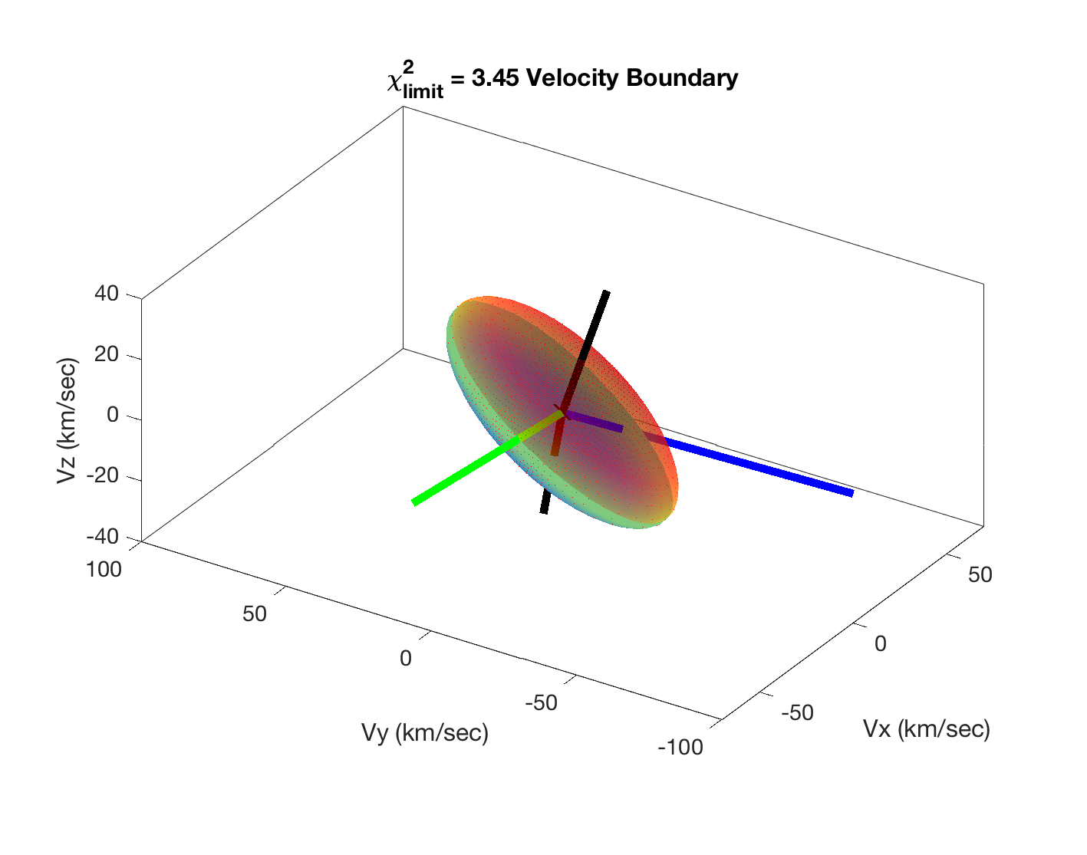
(At least) three “perpendicular” detectors are needed: without SPEC-E or SPEC-A, sensitivity along one horizontal axis is lost
Method
Velocity uncertainty boundaries (𝛘²_{limit} = 3.45)
SPEC-NP
All
detectors
used
to SPEC-A
SPEC-E
SPEC-SP

Slide 27
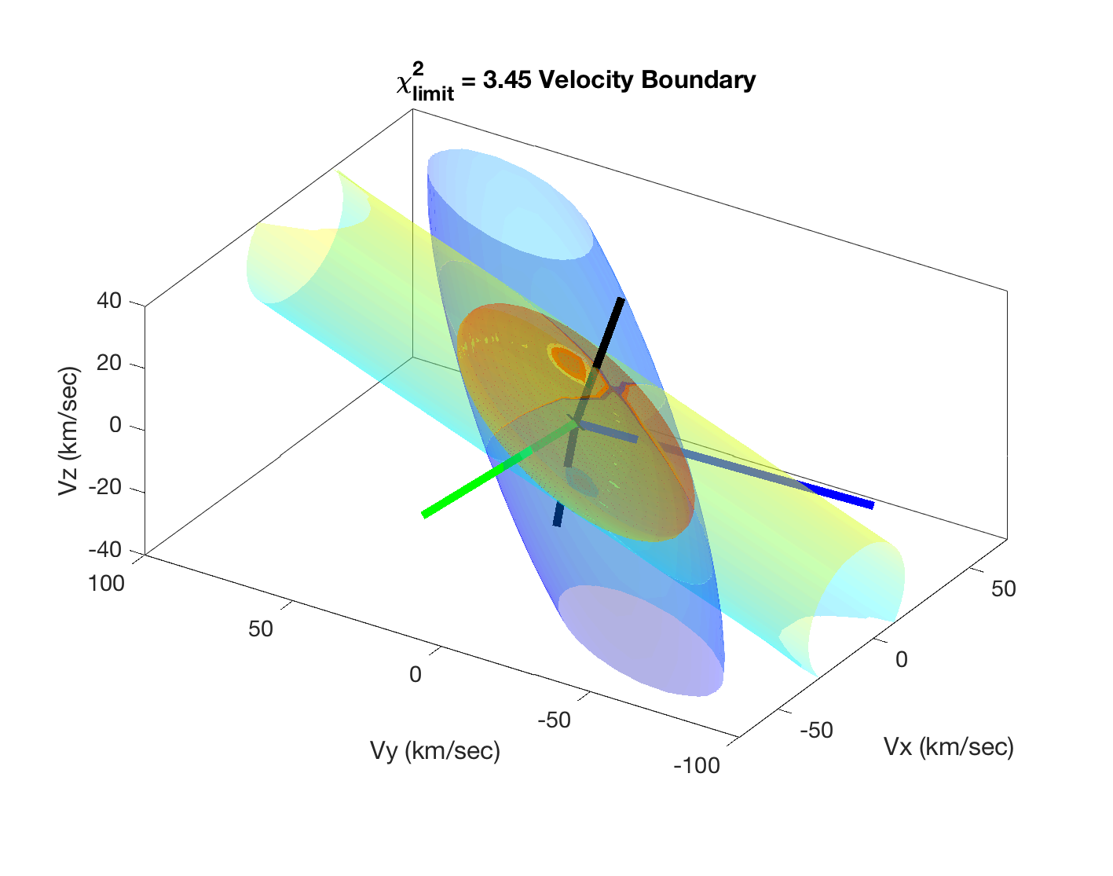
(At least) three “perpendicular” detectors are needed: without SPEC-E or SPEC-A, sensitivity along one horizontal axis is lost
Method
Velocity uncertainty boundaries (𝛘²_{limit} = 3.45)
No
SPEC-A
SPEC-NP
All
detectors
used
SPEC-E, SPEC-A, and one other detector are needed to perform this analysis.
to SPEC-A
SPEC-E
No
SPEC-E
SPEC-SP

Slide 28
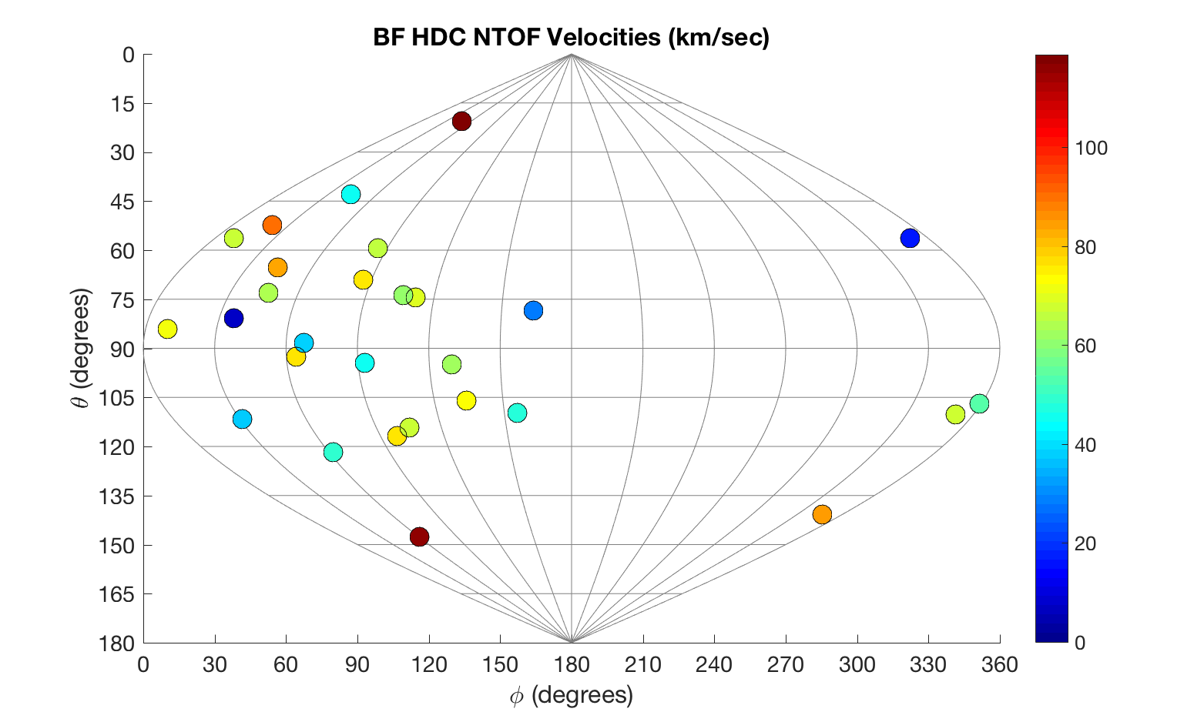
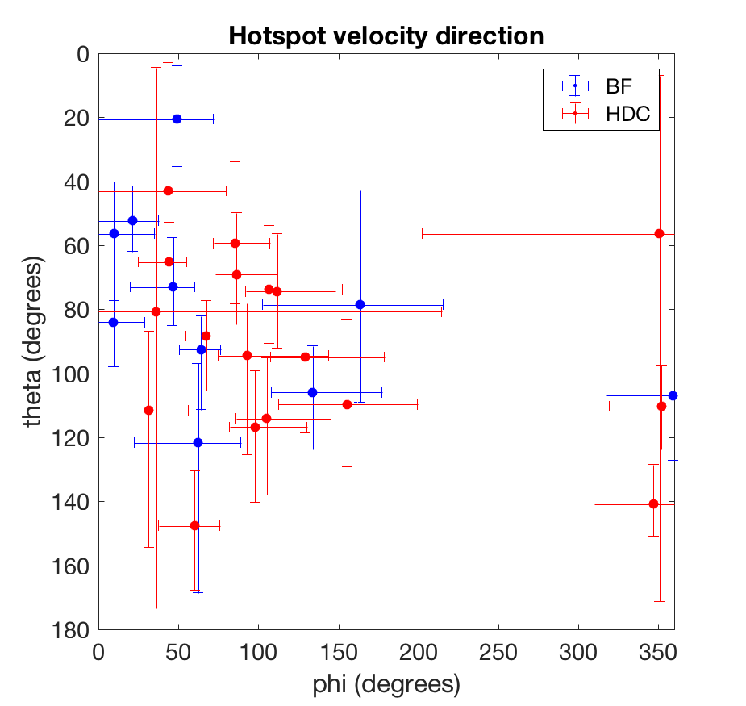
Looking at a group of cryogenic DT implosions, a pattern emerges: hotspot velocity tends towards ɸ ~ 90˚ on the equator.
Result #1: Velocity
HDC: 18 shots
BF: 10 shots
Showing analyzed shots, FY16—18

Slide 29
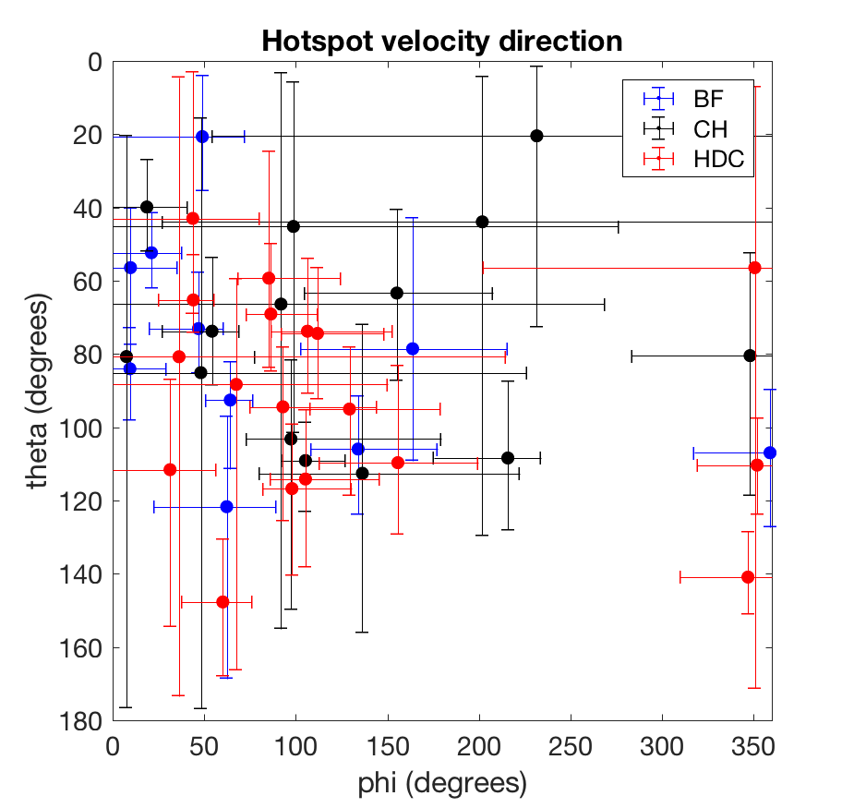
Looking at a group of cryogenic DT implosions, a pattern emerges: hotspot velocity tends towards ɸ ~ 90˚ on the equator.
Result #1: Velocity
HDC: 18 shots
BF: 10 shots
CH: 14 shots
Showing analyzed shots, FY16—18

Slide 30
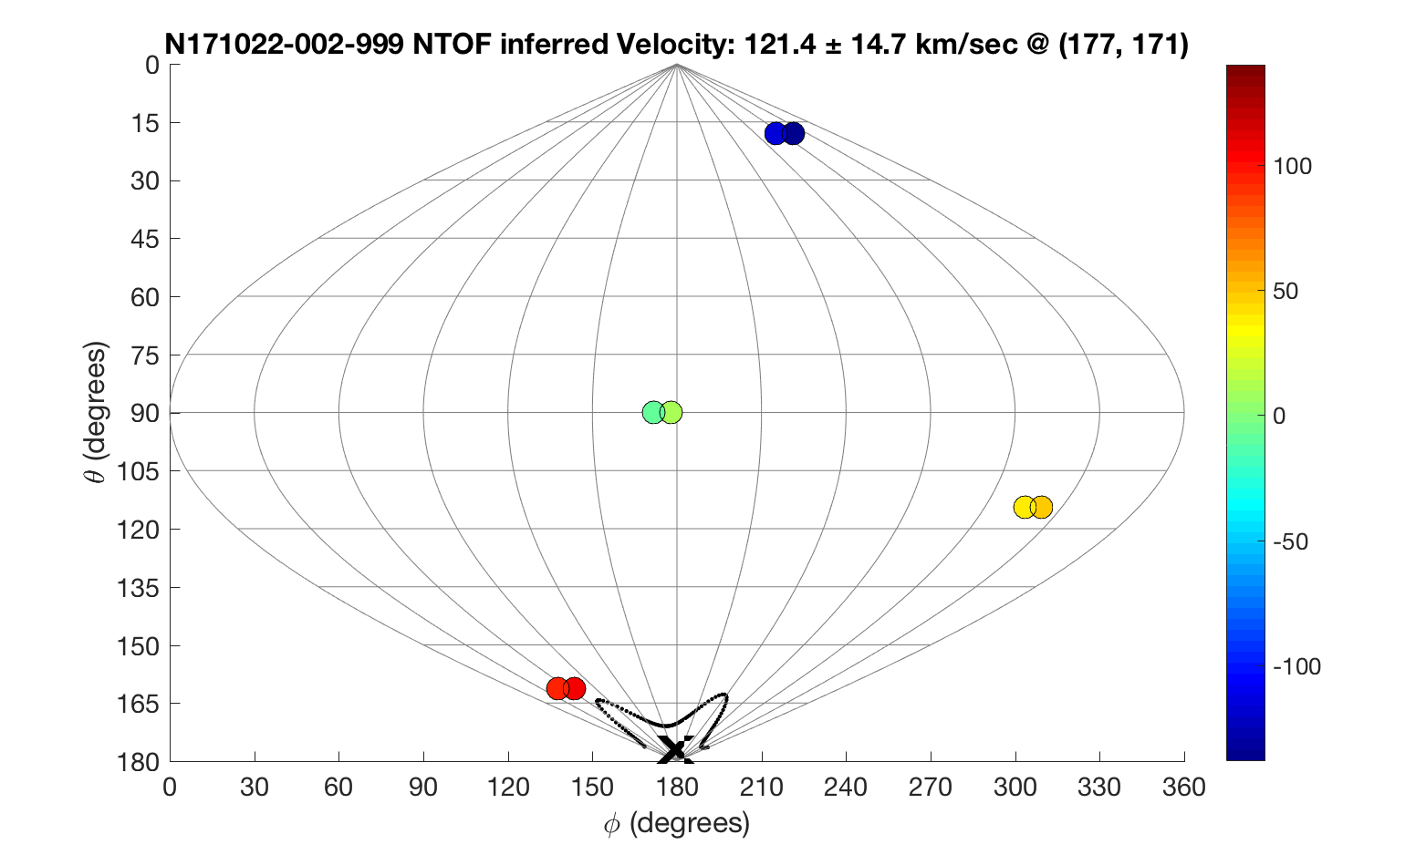
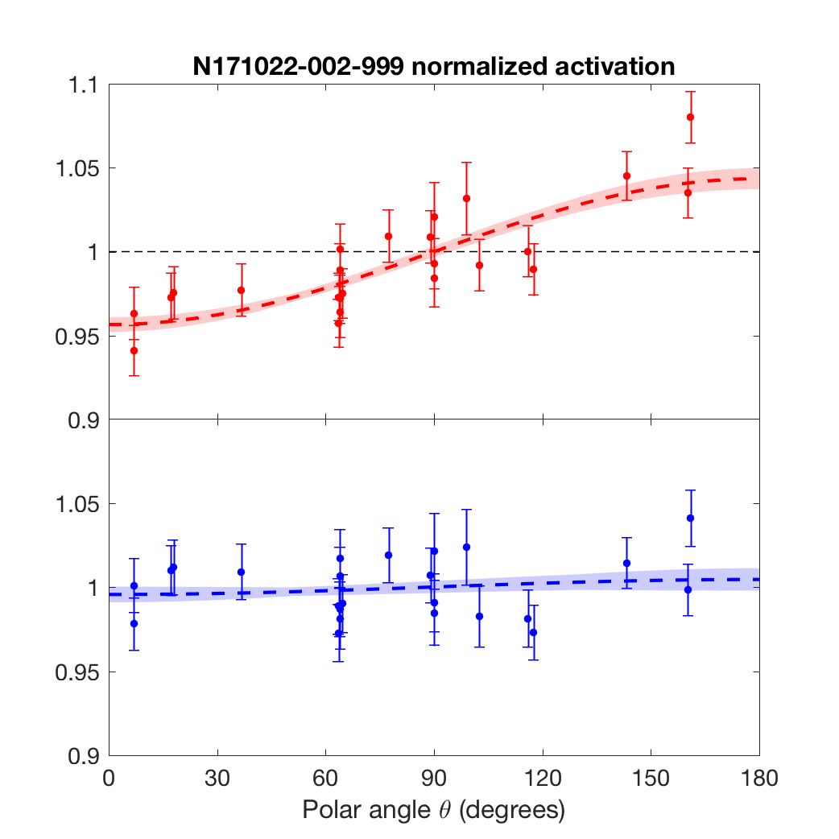
On “antipodal” shot with imposed drive asymmetry and low ρR_{fuel},* velocity correction eliminates the observed FNAD asymmetry
Test case
a)
Before correction:
P₁/P₀ = -4.3% ± 0.5%
b)
After correction:
P₁/P₀ = -0.4% ± 0.6%
N171022-002-999 | km/sec | θ | ɸ
nTOF velocity | 121 [+16, -14] | 177˚ [+3,-14] | 171˚ [±180]
Velocity corrected: V_{HS} = 121 ± 15 km/sec
Entire FNAD mode-1 is accounted for by velocity correction, as expected.
T_{i} = 4.27 keV
dsr = 0.44
*See D. Schlossberg, this session (BO6:7)

Slide 31
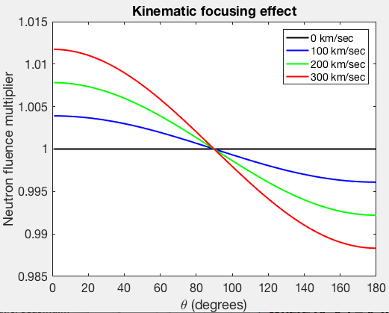
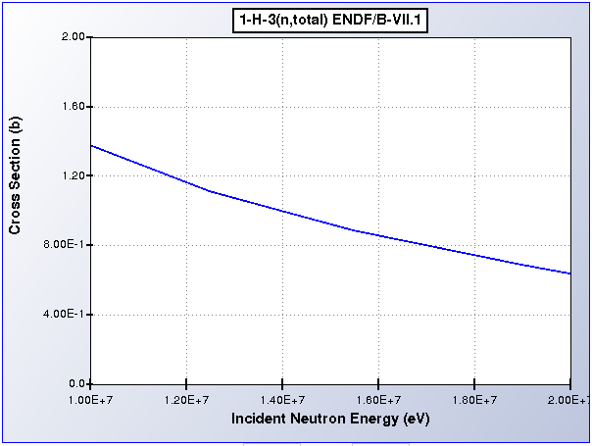
To interpret flange NAD data, hotspot velocity must be accounted for: change in activation, fluence, and scattering
Method: FNADs
#1: Change in activation with neutron energy
#2: Change in neutron fluence with velocity
F = 1 – dsr
∝ –ρR
ΔE
Shift in activation is interpolated from ENDF:
Effect | Magnitude of Activation Change
1. ΔE → activation | 2.81% cos θ / (100 km/s)
2. Kinematic ΔFluence | 0.39% cos θ / (100 km/s)
3. ΔE → scattering | 0.078% cos θ / (100 km/s) / (1 g/cm²)
TOTAL: | 3.2% cos θ / (100 km/s)
#3: Change scattering with neutron energy
n,T cross section
For more info: H. Rinderknecht et al., Rev. Sci. Instrum. 89, 10I125 (2018).

Slide 32
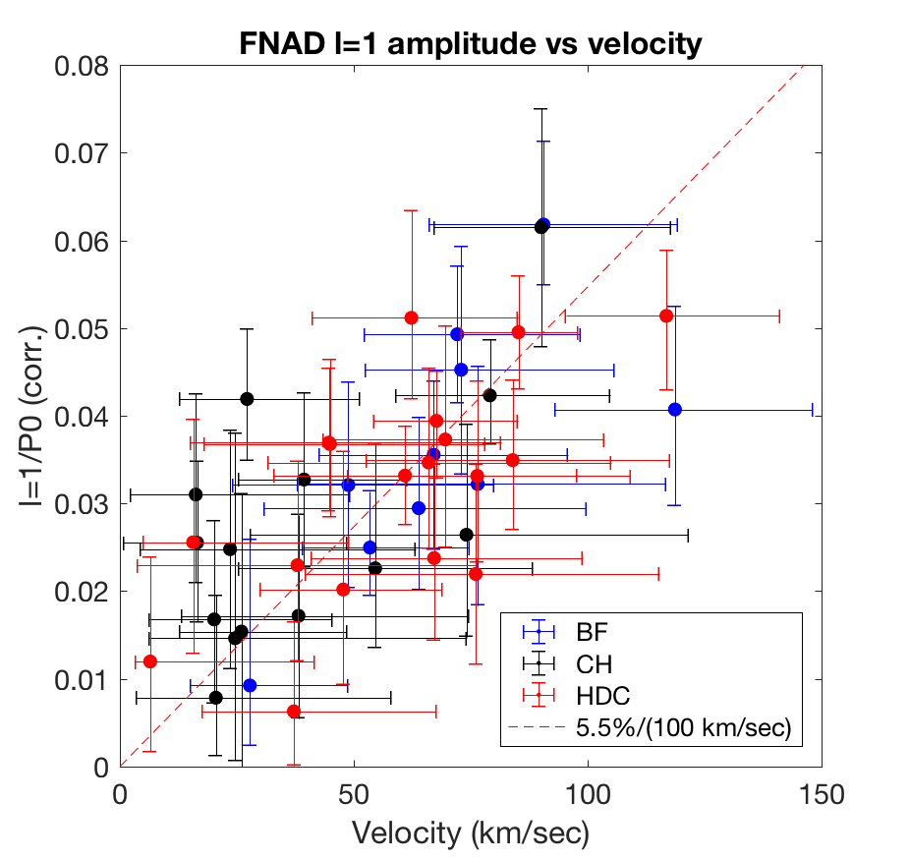
In cryogenic implosions, the corrected FNAD mode-1 amplitude (∝ ρR asymmetry) increases linearly with hotspot velocity
Result #2: ρR
FNAD amplitude vs Velocity
Mode-1 amplitude, corrected
Velocity (km/s)
High velocities (> 50 km/sec) and mode-1 amplitudes (> 4%) are observed in all campaigns.

Slide 33
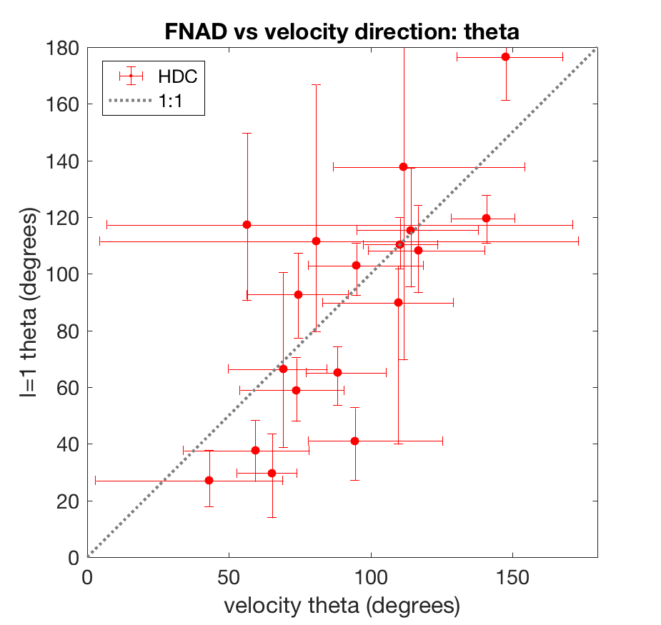
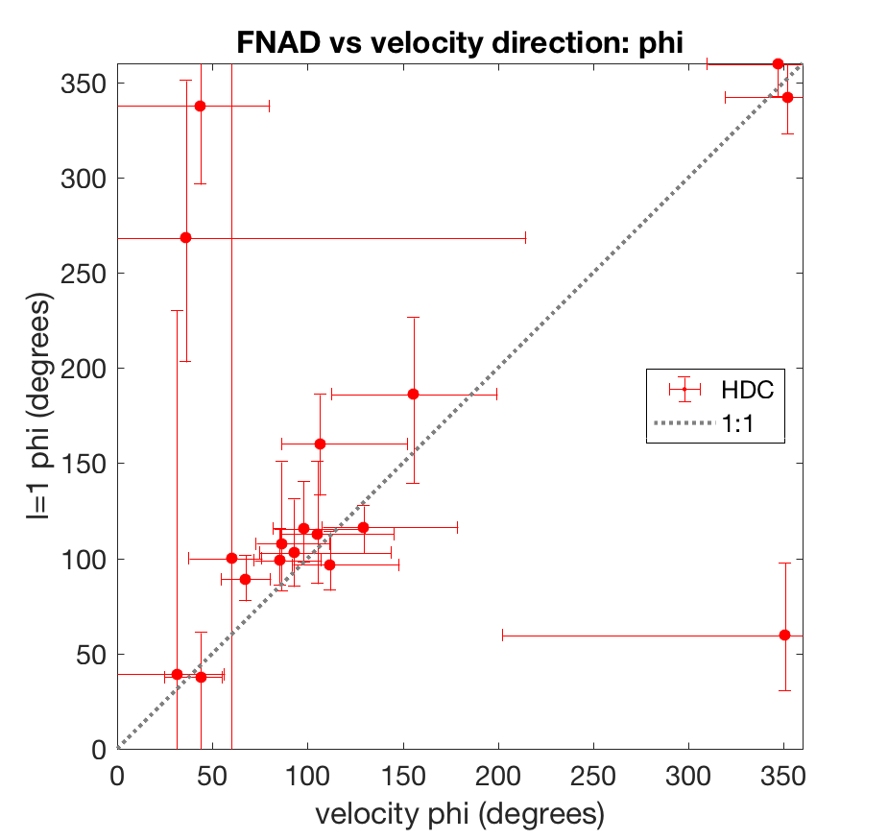
The residual FNAD mode-1 is in the same direction as the hotspot velocity: mean velocity and low ρR are toward ɸ = 90˚
Result #3: direction
Polar Direction θ
Azimuthal Direction ɸ
Mode-1 θ (degrees)
Mode-1 ɸ (degrees)
Velocity θ (degrees)
Velocity ɸ (degrees)
HDC: 18 shots
Showing analyzed shots, FY16—18

Slide 34
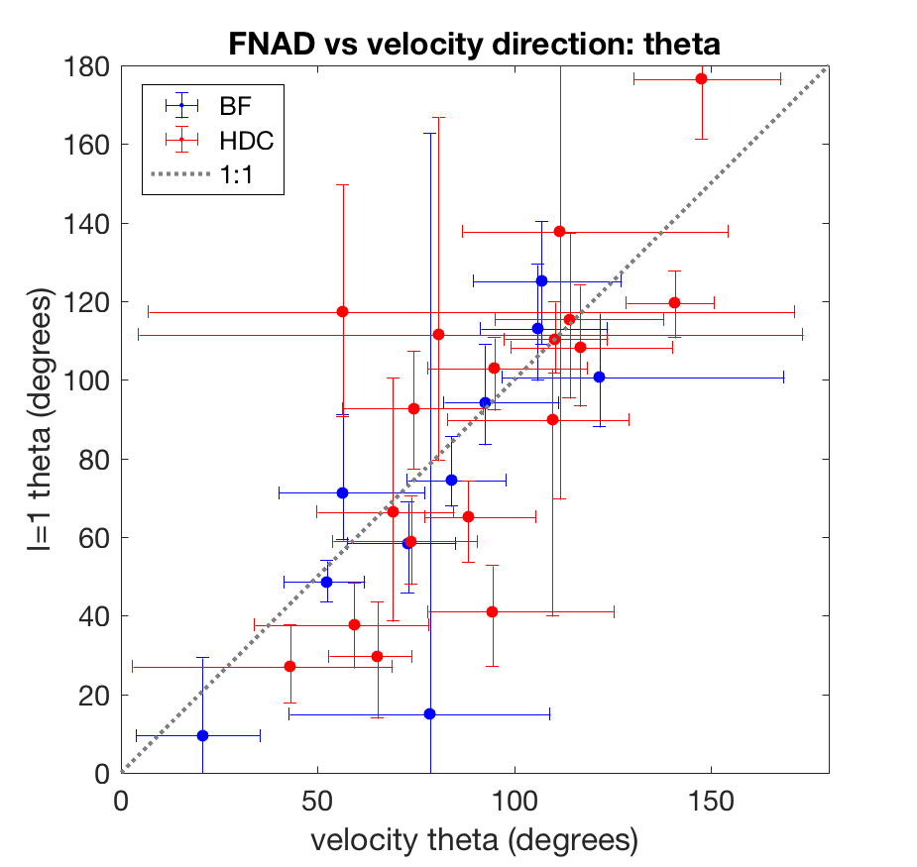
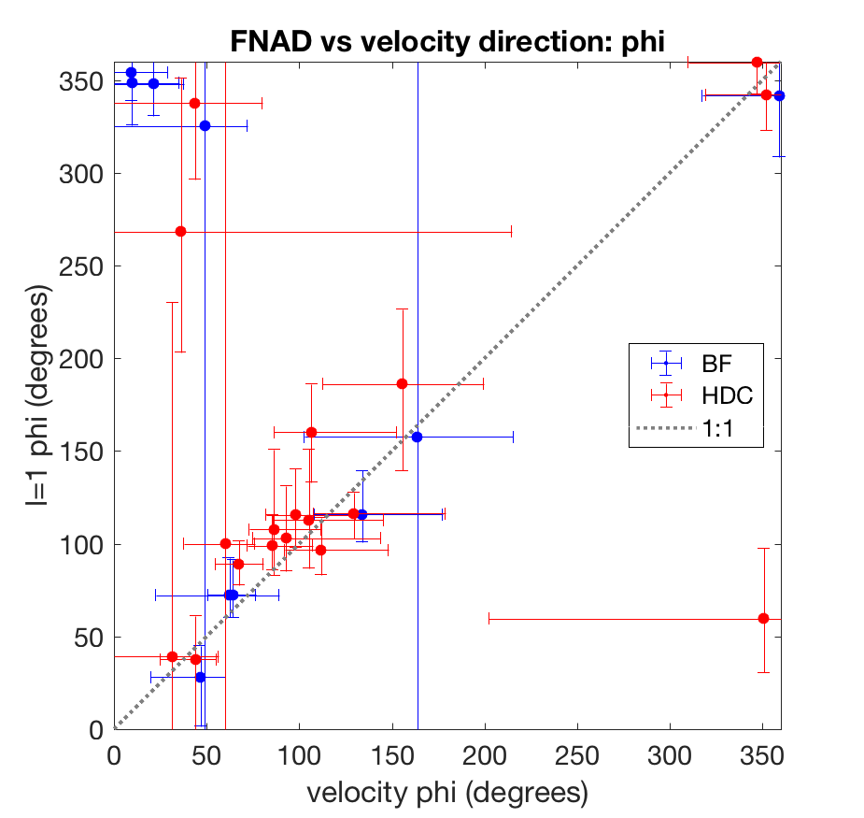
The residual FNAD mode-1 is in the same direction as the hotspot velocity: mean velocity and low ρR are toward ɸ = 90˚
Result #3: direction
Polar Direction θ
Azimuthal Direction ɸ
Mode-1 θ (degrees)
Mode-1 ɸ (degrees)
Velocity θ (degrees)
Velocity ɸ (degrees)
HDC: 18 shots
BF: 10 shots
Showing analyzed shots, FY16—18

Slide 35
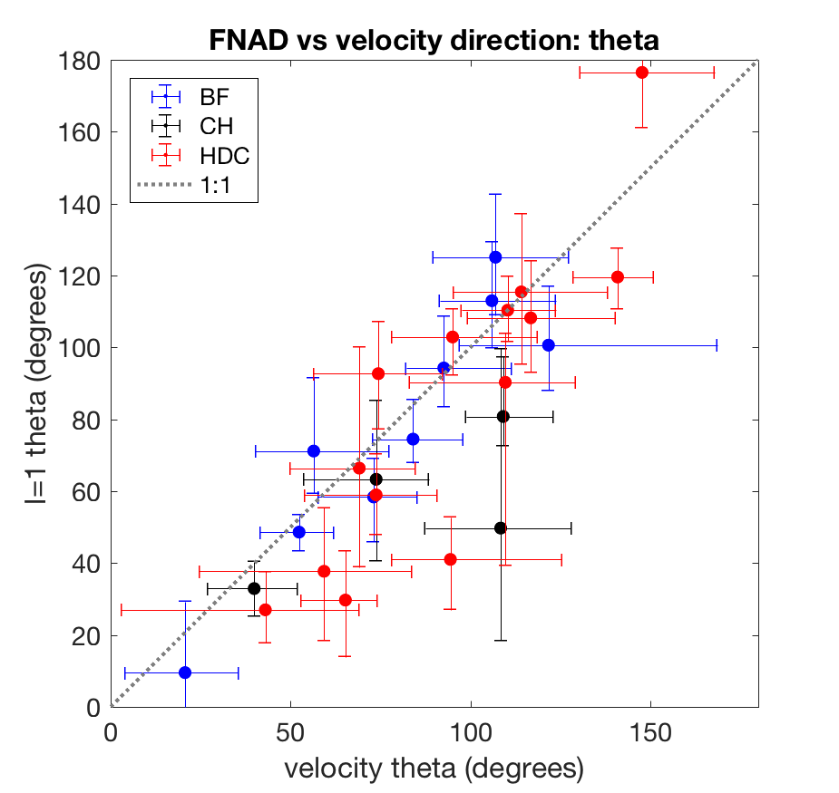
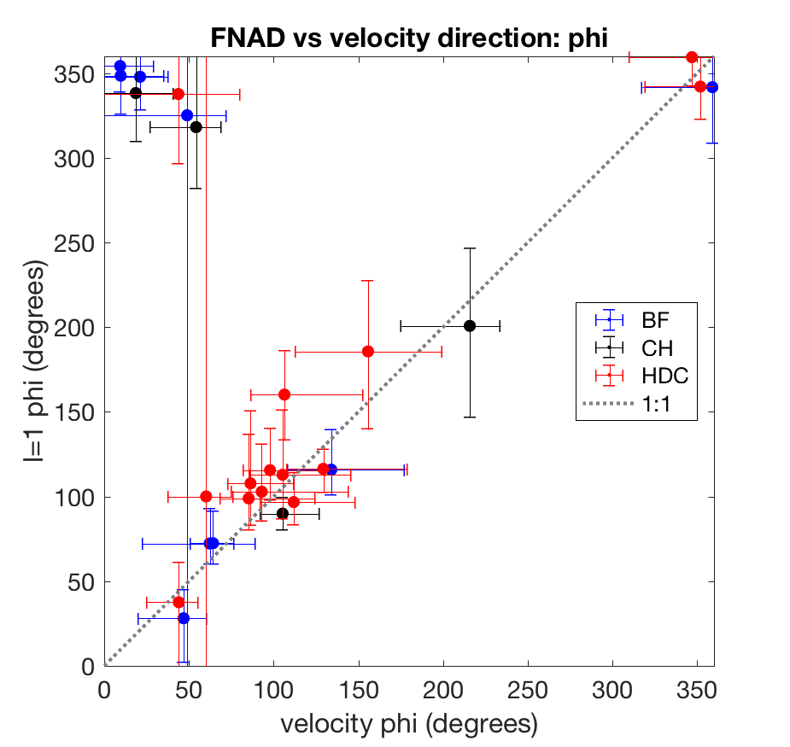
The residual FNAD mode-1 is in the same direction as the hotspot velocity: mean velocity and low ρR are toward ɸ = 90˚
Result #3: direction
Polar Direction θ
Azimuthal Direction ɸ
Mode-1 θ (degrees)
Mode-1 ɸ (degrees)
Velocity θ (degrees)
Velocity ɸ (degrees)
HDC: 14/18 shots
BF: 9/10 shots
CH: 6/14 shots
Showing analyzed shots, FY16—18
with V > 40 km/s

Slide 36
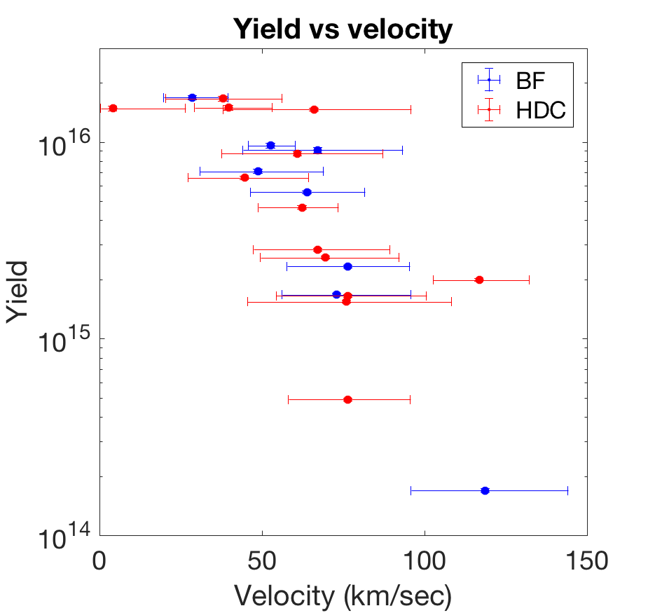
A cohesive picture of azimuthal asymmetry emerges from comparing hotspot velocity and ρR mode-1 amplitude
Future Work
Additional diagnostic comparisons
Test hypotheses & fix asymmetry
Downscattered ratio (MRS, nTOF, NIS)
X-ray late-time images
Neutron imaging (Volegov, Casey, …)
Hohlraum positioning offset
Fill tube (5 µm vs 10 µm)
Diagnostic patches (this summer)
2ω unconverted light asymmetry
…
DSR
FNAD fit
315
NITOF
315
MRS
SpecNP
0
0
7 (FT)
SpecE
7 (FT)
Model development
90
90
Analytical model for comparing magnitude of burn-averaged <V>, ρR mode-1 (Springer)
Impact on performance
…
BT -150ps
315
0
7 (FT)
90

Slide 37
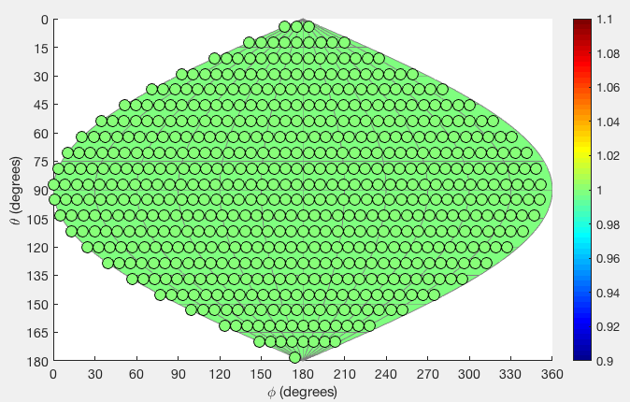
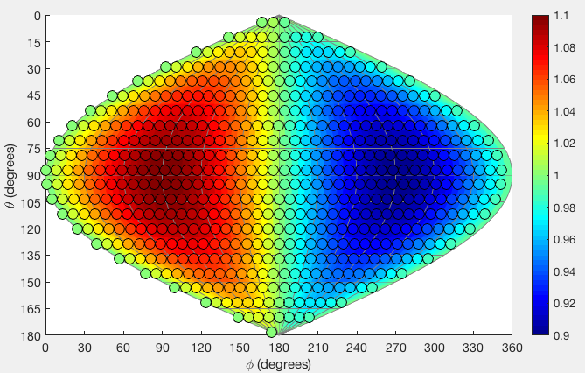
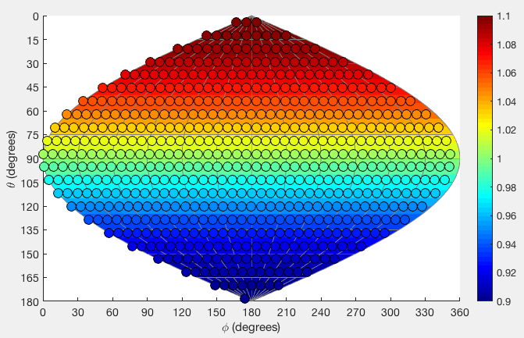
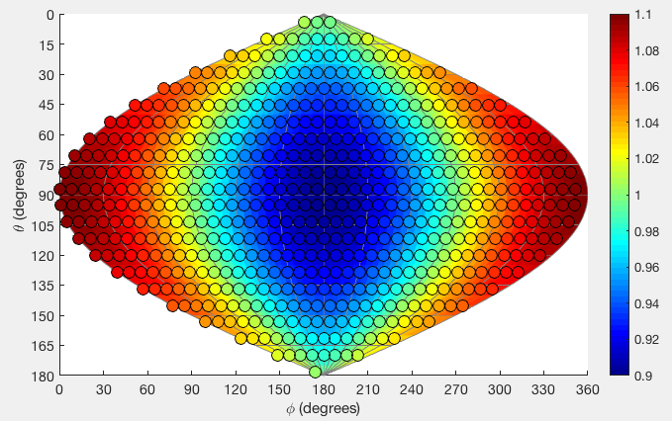
Spherical harmonic (“Y_{ℓm}”) normalization: amplitude = (max – mean)
a₀₀ = 1 → data = 1
ℓ = 0:
m = -1
m = 0
m = +1
ℓ = 1:
a_{1,-1} = 0.1 →
(max – mean) = 0.1,
(mean – min) = 0.1
a_{1,0} = 0.1 →
(max – mean) = 0.1,
(mean – min) = 0.1
a_{1,+1} = 0.1 →
(max – mean) = 0.1,
(mean – min) = 0.1
m = -2
m = -1
m = 0
m = +1
m = +2
ℓ = 2:
a_{2,-2} = 0.1 →
(max – mean) = 0.1,
(mean – min) = 0.1
a_{2,-1} = 0.1 →
(max – mean) = 0.1,
(mean – min) = 0.1
a_{2,0} = 0.1 →
(max – mean) = 0.1,
(mean – min) = 0.05
a_{2,+1} = 0.1 →
(max – mean) = 0.1,
(mean – min) = 0.1
a_{2,+2} = 0.1 →
(max – mean) = 0.1,
(mean – min) = 0.1

Slide 38
On conversion from FNAD variation to absolute ρR_{fuel}:
Say any scattering removes a neutron from activation.
Then the observed activation is normalized as:
We care about ρR(θ), and σ_{DT} is nearly constant. So we can solve for ΔρR = ρR - <ρR>:
We can use the formula <ρR> = 18.8 DSR g/cm² to get the relative variation:
This means a 10% variation in Y implies an 80—90% variation in ρR.
CAVEAT:
Neutron scattering & finite hotspot sizes inhibit direct areal density inference. Due to finite sources, FNADs cannot resolve high modes.

Slide 39
Appendix: simple fill-tube model

Slide 40
Velocity and FNAD data for a series of HDC implosions with 5/10µm fill tubes can test the hypothesis that fill-tube jets are causing these effects
What about fill tubes?
N170601
N170226
N170821
N161023
N170524
N161030

Slide 41
Comparing HDC implosions with 5µm vs 10µm fill tubes: hotspot velocity is ~60 km/sec for both cases, in the direction ɸ = 90˚± 40˚
What about fill tubes?
5 µm
10 µm
170226
170601
170821
170524
161023
161030
170226
170524
170601
161023
161030
170821

Slide 42
FNAD data tells a similar story: mode-1 asymmetry ~ 3—5%, with systematic variation in the direction of asymmetry
What about fill tubes?
5 µm
10 µm
170601
170524
170226
170821
161023
161030
170226
170524
170601
161023
161030
170821

Slide 43
The systematic difference in asymmetry direction suggests a hypothesis: 1. All hotspots have average velocity V_{HS} 2. 10 µm fill-tube injects a flow with velocity V_{jet}
What about fill tubes?
5 µm:
<V> = V_{HS}
10 µm:
V_{HS}
<V> = V_{HS} + V_{jet}
V_{jet}

Slide 44
The systematic difference in asymmetry direction suggests a hypothesis: 1. All hotspots have average velocity V_{HS} 2. 10 µm fill-tube injects a flow with velocity V_{jet}
What about fill tubes?
5 µm:
<V> = V_{HS}
Assuming the weight of the two features is the same, the best fit with this hypothesis is:
V_{HS} = 55 km/sec toward (59˚, 61˚)
V_{jet} = 66 km/sec toward (118˚, 169˚)
10 µm:
x data
o best model
V_{HS}
<V> = V_{HS} + V_{jet}
V_{jet}
# fit parameters: 6
# datapts: 6 x 3 = 18
Empirical status: highly speculative

