Slide 1
Cherenkov radiation from a plasma
J.P. Palastro, T.M. Antonsen Jr., L. Nguyen, A. Colaïtis,
R.K. Follett, D. Turnbull, J. Vieira, and D.H. Froula
60th Annual APS DPP Meeting
Portland, OR Nov 5th 2018

Slide 2
The superluminal ponderomotive force of a “flying focus” can drive Cherenkov radiation in a plasma
A simple plasma precludes Cherenkov radiation: the phase velocity of electromagnetic radiation exceeds c, and thus the velocity of typical drivers
The flying focus provides a superluminal driver: the peak intensity of a pulse focused by a chromatic lens travels at a velocity determined by the chirp

Slide 3
A medium will not emit far-field radiation when excited by a driver traveling slower than the phase velocity
Driver velocity
A driver excites dipole oscillations in the medium that radiate
The phase fronts of the
radiation outrun the driver
and fail to constructively
interfere

Slide 4
A medium will not emit far-field radiation when excited by a driver traveling slower than the phase velocity
Driver velocity
A driver excites dipole oscillations in the medium that radiate
The phase fronts of the
radiation outrun the driver
and fail to constructively
interfere

Slide 5
A medium will not emit far-field radiation when excited by a driver traveling slower than the phase velocity
Driver velocity
A driver excites dipole oscillations in the medium that radiate
The phase fronts of the
radiation outrun the driver
and fail to constructively
interfere

Slide 6
A medium will not emit far-field radiation when excited by a driver traveling slower than the phase velocity
Driver velocity
A driver excites dipole oscillations in the medium that radiate
The phase fronts of the
radiation outrun the driver
and fail to constructively
interfere

Slide 7
A medium will not emit far-field radiation when excited by a driver traveling slower than the phase velocity
Driver velocity
A driver excites dipole oscillations in the medium that radiate
The phase fronts of the
radiation outrun the driver
and fail to constructively
interfere

Slide 8
A medium can emit far-field radiation when excited by a driver traveling faster than the phase velocity
Driver velocity
A driver excites dipole oscillations in the medium that radiate
The phase fronts of the
radiation fall behind the
driver and constructively
interfere, resulting in
Cherenkov emisson

Slide 9
A medium can emit far-field radiation when excited by a driver traveling faster than the phase velocity
Driver velocity
A driver excites dipole oscillations in the medium that radiate
The phase fronts of the
radiation fall behind the
driver and constructively
interfere, resulting in
Cherenkov emisson

Slide 10
A medium can emit far-field radiation when excited by a driver traveling faster than the phase velocity
Driver velocity
A driver excites dipole oscillations in the medium that radiate
The phase fronts of the
radiation fall behind the
driver and constructively
interfere, resulting in
Cherenkov emisson

Slide 11
A medium can emit far-field radiation when excited by a driver traveling faster than the phase velocity
Driver velocity
A driver excites dipole oscillations in the medium that radiate
The phase fronts of the
radiation fall behind the
driver and constructively
interfere, resulting in
Cherenkov emisson

Slide 12
A medium can emit far-field radiation when excited by a driver traveling faster than the phase velocity
Driver velocity
A driver excites dipole oscillations in the medium that radiate
The phase fronts of the
radiation fall behind the
driver and constructively
interfere, resulting in
Cherenkov emisson

Slide 13
A medium can emit far-field radiation when excited by a driver traveling faster than the phase velocity
Driver velocity
A driver excites dipole oscillations in the medium that radiate
The phase fronts of the
radiation fall behind the
driver and constructively
interfere, resulting in
Cherenkov emisson

Slide 14
Dispersion in a simple plasma precludes Cherenkov emission: the phase velocity exceeds c and thus the driver velocity
Phase velocity in plasma:
*W. Sollfrey & H.T. Yura, Phys. Rev. 139, 48 (1965).

Slide 15
Dispersion in a simple plasma precludes Cherenkov emission: the phase velocity exceeds c and thus the driver velocity
Phase velocity in plasma:
Two options:
*W. Sollfrey & H.T. Yura, Phys. Rev. 139, 48 (1965).

Slide 16
Dispersion in a simple plasma precludes Cherenkov emission: the phase velocity exceeds c and thus the driver velocity
Phase velocity in plasma:
Two options:
1. Reduce the phase velocity
an applied magnetic field admits
an electromagnetic mode with a
subluminal phase velocity*
for
*W. Sollfrey & H.T. Yura, Phys. Rev. 139, 48 (1965).

Slide 17
Dispersion in a simple plasma precludes Cherenkov emission: the phase velocity exceeds c and thus the driver velocity
Phase velocity in plasma:
Two options:
1. Reduce the phase velocity
an applied magnetic field admits
an electromagnetic mode with a
subluminal phase velocity*
2. Increase the driver velocity
a Flying Focus can drive a
superluminal ponderomotive
current—novel mechanism
for
*W. Sollfrey & H.T. Yura, Phys. Rev. 139, 48 (1965).

Slide 18
A chirped laser pulse focused by a chromatic lens exhibits a dynamic, or “flying”, focus*
The flying focus:
Decouples the velocity of the peak
intensity from the group velocity
time
*D.H. Froula et al., Nat. Photonics 12, 262 (2018).

Slide 19
A chirped laser pulse focused by a chromatic lens exhibits a dynamic, or “flying”, focus*
The flying focus:
Decouples the velocity of the peak
intensity from the group velocity
time
v_{g}
*D.H. Froula et al., Nat. Photonics 12, 262 (2018).

Slide 20
A chirped laser pulse focused by a chromatic lens exhibits a dynamic, or “flying”, focus*
The flying focus:
Decouples the velocity of the peak
intensity from the group velocity
time
v_{g}
*D.H. Froula et al., Nat. Photonics 12, 262 (2018).

Slide 21
A chirped laser pulse focused by a chromatic lens exhibits a dynamic, or “flying”, focus*
The flying focus:
Decouples the velocity of the peak
intensity from the group velocity
time
v_{g}
*D.H. Froula et al., Nat. Photonics 12, 262 (2018).

Slide 22
A chirped laser pulse focused by a chromatic lens exhibits a dynamic, or “flying”, focus*
The flying focus:
Decouples the velocity of the peak
intensity from the group velocity
time
v_{g}
*D.H. Froula et al., Nat. Photonics 12, 262 (2018).

Slide 23
A chirped laser pulse focused by a chromatic lens exhibits a dynamic, or “flying”, focus*
The flying focus:
Decouples the velocity of the peak
intensity from the group velocity
time
v_{g}
*D.H. Froula et al., Nat. Photonics 12, 262 (2018).

Slide 24
A chirped laser pulse focused by a chromatic lens exhibits a dynamic, or “flying”, focus*
The flying focus:
Decouples the velocity of the peak
intensity from the group velocity
time
v_{d}
v_{g} < v_{d}
*D.H. Froula et al., Nat. Photonics 12, 262 (2018).

Slide 25
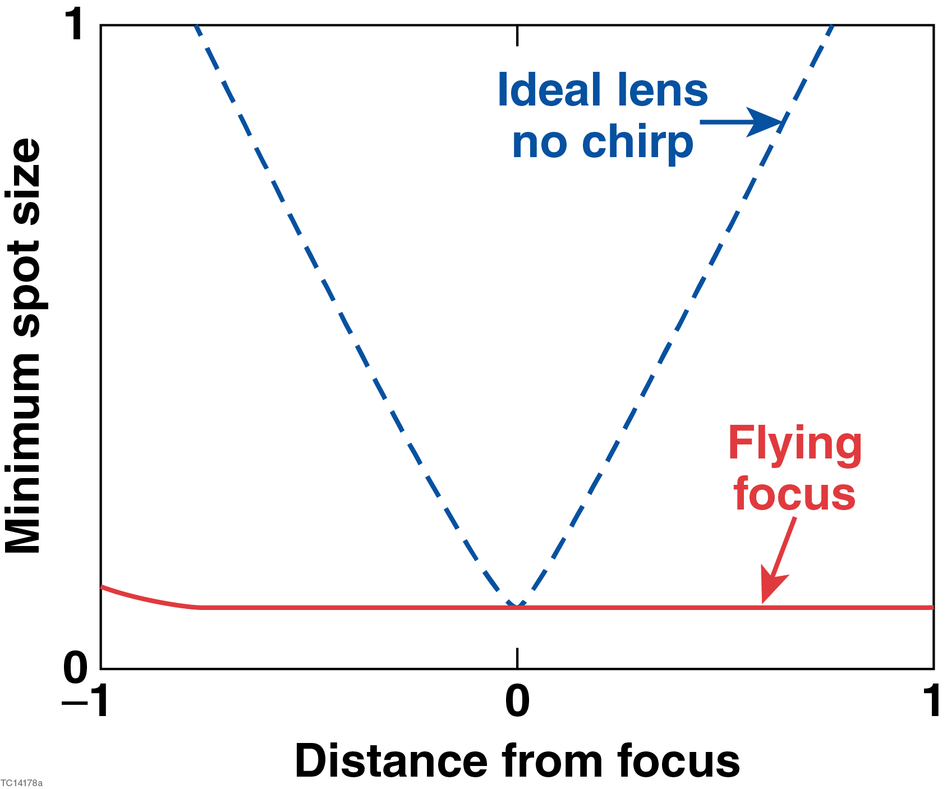
A chirped laser pulse focused by a chromatic lens exhibits a dynamic, or “flying”, focus*
The flying focus:
Decouples the velocity of the peak
intensity from the group velocity
Decouples the minimum spot size
from the Rayleigh range
time
v_{d}
v_{g} < v_{d}
*D.H. Froula et al., Nat. Photonics 12, 262 (2018).

Slide 26
The superluminal ponderomotive force of a flying focus can drive far-field electromagnetic radiation
Steady-state wave equation for the magnetic field
ponderomotive potential
density gradient
diffraction
refraction

Slide 27
The superluminal ponderomotive force of a flying focus can drive far-field electromagnetic radiation
Steady-state wave equation for the magnetic field
ponderomotive potential
density gradient
diffraction
refraction
Ponderomotive excitation of far-field radiation requires

Slide 28
The superluminal ponderomotive force of a flying focus can drive far-field electromagnetic radiation
Steady-state wave equation for the magnetic field
ponderomotive potential
density gradient
diffraction
refraction
density gradient
Ponderomotive excitation of far-field radiation requires
1. Density gradient,

Slide 29
The superluminal ponderomotive force of a flying focus can drive far-field electromagnetic radiation
Steady-state wave equation for the magnetic field
ponderomotive potential
density gradient
diffraction
refraction
dispersion
density gradient
Ponderomotive excitation of far-field radiation requires
1. Density gradient,
2. Superluminal driver,

Slide 30
The superluminal ponderomotive force of a flying focus can drive far-field electromagnetic radiation
Steady-state wave equation for the magnetic field
ponderomotive potential
density gradient
diffraction
refraction
dispersion
density gradient
Ponderomotive excitation of far-field radiation requires
1. Density gradient,
2. Superluminal driver,
emission
angle
Equivalent to the Cherenkov condition:

Slide 31
The superluminal ponderomotive force of a flying focus can drive far-field electromagnetic radiation
Ponderomotive excitation of far-field radiation requires:
1. Density gradient—preformed plasma
2. Superluminal driver—flying focus
preformed
plasma

Slide 32
The superluminal ponderomotive force of a flying focus can drive far-field electromagnetic radiation
Ponderomotive excitation of far-field radiation requires:
1. Density gradient—preformed plasma
2. Superluminal driver—flying focus
Cherenkov, v_{d} = v_{p}
preformed
plasma

Slide 33
The superluminal ponderomotive force of a flying focus can drive far-field electromagnetic radiation
Ponderomotive excitation of far-field radiation requires:
1. Density gradient—preformed plasma
2. Superluminal driver—flying focus
Cherenkov, v_{d} = v_{p}
preformed
plasma

Slide 34
The superluminal ponderomotive force of a flying focus can drive far-field electromagnetic radiation
Ponderomotive excitation of far-field radiation requires:
1. Density gradient—preformed plasma
2. Superluminal driver—flying focus
Cherenkov, v_{d} = v_{p}
preformed
plasma

Slide 35
The superluminal ponderomotive force of a flying focus can drive far-field electromagnetic radiation
Ponderomotive excitation of far-field radiation requires:
1. Density gradient—preformed plasma
2. Superluminal driver—flying focus
Cherenkov, v_{d} = v_{p}
preformed
plasma

Slide 36
The superluminal ponderomotive force of a flying focus can drive far-field electromagnetic radiation
Ponderomotive excitation of far-field radiation requires:
1. Density gradient—preformed plasma
2. Superluminal driver—flying focus
Cherenkov, v_{d} = v_{p}
preformed
plasma

Slide 37
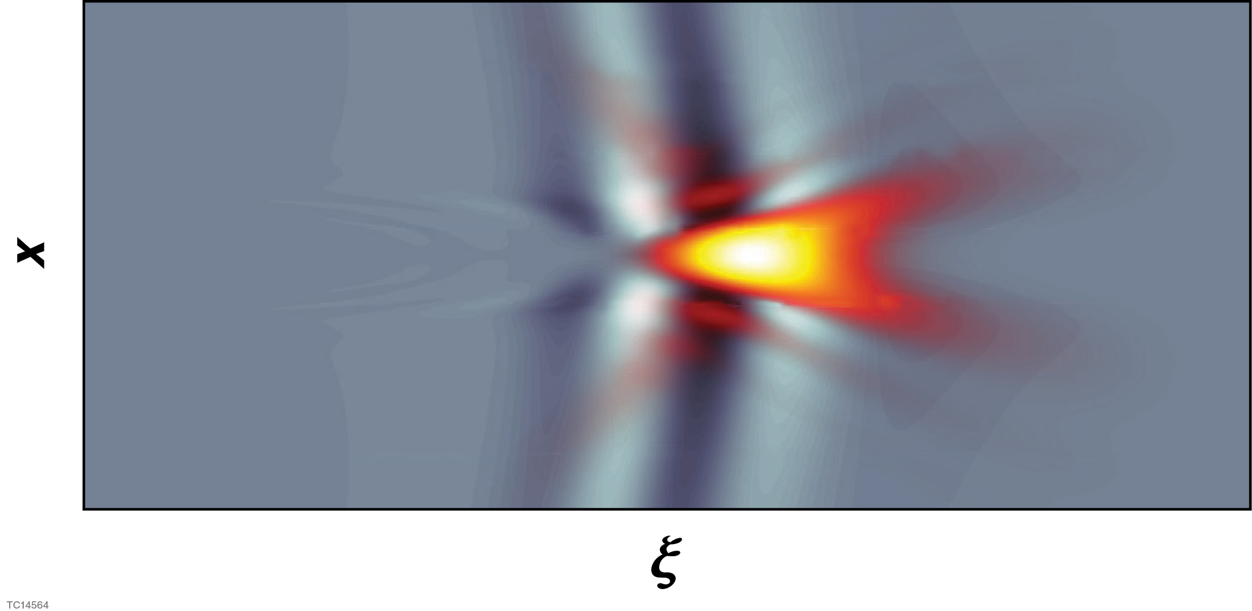
We have extended the quasistatic model of ponderomotively driven wakefields to model Cherenkov emission
Dynamic wave equation for B-field (a₀<1) in moving frame: ξ = ct -z
ponderomotive potential
density gradient
electrostatic
potential
Current density
Electrostatic potential

Slide 38
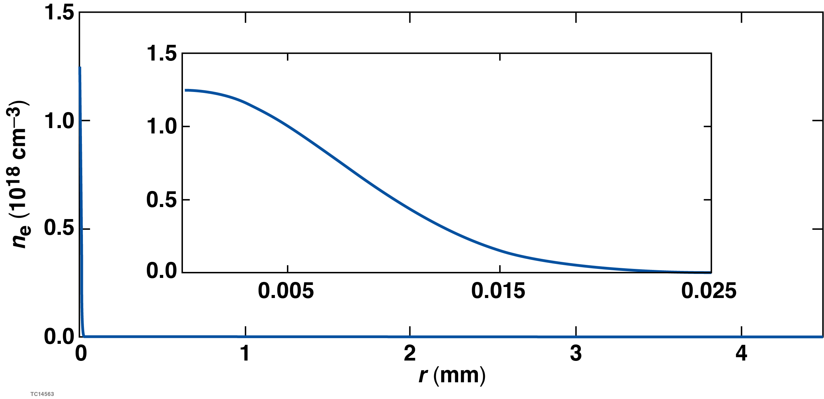
Simulation setup
Laser parameters
λ = 920 nm
The simulations have large radial domains to allow
the radiation to propagate into the quasi-farfield
Δλ = 60 nm
focal length = 0.2 m
background density
focal spot = 5.8 μm
Plasma parameters
n_{e} = 1.3x10¹⁸ cm⁻³
length = 9 mm
radius = 10 μm

Slide 39
Far-field radiation occurs when the focal velocity exceeds the speed of light
The simulation exhibits the expected behavior: no far-field emission
for focal velocities < c
v_{d} = 0.95 (small + chirp)
v_{d} = 1.06 (small - chirp)
laser intensity
Cherenkov rad. rS_{z}
laser intensity
Cherenkov rad. rS_{z}

Slide 40
The superluminal ponderomotive force of a “flying focus” can drive Cherenkov radiation in a plasma
A simple plasma precludes Cherenkov radiation: the phase velocity of electromagnetic radiation exceeds c, and thus the velocity of typical drivers
The flying focus provides a superluminal driver: the peak intensity of a pulse focused by a chromatic lens travels at a velocity determined by the chirp

