Slide 1
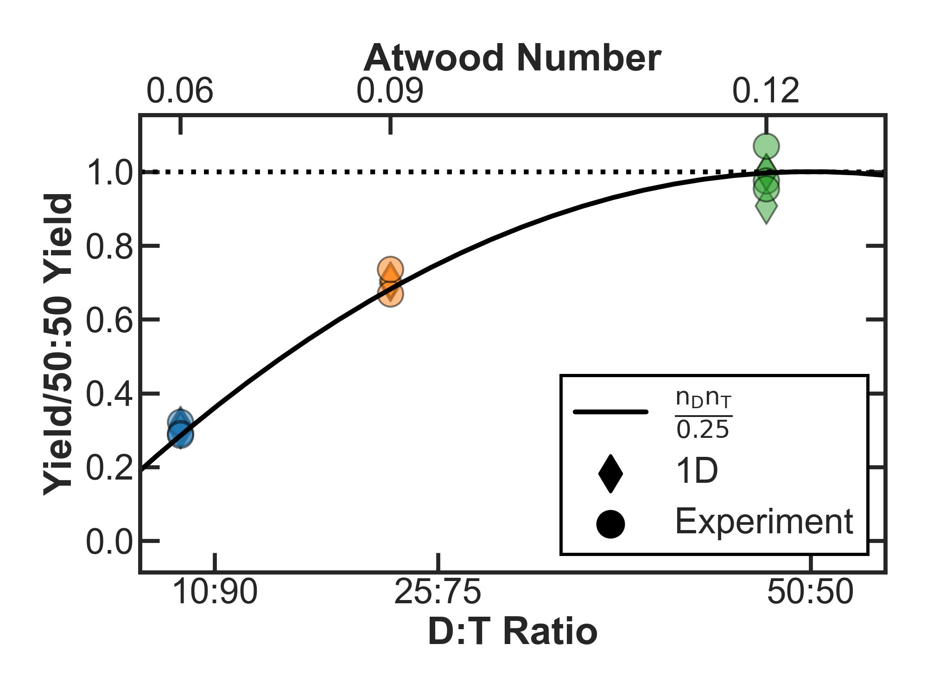
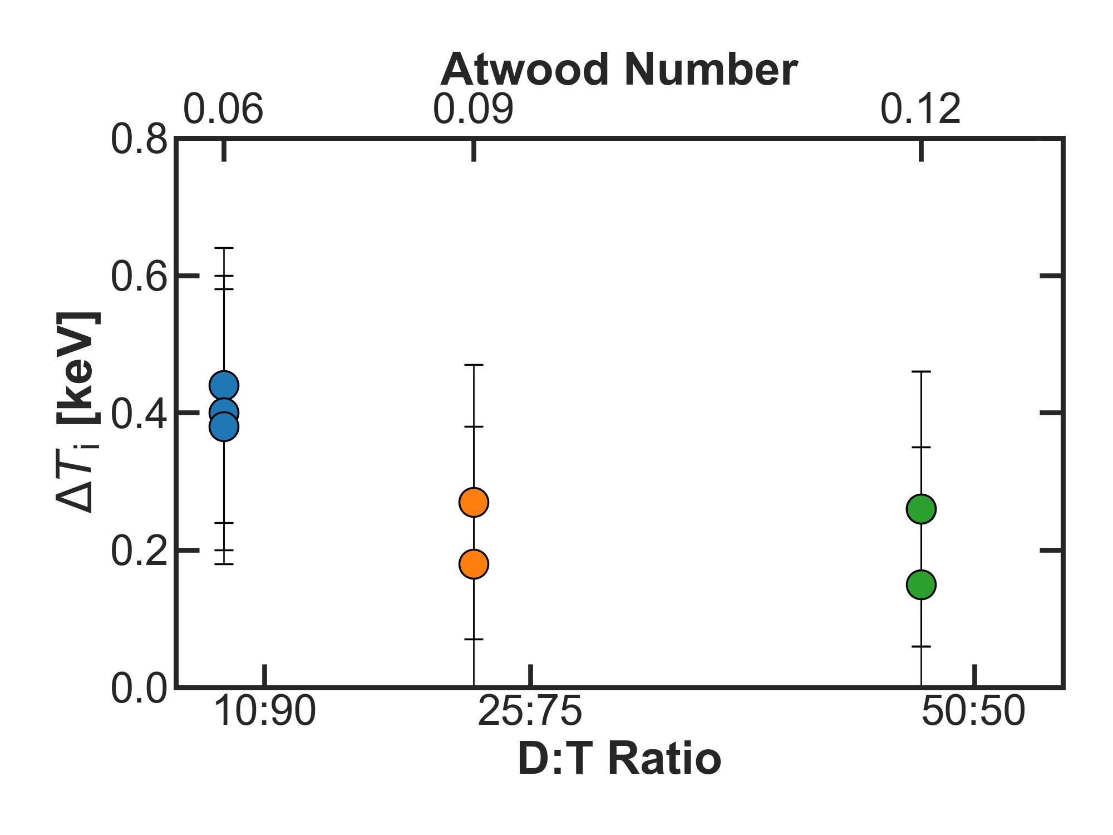
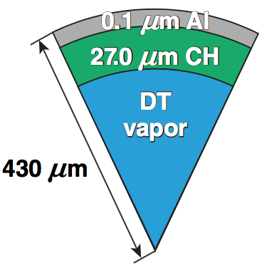
Deceleration-Phase Rayleigh–Taylor Growth Effects on the Performance of Direct-Drive Implosions
OMEGA direct-drive
room-temperature target
60th Annual Meeting of the
American Physical Society
Division of Plasma Physics
Portland, OR
5–9 November 2018
S. C. Miller
University of Rochester
Laboratory for Laser Energetics
Notes:
Read title
Talk about target in center
Same target specs, only varied D:T fill ratio
Talk about chart of left
Yield is normalized to the average D:T 50:50 yield for both 1D and experiment
Shows that yield scales due to composition
Talk about chart on right
Say how experiment measures multiple lines of sight
Ion temperature is inferred from neutron time of flight spectrum
We get a delta T
Say that all targets had similar levels of delta T which says that RT rates should be comparable
Due to the level of errors, it’s difficult to make any conclusive statement about each D:T performance

Slide 2
The Atwood number during deceleration is primarily determined by radiation heating of the pusher in room-temperature implosions
Summary
Notes:
Read title, read bullets, move on
Title:
The atwood number during deceleration is determined by radiation heating of the pusher in room temperature implosions
Observed Ti variation was marginally influenced by altering the Atwood number, suggesting that deceleration RT growth levels were similar

Slide 3
Collaborators
J. P. Knauer, C. J. Forrest, V. Yu. Glebov, O. M. Mannion, W. T. Shmayda
T. J. B. Collins, J. A. Marozas, K. S. Anderson
P. B. Radha, V. N. Goncharov
University of Rochester
Laboratory for Laser Energetics

Slide 4
Room–temperature implosions are classically RT–unstable during the deceleration phase due to the finite Atwood number at the material interface
D:T
10:90 | –0.02
25:75 | -0.00
50:50 | -0.05
Notes:
Read title
Compare LHS cryo vs warm
mass density profiles in 1D
note difference in materials, cryo is all DT, warm is CH + DT
Talk about material interface
at the interface, there is a jump in density
this interface is unstable, which sets up favorable conditions for classical RT growth to occur
Add pressure to show gradient in warm
Talk about atwood number and D:T ratios
RT growth is highly dependent on this nondim Atwood number, which can be found by these 2 equations
ratio of mass densities is determined by ion mass and atomic number
Experimentally, the atwood number was varied by setting the D:T ratio in the gas fill, which changes the mi of the fuel.
This was done to influence the RT growth rates estimated by classical theory (this leads into the next slide)

Slide 5
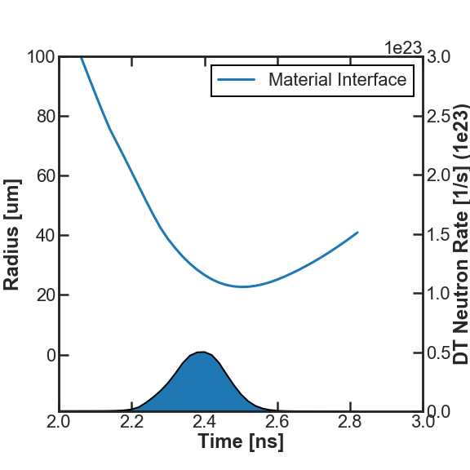
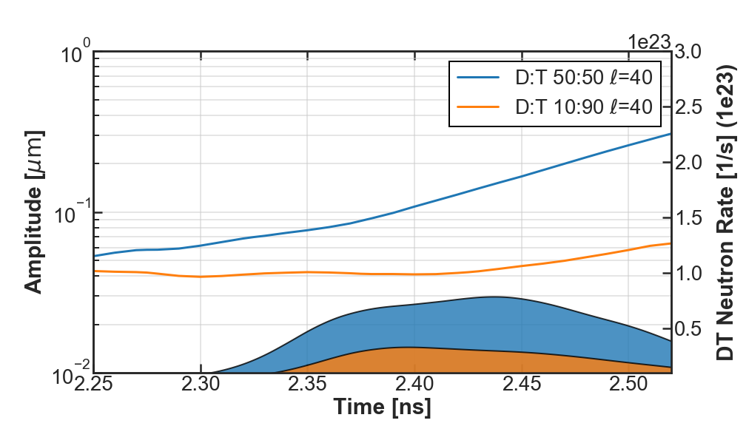
Single-mode, small-amplitude perturbation simulations demonstrated classic linear RT growth rates that scaled according to their difference in Atwood numbers
Single-mode, small-amplitude perturbations
Free-fall growth factor
DT Neutron Rates
Linear Rayleigh–Taylor Growth Rates
DT Neutron
Rate
Notes:
Read title
Change 1e23 location
Intro left chart
2D simulations with small amp, single mode perturbations, showed growth in 50:50 but practically none in 10:90 as expected
In 1D, RT growth factors can be estimated using simple scaling equations and the distance that the material interface travels during free-fall, as shown in the chart on the right. This distance is found by taking the difference in the radius of the material interface at the start of the deceleration to the radius at peak-neutron production. This distance, or delta R is then plugged into the scaling equation here, alongside the Atwood number and wave number for the perturbation in questions. Here I use a mode number of L= 40. This scaling then tells us that the 50:50 has a growth factor of 5 compared to 10:90 which has no growth due to the negative Atwood number.
Classical linear RT growth rates are shown here with the Atwood number estimated using the DT ion mass
Perturbation levels scaled as shown here, and using the Atwood number with the free fall delta R
H:D:T Atwood
0:10:90 -0.02
10:10:80 0.19
50:50 0.32
7:47:46 0.38

Slide 6
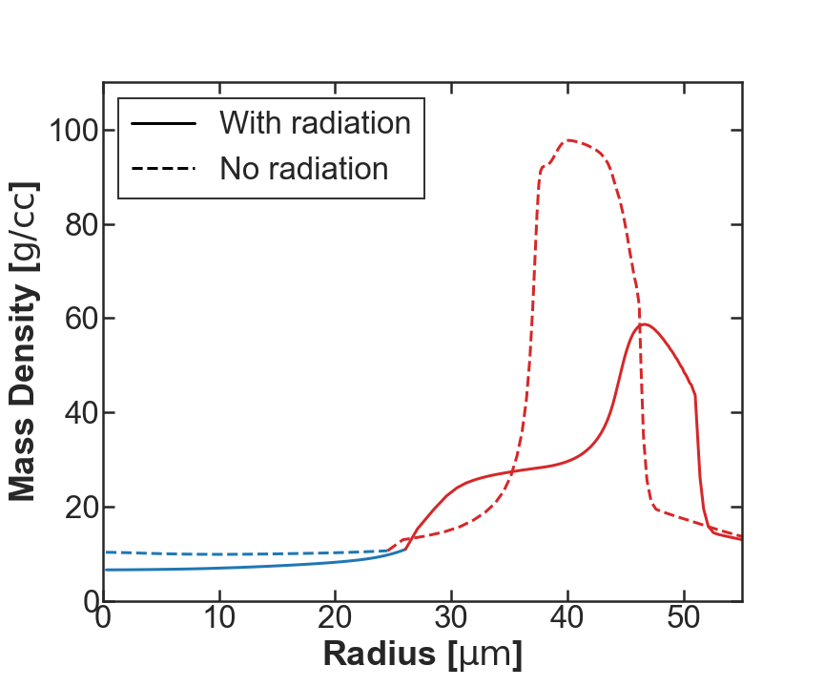
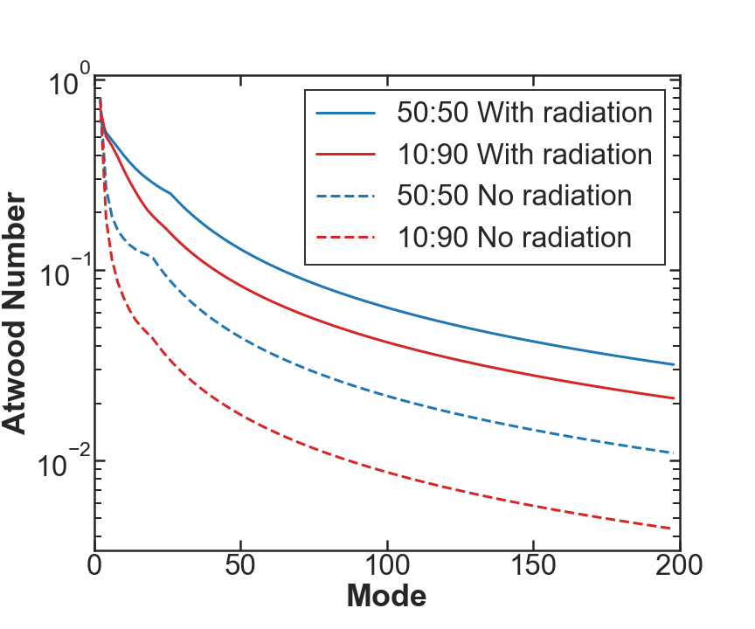
Perturbation growth is affected by radiation transport during the deceleration phase
D:T 50:50 density profile
at peak neutron production
Effective Atwood Numbers
at peak neutron production
Radiation transport increases the effective Atwood number.
Notes:
Read title
During the deceleration phase, the fuel in the target gets hot enough to release energy through radiation transport. This deposition of energy into the cold shell causes the shell to expand inwards. As shown in the chart on the left, this expansion of the shell inwards causes the density near the material interface to increase more than it would if radiation effects were not taken into account. The solid line shows the density with radiation effects while the dashed line shows what the shell would look like without it. You can see with your eyes how much the density local to the interface jumps as you move into the shell from the gas.
If you then calculate the effective Atwood number, or the Atwood number at the scale length of a particular perturbation, you can then see how the Atwood number changes with respect to each L mode. On the right I show how the D:T ratios of 10:90 and 50:50 react to the increase in Atwood number due to radiation absorption in the shell. Once again, the solid lines correspond to radiation included and dashed lines for the case when radiation effects are neglected. The point I mean to make with this chart is two-fold. First, the Atwood number depends on the scale-length of the perturbation, so different modes grow and different rates, and second, radiation causes the Atwood number to increase. The rate at which it does this though is different for each D:T ratio. This leads me then to the point in the yellow box here. Which is (read box)
Radiation transport raises the effective Atwood number by increasing the density near the material interface through mass ablation
The increase factor in D:T 10:90 due to radiation effects is roughly 6x compared to 4x in D:T 50:50
This non-constant Atwood number increase due to radiation can explain why the difference between 10:90 and 50:50 was smaller than expected
New title: Perturbation growth is effected by radiation transport during deceleration phase

Slide 7
Nonlinear perturbation growth is expected to be similar for different D:T fuel compositions
Early Time
(near shock convergence)
Bang Time
10:90
50:50
10:90
50:50
10:90
50:50
CH Shell
DT Vapor
Nonlinear Rayleigh–Taylor
Perturbation Growth
*V.N. Goncharov, Phys. Rev. Lett., 88 (13), 134502 (2002).
Notes:
Read title
Talk about new Atwood number, calculated for a particular mode. Note that 10:90 and 50:50 are closer and 10:90 is positive, due to radiation effects
Nonlinear RT bubble velocity scales like this. Rates are much closer and nonlinear RT perturbation growth becomes linear in time with the bubble velocity
On Right I have 2D draco results at early time and bang time, colored by the material. These show growth evolution at the interface and how similar they are to each other. The perturbation is detailed here and the rates were fairly insensitive to the mode number chosen
Knowing this, we then have a theoretical basis by which we can better interpret the data from the experiment

Slide 8
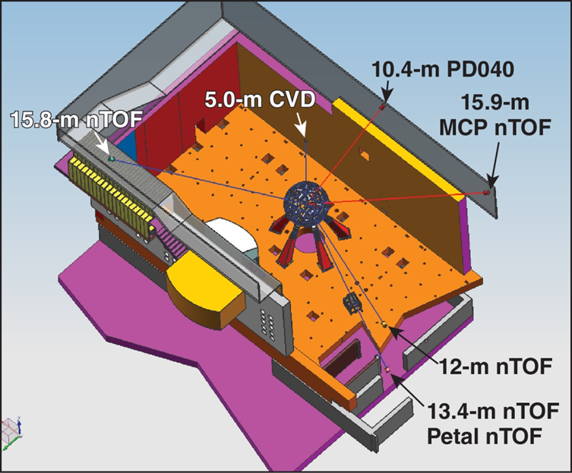
Six nTOF detectors provide multiple line-of-sight (LOS) measurements on OMEGA
Notes:
Read title
Read chart title
Read bullets
Next slide

Slide 9
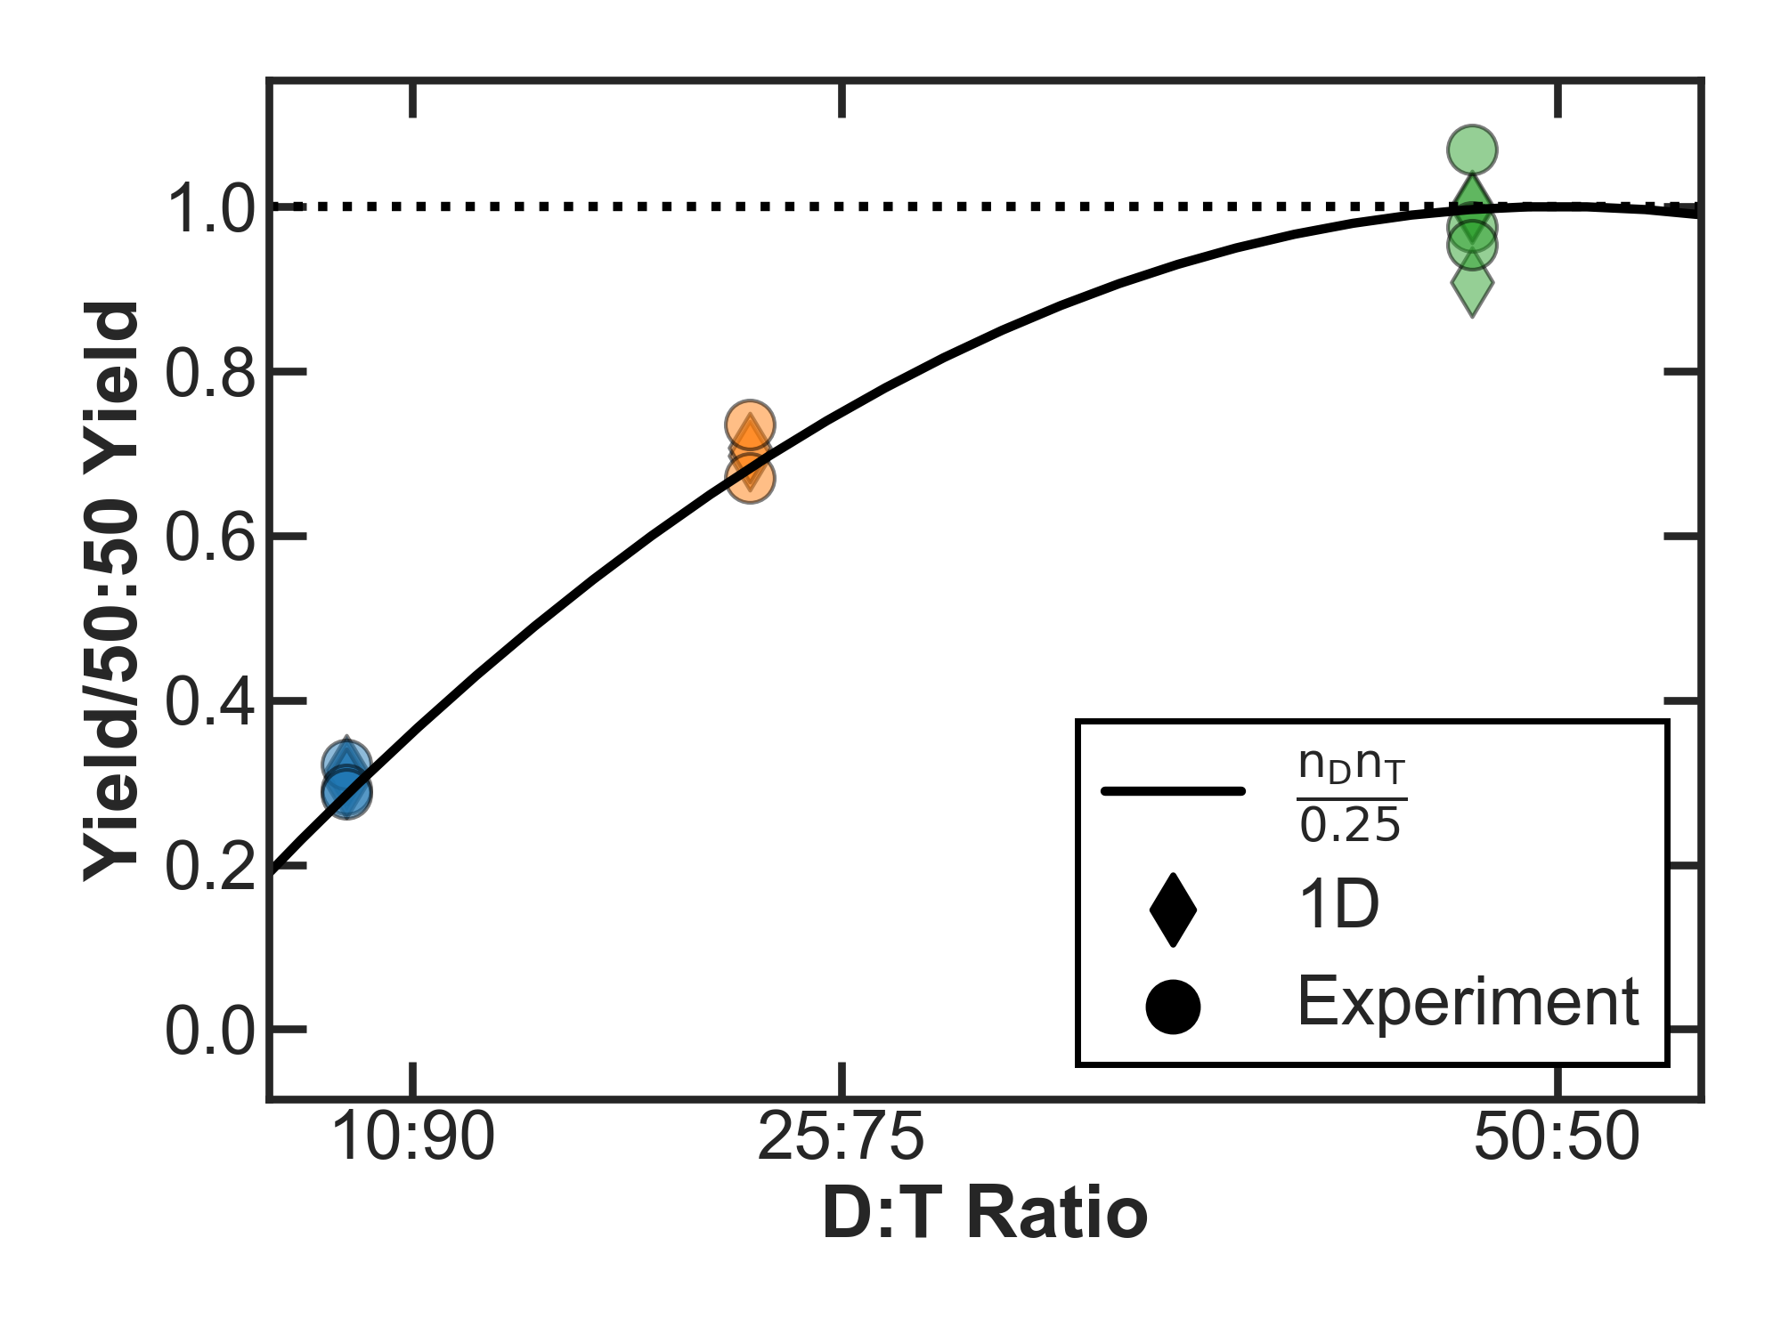
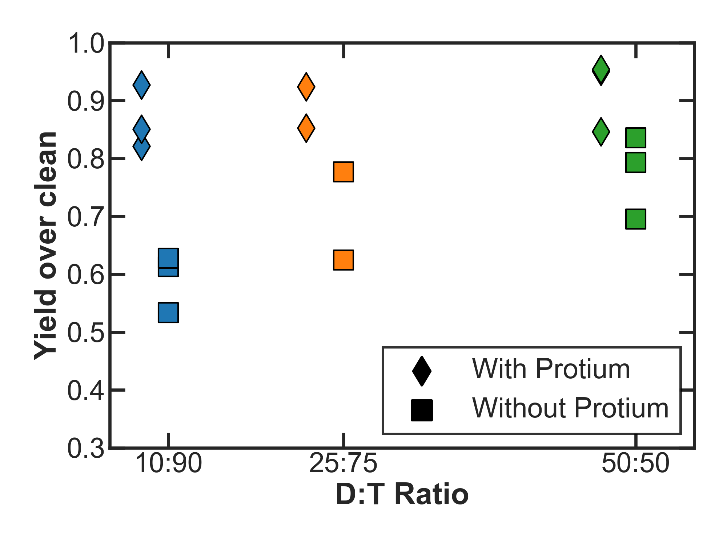
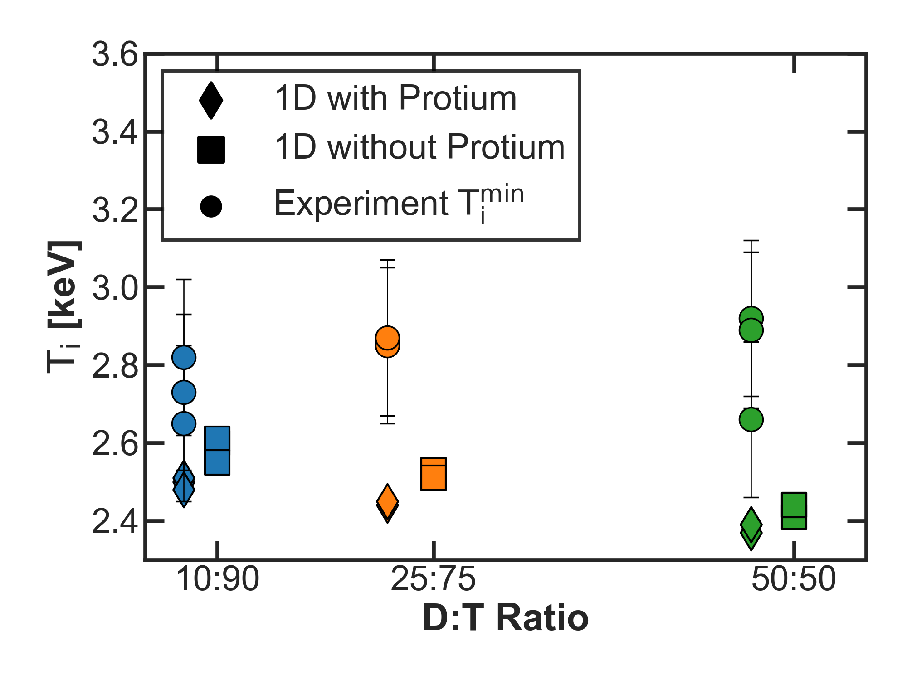
Both simulation and experimental data show that yield performance scales according to the fraction of deuterium and tritium present in the fuel
Design D:T | Design Atwood Number |  | New Atwood Number
10:90 | –0.02 | 12:8:80 | 0.06
25:75 | -0.00 | 10:22:68 | 0.09
50:50 | -0.05 | 7:46:47 | 0.12
Notes:
Add yoc and Ti with and without protium, update min exp tion
Read title
Read the first bullet
Reference the table with new HDT ratios
Talk about yield scaling now that protium is accounted for
YOC is now quite high and consistent across D:T ratios
Consistency suggests that the physics is fairly consistent across the D:T ratios
Talk about ion temp chart
These are minimum exp values, taken to be the closest to the true thermal temp, since inferred measurements are influenced by neutron weighted fuel flow
Simulations show increase ion temps for 10:90 which would also cause higher radiation effects (if time to talk about this)

Slide 10
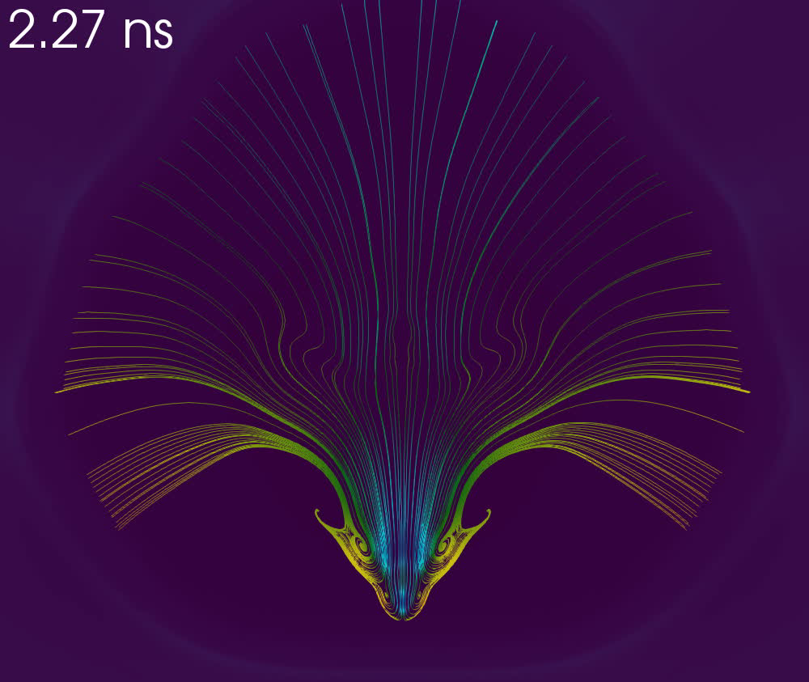
Low Modes Only
Low + High Modes
Overlay: 2-D DRACO hydro + IRIS3D* inferred T_{i}
* F. Weilacher et al., Physics of Plasmas 25, 042704 (2018).
Notes:
Read the title
Talk about the dots in the chart
Then read the first bullet
Then compare two regions indicated by the grey boxes

Slide 11
Radiation effects reduce the influence of D:T ratio on RT growth; significant levels of protium are responsible for reduction in yield
Summary/Conclusions
Notes:
Read the title
Read the bullets

