Slide 1
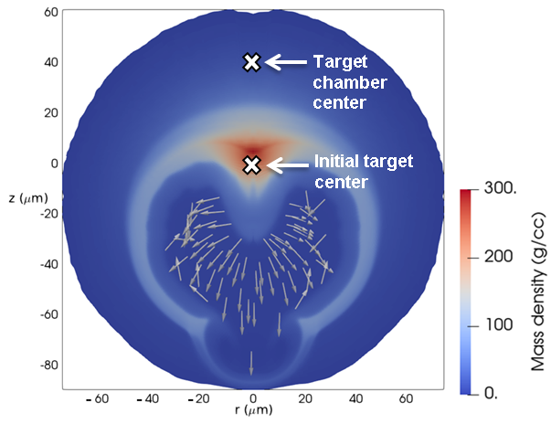
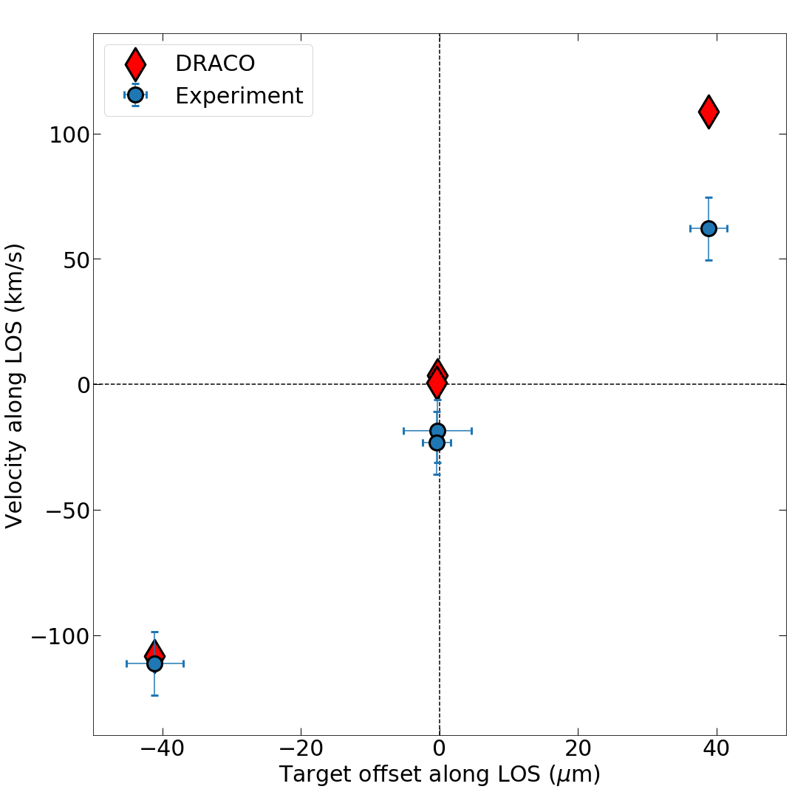
Integrated Analysis of Nuclear Measurements from the Target-Offset Campaign on OMEGA
2-D DRACO simulation with 40-$μ$m target offset
Room-temperature DT experiments
60th Annual Meeting of the
American Physical Society
Division of Plasma Physics
Portland, OR
5-9 November 2018
O. M. Mannion
University of Rochester
Laboratory for Laser Energetics

Slide 2
Experiments with intentional target offsets have been performed in order to isolate the effect of target offset on experimental observables
Random target offsets exist in the current cryogenic system on OMEGA, resulting in 86% of targets being positioned with 15 $μ$m of target chamber center (TCC)
Target offsets seed low-mode asymmetries, which degrade implosion performance
Room-temperature experiments with intentional 40-$μ$m target offsets have been performed on OMEGA using both DT- and DD-filled capsules
2-D radiation-hydrodynamic simulations show agreement with trends observed in measurements of hot-spot motion and ion-temperature asymmetry from nuclear diagnostics
Future work will extend this analysis to multiple lines of sight to infer the hot-spot center of mass velocity and compare the measured and simulated areal-density variations.

Slide 3
Collaborators
K. S. Anderson, C. J. Forrest, V. Yu. Glebov, J. P. Knauer, Z. L. Mohamed, S. P. Regan, T. C. Sangster, R. C. Shah, and C. Stoeckl
University of Rochester
Laboratory for Laser Energetics
M. Gatu Johnson
Plasma Science and Fusion Center
Massachusetts Institute of Technology

Slide 4
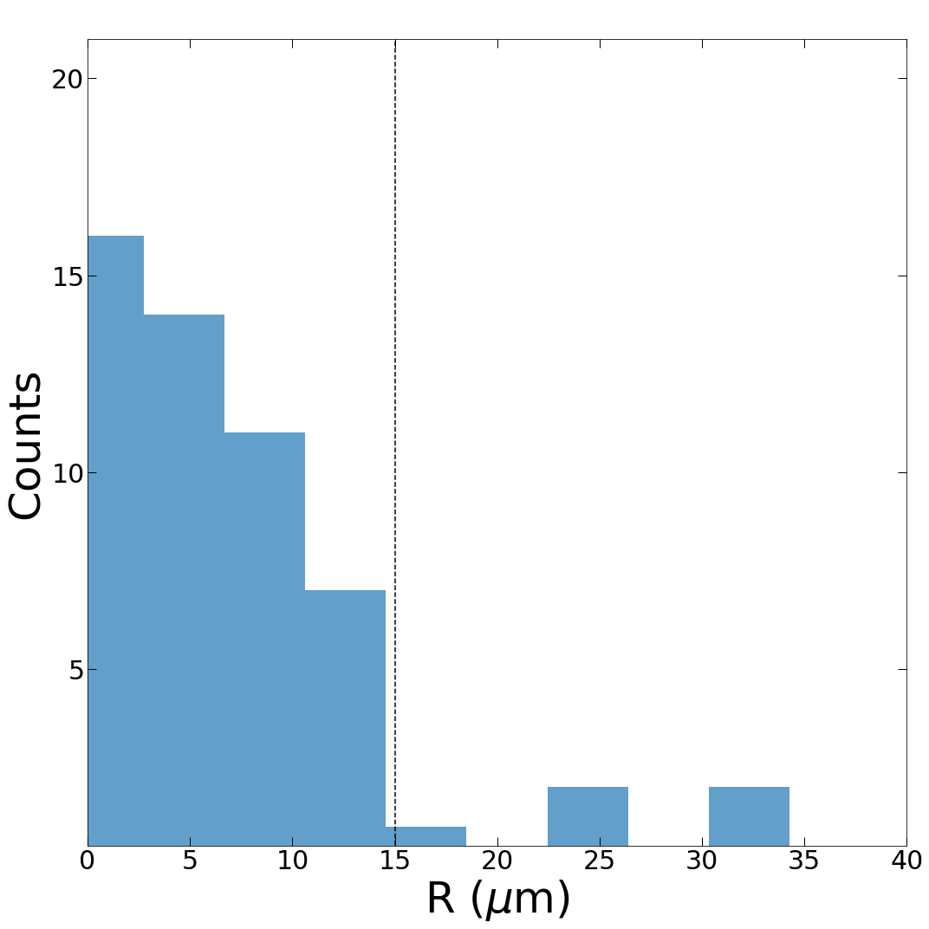
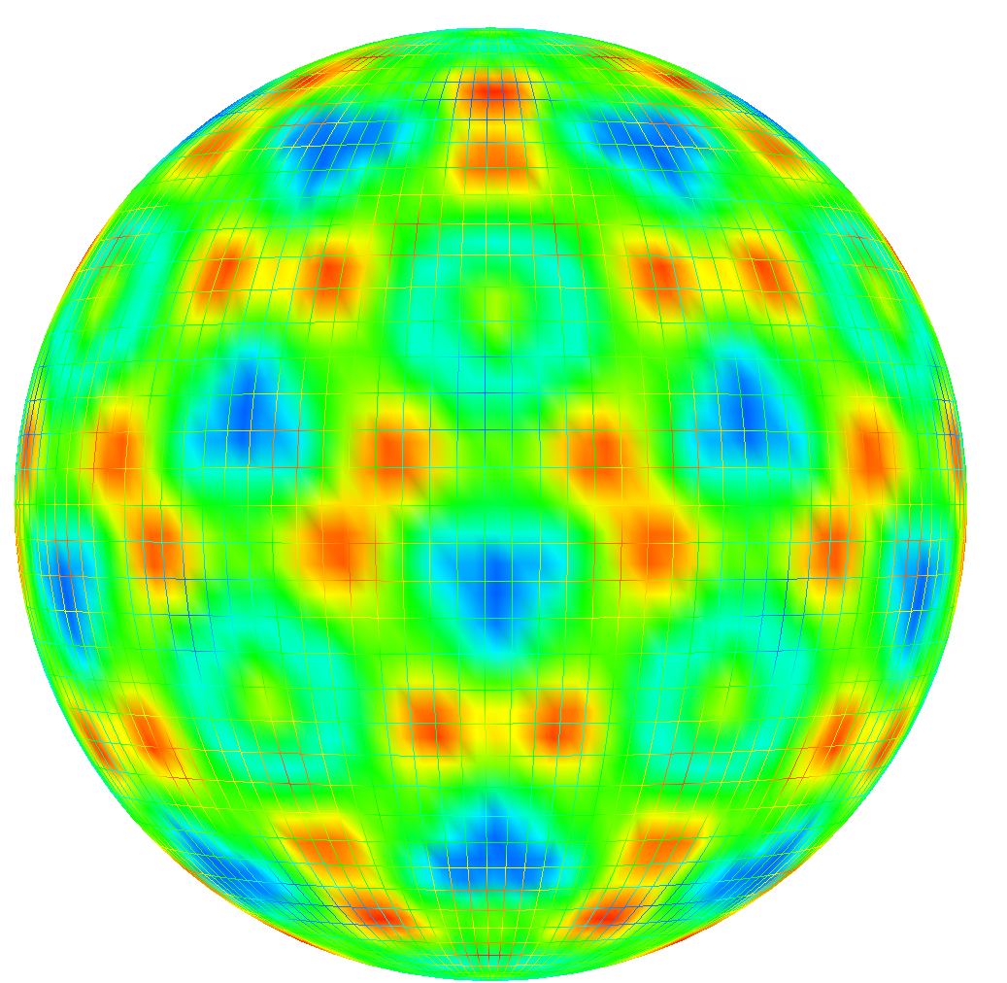
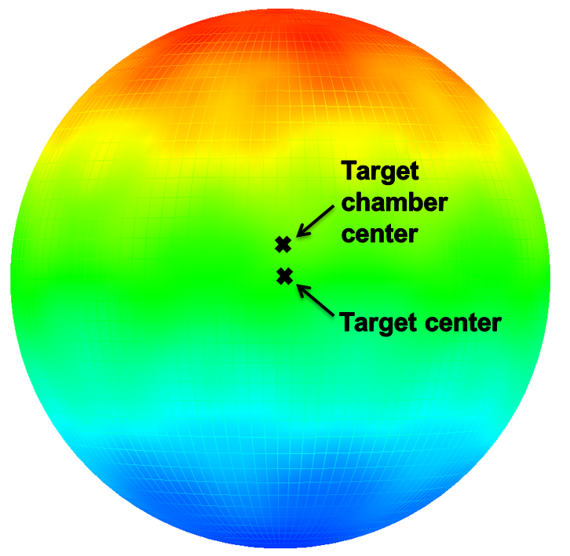
Isolating the effect of target offset is vital for the accurate interpretation of cryogenic implosion performance
On OMEGA, 86% of cryogenic targets* are positioned within 15 $μ$m of target chamber center
Room-temperature experiments are positioned within 5 $μ$m of the requested target position
Target offsets induce asymmetric laser illumination which seeds low-mode asymmetries**
Histogram of target offset in cryogenic experiments* (N = 53)
No offset
15 $μ$m
Illumination
uniformity
Illumination
uniformity
+1%
+12%
-1%
-12%
*All cryogenic experiments since 7/11/2017 excluding those with intentional target offset
** K. S. Anderson et al., BO6.00009

Slide 5
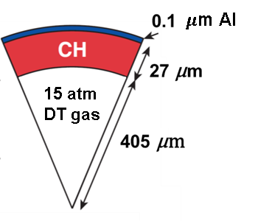
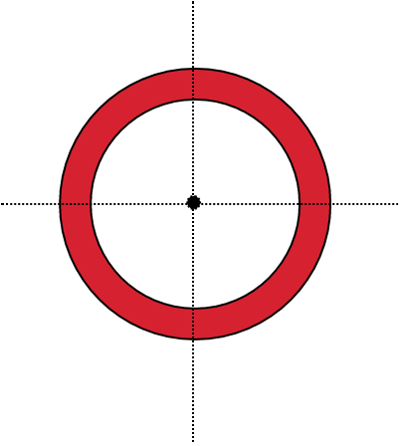
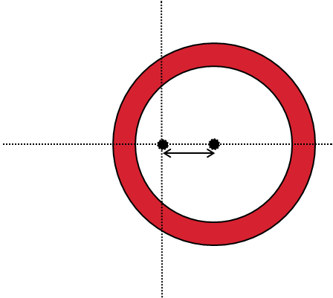
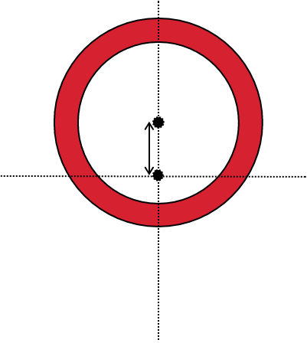
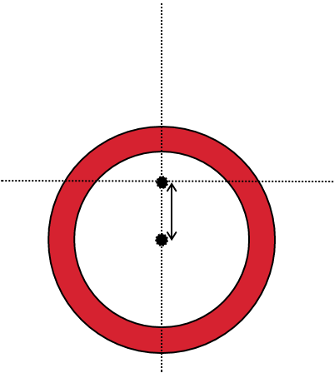
Room-temperature experiments with intentional 40-$μ$m target offsets were performed to exacerbate the effect of target offset
TCC reference

Slide 6
Post-shot simulations* show a dominant low-mode asymmetry in the direction of the target offset
2-D DRACO simulation with 40-$μ$m target offset
Signatures of low mode asymmetries manifest in nuclear measurements
Collective motion of the hot spot shifts the mean energy of the primary neutron energy spectrum
Flow variations within the hot spot induce non-thermal broadening of the primary neutron energy spectrum**
Areal-density variations shift the mean energy of secondary protons produced in DD experiments
Quantities inferred from nuclear measurements show only a weak dependence on the physics models used in simulations
*K. S. Anderson et al., BO6.00009
**T. Murphy, et al. Rev. Sci. Instrum. 68, 614 (1997).

Slide 7
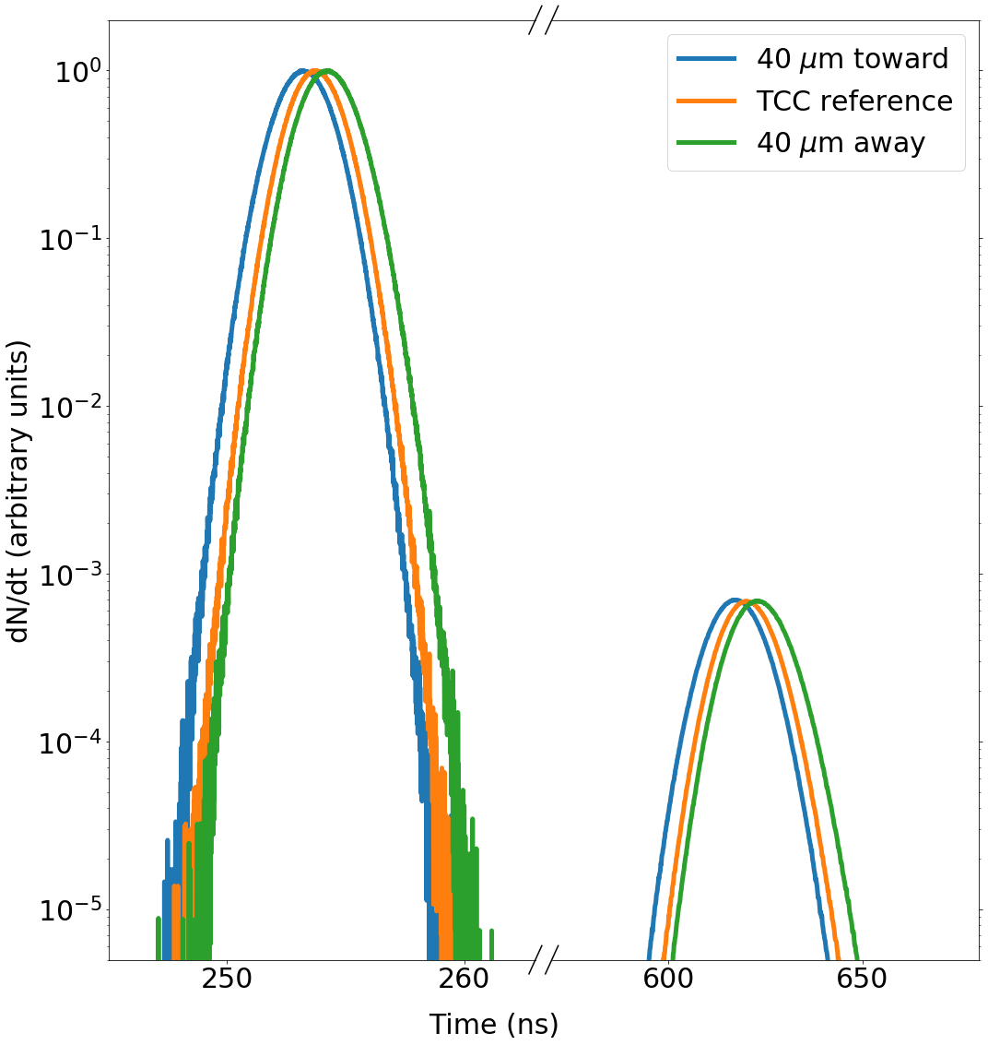
The code IRIS3D* has been used to produce synthetic nuclear spectra from post-shot simulations, which can be compared against experimental data
2-D DRACO simulation with 40-$μ$m target offset
IRIS3D primary nTOF signal
DT
IRIS3D
DD
*F. Weilacher, et al. Phys. Plasmas 25, 042704 (2018).
nTOF: neutron time of flight

Slide 8
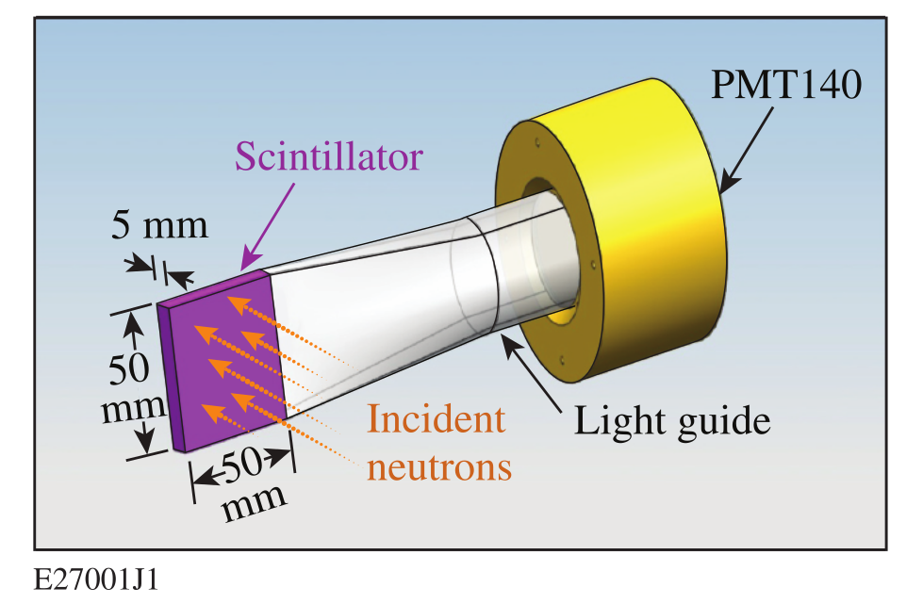
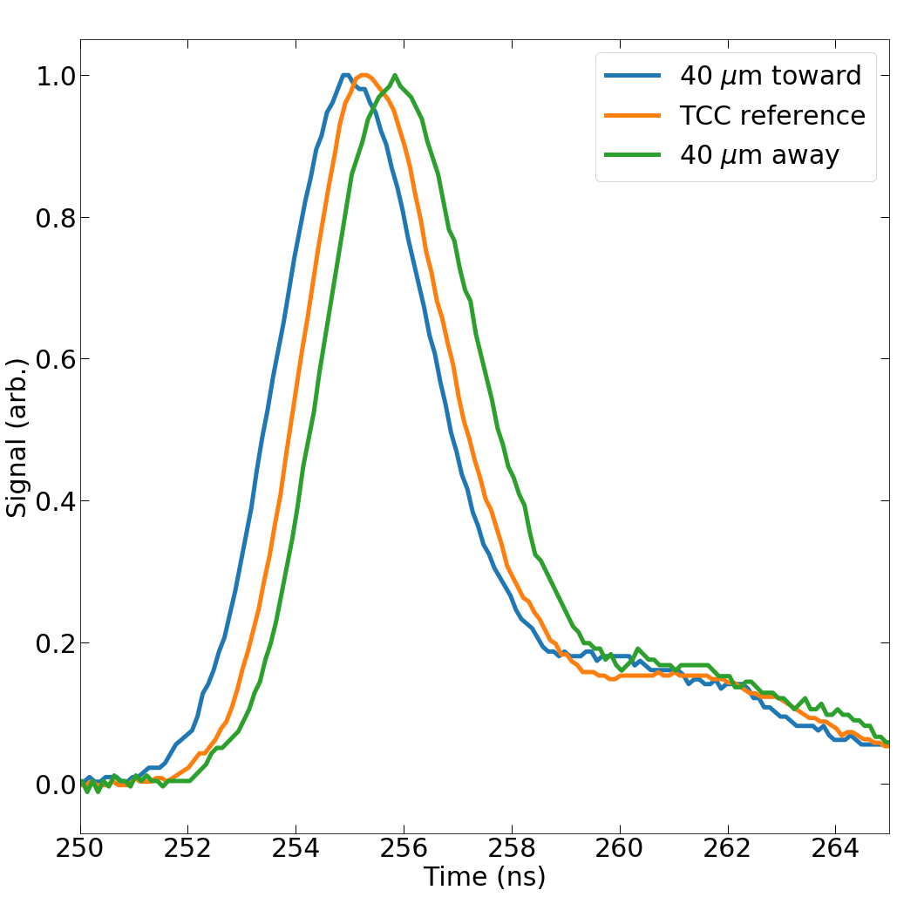
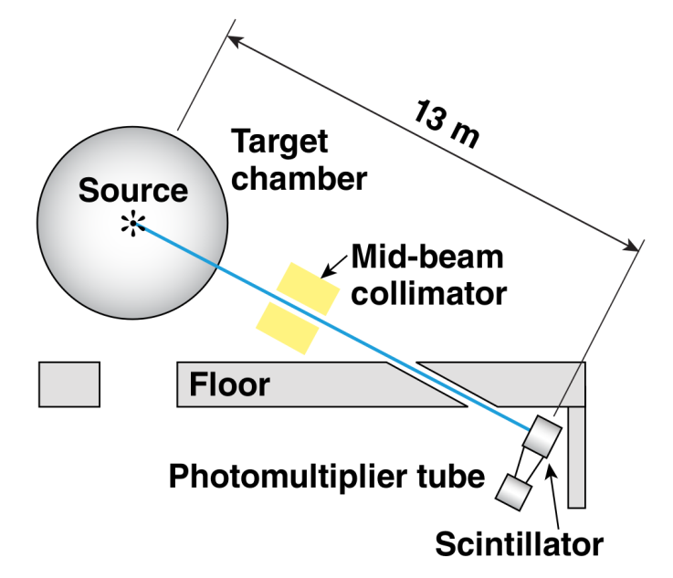
In DT experiments, a fast plastic scintillator measures the primary DT neutron energy spectrum and provides a measurement of the ion temperature and collective motion of the hot spot
Detector Model
Measured DT nTOF signal

Slide 9
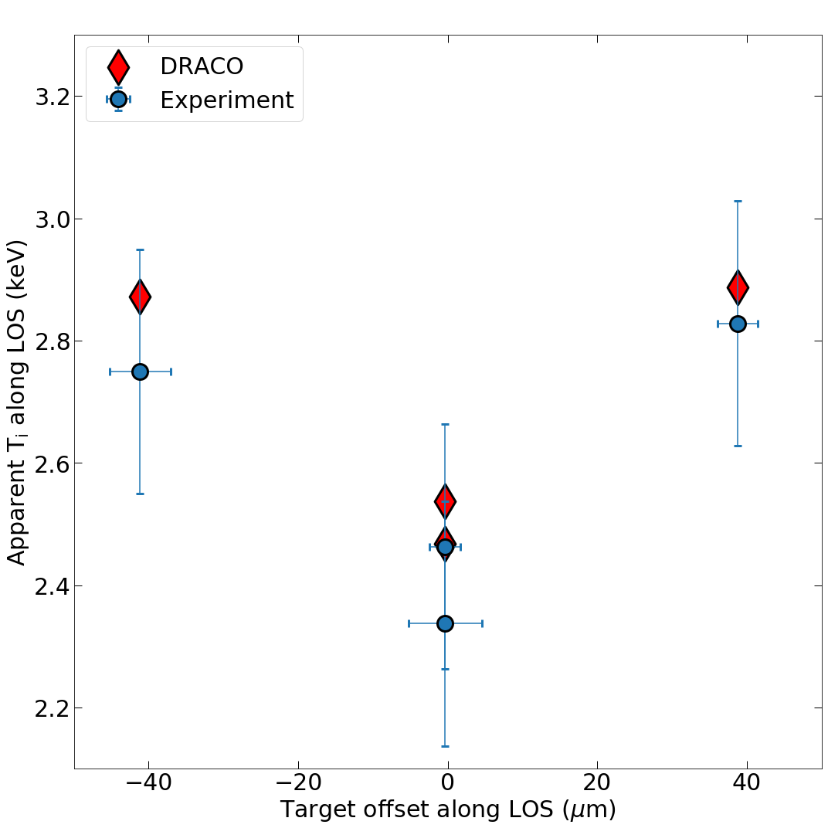
The inferred hot-spot motion and apparent ion temperature from the primary DT neutron energy spectrum show similar trends in experiment and simulation
Inferred hot-spot motion
Inferred ion temperature
TCC and
orthogonal
Orthogonal
TCC
Simulated data do not reproduce the systematic flow away from the detector observed in experiments.
LOS: line of sight

Slide 10
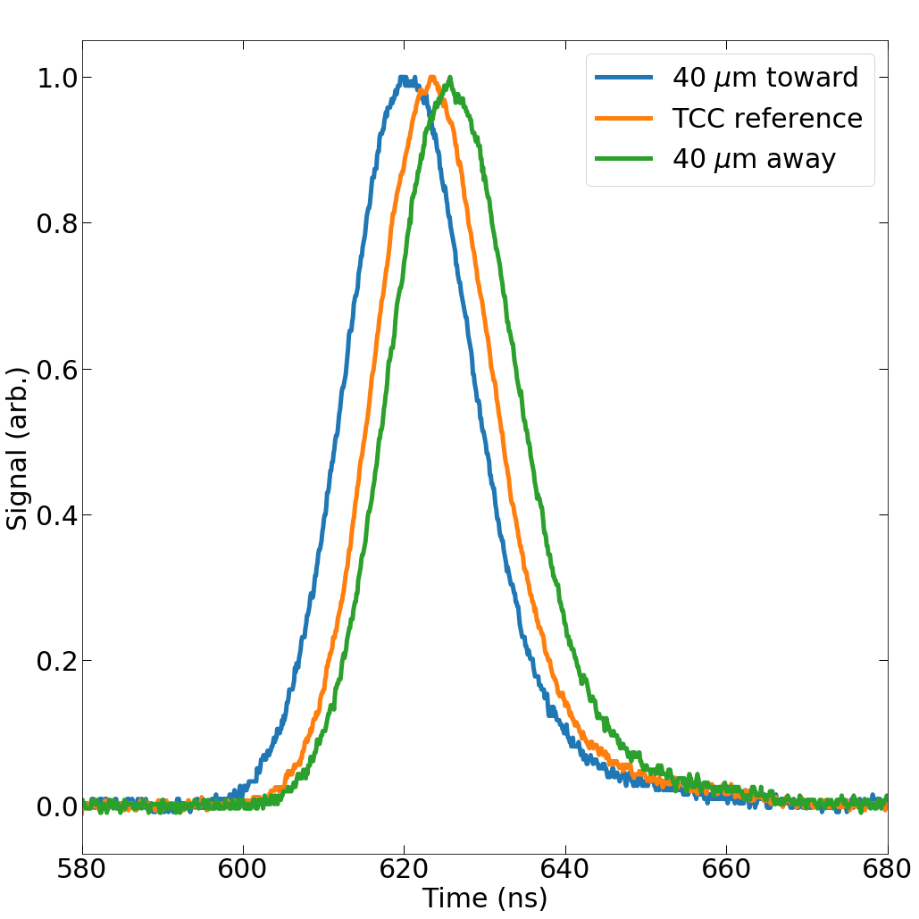
In DD experiments, a liquid scintillator measures the primary DD neutron energy spectrum and provides a measurement of the ion temperature and collective motion of the hot spot
Detector Model
Measured DD nTOF signal

Slide 11
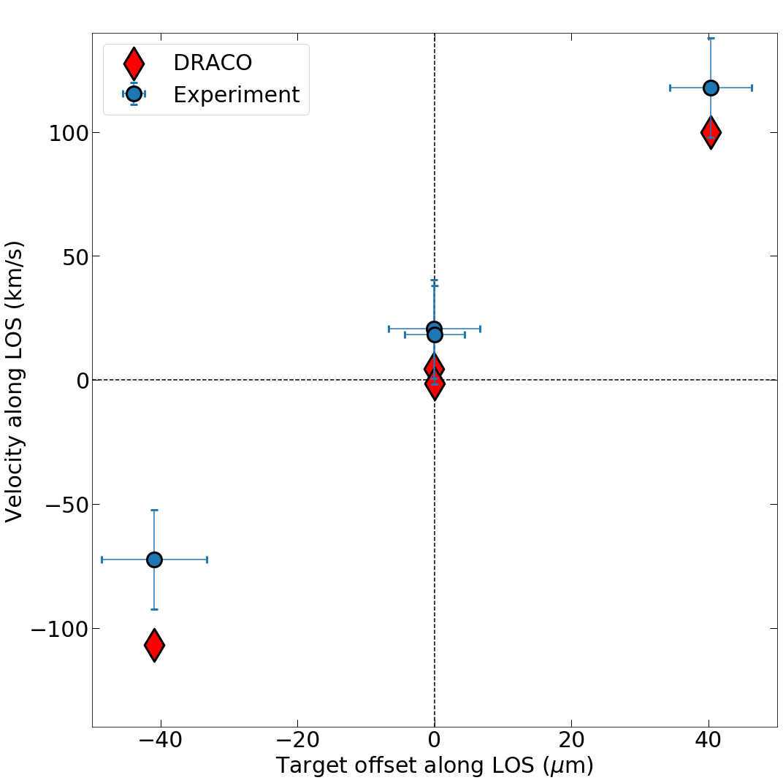
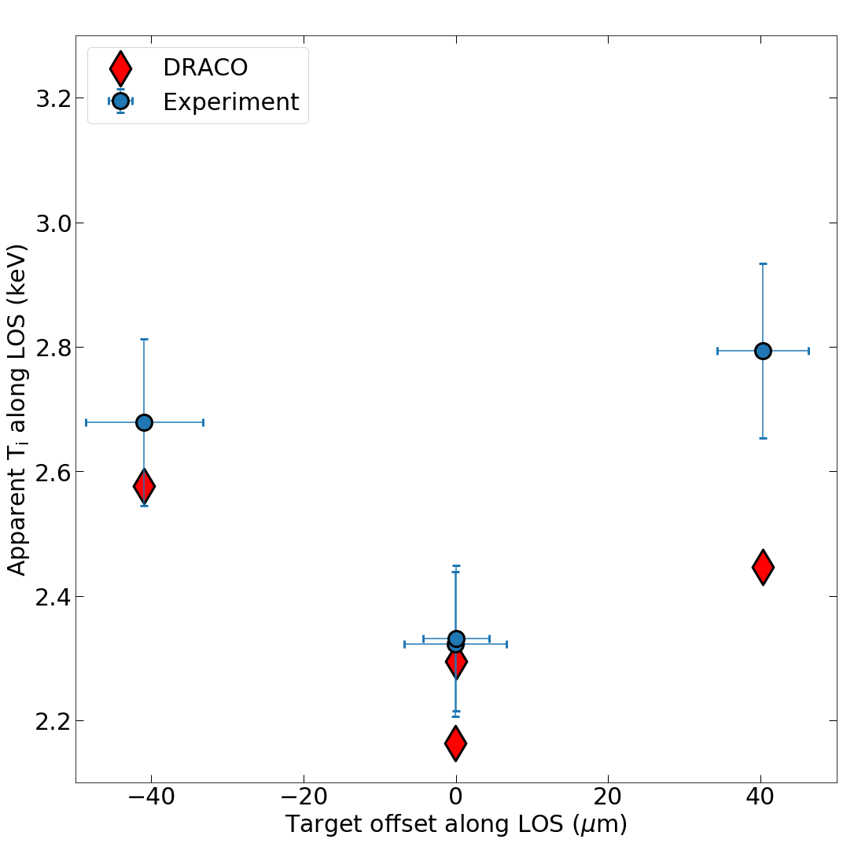
The inferred hot-spot motion and apparent ion temperature from the primary DD neutron energy spectrum show similar trends in experiment and simulation
Inferred hot-spot motion
Inferred ion temperature
TCC and
orthogonal
TCC and
orthogonal

Slide 12
Experiments with intentional target offsets have been performed in order to isolate the effect of target offset on experimental observables
Random target offsets exist in the current cryogenic system on OMEGA, resulting in 86% of targets being positioned with 15 $μ$m of target chamber center (TCC)
Target offsets seed low-mode asymmetries, which degrade implosion performance
Room-temperature experiments with intentional 40-$μ$m target offsets have been performed on OMEGA using both DT- and DD-filled capsules
2-D radiation-hydrodynamic simulations show agreement with trends observed in measurements of hot-spot motion and ion-temperature asymmetry from nuclear diagnostics
Future work will extend this analysis to multiple lines of sight to infer the hot-spot center of mass velocity and compare the measured and simulated areal-density variations.

Slide 13
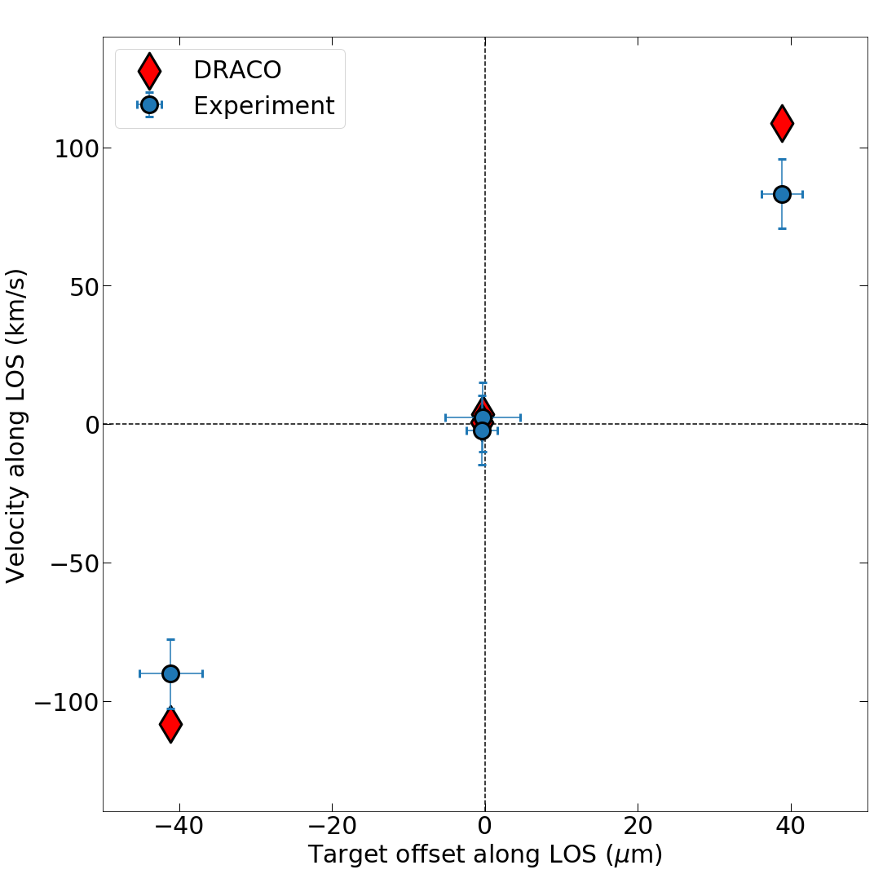
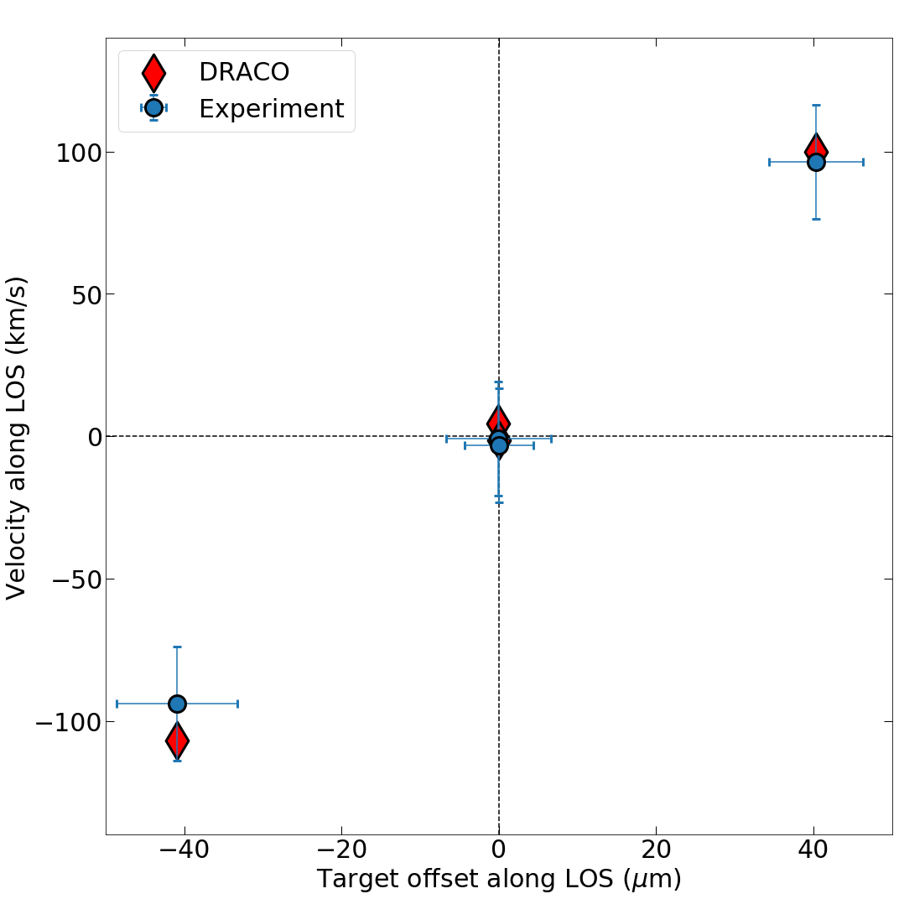
A systematic shift in the inferred collective motion shows a better agreement with simulation
DT Experiments
DD Experiments
+21 km/s shift
-21 km/s shift
*Data have been shifted such that TCC reference shot has no flow

