Slide 1
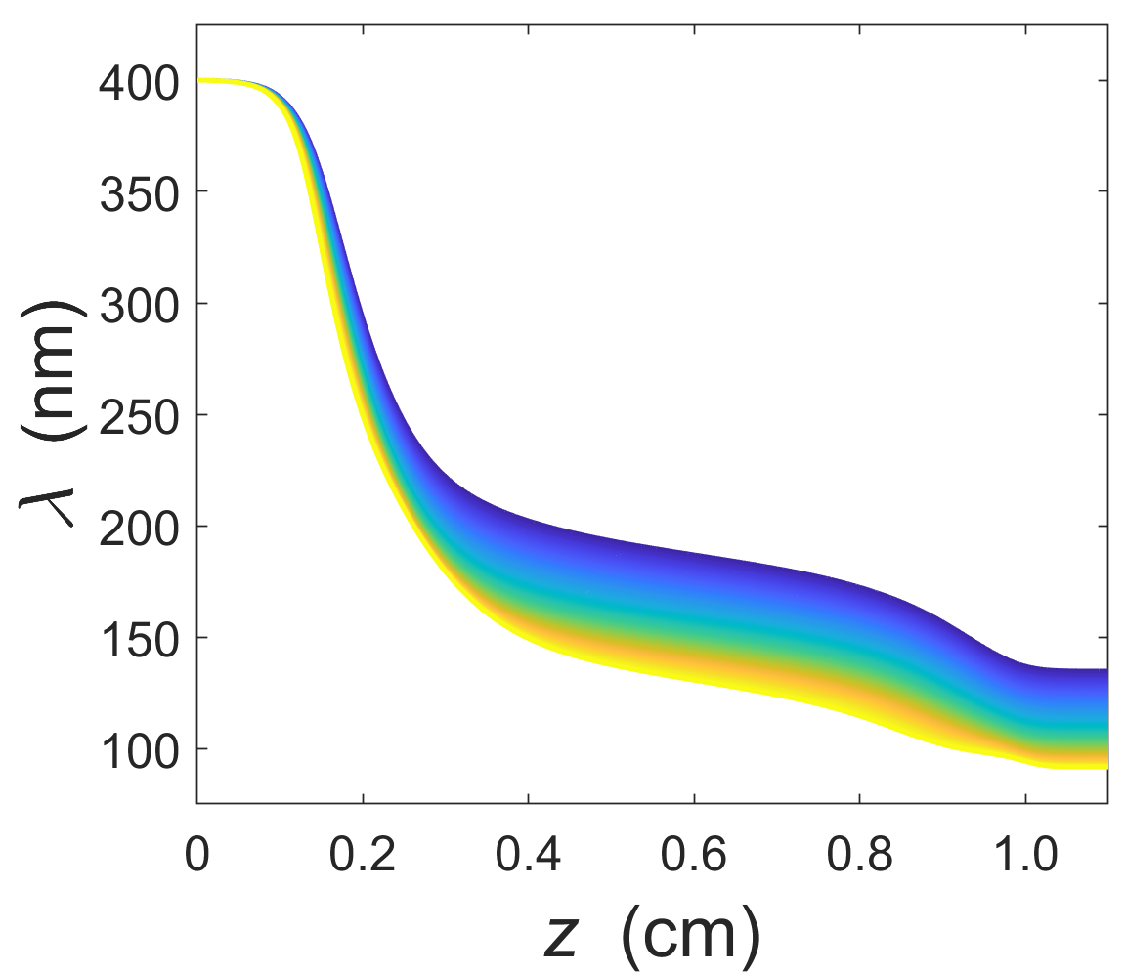
Photon Acceleration in the Ionization Front of a Flying Focus
60th Annual Meeting of the American Physical Society Division of Plasma Physics Portland, Oregon, USA November 5-9, 2018
A. Howard, D. Turnbull,
A. Davies, D.H. Froula,
and J.P. Palastro
University of Rochester Laboratory for Laser Energetics
DOE Grant No. DE-SC0019135

Slide 2
Collaborators
A. Howard, D. Turnbull, A. Davies, D.H. Froula, and J.P. Palastro
University of Rochester
Laboratory for Laser Energetics
DOE OFES Grant No. DE-SC0019135
This material is based upon work supported by the Department of Energy National Nuclear Security Administration under Award Number DE-NA0003856.

Slide 3
A flying focus pulse can trigger an ionization front that upshifts photons from the optical to the extreme ultraviolet (XUV)
Summary
The theory of photon acceleration is well developed, but experiments have long suffered from several recurrent problems
The flying focus effectively eliminates three of the most common problems
For short pulses, simulations of photon acceleration in a flying focus demonstrate frequency conversion from the optical to the XUV
This method can be scaled to produce even larger frequency shifts

Slide 4
Reliable sources of XUV radiation are essential to a number of growing scientific fields
XUV radiation (10 to 120 nm) is becoming increasingly important for HED diagnostics, material ablation¹, nano-machining, and photolithography
Sources are difficult to produce; traditional methods include four-wave mixing, high harmonic generation, and XUV lasing/line emission in Xe/Sn/Li plasmas²
Each of these methods has limitations in either tunability, monochromaticity, spatial coherence, divergence, or efficiency
$$\text{Photon} \text{acceleration} \text{offers} \text{an} \text{alternative} \text{method} \text{for} \text{XUV} \text{production} \text{that} \text{potentially} \text{overcomes} \text{these} \text{limitations}$$
¹Tanaka, N., et al. Journal of Physics: Conference Series. Vol. 688. No. 1. IOP Publishing, 2016. ²Banine, Vadim, et al. Journal of Physics D: Applied Physics 37.23 (2004): 3207.

Slide 5
Photon acceleration occurs in a time-varying refractive index, such as an ionization wave (IW)
$space (z)$
$$v_{ph}$$
$$time (t)$$
v_{IW} < c
$$λ$$
Linear Approx.
$$z$$
$$v_{IW}$$

Slide 6
Photon acceleration occurs in a time-varying refractive index, such as an ionization wave (IW)
$space (z)$
$$v_{ph}$$
$$time (t)$$
v_{IW} < c
$$λ$$
$$v_{g}$$
Linear Approx.
$$z$$
$$v_{IW}$$

Slide 7
Photon acceleration occurs in a time-varying refractive index, such as an ionization wave (IW)
$space (z)$
$$v_{ph}$$
$$time (t)$$
v_{IW} < c
$$λ$$
Linear Approx.
$$z$$
If v_{IW} < c, accelerated photons outpace the ionization front
$$v_{IW}$$
$$<$$
$$v_{g}$$

Slide 8
An ionization wave travelling at the speed of light in vacuum can continually upshift frequency
$space (z)$
$$v_{ph}$$
$$time (t)$$
v_{IW} < c
$$λ$$
v_{IW} < c
Linear Approx.
$$z$$
$v_{IW }=c \sim$ $v_{g}$

Slide 9
An ionization wave travelling at the speed of light in vacuum can continually upshift frequency
$space (z)$
$$v_{ph}$$
$$time (t)$$
v_{IW} < c
$$λ$$
v_{IW} < c
Linear Approx.
$$z$$
$v_{IW }=c \sim$ $v_{g}$

Slide 10
An ionization wave travelling at the speed of light in vacuum can continually upshift frequency
$space (z)$
$$v_{ph}$$
$$time (t)$$
v_{IW} < c
$$λ$$
v_{IW} < c
Linear Approx.
$$z$$
If v_{IW} = c, photons upshift to significantly higher frequencies
$v_{IW }=c \sim$ $v_{g}$

Slide 11
The flying focus (FF) can produce ionization waves of arbitrary velocity (IWAVs)
$space (z)$
$$v_{d}$$
A chirped pulse sent through a chromatic lens will create a moving or “flying” focus¹
$$time (t)$$
$$Drive pulse$$
¹D. H. Froula, et al., Nat. Photonics 12, 262-265 (2018)

Slide 12
The flying focus (FF) can produce ionization waves of arbitrary velocity (IWAVs)
$space (z)$
$$v_{d}$$
A chirped pulse sent through a chromatic lens will create a moving or “flying” focus¹
A negative chirp can create a focus that counter-propagates with respect to the drive pulse at c
$$time (t)$$
$$Drive pulse$$
$$v_{d}$$
$$v_{f}=c$$
¹D. H. Froula, et al., Nat. Photonics 12, 262-265 (2018)

Slide 13
The flying focus (FF) can produce ionization waves of arbitrary velocity (IWAVs)
$space (z)$
$$v_{d}$$
A chirped pulse sent through a chromatic lens will create a moving or “flying” focus¹
A negative chirp can create a focus that counter-propagates with respect to the drive pulse at c
$$time (t)$$
$$Drive pulse$$
$$v_{d}$$
$$v_{f}=c$$
¹D. H. Froula, et al., Nat. Photonics 12, 262-265 (2018)

Slide 14
The flying focus (FF) can produce ionization waves of arbitrary velocity (IWAVs)
$space (z)$
$$v_{d}$$
A chirped pulse sent through a chromatic lens will create a moving or “flying” focus¹
A negative chirp can create a focus that counter-propagates with respect to the drive pulse at c
If the pulse has sufficient intensity to ionize, the flying focus will create an IWAV traveling at c
$$time (t)$$
$$Drive pulse$$
$$v_{d}$$
$$v_{f}=v_{IWAV}=c \sim v_{g}$$
¹D. H. Froula, et al., Nat. Photonics 12, 262-265 (2018)

Slide 15
A counterpropagating IWAV travelling at the speed of light in vacuum eliminates three of the most common limitations of a photon accelerator
$space (z)$
$$v_{d}$$
Ensures accelerated photons cannot outrun the ionization front
Mitigates ionization refraction of the drive pulse
Extends interaction distance long past the Rayleigh range of the drive pulse
$$time (t)$$
$$v_{g}$$
$$Drive pulse$$
$$v_{d}$$
$$v_{f}=v_{IWAV}=c \sim v_{g}$$

Slide 16
The self-consistent profile of the IWAV was determined using a propagation simulation¹
Propagation equation (in moving frame):
diffraction
ionization and IB energy losses
spatiotemporal
modifications
plasma
refraction
¹J. P. Palastro, et al. Phys. Rev. A 97, 033835 (2018).

Slide 17
The self-consistent profile of the IWAV was determined using a propagation simulation¹
Propagation equation (in moving frame):
diffraction
ionization and IB energy losses
spatiotemporal
modifications
plasma
refraction
Electron density:
$$c\frac{∂}{∂ξ}n_{e} \text{= }ν_{FI}n_{g} \text{+} α_{CI}n_{e}n_{g} \text{−} α_{R}{n_{e}}^{2} \text{−} β_{3B}{n_{e}}^{3}$$
field ionization
3-body recombination
radiative recombination
collisional ionization
¹J. P. Palastro, et al. Phys. Rev. A 97, 033835 (2018).

Slide 18
The self-consistent profile of the IWAV was determined using a propagation simulation¹
Propagation equation (in moving frame):
Laser: 2ω Ti:sapphire
Parameter | Value
λ | 400 nm
Δλ | 6.0 nm
T | 54 ps
f | 1.02 m
f/# | 14
Energy | 5.6 J
diffraction
ionization and IB energy losses
spatiotemporal
modifications
plasma
refraction
Electron density:
$$c\frac{∂}{∂ξ}n_{e} \text{= }ν_{FI}n_{g} \text{+} α_{CI}n_{e}n_{g} \text{−} α_{R}{n_{e}}^{2} \text{−} β_{3B}{n_{e}}^{3}$$
field ionization
3-body recombination
radiative recombination
collisional ionization
¹J. P. Palastro, et al. Phys. Rev. A 97, 033835 (2018).

Slide 19
The self-consistent profile of the IWAV was determined using a propagation simulation¹
Propagation equation (in moving frame):
Laser: 2ω Ti:sapphire
Medium: H₂ gas jet
Parameter | Value
λ | 400 nm
Δλ | 6.0 nm
T | 54 ps
f | 1.02 m
f/# | 14
Energy | 5.6 J
Parameter | Value
Species | H₂
n_{g} | 1.8 $×$ 10²¹ cm⁻³
U_{I} | 13.6 eV
diffraction
ionization and IB energy losses
spatiotemporal
modifications
plasma
refraction
Electron density:
$$c\frac{∂}{∂ξ}n_{e} \text{= }ν_{FI}n_{g} \text{+} α_{CI}n_{e}n_{g} \text{−} α_{R}{n_{e}}^{2} \text{−} β_{3B}{n_{e}}^{3}$$
field ionization
3-body recombination
radiative recombination
collisional ionization
¹J. P. Palastro, et al. Phys. Rev. A 97, 033835 (2018).

Slide 20
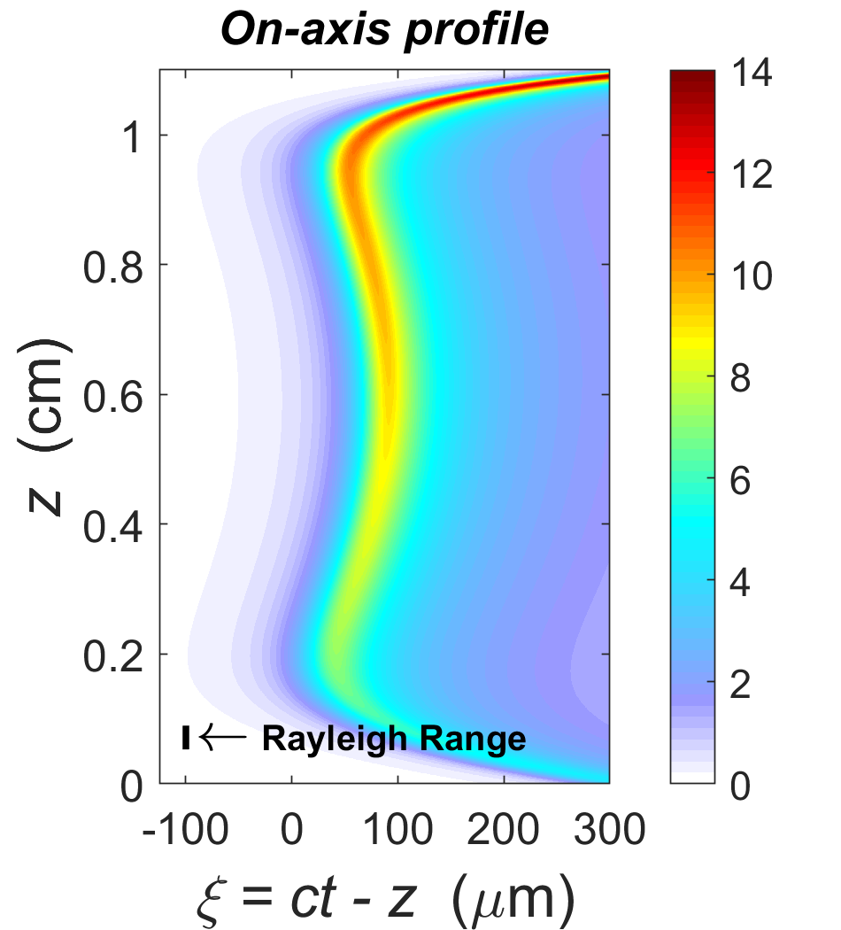
The electron density is roughly uniform along the length of the photon accelerator, with a sharp gradient throughout

Slide 21
The electron density is roughly uniform along the length of the photon accelerator, with a sharp gradient throughout

Slide 22
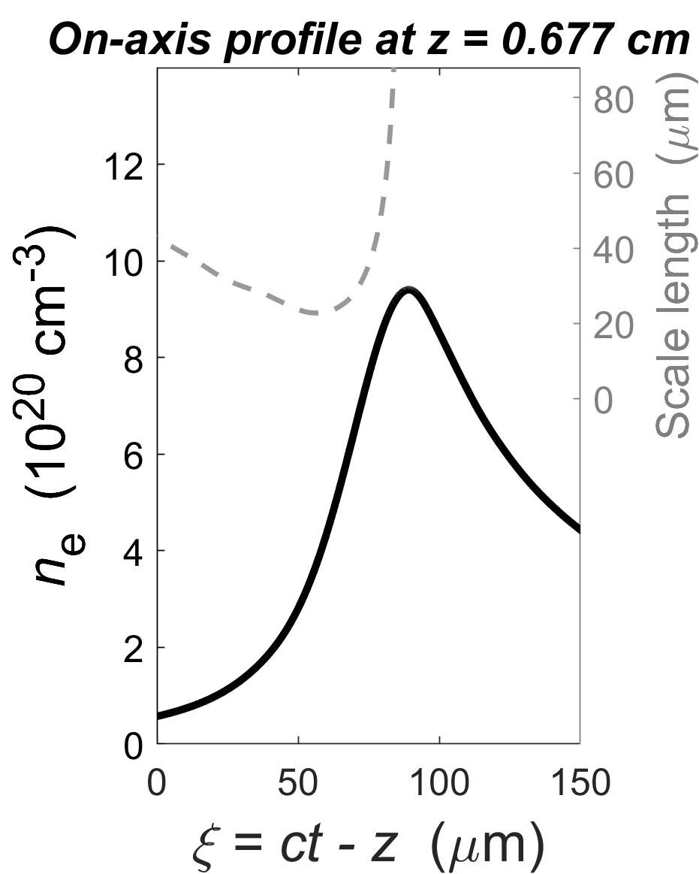
The electron density is roughly uniform along the length of the photon accelerator, with a sharp gradient throughout

Slide 23
Photon kinetics equations were formulated to quantify the frequency upshift of a witness pulse copropagating with the IWAV
The dispersion relation $ω={({ω_{p}}^{2}+c^{2}k^{2})}^{\frac{1}{2}}$
provides equations of motion for:
I. Spatial refraction, $\frac{dk}{dt}=−∇ω$
II. Group velocity, $\frac{dr}{dt}=\frac{∂ω}{∂k}$
III. Time refraction, $\frac{dω}{dt}=\frac{1}{2ω}\frac{∂}{∂t}{ω_{p}}^{2}$
Eq. III in the moving frame:
$$\frac{dω}{dz}= \frac{1}{2ck_{z}}\frac{∂}{∂ξ}{ω_{p}}^{2}$$

Slide 24
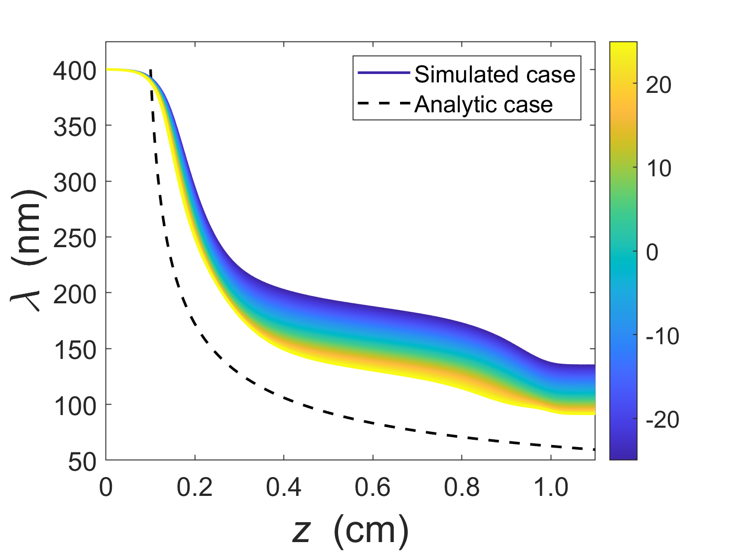
Photon kinetics simulations for a 50-fs witness pulse of 400-nm light predict frequency conversion to the XUV
An analytic model reveals multiple paths to shorter wavelengths:
$${ω_{p0}}^{2}$$
$$\frac{∆ω}{ω_{0}}=\sqrt{\frac{1}{2}\left(\frac{{ω_{p0}}^{2}}{{ω_{0}}^{2}}\right)\frac{z}{L}}$$
$${ω_{p}}^{2}$$
$$ξ$$
$$L$$
$∆ω$ scales with…
the length of the focal region ($↑z$)
the density of medium (${↑n}_{e}$)
the intensity of the drive pulse (${↑n}_{e},↓L$).
$$λ_{min} ≅ 91 nm$$

Slide 25
A flying focus pulse can trigger an ionization front that upshifts photons from the optical to the extreme ultraviolet (XUV)
Conclusions
The theory of photon acceleration is well developed, but experiments have long suffered from several recurrent problems
The flying focus effectively eliminates three of the most common problems
For short pulses, simulations of photon acceleration in a flying focus demonstrate frequency conversion from the optical to the XUV
This method can be scaled to produce even larger frequency shifts

Slide 26
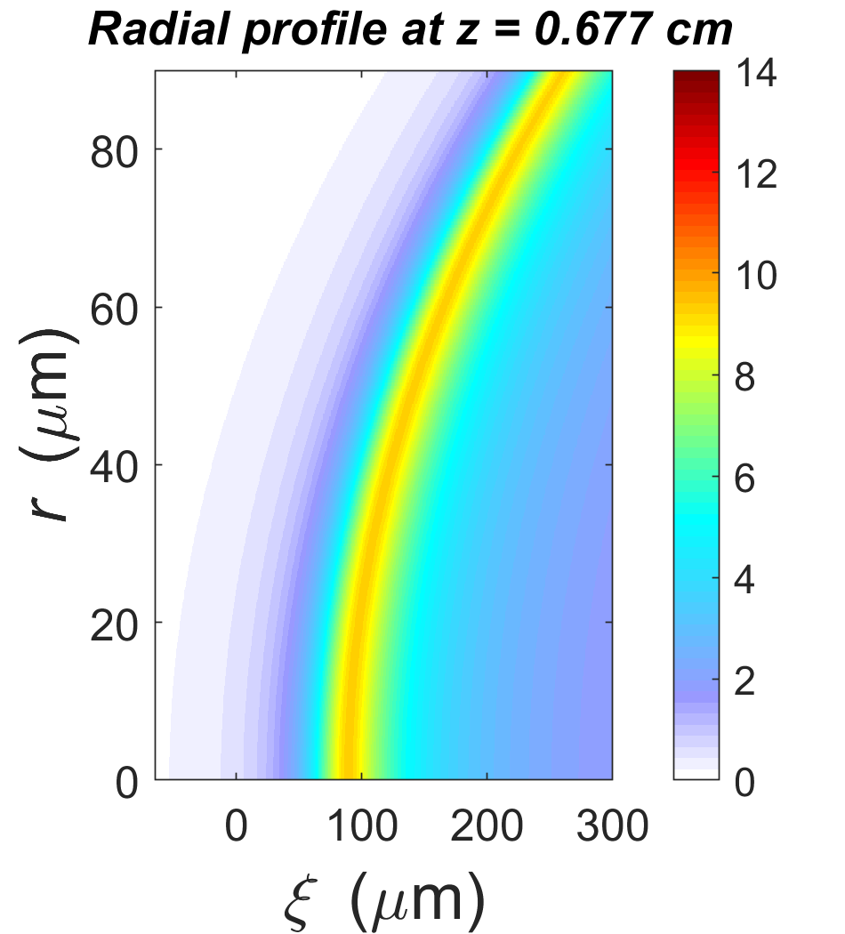
Backup Slide: The simulated electron density is roughly planar along a 40 μm diameter of the radial profile

Slide 27
Backup Slide: Photon kinetics simulations for a 50 fs witness pulse of 400 nm light predict frequency conversion to the XUV

