Slide 1
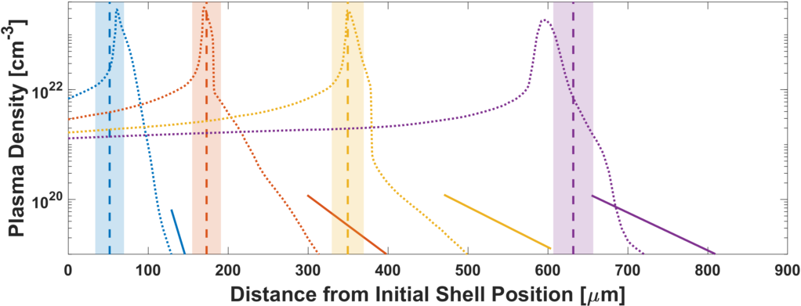
Density Measurements of the Inner Shell Release
1 ns
2 ns
3 ns
4 ns
D. Haberberger
University of Rochester
Laboratory for Laser Energetics
60th Annual Meeting of the American Physical Society
Division of Plasma Physics
Portland, OR
5 - 9 November 2018

Slide 2
A platform was developed to study the time history of the low-density plasma release ahead of a driven shell
Summary
A 37-µm-thick CH shell was driven with two UV (351-nm) laser beams with a total of 6 kJ of energy in a 5-ns pulse focused to a 750-µm spot
The position of the driven shell was measured using streaked x-ray radiography from an aluminum backlighter
The position and density profile of the underdense plasma ahead of the shell was simultaneously measured by the 4ω probe using interferometry and angular filter refractometry
The results are compared to DRACO hydrodynamic simulations showing differences in position and scale length of the released plasma ahead of the shell

Slide 3
Collaborators
A. Shvydky, J. P. Knauer, S. X. Hu, V. N. Goncharov, S. T. Ivancic, and D. H. Froula
University of Rochester Laboratory for Laser Energetics

Slide 4
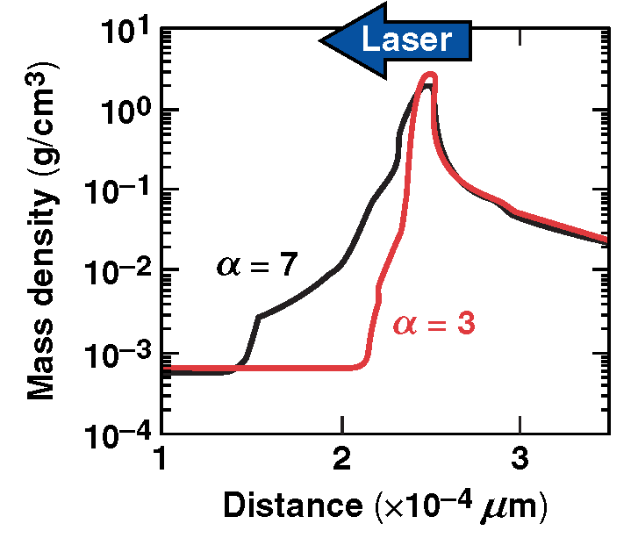
The low-density plasma ahead of the inner shell can have a detrimental effect on ICF target performance
Motivation
Reducing the adiabat of the implosion increases the convergence ratio which should lead to a larger hot-spot pressure
Experimental trends have shown a saturation in hot-spot pressure as the design adiabat decreases
This could be due in part to a low-density plasma ahead of the shell that extends beyond that predicted by simulations
100 200 300
Distance (µm)
ICF = inertial confinement fusion

Slide 5
A platform was developed on OMEGA EP to study the position of a driven shell, the location of the low-density plasma, and its profile
Time t₀
Time t₁
Two drive beams
λ = 351 nm
750-µm DPP*
E_{total} = 6 kJ
Δt = 5 ns
I_{overlapped} = 8.5 x 10¹⁴ W/cm²
n_{e}
x₁
x₂
DPP = distributed phase plate

Slide 6
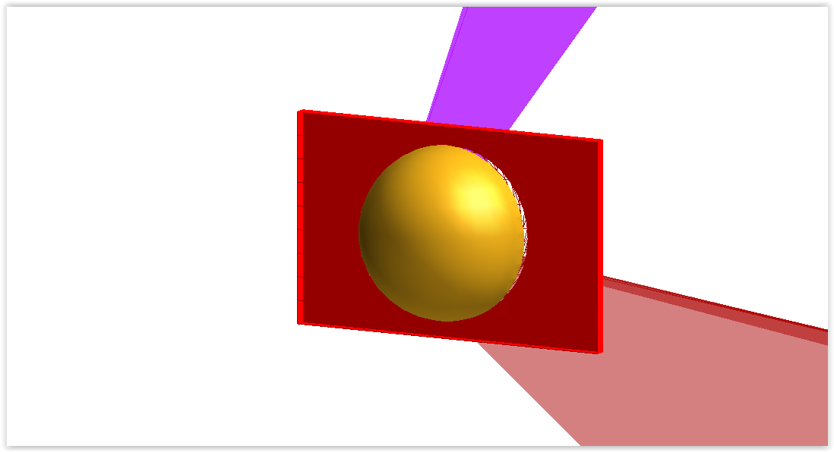
A platform was developed on OMEGA EP to study the position of a driven shell, the location of the low-density plasma, and its profile
37-µm CH shell
4-mm diam.

Slide 7
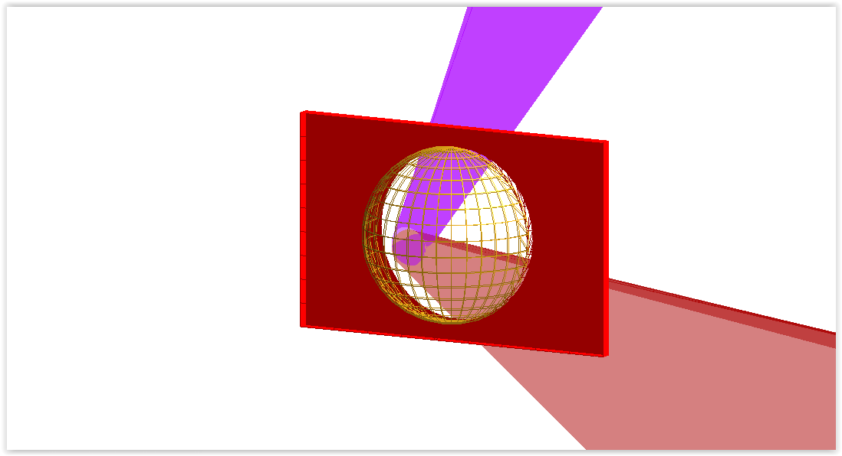
A platform was developed on OMEGA EP to study the position of a driven shell, the location of the low-density plasma, and its profile
37-µm CH shell
4-mm diam.

Slide 8
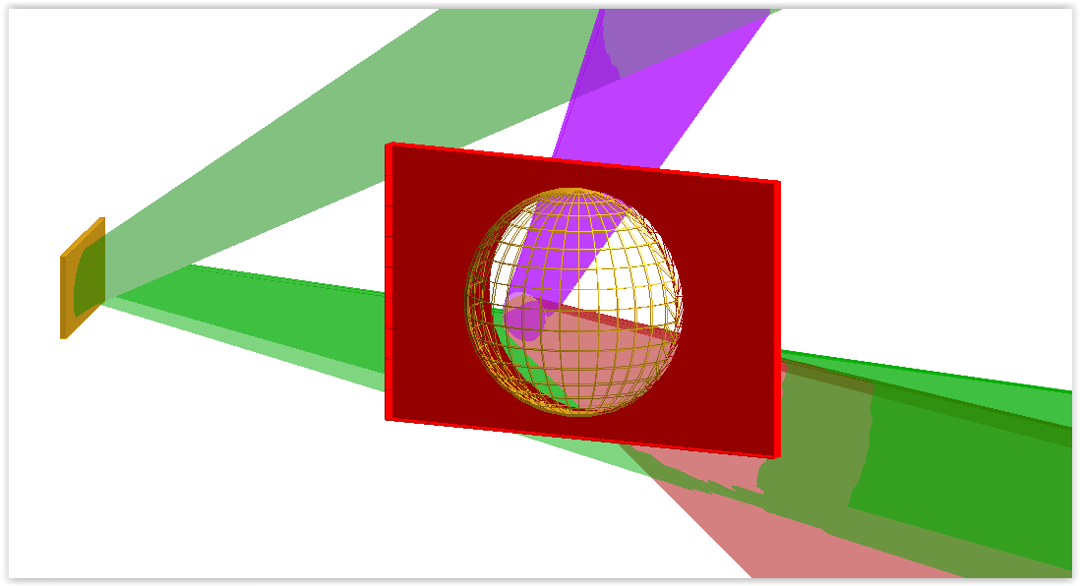
A platform was developed on OMEGA EP to study the position of a driven shell, the location of the low-density plasma, and its profile
37-µm CH shell
4-mm diam.
Aluminum Backlighter

Slide 9
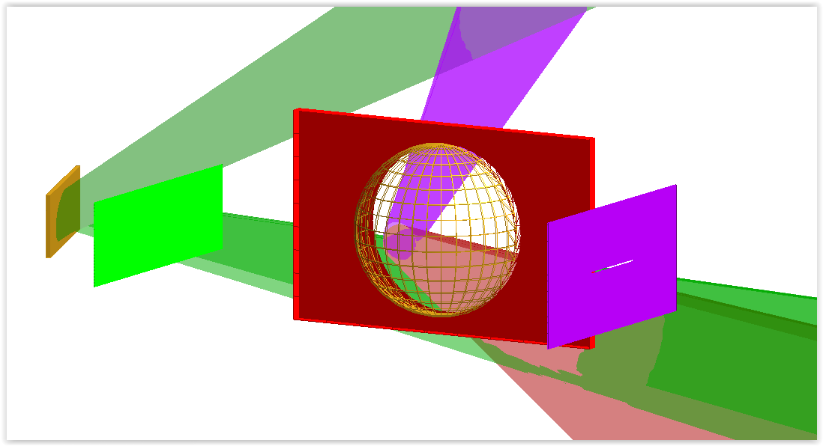
A platform was developed on OMEGA EP to study the position of a driven shell, the location of the low-density plasma, and its profile
37-µm CH shell
4-mm diam.
Aluminum Backlighter
CH
heat shield
Tantalum
aperture

Slide 10
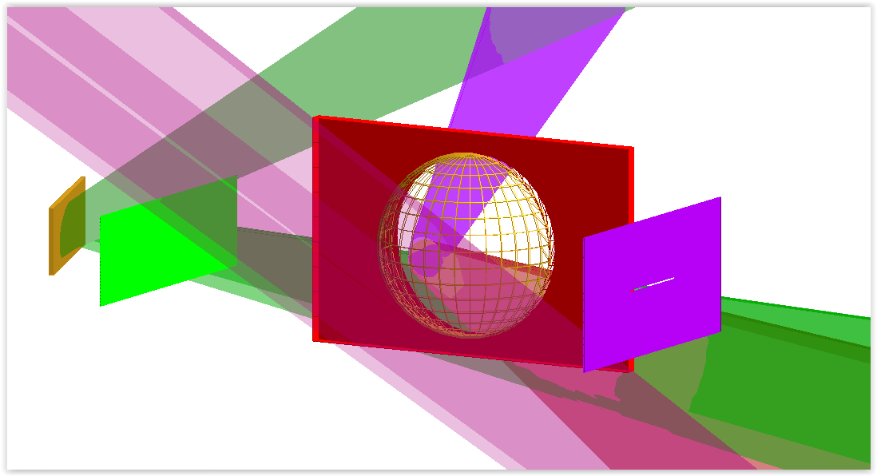
A platform was developed on OMEGA EP to study the position of a driven shell, the location of the low-density plasma, and its profile
37-µm CH shell
4-mm diam.
Aluminum Backlighter
CH
heat shield
Tantalum
aperture

Slide 11
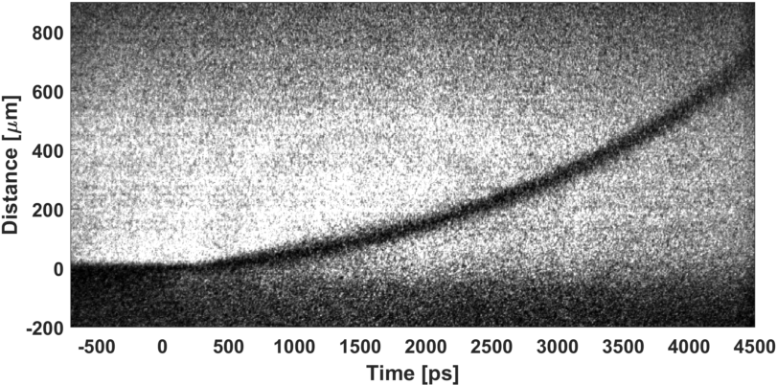
The x-ray radiography using ~1.5-keV (Al k_{α}) photons tracked the driven shell position across 700 µm over 5 ns
Raw radiography signal
Start of drive
Spatial resolution ~20 µm as measured by undriven shell
Spatial synchronization with 4ω diagnostic obtained by undriven shell position
Temporal synchronization with 4ω diagnostic obtained through a timing fiducial with an accuracy of ±20 ps
Initial shell position

Slide 12
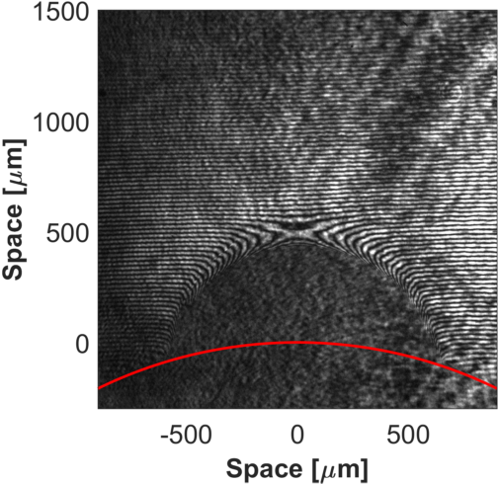
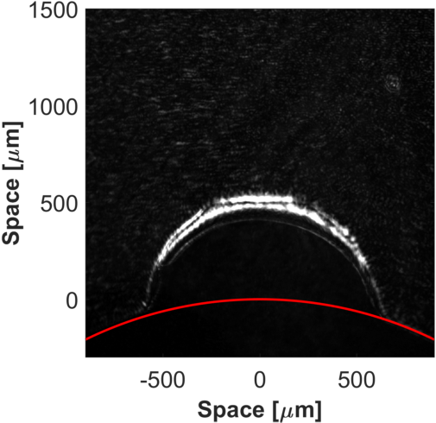
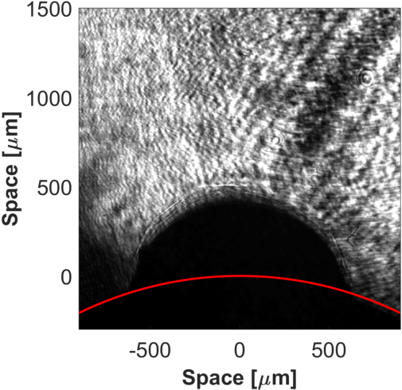
The 4ω diagnostic suite was used to track the low-density plasma expansion on the back side of the driven shell
Angular Filter Refractometry
Signal $∝$ dφ/dx
Interferometry
Signal $∝$ φ
Shadowgraphy
Signal $∝$ d²φ/dx²

Slide 13
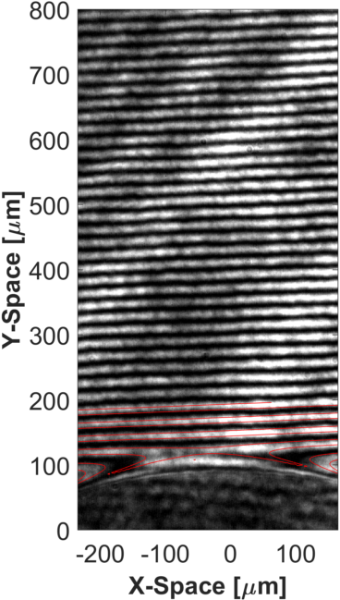
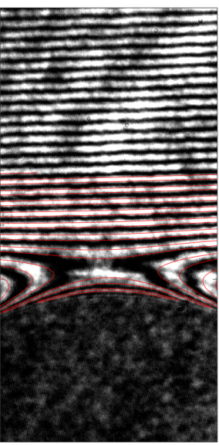
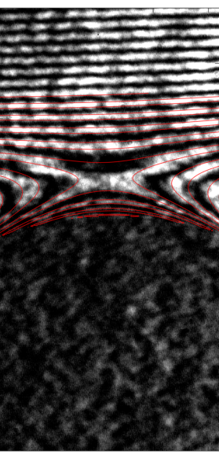
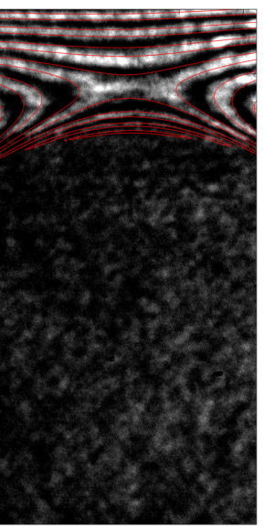
The approximate plasma density profiles were deduced by comparing simulated and experimental interferograms using a simple density function
1 ns
2 ns
3 ns
4 ns
Current analysis
$$n\left(y\right)=exp\left[−\frac{y}{L_{y}}\right]$$
$$n\left(x,z\right)=exp\left[−\frac{x^{2},z^{2}}{L_{fwhm}}\right]$$
Future analysis
Increase the complexity of the density function
Compare simulated data across all three 4ω diagnostics

Slide 14
The measured shell trajectory along with the low-density released plasma are compared to DRACO hydrodynamic simulations
1 ns
2 ns
3 ns
4 ns

Slide 15
A platform was developed to study the time history of the low-density plasma release ahead of a driven shell
Conclusion
A 37-µm-thick CH shell was driven with two UV (351-nm) laser beams with a total of 6 kJ of energy in a 5-ns pulse focused to a 750-µm spot
The position of the driven shell was measured using streaked x-ray radiography from an aluminum backlighter
The position and density profile of the underdense plasma ahead of the shell was simultaneously measured by the 4ω probe using interferometry and angular filter refractometry
The results are compared to DRACO hydrodynamic simulations showing differences in position and scale length of the released plasma ahead of the shell

