Slide 1
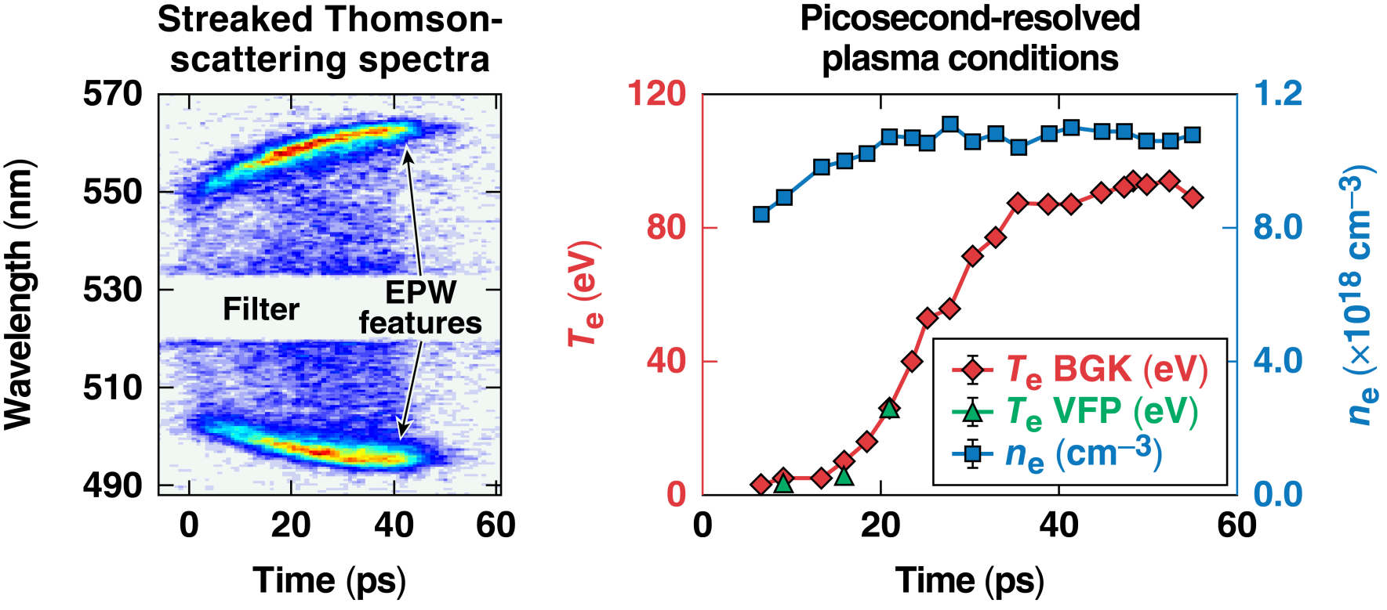
Ultrafast Thomson Scattering and the Effects of Collisions on the Electron Plasma Wave Feature
A. Davies
University of Rochester
Laboratory for Laser Energetics
60th Annual Meeting of the American Physical Society
Division of Plasma Physics
Portland, OR
5-9 November 2018
Notes:
Don’ let you voice trail off.
Don’t forget to say picosecond resolution here.
Say “plasma evolution” for the transition to the next slide

Slide 2
The plasma creation and picosecond evolution of electron temperature and density has been measured
Summary
A pulse-front tilt-compensated streaked spectrometer was invented to measure the picosecond thermal
and ionization dynamics
For temperatures below ~35 eV, a collisional model was required to reproduce the measured spectrum
The electron temperature was suppressed during ionization and then rapidly increased to a plateau temperature of ~90 eV once fully ionized
These measurement techniques enable studies to optimize laser-plasma devices and might help to resolve discrepancies* between simulation and measurements of laser-imprint induced shock-velocity modulation
*J. Peebles, S. X. Hu, P. M. Celliers et al., Phys. Rev. Lett. (to be submitted)
Fiche #
Notes:
To figure out a physics model for the initial plasma formation, which can be implemented into hydro-codes for more realistic laser-imprint simulations
Discrepancies have been seen between simulation and OHRV-measurements on laser-imprint-induced shock-velocity modulation
However, as demonstrated in this Letter, this approach grossly underpredicts perturbations because the detailed microphysics (material breakdown via multiphoton and tunneling ionization) for the initial plasma formation are not included in most simulations
To more accurately capture the production of imprint-seeded instabilities, the detailed process of initial plasma formation must be included in the calculations
These measurements enables optimization of plasma devices, such as laser-plasma amplifier, which require knowledge of plasma temperature and density dynamics.

Slide 3

Collaborators
J. Katz, S. Bucht, D. Haberberger, J. P. Palastro, I. A. Begishev, J. L. Shaw, D. Turnbull, R. Boni, and D. H. Froula
Laboratory for Laser Energetics, University of Rochester
W. Rozmus
Department of Physics, University of Alberta, Edmonton, Canada
This material is based upon work supported by the Department of Energy National Nuclear Security Administration under Award Number DE-NA0003856 and the Office Fusion Energy Sciences under Contract Number DE-SC0016253

Slide 4
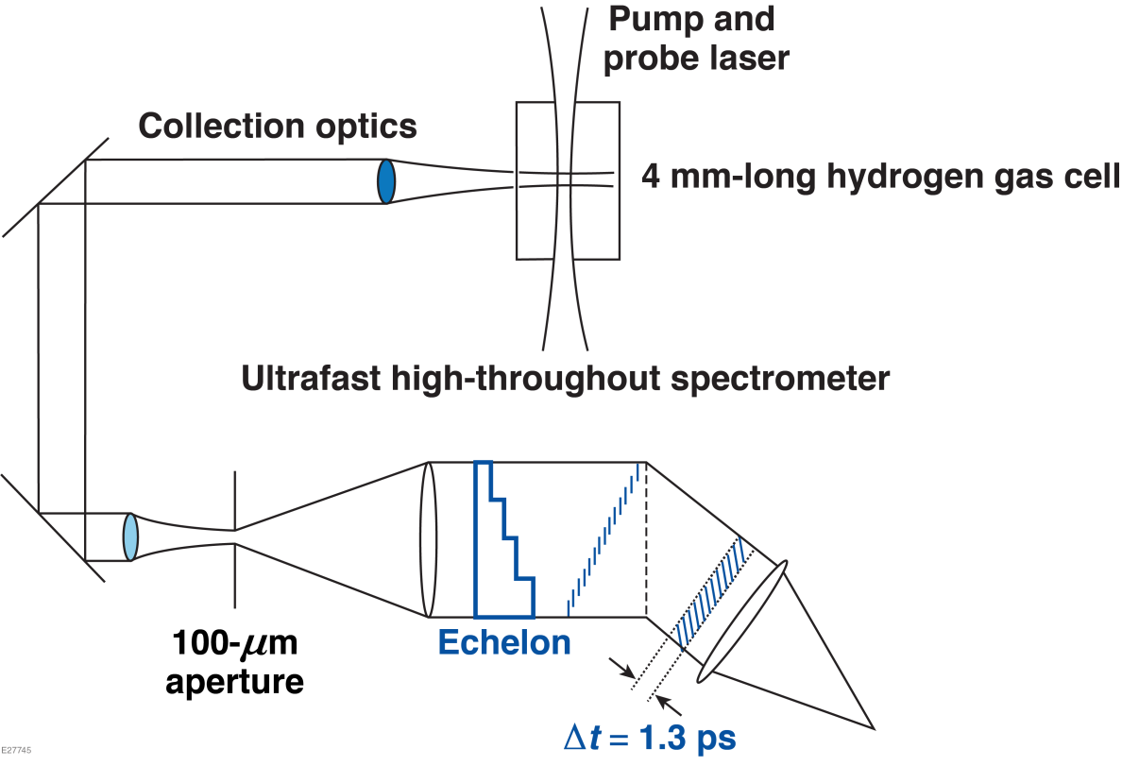
The experiments were conducted on the Multi-Terawatt (MTW) Laser
System at the University of Rochester’s Laboratory for Laser Energetics
Pump
  λ_{pump} = 1053 nm
  I = 3 × 10¹⁴ W/cm²
  Δt = 60 ps (~5-ps rise)
Thomson-scattering probe
  λ_{probe} = 527 nm
  I = 8 × 10¹³ W/cm²
  Δt = 55 ps (~5-ps rise)
Notes:
Check a new gas shot probe length. I don’t want the rise time and pulse duration to be convolved with the IAW. For now I will take ((5 ps rise)/sqrt2)*2 = 7 ps. 60- 7 = 53 ps

Slide 5
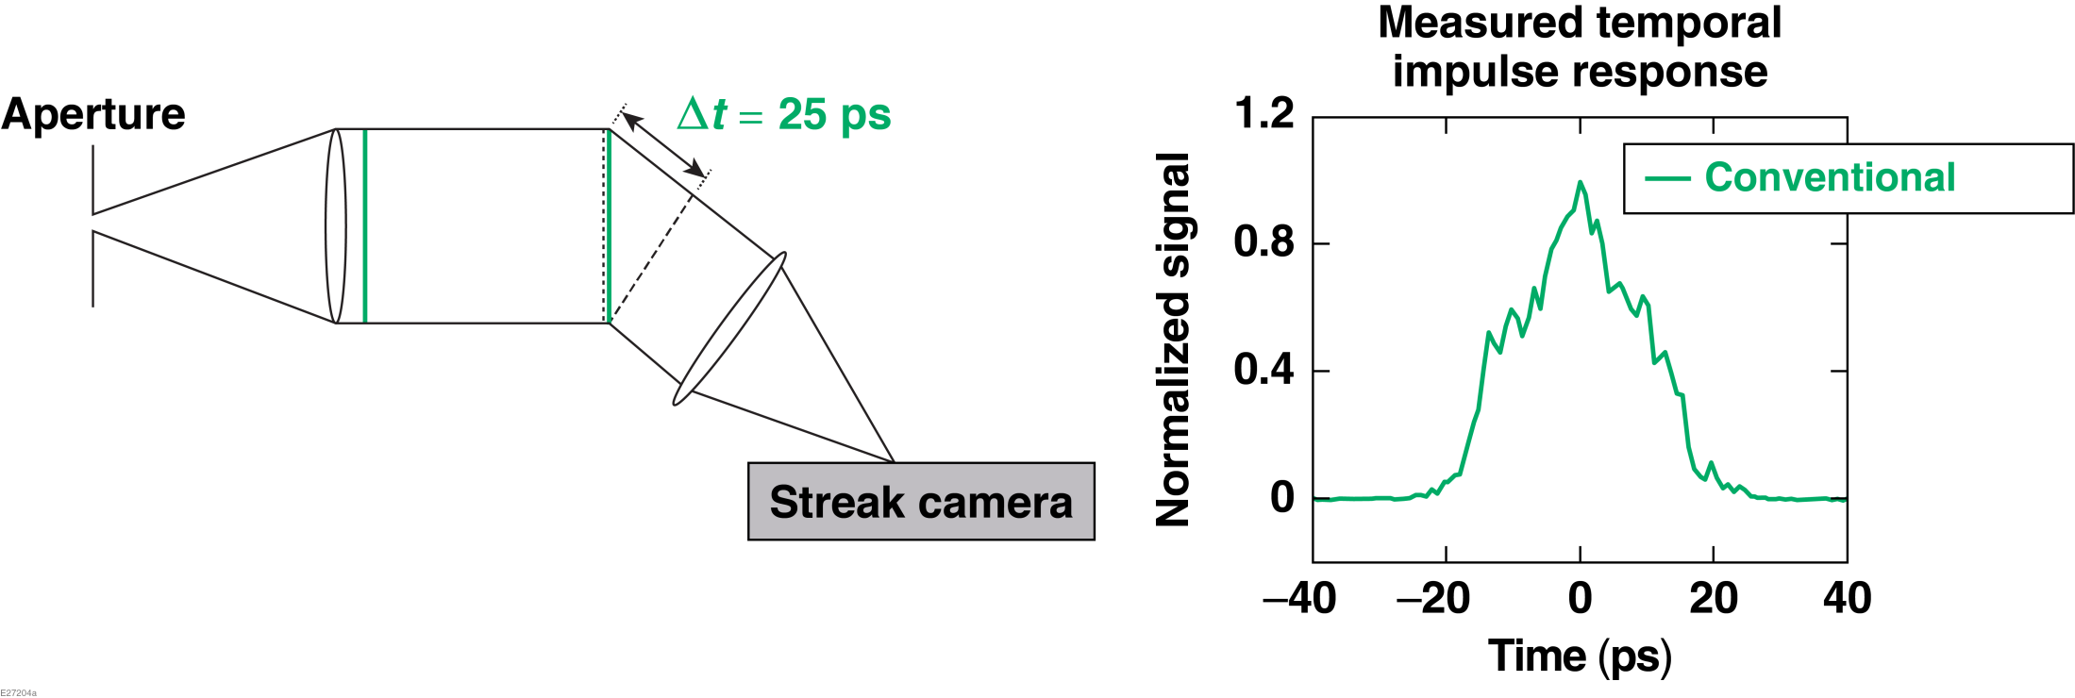
A pulse-front tilt-compensated spectrometer* was invented to trade unutilized resolving power with temporal resolution
*J. Katz et.al., Rev. Sci. Instrum. 87, 11E535 (2016)
Notes:
Change time axis to center zero on peak location

Slide 6
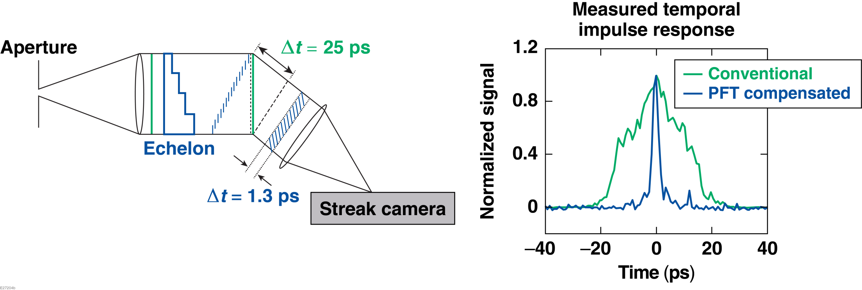
A pulse-front tilt-compensated spectrometer* was invented to trade unutilized resolving power with temporal resolution
This system is greater than 10 times faster than an equivalent (f/5) conventional streaked spectrometer diagnostic while maintaining 1-nm spectral resolution.
*J. Katz et.al., Rev. Sci. Instrum. 87, 11E535 (2016)
Notes:
Change time axis to center zero on peak location
Make images line up on slide transition

Slide 7
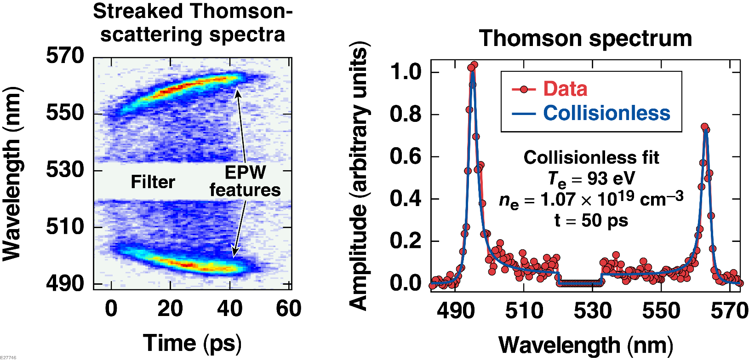
Thomson-scattering data and collisionless Thomson-scattering theory
are in excellent agreement in the hot plasma conditions present late in time
A. S. Davies et al., Phys. Rev. Lett. (to be submitted).
Notes:
when there were no temporal gradients Mention that I fit with a collenless model late in time. We will sweep gradients under the rug to keep the talk simple.
Get illustrations to do this image and normalize to the fit.

Slide 8
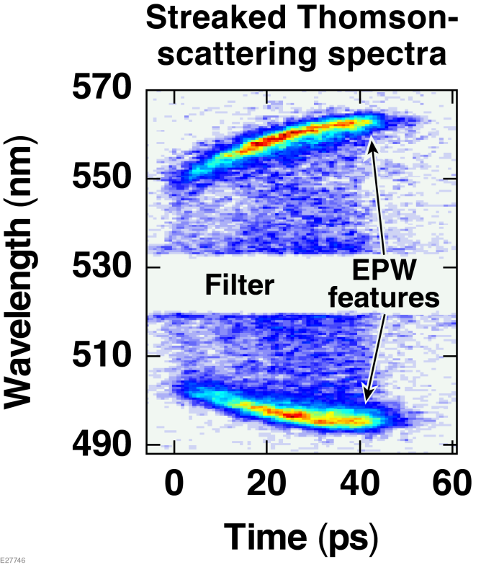
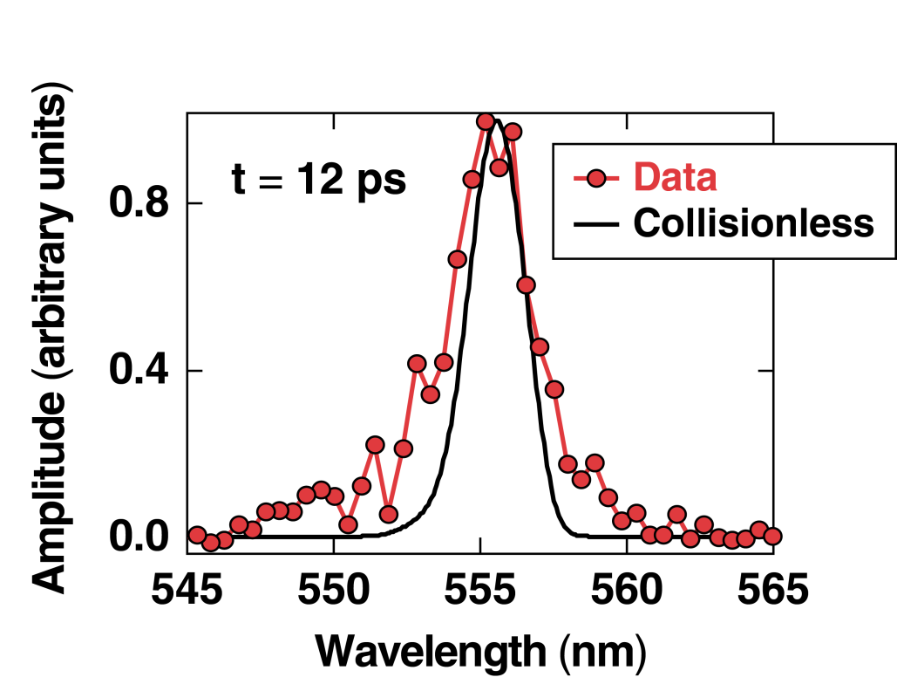
In contrast, the collisionless theory fails to reproduce the data’s spectral width
in cold plasma present early in time
An additional damping term is required to model the data
A. S. Davies et al., Phys. Rev. Lett. (to be submitted).
Notes:
“The failure to fit the width indicates I don’t have enough damping in our models.” This leads into the next slide were I talk about collisions

Slide 9
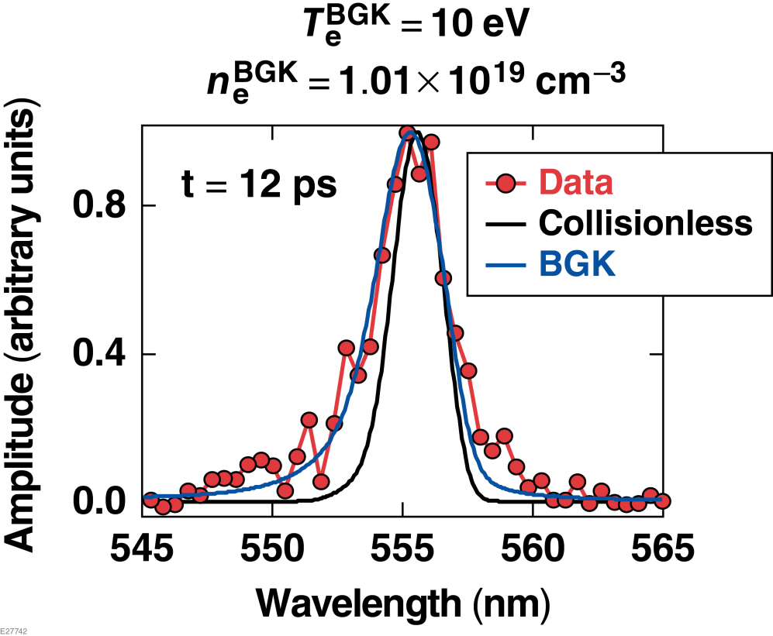
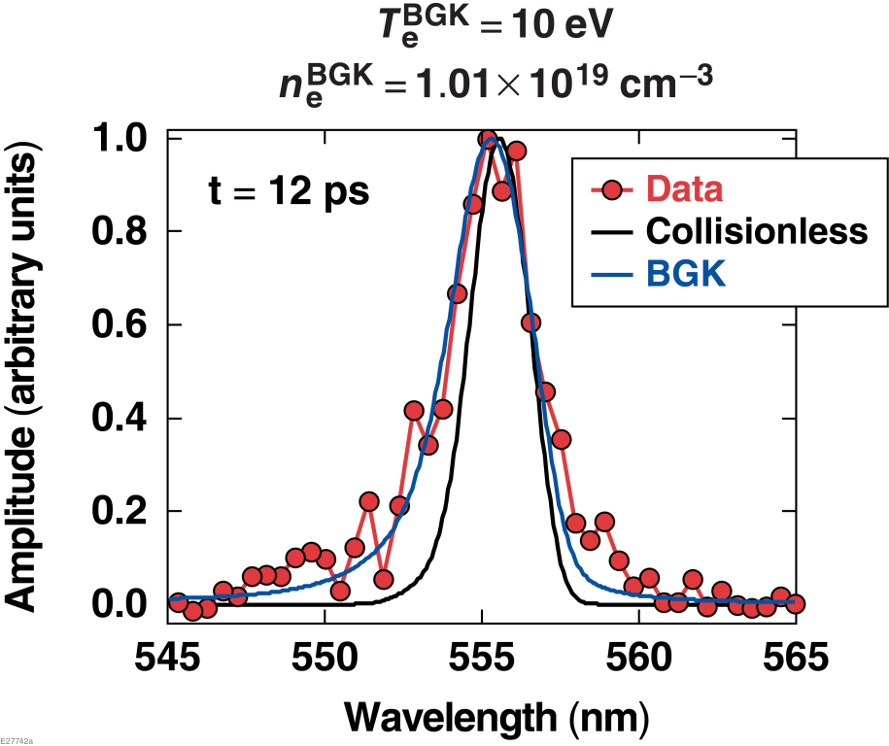
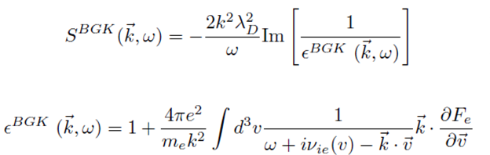
The computationally efficient collisional Bhatnagar Gross Krook (BGK) model reproduced the cold measured spectrum
Can you set the text to be the same as the figure like tthis on slide 6 so the slides line up and you only seed the changes when I transition
P. L. Bhatnager, E. P. Gross, and M. Krook, Phys. Rev. Lett. 94, 511 (1954)

Slide 10
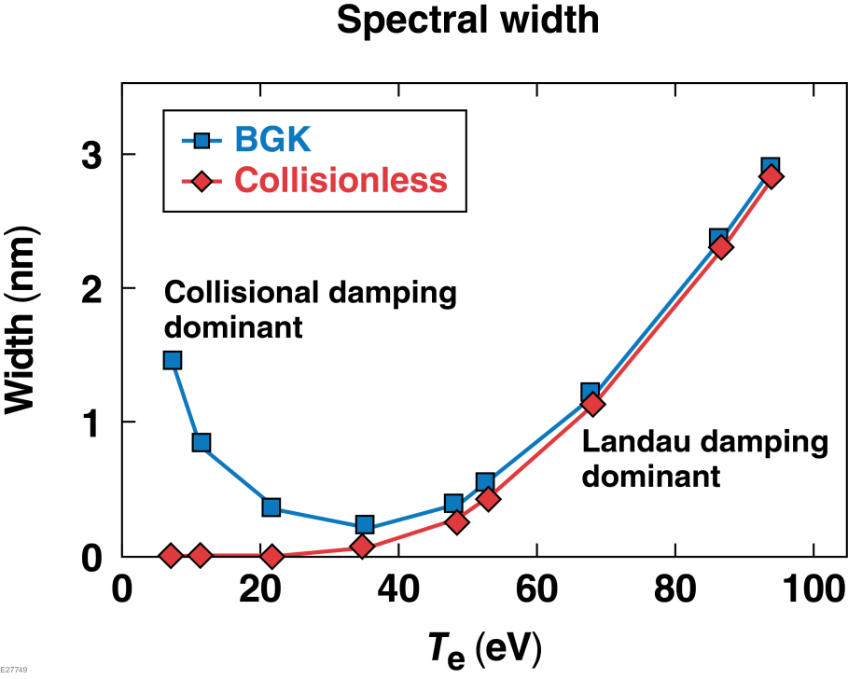
Collisional damping dominates the width of the electron plasma wave features
at electron temperatures below ~35 eV

Slide 11
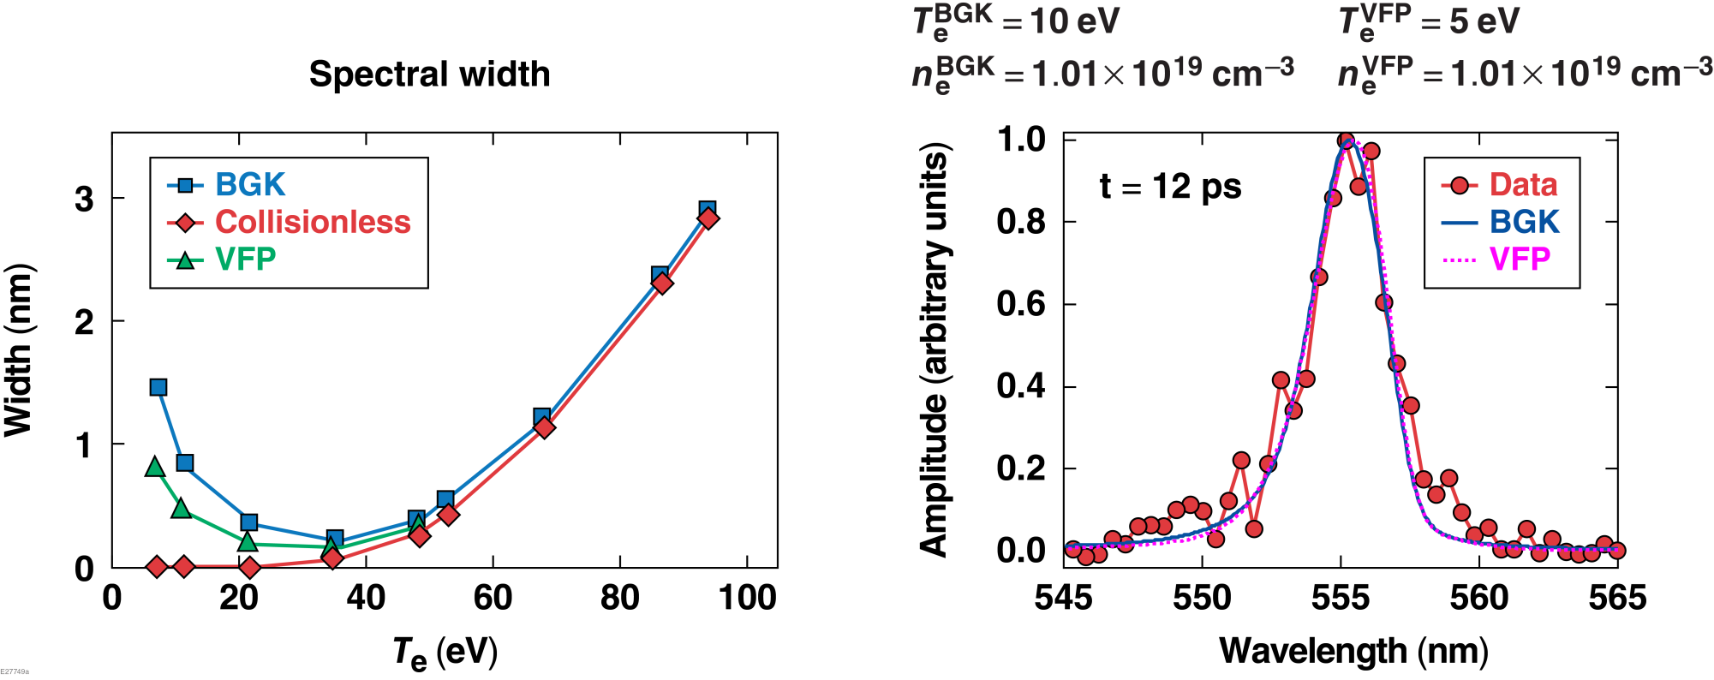
To understand the impact of using the BGK model to approximate collisions, a more-complete but computationally expensive Vlasov Fokker Planck (VFP)
model* was fit to three spectrums
The BGK model overestimates spectral width at low temperatures.
*W. Rozmus et.al., Phys. Rev. E 96, 043207 (2017)
Notes:
The VFP model recovered a statistically equivalent spectral fit as the BGK model with the same density . However the electron temperature determined by the VFP model was 50% lower

Slide 12
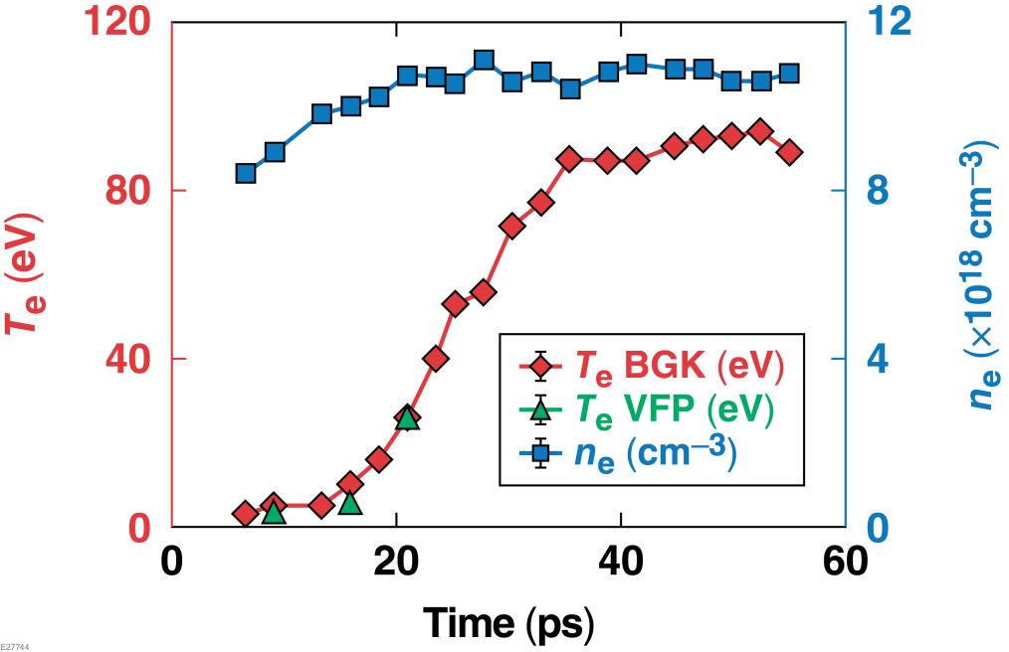
Armed with the new diagnostic and the BGK model, the picosecond time history
of the plasma conditions can be determined
During ionization the electron temperature was observed
to rise modestly from an initial 3 eV to 16 eV
  T_{e} is suppressed by ν_{e-H}
  Rising laser intensity
Once the plasma was fully ionized, the temperature rapidly increased to a plateau temperature of ~90 eV
  Inverse bremsstrahlung = Thermal conduction
At temperatures below 20 eV the BGK model has a high percent error (~10% - 50%), but the absolute value is bounded to a small range (1 to 5 eV) at all times
Notes:
Talk about why I only did VFP at low temperatures. Say that it converges at ~30 eV so there isn’t a need to use the more computational expensive model.
Add the two additional VFP fits to this plot
The electron temperature has been determined to 5 eV or better and the electron density has been determined t
It’s hypothesized that the electron temperature is suppressed by inelastic electron hydrogen collisions and a still rising laser intensity
It’s hypothesized that the inverse bremsstrahlung heating mechanism is in equilibrium with thermal conduction to the surrounding gas

Slide 13
The plasma creation and picosecond evolution of electron temperature and density has been measured
Summary/Conclusions
A pulse-front tilt-compensated streaked spectrometer was invented to measure the picosecond thermal
and ionization dynamics
For temperatures below ~35 eV, a collisional model was required to reproduce the measured spectrum
The electron temperature was suppressed during ionization and then rapidly increased to a plateau temperature of ~90 eV once fully ionized
These measurement techniques enable studies to optimize laser-plasma devices and might help to resolve discrepancies* between simulation and measurements of laser-imprint induced shock-velocity modulation
*J. Peebles, S. X. Hu, P. M. Celliers et al., Phys. Rev. Lett. (to be submitted)
Fiche #
Notes:
To figure out a physics model for the initial plasma formation, which can be implemented into hydro-codes for more realistic laser-imprint simulations
Discrepancies have been seen between simulation and OHRV-measurements on laser-imprint-induced shock-velocity modulation
However, as demonstrated in this Letter, this approach grossly underpredicts perturbations because the detailed microphysics (material breakdown via multiphoton and tunneling ionization) for the initial plasma formation are not included in most simulations
To more accurately capture the production of imprint-seeded instabilities, the detailed process of initial plasma formation must be included in the calculations
These measurements enables optimization of plasma devices, such as laser-plasma amplifier, which require knowledge of plasma temperature and density dynamics.

