Slide 1
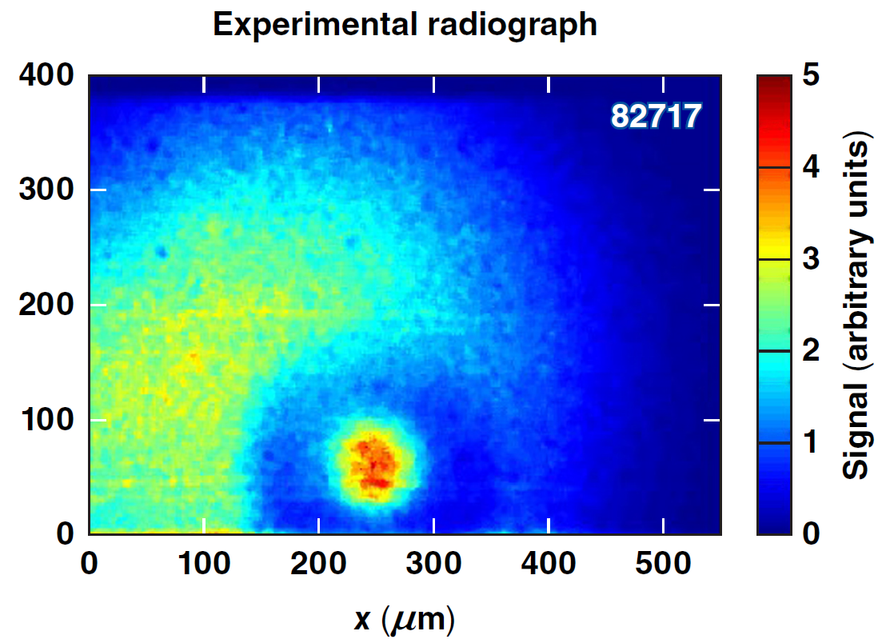
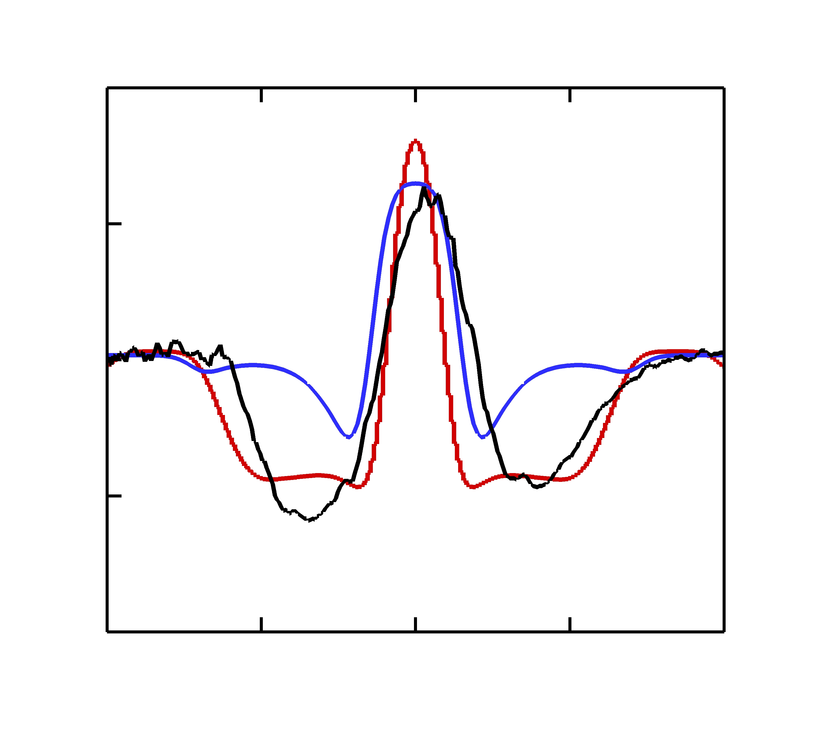
Cryogenic Target Performance and
Fuel-Ablator Perturbation Growth
Lineout
40
CR ~ 10 82717
α = 1.9
30
XRFC
LILAC
20
10
DRACO,
imprint
0
0
–100
100
x (μm)
60th Annual Meeting of the
American Physical Society
Division of Plasma Physics
Portland, OR
5 November–9 November 2018
T. J. B. Collins
University of Rochester
Laboratory for Laser Energetics

Slide 2
Comparison of experimental and synthetic radiographs shows that imprint is a dominant source of fuel-ablator mix in low-adiabat implosions
A crystal imager* was used for short-pulse (40-ps), monochromatic Si He_{α} x-ray backlighting** of OMEGA cryogenic implosions with low and moderate fuel adiabats
2-D DRACO simulations, post-processed with Spect3D,† agree well with experimental data when imprint is modeled
Simulations incorporating the effects of ion-diffusive mix indicate it cannot be responsible for the observed radiograph signatures in low-adiabat implosions

Slide 3
Collaborators
C. Stoeckl, R. Epstein, R. Betti, J. A. Delettrez, W. Bittle, C. J. Forrest, V. Yu. Glebov, V. N. Goncharov, D. R. Harding, I. V. Igumenshchev, D. W. Jacobs-Perkins, R. J. Janezic, J. H. Kelly, T. Z. Kosc, C. Mileham, D. T. Michel, R. L. McCrory, P. W. McKenty, F. J. Marshall, S. F. B. Morse, P. B. Radha, S. P. Regan, B. Rice, T. C. Sangster, M. J. Shoup III, W. T. Shmayda, C. Sorce, W. Theobald, J. Ulreich, and M. D. Wittman
University of Rochester
Laboratory for Laser Energetics
J. A. Frenje, M. Gatu Johnson, and R. D. Petrasso
Plasma Science and Fusion Center
Massachusetts Institute of Technology

Slide 4
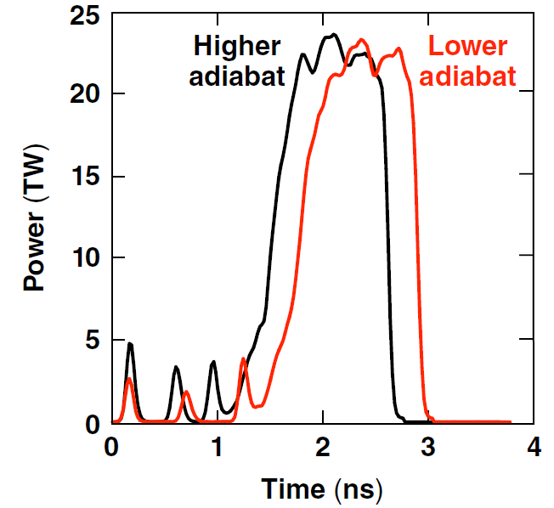
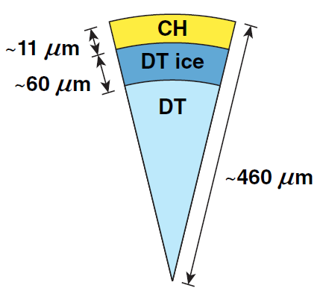
Comparison of moderate- and low-adiabat backlit cryogenic implosions* shows a drop in performance for the lower-adiabat implosion
LILAC
Experiment
Shot | α | IFAR | V_{imp} (μm/ns) | ρR (mg cm⁻²) | T_{i,LILAC} (keV) | Y_{LILAC} (10¹³) | ρR/clean | T_{i,Exp} (keV) | YOC
81590 | 2.5 | 10 | 240 | 250 | 2.2 | 1.4 | 78% | 2.7 | 19%
82717 | 1.9 | 14 | 280 | 246 | 2.4 | 2.6 | 41% | 2.4 | 8%
Offsets are small (~10 μm)
Ice-layer features at the ablator interface are also being investigated

Slide 5
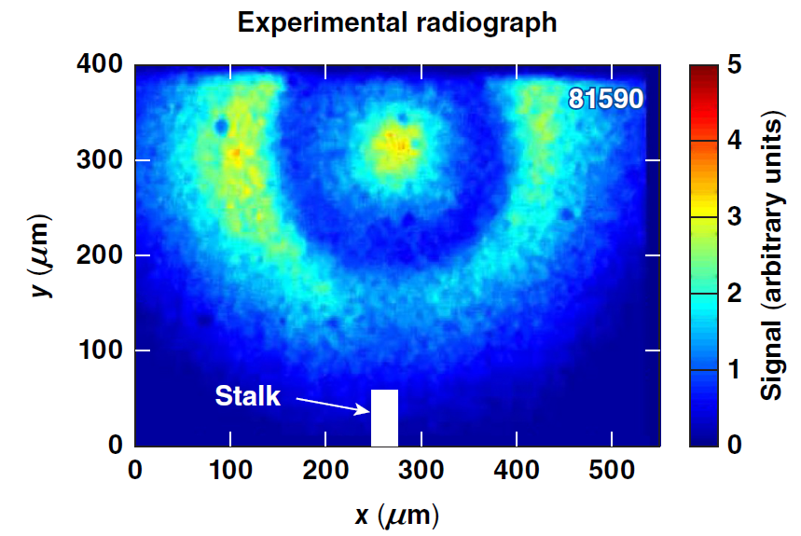
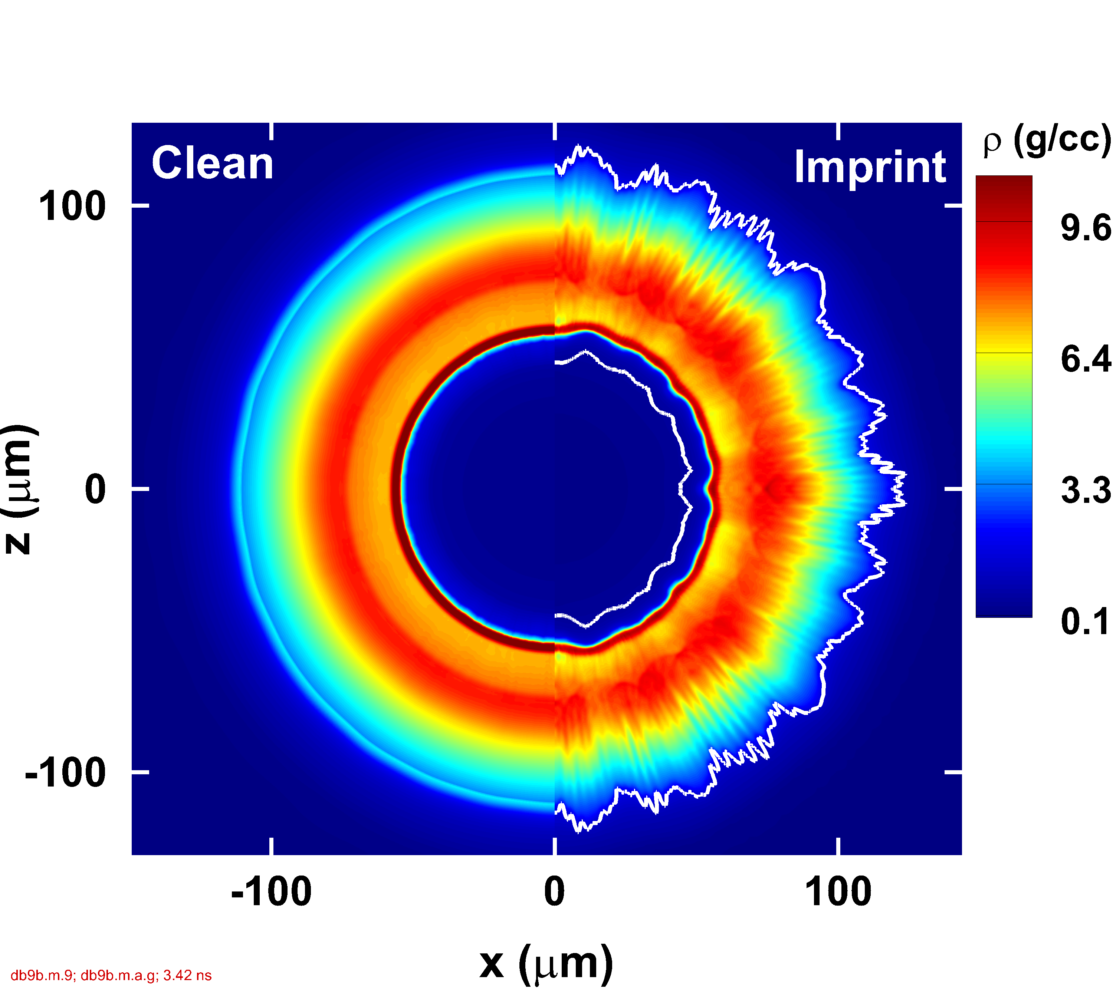
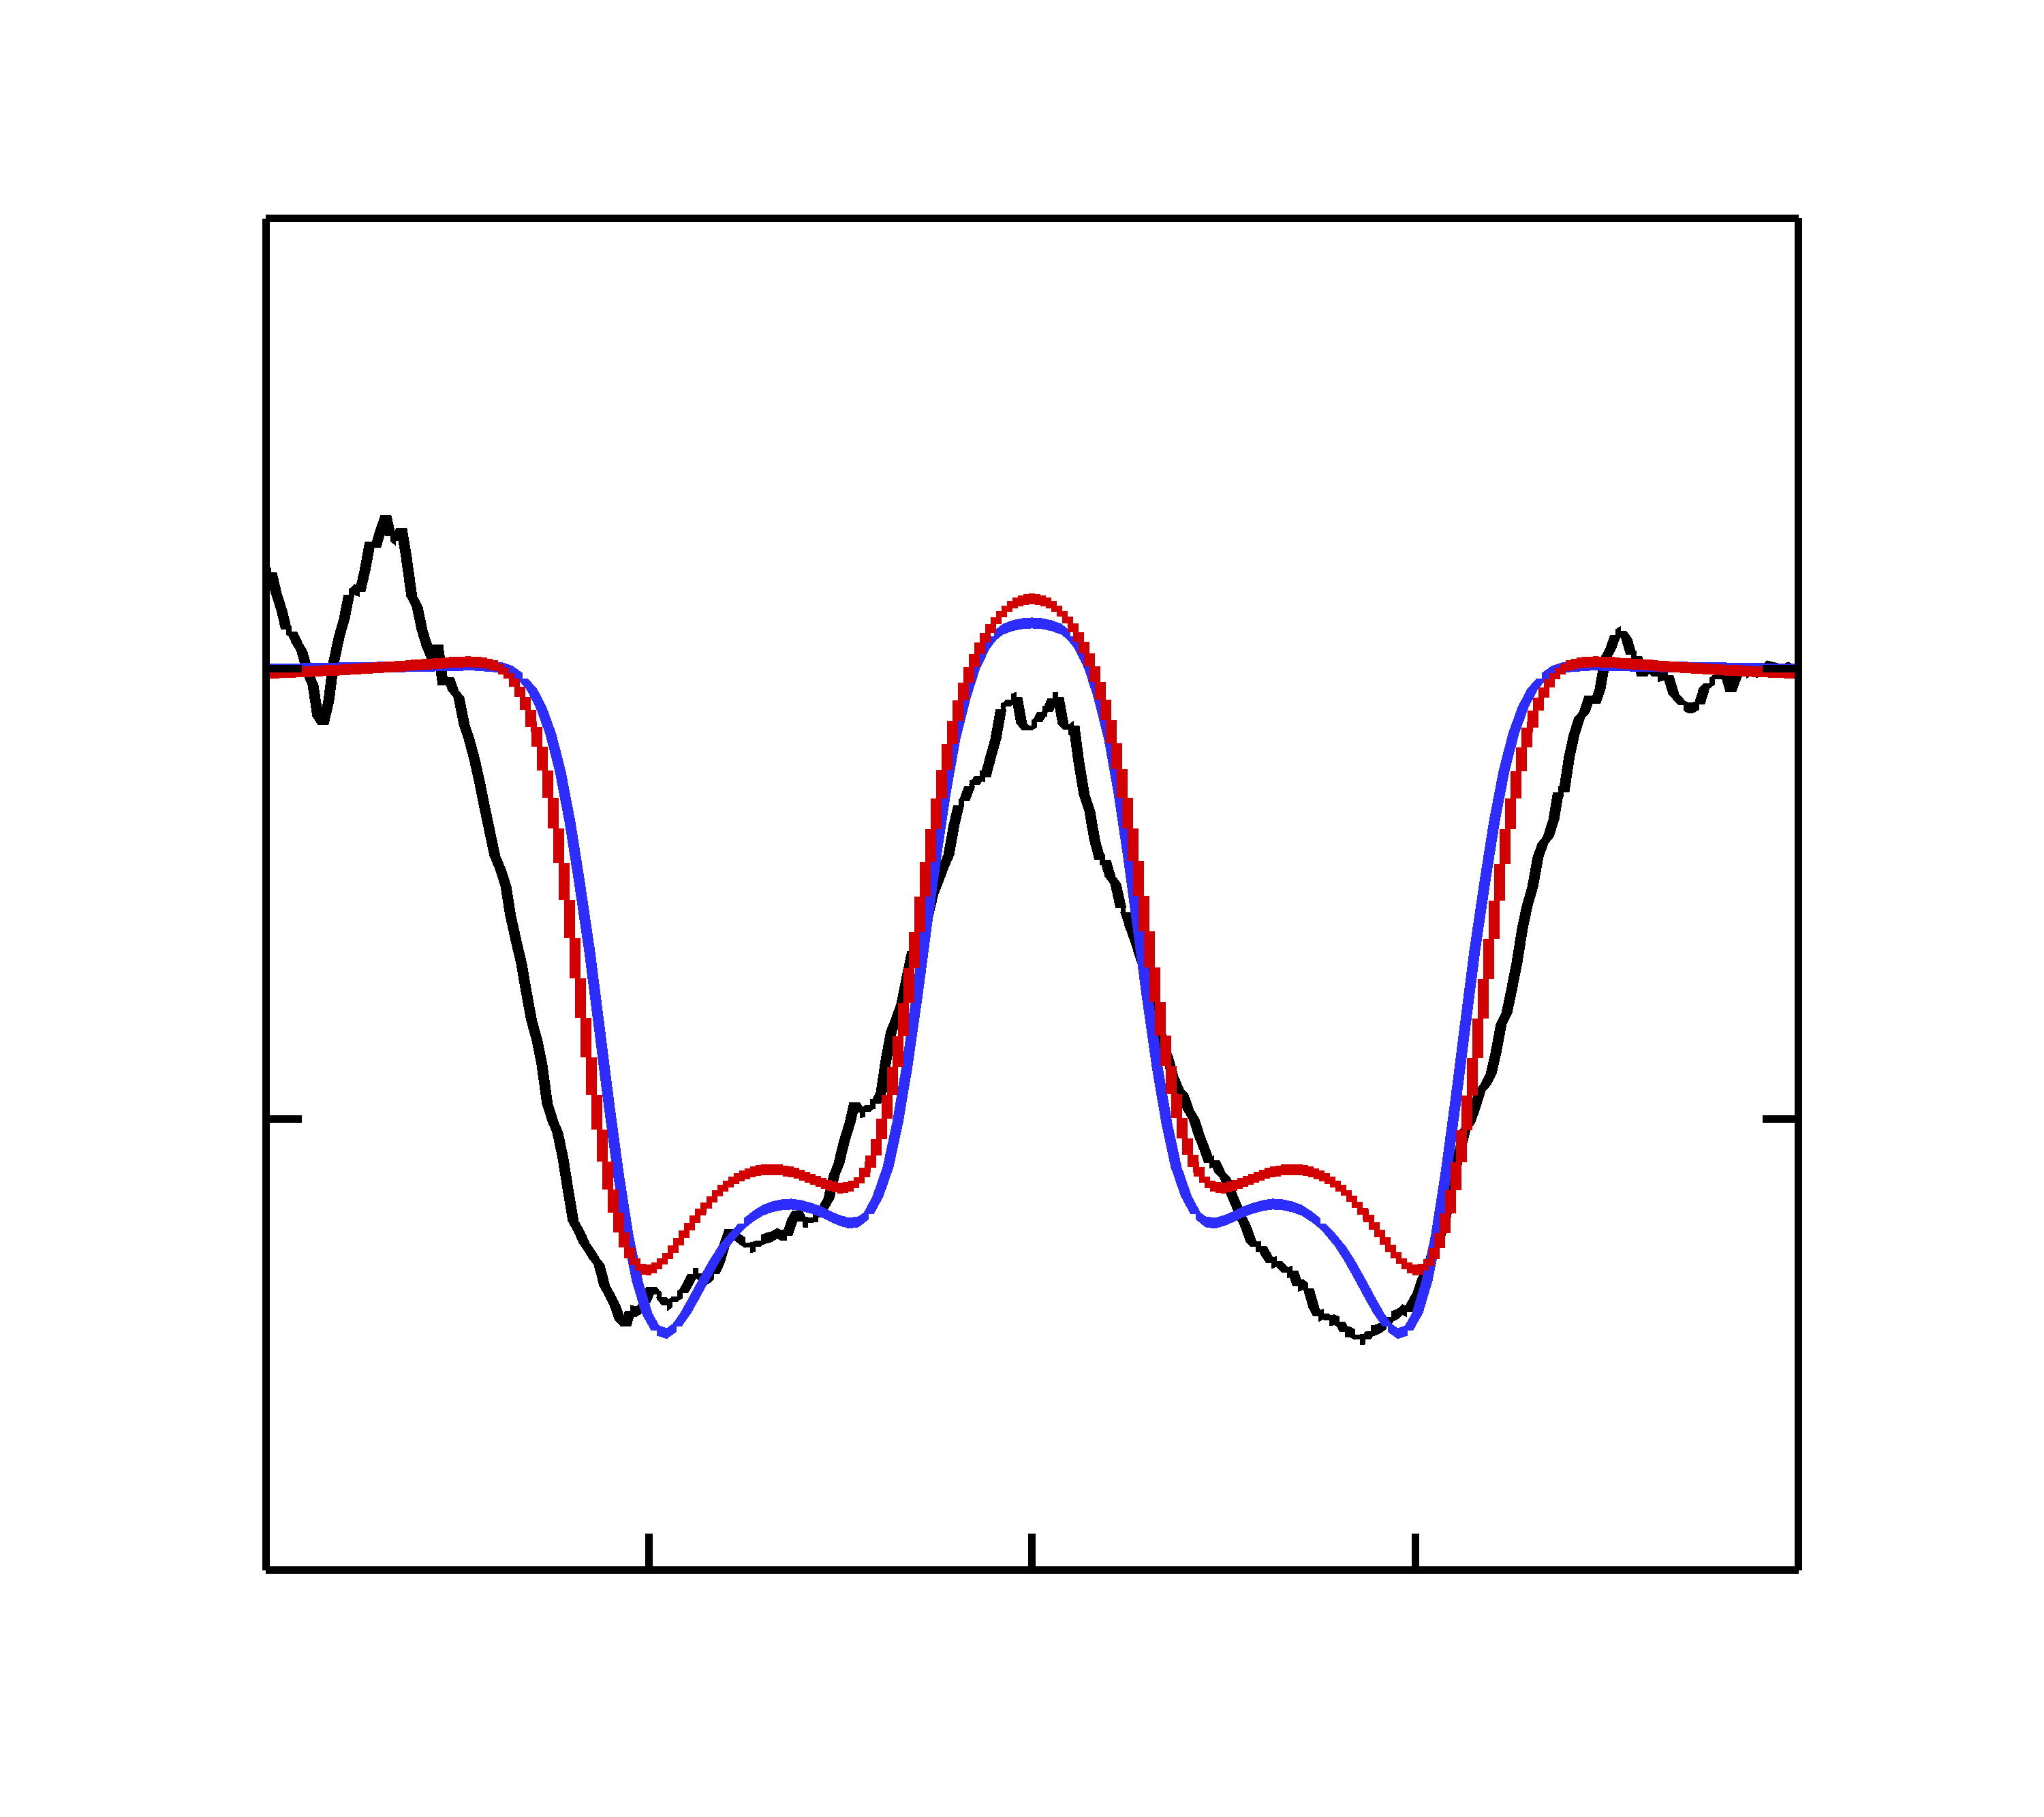
Synthetic backlighter images for the moderate-adiabat shot (α = 2.5) show substantial agreement with experimental data
Shell
2-D DRACO
Lineout
30
CR ~ 7 81590
α = 2.5
XRFC
20
Signal (arbitrary units)
10
α = 2.5; IFAR = 10
LILAC
DRACO
imprint
0
–100
0
100
Core
x (μm)
Imprint was simulated in DRACO, incorporating cross-beam energy transfer (CBET) and nonlocal electron heat transport (NLET), modeling Legendre modes {:2 to 150}
The DRACO simulation radiograph* shows a softer limb profile than the 1-D LILAC simulation, indicating minor effects due to imprint

Slide 6
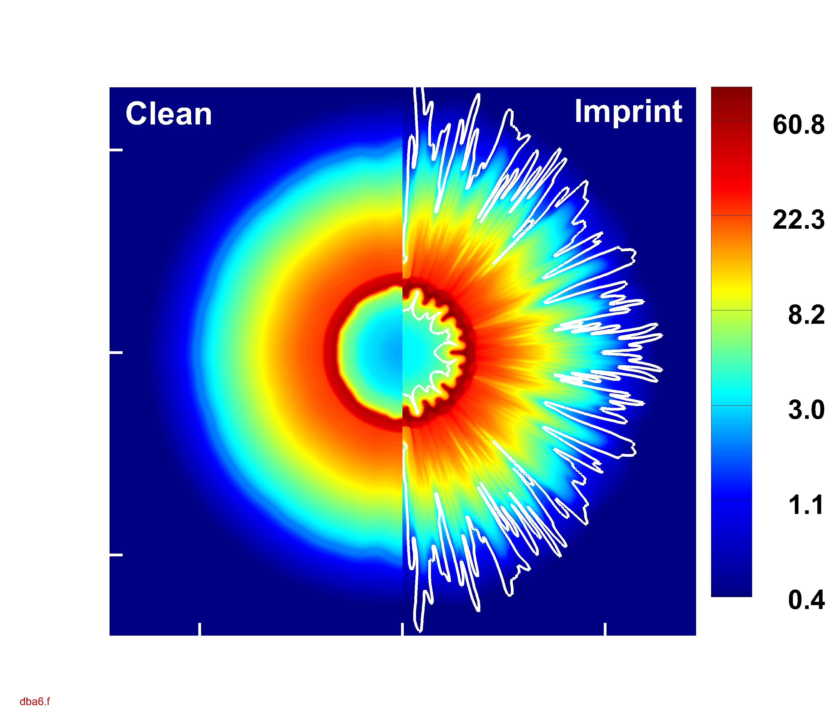
A 2-D DRACO imprint simulation of the low-adiabat (α = 1.9) implosion reproduces the deep shadow seen in the experimental data
Shell
2-D DRACO
ρ (g/cc)
Lineout
40
CR ~ 10 82717
α = 1.9
100
30
XRFC
LILAC
z (μm)
z (μm)
0
20
Signal (arbitrary units)
10
DRACO,
imprint
α = 1.9
IFAR = 14
–100
0
–100
0
100
–100
0
100
Core
x (μm)
x (μm)
Radiograph lineouts show greater absorption than is found in 1-D simulations, indicating mixing of carbon into the fuel
The shadow is reproduced in 2-D DRACO simulations incorporating imprint and a time-dependent flux limiter reproducing the shell trajectory of CBET-NLET simulations

Slide 7
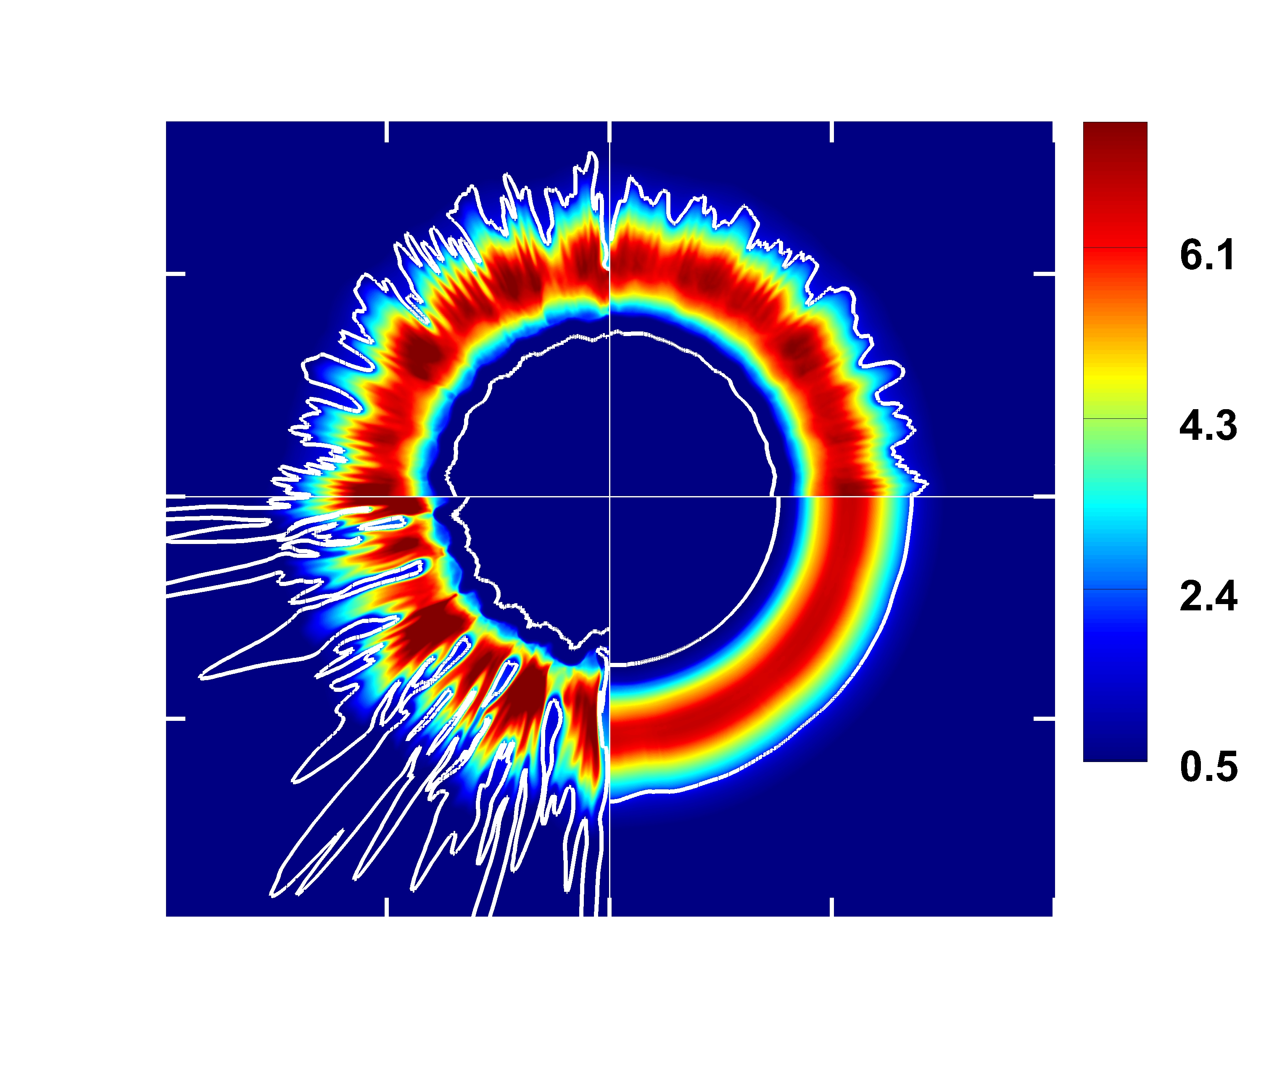

The depth of the synthetic radiograph shadow depends on the amplitude of the simulated imprint
ρ (g/cc)
Lineout
7.5
Imprint multiplier | Max carbon penetration depth (μm), 3.41 ns
0 | 0
0.5 | 14
1 | 29
2 | 45
40
×1
×½
CR ~ 10 82717
α = 1.9
100
30
XRFC
LILAC
z (μm)
0
Signal (arbitrary units)
20
–100
10
×2
No imprint
DRACO
imprint
–200
–100
0
100
200
0
–100
0
100
x (μm)
x (μm)
The time-dependent flux limiter overestimates the shell opacity (corrected above based on CBET-NLET simulations of α = 2.5 shot 81590)
Simulations of shot 82717 are underway incorporating CBET and NLET and varying imprint levels
Comparison of experiment and simulation will be used to constrain the level of imprint

Slide 8
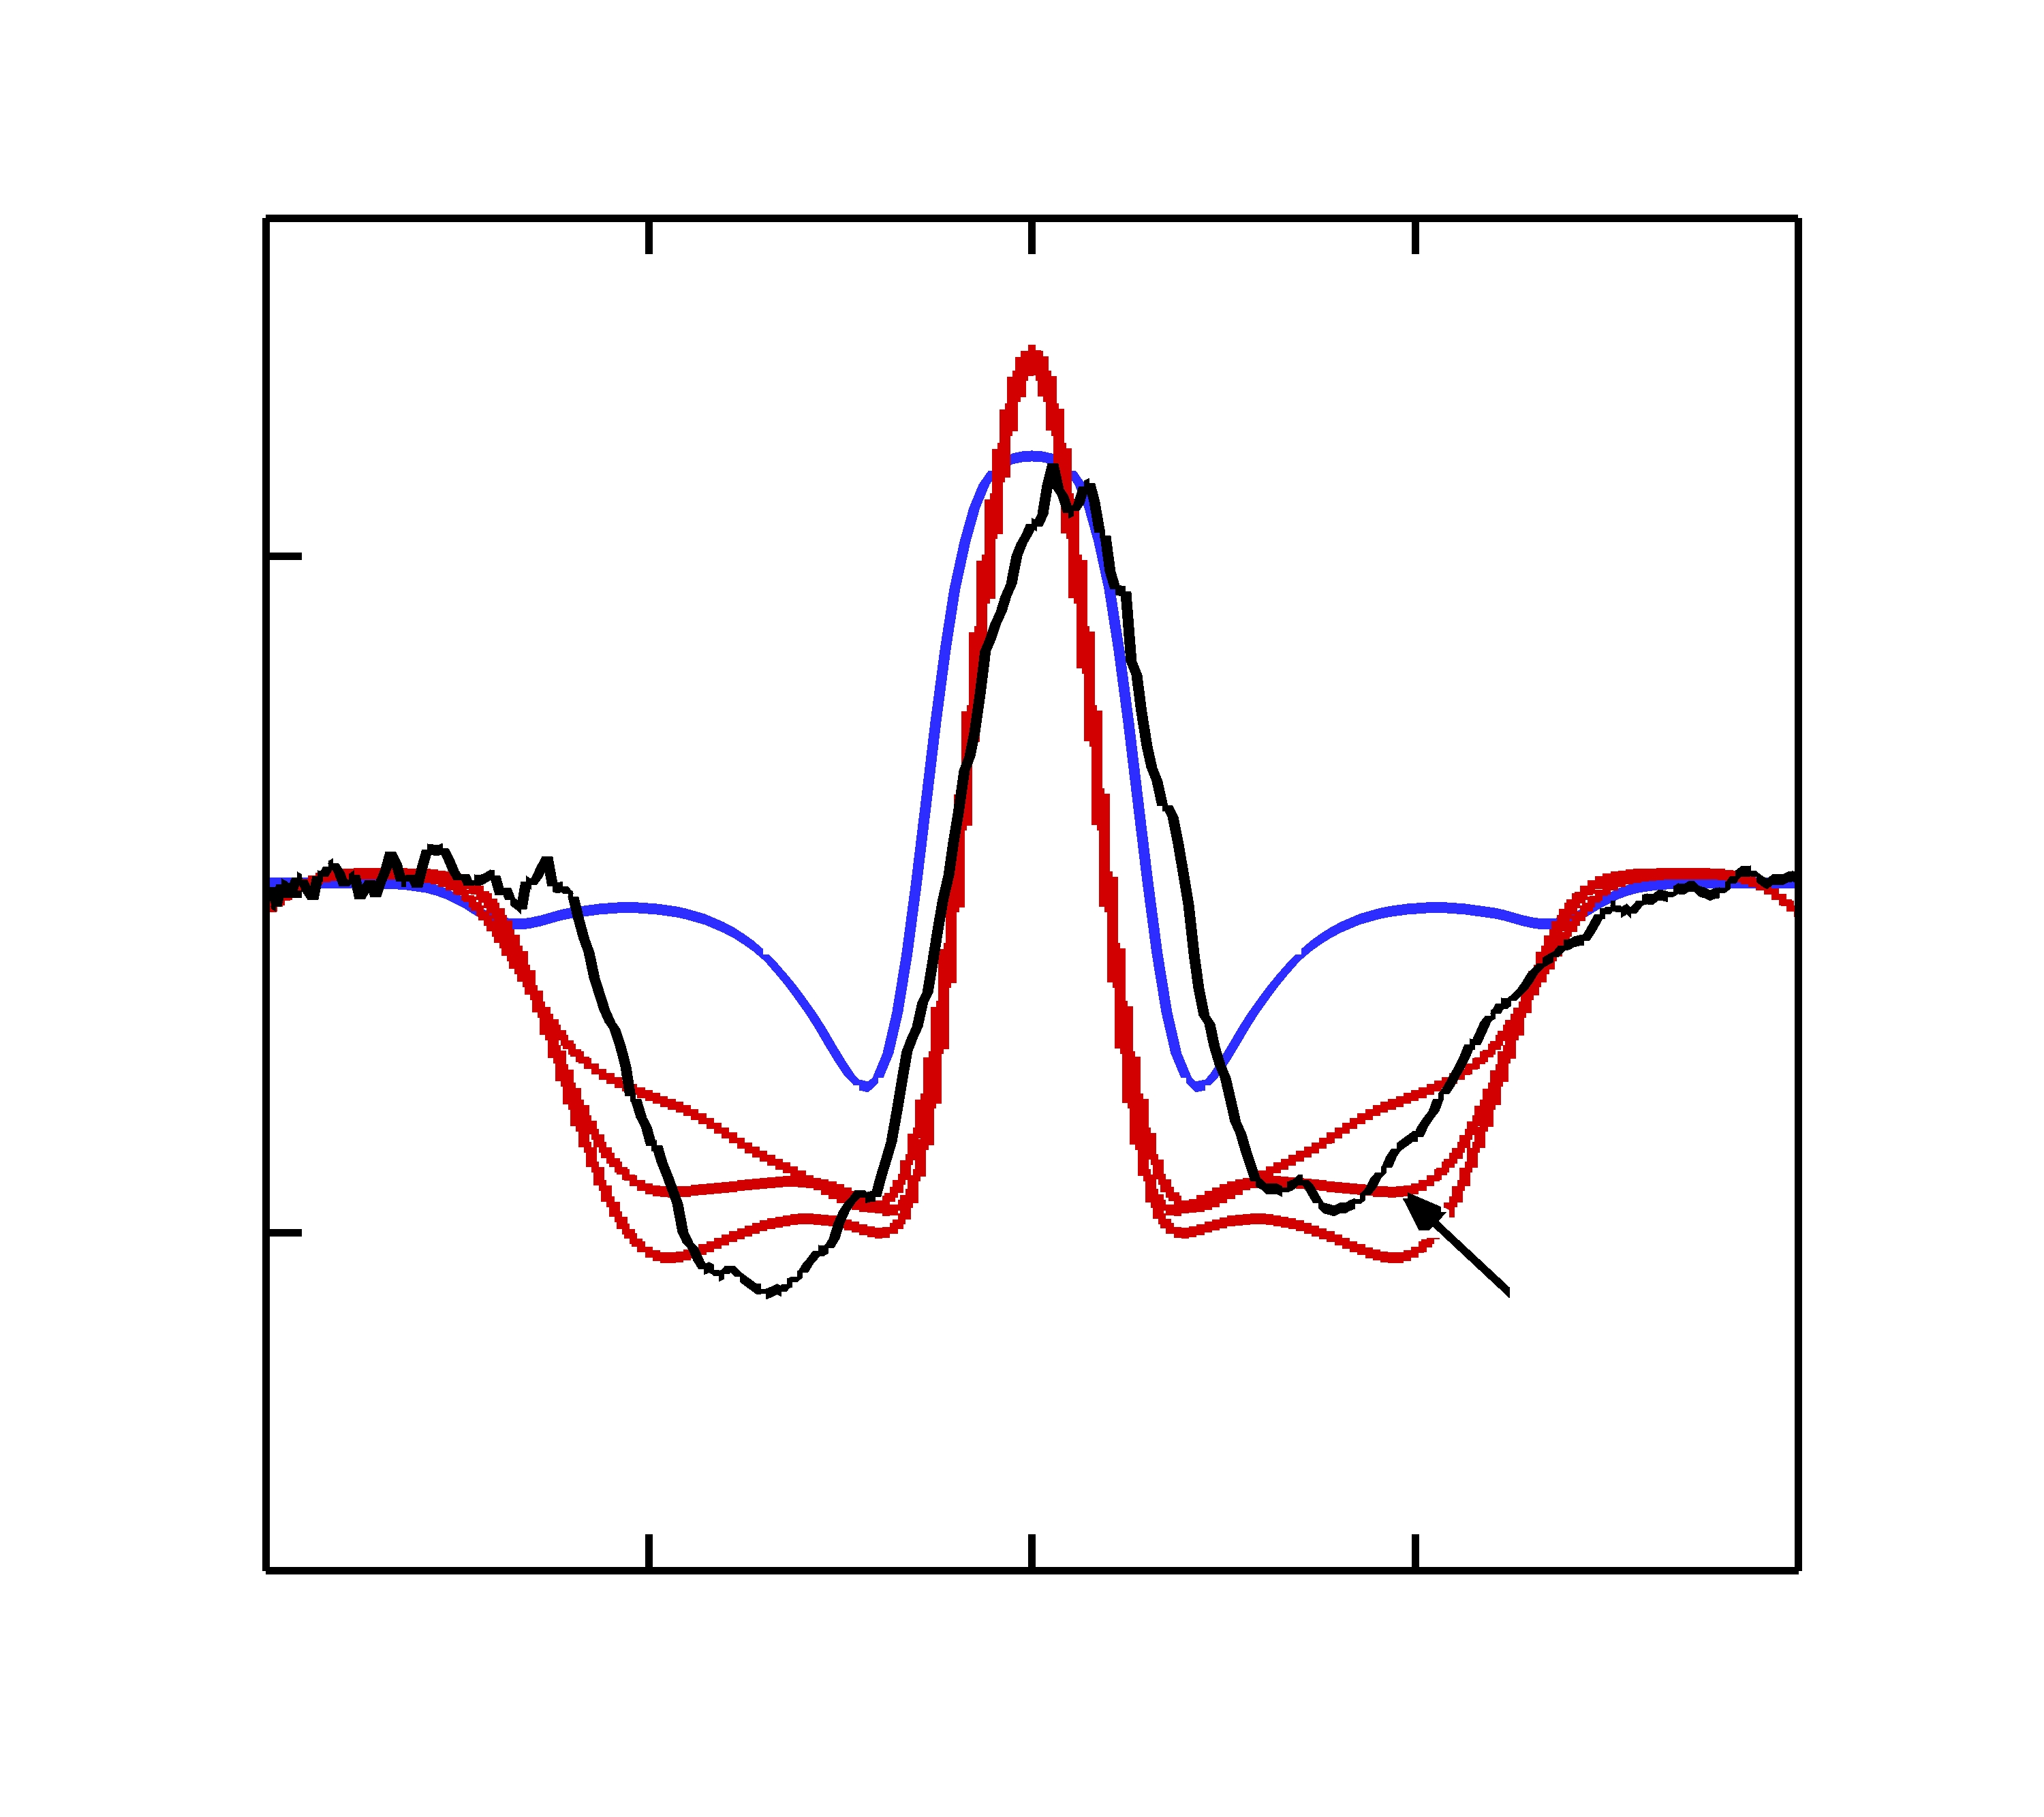
The depth of the synthetic radiograph shadow depends on the amplitude of the simulated imprint
ρ (g/cc)
Lineout
7.5
Imprint multiplier | Max carbon penetration depth (μm), 3.41 ns
0 | 0
0.5 | 14
1 | 29
2 | 45
40
×1
×½
CR ~ 10 82717
α = 1.9
100
30
XRFC
LILAC
z (μm)
0
Signal (arbitrary units)
20
×½
–100
10
×2
×1
×2
No imprint
DRACO
imprint
–200
–100
0
100
200
0
–100
0
100
x (μm)
x (μm)
The time-dependent flux limiter overestimates the shell opacity (corrected above based on CBET-NLET simulations of α = 2.5 shot 81590)
Simulations of shot 82717 are underway incorporating CBET and NLET and varying imprint levels
Comparison of experiment and simulation will be used to constrain the level of imprint

Slide 9
Ion mass diffusion is also being investigated as a possible carbon transport mechanism
The ablator–fuel interface introduces a boundary in ion concentration, driving flow across the interface
Mass diffusion has been demonstrated in the context of OMEGA exploding pushers* and is tied to similar effects such as baro- and thermodiffusion and nonequilibrium shock-species separation
2-D ion mass diffusion has been implemented in DRACO, with flux J_{k} calculated by Fick’s First Law,** , where D_{k} is the diffusion coefficient, and n_{k} is the ion number density, using a momentum-conserving collision frequency based on Simakov and Molvig (2016) ‡
The classical diffusion coefficient is given by†
Ion mass diffusion will be important when temperature is high and density is low, when

Slide 10
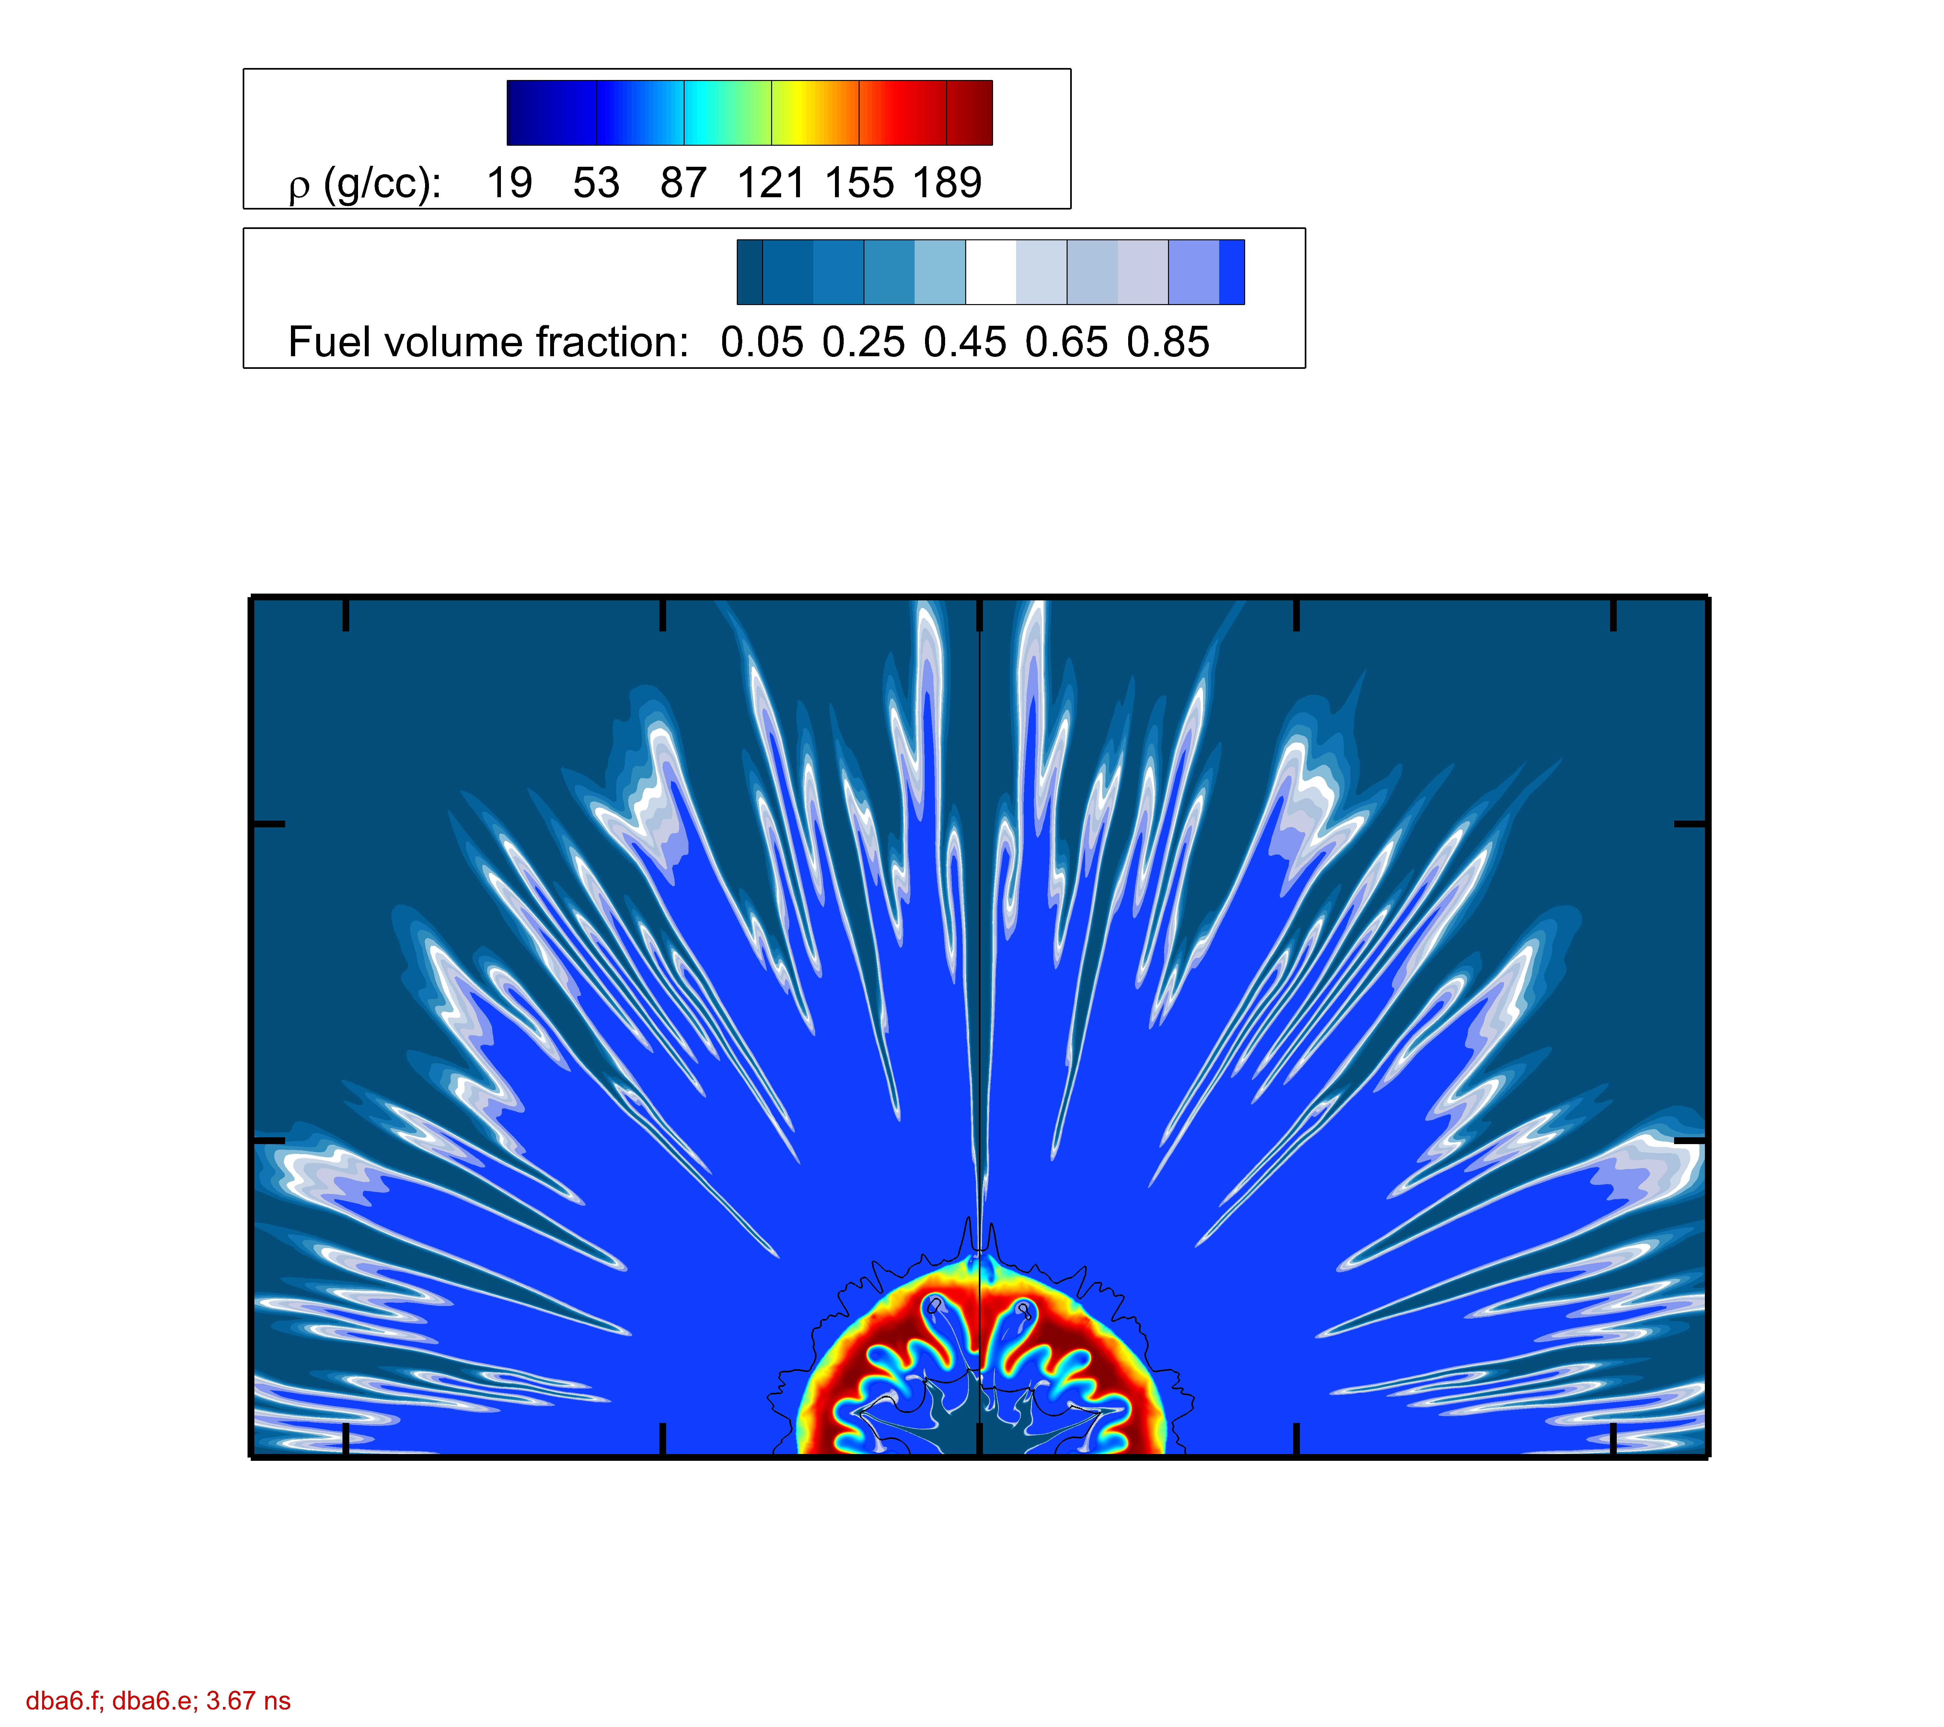

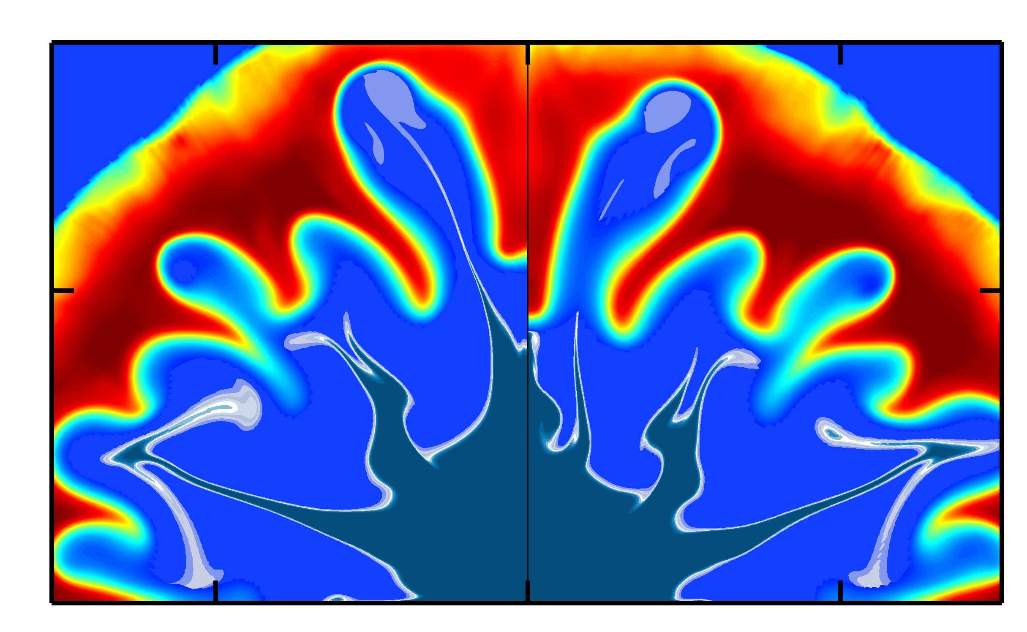
Ion mass diffusion does not play a significant role in these implosions at the fuel–ablator interface
The fuel-ablator interface is ablated just after the pulse ends, and D ~ 10^{–2} μm²/ns
For the gas–fuel interface at bang time, v_{th} ~ 400 μm/ns, collision time τ ~ 0.8 ps, and D ~ 120 μm²/ns, leading to minor but visible effects
Ion diffusion may be important for implosions in which the ablator is fully ablated before the end of the laser pulse
No ion diffusion
With ion diffusion
Bang time
3.67 ns
82717
z (μm)
CH
No
diffusion
With
diffusion
DT
15
z (μm)
–100
–50
0
50
100
x (μm)
0
–15
0
15
x (μm)

Slide 11
Comparison of experimental and synthetic radiographs shows that imprint is a dominant source of fuel-ablator mix in low-adiabat implosions
A crystal imager* was used for short-pulse (40-ps), monochromatic Si He_{α} x-ray backlighting** of OMEGA cryogenic implosions with low and moderate fuel adiabats
2-D DRACO simulations, post-processed with Spect3D,† agree well with experimental data when imprint is modeled
Simulations incorporating the effects of ion-diffusive mix indicate it cannot be responsible for the observed radiograph signatures in low-adiabat implosions
Isolated ice features at the fuel-ablator interface are also being investigated for their role in fuel-ablator mixing

