Slide 1
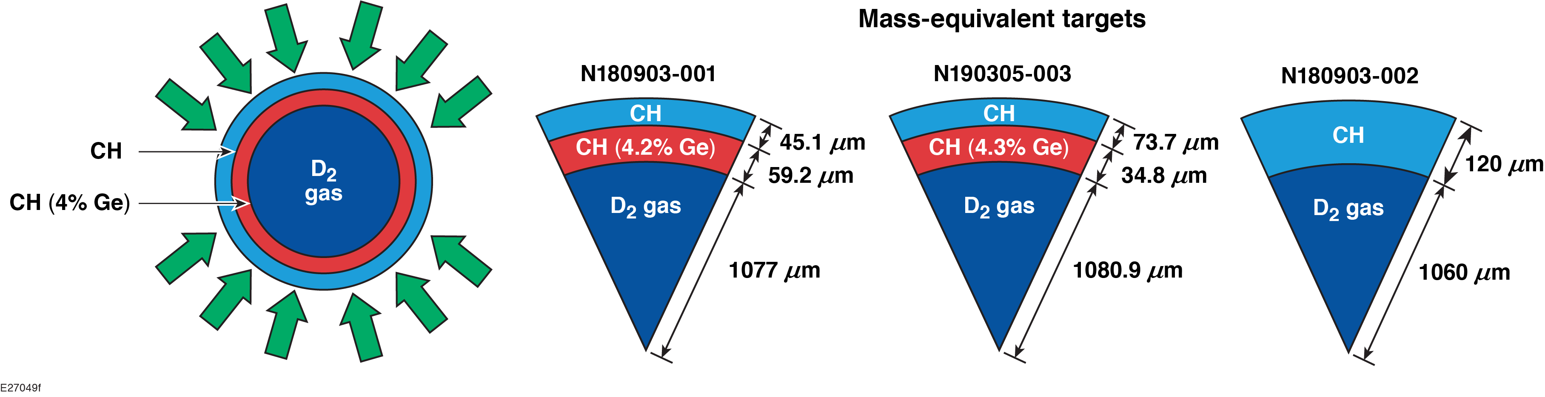
Hot-Electron Preheat and Energy Deposition in Direct-Drive
Implosion Experiments at the National Ignition Facility
A. A. Solodov et al.
University of Rochester
Laboratory for Laser Energetics
48th Anomalous Absorption Conference
Telluride, CO
9–14 June 2019

Slide 2
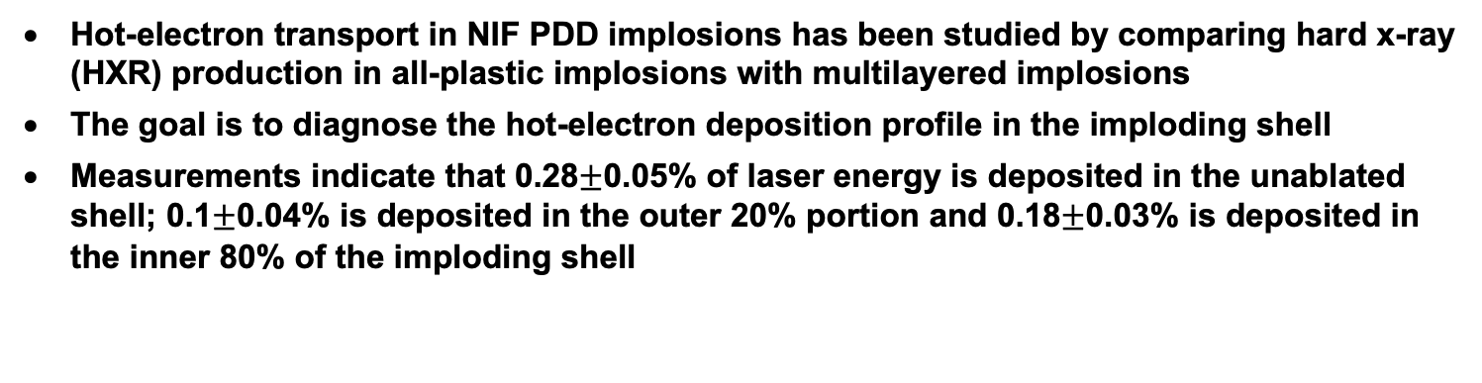
Hot-electron preheat and energy deposition in the unablated shell have been measured in polar-direct-drive (PDD) implosions on the NIF
Hot-electron transport in NIF PDD implosions has been studied by comparing hard x-ray (HXR) production in all-plastic implosions with multilayered implosions
The goal is to diagnose the hot-electron deposition profile in the imploding shell
Measurements indicate that 0.28$±$0.05% of laser energy is deposited in the unablated shell; 0.1$±$0.04% is deposited in the outer 20% portion and 0.18$±$0.03% is deposited in the inner 80% of the imploding shell
Hot-electron preheat mitigation using mid-Z layers and laser frequency detuning/bandwidth strategies are being explored.*

Slide 3
M. J. Rosenberg, A. R. Christopherson, R. Betti, M. Stoeckl, W. Seka, R. Epstein, R. K. Follett,
P. B. Radha, S. P. Regan, D. H. Froula, and V. N. Goncharov
University of Rochester
Laboratory for Laser Energetics
J. F. Myatt
University of Alberta
M. Hohenberger, B. Bachmann, and P. Michel
Lawrence Livermore National Laboratory

Slide 4
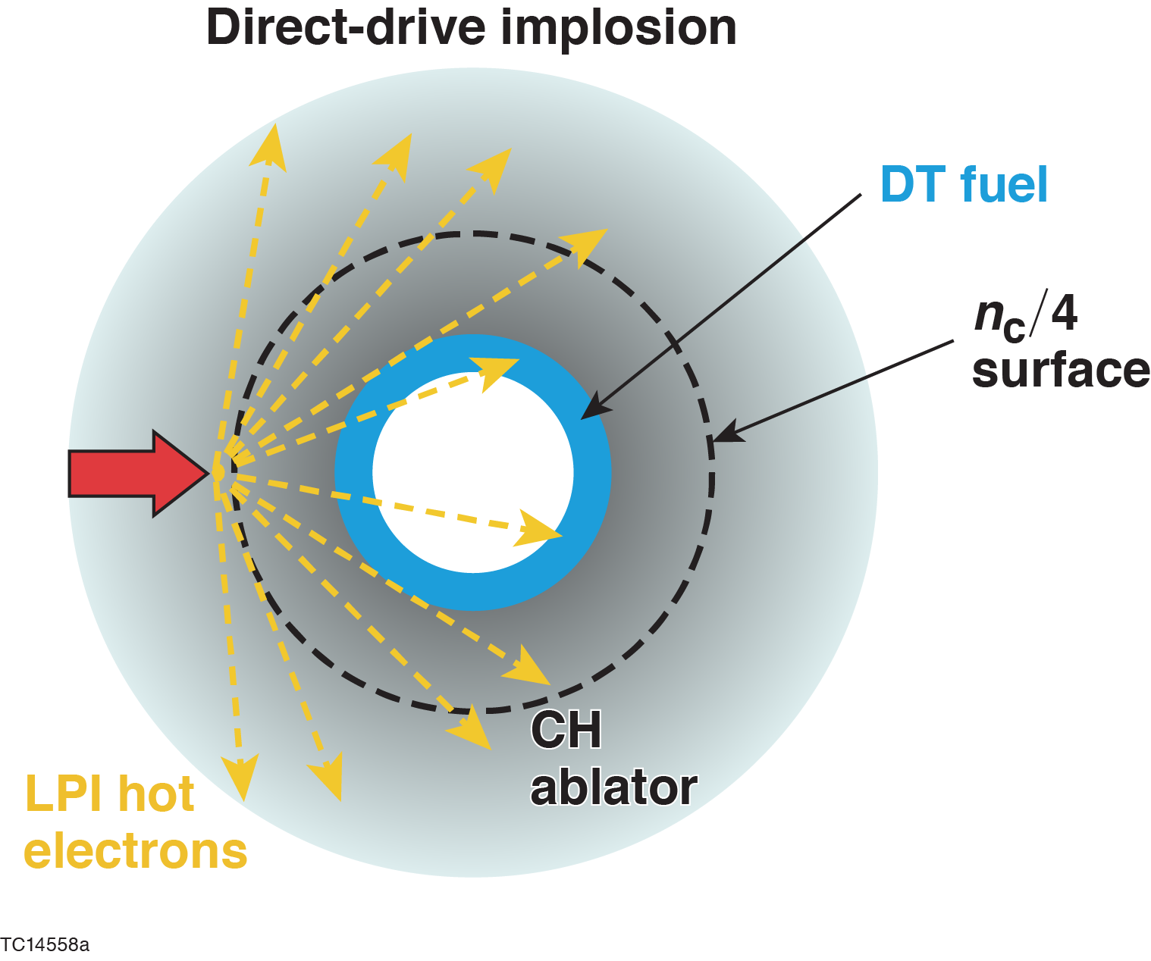
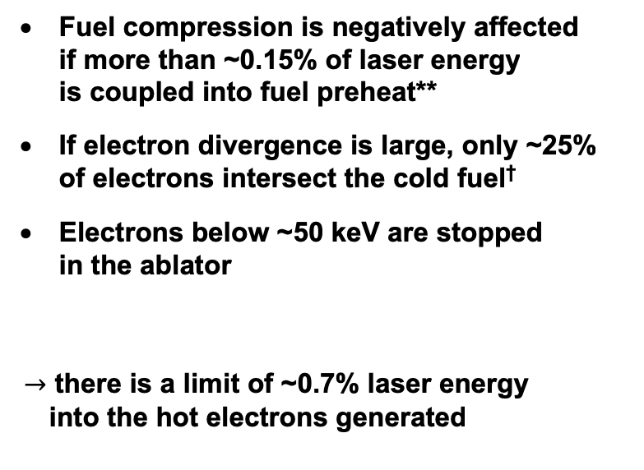
Hot-electron preheat can degrade fuel compression in direct-drive ignition designs
Motivation
Fuel compression is negatively affected
if more than ~0.15% of laser energy
is coupled into fuel preheat**
If electron divergence is large, only ~25%
of electrons intersect the cold fuel†
Electrons below ~50 keV are stopped
in the ablator
$→$ there is a limit of ~0.7% laser energy
into the hot electrons generated

Slide 5
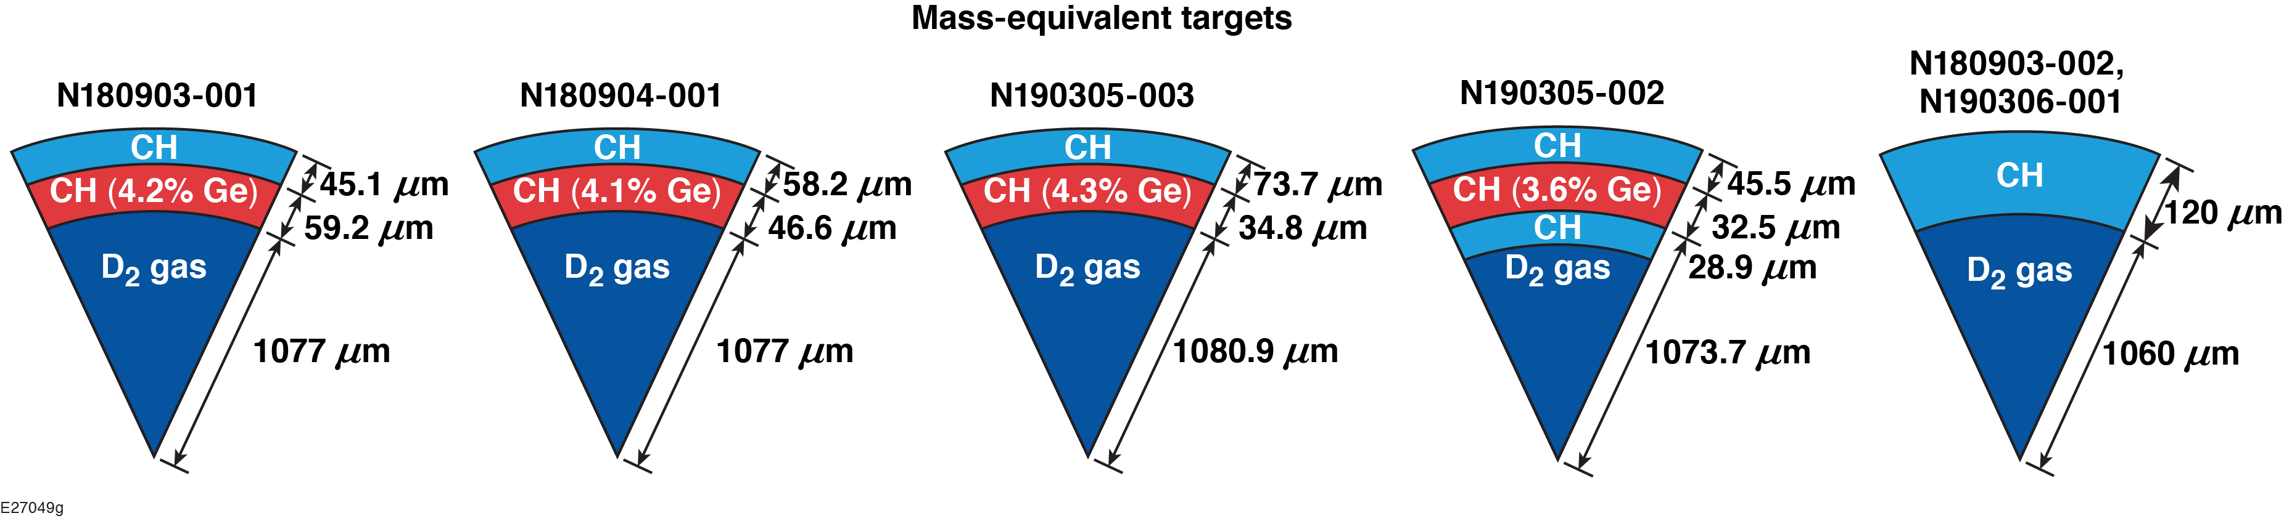
Hot-electron transport in NIF PDD implosions was studied by comparing HXR between all-plastic and multilayered implosions
Different buried depths and thicknesses of the Ge-doped layer are examined to diagnose the hot-electron deposition profile in the imploding shell.

Slide 6
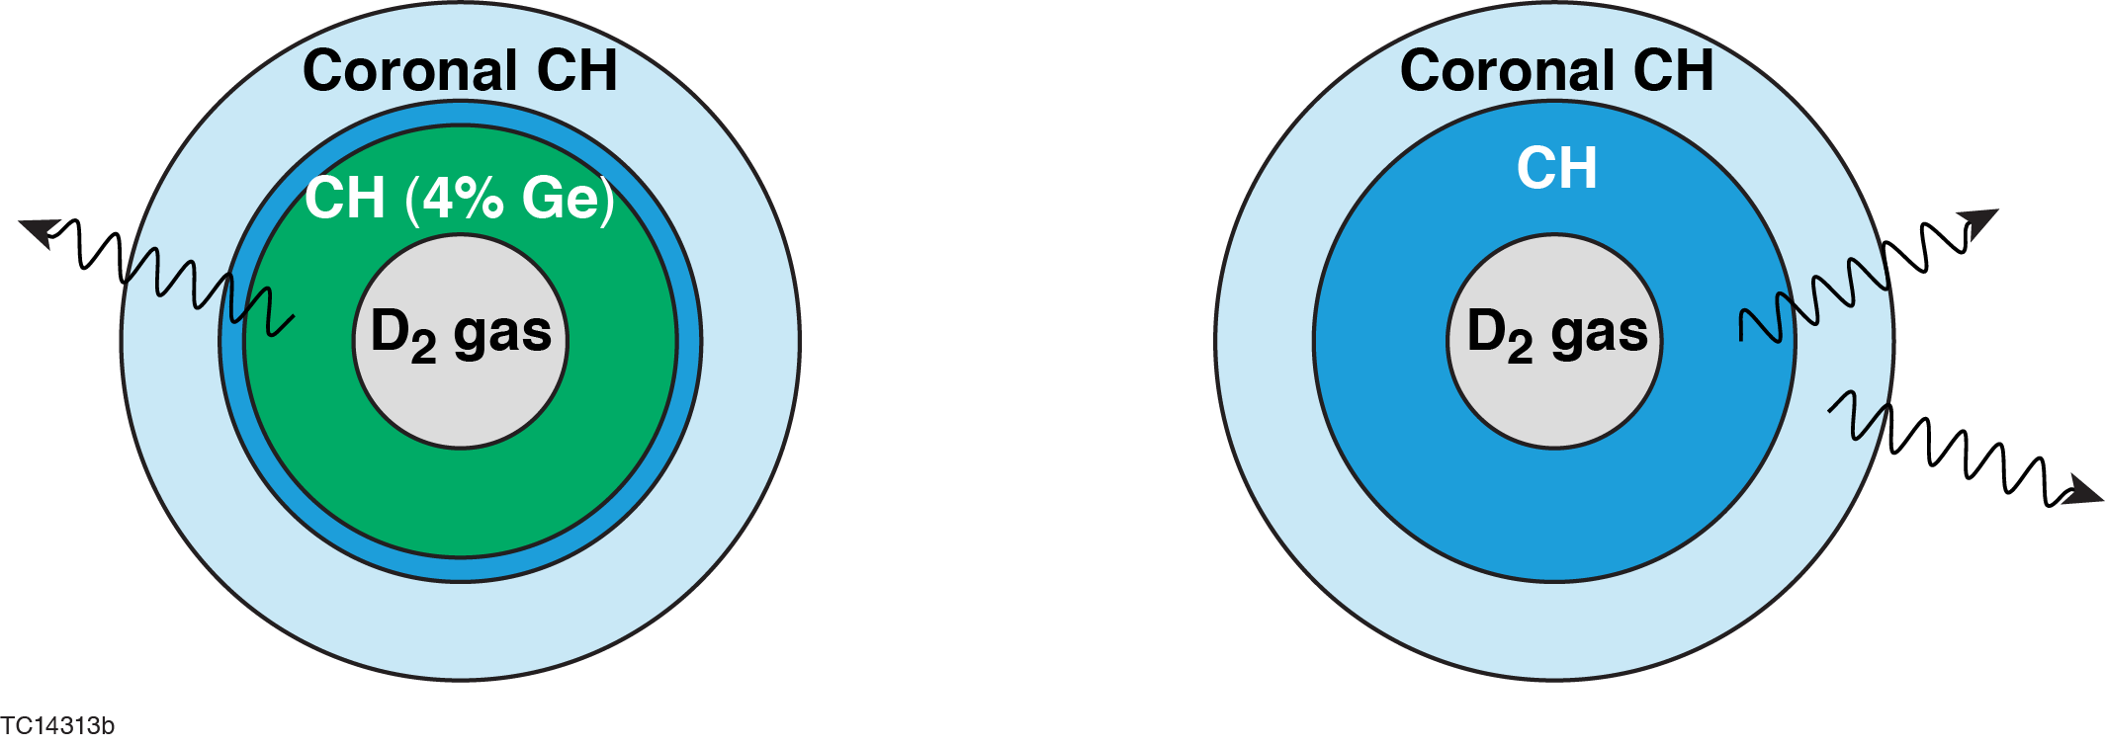
The energy deposited into a payload can be inferred by subtracting the all-CH HXR from the HXR of a Ge-doped layered target
is taken from theory; it is proportional to , depends on T_{hot}, and logarithmically on plasma density
and are HXR measurements
Preheat formula:*

Slide 7
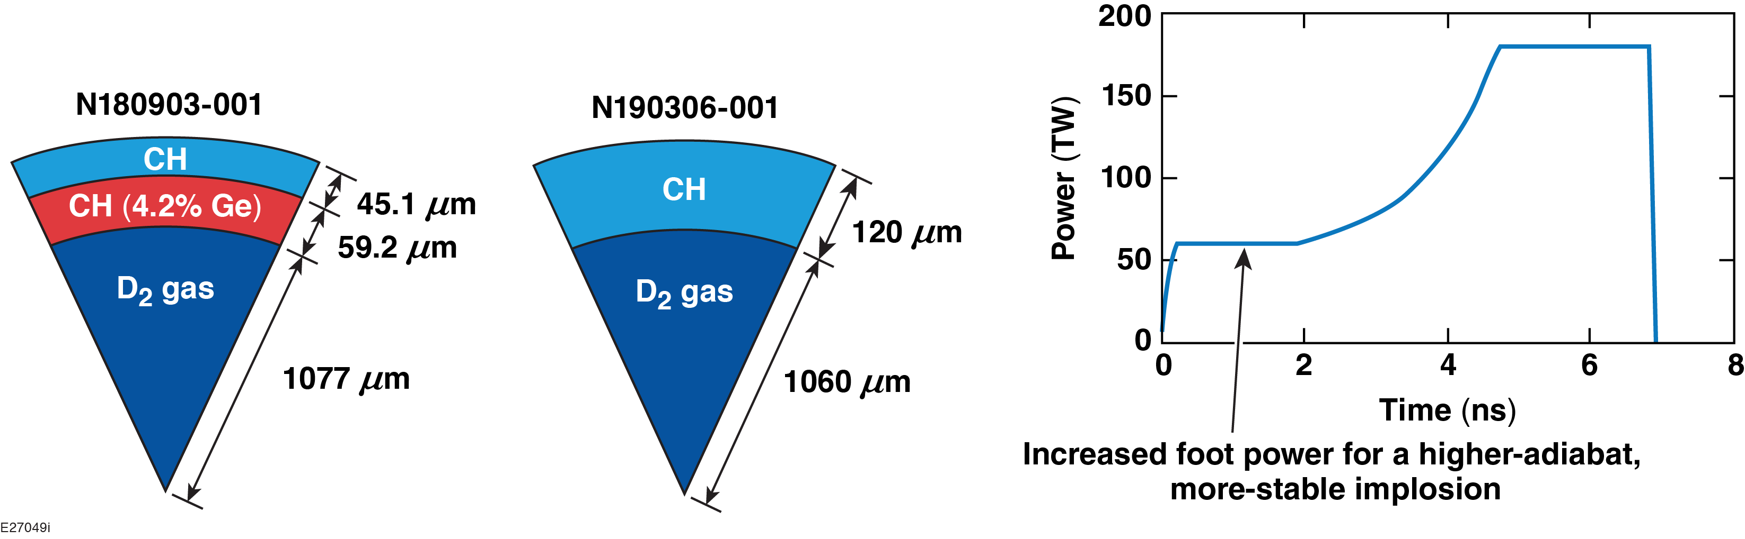
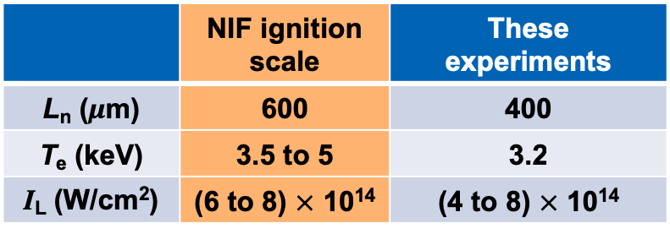
The experiments use thicker shells and higher-adiabat implosions than in the standard PDD design* to reduce possible hydro instabilities
Simulated plasma conditions at n_{c}/4
 | NIF ignition scale | These experiments
L_{n} (μm) | 600 | 400
T_{e} (keV) | 3.5 to 5 | 3.2
I_{L} (W/cm²) | (6 to 8) $×$ 10¹⁴ | (4 to 8) $×$ 10¹⁴

Slide 8
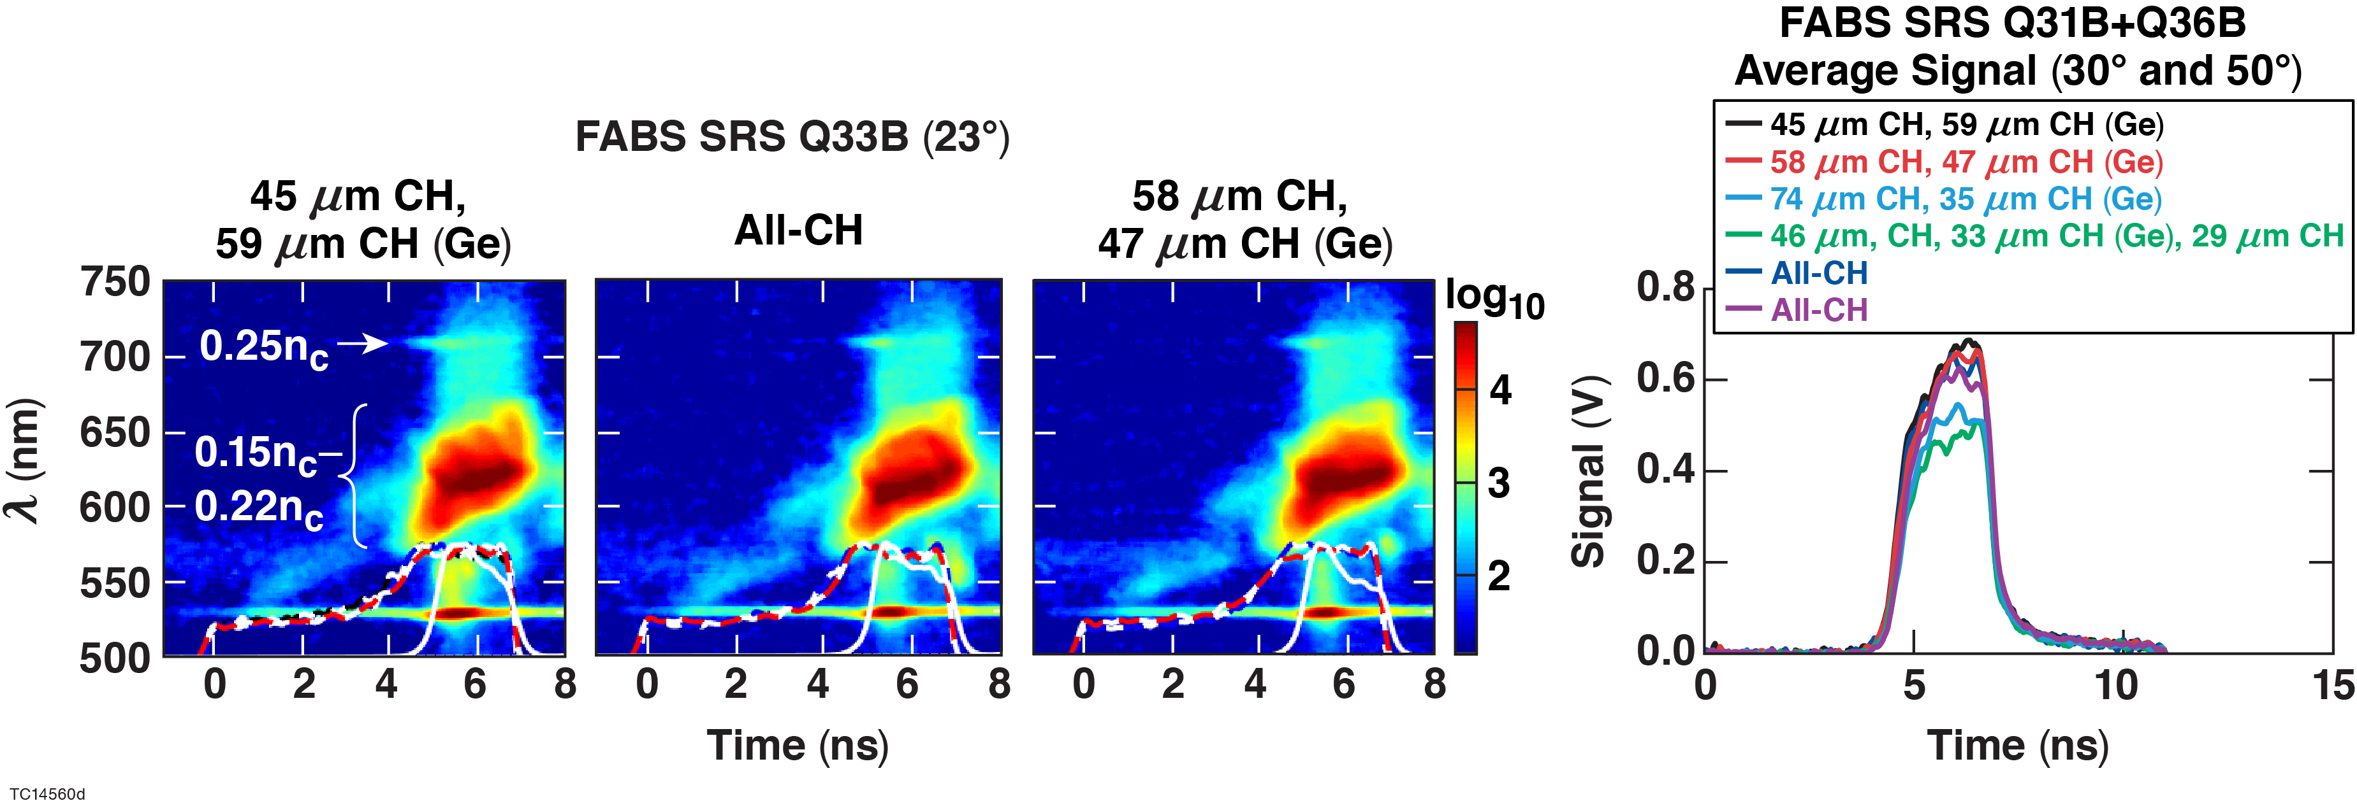

Time-resolved scattered-light spectra indicate that LPI is similar between the all-CH and Ge-doped payload implosions
LPI is dominated by SRS at n_{c}/4 and at lower densities
Up to ~25% variation in SRS is observed in some shots, associated with power variation in the nearest beam quads
Similar LPI $→$ similar hot-electron source

Slide 9
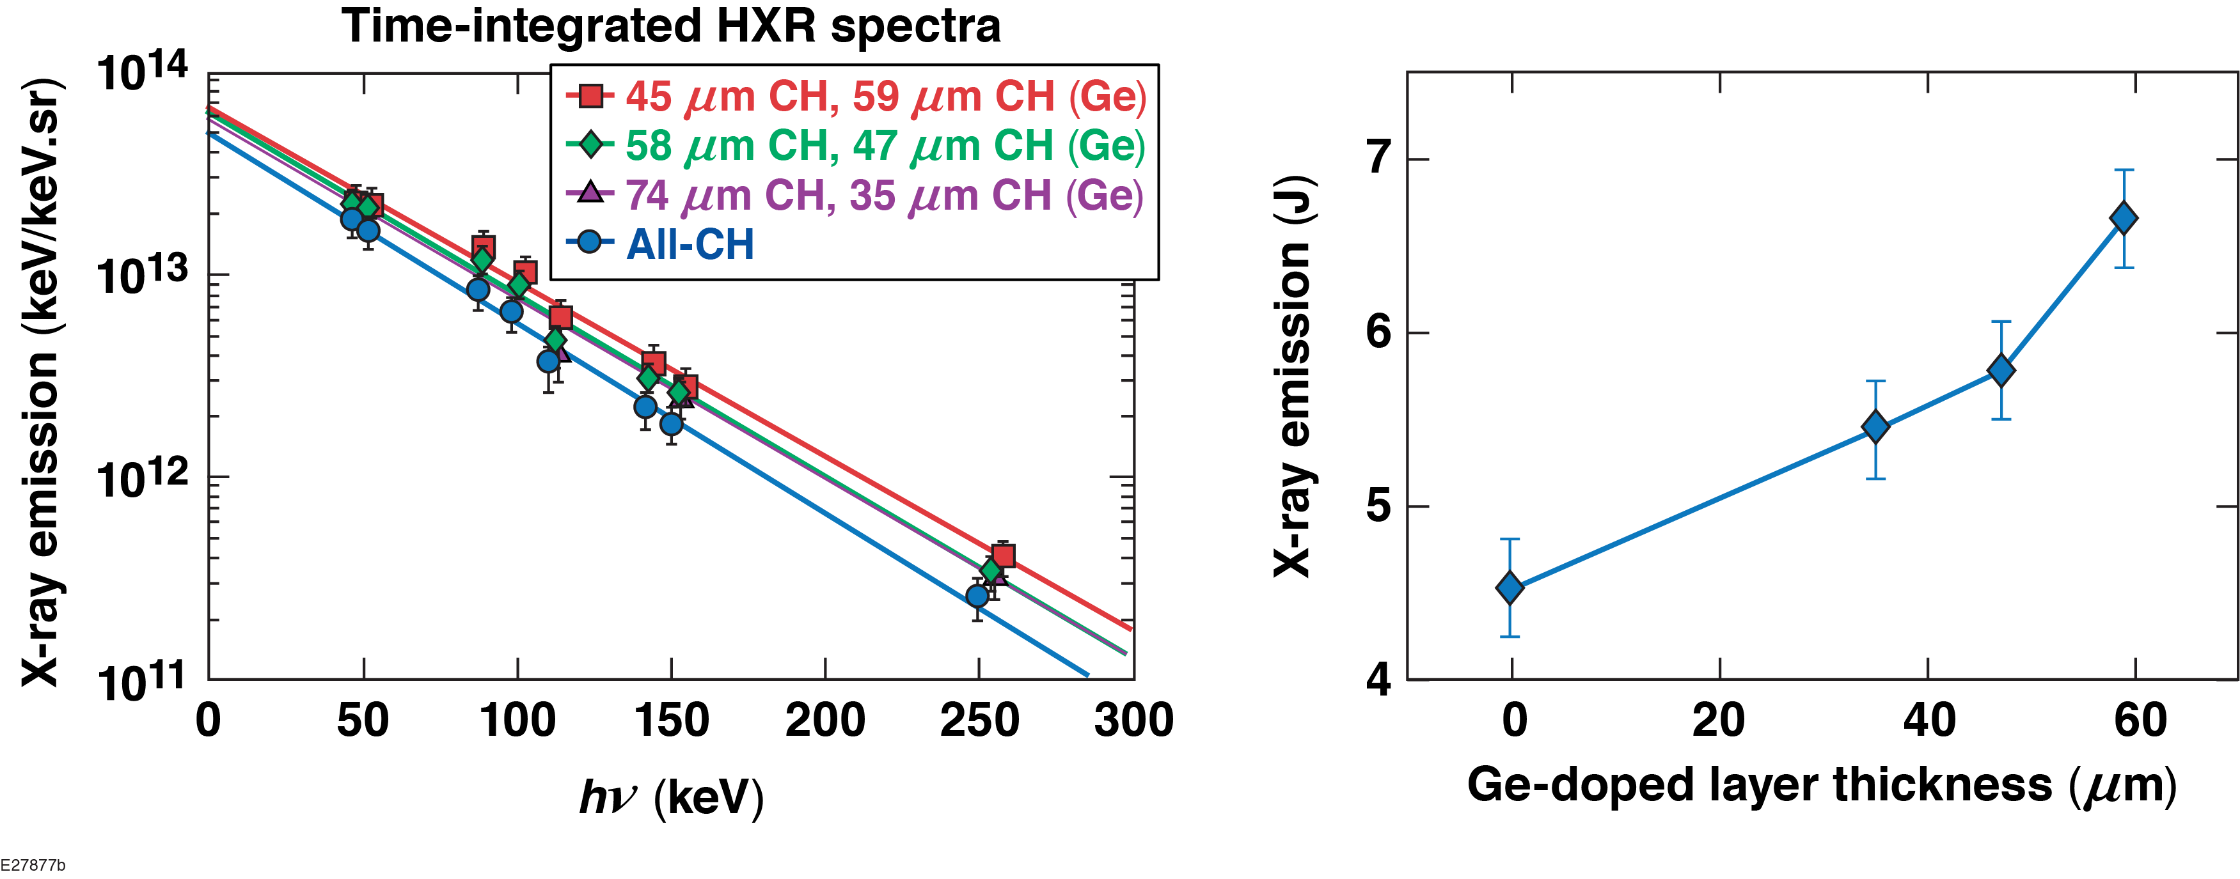
The hard x-ray measurement recorded with the FFLEX* diagnostic shows enhanced HXR emission with the Ge dopant
T_{HXR} = T_{hot} ≈ 50 keV

Slide 10
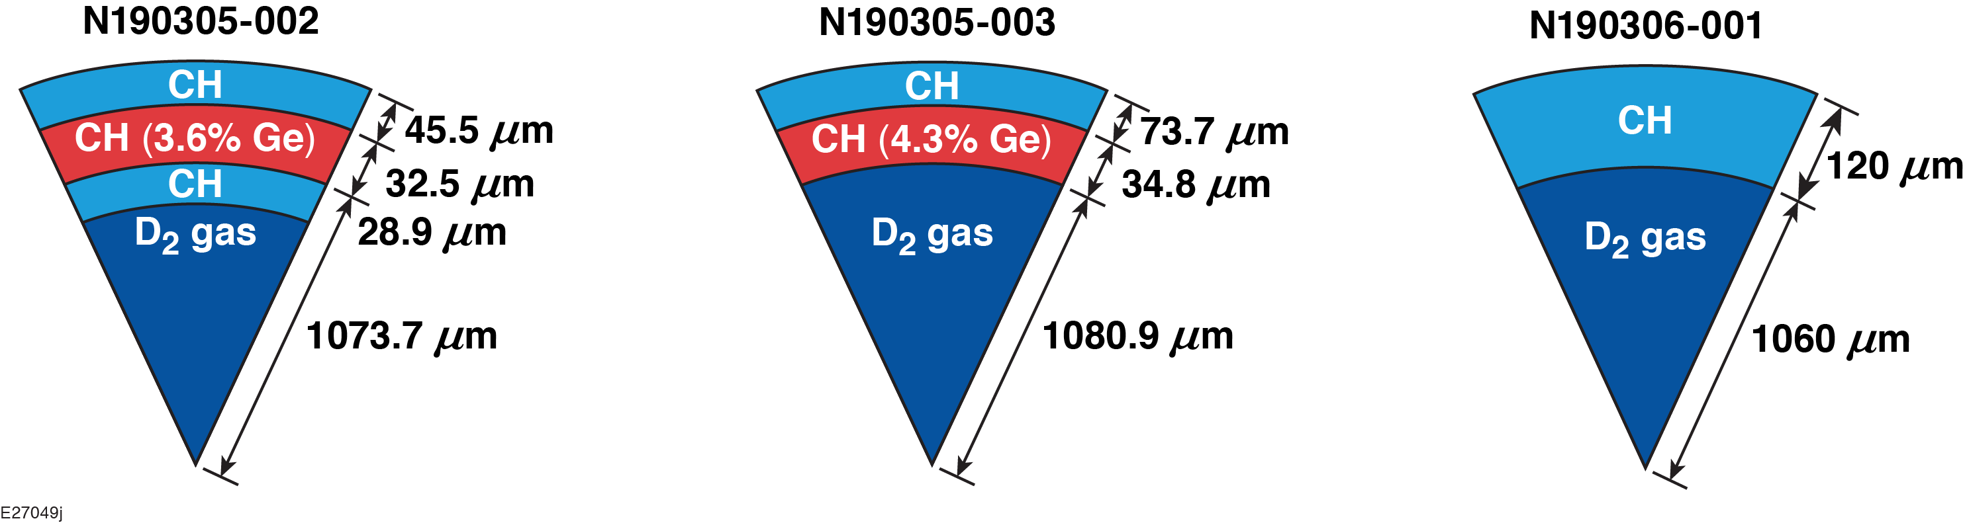
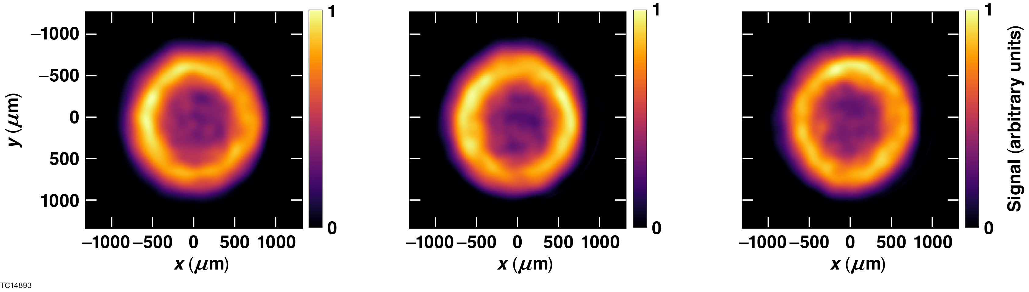
Time-integrated penumbral images* show hard x-ray variation with polar angle

Slide 11
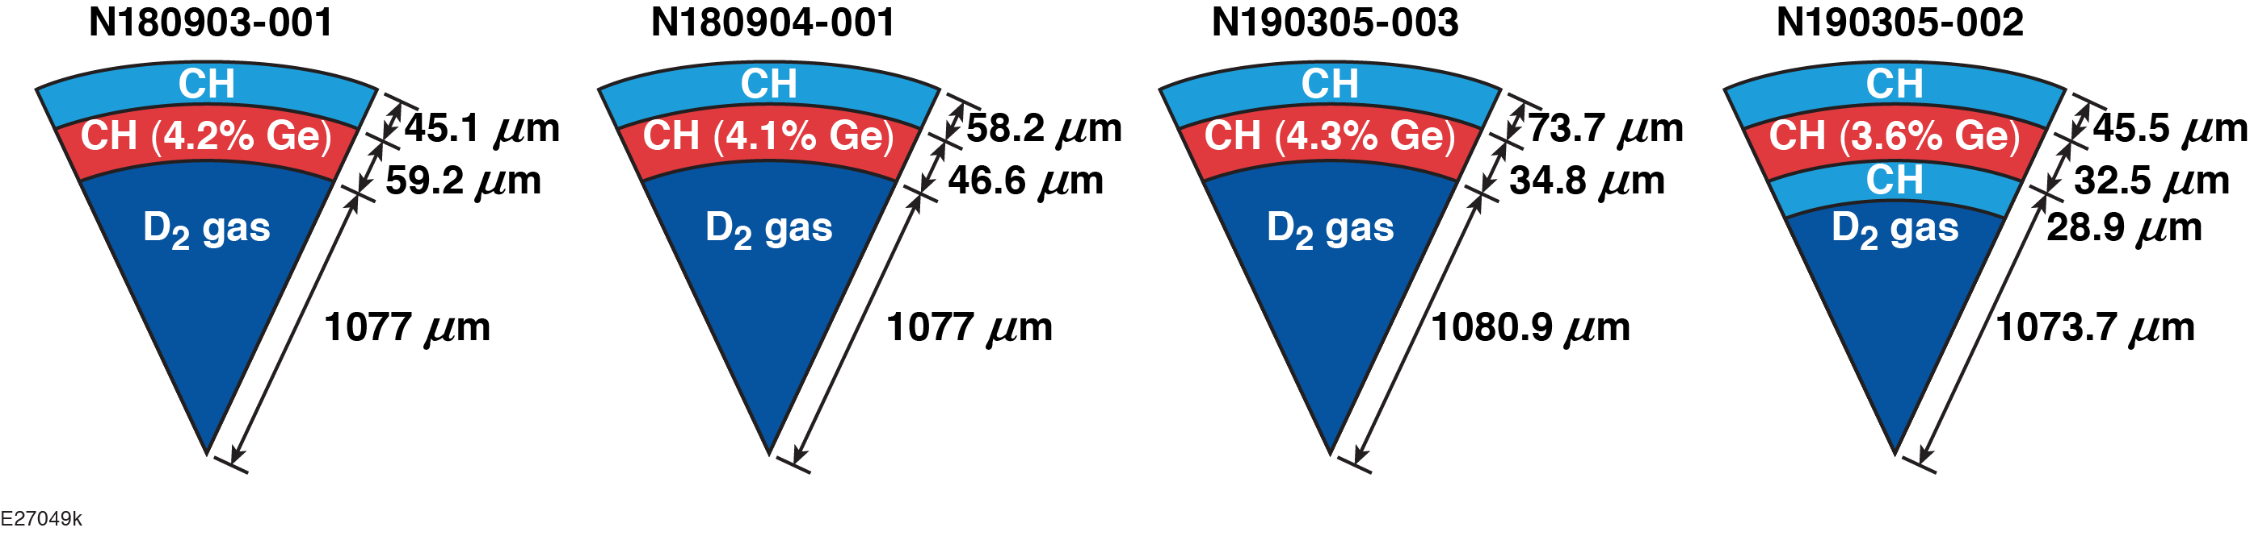
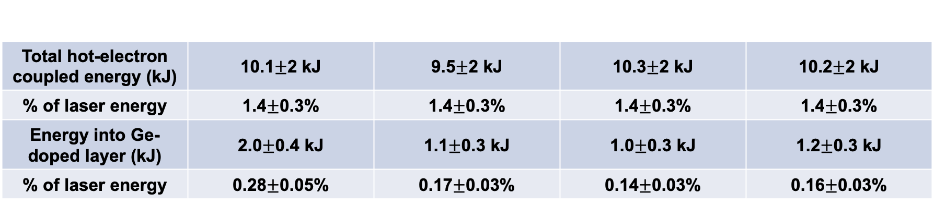
The energy deposition in different parts of the imploding shell has been found
Total hot-electron coupled energy (kJ) | 10.1$±$2 kJ | 9.5$±$2 kJ | 10.3$±$2 kJ | 10.2$±$2 kJ
% of laser energy | 1.4$±$0.3% | 1.4$±$0.3% | 1.4$±$0.3% | 1.4$±$0.3%
Energy into Ge-doped layer (kJ) | 2.0$±$0.4 kJ | 1.1$±$0.3 kJ | 1.0$±$0.3 kJ | 1.2$±$0.3 kJ
% of laser energy | 0.28$±$0.05% | 0.17$±$0.03% | 0.14$±$0.03% | 0.16$±$0.03%
Targets show consistent total hot-electron production

Slide 12
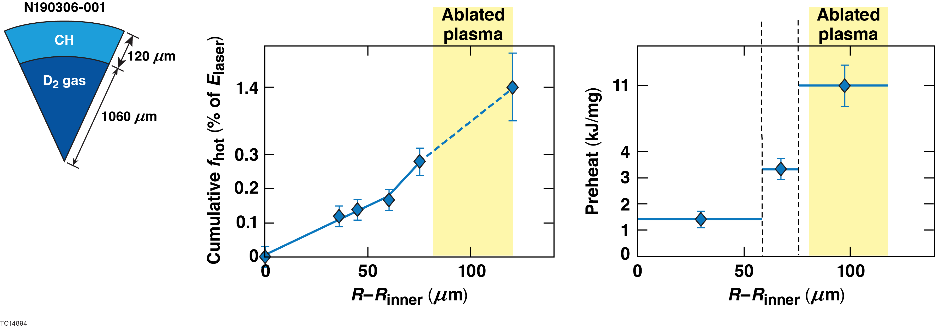
The energy deposition profile in the imploding shell has been inferred
About a quarter of total hot-electron energy coupled to the implosion is coupled to the unablated shell, indicating a wide angular divergence of hot electrons

Slide 13
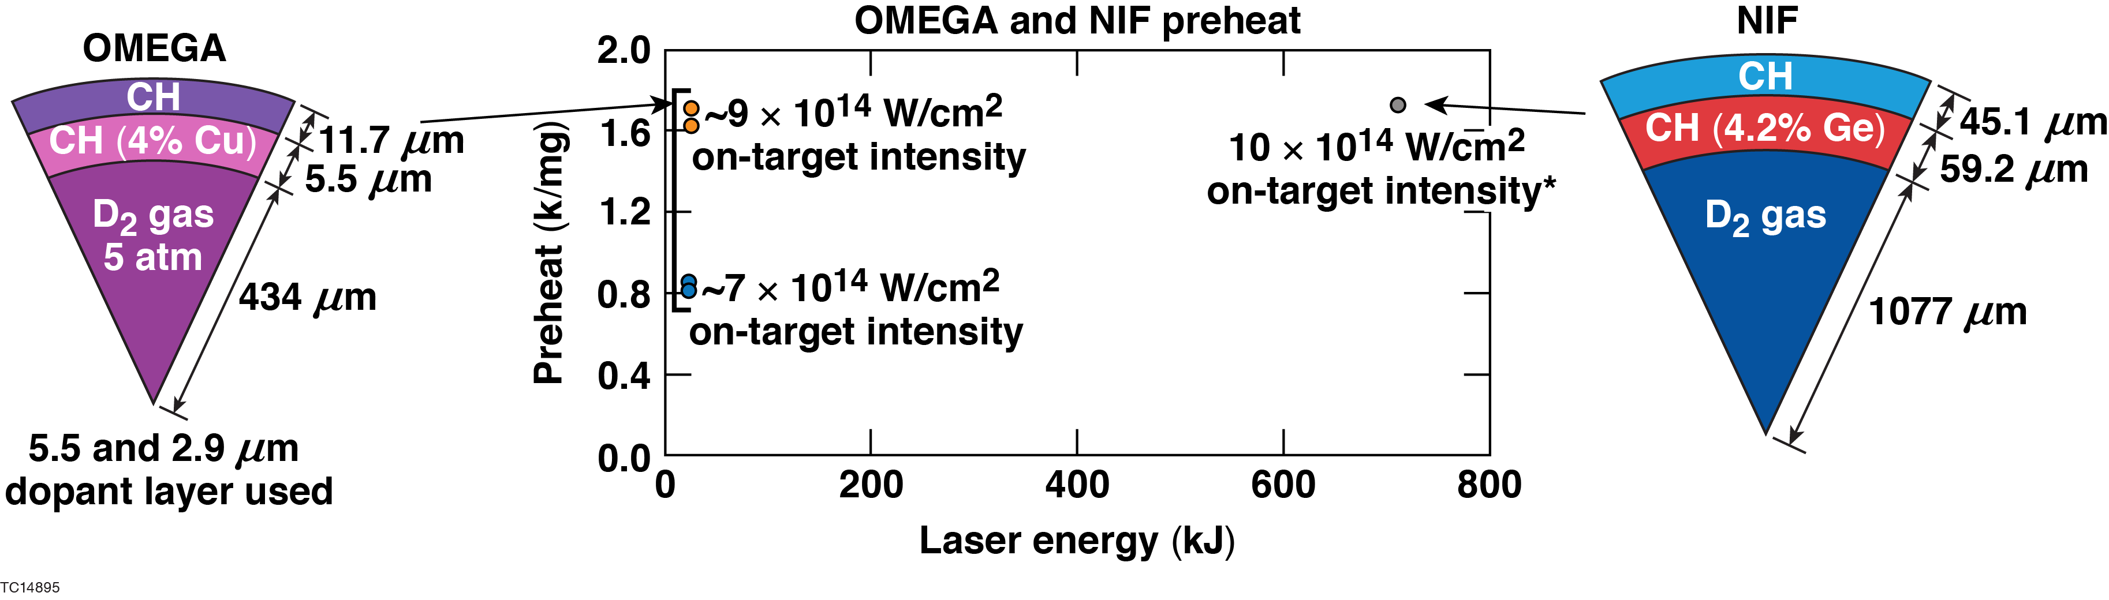
OMEGA and NIF experiments show roughly similar preheat per mass, even though implosion conditions are different (not hydro-equivalent)
The difference in intensity, and doped/undoped layer thickness ratio complicates a direct comparison; OMEGA experiments hydro-equivalent to the NIF design are proposed for FY20.

Slide 14
Hot-electron preheat and energy deposition in the unablated shell have been measured in polar direct-drive (PDD) implosions on the NIF
Hot-electron transport in NIF PDD implosions has been studied by comparing hard x-ray (HXR) production in all-plastic implosions with multilayered implosions
The goal is to diagnose the hot-electron deposition profile in the imploding shell
Measurements indicate that 0.28$±$0.05% of laser energy is deposited in the unablated shell; 0.1$±$0.04% is deposited in the outer 20% portion and 0.18$±$0.03% is deposited in the inner 80% of the imploding shell
Hot-electron preheat mitigation using mid-Z layers and laser frequency detuning/bandwidth strategies are being explored.*

