Slide 1
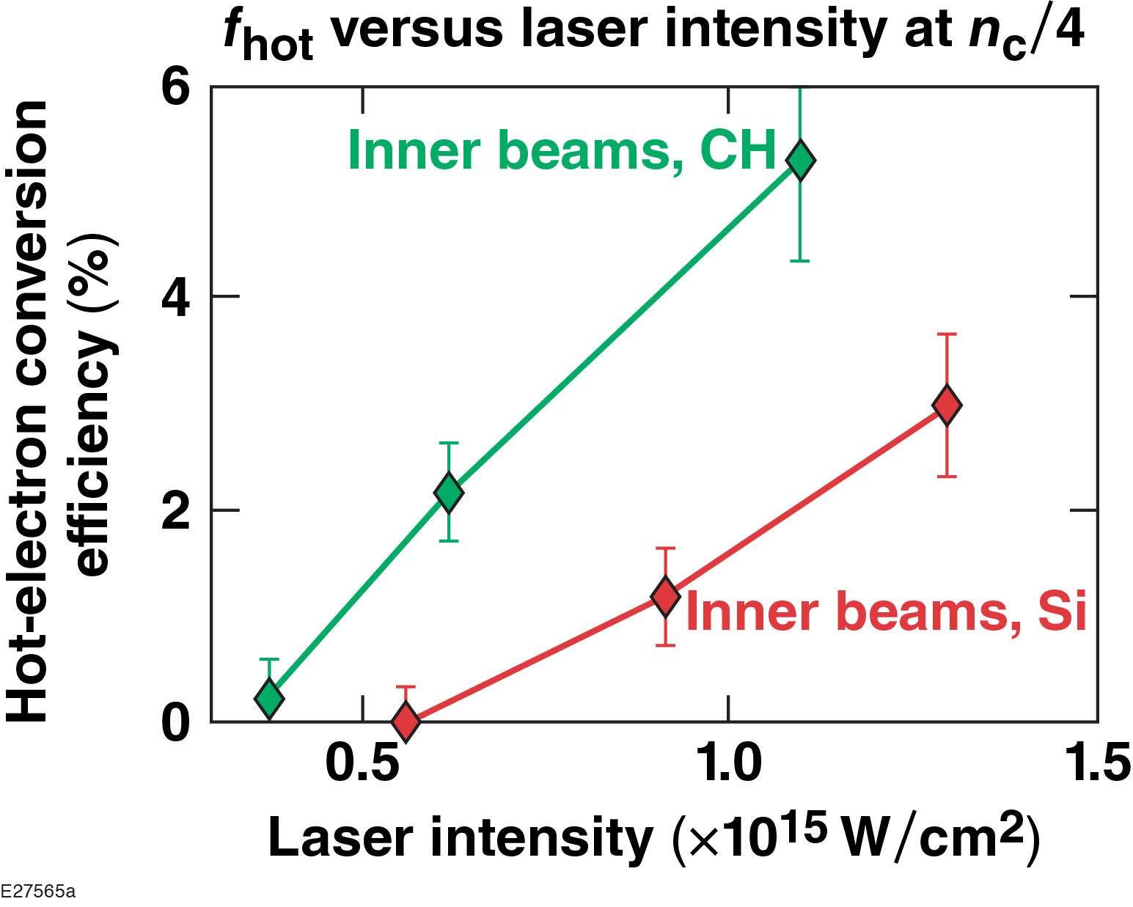
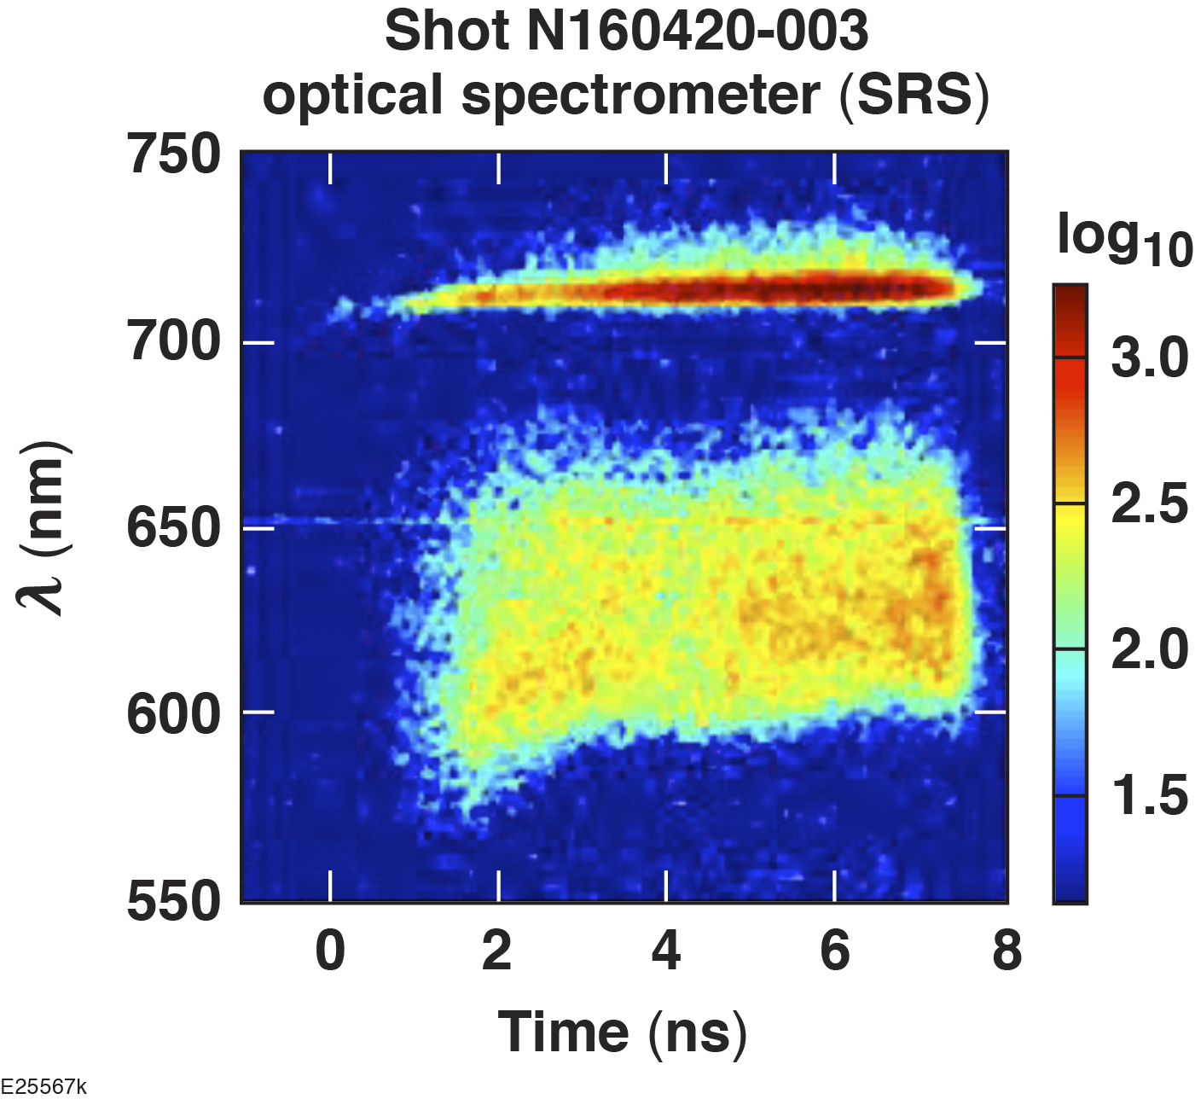
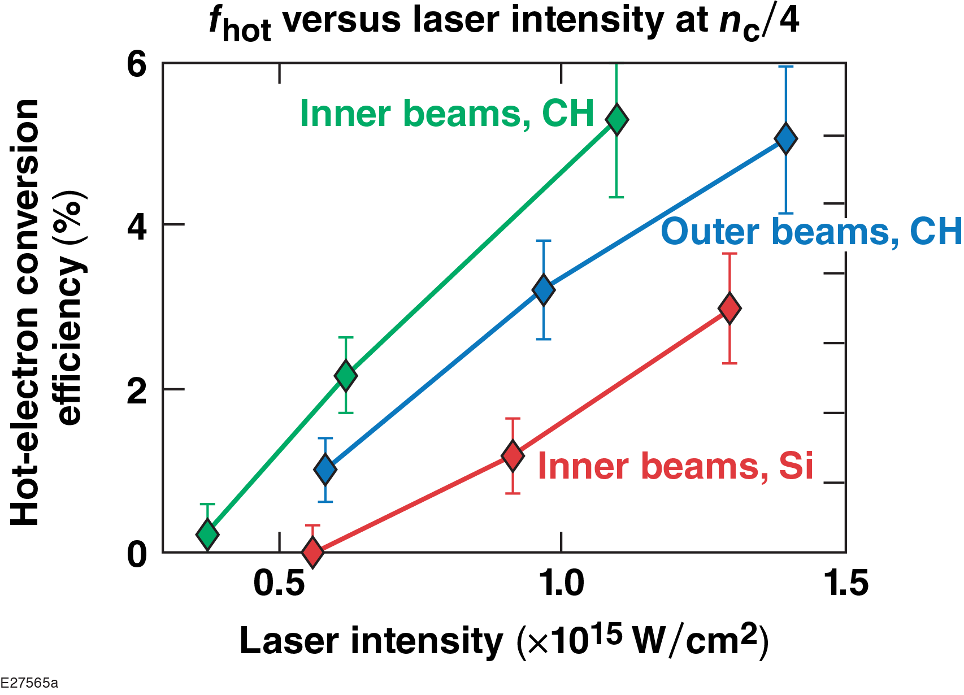
Planar Laser–Plasma Interaction Experiments at Direct‑Drive
Ignition-Relevant Scale Lengths at the National Ignition Facility
Tolerable preheat
in ignition designs
M. J. Rosenberg
University of Rochester
Laboratory for Laser Energetics
49th Anomalous Absorption Conference
Telluride, CO
9–14 June 2019

Slide 2
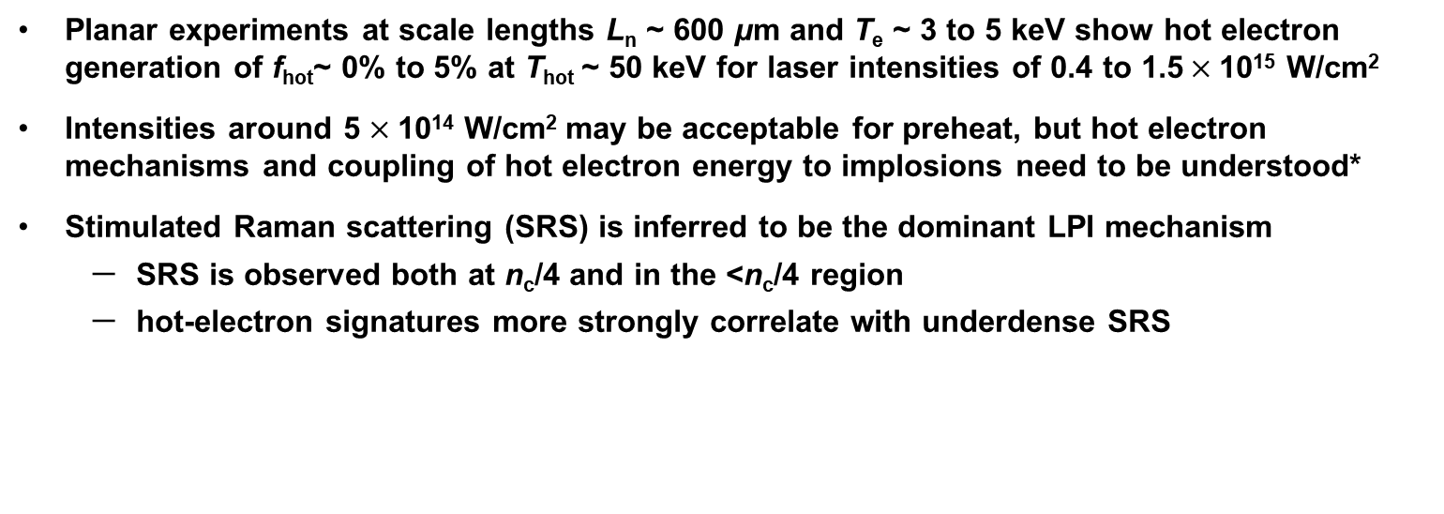
Planar experiments at the NIF have studied LPI mechanisms responsible for hot-electron generation at direct-drive ignition-relevant coronal conditions
Planar experiments at scale lengths L_{n} ~ 600 μm and T_{e} ~ 3 to 5 keV show hot electron generation of f_{hot}~ 0% to 5% at T_{hot} ~ 50 keV for laser intensities of 0.4 to 1.5$×$10¹⁵ W/cm²
Intensities around 5 $×$10¹⁴ W/cm² may be acceptable for preheat, but hot electron mechanisms and coupling of hot electron energy to implosions need to be understood*
Stimulated Raman scattering (SRS) is inferred to be the dominant LPI mechanism
  SRS is observed both at n_{c}/4 and in the <n_{c}/4 region
  hot-electron signatures more strongly correlate with underdense SRS
Ongoing work is focused on identifying the SRS mechanism responsible for hot electron generation and interpreting 3ω/2 measurements of SRS and TPD waves at n_{c}/4

Slide 3
A. A. Solodov, W. Seka, R. K. Follett, S. P. Regan, C. Ren, R. Epstein, A. R. Christopherson, R. Betti, A. V. Maximov, T. J. B. Collins, V. N. Goncharov, R. W. Short, D. H. Froula, and P. B. Radha
University of Rochester
Laboratory for Laser Energetics
J. F. Myatt
University of Alberta
Department of Electrical and Computer Engineering
P. Michel, M. Hohenberger, L. Masse, G. Swadling, J. S. Ross, T. Chapman, and J. D. Moody
Lawrence Livermore National Laboratory
J. W. Bates and A. J. Schmitt
Naval Research Laboratory

Slide 4
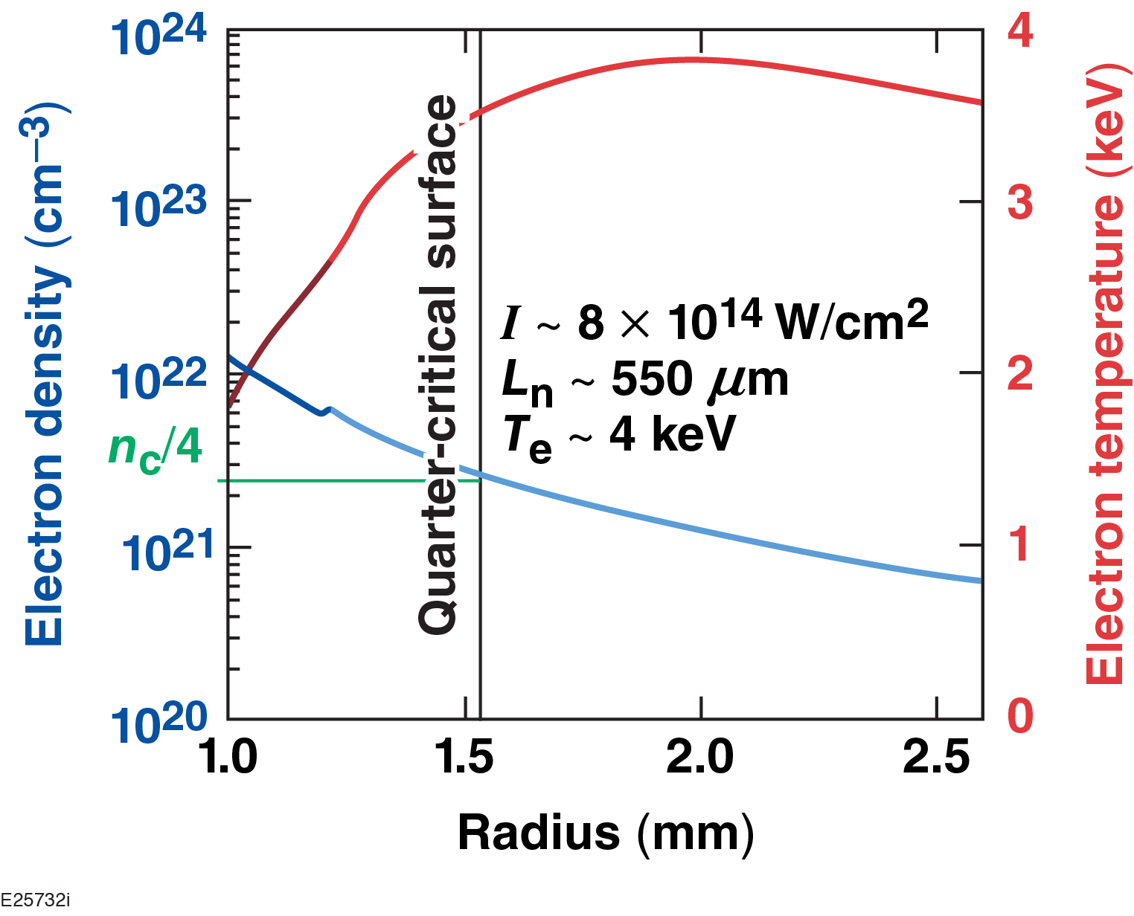
Direct-drive–ignition designs predict long-density scale lengths and high electron temperatures at which LPI may generate hot-electron preheat
Motivation
1-D simulated plasma conditions for an igniting direct-drive design
Experiments must be performed at these conditions to understand LPI at the NIF/ignition scale.

Slide 5
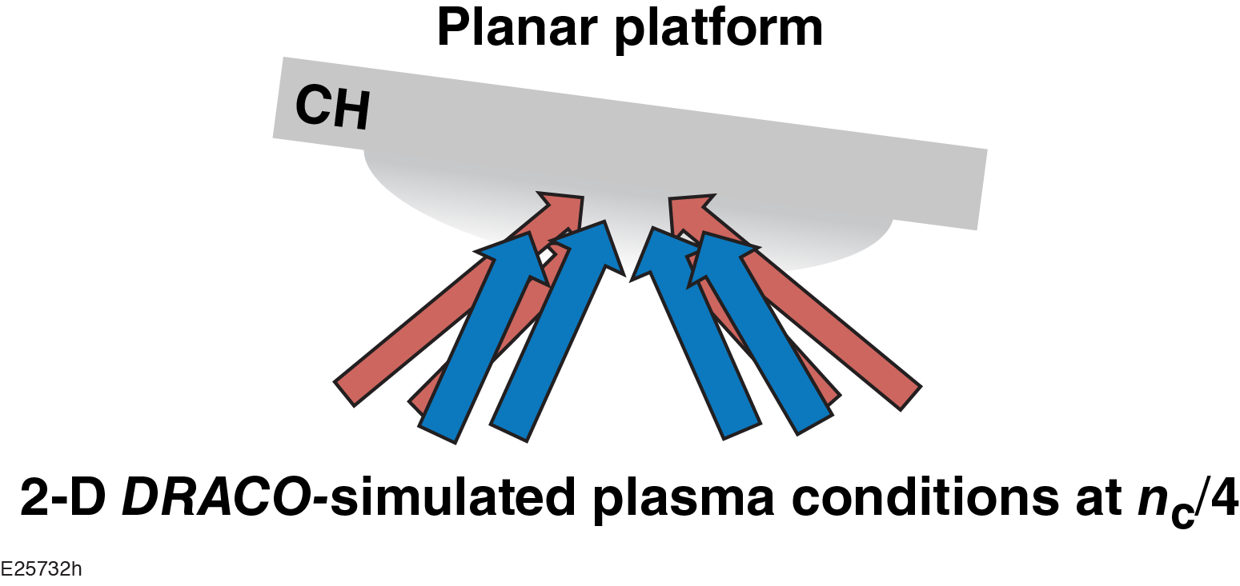
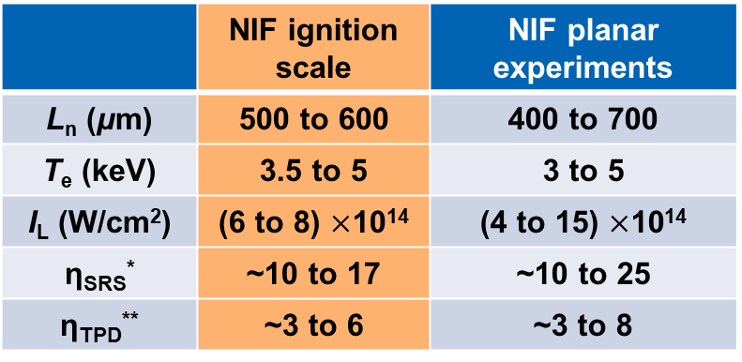
Planar experiments on the NIF were designed to achieve plasma conditions comparable to direct-drive–ignition designs
Motivation
1-D simulated plasma conditions for an igniting direct-drive design
 | NIF ignition scale | NIF planar experiments
L_{n} (μm) | 500 to 600 | 400 to 700
T_{e} (keV) | 3.5 to 5 | 3 to 5
I_{L} (W/cm²) | (6 to 8) $×$10¹⁴ | (4 to 15) $×$10¹⁴
η_{SRS}* | ~10 to 17 | ~10 to 25
η_{TPD}** | ~3 to 6 | ~3 to 8
Experiments must be performed at these conditions to understand LPI at the NIF/ignition scale.

Slide 6
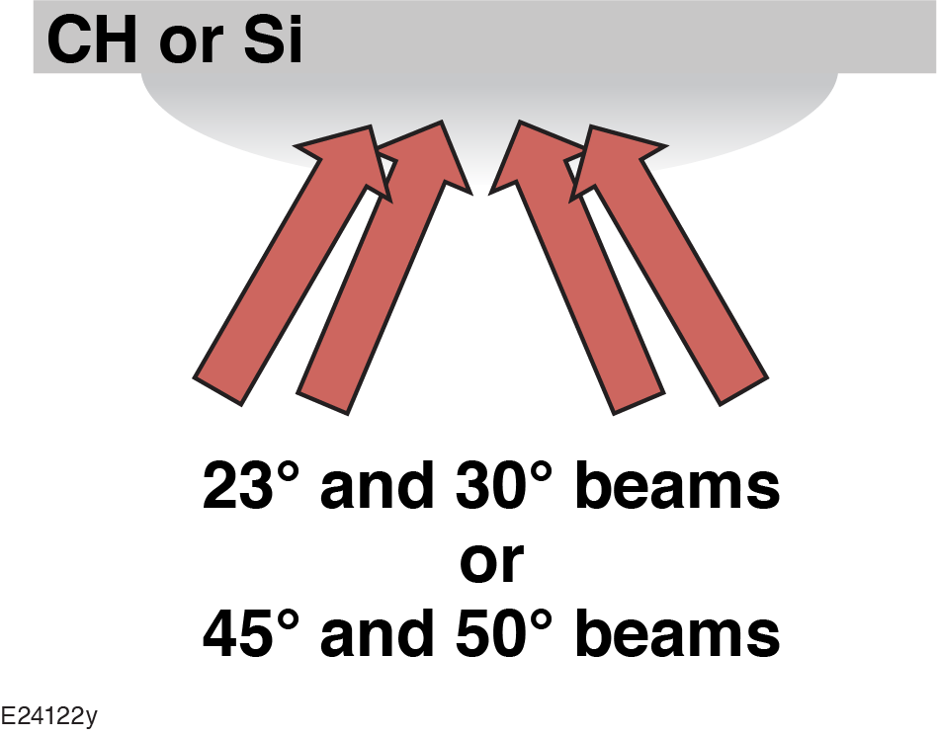
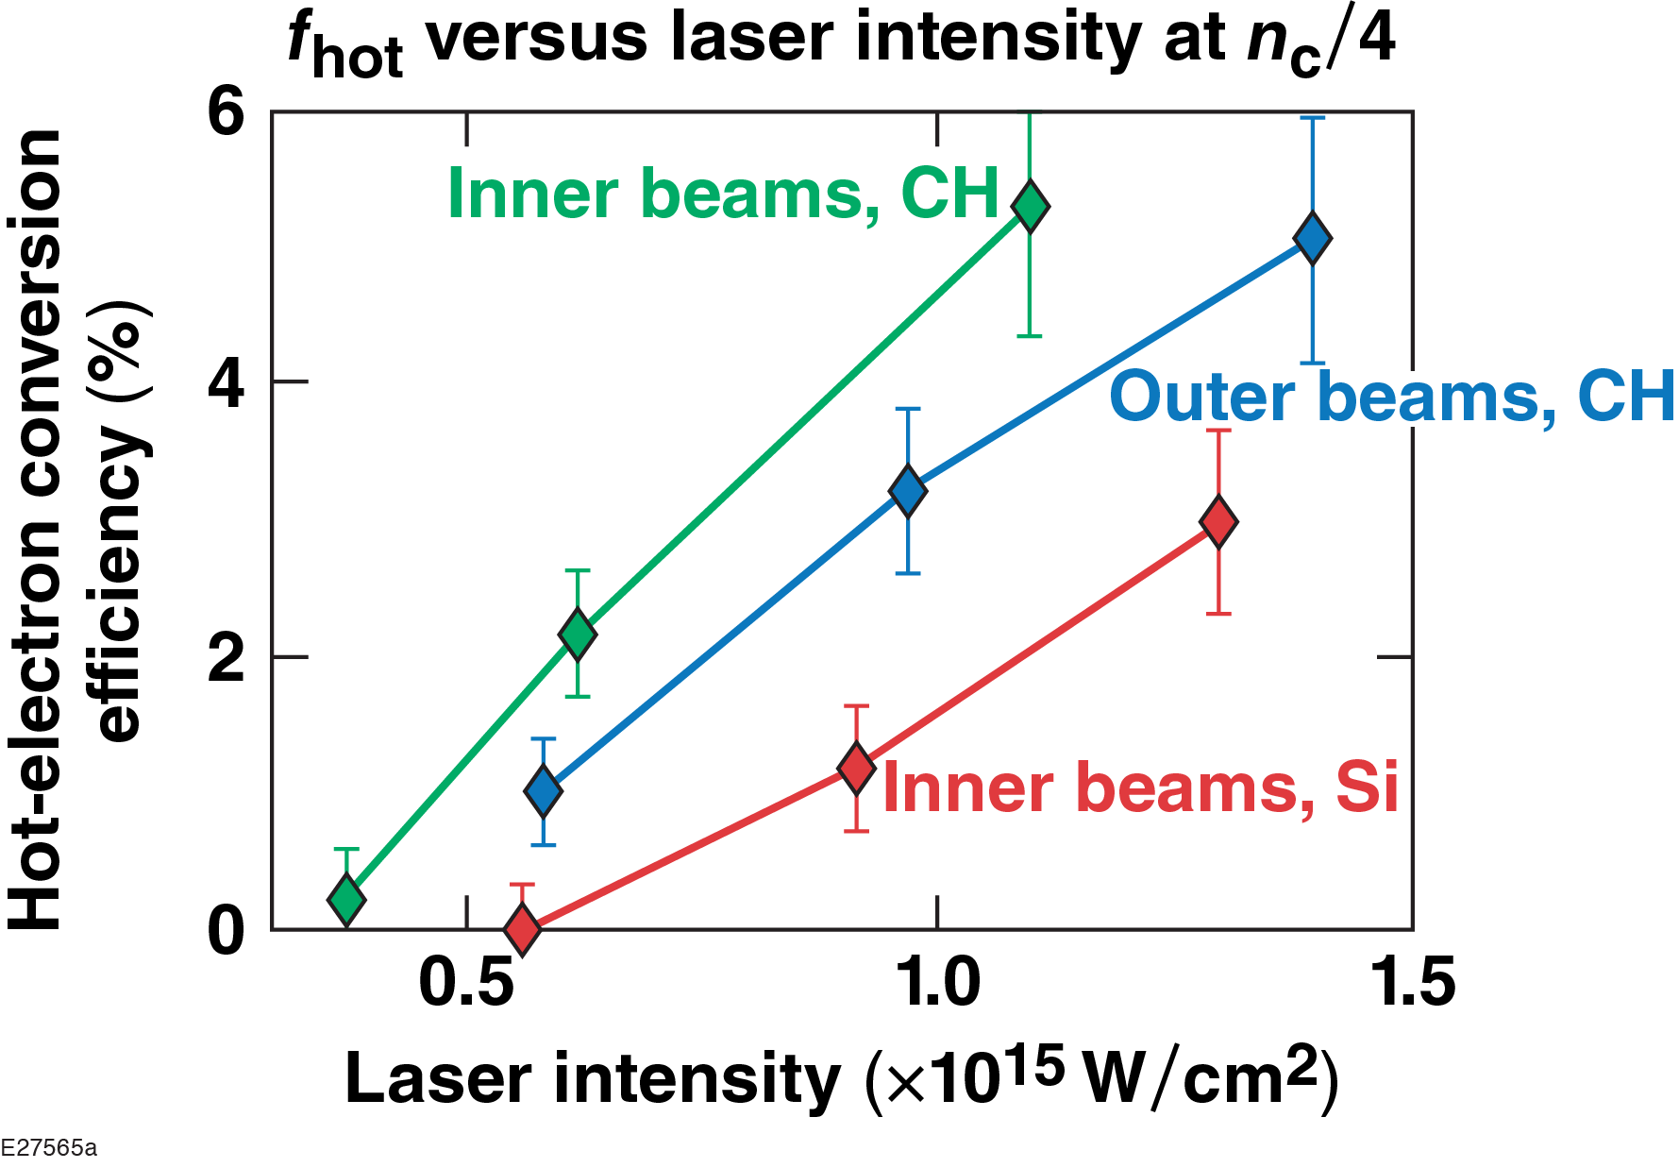
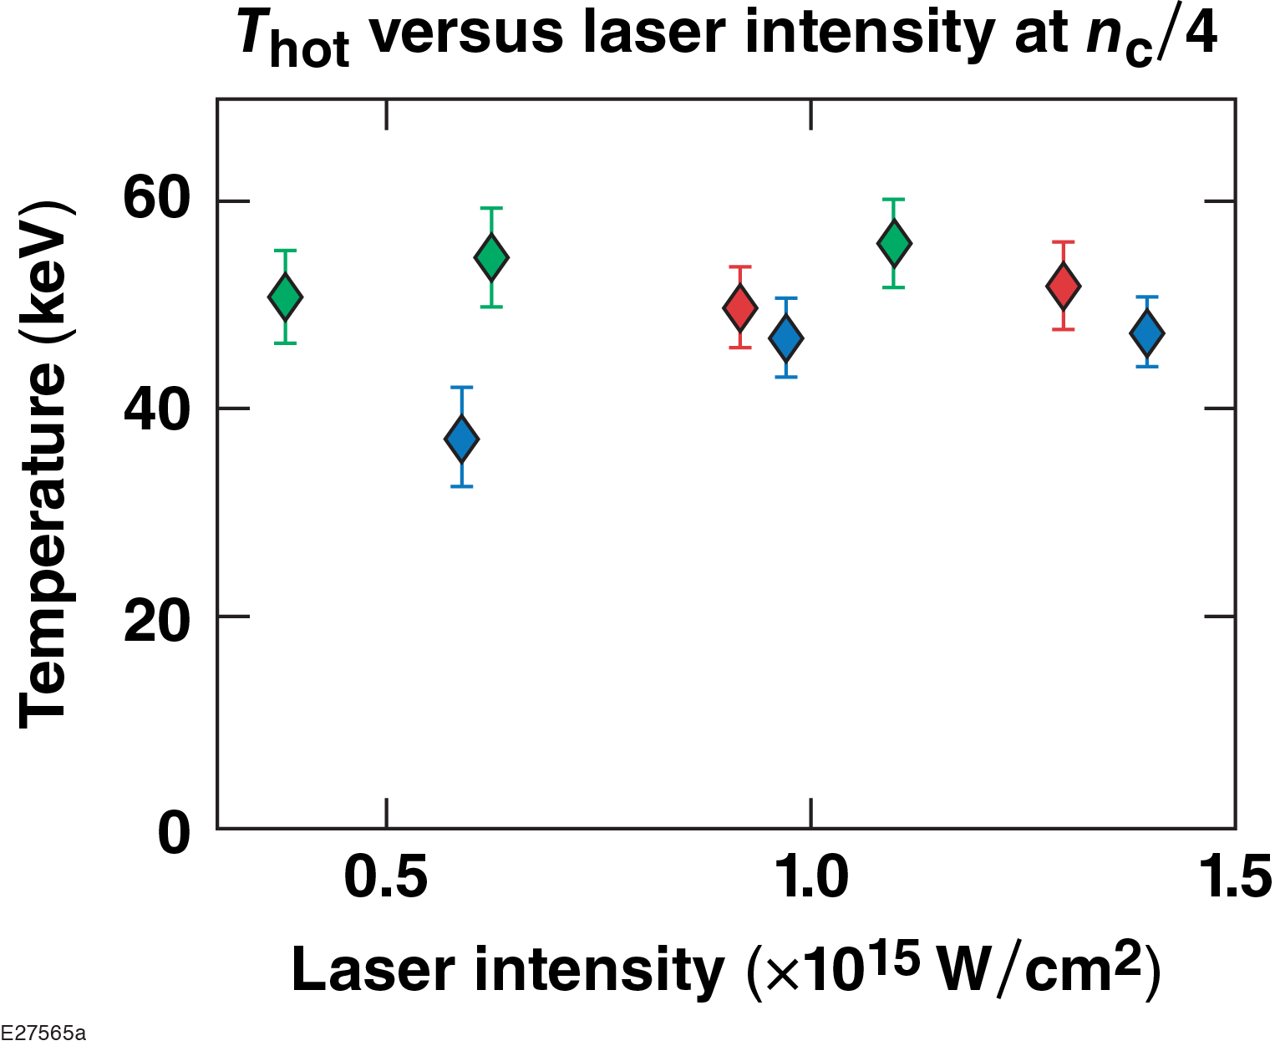
Hot-electron generation of f_{hot} up to 5% and T_{hot} of 40 to 60 keV has been inferred in planar CH and Si targets at intensities around 10¹⁵ W/cm²
Tolerable preheat in ignition designs (if angular divergence is large)
Intensity around 5$×$10¹⁴ W/cm² may be acceptable for preheat, but we need to understand: (1) LPI mechanisms (for mitigation), (2) how hot e– diverge or couple to an implosion.*

Slide 7
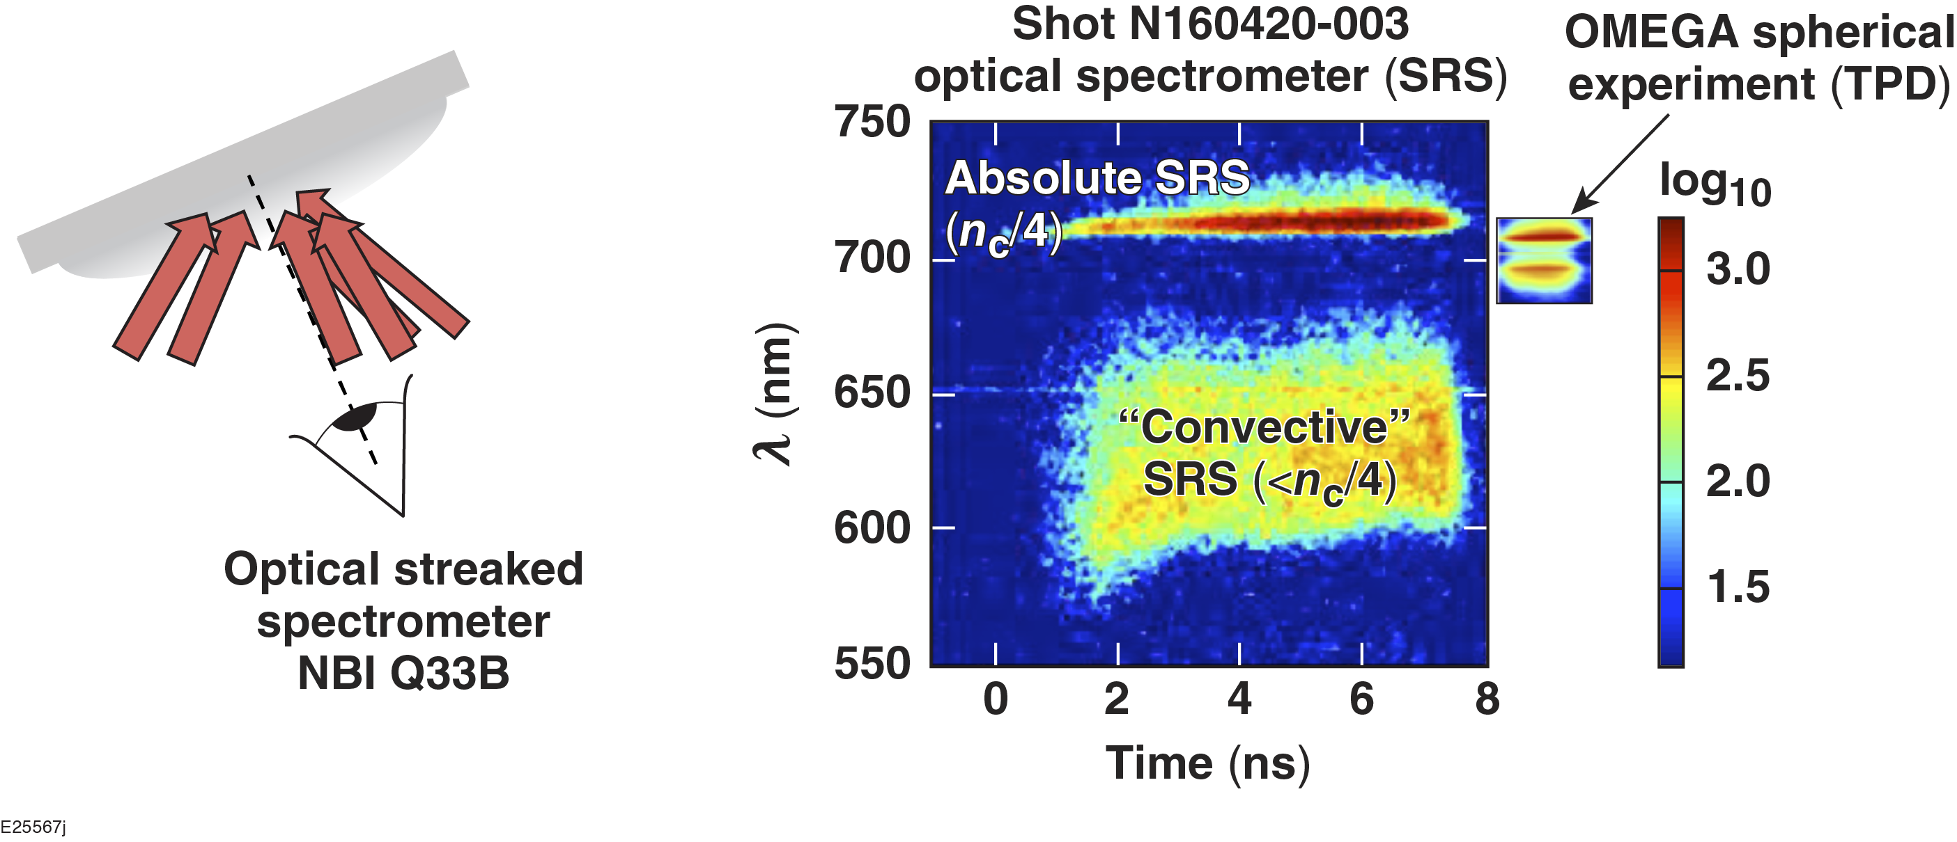
Optical data demonstrate different LPI physics on the NIF than on OMEGA:
SRS dominates the scattered-light spectrum (both at and below n_{c}/4)
NIF: L_{n} = 525 μm
T_{e} = 4.5 keV
OMEGA:* L_{n} = 150 μm
T_{e} = 2.8 keV
This data suggests SRS is the dominant hot-electron source, but does not rule out the presence of TPD
____________
M. Rosenberg et al. Phys. Rev. Lett. 120, 055001 (2018).

Slide 8
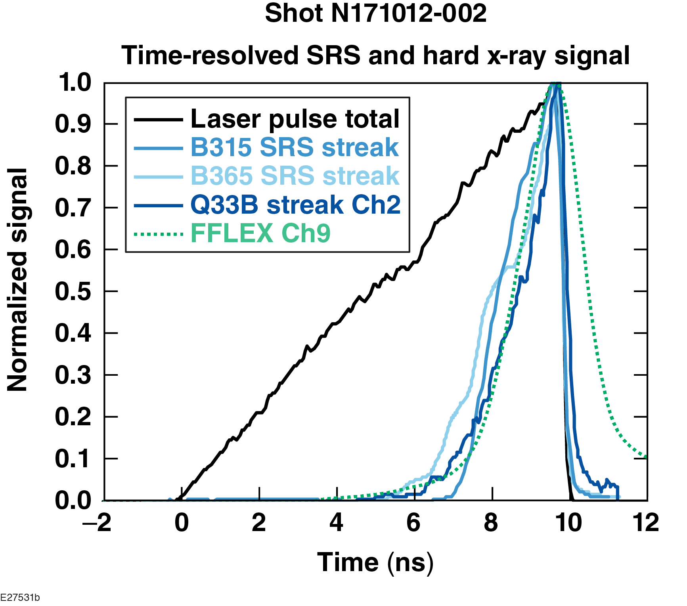
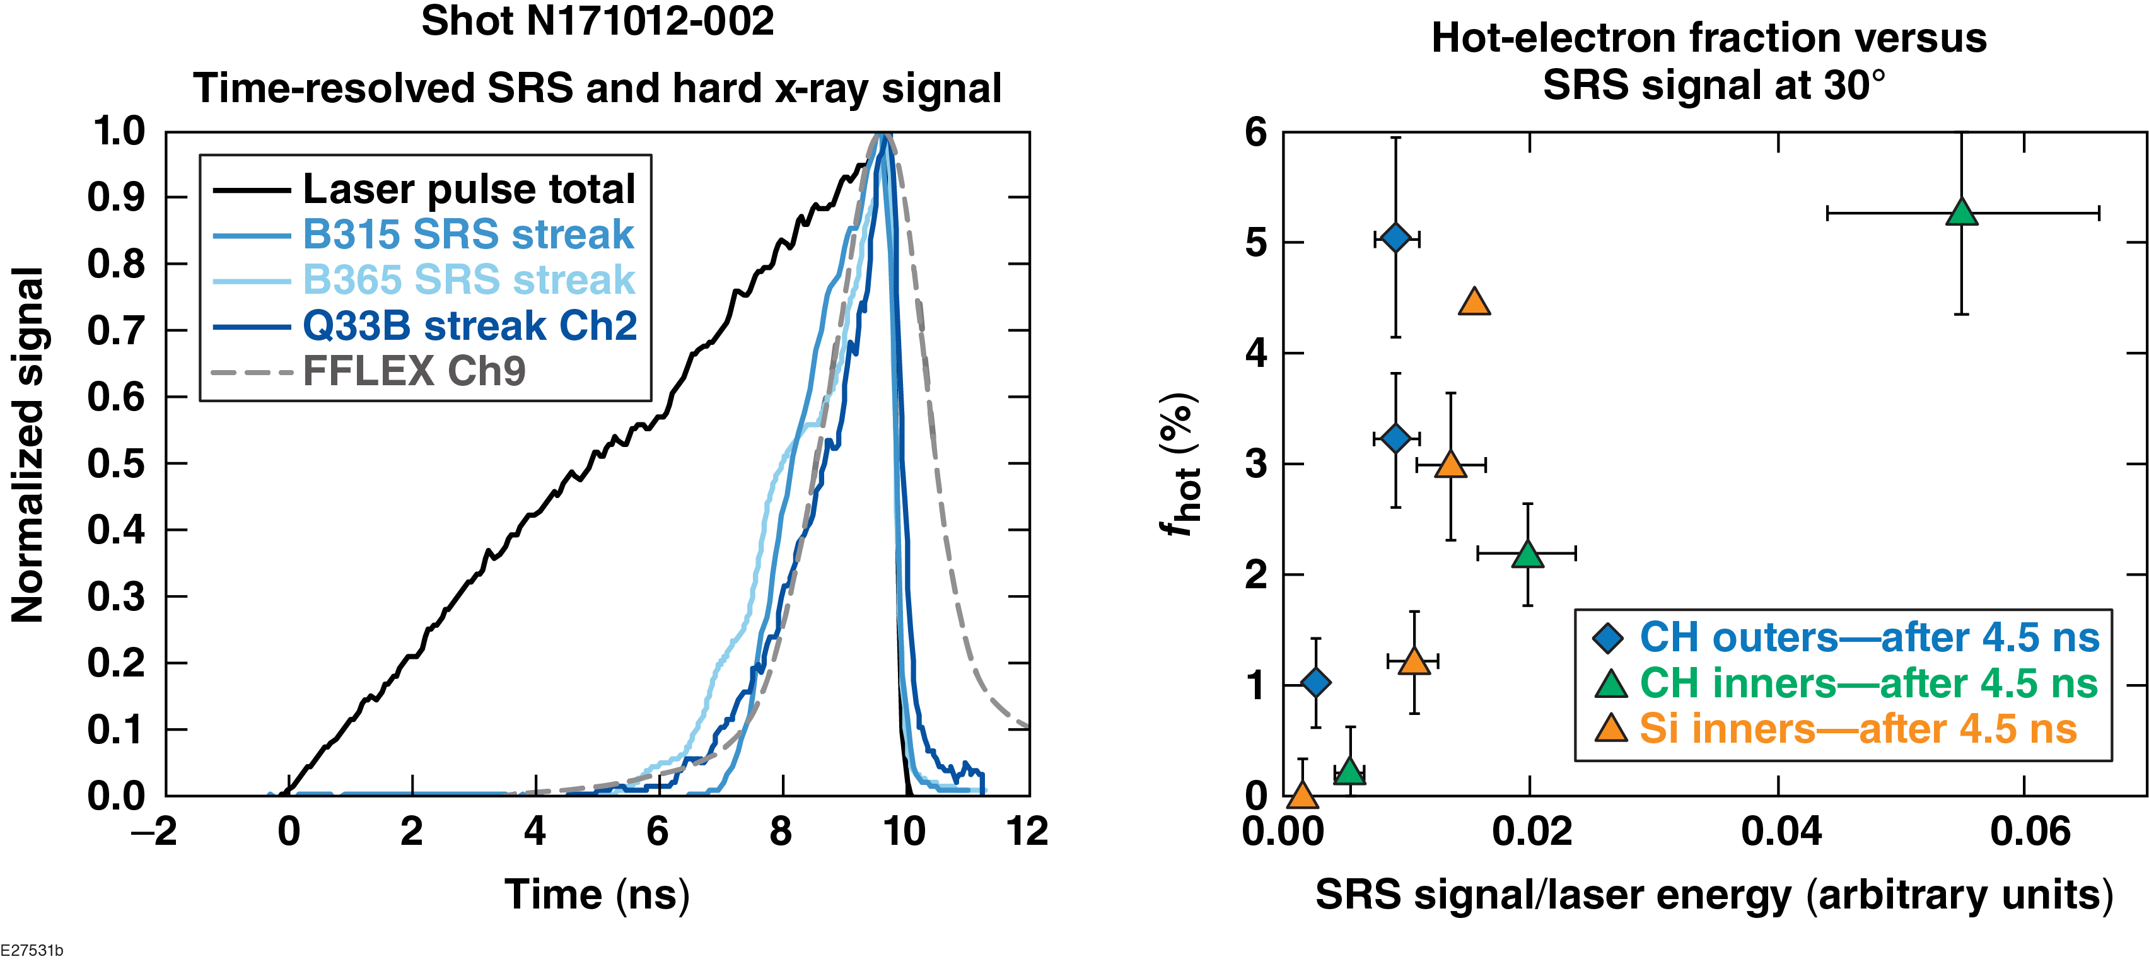
SRS observations correlate with hard x-ray measurements in both time and magnitude
SRS – 30°
SRS – 50°
SRS – 23°
HXR ~150 keV
CH outers
CH inners
Si inners

Slide 9
Various SRS mechanisms scale differently in ramp-pulse experiments: absolute n_{c}/4 SRS instability scales linearly with intensity; underdense SRS instability scales exponentially with intensity

Slide 10
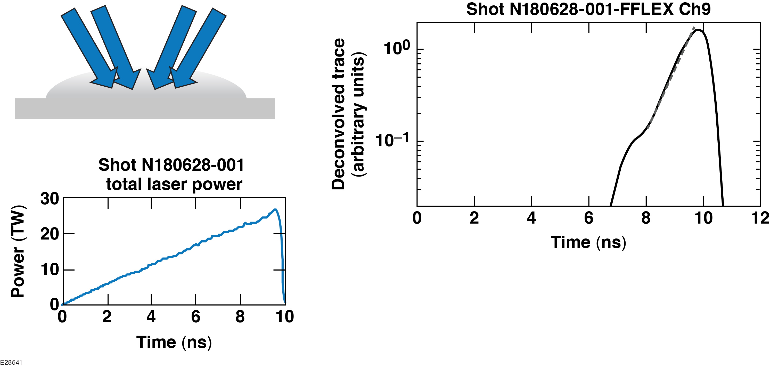
Hard x-ray (HXR) emission from hot electrons scales near-exponentially on ramp-pulse experiments
HXR scaling looks ~exponential over >1 decade and 2 ns
Exponential scaling suggests a connection between hot-electron generation and underdense SRS,
but more work is needed to identify definitively where in the density profile hot electrons are produced

Slide 11
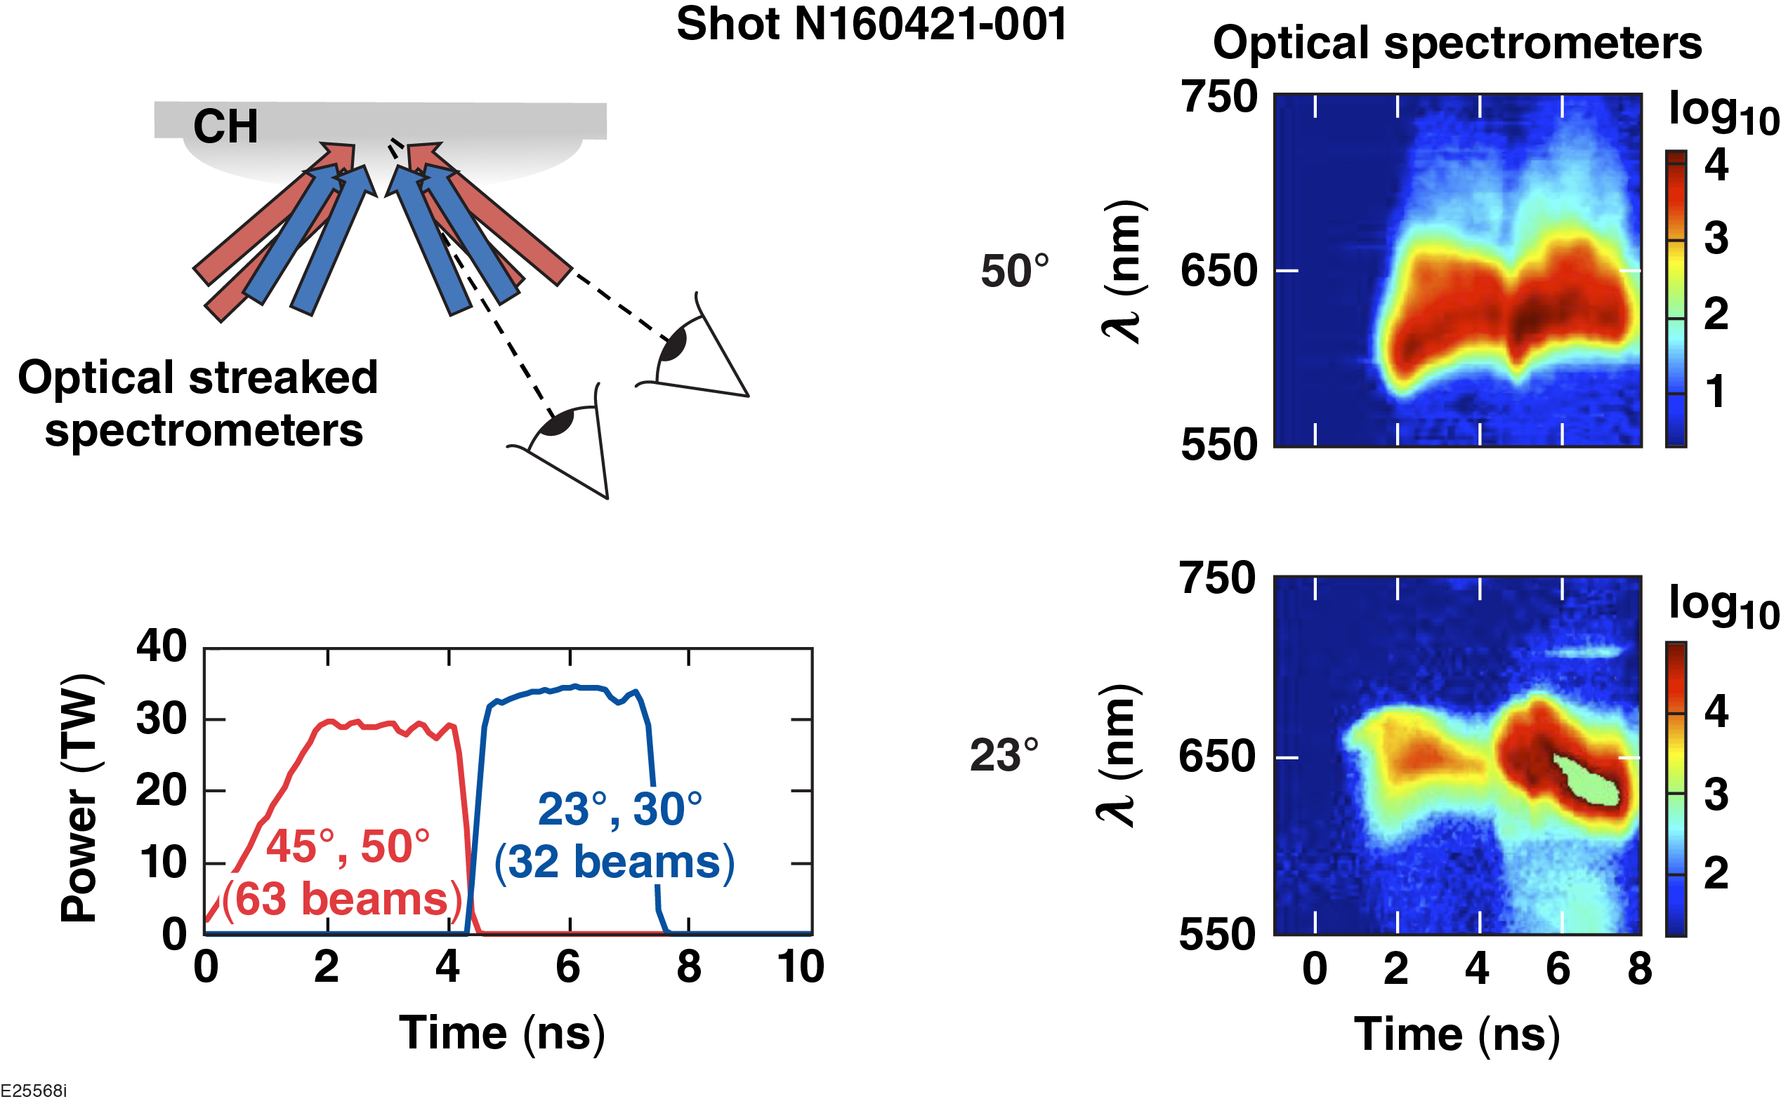
SRS sidescatter is observed and is thought to be a key underdense SRS mechanism
Observation at 50°
can only be sidescatter. Tangential SRS sidescatter theory* predicts scattered light wavelength independent of beam angle, as observed.

Slide 12
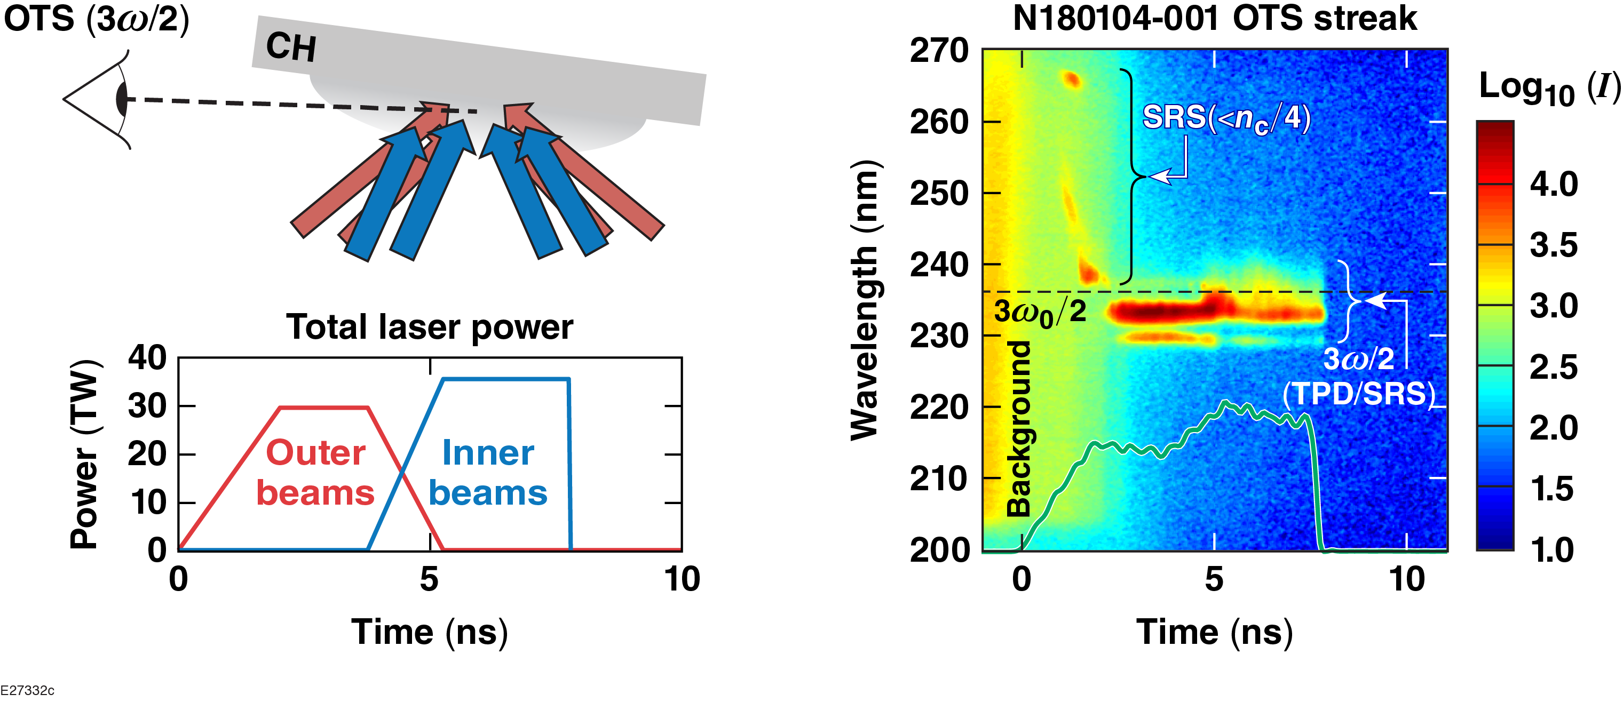
In addition to SRS measurements, recent experiments diagnosed Thomson-scattered light from plasma waves at and below n_{c}/4
Wave-matching conditions likely not satisfied for probing underdense SRS, but 3ω/2 feature contains information about plasma waves at n_{c}/4

Slide 13
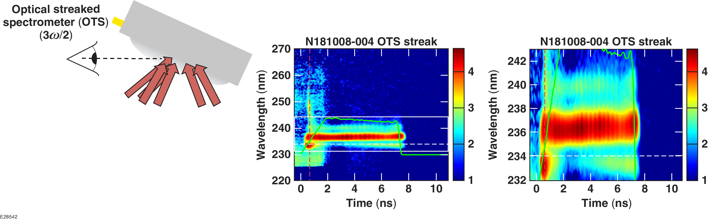
A complex 3ω/2 feature is observed, which is related to SRS and/or TPD near n_{c}/4
3ω/2 “triplet”
Next steps:
Experiments with toggled probe beams to determine the exact plasma waves (k_{p}) being probed
Use of modeling (LPSE, PIC, etc.) to understand 3ω/2 signatures

Slide 14
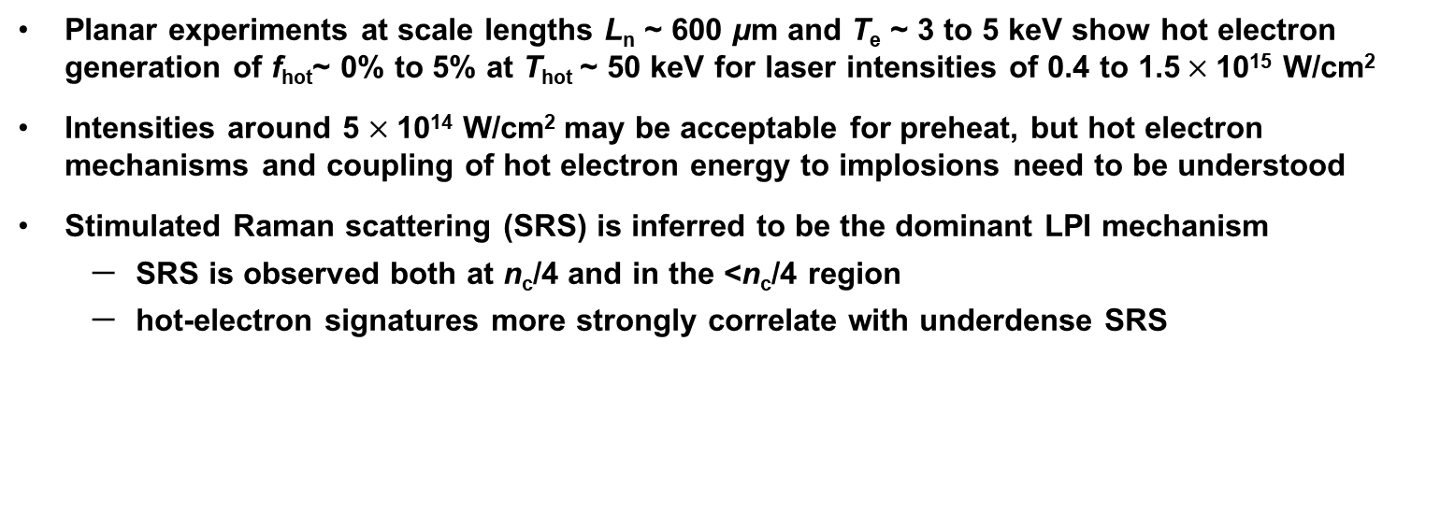
Planar experiments at the NIF have studied LPI mechanisms responsible for hot-electron generation at direct-drive ignition-relevant coronal conditions
Planar experiments at scale lengths L_{n} ~ 600 μm and T_{e} ~ 3 to 5 keV show hot electron generation of f_{hot}~ 0% to 5% at T_{hot} ~ 50 keV for laser intensities of 0.4 to 1.5$×$10¹⁵ W/cm²
Intensities around 5 $×$10¹⁴ W/cm² may be acceptable for preheat, but hot electron mechanisms and coupling of hot electron energy to implosions need to be understood
Stimulated Raman scattering (SRS) is inferred to be the dominant LPI mechanism
  SRS is observed both at n_{c}/4 and in the <n_{c}/4 region
  hot-electron signatures more strongly correlate with underdense SRS
Ongoing work is focused on identifying the SRS mechanism responsible for hot electron generation and interpreting 3ω/2 measurements of SRS and TPD waves at n_{c}/4

Slide 15
APPENDIX

Slide 16
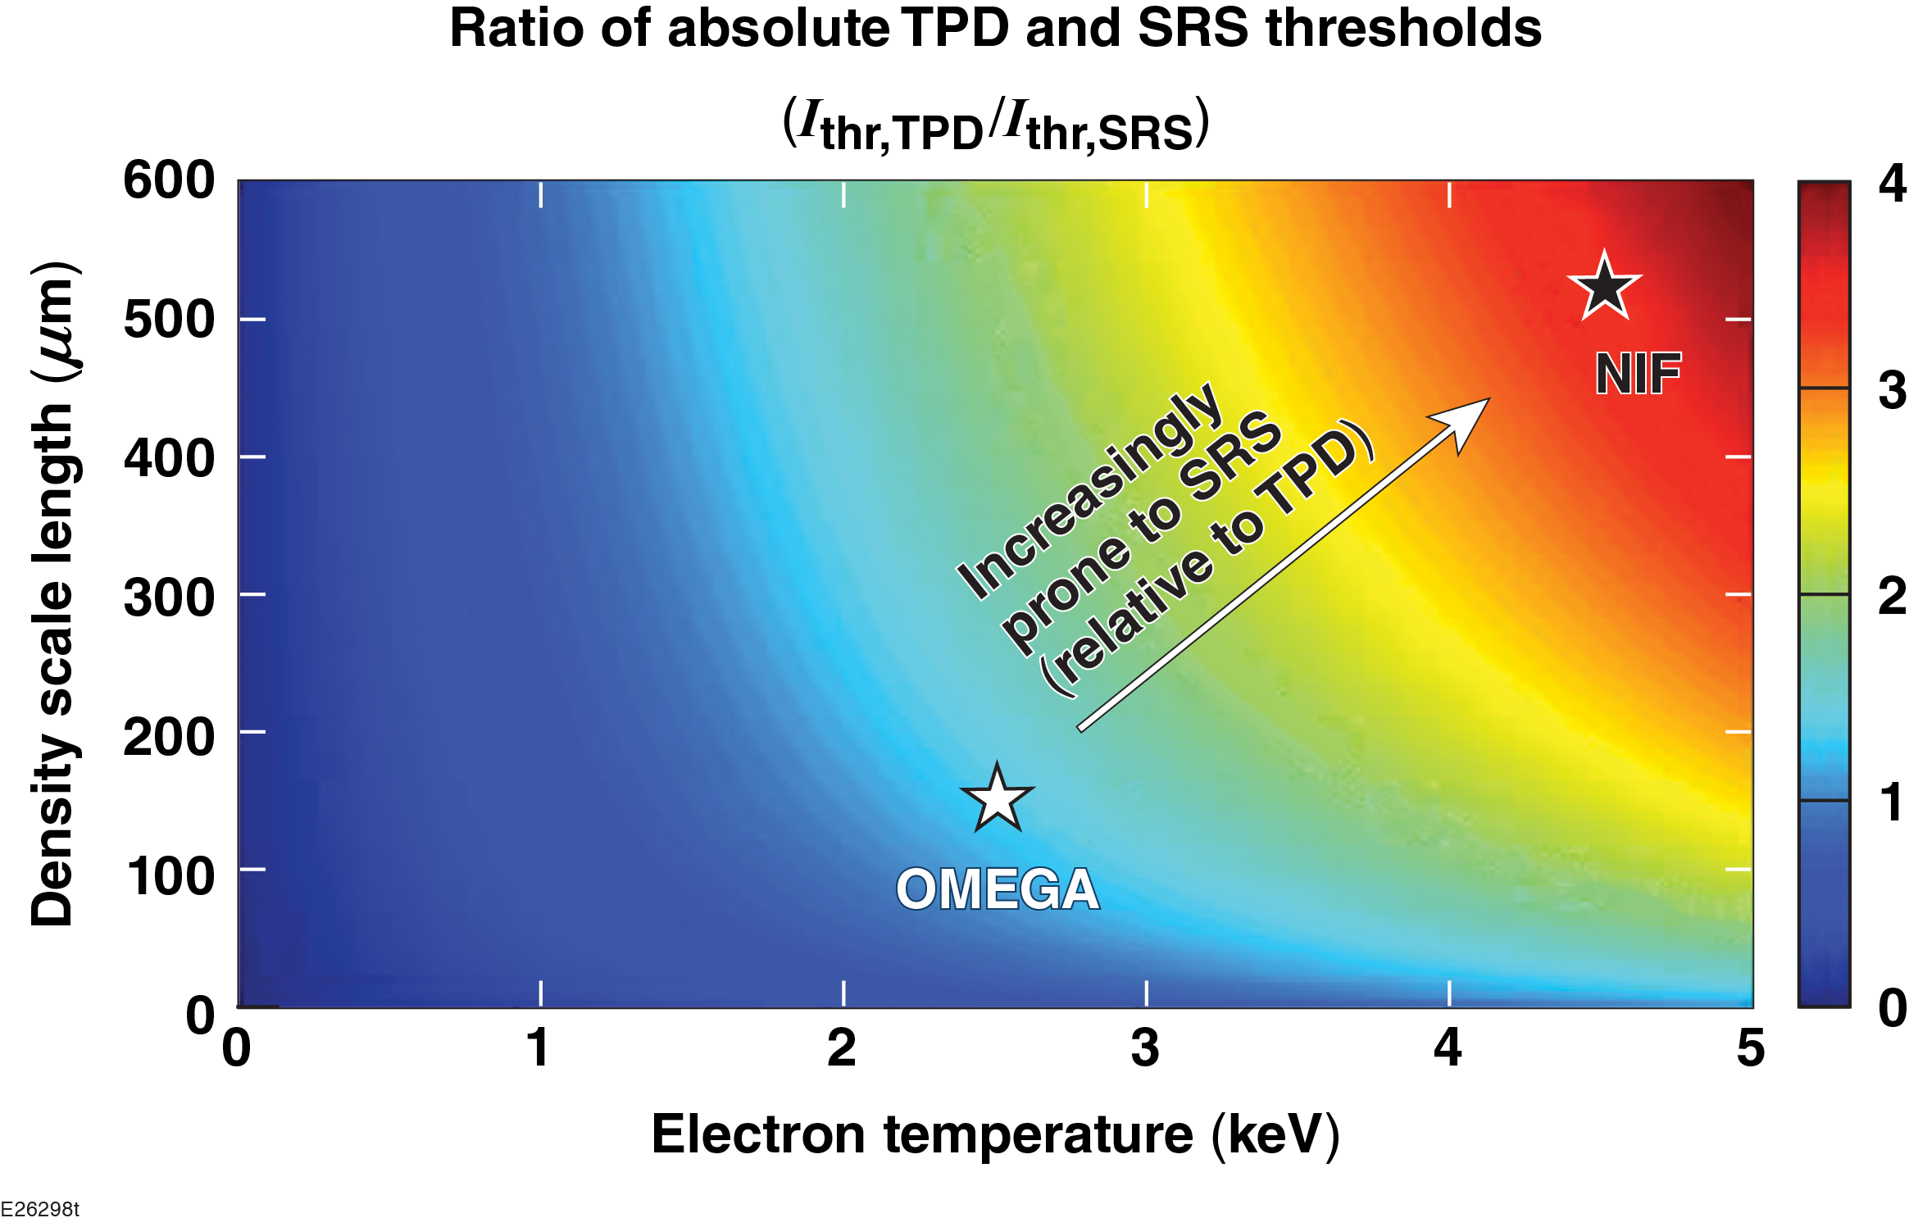
The dominance of SRS at the NIF scale may be partially explained by evaluating the absolute thresholds of SRS versus TPD

Slide 17
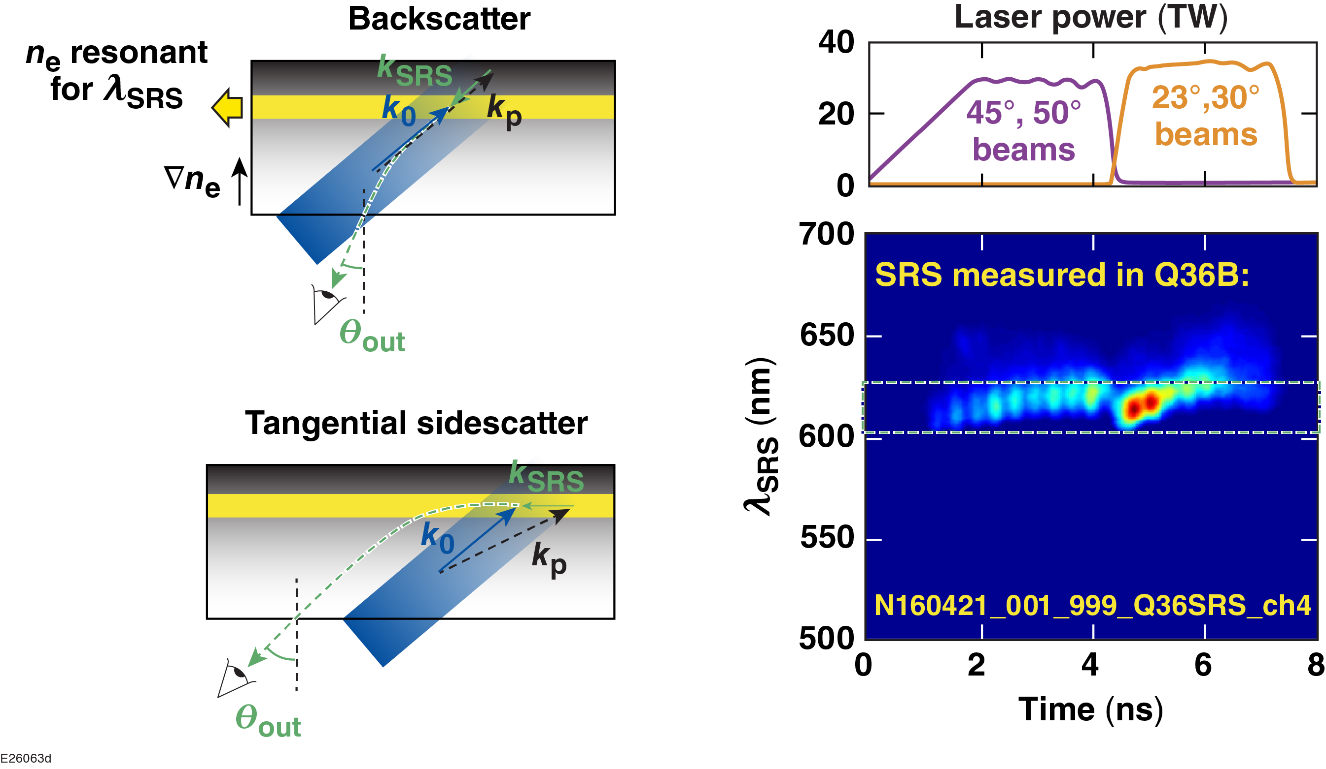
This observation can be explained by tangential SRS sidescatter,* which allows for SRS observation at large angles and wavelength independent of drive-beam angle
Tangetial sidescatter exit angle does not depend on the incidence ange

Slide 18
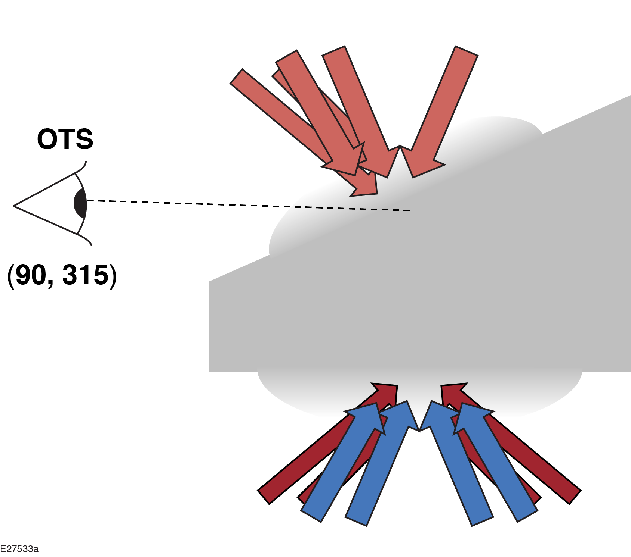
Experiments in September aim to identify the exact quarter-critical plasma waves that are being probed, with the help of new 3-D SRS/TPD modeling in LPSE

Slide 19
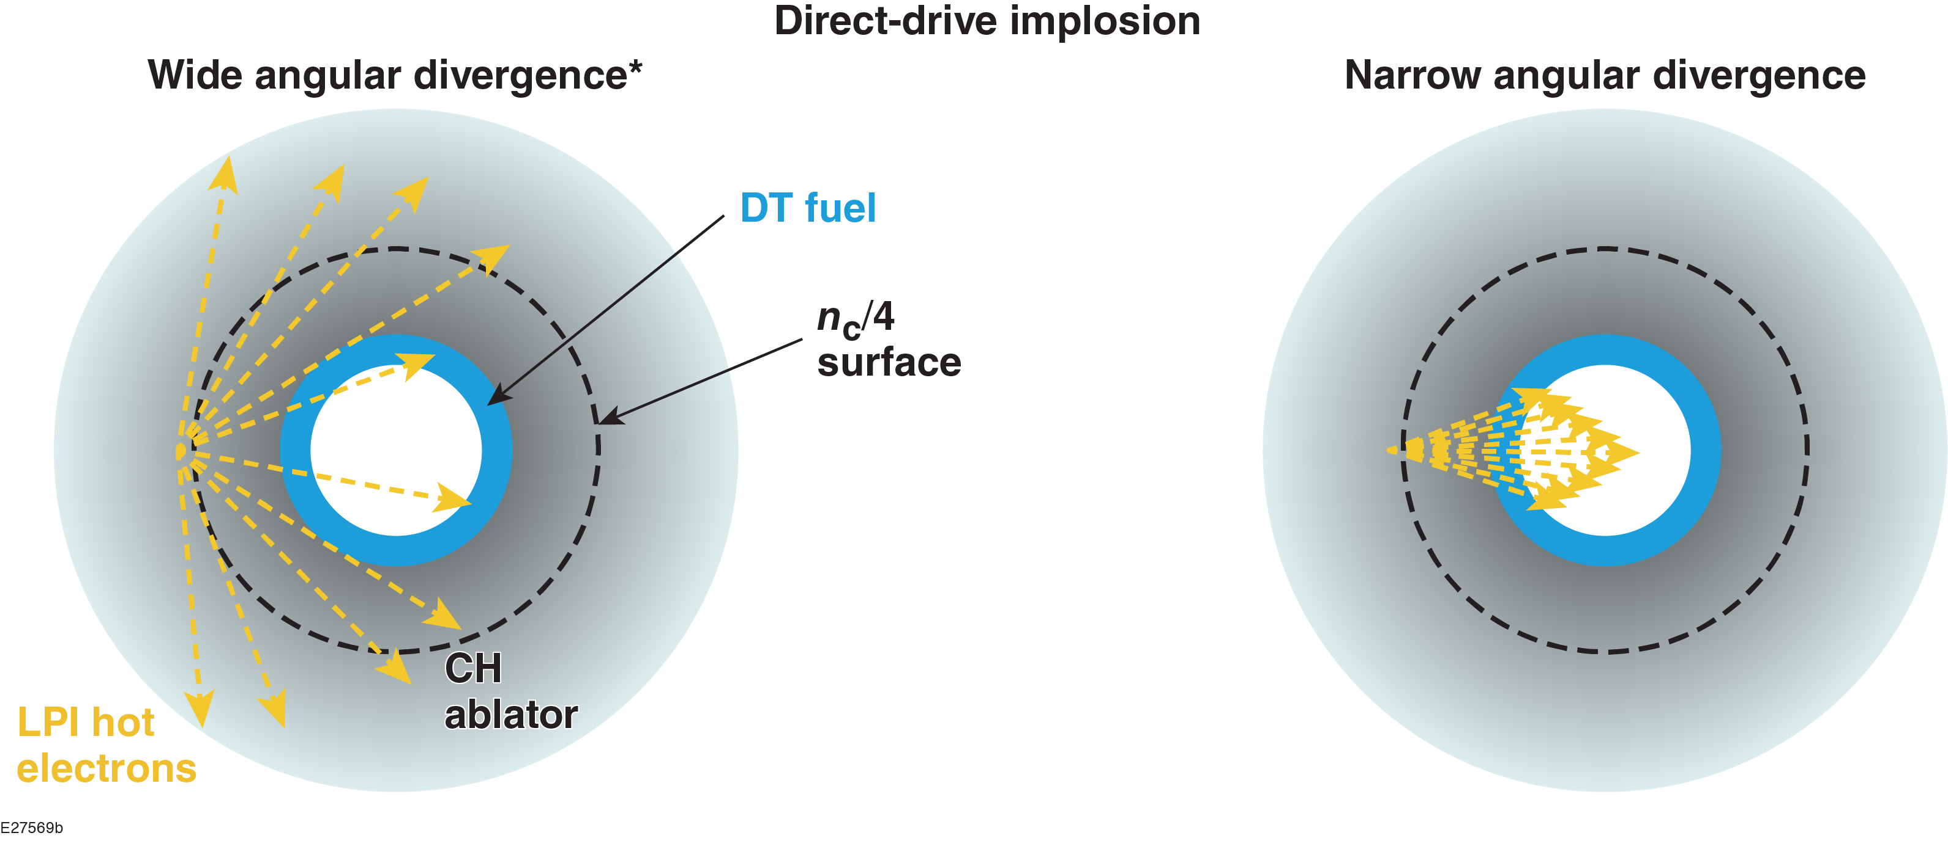
The tolerable fraction of hot electrons generated (f_{hot}) depends on how the electrons couple to an implosion
Tolerable f_{hot} ~ 0.7%
Tolerable f_{hot} ~ 0.2%

Slide 20
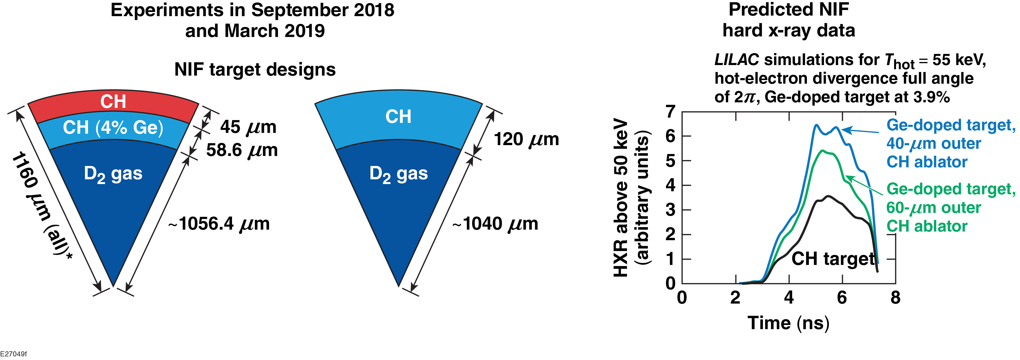
A spherical-geometry platform has been implemented on the NIF to diagnose coupling of hot electrons to an imploding shell
*Platform adapted from OMEGA:
A. Christopherson et al., APS-DPP Meeting (2016)
Difference in hard x-ray signals between mass-equivalent CH and multilayered implosions $→$ hot-electron energy deposited in the inner shell layer.

Slide 21
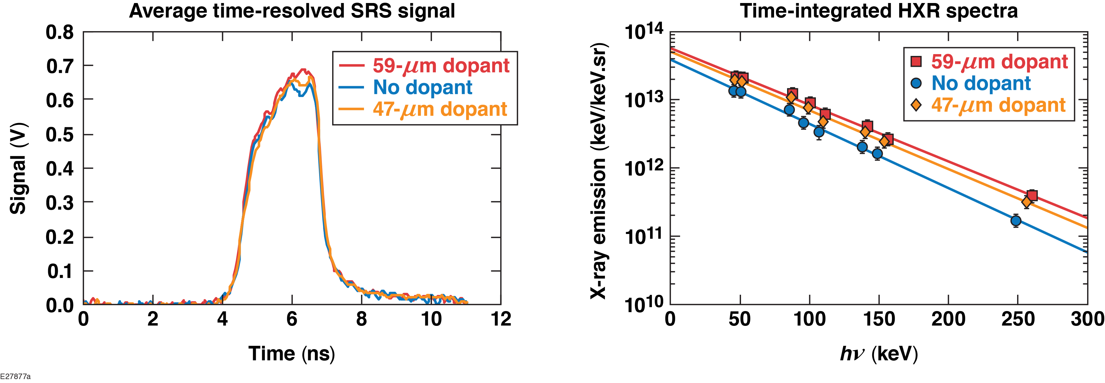
Experiments demonstrate an identical SRS/hot-electron source and a ~2$×$ enhancement of HXR signal in the doped targets
Hard x-ray enhancement is consistent with a wide angular divergence and ~XX% of hot-electron energy deposited as preheat in the inner shell layer.

