Slide 1
Cherenkov radiation from a plasma
J.P. Palastro, T.M. Antonsen Jr., L. Nguyen,
A. Howard, D. Ramsey, T. Simpson, R.K. Follett,
D. Turnbull, J. Vieira, and D.H. Froula
49th Anomalous Absorption Conference
Telluride, CO June 10th 2019

Slide 2
The superluminal ponderomotive force of a “flying focus” can drive Cherenkov radiation in a plasma
A simple plasma precludes Cherenkov radiation: the phase velocity of electromagnetic radiation exceeds c, and thus the velocity of typical drivers
The flying focus provides a superluminal driver: the peak intensity of a pulse focused by a chromatic lens travels at a velocity determined by the chirp

Slide 3
A medium will not emit far-field radiation when excited by a driver traveling slower than the phase velocity
Driver velocity
A driver excites dipole oscillations in the medium that radiate
The phase fronts of the
radiation outrun the driver
and fail to constructively
interfere

Slide 4
A medium will not emit far-field radiation when excited by a driver traveling slower than the phase velocity
Driver velocity
A driver excites dipole oscillations in the medium that radiate
The phase fronts of the
radiation outrun the driver
and fail to constructively
interfere

Slide 5
A medium will not emit far-field radiation when excited by a driver traveling slower than the phase velocity
Driver velocity
A driver excites dipole oscillations in the medium that radiate
The phase fronts of the
radiation outrun the driver
and fail to constructively
interfere

Slide 6
A medium will not emit far-field radiation when excited by a driver traveling slower than the phase velocity
Driver velocity
A driver excites dipole oscillations in the medium that radiate
The phase fronts of the
radiation outrun the driver
and fail to constructively
interfere

Slide 7
A medium will not emit far-field radiation when excited by a driver traveling slower than the phase velocity
Driver velocity
A driver excites dipole oscillations in the medium that radiate
The phase fronts of the
radiation outrun the driver
and fail to constructively
interfere

Slide 8
A medium can emit far-field radiation when excited by a driver traveling faster than the phase velocity
Driver velocity
A driver excites dipole oscillations in the medium that radiate
The phase fronts of the
radiation fall behind the
driver and constructively
interfere, resulting in
Cherenkov emisson

Slide 9
A medium can emit far-field radiation when excited by a driver traveling faster than the phase velocity
Driver velocity
A driver excites dipole oscillations in the medium that radiate
The phase fronts of the
radiation fall behind the
driver and constructively
interfere, resulting in
Cherenkov emisson

Slide 10
A medium can emit far-field radiation when excited by a driver traveling faster than the phase velocity
Driver velocity
A driver excites dipole oscillations in the medium that radiate
The phase fronts of the
radiation fall behind the
driver and constructively
interfere, resulting in
Cherenkov emisson

Slide 11
A medium can emit far-field radiation when excited by a driver traveling faster than the phase velocity
Driver velocity
A driver excites dipole oscillations in the medium that radiate
The phase fronts of the
radiation fall behind the
driver and constructively
interfere, resulting in
Cherenkov emisson

Slide 12
A medium can emit far-field radiation when excited by a driver traveling faster than the phase velocity
Driver velocity
A driver excites dipole oscillations in the medium that radiate
The phase fronts of the
radiation fall behind the
driver and constructively
interfere, resulting in
Cherenkov emisson

Slide 13
A medium can emit far-field radiation when excited by a driver traveling faster than the phase velocity
Driver velocity
A driver excites dipole oscillations in the medium that radiate
The phase fronts of the
radiation fall behind the
driver and constructively
interfere, resulting in
Cherenkov emisson

Slide 14
Dispersion in a simple plasma precludes Cherenkov emission: the phase velocity exceeds c and thus the driver velocity
Phase velocity in plasma:
*W. Sollfrey & H.T. Yura, Phys. Rev. 139, 48 (1965).

Slide 15
Dispersion in a simple plasma precludes Cherenkov emission: the phase velocity exceeds c and thus the driver velocity
Phase velocity in plasma:
Two options:
*W. Sollfrey & H.T. Yura, Phys. Rev. 139, 48 (1965).

Slide 16
Dispersion in a simple plasma precludes Cherenkov emission: the phase velocity exceeds c and thus the driver velocity
Phase velocity in plasma:
Two options:
1. Reduce the phase velocity
an applied magnetic field admits
an electromagnetic mode with a
subluminal phase velocity*
for
*W. Sollfrey & H.T. Yura, Phys. Rev. 139, 48 (1965).

Slide 17
Dispersion in a simple plasma precludes Cherenkov emission: the phase velocity exceeds c and thus the driver velocity
Phase velocity in plasma:
Two options:
1. Reduce the phase velocity
an applied magnetic field admits
an electromagnetic mode with a
subluminal phase velocity*
2. Increase the driver velocity
a Flying Focus can drive a
superluminal ponderomotive
current—novel mechanism
for
*W. Sollfrey & H.T. Yura, Phys. Rev. 139, 48 (1965).

Slide 18
A chirped laser pulse focused by a chromatic lens exhibits a dynamic, or “flying”, focus*
The flying focus:
Decouples the velocity of the peak
intensity from the group velocity
time
*D.H. Froula et al., Nat. Photonics 12, 262 (2018).

Slide 19
A chirped laser pulse focused by a chromatic lens exhibits a dynamic, or “flying”, focus*
The flying focus:
Decouples the velocity of the peak
intensity from the group velocity
time
v_{g}
*D.H. Froula et al., Nat. Photonics 12, 262 (2018).

Slide 20
A chirped laser pulse focused by a chromatic lens exhibits a dynamic, or “flying”, focus*
The flying focus:
Decouples the velocity of the peak
intensity from the group velocity
time
v_{g}
*D.H. Froula et al., Nat. Photonics 12, 262 (2018).

Slide 21
A chirped laser pulse focused by a chromatic lens exhibits a dynamic, or “flying”, focus*
The flying focus:
Decouples the velocity of the peak
intensity from the group velocity
time
v_{g}
*D.H. Froula et al., Nat. Photonics 12, 262 (2018).

Slide 22
A chirped laser pulse focused by a chromatic lens exhibits a dynamic, or “flying”, focus*
The flying focus:
Decouples the velocity of the peak
intensity from the group velocity
time
v_{g}
*D.H. Froula et al., Nat. Photonics 12, 262 (2018).

Slide 23
A chirped laser pulse focused by a chromatic lens exhibits a dynamic, or “flying”, focus*
The flying focus:
Decouples the velocity of the peak
intensity from the group velocity
time
v_{g}
*D.H. Froula et al., Nat. Photonics 12, 262 (2018).

Slide 24
A chirped laser pulse focused by a chromatic lens exhibits a dynamic, or “flying”, focus*
The flying focus:
Decouples the velocity of the peak
intensity from the group velocity
time
v_{d}
v_{g} < v_{d}
*D.H. Froula et al., Nat. Photonics 12, 262 (2018).

Slide 25
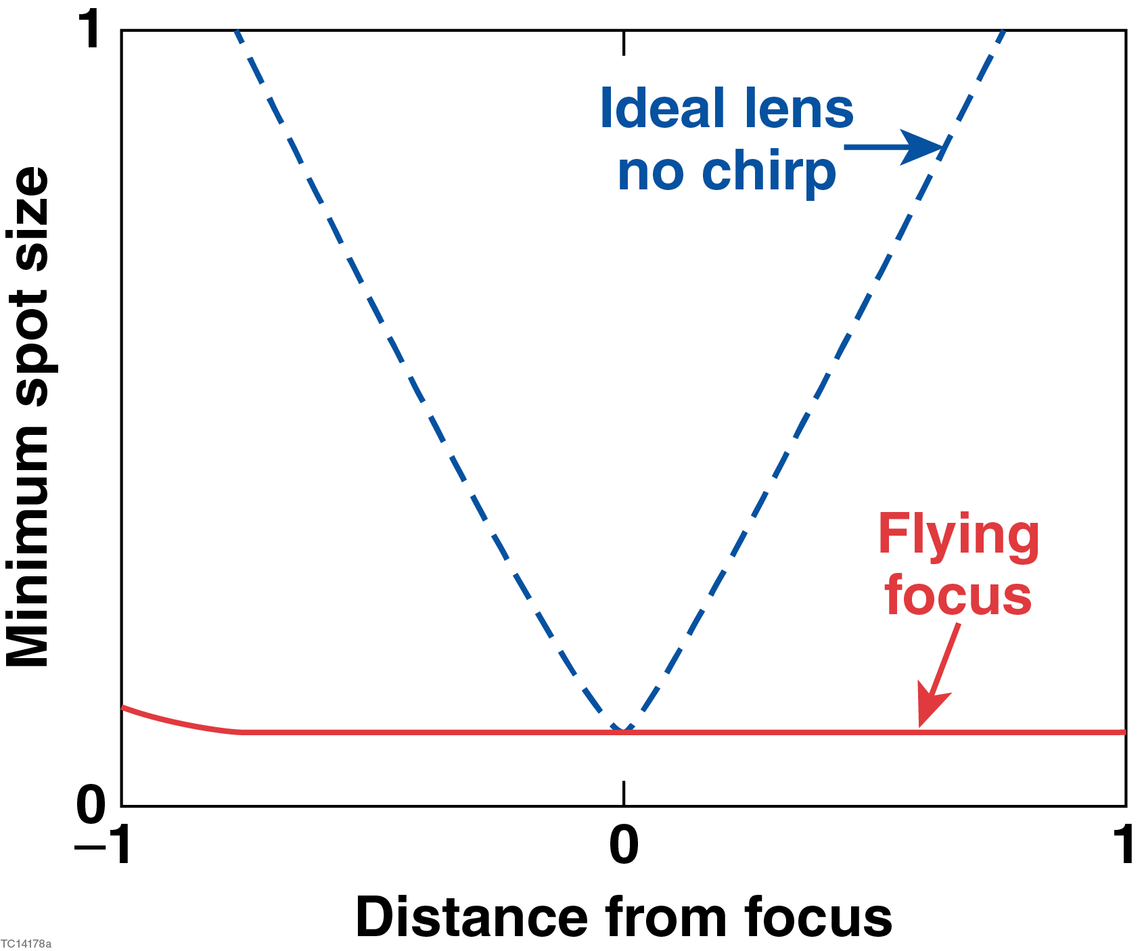
A chirped laser pulse focused by a chromatic lens exhibits a dynamic, or “flying”, focus*
The flying focus:
Decouples the velocity of the peak
intensity from the group velocity
Decouples the minimum spot size
from the Rayleigh range
time
v_{d}
v_{g} < v_{d}
*D.H. Froula et al., Nat. Photonics 12, 262 (2018).

Slide 26
The superluminal ponderomotive force of a flying focus can drive far-field electromagnetic radiation
Steady-state wave equation for the magnetic field
ponderomotive potential
density gradient
diffraction
refraction

Slide 27
The superluminal ponderomotive force of a flying focus can drive far-field electromagnetic radiation
Steady-state wave equation for the magnetic field
ponderomotive potential
density gradient
diffraction
refraction
Ponderomotive excitation of far-field radiation requires

Slide 28
The superluminal ponderomotive force of a flying focus can drive far-field electromagnetic radiation
Steady-state wave equation for the magnetic field
ponderomotive potential
density gradient
diffraction
refraction
density gradient
Ponderomotive excitation of far-field radiation requires
1. Density gradient,

Slide 29
The superluminal ponderomotive force of a flying focus can drive far-field electromagnetic radiation
Steady-state wave equation for the magnetic field
ponderomotive potential
density gradient
diffraction
refraction
dispersion
density gradient
Ponderomotive excitation of far-field radiation requires
1. Density gradient,
2. Superluminal driver,

Slide 30
The superluminal ponderomotive force of a flying focus can drive far-field electromagnetic radiation
Steady-state wave equation for the magnetic field
ponderomotive potential
density gradient
diffraction
refraction
dispersion
density gradient
Ponderomotive excitation of far-field radiation requires
1. Density gradient,
2. Superluminal driver,
emission
angle
Equivalent to the Cherenkov condition:

Slide 31
The superluminal ponderomotive force of a flying focus can drive far-field electromagnetic radiation
Ponderomotive excitation of far-field radiation requires:
1. Density gradient—preformed plasma
2. Superluminal driver—flying focus
preformed
plasma

Slide 32
The superluminal ponderomotive force of a flying focus can drive far-field electromagnetic radiation
Ponderomotive excitation of far-field radiation requires:
1. Density gradient—preformed plasma
2. Superluminal driver—flying focus
Cherenkov, v_{d} = v_{p}
preformed
plasma

Slide 33
The superluminal ponderomotive force of a flying focus can drive far-field electromagnetic radiation
Ponderomotive excitation of far-field radiation requires:
1. Density gradient—preformed plasma
2. Superluminal driver—flying focus
Cherenkov, v_{d} = v_{p}
preformed
plasma

Slide 34
The superluminal ponderomotive force of a flying focus can drive far-field electromagnetic radiation
Ponderomotive excitation of far-field radiation requires:
1. Density gradient—preformed plasma
2. Superluminal driver—flying focus
Cherenkov, v_{d} = v_{p}
preformed
plasma

Slide 35
The superluminal ponderomotive force of a flying focus can drive far-field electromagnetic radiation
Ponderomotive excitation of far-field radiation requires:
1. Density gradient—preformed plasma
2. Superluminal driver—flying focus
Cherenkov, v_{d} = v_{p}
preformed
plasma

Slide 36
The superluminal ponderomotive force of a flying focus can drive far-field electromagnetic radiation
Ponderomotive excitation of far-field radiation requires:
1. Density gradient—preformed plasma
2. Superluminal driver—flying focus
Cherenkov, v_{d} = v_{p}
preformed
plasma

Slide 37
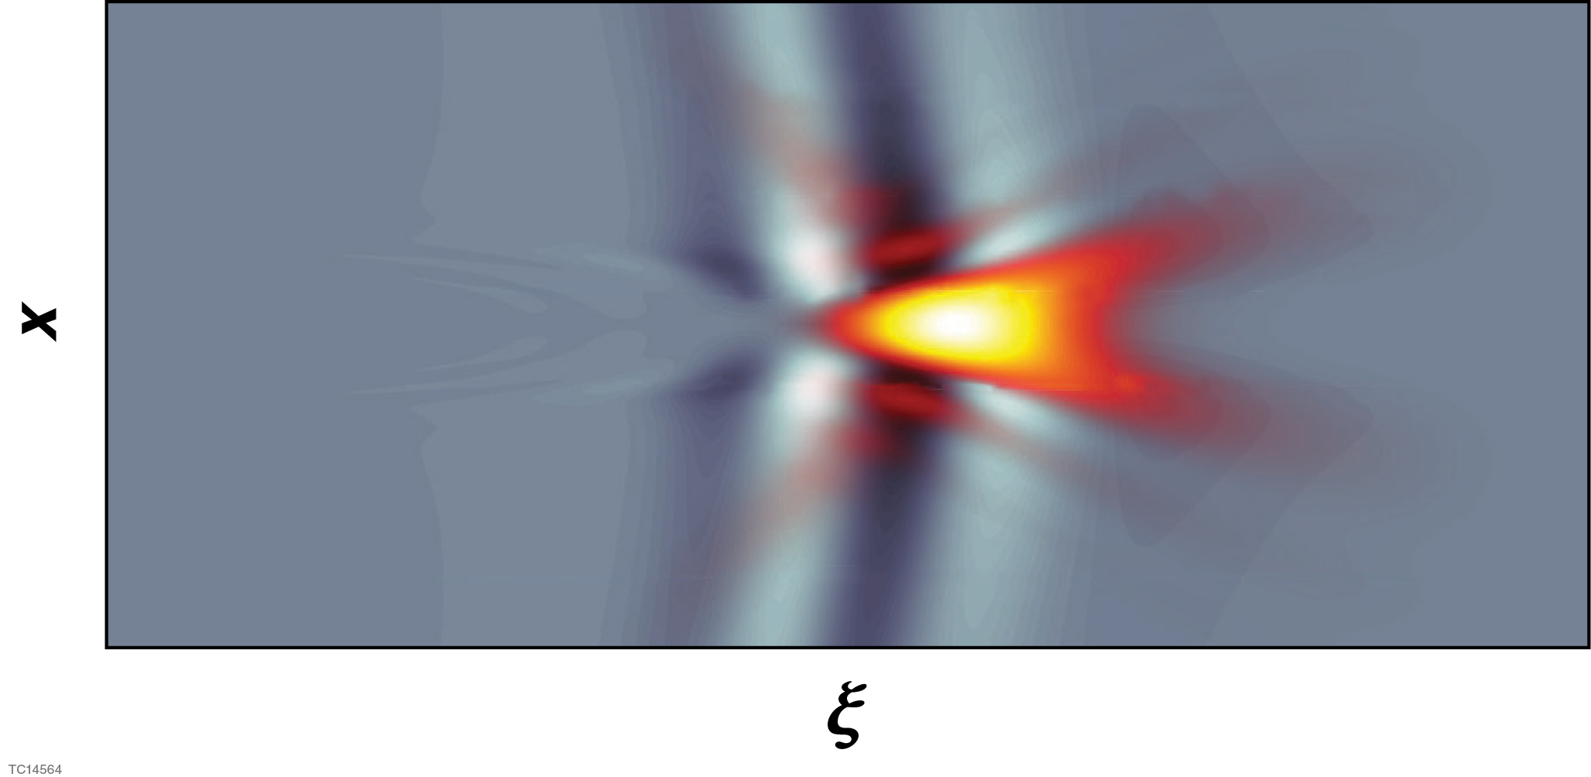
We have extended the quasistatic model of ponderomotively driven wakefields to model Cherenkov emission
Dynamic wave equation for B-field (a₀<1) in moving frame: ξ = ct -z
ponderomotive potential
density gradient
electrostatic
potential
Current density
Electrostatic potential

Slide 38
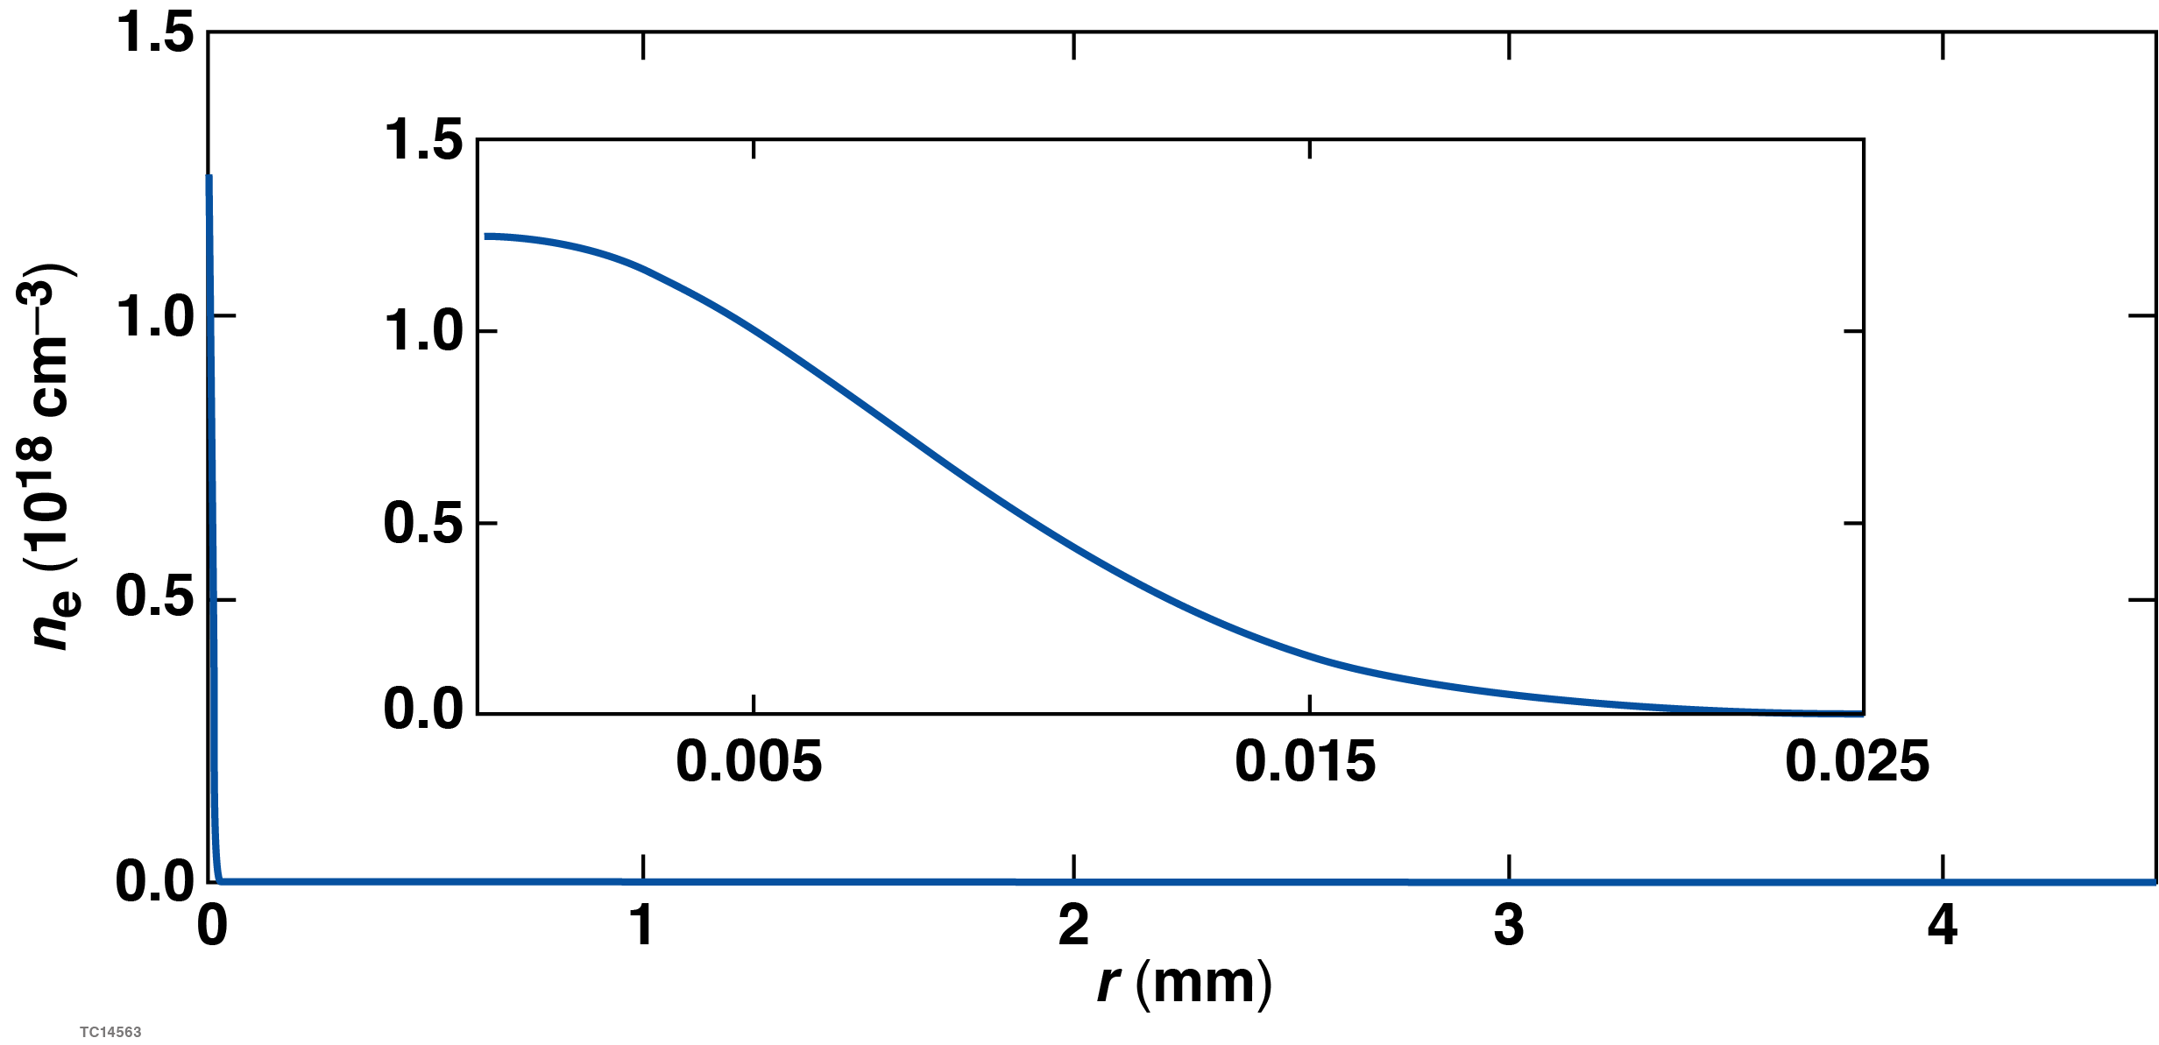
Simulation setup
Laser parameters
λ = 920 nm
The simulations have large radial domains to allow
the radiation to propagate into the quasi-farfield
Δλ = 60 nm
focal length = 0.2 m
background density
focal spot = 5.8 μm
Plasma parameters
n_{e} = 1.3x10¹⁸ cm⁻³
length = 9 mm
radius = 10 μm

Slide 39
Far-field radiation occurs when the focal velocity exceeds the speed of light
The simulation exhibits the expected behavior: no far-field emission
for focal velocities < c
v_{d} = 0.95 (small + chirp)
v_{d} = 1.06 (small - chirp)
laser intensity
Cherenkov rad. rS_{z}
laser intensity
Cherenkov rad. rS_{z}

Slide 40
The superluminal ponderomotive force of a “flying focus” can drive Cherenkov radiation in a plasma
A simple plasma precludes Cherenkov radiation: the phase velocity of electromagnetic radiation exceeds c, and thus the velocity of typical drivers
The flying focus provides a superluminal driver: the peak intensity of a pulse focused by a chromatic lens travels at a velocity determined by the chirp

