Slide 1
Modeling stimulated Raman scattering and cross-beam energy transfer in direct-drive National Ignition Facility plasmas
Laser light
laser light
A. V. Maximov, J. G. Shaw, and J. P. Palastro
University of Rochester
Laboratory for Laser Energetics
49th Annual Anomalous Absorption Conference
Telluride, CO
June 9 – 14, 2019

Slide 2
Saturation of the absolute instability of stimulated Raman scattering (SRS) determines the transmission of laser light through the instability region and can influence CBET
Summary
For the National Ignition Facility (NIF) conditions, the saturation of the SRS instability near the quarter-critical density has been modeled with Laser-Plasma Simulation Environment (LPSE)*.
The instability driven by single or multiple laser beams saturates dynamically due to coupling to incoherent low-frequency density perturbations .
SRS at saturation can couple to CBET via low-frequency density perturbations.
The instability saturation determines the power balance between the transmission of incoherent laser light past the quarter critical density and the scattering into Raman light and via CBET.
*J. F. Myatt et al., Phys. Plasmas 24, 056308 (2017)

Slide 10
The spectra of scattered waves in saturation stage are broader in the case of two driving laser beams
Laser light
Saturation:
t = 8.5ps
Plasma waves
backscatter
incident
Plasma waves
Laser light
Raman light
Raman light
Low-frequency
density
perturbations

Slide 11
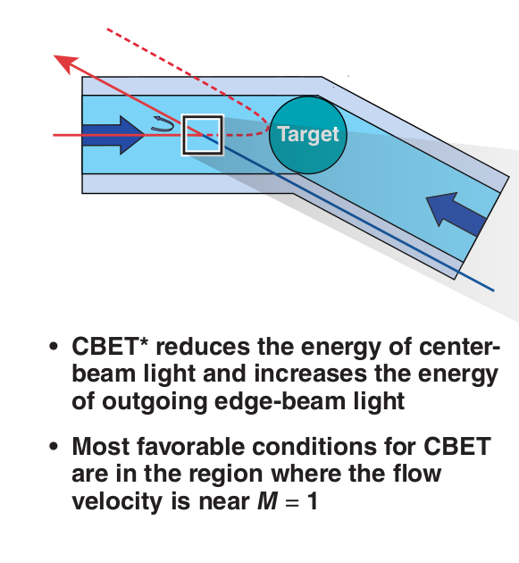
SRS and CBET can develop together when the flow velocity M=1 region is near quarter-critical density
Laser light
Early time:
t = 1 ps
I₀
0.1 I₀
Saturation:
t = 8.5ps
Transmission T=0.52
*I. V. Igumenshchev et al., Phys. Plasmas 19, 056314 (2012)

Slide 12
SRS at saturation and CBET can share the low-frequency density perturbations in the long wave-vector domain
Laser light
Low-frequency
density
perturbations
Plasma waves
Saturation:
t = 8.5ps

Slide 13
When the instability is driven by two laser beams, the interplay of SRS and CBET increases the level of density perturbations
Laser light
Saturation:
t = 8.5ps
Transmission
T=0.43
Low-frequency
density
perturbations
I₀
0.1 I₀
Raman light

Slide 14
With the two driving laser beams there are multiple couplings between waves through low-frequency density perturbations
Saturation:
t = 8.5ps
Laser light
Low-frequency
density
perturbations
Plasma waves
SRS drives LDI and these low-frequency
density perturbations
can increase CBET

Slide 15
Saturation of the absolute instability of stimulated Raman scattering (SRS) determines the transmission of laser light through the instability region and can influence CBET
Summary/
Conclusions
Summary
For the National Ignition Facility (NIF) conditions, the saturation of the SRS instability near the quarter-critical density has been modeled with Laser-Plasma Simulation Environment (LPSE)*.
The instability driven by single or multiple laser beams saturates dynamically due to coupling to incoherent low-frequency density perturbations .
SRS at saturation can couple to CBET via low-frequency density perturbations.
The instability saturation determines the power balance between the transmission of incoherent laser light past the quarter critical density and the scattering into Raman light and via CBET.
*J. F. Myatt et al., Phys. Plasmas 24, 056308 (2017)

