Slide 1
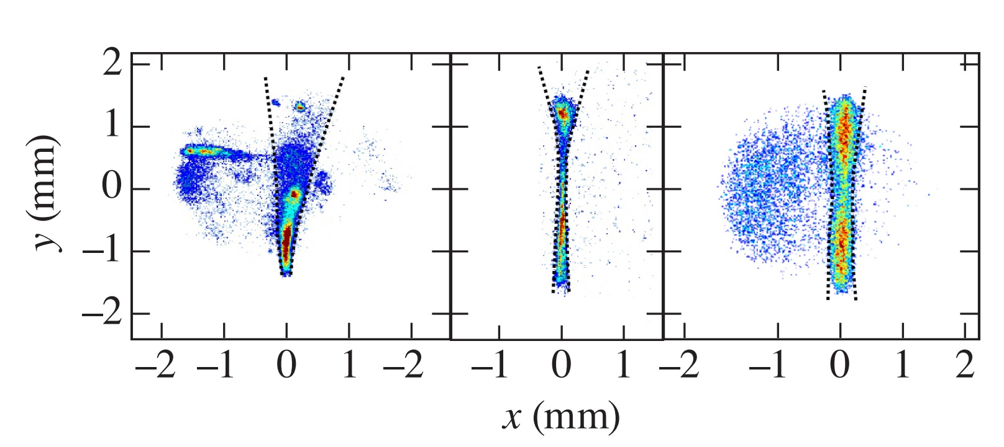
Phase plates in Thomson-scattering experiments
P / P_{cr} ~ 100
P / P_{cr} ~ 4
P / P_{cr} ~ 0.1
n_{e}~ 3.0 x 10²⁰
n_{e}~ 0.3 x 10²⁰
n_{e}~ 2.0 x 10²⁰
Propagation Direction
No DPP
No DPP
W/ DPP
A. M. Hansen
Physics Department
University of Rochester
Laboratory for Laser Energetics
49th Anomalous Absorption Conference
Telluride, CO
June 9 - 14, 2019

Slide 2
Phase plates in Thomson-scattering experiments enable the measurement of electron-plasma waves by increasing the self-focusing threshold
2D Thomson-scattering measured self-focusing of the probe beam
Phase Plates (DPP) were used to mitigate self-focusing
Super-Gaussian electron velocity distribution functions (VDF) were measured to be consistent with laser heating models*
Phase plates introduced speckle-scale non-uniformities** in the plasma conditions which were measured with Thomson-scattering
___________
*A. B. Langdon, Phys. Rev. Lett. 44, 575 (1980).
*J. P. Matte et al., Plasma Phys. Controlled Fusion 30, 1665 (1988).
** B. Afeyan et al., Phys. Rev. Lett. 80(11) 1998

Slide 3
D. Turnbull, J. Katz, A. L. Milder, J. Palastro
D. Mastrosimone, and D. H. Froula
University of Rochester
Laboratory for Laser Energetics

Slide 4
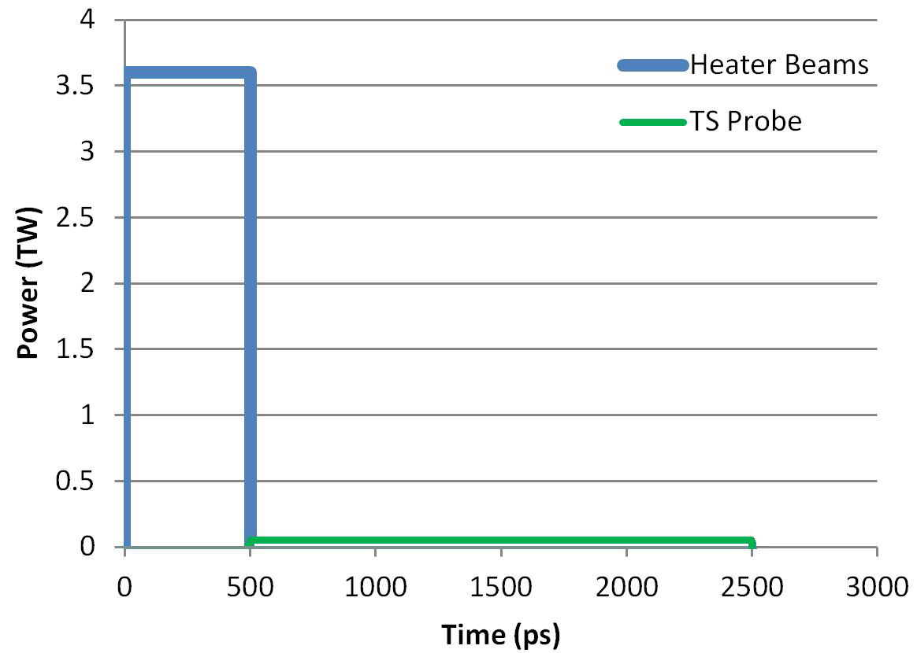
A gas-jet plume is heated by nine UV beams and probed by one green beam and/or one or several UV beams
(3.6 Tw)
(0.01 Tw)
Heater Beam
Heater Beam
Heater Beam
Heater Beam
f/10 Thomson-scattering
Collection
60 x 60 x 60 μm³
TS Volume
TS Probe Beam
Heater Beam

Slide 5
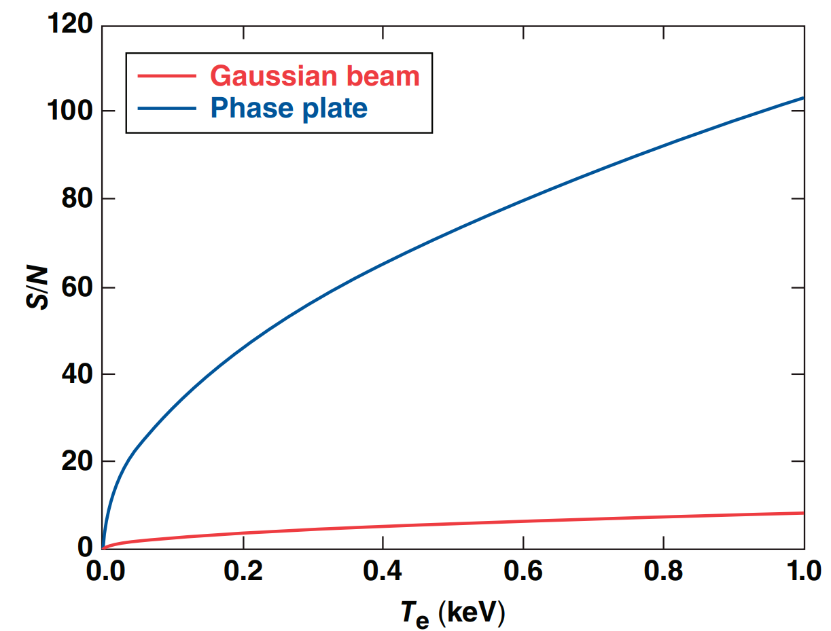
Self-focusing limits the effectiveness of Thomson-scattering in some regimes of plasma conditions and laser parameters
P / P_{cr} ~ 100
P / P_{cr} ~ 4
P / P_{cr} ~ 0.1
n_{e}~ 3.0 x 10²⁰
n_{e}~ 0.3 x 10²⁰
n_{e}~ 2.0 x 10²⁰
Propagation Direction
No DPP
No DPP
W/ DPP
Notes:
Thomson scattering has a small cross section -> need high power probe laser
High power probe lasers can slef focus in a plasma due to the ponderomotive force digging a channel
Self focusing can cause the probe laser to refract and miss the thomson sollection volume
Probe laser power must be under p_{cr} in thomson scattering experiments

Slide 6
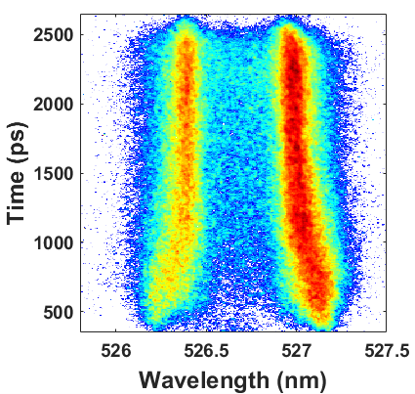
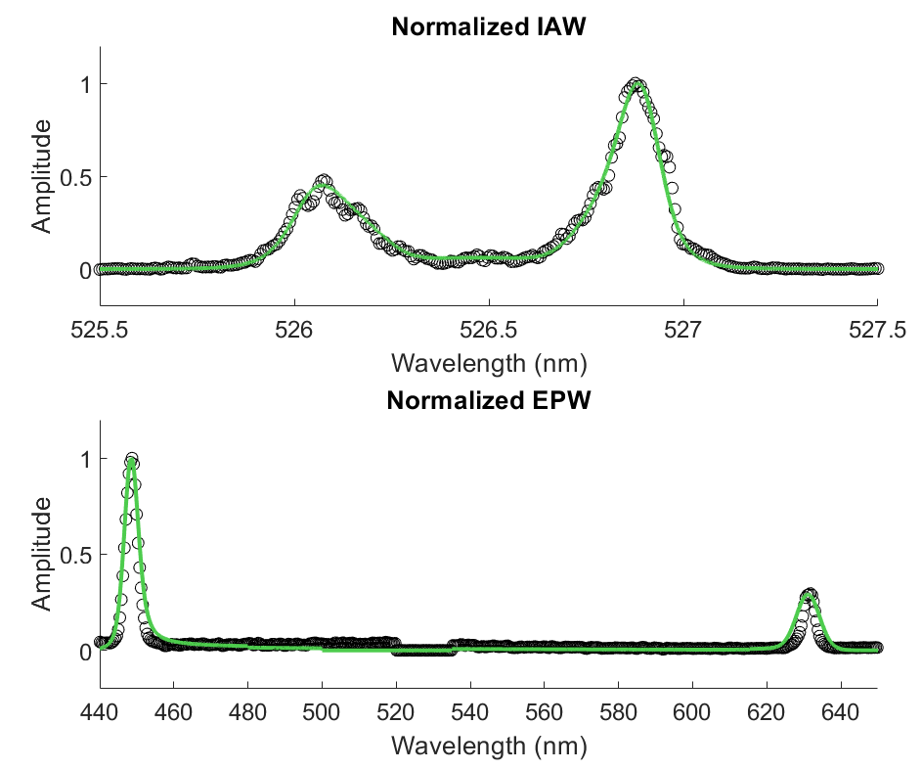
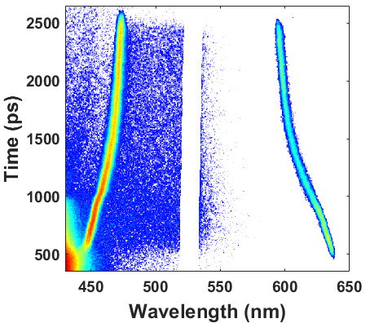
Streaked Thomson-scattering provides time-resolved information about plasma conditions throughout the experiment
Notes:
Explain streaked thomson scattering

Slide 7
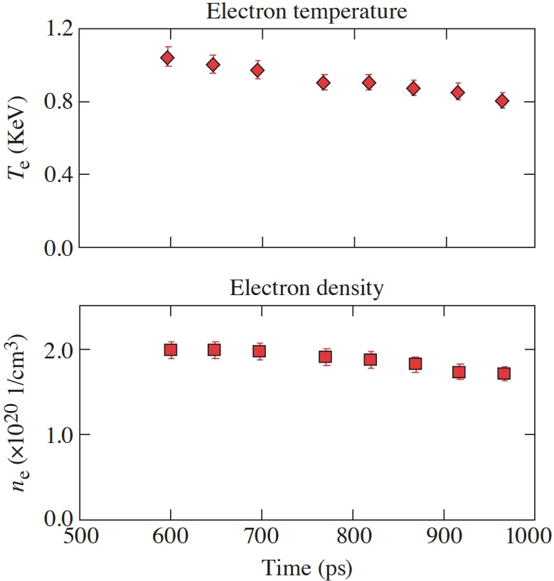
Streaked Thomson-scattering provides time-resolved information about plasma conditions throughout the experiment
Notes:
Explain streaked thomson scattering

Slide 8
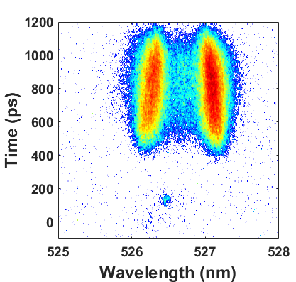
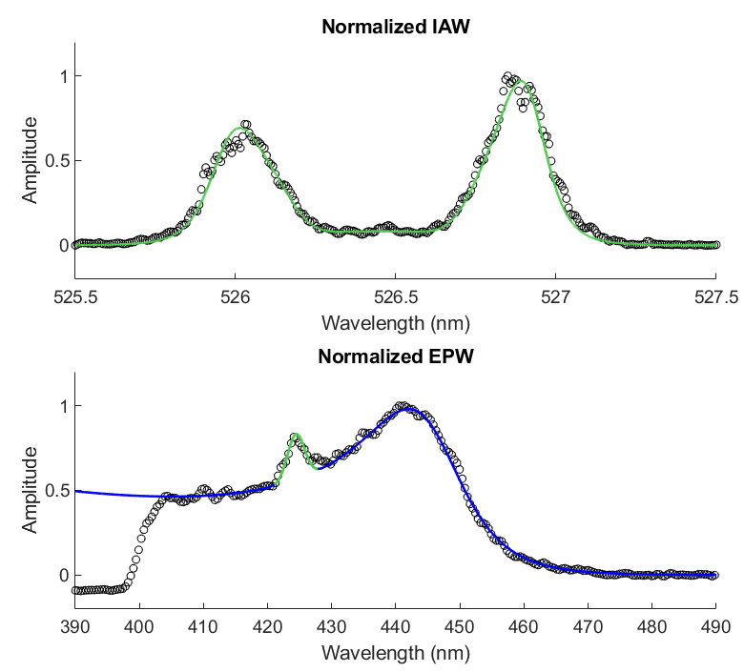
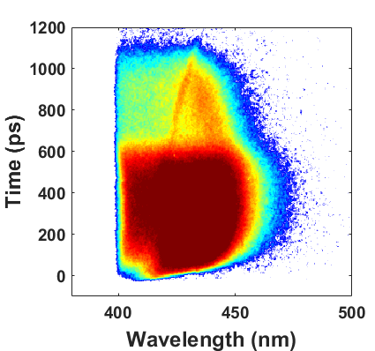
Combined 2ω and 3ω Thomson-scattering breaks degeneracies in scattered spectra allowing for characterization of the electron VDF
Fit Parameters
Te = 1.02
n_{e} = 2.0e20
m = 2.4

Slide 9
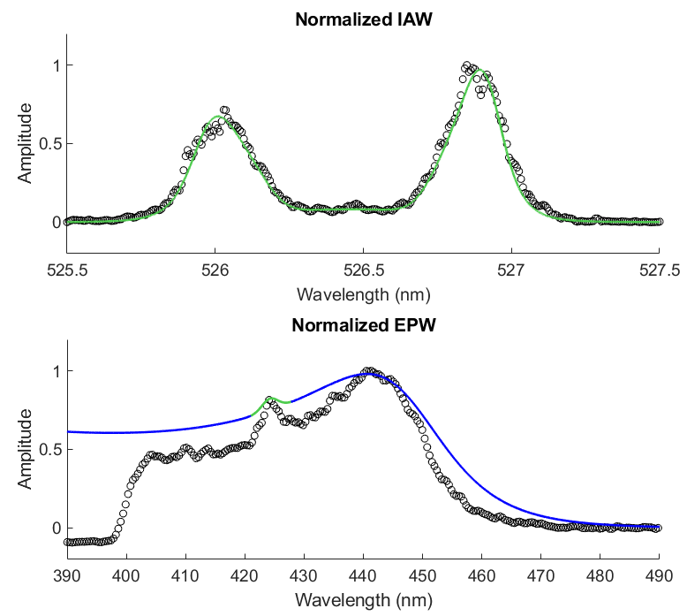
Combined 2ω and 3ω Thomson-scattering breaks degeneracies in scattered spectra allowing for characterization of the electron VDF
Fit Parameters
Te = 1.15 (+13%)
n_{e} = 1.95e20 (-2%)
m = 2.0 (-0.4)
Te = 1.15
n_{e} = 1.95e20
m = 2.0

Slide 10
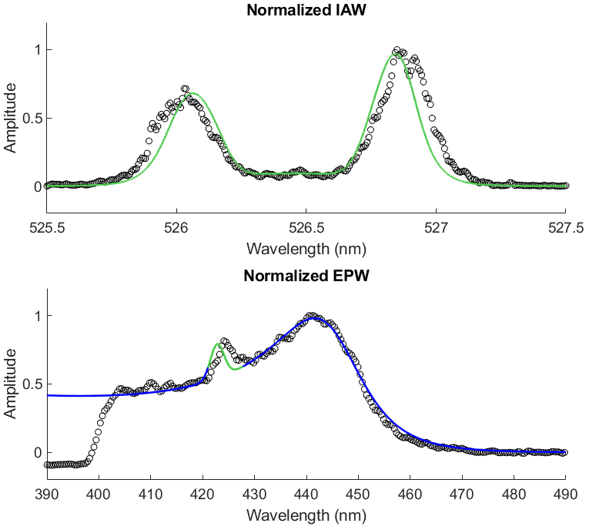
Combined 2ω and 3ω Thomson-scattering breaks degeneracies in scattered spectra allowing for characterization of the electron VDF
Fit Parameters
Te = 0.98 (-4%)
n_{e} = 2.10e20 (+5%)
m = 2.0 (-0.4)

Slide 11
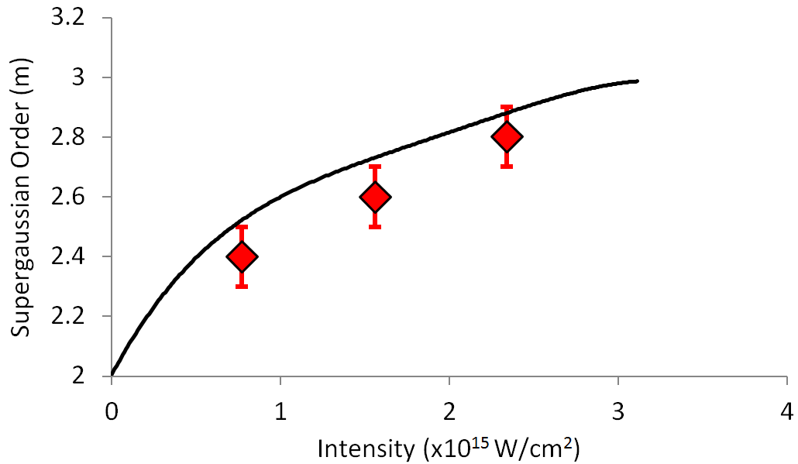
Measurements of the electron velocity distribution function are consistent with laser heating models
Predicted super-Gaussian m order:
________
*A. B. Langdon, Phys. Rev. Lett. 44, 575 (1980).
**J. P. Matte et al., Plasma Phys. Controlled Fusion 30, 1665 (1988).
†A. Milder Invited Talk AAC 2019

Slide 12
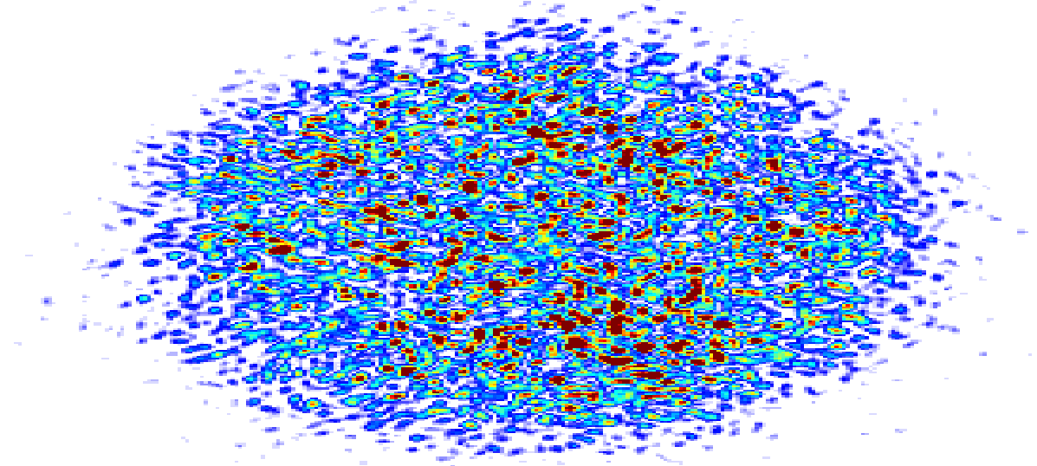
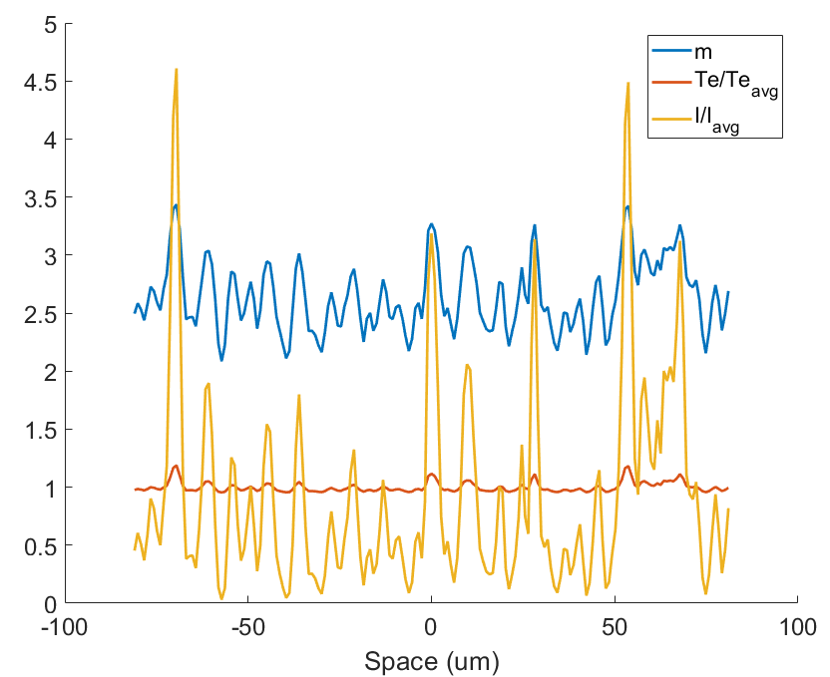
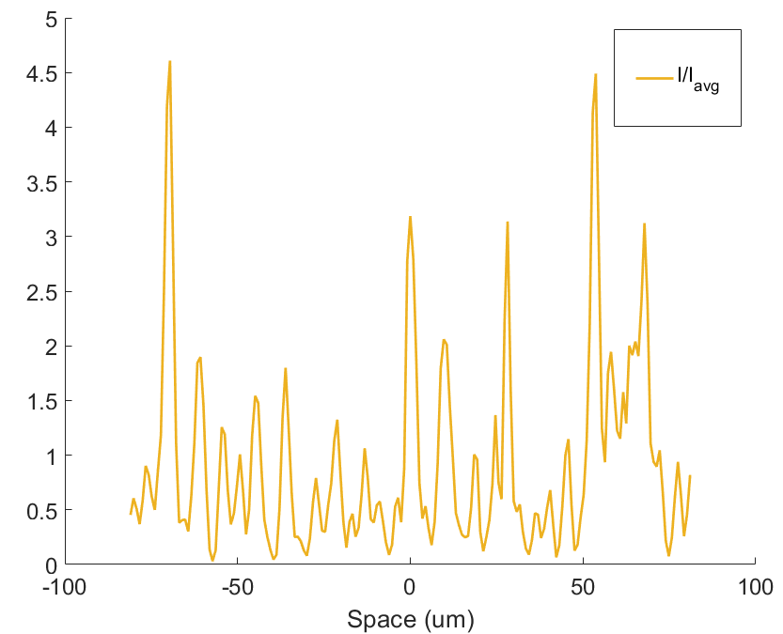
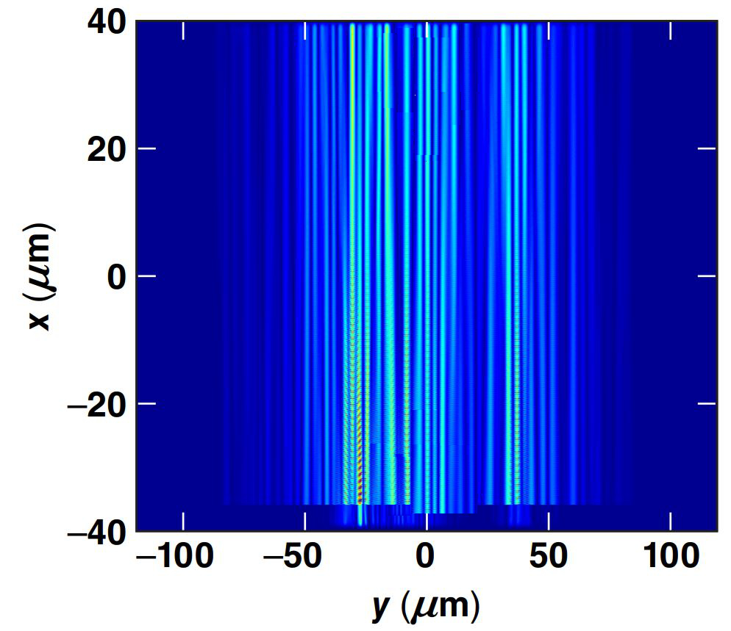
High intensity speckles in a phase plate drive speckle-scale non-uniform plasma conditions
Notes:
One consequence of the intensity dependence of the langdon effect is that the super-gaussian order driven by a beam with a phase plate can vary spatially due to the high intensity speckles in the beam
Explain DPP langdon effect calculation

Slide 13
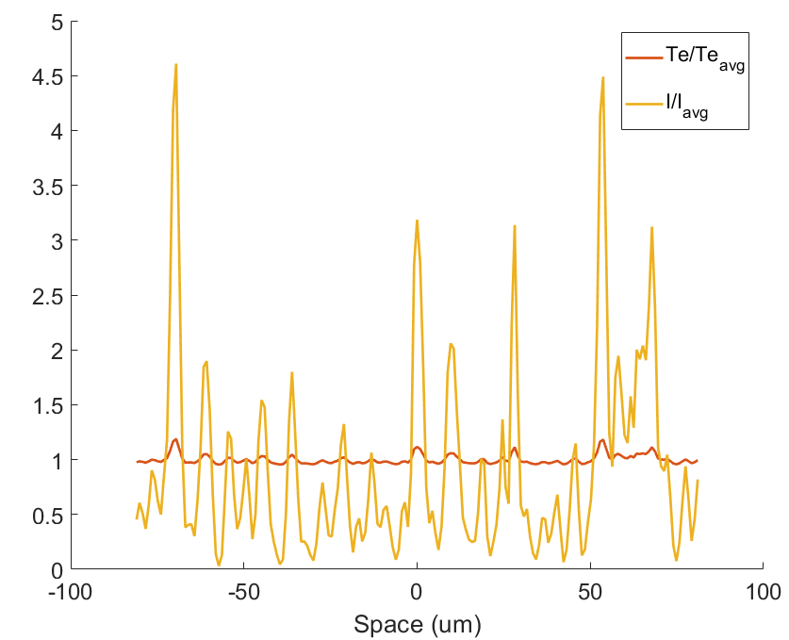
High intensity speckles in a phase plate drive speckle-scale non-uniform plasma conditions
Notes:
One consequence of the intensity dependence of the langdon effect is that the super-gaussian order driven by a beam with a phase plate can vary spatially due to the high intensity speckles in the beam
Explain DPP langdon effect calculation

Slide 14
High intensity speckles in a phase plate drive speckle-scale non-uniform plasma conditions
Notes:
One consequence of the intensity dependence of the langdon effect is that the super-gaussian order driven by a beam with a phase plate can vary spatially due to the high intensity speckles in the beam
Explain DPP langdon effect calculation

Slide 15
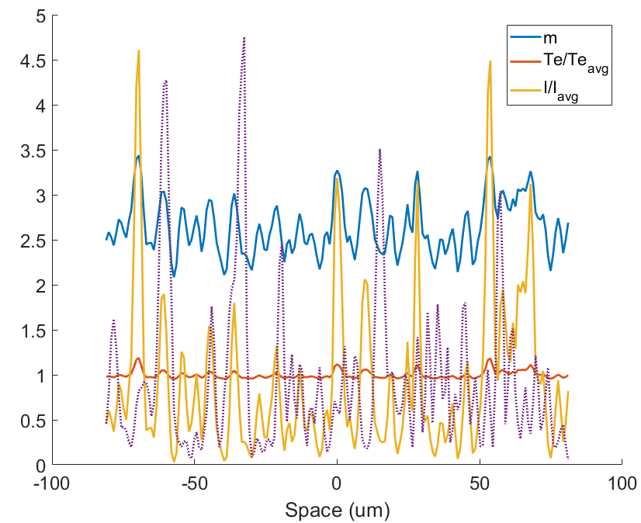
High intensity speckles in a phase plate drive speckle-scale non-uniform plasma conditions
Notes:
One consequence of the intensity dependence of the langdon effect is that the super-gaussian order driven by a beam with a phase plate can vary spatially due to the high intensity speckles in the beam
Explain DPP langdon effect calculation

Slide 16
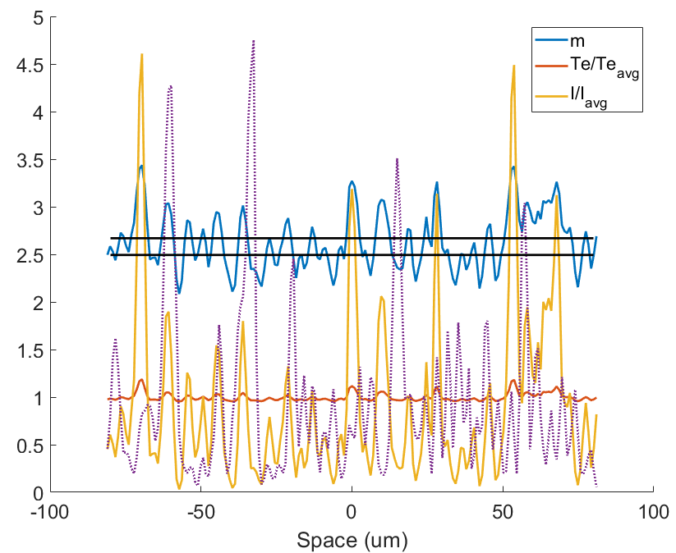
High intensity speckles in a phase plate drive speckle-scale non-uniform plasma conditions
m_{high-intensity} = 2.67
m_{low-intensity} = 2.49
Notes:
One consequence of the intensity dependence of the langdon effect is that the super-gaussian order driven by a beam with a phase plate can vary spatially due to the high intensity speckles in the beam
Explain DPP langdon effect calculation

Slide 17
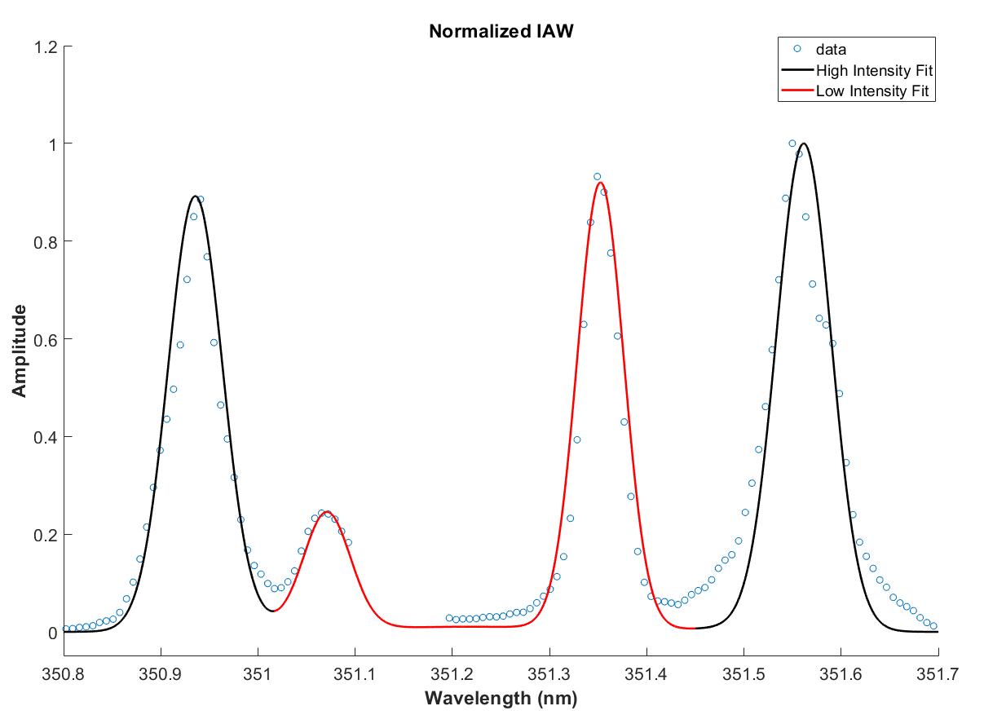
Thomson-scattered light from a high-intensity and low-intensity beam in the same volume of plasma reveal speckle-scale non-uniformities
Both Beams
Z ~ 15
n_{e} = 6.85 x 10¹⁹ 1/cc
T_{i} = 0.19 keV
Low Intensity Beam
I₀ = 0.5 x 10¹⁵ W/cm²
T_{e} = 0.81 keV
m = 2.9
High Intensity Beam
I₀ = 5 x 10¹⁵ W/cm²
T_{e} = 0.92 keV (+14%)
m = 3.2 (+0.3)

Slide 18
Phase plates in Thomson-scattering experiments enable the measurement of electron-plasma waves by increasing the self-focusing threshold
2D Thomson-scattering measured self-focusing of the probe beam
Phase Plates (DPP) were used to mitigate self-focusing
Super-Gaussian electron velocity distribution functions (VDF) were measured to be consistent with laser heating models*
Phase plates introduced speckle-scale non-uniformities** in the plasma conditions which were measured with Thomson-scattering
___________
*A. B. Langdon, Phys. Rev. Lett. 44, 575 (1980).
*J. P. Matte et al., Plasma Phys. Controlled Fusion 30, 1665 (1988).
** B. Afeyan et al., Phys. Rev. Lett. 80(11) 1998

Slide 19
Extra Slides

Slide 20
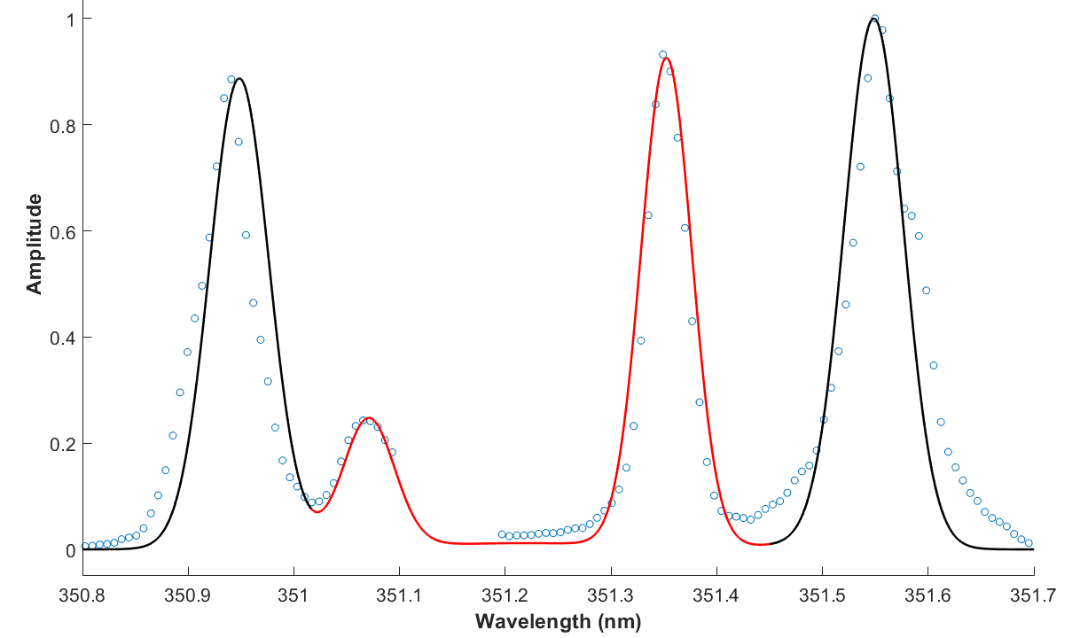
Thomson-scattering can be utilized to reveal the non-uniformities in plasma conditions driven by the intense speckles of a beam using a DPP
Both Beams
Z = 15
n_{e} = 6.85 x 10¹⁹ 1/cc
T_{i} = 0.19 keV
Low Power Beam
I₀ = 0.5 x 10¹⁵ W/cm²
T_{e} = 0.81 keV
m = 2.9
High Power Beam
I₀ = 5 x 10¹⁵ W/cm²
T_{e} = 0.92 keV (+14%)
m = 3.2 (+0.3)

Slide 21
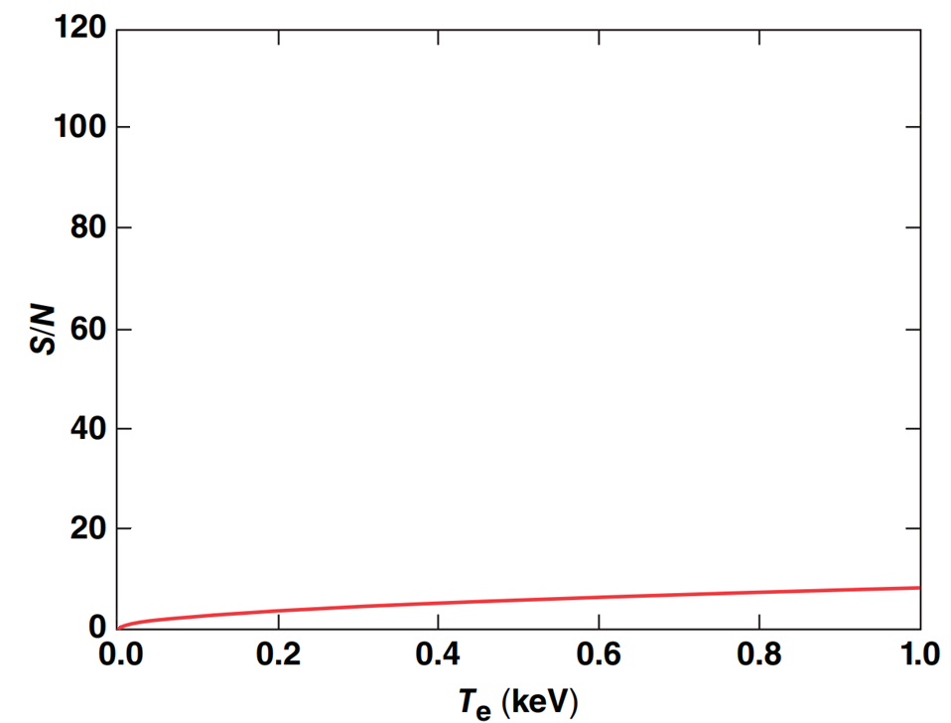
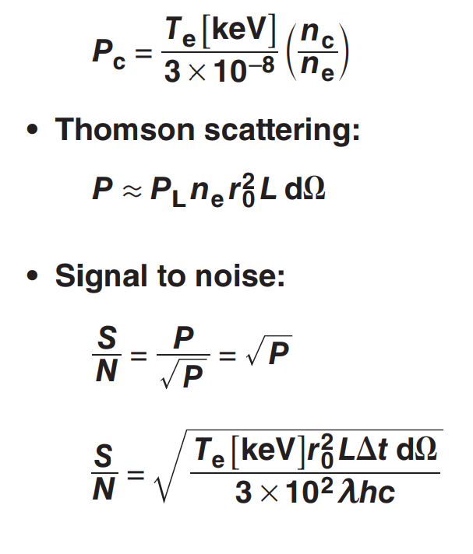
Utilizing phase plates in Thomson-scattering probes dramatically increase the achievable signal-to-noise
Notes:
Setting the thomson probe power to pcr we find that we can calculate the snr using poisson statistics and find that snr is only a function of electron temperature

Slide 22
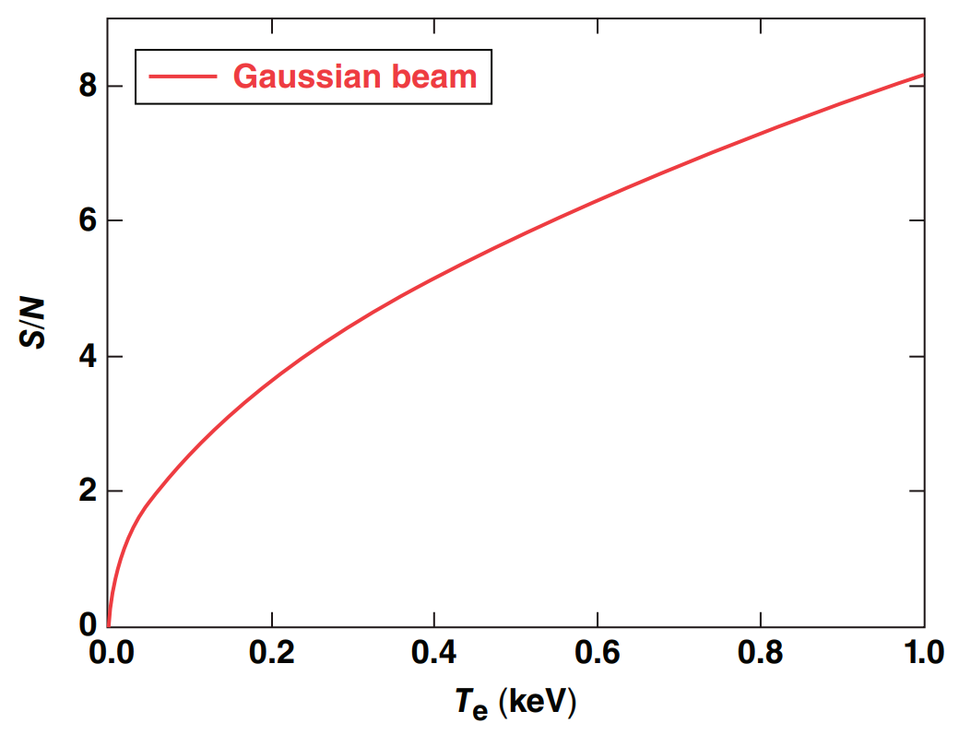
Utilizing phase plates in Thomson-scattering probes dramatically increase the achievable signal-to-noise
Phase plates increase S/N ~ x10 (P_{cr,DPP} / P_{cr} ~ 100)
Notes:
When a phase plate is added to the probe pcr is increased by nearly a factor of 100 which means the snr can be increased by approximately 10 without exceeding the threshold for self focusing

Slide 23
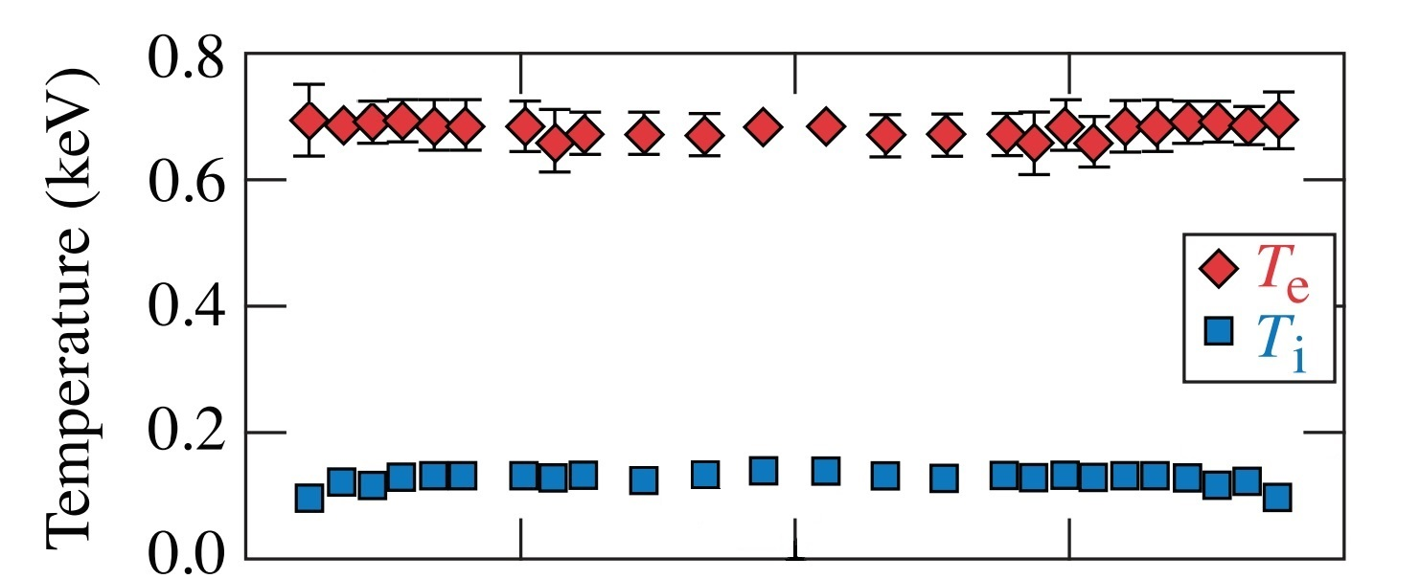
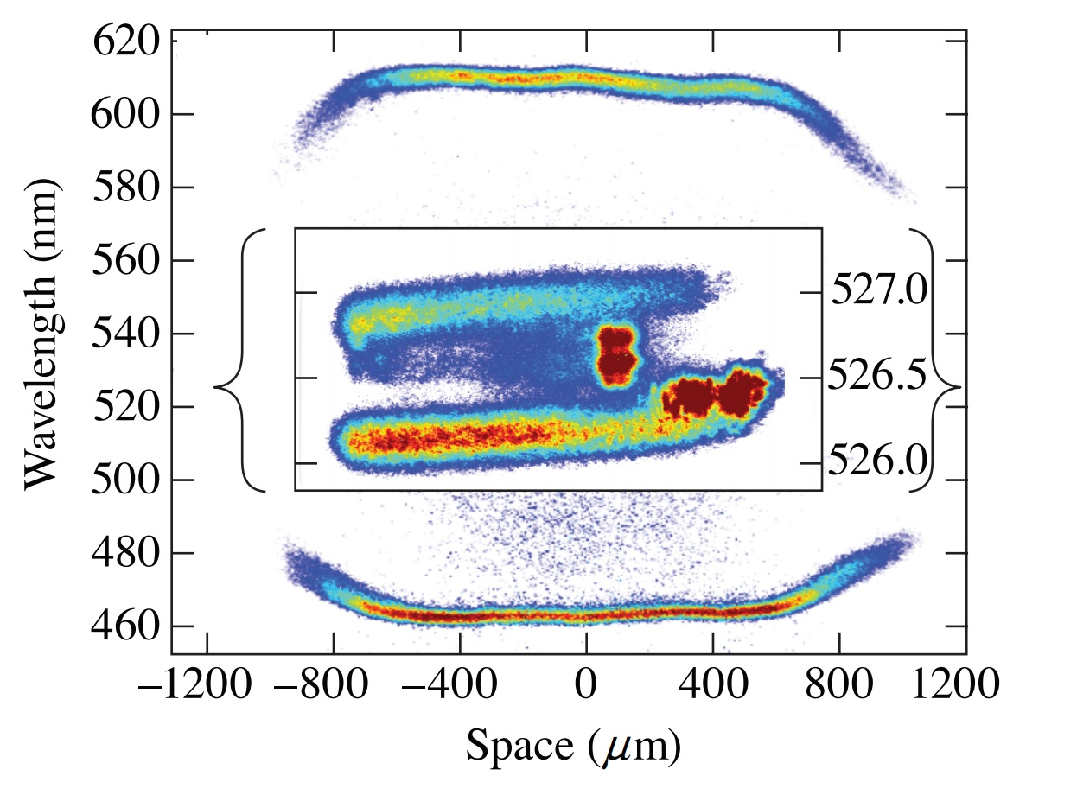
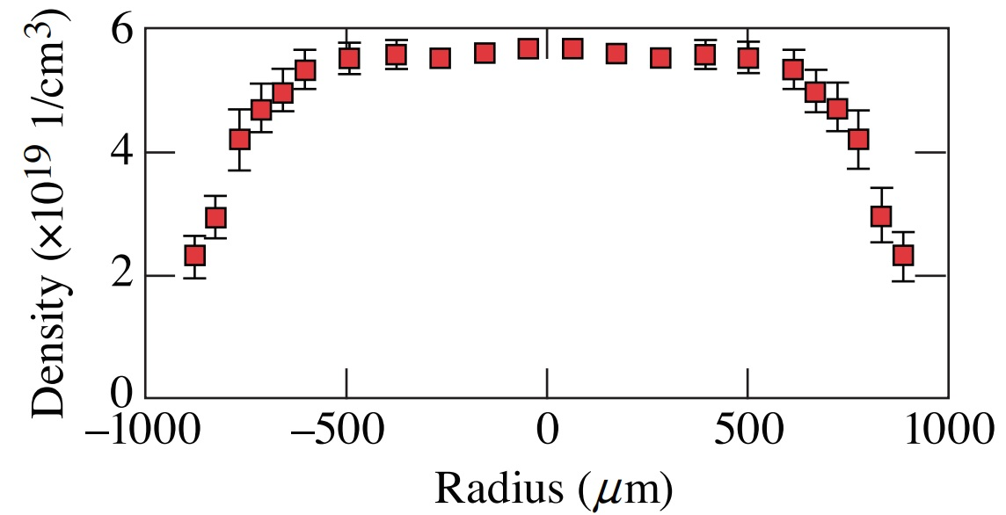
The implementation of phase plates on the OMEGA LPI platform enabled exceptional characterization of the target plasma
Notes:
Explain imaging thomson scattering
By using dpp the probe beam can propopagate efficiently across the a long range in the plasma allowing us to collect high quality imaging thomson data

