Slide 1
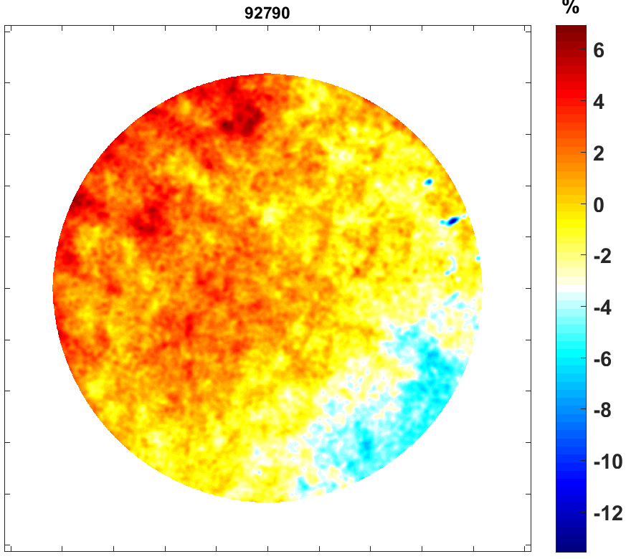
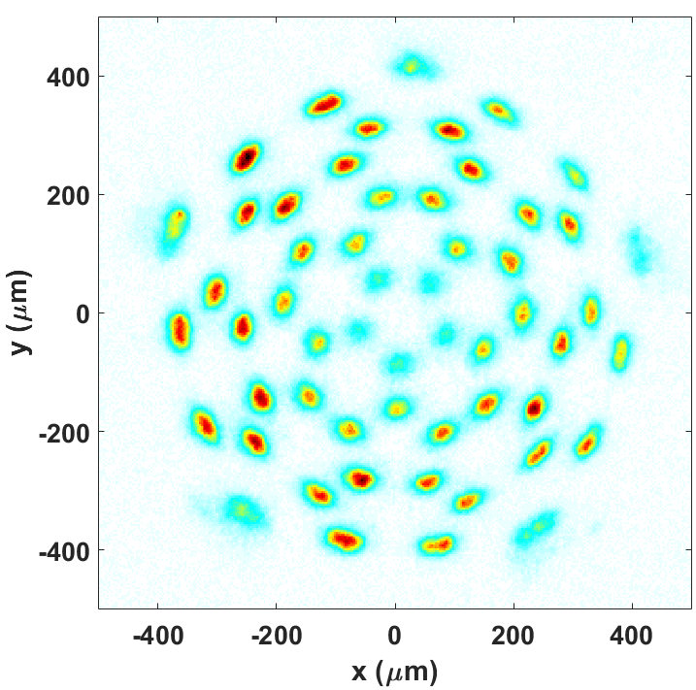
Anomalous asymmetry of unabsorbed light in OMEGA implosions
Image of the scattered light variation across an OMEGA port
CBET beamlets image

Slide 2
Unabsorbed light measurements may indicate some LPI process is causing anomalously large variations in absorption around the target
Uniform laser energy absorption is essential for successful laser direct drive implosions
If absorption is uniform, the unabsorbed light scattered around the target chamber should be uniform as well
Multiple different diagnostics on OMEGA show an anomalously large variation in scattered light around the target chamber (tens of percent)

Slide 3
Collaborators
D. H. Edgell, R. Bahr, J. Katz, and D. H. Froula
University of Rochester
Laboratory for Laser Energetics

Slide 4
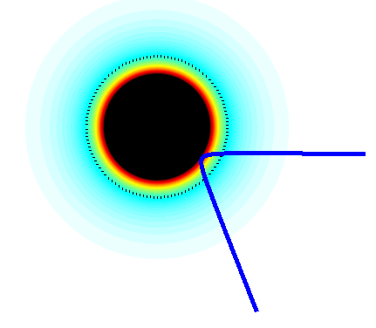
Uniform laser energy absorption is essential for successful laser direct drive implosions
  1% rms intensity balance on target required for inertial confinement fusion¹
Quasi-uniform absorption is realized by multiple symmetric overlapping beams
Energy is deposited through inverse Bremsstrahlung absorption along the beamlet path
1. V.N. Goncharov et al., Plasma Phys. Control. Fusion 59,014008 (1017)

Slide 5
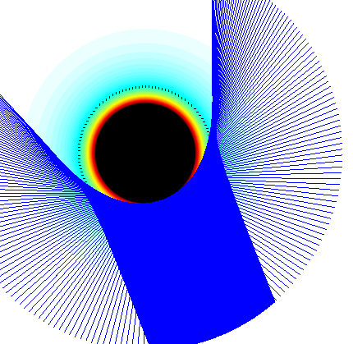

The energy absorbed in the target is diagnosed by measured the amount of unabsorbed light that leaves the target
unabsorbed light from a laser beams are scattered over the target chamber surface
Scattered Light Diagnostic
For multi-beam implosions, the overlapped unabsorbed light is quasi-uniformly spread over the target chamber

Slide 6
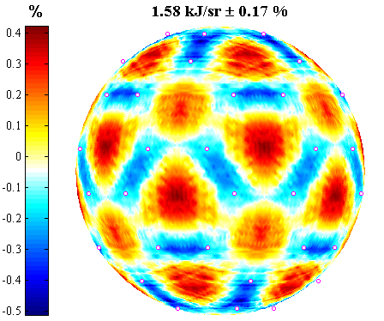
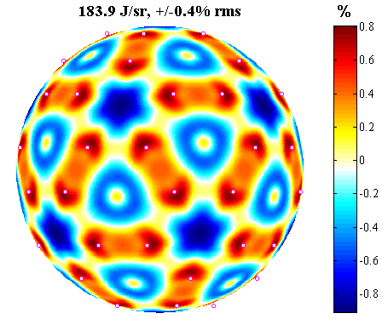

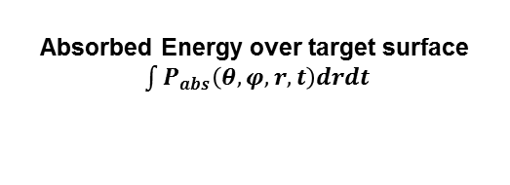
Calculated total absorbed and scattered energy shows a variation a few tenths of a percent over the surface when crossed beam energy transfer (CBET) is ignored
Absorbed Energy over target surface
$\int{P_{abs}\left(θ,φ,r,t\right)drdt}$
Scattered Energy over chamber surface $\int{P_{scat}\left(θ,φ,t\right)dt}$
23kJ, 1ns-square pulse

Slide 7
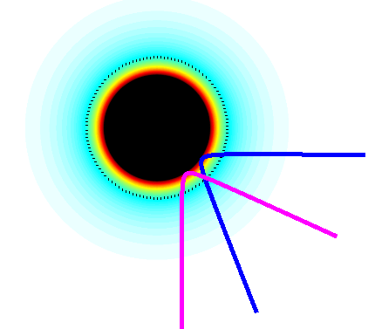
Crossed beam energy transfer (CBET) redistributes the laser energy from uniform illumination and reduces the total energy absorbed.
In symmetric implosions CBET transfers power from the center to the edge of a beam
When two beamlets cross energy can be exchanged via ion acoustic beat waves.

Slide 8
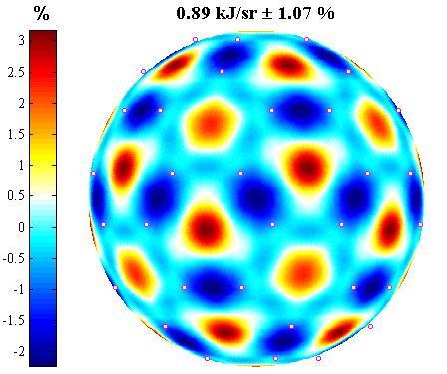
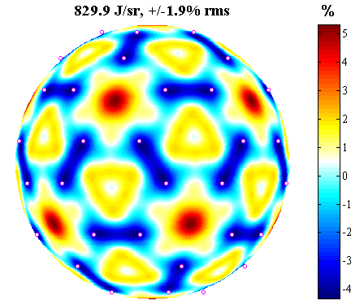
Calculations including CBET predict higher variations of a few percent in total absorbed and scattered energy over the surface
Absorbed Energy over target surface
$\int{P_{abs}\left(θ,φ,r,t\right)drdt}$
Scattered Energy over chamber surface $\int{P_{scat}\left(θ,φ,t\right)dt}$
23kJ, 1ns-square pulse

Slide 9
Large imbalances in the total scattered light measured by calorimeters have been observed
Diagnostic hardware was swapped after 5 shots: Trend continued unchanged
calorimeters are the primary scattered light diagnostics used to calculate the laser absorption

Slide 10
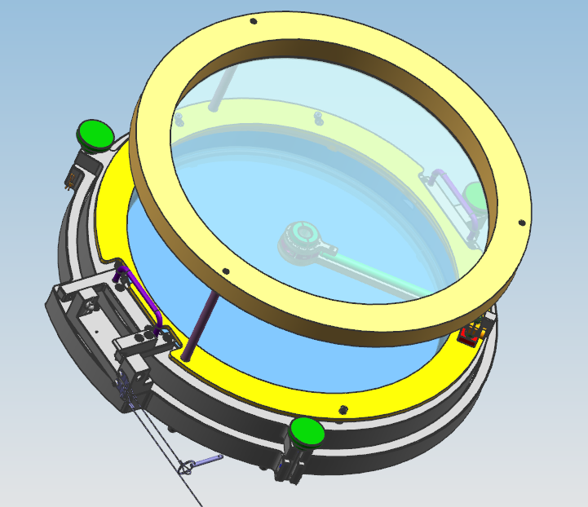
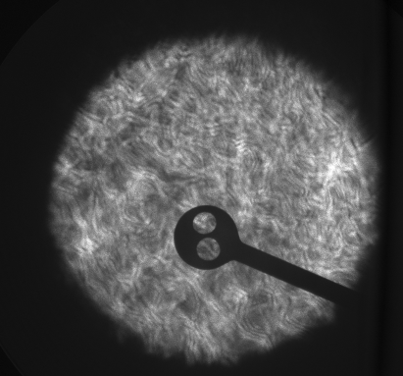
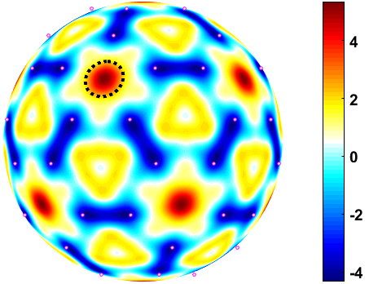
The P9-TBD Transmitted Beam Diagnostic provides an image of the time integrated scattered light over a port on the chamber surface
Port Area
%
~30cm Beam
P4 Vacuum Window and Diffuser Assembly
images the UV light incident on a diffuser plate in the port opposite the TOP9 beam
< 3% variation in scattered light centered on port predicted

Slide 11
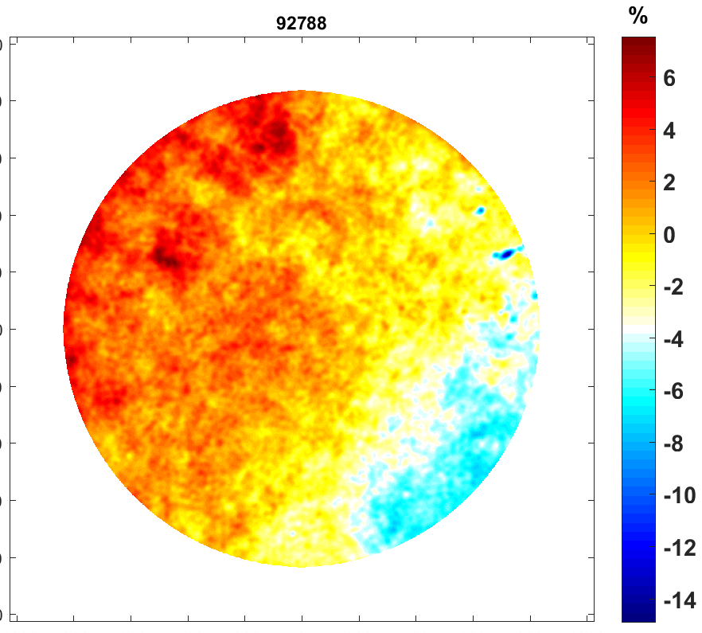
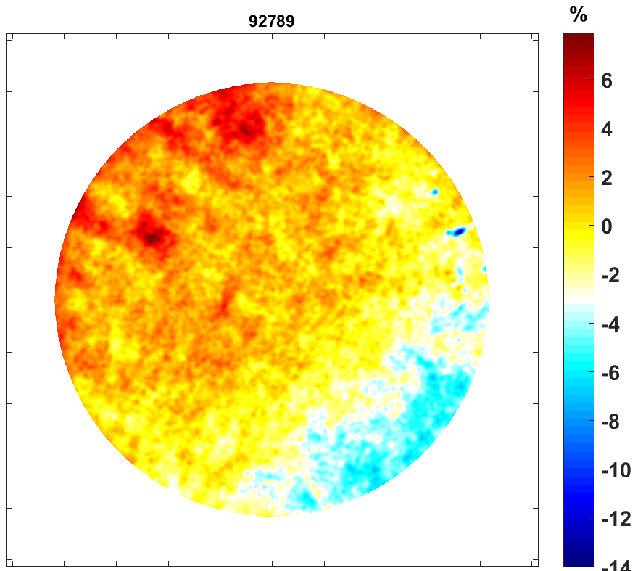
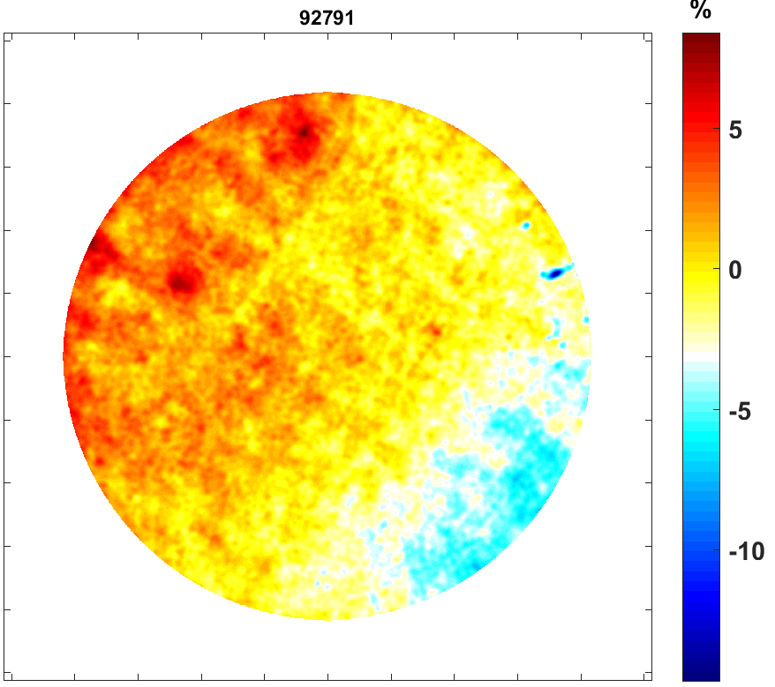
P9-TBD images show a large (~10%) and consistent variation in scattered light across the observation port
~38.5 cm
~13.6°
Four similar shots on same day show a similar variation pattern
Pattern is not symmetrically centered on port as would be expected from the beam symmetry.

Slide 12
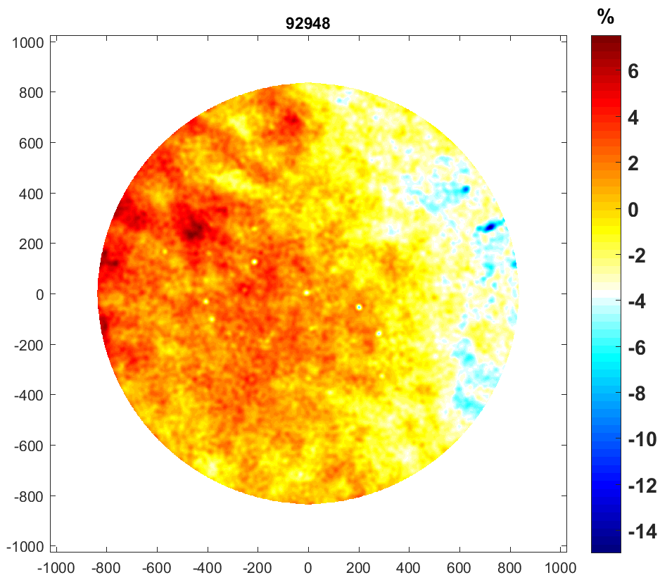
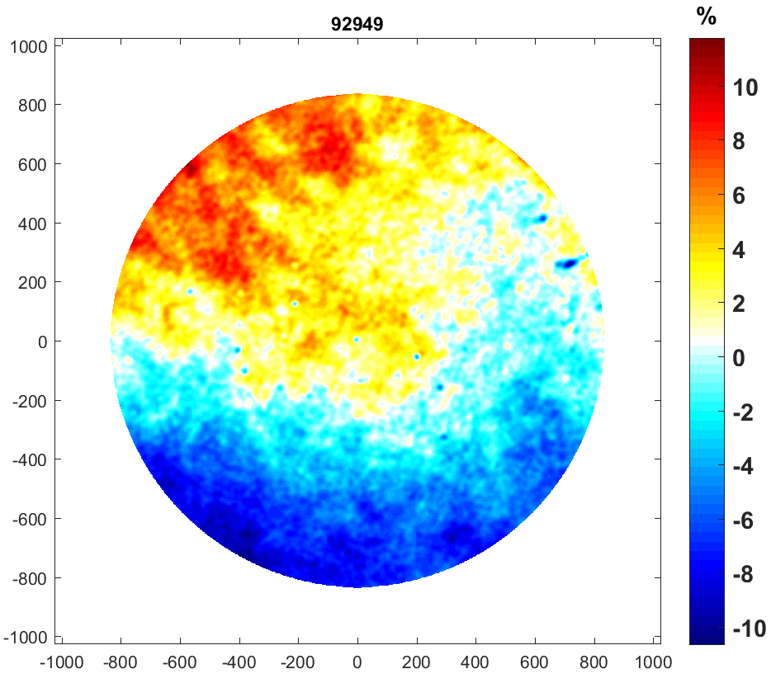
The observed scattered light variation across the port is different for different pulse shapes
22kJ, 1ns-square pulse
22kJ, triple picket shaped pulse

Slide 13
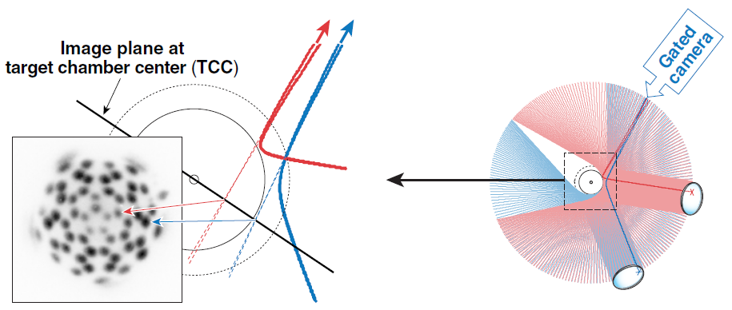
The CBET beamlets diagnostic records scattered-light intensities each from a unique light path and from a different OMEGA beam

Slide 14
In a symmetric implosion, all beamlets in a radial “group” have equivalent pathways and interactions so they should have similar intensities

Slide 15
Differences of 10’s of percent are observed between beamlet spots that should have identical intensities in a symmetric implosion

Slide 16
Differences of 10’s of percent are observed between beamlet spots that should have identical intensities in a symmetric implosion

Slide 17
The intensity pattern has been observed to persist for different shots and different times
Inner rings variation could be counting statistics but the persistent pattern in outer ring intensity indicates it is not due to counting statistics

Slide 18
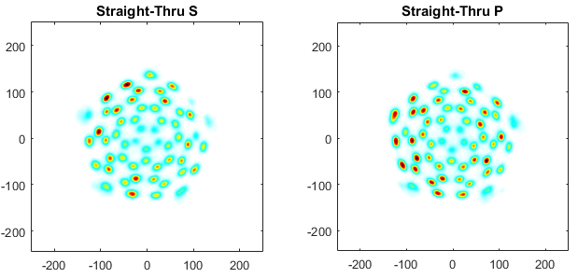
Separate spot patterns for orthogonal polarizations show similar patterns but also indicate that beamlets are polarized

Slide 19
Separate spot patterns for orthogonal polarizations show similar patterns but also indicate that beamlets are polarized
Is polarization imbalance from the laser system or is it being altered by LPI (CBET?)

Slide 20
Unabsorbed light measurements may indicate some LPI process is causing anomalously large variations in absorption around the target
Uniform laser energy absorption is essential for successful laser direct drive implosions
If absorption is uniform, the unabsorbed light scattered around the target chamber should be uniform as well
Multiple different diagnostics on OMEGA show an anomalously large variation in scattered light around the target chamber (tens of percent)

