Slide 1
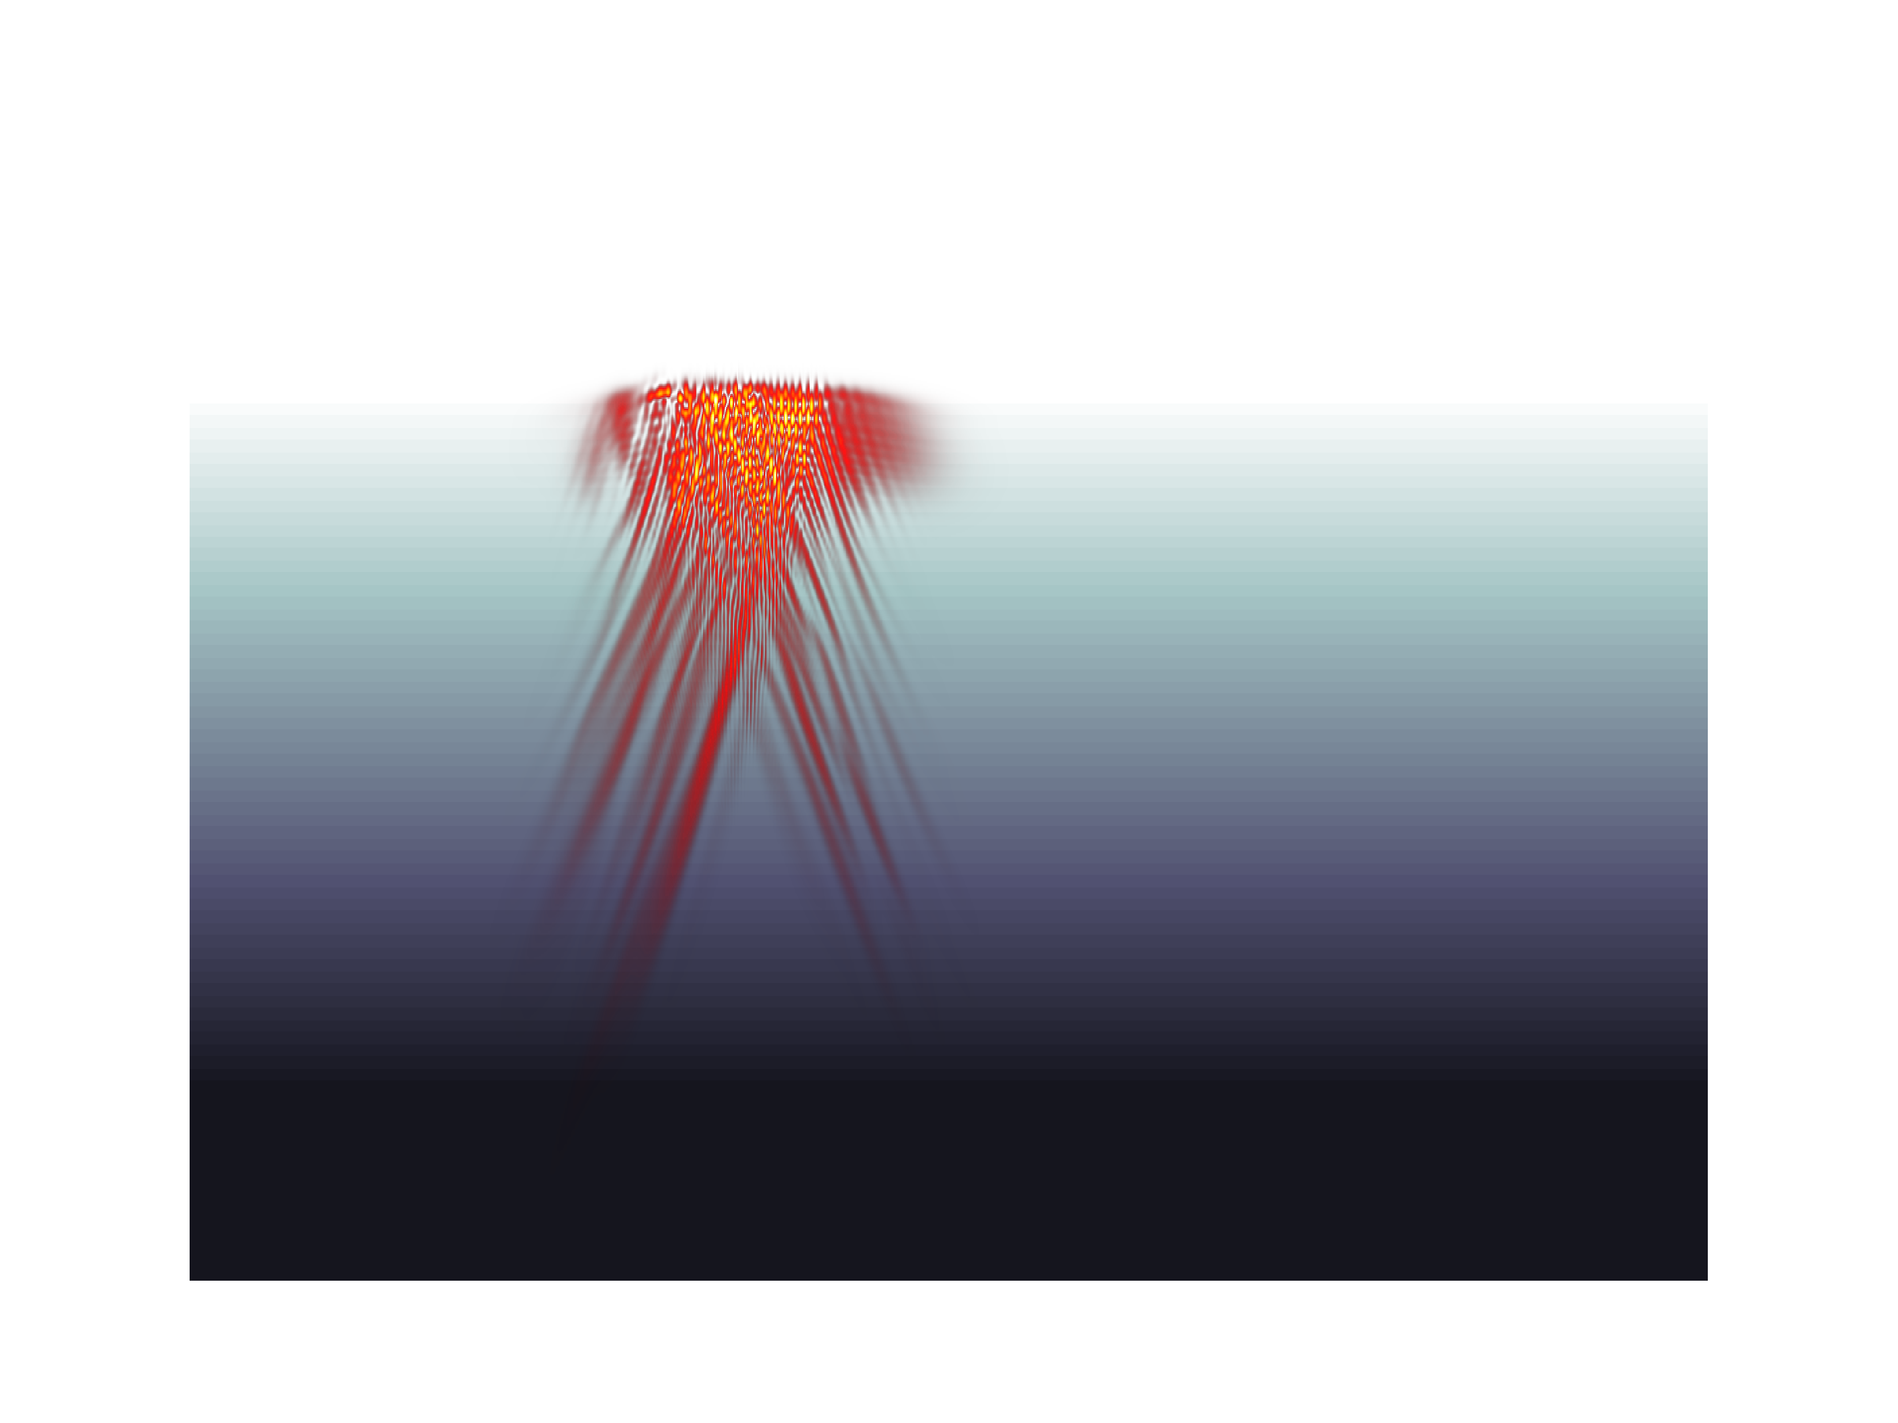
Resonance absorption of a broadband laser pulse
J.P. Palastro, J.G. Shaw, R.K. Follett, A. Colaïtis,
D. Turnbull, A. Maximov, V.N. Goncharov, D.H. Froula
48th Anomalous Absorption Conference
Bar Harbor, ME July 9th 2018

Slide 2
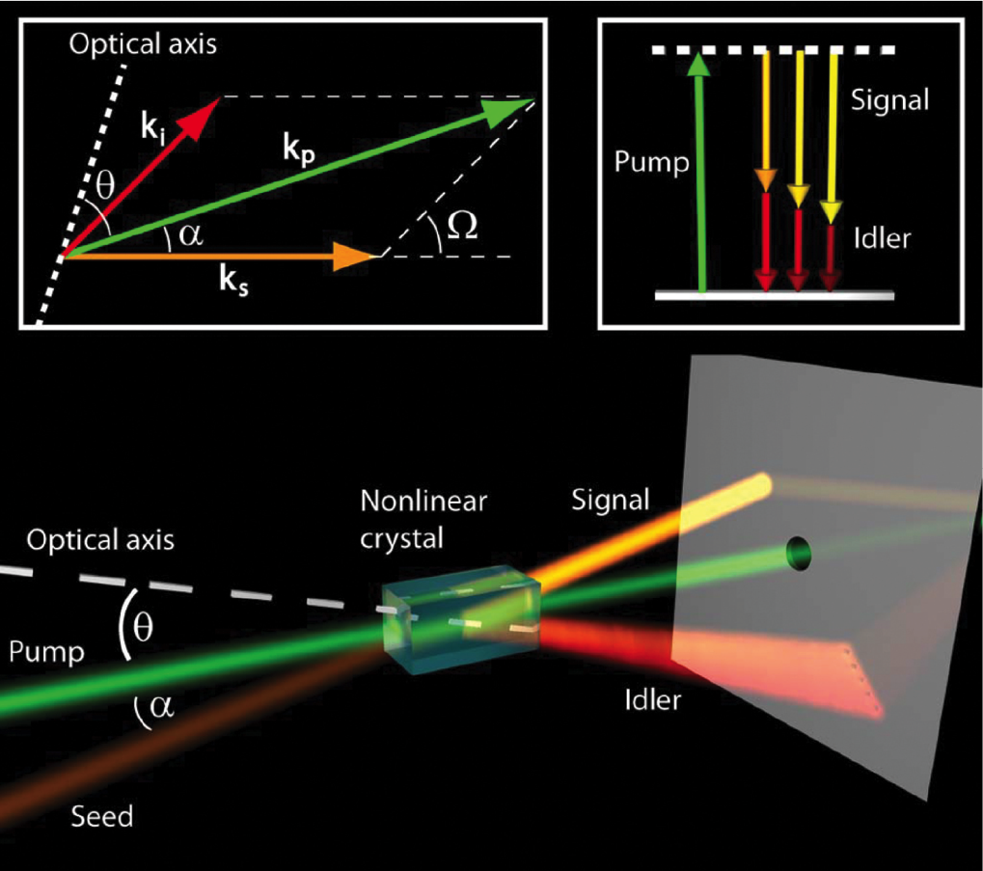
The advent of high-power optical parametric amplifiers has renewed interest in long-wavelength drivers
Optical parametric amplifiers create broadband, infrared light (~1ω)
This presents a tradeoff:
The broad bandwidth suppresses CBET, absolute TPD, and absolute SRS, but
precludes efficient conversion to 3ω,
where LPIs are weaker
Does operation at 1ω or 2ω exacerbate effects such as resonance absorption?
*
*S. Witte and K. Eikema, IEEE J. of Sel. Top. in Quant. Elec. (2011).

Slide 3
Resonance absorption is a fundamental mechanism for the deposition of electromagnetic energy in plasmas
Resonance absorption occurs when an electromagnetic wave (EM)
resonantly excites a plasma wave at the critical surface
In direct-drive inertial confinement fusion, resonance absorption can
reduce the hydrodynamic efficiency:
Landau damping of the plasma wave creates a hot electron flux directed away from the conduction zone
2. The field enhancement at the critical surface can modify
thermal transport
The effects of resonance absorption are more prominent at longer
wavelengths—a motivating factor in the transition from 1ω to 3ω drivers

Slide 4
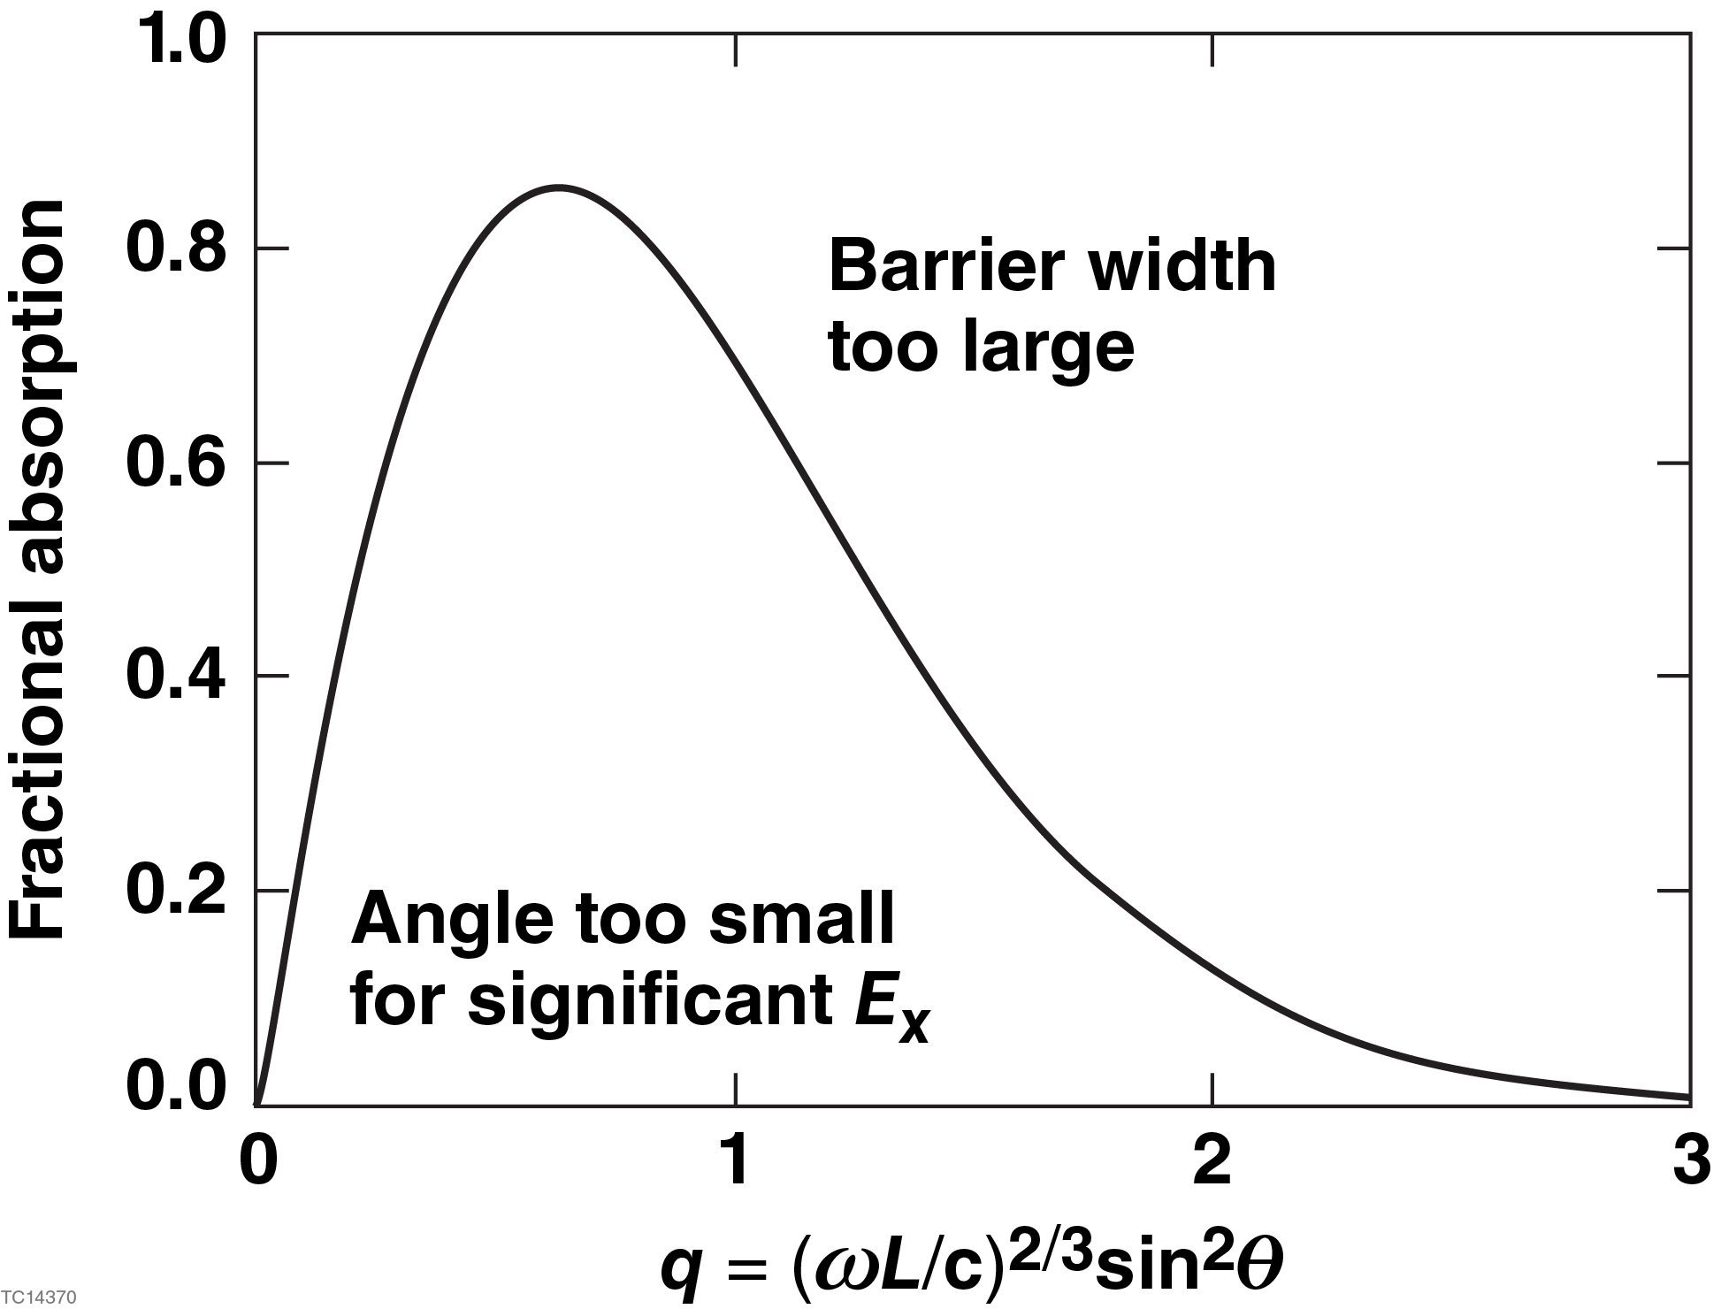
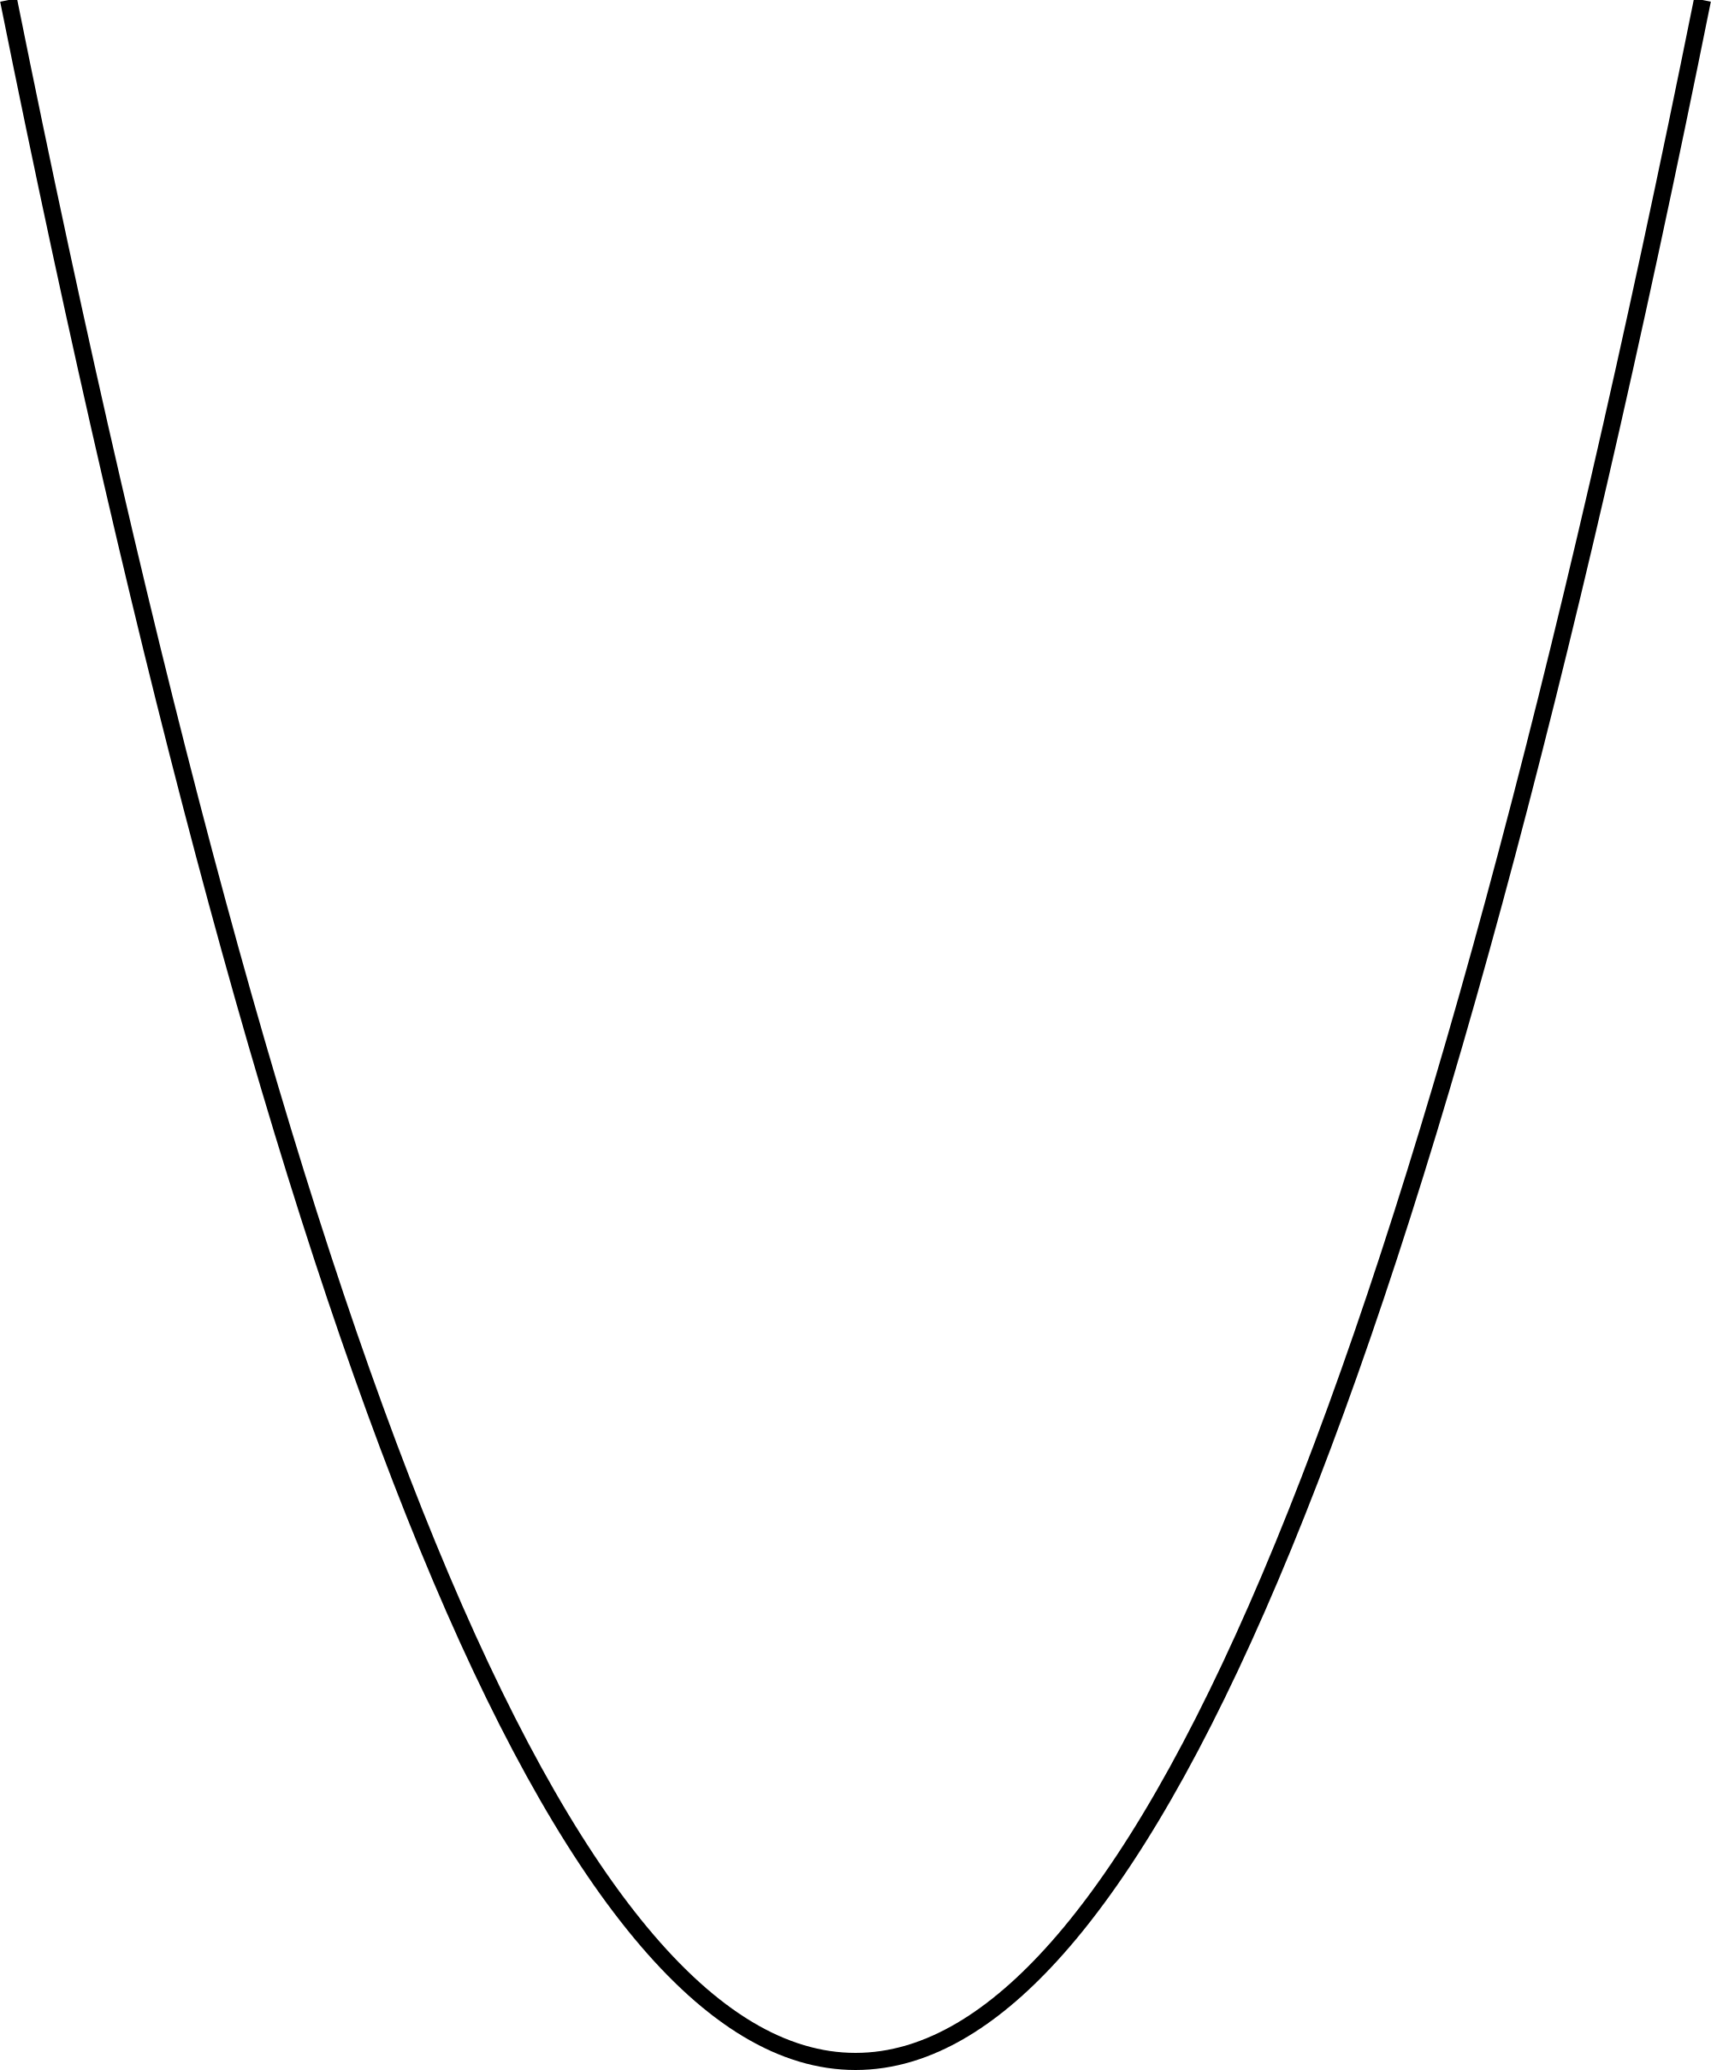
An electromagnetic wave can resonantly excite Langmuir waves in inhomogeneous plasma
Langmuir
wave excitation
n_{cr}
n_{cr}cos²θ
Tunneling
x
Incident
EM wave
Reflected
EM wave
90-θ
y

Slide 5
A resonance absorption model has been implemented in LPSE*
Time-enveloped, electromagnetic/static wave equation
*Laser Plasma Simulation Environment

Slide 6
A resonance absorption model has been implemented in LPSE*
Time-enveloped, electromagnetic/static wave equation
collisional
absorption
diffraction
dispersion
Boltzmann
current
Landau damping
*Laser Plasma Simulation Environment

Slide 7
A resonance absorption model has been implemented in LPSE*
Time-enveloped, electromagnetic/static wave equation
collisional
absorption
diffraction
dispersion
Boltzmann
current
Landau damping
The equation reduces to an electromagnetic wave equation upon
taking the curl
conversion from
ES waves
*Laser Plasma Simulation Environment

Slide 8
A resonance absorption model has been implemented in LPSE*
Time-enveloped, electromagnetic/static wave equation
collisional
absorption
diffraction
dispersion
Boltzmann
current
Landau damping
The equation reduces to an electrostatic wave equation upon
taking the divergence
conversion from
EM waves
*Laser Plasma Simulation Environment

Slide 9
A resonance absorption model has been implemented in LPSE*
Time-enveloped, electromagnetic/static wave equation
collisional
absorption
diffraction
dispersion
Boltzmann
current
Landau damping
Linear: the electric field does not couple to low-frequency density fluctuations
linear
*Laser Plasma Simulation Environment

Slide 10
A resonance absorption model has been implemented in LPSE*
Time-enveloped, electromagnetic/static wave equation
collisional
absorption
diffraction
dispersion
Boltzmann
current
Landau damping
Nonlinear: the electric field couples to low-frequency density fluctuations
nonlinear
*Laser Plasma Simulation Environment

Slide 11
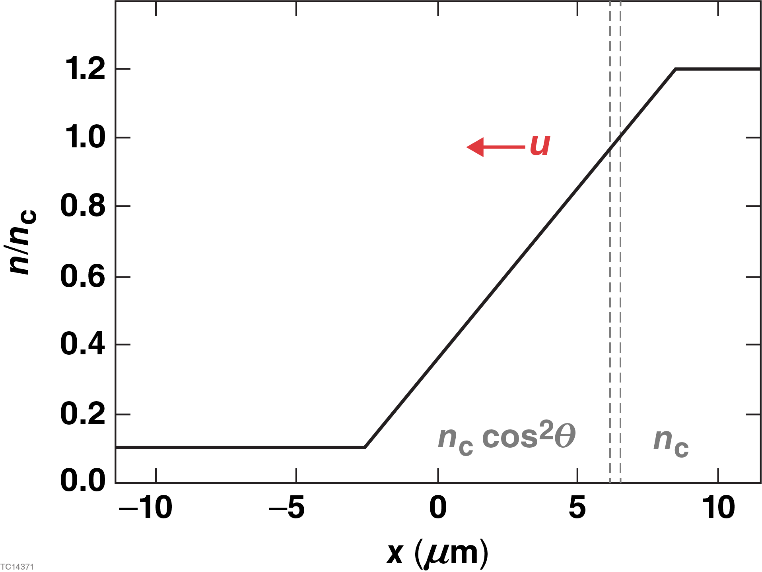
The simulation parameters are based on the plasma conditions after the first picket in a CH capsule design
Laser parameters
Plasma profile
λ = 1.054 nm
spot size = 6 μm
SG4
Plasma parameters
scale length: 10 μm
ZT_{e}/T_{i} = 3.1
Zm_{e}/m_{i} = 3x10⁻⁴
u = 0.5 c_{s}

Slide 12
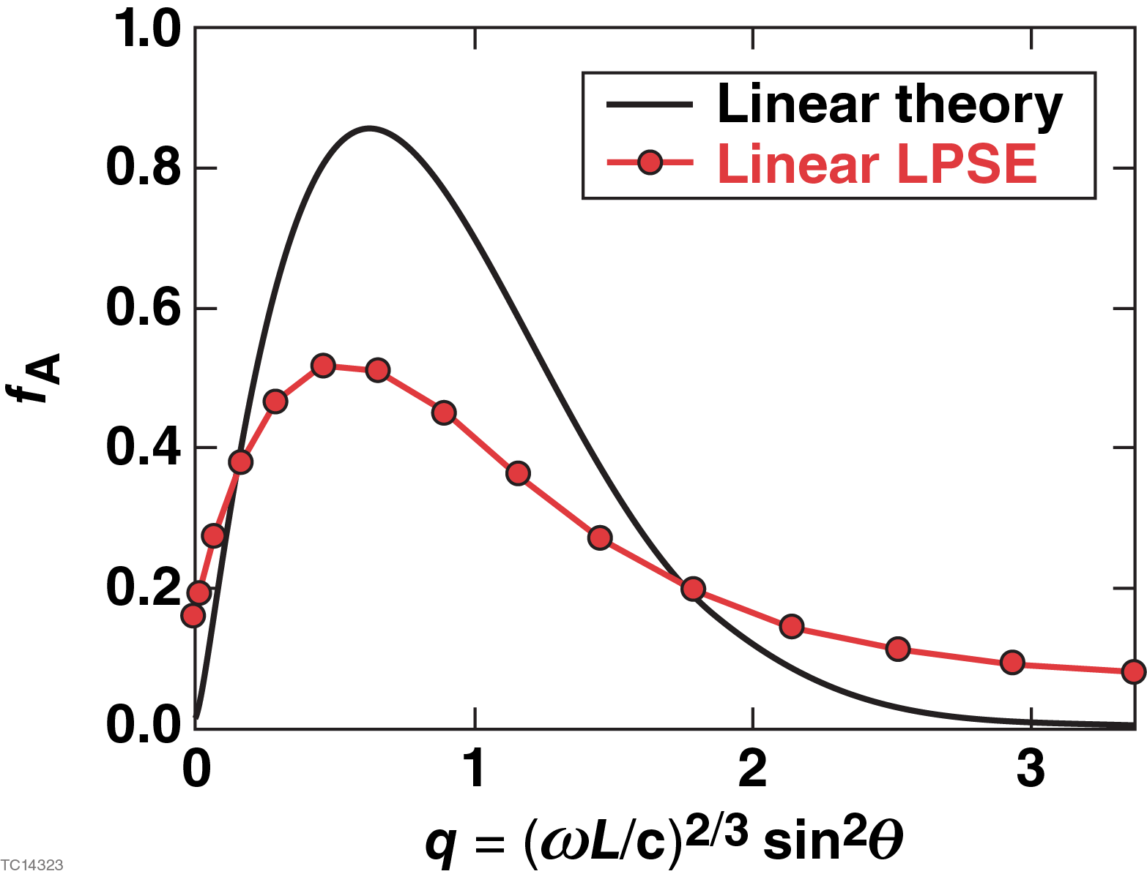
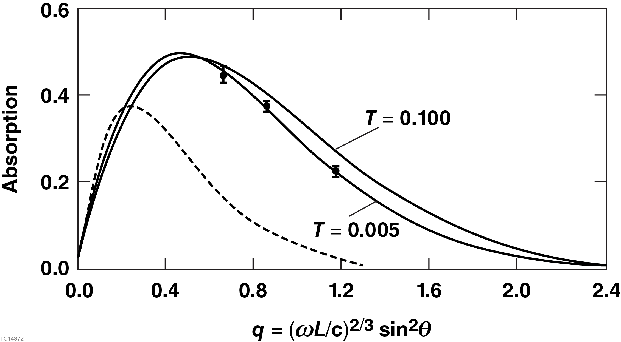
LPSE reproduces the fractional absorption predicted by other linear calculations
*
Discrepancies result from the known over-prediction of absorption in linear theory and inclusion of collisional absorption and finite beam effects in LPSE
*Forslund et al., PRA 11, 670 (1975)

Slide 13
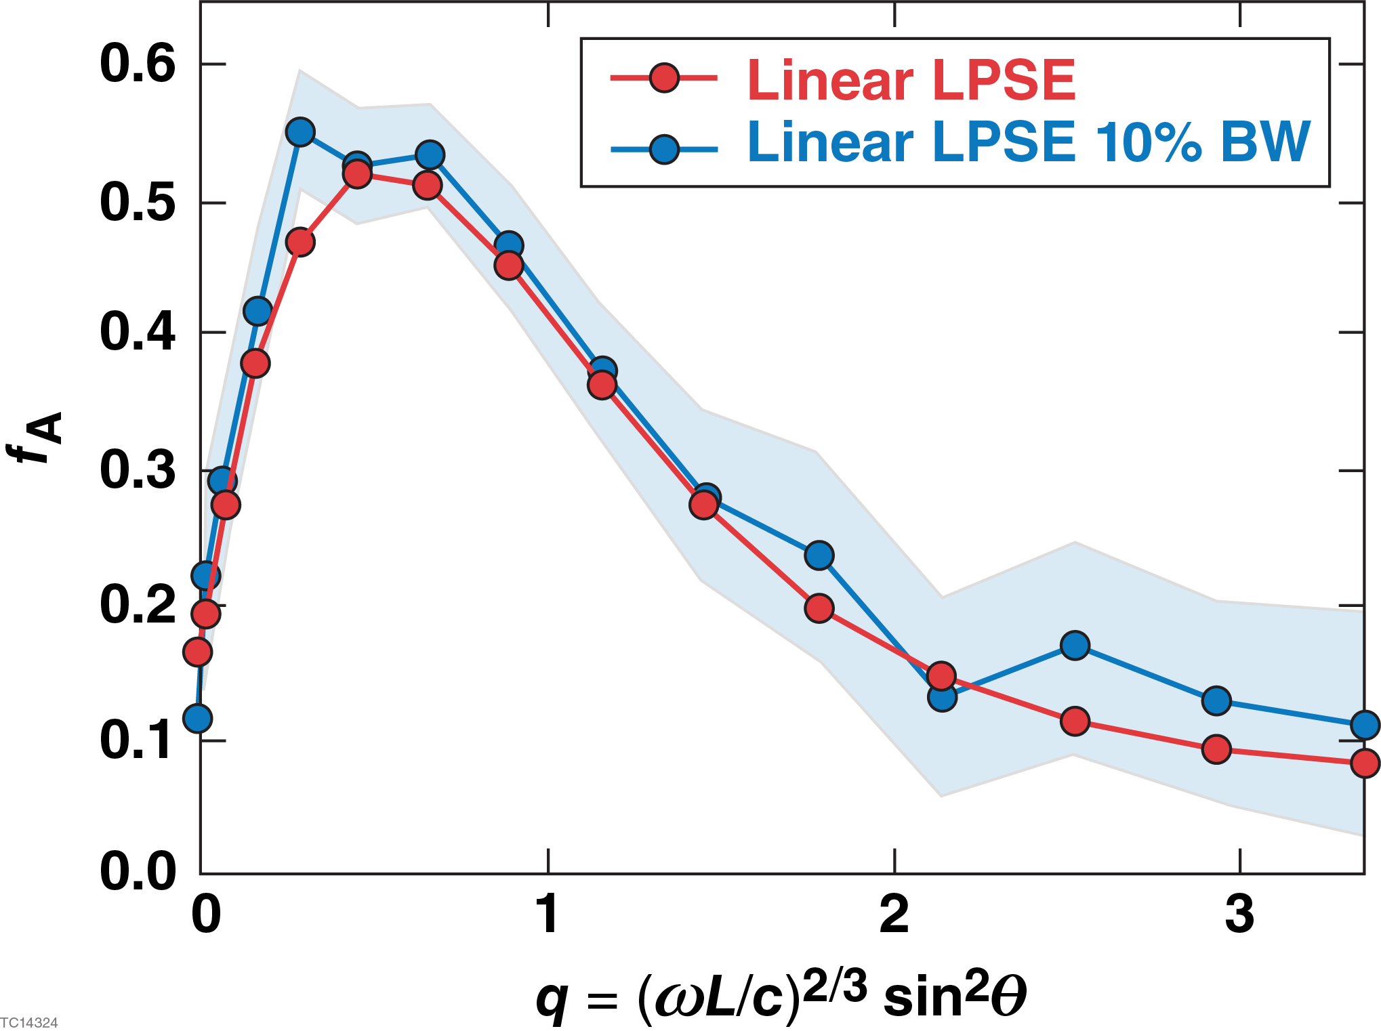
Bandwidth has no effect on the energy absorbed from resonantly excited plasma waves in the linear regime
For small scale lengths or angles
of incidence
Lower frequency EM waves convert to
plasma waves less efficiently than those
with higher frequency: the two offset,
resulting in the same total absorption
For large scale lengths or angles
of incidence
Lower frequency EM waves convert to
plasma waves more efficiently than those
with higher frequency: the two offset,
resulting in the same total absorption

Slide 14
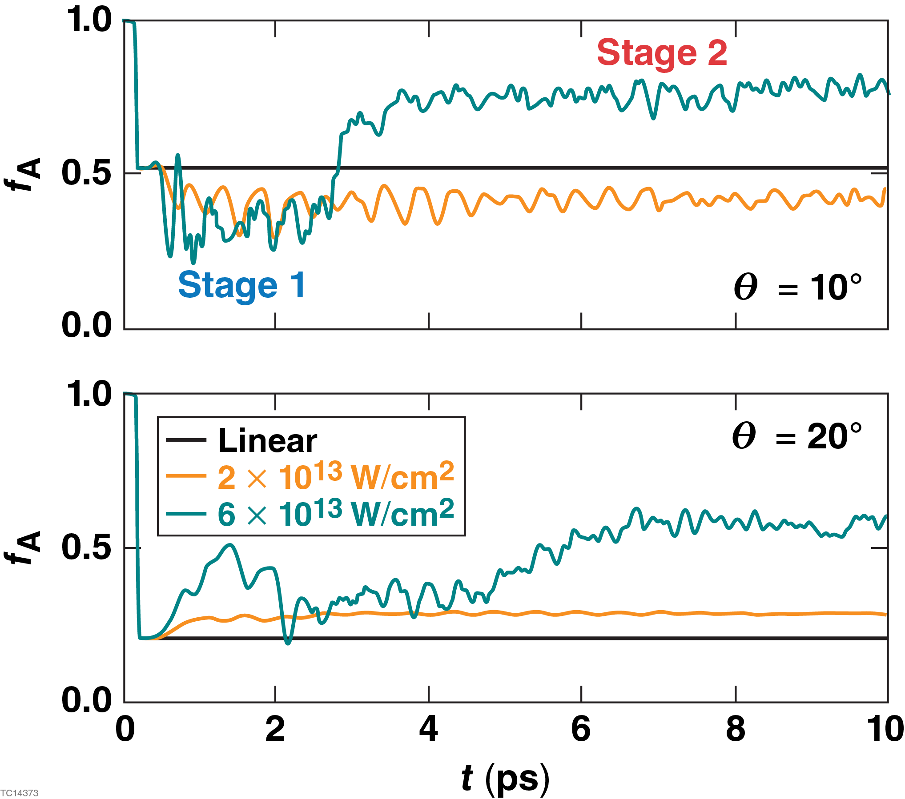
With nonlinear coupling, the absorption evolves through
two stages
In the first stage, absorption can either increase or decrease depending on the angle of incidence
In the second stage, the absorption is
significantly enhanced with respect to
the linear result
The second stage has a threshold intensity and intensity-dependent onset time, suggesting an instability is at play

Slide 15
Nonlinear movie

Slide 16
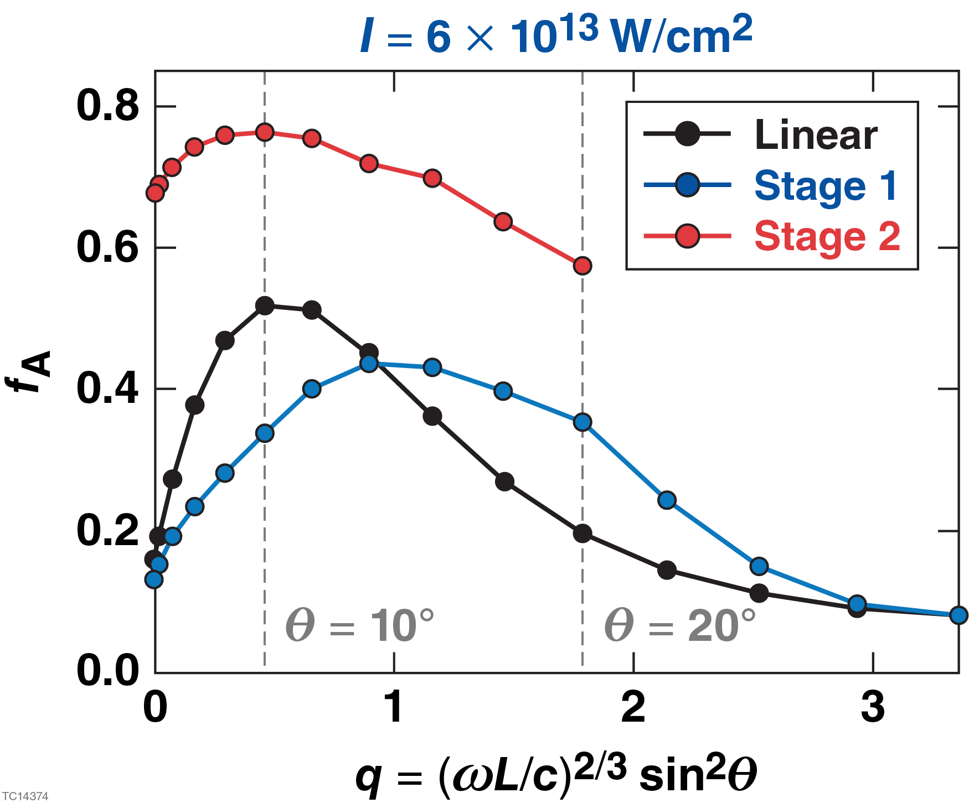
The fractional absorption depends the angle of incidence
The instability responsible for the
second stage drops below threshold for
sufficiently large incidence angles (20º)
This suggests that the transverse
component of the EM wave drives the
instability

Slide 17
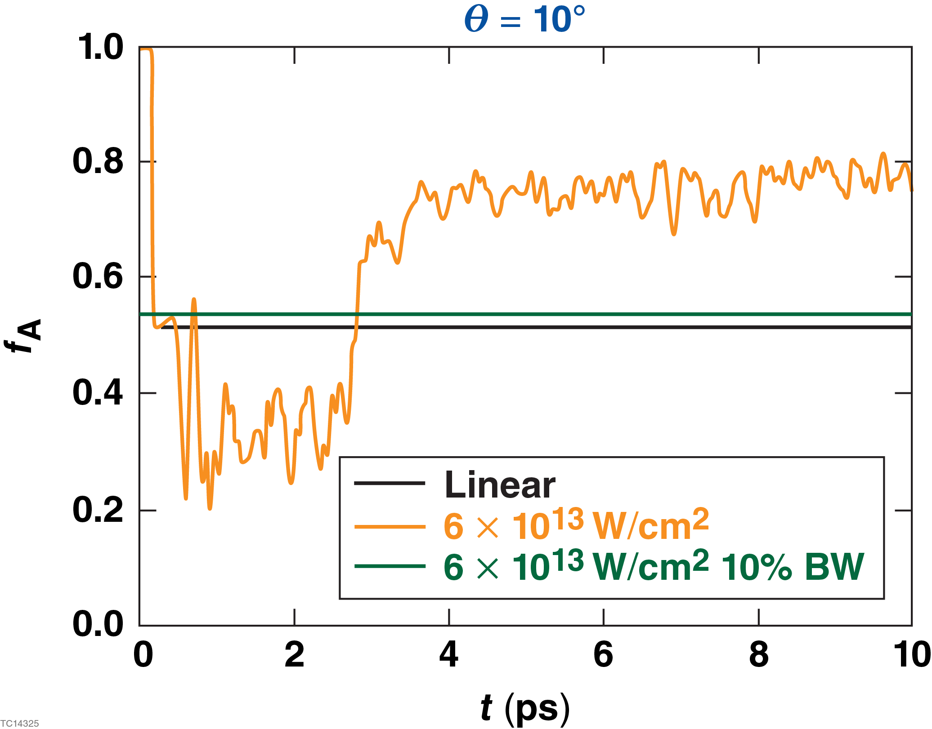
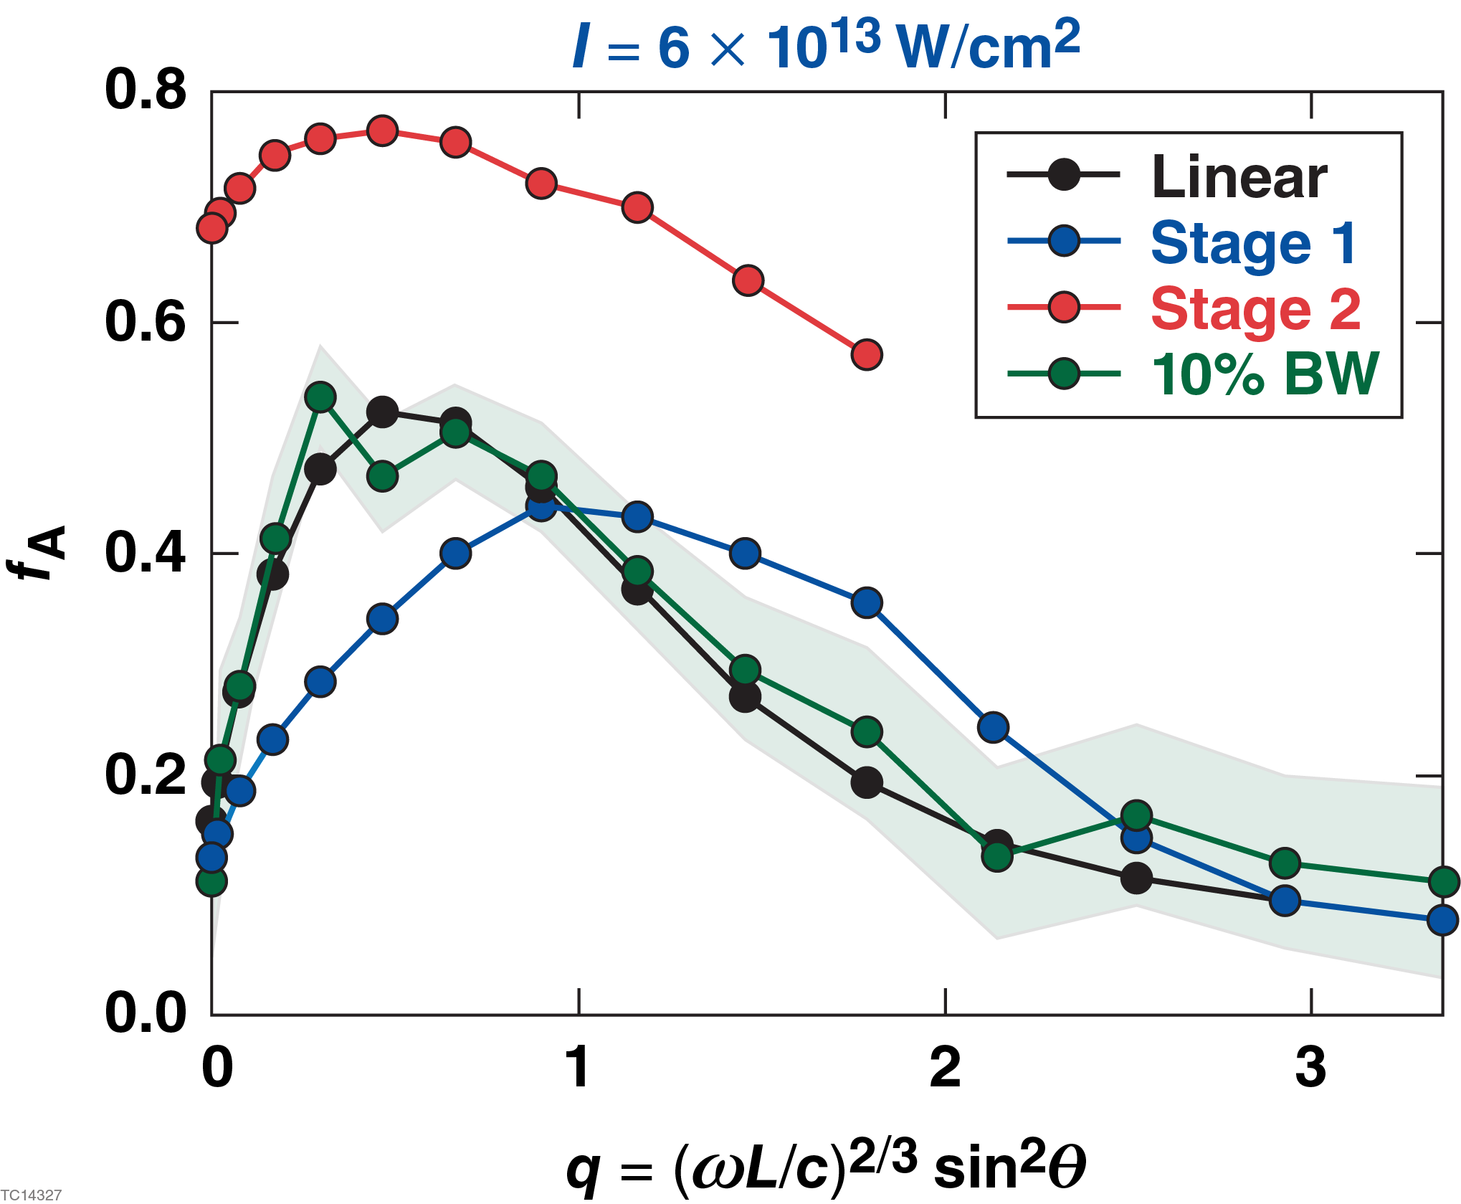
Bandwidth returns absorption to the linear levels

Slide 18
Linear movie

Slide 19
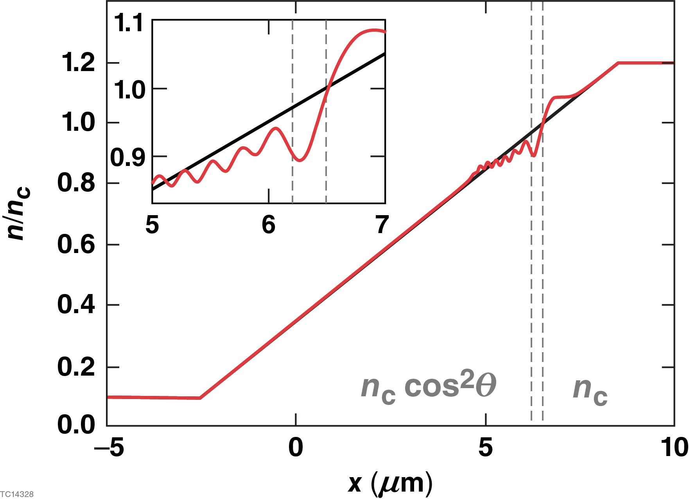
The modified absorption in Stage 1 results from profile steepening at the critical surface
The ponderomotive force of the ES
wave creates a low-frequency density
perturbation that steepens the density
profile
The steepened profile has a smaller
effective scale length, L_{eff}, which shifts
the absorption curve to larger values of
q = (ωL/c)^{2/3}sin²θ

Slide 20
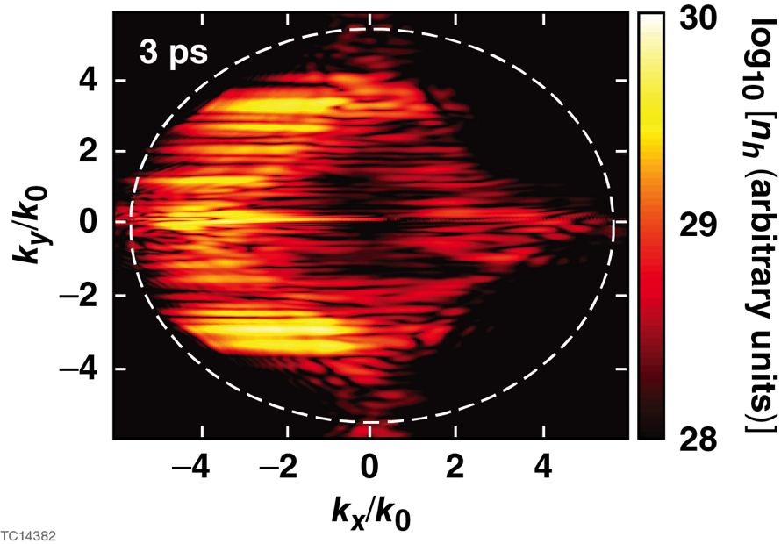
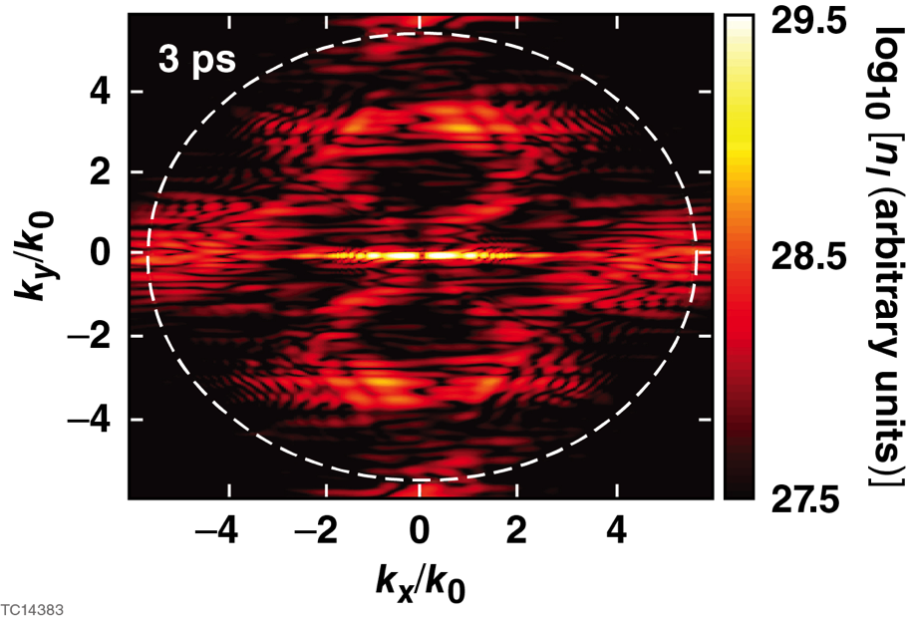
The modified absorption in Stage 2 results from the oscillating two stream instability
Oscillating two stream instability: an EM wave near its turning point decays
into a low-frequency fluctuation and an electron plasma wave with nearly
equal and opposite transverse wavenumbers
The transverse fluctuations enhance the
conversion of EM waves to ES waves

Slide 21
Summary and Conclusions
OPAs* produce broadband light that substantially mitigates CBET, TPD, and SRS
The broad bandwidth cannot be frequency tripled; operation at 1ω or 2ω may exacerbate resonance absorption
Resonance absorption has been implemented in LPSE
Linear, resonance absorption is insensitive to bandwidth
Nonlinear, resonance absorption occurs in two stages
Stage 1 results from profile steepening and increases or decreases the absorption depending on L_{eff}
Stage 2 results from the oscillating two stream instability and
increases the absorption
Bandwidth returns nonlinear, resonance absorption to linear levels
*optical parametric amplifiers

Slide 22
Backup

Slide 23
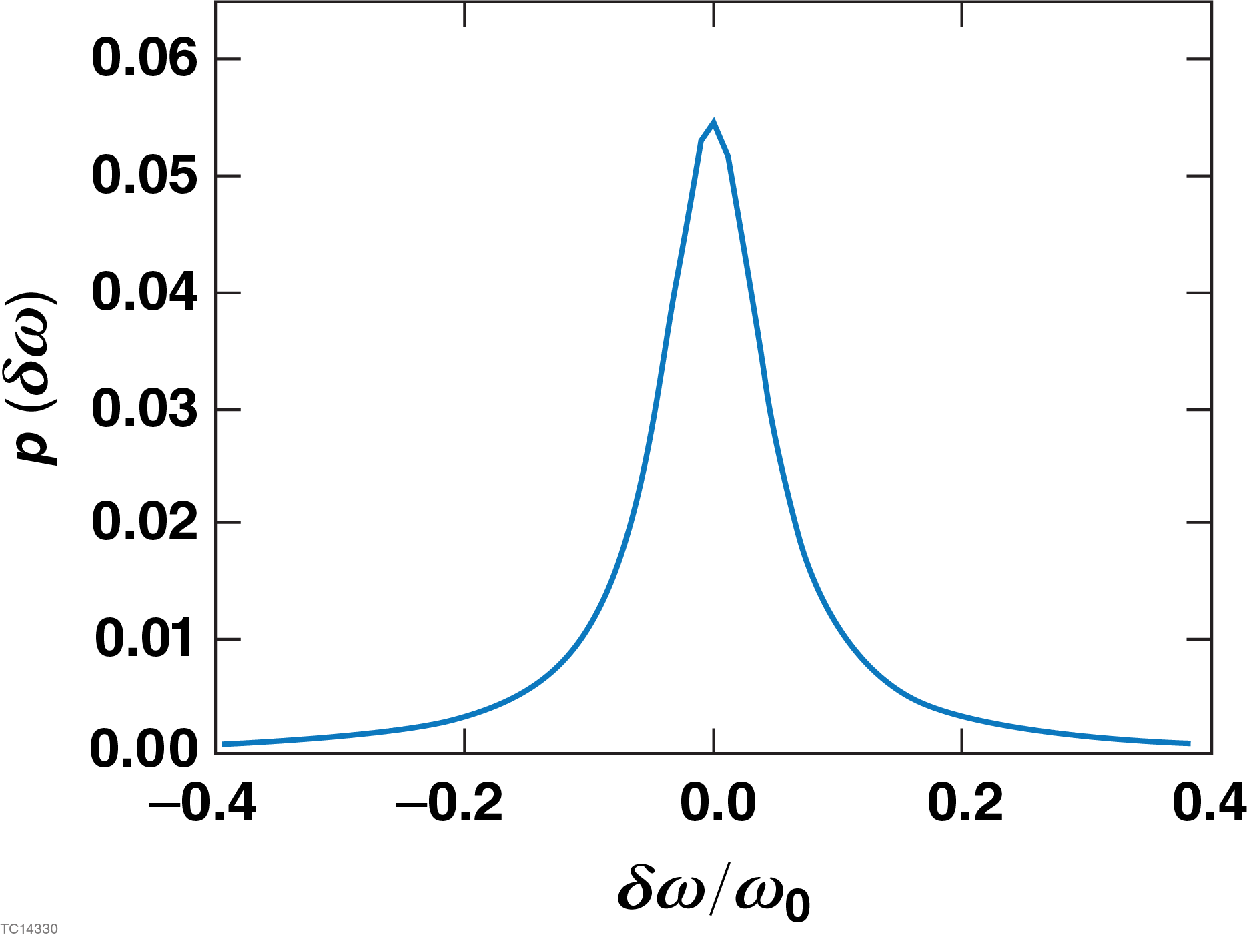
Bandwidth has no effect on the energy absorbed from resonantly excited plasma waves in the linear regime
The insensitivity of linear, resonant absorption can be shown analytically
Approximate fractional absorption at a single frequency
Total absorption fraction
(δω/ω₀)² << 1

Slide 24
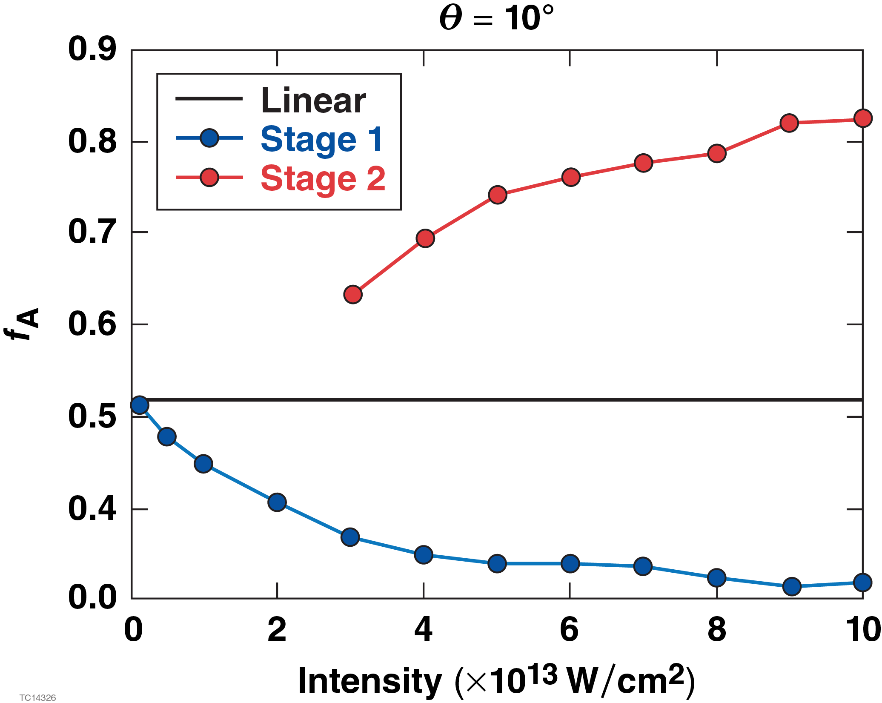
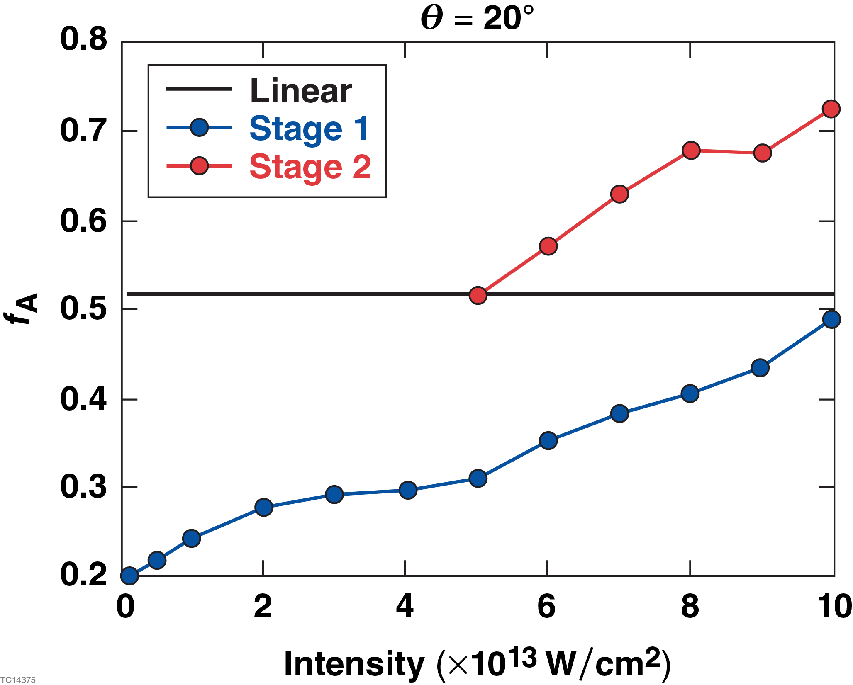
With nonlinear coupling, the fractional absorption depends on the angle of incidence and intensity

Slide 25
LPSE can simulate the propagation of relatively broadband pulses, δω/ω₀ ~ 0.1
There are many methods to generate laser
pulses with a particular type of bandwidth
Method used here:
1. Choose N ω’s from a uniform random
distribution on the interval -ω_{max} to ω_{max}
2. Choose N phases from a uniform random
distribution on the interval –π to π
3. Weight each frequency by the square root
of the desired power spectrum
4. Renormalize for the desired average intensity

