Slide 1
The Fourth-generation Laser for Ultrabroadband eXperiments

Slide 2
Solid-state laser drivers can produce the large fractional bandwidths required to mitigate laser-plasma instabilities
 | StarDriverTM | FLUX
Concept
Number of beamlines | 1,000s (concept) | 1 (in 2022)
Δω/ω (total) | 2% (existing glass) 10% (new glass development) | 1.5%
Δω/ω (per beamline) | 0.1% | 1.5%

Slide 3
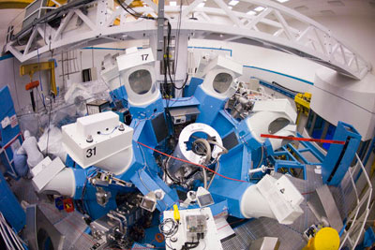
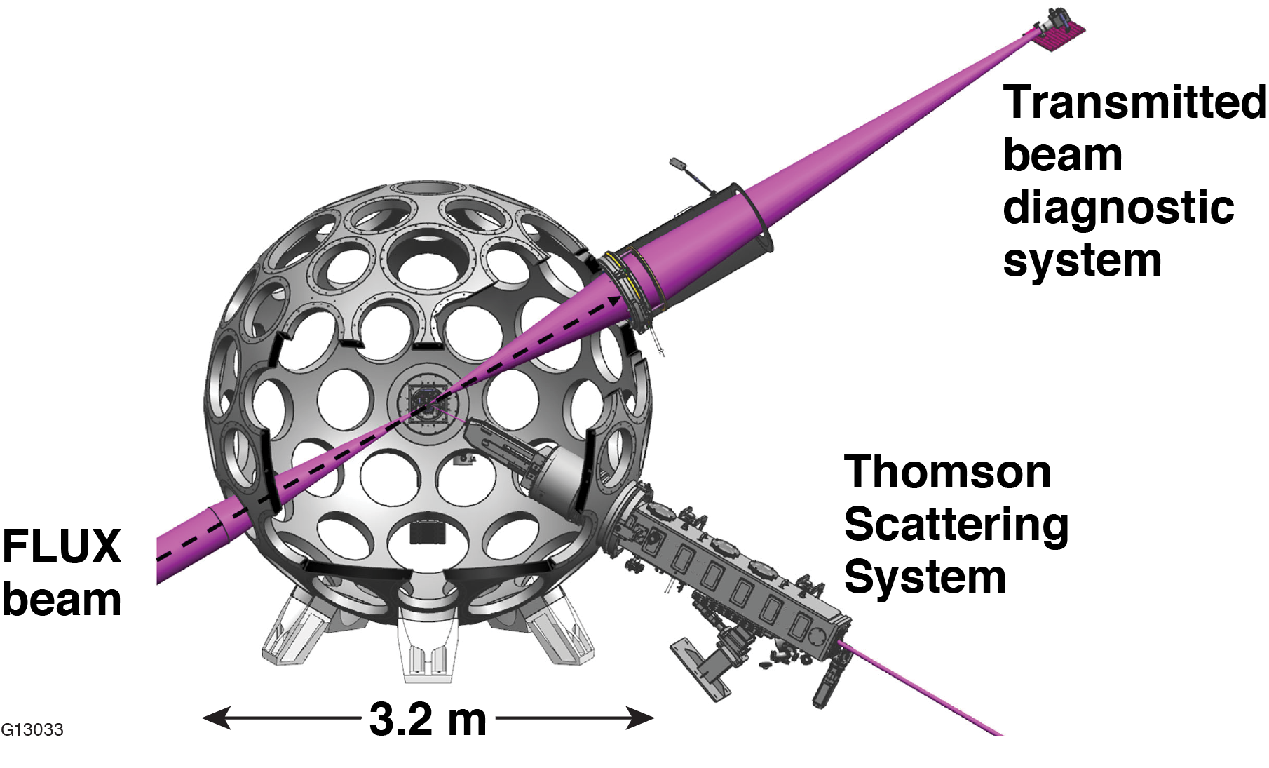
The Fourth-generation Laser for Ultrabroadband eXperiments (FLUX) is being built to investigate the mitigation of LPI and beam imprint with bandwidth
OMEGA-60 target chamber
FLUX (Fourth-generation Laser for Ultrabroadband Experiments)
Physics requirement | Specification
Central wavelength | 351 nm (3$ω$)
Fractional bandwidth Δ$ω$/$ω0$ | 1.5%
Pulse duration/shape | 1.5 ns/flat in time
Energy | 150 J
On-target power | 0.1 TW
Far-field size | Focusable to 100 $μ$m (with distributed phase plates)
On-target intensity | 10¹⁵ W/cm²
The broadband spectrally incoherent FLUX pulses will be used with the 60 narrowband OMEGA pulses to support experiments, modeling capabilities, and technology for future ICF drivers.

Slide 4
FLUX relies on parametric amplification and a novel sum-frequency-generation (SFG) scheme to generate high-energy spectrally incoherent UV pulses

