Slide 1
Broadband mitigation of laser-plasma instabilities
Stimulated Raman scattering (SRS) absolute threshold
Laser-plasma instabilities limit the laser intensity that can be used in inertial confinement fusion (ICF) implosions
The key factor in determining the effectiveness of a bandwidth scheme at suppressing instabilities is the coherence time
R. K. Follett
University of Rochester
Laboratory for Laser Energetics
A future broadband laser based on optical parametric amplifiers is currently being developed at LLE

Slide 2
Motivation
In direct-drive ICF implosions, TPD and SRS can lead to hot-electron preheat
SRS
n_{c}/4
EMW₂
EMW₁
e–
EPW
n_{c}/4
Laser
EMW: electromagnetic wave
EPW: electron plasma wave

Slide 3
There are many different bandwidth formats that can be used to suppress LPI
Lorentzian
Gaussian
Flat
Discrete bandwidth
Δω/ω₀ = 1%
Δω/ω₀ = 1%
Δω/ω₀ = 1%
Δω/ω₀ = 1%
0.35
0.3
0.25
0.2
Spectral intensity (norm.)
Spectral intensity (norm.)
Spectral intensity (norm.)
Spectral intensity (arb.)
0.15
0.1
0.05
δω/ω₀ (%)
0
-2
-1
0
1
2
δω/ω₀ (%)
δω/ω₀ (%)
δω/ω₀ (%)

Slide 4
Different bandwidth formats provide varying degrees of instability mitigation
1-D SRS absolute threshold (L_{n}=208 μm, T_{e}= 2 keV)
TPD absolute threshold
(L_{n}=208 μm, T_{e}= 2 keV)
Notes:
Matlab: m201901_lpseBandwidthThreshold_figsForPaper_v01.m
case '1a'
flag.plotVlasovThreshold = true;
groupLength = 10;
numEnsemble = 4;
useGroups = {1:8, 1:8, 1:4};
startIndex = {2, 81, 41};
sharedRuns = 1:10:31;
additionalRuns = {510:513, 518:521, 514:517, []};
vs.groupLength = 10;
vs.numEnsemble = 4;
vs.useGroups = {1:7, 1:8, 1:4};
vs.startIndex = {2, 81, 41};
vs.sharedRuns = 1:10:31;
vs.additionalRuns = {[362,364,366,368, 378:381], [386:389], [382:385]}; %Lorentzian, inject inside plasma
axisRange = [-0.2, 4.2, 1, 5.5];
legendOrder = [1,4,2,5,3,6,7];
legendStr = {'Lorentzian (LPSE)', 'Gaussian (LPSE)','Flat (LPSE)','Lorentzian (Vlasov)', 'Gaussian (Vlasov)' ...
,'Flat (Vlasov)', '0.075\times Lu SRS threshold'};
flag.normalizeToSingleBeamSrsThreshold = true;
flag.plotLuSrsThreshold = true;
LuSrsThresholdMultiplier = 0.075;
errorBarWidth = 0.04;
Shape = {'o','^','<','s','v','>','p','h','o','o'};
excelFilename = 'T:\Documents and Settings\rfollett\My Documents\Excel\2017_12_21_LPSE_SRS_runs_v06.xlsx';
primaryPath = '//fast/rfollett/LPSE/CampaignSRS6/';
legendFontsize = 10;
case '1b'
flag.plotVlasovThreshold = true;
groupLength = 10;
numEnsemble = 4;
useGroups = {1:8, 1:8, 1:4};
startIndex = {162, 241, 201};
sharedRuns = 161:10:191;
additionalRuns = {526:529,534:537,530:533};
vs.groupLength = 10;
vs.numEnsemble = [4,4,4];
% vs.useGroups = {1:7, 1:8, 1:4};
vs.useGroups = {1:9, 1:9, 1:5};
vs.startIndex = {403, 482, 442};
vs.sharedRuns = 402:10:421;
% vs.additionalRuns = {[390:391, 374:377],[398:401], [394:397]}; %Lorentzian, inject inside plasma
% vs.startIndex = {122, 201, 161};
% vs.sharedRuns = 121:10:151;
% vs.additionalRuns = {[390:391, 374:377],[398:401], [394:397]}; %Lorentzian, inject inside plasma
axisRange = [-0.2, 4.2, 1, 8.5];
legendOrder = [1,4,2,5,3,6,7];
legendStr = {'Lorentzian (LPSE)', 'Gaussian (LPSE)','Flat (LPSE)','Lorentzian (Vlasov)', 'Gaussian (Vlasov)' ...
,'Flat (Vlasov)', '0.075\times Lu SRS threshold'};
flag.normalizeToSingleBeamSrsThreshold = true;
Shape = {'o','^','<','s','v','>','p','h','o','o'};
flag.plotLuSrsThreshold = true;
LuSrsThresholdMultiplier = 0.075;
errorBarWidth = 0.04;
excelFilename = 'T:\Documents and Settings\rfollett\My Documents\Excel\2017_12_21_LPSE_SRS_runs_v06.xlsx';
primaryPath = '//fast/rfollett/LPSE/CampaignSRS6/';
legendFontsize = 10;

Slide 5
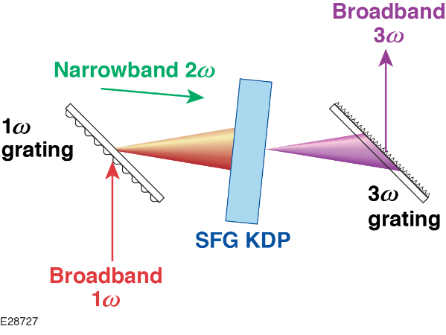
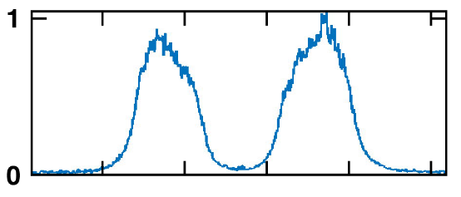
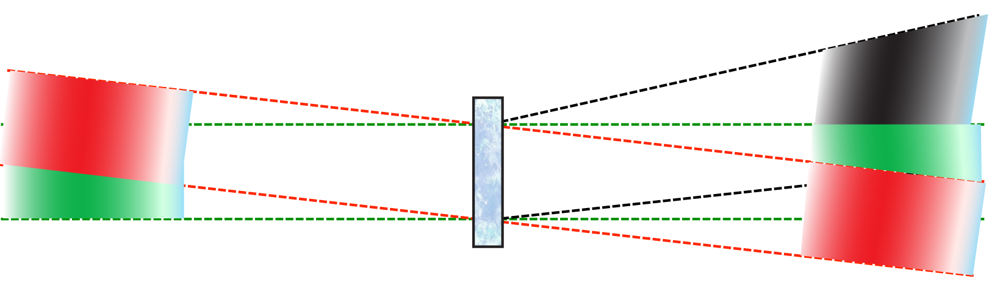

High-bandwidth technologies developed to support short-pulse lasers are being used at LLE to build a next-generation driver for ICF
Optical Parametric Amplifiers
(developed for short-pulse lasers)
LLE MTW Experiments
(configured with Collinear-OPA)
Novel Sum-Frequency Generation (SFG)
Nonlinear
crystal χ ⁽²⁾
Idler
(1100 to 1500 nm)
Signal
Spectral Power
Pump
Amplified
signal
Novel co-linear OPA proposed for efficient amplification
77% efficiency from pump to broadband (Δω/ω>3%) pulse
Efficient broadband frequency conversion (1ω to 3ω) by SFG with narrowband 2ω

