Slide 1
Implementation of a Thomson Parabola on OMEGA for plasma-nuclear and ablator-ion studies
J. Cobble, N. Sinenian and D. Mastrosimone

Slide 2
TPIE complements the existing OMEGA charged-particle diagnostics suite and opens the door to new physics studies
Plasma nuclear science - high-resolution ion (spectral) measurements
TT - α (0- 4.0 MeV)
T ³He - α (0- 12.1 MeV)
p ¹¹B - α (0- 8.7 MeV)
Survey of heavy ablator-ions for measurements of total ablator-ion energy loss
CH, SiO₂ and CD-cryo
Other possible applications
Fast-ignition
Backlighting in OMEGA target chamber

Slide 3
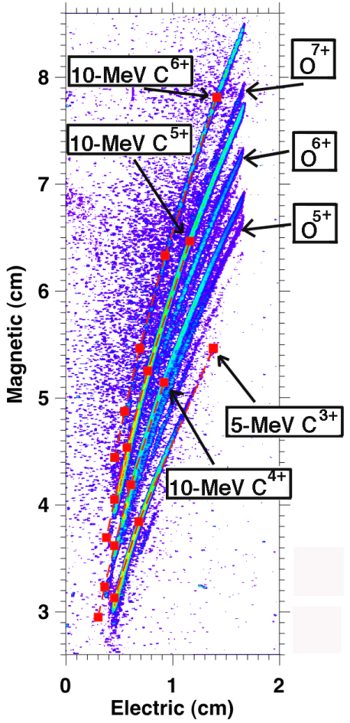
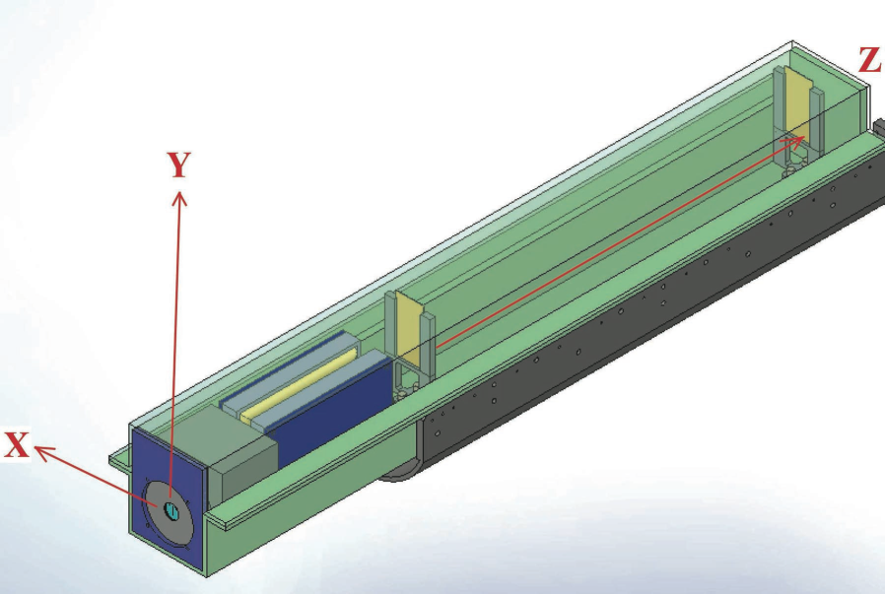
TPIE has successfully measured heavy-ion spectra on EP, and has more recently been demonstrated on OMEGA
OMEGA-EP (short-pulse)
E
B
CR-39: variable position
Pinhole assembly
J. Cobble, et. al., Rev. Sci Instrum. (2011)

Slide 4
On OMEGA, the high flux of low-energy ions hinders proper operation; filtering was used to remove this background
No filtering on CR-39
1.5 um of Mylar on CR-39
Observed background on TPIE was mitigated
(Demonstrated on cryo-ride along PI: Sangster)
OMEGA Shot 64680
(First Data Acquired on MIT-NLUF)

Slide 5
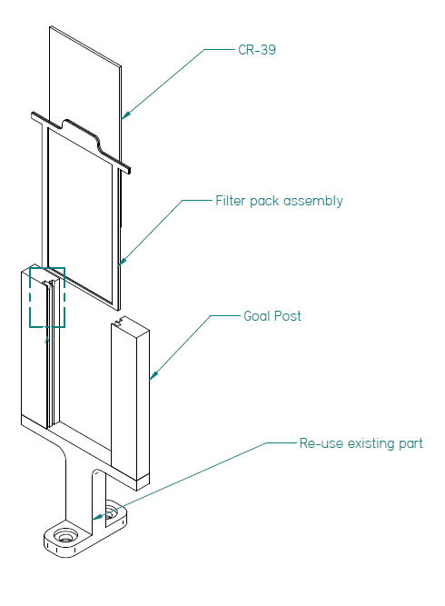
Filtering capability has been added to TPIE for proper operation on OMEGA
CR-39
Filter pack
assembly
New goalposts
Existing
base
0.9-1.5 um Mylar filter is sufficient for most cases; this has little impact on the low-energy cutoff of the instrument

Slide 6
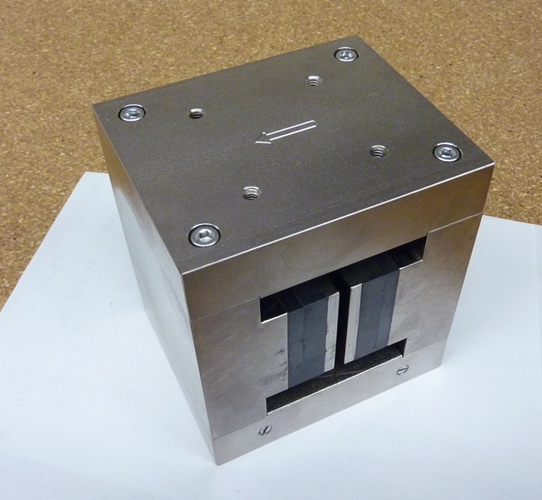
A new magnet is being implemented to measure lower-energy particles (e.g. TT- α studies)
Same form-factor as original magnet
1650 G peak field strength
Now have option for 1.65kG, 5.6kG and 8.4kG field strengths
TCC
B
The (1.65 kG) magnet allows measurements of
protons (or fully ionized ⁴He) down to ~ 250 keV

Slide 7
Summary
TPIE now operational on OMEGA
Filter / magnet selection will be available on SRFs in coming week(s)
Use on tritium shots approved/supported by J. Cobble and G. Pien
(Image plates must be cleaned prior to removal)

