Slide 1
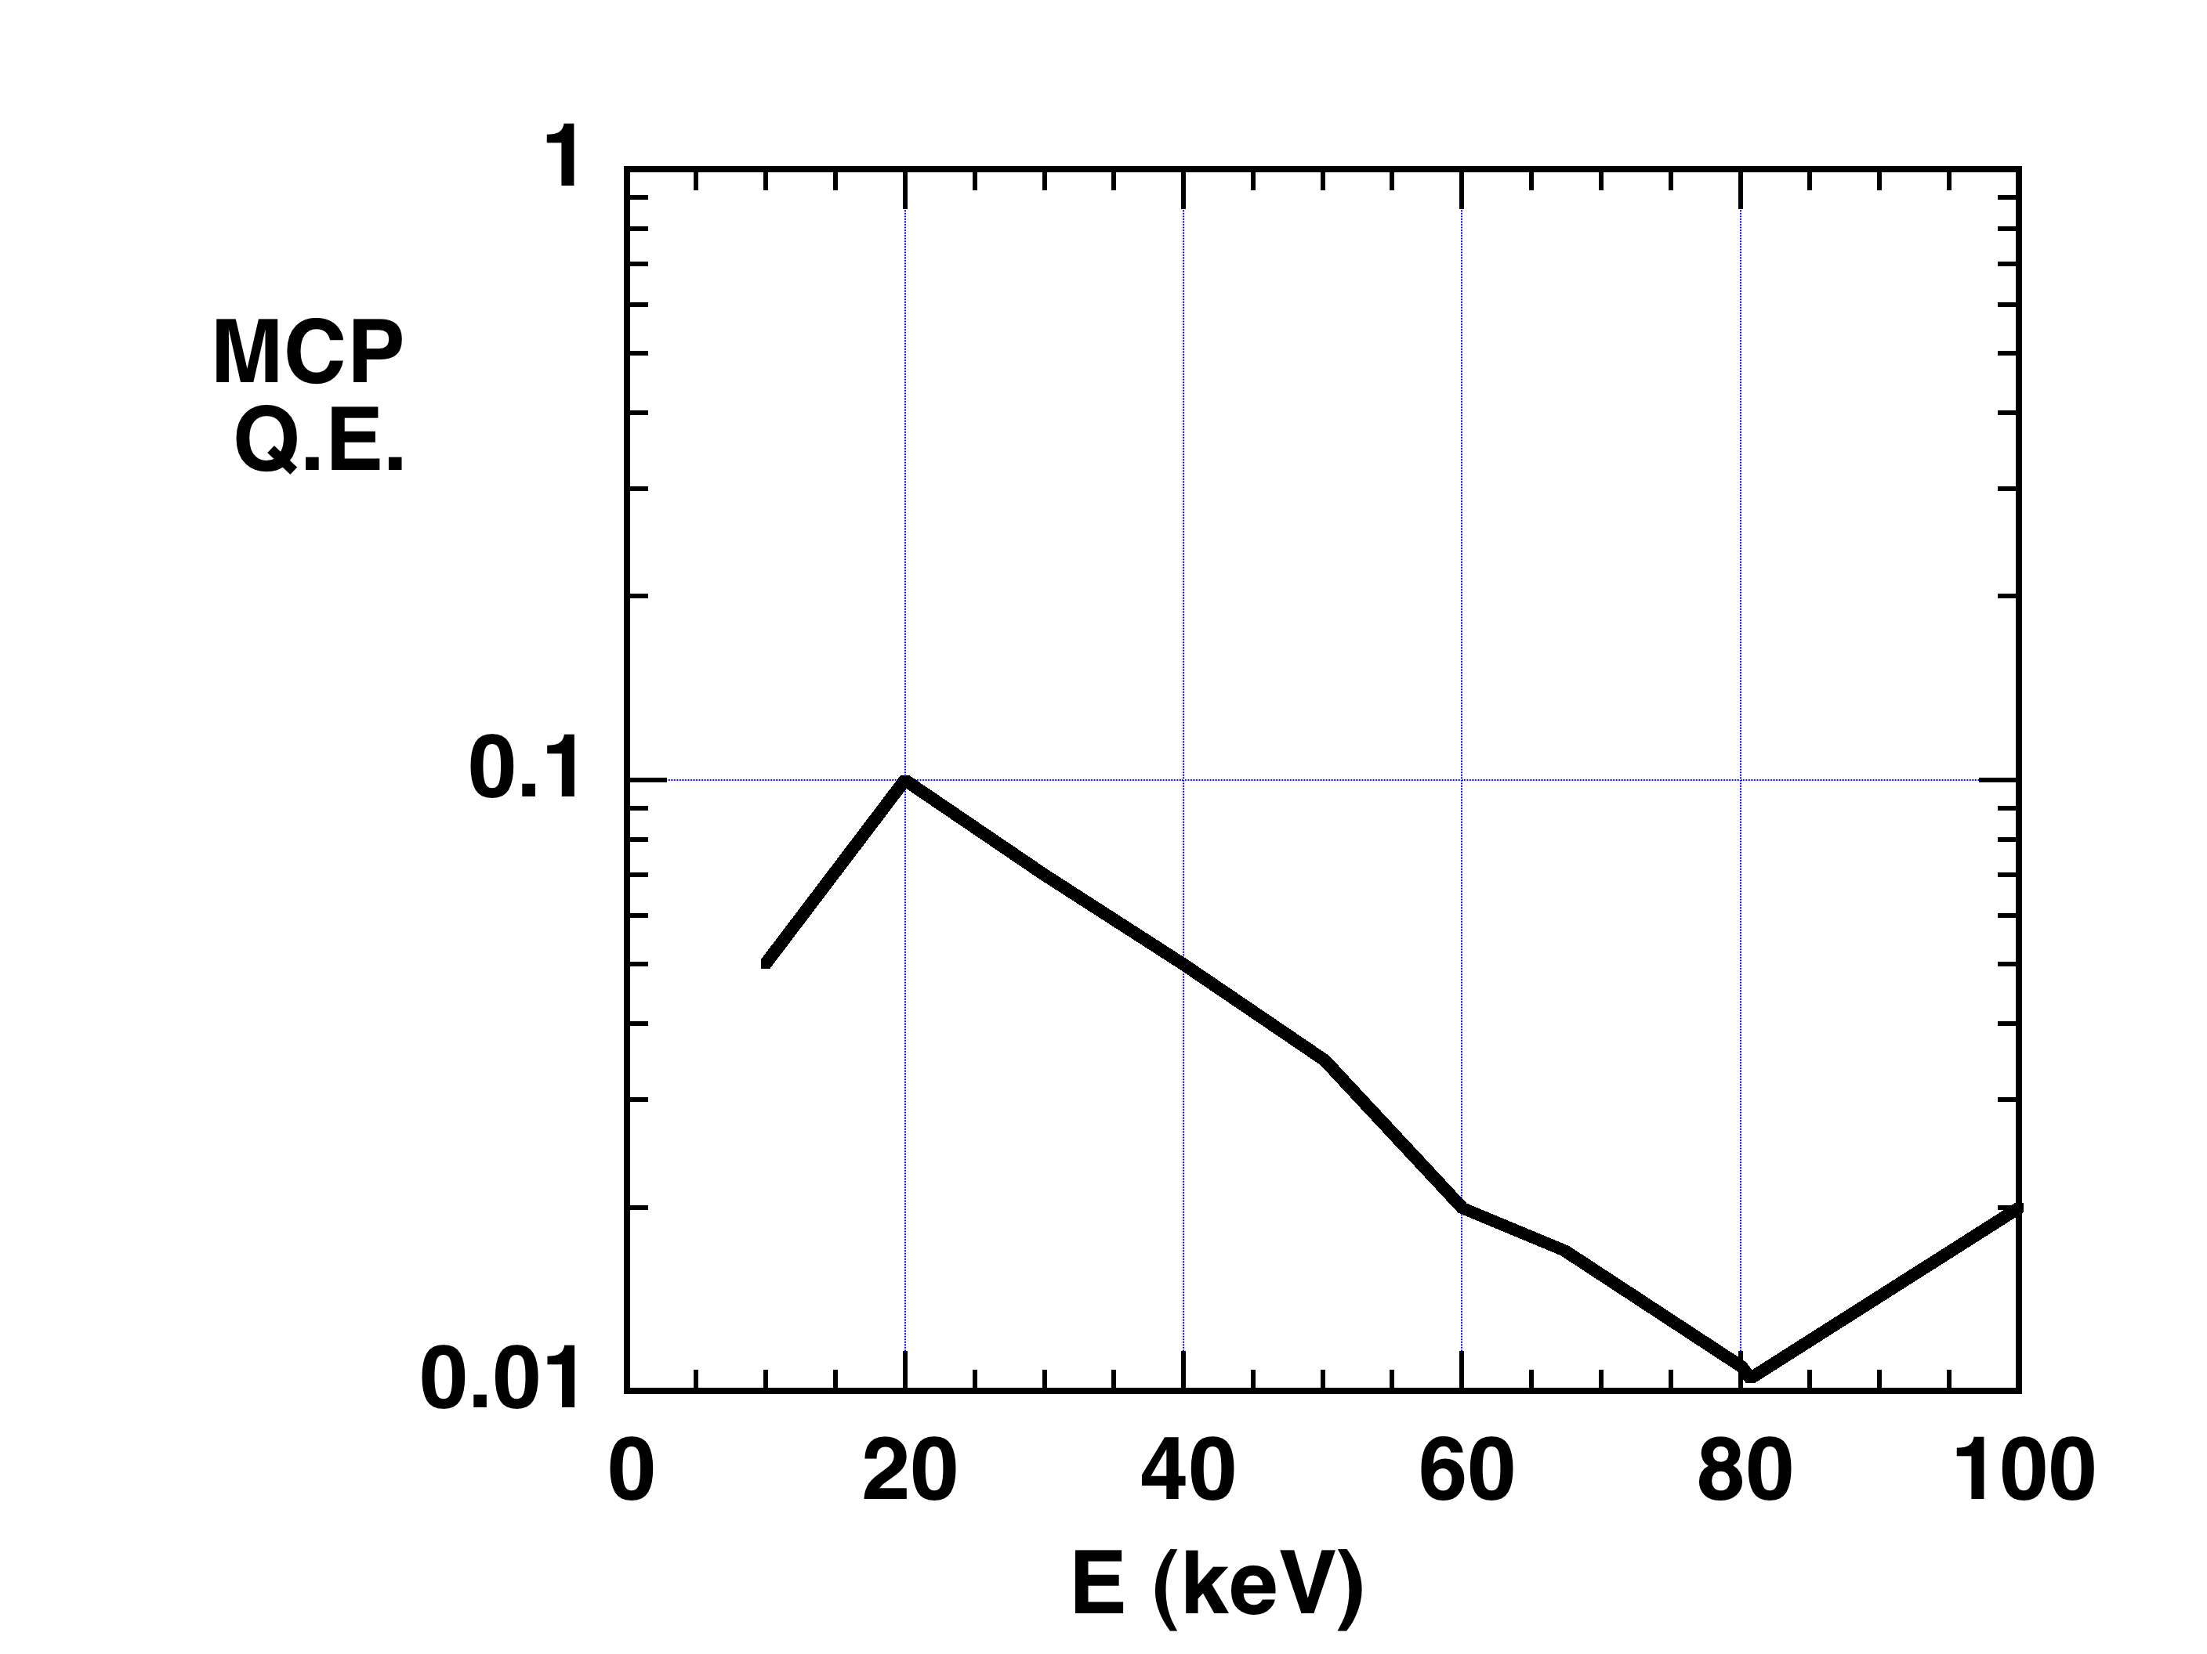
Beyond Bateman: 10x higher Q.E. MCPs at 10 - 100 keV
Single MCP
Bateman, NIM, 1977
Future: Two MCP (Proximity focus coupling)?
hν
N. Izumi, 2011
Unity gain thick MCP (DC)
Electron multiplier MCP (Gated)
Phosphor
Time-discriminating detectors will be needed even at high photon energy when sources to be backlit or other sources have strong self-emission (hohlraums, implosions, and other short pulse sources producing background due to hot electrons, hard x-rays, neutrons, and gammas)

Slide 2
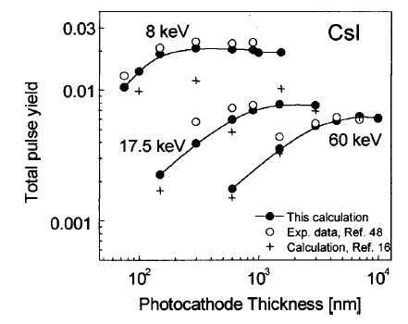
Beyond Henke: 10x higher PC Q.E. than current ≈ 1%
Existing CsI:
Frumkin, Phys. Rev. A, 1993
Boutbol, JAP, 1999
Future: Thick MCP Photocathode?
hν
PC in form of thick MCP
L/D = 10
Grid
To Streak Camera, DIXI
Time-discriminating detectors will be needed even at high photon energy when sources to be backlit or other sources have strong self-emission (hohlraums, implosions, and other short pulse sources producing background due to hot electrons, hard x-rays, neutrons, and gammas)

Slide 3
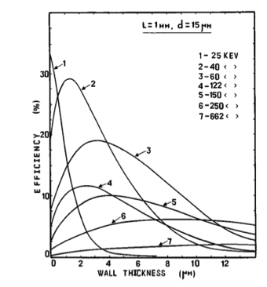
Beyond Henke: 10x higher Q.E. MCPs and photocathodes at 20- 100 keV
Example: Two MCP (Proximity focus coupling)
Increase channel wall thickness
N. Izumi, 2011
Shikhaliev, RSI (1997)
hn
Unity gain photocathode (DC)
Electron multiplier MCP (Gated)
phosphor
Achievable: ~10% QE @ 100 keV

Slide 4
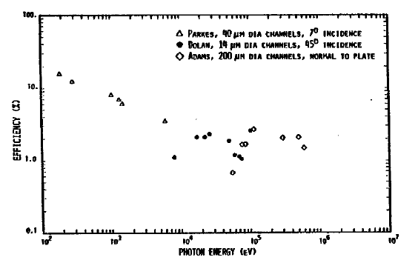
Flat MCP sensitivity between 10 and 600 keV has been reported previously
From Wiza, NIM, 1979
1 10 100 1000
Photon Energy (keV)

Slide 5
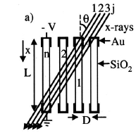
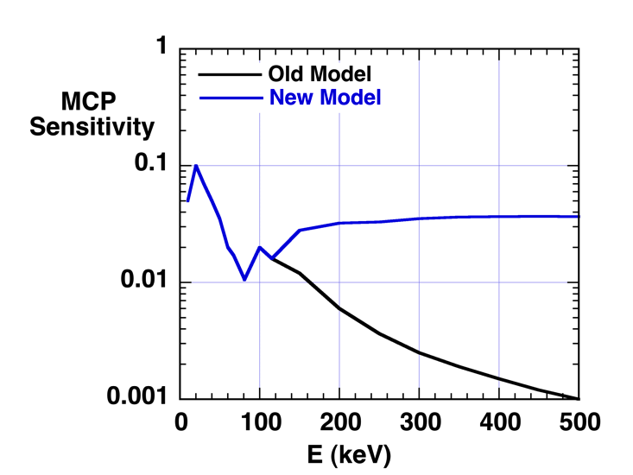
However, sensitivity is flat because number of primary interactions increases to compensate for Q.E. dropping
Drop in x-ray interaction probability compensated by increase in primary range and number of secondaries escaping into pores
Leads to predicted almost flat MCP response above 150 keV
For hν between 150 and 500 keV:
Signal ~ Range of electrons/x-ray mfp ~ (hν – I.P. Pb K edge)^{1.6}/(hν)^{2.0}
Range of 100 keV electron = 66 µm in MCP Pb-doped glass

