Slide 1
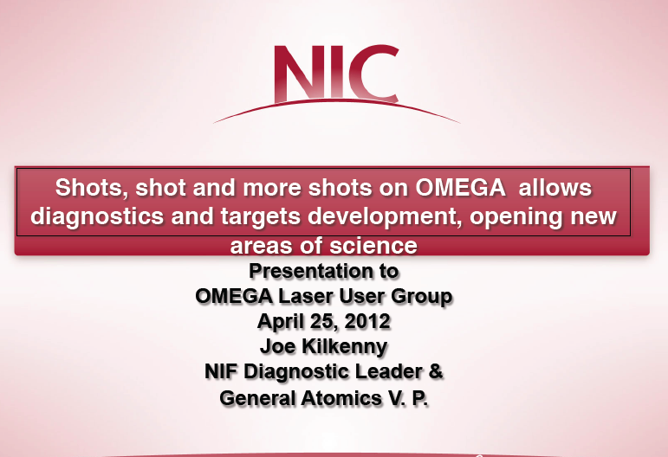

Slide 2
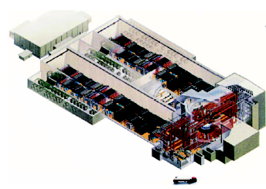
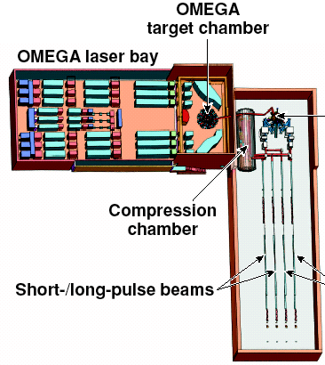
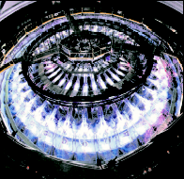
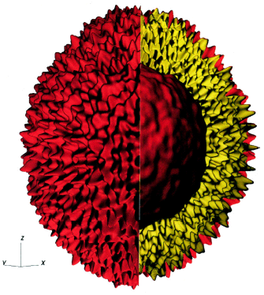
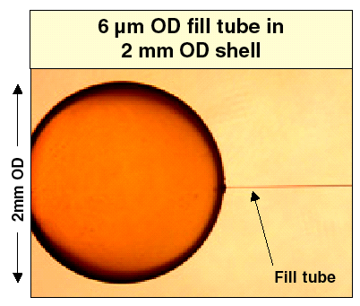
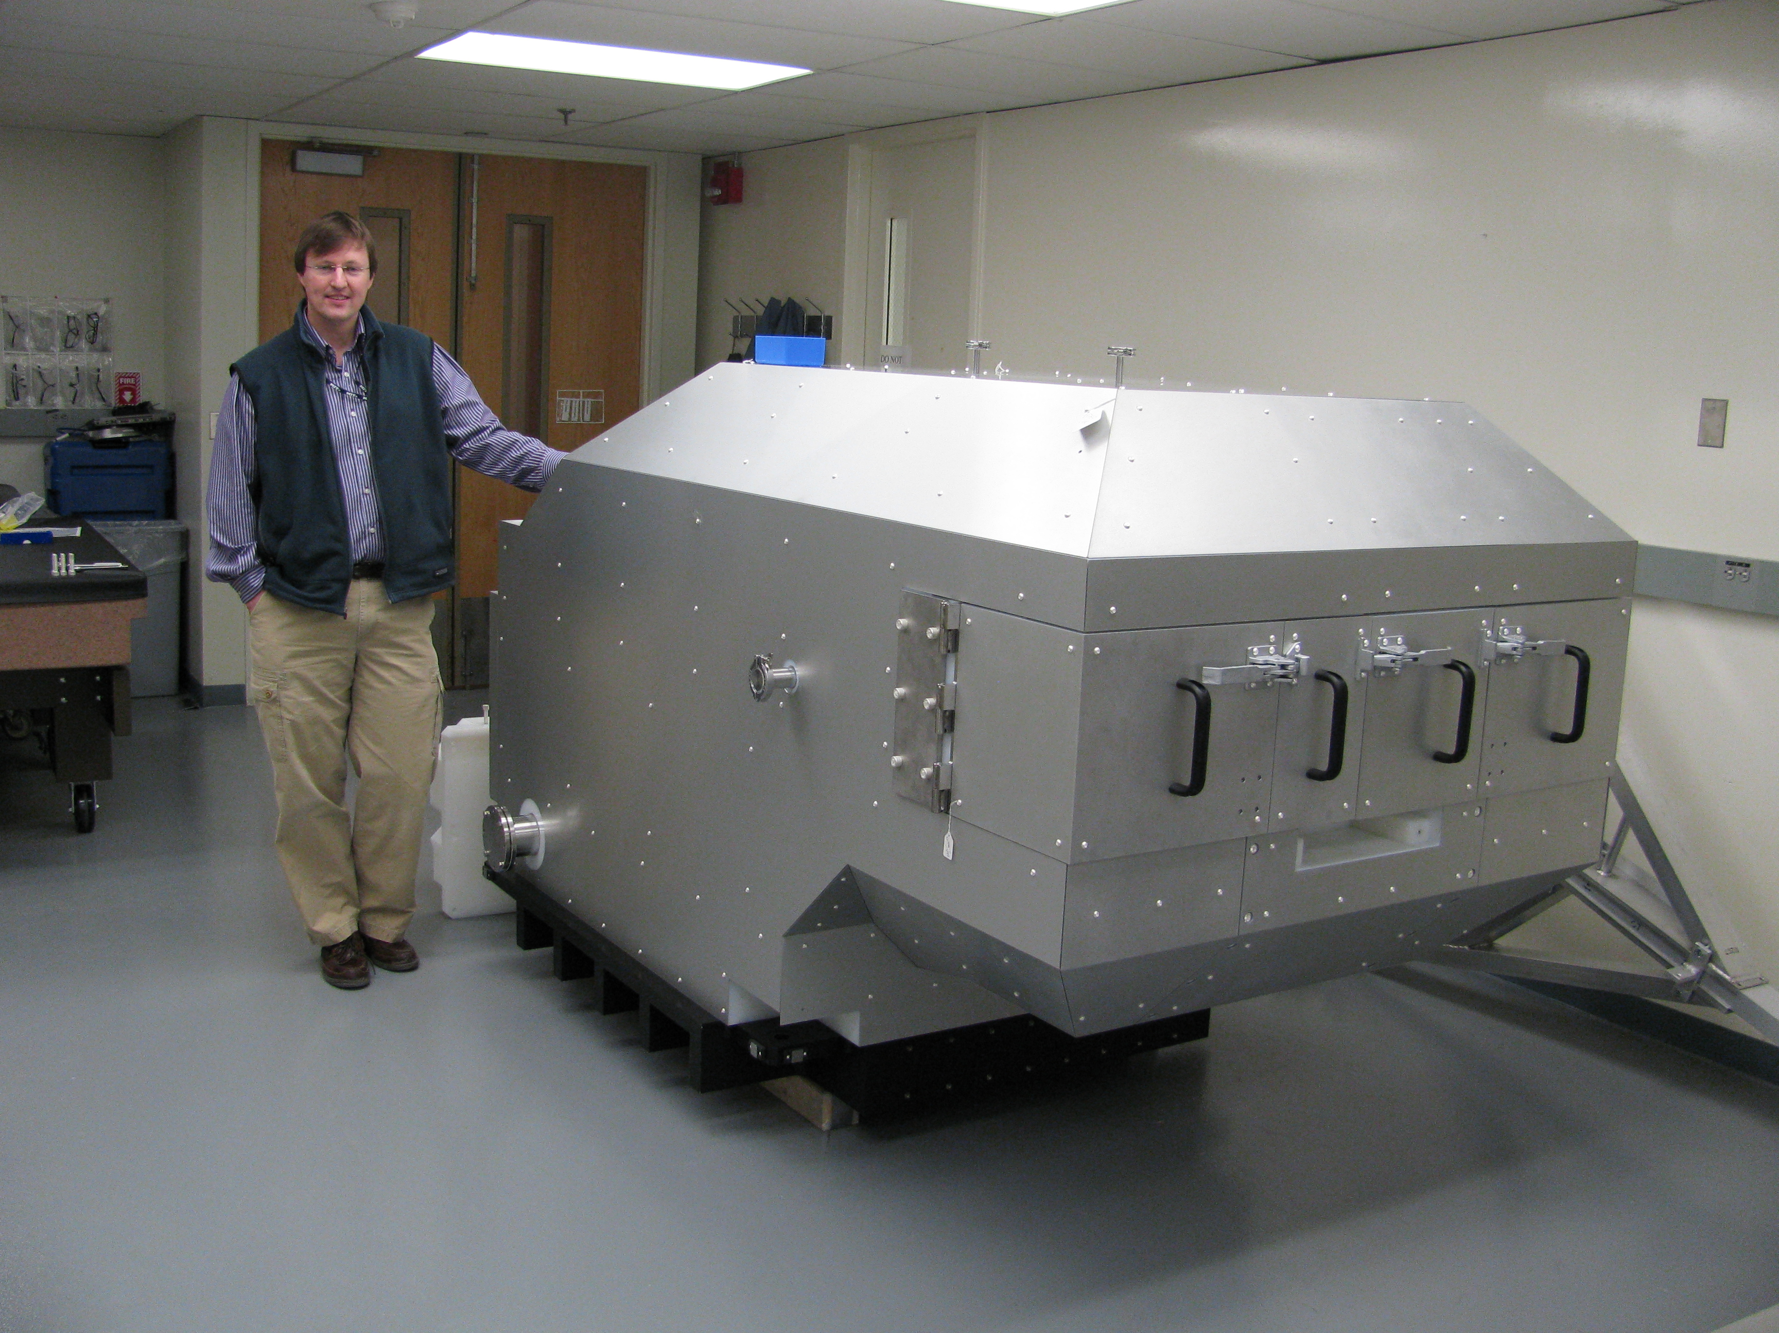
Advances in High Energy Density Physics Require:
•Targets
Drivers
Theory
Targets
Diagnostics
Given a driver, innovation in targets and diagnostics drive new science

Slide 3
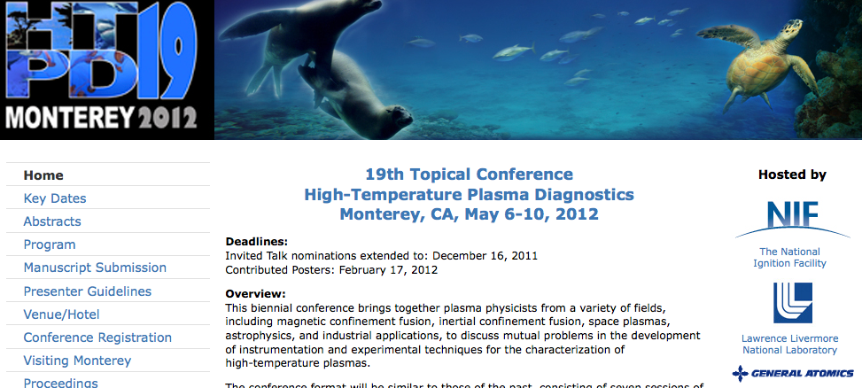
Experimental measurements drive ICF: theory is a guide
• Sixties – Magnetic fusion development of high temperature plasma diagnostics
• Seventies- nuclear test and ICF diagnostic development started- borrowed from MFE
• Eighties - Nuclear Test Measurements
• Nineties and First decade- Nova, OMEGA, led to initial NIF diagnostics
• What next ?
Diagnostics you invent for the second decade will challenge theory/simulations and drive HED science

Slide 4
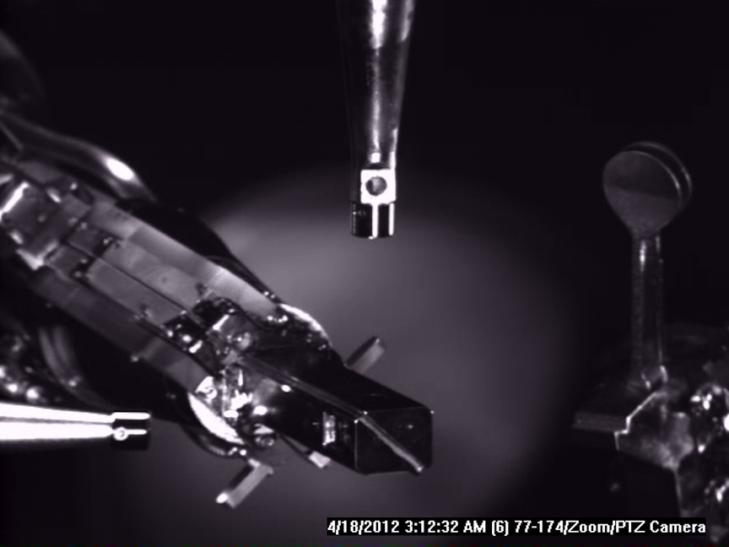
NIF supports ~50 sophisticated diagnostics for users (through ~ 2012 : more to come)
X-ray imagers and
MRS foil on NIF
Optical ~7 : Backscatter, into and close to lenses, VISAR and Streaked Optical Pyrometer, 4ω fiducials
X-ray ~25: Gated and streaked imaging and spectroscopy, absolute time resolved x-ray band spectrometers
Nuclear ~15: Neutron yield, spectroscopy and imaging, radio-chemistry, proton temporal and spectral, time resolved gamma band spectroscopy
Diagnostic operations: facility operations and data acquisition
Most were developed at NTS, Nova or OMEGA
Kilkenny - NIF Diagnostics Discussion, Jan. 30, 2012
NIF-0112-24078.ppt
Kilkenny - BOG S&T, July 12-13, 2011
NIF-0711-22517.ppt
4
4

Slide 5

We have multiple redundant diagnostics of the key attributes of the DT implosions- to cross check values
Theoretical view: correct ??
ρR_{Total}
(confinement)
T_{HS}
(reactivity)
ρR_{HS}
(bootstrap heating)
R_{HS}
(convergence)
ΔR_{mix}/ΔR_{shell}
(confinement)
Hot Spot
T_{HS} | 4.5 keV | NTOF20, hGXI, ARIANE,DIXI
<R_{HS}> | 25µm | hGXI, ARIANE, DIXI, NI
Y_{n} | 10¹⁴⁻¹⁹ | NToF, NAD, MRS, CR39
t_{burn,bang} | <100 ps, ~20ns | hGXI, SPBT, NToF4BT, GRH, SPIDER
_{mix} | 30% | hGX, ARIAN,DIXI, HEXRS,GRH
Cold Fuel
<ρR> | > 1.7 g/cm² | NToF20,3.9, WRF MRS, RAGS, ARC, NI, GRH
ΔρR(θ) | < 0.4 g/cm² | ARC, NI
ΔR_{mix}/ΔR_{shell} | < 0.25 | hGXI
Author—NIC Review, December 2009
NIF-0000-00000s2.ppt
Kilkenny—NIC Review, December 9–11, 2009
5
NIF-1209-17998.ppt
5

Slide 6
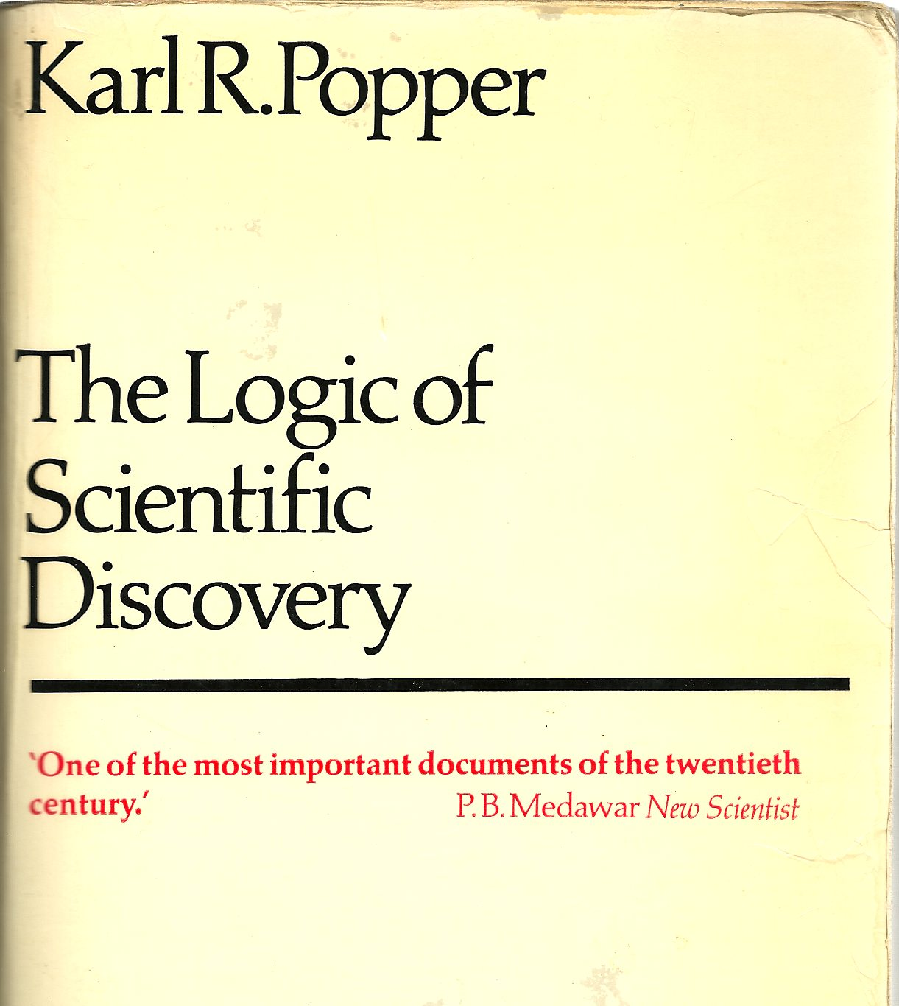
Complementary redundant diagnostics are essential for the scientific method
Karl Popper, Hutchinson Press, 1959: ”cannot prove a theory (measurement) is right, can prove it is wrong”- by test ( comparison with other diagnostics
Falsifiability and Testability
: “Hypotheses are nets: only he who casts will catch”
• Down Scatter Fraction (DSF): measure
by NToF and Magnetic Recoil Spectrometer
• ρR: measure with NToF, MRS, Radchem
and by ARC
• Hot spot T measured by x-rays
and neutron emission
NIF-1209-17998.ppt
Kilkenny, NIC Review, December 9–11, 2009
6

Slide 7
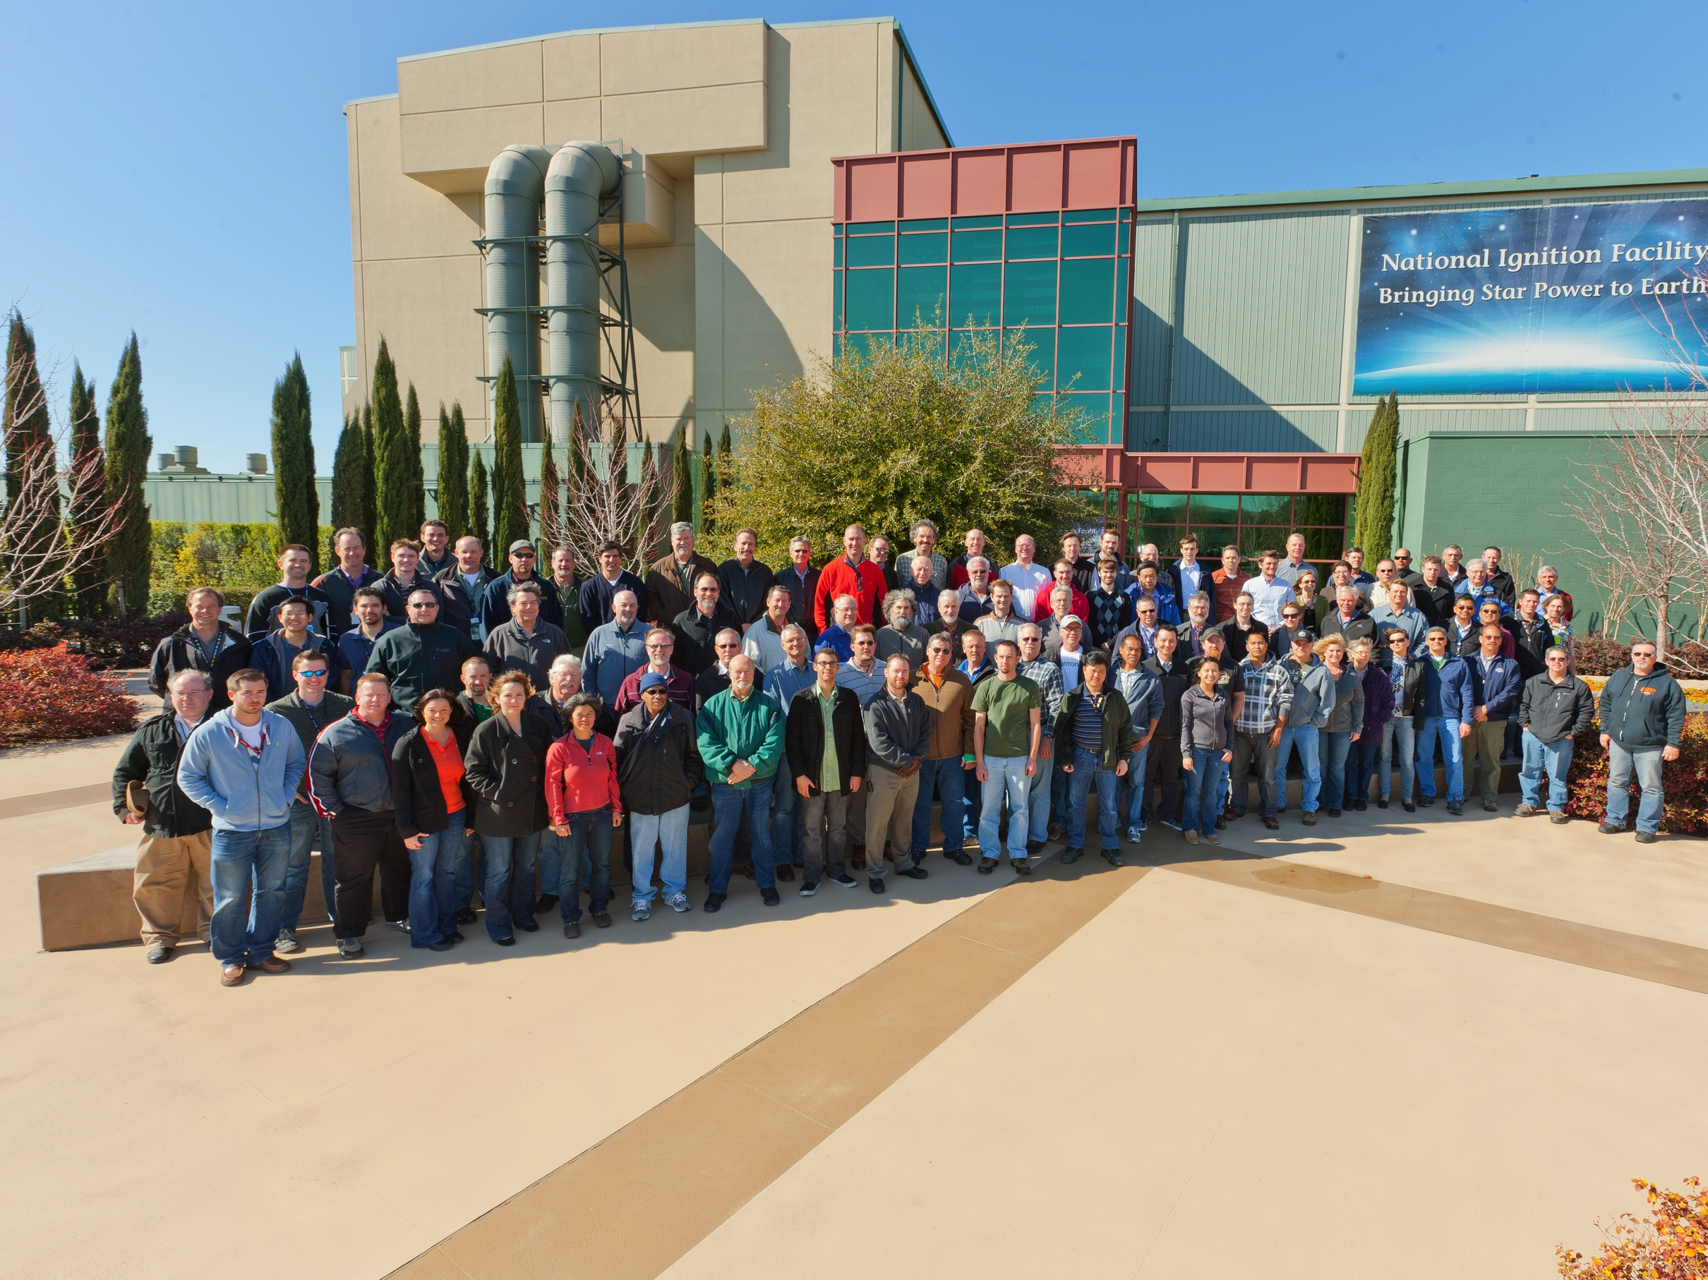
NIF diagnostics engage the user community, and is major effort by the community: > 200 scientists and engineers at LLNL, LLE, MIT, LANL,SNL, GA, AWE, CEA
• About 50 diagnostics systems have been implemented over the last 5 years. Proposed by community. Scope driven by ICF and SSP programs, reviewed by community

Slide 8
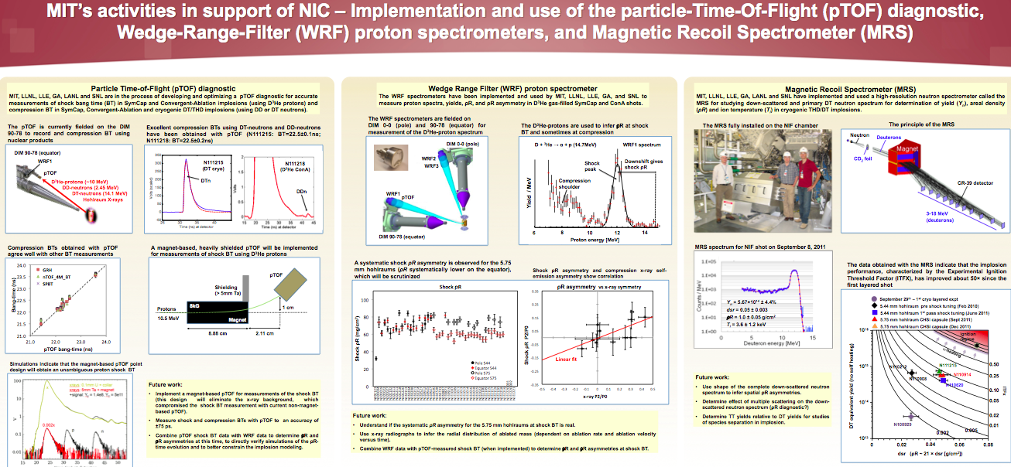
Major contributions from MIT

Slide 9
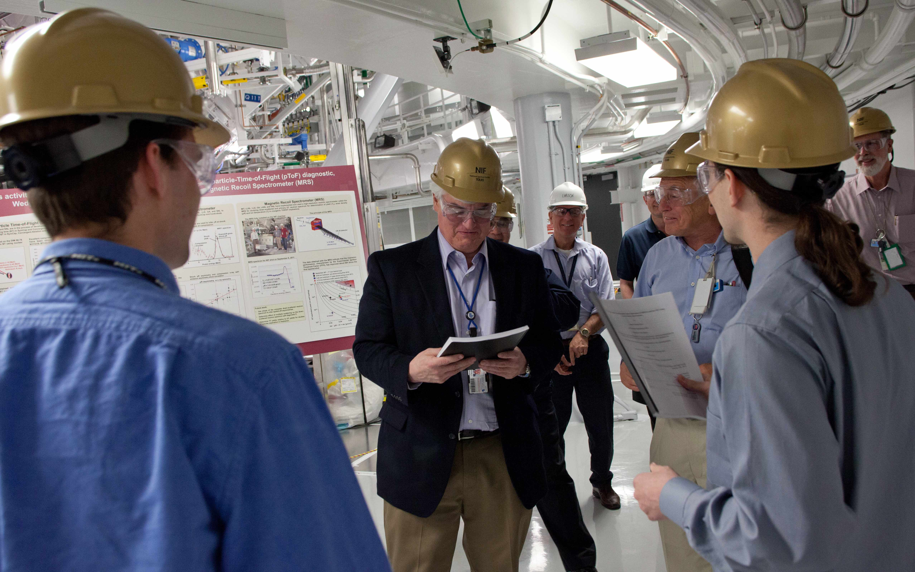
LLNL’s new Director, Parney Albright (theoretician), receives a copy of Casey’s thesis, NIF’s first Ph. D.
Dan
Casey
Alex
Zylstra
Parney
Albright
I would like to thank all of you for the excellent and comprehensive tour of the NIF diagnostics systems. The combined science and engineering that has gone into these systems has effectively provided the “eyes and ears” of the NIF enterprise and a foundational element of all NIF experiments. As we discussed, I would like to hear more about the opportunities for next-generation diagnostics with the essential overlay of a strong mission/programmatic “pull” for advanced diagnostics investments. I continue to be wowed by the accomplishments of team NIF and this tour was no exception. Regards, Parney

Slide 10
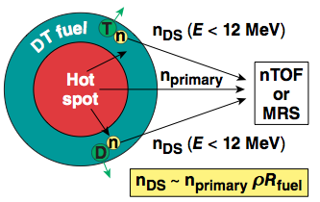
DSR that Nino went on about: down scattered neutrons are generated by scattering of the primary neutrons off the cold fuel- measure ρR
Down-scatter ratio (DSR) technique
DSR = (10-12MeV) / (13-15MeV), ρ R_{fuel} = 21 DSR gm /cm²
Some variation of ρR with direction is be measured from DSR(θ,φ)
10

Slide 11
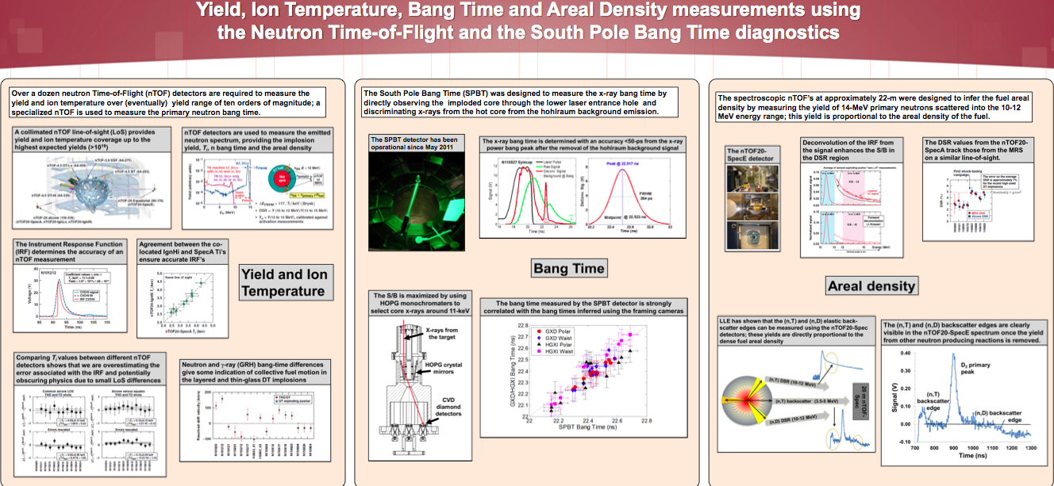
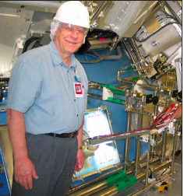
Major diagnostic contributions from LLE

Slide 12
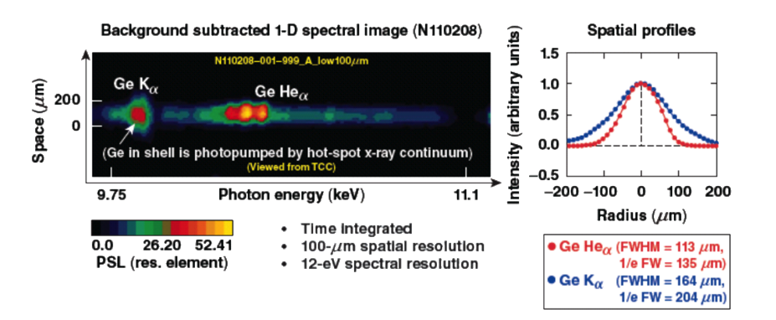

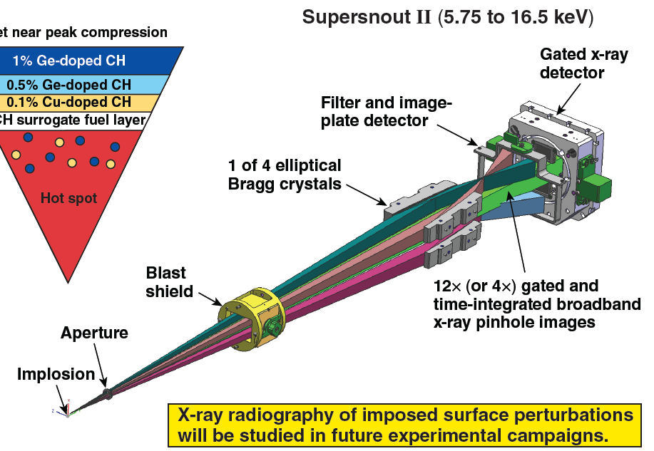
LLE: Special capsules and spectrometer have been designed to trace origin of ablator mix in the hot spot
Development of spectrometer by Sean R. will enable
x-ray Thomson scattering on NIF and OMEGA
Cu, Ge, Si doped CH ablator
5
4
Supersnout II (5.75 – 16.5 keV)
3
layer | dopant (atomic %)
1 | Cu(0.1%)
2 | Si(0.7%) Ge(0.15%)
3 | Si(1.7%) Ge(0.15%)
4 | Si(1%)
5 | none
1
2

Slide 13
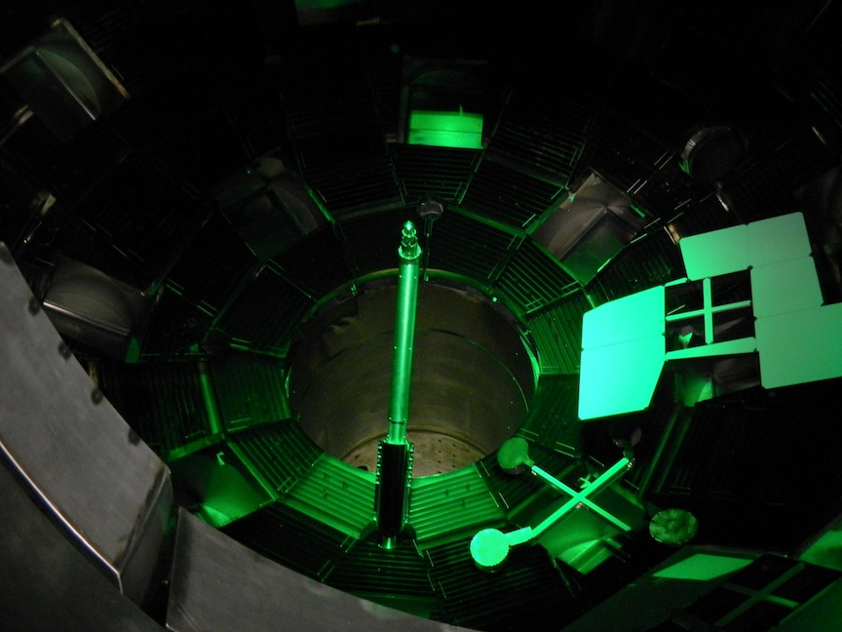
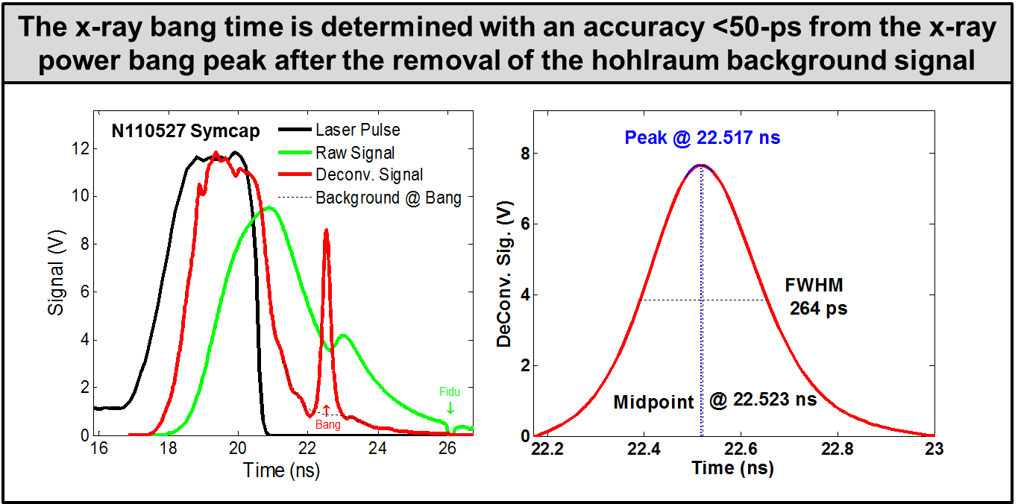
South pole bang time x-ray detector robustly measures x-ray and neutron bang-time:- LLE/LLNL
South pole bang time detector looks up the hohlraum axis, sees implosion
Kilkenny - NIF Diagnostics Discussion, Jan. 30, 2012

Slide 14
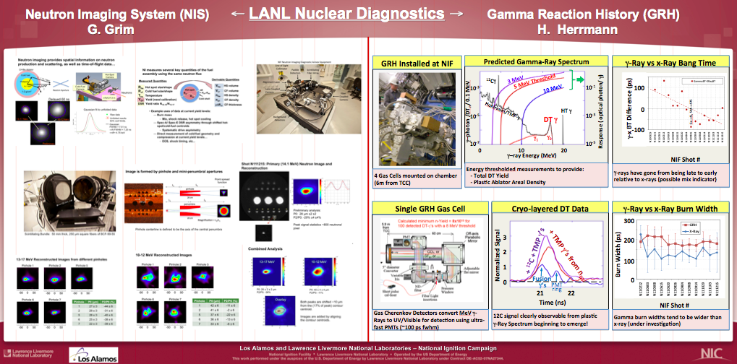
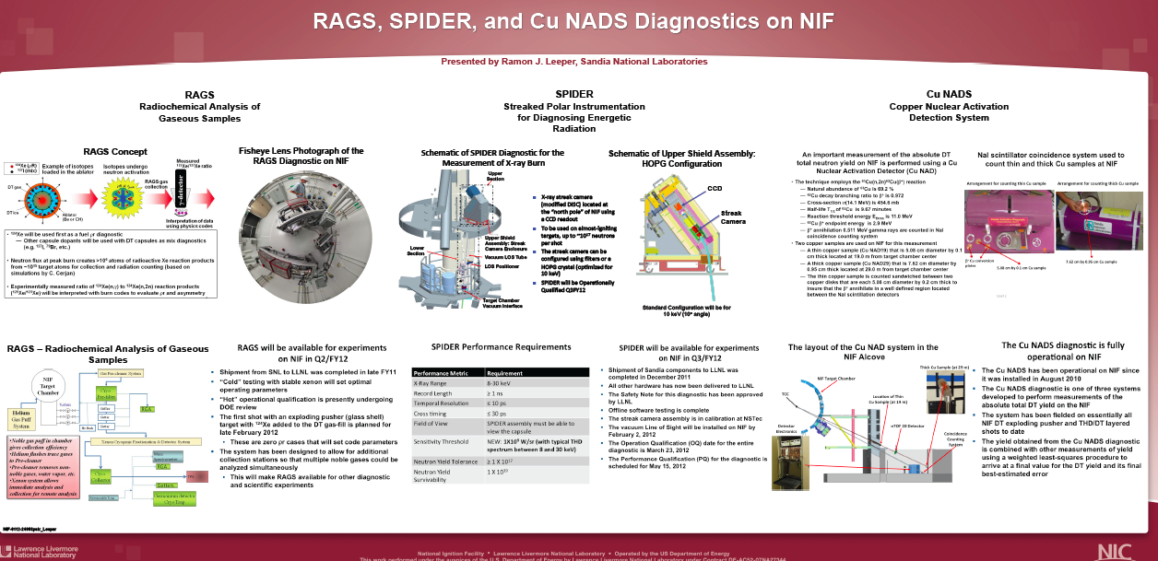
Major contributions from LANL and SNL

Slide 15
Diagnostics evolve and generate new programs and scope. In general, diagnostics are used beyond their original scope.
Examples of evolution of diagnostics
  Gamma Reaction History, discovered uncertainty in the branching ratio, led to the Gamma Compton Spectrometer - Hans Hermann tomorrow
  NToF led to use for DSR, led to neutron backscatter edge and low energy neutron spectroscopy
  GXD led to hGXI led to ARIANE led to DIXI
  HEXRS led to super-snout 1 and 2 and then to high resolution spectroscopy, x-ray Thomson scattering- Sean Regan
We've taken NTS/Omega/Nova concepts, built a new generation of instruments. BUT they are old. We need a new set of diagnostics for our three superb facilities

Slide 16
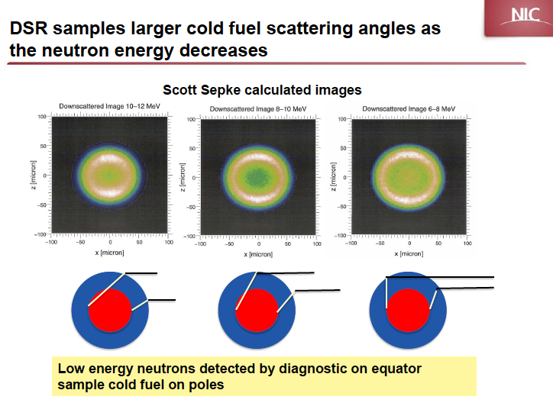

Slide 17
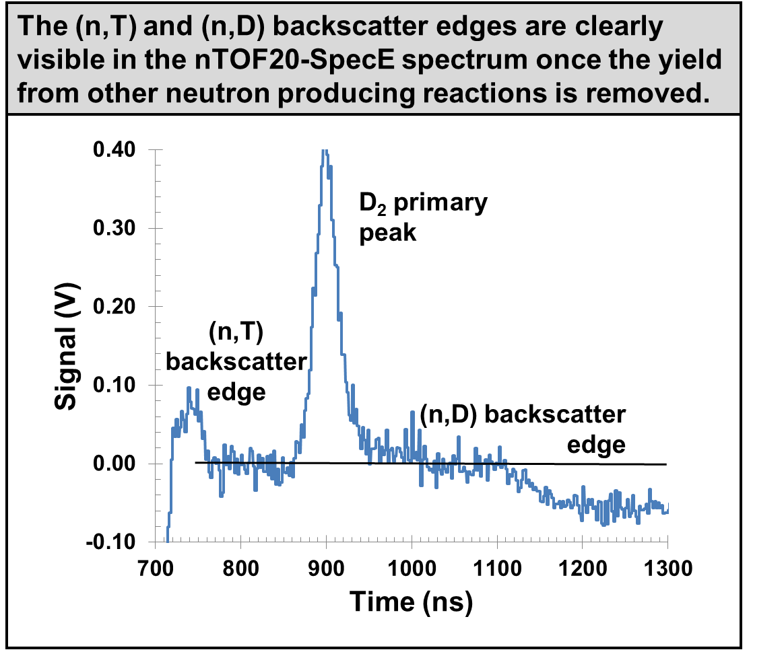
Evolutionary improvement of NToF: back scattered and down scattered neutrons probe different cold fuel regions
NToF - logarithmic
neutrons
nT and nD down scatter 10 – 12 MeV
neutrons
DT neutrons from Hot Spot 14 MeV
D₂ neutrons from Hot Spot 2.45 MeV
neutrons
nT back scatter 3.5 MeV
nD back scatter 1.6 MeV
17
17

Slide 18
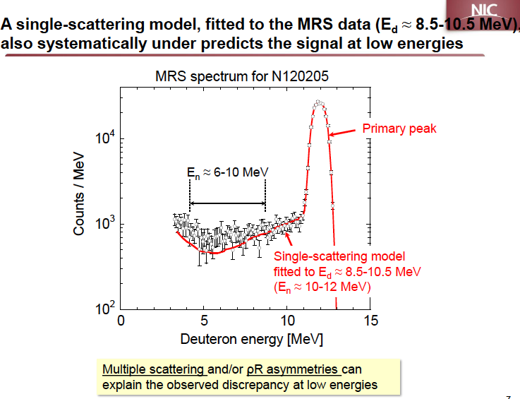

Slide 19
How we decided the NIF diagnostics so far
NIC EP and the NIF CDR contained the primary, requirements driven NIC implosion diagnostics.
NIC EP had a conceptual agreement for partners to contribute
6 Diagnostics workshop 2008 – 2011 refined requirements, defined diagnostics, scoped resources, reached inter-lab agreements on resource commitments, explored analysis routines and calibrations
  Examples:
      Neutron Imager- LANL
      Magnetic Recoil Spectrometer- MIT & LLE
      NToF- LLE
      NAD – SNL
• Evolutionary diagnostics were agreed and assigned
      Hard Xray spectrometer- LLE
      WRF- MIT – SPIDER-SL
Community assignment of diagnostics success of NIF

Slide 20
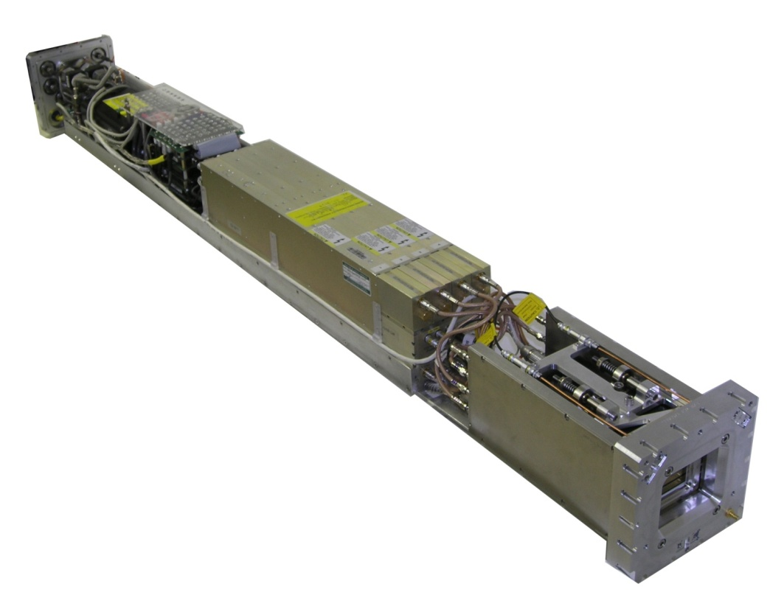
Some of the existing diagnostics are foundational
Gated x-ray cameras widely used
CCD Power Supply
MCP Pulser Electronics
Embedded Computer
MCP Module
CCD Camera
Although widely used at the moment they are middle aged
20

Slide 21
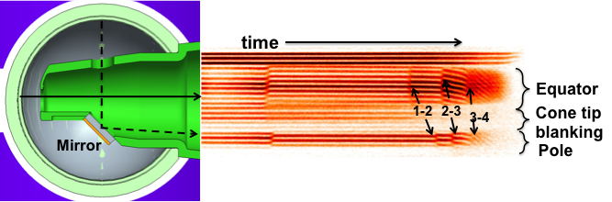
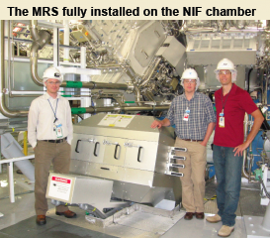
Some of the existing diagnostics are foundational
VISAR used for ignition, WCI and Basic Science
Although widely used at the moment they are middle aged
NIF-0112-24078.ppt
Kilkenny - NIF Diagnostics Discussion, Jan. 30, 2012
21
21

Slide 22
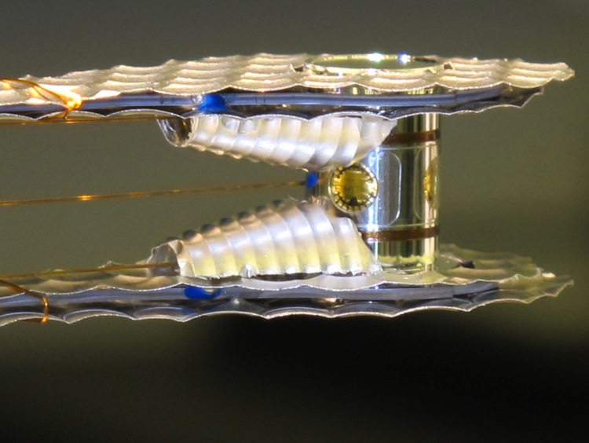
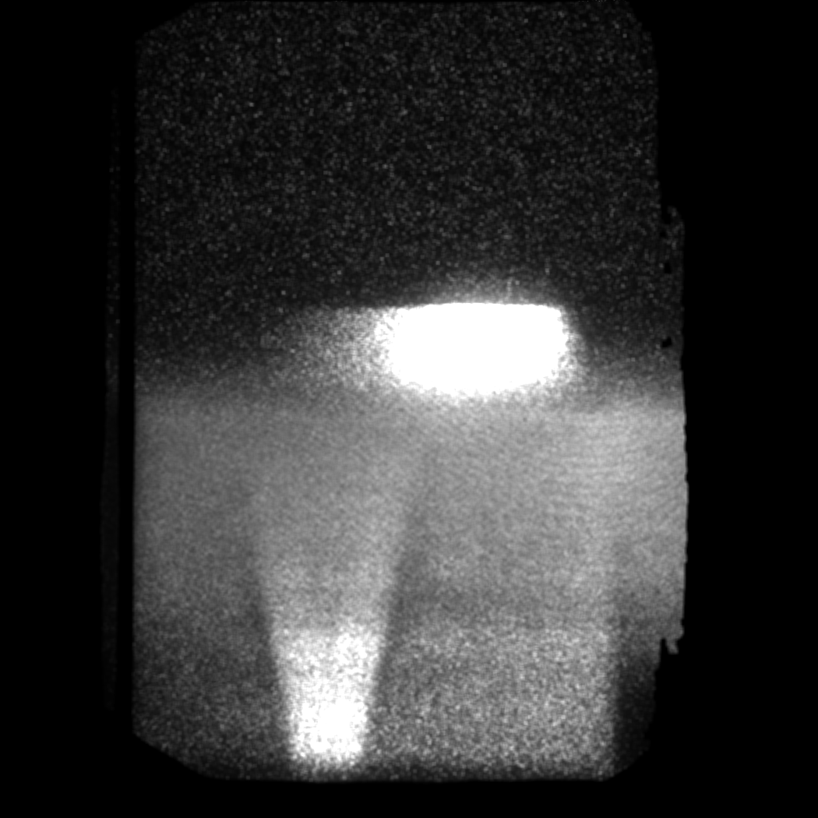
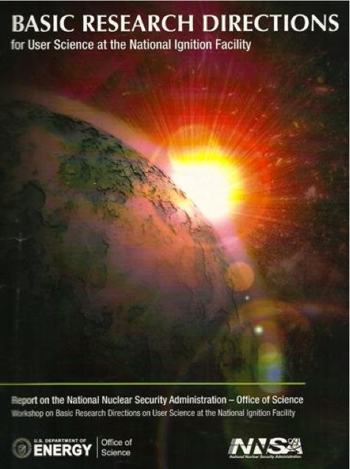
What next ?
The next set of diagnostics will be chosen to satisfy NIF’s missions in the second decade
MTF 10.1: ICF
MTF 10.2:HED
Science Use
Use theory/simulations to generate requirements- pinch of salt

Slide 23
Future diagnostics: “build and they will come” or ask designers what they want
• Simulations/theory are challenged in driving innovation. Theory sometimes follows.
• Sometimes, theory gets in the way. E.g. areal density difference in DSR vs. angular position cant be explained by theory and “so the “measurements must be wrong”
• Need balance between mission requirements and diagnostic technology push
“As we discussed, I would like to hear more about the opportunities for next-generation diagnostics with the essential overlay of a strong mission/programmatic “pull” for advanced diagnostics investments.
Regards, Parney” ( A theoretician !)
Our job as experimentalists is to challenge accepted theory with
clever experiments and measurements

Slide 24
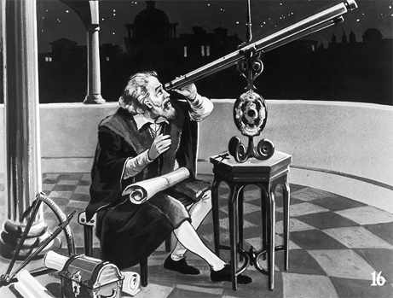
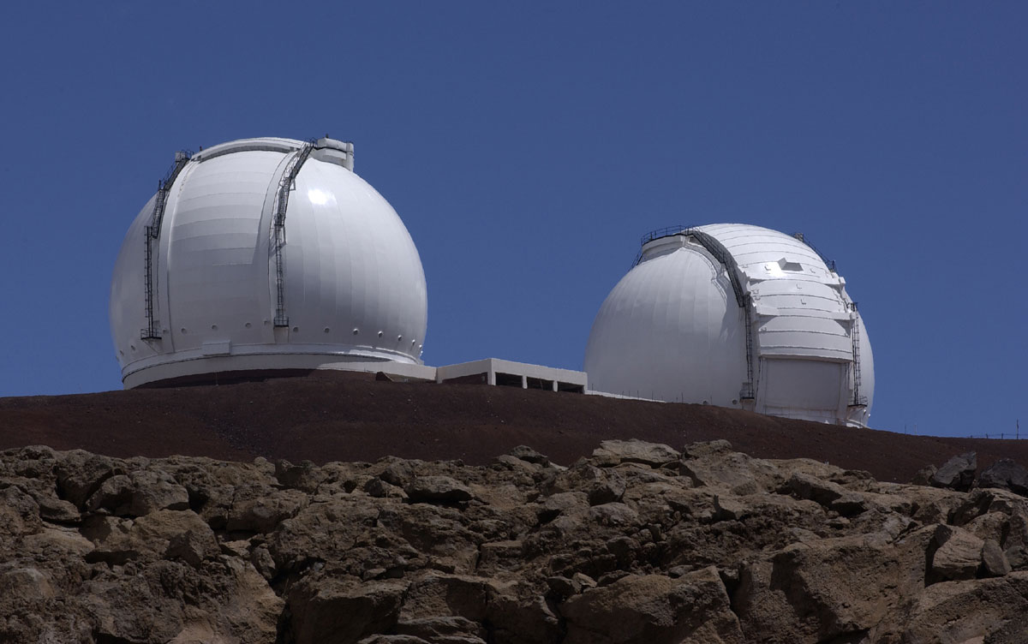
Much of what we know about the universe comes from telescopes
• Telescopes evolved slowly over several centuries
• Our atmosphere restricted studies of the universe to the visible
Space flight changed all that

Slide 25
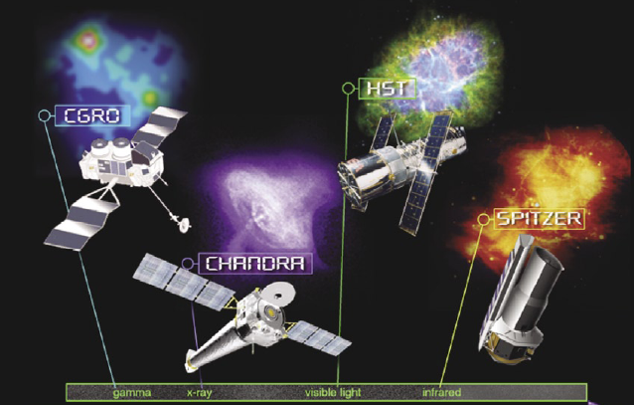
Shuttle enabled NASA’s Great Observatories covering the spectrum from γ s to the infrared and opened our eyes on the Universe
Just as the great observatories exploited space flight, so the great
observatories- diagnostics on NIF and OMEGA should enable
discovery science in the laboratory
NIF-0112-24078.ppt
Kilkenny - NIF Diagnostics Discussion, Jan. 30, 2012
25

Slide 26
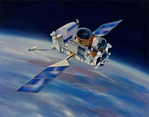
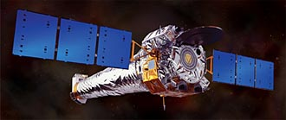
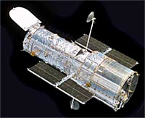
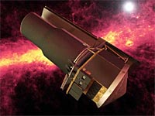
NASA’s Great Observatories, are four space-borne observatories measuring in four different bands: visible, gamma rays, x-ray, and infrared)
Chandra x-ray observatory : X-ray telescopes.
Detailed studies of black holes, supernovas,
and dark matter.
The Compton Gamma Ray Observatory:
violent physical processes in the Universe,
emitting γ ‘s
Hubble Space Telescope: 2.4 m optical: star birth,
star death, and galaxy evolution, and has helped
move black holes from scientific theory to fact.
The Spitzer Space Telescope: infrared

Slide 27
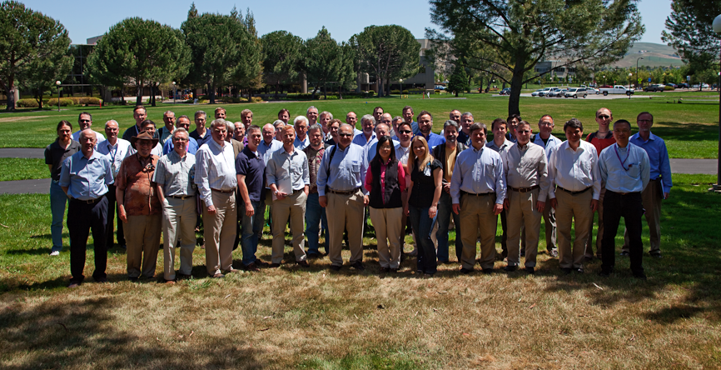
What could we do ? The 7th NIF diagnostic workshop 5/14–6/16 We have started process for diagnostic plan beyond 2012
New diagnostics proposed | #
Neutron spectroscopy | 7
Neutron/gamma imaging | 2
Radio-chemistry | 2
Gamma spectroscopy | 5
Optical: interferometry, Faraday,Thomson | 3
X-ray spectroscopy | 9
X-ray imaging | 8
Manipulators | 2
NIF-0711-24080.ppt
Kilkenny - NIF Diagnostics Discussion, Jan. 30, 2012
27

Slide 28
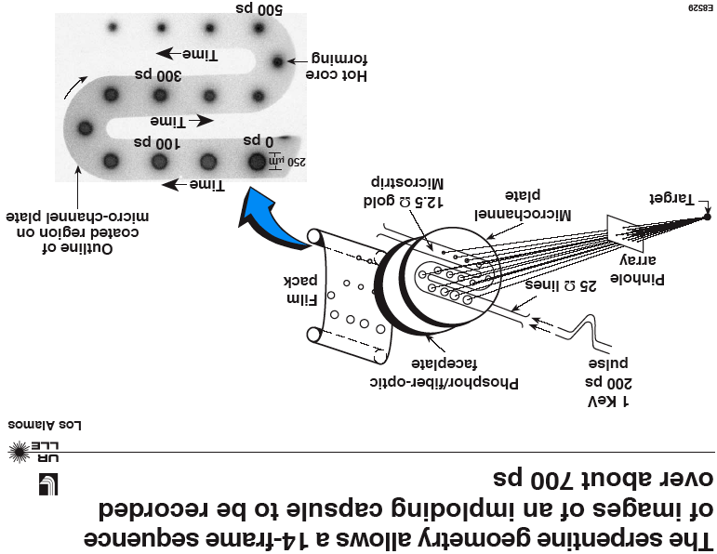
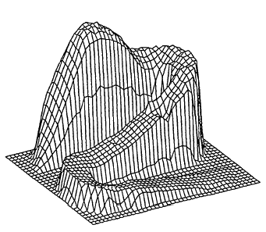
X-ray microscopes_ what do we do ? NIF and OMEGA’s
x-ray movies were really good in the early nineties
gain

Slide 29
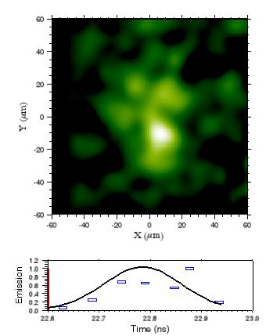
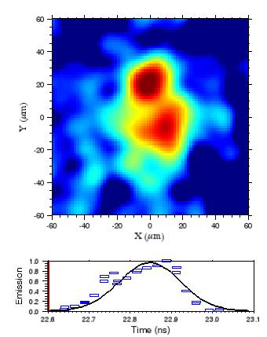
NIF: x-ray movies from 120321: ITFX =0.1 but kidney shaped
Polar View
Equatorial View
We are developing the Chandra observatory of ICF

Slide 30
NIF’s Chandra?
• KB optic coated for 10 -15 keV, dx ~ 3 micron
• Fielding on DIM at 10 -20 cm
• Image at ~ 7 m
• n and gamma screened detector
• True framing camera detector dt ~ 100 ps

Slide 31
What is the ICF analogy of Hubble? new optical diagnostics will be foundational for NIF
Thomson scattering used for all missions
Optical probe for interferometry, Faraday
Should we use a soft
X-ray laser?

Slide 32
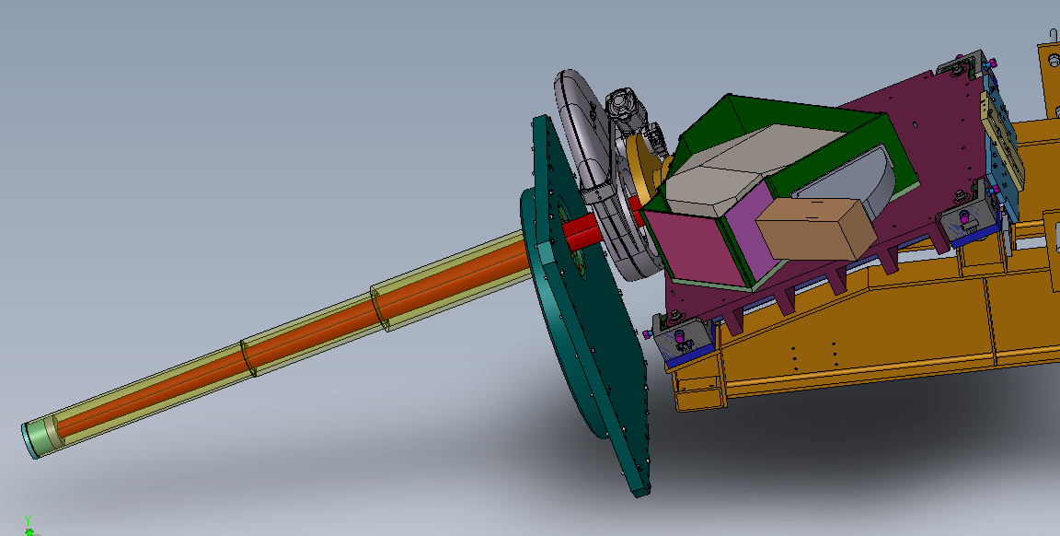
An energy-resolving Gamma Compton Spectrometer (GCS) : LANL, LLNL, GA & NSTec
Calculated DT Gamma-Ray Spectrum
Gamma Compton Spectrometer
¹²C(n,n’γ)
DT Fusion
Hohlraum/TMP n-γ
¹²C(n,γ)
¹²C(n,γ)
D(n,γ)
Spectral uncertainties call for energy resolution
  GRH is only energy thresholding, not resolving
  Spectral lines may provide:
    DT yield from 16.75 MeV fusion line
    Fuel rhoR from D(n,γ) 15.58 MeV line
    Ablator rhoR from 12C(n,n’γ) 4.44 MeV line
    Additional nuclear physics outside of NIC campaign
Requirements
  Yield >1e16 DTn
  Energy Resolution ≤ 0.5 MeV
  <1ns temporal response
  Tunable energy range (1-20 MeV)

Slide 33
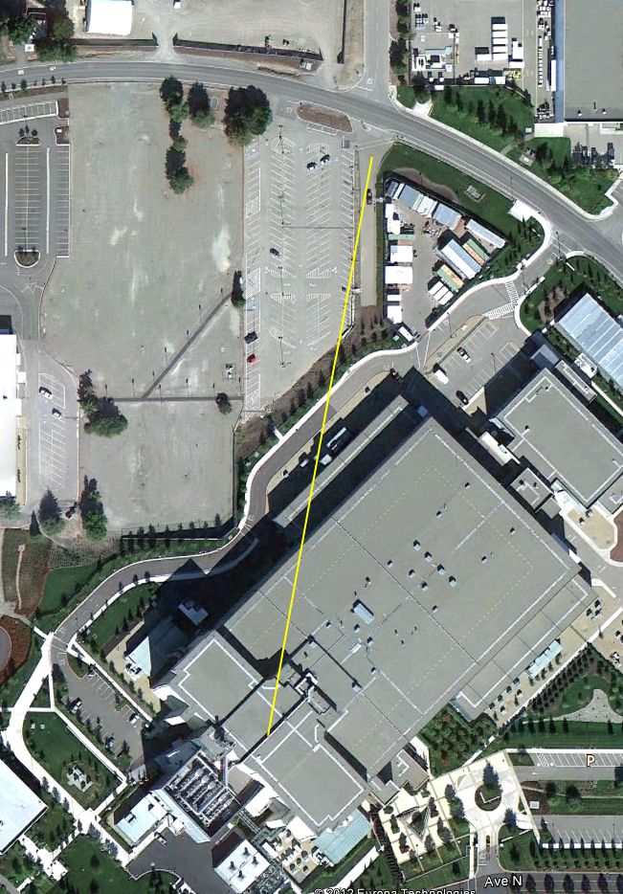
Gamma ray spectroscopy, single hit pixelated detector, conceptualized as a multi-purpose new
260 m detector station
Calculated DT Gamma-Ray Spectrum
260 meter
¹²C(n,n’γ)
DT Fusion
Hohlraum/TMP n-γ
¹²C(n,γ)
¹²C(n,γ)
D(n,γ)
New detector station will be multi-purpose and will
require a broad user community support

Slide 34
A new set of “great observatories” diagnostics will explore the physics of the Universe using NIF, OMEGA & Z
X-rays – NIF has > 10 μm pinhole cameras, single frame dt ~ 100 psec
and low resolution spectroscopy
- `NIF needs dx ~ 2 μm, dt ~10 psec with real framing, λ/δλ ∼10,000
Gammas - NIF, OMEGA has several MeV resolution, dt ~ 10s psec
- NIF, OMEGA needs 0.1 MeV resolution, dt ~ 10 psec.
Optical - NIF, OMEGA has a limited interferometry (f/3.3, 600 nm VISAR)
-NIF, OMEGA needs Thomson, interferometry/Faraday into u.v.
Neutrons- NIF has medium energy spectrometers, 20 μm static imaging
- NIF needs good sub-MeV resolution, versatile imaging
,
Foundational diagnostics need technology basis, consensus, phasing(Ω, Z) and long term commitment

