Slide 1

ICF Gamma Spectroscopy:
New Window to Plasma Nuclear Science
OMEGA Laser Users’ Group Workshop, Apr 26, 2012
Hans W. Herrmann
Los Alamos National Laboratory
Los Alamos and Lawrence Livermore National Laboratories – National Ignition Campaign
LA-UR 10-07461
This work performed under the auspices of the U.S. DOE by Los Alamos and Lawrence Livermore National Laboratories under Contracts DE-AC52-06NA25396 and DE-AC52-07NA27344

Slide 2



Acknowledgments
Y.H. Kim, N. Hoffman, D.C. Wilson, C.S. Young, J.M. Mack, J.R. Langenbrunner,
S. Evans, T. Sedillo, S. Batha,…
Los Alamos Nat’l Lab
W. Stoeffl, L. Bernstein, J. Church, A. Carpenter, L. Dauffy, J. Liebman, E. Grafil
and the NIF Team
Lawrence Livermore Nat’l Lab
C.J. Horsfield, M. Rubery, W. Garbett
Atomic Weapons Establishment
E.K. Miller, R. Malone, M. Kaufman, B. Cox, Z. Ali, T. Tunnell,…
Nat’l Security Technologies
R. Petrasso, J. Frenje, D. Casey, A. Zylstra, H. Rinderknecht, M. Gatu Johnson
MIT
V. Yu. Glebov, T. Duffy and the OMEGA Team
Laboratory for Laser Energetics

Slide 3
Summary
Gas Cherenkov detectors (GCD) have been operating on OMEGA for over a decade, and are now making an impact at NIF (Gamma Reaction History (GRH))
Opening new windows in Plasma Nuclear Science:
  fusion γ-branches (DT, D³He, HD, HT, DD, TT)
  inelastic neutron scattering (ablator ρR, stopping power)
  radiative neutron capture (stellar nucleosynthesis s-process)
New γ-ray capabilities are needed:
  Higher sensitivity → “Super” GCD
  Energy resolution → Gamma Compton Spectrometer, Pixilated “Furlong”
  Higher bandwidth → GRH-15m (streak camera)
  Imaging capability → Gamma Imaging System (GIS)

Slide 4
Outline
Intro
  Fusion Reaction History
  γ-Ray Gas Cherenkov Detectors (GCD-1&2, GRH)
Fusion γ-Ray Studies
  DT γ-ray Energy Spectrum & γ/n Branching Ratio
  Other Fusion γ-Ray Studies (³DHe, HD, HT, DD, TT)
Inelastic Neutron Scattering Cross Section measurements (Pucks)
  Hohlraum & Thermo-Mechanical Package (TMP) Materials (Au, Al, Si, Cu)
  Ablator Materials (C, SiO2)
Ablator Areal Density
  Charged Particle Stopping Power
Neutron Capture Cross Section measurements
  Stellar nucleo-synthesis s-process
Future Directions
  “Super” GCD, GCS, GRH-15m, GIS
Summary

Slide 5
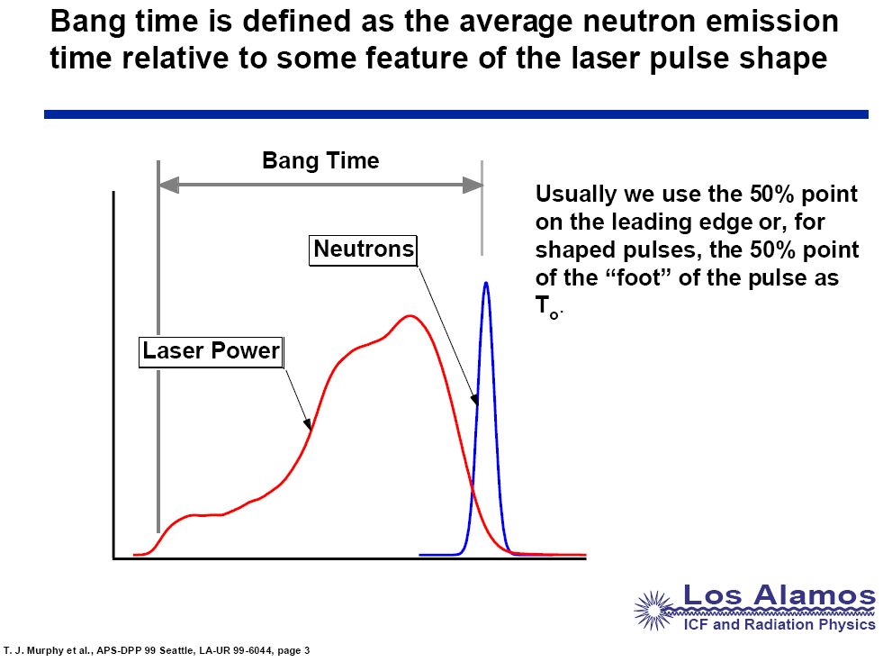
Fusion Reaction History can be determined through time-resolved measurements of escaping fusion products
Doppler
broadened
no escape
(hopefully)
D + T→ ⁵He*
Y. Kim
C. Horsfield
Neutrons or
Gammas
Bang Time - used to establish laser energy coupling to target (shell velocity)
Burn Width - used for failure mode correlation
Reaction Rate
Burn
Width
Foot
Time

Slide 6
Why use a Gas Cherenkov Detector (GCD)?
1. Convert MeV γ-rays to UV/Visable photons
γ-e⁻ Converter
Cherenkov Radiation
DT
Implosion
Bias Voltage
CO₂
PMT
GCD-1
Fusion γ’s
PMT Signal
20 cm
Relativistic electron
Tungsten Shielding
Cassegrainian Optics
2. Variable Energy Thresholding
3. Fast Time Response
DT-γ
v_{e}>c/n
200 psig limit
CO₂
SF₆
3.0 MeV Threshold

Slide 7
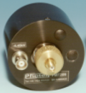

Gamma Reaction History (GRH)- optimized to operate outside target chamber.
1 gas cell at Omega (4 at NIF)
1.87 m from
TCC
60 cm
Off-axis
Parabolic
Mirror
Reflected 3ω
laser light
PMT
W
Shield
Mach
Zehnder
γ-rays
e⁻ → UV/Vis
CO₂ or SF₆
5” diameter Converter
Adjustable flat mirror
Port flange
Fidu
Pressure
Window
Short pulse
cal-laser
Fiber light insertions
LA-UR 10-07461

Slide 8
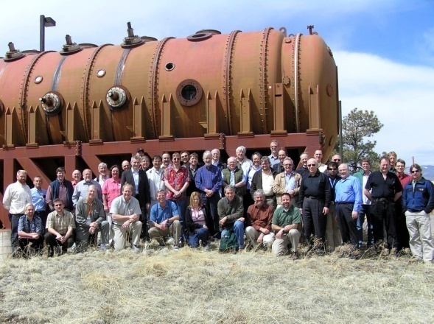
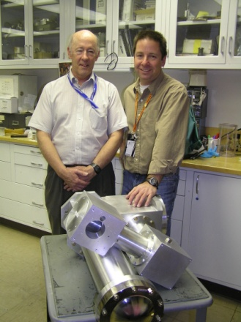
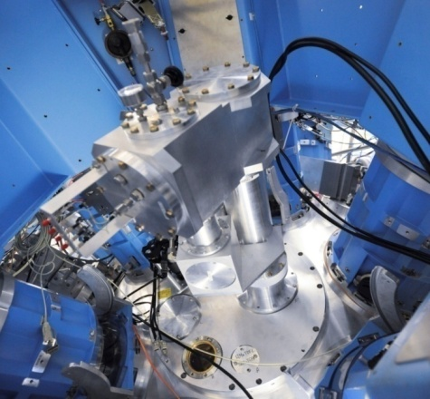
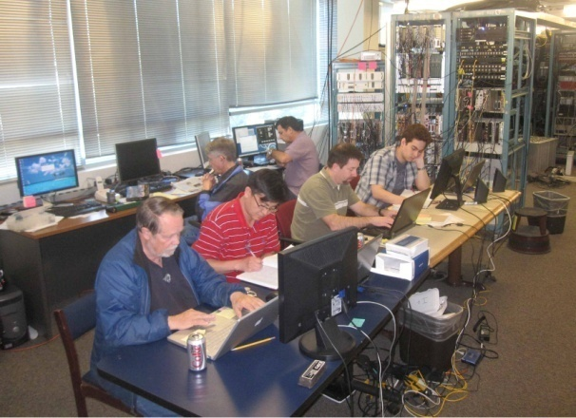
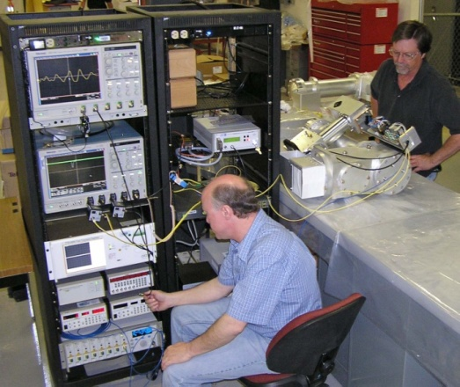
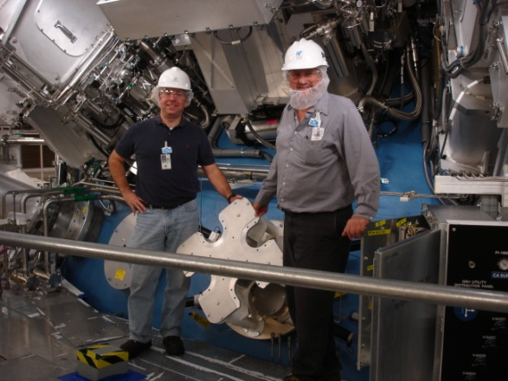
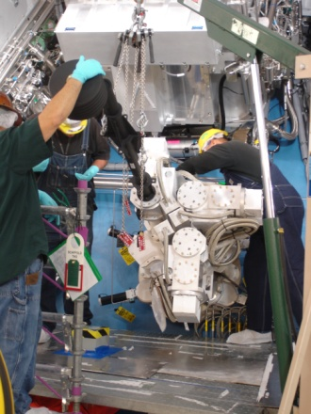
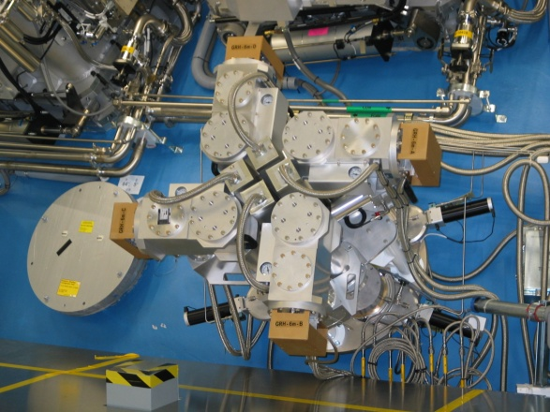
Gamma Reaction History (GRH)
NIF Nuclear Diagnostics LANL Workshop
Conceptualized
Mar’08
Prototype
Fab Oct’08
OMEGA Installation
Jan’09
HIγS Calibrations
Apr’10
NIF Assembly &Testing
Spring’10
NIF Installations
Summer’10
Data on First DT Shot
Sep’10

Slide 9
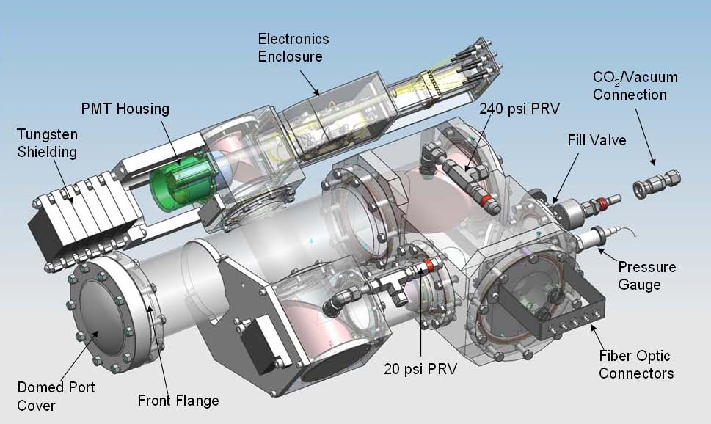

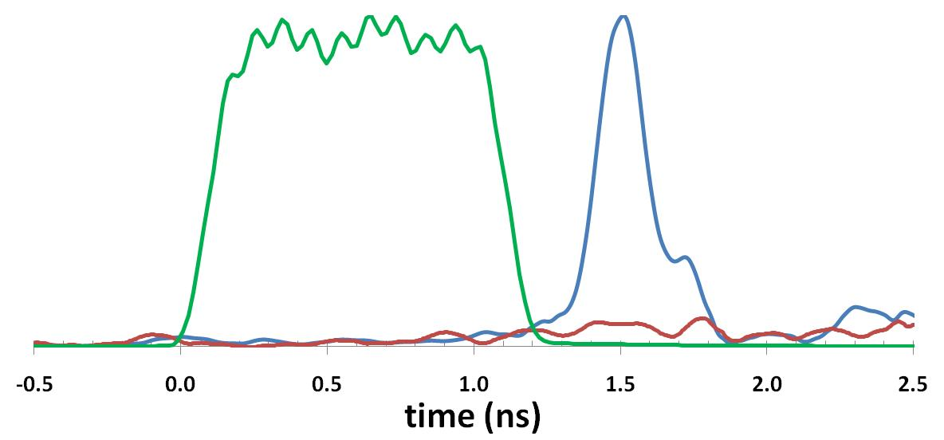
Single-channel GRH prototype performance demonstrated at OMEGA (U. of Rochester)
GRH
Gas Cell
Data from OMEGA
DT-γ
6.3 MeV Threshold
(100 psia CO₂)
Shot 55983(raw) Y_{DTn}=9e12
Laser Pulse
Background
(no gas)
Shot 55989
Installed on OMEGA
t₀

Slide 10
Outline
Intro
  Fusion Reaction History
  γ-Ray Gas Cherenkov Detectors (GCD-1&2, GRH)
Fusion γ-Ray Studies
  DT γ-ray Energy Spectrum & γ/n Branching Ratio
  Other Fusion γ-Ray Studies (³DHe, HT, HD, DD, TT)
Inelastic Neutron Scattering Cross Section measurements (Pucks)
  Hohlraum & Thermo-Mechanical Package (TMP) Materials (Au, Al, Si, Cu)
  Ablator Materials (C, SiO2)
Ablator Areal Density
  Charged Particle Stopping Power
Neutron Capture Cross Section measurements
  Stellar nucleo-synthesis s-process
Future Directions
  “Super” GCD, GCS, GRH-15m, GIS
Summary
LA-UR 10-07461

Slide 11
The full gamma ray spectrum could provide valuable information to the Ignition Campaign
Calculated DT Gamma Ray Spectrum
(for Cryo-layered DT shot at NIF)
¹²C(n,n’γ)
DT Fusion
Hohlraum/TMP n-γ
D(n,γ)
¹²C(n,γ)
  Spectral lines may provide:
    16.75 MeV fusion γ → Total DT yield
    4.44 MeV ¹²C(n,n’γ) → CH Ablator ρR
    15.58 MeV D(n,γ) → Fuel ρR
Notes:
11

Slide 12
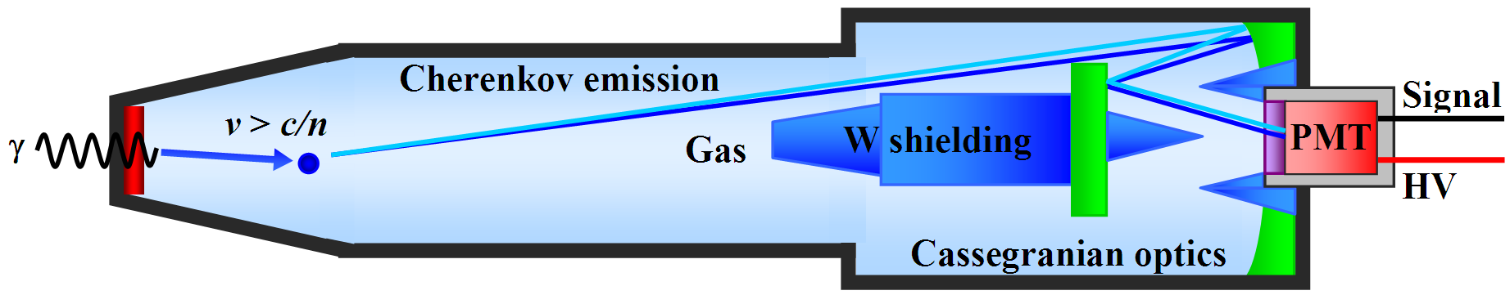
ICF vs. Accelerator beam-target: background better mitigated through: 1) short fusion pulse + fast detector response
GCD
TCC
20 cm
DT-γ & other prompt γ’s
neutron
induced signal
~ 3 ns
Time
Temporal separation w/ Cherenkov detector
Slide 12
Y. Kim (LANL)
Notes:
12

Slide 13
ICF vs. Accelerator beam-target: background better mitigated through: 2) relatively clean spectrum & γ-ray energy thresholding
Calculated for CH Exploding Pusher at OMEGA
12C(n,n’)γ
γ
4.44MeV
n
n′
DT-γ₀
D+T
DT-γ₁
D+T
D+T
12C(n,γ)
12C(n,γ)
Slide 13
Y. Kim (LANL)
Notes:
13

Slide 14
ICF vs. Accelerator beam-target: background better mitigated through: 2) relatively clean spectrum & γ-ray energy thresholding
12C(n,n’)γ
GCD
(6.3 MeV threshold)
γ
4.44MeV
n
n′
DT-γ₀
D+T
DT-γ₁
Detector Response (Ch_phtns/Inc_γ)
D+T
D+T
12C(n,γ)
12C(n,γ)
Variable energy thresholding of Cherenkov detector
Slide 14
Y. Kim (LANL)
Notes:
14

Slide 15
DT nuclear fusion produces high energy γ-rays, in addition to alpha & neutron
D + T → ⁵He* → ⁴He (3.5 MeV) + n (14.1 MeV)
→ ⁵He + γ₀ (16.75 MeV)
⁵He*
16.75 MeV
γ₀
γ₀
0 MeV
-0.96 MeV
4He + n
Slide 15
Y. Kim, G. Hale (LANL)
Notes:
15

Slide 16
DT nuclear fusion produces high energy γ-rays, in addition to neutron & alpha
D + T → ⁵He* → ⁴He (3.5 MeV) + n (14.1 MeV)
→ ⁵He + γ₀ (16.75 MeV)
→ ⁵He* + γ₁ (~13.5 MeV)
⁵He*
16.75 MeV
γ₀
γ₁
γ₀
4.5 MeV
γ₁
0 MeV
-0.96 MeV
4He + n
Slide 16
Y. Kim, G. Hale (LANL)
Notes:
16

Slide 17
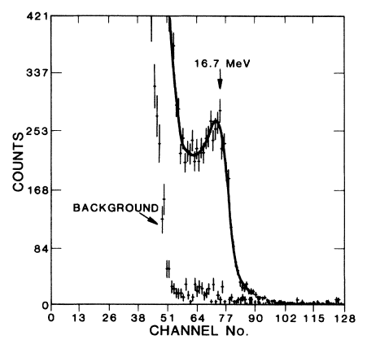
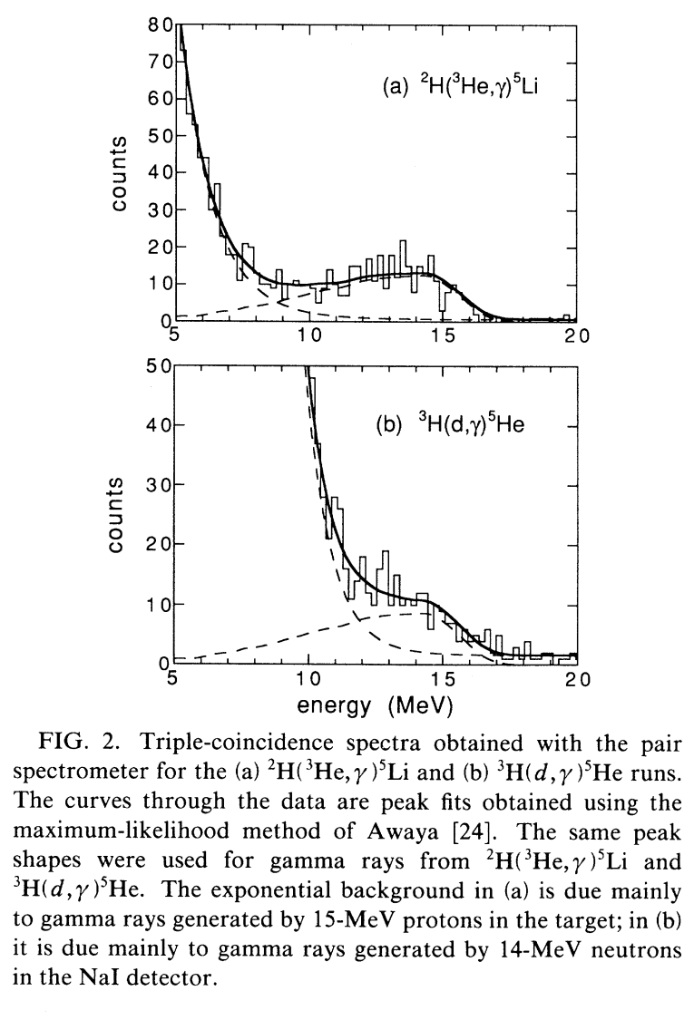
Beam-target expt’s have had difficulty in measuring γ₁ line due to 14 MeV neutron background
G. Morgan (1986)
J. Kammeraad (1993)
γ₀
γ₁?
neutron
γ₀
γ₁?
neutron
background
γ₁ is obscured by background
Y. Kim (LANL)

Slide 18
DT fusion γ-ray line ratio (γ₁/γ₀) has been determined through GCD energy threshold scans
Experimental data from OMEGA
γ₁/γ₀ ≅ 2.3 ± 0.4*
γ₀
Calculated for γ₁/γ₀ = 2.3
γ₁
Calculated for
γ₁/γ₀ = 0 (i.e., γ₀ only)
assuming lines shapes offered by R-Matrix analysis (G. Hale, LANL)
Slide 18
C. Horsfield (AWE), Y. Kim (LANL)
Notes:
18

Slide 19
DT γ/n Branching Ratio = (4.2 ± 2.0)×10⁻⁵ determined by 2 methods: 1) absolute and 2) D-³He cross-calibration
Absolute γ calibration
at HIγS
D-³He γ
cross-cal.
at OMEGA
Supporting Evidence
(Puck n-γ calibration
at OMEGA)
Monte Carlo Code Development: ACCEPT & GEANT4
Slide 19
Y. Kim (LANL)

Slide 20
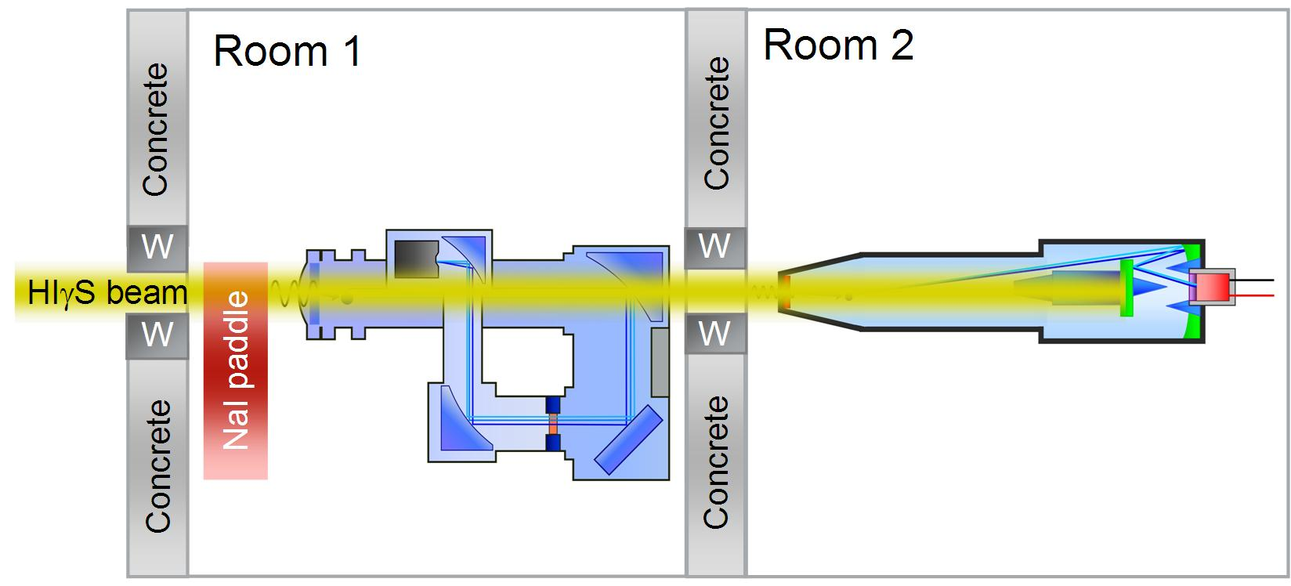
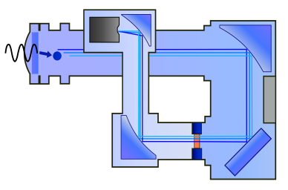
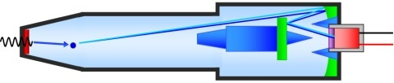
GCD & GRH absolutely calibrated at HIγS
Room 1
Room 2
GRH
Concrete
GCD
Concrete
W
W
HIγS beam
W
W
NaI paddle
Concrete
Concrete
High Intensity γ Source at Duke University (TUNL)
  Inverse Compton γ source (2 – 60 MeV)
  Mono-energetic γ pencil beam energy: 4.4 MeV, 10 MeV, 16.86 MeV
Slide 20
Y. Kim (LANL)

Slide 21
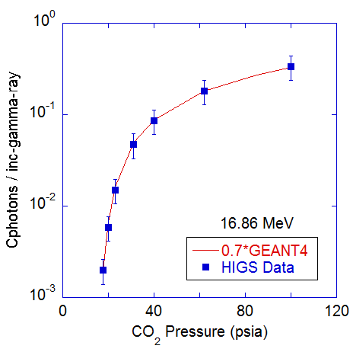
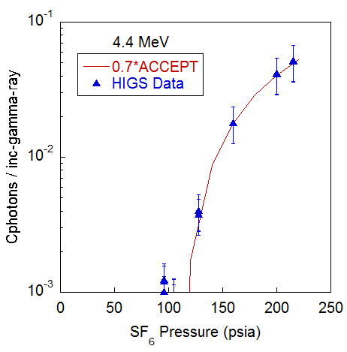
0.7 calibration factor applied to match detector models to experimental data
16.86 MeV γ’s on GCD
4.4 MeV γ’s on GRH
Slide 21
Y. Kim (LANL)

Slide 22
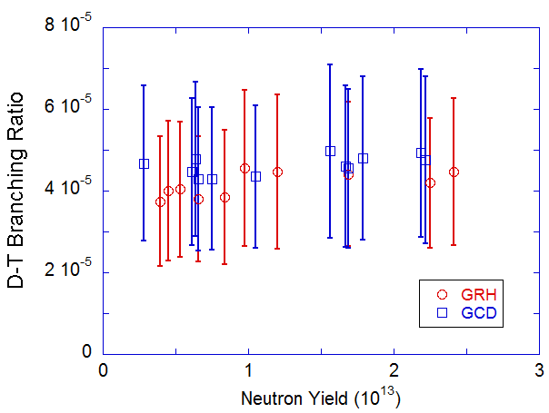
Validated codes are then applied to ICF data to determine absolute DT-BR at OMEGA
OMEGA Data
from absolute method
³H(d,γ)/³H(d,n) = (4.3 ± 1.8) × 10⁻⁵
Slide 22
Y. Kim (LANL)
Notes:
22

Slide 23
D-T γ/n vs. D-³He γ/p measurements at Omega eliminates need for absolute detector calibration
Assumes mirror nuclei ⁵He & ⁵Li γ-ray spectra are identical (plan to test assumption in Aug)
D-T reactions
D + T → ⁴He + n (14.1 MeV) D + T → ⁵He* + γ₀ (16.75 MeV) D + T → ⁵He* + γ₁ (~ 13.5 MeV)
ntof (LLE)
MIRROR REACTIONS
D-³He reactions
D + ³He → ⁴He + p (14.7 MeV) D + ³He → ⁵Li* + γ₀ (16.66 MeV) D + ³He → ⁵Li* + γ₁ (~ 13 MeV)
CR-39 (MIT)
Data from Cecil
(12.5 ± 4.2)×10⁻⁵
Slide 23
Y. Kim (LANL)
Notes:
23

Slide 24
Cross-calibration to D-³He further qualifies the BR determination.
D³He BR from Cecil
= (12.5 ± 4.2)×10⁻⁵
DT BR from D³He
= (3.9 ± 2.3)×10⁻⁵
D³He γ/p
~ 3X
DT γ/n
Y. Kim (LANL)

Slide 25
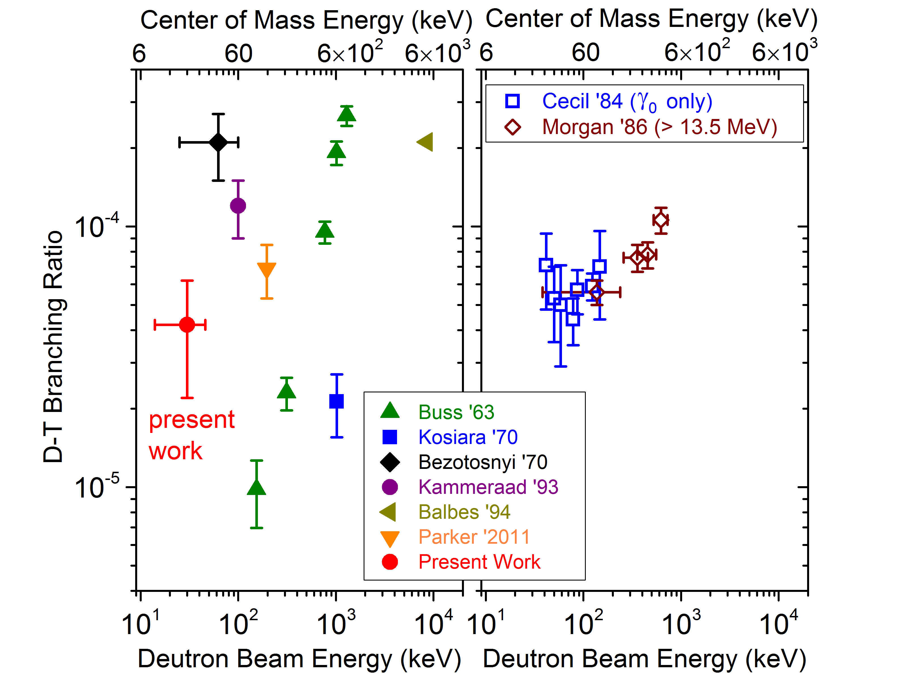
D-T γ/n branching ratio measured at OMEGA may help resolve disparity amongst beam-target results
³H(d,γ)/³H(d,n) = (4.2 ± 2.0) × 10⁻⁵
Y. Kim, Phys. Rev. C, submitted 2012
Y. Kim, Phys. Plasmas, accepted 2012
Slide 25
Y. Kim (LANL)
Notes:
25

Slide 26
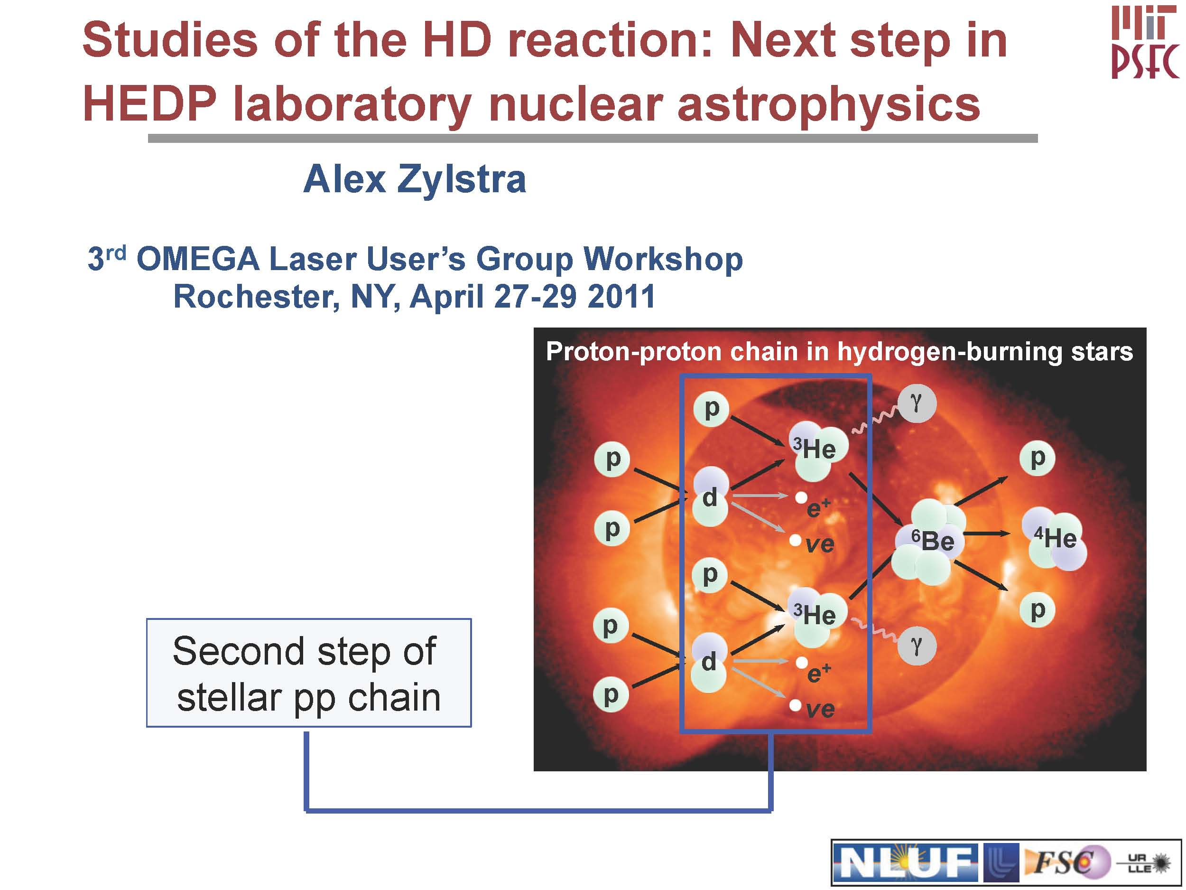
5.5 MeV
A. Zylstra (MIT)

Slide 27
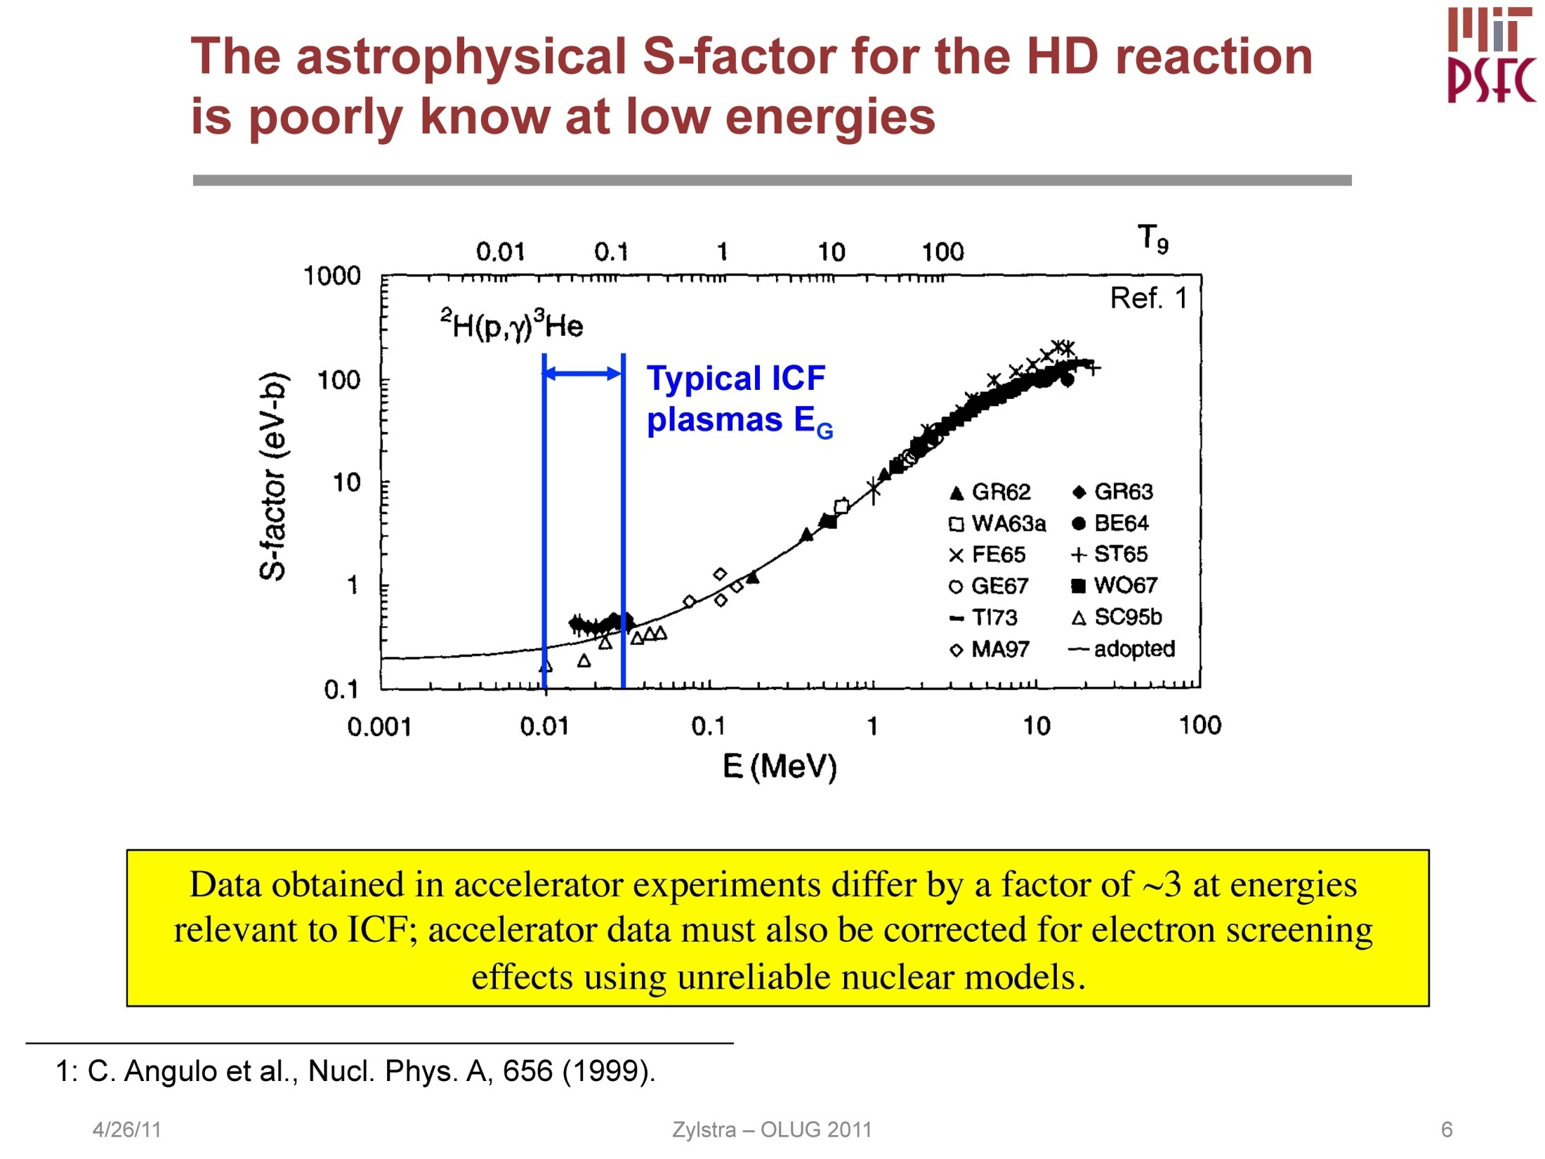
Requires a high-sensitivity “Super” GCD
A. Zylstra (MIT)

Slide 28
Outline
Intro
  Fusion Reaction History
  γ-Ray Gas Cherenkov Detectors (GCD-1&2, GRH)
Fusion γ-Ray Studies
  DT γ-ray Energy Spectrum & γ/n Branching Ratio
  Other Fusion γ-Ray Studies (³DHe, HT, HD, DD, TT)
Inelastic Neutron Scattering Cross Section measurements (Pucks)
  Hohlraum & Thermo-Mechanical Package (TMP) Materials (Au, Al, Si, Cu)
  Ablator Materials (C, SiO2)
Ablator Areal Density
  Charged Particle Stopping Power
Neutron Capture Cross Section measurements
  Stellar nucleo-synthesis s-process
Future Directions
  “Super” GCD, GCS, GRH-15m, GIS
Summary

Slide 29
Need to better understand low energy part of spectrum to extract ¹²C ρR
Calculated DT Gamma Ray Spectrum
(for Cryo-layered DT shot at NIF)
¹²C(n,n’γ)
DT Fusion
Hohlraum/TMP n-γ
D(n,γ)
¹²C(n,γ)
Notes:
29

Slide 30
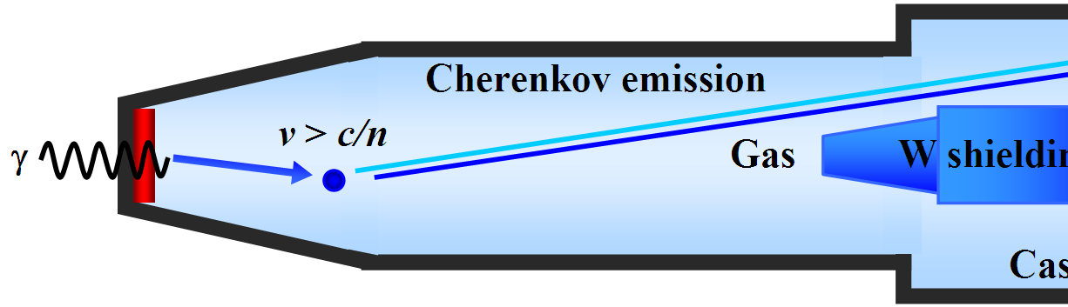
Neutron interactions with “Pucks” near TCC allow characterization of capsule & TMP materials
TCC
Puck
n
DT-γ
= Y_{n} ⋅ BR ⋅ <η(γ_{DT})>
Puck-γ
= Y_{puck-γ} ⋅ <η(γ)>
Time
Slide 30
Y. Kim (LANL)

Slide 31
GCD measures DT-γ and Puck n-γ simultaneously for in-situ calibration
DT-γ
With Puck
Without Puck
Si puck n-γ
PMT ring
5.8 cm
Slide 31
Y. Kim (LANL)

Slide 32
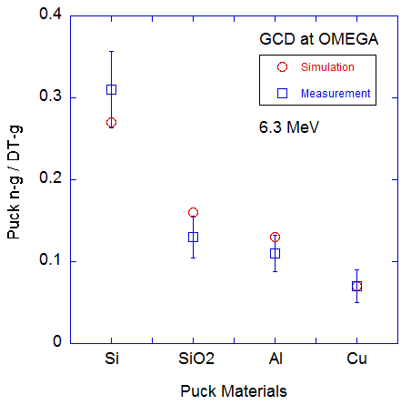
Various materials were tested at OMEGA
(currently testing angular dependencies)
Y. Kim (LANL)

Slide 33
Outline
Intro
  Fusion Reaction History
  γ-Ray Gas Cherenkov Detectors (GCD-1&2, GRH)
Fusion γ-Ray Studies
  DT γ-ray Energy Spectrum & γ/n Branching Ratio
  Other Fusion γ-Ray Studies (³DHe, HT, HD, DD, TT)
Inelastic Neutron Scattering Cross Section measurements (Pucks)
  Hohlraum & Thermo-Mechanical Package (TMP) Materials (Au, Al, Si, Cu)
  Ablator Materials (C, SiO2)
Ablator Areal Density
  Charged Particle Stopping Power
Neutron Capture Cross Section measurements
  Stellar nucleo-synthesis s-process
Future Directions
  “Super” GCD, GCS, GRH-15m, GIS
Summary

Slide 34
Areal Density of imploding plastic capsules can be inferred from γ-Ray yields
Plastic Ablator ρR
  Relates to: 1) ablator compression; 2) ablator mass remaining; 3) ablator/fuel mix
  ¹²C(n,n’) γ : 14 MeV neutrons inelatically scatter off ¹²C in plastic ablator producing 4.44 MeV γ-rays
CH
n’
γ
n
D+T
p
D+³He
p’
n_{e}, T_{e}
Charged-Particle Stopping Power measurements may now be possible
  Fusion ignition depends on energy deposited by alpha particles
    Current knowledge almost exclusively theoretical
  Need to combine ρR measurement with:
    Charged-particle energy downshift measurements (MIT: WRF & CPS)
    n_{e}, T_{e} measurements (LLE: Hotspot X-Ray Spectrometer)
N. Hoffman (LANL)

Slide 35
Outline
Intro
  Fusion Reaction History
  γ-Ray Gas Cherenkov Detectors (GCD-1&2, GRH)
Fusion γ-Ray Studies
  DT γ-ray Energy Spectrum & γ/n Branching Ratio
  Other Fusion γ-Ray Studies (³DHe, HT, HD, DD, TT)
Inelastic Neutron Scattering Cross Section measurements (Pucks)
  Hohlraum & Thermo-Mechanical Package (TMP) Materials (Au, Al, Si, Cu)
  Ablator Materials (C, SiO2)
Ablator Areal Density
  Charged Particle Stopping Power
Neutron Capture Cross Section measurements
  Stellar nucleo-synthesis s-process
Future Directions
  “Super” GCD, GCS, GRH-15m, GIS
Summary
LA-UR 10-07461

Slide 36
NIF allows studies of nuclear physics in a plasma environment
Hot
kT=1-100 keV
10⁴⁰
Dense
1-1000 g/cm³
s-process
(n,γ) in a HEDP
10²⁷⁻³³{
Flux (n/s/cm²)
10²⁰
High Neutron Flux
≈10²⁷⁻³³ cm⁻² s⁻¹
(fluence=10¹⁷⁻²²cm⁻²)
10⁰
LANSCE/WNR Reactor SNS NIF
L. Bernstein (LLNL)
36
Notes:
Title of Presentation
36

Slide 37
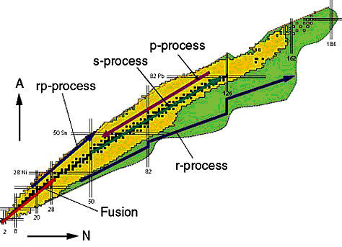
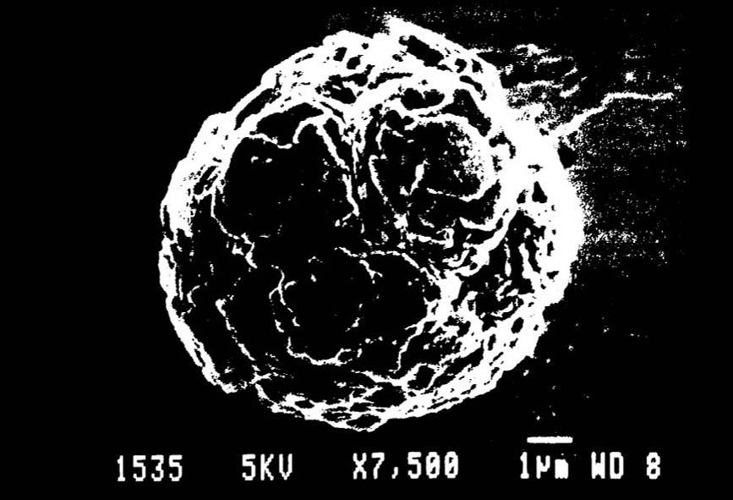
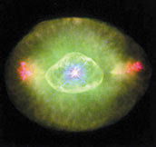
The huge neutron fluence in a NIF capsule (10¹⁸ cm⁻²) suggests s-process branch point neutron capture
AGB stars ➔
disperse elements
Pre-solar grains
¹⁷⁰Yb
¹⁷¹Yb
¹⁷²Yb
¹⁷³Yb
5.04 keV
3/2⁺
¹⁶⁹Tm
¹⁷⁰Tm
4 ns
¹⁷¹Tm
¹⁷²Tm
1/2⁺
¹⁷¹Tm
(n,γ) cross sections on branch-point nuclei in a thermal distribution of
excited states cannot be measured with even the most intense neutron beams
NIF crams 2800 years* of neutron capture into every shot
L. Bernstein (LLNL)
*Busso, Gallino and Wasserburg, Annu. Rev. Astron. Astrophys. 1999. 37:239–309
Notes:
Title of Presentation
37

Slide 38
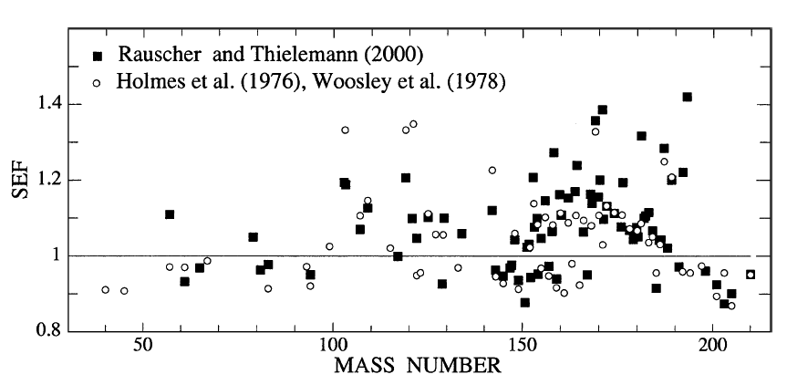
Many important* s-process branch point nuclei have HEDP-populated low-lying excited states
Branch Point | Gnd State J^{π} | 1st Exc. State E_{x} (keV) | 1st Exc. State J^{π}
⁷⁹Se | 7/2⁺ | 95.77 | 1/2⁻
⁸⁵Kr | 9/2⁺ | 304.871 | 1/2⁻
¹⁴⁷Pm | 7/2⁺ | 91.1 | 5/2⁺
¹⁵¹Sm | 5/2– | 4.821 | 3/2⁻
¹⁶³Ho | 7/2– | 100.03 | 9/2⁻
¹⁷⁰Tm | 1⁻ | 38.7139 | 2⁻
¹⁷¹Tm | 1/2⁺ | 5.0361 | 3/2⁺
¹⁷⁹Ta | 7/2⁺ | 30.7 | 9/2⁺
²⁰⁴Tl | 2⁻ | 414.1 | 4⁻
²⁰⁵Pb | 5/2⁻ | 703.3 | 7/2⁻
¹⁸⁵W | 3/2⁻ | 23.547 | 1/2⁻
S-process (n,γ) enhancement due to excited states*
*Bao & Kappeler At. Dat. Nucl. Dat. Tables 76, 70–154 (2000)
NIF (or LMJ) are the only places where (n,γ)
might be measured on ground+excited states
L. Bernstein (LLNL)

Slide 39
Outline
Intro
  Fusion Reaction History
  γ-Ray Gas Cherenkov Detectors (GCD-1&2, GRH)
Fusion γ-Ray Studies
  DT γ-ray Energy Spectrum & γ/n Branching Ratio
  Other Fusion γ-Ray Studies (³DHe, HT, HD, DD, TT)
Inelastic Neutron Scattering Cross Section measurements (Pucks)
  Hohlraum & Thermo-Mechanical Package (TMP) Materials (Au, Al, Si, Cu)
  Ablator Materials (C, SiO2)
Ablator Areal Density
  Charged Particle Stopping Power
Neutron Capture Cross Section measurements
  Stellar nucleo-synthesis s-process
Future Directions
  “Super” GCD, GCS, GRH-15m, GIS
Summary

Slide 40
“Super” GCD
200 psia SF₆
Lower threshold limit of current GCD-1 is 6.3 MeV
100 psia CO₂
Goal: reduce threshold to 2.9 MeV for improved response
Requires SF₆ at 200 psia
  metal seals to prevent SF6 from leaking into chamber and poisoning tritium purification catalyst
  Stainless steel body

Slide 41
An energy-resolving Gamma Compton Spectrometer (GCS) is being conceived by LANL, LLNL, GA & NSTec
Gamma Compton Spectrometer
γ-rays
Compton
electrons
magnet
(γ,e)
converter
detector array
Requirements
  Yield >3e14 DTn (for 12C(n,n’γ))
  Energy Resolution ΔE/E ≤ 3%
  <1ns temporal response
  Tunable energy range (2-25 MeV)

Slide 42
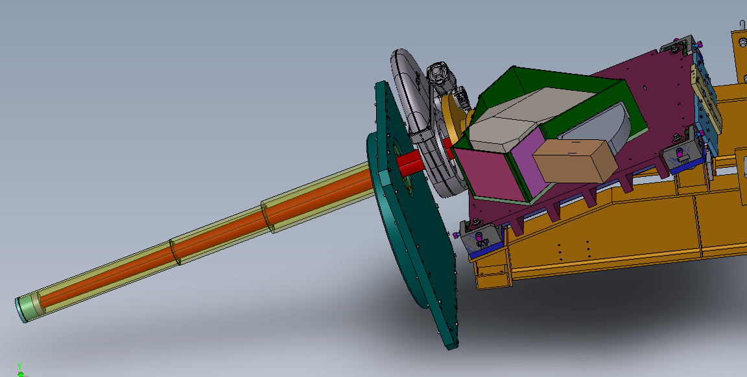
Pre-CDR Workshop 4/20/12 held to flush out design options

Slide 43
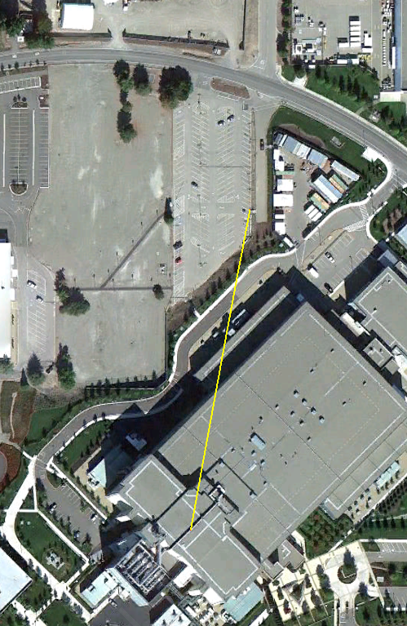
“Furlong”: Single-Hit, Pixelated Gamma Spectrometer
Large array of scintillator detectors
  ~10,000
  High Z (e.g., LaBr₃)
  Good Energy Resolution (ΔE/E≈1%)
  Sufficiently fast (~25 ns decay)
201 meter
NIF
W. Stoeffl (LLNL)

Slide 44
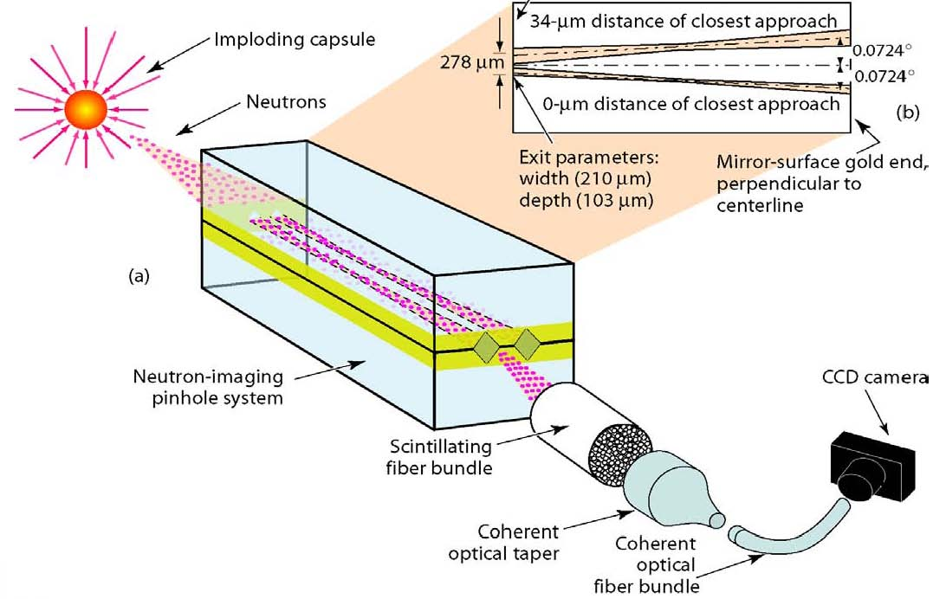

Other Future Diagnostic Options
Shielded
Streak
Cameras
NIS
Scope
PMTs
Streaked GRH-15m
(H. Herrmann)
γ-Ray Imaging of Ablator (¹²C-γ)
(G. Grim)

Slide 45
Summary
Gas Cherenkov detectors (GCD) have been operating on OMEGA for over a decade, and are now making an impact at NIF (Gamma Reaction History (GRH))
Opening new windows in Plasma Nuclear Science:
  fusion γ-branches (DT, D³He, HD, HT, DD, TT)
  inelastic neutron scattering (ablator ρR, stopping power)
  radiative neutron capture (stellar nucleosynthesis s-process)
New γ-ray capabilities are needed:
  Higher sensitivity → “Super” GCD
  Energy resolution → Gamma Compton Spectrometer, Pixilated “Furlong”
  Higher bandwidth → GRH-15m (streak camera)
  Imaging capability → Gamma Imaging System (GIS)

Slide 46
Backup Slides

Slide 47
Abstract
High bandwidth measurement of DT ICF gamma rays using energy-thresholded, gas Cherenkov detectors has been developed over the past decade at OMEGA and is now a workhorse for fusion reaction history on the National Ignition Facility (NIF). In addition to reaction history, gamma-ray studies at OMEGA and NIF have opened a new window to Plasma Nuclear Science (PNS). ICF platforms offer advantages when making certain nuclear measurements over traditional accelerator-based techniques- owing to the short pulse, high plasma areal density, and extreme neutron flux of ICF implosions. Through PNS, we now have a much better understanding of the DT gamma energy spectrum and the gamma/neutron branching ratio. Gammas from inelastic neutron scattering in the ablator leads to inferences of implosion performance and radiative neutron capture might help us understand the formation of the heavy elements within the stars. However, taking these studies further is going to require increased capability, including higher sensitivity (“Super” GCD), energy resolution (Gamma Compton Spectrometer, pixilated “Furlong” detector), higher bandwidth (streaked GRH-15m) and imaging capability (GIS).

Slide 48
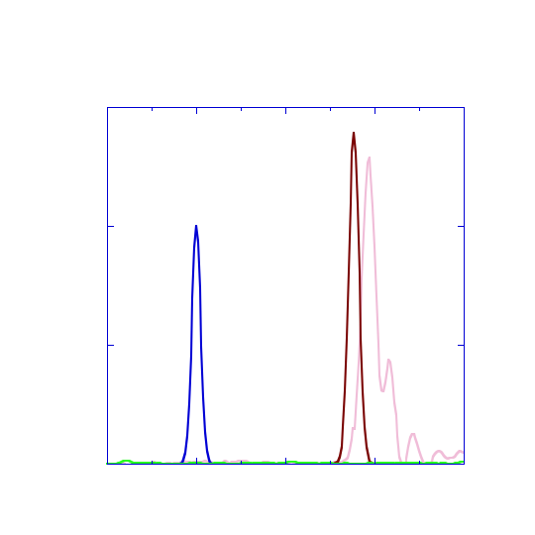
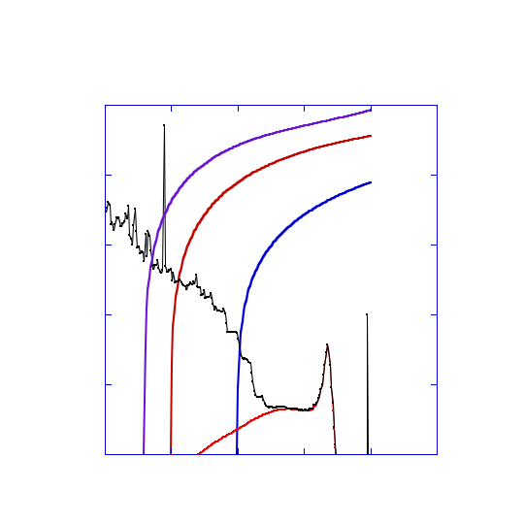
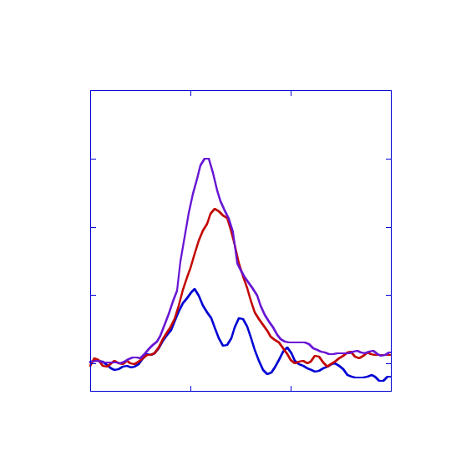
NIF Gamma Reaction History (GRH) measures Bang Time (±30 ps), Burn Width (± 15 ps), and γ-Ray Yields for Total DT Yield and Ablator ρR
GRH-6m at (64,20)
DT Exploding Pusher Data
  4 Gas Cherenkov Detectors with Ultra-fast MCP PMTs and optical Mach Zehnders
N101029
N101212
PMT
MZ
Bang time
DTγ
Timing Shot Fit
5 10¹⁴
Yield Rate (n/ns)
Deconvolved Gaussian Fit
Burn width
Raw
Calculated THD γ-Ray Spectrum
0
-1
0
1
2
3
Time (ns)
No CO₂
¹²Cγ
3 MeV
5 MeV Threshold
10⁻¹
Cryo-layered THD Data
10⁻³
10 MeV
N1110212
Raw Data
Hohlraum/TMP-γ
HT γ
γ–photon /DT_{n}/ 0.1 MeV
Response ( optical photon/ γ)
10⁻⁵
10⁻³
1.5e-4
DT γ
1.0e-4
+ ¹²C + TMP γ’s
+ TMP γ’s from n_{DT}
Thresh:
3 MeV
5 MeV
10 MeV
Normalized Signal
γ₁
γ₀
0.5e-4
10⁻⁷
10⁻⁵
0
Fusion
γ’s
0
10
20
γ–ray Energy (MeV)
PMT
ring
  Energy thresholded measurements to provide:
  Total DT Yield
  Plastic Ablator Areal Density
21
Time (ns)
22
  ¹²C signal clearly observable from plastic
  γ-Ray Spectrum beginning to emerge!
48

Slide 49
GCD energy threshold scan was performed to infer n-γ spectrum
May 2009 Data
GCD at OMEGA
Si
Slide 49
Y. Kim (LANL)

Slide 50
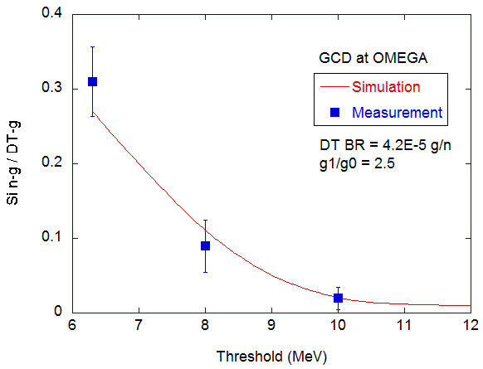
Si puck-γ data are in good agreement with MCNP/ACCEPT simulation
Y. Kim (LANL)

Slide 51
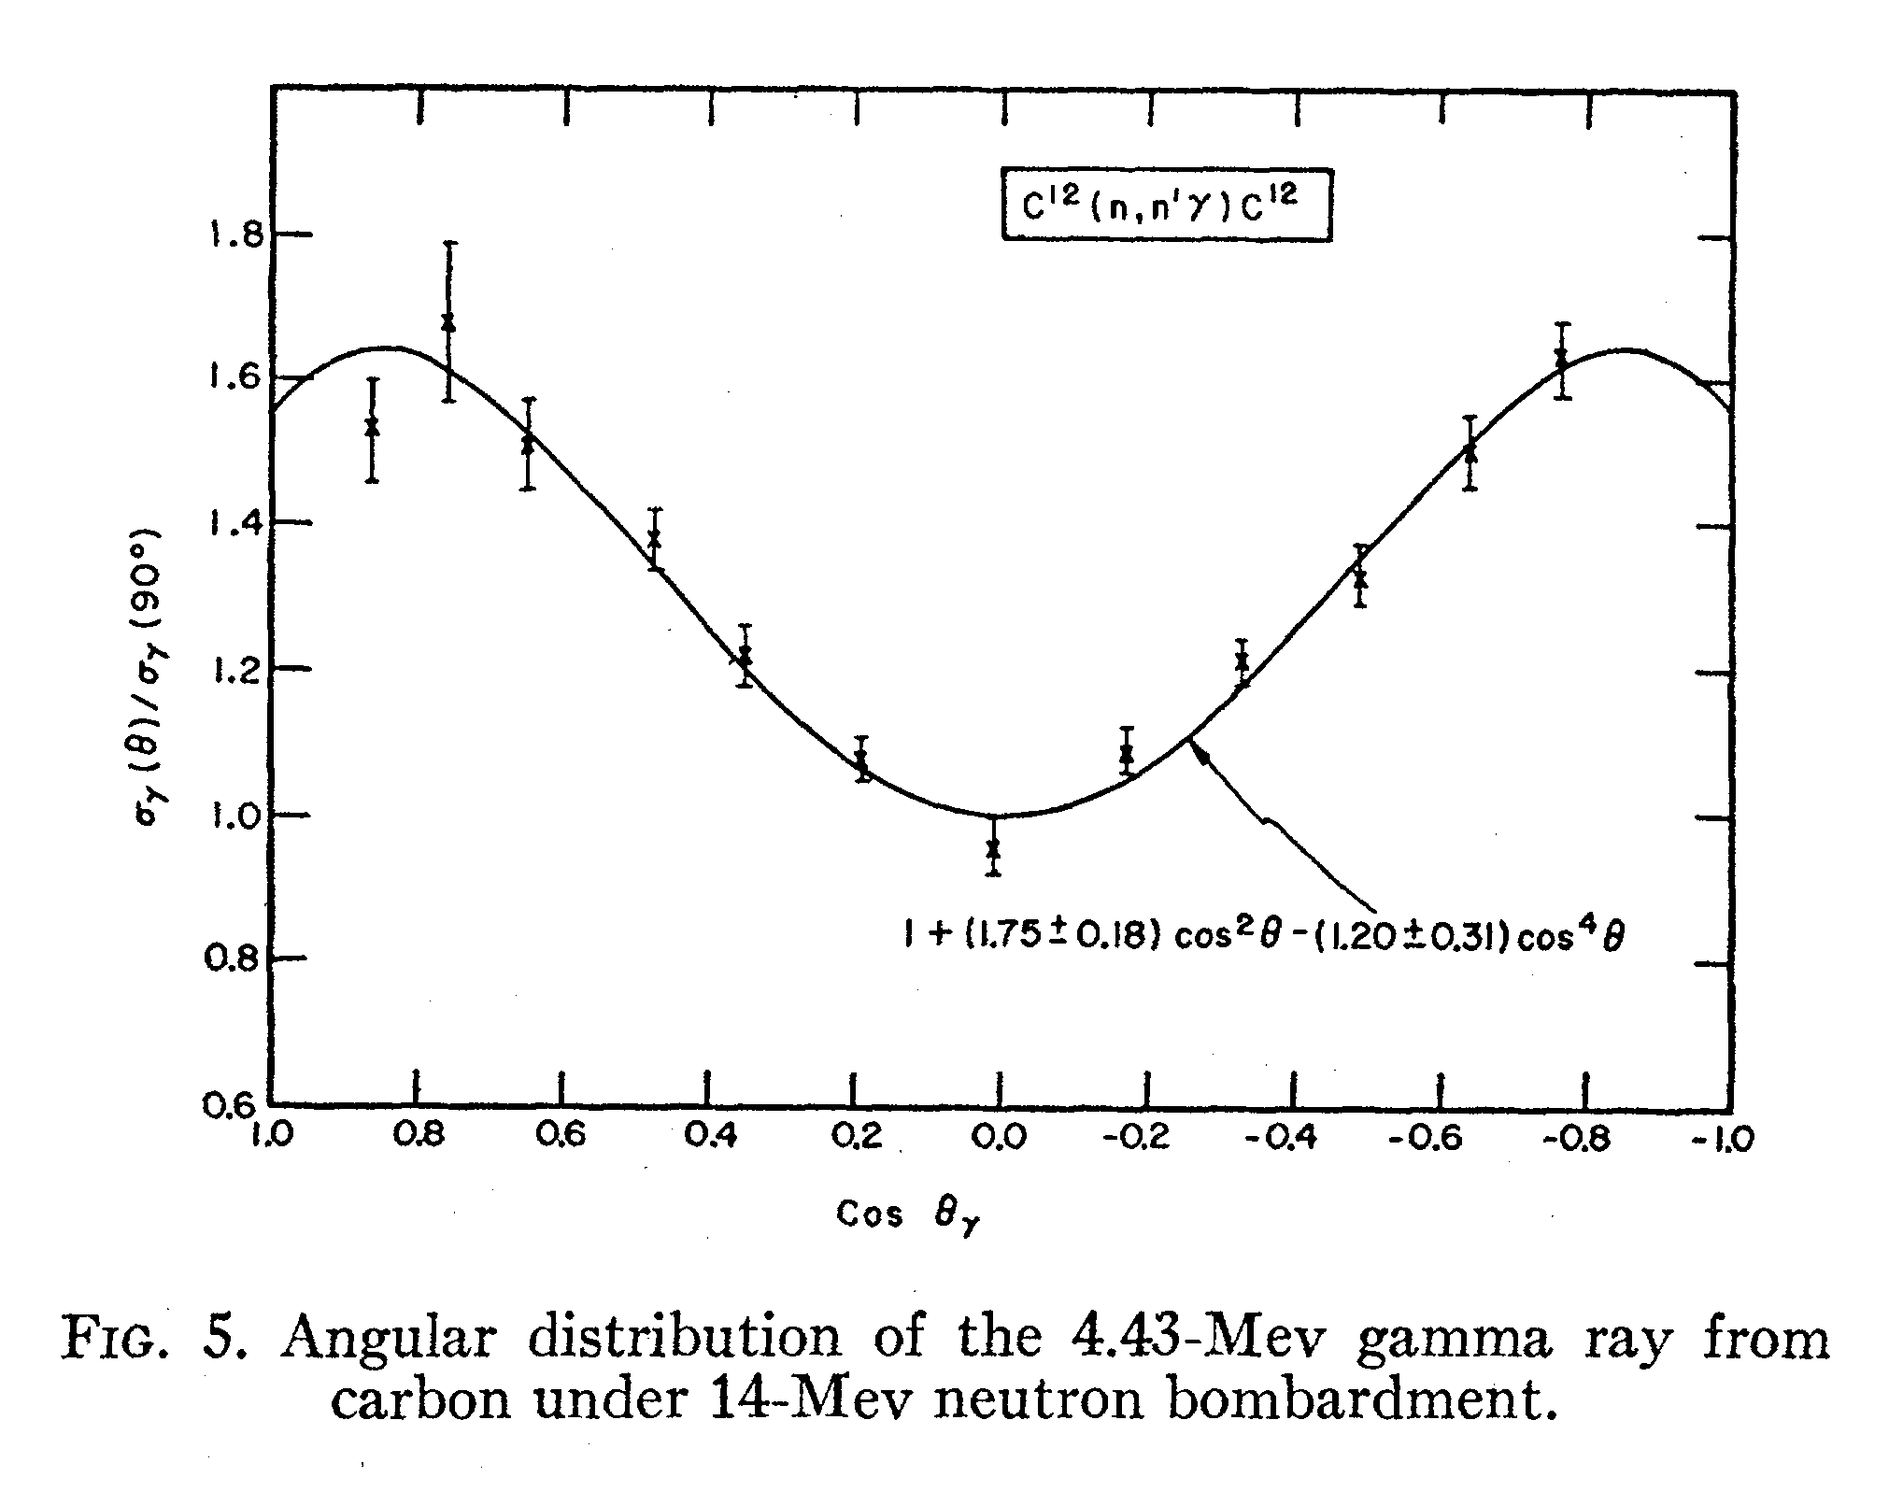
Recently, GRH was added to n-γ angular distribution study
 | angle distance (degree) | COS(angle distance)
GRH  TIM-1 | 41.58 | 0.748
GRH  TIM-5 | 104.73 | -0.25
TIM-1
GCD-2
TIM-1
TIM-5
GRH
GCD-1
TIM-5
Slide 51
Y. Kim (LANL)

Slide 52
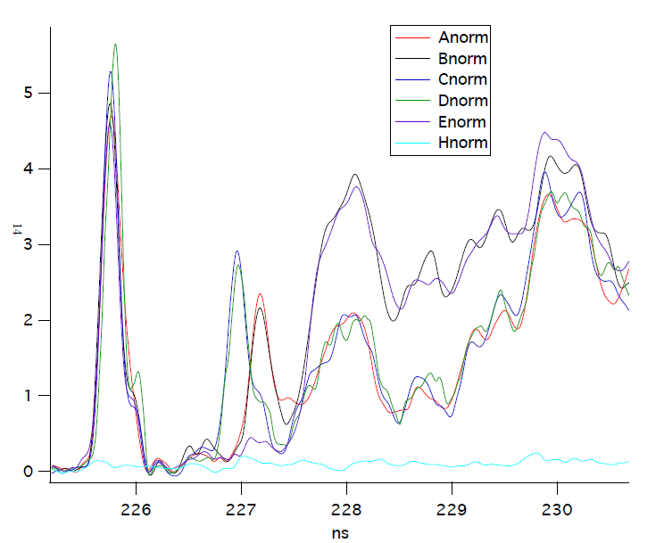
GRH has measured ¹²C, Al, SiO₂, Si puck n-γ
DT
TAD
Al from
TIM5
Al from
TIM1
Slide 52
Y. Kim (LANL)

Slide 53
Inferred carbon areal density for eleven OMEGA shots is about 25 mg/cm², for DT neutron yields greater than ~5 x 10¹²
Areal density
N. Hoffman
Data is shown for eleven CH capsule implosions at Omega in May and September 2010
40 mg/cm2
30 mg/cm2
20 mg/cm2
10 mg/cm2
0 mg/cm2
This region is excluded on basis of detector calibrations and DT gamma contribution to low-threshold signal
Data in “excluded” region indicates large signal uncertainty for low yields
N. Hoffman (LANL)

Slide 54


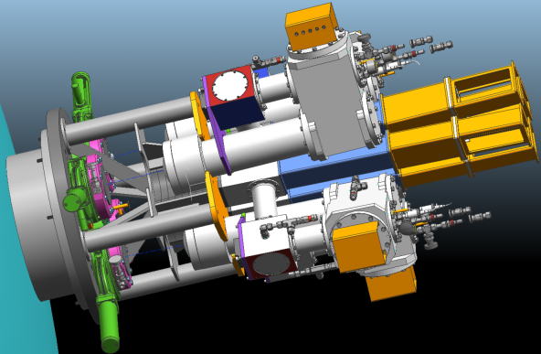
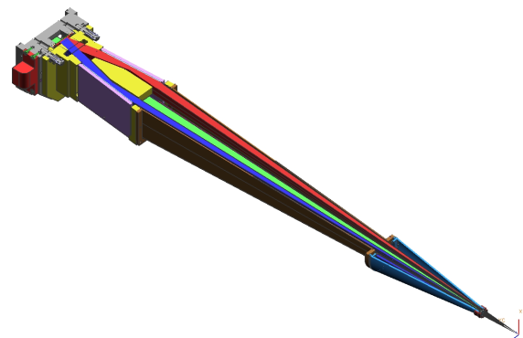
Stopping-power experiment, N. Hoffman, C-10 & NIF Science proposals
M
I
T
Experimental conditions:
Direct-drive, non-cryo DT3He,
CH capsule w/ compressed ρΔx ≈ 200 mg/cm²
Tungsten shielding
n′
γ
Mach Zehnder
GRH (Gamma Reaction History) measures areal density ρΔx of plastic ablator at bang time via yield of (n,n′) γ rays from ¹²C
n
GRH
ρΔx
C,
H,
O,
Ge
D+T
WRF
WRFs (Wedge Range Filters) measure energy loss ΔE of protons produced by D+³He reactions at bang time as they traverse ablator
D+³He
WRF2 WRF1
p
Polar DIM
ΔE
p
HSXRS (Hotspot X-Ray Spectrometer), at large Bragg angle, allows inference of electron density n_{e} and temperature T_{e} in Ge-doped plastic ablator based on 1s-2p x-ray absorption spectrum of cold, dense Ge at hν < 10 keV
Low energy channel (9.75 – 11.2 keV)
HSXRS
n_{e}, T_{e}
High energy channel (11.4 to 13.1 keV)

Slide 55
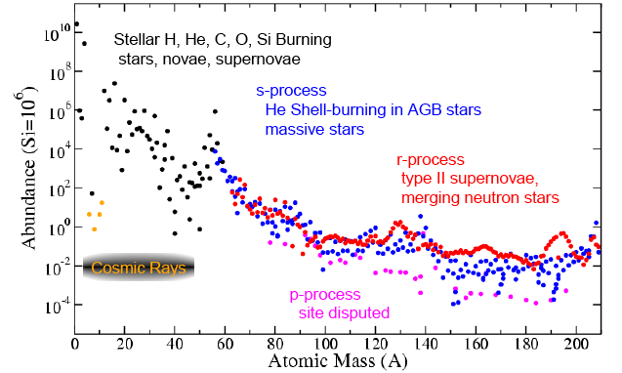
The majority of elements with Z>26 (Iron) are formed in neutron capture reactions in astrophysical settings
s-process
He -Shell burning
in AGB stars
r-process: Type II SN, neutron stars
*thanks to Aaron Couture for the figure!

Slide 56
Nuclear-plasma interactions in the hot dense plasma can cause thermal population of low-lying nuclear states
Photo-absorption
Time Reverse: γ-ray decay
Atomic-nuclear (electron) interactions
NEEC, NEET, IES*
Time Reverse: IC-decay
e
e
N
N*
N
N*
Photons
HEDP
electrons
Atom
electrons
Nucleus
Photons
Are these interactions fast enough to thermalize nuclei at NIF?
L. Bernstein (LLNL)

Slide 57
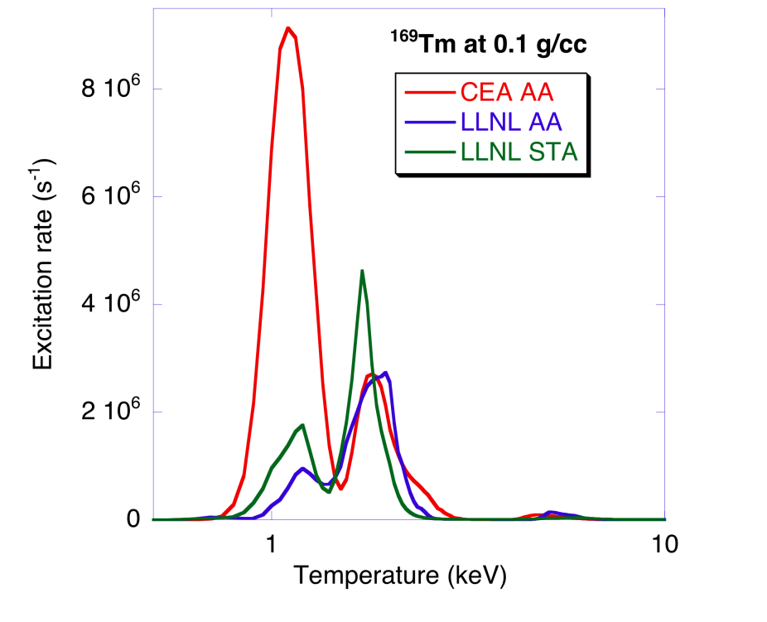

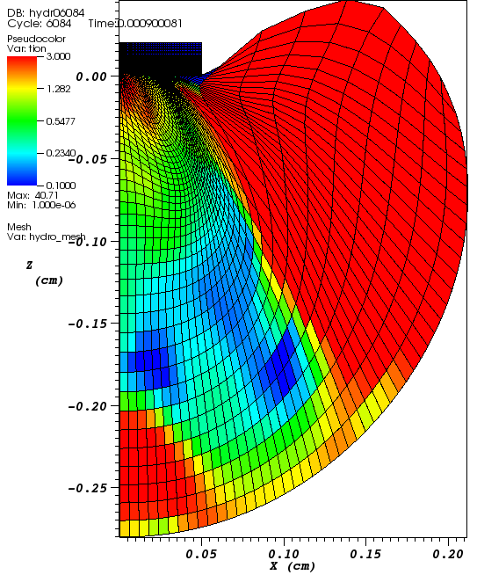

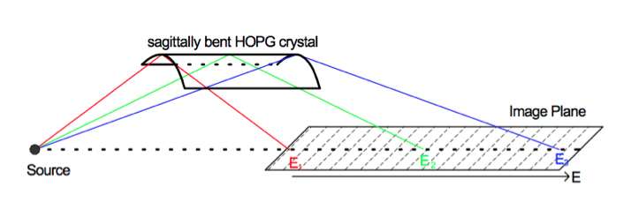
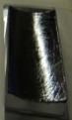
Calculations of NEET/NEEC rates are highly uncertain
Coupled Plasma-Atomic-Nuclear models have large discrepancies
Experimental configuration
“Blow-off plasma”
T_{ion} (simulation)
44-56 Drive Beams
Target Foil
Sagittally Bent HOPG crystal
θ_{Bragg}=12º
Source
X-ray framing camera + CCD
We will try to measure these rates in a hot
dense plasmas at LLE on 1/23 (A. Kritcher)
L. Bernstein (LLNL)
Notes:
57

Slide 58
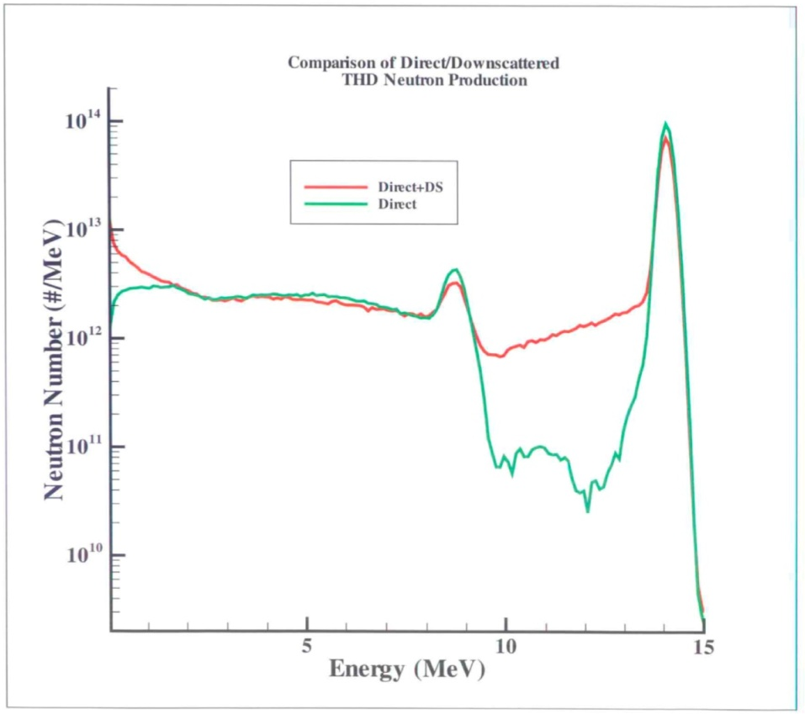
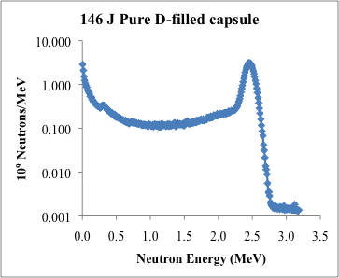
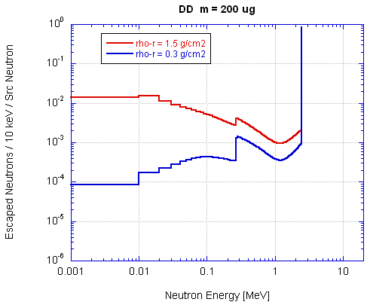
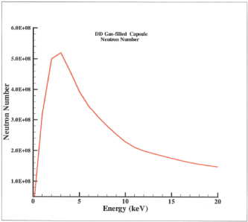

Are sub-MeV neutrons present at NIF?
Simulations show that high ρR_{fuel} D and THD-loaded shots produce lots of them
HYDRA (Cerjan)
MCNP (Hagmann)
251 J HT(0.5%D)
ρR≈1.26 g/cm²
The low energy component is the same
because the neutrons are thermal
L. Bernstein (LLNL)

Slide 59




We have explored two ways to simultaneously measure (n,γ) on samples loaded into a NIF capsule
We can ion implant ≤10¹⁶ atoms into a C nanofoam scaffold (Kucheyev et al.,)
RBS Yield
(Xe)
Collect “debris” & count
Gostic, Shaughnessy,
Grim, Greife
Measure prompt γ-rays
following capture
I will show data from both approaches
L. Bernstein (LLNL)

Slide 60






Approach #1: γ-rays from (n,xγ) are measured using a Gas
Cherenkov-based system: GRH (Gamma Reaction History)
Gas pressure determines E_{th}
3.5 MeV
10 MeV
7.7 MeV
12 MeV
15 MeV
Transition
Radiation
DTγ
NIF shot N101212
LLE data
Snout n-γ Chernenkov
(H. Herrmann & W. Stoeffl)
L. Bernstein (LLNL)

Slide 61

GRH data from the N110212 THD shot shows the
¹²C(n₁₄,n’γ_{4.4}) from the ≈10⁻² of the CH shell left at τ_{peak}
Mostly Shell ¹²C(n₁₄,n’γ)
N_{4.4}≥2±1.5 x 10¹¹*
Mostly Hohlraum/TMP
^{nat}Si,^{nat}Al(n₁₄,n’γ)
To get these many gammas you would
need to run ≈10¹⁷ neutrons on target
L. Bernstein
(LLNL)
*N. Hoffman - LANL

Slide 62
0.5 MeV resolution (ΔE/E ≈ 3%) at high energy is adequate

Slide 63
0.5 MeV resolution (ΔE/E ≈ 3%) at high energy is adequate

Slide 64


Interpreting GRH data requires good knowledge of the (n₁₄,xγ) cross sections on materials near TCC (Al, Si, Au etc.)
T/H/D: 74/24/2, t₀±¼ ns
3 MeV
3 MeV
5 MeV
5 MeV
~ ½ ns
DT
HT
8 MeV
8 MeV
14 MeV
14 MeV
Hohlraum
Response to 14 MeV only
(MCNP)
L. Bernstein (LLNL)

Slide 65




Any input signal must be passed through the GRH instrument response function (IRF)
N110212 - GRH 2.9 MeV Channel
…and accounts
for this shoulder
Gets rid of
about ½
≤10⁸ neutrons
L. Bernstein (LLNL)

Slide 66


The eventual goal is to measure (n,γ) on a nucleus “seeded” into a capsule loaded with pure D-fuel
¹⁷⁰Tm
From X-rays: σ_{ρR-Tm}≈10%
What we want
From particle-γ
measurement≈10%
From hohlraum
Late time signal
σ_{ρR-Au}≈5%
σ_{Au}≈2%
L. Bernstein (LLNL)

