Slide 1
Gamma Spectroscopy
4/26/12
H. Herrmann (LANL)

Slide 2
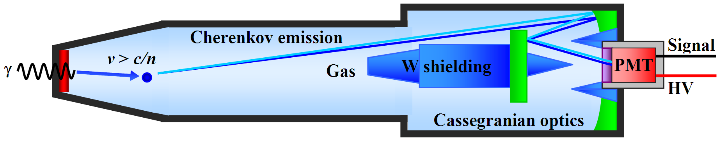
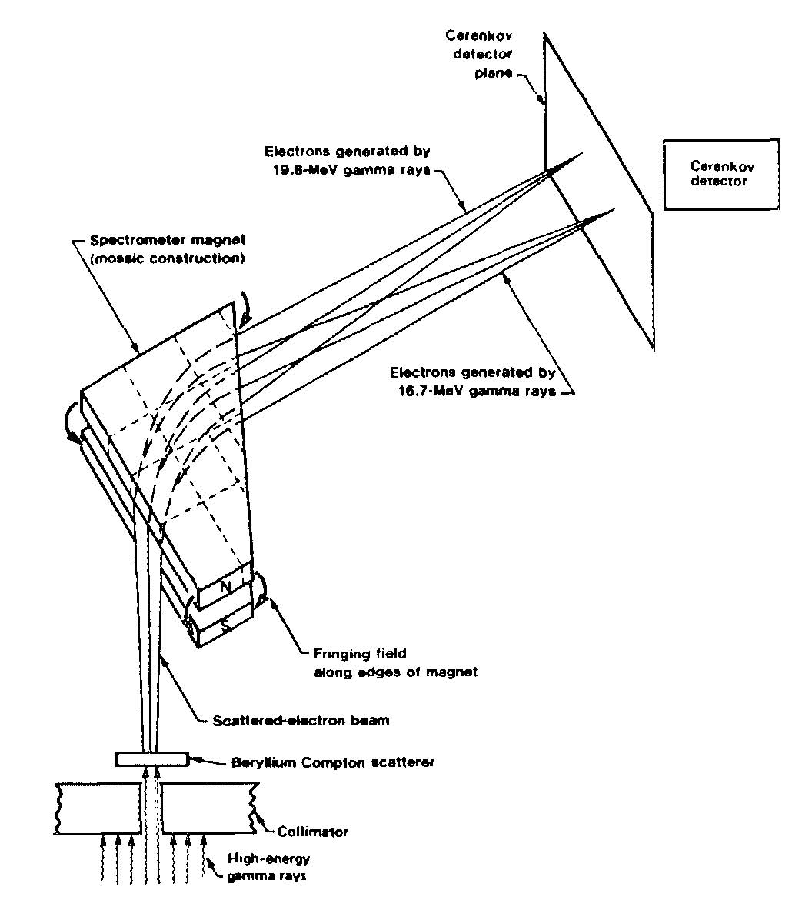
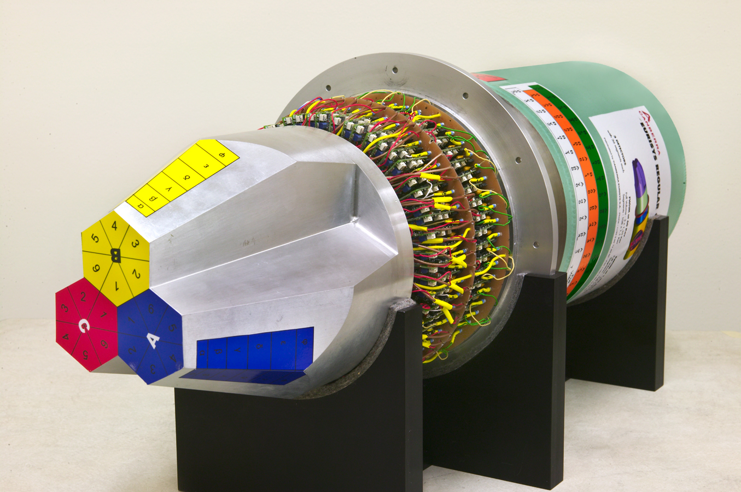
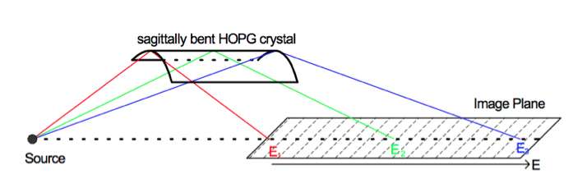
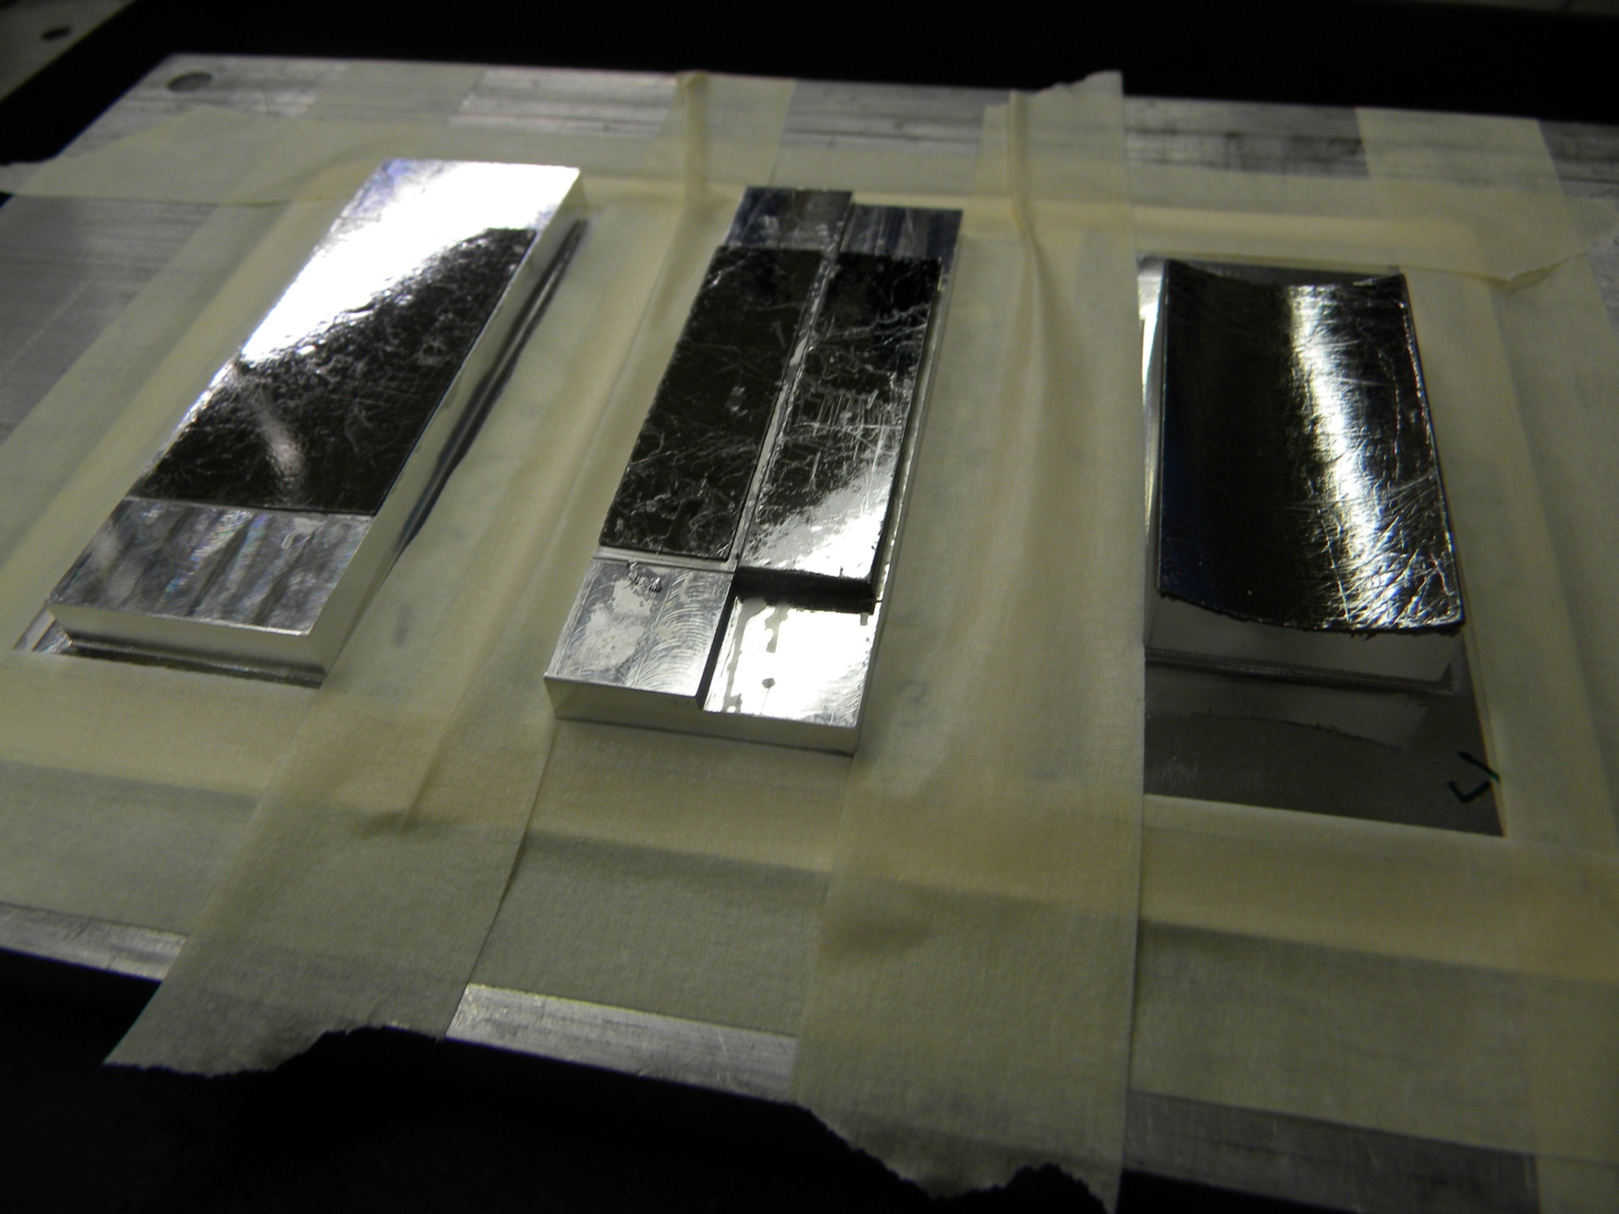
Next Steps
Cherenkov detectors
Energy thresholded
Gas limited to >2.5 MeV
Solid limited to <~0.2 MeV
Aerogel might span the gap
Real γ-ray spectroscopy (Energy resolved)
e⁻
Compton Spect. (>2 MeV)
Pixelated Single-Hit “Furlong” (>0.1 MeV?)
Bent Crystal
(<1.5 MeV)
Sagittally Bent HOPG crystal
θ_{Bragg}=12º
Source
X-ray framing camera + CCD
M. Moran, RSI 56, 1066 (1985)

Slide 3
Energy resolution would provide valuable information to the Ignition Campaign
Calculated DT Gamma-Ray Spectrum
Spectral uncertainties call for energy resolution
  GRH is only energy thresholding, not resolving
  Be Ablator ρR from impurity ¹⁶O(n,n’γ) at 6.1, 6.9, 7.1 MeV
¹²C(n,n’γ)
DT Fusion
Hohlraum/TMP n-γ
¹²C(n,γ)
¹²C(n,γ)
D(n,γ)
  Spectral lines may provide:
    16.75 MeV fusion γ → DT yield
    4.44 MeV ¹²C(n,n’γ) → CH Ablator ρR
    15.58 MeV D(n,γ) → Fuel ρR
Notes:
3

Slide 4
DT Fusion γ-ray spectrum needs to be mapped out better
Γ_{γ-total}/Γ_{n} = (4.2 ± 2.0) × 10⁻⁵
D + T → ⁵He*
γ₁/γ₀ ≅ 2.3 ± 0.4
⁵He*
16.75 MeV
γ₀
γ₁
γ₁
γ₀
4.5 MeV
0 MeV
⁵He
⁴He + n
-0.96 MeV
GCD mapping of γ spectrum at OMEGA used assumed line shapes determined by R-Matrix analysis (G. Hale, LANL
Needs to be verified by spectroscopy
Y. Kim (LANL), C. Horsfield (AWE)

Slide 5
0.5 MeV resolution (ΔE/E ≈ 3%) at high energy is adequate

Slide 6
0.5 MeV resolution (ΔE/E ≈ 3%) at high energy is adequate

Slide 7
0.5 MeV resolution at low energy (adequate, but GCS will do better at 3%)

Slide 8
Mix-dependant γ-ray lines could aid Ignition Campaign
MeV alpha-particles born in the DT burn and MeV knockon deuterons and tritons interacting with ablator material (C or Be)
Reactions emitting gammas sensitive to stopping power with σ_{γ}>~10 mb/sr/gamma-ray:
reaction | Eγ (ΜeV) | Application
¹³C(d,n)¹⁴N* | 4.91, 5.69 | ¹³C layers in CH or doped in Be
⁹Be(d,n)¹⁰B* | 2.8, 3.4 , 4.49, 6.03 | Be Capsule
⁹Be(α,n)¹²C* | 4.4 | Be Capsule
A. Hayes, LANL

Slide 9
Challenge: measure high energy γ-ray in background of other γ-rays & LPI x-rays
2-Temp LPI x-rays spectrum (Kruer model)
  3 orders-of-mag more x-ray energy below 300 keV than above
  Nearly 4 orders-of-mag more energy in LPI x-rays than Prompt Nuclear γ-rays
  Comparable energy in x-rays & γ-rays above ~300 keV
    Empirically, there’s ~3x more FFLEX signal from γ-rays than x-rays at >250 keV
    GRH background is dominated by <250 keV x-rays
¹²C(n,n’γ)
DT- γ D(n,γ)
γ-rays of interest:

Slide 10
Physics-based Requirements:
Topic | Requirement
Resolution | ΔE/E ≤ 5%
Sensitivity Req’d n Yield | ≥100 e⁻ in bins of interest: Y > 3e14 for ¹²C-γ (at ρR_{12C} ≈200 mg/cm²) Y > 3e15 for DT-γ₀ Y > 1e16 for DT-γ₁ and D(n,γ)
Binning | ≥12 energy bins
Temporal Response | <1ns
SNR | >5
Energy Range | Total: 2-25 MeV Single Shot: 2/3E_{high} to E_{high} (e.g., 12-18 MeV)

Slide 11
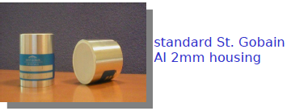
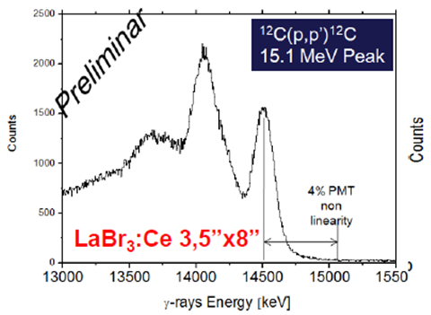
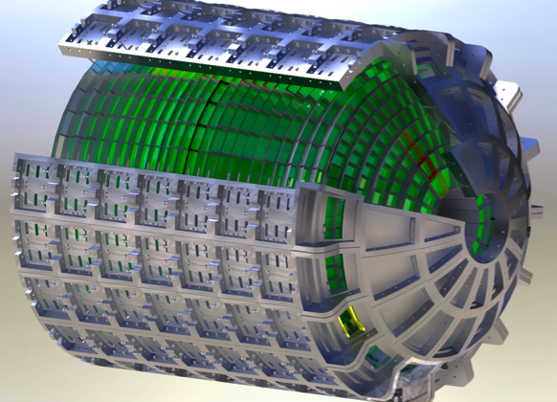


Option: FURLONG, does not need high neutron yield…
Each detector records less than one gamma ray, many detectors.
Build a spectrum by summing over many detectors.
Painful, but very high quality data.
LaBr3 “Brilliance” detectors.
The Best…. But VERY expensive.
Need to build factory, share with GSI / FAIR plans
Very good energy resolution
Detector array planned at FAIR
W. Stoeffl (LLNL)

